Slide 1


Asthma phenotyping: why, when and how
Antonio Spanevello
Università degli Studi dell’Insubria, Varese
Dipartimento di Medicina Clinica e Sperimentale
Malattie dell’Apparato Respiratorio
Fondazione Salvatore Maugeri, IRCCS, Tradate
Dipartimento di Medicina e Riabilitazione Cardiorespiratoria
U.O.C. Pneumologia Riabilitativa

Slide 2
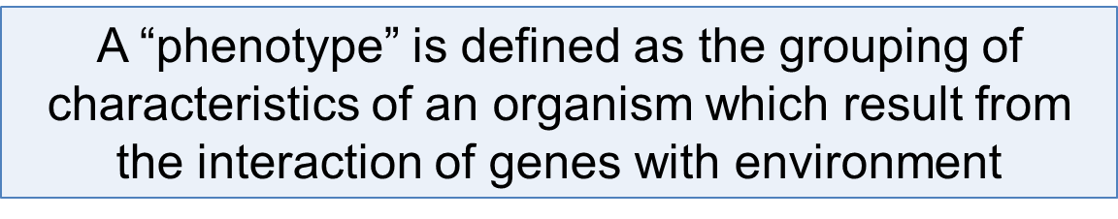

Genes
Environment
Clinical expression
of disease
Response to treatment

Slide 3
Asthma phenotyping: why, when and how
Asthma heterogeneous disease
  Symptoms – lung function
  Inflammation

Slide 4

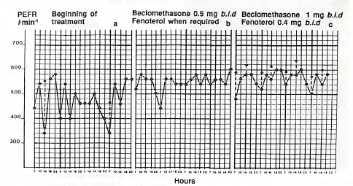
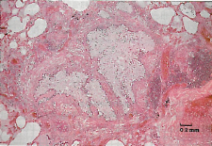
panel a
first four days of treatment
panel b
four days of the following week
panel c
the last four days
before the fatal attack
mucous plug
thickening of the
basement membrane
Saetta M et al. ERJ 1989;2:1008-1012

Slide 5
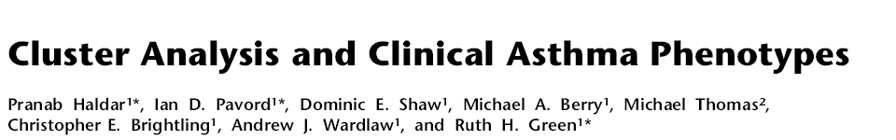
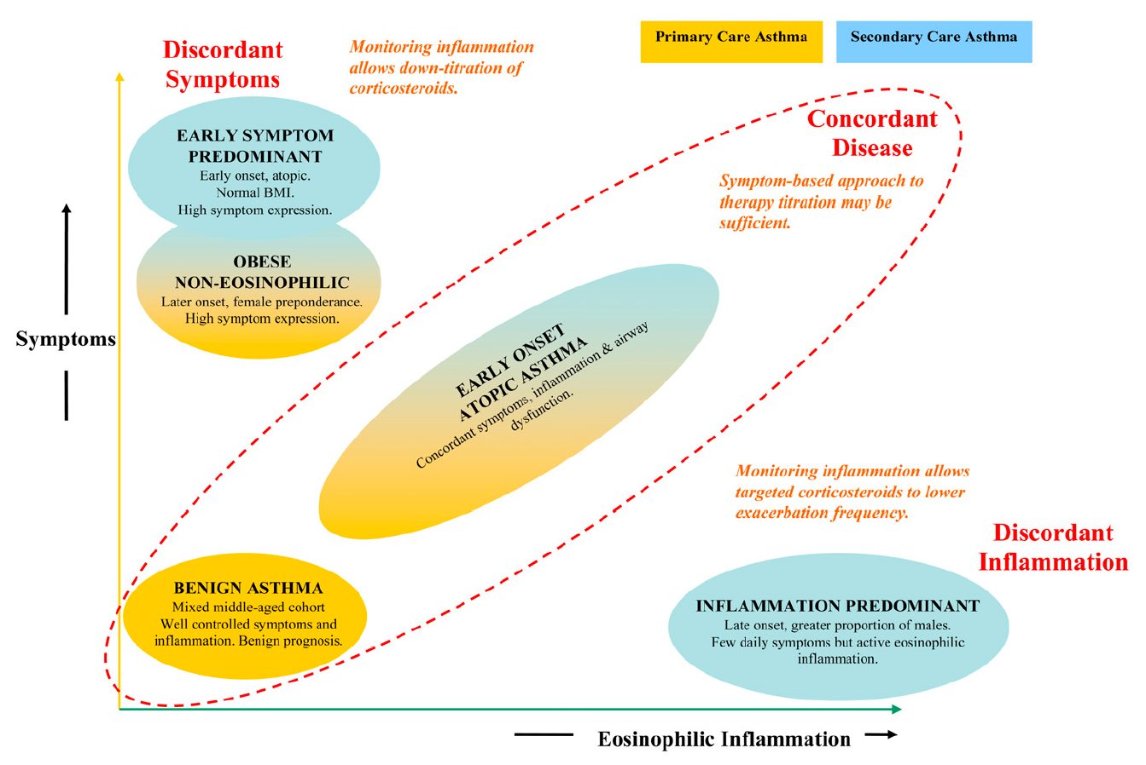
Different asthma phenotypes have different monitoring strategies depending on the weight that symptoms and airway inflammation have on the disease.

Slide 6
New phenotypes by clinical criteria
Asthma heterogeneous disease
  Symptoms – lung function
  Inflammation

Slide 7

726 well characterized asthmatics
This approach identified 5 clinical phenotypes
Discriminant analysis revealed that using only 3/34 variables could accurately identify the asthma phenotype for 80% of subjects
  Baseline FEV₁ (pre-bronchodilator)
  Maximum FEV₁ (post-bronchodilator)
  Age at onset

Slide 8
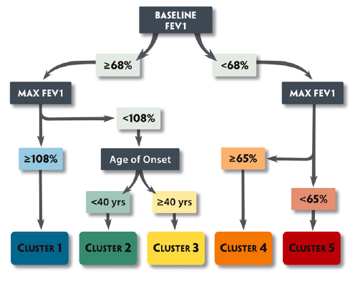
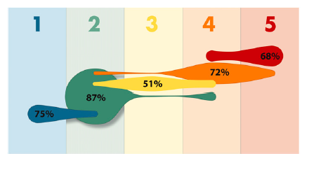
Moore WC, et al.,
Mild atopic asthma
Mild to moderate atopic asthma
Late onset nonatopic asthma
Severe atopic asthma
Severe asthma with fixed flow
Notes:
the five asthma clusters support the importance of disease heterogeneity in asthma and suggest differences in pathophysiologic mechanisms that determine cluster assignments.

Slide 9
New phenotypes by clinical criteria
Asthma heterogeneous disease
  Symptoms – lung function
  Inflammation

Slide 10
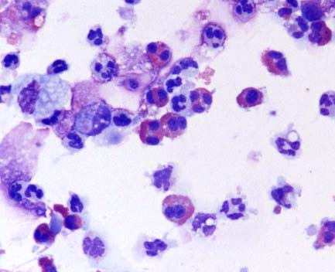
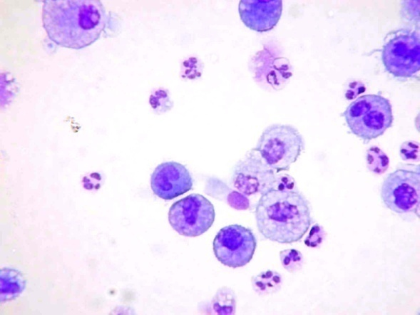
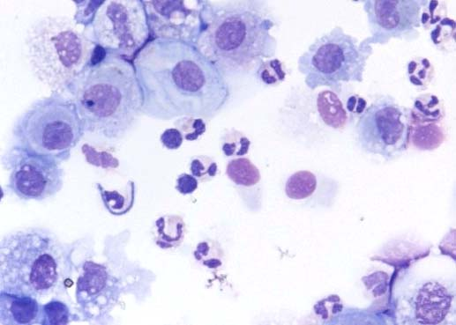
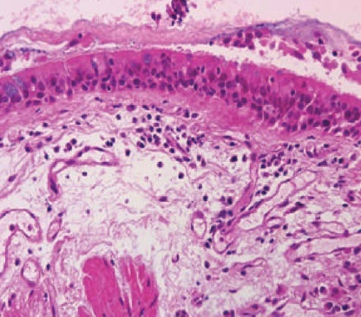
Inflammatory Phenotypes
Eosinophilic asthma
Neutrophilic asthma
EG2 +
Paucigranulocytic asthma
Neutrophil elastase +
Haldar e Pavord JACI 2007

Slide 11
Comparison of two methods of processing induced sputum: selected versus entire sputum
A Spanevello et al. AJRCCM 1998; 157: 665-668
30
25
20
15
10
5
0
asthmatics
normals
Eosinophils (%)
Selected Sputum
Entire Sputum

Slide 12

Sputum eosinophils are higher in asthmatics than in controls and their amount in sputum increases with the severity of the disease

Slide 13
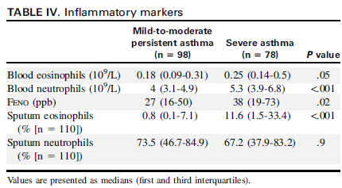
Volume 132, Issue 2 , Pages 336-341
The majority of patients with severe adult-onset asthma are nonatopic and have persistent eosinophilic airway inflammation.

Slide 14
Inflammatory Phenotypes
Eosinophilic asthma
Neutrophilic asthma
EG2 +
Paucigranulocytic asthma
Neutrophil elastase +
Haldar e Pavord JACI 2007

Slide 15
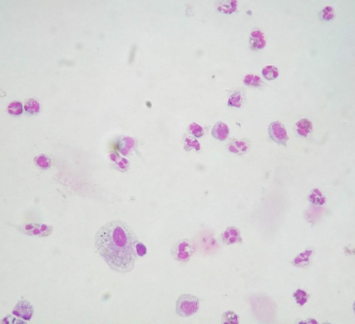
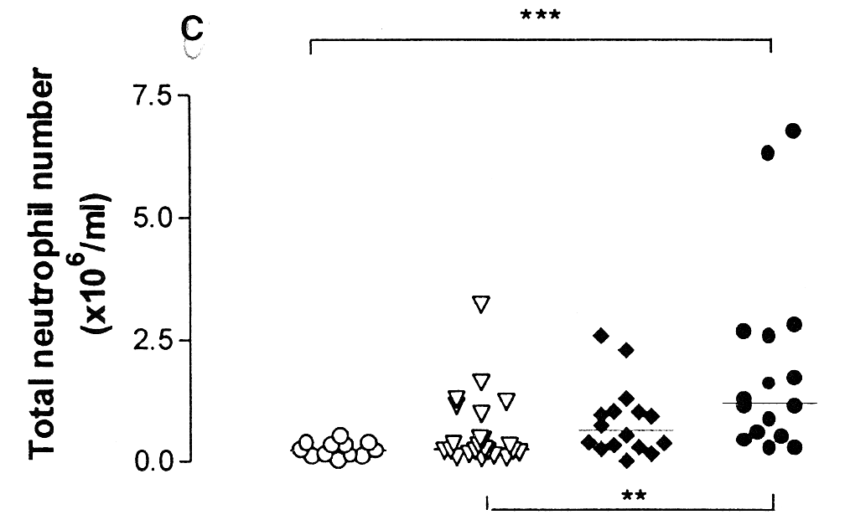
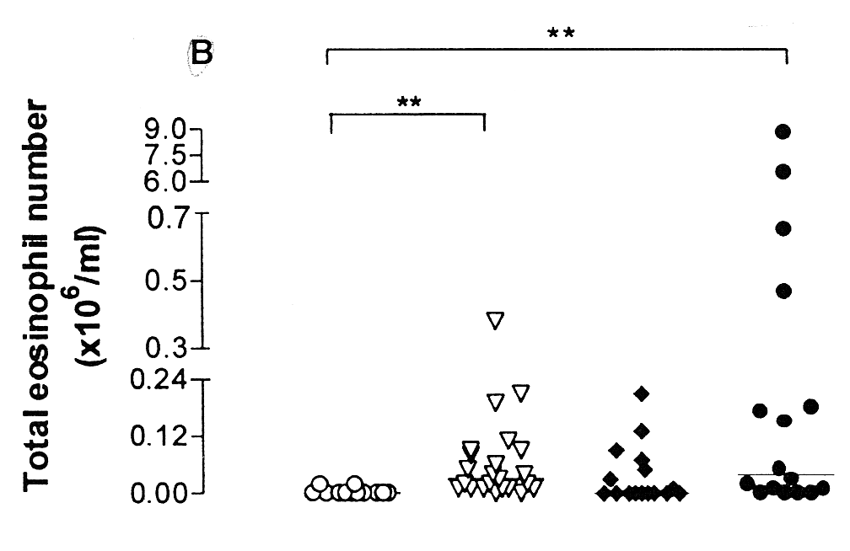
Neutrophilic Inflammation in severe persistent asthma.
A Jatakanon et al. AJRCCM 1999; 160: 1532-1539

Slide 16
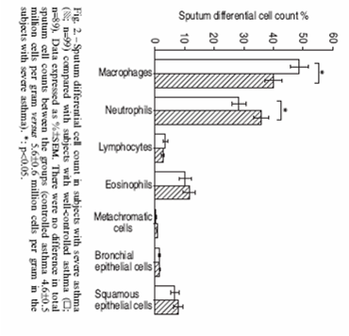
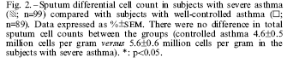
AIRWAY INFLAMMATION
Well controlled asthma
Severe asthma
Notes:
Nello studio Enfumosa che raccoglie dati sull’asma grave, la percentuale di neutrofili nell’espettorato è l’unica significativamente differente tra i pazienti con asma severo e con asma ben controllato

Slide 17
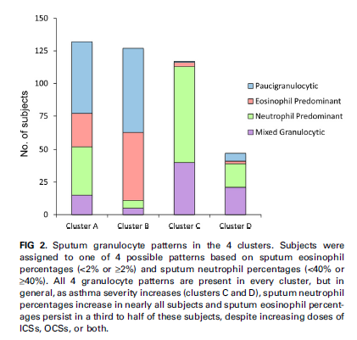
In this analysis severe asthma was associated with sputum neutrophilia with or without eosinophilia, suggesting that new biologic therapies for these patients might need to target both inflammatory cell types.

Slide 18

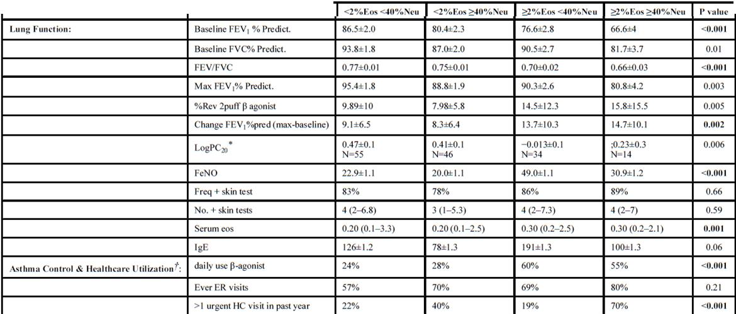
Hastie AT et al.,
Mixed granulocytic inflammation
Combined increased sputum eosinophils and neutrophils identified asthmatics with the lowest lung function and worse asthma control, increased symptoms and healthcare requirements.

Slide 19
Inflammatory Phenotypes
Eosinophilic asthma
Neutrophilic asthma
EG2 +
Paucigranulocytic asthma
Neutrophil elastase +
Haldar e Pavord JACI 2007

Slide 20
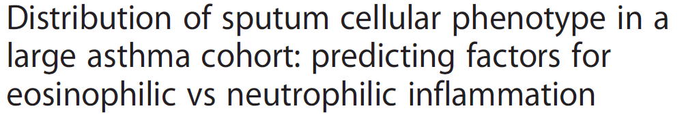
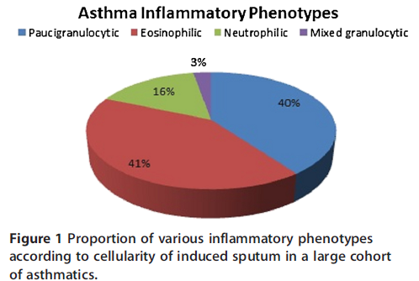
Eosinophilic and paucigranulocytic asthma are the dominant inflammatory phenotypes.
Notes:
retrospective study was conducted in 508 asthmatics Eosinophilic (≥3%) and neutrophilic (≥76%) airway inflammation were observed in 46% and 18% of patients respectively. Eosinophilic and paucigranulocytic asthma are the dominant inflammatory phenotypes

Slide 21
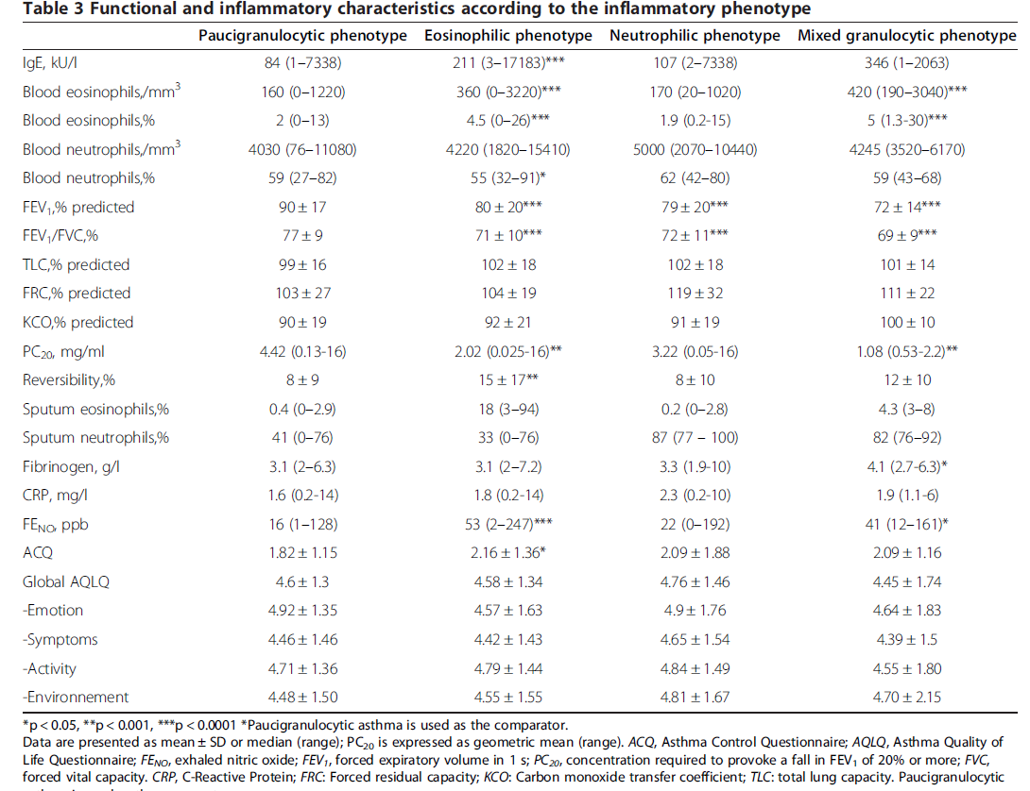
Notes:
I pazienti con un fenotipo paucigranulocitico inoltre hanno una funzionalità respiratoria migliore rispetto agli altri fenotipi

Slide 22

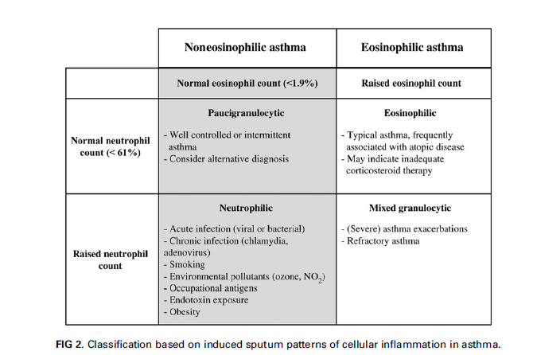
JACI 2007
Notes:
il pattern paucigranulare è caratteristico di un asma meno grave o comunque ben controllato dalla terapia o addirittura dovrebbe far pensare ad una rivalutazione della diagnosi

Slide 23
Is the inflammatory phenotype stable?

Slide 24
Phenotypes
AO + AHR + Eosinophils
AO + AHR + Neutrophils (infective)
AO + AHR + Neutrophils (non-infective)
AO + AHR + Eosinophils + Neutrophils
no AO + AHR + eosinophils
no AO + AHR, no cellular inflammation
no AO + no AHR + eosinophils
Unpublished data

Slide 25
AI types varies from time to time
Clinical sputum database begun January 2005
388 samples
297 patients
107 exacerbations
47% eosinophils
38% neutrophils
5% eosinophils + neutrophils
15% other
37% changed type of AI
Unpublished data

Slide 26
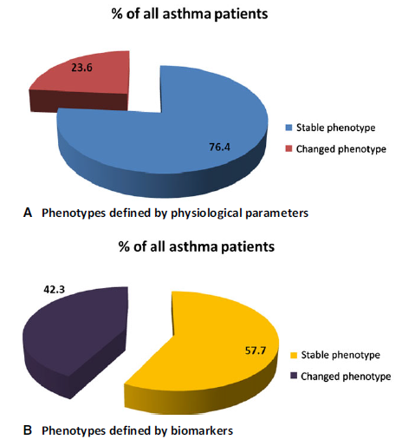
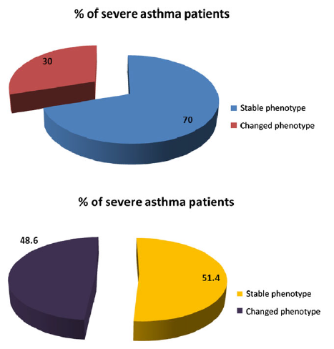
Phenotypes determined by biomarkers are less stable than those defined by physiological variables, especially in severe asthmatics
Definition of asthma phenotypes is improved by repeated measures to
account for fluctuations in lung function, biomarkers and asthma control
Notes:
138 patients (80 Severe asthma and 58 Mild/moderate asthma) completed 1 year of the follow-up study. Esepttorato prima e dopo 1 anno così come lung function e asthma control . Terapia definita all’inizio in base alla severità dell’asma. Il punto critico di questo lavoro è che il fenotipo infiammatorio, particolarmente quello eosinofilico può non essere stabile perchè influenzato in modo molto stretto dal trattamento e per I pazienti allergici dall’esposizione. I pz che da eosinofilici diventano none osinofilici potrebbero essere quelli in cui il trattamento è più efficace mentre quelli che aumentano l’eosinofilia potrebbero essere sottotrattati. Il fatto che la funzionalità respiratoria e I sintomi non seguano l’andamento dell’infiammazione abbiamo già visto può essere dovuto ad una dissociazione tra infiammazione e funzionalità polmonare e dalla sensibilità diversa dell’infiammazione eosinofilica per il trattamento steroideo.

Slide 27
Asthma phenotyping: why, when and how
At diagnosis?
Risk of exacerbation?
Poor disease control?
For treatment?
For prospective studies?

Slide 28
Different asthma phenotypes have different monitoring strategies depending on the weight that symptoms and airway inflammation have on the disease.

Slide 29

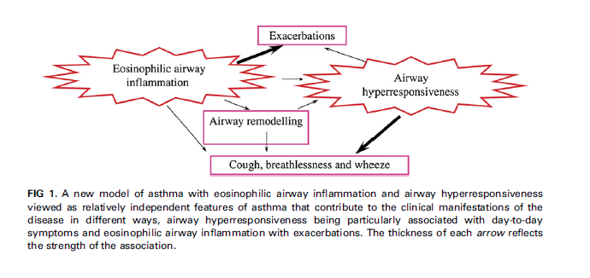
JACI 2007;119:1043-52

Slide 30

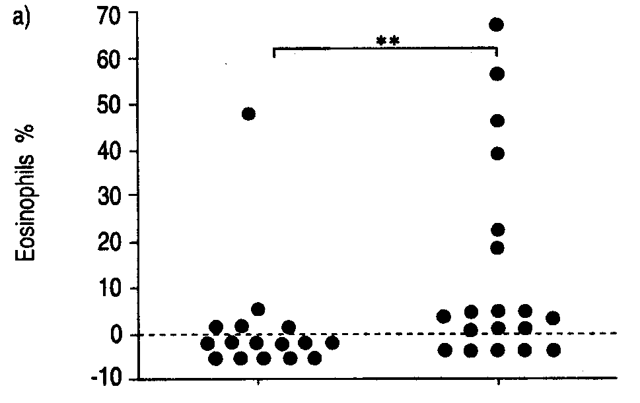
Romagnoli et al ERJ 2002
Daily symptoms 0
Night waking 0
Rescue b-agonists 0
PEF variability > 5%
Daily symptoms
Night waking 5/w
Rescue b-agonists 4/d
PEF variability > 20%
Controlled
Uncontrolled
The amount of sputum eosinophils increased with the lack of disease control

Slide 31
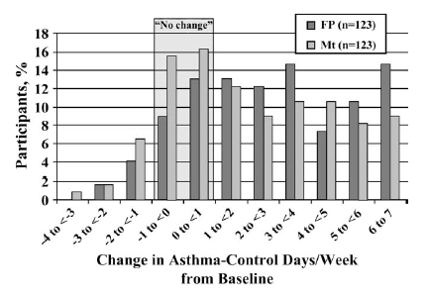
25-35% of Asthma Patients do not respond to ICS
Zeiger, et al. J Allergy Clin Immunol 2006;117: 45-52
Notes:
Quando la terapia convezionale per gli asmatici non ha successo la fenotipizzazione del paziente consente di individuare strategia alternative.

Slide 32
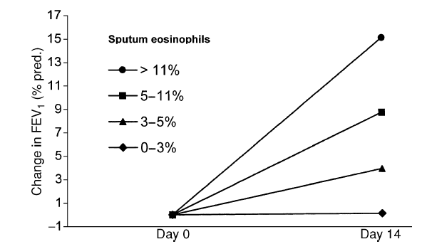
Sputum eosinophil count predicts response to corticosteroids
Meijer et al Clin Exp Med 2002;32:1096-1103
Notes:
This is perhaps better illustrated by this figure which shows that the higher the sputum eosinophil count the greater the improvement in spirometry following treatment with corticosteroids.

Slide 33
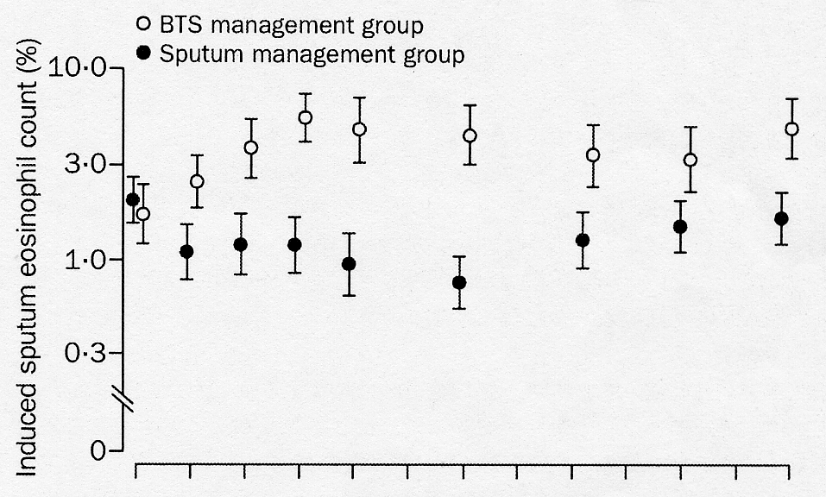
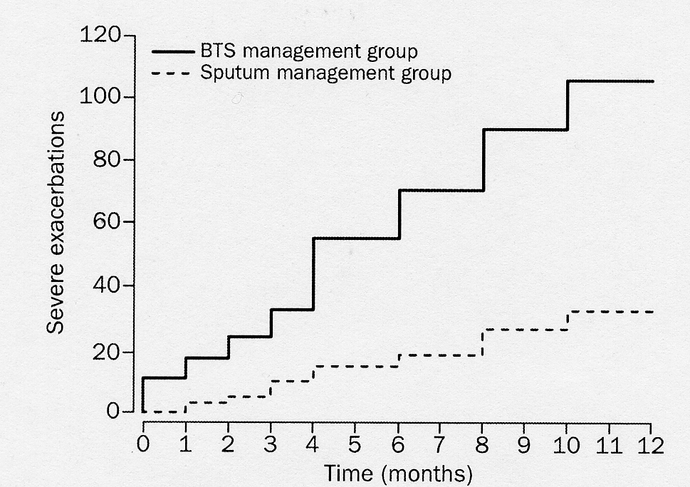
Asthma exacerbations and sputum eosinophil counts: a randomised controlled trial
Lancet 2002;360: 1715-21
Ruth H Green, Christopher E Brightling, Susan McKenna, Beverley Hargadon, Debbie Parker, Peter Bradding, Andrew J Wardlaw, lan D Pavord
A treatment strategy directed at normalisation of the induced sputum eosinophil count reduces asthma exacerbations and admissions without the need for additional anti-inflammatory treatment.

Slide 34
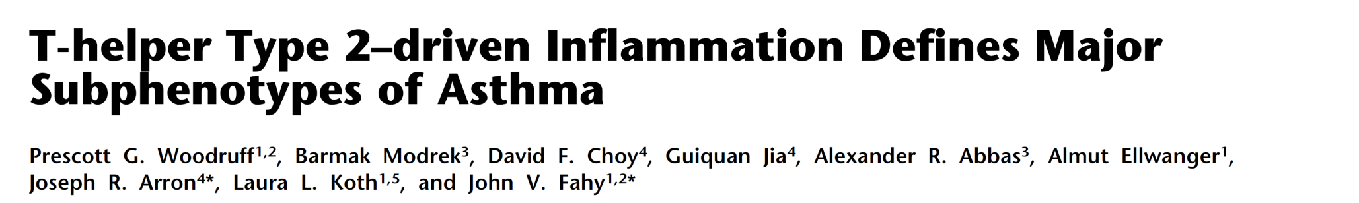
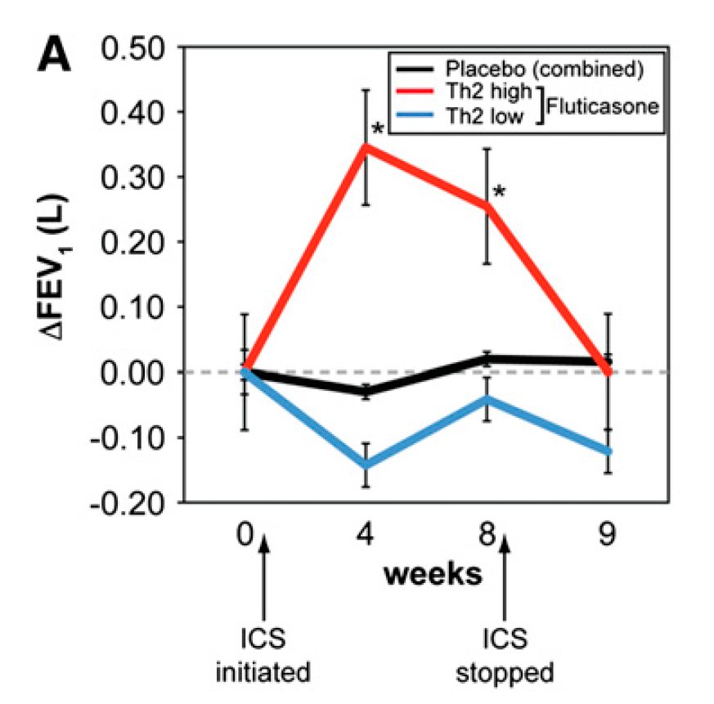
AJRCC 2009
Notes:
Il passaggio poi dai fenotipi ai subfenotipi consente di individuare pz responsivi alla terapia

Slide 35

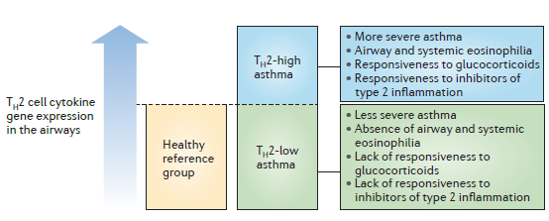
Notes:
Asthma can be divided into TH2‑low and TH2‑high subgroups. Levels of gene expression for T helper 2 (TH2) cell cytokines or for the activation of epithelial cells by TH2 cell cytokines show a continuum in the airways of patients with asthma (rather than a bimodal distribution). Individuals with asthma who have expression levels higher than the range found in healthy controls have specific clinical, pathological and treatment-response characteristics. This suggests a threshold effect of TH2 cell cytokines in the airways above which type 2 inflammation influences the clinical features of asthma and the responsiveness to specific treatments. Biomarkers of type 2 inflammation in blood and exhaled air can identify individuals with asthma who are above and below this threshold, and are showing promise as predictors of responsiveness to a growing list of type 2 cytokine inhibitors that are in late-phase clinical trials for asthma.

Slide 36

Is phenotype analysis useful in prospective studies?
112 patients with severe asthma,
5 Severe Asthma Research Program (SARP) clusters were identified
All these clusters shared similar asthma outcomes:
ACQ-6 score did not change in any cluster.
Exacerbation rate was similar
Time to first exacerbation was similar
Treatment requirements was similar

Slide 37
Asthma phenotyping: why, when and how
Functional data, symptoms
Induced sputum
Blood biomarkers
FeNO

Slide 38
Moore WC, et al.,
Mild atopic asthma
Mild to moderate atopic asthma
Late onset nonatopic asthma
Severe atopic asthma
Severe asthma with fixed flow
Notes:
the five asthma clusters support the importance of disease heterogeneity in asthma and suggest differences in pathophysiologic mechanisms that determine cluster assignments.

Slide 39
Asthma phenotyping: why, when and how
Functional data, symptoms
Induced sputum
Blood biomarkers
FeNO

Slide 40
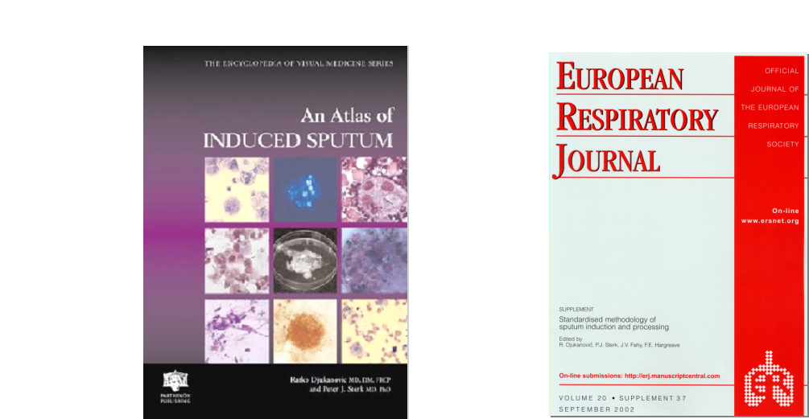
Methods of sputum induction
Methods of sputum processing

Slide 41

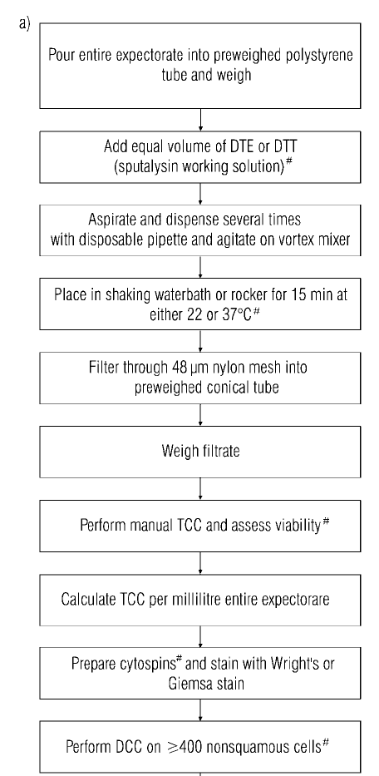
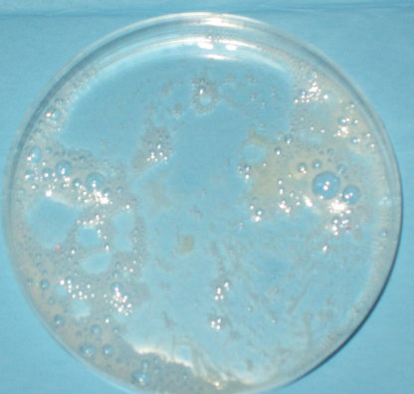
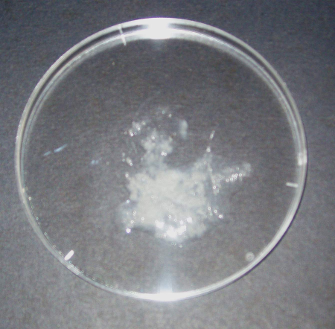
Whole sputum sample
Plug selection

Slide 42
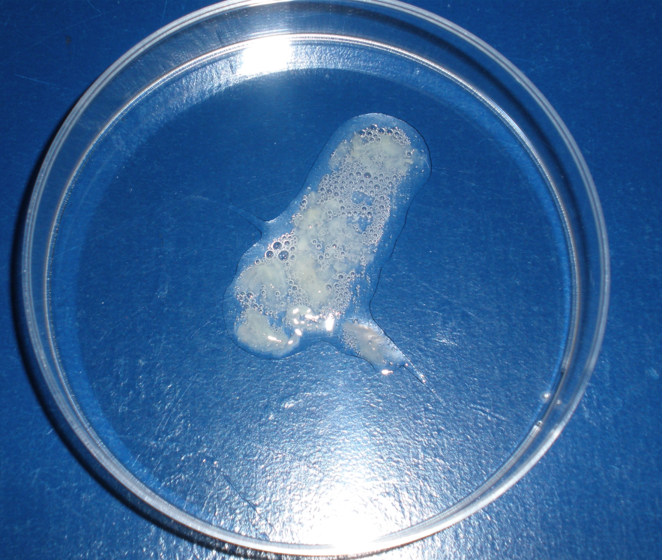
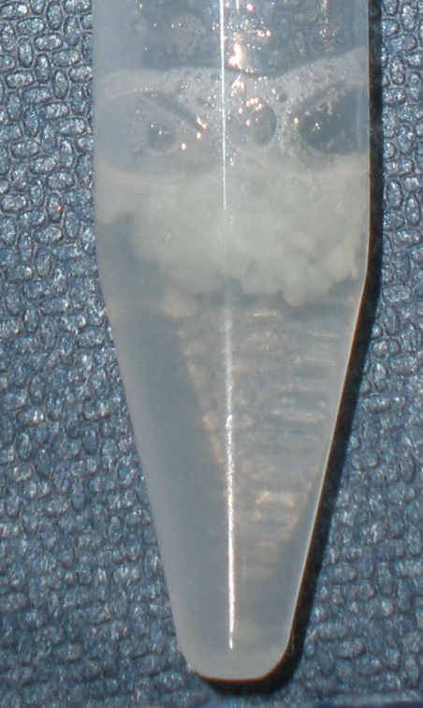
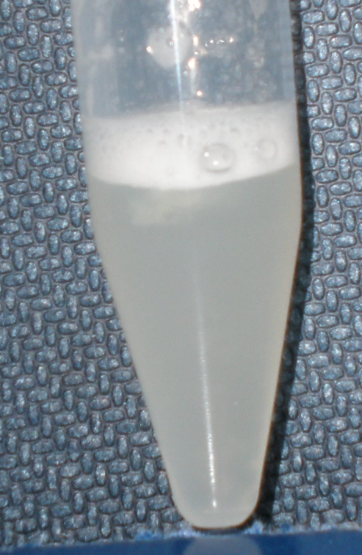
Sputum processing with DTT
Selected sputum plugs
Before DTT processing
After DTT processing
Notes:
A selection of the sputum sample can be gently transferred in a polypropylene tube (in a pre-weighed conical tube)
The introduction of reducing agent, such as Dithiothreitol (DTT) allows to disperse mucus and to release trapped cells, in order to prepare homogeneous cell suspension

Slide 43
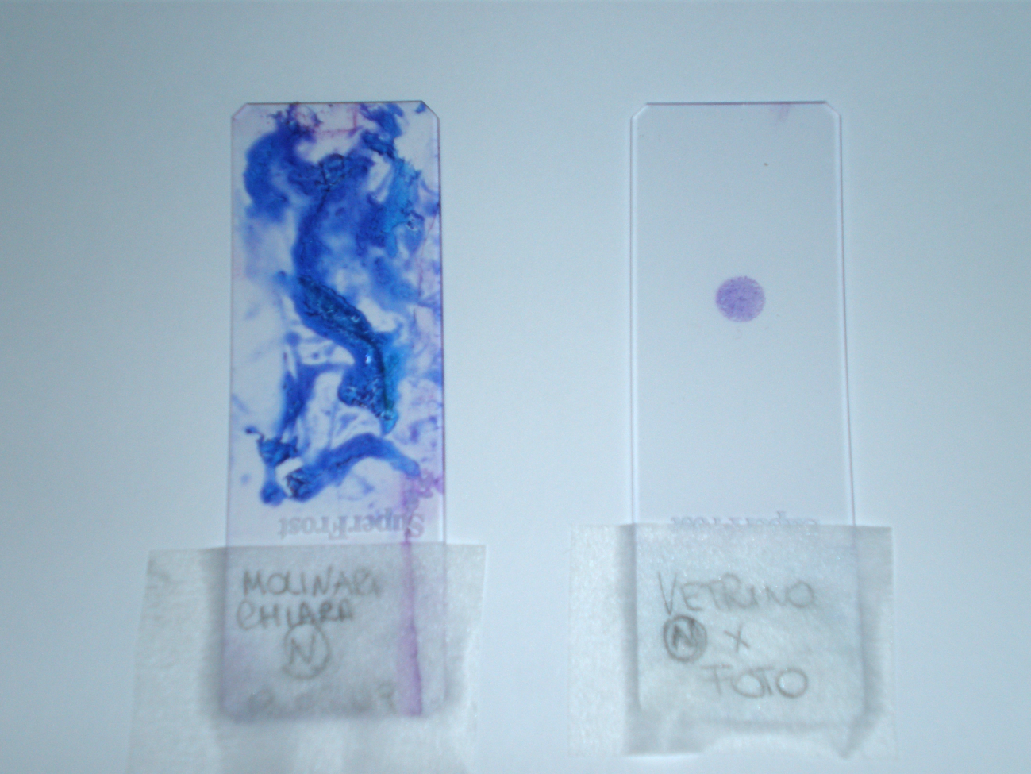
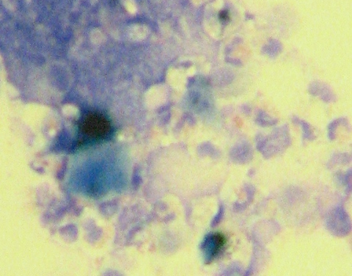
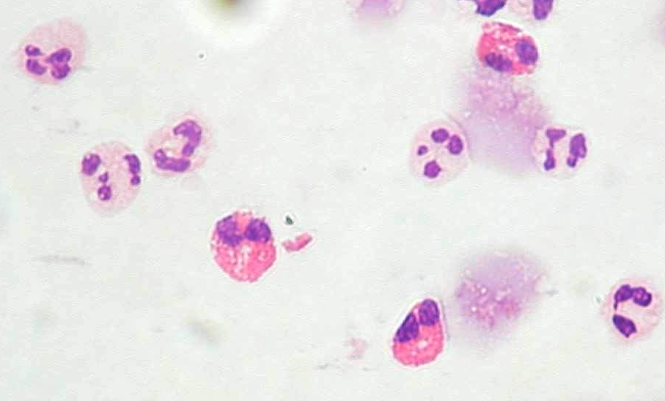
Processing sputum samples
Smearing of sputum sample
Cytospin of processed sputum sample

Slide 44
REPRODUCIBILITY BETWEEN SAMPLE
Spanevello A et al. Clin Exper Allergy 1997; 27: 1138-1144
R
0.7
0.4
TCC MAC NEU EOS LYM EPI ECP
Notes:
Another important issue that was addressed is the following: is induced sputum a reproducible method to assess airway inflammation?
To answer this question, we studied 53 stable asthmatics, 16 subjects with seasonal rhinitis and 19 healthy subjects.
Reproducibility was examined within sample (two different plugs of the same sample), between sample (two specimens of induced sputum obtained within one week) and between examiners.
We have found that the method is highly reproducible within sample and between examiners for all types of cells. Moreover, it is reproducible between sample for Eosinophils, Macrophages, Neutrophils, but not for Lymphocytes and for Epithelial Cells.
The importance of this study is the confirmation, within important statistical guidelines for a study of reproducibility, that the methods examined are reproducible and valid. Taking in account these results and previous findings, induced sputum can be used to follow airway inflammation non-invasively in subjects with airway disease.

Slide 45
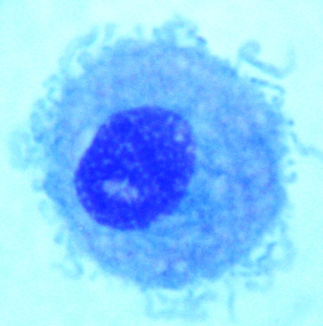
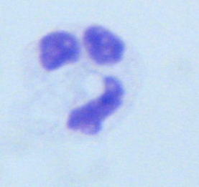
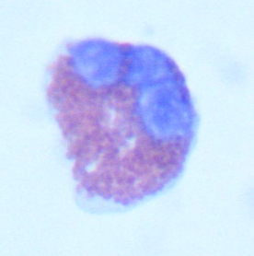
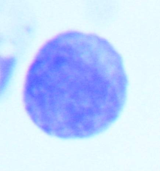
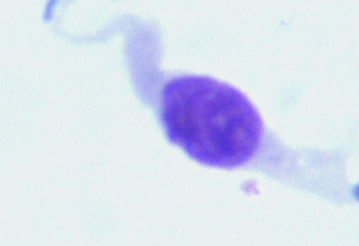
Differential cell count
Normal values
Macrophages 69.2 ± 13.0%
Neutrophils 27.3 ± 13.0%
Eosinophils 0.6 ± 0.8%
Lymphocytes 1.0 ± 1.2%
Epit. cells 1.5 ± 1.8%
Spanevello A et al. Am J Respir Crit Care Med 2000

Slide 46
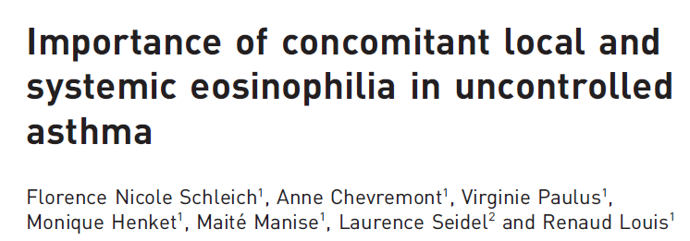


The group with concordant systemic and airway eosinophilia showed remarkable male predominance, and had the lowest airway calibre, asthma control and quality of life, and the highest bronchial hyperresponsiveness, FeNO and exacerbation rate
Notes:
La valutazione dell’eosinofilia nel sangue periferico non è semplicemente un surrogato dell’eosinofilia nelle vie aeree ma identifica un gruppo di asmatici con infiammazione sia sistemica che periferica che hanno funzionalità polmonare ridotta, maggiore iperreattività bronchiale e maggior numero di esacerbazioni di malattia, mentre la sola eosinofilia periferica evidenzia un gruppo di soggetti meno critici. E la sola eosinofilia sistemica non fornisce grande utilità→ Quindi è importante, se possibile, valutare sia l’infiammazione sistemica che quella periferica

Slide 47
why
when
how

Slide 48

Ringraziamenti
Patrizia Pignatti
Francesca Cherubino
Elena Stocco
Elisabetta Zampogna

Slide 50



Nieves A et a.
Non-atopic asthmatics displayed lower FEV1 and FVC.
Asthma was more severe in these patients.
Notes:
Diversi studi sono stati fatti confrontando le caratteristiche dell’asma atopico da quelle dell’asma non atopico e sebbene molte siano le similitudini, in questo lavoro si mostra come i soggetti non atopici abbiano un asma con più sintomi soprattutto tosse e dispnea e una funzionalità respiratori peggiore e in generale un asma più severo.

Slide 51

Kanemitsu Y, et al.
High serum periostin levels (>95 ng/mL) at enrollment, the highest treatment step, higher ICS daily doses, a history of admission due to asthma exacerbation, comorbid or a history of sinusitis, and ex-smoking were associated with a decline in FEV1 of 30 mL or greater per year

Slide 52
McGrath KW et al.
1st cluster= 42% younger age, female sex, lean body mass, well-preserved FEV1, and moderate-to-severe bronchial hyperresponsiveness
2nd cluster= 22% older age, female sex, later-onset asthma, high body mass index,
low lung function, high sputum neutrophils, low IgE levels, and infrequent skin test reactivity to aeroallergens
3rd cluster= 36% younger age, lean body mass, male sex, low FEV1, childhood-onset asthma, and sensitivity to fungal aeroallergens (especially to Alternaria).

Slide 53
From Phenotype to Endotype
Pathogenic mechanisms described in asthma
Th2/ allergic and eosinophilic inflammation,
airway hyper-responsiveness,
neuro-immune interactions,
bronchial and possibly lung remodeling
changes in airway secretions, and angiogenesis.
Starting point to define endotypes would be the identification of corresponding molecular biomarkers
for such a pathogenetic mechanism.

Slide 54


OGGI: - trattare con appropriatezza con i farmaci attualmente disponibili
- valutare accuratamente controllo ed aderenza
- fenotipizzare i pazienti non ottimamente responsivi al trattamento
Wenzel S., Nature Med.2012

Slide 55
Asthma: a heterogeneous disease
  Asthma can be very heterogeneous.
  Phenotypes are based on symptom pattern, atopic status, bronchial obstruction pattern which can frequently overlap and can change over time.
Notes:
Perché dobbiamo fenotipizzare l’asma? Principalmente perché è una malattia eterogenea. Questo è quanto riportato dalle Dae Linee guida Gina secondo cui i fenotipi sono determinati dalla vaietà dei sintomi, dalla presenza dia topia e dall’ostruzione con possibili overlap e cambiamenti nel tempo.

Slide 56


213 subjects with mild asthma
Airway inflammation often persists in subjects with good clinical or physiological asthma control scores.

Slide 57
GINA revision 2014
Asthma phenotypes :
Allergic asthma → usually eosinophilic inflammation
Non-allergic asthma → eosinophilic - neutrophilic
paucigranular inflammation

Slide 58
GINA draft 2014
Fenotipo infiammatorio neutrofilico
Asthma phenotypes:
Allergic asthma → usually eosinophilic inflammation
Non-allergic asthma → neutrophilic, eosinophilic or paucigranular inflammation
Notes:
Tra i pazienti con pattern noneosinofilico abbiamo quelli con fenotipo neutrofilico. Questo fenotipo è più frequente nell’asma non allergico, nell’asma con ostruzione fissa →overlap asma/COPD e nell’asma degli obesi.

Slide 59
GINA revision 2014
Asthma phenotypes :
Allergic asthma → usually eosinophilic inflammation
Non-allergic asthma → neutrophilic, eosinophilic or paucigranular inflammation
Late-onset asthma → tended to be non-allergic
Asthma with fixed airflow limitation → airway remodeling
Asthma with obesity → little eosinophilic airway inflammation
Mix of clinical and inflammatory phenotypes
Notes:
Il concetto di fenotipizzazione ha subito modifiche e soprattutto un ampliamento. Nella revisione 2014 delle GINA sono indicati alcuni tra i fenotipi dell’asma più comuni, identificati in base allo stato allergico del paziente, all’onset della malattia, alla presenza di ostruzione fissa e all’obesità. Alcuni di questi fenotipi come quello allergico sono caratterizzati da un pattern di infiammazione particolare come quello eosinofilico, altri possono presentare sia eosinofilia che neutrofilia altri ancora sono caratterizzati da una scarsa componente infiammatoria.

Slide 60
From phenotypes to endotypes…..

Slide 61

Notes:
In realtà considerando le variabili cliniche e quelle infiammatorie i fenotipi sono diversi, se consideriamo poi i meccanismi alla base dei fenotipi la complessità aumenta

Slide 62
Endotype
A phenotype covers the clinically relevant properties of the disease, but does not show the direct relationship to disease etiology and pathophysiology.
Different pathogenetic mechanisms might cause similar asthma/COPD symptoms and might be operant in a certain phenotype. These putative mechanisms are addressed by the term ‘Endotype’
Il meccanismo patogenetico alla base della clinica

Slide 63



Slide 64
Old phenotypes useful at diagnosis
Extrinsic and intrinsic asthma
Exercise induced asthma
Aspirin intolerant asthma
Professional asthma

Slide 65

Th2 asthma
Notes:
Fenotipizzazione dell’asma in Th2 asma consente di poter utilizzare nuove strategie terapeutiche…di cui parlerà Papi …..

Slide 66

Guiding asthma therapy by sputum eosinophils.
Exacerbations by asthma severity
Jayaram et al. ERJ 2006;27:483-494
Mild asthma
Moderate to
Severe asthma
control
strategy
control
strategy
sputum
strategy
sputum
strategy
Notes:
La valutazione nel tempo dell’eosinofilia dell’espettorato è risultata
utile nel modulare il piano terapeutico nei pazienti con asma moderato-
Grave.

Slide 67
  Baseline FEV₁ (pre-bronchodilator)
  Maximum FEV₁ (post-bronchodilator)
  Age at onset
Moore et al AJRCCM 2010

Slide 68


Yan X, et al.
120 Sputum arrays for the expression levels of 5,500 genes
Transcriptomic endotypes of asthma (TEA); gene signatures that discriminate phenotypes of disease
There are common patterns of gene expression in the sputum and blood
of children and adults that are associated with near fatal, severe and milder asthma.
Notes:
This study is the first to use non-invasive analysis
of sputum gene expression to identify transcriptomic endotypes of asthma (TEA
Clusters) that correlate with clinical characteristics of severe disease including a history
of hospitalization and near fatal asthma attack. TEA cluster 1
had the most subjects with a history of intubation (P = 0.05), a lower pre-bronchodilator
FEV1 (P = 0.006), a higher bronchodilator response (P = 0.03), and higher exhaled nitric
oxide levels (P = 0.04), compared to the other TEA clusters. TEA cluster 2, the smallest
cluster had the most subjects that were hospitalized for asthma (P = 0.04). TEA cluster
3, the largest cluster, had normal lung function, low exhaled nitric oxide levels, and lower
inhaled steroid requirements

Slide 69



62 patients diagnosed with severe asthma
persistent airflow limitation
nonpersistent airflow limitation
This study demonstrates the utility of periostin in phenotyping severe asthma. Periostin levels in sputum are associated with persistent airflow limitation in asthma patients with airway eosinophilia despite treatment with high-dose inhaled corticosteroids.

Slide 70
J Allergy Clin Immunol. 2005 Dec;116(6):1249-55.
Exhaled nitric oxide identifies the persistent eosinophilic phenotype in severe refractory asthma.
Silkoff PE¹, Lent AM, Busacker AA, Katial RK, Balzar S, Strand M, Wenzel SE.
Subjects with severe refractory asthma (SRA,) subjects with mild-moderate asthma, and healthy control subjects had FENO measured, followed by endobronchial biopsy and bronchoalveolar lavage
FENO measurement identified the subgroup of subjects with SRA with persistent eosinophilia despite steroid therapy.

Slide 71

Allergic asthma → Anti IgE therapy
Effects of Anti-IgE Omalizumab on Inflammation in Asthma
Djukanovic et al Am J Respir Crit Care Med 2004:170 p583-593

Slide 72
How to phenotype asthma with biomarkers?
Allergic asthma → usually eosinophilic inflammation
Blood eosinophils
Sputum eosinophils
FeNO
Non-allergic asthma → neutrophilic, eosinophilic or paucigranular inflammation
  Induced sputum

Slide 73
Phenotype
A “phenotype” is defined as the grouping of characteristics of an organism which result from the interaction of genes with environment
A Phenotype is any observable characteristic or trait of a disease, such as clinical, morphologic, development, biochemical or physiological properties, or behaviour.
Come si presenta clinicamente il malato

Slide 74
Some “old” asthma phenotypes
Extrinsic and intrinsic asthma
Exercise induced asthma
Aspirin intolerant asthma
Professional asthma
Do not reflect the heterogeneous and clinical characteristics of
this disease.
Notes:
I primi fenotipi identificati si basavano su caratteristiche ben distinte dell’asma.

Slide 75


Guiquan Jia, et al.
Serum periostin is a systemic biomarker of airway eosinophilia in asthmatic patients and has potential utility in patient selection for emerging asthma therapeutics targeting TH2 inflammation.

