Slide 1
Acute Respiratory Distress Syndrome
Disease Pathogenesis
and
Clinical Progression
G. Umberto Meduri M.D.
Memphis VA Medical Center

Slide 2
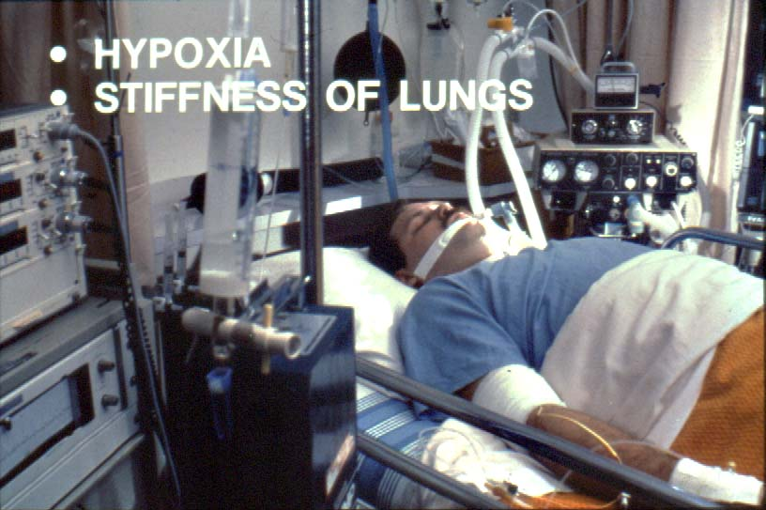
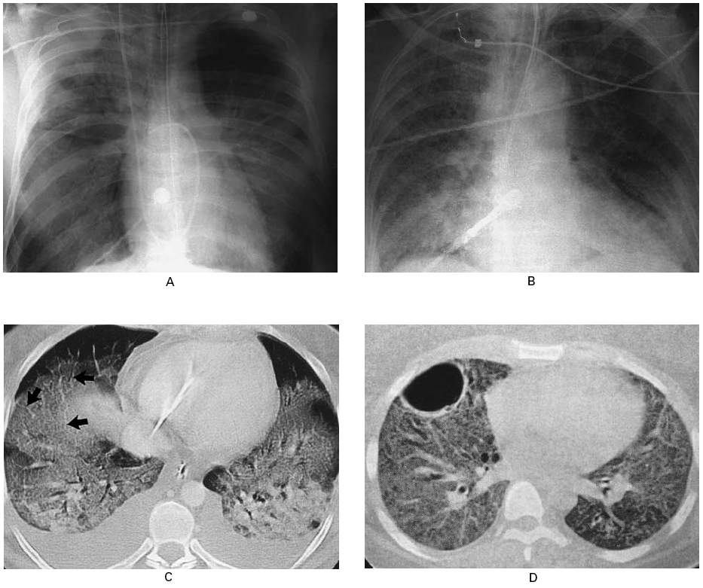
Acute Respiratory Distress
Severe illness complicated by systemic inflammation ➔➔➔
Pulmonary lobules inflammation
  Development: rapid and severe
  Distribution: diffuse and non-homogeneous
Breakdown of gas exchange barrier ➔ pulmonary edema
  non-cardiogenic
  rich in protein and neutrophilis
  Diffuse bilateral infiltrates
  Hypoxemic respiratory failure

Slide 3
Acute Lung Injury - ARDS
Incidence US: 86 cases /100,000 = 200,000 cases/year
Duration of mechanical ventilation: 2 - > 4 week
Progression: inflammation into fibroproliferation
Cause of death: dysregulated systemic inflammation
Hospital mortality: 38.5%- 41%
Estimated annual hospital deaths - US: 75,000-80,000
Hospital cost / per patient in 1999: $83,000
Hospital days - US: 3.6 million*
* N Engl J Med 2005; 353:1685-93.

Slide 4
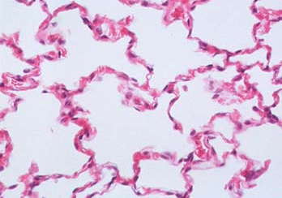
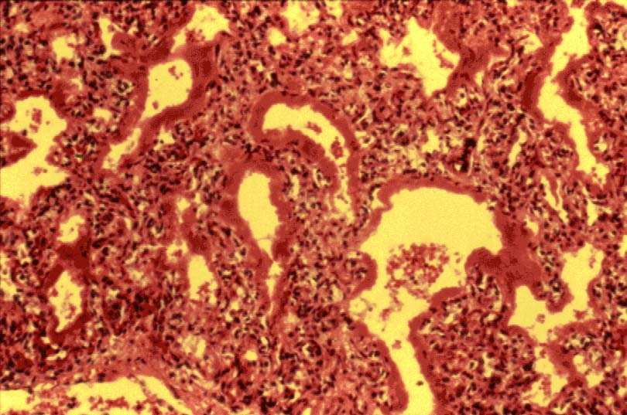
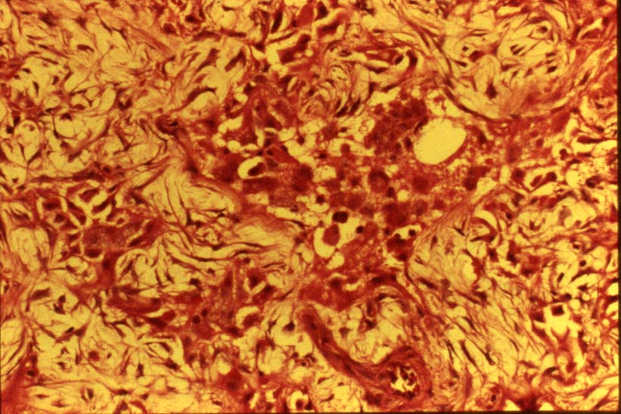
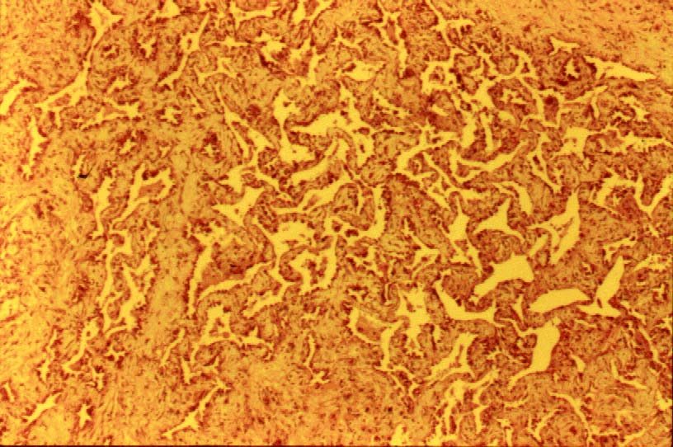
Histological Appearance
insult
Diffuse Alveolar Damage
Exudative Phase
Proliferative Phase
Fibrotic Phase
neutrophilic exudative edema
organization & repair
end-stage fibrosis
Days 1-7
Days 7-14
Days 14-28

Slide 5

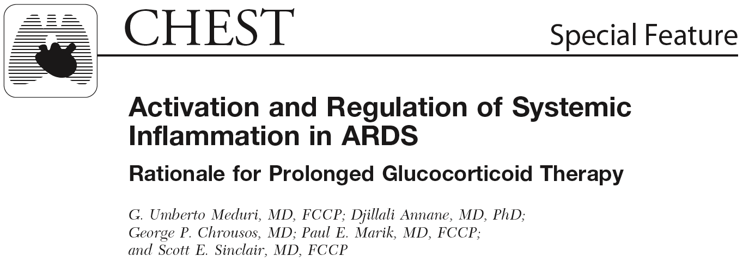

Slide 6
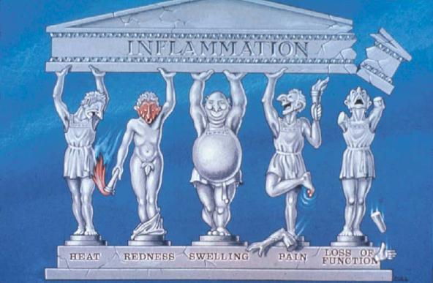
Inflammation
Inflammation: in = in + flama = flame
Localized protective response characterized by
Nature Reviews Immunology 2, 787-795 (October 2002)

Slide 7

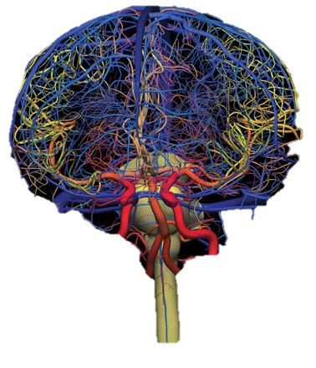
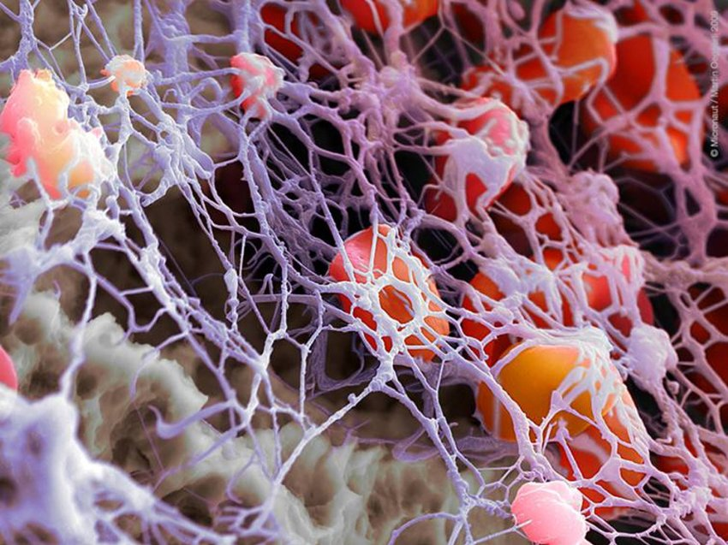
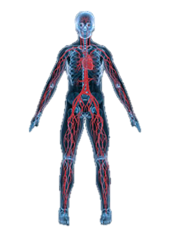
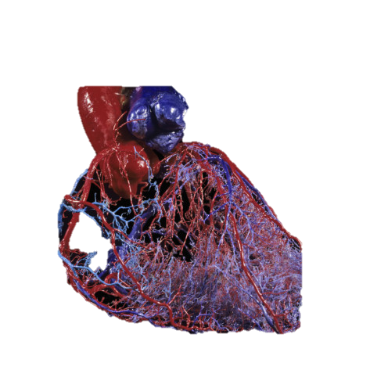
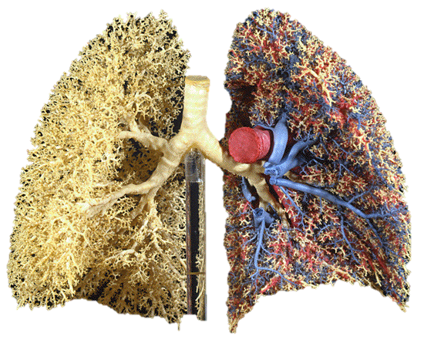
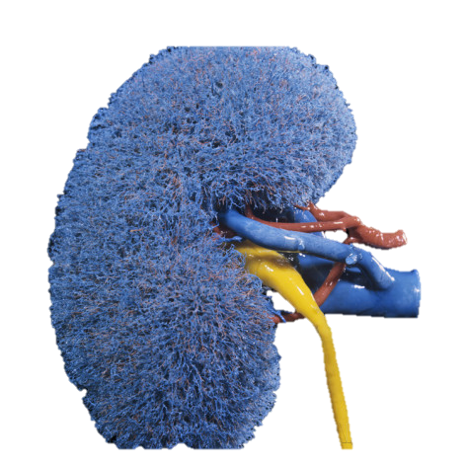
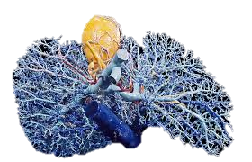
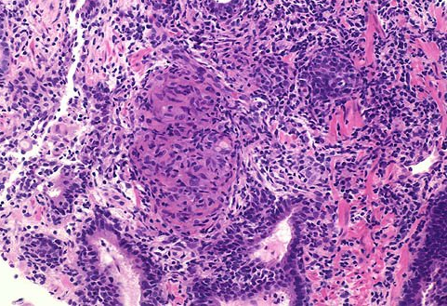
Systemic Inflammation*
The inflammatory reaction is a central component of the host innate immune response to insults:
  infectious
  non-infectious
TNF-a, IL-1β, and IL-6
Tissue
Inflammation
Systemic
Inflammation
Multiple Organ
Dysfunction
* reaction of vascularized living tissue to inflammatory mediators

Slide 8
Cytokines TNF-α and IL-1β
Proximal mediators of the Innate Immune Response
Activate simultaneously 5 integrated pathways
HPA-axis Activation
Down-regulation
Inflammation
Coagulation
TNF-α
IL-1β
Tissue Repair
Immunity
Eur Respir J 1996; 9: 2650-2670.

Slide 9
TNF-α and IL-1β
Inflammation
Coagulation
Tissue Repair
Vasodilation and stasis
Activation of
coagulation
Angiogenesis
Increased expression of
adhesion molecules
Inhibition of
fibrinolysis*
Epithelial growth
Increased permeability of
the microvasculature
with exudative edema
Intravascular
clotting
Fibroblast migration
and proliferation
Leukocyte extravasation
with release of leukocyte
products -> ± injury
Extravascular
fibrin deposition
Deposition of
extracellular matrix
and remodeling
* Increased plasminogen activator inhibitor-1 (PAI-1) and antiplasmin
Eur Respir J 1996; 9:2650-2670.

Slide 10

Menage a Trois (3)
Inflammation
Coagulation
Tissue
Repair

Slide 11
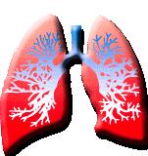
Disease Elements
Insult
Etiology
Anatomical area
Disease process
Functional consequences of morphologic changes
Physiology
Structural alterations in cells and organs
Morphology
Mechanisms of disease development
Pathogenesis

Slide 12
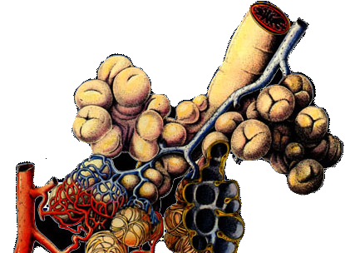
Disease - Anatomy: Acinus
Portion of the lobule distal to the terminal bronchiole
Acinus: 3-4,000 alveoli
Terminal bronchiole
Vein
Alveoli surrounding
alveolar ducts
Capillary network of the alveolar wall
Interstitial fibrous
network of the alveolar wall
Lobular artery (muscular)
Arteriole
Morgenworth, Newhouse, Nolte. Atlas of Pulmonary Pathology,
Munich: Pharmazeutische Verlagsgesellschaft, 1982.

Slide 13
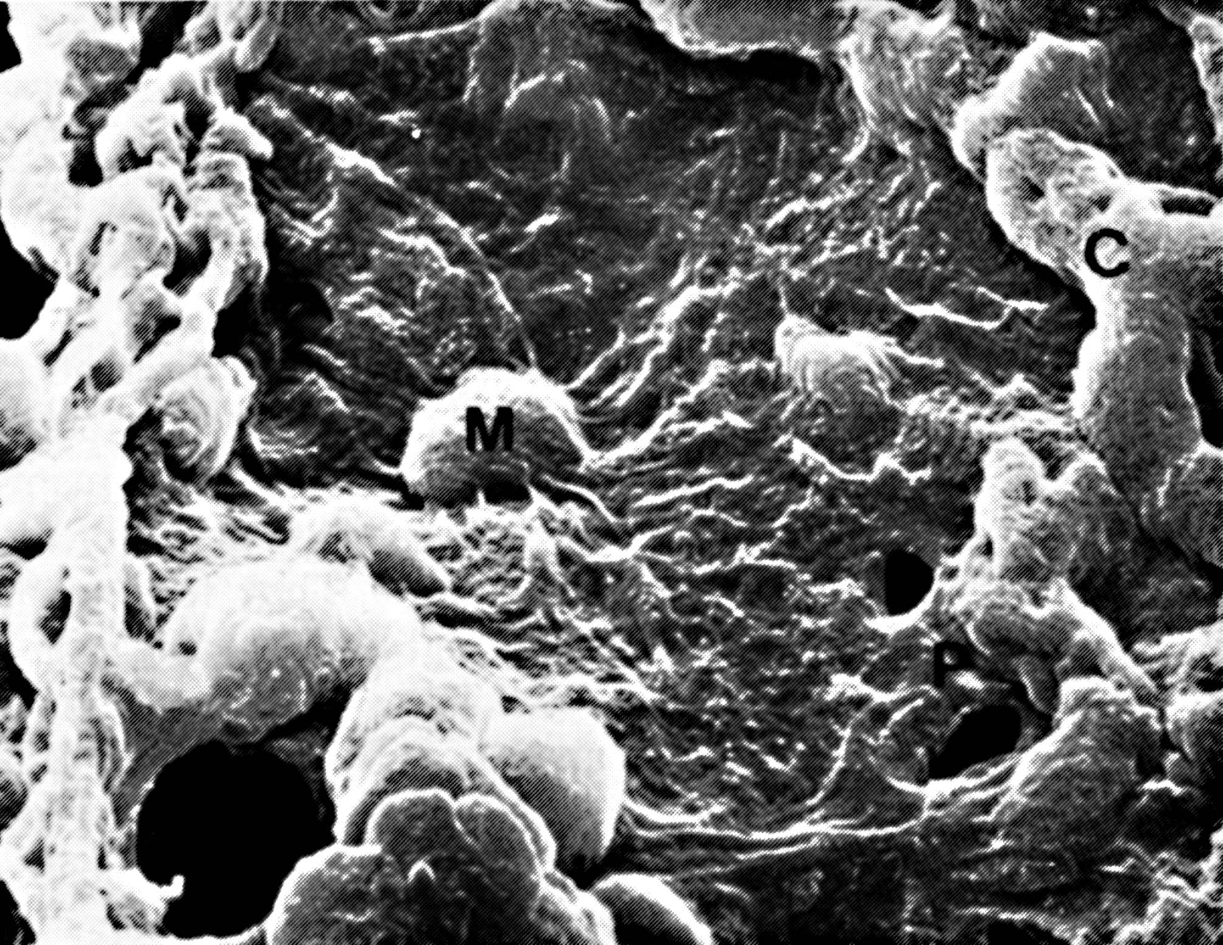
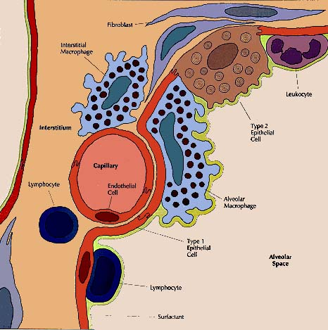
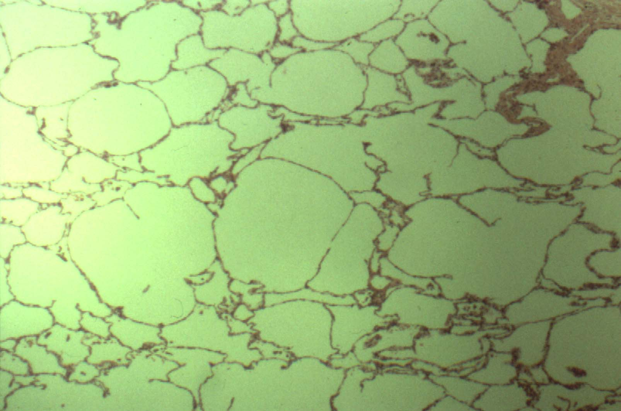
Disease - Anatomy: ACM
thick interstitium
(support
cell reservoir)
C
AM
thin interstitium
(gas exchange)
Dr. Nai-Sai Wang McGill University

Slide 14
Early ARDS: Cytokine levels
Survivors (n = 17)
750
Nonsurvivors (n = 17)
20000
18000
600
16000
14000
*
*
450
12000
Plasma (pg/ml)
BAL (pg/ml)
†
10000
300
8000
*
*
6000
*
150
4000
*
*
2000
TNF-α
IL-1β
IL-6
IL-8
TNF-α
IL-1β
IL-6
IL-8
* p < 0.0001 † p = 0.0002
Chest 1995; 107: 1062-1073. Chest 1997; 111: 1306 -1321.

Slide 15
EARDS Early: ACM
Inflammation
Coagulation
Repair
histological
radiographic
physiological
changes
Disruption of ACM with loss of compartmentalization
Activation of
coagulation and inhibition of
fibrinolysis
Initiation of fibro-proliferation with collagen deposition
Intra-alveolar fibrin deposition with
formation of HM
Intravascular coagulation with thrombus formation
Intra-alveolar & Interstitial
Protein-rich edema
Neutrophils’ accumulation
Eur Respir J 1996; 9:2650-2670.

Slide 16
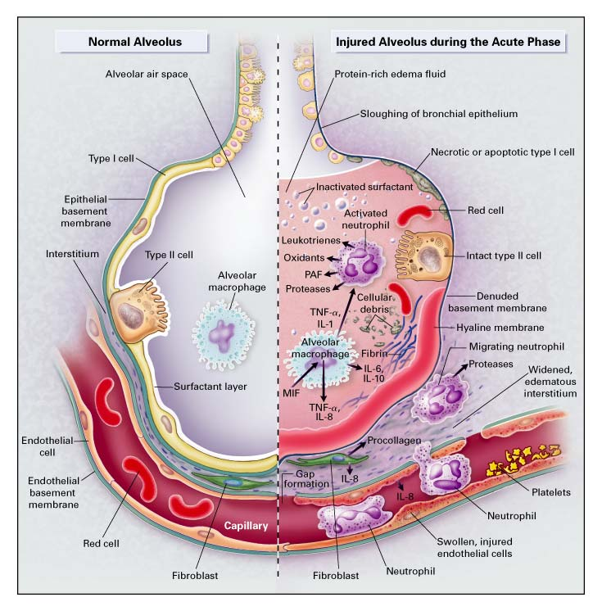
NEJM 2000; 342:1334-1349.

Slide 17
Early ARDS: Procollagen
Inflammation
Coagulation
Tissue
Repair
Type I
80
Type III
70
60
50
40
30
20
10
Plasma (N = 20)
BAL
Fibroproliferation with collagen deposition is an early event in ARDS
Am J Respir Crit Care Med 1998; 158:1432-1441.

Slide 18
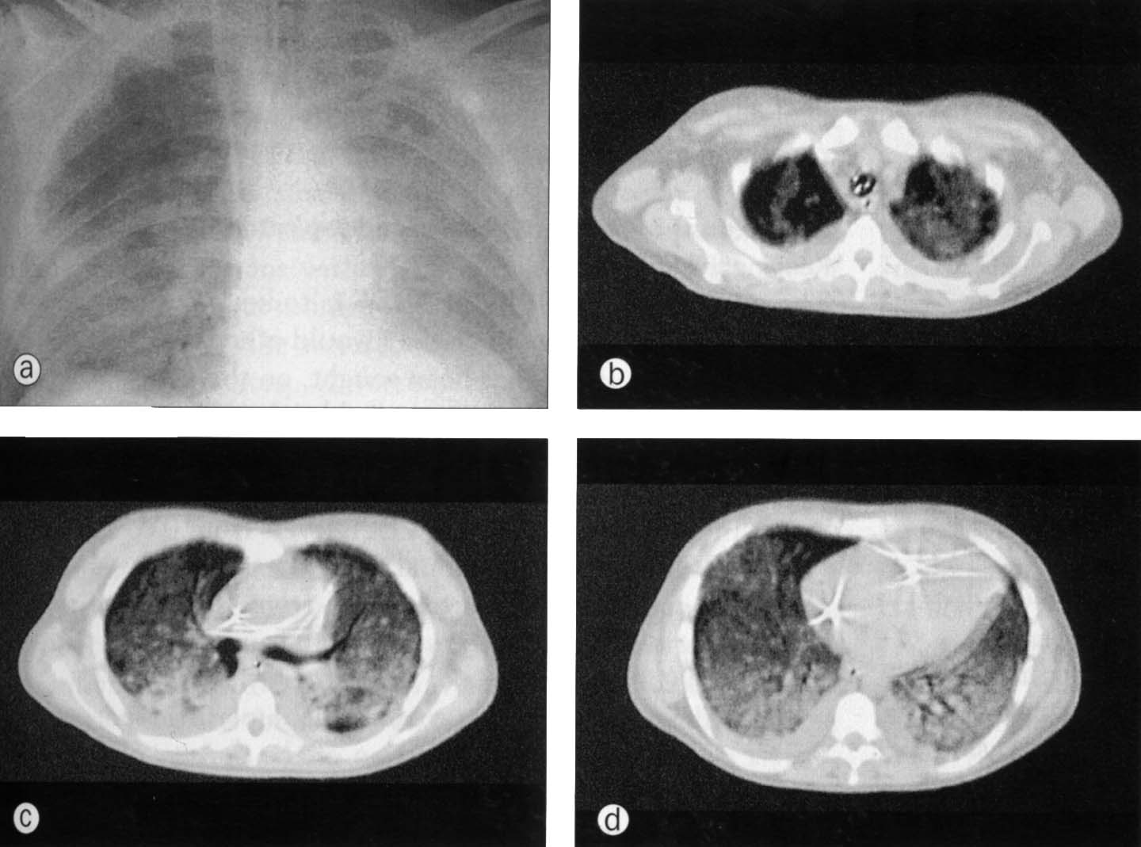
Early ARDS: Exudative Phase
Interstitial edema and inflammatory cells accumulation
Hyaline membranes
Intra-alveolar protein-rich exudate and inflammatory cells accumulation
Seminars in Respiratory Infections 1995; 10: 154-175.

Slide 19
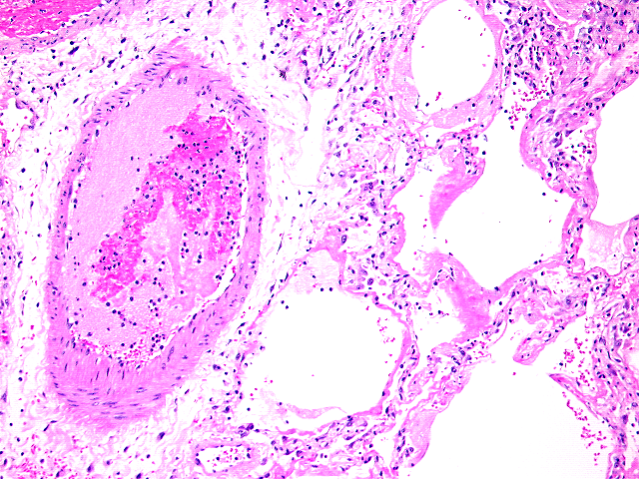
Early ARDS: I.V. Clotting
Inflammation
Coagulation
Tissue
Repair
With permission of Dr. Rubin Tuder JHU

Slide 20
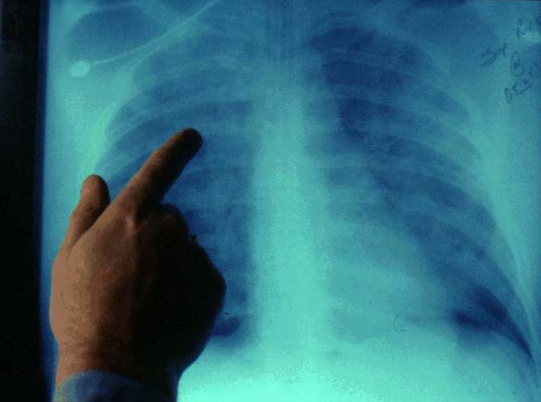
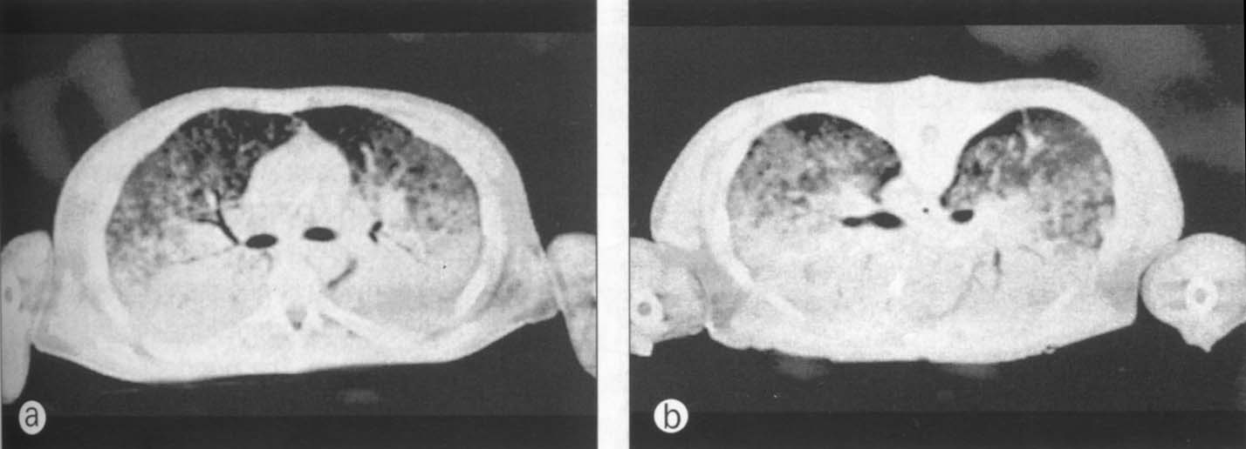
Early ARDS: Radiography
Diffuse lung inflammation with ≈ homogeneous distribution of interstitial edema (sponge model)
Superimposed pressure ➔Dependent atelectasis
Dependent
atelectasis
(shunt)
ARDS in Comprehensive Respiratory Medicine

Slide 21
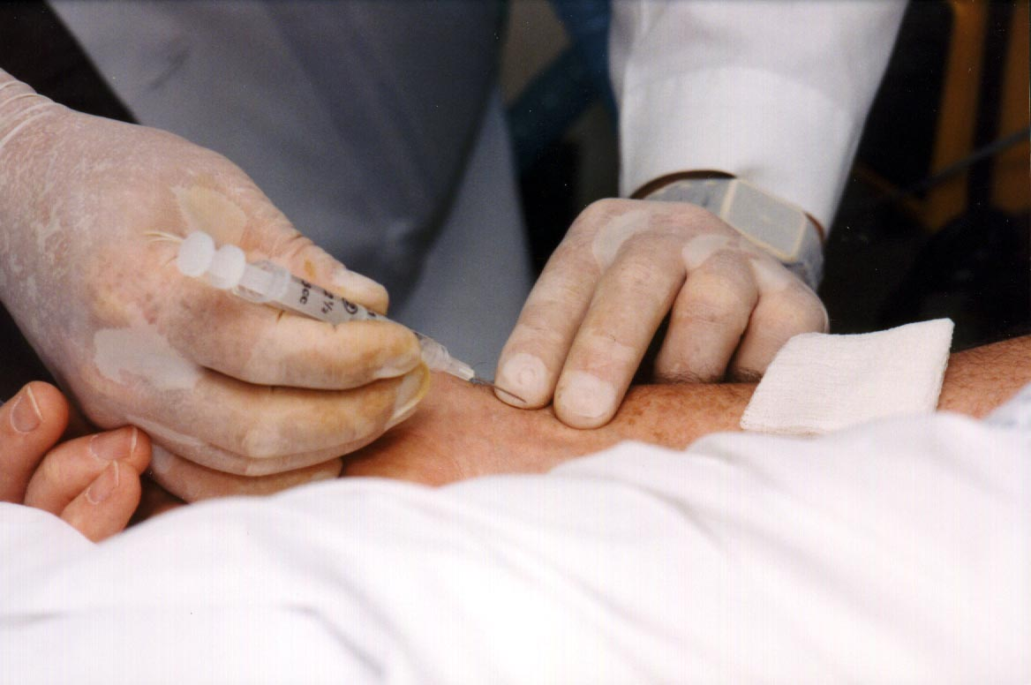
Lung Injury Score
LIS quantifies physiological impairment in ARDS
  Four-point based score
Components
  1. Chest roentgenogram
  2. PaO₂:FiO₂
  3. PEEP
  4. Respiratory compliance
ABG
PEEP (cmH₂O)
Compliance (mL/ cmH₂O)
Score
  Mild-moderate: 1 - 2.5
  Severe: 2.5 - 4
Am Rev Respir Dis 1988; 138: 720-723.

Slide 22
Resolving vs. Unresolving ARDS
Lung Injury Score
> 1-point reduction in LIS by Day 8
Yes = Resolving - mortality 17%
No = Unresolving - mortality 83%
4
3.5
3
Lung Injury Score
> 1-point*
2.5
2
Day
1
3
5
7
Chest 1997; 111: 1306 -1321.
* or PaO₂:FiO₂ > 100

Slide 23
Histological Evolution
ARDS Day
Exudative Phase
neutrophilic
exudative edema
5 - 15% early death
5 - 10% extubated
1 - 7
Proliferative Phase
organization
and repair
Adaptive response
Maladaptive
response
?
7 - 28
Resolving ARDS
20-30%
Unresolving
ARDS
40-60%
Eur Respir J 1996; 9:2650-2670.

Slide 24
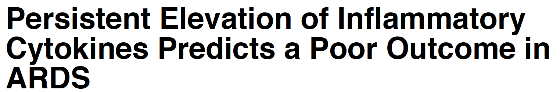
Nonsurvivors (n = 17)
750
Dysregulated = Persistent elevation
650
IL-8
550
450
IL-6
350
250
IL-1β
150
TNF-α
Day
1
2
3
5
7
10
Survivors (n = 17)
750
Regulated = Progressive reduction
650
IL-8
550
450
IL-6
350
250
IL-1β
150
TNF-α
Day
1
2
3
5
7
10
Notes:
This slide provides original data from our group published in 1995 – it received two national research awards - and was later reproduced by us and other groups. It compares the longitudinal course of systemic inflammation in patients with resolving and unresolving ARDS, with measurements of IC TNF, IL-1, and IL-6 and chemokine IL-8. Similar findings for BAL are not shown.
The top shows nonsurvivors
The bottom shows survivors
Patients with unresolving ARDS, contrary to patients with resolving ARDS, have higher initial elevation and persistent elevation over time. Survivors, have lower initial levels and are capable of down-regulating the systemic inflammatory response – regulated systemic inflammation
Whereas appropriately regulated inflammation – tailored to stimulus and time – is beneficial, excessive or persistent systemic inflammation incites tissue destruction and disease progression.
It is the lack of regulation (dysregulated systemic inflammation) of this vital response that is central to the pathogenesis of organ dysfunction in patients with sepsis and ARDS.

Slide 25
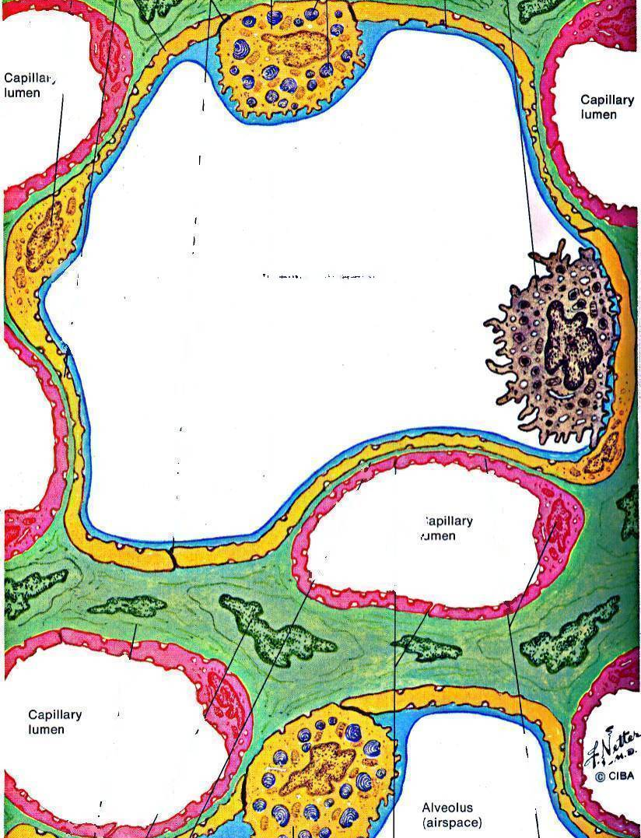
Adaptive vs Maladaptive Response
ACM Injury - BAL Albumin
p < 0.001
Total Protein
Albumin
Total Protein (g/L)
p = 0.002
Albumin (g/L)
= Survivors
= Nonsurvivors
Chest 1995; 108: 1303-1314.

Slide 26
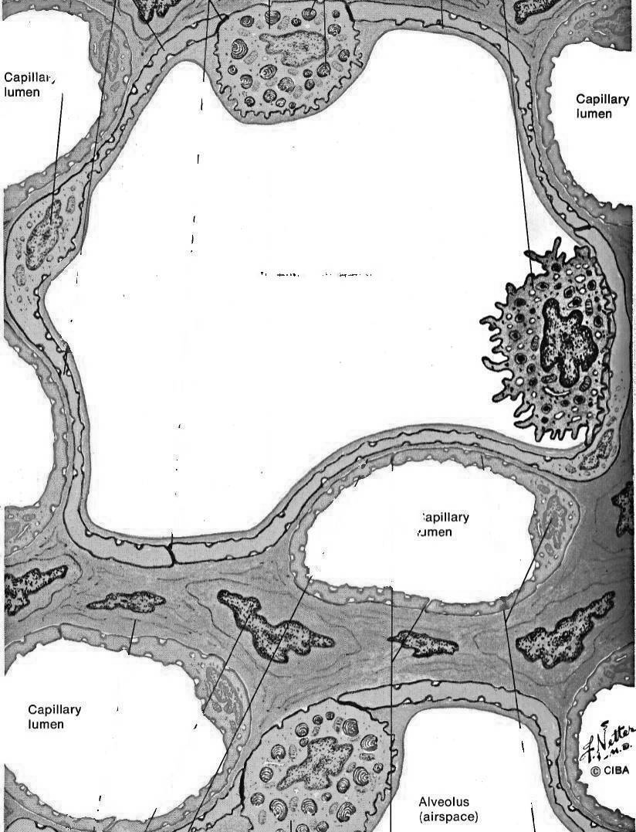
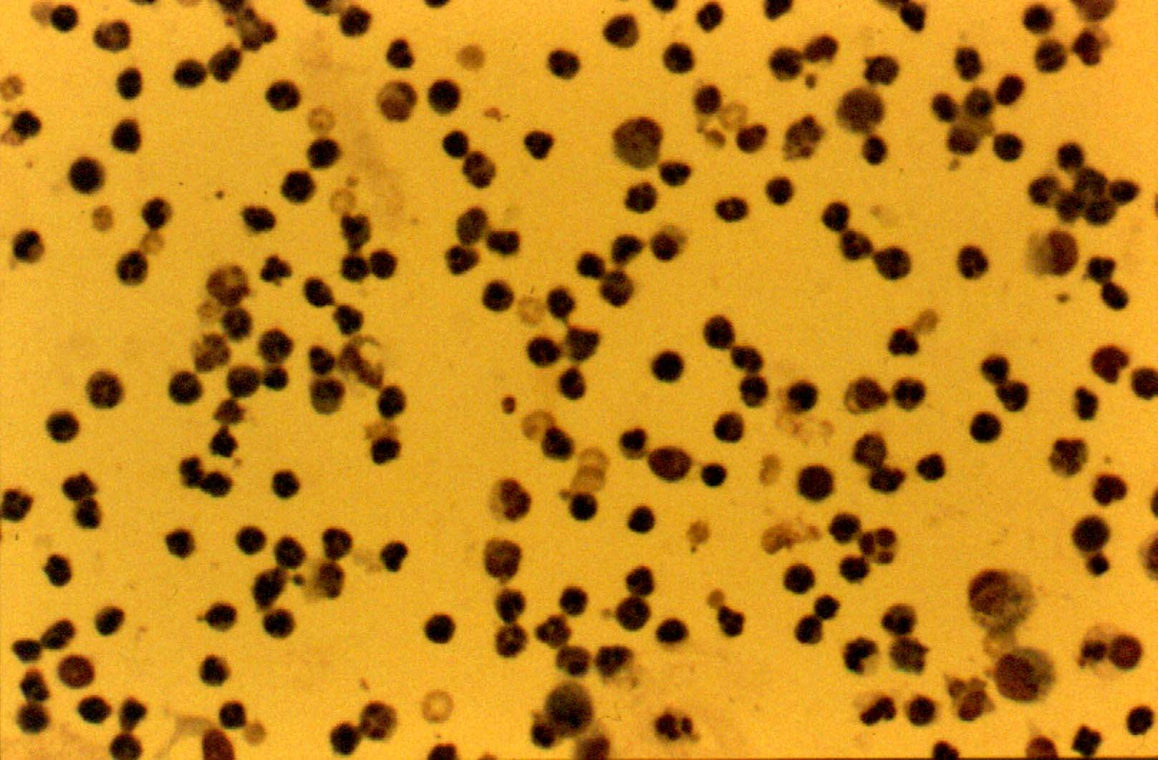
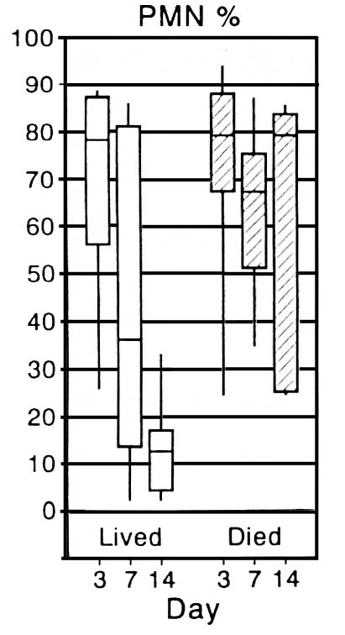
Adaptive vs Maladaptive Response
ACM Injury - BAL PMN Percentage
Neutrophils
Am J Respir Crit Care Med 1994; 150:113-122.

Slide 27
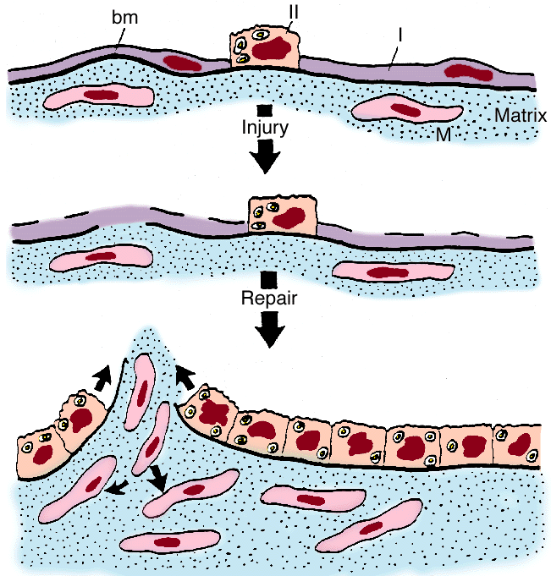
Myofibroblasts
Migration and Proliferation
↑↓

Slide 28
Procollagen Type III
Inflammation
Coagulation
Tissue
Repair
Improvers (n =7)
50
Nonimprovers (n= 17)
p = 0.001
45
p = 0.004
40
35
30
Plasma Procollagen (pg/ml)
25
20
15
10
5
Days
< 2
3
5 - 7
8 - 10
Fibroproliferation over time
  Adaptive = decreases
  Maladaptive = increases
Am J Resp Crit Care Med 1998; 158: 1432-1441.

Slide 29
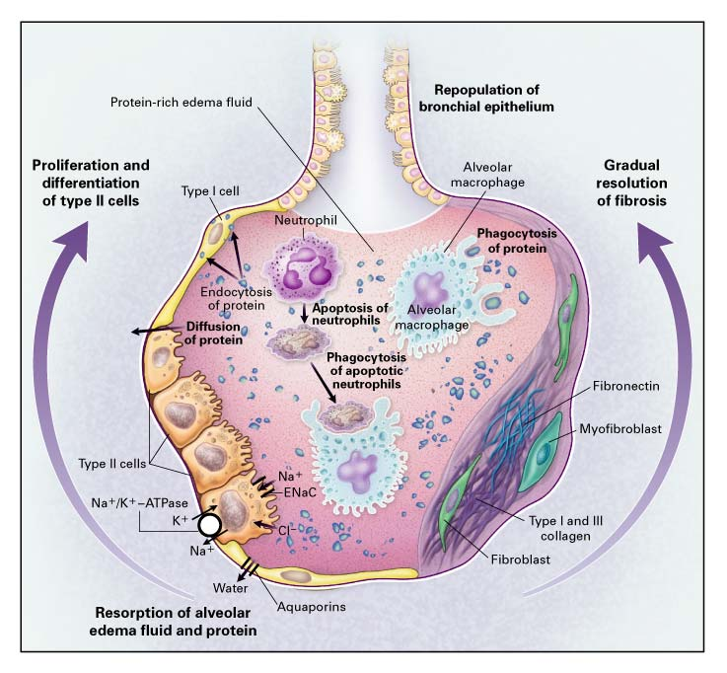
Adaptive Repair
NEJM 2000; 343: 1334-1349.

Slide 30
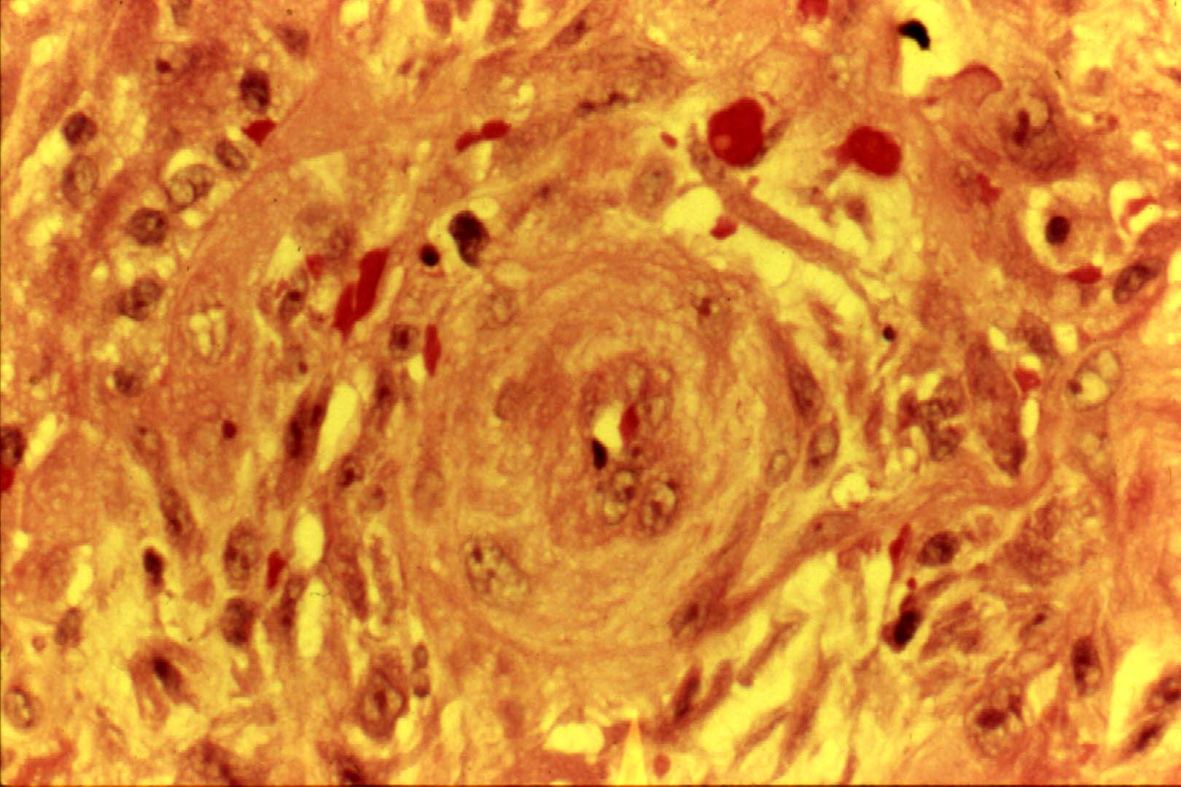
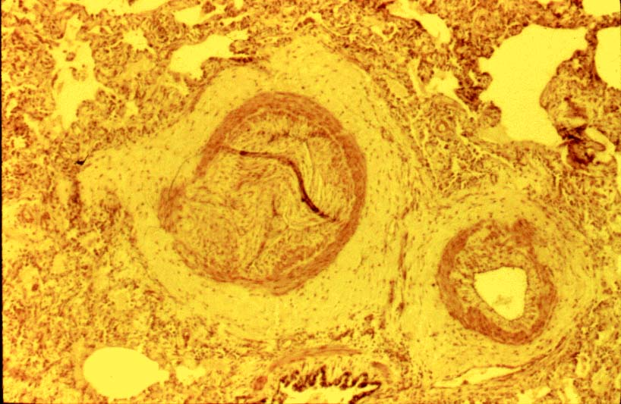
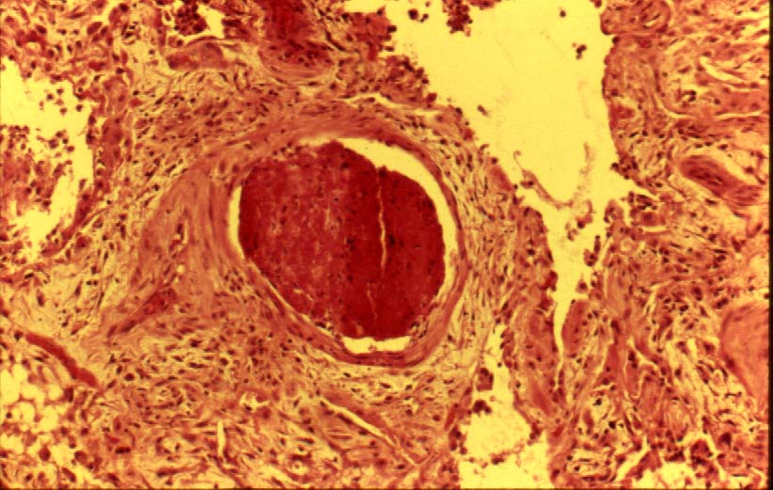
Maladaptive Response
Pulmonary vascular occlusion
High flow from reduced capacity of the pulmonary circulation stimulates medial hypertrophy of small muscular and partially muscular arteries
Lobular artery (muscular)
Arteriole
Tissue Repair
Coagulation
Small pulmonary artery
Subintimal Fibroproliferation
Vascular Thrombosis
Seminars in Respiratory Infections 1995; 10: 154-175.

Slide 31
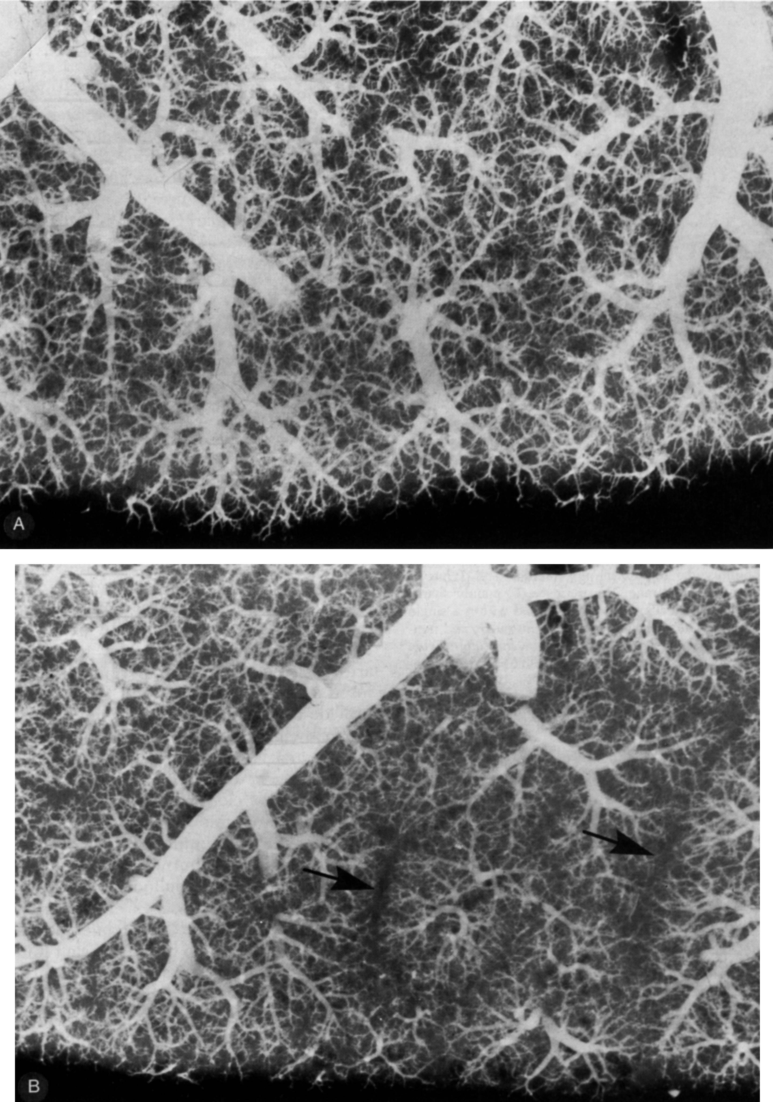
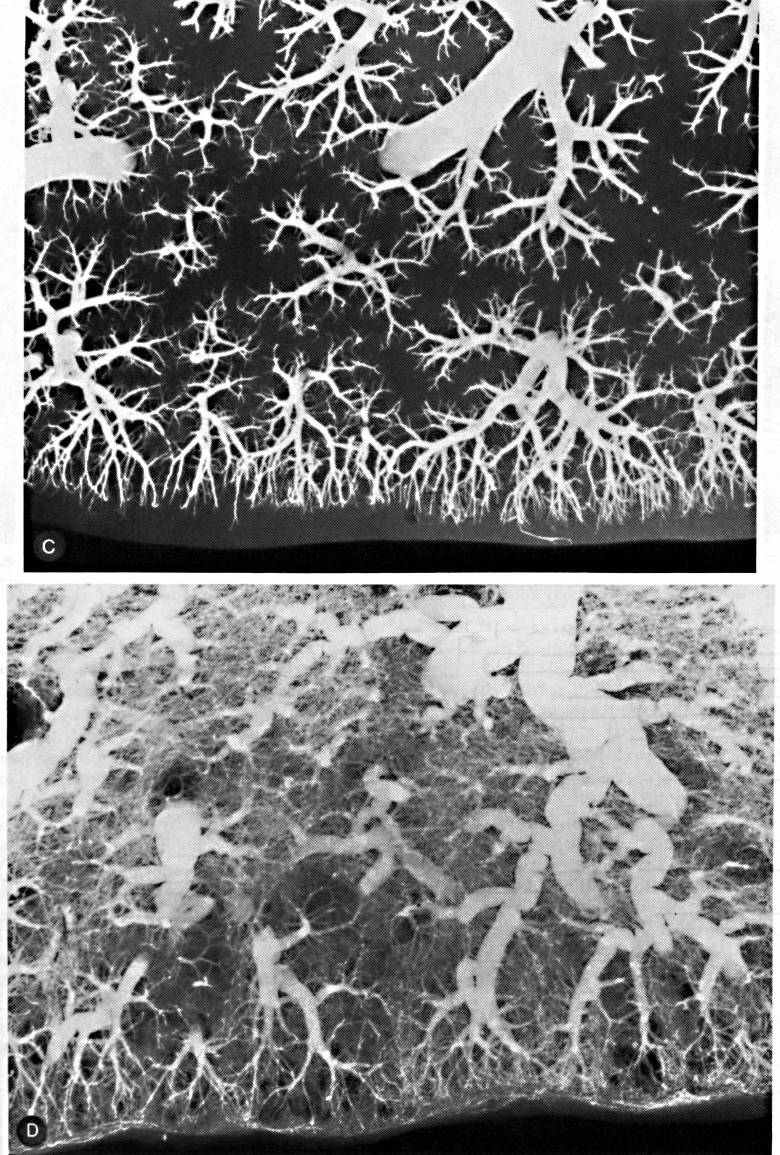
Post-mortem Arteriography
Extensive reduction of
peripheral arteries from
intimal obliteration
Normal lung
Visceral pleura
ARDS day 16
Picket fence appearance
Edema of the interlobular fissure
Arterial tortuosity
Reduced filling of
small arteries
Honeycomb cysts
ARDS day 6
ARDS day 26
Tomashefski J. Chest Clinics 1990; 593

Slide 32
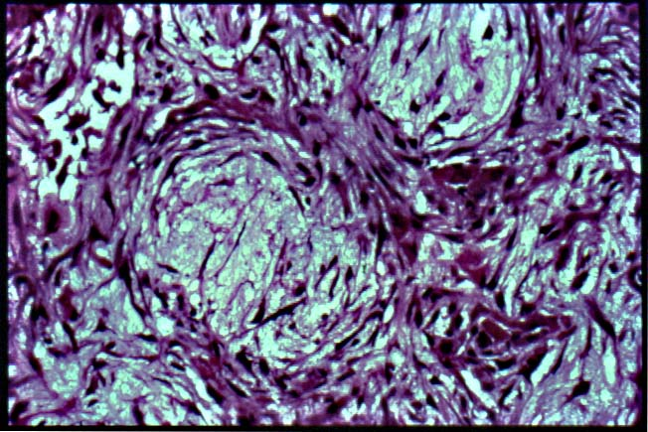
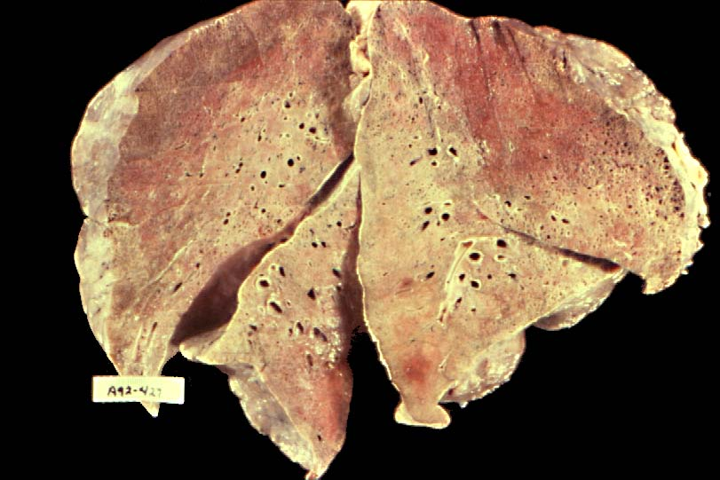
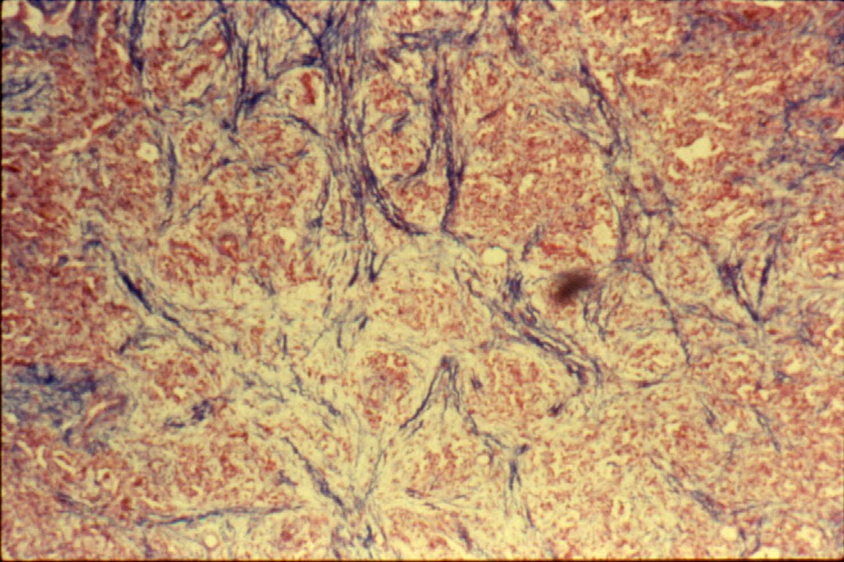
Maladaptive Response
Fibroproliferation
Obliteration of the airspaces by concentrically arranged fibroblasts
Exudative
Diffuse consolidation from massive fibroblast infiltration
Collagen (blue stain)
Seminars in Respiratory Infections 1995; 10: 154-175.

Slide 33


Slide 34
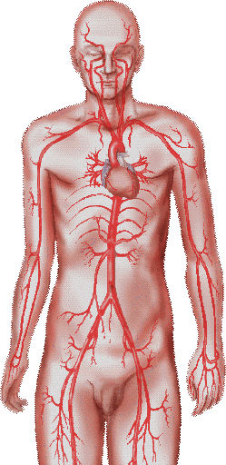
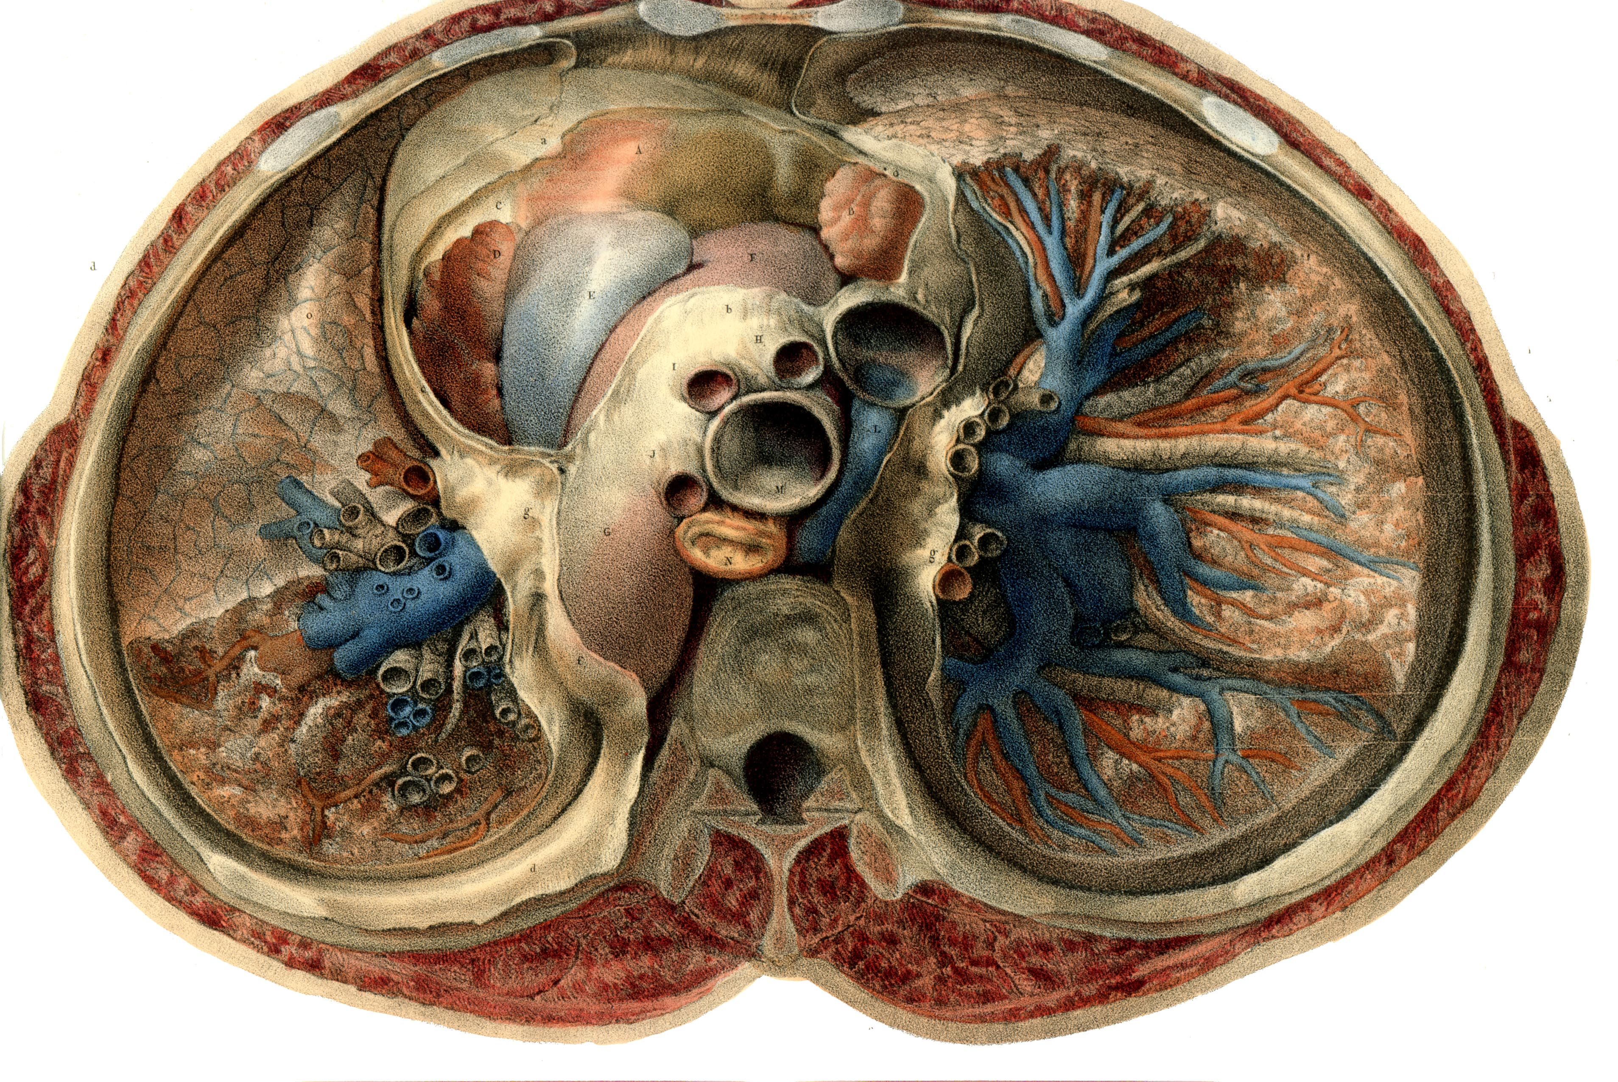
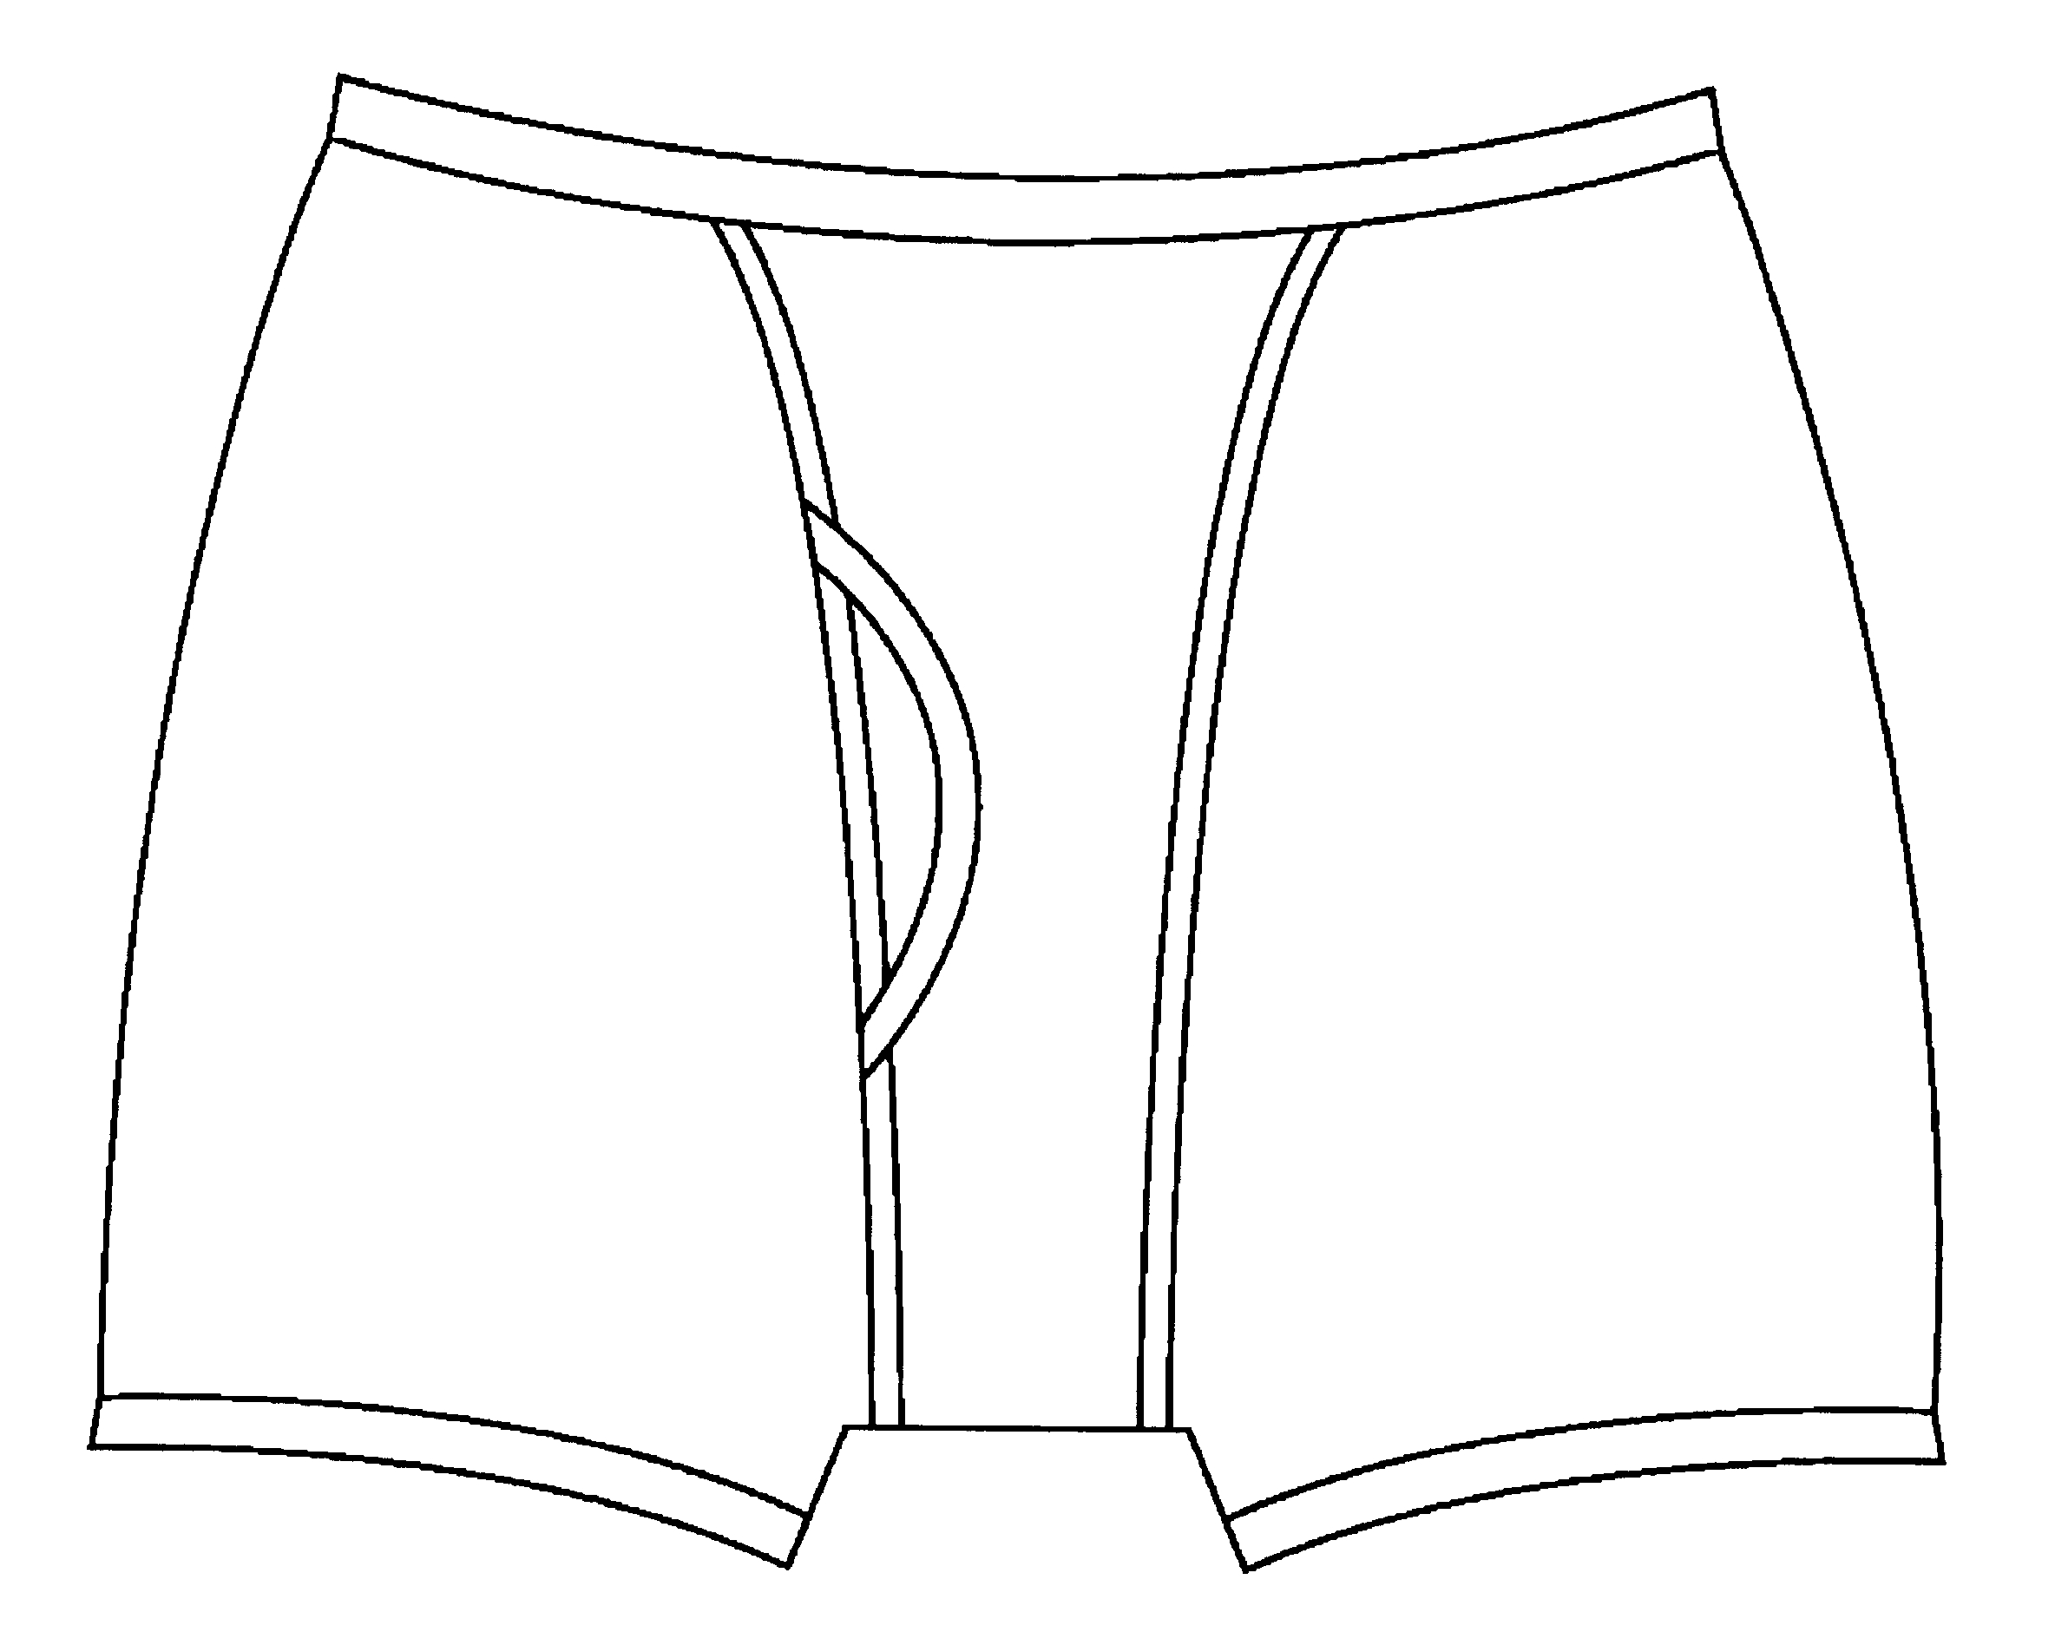
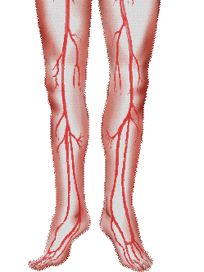
Acute Respiratory Distress Syndrome
Insult
Noninfectious
Infectious
Direct
Indirect
Systemic
Inflammation
Previously
Healthy
Lung

Slide 35
Plasma Inflammatory Cytokines
Maladaptive
750
650
IL-8
550
450
IL-6
350
250
IL-1β
150
TNF-α
Day
1
2
3
5
7
10
Adaptive
750
650
IL-8
550
450
IL-6
350
250
IL-1β
150
TNF-α
Day
1
2
3
5
7
10
Chest 1995;107:1062.

Slide 36
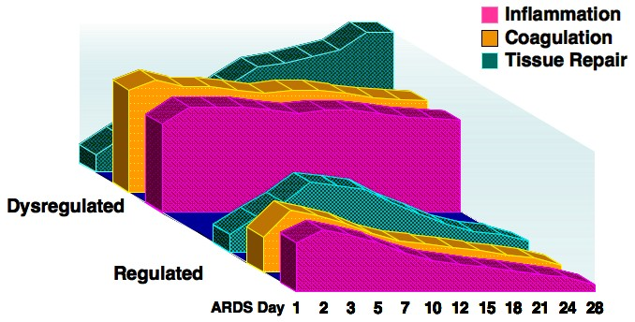
Adaptive vs Maladaptive Response
Maladaptive
Adaptive
4
3.5
3
Lung Injury Score
> 1-point
2.5
2
Day
1
3
5
7

Slide 37


Slide 38

Dysregulated = persistent elevation
750
650
IL-8
550
450
GRα
IL-6
350
250
IL-1β
150
TNF-α
Day
1
2
3
5
7
10
Activated
Glucocorticoid
Receptor α
Regulated = progressive reduction
750
650
IL-8
550
450
IL-6
350
250
IL-1β
150
TNF-α
Day
1
2
3
5
7
10
Notes:
This slide provides original data from our group published in 1995 – it received two national research awards - and was later reproduced by us and other groups. It compares the longitudinal course of systemic inflammation in patients with resolving and unresolving ARDS, with measurements of IC TNF, IL-1, and IL-6 and chemokine IL-8. Similar findings for BAL are not shown.
The top shows nonsurvivors
The bottom shows survivors
Patients with unresolving ARDS, contrary to patients with resolving ARDS, have higher initial elevation and persistent elevation over time. Survivors, have lower initial levels and are capable of down-regulating the systemic inflammatory response – regulated systemic inflammation
Whereas appropriately regulated inflammation – tailored to stimulus and time – is beneficial, excessive or persistent systemic inflammation incites tissue destruction and disease progression.
It is the lack of regulation (dysregulated systemic inflammation) of this vital response that is central to the pathogenesis of organ dysfunction in patients with sepsis and ARDS.

