Slide 1




University of Pavia School of Medicine
San Matteo Hospital, Division of Cardiac Surgery
Pavia, Italy
Prof. Andrea M. D’Armini, M.D.
PULMONARY ENDARTERECTOMY: THE PAVIA EXPERIENCE

Slide 2
PULMONARY ENDARTERECTOMY: THE PAVIA EXPERIENCE
FINANCIAL DISCLOSURE
Last two years
Actelion Pharmaceuticals Ltd
Bayer HealthCare

Slide 3
PULMONARY ENDARTERECTOMY: THE PAVIA EXPERIENCE
INTRODUCTION
DANA POINT 2008 – PH CLINICAL CLASSIFICATION
4%

Slide 4


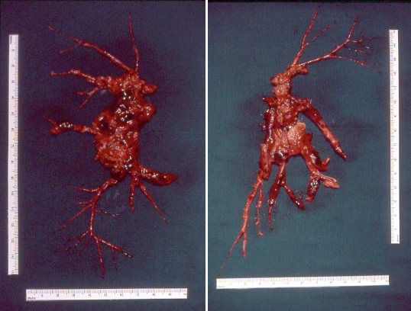
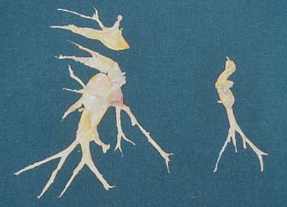
PULMONARY ENDARTERECTOMY: THE PAVIA EXPERIENCE
INTRODUCTION
Chronic ThromboEmbolic Pulmonary Hypertension
PULMONARY ENDARTERECTOMY
ANTICOAGULATION
Acute pulmonary embolism

Slide 5
PULMONARY ENDARTERECTOMY: THE PAVIA EXPERIENCE
INTRODUCTION
Chronic thromboembolic pulmonary hypertension (CTEPH) represents the only type of pulmonary hypertension surgically treatable, in the majority of cases, without transplant
This life-saving conservative surgery is called pulmonary endarterectomy (PEA)

Slide 6
PULMONARY ENDARTERECTOMY: THE PAVIA EXPERIENCE
SURGICAL TREATMENT OF CTEPH
PAVIA EXPERIENCE
First HLTx for CTEPH
First PEA in patient listed for DLTx
First PEA
First DLTx for CTEPH
First PEA in patient previously enrolled in RCT for inoperability
08-MAR-1991
11-APR-1994
25-DEC-1995
28-JUL-2003
30-NOV-2009

Slide 7
PULMONARY ENDARTERECTOMY: THE PAVIA EXPERIENCE
EPIDEMIOLOGY
Epidemiologic data: in Italy ≈18.000 cases / year 2013 of acute symptomatic pulmonary embolism (PE)
Prevalence of CTEPH in pts surviving an acute PE (≈80%) is calculated between 1%-4%
→ up to 150-600 new cases / year
Considering asymptomatic pulmonary embolism (≈30%-35%)
→ up to 50-200 new cases / year
The true incidence in Italy of CTEPH may be
→ up to 200-800 new cases / year
Jamieson SW, Kapelanski DP. Pulmonary endarterectomy. Curr Probl Surg 2000; 37:165-252
Fedullo PF, Auger WR, Kerr KM, Rubin LJ. Chronic thromboembolic pulmonary hypertension. N Engl J Med 2001; 345:1465-72
Pengo V, Lensing AV, Prins MH, Marchiori A, Davidson BL, Tiozzo F et al. Incidence of chronic thromboembolic pulmonary hypertension after pulmonary embolism. N Engl J Med 2004; 350:2257-64

Slide 8
PULMONARY ENDARTERECTOMY: THE PAVIA EXPERIENCE
CURRENT SITUATION
CTEPH is still under-diagnosed and nowadays only few physicians are aware of the surgical procedure called PEA
For all these reasons less than 10000 PEA have been performed worldwide so far with ≈ 30 % of all cases carried out by the San Diego Group

Slide 9
PULMONARY ENDARTERECTOMY: THE PAVIA EXPERIENCE
NATURAL HISTORY
Pulmonary embolism (symptomatic / asymptomatic)
Possible “honeymoon” period: months / years
Hypertensive remodeling of the patent pulmonary vascular bed (Eisenmenger-like)
Onset and progressive worsening of pulmonary arterial hypertension
Right ventricle hypertrophy with progressive right heart deterioration → right heart failure
Left ventricle compression with left heart functional impairment → biventricular heart failure
Multiorgan failure (end stage disease)

Slide 10
PULMONARY ENDARTERECTOMY: THE PAVIA EXPERIENCE
GENERAL CONDITIONS
Low cardiac output with dyspnea, cough, cyanosis, hepatomegaly, ascites, lower limb edema, syncope, hemoptysis and interscapular olosystolic murmur
Chronic respiratory failure (oxygen-dependent)
Frequent positive anamnesis for deep venous thrombosis and / or coagulative and immunologic disorders

Slide 11
PULMONARY ENDARTERECTOMY: THE PAVIA EXPERIENCE
COAGULATIVE DISORDERS
DISORDER | % PTS | MEAN ± SD | RANGE
HYPERHOMOCYSTEINEMIA (μmol/L) | 72.6 % | 21.7 ± 8.3 | 14.1 – 63.2
EXCESS FACTOR VIII ANTIGEN (%) | 78.2 % | 206.7 ± 33.9 | 161.1 – 392.9
EXCESS FACTOR VIII RISTOCETIN (%) | 47.6 % | 182.1 ± 46.6 | 150.0 – 334.0
EXCESS FACTOR VIII (%) | 27.4 % | 179.3 ± 25.8 | 153.4 – 220.0
PAI EXCESS (U/ml) | 53.2 % | 5.1 ± 1.2 | 3.6 – 7.9
FACTOR V LEIDEN | 15.3 % | 1.34 ± 0.55 | 0.50 – 1.99

Slide 12
PULMONARY ENDARTERECTOMY: THE PAVIA EXPERIENCE
IMMUNOLOGIC DISORDERS
DISORDER | % PTS | MEAN ± SD | RANGE
Anti-Nuclear Antibodies (ANA) | 23.4 % | – | –
Lupus Anticoagulant (LAC) | 19.4 % | – | –
Anti-Cardiolipin Antibodies (ACA) IgG | 20.2 % | 56.3 ± 40.3 | 10.3 – 121.0
Anti-Cardiolipin Antibodies (ACA) IgM | 13.7 % | 30.8 ± 30.5 | 7.3 – 101.0
Anti-Phospholipid Antibodies (APA) IgG | 14.5 % | 63.2 ± 36.5 | 8.4 – 121.0
Anti-Phospholipid Antibodies (APA) IgM | 12.9 % | 28.0 ± 23.5 | 10.1 – 91.3
Positive Direct Coombs’ Test | 8.9 % | – | –

Slide 13
PULMONARY ENDARTERECTOMY: THE PAVIA EXPERIENCE
MARKED THROMBOPHILIA
A PERMANENT INFERIOR VENA CAVA FILTER was placed before PEA in the majority of patients
Lifelong oral anticoagulation was prescribed after PEA

Slide 14
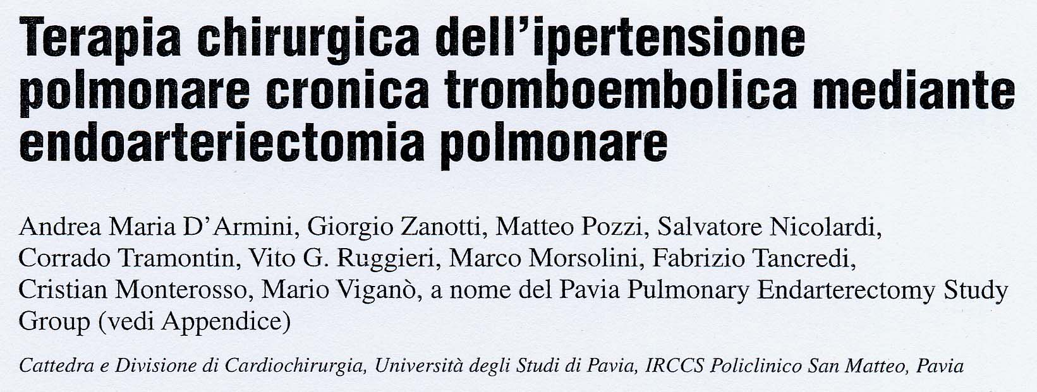
PULMONARY ENDARTERECTOMY: THE PAVIA EXPERIENCE
REFERENCE

Slide 15
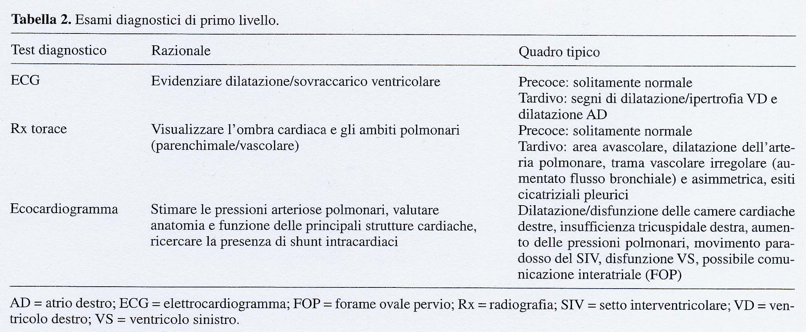
PULMONARY ENDARTERECTOMY: THE PAVIA EXPERIENCE
REFERENCE

Slide 16
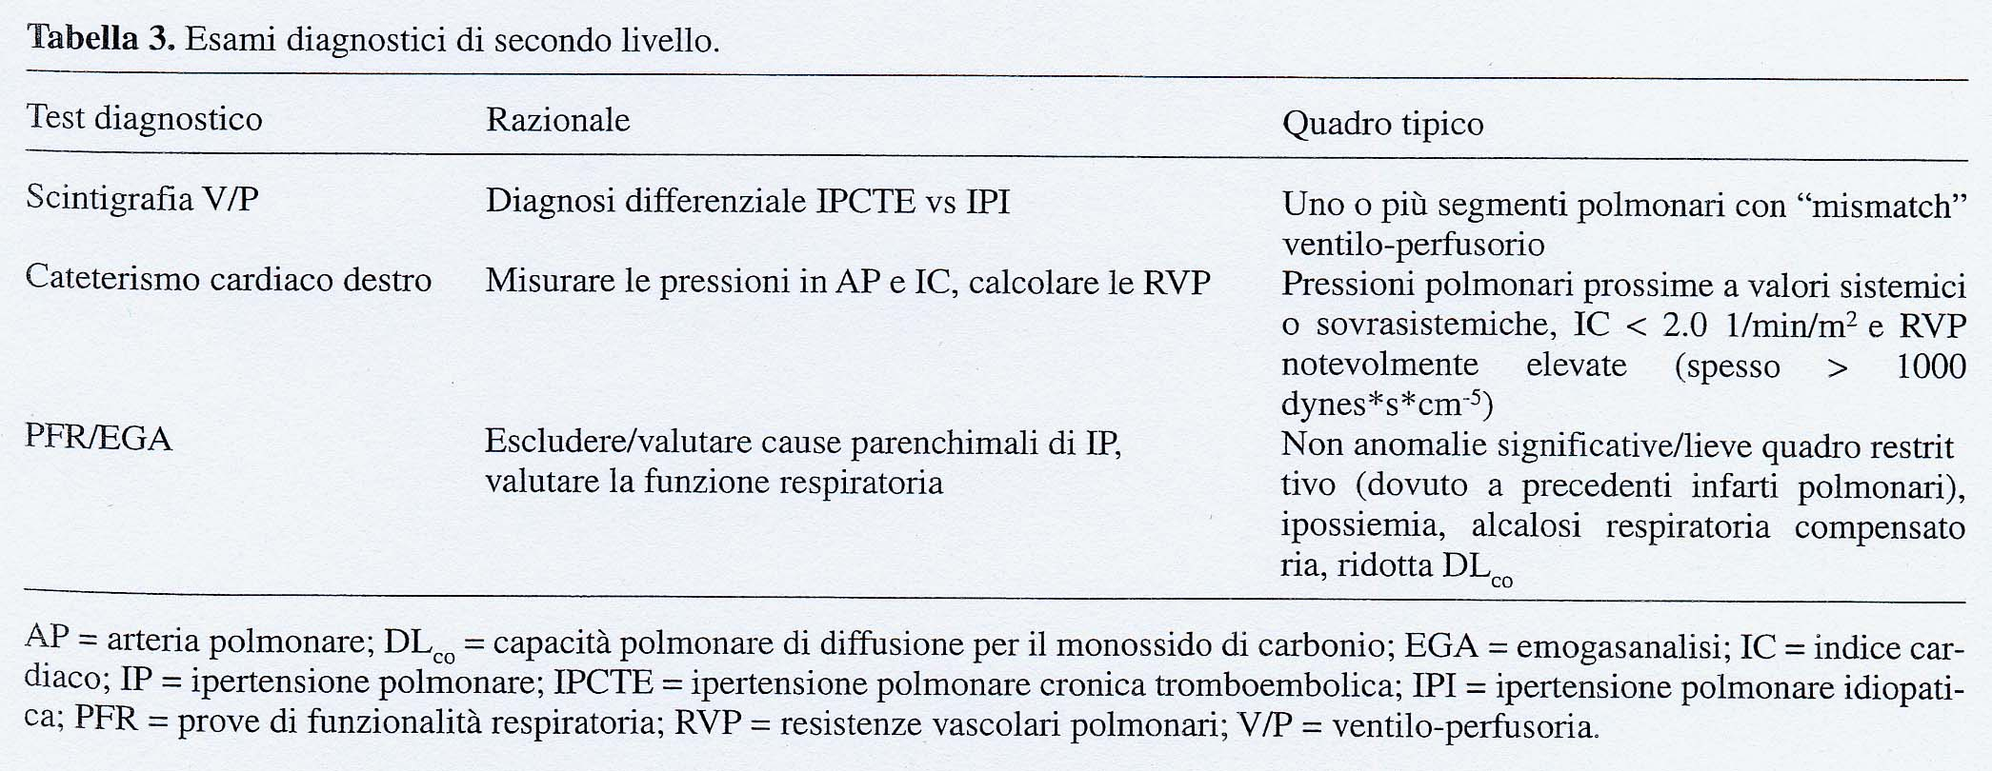
PULMONARY ENDARTERECTOMY: THE PAVIA EXPERIENCE
REFERENCE

Slide 17
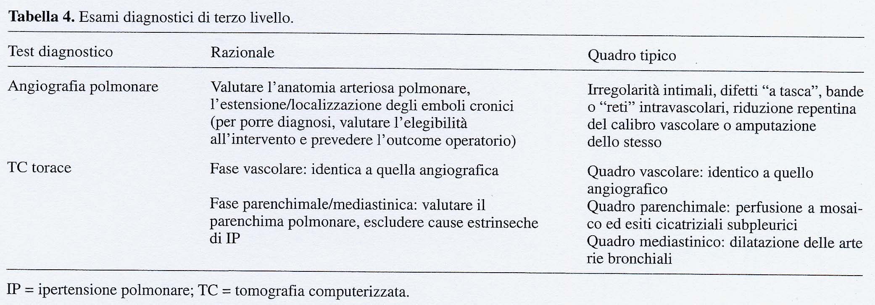
PULMONARY ENDARTERECTOMY: THE PAVIA EXPERIENCE
REFERENCE

Slide 18
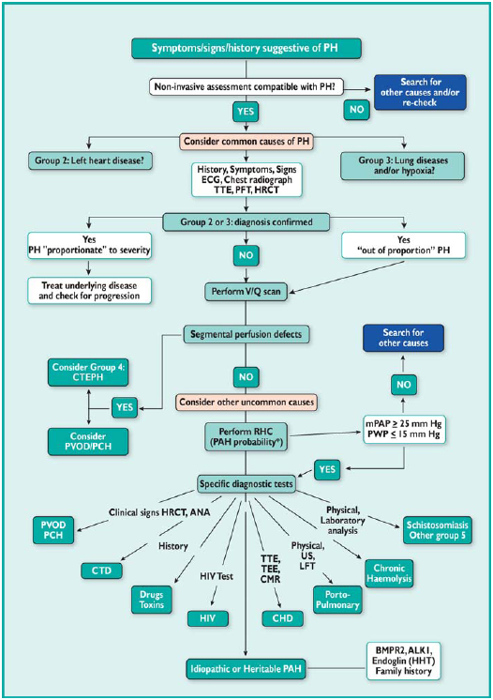
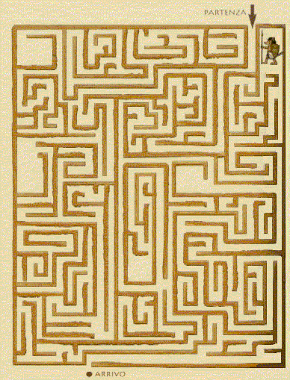
PULMONARY ENDARTERECTOMY: THE PAVIA EXPERIENCE
DIAGNOSTIC WORKUP

Slide 19
PULMONARY ENDARTERECTOMY: THE PAVIA EXPERIENCE
DIAGNOSTIC WORKUP
SYMPTOMS / SIGNS / HISTORY SUGGESTIVE FOR PH
Consider COMMON CAUSES of PH
Group 2 – Left heart disease
Group 3 – Lung disease / hypoxia
COMMON CAUSES OF PH EXCLUDED
V/Q SCAN
Group 4 – CTEPH
Group 1 – PAH

Slide 20

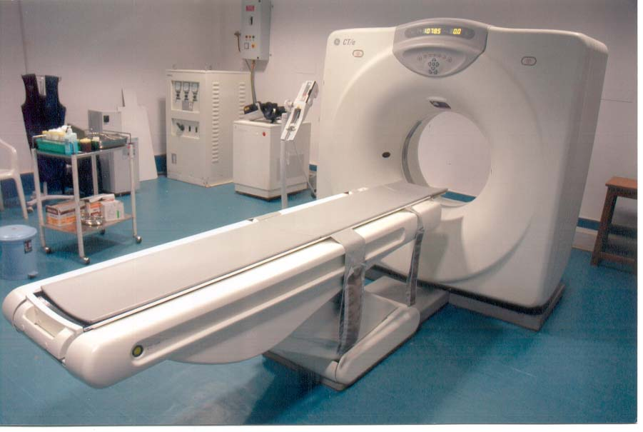
PULMONARY ENDARTERECTOMY: THE PAVIA EXPERIENCE
DIAGNOSTIC WORKUP
CTEPH OPERABILITY ASSESSMENT
PULMONARY ANGIOGRAPHY
CT SCANNING

Slide 21
PULMONARY ENDARTERECTOMY: THE PAVIA EXPERIENCE
INDICATIONS FOR SURGERY
The indications for the surgical treatment of these patients are based on
CLINIC
HEMODYNAMIC
The indications for the type of surgery are based on
ANATOMY

Slide 22
PULMONARY ENDARTERECTOMY: THE PAVIA EXPERIENCE
CLINIC
Patients must be in NYHA or WHO functional class III or IV
Full anticoagulation for at least 3 months
Since 2003 we have performed PEA in NYHA or WHO functional class II patients, given the natural history of the disease

Slide 23
PULMONARY ENDARTERECTOMY: THE PAVIA EXPERIENCE
HEMODYNAMIC
Pulmonary hypertension (mPAP ≥ 25 mmHg)
Causing low cardiac output
Resulting in calculated pulmonary vascular resistances (PVR) > 300 dyne*sec*cm⁻⁵

Slide 24
PULMONARY ENDARTERECTOMY: THE PAVIA EXPERIENCE
ANATOMY
The surgical treatment depends on the localization of the lesions in the pulmonary arterial branches
Lesions can be classified as PROXIMAL
DISTAL

Slide 25
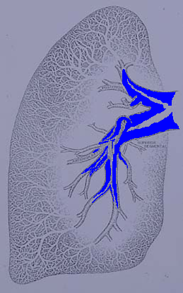
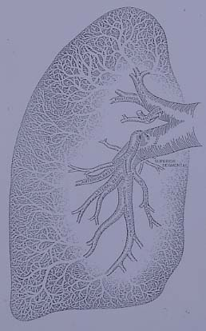
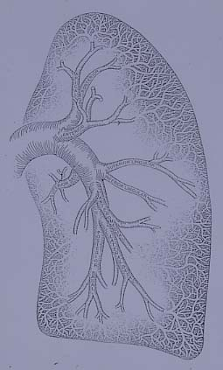
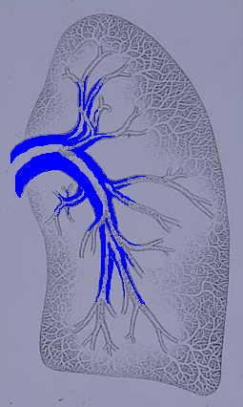
PULMONARY ENDARTERECTOMY: THE PAVIA EXPERIENCE
PROXIMAL LESIONS

Slide 26
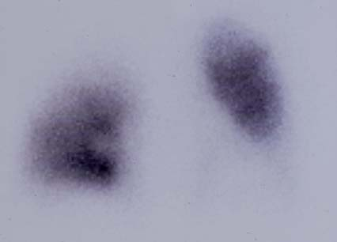
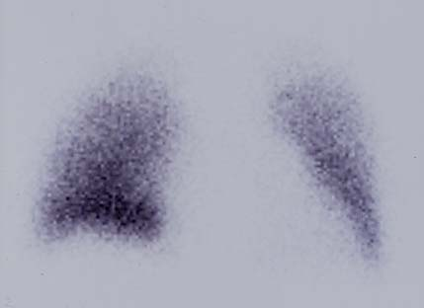
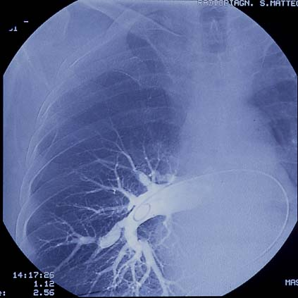
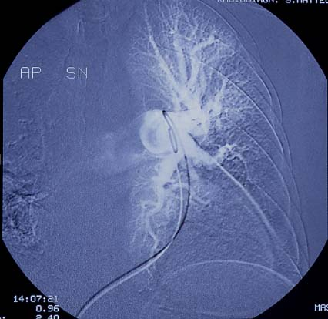
PULMONARY ENDARTERECTOMY: THE PAVIA EXPERIENCE
M.B. – 62 yrs M – Jul 2001 – PEA #64
Perfusion and ventilation scan
Pulmonary angiogram
Hemodynamic
mPAP 67
CI 1.6
PVR 1766

Slide 27
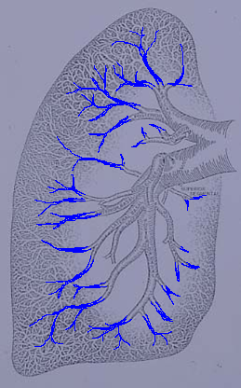
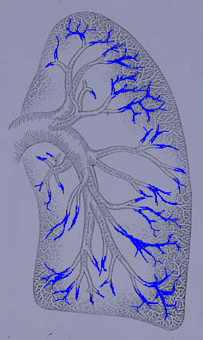
PULMONARY ENDARTERECTOMY: THE PAVIA EXPERIENCE
DISTAL LESIONS

Slide 28
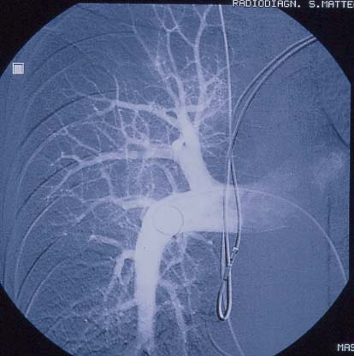
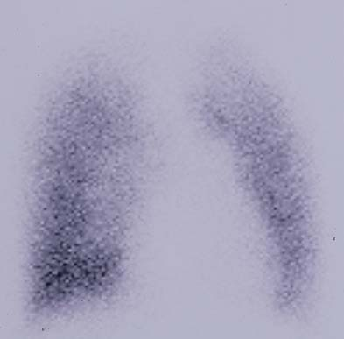
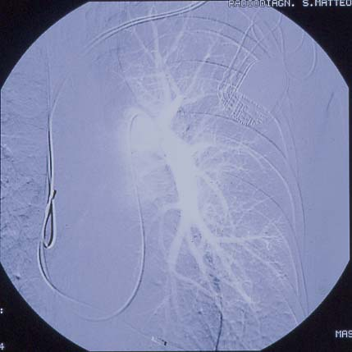
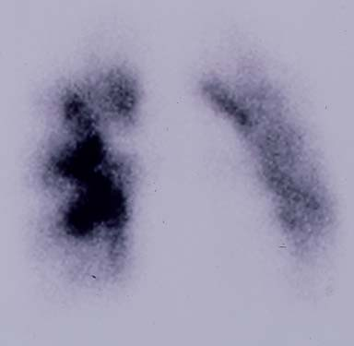
PULMONARY ENDARTERECTOMY: THE PAVIA EXPERIENCE
S.S. – 31 yrs M – Sep 2002
Perfusion and ventilation scan
Pulmonary angiogram
Hemodynamic
mPAP 50
CI 1.8
PVR 1120

Slide 29
PULMONARY ENDARTERECTOMY: THE PAVIA EXPERIENCE
OPERABILITY ASSESSMENT
Which lesions have to be considered as inoperable?
Growing single surgeon’s experience due to learning curve
Different operability assessments from different Centers

Slide 30
PULMONARY ENDARTERECTOMY: THE PAVIA EXPERIENCE
BACKGROUND
PEA is the treatment of choice for patients with CTEPH
About only 15-20 Centers worldwide are performing PEA on a routine basis (> 20 EAPs/year)
In expert hands, mortality ranges between 5% and 10% and technical failure is below 10%
Early hemodynamic results
are known to be excellent in
case of successful operation

Slide 31
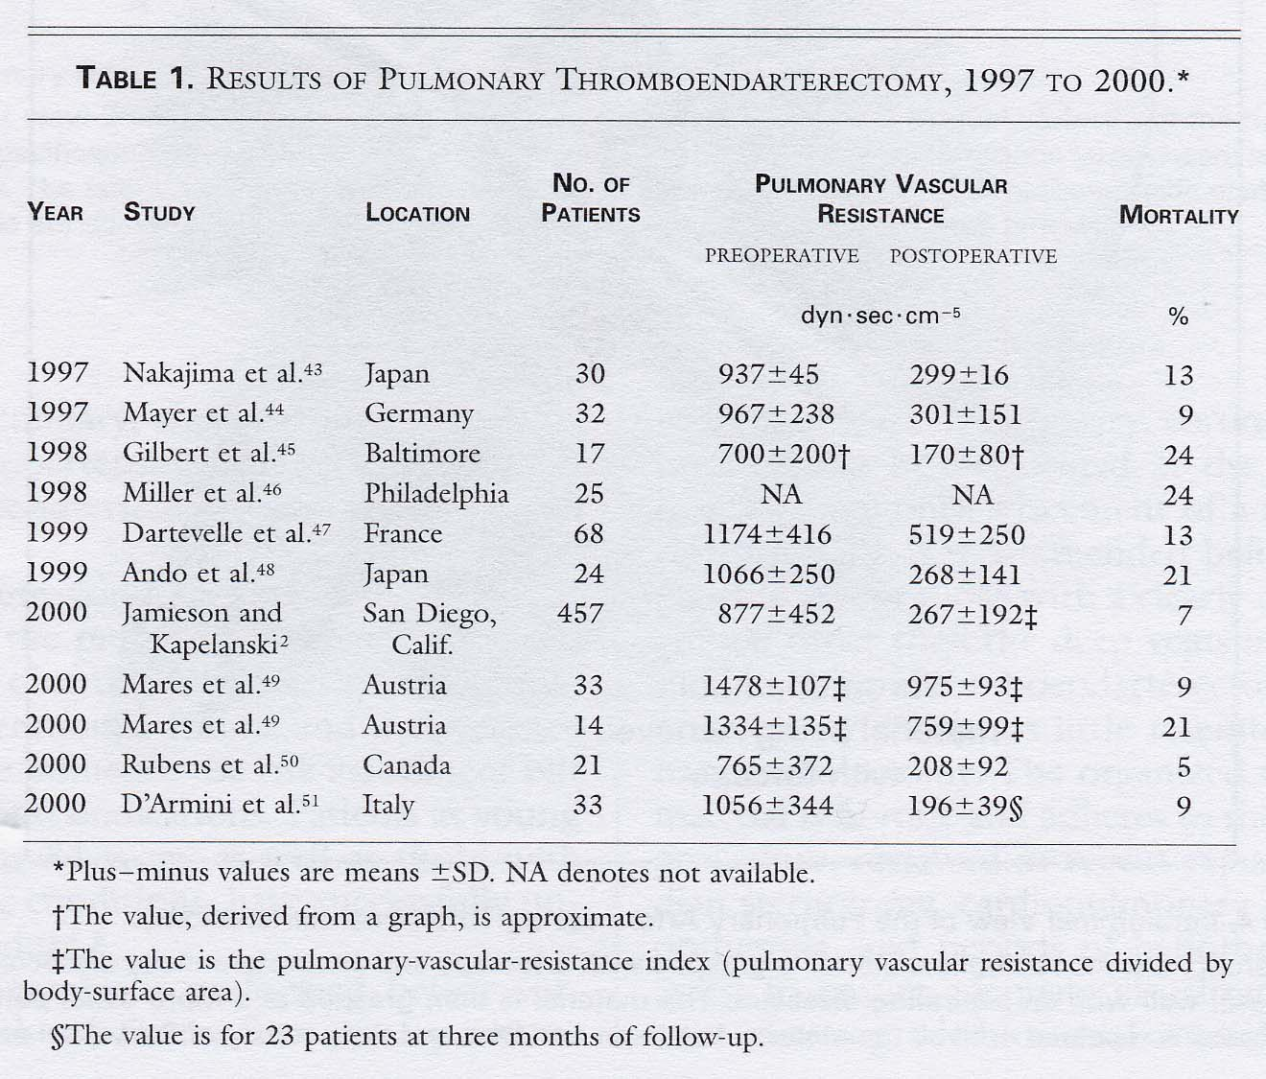
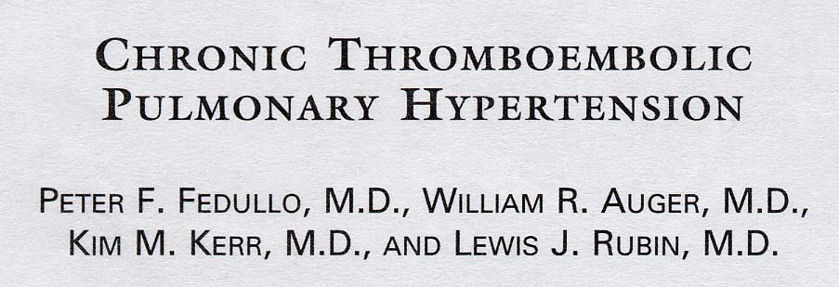
PULMONARY ENDARTERECTOMY: THE PAVIA EXPERIENCE
REFERENCE

Slide 32
PULMONARY ENDARTERECTOMY: THE PAVIA EXPERIENCE
OUR PROGRAM
National referral program
Begin: April 1994
To date: 620 PEAs performed

Slide 33
PULMONARY ENDARTERECTOMY: THE PAVIA EXPERIENCE
PATIENTS’ REFERRAL
18
2
182
15
30
80
FROM 4/1994 TO 4/2015
620 PEAs
27
29
50
7
10
6
42
4
29
26
12
3
Pts coming from outside Italy
Greece 1
Kosovo 1
Romania 2
- U.S.A. 1
- Uganda 1
≤ 20 pts
21 – 40 pts
14
≥ 41 pts
28

Slide 34
PULMONARY ENDARTERECTOMY: THE PAVIA EXPERIENCE
PATIENTS’ REFERRAL
7
0
10
10
10
4
2
FROM 2009 TO 2013 → 322 PEAs
PTS / 10⁶ POPULATION
8
7
1
3
4
4
6
3
3
3
≤ 3 pts / 10⁶
3
4 – 6 pts / 10⁶
3
≥ 7 pts / 10⁶
3
Update date population at 01/01/2014 (ISTAT)

Slide 35
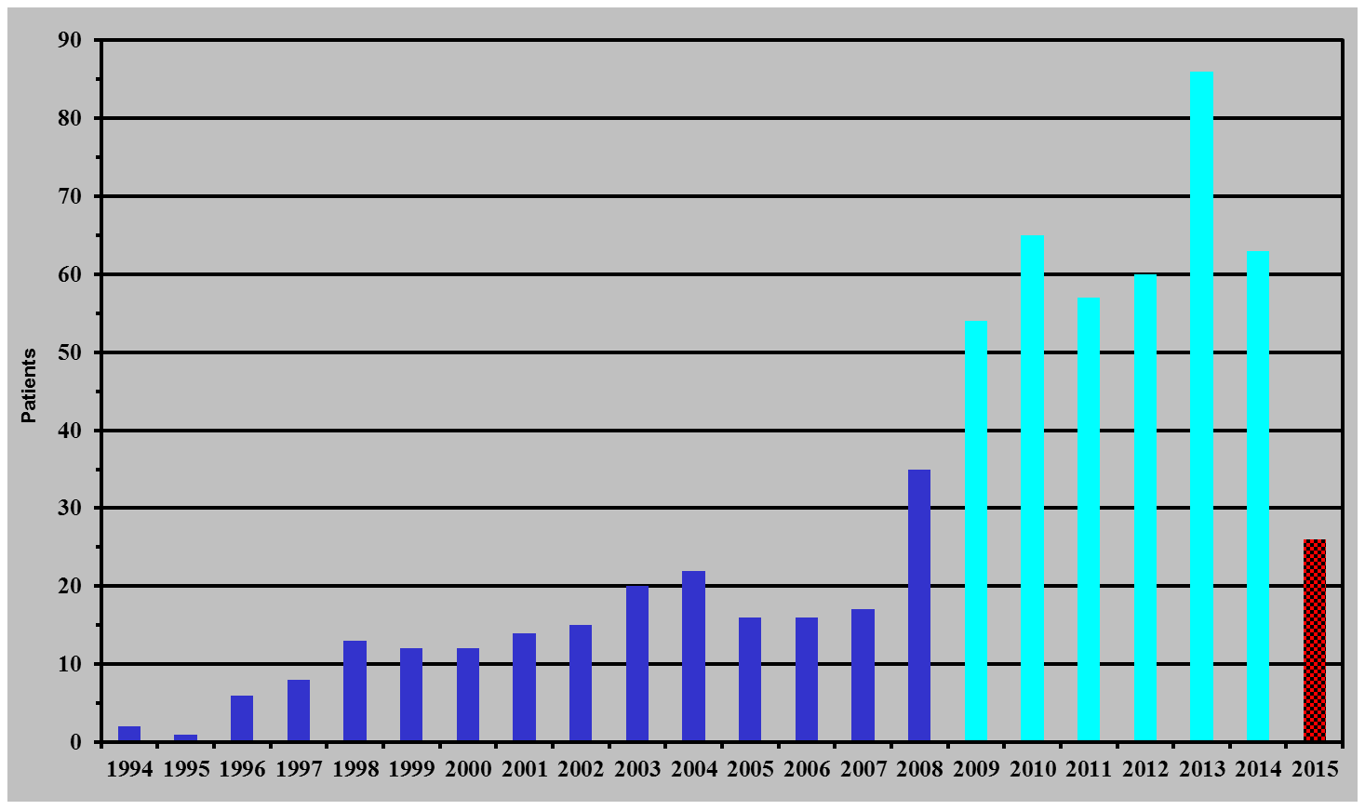
PULMONARY ENDARTERECTOMY: THE PAVIA EXPERIENCE
AMOUNT OF PATIENTS
620 PEAs
2009-2014 (6 yrs): 385 PEAs
1994-2008 (15 yrs): 209 PEAs

Slide 36
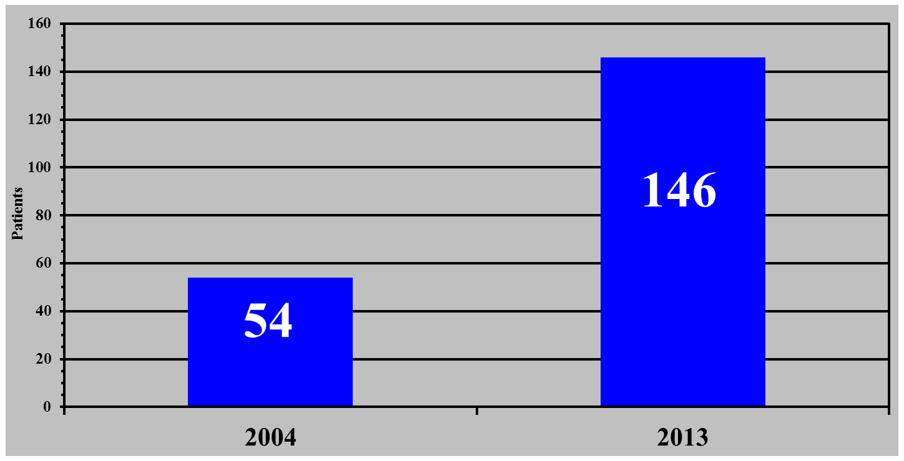
PULMONARY ENDARTERECTOMY: THE PAVIA EXPERIENCE
AMOUNT OF PATIENTS
NEW EVALUATIONS
+ 170%

Slide 37
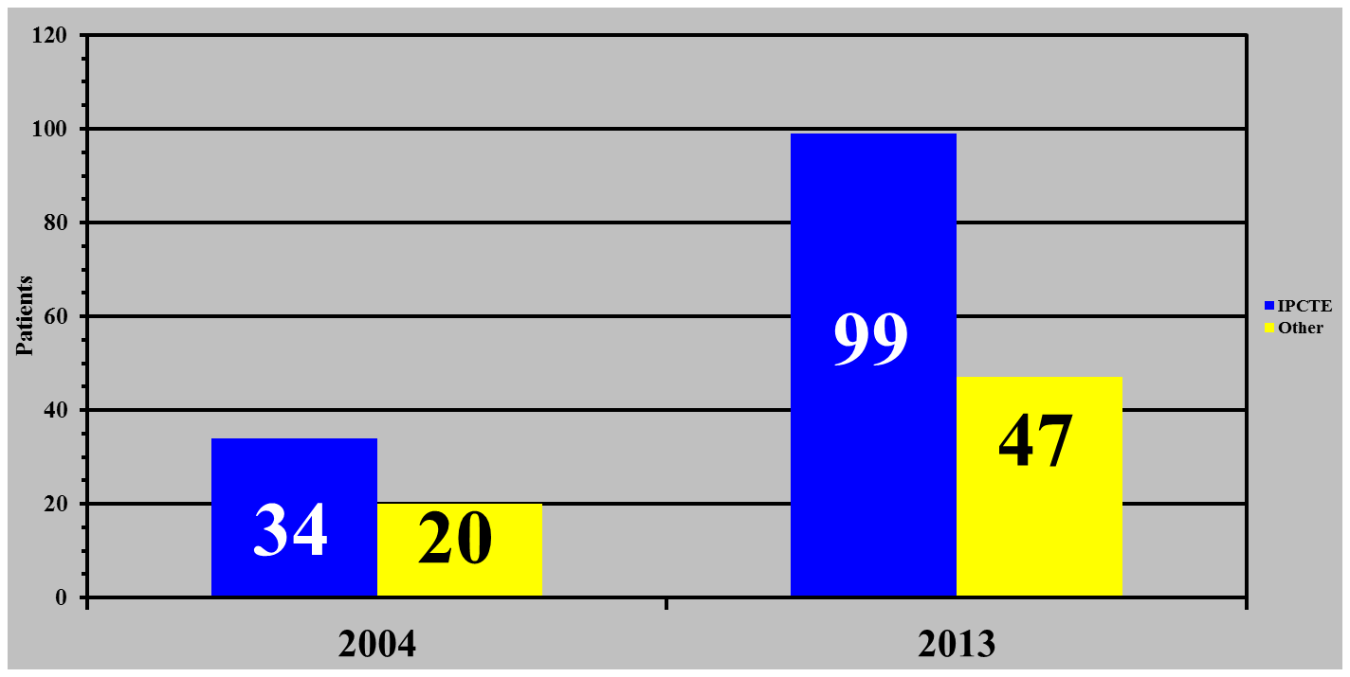
PULMONARY ENDARTERECTOMY: THE PAVIA EXPERIENCE
AMOUNT OF PATIENTS
DIAGNOSTIC ACCURACY
68%
+ 8%
63%

Slide 38
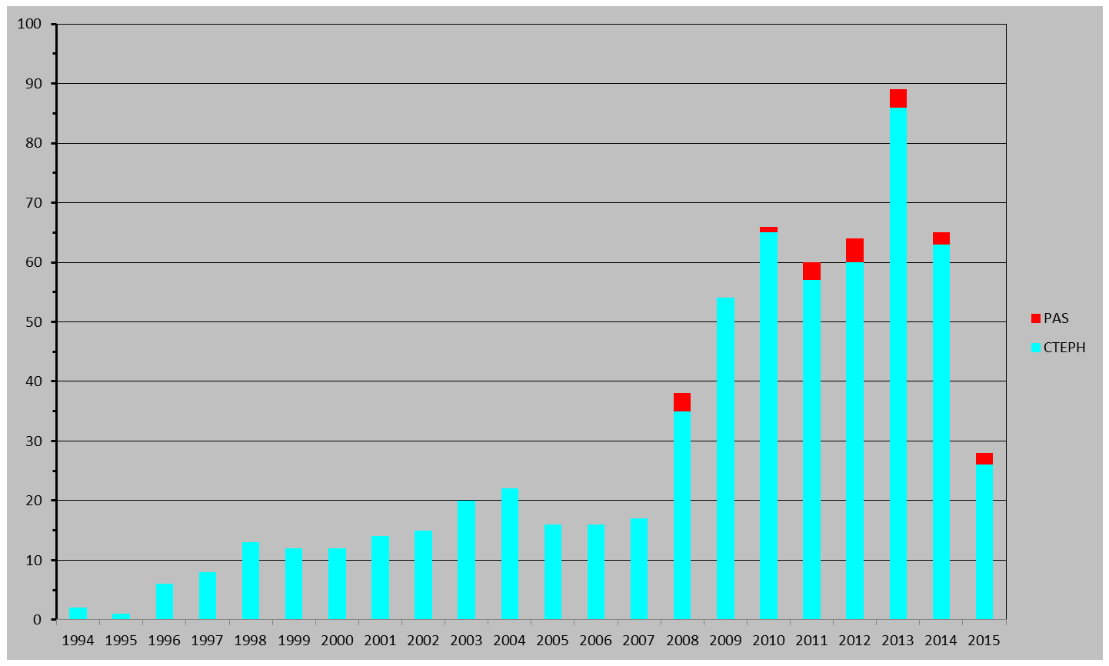
PULMONARY ENDARTERECTOMY: THE PAVIA EXPERIENCE
CTEPH & PAS PATIENTS
620 & 18 → 638 PEAs

Slide 39
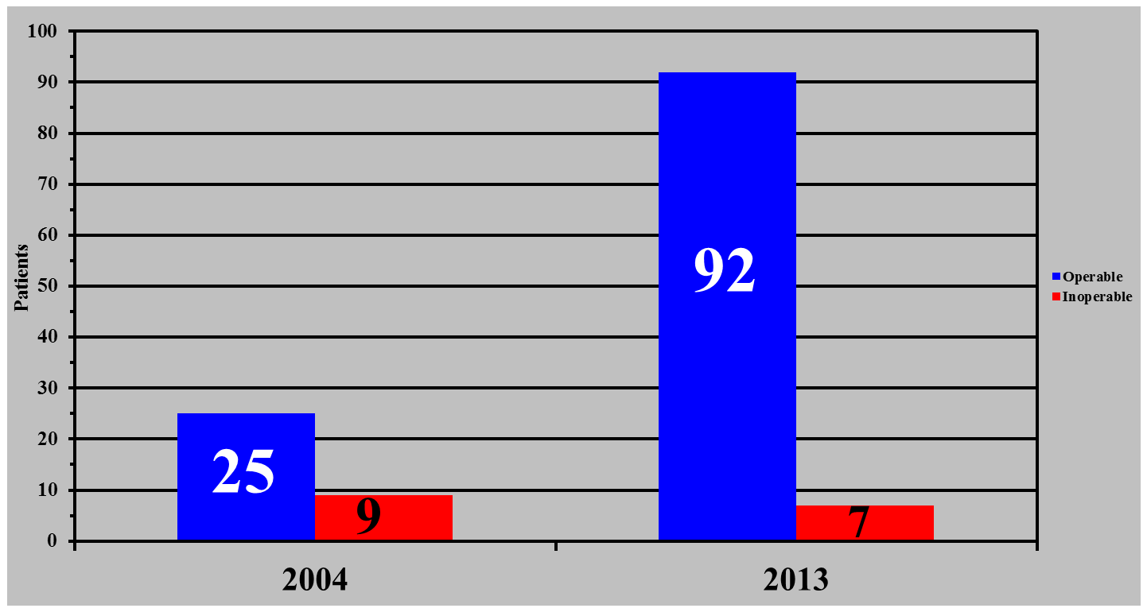
PULMONARY ENDARTERECTOMY: THE PAVIA EXPERIENCE
AMOUNT OF PATIENTS
OPERABILITY RATE
93%
+ 27%
74%

Slide 40
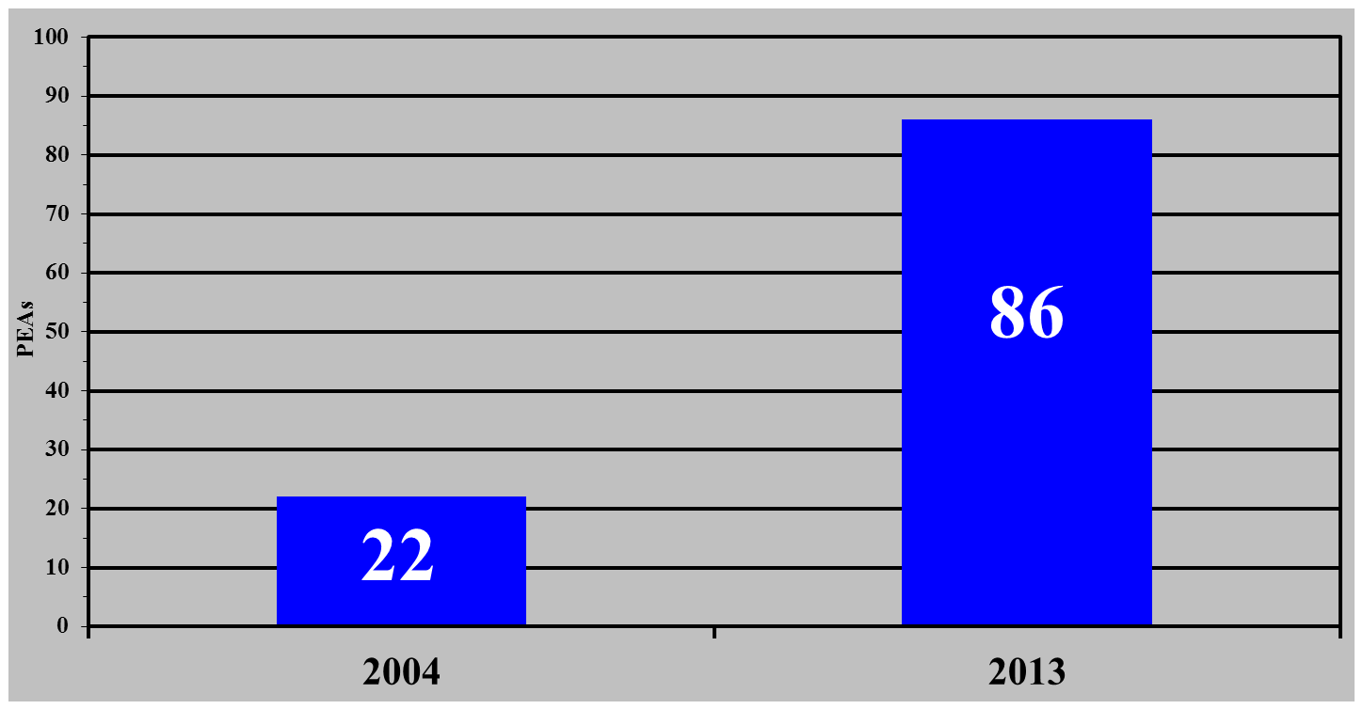
PULMONARY ENDARTERECTOMY: THE PAVIA EXPERIENCE
AMOUNT OF PATIENTS
PEAs PERFORMED
+ 291 %

Slide 41
PULMONARY ENDARTERECTOMY: THE PAVIA EXPERIENCE
PAVIA CTEPH PROGRAM
January, 1st - December, 31st 2004 → 130 pts
EVALUATION (54 pts) FOLLOW-UP (72 pts) DLTx (4 pts)
CONFIRMED (34 pts - 63%) OTHER DIAGNOSIS (20 pts - 37%)
PROXIMAL LESIONS (25 pts)
- 22 PEAs
- 2 pts refused
- 1 pt died on evaluation
RECENT EMBOLIZATION (3 pts)
- 2 medical therapy
- 1 surgical embolectomy
TUMORS (5 pts)
- 3 pulmonary angiosarcoma
- 1 adenocarcinoma with pulmonary artery thrombosis
- 1 intestinal tumor with liver metastases
OPERABILITY RATE 74 %
DISTAL LESIONS (7 pts)
- 5 DLTx waiting-list
- 2 medical therapy (too old for DLTx)
MISCELLANEOUS (12 pts)
ASSOCIATION WITH SEVERE EMPHYSEMA (2 pts)
- 2 DLTx waiting-list

Slide 42
PULMONARY ENDARTERECTOMY: THE PAVIA EXPERIENCE
PAVIA CTEPH PROGRAM
January, 1st – December, 31st 2013 → 358
New Evaluations (146 pts) Postop FUP (202 pts) Clinical Trials (8 pts) HLTx (2 pts)
CONFIRMED (99 pts - 71%) OTHER DIAGNOSIS (47 pts - 29%)
PROXIMAL LESIONS (92 pts)
- 86 PEAs
- 2 waiting for PEA
- 1 refused PEA
- 1 discrepancy between PH (high) and CTE lesions (few): medical therapy as bridge to PEA
- 2 died before arrival
RECENT ACUTE PUL EMB (19 pts)
- 18 medical therapy - 1 angiojet
PREVIOUS ACUTE PUL EMB WITHOUT SIGNS (3 pts)
- 3 medcal therapy
ACUTE OVER CHRONIC (1 pt)
- 1 3-month m.t.→new evaluation
MINIMAL CTE LESIONS WITHOUT/LOW PH (6 pts)
- 6 medical therapy
OPERABILITY RATE 93%
PULMONARY ARTERY MALIGNACY (4 pts)
- 3 PEAs - 1 medical therapy
DISTAL LESIONS (7 pts)
- 6 too old for DLTx
- 1 too early for DTx
MISCELLANEOUS (14 pts)
- 4 Eisenmenger
- 8 PPH
- 1 Portopulmonary hypertension
- 1 Mediastinal fibrosis

Slide 43
PULMONARY ENDARTERECTOMY: THE PAVIA EXPERIENCE
PAVIA CTEPH PROGRAM
January, 1st – April, 14th 2015 → 139
NewEvaluations (69 pts) Post-opFUP (68 pts) FUPno-PEA (1pt) ClinicalTrials (1 pt)
CONFIRMED (35 pts - 51%) OTHER DIAGNOSIS (34 pts - 49%)
PROXIMAL LESIONS (33 pts)
- 26 PEAs (6 pts evaluated in 2014)
- 5 waiting for PEA
- 3 refused evaluation for PEA
- 3 with severe co-morbidities
- 2 died before evaluation or before PEA
RECENT ACUTE PUL EMB (11 pts)
- 11 medical therapy
PREVIOUS ACUTE PUL EMB WITHOUT SIGNS (5 pts)
- 5 medcal therapy
ACUTE OVER CHRONIC (2 pts)
- 2 3-month m.t.→new evaluation
MINIMAL CTE LESIONS WITHOUT/LOW PH (6 pts)
- 6 medical therapy
OPERABILITY RATE 94%
PULMONARY ARTERY MALIGNACY (6 pts)
- 2 PEAs - 2 inoperable - 2 died before evaluation or before PEA
PULMONARY ARTERY ANEURYSM (1 pt)
- 1 medical therapy
DISTAL LESIONS (2 pts)
- 1 DLTx waiting-list
- 1 controindication for DLTx
MISCELLANEOUS (3 pts)
- 1 PAH
- 2 Talassemia&splenectomy

Slide 44
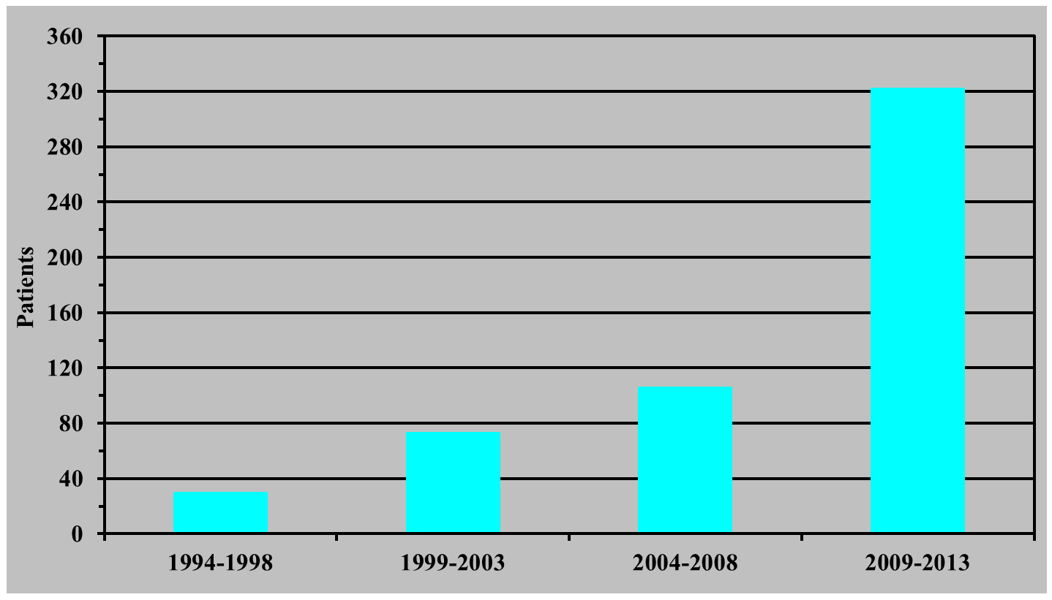
PULMONARY ENDARTERECTOMY: THE PAVIA EXPERIENCE
AMOUNT OF PATIENTS
531 PEAs
≅ 65 PEAs / yr
≅ 20 PEAs / yr
≅ 15 PEAs / yr
≅ 5 PEAs / yr

Slide 45
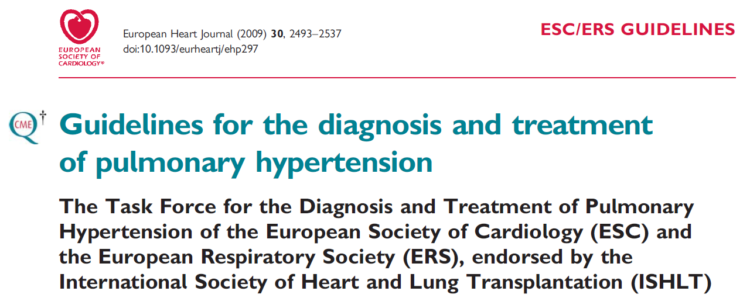
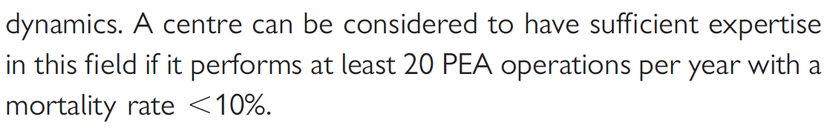
PULMONARY ENDARTERECTOMY: THE PAVIA EXPERIENCE
PEA EXPERT CENTER

Slide 46
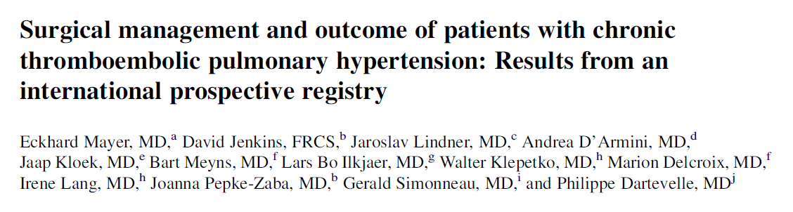
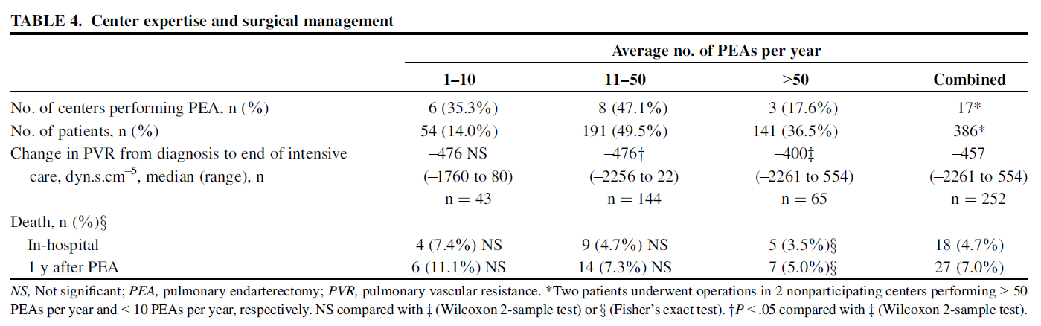
PULMONARY ENDARTERECTOMY: THE PAVIA EXPERIENCE
PEA EXPERT CENTER

Slide 47
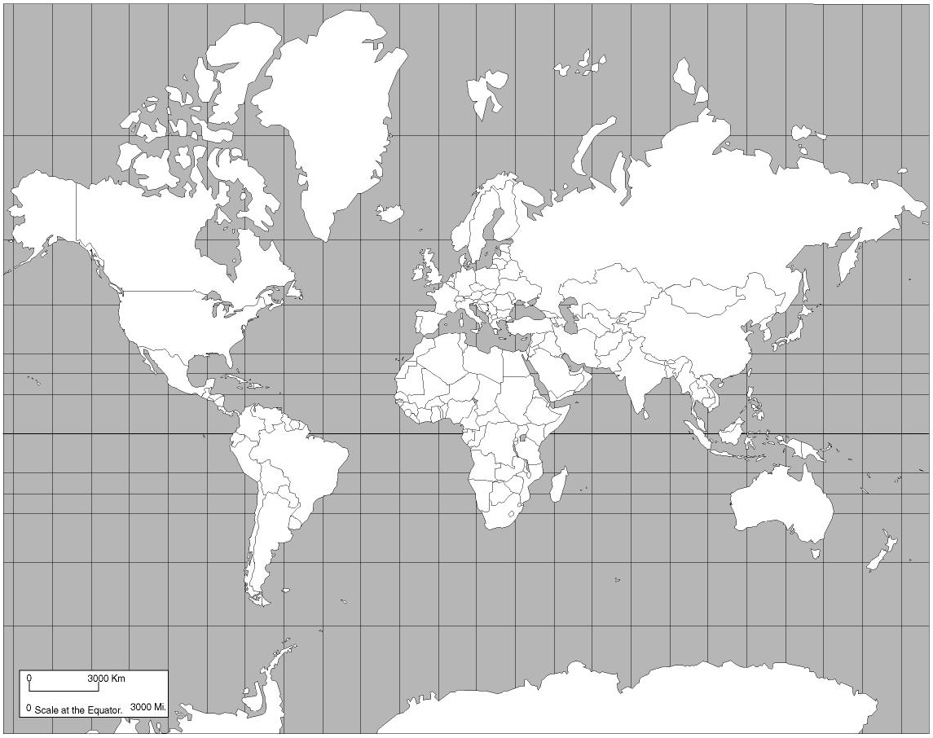
PULMONARY ENDARTERECTOMY: THE PAVIA EXPERIENCE
MAIN WORLD PEA CENTERS
Cambridge, UK
≈150 PEAs / year
NATIONAL REFERRAL PROGRAM BY LAW
Bad Nauheim, Germany
≈80 PEAs / year
MORE THAN ONE PROGRAM
San Diego, California, USA
≈160 PEAs / year
NATIONAL REFERRAL PROGRAM FOR EXCELLENCE
Pavia, Italy
≈80 PEAs / year
MORE THAN ONE PROGRAM
Paris, France
≈120 PEAs / year
NATIONAL REFERRAL PROGRAM FOR EXCELLENCE

Slide 48
PULMONARY ENDARTERECTOMY: THE PAVIA EXPERIENCE
PEA POPULATION
OF 620 PEAs

Slide 49
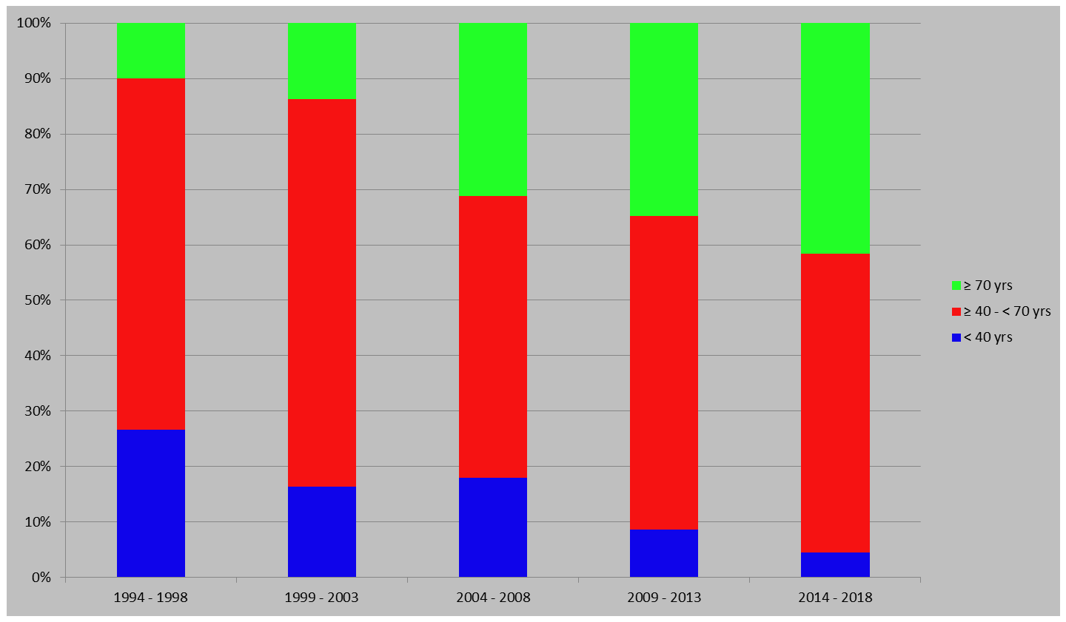
PULMONARY ENDARTERECTOMY: THE PAVIA EXPERIENCE
AGE
OF 620 PEAs

Slide 50
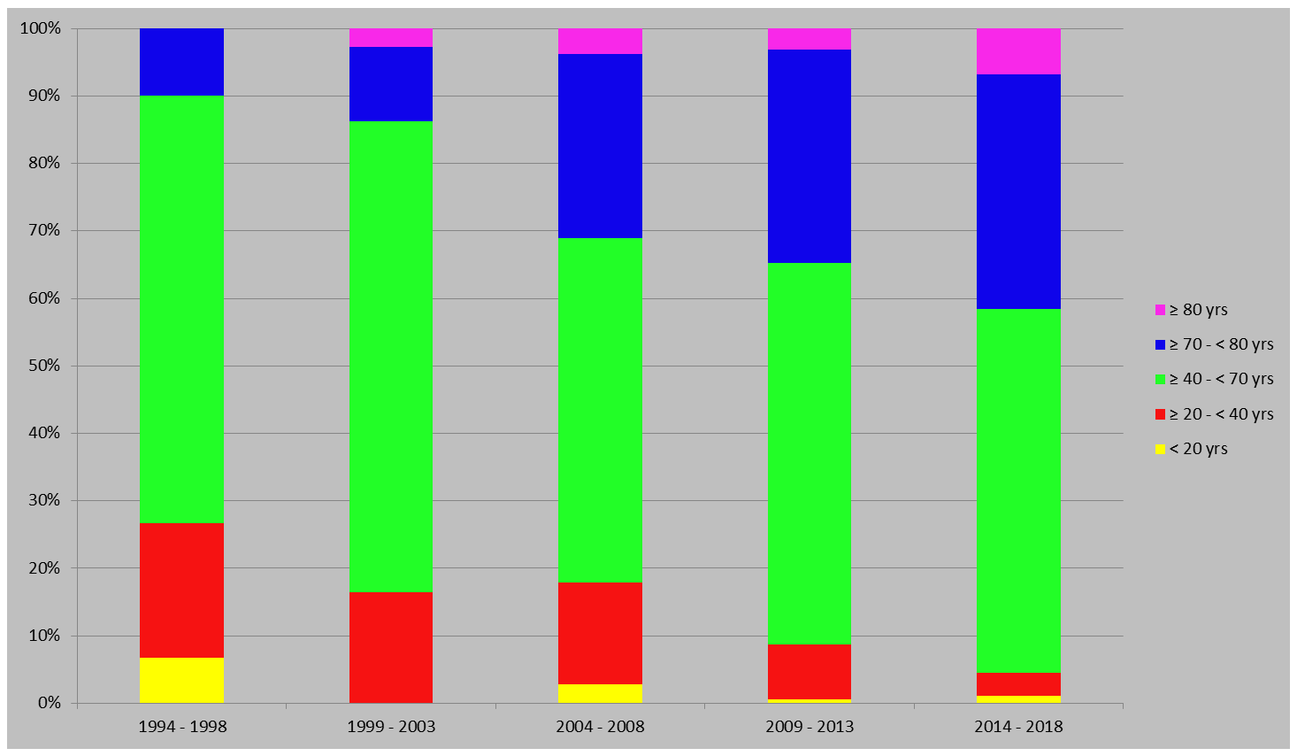
PULMONARY ENDARTERECTOMY: THE PAVIA EXPERIENCE
AGE
OF 620 PEAs

Slide 51
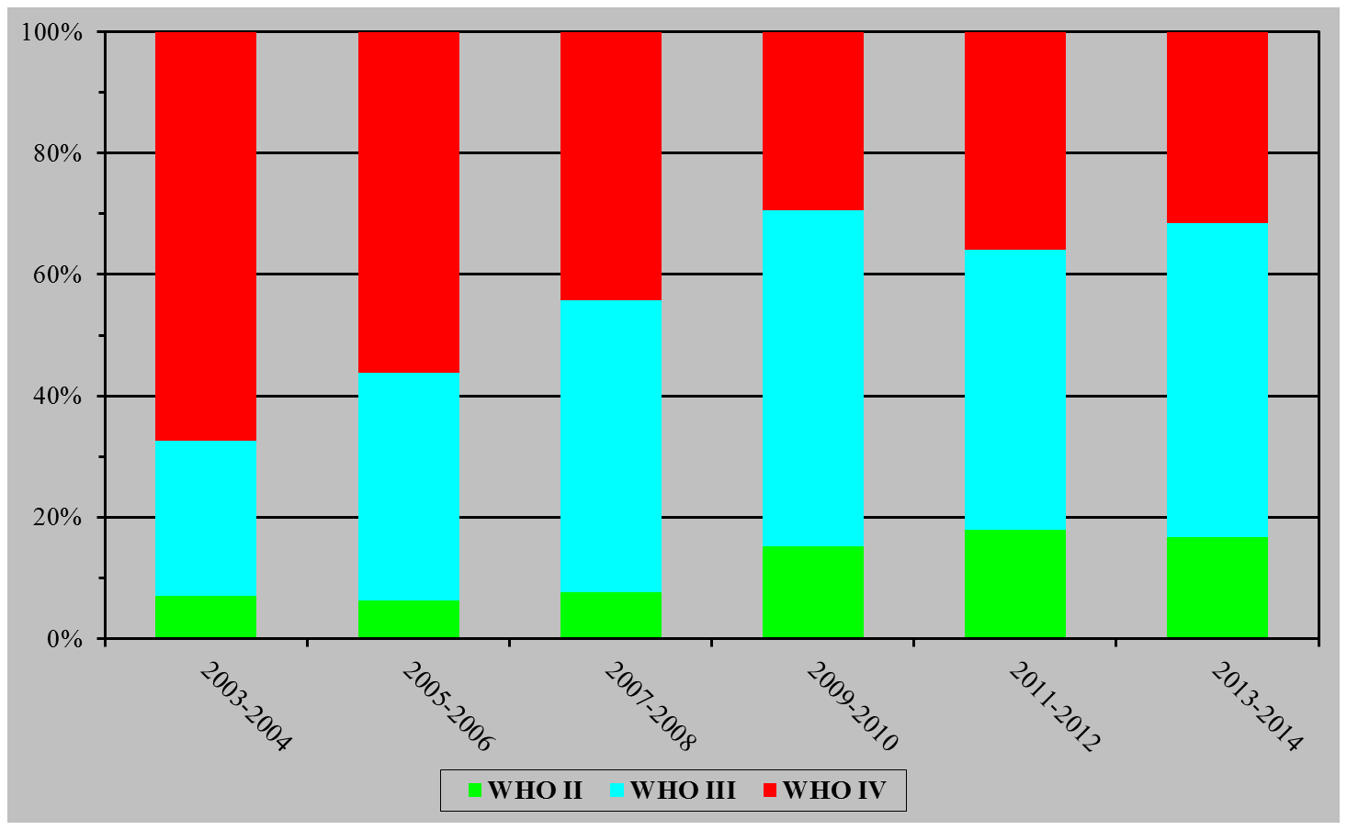
WHO CLASS DISTRIBUTION

Slide 52
PULMONARY ENDARTERECTOMY: THE PAVIA EXPERIENCE
ARTERIAL BLOOD GASES
OF 620 PEAs

Slide 53
PULMONARY ENDARTERECTOMY: THE PAVIA EXPERIENCE
MODIFIED BRUCE TEST
OF 620 PEAs

Slide 54
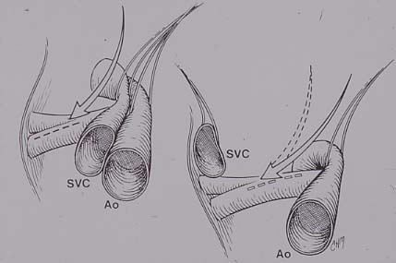
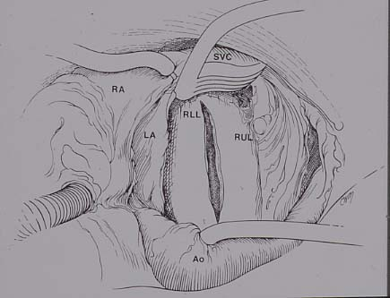
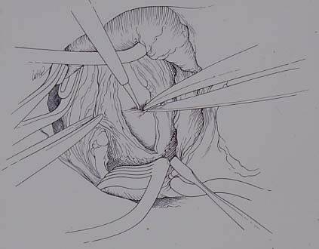
PULMONARY ENDARTERECTOMY: THE PAVIA EXPERIENCE
PULMONARY ENDARTERECTOMY
Median sternotomy
Cardio Pulmonary Bypass
Moderate hypotermia (24 °C)
Circulatory arrest (7 min)
Reperfusion period (5 min)
Bilateral
J Thorac Cardiovasc Surg 1993;106:116-27

Slide 55

PULMONARY ENDARTERECTOMY: THE PAVIA EXPERIENCE
PULMONARY ENDARTERECTOMY

Slide 56
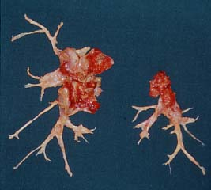
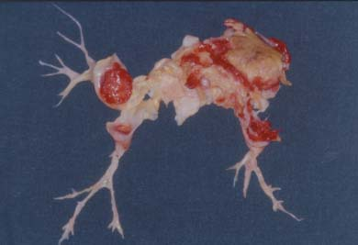
PULMONARY ENDARTERECTOMY: THE PAVIA EXPERIENCE
TYPICAL SURGICAL SPECIMENS
E.L. – 38 yrs M – Dec 1999 – PEA #42
mPAP 43 → 20 (-53%)
CO 3.3 → 6.9 (+109%)
PVR 994 → 220 (-78%)
P.A. – 66 yrs M – Jun 2001 – PEA #60
mPAP 50 → 25 (-50%)
CO 2.6 → 4.4 (+69%)
PVR 1385 → 364 (-74%)

Slide 57
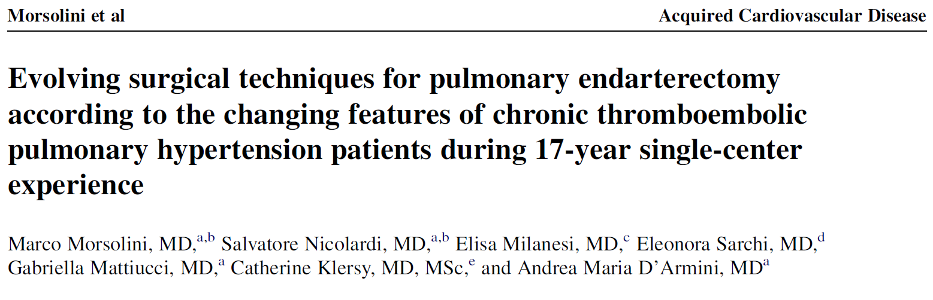
PULMONARY ENDARTERECTOMY: THE PAVIA EXPERIENCE
CPB MANAGEMENT

Slide 58
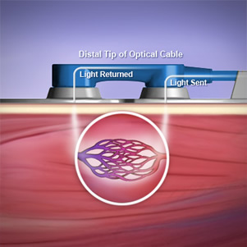

PULMONARY ENDARTERECTOMY: THE PAVIA EXPERIENCE
CEREBRAL PROTECTION STRATEGY
NIRS MONITORING
Near-InfraRed Spectroscopy
Clinical application

Slide 59
PULMONARY ENDARTERECTOMY: THE PAVIA EXPERIENCE
CEREBRAL PROTECTION STRATEGY
NIRS MONITORING
Near-InfraRed Spectroscopy
CPB start
Patient’s cooling
Pre-HCA baseline
HCA maximum drop
Reperfusion
Changing PEA side
End of PEA
Right channel
Left channel

Slide 60
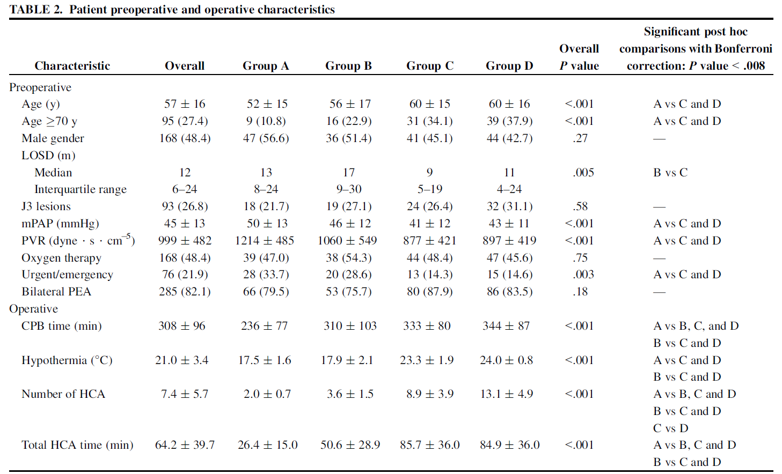
PULMONARY ENDARTERECTOMY: THE PAVIA EXPERIENCE
CPB MANAGEMENT

Slide 61
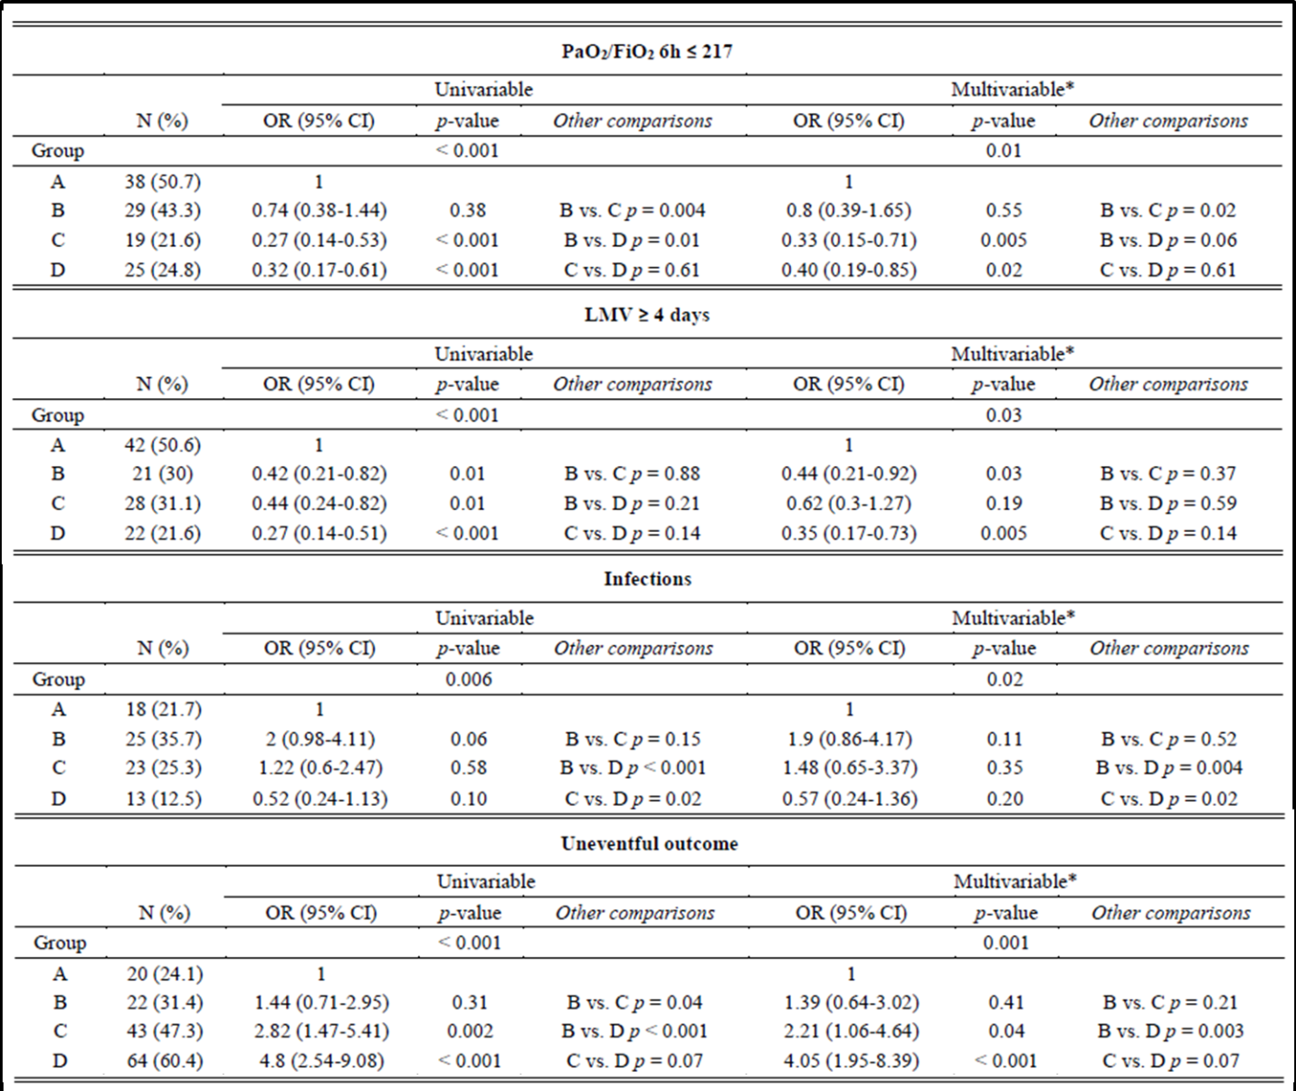
EVOLVING SURGICAL TECHNIQUE
Multivariable outcome analysis (adjusted for the potential predictors of outcome):
  a better postoperative respiratory function (PaO2/FiO2 6h)
  a reduction in length of mechanical ventilation (LMV)
  a reduction in the incidence of postoperative infections (mainly VAP)
  a remarkable improvement of uneventful postoperative outcome

Slide 62

EVOLVING SURGICAL TECHNIQUE
Multivariable outcome analysis (adjusted for the potential predictors of outcome):
  despite increased total HCA time and moderate hypothermia, a trend towards a reduction of transient neurological events (TNE) was observed

Slide 63
PULMONARY ENDARTERECTOMY: THE PAVIA EXPERIENCE
LEARNING CURVE
DISTAL LESIONS
JAMIESON TYPE III

Slide 64
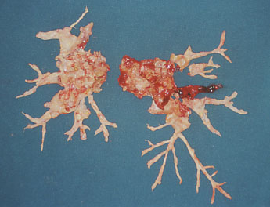

PULMONARY ENDARTERECTOMY: THE PAVIA EXPERIENCE
JAMIESON TYPE I vs. TYPE II vs. TYPE III
L.M.E.L. - 65 yrs M - Oct 2004 - PEA #119
mPAP 39 → 19 (-51%)
CO 4.4 → 5.4 (+23%)
PVR 665 → 222 (-66%)
G.A.C. - 52 yrs F - Jul 2003 - PEA #96
mPAP 48 → 27 (-44%)
CO 2.1 → 4.2 (+100%)
PVR 1638 → 381 (-77%)
B.A. - 43 yrs F - May 2009 - PEA #233
mPAP 49 → 19 (-61%)
CO 3.3 → 5.0 (+52%)
PVR 1067 → 224 (-79%)

Slide 65

PULMONARY ENDARTERECTOMY: THE PAVIA EXPERIENCE
JAMIESON TYPE III

Slide 66
DISTAL LESIONS
CURRENTLY OPERABLE

Slide 67


Slide 68


Slide 69


Slide 70


Slide 71
ADVANCED
SURGICAL TECHNIQUE
TECHNICALLY INOPERABLE
FOR DISTAL LESIONS?

Slide 72


SURGICAL INSTRUMENTS
Derived from minimally-invasive cardiac surgery

Slide 73

TRICKS AND TIPS
The correct arterial dissection plane
Yellow-fibro-lipid plaques included into the removed cast

Slide 74

TRICKS AND TIPS
The correct arterial dissection plane
Yellow-fibro-lipid plaques included into the removed cast

Slide 75


TRICKS AND TIPS
Proximal dissection for the clearance of distal obstructions

Slide 76


TRICKS AND TIPS
Proximal dissection for the clearance of distal obstructions
900 μm
350 μm
12 μm
Yellow fiber-lipid plaque

Slide 77

TRICKS AND TIPS
Proximal dissection for the clearance of distal obstructions
2-4 layers of elastic lamellae from the tunica media
Foam cells

Slide 78



TRICKS AND TIPS
Proximal dissection for the clearance of distal obstructions
Sample

Slide 79
EVOLVING SURGICAL TECHNIQUE
DHCA 59 min
DHCA 81 min
MHCA 135 min
L.M.E.L. – 65-yo M
mPAP 39 → 19 (-51%)
CO 4.4 → 5.4 (+23%)
PVR 665 → 222 (-66%)
G.A.C. – 52-yo F
mPAP 48 → 27 (-44%)
CO 2.1 → 4.2 (+100%)
PVR 1638 → 381 (-77%)
B.A. – 43-yo F
mPAP 49 → 19 (-61%)
CO 3.3 → 5.0 (+52%)
PVR 1067 → 224 (-79%)
INCREASED OPERABILITY RATE

Slide 80
PULMONARY ENDARTERECTOMY: THE PAVIA EXPERIENCE
CUMULATIVE PROPORTION SURVIVING
OF 620 PEAs
296
238
182
140
119
103
88
68
50
42
32
31
24
18
9
3
3
2
90.0%
88.3%
87.1%
86.4%
84.8%
83.0%
81.1%
79.5%
77.6%
74.7%
Hospital mortality
Global 51/620 (8.2%)
WHO II 0/81 (0.0%)
WHO III 17/293 (5.8%)
WHO IV 34/246 (13.8%)
Apr 94 – Dec 08 15 yrs 22/209 (10.5%)
Jan 09 – Dec 13 5 yrs 24/322 (7.5%)
Jan 14 – Apr 15 2 yrs 5/89 (5.6%)

Slide 81
PULMONARY ENDARTERECTOMY: THE PAVIA EXPERIENCE
FOLLOW-UP
In literature few data are reported on mid- and long- term cardiopulmonary function, particularly on exertion, and on clinical outcomes after PEA

Slide 82
PULMONARY ENDARTERECTOMY: THE PAVIA EXPERIENCE
FOLLOW-UP TIMING
All pts underwent follow-up evaluation at:
  discharge (at this interval NYHA class, lung function, and exercise tolerance are excluded because pts are to close to the surgical procedure)
  3th month
  yearly for 5 years
  7th, 10th, 15th and 20th year (11 controls)

Slide 83

PULMONARY ENDARTERECTOMY: THE PAVIA EXPERIENCE
WHO FUNCTIONAL CLASS
p < 0.01

Slide 84

PULMONARY ENDARTERECTOMY: THE PAVIA EXPERIENCE
mean PULMONARY ARTERY PRESSURE
p < 0.01

Slide 85

PULMONARY ENDARTERECTOMY: THE PAVIA EXPERIENCE
PULMONARY VASCULAR RESISTANCES
p < 0.01

Slide 86




PULMONARY ENDARTERECTOMY: THE PAVIA EXPERIENCE
ECHOCARDIOGRAPHY
Before PEA

Slide 87




PULMONARY ENDARTERECTOMY: THE PAVIA EXPERIENCE
ECHOCARDOGRAPHY
First echo after PEA – POD #9

Slide 88




PULMONARY ENDARTERECTOMY: THE PAVIA EXPERIENCE
ECHOCARDIOGRAPHY
3-months FUP after PEA

Slide 89

PULMONARY ENDARTERECTOMY: THE PAVIA EXPERIENCE
ARTERIAL OXYGEN PARTIAL PRESSURE
p < 0.01

Slide 90

PULMONARY ENDARTERECTOMY: THE PAVIA EXPERIENCE
MODIFIED BRUCE TEST
p < 0.01

Slide 91
PULMONARY ENDARTERECTOMY: THE PAVIA EXPERIENCE
EXTENSION OF
SURGICAL CRITERIA
PULMONARY ENDARTERECTOMY
IN WHO FUNCTIONAL CLASS II

Slide 92
PEA IN WHO CLASS II PATIENTS
TOO EARLY
FOR CARDIAC SURGERY?

Slide 93

PULMONARY ENDARTERECTOMY: THE PAVIA EXPERIENCE
PATHOPHYSIOLOGY

Slide 94
PULMONARY ENDARTERECTOMY: THE PAVIA EXPERIENCE
PATHOPHYSIOLOGY
ACCORDING TO THE LENGTH OF THE DISEASE
Hypertensive remodeling of the patent arteries
Chronic arteriopathy of the obstructed branches
Plexiform lesions
Development of pathological arterial shunts
In situ thrombosis

Slide 95
PULMONARY ENDARTERECTOMY: THE PAVIA EXPERIENCE
PATHOPHYSIOLOGY
ACCORDING TO THE LENGTH OF THE DISEASE
Hypertensive remodeling of the patent pulmonary vascular bed (Eisenmenger-like) due to volume and pressure overload

Slide 96
PULMONARY ENDARTERECTOMY: THE PAVIA EXPERIENCE
PATHOPHYSIOLOGY
ACCORDING TO THE LENGTH OF THE DISEASE
Chronic arteriopathy of the obstructed branches with calcifications and possible retraction of the distal vessels

Slide 97

PULMONARY ENDARTERECTOMY: THE PAVIA EXPERIENCE
PATHOPHYSIOLOGY
ACCORDING TO THE LENGTH OF THE DISEASE
Plexiform lesions stemming from the capillary bed

Slide 98



PULMONARY ENDARTERECTOMY: THE PAVIA EXPERIENCE
PATHOPHYSIOLOGY
ACCORDING TO THE LENGTH OF THE DISEASE
Coronary-bronchial arteries connections

Slide 99
PEA IN WHO CLASS II PATIENTS
EARLY DIAGNOSIS
EARLY TREATMENT

Slide 100

WHO CLASS DISTRIBUTION

Slide 101
PULMONARY ENDARTERECTOMY: THE PAVIA EXPERIENCE
BENEFiT STUDY

Slide 102


Slide 103

CHEST STUDY

