Slide 1
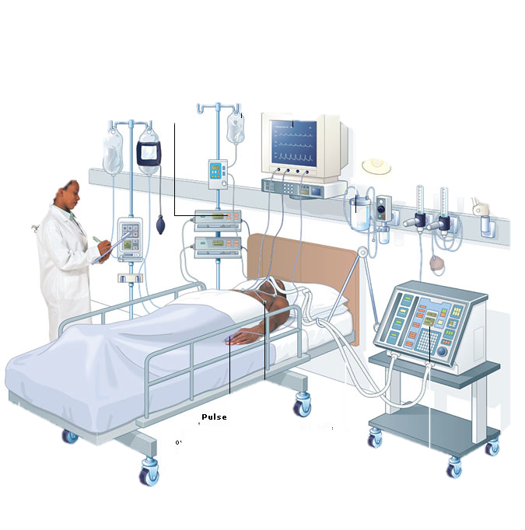
How To Evaluate And Monitor Patients in the
Intensive Care Unit
G. Umberto Meduri, M.D.
Memphis VA Medical Center

Slide 2
Initial approach – 3 Questions
ICU translation
Plain English
Age and Comorbidities
Admission Diagnosis
Organ Dysfunction
Who is this patient?
What happened?
What are the consequences?

Slide 3
Severity of Illness - at ICU entry APACHE IV score
Age and Comorbidities
Admission Diagnosis
Organ Dysfunction
Heart | Heart rate, Blood Pressure*
Lung | RR, pH, PaO₂*, A-aDO₂
Kidney | Cr*, BUN, urine output*, sNa
Liver | Bilirubin*, Albumin, Glucose
Brain | Glasgow Coma Score*
Heme | Hematocrit %
APACHE IV score
* Values also used in the SOFA score

Slide 4
Comorbidities - Communication
Present each organ systems in order:
  Predisposing disease(s) [risk factors]
  Main disease (disease specifics)
Cardiovascular: (a) HTN, DM, Dyslipidemia ➔ (b) ASCVD: CAD, PVD, CVA
Hepatic: ETOH abuse or Hep C ➔ Cirrhosis

Slide 5
Comorbidities - Communication
Disease: specify severity [± duration]
CAD: s/p AMI [1998-inferior], CABG [2003 x 3 vessels], CHF [EF 25%]
Cirrhosis: portal HTN, ascites, Pugh class ..
COPD: stage X (FEV1%), O₂ requirements, ..

Slide 6
Comorbidities – Impact on outcome
Higher number of comorbidities
  Increased risk of death
Specific comorbidities – in the presence of ⬆ stress ➔ ⬆ risk for certain complications
  ASCVD: ACS, SCD, arrhythmias, CVA, etc.
  Cirrhosis: bleeding and infections, etc.

Slide 7
Pathophysiology of
Critical Illness

Slide 8
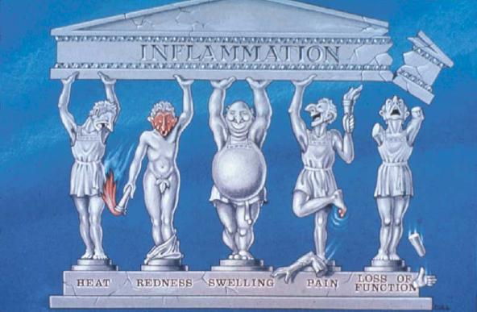
Inflammation
Inflammation: in = in + flama = flame
Localized protective response characterized by
Nature Reviews Immunology 2, 787-795 (October 2002)

Slide 9
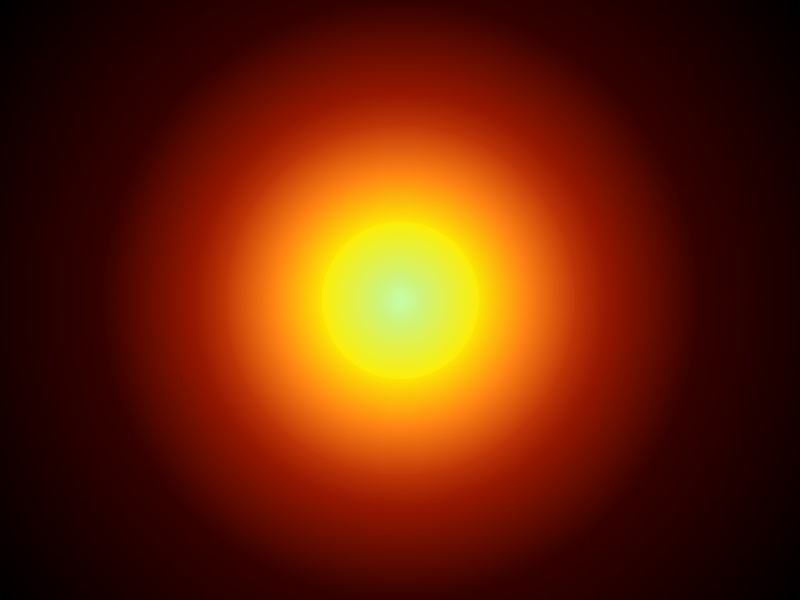
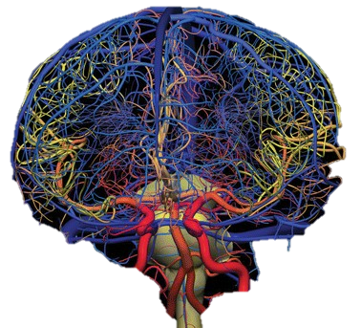
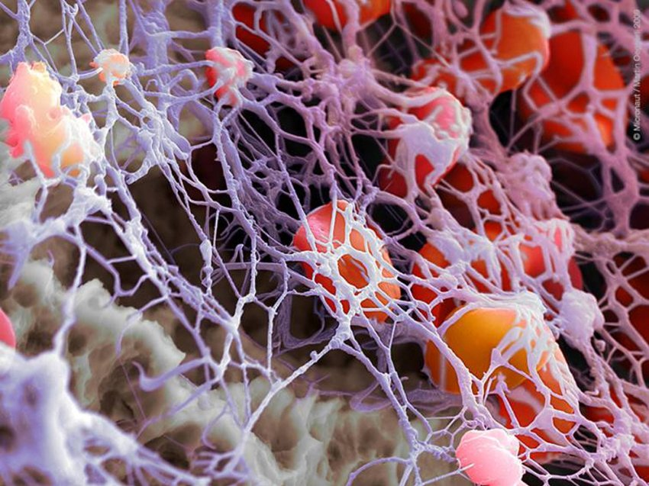
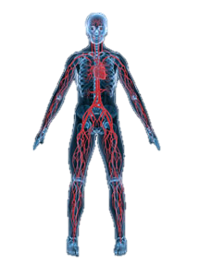
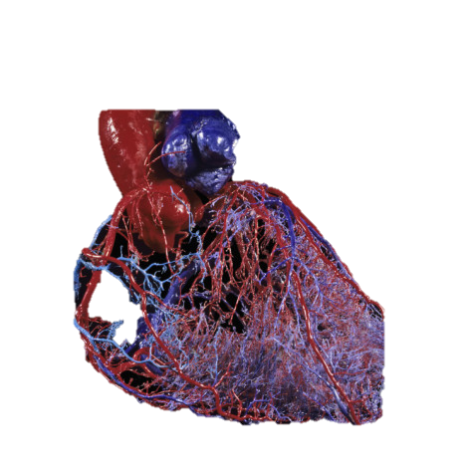
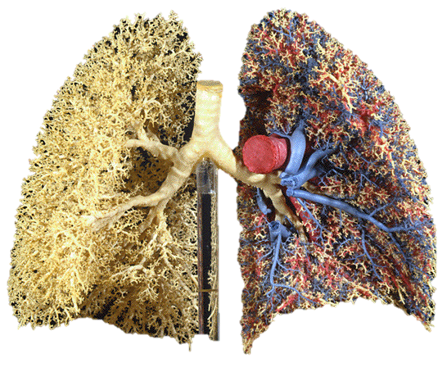
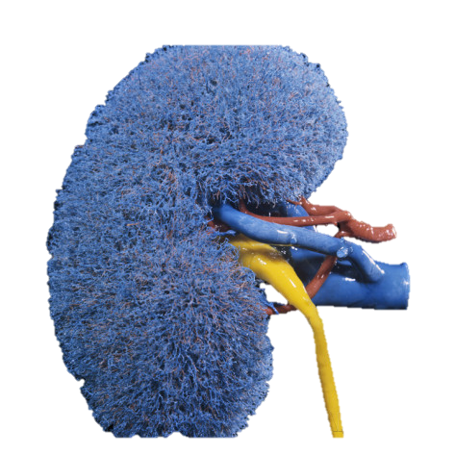
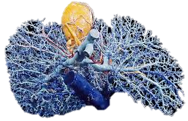
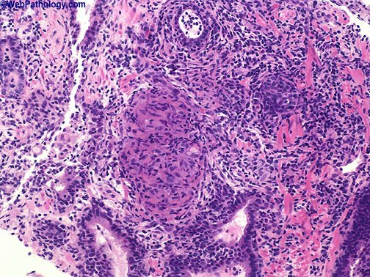
Systemic Inflammation - Overview
The inflammatory reaction is a central component of the host response to insults:
  infectious
  non-infectious
TNF-α, IL-1β, and IL-6
Tissue Inflammation
Systemic Inflammation
Multiple Organ Dysfunction
* reaction of vascularized living tissue to inflammatory mediators

Slide 10

Systemic Inflammation–3 Responses
Stress Response
Acute Phase Response
Tissue Defense Response
TNF-α, IL-1β, and IL-6
Multiple Organ Dysfunction

Slide 11
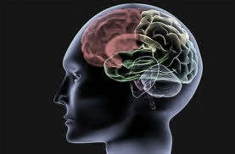
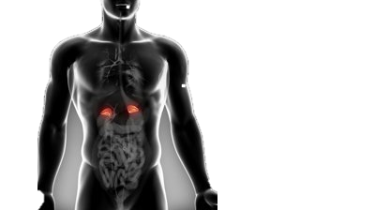
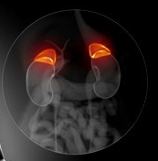
Stress Response
Hypothalamus
CRH and Vasopressin
Locus Ceruleus [BS]
Norepinephrine
Pituitary
ACTH
TNF-α, IL-1β, and IL-6
Adrenal Glands
Cortex: Cortisol
  Medulla:
    Norepinephrine
    Epinephrine

Slide 12
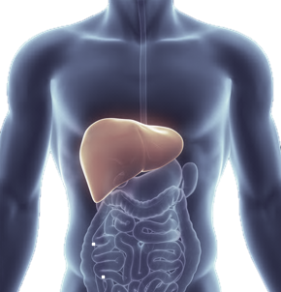
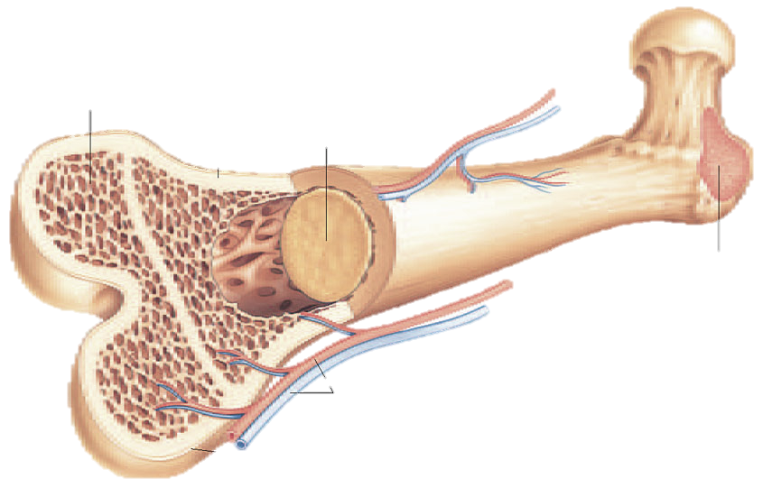
Acute Phase Response
[Prostaglandin] ➔ Fever
⬇⬇ | Albumin
⬆ Acute Phase Proteins | C-reactive protein (CRP) Serum amyloid Fibrinogen, Prothrombin, Factor VIII, von Willebrand f. Plasminogen Alpha 2-macroglobulin Mannose binding protein Complement components Ferritin, Ceruloplasmin
TNF-α, IL-1β, and IL-6
Leukocytosis

Slide 13
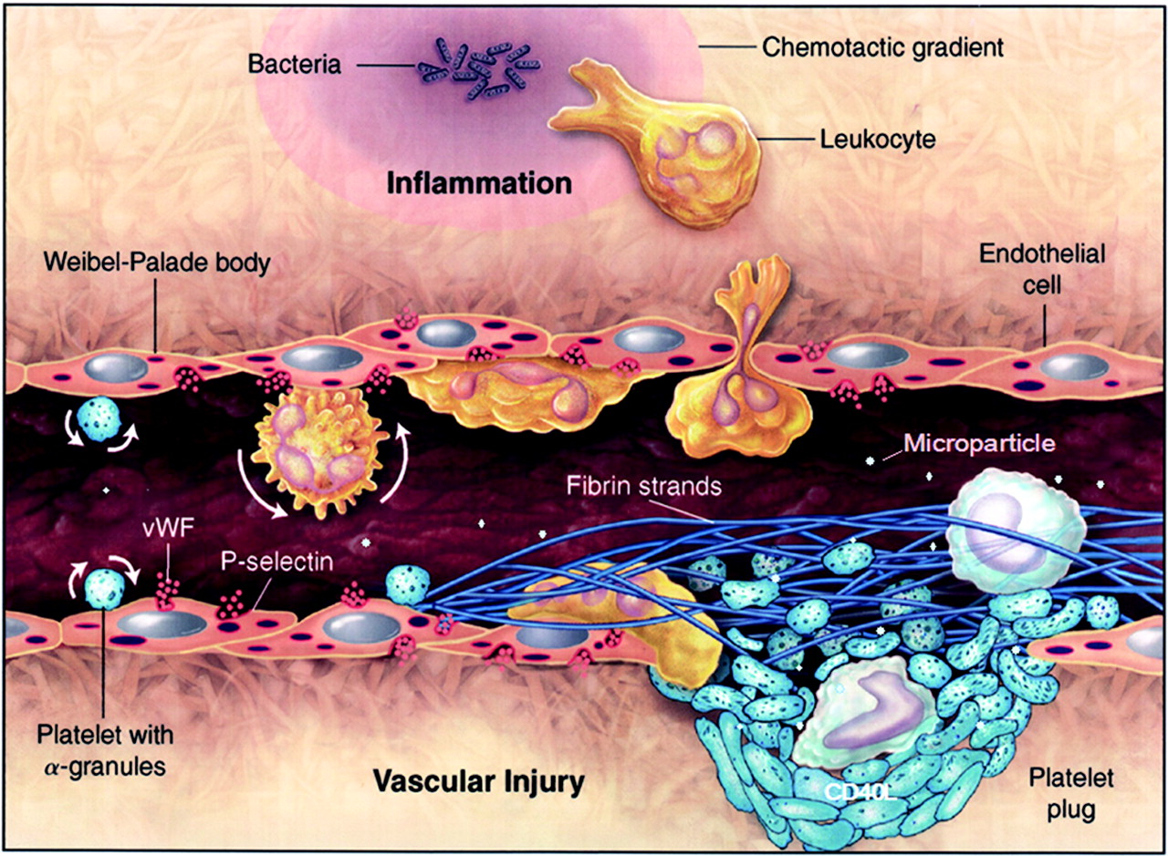
Tissue Defense Response - Vascular
Neutrophil
  activation
  adhesion
  diapedesis
Endothelial cell
  permeability
  cell injury [gaps]
Intravascular changes
  fibrin deposition
  platelet plug - clotting
  reduced No. perfused capillaries
Wagner D D Arterioscler Thromb Vasc Biol. 2005;25:1321-1324

Slide 14
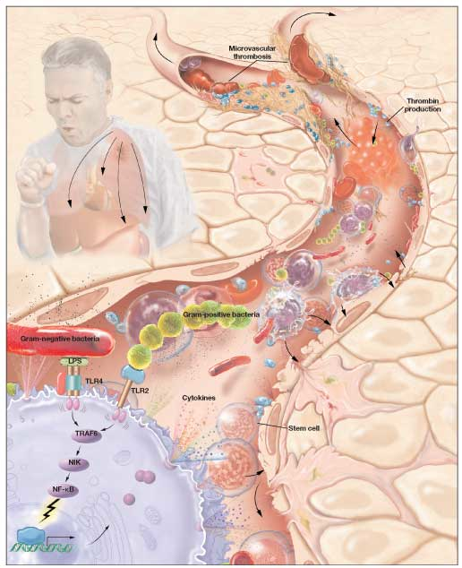
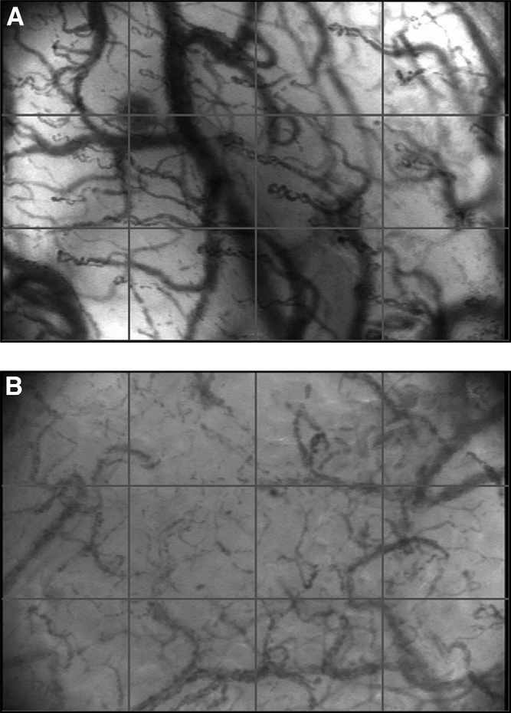
TDR: Capillary Density
High capillary density
Low capillary density
Sidestream Dark-Field Images of Sublingual Microcirculation in a Healthy Volunteer and a Patient with Septic Shock.

Slide 15
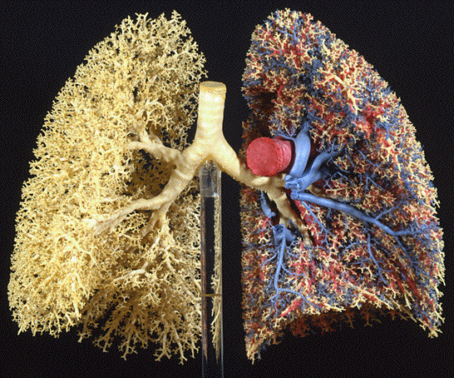
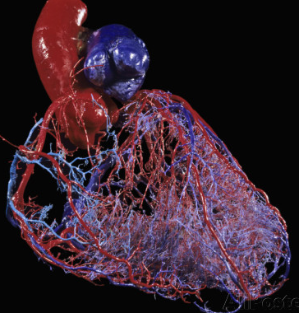
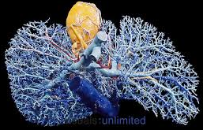
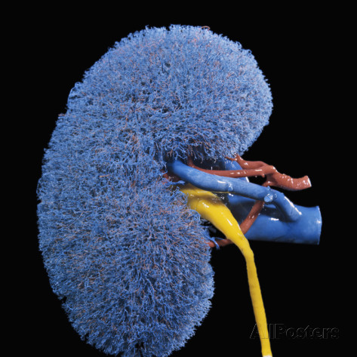
TDR: Organ Dysfunction
Low capillary density
PaO₂:FiO₂
Platelet count
Bilirubin
Blood pressure
Vasopressor dose
Glasgow Coma Score
Creatinine
Urinary output
lungs
Heart
Hematopoietic
Brain
Liver
kidney

Slide 16
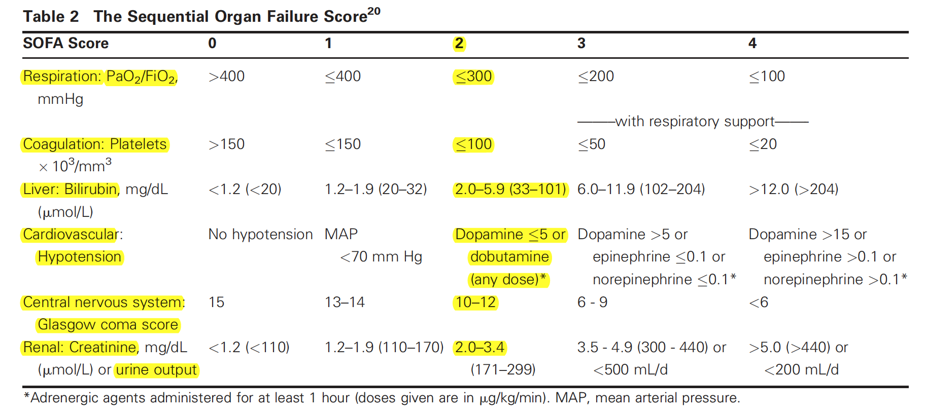
TDR: Organ Dysfunction-SOFA Score
TNF-α, IL-1β, and IL-6

Slide 17
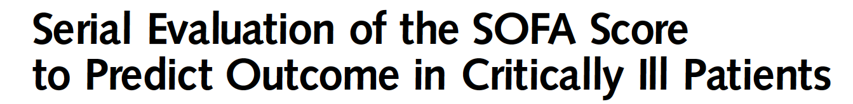
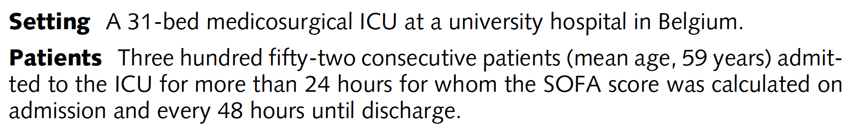
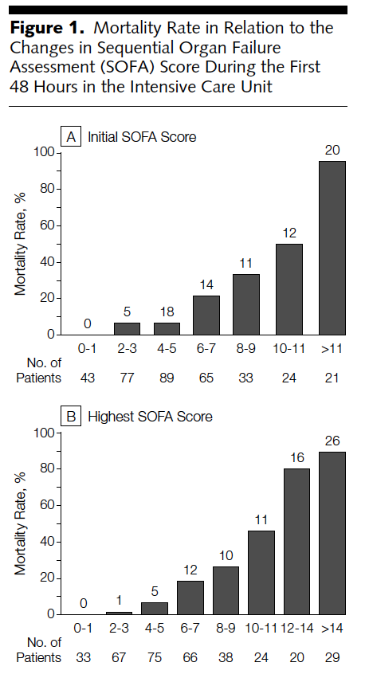

48 hours

Slide 18
ICU Note -1
Age - gender
Comorbidities
  CV [RF] = [HTN, DM] ➔ASCVD: AMI (CABGx3 - 2005), CHF [EF 30% - 2010]
  Pulmo = Smoker ➔COPD (stage 4) –O2 dep.
Reason for ICU admission
  CAP with severe sepsis – MODS: CV (3), Pulmo (3), Renal (2), CNS (2) – SOFA score: 10

Slide 19
ICU Note - 2
Age - gender
Comorbidities …….
Reason for ICU admission [date]
  CAP with severe sepsis – MODS: CV (3), Pulmo (3), Renal (2), CNS (2) – SOFA score: 10
Conditions resolved during ICU admission:
  MODS: CV [off pressors], Pulmonary [extubated]
Active ICU issue
  Thrombocytopenia [HIT w/u in progress ],
  AKI [improving]

Slide 20
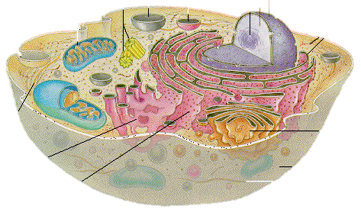
TDR: Organ Dysfunction -Cellular
lungs
Heart
Hematopoietic
Brain
Liver
kidney

Slide 21
Inflammation Cell. Regulation Over Time
IC: persistent elevation
TDR: maladaptive
MODS: progression [SOFA]
Mortality: high
NF-κB-driven transcription of
inflammatory
mediators
GC-GRα
downregulation
of NF-κB
IC: progressive reduction
TDR: adaptive
MODS: resolution [SOFA]
Mortality: low

Slide 22
Approach to
Shock

Slide 23
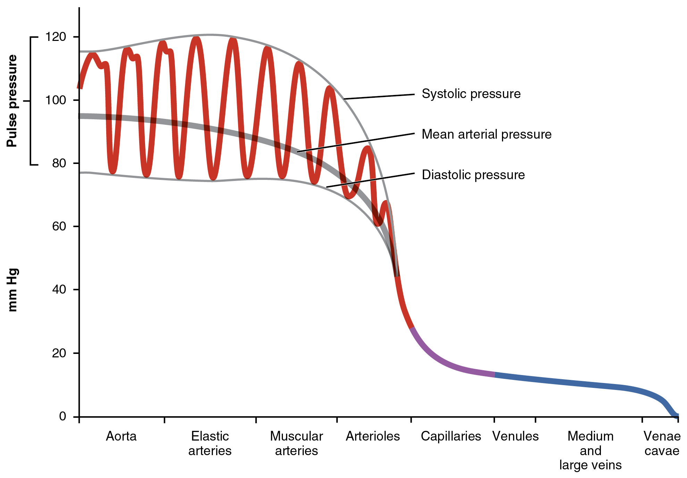
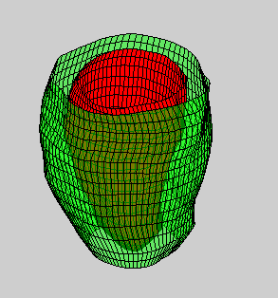
Approach to Shock: Blood Pressure
Pulse pressure
Left Ventr.
Stroke
Volume
Diastolic pressure
Vascular tone

Slide 24
Diastolic and Pulse Pressure
Circulation
⬇Diastolic
Vasodilation
Hypovolemia
Lung
⬇LV volume
Pulse
pressure
Decreased return to LV
Heart
⬇LV stroke
Decreased
stroke of LV

Slide 25
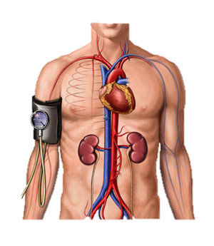
Diastolic Pr. -Decreased Vascular Tone
Circulation
⬇Diastolic
Vasodilation
Massive vasodilation
  Septic shock
  Anaphylactic shock
  Neurogenic shock
Lung
⬇LV volume
Pulse
pressure
Decreased return to LV
Heart
⬇LV stroke
Decreased
stroke of LV

Slide 26
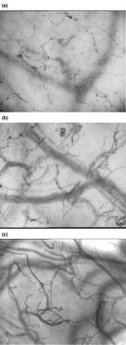
Septic Shock – Distributive
Systemic vasodilatation - Massive
Systemic vascular leak - Massive
  Most crystalloid fluid is third spaced < 1 hour
Systemic vascular damage (distributive shock)
  Clotting & impaired microcirculation ➔ MODS
Healthy microcirculatory flow in all vessels.
some capillaries showing stasis and others showing high flow
complete stasis in the capillaries
Elbers and Ince Critical Care 2006 10:221

Slide 27
Pulse Pres: Decreased LV volume
Circulation
Hypovolemia
⬇LV volume
Hypovolemia – ⬇ venous return to RV➔LV
  With bleeding
  Without bleeding

Slide 28
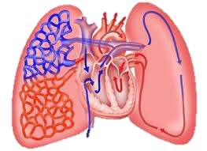
Pulse Pres: Decreased LV volume
Lung
⬇LV volume
Decreased return to LV
  A. ⬆ Intra-thoracic presure [PIP]
    ⬇ venous return to RV ➔LV
B
  B. Pulmonary embolism
    ⬇ venous return to LV
A

Slide 29
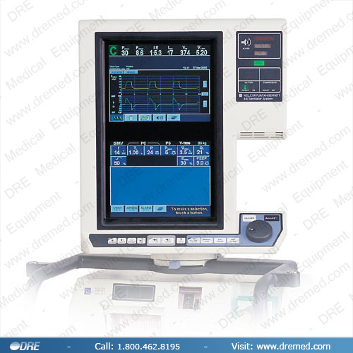
Pulse Pressure – Patient on MV
New reduction in blood pressure
First check the PIP
If elevated
  Consider auto-PEEP
  Disconnect MV ➔ Observe

Slide 30
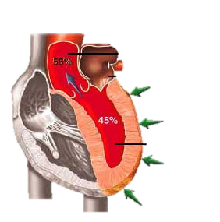
Pulse Pressure: Decreased LV stroke
Heart
⬇LV stroke
Decreased
stroke of LV
  Myocardial injury (pump)
    ECG, troponin, echo
  Pericardial Tamponade
    Exam, chest radiograph, echo
  Aortic dissection
    Exam, chest radiograph, CT, ..
  Rhythm

Slide 31
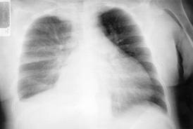
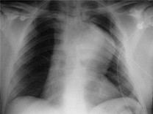
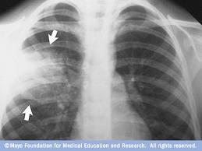
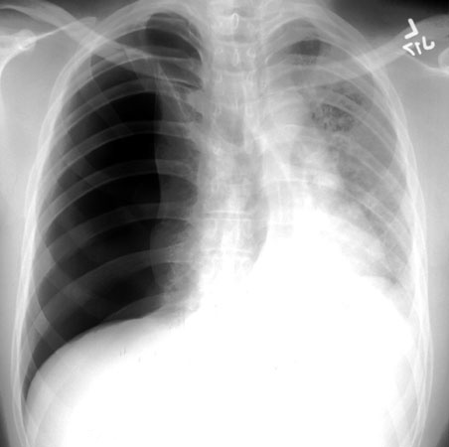
Always include in evaluating Shock
Cardiac component: ECG – troponin
Extent of microcirculatory ischemia: lactate, AG
Chest radiograph:
Tamponade
Dissection
Pneumonia
Tension PTX

Slide 32
Approach to
Respiratory Failure

Slide 33
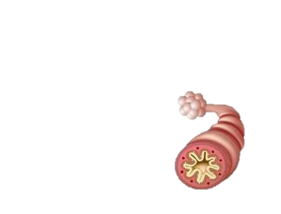
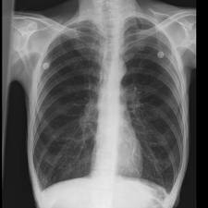
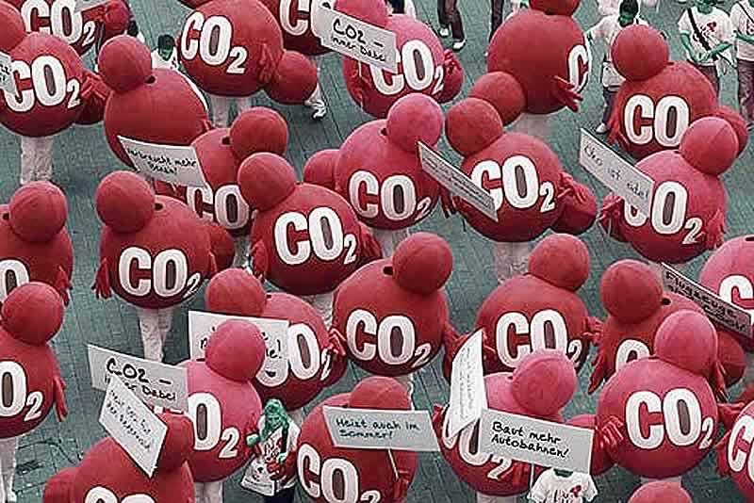
Approach to ARF – Hypercapnic*
Approach to ARF - Hypercapnic
⬇expiratory flow [Raw] | ⬆Air trapping [autoPEEP] | ⬇effective VE ⬆PacO2
Pathophysiology
Monitor | PIP-Plateau [Raw]
 | Peak Insp. Pr. [PEEPi]
 | PaCO₂:VE [Vd/Vt]
* Acute exacerbation: asthma and COPD

Slide 34
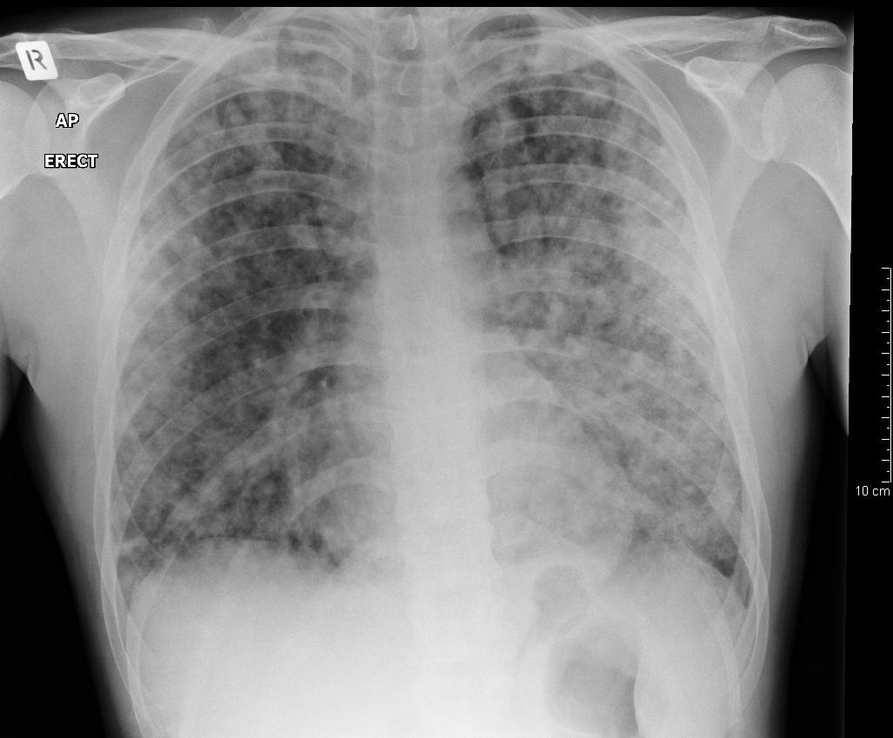
Approach to ARF - Hypoxemic
Diffuse lung involvement (Chest X-ray - bilateral infiltrates)
Transudate [C.P. Edema] | Exudate [ALI-ARDS] | Pus [PMN+pathogens] [Pneumonia] | Blood [Hemorrhage]
⬆ Hydrostatic pr. = Protein content = Neutrophils | = Hydrostatic pr. ⬆ Protein content ⬆ Neutrophils | = Hydrostatic pr. ⬆ Protein content ⬆ Neutrophils | = Hydrostatic pr. ≠ Protein content ⬆ Red blood cells
Monitor | PaO₂:FiO₂ [V/Q match]
 | Compliance [Cst]*
 | Chest X-ray
  * Cst = Vt / Plateau pr. -PEEP

Slide 35
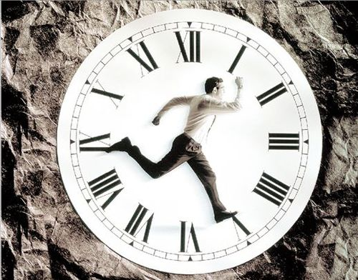
15 Seconds Visual Assessment

Slide 36
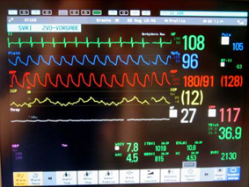
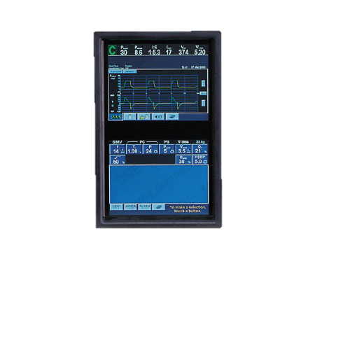
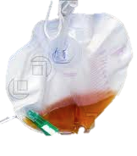
15 Seconds Visual Assessment
Heart Rhythm
Blood pressure
PIP = lung mechanics
VE = ventilatory needs
SaO₂% / FiO₂
Urinary output

Slide 37
TDR- MODS: Daily Monitoring
Lung
  Ventilation: VE/PaCO₂ ; Raw
  Oxygenation: O₂sat/ FiO₂ ; Cst
Hematopoietic
  Platelet count, Hct%, INR
Liver
  Albumin, bilirubin
lungs
Hematopoietic
Liver

Slide 38
TDR- MODS: Daily Monitoring
Cardiovascular:
  Tissue perfusion/oxygenation: lactate, AG,
  Myocardial injury: ECG, troponin,
  Arrhythmia risk: QTc [Mg, Ca, K, Rx]
Brain:
  GCS, CAM-ICU
Renal:
  Intake-output, Cr, electrolytes, …
Heart
Brain
kidney

Slide 39

Grazie

