Slide 1
Lung repair, remodeling and regeneration:
From development to clinic
Ivan Bertoncello
Lung Health Research Centre
Department of Pharmacology and Therapeutics
University of Melbourne

Slide 2
Overview:
Relevance of lung development to adult lung regeneration
Modelling lung stem cell organisation and regulation in mice
The role of the stem cell microenvironment in lung regeneration
Limitations of mouse models in understanding human biology
What is known about human lung stem cells
Challenges in harnessing stem cells in lung regenerative medicine

Slide 3

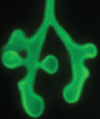
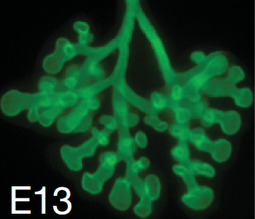
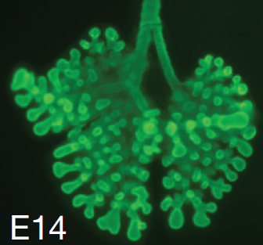
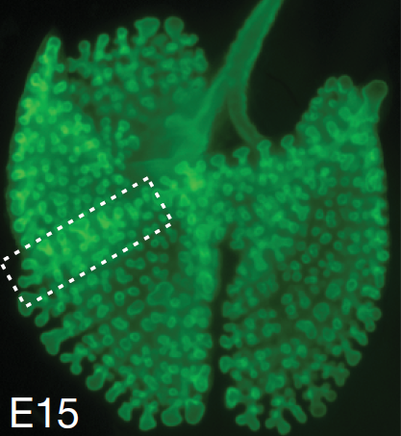
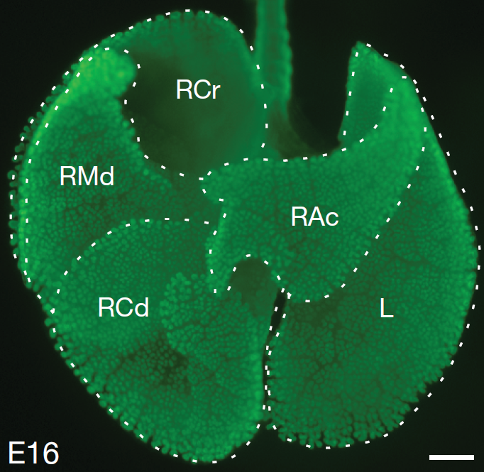
Mouse lung development:
E11
E12
Oesophagus
Lung bud
Trachea
Metzger et al (2008) Nature 453: 745-750

Slide 4
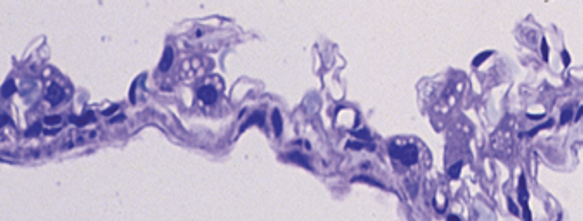
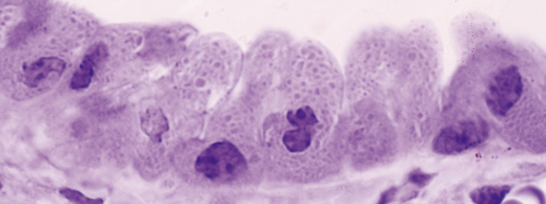
Molecular mechanisms of lung specification:
Embryonic
Pseudoglandular
Canalicular
Saccular
Alveolar
early
late
Proximal
Epithelium
Club cell
Cilliated cell
Branching
Morphogenesis
Distal
Epithelium
Type II & Type I
Pneumocytes
SP-C
SP-A
SP-B
CCSP
RCA1
TTF-1
HNF-3α,β
N-myc
HFH-4
HoxA5
HoxD4
HoxB5
E9
E11
E13
E15
E17
E19
NB
D10
D20
D30
Prenatal Postnatal

Slide 5
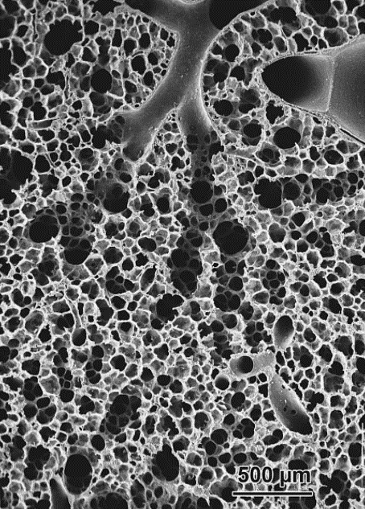
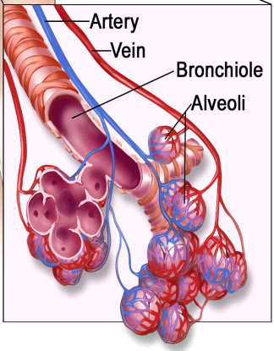
The human airway tree:
Weibel, (2009) Swiss Med Wkly 139:375-386

Slide 6
The adult lung comprises at least 40 cell lineages:
Tracheal and Airway Epithelium
Goblet Cells
Ciliated Cells
Club Cells
Neuroendocrine Cells
Basal and Parabasal Cells
Serous Cells
Mucous Cells
Anion Secreting Cells
Non-Ciliated Columnar Cells
Alveolar Epithelium
Type 1 & Type 2 Pneumocytes
Transitional Cuboidal Non-ciliated Cells
Interstitial Connective Tissue
Smooth Muscle
Cartilage
Fibroblasts/Myofibroblasts/Lipofibroblasts
Adipose tissue
Neural cells
Blood Vessels and Lymphatics
Endothelial Cells
Pericytes
Smooth Muscle Cells
Fibroblasts/Myofibroblasts
Hematopoietic and Lymphoid Tissue
Lymphocytes
Plasma cells
Megakaryocytes
Macrophages
Langerhans cells
Mast cells
Neutrophils/Eosinophils/ Basophils
Pleural Tissue
Mesothelial Cells
Adipose cells - intrapleural fat
Lymphatics

Slide 7
Signalling in early lung development:
Volckaert and De Langhe (2014) Fibrogenesis and Tissue Repair 7:8

Slide 8
Regeneration and repair recapitulates ontogeny:
Gene | Molecular Function | Lung development | Adult regeneration/repair | Pathophysiology
Wnt | Signaling pathway | Specification of early lung endoderm | Bronchoalveolar stem cell expansion | Chronic activation: Increased fibrosis
Notch | Signaling pathway | Differentiation of secretory epithelium | Basal cell differentiation | Excess notch: mucous metaplasia
HDAC1/2 | Histone deacetylases | Proximal airway development | Activation of cell cycle progression | Deletion/Inhibition: emphysema
Fgf10 | Growth factor | Branching morphogenesis | Lung epithelial stem cell proliferation | Reduced FgF10: Bronchopulmonary displasia
HGF | Growth factor | Alveologenesis | Promotes lung repair | Missing HGF receptors: Impaired airspace formation
TTF-1 (Nkx2.1) | Transcription factor | Lung parenchyma formation; epithelial differentiation | Normal airway and alveolar epithelial differentiation | Mutations: Alveolar dysgenesis; Interstitial lung disease
Sox-2 | Transcription factor | Patterning of proximal airway epithelium | Ciliated, club, basal and goblet cell differentiation | Deletion: airways devoid of normal epithelium

Slide 9
Endogenous lung stem cells - key questions:
How are regenerative cells in the lung organised?
What factors are required for their maintenance and regulation?
How are lung regenerative cells perturbed or compromised in chronic disease?
Does regeneration and repair in the adult lung recapitulate ontogeny?
What are the most appropriate targets around which cellular therapies for lung diseases can be tailored?

Slide 10
Alternative models of lung stem cell organisation:
Multiple unipotent
progenitors?
Functional, differentiated cells able to de-differentiate following severe injury?
Facultative stem cells?
Hierarchies of Multipotent
Stem/Progenitor cells?

Slide 11
Experimental approaches:
Genetically engineered mouse models
Reporter constructs for in vivo cell lineage tracing and clonal analysis
Specific lung injury models
In vitro 3-dimensional clonal assays

Slide 12
Lineage tracing:
Green chimeric mice:
C57Bl/6-Tg(CAG-EGFP)1Osb/J mice
Confetti mice:
Scgb1a1-CreER x Rosa26R-Confetti mice
Giangreco et al., (2009) PNAS 106:9286 - 9291
Chen et al., (2012) Stem Cells 30:1948 - 1960

Slide 13
Unmasking lung stem cells in mice by selective toxicity:
Cytotoxic Agent | Route | Target Cells | Maximum Injury | Repair
SO₂ | Inhalation | Tracheobronchial luminal cells | 36 hrs | 7 days
Naphthalene | Intraperitoneal or Intravenous | CYP2F2^{pos} Club cells | 3 days | 10 days
Bleomycin | Intratracheal or Intravenous | AT1 and AT2 cells; endothelium | 6 - 10 days | 21 days
H1N1 virus | Inhalation | Club cells; Ciliated cells; AT2 cells | 11 days | 21 – 60 days
Pneumonectomy | Surgical removal of lobe | All lung tissue | At surgery | 15+ days
Asselin-Labat and Filby (2012) Open Biol 2:120094

Slide 14
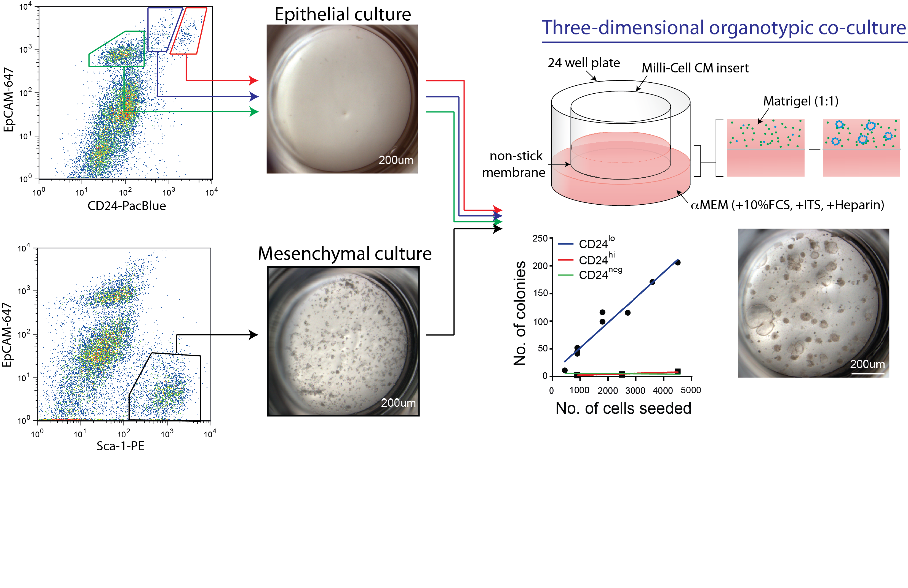
Adult lung epithelial colony-forming cell assay :
Lung epithelial CFU are: CD45^{neg}CD31^{neg}Sca-1^{low}EpCAM^{pos}α6^{pos}β4^{pos}CD24^{low}
McQualter et al., (2010) PNAS 107: 1414 - 1419

Slide 15
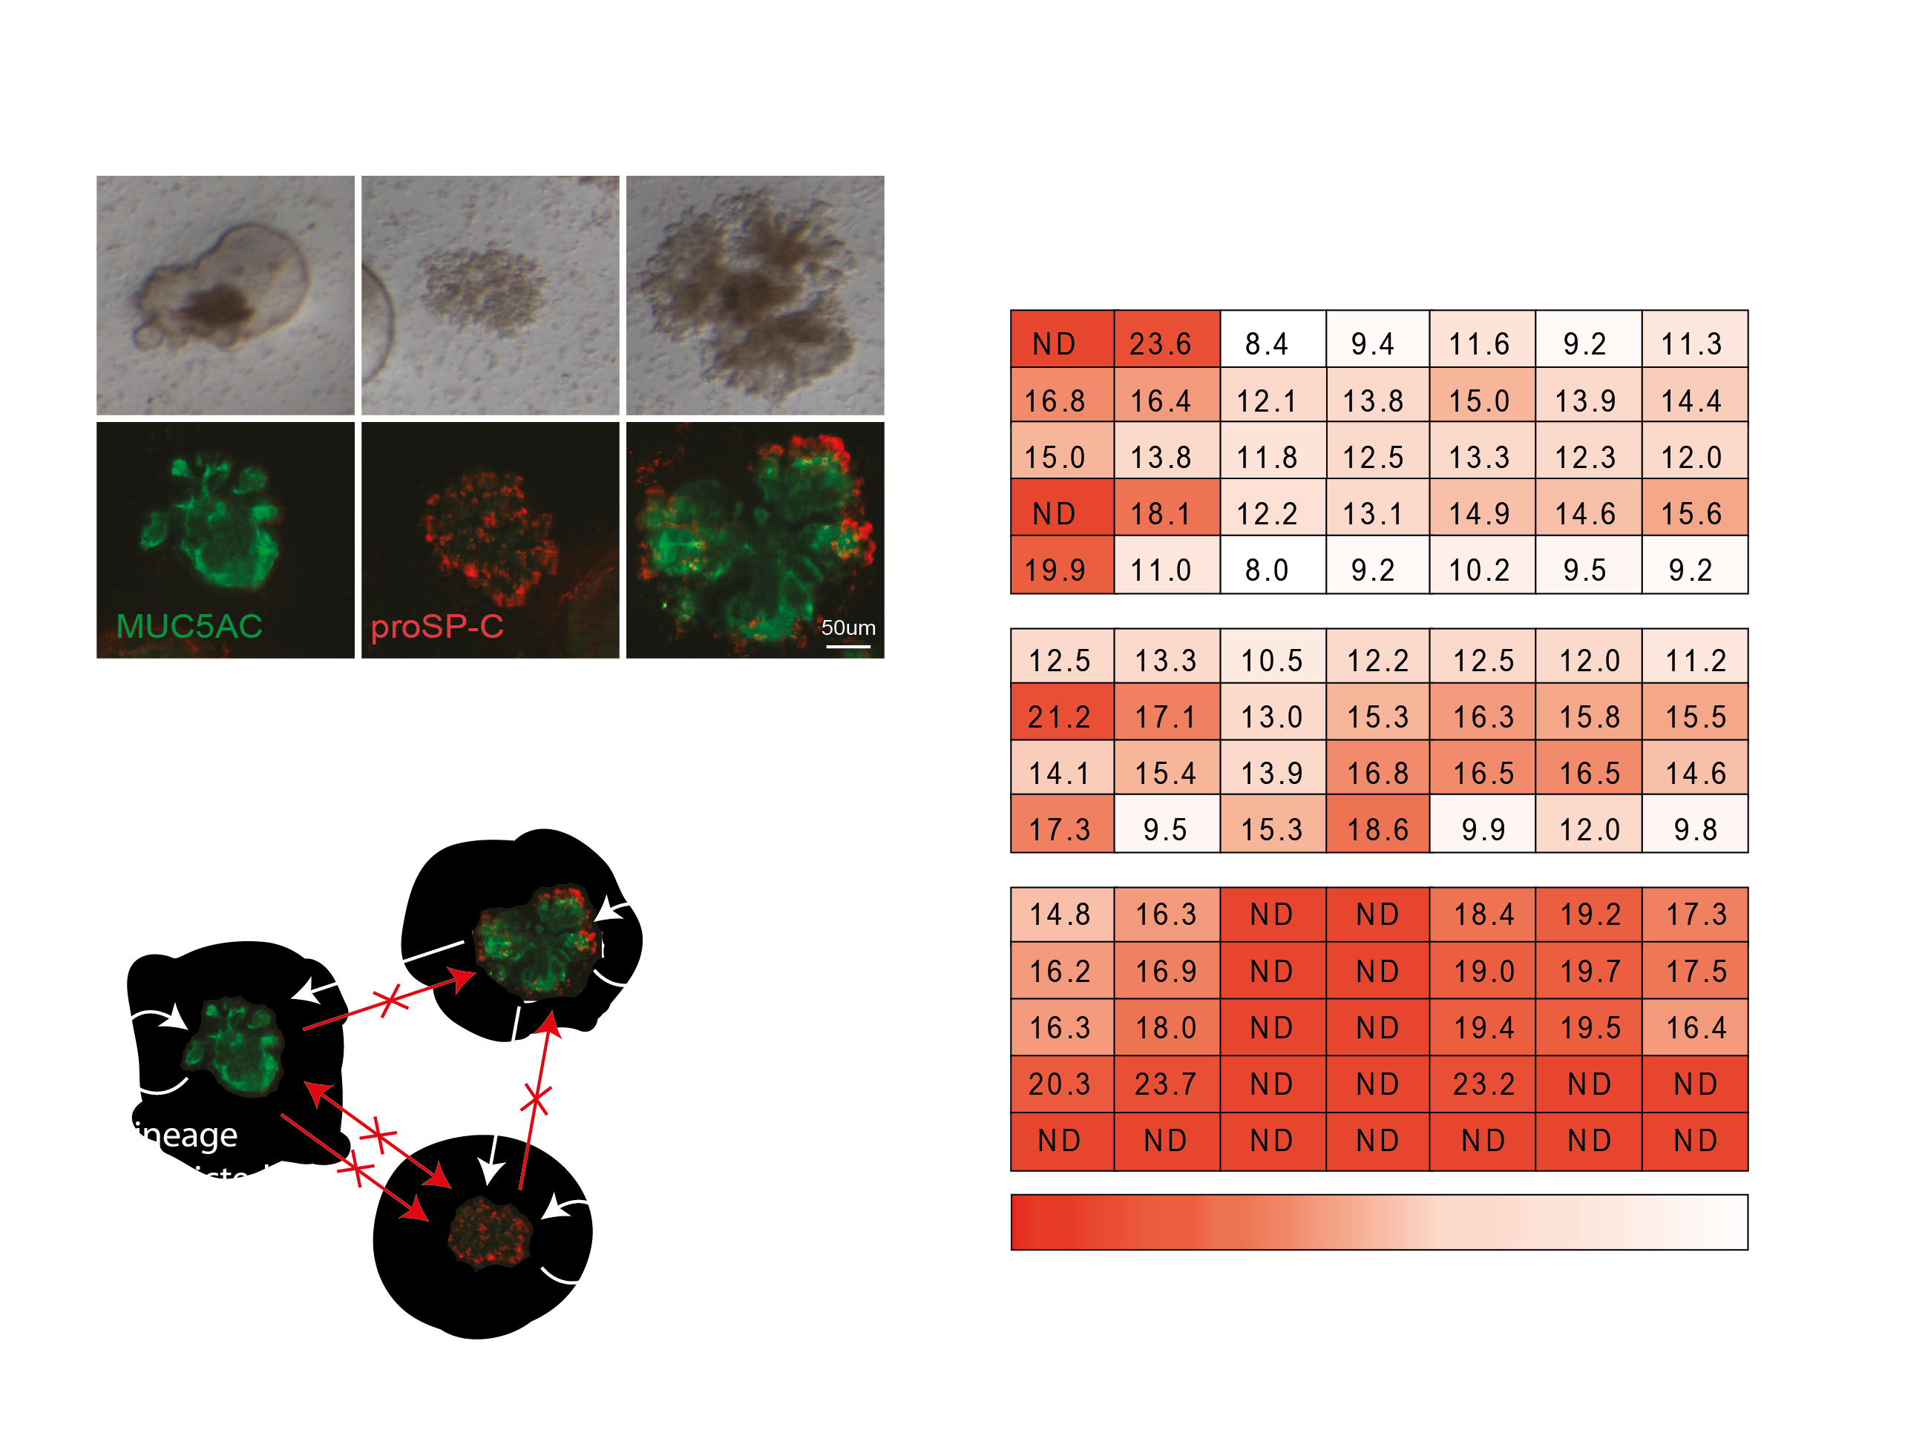
Evidence of multilineage differentiation:
Multi-lineage Differentiation
Gene Expression Heat Map (ΔCt)
Recloning Potential
McQualter et al., (2010) PNAS 107: 1414 - 1419

Slide 16
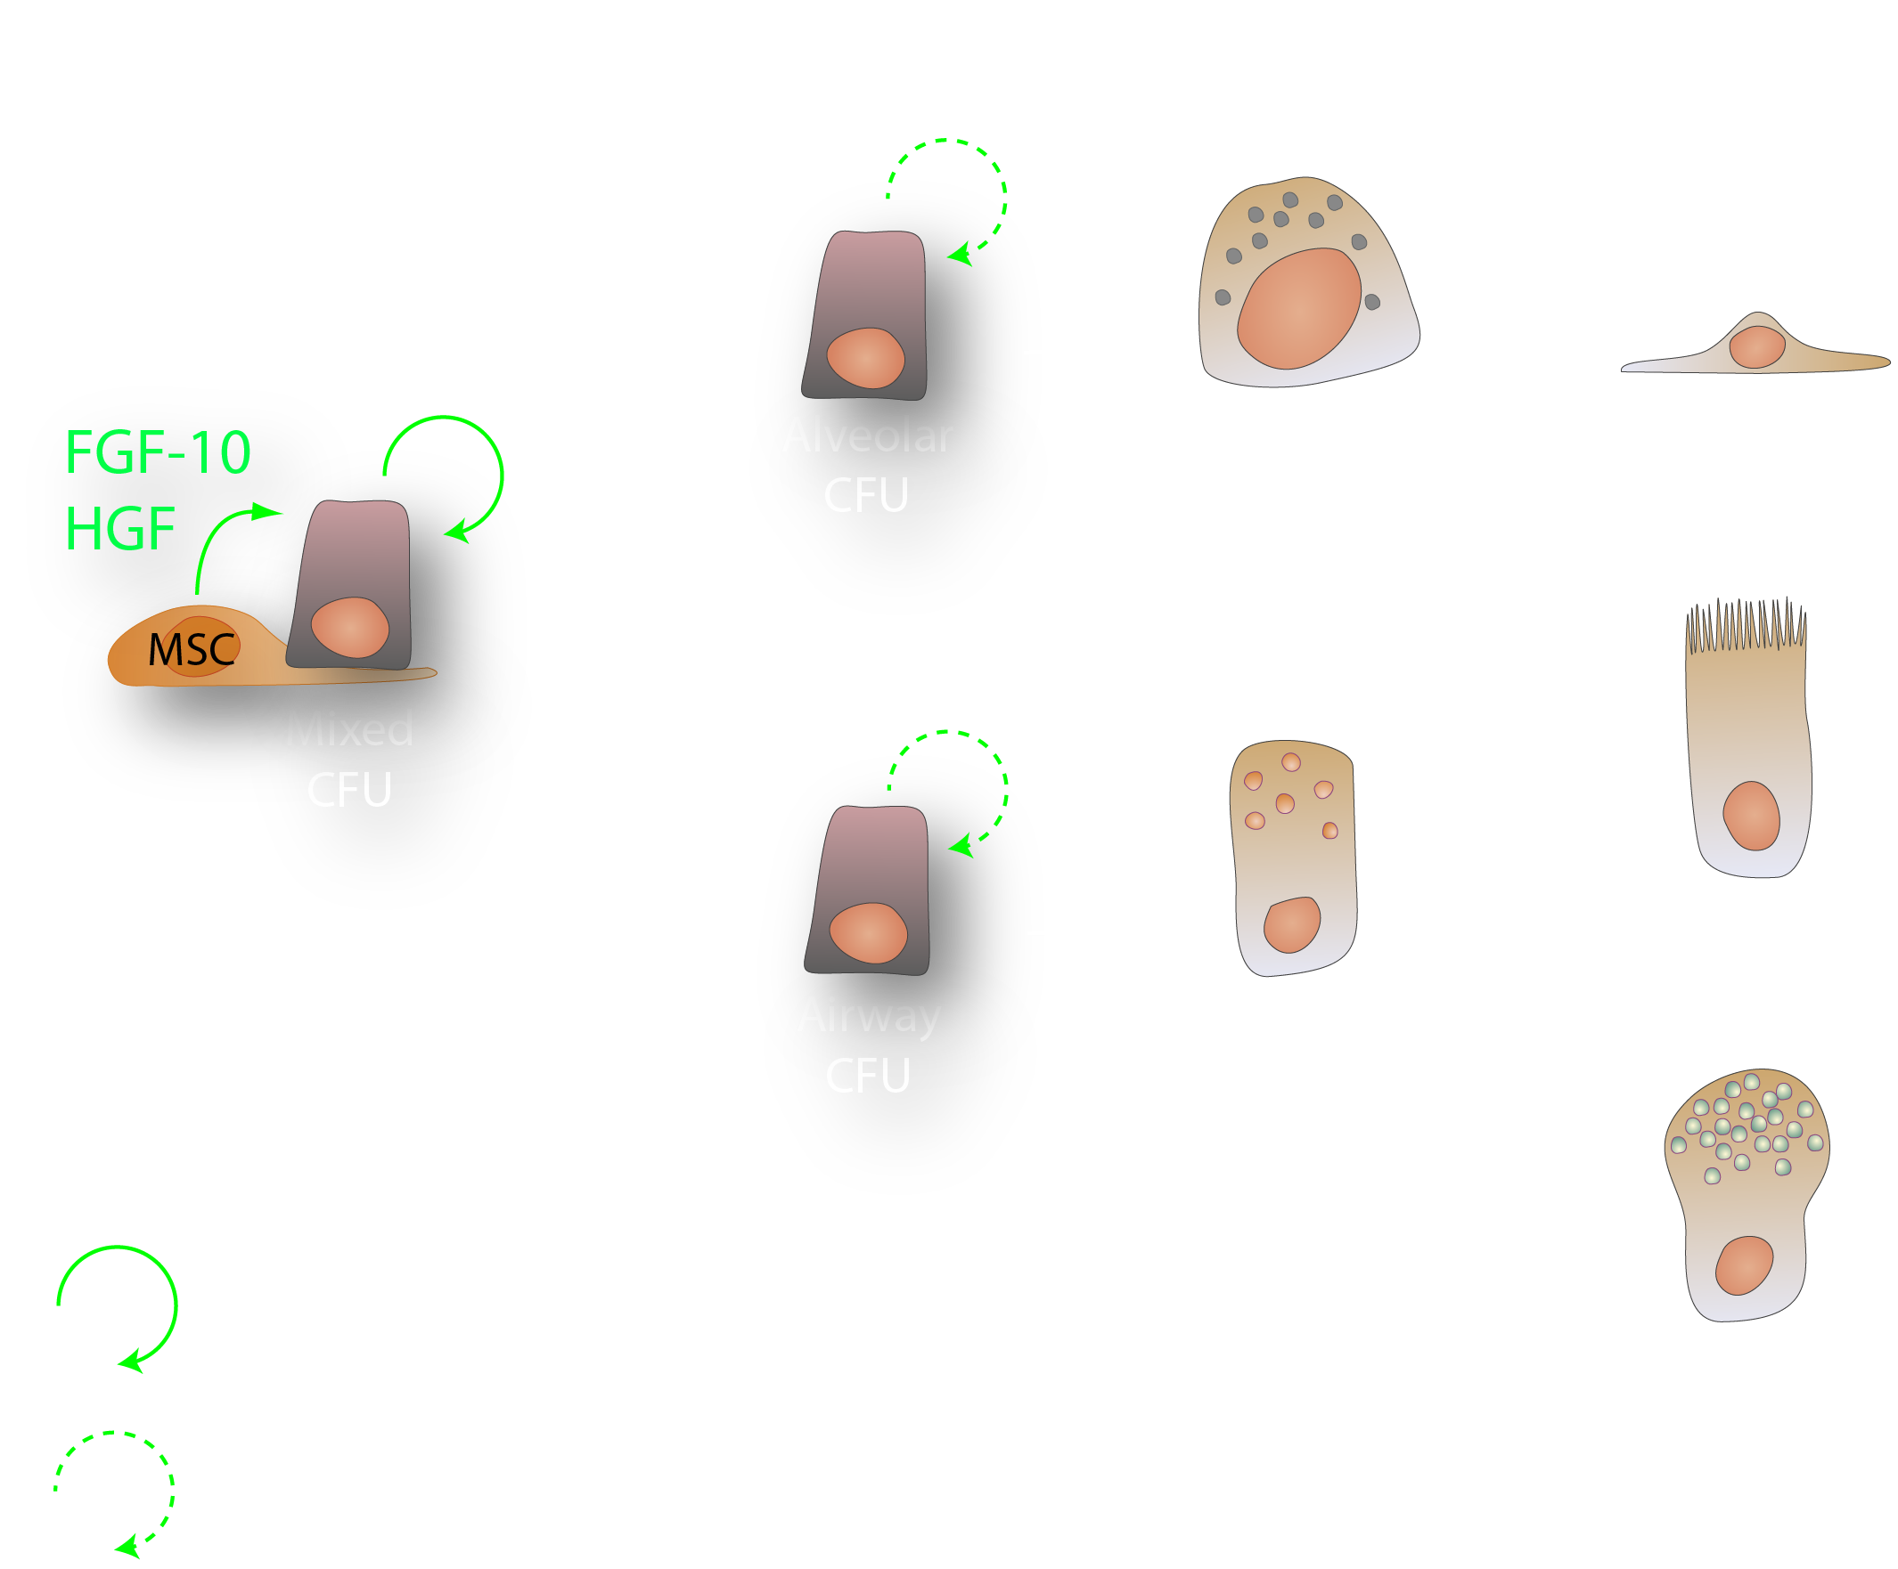
Evidence of a lung epithelial stem cell hierarchy:
Multipotent Lineage-restricted Differentiated
CD45^{neg}CD31^{neg}
Sca1^{low}EpCAM^{pos}
α6^{pos}β4^{pos}CD24^{low}
McQualter et al., (2010) PNAS 107, 1414 - 1419

Slide 17
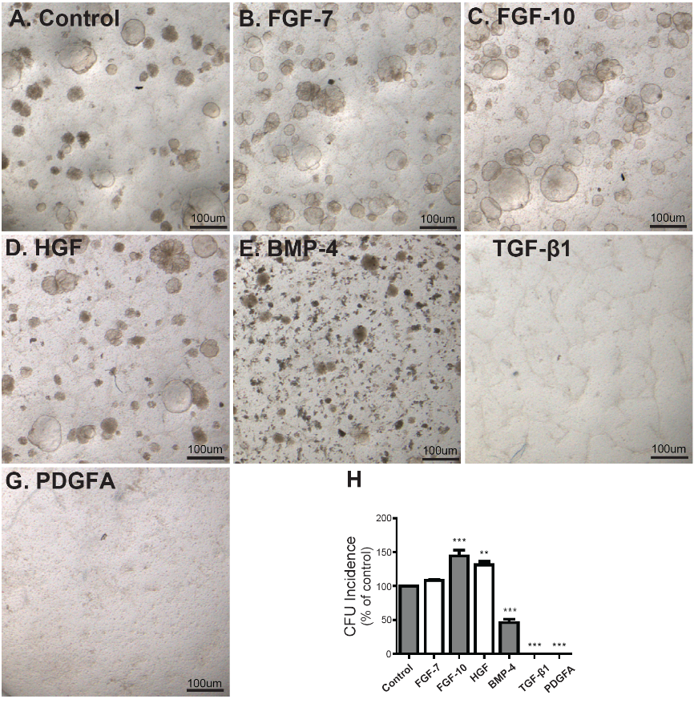
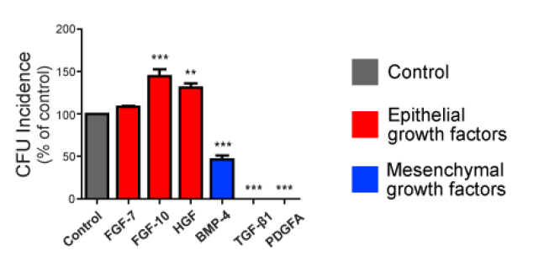
Clonal assay reveals potential targets for promoting repair:
Mesenchymal regulation of stem cell commitment:

Slide 18
Clonal assay reveals potential targets for promoting repair:
Organ-specific endothelial regulation of stem cell commitment:
Lung Liver
endothelial cells
Thrombospodin-1 (TSP1) expression: Lung >> Liver endothelium
Upregulated in alveolar repair
Lee et al., (2014) Cell 156: 440 - 455

Slide 19
Regional lung stem cell pools in homeostasis:

Slide 20
Stem cell plasticity is revealed by injury :
Homeostasis
SO₂ Luminal cell ablation
p63^{pos}Krt5^{pos}
Basal stem cell
p63^{pos}Krt5^{pos}
Basal stem cell
notch
p63^{pos}Krt5^{pos}
Krt8^{pos}
N2ICD^{pos}
p63^{pos}Krt5^{pos}
Krt8^{pos}
c-Myb^{pos}
p63^{pos}Krt5^{pos}
Krt8^{low}
Basal luminal progenitor
Krt8^{pos}
N2ICD^{pos}
Krt8^{pos}
c-Myb^{pos}
Maturation
~ 12 days
notch
Basal cell ablation
Secretory
Ciliated
Secretory
Ciliated
Watson et al., (2015) Cell Rep 12: 90 - 101
Pardo-Saganta et al., (2015) Cell Stem Cell 16:184 - 195

Slide 21
Different injuries activate different stem cells:
Homeostasis
Injury: Regeneration/Repair
Tracheal
Basal
SO₂ luminal cell ablation
Ciliated
Basal cell ablation
Club
Naphthalene
V. Club
Bronchiolar
?
PNEC
Bleomycin, H1N1 Viral infection
BASC
LNEP/DASC
Alveolar
Pneumonectomy
AT2
AT1

Slide 22
Stem cells are defined in context:
Intrinsic
Potential
Stem Cell
Microenvironment
Stromal cells
Soluble & insoluble cytokines
Extracellular matrix
Vasculature
Neural cells
Hematopoietic cells
Permissive
Inductive
microenvironment
Restrictive
Regenerative potential is determined by:
Intrinsic potential of the stem cell
Permissive or restrictive microenvironmental cues

Slide 23

Cross-talk between stem cell and niche is reciprocal:
Epithelial cells
Mesenchymal cells
Factors
Cytokines
Gene
expression
Transcription
factors
Signalling
Gene
expression
Transcription
factors
Signalling
Proliferation,
Differentiation
Migration
Proliferation,
Differentiation
Migration
Extracellular Matrix
After: Shi et al., (2009) Respirology 14:656 - 665

Slide 24
Mechanotransduction and remodelling:
Periodicity and amplitude of stretch affect proliferation and differentiation
Ingber (2003) J Cell Sci 116:1397 – 1408
Sadati et al., (2013) Differentiation 86: 121 - 125

Slide 25
Stem cells in context:

Slide 26
Molecular Systems Biology 11:819
“……Mass spectrometry quantified 8366 proteins from total tissue and BALF over course of 8 weeks, surveying tissue composition from onset of inflammation and fibrosis to full recovery……”

Slide 27
Summary:
Adult lung regeneration and lung development use similar mechanisms
Different stem cell types repair injury of different severity
The ability of stem cells to repair is context dependent
Identification of potential therapeutic targets

Slide 28
Mice are not human:
 | Mouse | Human
Genome | Highly conserved: 99% genes in common
Size | 0.2gm | ~ 1.1Kg
Alveolar bed | 85cm² | 130m²
Cartilage rings | Only extrapulmonary airways | Extend several airway generations
Submucosal glands | Restricted to upper trachea | Tracheobronchial region
Pseudostratified epithelium (basal cells) | Restricted to trachea | Extends to terminal bronchioles
Cuboidal epithelium | Bronchiolar airways | Restricted to respiratory bronchioles
Terminal bronchioles | End in bronchioalveolar ducts | Transition to respiratory bronchioles
Goblet cells | rare | abundant
Inflammation/Innate Immunity | Poorly reproduced in mice

Slide 29
Problems not anticipated by animal experimentation:
Individual biological variation in human subjects
Unique clinical problems encountered in older patients and patients with unrelated health problems and co-morbidities
Opportunistic infections not seen in mice housed in pathogen-free conditions
Human diseases for which there are no good animal models

Slide 30
Technical issues:
Variability and quality of “normal” lung tissue:
Normal tissue from lung cancer resection
Small samples from tracheobronchiolar biopsies for various indications
Discarded airways from transplanted lung
Lung unsuitable for transplant
Healthy lung from young trauma victims
Lack of assay standardisation:
Different cell dissociation protocols
Different cell separation strategies
Different cell culture media and supplements
Different assay endpoints

Slide 31
Human lung stem cell characterisation:
Resected normal lung – cancer surgery
Normal healthy lung –trauma victims
Rock et al (2009)
Ghosh et al (2013)
Krt5^{pos}Krt14^{pos} TF^{pos}CD151^{neg} cells generate p63^{pos}Krt5^{pos}Krt14^{neg} colonies
α6^{pos}NGFR^{pos} cells generate Krt14^{pos}Krt8^{pos} colonies
Discarded airways - transplanted lung
Hegab et al (2012)
NGFR^{pos}CD44^{pos}CD166^{pos} cells generate p63^{pos}Krt14^{pos}Krt8^{pos} organoids

Slide 32
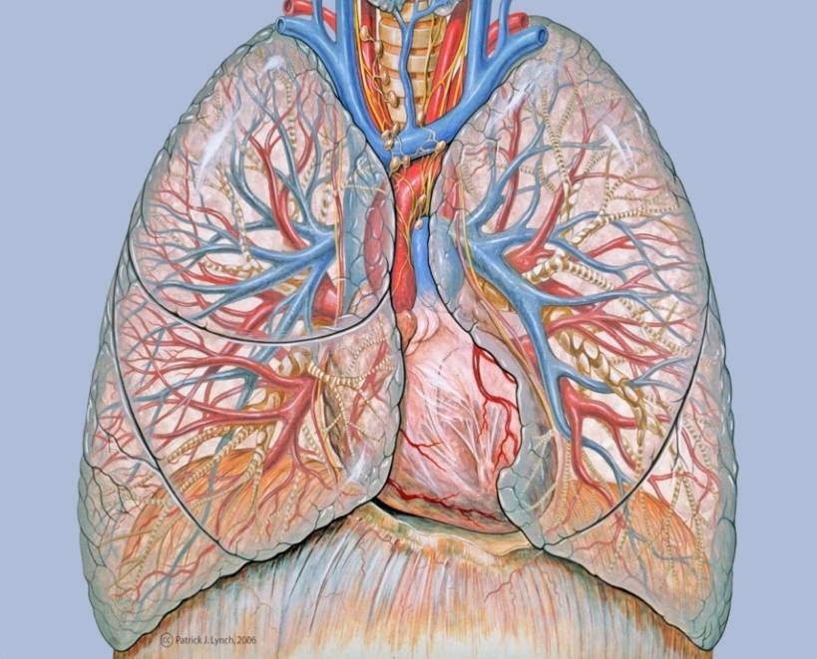
Challenges in cell therapy:
How to deliver?
Delivery
Conditioning
What to repair?
Stem cell
Microenvironment
How to match the growth rate of different structural elements?

Slide 33
What is the defect and what do we repair?
different diseases – different targets
Disease Therapeutic Goal
COPD Prevent airway epithelial loss
Inhibit airway remodeling
Interstitial Pulmonary Fibrosis Promote alveolar re-epithelialisation
Inhibit myofibroblast expansion
Cystic Fibrosis Deliver functional CFTR
Chronic Asthma Inhibit airway remodeling
Bronchiectasis Restore airway structure
Congenital Lung Hypoplasia Generate alveolar septa
After: Neuringer & Randell (2004) Respir Res 5:6

Slide 34
Exogenous stem cell sources in lung regeneration:
Sources tested include haematopoietic stem cells, umbilical cord cells, mesenchymal stromal cells, adipose-derived stem cells......
Contribution to lung epithelial-regeneration by respecification or transdifferentiation is minimal and too low to be of clinical benefit.
Where infusion of mesenchymal stromal cells has attenuated lung injury, tissue repair is mediated by factors including:
  - paracrine stimulation of endogenous cells cytokines
  - immunomodulatory activity of MSC

Slide 35
MSC clinical trials – lung diseases:
Pulmonary Hypertension:
EPC-based gene therapy
Emphysema:
IPF:
BM-MSC
COPD; Silicosis:
Bone marrow stem cells
ARDS
Bronchopulmonary dysplasia
Pneumoconiosis
Umbilical cord-derived MSC
COPD
ARDS
BM-MSC
Bronchopulmonary dysplasia:
Umbilical cord-derived MSC
COPD
IPF
Adipose-derived MSC
IPF:
Placental MSC
Source: http://www.clinicaltrial.gov

Slide 36
Clincal trials – cell therapy for lung disease:
Lung Disease | Stem Cell Source | Effect | Side Effect | Conclusion
BPD | Allogeneic hUCB-MSC |  | No dose-limiting toxicity | Safe: Lower risk of moderate/severe BPD
ARDS | Allogeneic Adipose-derived MSC | Marginal/weak | No serious events | Safe: No significant clinical effect
COPD Stage II or III | Allogeneic MSC | Marginal/weak | No serious events | Safe: No significant clinical effect
IPF Moderate to severe | Allogeneic Placental MSC | Marginal/none | No serious events | Safe: No significant clinical effect
Stabler et al., (2015) 115:45 -56

Slide 37
Challenges in cell therapy:
How to deliver?
Delivery
Conditioning
What to repair?
Stem cell
Microenvironment
How to match the growth rate of different structural elements?

Slide 38
What is needed to move forward?
Better biomarkers to monitor endogenous lung stem cell compartments
Standardised protocols for tissue acquisition, annotation and processing
Consensus signature profiles for classification of human lung stem and progenitor cells
Comparison and validation of assays used by different laboratories
Better profiling of the human stem cell niche
Constant dialogue between physicians and scientists

Slide 39
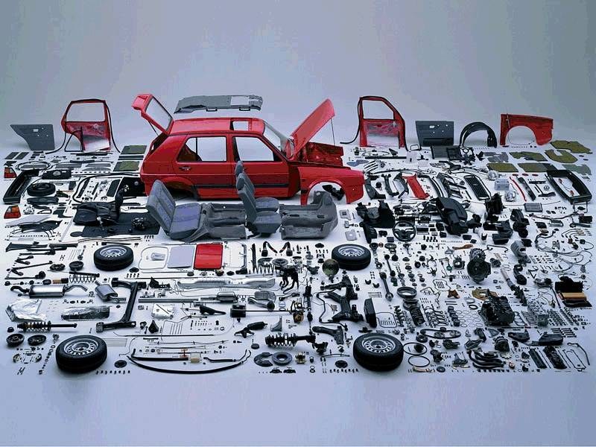

Lung Regeneration and repair – the “IKEA” model !!!

Slide 40
? Sox2 overexpression
Squamous Cell Carcinoma
Basal
Ciliated
Club
V. Club
PNEC
Loss of Rb1 and p53
Small Cell Carcinoma
BASC
LNEP/DASC
K-ras activation/loss of p53
AT2
Adenocarcinoma
AT1

