Slide 1
AGGIORNAMENTO SULLA GESTIONE ATTUALE
DELLA TERAPIA DELL’ASMA
Università degli
Studi di Pisa
Azienda Ospedaliera Pisana
Pierluigi Paggiaro
GINA International Executive Committee, Chairman GINA ITaly
Cardio-Thoracic and Vascular Department, University of Pisa
PneumoTrieste 2016
Trieste 11-12 aprile 2016

Slide 2
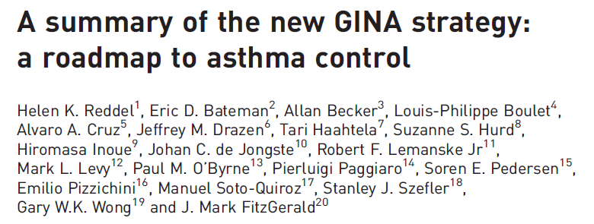
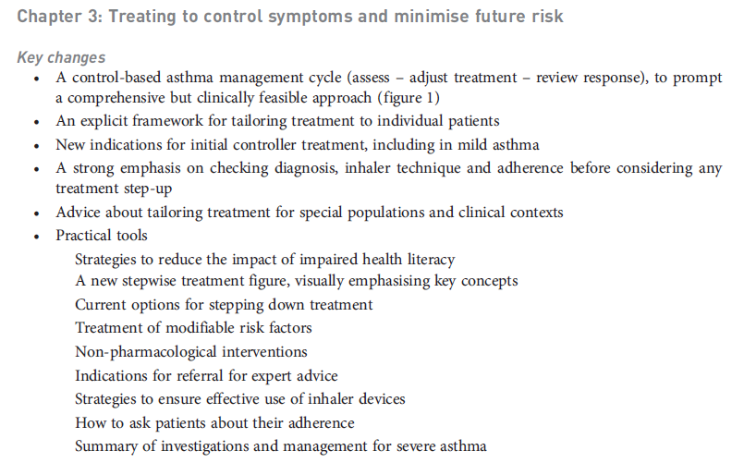
ERJ, 2015

Slide 3
Bronchial Asthma heterogeneity in clinical presentation
Large difference in clinical manifestations, related to:
Severity of the disease
Heterogeneity of inducers and/or triggers
Level of adherence to therapeutic plan
Existance of different phenotypes
Clinical and functional
Biological
Difference in:
Strategy of asthma treatment
Strategy in asthma management

Slide 4
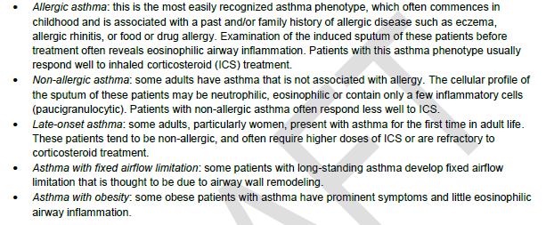
A new definition of asthma (GINA 2014): a heterogeneous disease
GINA 2014, draft

Slide 5
Bronchial Asthma heterogeneity in clinical presentation
Large difference in clinical manifestations, related to:
Severity of the disease
Heterogeneity of inducers and/or triggers
Level of adherence to therapeutic plan
Existance of different phenotypes
Clinical and functional
Biological
Difference in:
Strategy of asthma treatment
Strategy in asthma management

Slide 6
Asthma phenotypes Eosinophilic vs non-eosinophilic asthma
Eosinophilic phenotype
Allergen-induced asthma, children asthma
Severe asthma with frequent exacerbations (CS-dependent asthma)
Non eosinophilic phenotype
Specific “triggers” (pollutants, endotoxins, chemicals, viruses)
In all asthma severity levels
Stable over time ?
Lower response to ICS
→ different therapeutic strategies ?

Slide 7
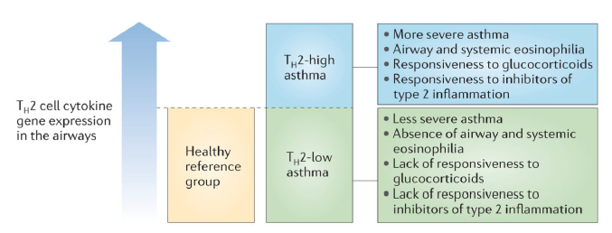
Fahy, Nat Rev Immunol 2015

Slide 8
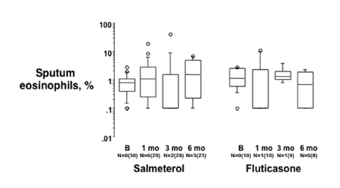
Both eosinophilic and non-eosinophilic inflammatory patterns in asthma seem fairly stable over time
Sputum Eosinophils
Sputum Eosinophils
100
87%
10
3
5%
2
1
0.1
1
2
3
4
5
6
7
8
9
10
11
12
13
14
15
16
17
18
19
20
Dente et al, IAAI 2015
Bacci et al, Respirology 2012

Slide 9
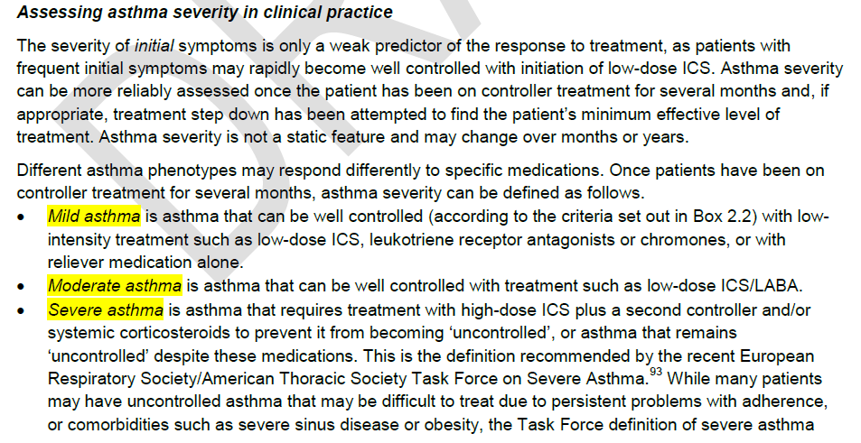
Assessment of asthma severity
GINA 2014

Slide 10
Asthma treatment: open points
Mild asthma:
Regular low-dose ICS vs «as-needed» therapy
Low-dose ICS vs LRTA
Moderate asthma:
Regular low-medium dose ICS/LABA vs SMART therapy
Severe asthma:
Anticholinergics drugs
Omalizumab: efficacy and safety
New biologics

Slide 11
EFFECT OF EXACERBATIONS
2
1,5
Number of exacerbations per patients/year
1
0,5
0
As needed
As needed
Regular
Regular
combination
albuterol
beclomethasone
combination
Papi et al, N Engl J Med 2007;356; 2040-2052

Slide 12
CUMULATIVE DOSE OF BECLOMETHASONE (BDP)
**
100
**
80
60
mg
40
20
0
prn BDP/S
prn S
regular BDP
regular
BDP/S
Papi et al, N Engl J Med 2007;356; 2040-2052

Slide 13
Randomised controlled trial if inhaled corticosteroid/fast-onset LABA reliever therapy in mild asthma
The Novel START trial will investigate the efficacy and safety of ICS/fast-onset LABA as sole reliever therapy in pts with intermittent or mild persistent asthma.
Primary aim: compare efficacy *BUD/FORM with:
SABA reliever therapy
Maintenance ICS plus SABA
*N° of exacerbations per patient x year
Beasly R et al, ERJ February 2016

Slide 14
New aspects of asthma management
Confirming the importance of maintenance therapy
Except mild asthma
Major role of combination therapy (LABA/ICS)
Major focus on step-up and step-down
Using different strategy for assessing and maintaining the control
Monitoring symptoms, PEF and/or inflammation
Focus on severe asthma
Add tiotropium (triple therapy)
Add omalizumab
Add new biologics

Slide 15
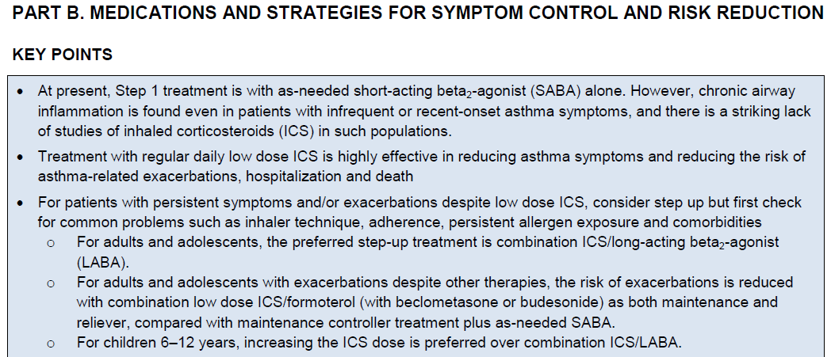
Regular treatment with ICS or combinations is the recommended treatment in almost all treatments steps
GINA 2014

Slide 16
ICS/LABA combination therapy
Different ICS/LABA combinations
Fluticasone propionate/salmeterol MDI and DPI
Different strenght, standard dosing
Budesonide/formoterol DPI
Single strenght, different dosing
BDP/formoterol MDI and DPI
Single strenght, different dosing
Fluticasone propionate/formoterol MDI
Different strenght, standard dosing
Fluticasone furoate/vilanterol DPI
Different strenght, once daily
Different indications
Traditional treatment vs maintenance and reliever treatment
Different severity ?

Slide 17
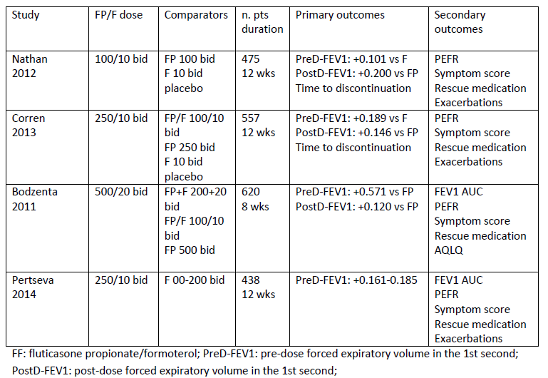
FP/F combination:
comparison with monocomponents
Latorre et al, Pulm Pharm Ther 2015

Slide 18
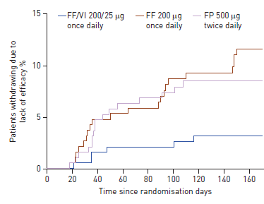
Efficacy and tolerability of FF/VI 184/22 (high strenght) in asthma: drop out for lack of efficacy
Durante le 24 settimane di trattamento un numero inferiore di pazienti trattati con FF/VI è uscito dallo studio (3%) rispetto a quanto successo nei bracci trattati con FF (11%) e FP (9%)
O’Byrne et al; Eur Respir J. 2014

Slide 19
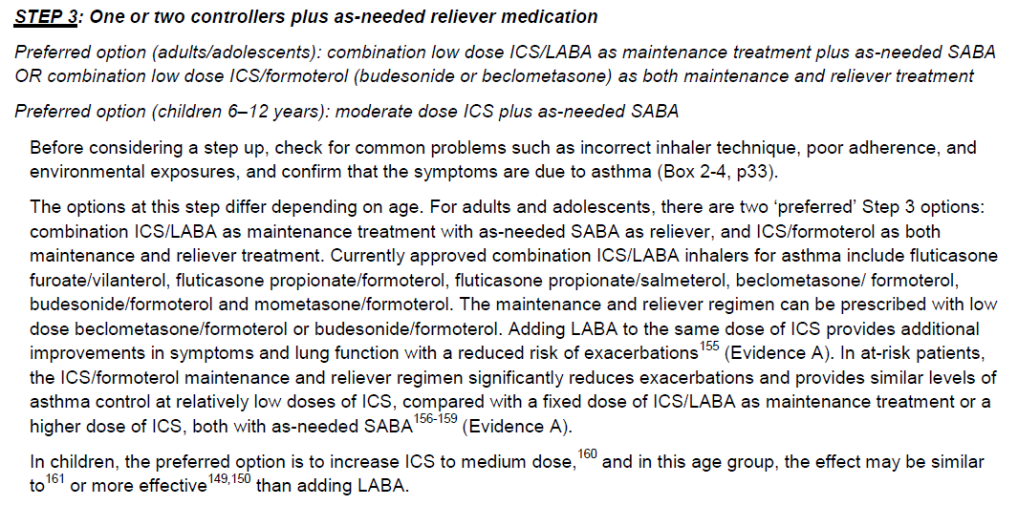
Role of combination therapy
GINA 2014

Slide 20
“Maintenance and reliever” strategy reduces asthma exacerbations, as well as or better than traditional strategies
Humbert et al, Allergy 2008
Notes:
Optimal treatment strategy for asthma 09/02/05
20

Slide 21
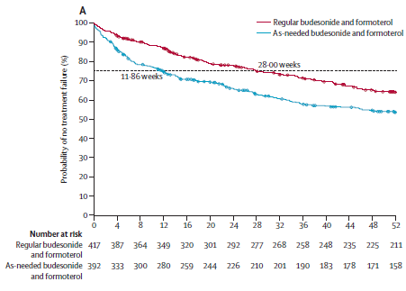
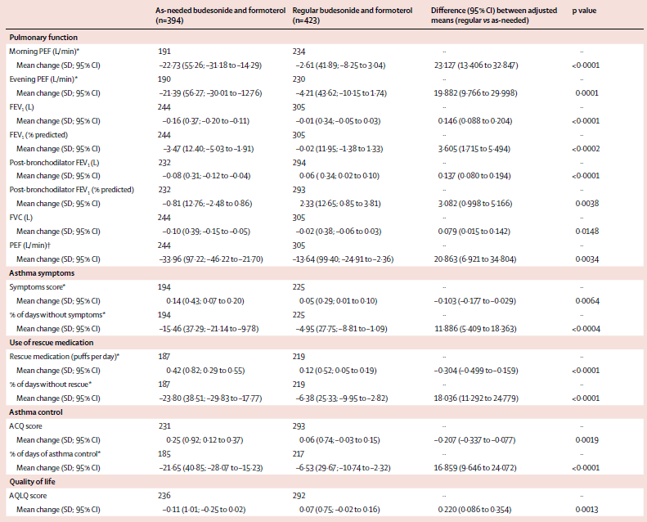

Slide 22
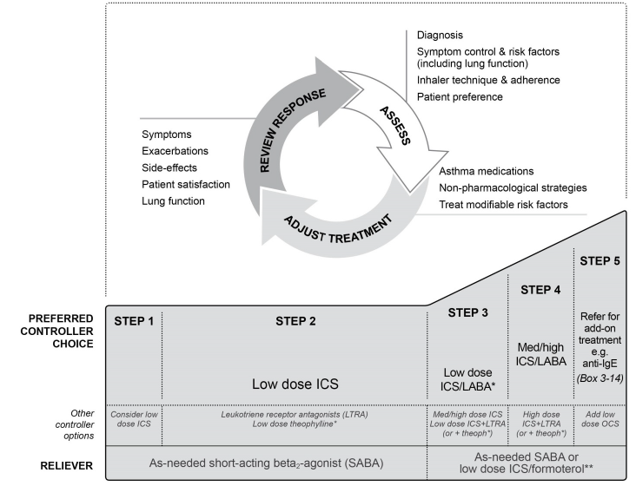

Slide 23
New aspects of asthma management
Confirming the importance of maintenance therapy
Except mild asthma
Major role of combination therapy (LABA/ICS)
Major focus on step-up and step-down
Using different strategy for assessing and maintaining the control
Monitoring symptoms, PEF and/or inflammation
Focus on severe asthma
Add tiotropium (triple therapy)
Add omalizumab
Add new biologics

Slide 24
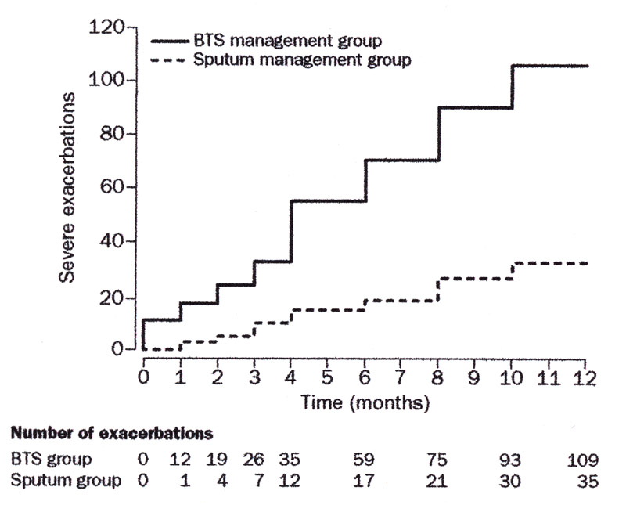
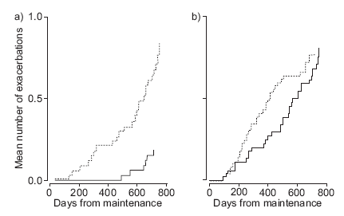
The control of sputum eosinophilia is associated
with a reduction in asthma exacerbations,
but only for eosinophilic exacerbations
Green et al, Lancet 2002
Jayaram et al, ERJ 2006

Slide 25
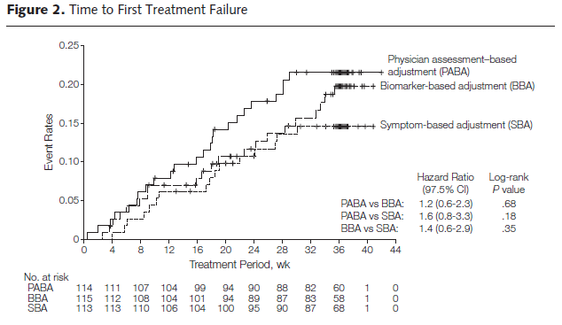
Biomarker-based or symptom-based adjustement of ICS is not superior to physician-based adjustment
Calhoun et al, JAMA 2013

Slide 26
New aspects of asthma management
Confirming the importance of maintenance therapy
Except mild asthma
Major role of combination therapy (LABA/ICS)
Major focus on step-up and step-down
Using different strategy for assessing and maintaining the control
Monitoring symptoms, PEF and/or inflammation
Focus on severe asthma
Add tiotropium (triple therapy)
Add omalizumab
Add new biologics

Slide 27
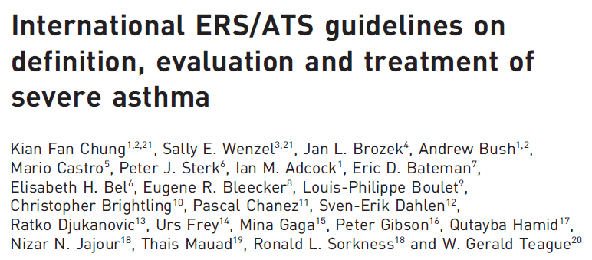

Slide 28
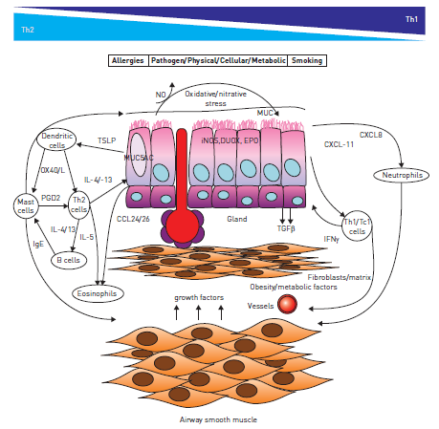
Severe asthma: heterogeneity of mechanisms
Chung et al,
ERJ 2014

Slide 29
Anticholinergics in asthma
Short-acting anticholinergics in asthma
Less effective than short-acting beta2-agonists
Recommended only in acute severe asthma attack
Tiotropium:
Largely used in COPD
Recent studies on tiotropium in asthma
Since 2007
Large RCTs with Tiotropium in Asthma (TinA)
In severe asthmatics (Primo-TinA: Kernstjen, NEJM 2012)
In moderate asthmatics (Mezzo-TinA: Kernstjen, LancetResp 2015)
In mild asthmatics (Grazia-TinA: Paggiaro, JACI 2015 under revision)

Slide 30
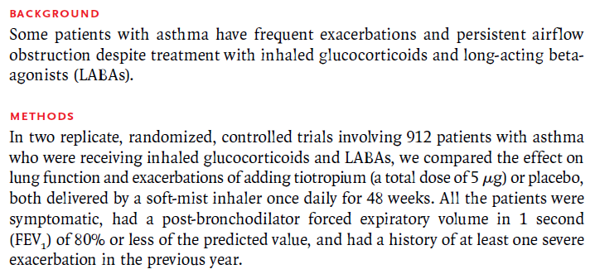

Slide 31
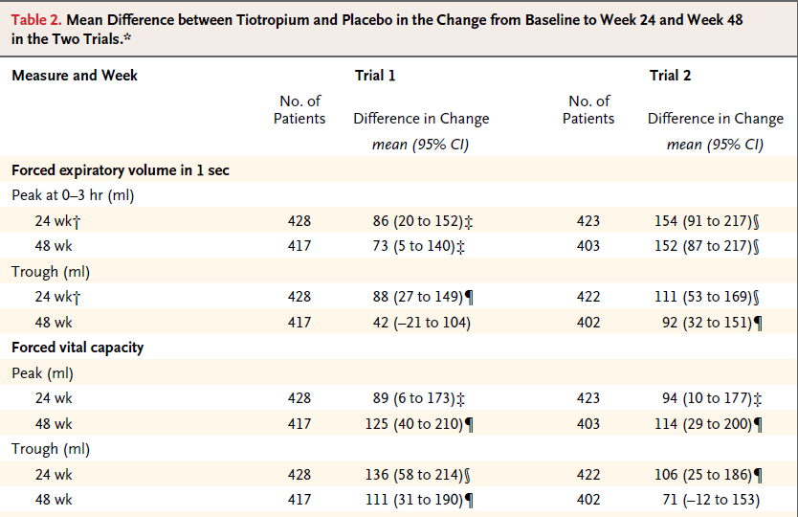
First two coprimary endopoints (FEV1)
Kerstjens et al, NEJM 2012

Slide 32
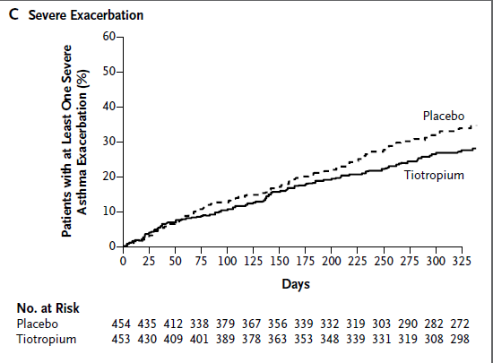
Third coprimary endopoint (severe exacerbations)
Severe exacerbation rate
- 21%
Time to first ex: + 56 days
NNT: 15
Minor changes in symptoms
- ACQ7
-0.09 in trial 1 (n.s.)
-0.13 in trial 2 (p=0.06)
- AQLQ
-0.04 in trial 1 (n.s.)
-0.18 in trial 2 (p=0.02)
Kerstjens et al, NEJM 2012

Slide 33
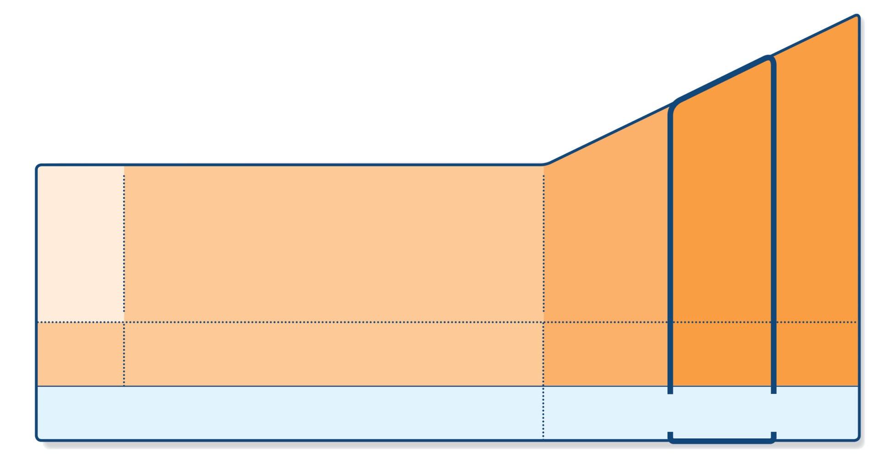
GINA 2015 – changes to Steps 4 and 5
STEP 5
STEP 4
PREFERRED CONTROLLER CHOICE
STEP 1
STEP 2
STEP 3
Refer for add-on treatment
e.g.
anti-IgE
Med/high ICS/LABA
Low dose ICS/LABA*
Low dose ICS
Other controller options
Consider low dose ICS
Leukotriene receptor antagonists (LTRA)
Low dose theophylline*
Med/high dose ICS
Low dose ICS+LTRA
(or + theoph*)
Add tiotropium#
High dose ICS + LTRA (or + theoph*)
Add tiotropium#
Add low dose OCS
As-needed short-acting beta₂-agonist (SABA)
As-needed SABA or low dose ICS/formoterol**
RELIEVER
*For children 6-11 years, theophylline is not recommended, and preferred Step 3 is medium dose ICS
**For patients prescribed BDP/formoterol or BUD/formoterol maintenance and reliever therapy
# Tiotropium by soft-mist inhaler is indicated as add-on treatment for patients with a history of exacerbations; it is not indicated in children <18 years.
GINA 2015, Box 3-5, Steps 4 and 5
© Global Initiative for Asthma

Slide 34
Triple therapy in asthma
Combination of ICS, LABA, LAMA
Different inhalers
Single inhaler (once daily vs twice daily)
Current position (EMA approved)
LAMA in addition to ICS/LABA
Severe uncontrolled asthma with exacerbations
Future perspectives
ICS + LAMA vs ICS + LABA
Advantages: safety vs efficacy vs asthma heterogeneity

Slide 35
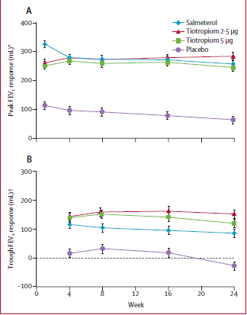
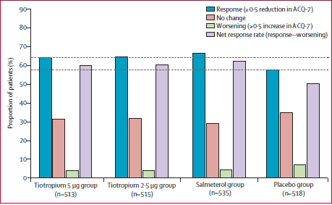
Tiotropium is effective when added to ICS in moderate asthma
Kerstjen et al, Lancet Respiratory 2015

Slide 36
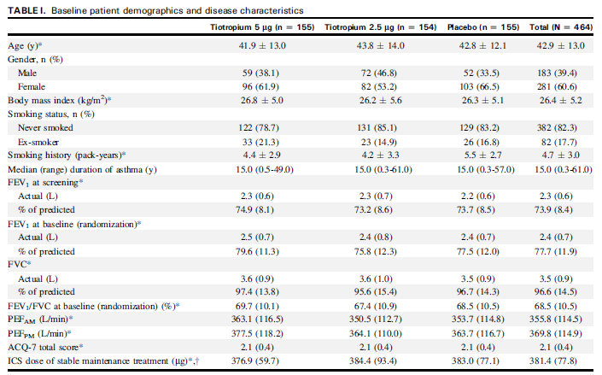

Slide 37
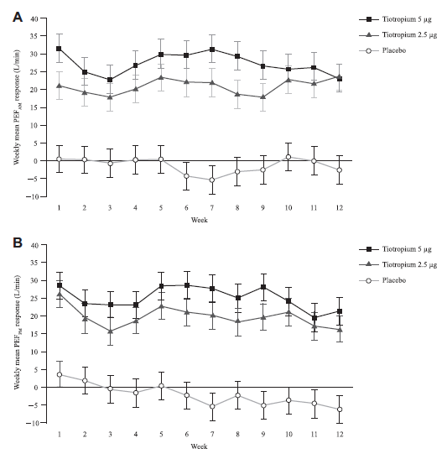
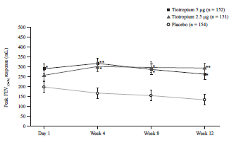

Slide 38
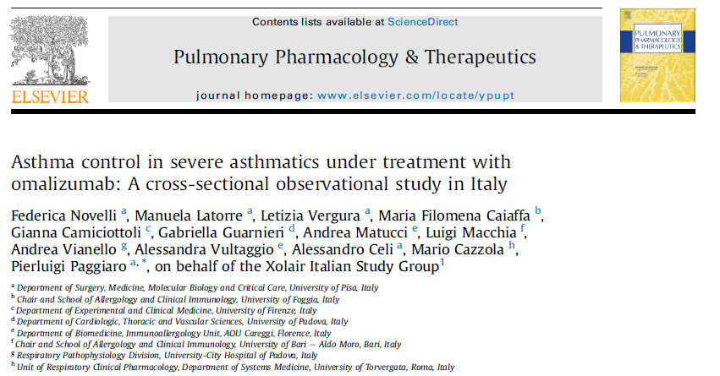

Slide 39
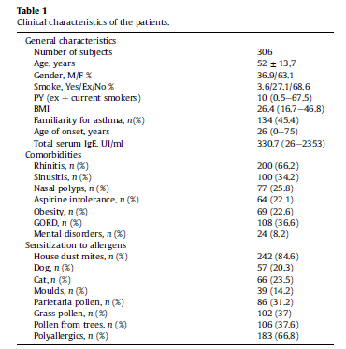
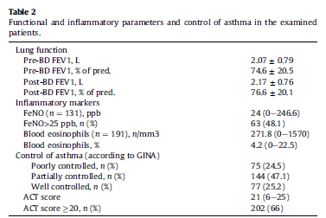
Novelli et al, Pulm Pharm Ther 2014

Slide 40
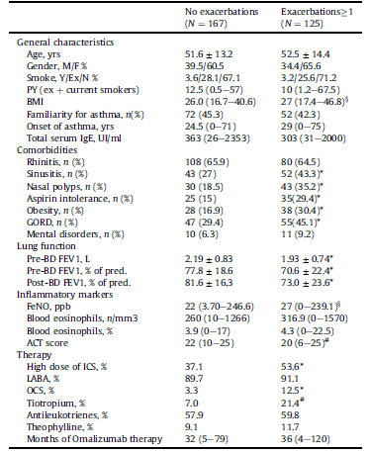
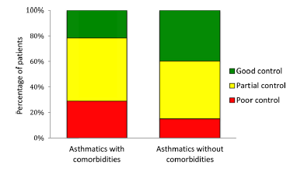
Novelli et al, Pulm Pharm Ther 2014

Slide 41
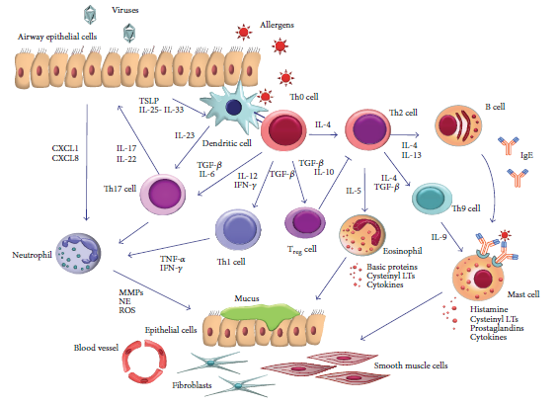
Different targets for intervention on the «inflammatory cascade»
Pelaia et al, Med Inflamm 2015

Slide 42
Future biologic drugs in asthma
Name | Target | Phase | Biomarkers
Mepolizumab | IL-5 | Phase III – EMA+ | Blood eos
Benralizumab | IL-5 R | Phase III | Blood eos
Reslizumab | IL-5 | Phae III | Blood eos
Lebrikizumab | IL-13 | Phase III | Periostin
Tralokinumab | IL-13 | Phase II-III | DPP-4, periostin (?)
Dupilumab | IL-4 | Phase III | ??
Brodalumab | IL-17 | Phase II | ??
??

Slide 43
New initiatives on severe asthma in Italy
PROXIMA - an observational, 2 phase, patient reported outcomes study
Level of asthma control
Impact on physical and emotional status
SANI – severe asthma network in Italy
GINA Italy, SIAIC, SIMeR

Slide 44
Main evolution in asthma guideline: «Asthma as a heterogeneous disease»
Identification of different phenotypes
According to etiology
According to pathogenesis
According to severity
Implication for treatment («target therapy»)
With current drugs
With biologic drugs
With allergen-immunotherapy
With thermoplasty
«tailoring» asthma approach

Slide 45
Asthma: from population-level to patient-level «personalized therapy»
GINA 2014

