Slide 1
IDIOPATHIC PULMONARY FIBROSIS: IT IS A MISNOMER
Venerino Poletti,
Dipartimento Malattie Apparato Respiratorie e del Torace, Azienda USL Romagna, Forlì/Ravenna (I)
Department of Respiratory Diseases & Allergy
Aarhus University Hospital (DK)

Slide 2
IPF: a diffuse disease limited to the lungs of unknown
cause or origin characterized by
UIP pattern in HRCT Scan or
UIP pattern in lung biopsy samples.

Slide 3
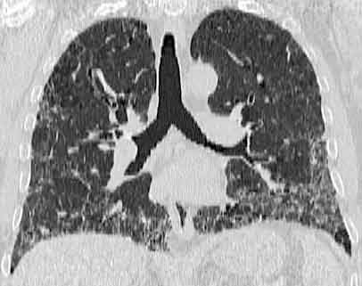
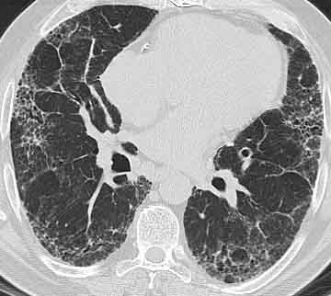
UIP pattern

Slide 4
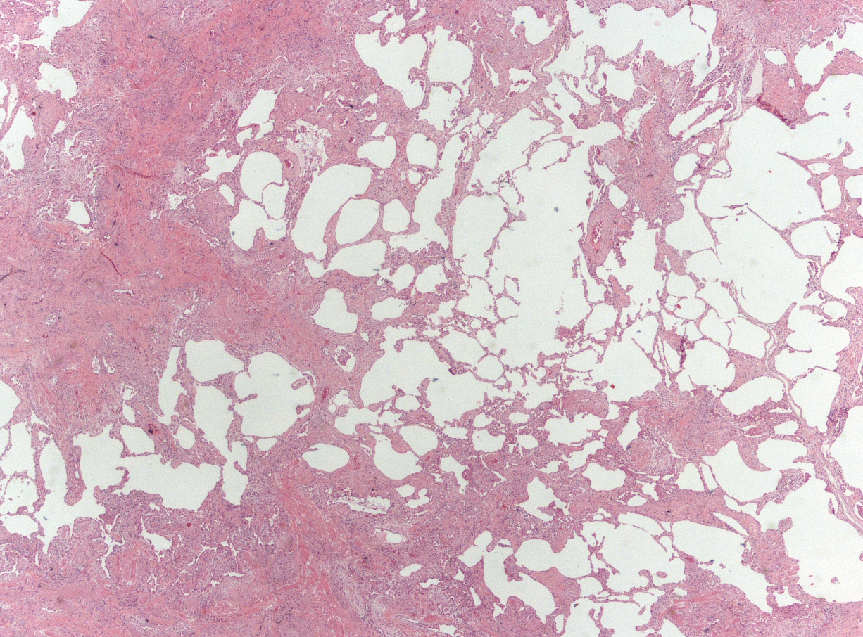
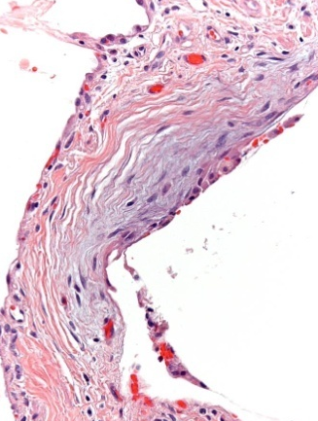
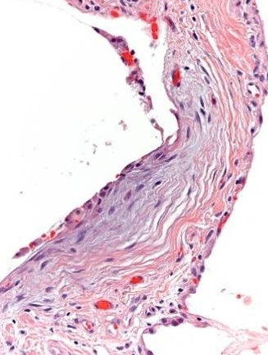
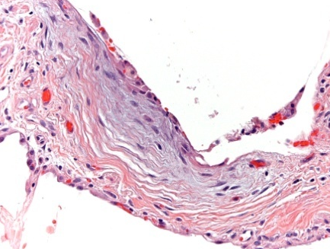
UIP pattern

Slide 5
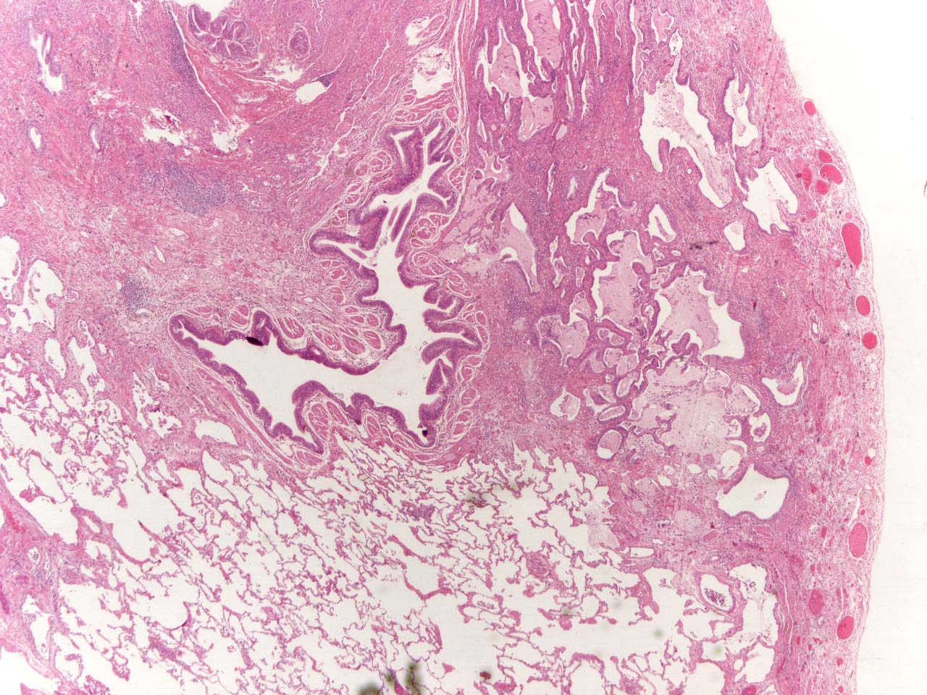
UIP pattern

Slide 6
IPF: a diffuse disease limited to the lungs of unknown
cause or origin characterized by
UIP pattern in HRCT Scan or
UIP pattern in lung biopsy samples.
  Unkown cause or origin
  Limited to the lungs
  Fibrosis

Slide 7
UNKNOWN CAUSE or ORIGIN

Slide 8
IPF: an envinromental disease
*Hubbard R, et al. Occupational exposure to metal or wood dust and etiology of
cryptogenic fibrosing alveolitis.
Lancet. 1996; 347: 284–289.
*Iwai K, et al. Idiopathic pulmonary fibrosis: epidemiologic approaches to
occupational exposures. Am J Respir Crit Care Med. 1994; 150: 670–675.
*Miyake Y, et al. Occupational and environmental factors and idiopathic pulmonary
fibrosis in Japan. Ann Occup Hyg. 2005; 49: 259–265.
*Taskar VS, Coultas DB. Is idiopathic pulmonary fibrosis an environmental disease?.
Proc Am Thorac Soc. 2006; 3:293–298.

Slide 9

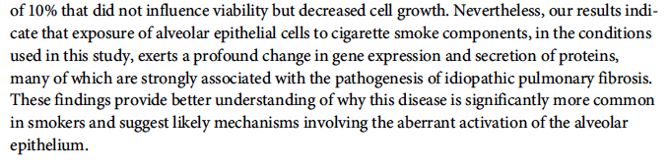
PLOSONE 2016

Slide 10
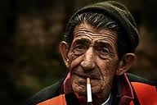
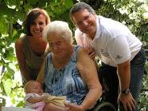

Our cohort of 311 italian IPF patients
Males N 192 (74%)
66 years (41-92)
Current and Former Smokers N 163 (63%)
FPF N 51 (19%) , from 26 families
Age 65 years (39-80)
Males N = 27 (52%)
Current or Former Smokers 59%
Females N 68 (26%)
66 years (33-84)
Never Smokers N 40, (58%)
unpublished data

Slide 11
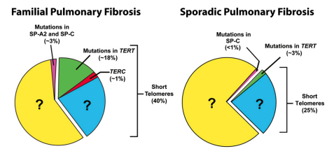
IPF , update on genetic discoveries
C.K. Garcia, Proc Am Thorac Soc Vol 8. pp 158–162, 2011
Notes:
Family members without TERT mutations have a shorter mean telomere
length than normal, demonstrating epigenetic inheritance of shortened telomere lengths in the absence of an inherited
TERT mutation.
- genes hTERT and hTR, encoding telomerase reverse transcriptase and telomerase RNA,
- Telomerase has two essential components: the catalytic protein encoded by TERT and the telomerase RNA (TERC) that provides
a template for the repeat sequence added in tandem to the ends of chromosomes.
Telomerase is a specialized polymerase that adds telomere repeats to the ends of chromosomes
In autosomal dominant dyskeratosis congenita,
anticipation can be seen in which phenotypes present
earlier and more severely in successive generations
Since the consequences of
carrying mutant telomerase genes can appear in
adulthood as either idiopathic pulmonary fibrosis
or aplastic anemia without dyskeratosis, the
consideration of such cases as part of a syndrome
of telomere shortening may heighten the index of
suspicion and facilitate diagnosis.

Slide 13
PNAS 2008

Slide 16
LIMITED TO THE LUNGS

Slide 17
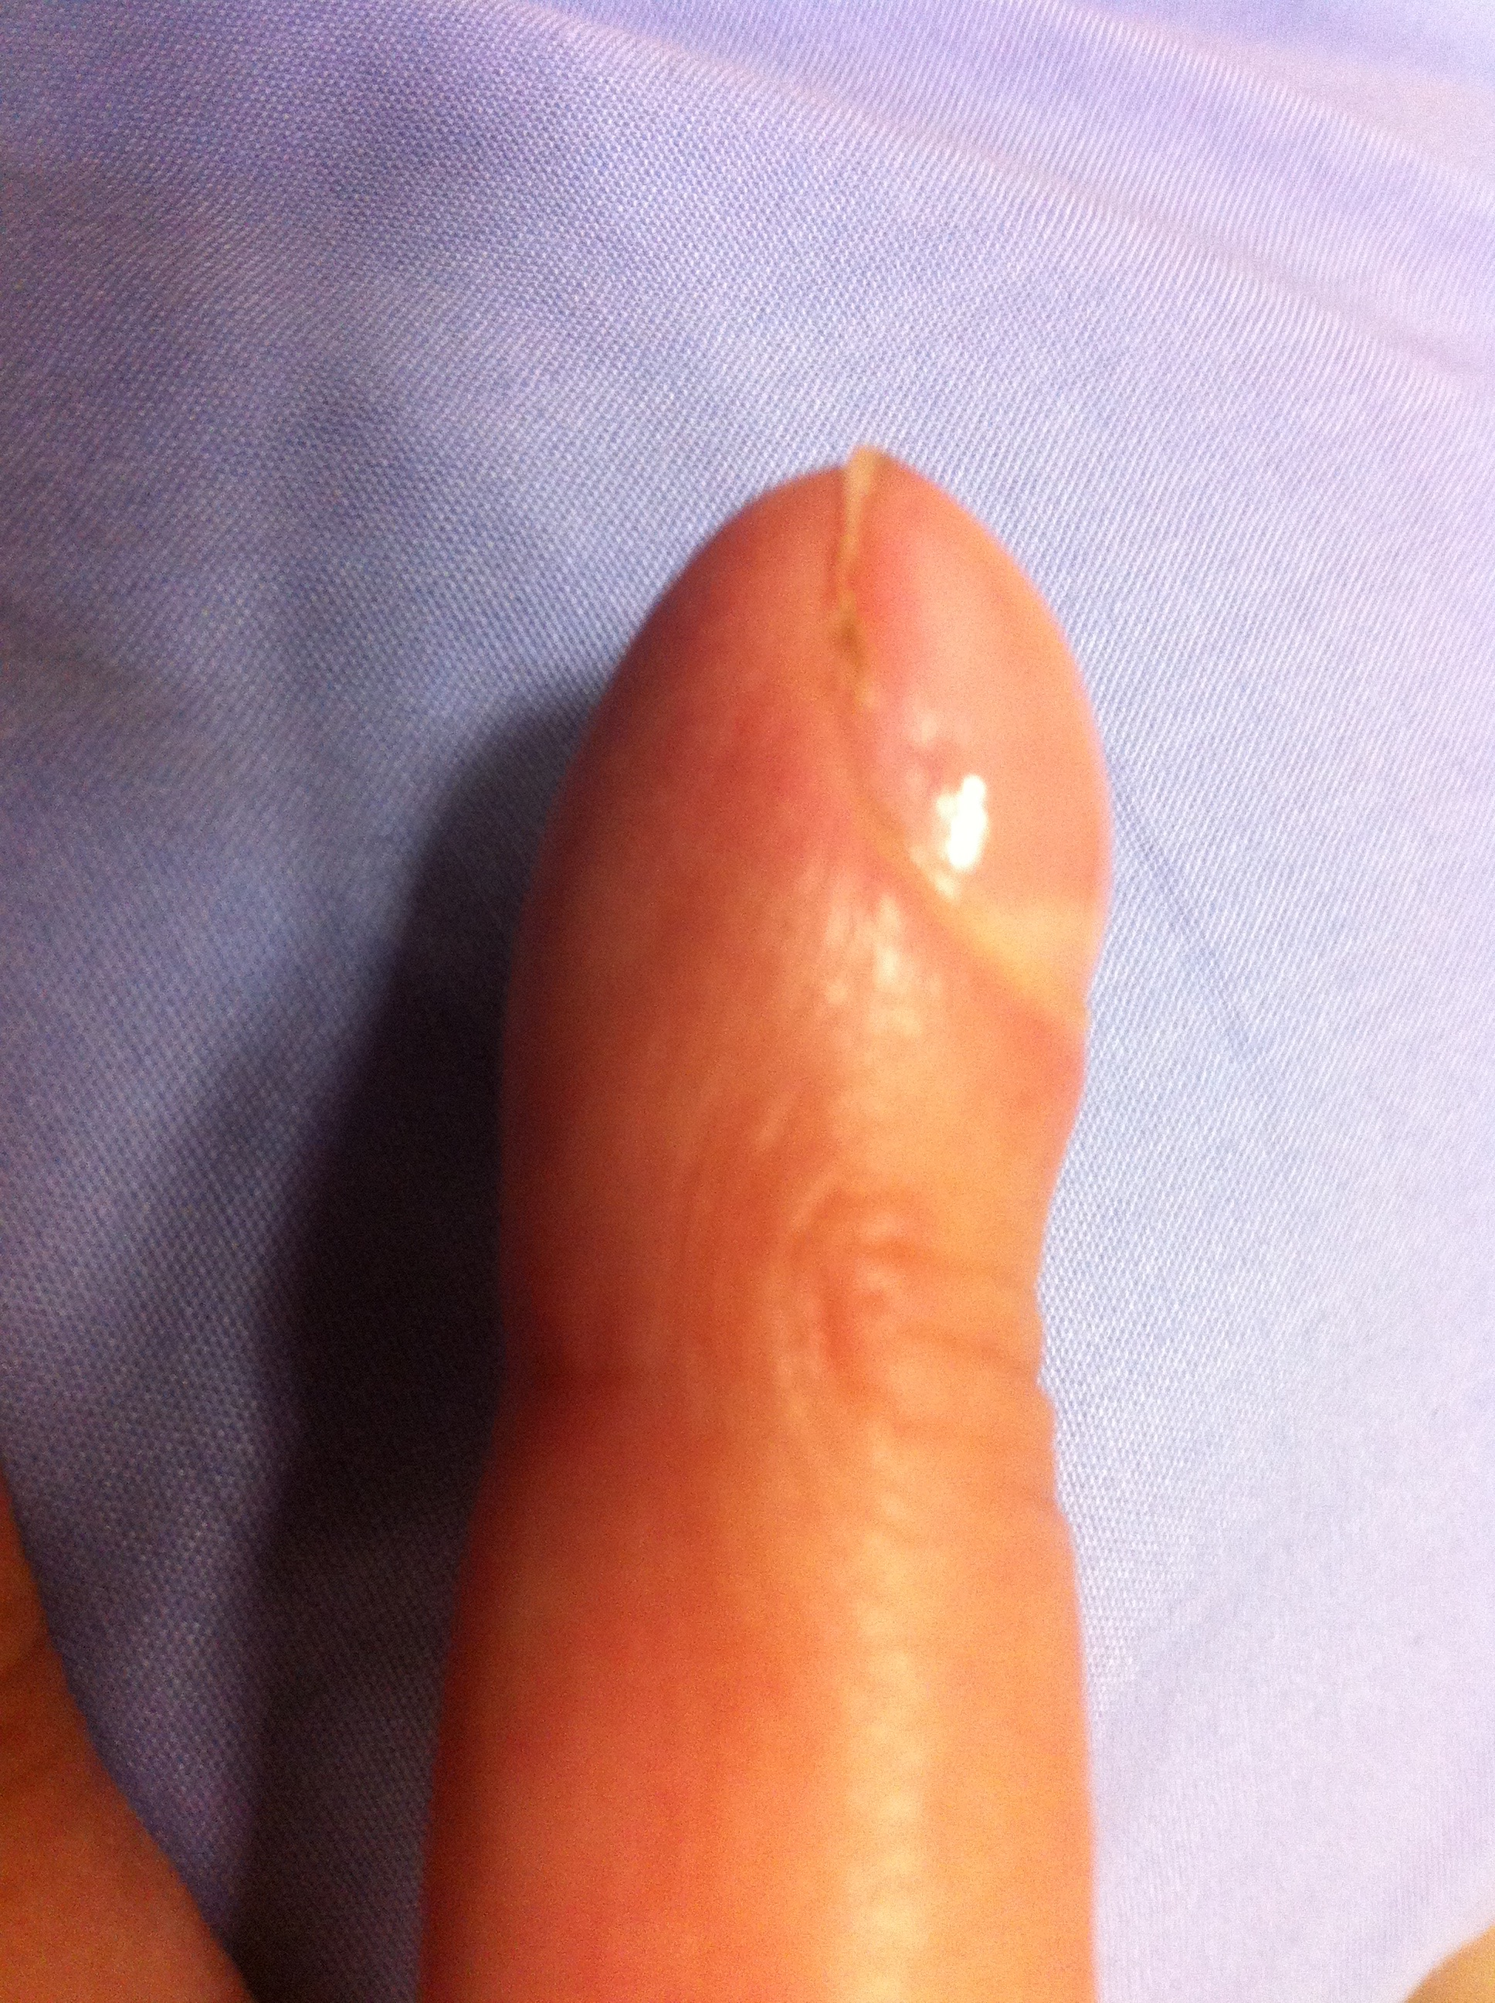
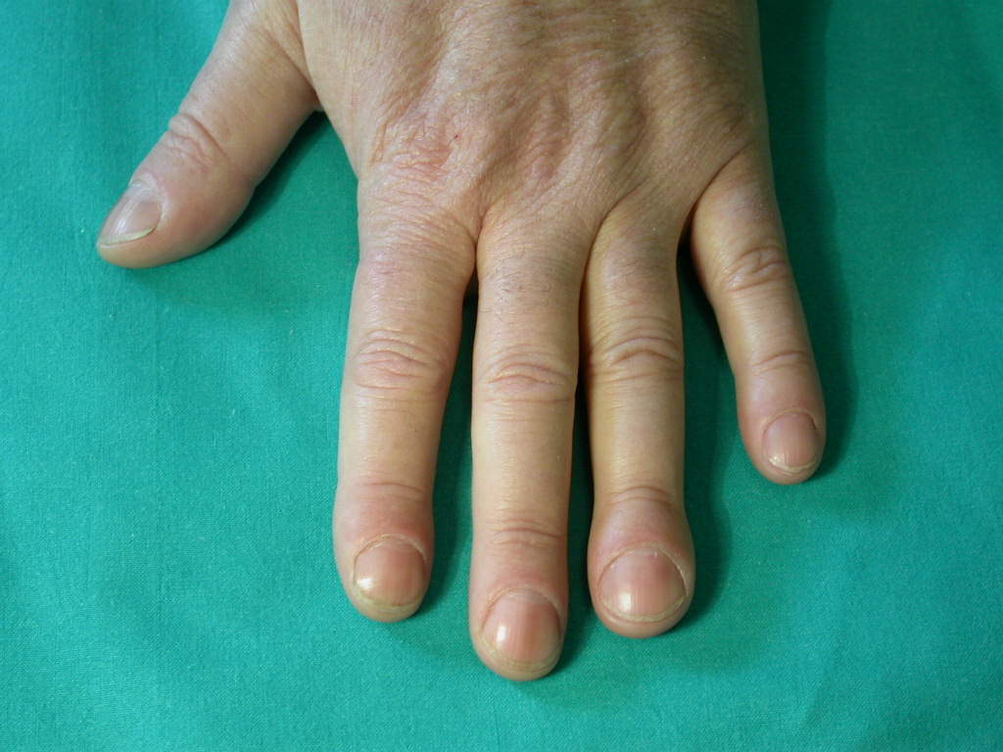
DIGITAL CLUBBING 25-50% of cases
Not related to hypoxemia

Slide 18
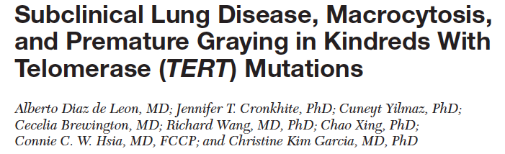
Chest 2011

Slide 19
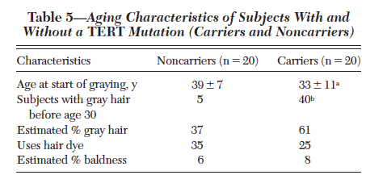

Slide 20
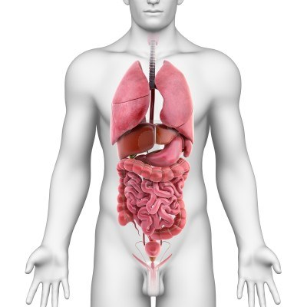
Telomeropathies heterozigous TERT mutations
Early hair graying
Hypothyroidism, 9%
Pulmonary Fibrosis 39%
Lung cancer 2%
GERD, 26%
Gastritis, 8%
Gastric cancer, 2%
Elevated LFTs, 8%
Anemia, 13%
Aplastic anemia, 3%
Lymphomas, 1.5%
Osteopenia/
osteoporosis, 26%
adapted from Diaz de Leon A, et al. PLoS ONE. 2010
Notes:
Strong association have been found with mutations in surfactant proteins and telomerase gene
2) Family members within kindreds who do not inherit the TERT mutation have shorter telomere lengths than controls,
demonstrating epigenetic inheritance of a shortened parental telomere length set-point.
20

Slide 21
FIBROSIS

Slide 22
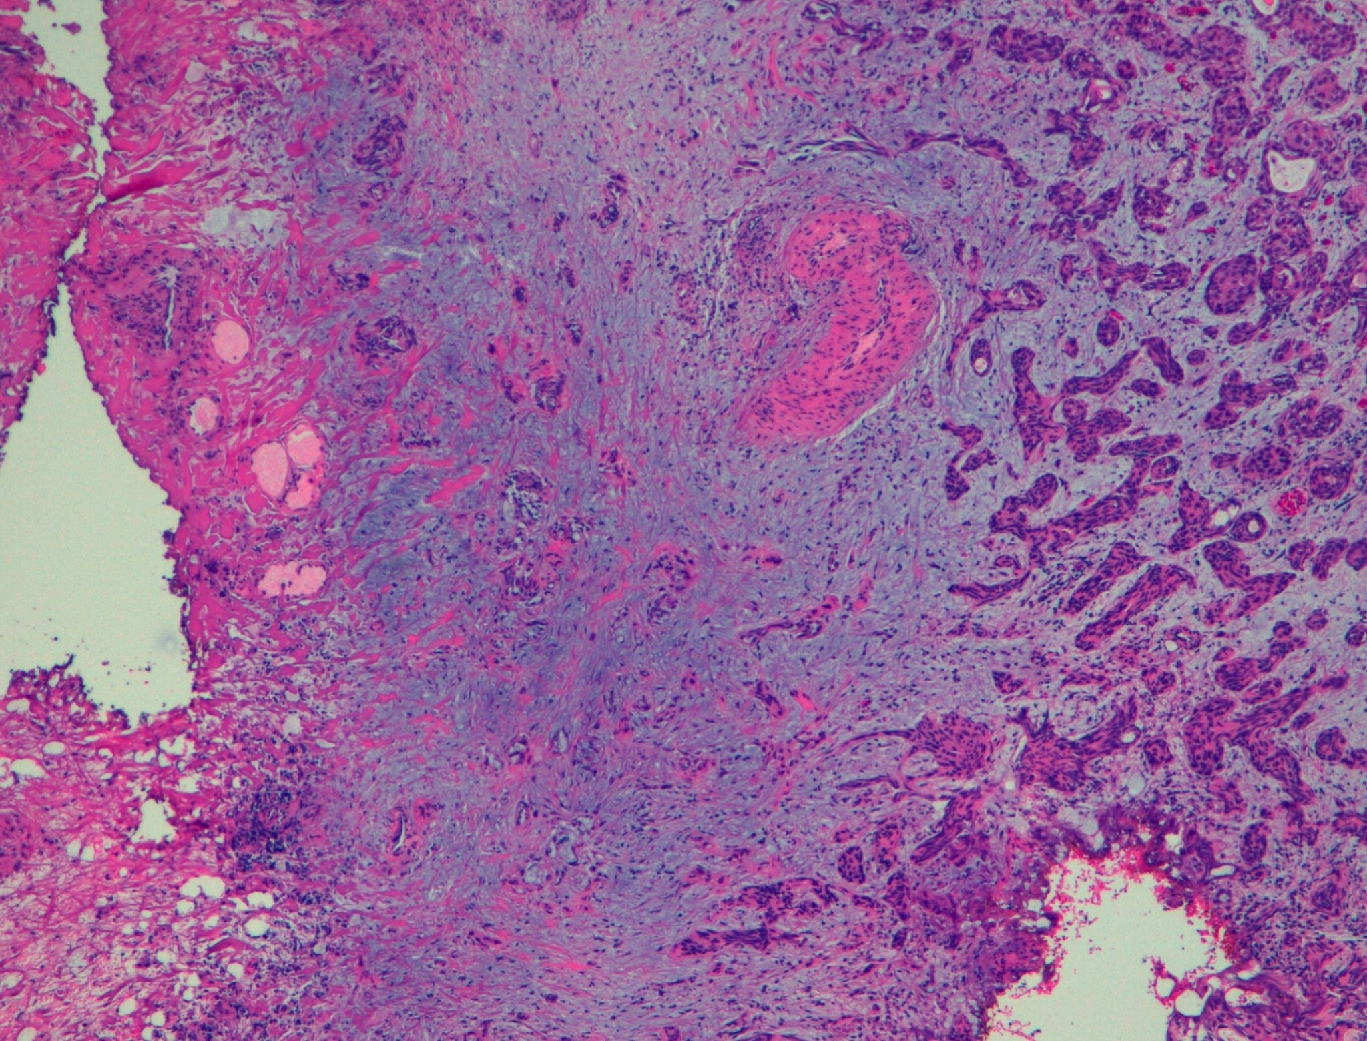
INFILTRATING BLADDER CANCER: IS IT A FIBROTIC DISEASE?

Slide 23
Lysil Oxidase
IL7, IL13…
Immunoaging/inflammation/
chronic colonization

Slide 24
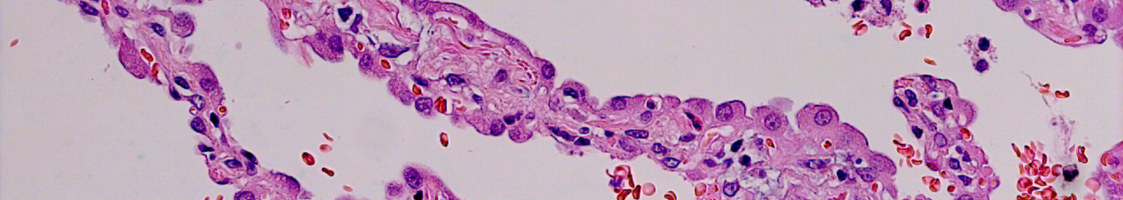
Progressive alveolar loss
PN-II attempted regeneration
Frustrated renewal
apoptosis
cMYC
WNT
WNT
SASP
Proliferative molecular signals
Bronchiolar proliferation
Honeycombing
Gremlin
BMP
OIS
Beta-Catenin
myofibroblast
proliferation
WNT
Vascular changes
neoangiogenesis
INTERSTITIAL FIBROSIS
Honeycombing
EMT
PAH

Slide 25
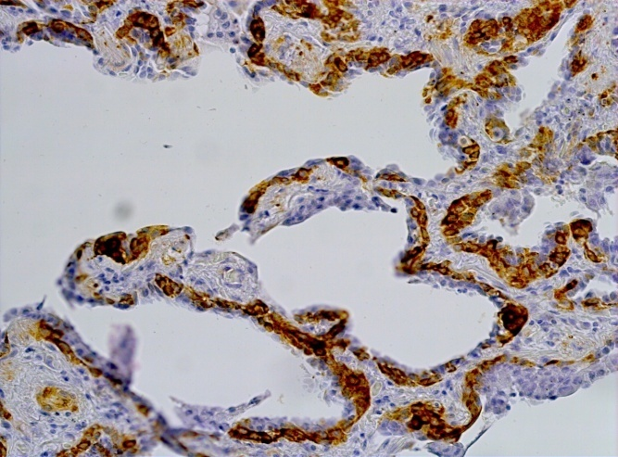
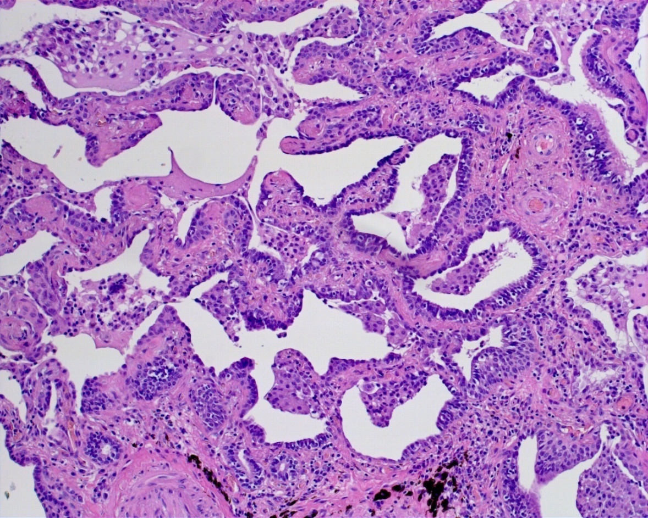
Bronchiolar hyperplasia
Alveolar cells
Columnar cells
Basal cells
ΔN-p63

Slide 26
UIP pattern

Slide 27
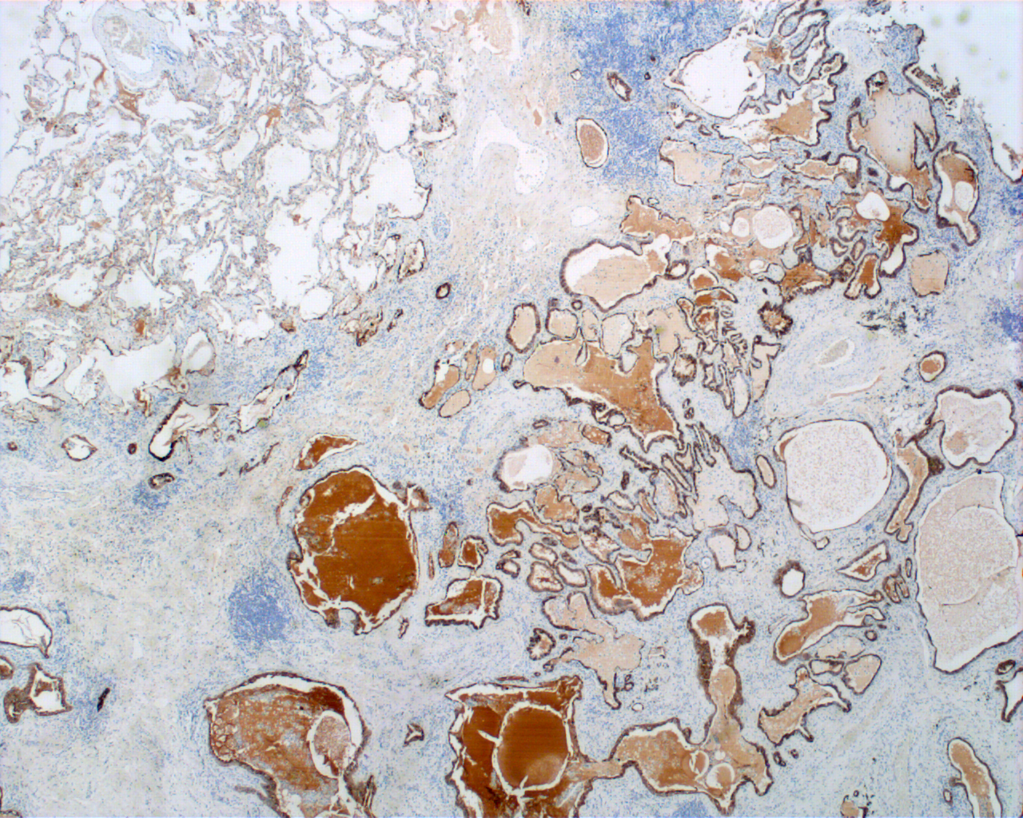
HONEYCOMBING: BRONCHIOLAR DYSPLASTIC PROLIFERATION

Slide 28
IPF: IT IS A MISNOMER
IDIOPATHIC
Smoking habit/genetic mutations
FIBROSIS
Alveolar stem cell exhaustion/failure; bronchiolar dysplastic
proliferation. Fibrosis could be considered an “epiphenomenon”
LIMITED TO THE LUNGS
Digital clubbing
Early hair graying
Macrocytosis
Liver “fibrosis”
………………………..

