Slide 1


PNEUMOTRIESTE 2016
Trieste, 11-13 Aprile 2016
La funzione respiratoria
nel soggetto anziano
Claudio Tantucci
Università degli studi di Brescia

Slide 2
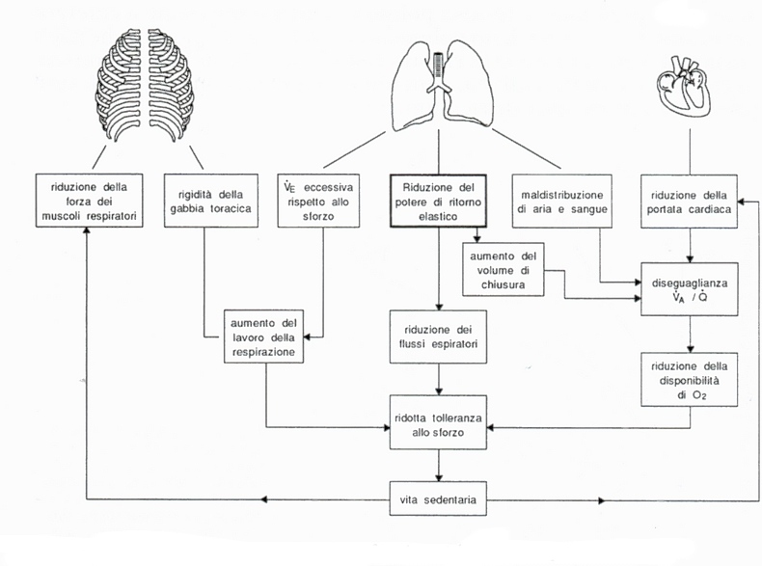
The ageing and respiratory system
Decondizionamento
muscoli locomotori
FLE
Iperinflazione dinamica

Slide 3
The aging pump

Slide 4
Ageing and Control of breathing
Reduced ventilatory (ΔVE) and neuro-muscular response (ΔP0.1) to chemical stimuli (50% - 60%)
(more in women than in men ?)
  Kronenberg RS, Drage CW. Attenuation of the ventilatory and heart rate response to hypoxia and hypercapnia with aging in normal men. J Clin Invest 1973; 53: 1812-1819.
  Peterson DD, Pack AI, Silage DA, Fishman AP. Effects of aging on the ventilatory and occlusion pressure
  responses to hypoxia and hypercapnia. Am Rev Respir Dis 1981; 124: 387-391.
  Brischetto M, Millman D, Peterson D et al.. Effects of aging on ventilatory response to exercise and CO2. JAP 1984; 56:1143-1150.

Slide 5
Ageing and Control of breathing
Reduced ventilatory (ΔVE) and neuro-muscular response (ΔP0.1) to chemical stimuli (50% - 60%)
(more in women than in men ?)
  Kronenberg RS, Drage CW. Attenuation of the ventilatory and heart rate response to hypoxia and hypercapnia with aging in normal men. J Clin Invest 1973; 53: 1812-1819.
  Peterson DD, Pack AI, Silage DA, Fishman AP. Effects of aging on the ventilatory and occlusion pressure
  responses to hypoxia and hypercapnia. Am Rev Respir Dis 1981; 124: 387-391.
  Brischetto M, Millman D, Peterson D et al.. Effects of aging on ventilatory response to exercise and CO2. JAP 1984; 56:1143-1150.
Unchanged ventilatory (ΔVE) and neuro-muscular response (ΔP0.1) to chemical stimuli
  Smith WD, Cunningham DA, Poulin MJ et al.. Ventilatory response to isocapnic hypoxia in the eighth decade. Adv Exp Med Biol 1995; 393:267-270.
  Pokorski M, Marczak M. Ventilatory response to hypoxia in elderly women. Ann Hum Biol 2003; 30:53-64.
  Rubin S, Tack M, Cherniack N. Effects of aging on respiratory response to CO2 and inspiratory resistive loads. J Gerontol 1982; 37:306-312.

Slide 6
Ageing and Control of breathing
Decreased ventilatory load compensation
  Trak M, Altose M, Cerniack N. Effects of ageing on respiratory sensation produced by elastic loads. JAP 1981; 50:844-850.
  Trak M, Altose M, Cerniack N. Effects of aging on the perception of resistive ventilatory loads. ARRD 1982; 126:463-467.
  Akiyama Y, Nishimura M, Kobayaski S, et al.. Effects of aging on respiratory load compensation and dyspnea sensation. Am Rev Respir Dis 1993; 148: 1586-1591.

Slide 7
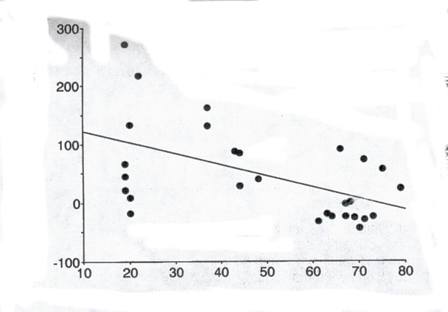
Effect of ageing on respiratory load compensation
Percent increase in neuro-muscular response to progressive hypercapnia under external resistive load
r = 0.53
p = 0.01
Δ P0.1/PetCO2 (% del basale)
Età (anni)
Akiyama et al. ARRD 1993, 148:1586

Slide 8
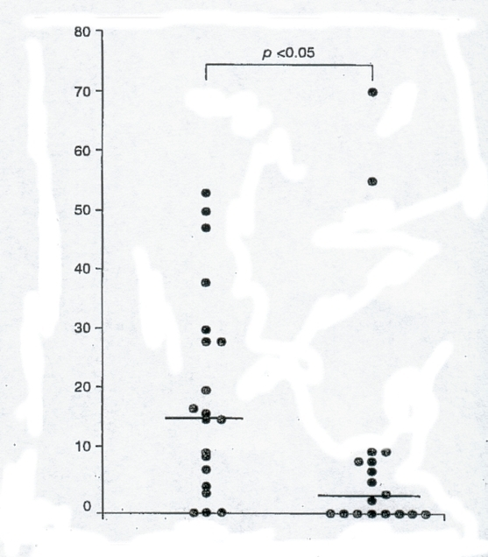
Minore percezione della dispnea
in presenza di broncocostrizione
Asma di comparabile durata e gravità
(FEV1 % pred.)
Punteggio VAS (mm)
asmatici giovani
asmatici anziani
Battaglia S et al. Aging Clin Exp Res 2005; 17:287-292

Slide 9
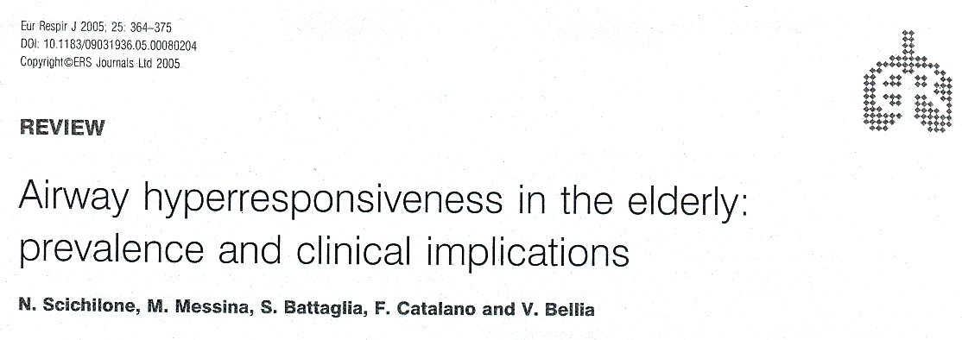
Overall, the analysis shows a positive association between (older) age and increased airway responsiveness.
Reduced lung function (because of geometrical factors),
hystory of smoking (because of the length of exposure)
and documented atopy are the most important determinants.
Alteration of autonomic nervous system control ?
(because of cholinergic/adrenergic unbalance)
Asymptomatic airway (neutrofilic) inflammation ?
(because of reduced airway-lung interdependence)
Scichilone et al. ERJ 2005, 25:364

Slide 10
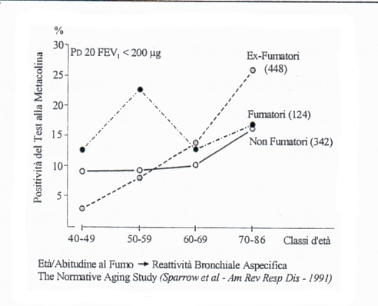
Bronchial hyperespnsiveness (BHR)
Effect of ageing

Slide 11
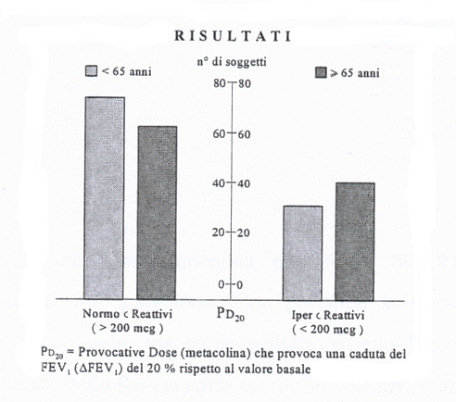
Bronchial hyperresponsiveness (BHR)
Effect of ageing

Slide 12
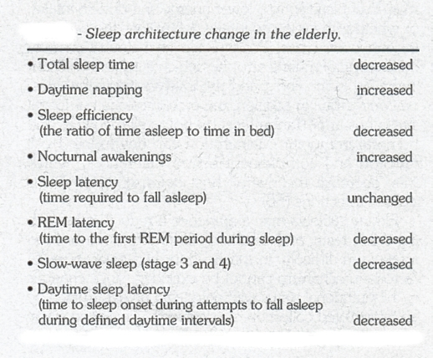
Sleep in the elderly
Rossi A, Tantucci C et al. Aging Clin Exp Res 1996; 143:161

Slide 13
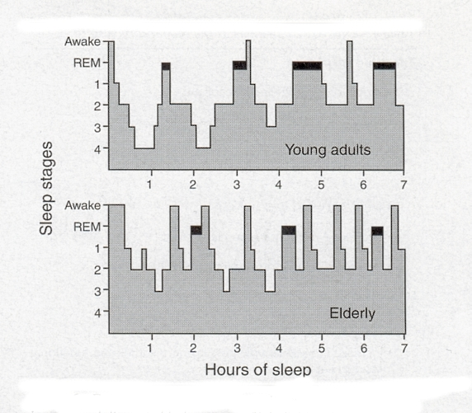
Rossi A, Tantucci C et al. Aging Clin Exp Res 1996; 143:161

Slide 14
During sleep..
13 to 62% of elderly subjects suffer from
OSA (AHI >10)
Respiratory effort in response to upper
airway occlusion is decreased
(because of lower perception of added resistive loads and less respiratory load compensation and also
reduced inspiratory muscles performance)
However, mean apnea duration was not
significantly prolonged
  Jansenn JP, Pautex S, Hilleret H et al.. Sleep disorderd in the elderly. Aging Clin Exp Res 2000; 12:417-429.
  Krieger J, Sforza E, Boudewijns a et al.. Respiratory effort during obstructive sleep apnea : role of age and sleep state, Chest 1997; 11:875-884.

Slide 15
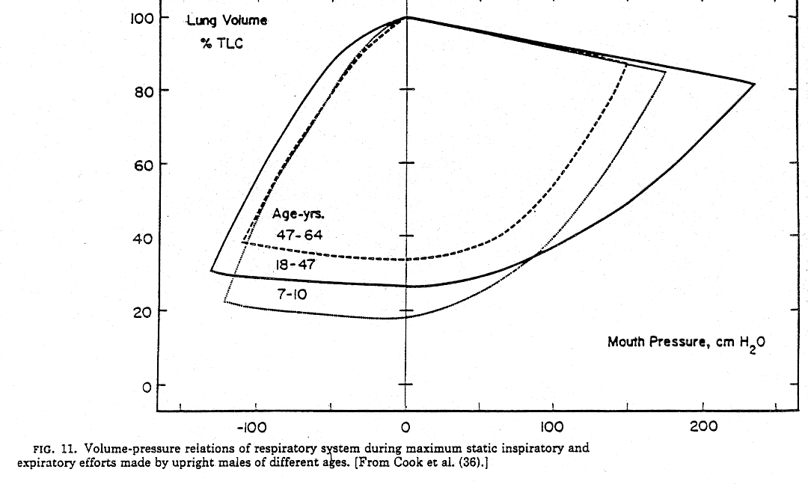
Respiratory Muscles and ageing
Decreased strength
(age-related structural, functional and metabolic changes)
Functional weakness
(geometrical factors, nutritional status, energy availability)

Slide 16
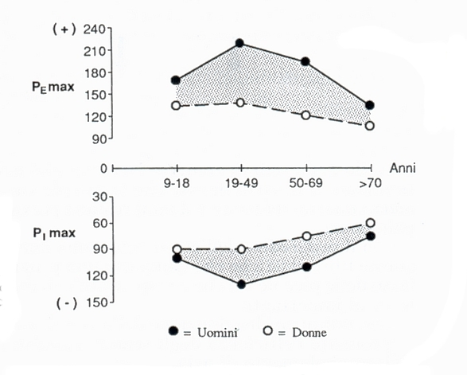
Rossi A, Tantucci C et al. Aging Clin Exp Res 1996; 143:161

Slide 17
Valori normali
 | Età | Sniff Pna FRC | MIP FRC | MIP RV
 | anni | cm H2O | cm H2O | cm H2O
Uomini | 20-65 | 111 (63-159) | 106 (60-152) | 115 (67-163)
 | 66-80 | 91 (48-134) | 82 (37-127) | 90 (40-140)
Donne | 20-65 | 87 (51-123) | 83 (45-121) | 84 (46-122)
 | 66-80 | 75 (53-97) | 58 (26-90) | 67 (33-101)
Da Uldry e Fitting

Slide 18
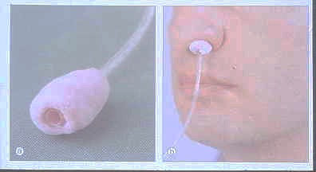
Sniff e Pna

Slide 19
Valori normali
 | Età | MEP FRC | MEP TLC
 | anni | cm H2O | cm H2O
Uomini | 20-65 | 130 (72-188) | 146 (72-120)
 | 66-80 | 102 (38-166) | 118 (40-196)
Donne | 20-65 | 86 (46-126) | 101 (45-157)
 | 66-80 | 69 (33-105) | 79 (37-121)
Da Uldry e Fitting

Slide 20
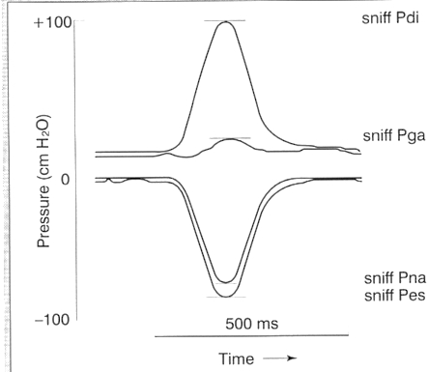
< - 60/50 cmH2O per escludere una importante debolezza dei m. inspiratori

Slide 21
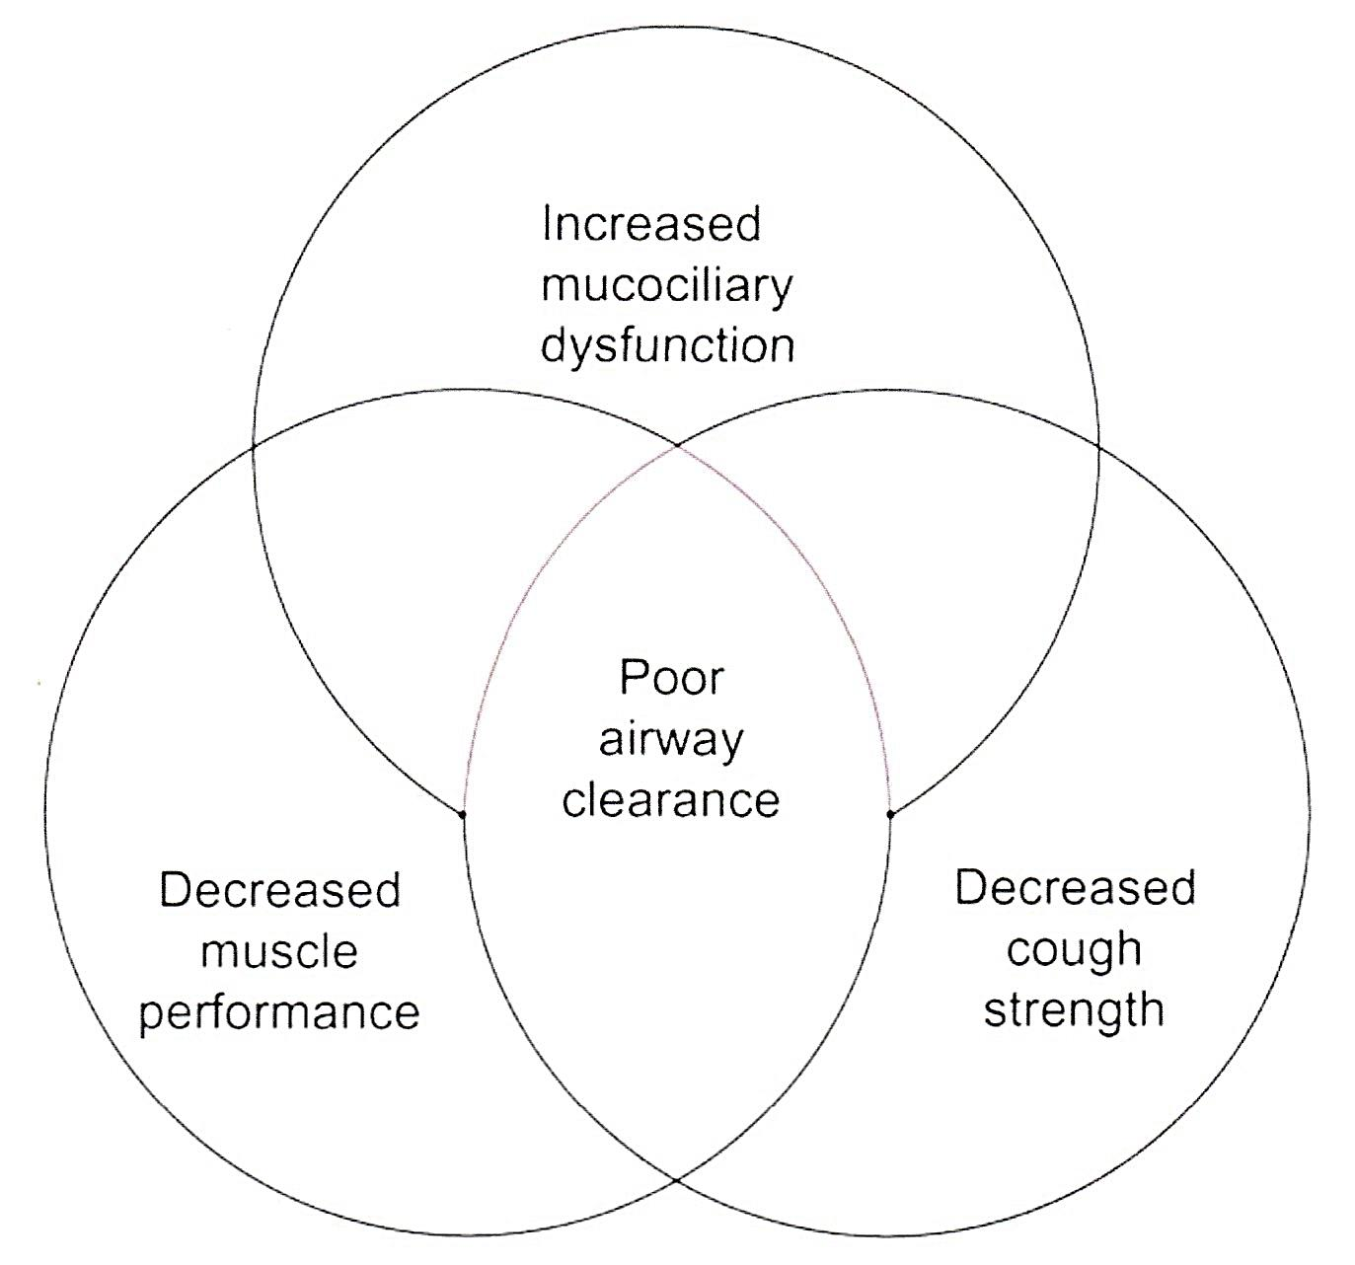
Le modificazioni funzionali nell’Ageing che pongono i pazienti anziani a rischio di una inefficace clearance delle vie aeree.

Slide 22
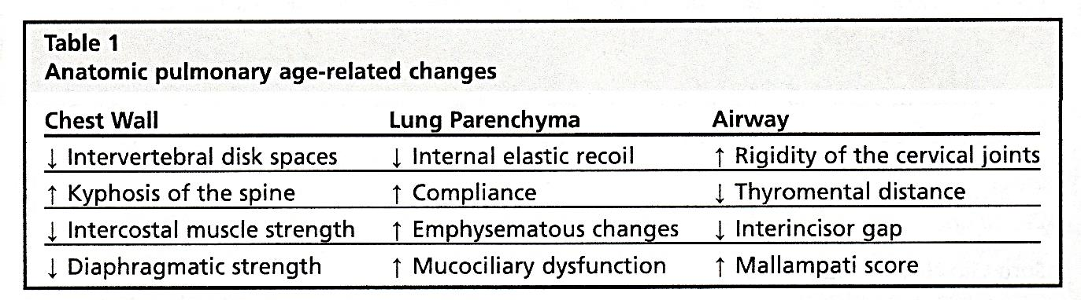
Chest Wall
Reduced compliance of CW (about 30%)

Slide 23
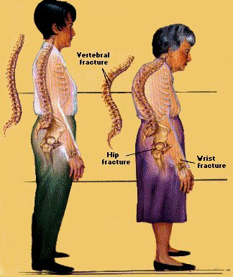
Thoracic vertebral fractures
Thoracic vertebral fractures
Consequences on respiratory function:
alteration of respiratory pattern
decrease in lung volumes with restrictive ventilatory defect (about 9% fall of FVC for each
thoracic vertebral fracture)
(Leech JA, 1990)
respiratory muscle dysfunction
(Lisboa C, 1985)

Slide 24
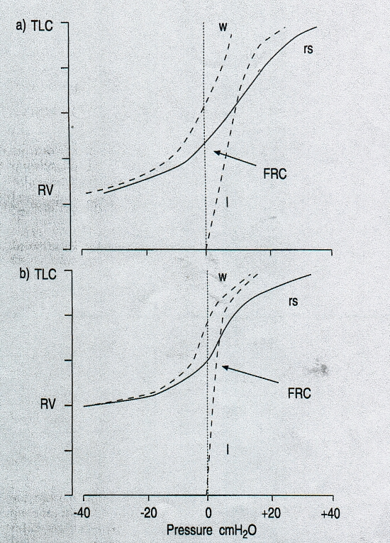
Chest Wall
The chest wall V-P static relationship
Is less steeper and shifted to the right.
The chest wall recoil would
amount to 30-40% of the
recoil of the RS at full inflation.
During normal breathing
rib cage expansion acounts for
about 40% of the change in lung
volume in young persons and
about 30% in the elderly.
Greater static elastance of RS at Vt
(increased WOB)
However, due to larger decrease
in the lung elastic recoil, we have
higher relaxation volume (Vr) of RS
(increase in FRC and decrease in IC)
young
elderly
l = lung
w = chest wall
rs = respiratory system

Slide 25
The aging lung

Slide 26
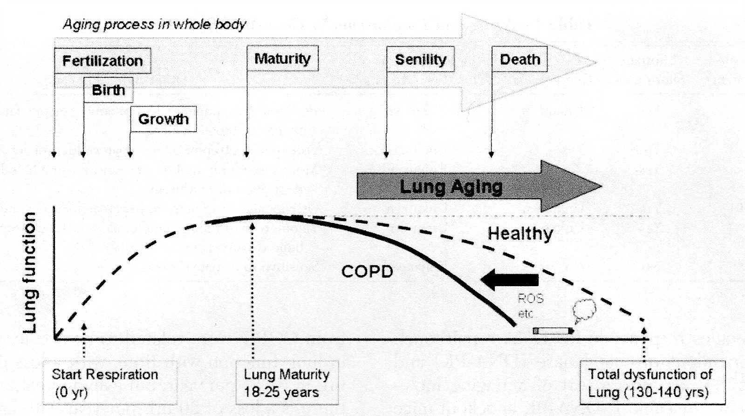
Invecchiamento del polmone
L’esposizione ambientale (per es. stress ossidativo, il fumo di sigaretta, l’inquinamento ambientale) accelera il deficit di funzione ageing-dipendente
(K. Ito, P.J. Barnes – CHEST 2009)

Slide 27
Ageing : i meccanismi implicati
Accorciamento dei telomeri
Senescenza cellulare (immuno-senescenza – immune-aging)
Stress ossidativo
Disfunzione mitocondriale
Attivazione mTOR
Autofagia difettosa
Difettose molecole e vie anti-invecchiamento
Esaurimento delle cellule staminali
Meccanismi epigenetici

Slide 28
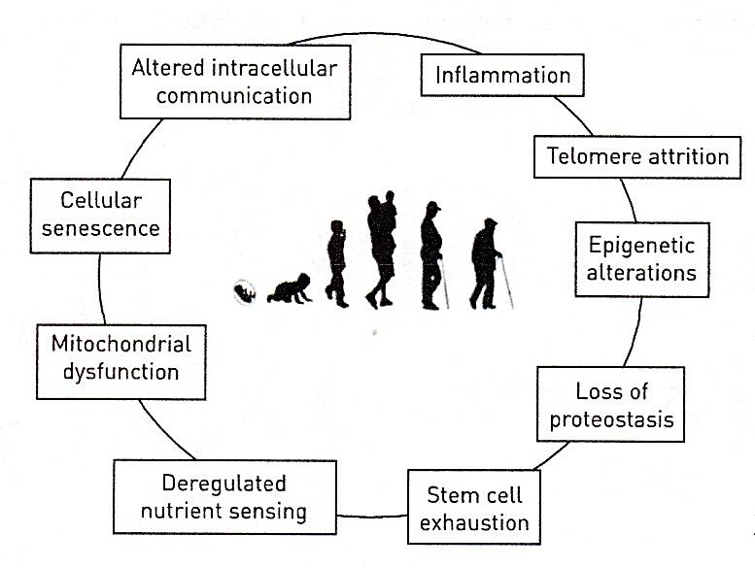
Gli hallmarks dell’Ageing

Slide 29
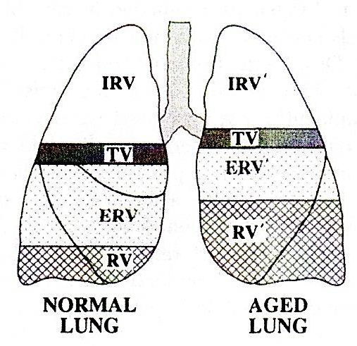
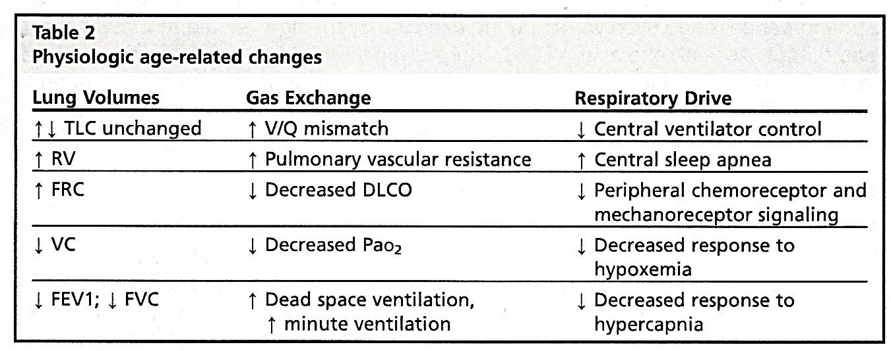
Durante l’invecchiamento il tessuto polmonare si deteriora progressivamente e l’infiammazione polmonare anch'essa progressivamente aumenta determinando modificazioni strutturali a livello del parenchima polmonare e delle piccole vie aeree.
Rappresentazione schematica delle modificazioni dei volumi polmonari associate all’Ageing

Slide 30
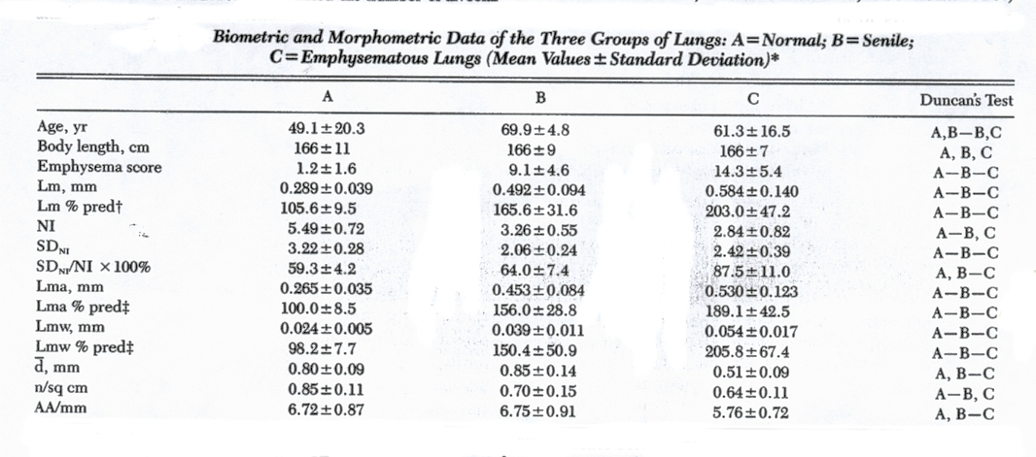
control (12)
senile (6)
Emphysematous CLE (11)
Verbeken EK et al., Chest 1992; 101:793-799

Slide 31
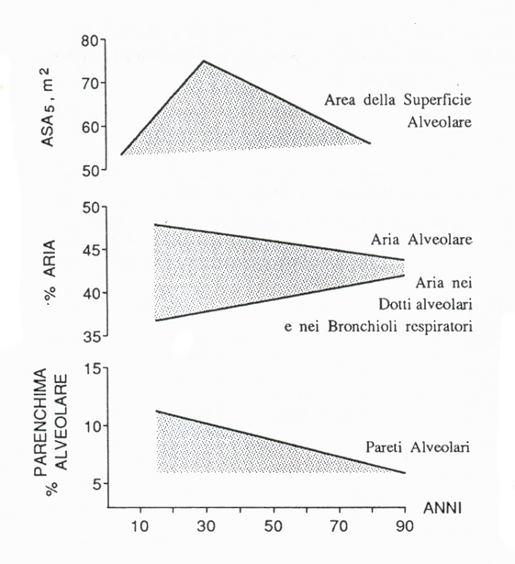
Rossi A, Tantucci C et al. Aging Clin Exp Res 1996; 143:161

Slide 32
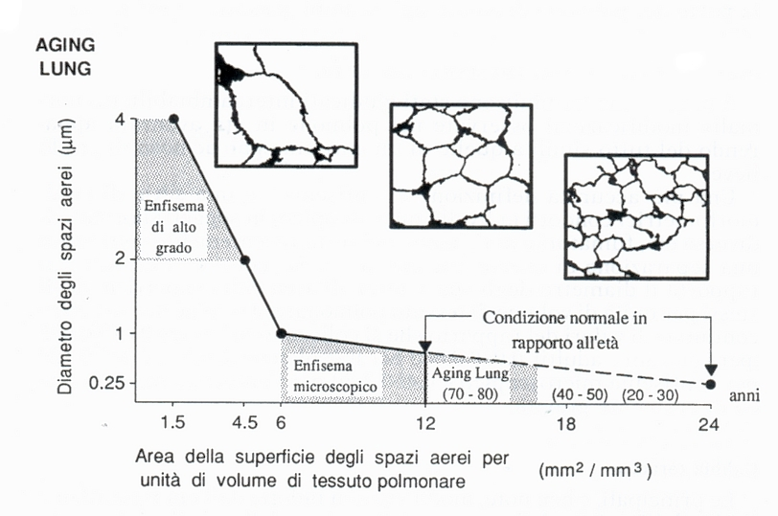
SMP-30
Rossi A, Tantucci C et al. Aging Clin Exp Res 1996; 143:161

Slide 33
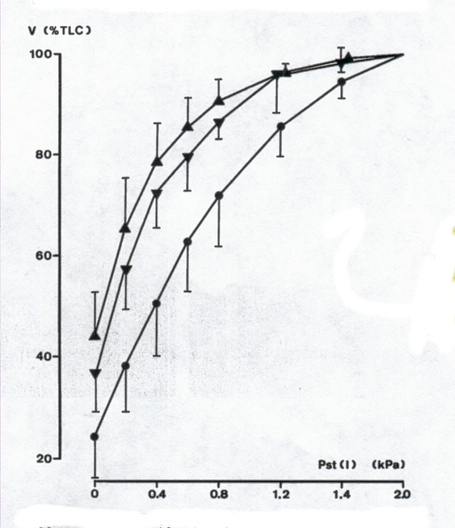
Static P-V curve of the lung
emphysematous (11)
senile (6)
control (12)
Verbeken EK et al., Chest 1992; 101:800-809

Slide 34
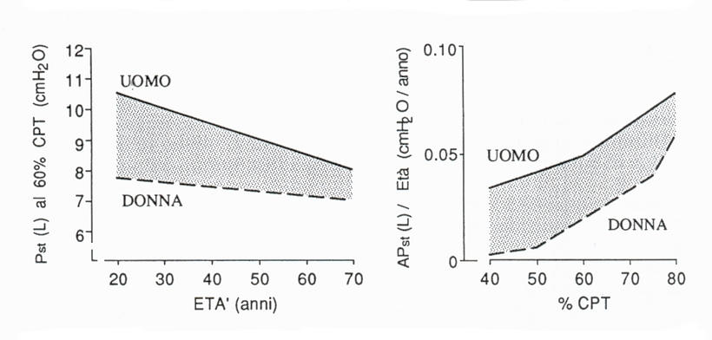
Elastic recoil pressure of the lung
Rossi A, Tantucci C et al. Aging Clin Exp Res 1996; 143:161

Slide 35
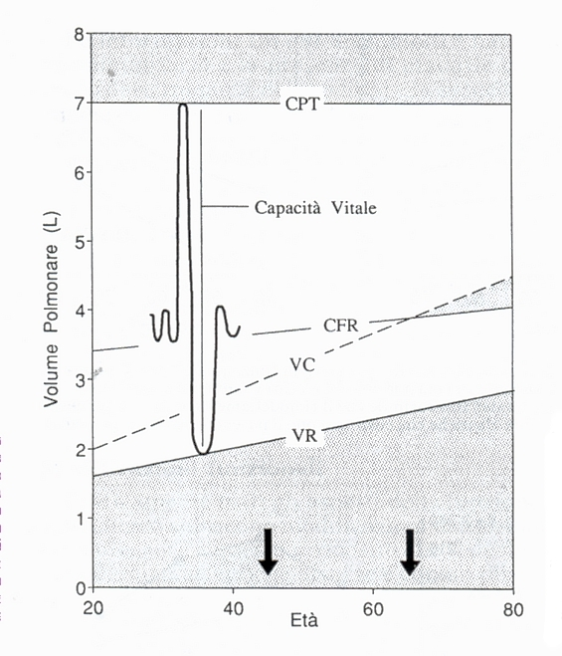
Age-related decrease in
lung elastic recoil leads
to lower distending pressures
of the intra-parenchymal
airways
Premature small airway closure
during exalation and greater
residual volume
Capacità inspiratoria

Slide 36
Volume residuo:
determinanti fisio-patologici
Minima “ compliance” del sistema respiratorio ai bassi volumi polmonari
Chiusura delle vie aeree a volumi più alti
(a pressioni transmurali bronchiali meno neg.)
Tempo di apnea
Riduzione della forza dei muscoli esp.

Slide 37
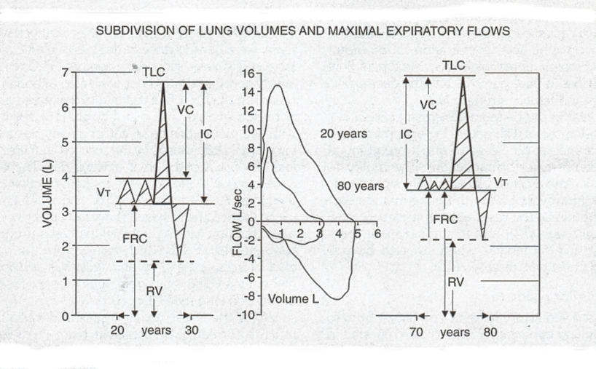
Rossi A, Tantucci C et al. Aging Clin Exp Res 1996; 143:161

Slide 38
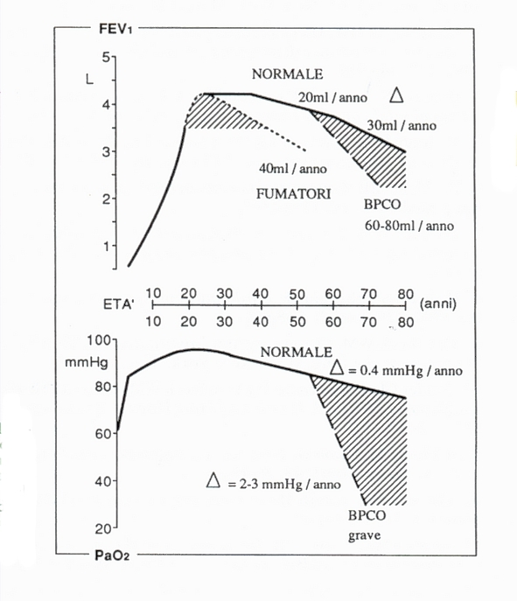
Rossi A, Tantucci C et al. Aging Clin Exp Res 1996; 143:161

Slide 39
SHORTCOMINGS OF FEV₁/FVC%
IN DEFINING AIRFLOW OBSTRUCTION
80
75
False negative
70
FEV₁/FVC (%)
False positive
65
60
25
50
75
Age (yr)
Enright PL, Kaminsky DA. Respiratory Care 2003;48:1194-1203

Slide 40
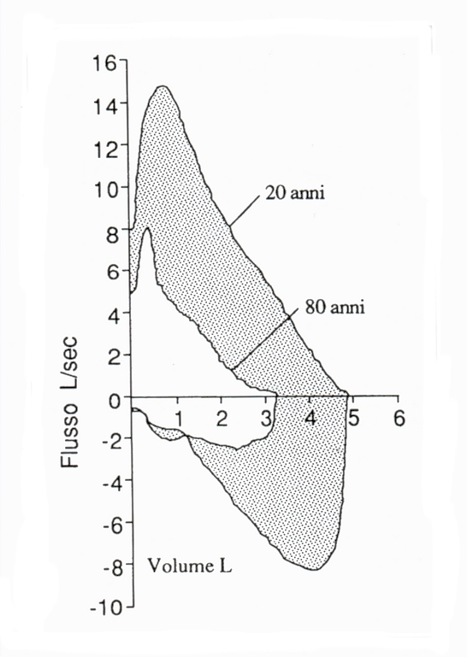
expected decrease in PEF = 4-2.5 L/min/yr (70-40 ml/s/yr)
Elastic loss of supporting tissue around the small airways is a plausibile explanation for this finding
Rossi A, Tantucci C et al. Aging Clin Exp Res 1996; 143:161

Slide 41
Age-related decrease in
lung elastic recoil leads to
lower distending pressures
of the intra-parenchymal
airways
-> (1) Greater airway narrowing and premature small airway closure during exalation with increased air trapping (higher RV)
-> (2) Hgher closing volume (CV) and closing capacity (CC),
and tidal dependent airway closure when CC > FRC
abnormal gas exchange
and
decreased maximal expiratory
flow-rates at low lung volumes
Capacità inspiratoria
(2)
Volume di chiusura
Capacità di chiusura (CC = VR+VC)

Slide 42
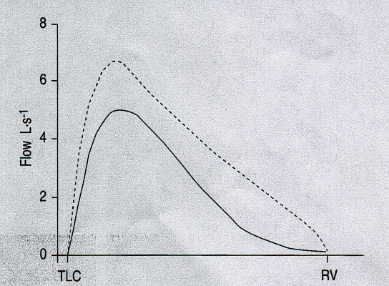
young people
old people
Volume (L)

Slide 43
flow
flow
limitation
volume
volume

Slide 44
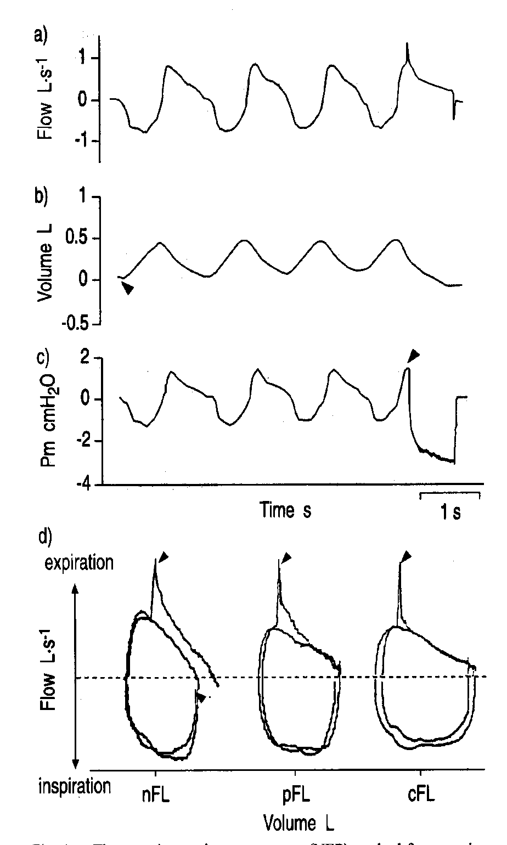
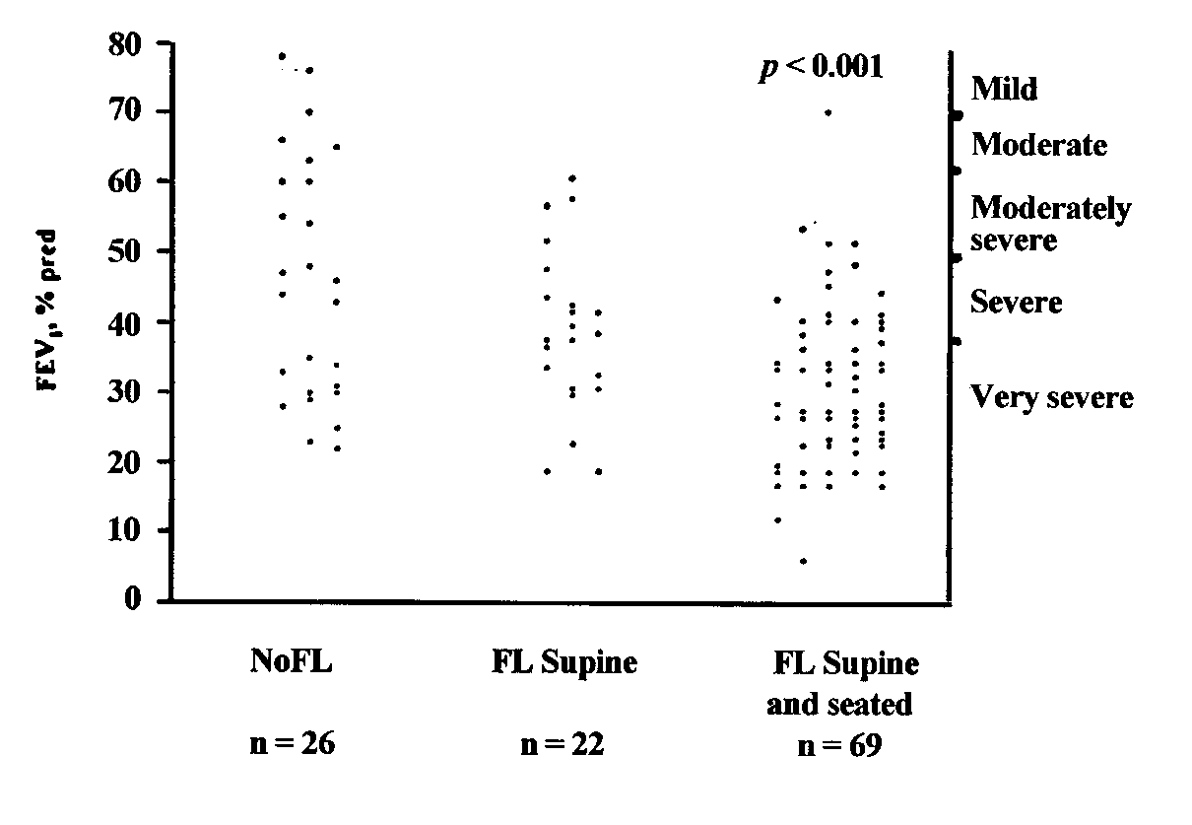
NEP set-up

Slide 45
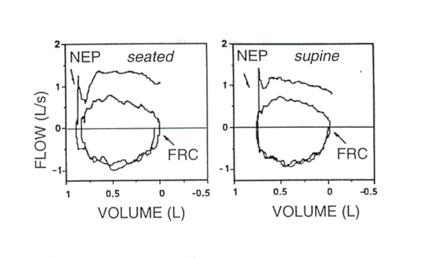
subject aged 78
Grassi et al. Aging 1998;10:141

Slide 46
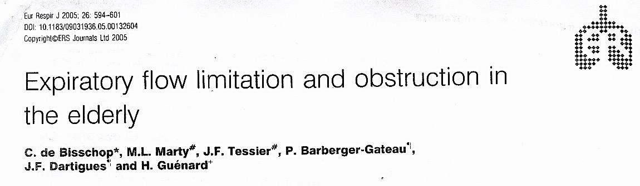
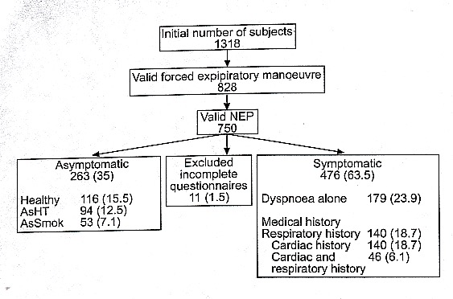
Tidal EFL
66-88 yrs
De Bisschop et al. ERJ, 2005, 26:594

Slide 47
RESULTS
Tidal Expiratory Flow Limitation (EFL) is common in the elderly with no overt diseases (overall 47%)
EFF is more common in females (52%) than in males (42%) in healthy old subjects
EFL is more frequent in older people
- men 20% if <80 yr vs 80% if >80 yr (p<0.01)
- women 33% if <80 yr vs 67% if >80 yr (p=0.057)
EFL is related (positively) to BMI
EFL increases as the grade of dyspnea increases
EFL is often present in subjects (mainly females) with dyspnea but with negative medical hystory
EFL is more frequent in subjects with respiratory or cardiac diseases as compared with healthy subjects
Notes:
47

Slide 48
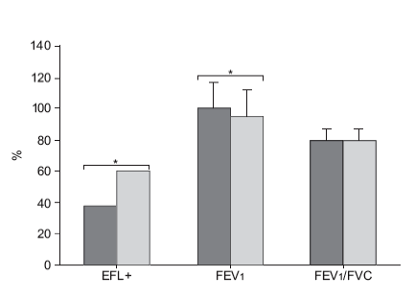
Asymptomatic vs symptomatic (dyspnea)
elderly non smoker women
bleu = asymptomatic
white = symptomatic
De Bisschop et al. ERJ, 2005, 26:594
Notes:
48

Slide 49
interim CONCLUSIONS
In the elderly,
to be female, > 80 yr, overweight/obese and short
are strong risk factors for suffering from EFL and EFL-related dyspnea (chronic and exertional)
in the absence of overt diseases and smoking history
EFL is more frequent in subjects with respiratory or cardiac diseases as compared with healthy subjects
Notes:
49

Slide 50
Increase in Closing Volume and Closing Capacity
Dependent airways begin to close
at higher lung volume because of
decreased lung elastic recoil
Closing capacity encroaches on
tidal volume earlier in the supine
and later in the seated position
Together with greater imbalance
in V/Q relationships, this causes
widening of the A-a difference
of PO2 and arterial hypoxemia

Slide 51
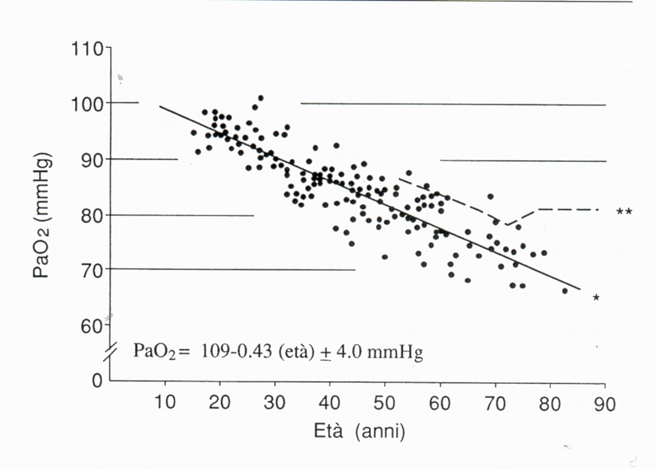
expected decrease in PaO₂ = 0.33 mmHg/yr
supine position
Sorbini C, Grassi V et al. Respiration, 1968; 25:3-13

Slide 53
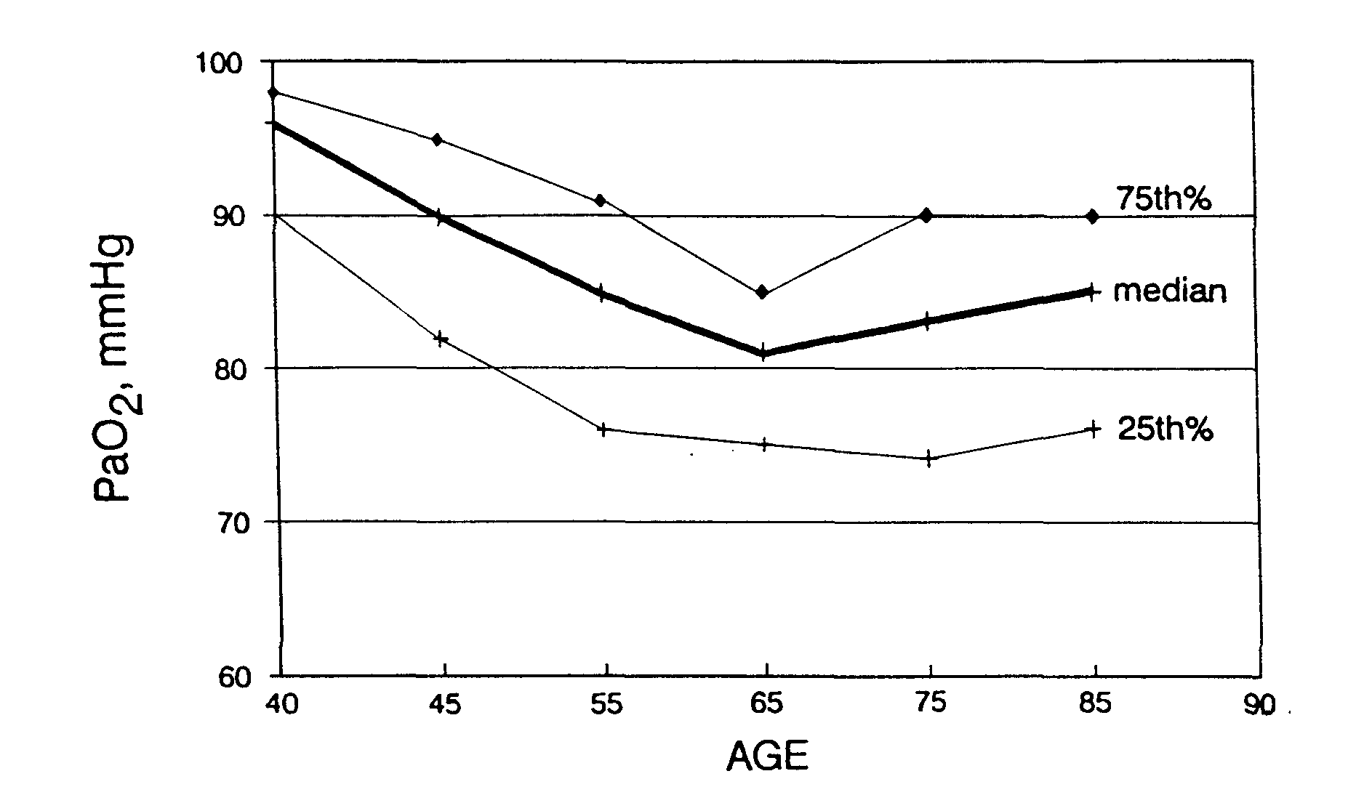
ANDAMENTO PaO₂
NELLE VARIE CLASSI DI ETÀ
IN CAMPIONE DI SOGGETTI NORMALI
Cerveri et, AJRCCM 1995

Slide 54
EQUAZIONE PREDITTIVA DELLA PaO₂ TRA 40 E 70 ANNI
Cerveri et, AJRCCM 1995
PaO₂ = 143.6 - 0.39 ETÀ - 0.56 BMI - 0.57 PaCO₂

Slide 55
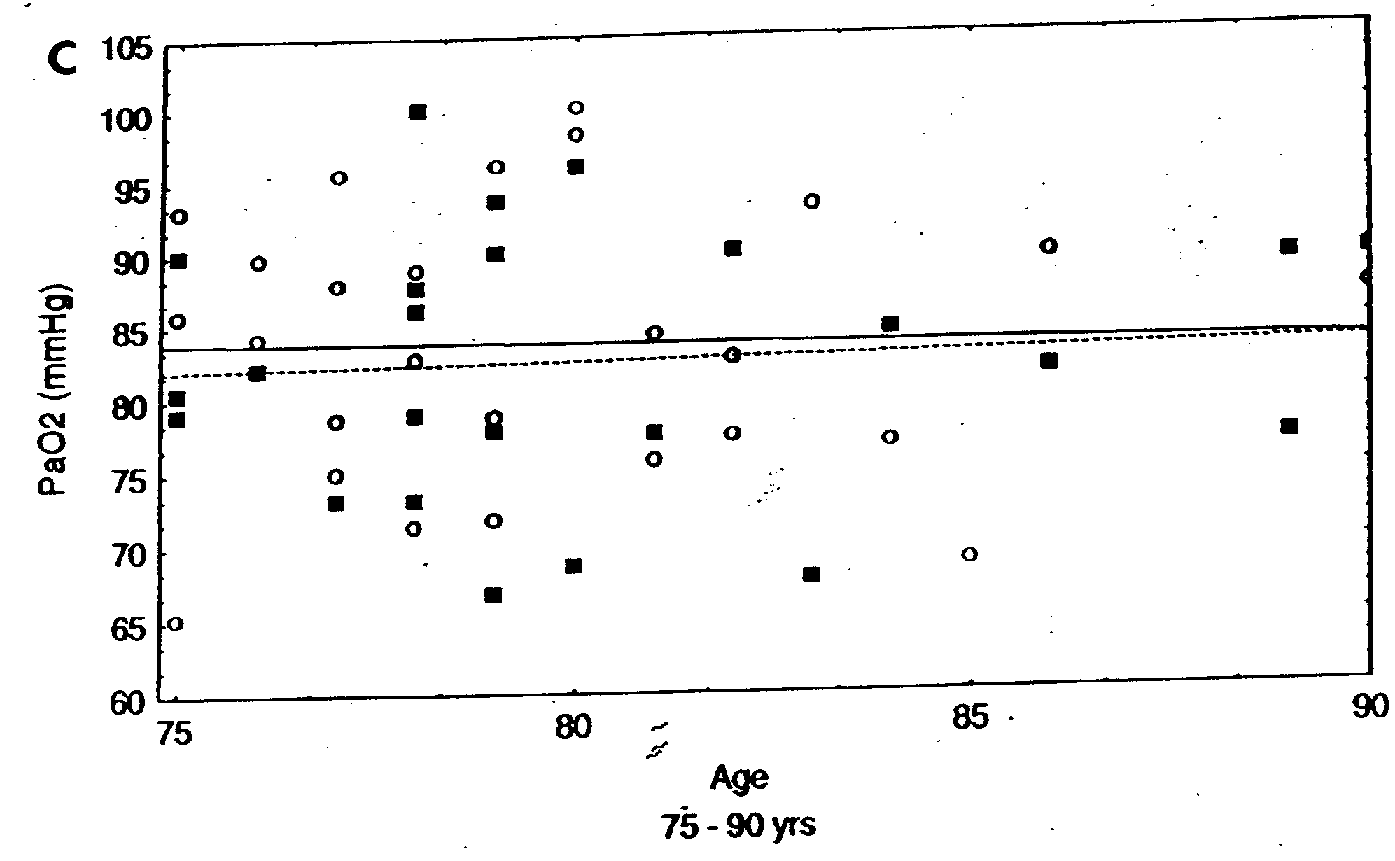
CORRELAZIONE TRA ETÀ E PaO₂
(75-90 anni)
Cerveri et al. AJRCCM 1995

Slide 56
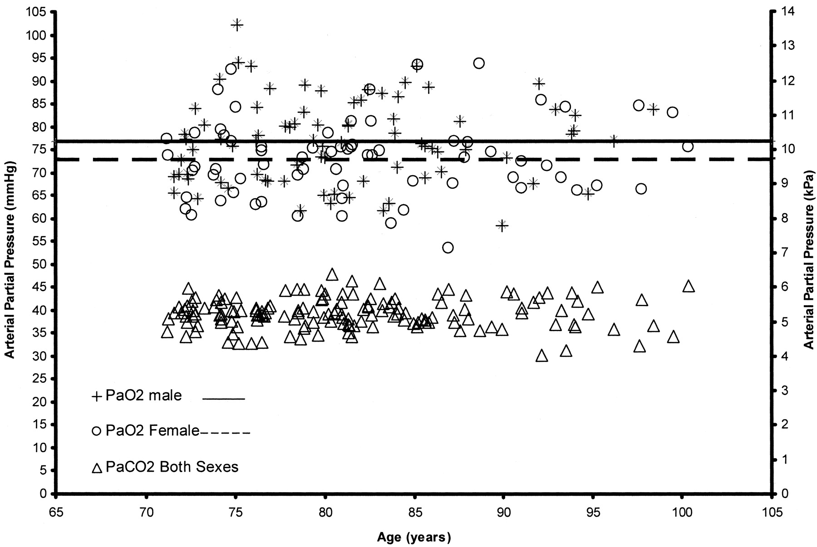
REFERENCE VALUES FOR
ARTERIAL BLOOD GASES IN THE ELDERLY
Hardie et al, Chest 2004

Slide 57
REFERENCE VALUES FOR
ARTERIAL BLOOD GASES IN THE ELDERLY
PaO₂ significantly lower among women
Blood gas values not associated with age:
1) Survival effects
2) Selection bias
Hardie et al. Chest 2004

Slide 58
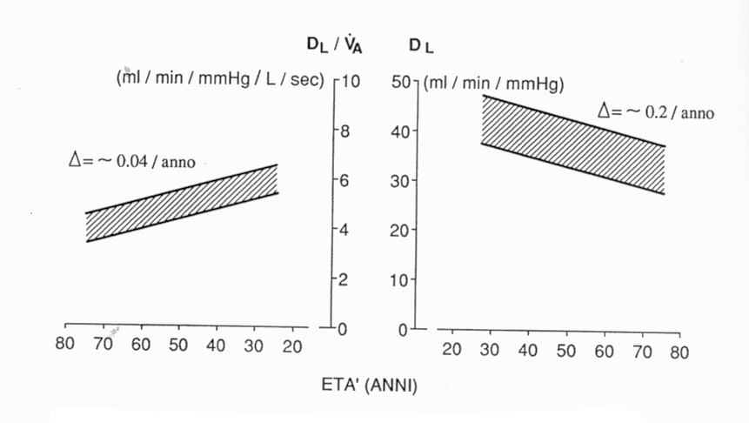
TRANSFER FACTOR WITH AGEING
Cotes JE, Chinn DJ, Quanjer PH, Roca J, Yernault JC.
Standardization of the measurement of transfer factor (diffusing capacity).
Eur Respir J 1993; 6 (Suppl 16): 41-52.

Slide 59
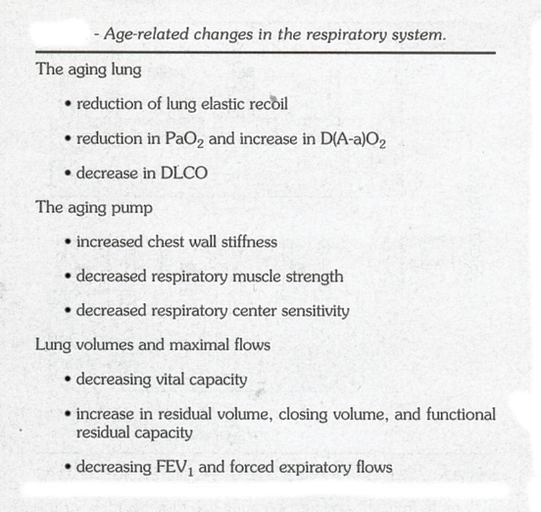
Rossi A, Tantucci C et al. Aging Clin Exp Res 1996; 143:161

Slide 60
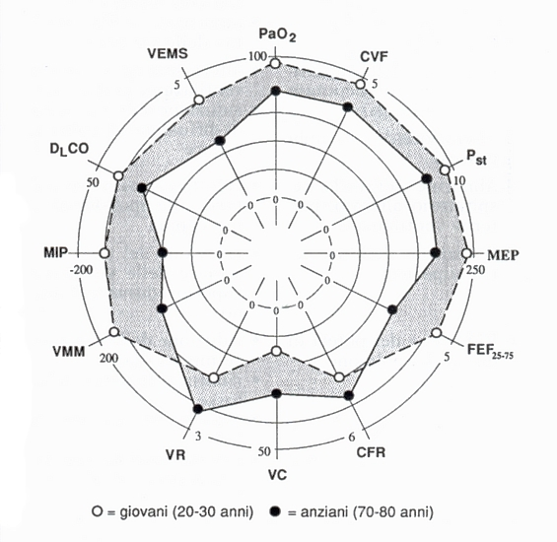
Rossi A, Tantucci C et al. Aging Clin Exp Res 1996; 143:161

Slide 61
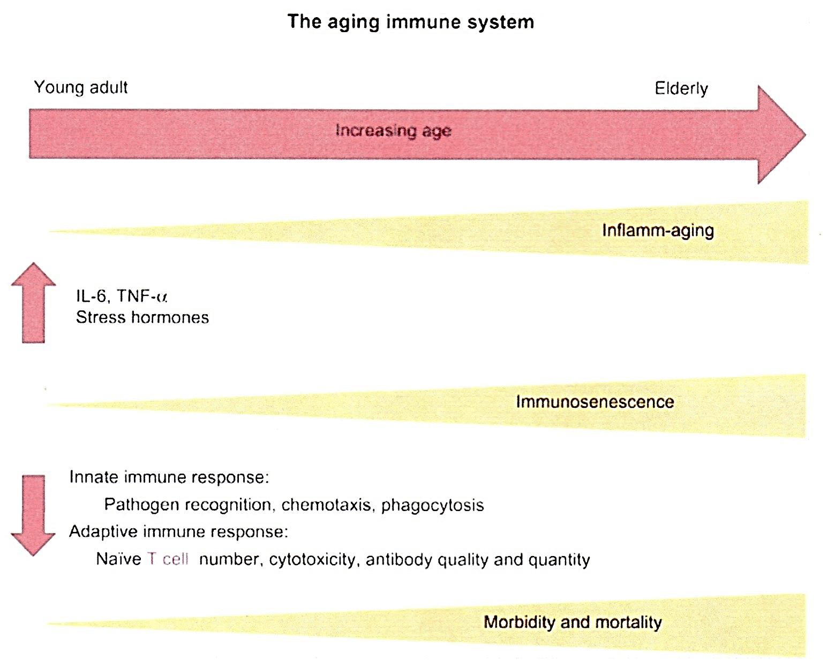
Il progredire dell’età comporta aumento dei livelli basali dell’infiammazione (Inflamm-ageing) e aumento della immuno-senescenza.

Slide 62
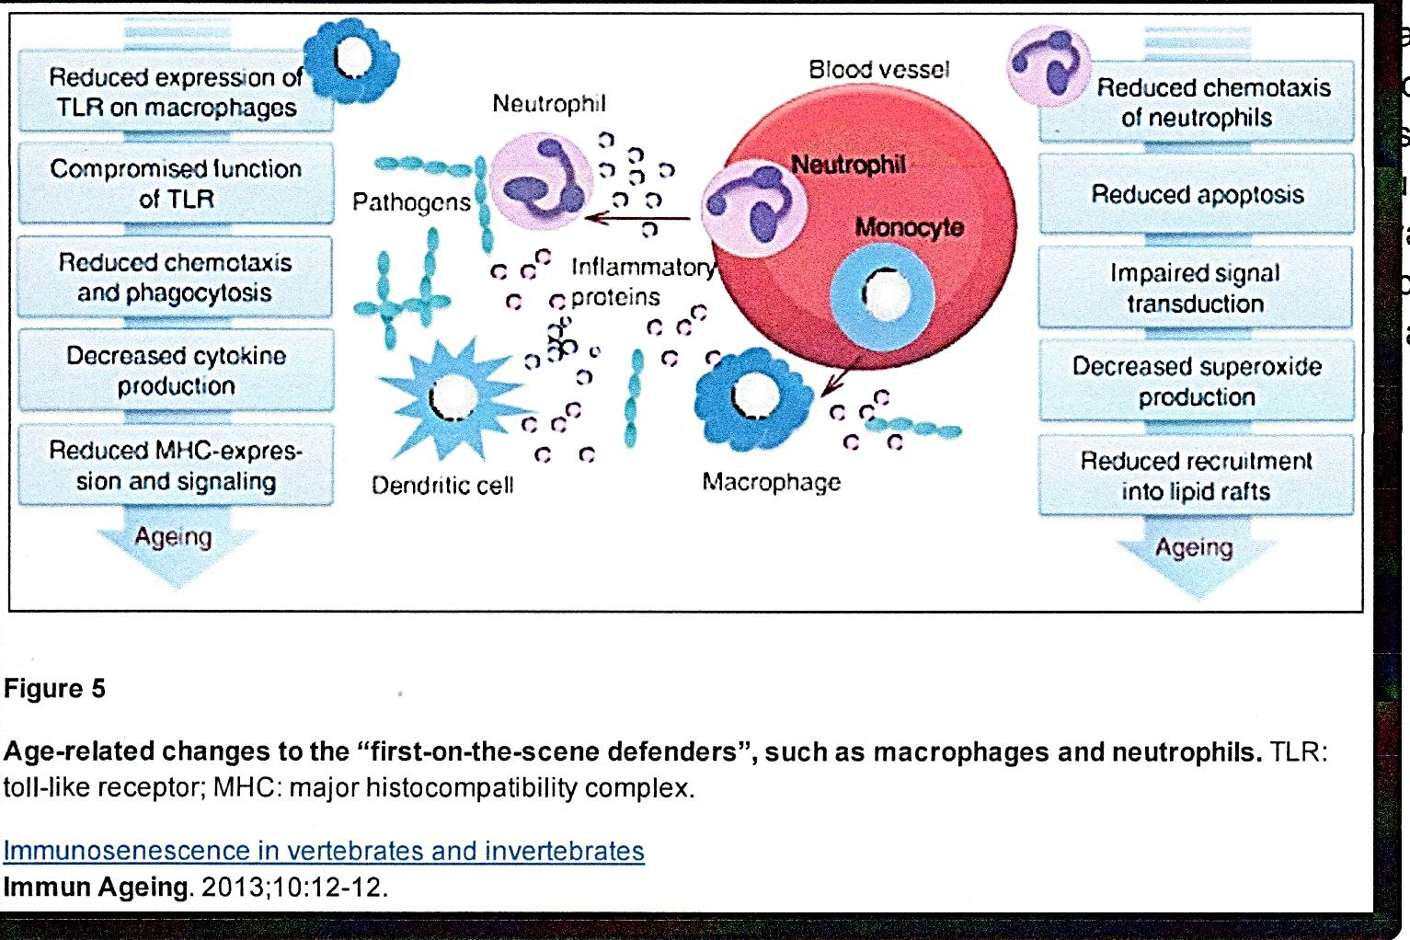
(L. Muller e coll – Immunity & Ageing – 2013)

Slide 63
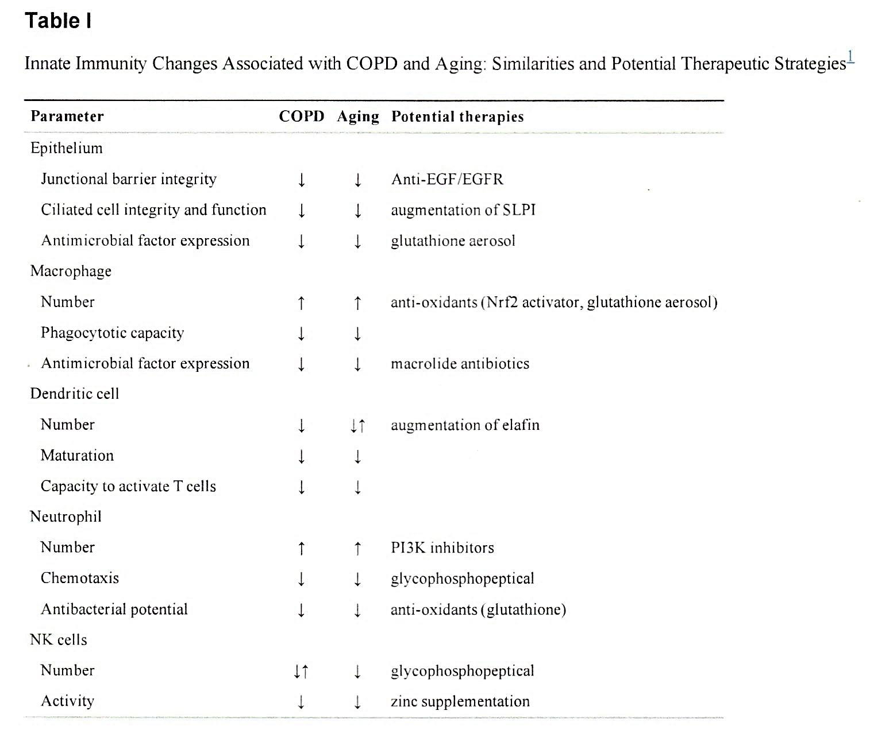
Modificazioni dell'immunità innata associate all’Ageing e alla BPCO

Slide 64
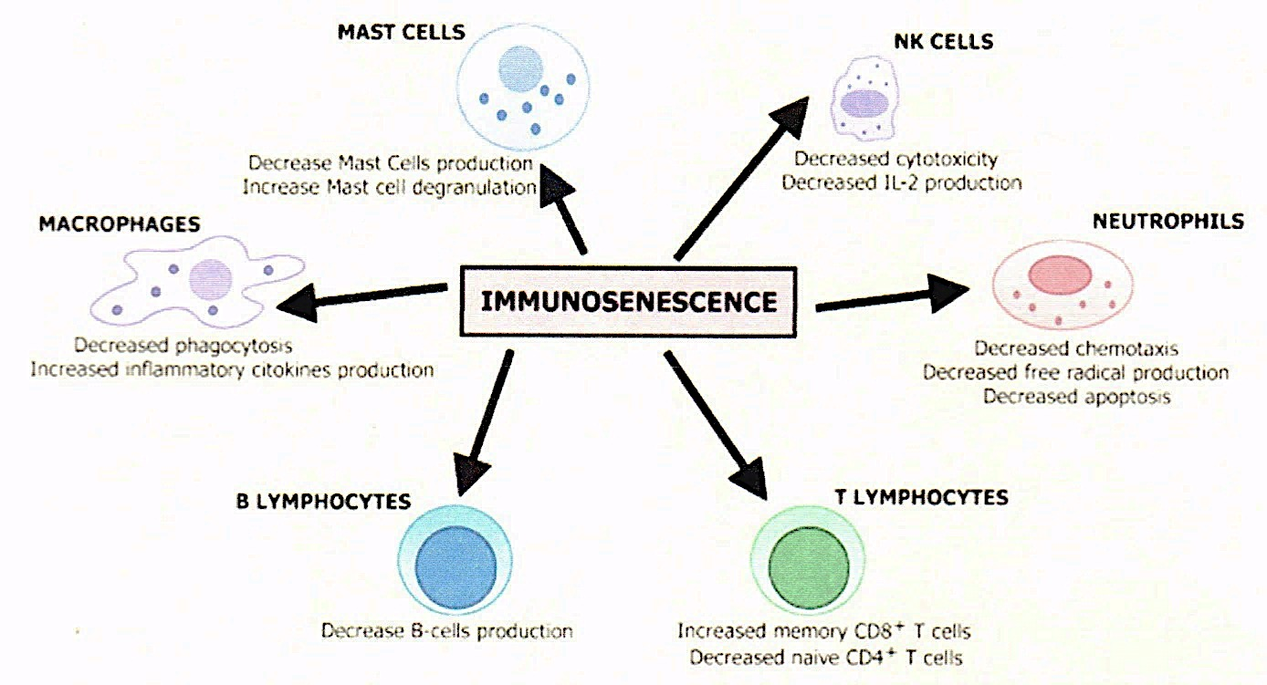
(Immun Ageing – 2013)

Slide 65
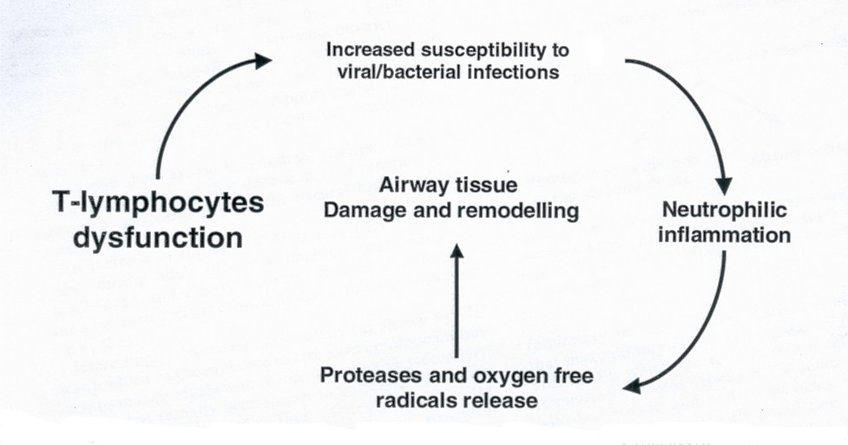
Vignola et al. Allergy 2003; 58:165-175

Slide 66
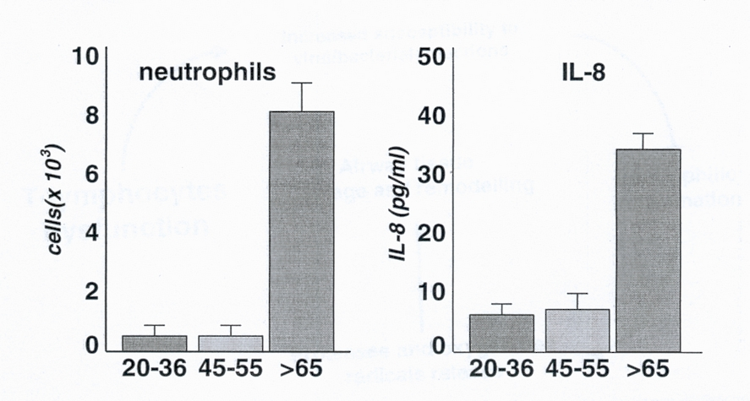
Immune dysregulation in the aging human lung
Meyer et al. Am J Respir Int Care Med 1996;153:1072

Slide 67
Tidal expiratory flow
limitation ?
Tidal dependent airways closure
and
reopening
(when CC>FRC)
Notes:
67

Slide 68


