Slide 1
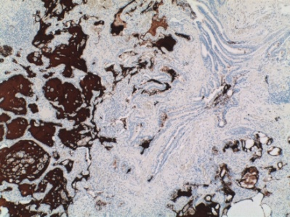
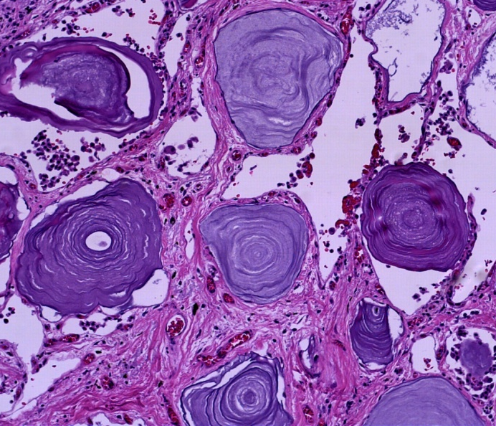
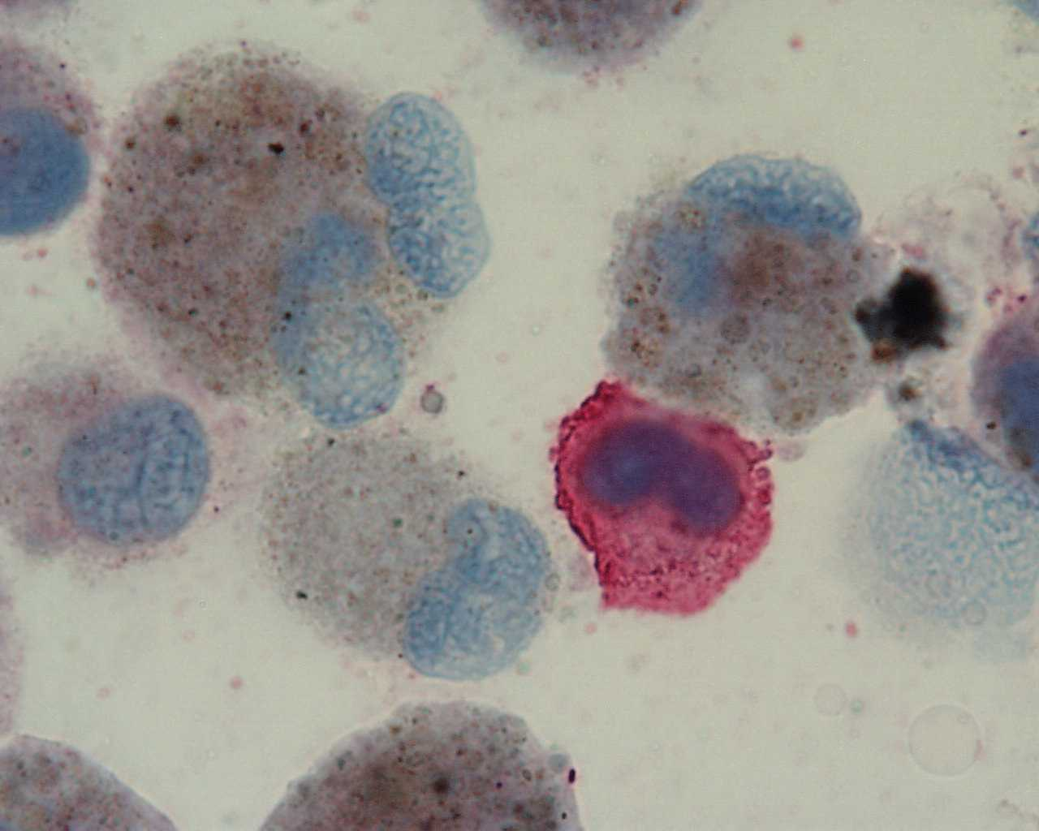
News at the horizon:
Pathogenesis of ILD
Marco Chilosi, Verona

Slide 2
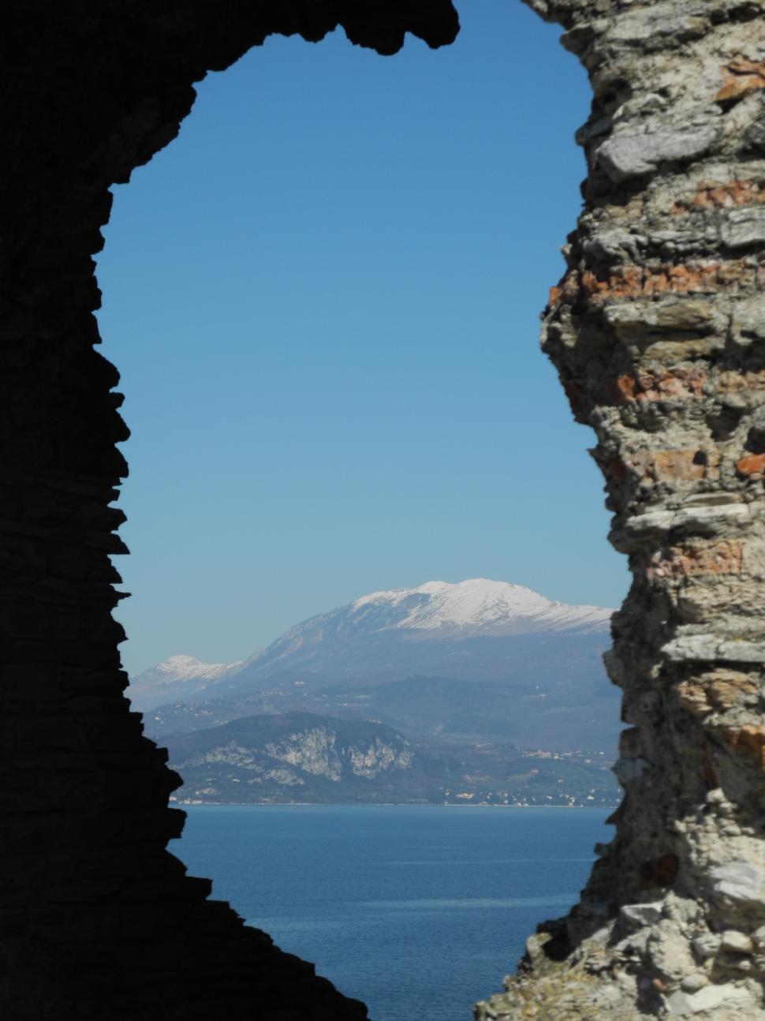
News at the horizon:
Pathogenesis of ILD

Slide 3
Understanding the Pathogenesis is the basis
for correct diagnosis and therapy
New robust diagnostic criteria
Mechanisms of action of new (and old) drugs
New therapeutic options
Pathogenesis
Diagnosis
Therapy

Slide 4
Intrinsic
extrinsic
Genetic background/predisposition
EMT
Etiologic trigger
Apoptosis
Inflammation
Proliferation
WNT
mTOR
TGFβ
Damage
Cell senescence
Cellular response to damage
Oncogene-induced senescence
Repair
SASP
Inflammation
fibrosis
fibrosis
Autophagy
Heterogeneous responses to tissue damage producing different repair patterns
(NSIP, UIP, DAD, OP, AFOP, etc.)

Slide 5
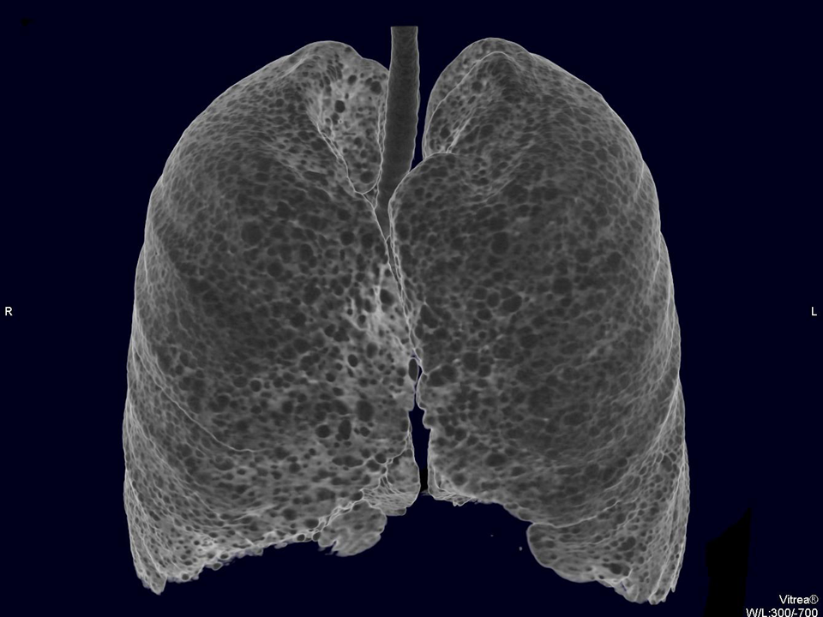
example
the mysterious LAM

Slide 6
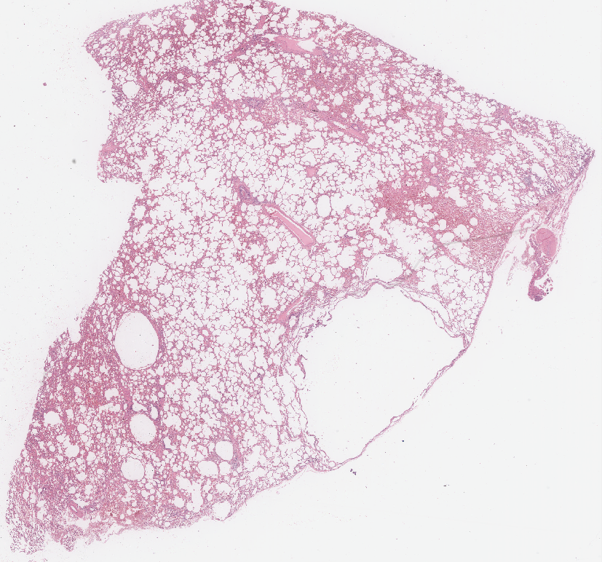
Lymphangioleiomyomatosis (LAM)
is a rare and progressive disease that affects the lungs of women, usually in premenopausal age
Pneumotorax
Lymphatic obstruction
Cystic disease
Progressive dyspnea
Renal AML

Slide 7
LAM cells are neoplastic cells
2000
2006

Slide 8
The peculiar phenotype of LAM cells
The Perivascular epithelioid system (PEC)
HMB45
Transbronchial biopsy in lymphangioleiomyomatosis of the lung: HMB45 for diagnosis.
Bonetti F, et al. Am J Surg Pathol. 1993(11):1092-102.
α-SMA

Slide 9
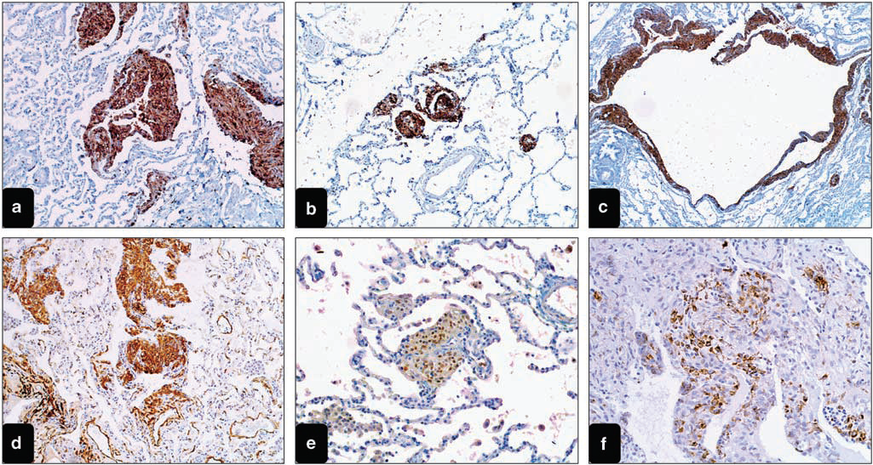
Arch. Pathol 2006
The development of PEComas is related to inactivating losses of gene TSC1 (9q34) or TSC2 (16p13.3)
Cathepsin-K
Stromal destruction → Cyst formation

Slide 11
Autophagy. 2011 Nov;7(11):1400-1.
Sirolimus
Cell
proliferation
Autophagy
(LAM cell survival)

Slide 12
El-Chemaly S, Taveira-Dasilva A, Goldberg HJ, Peters E, Haughey M, Bienfang D, Jones AM, Julien-Williams P, Cui Y, Villalba JA, Bagwe S, Maurer R, Rosas IO, Moss J, Henske EP. Sirolimus and Autophagy Inhibition in LAM: Results of a Phase
I Clinical Trial. Chest. 2017 Feb 10, (17)30174-5.

Slide 14
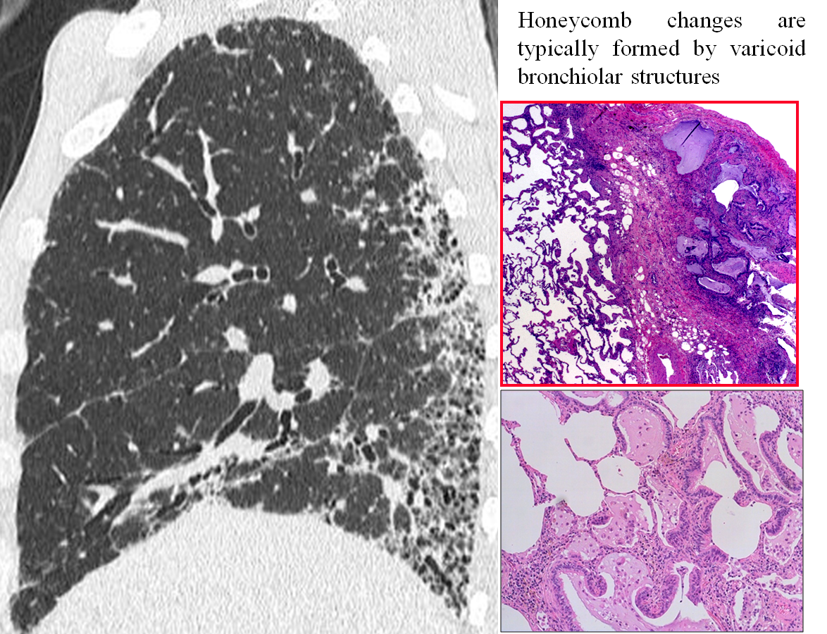
What is IPF ? What is “honeycombing” ?

Slide 15
IPF
at the beginning…..
Focal Alveolar damage
in IPF

Slide 16
WHY ?
Proc Am Thorac Soc Vol 8. pp 158–162, 2011
Telomere dysfunction
Endoplasmic reticulum stress (unfolded proteins)
Epithelial stem cell exhaustion

Slide 17
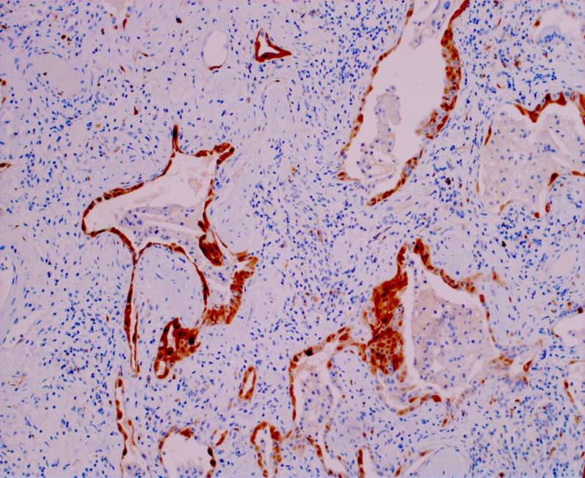
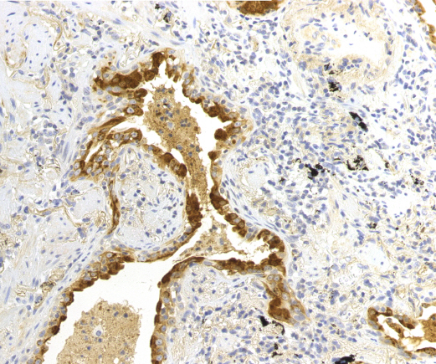
Van Deursen JM. The role of senescent cells in ageing.
Nature 2014;509(7501):439-446
p16^{INK4B}
Surf-Prot-A1

Slide 18
IPF pathogenesis
Stem cell exhaustion
Pulmonary disease determined by accelerated aging of lung parenchyma leading to abnormal tissue renewal with tissue remodelling, and progressive functional impairment.
Complications:
senescence related co-morbidities
Acceleration with DAD features,
Carcinoma development
WNT
mTOR
EMT
OIS
SASP
INDUCTION
HONEYCOMB
Sarcoidosis Vasc Diffuse Lung Dis. 2010

Slide 19
Aging
Replicative senescence and Telomere attrition
Genetic
Telomerase gene mutations
Surfactant gene mutations
Endoplasmic reticulum stress
IPF
Epithelial Stem cell exhaustion
INTRINSIC DEFECT
Smoking, pollutions:
Oxidative stress, ROS, NOX4
Anatomy
Mechanical stress
Sarcoidosis Vasc Diffuse Lung Dis. 2010

Slide 20
Experimental studies
JCI Insight. 2016;1(14):e86704.

Slide 21
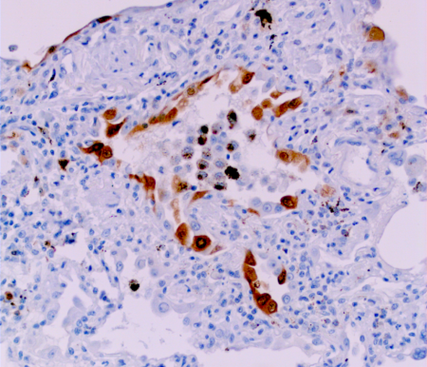
EMT

Slide 24
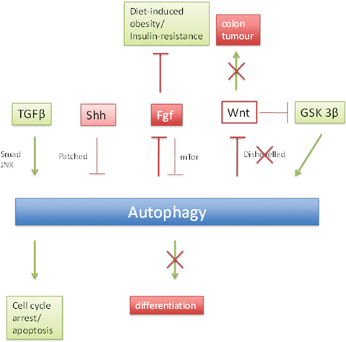
Biochem. Soc. Trans. (2013) 41, 1489–1494

Slide 25
J Clin Invest. 2017;127(2):405–414.

Slide 26
PLOS 2012:e41394
PLOS 2013:e61017

Slide 27
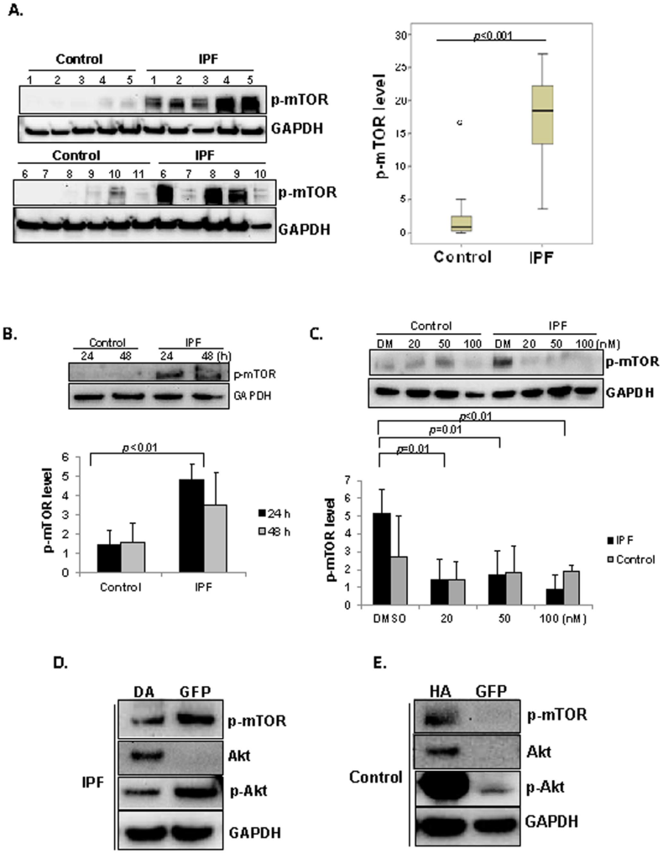
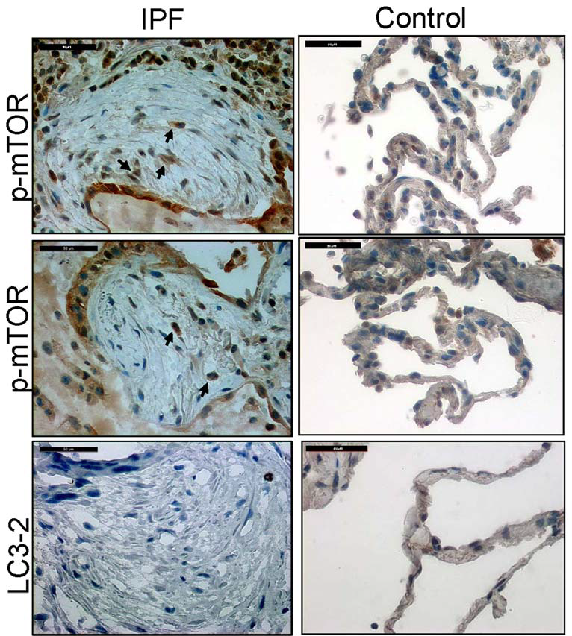
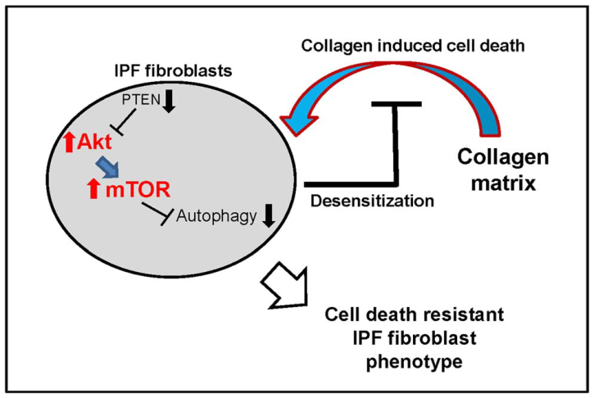
April 2014 | Volume 9 | Issue 4 | e94616

Slide 28
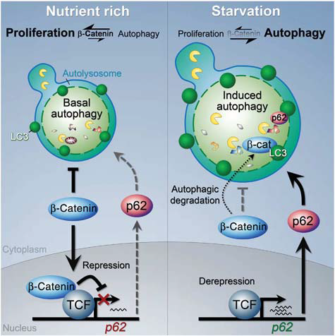
Here we identify the Wnt/b-catenin signalling pathway as a negative regulator of both basal and stress-induced autophagy

Slide 29
These findings suggest that whereas activation of β-catenin contributes to tumor growth, epithelial stem cells may be endowed with a protective mechanism that results in cell senescence upon the persistent stimulation of proliferative pathways that activate mTOR, ultimately suppressing tumor formation.

Slide 30
El-Chemaly S, Taveira-Dasilva A, Goldberg HJ, Peters E, Haughey M, Bienfang D, Jones AM, Julien-Williams P, Cui Y, Villalba JA, Bagwe S, Maurer R, Rosas IO, Moss J, Henske EP. Sirolimus and Autophagy Inhibition in LAM: Results of a Phase
I Clinical Trial. Chest. 2017 Feb 10, (17)30174-5.

Slide 31
Conclusions: Everolimus use was associated with more rapid disease progression in a well-defined cohort of patients with IPF confirmed by surgical lung biopsy followed for 3 years.

Slide 32
This study implies a significant fibrogenic induction activity of rapamycin by activating AKT and inducing CCN2 expression in vitro and provides the possible mechanisms for the in vivo findings which previously showed no antifibrotic effect of rapamycin on lung fibrosis.
Laboratory Investigation (2015) 95, 846–859;

Slide 33
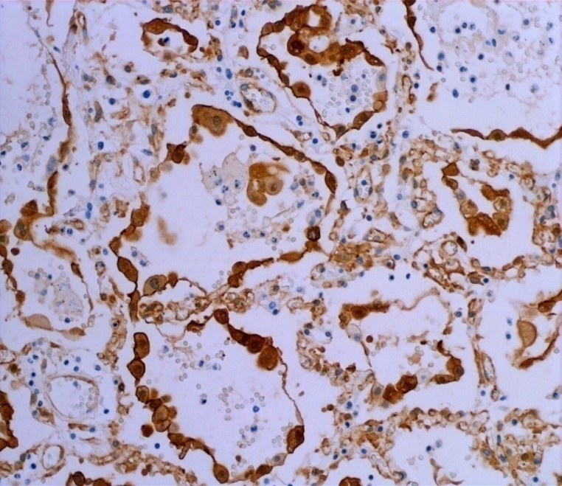
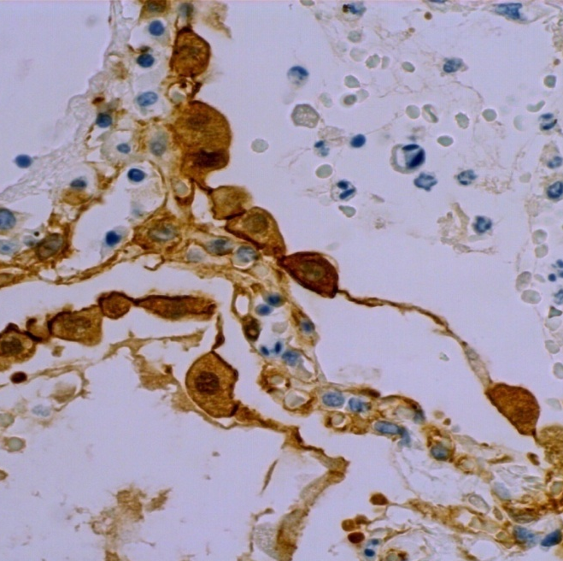
DAD/ARDS
ph-mTOR
β-Catenin

Slide 34
Our data reveal, for the first time, a dose-dependent EVE-induced EMT in alveolar and airway cells. They suggest that clinicians should employ, wherever possible, low
dosages of mTOR-Is in transplant recipients, assessing periodically their pulmonary function.

Slide 36
EMT in embriogenesis

Slide 37
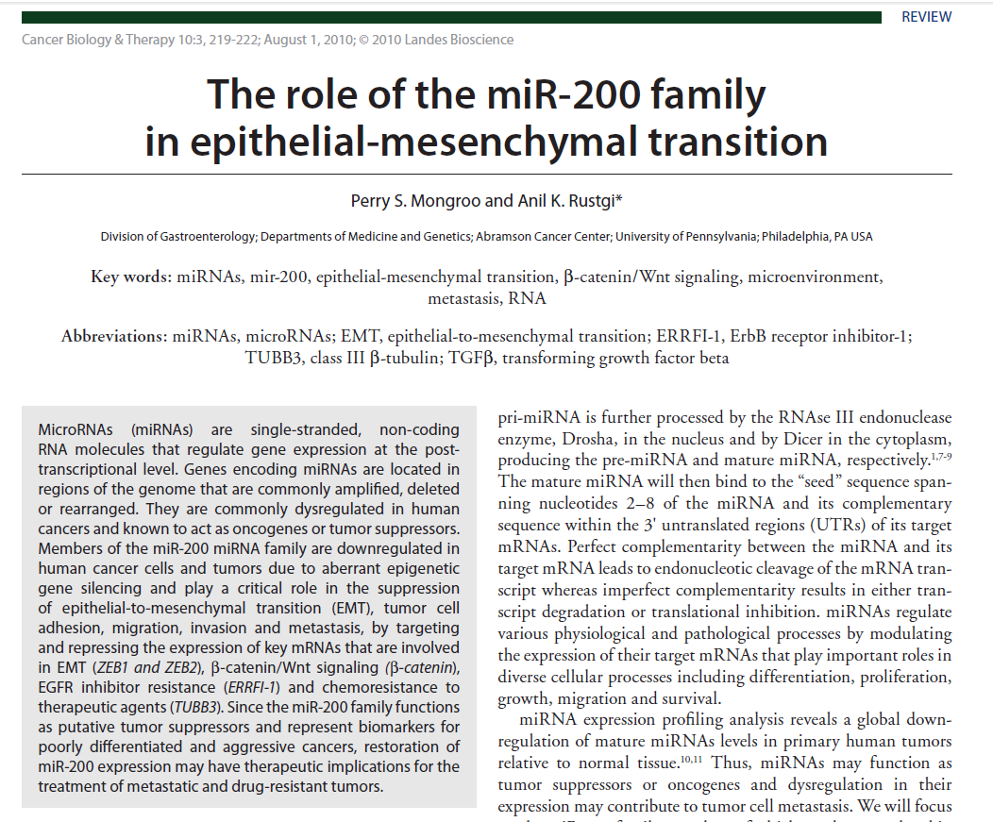
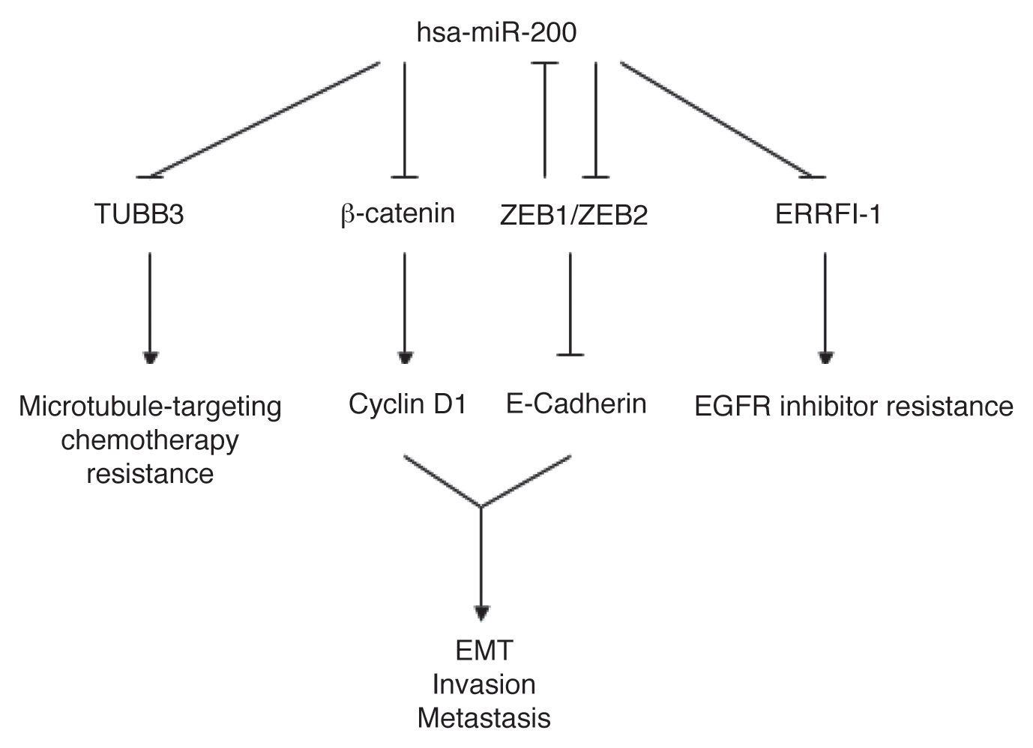

Slide 38
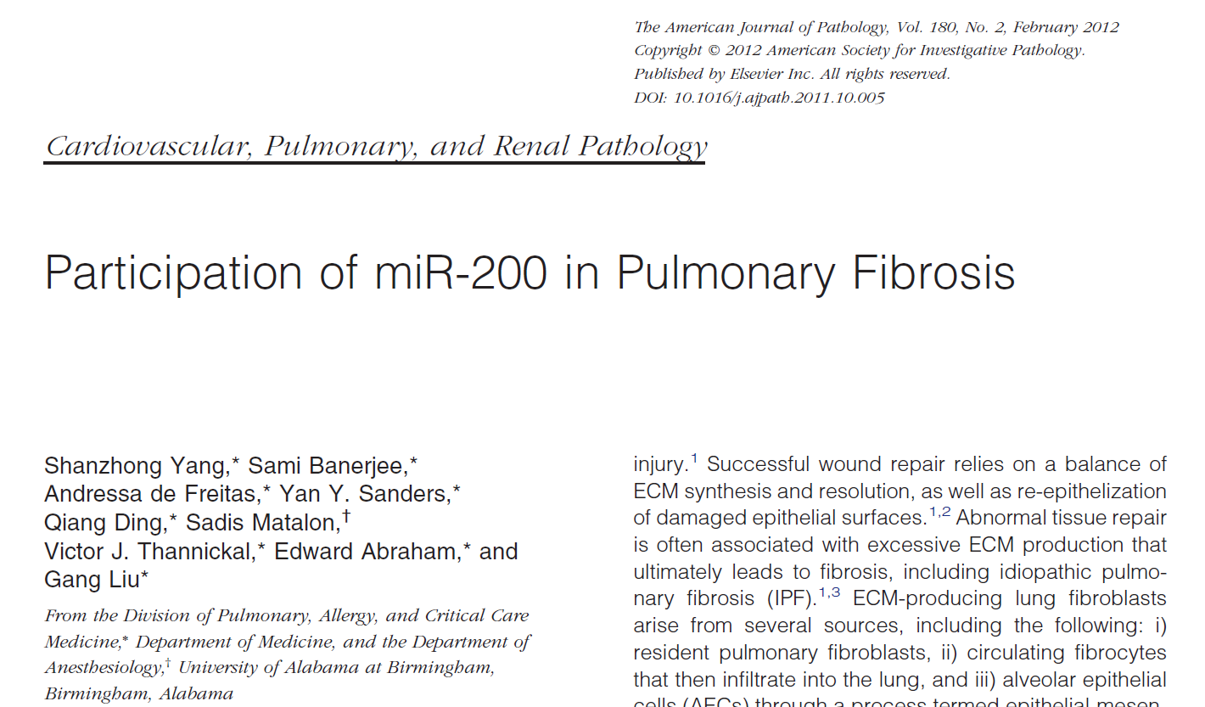

Slide 39
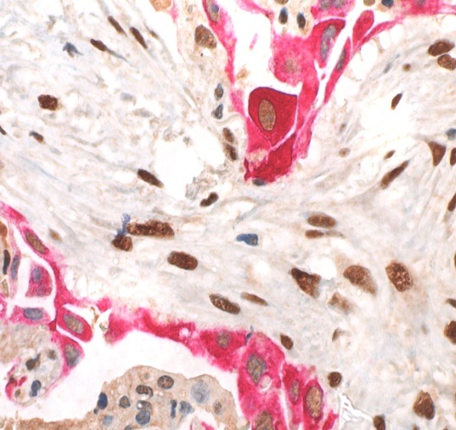
EMT in Pneumocytes-II in UIP/IPF
CK8/18
ZEB1
Nuclear ZEB1 immunofluorescence expression is evidenced in both myofibroblasts and regenerating pneumocytes, as confirmed by double immunostaining (ZEB1-green, cytokeratin 8-orange) (arrows, 40x).

Slide 40
Induction
The ability of one tissue to change the behavior of an adjacent tissue is a key process during organogenesis, including lung morphogenesis.
These studies reveal the requirement for lung mesenchyme to initiate branching morphogenesis and direct epithelial cell fate.

Slide 41
Induction

Slide 42
IPF
- nuclear expression of beta-Catenin in proliferative bronchiolar lesions and honeycoming.
- abnormal expression of WNT-target proteins
(MMP7, cyclin-D1)
in bronchiolar basal cells
Chilosi et al. Am J Pathol ;162: May 2003

Slide 43
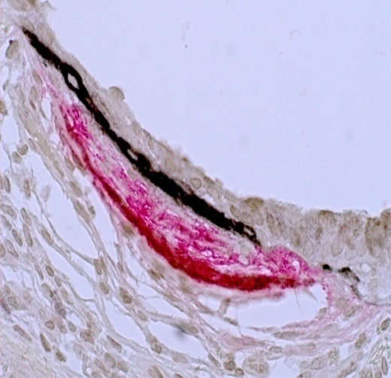
Attempted regeneration
Intrinsic PNII defects
pleura
WNT
Waves of abnormal signaling
OIS
SASP
abnormal Induction
Waves of abnormal mesenchymal cells
bronchioles

Slide 44
TA-p63
P53
P21waf1
p16
apoptosis
Alveolar pneumocytes
β-catenin
transcription factor
c-myc
Bronchiolar basal cells
MMP7
LAM5γ2
HSP27
Proliferation
ΔN-p63
P53
p21waf1
Cell-motility

Slide 45
Can this pathogenetic complexity and heterogeneity be successfully described by “classical” morphologic classification?

Slide 46
Diffuse Parenchymal Lung Disease
DPLD of known cause e.g. drugs or association e.g. collagen vascular disease
Idiopathic Interstitial Pneumonias
Granulomatous DPLD e.g. sarcoidosis
Other forms of DPLD e.g.
LAM, HX
Idiopathic Pulmonary Fibrosis
IIP other than Idiopathic Pulmonary Fibrosis
Desquamative interstitial pneumonia
Respiratory bronchiolitis interstitial lung disease
Acute interstitial pneumonia
Cryptogenic organizing pneumonia
Nonspecific interstitial pneumonia
Lymphocytic interstitial pneumonia
Am J Respir Crit Care Med 2002 Jan 15;165(2):277-304
American Thoracic Society/European Respiratory Society International Multidisciplinary Consensus Classification of the Idiopathic Interstitial Pneumonias.

Slide 47
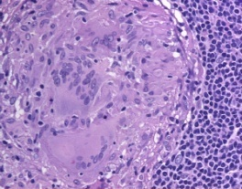
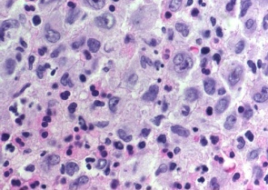
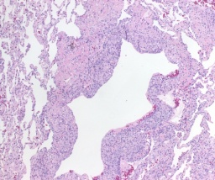
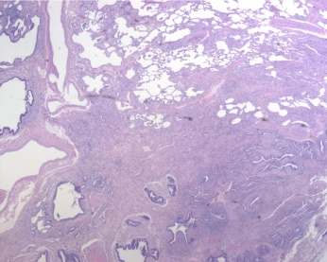
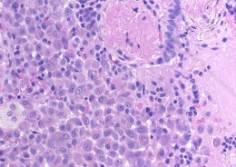
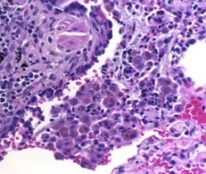
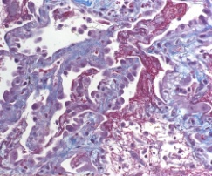
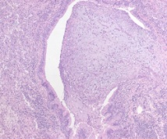
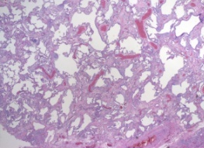
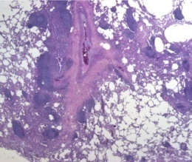
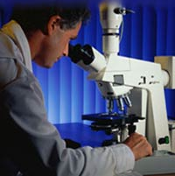
Diffuse Parenchymal Lung Disease
DPLD of known cause e.g. drugs or association e.g. collagen vascular disease
Idiopathic Interstitial Pneumonias
Granulomatous DPLD e.g. sarcoidosis, HP
Other forms of DPLD e.g. LAM, HX etc.
IPF
IIP other than IPF
Desquamative interstitial pneumonia
Respiratory bronchiolitis interstitial lung disease
Cryptogenic organizing pneumonia
Acute interstitial pneumonia
Nonspecific interstitial pneumonia
Lymphocytic interstitial pneumonia
Histological Patterns

Slide 48
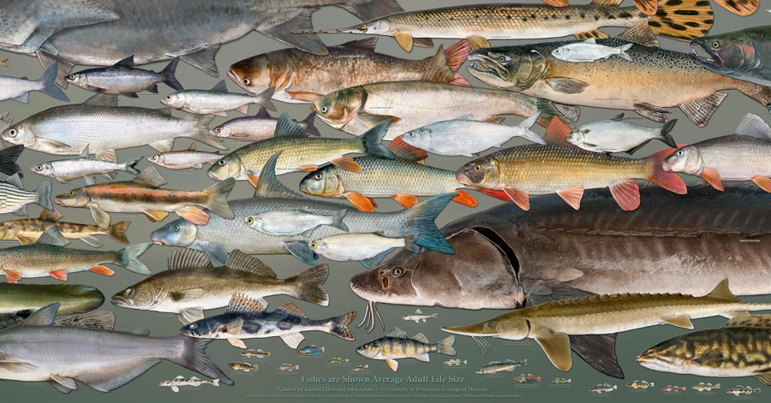
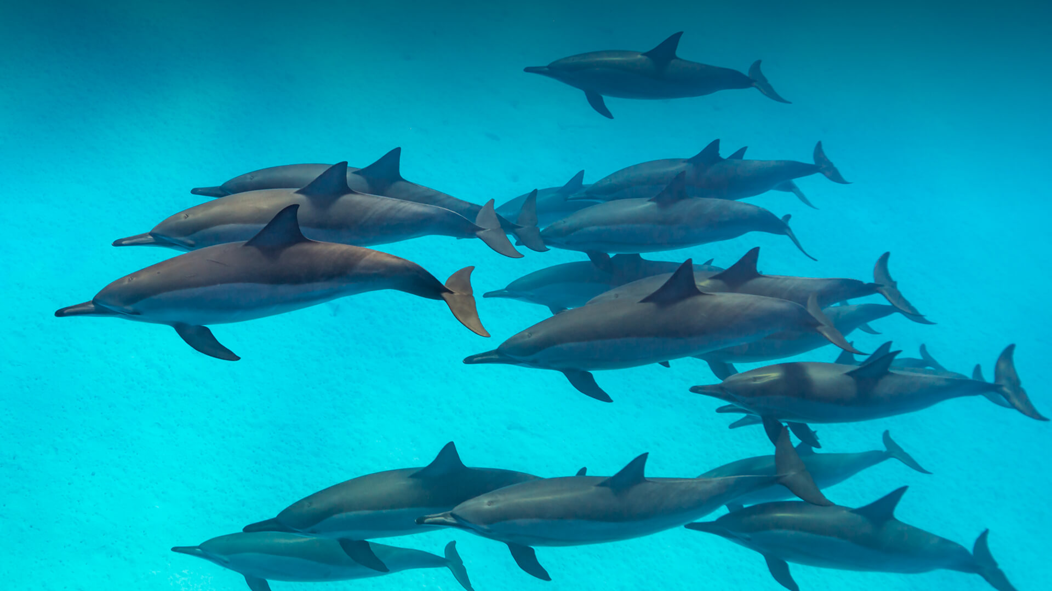
Limits of Morphological Classification
Fishes ?

Slide 49
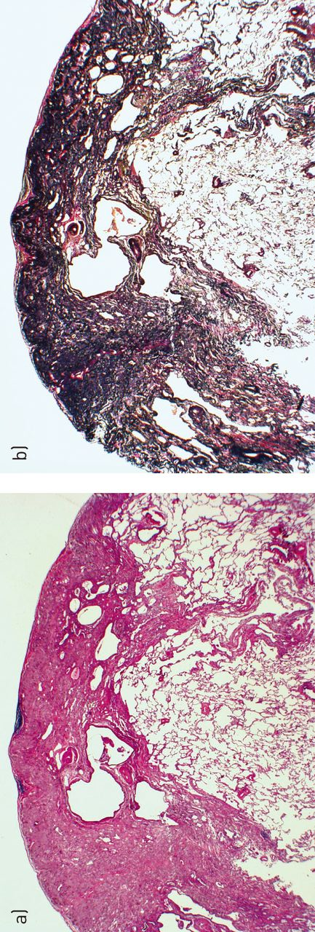
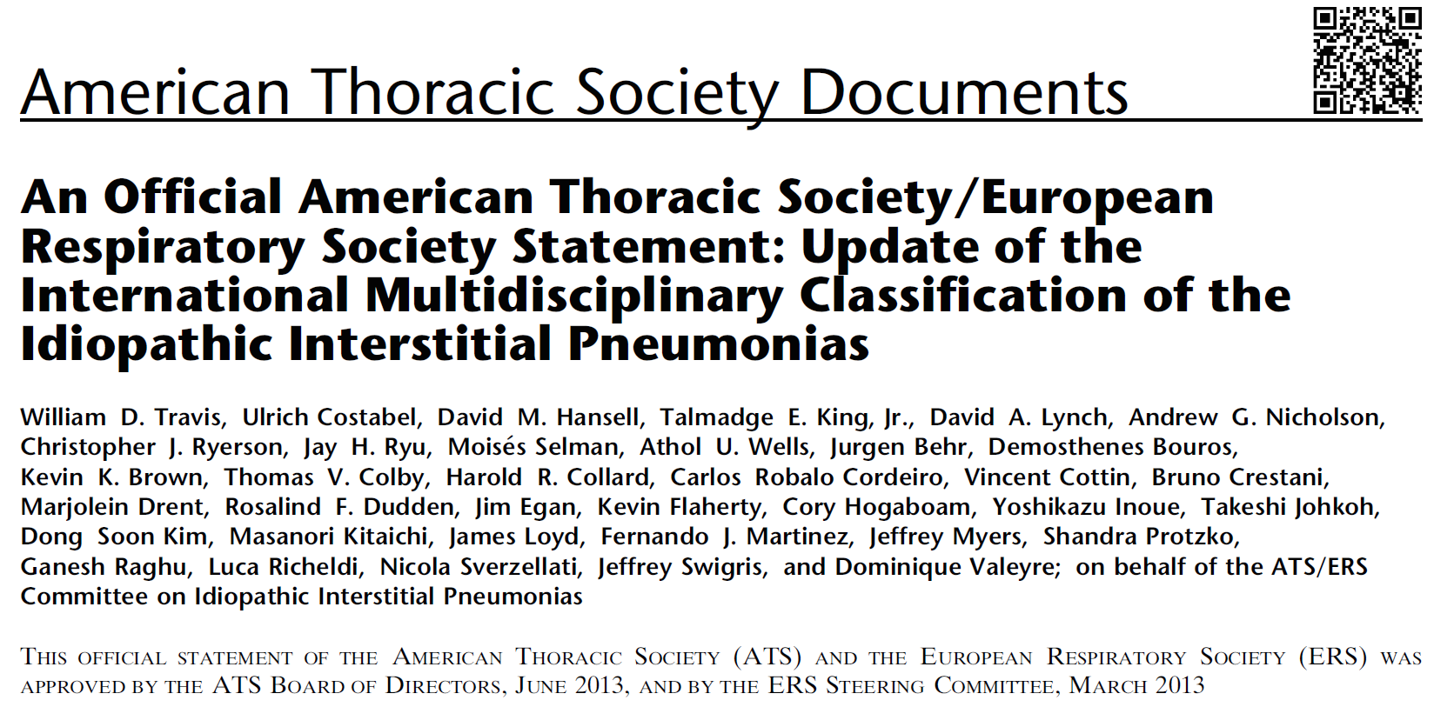

Slide 51
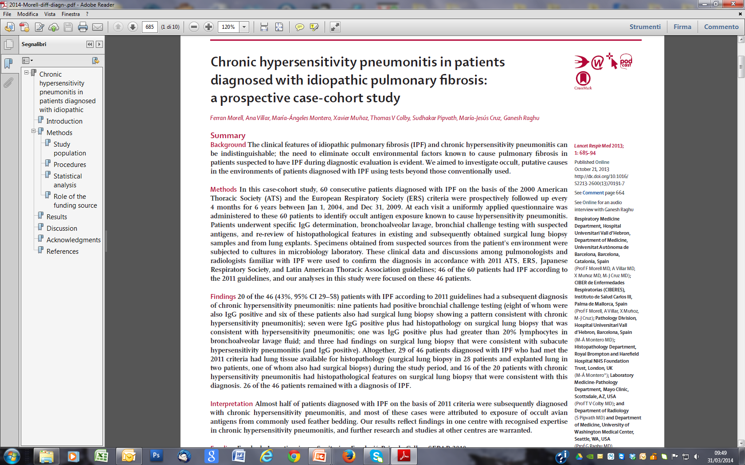

Slide 52
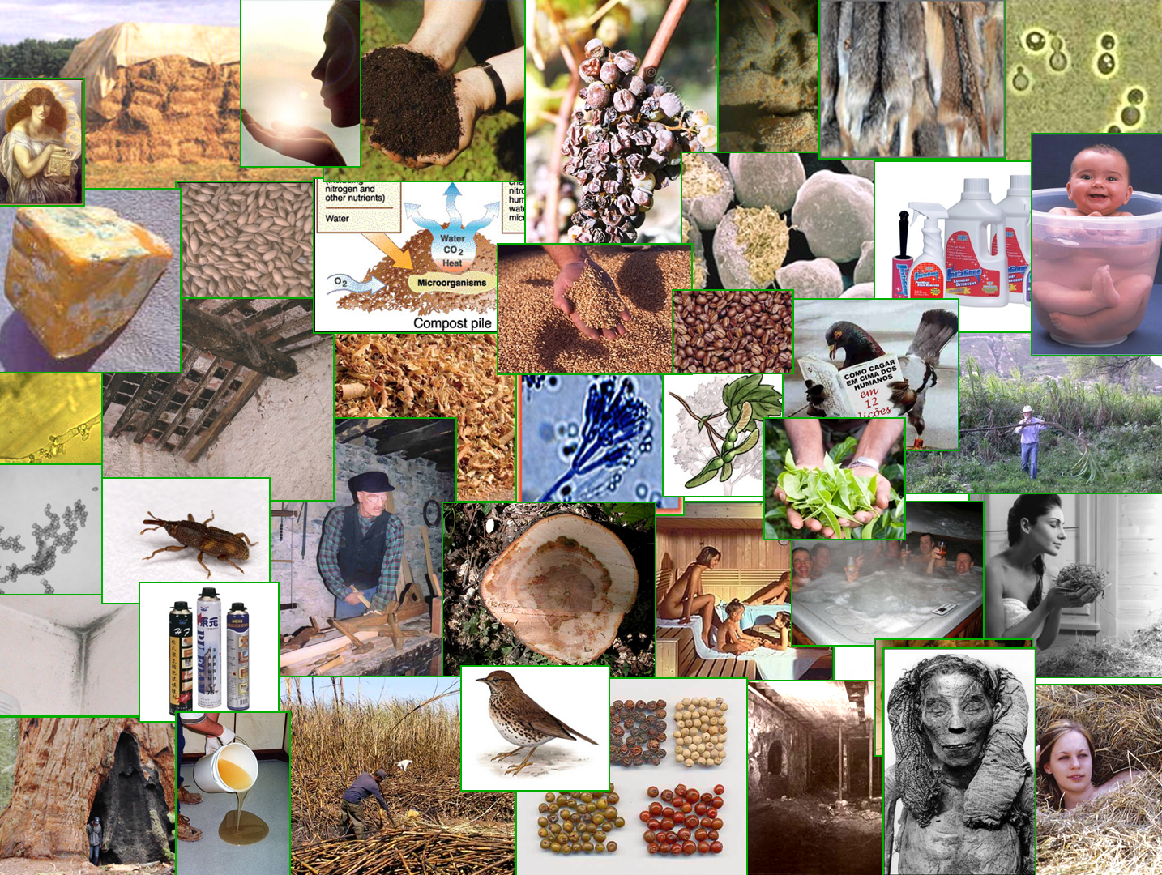
Hypersensitivity
Pneumonitis
Acute
Subacute
chronic

Slide 53
HP - Pathogenesis
Humoral immune response
Cell-mediated immune response (TH1)
Inducing Factor (antigen)
Subclinical Alveolitis
Promoting Factors
- Genetic predisposition
(MHC, TNFa-promoter)
- Persistent antigen inhalation
- Chemicals (pesticides)
- Age (immunoaging, inflammaging)
Impaired T-cell suppressor response
CD8+ alveolitis
→ TH2 switch
Chronic forms
Fibrosis
UIP pattern

Slide 54
IPF
Chronic HP
???

Slide 55
HP
Hypersensitivity-mediated bronchiolar and alveolar damage
Repair and resolution
Chronic HP
Persistence of the damage (TH2 switch)
Premature lung senescence (genetic background)
Triggering of the “UIP” remodelling mechanism

Slide 56
HP
Hypersensitivity-mediated bronchiolar and alveolar damage
Repair and resolution
Chronic HP
Persistence of the damage (TH2 switch)
Premature lung senescence (genetic background)
Triggering of the “UIP” remodelling mechanism
Same therapy ??

Slide 57
Pathogenetic classification of ILD
(potentially useful for therapy)
Inflammatory Non Inflammatory

Slide 58
Pathogenetic classification of ILD
Inflammatory
Hypersensitivity (granulomatous)
- sarcoidosis, berylliosis
hypersensitivity pneumonitis
Smoke related (macrophagic)
- respiratory bronchiolitis-ILD
DIP
3. Autoimmune (CVD)
systemic sclerosis, rheumatoid arthritis, anti-synthetase, etc.
IPAF
5. drug related
To be specified the specific immune-mechanisms involved (e.g TH1/TH2) and the role of genetic background

Slide 59
AMERICAN JOURNAL OF RESPIRATORY AND CRITICAL CARE MEDICINE VOL 188 2013

Slide 60
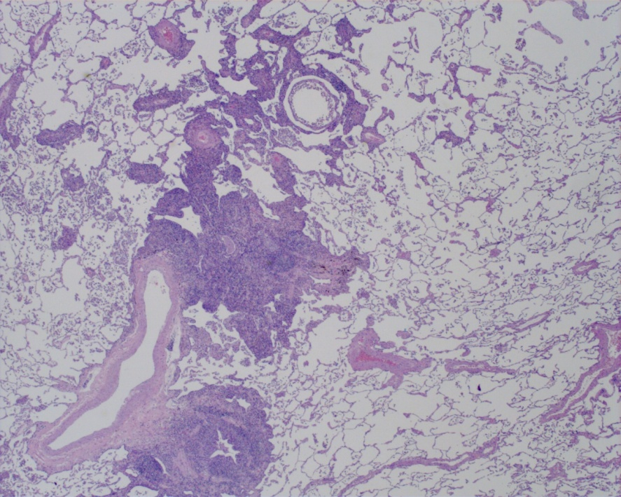
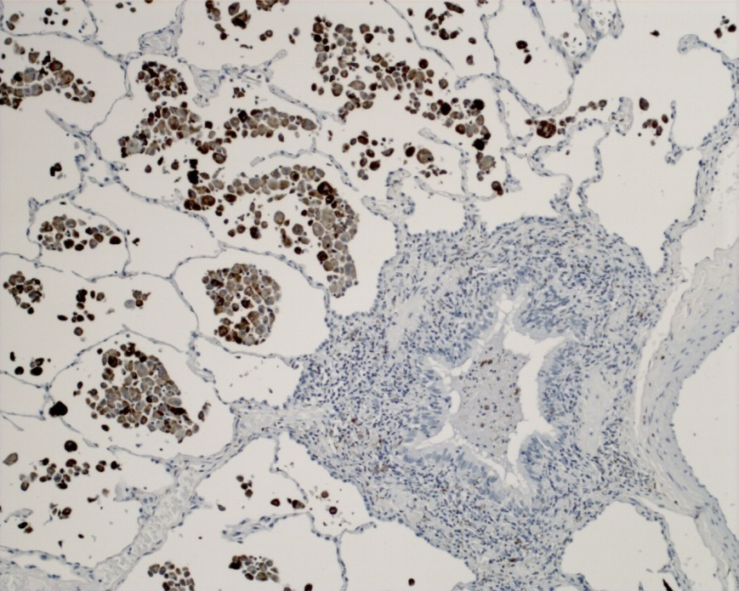
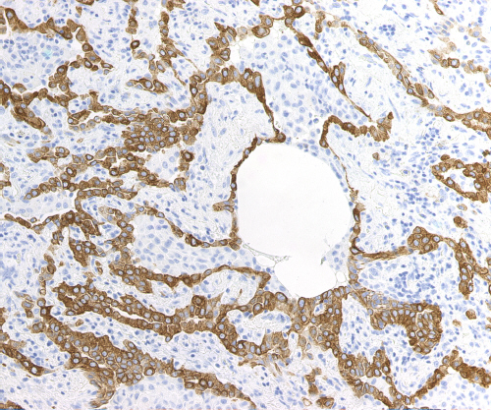
RB-ILD and DIP

Slide 61
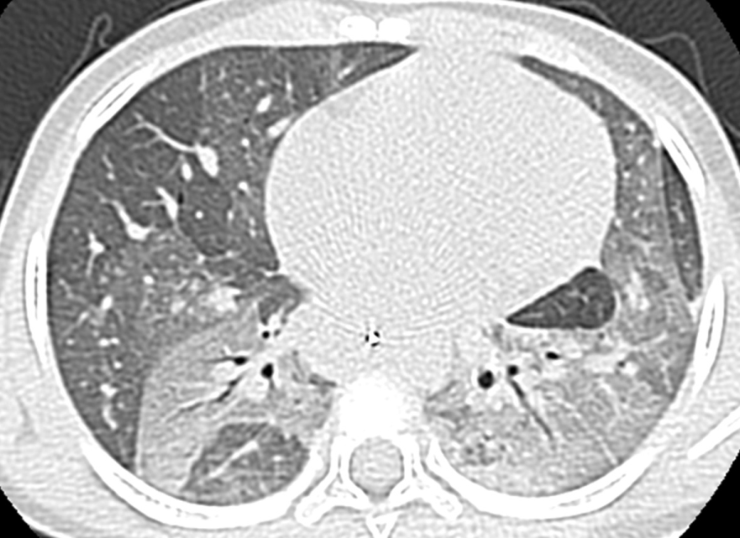
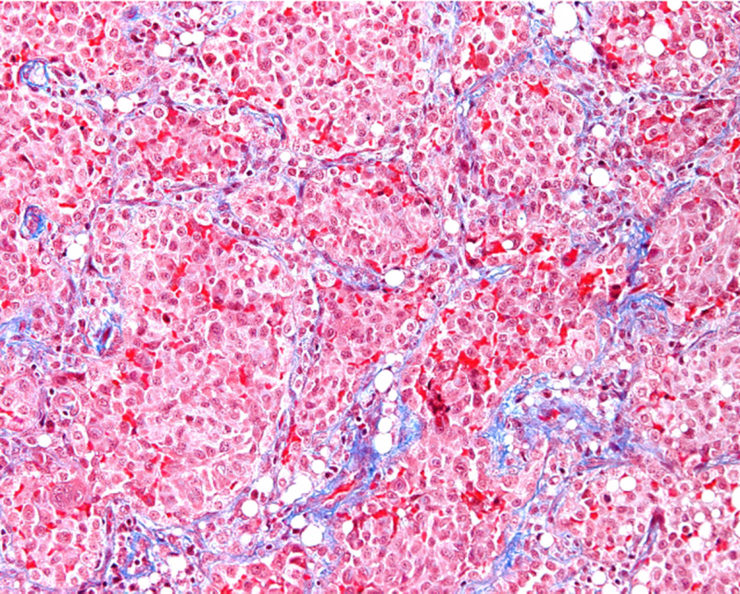
Limits of Morphological Classification

Slide 62
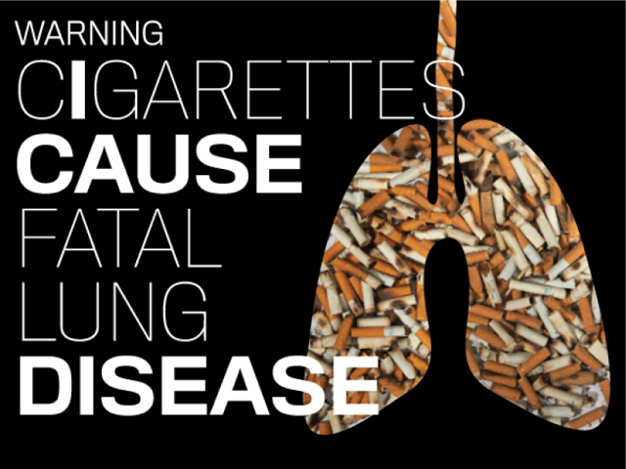
Cigarette Smoke and Lung Pathology
DIP
COPD
Emphysema
RB-ILD
PLCH
IPF
Alveolar
proteinosis
CPFE
Carcinoma

Slide 65
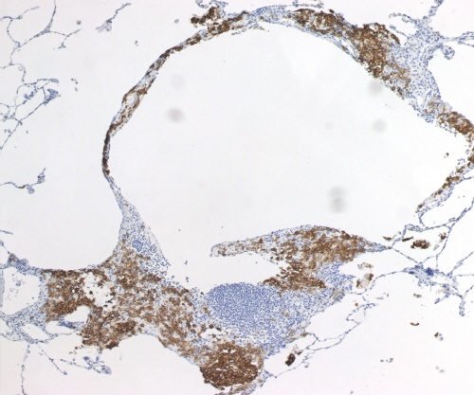
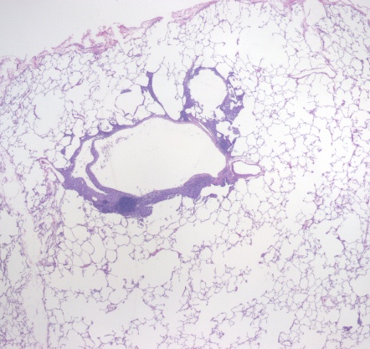
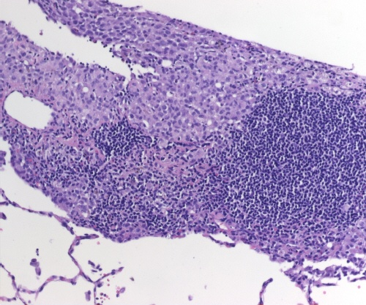
Langerhans cell Histiocytosis
CD1a
CD68-, CD1a+, S100+, langerin+

Slide 66
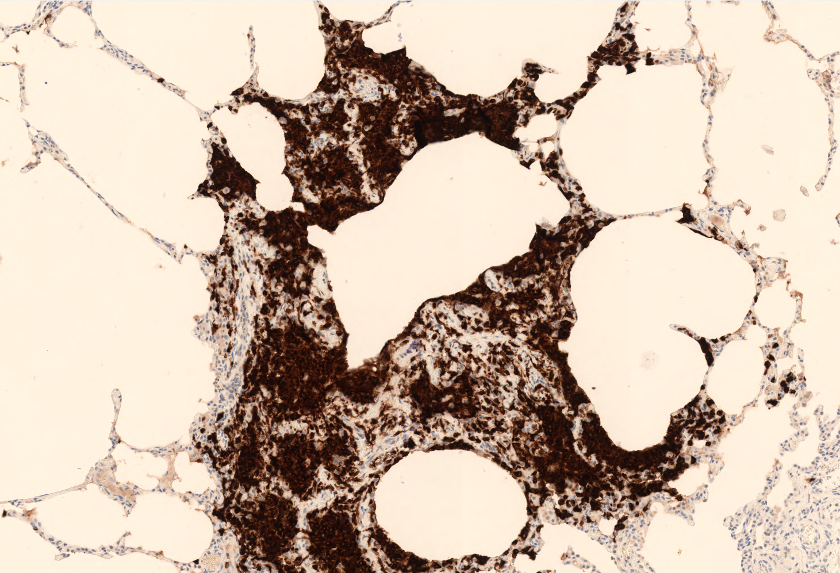
In contrast to systemic LCH, pulmonary LCH appears to be primarily a reactive process….

Slide 67
35/61 cases 57%

Slide 69
12/19 pulmonary LCH → BRAF+
19/19 → p16+, p21+

Slide 70
Anti-BRAF V600E

Slide 71
Bone marrow -derived
monocyte precursor
BRAF V600E mutation
BRAF-VE1
OIS
P16 over-expression
SASP
P16
Fibrosis
remodelling

Slide 73
Pathogenetic classification of ILD
Non inflammatory
known genetic/molecular pathogenesis
Alveolar microlithiasis (SLC34A2 gene mutations)
- Hermansky Pudlak (HPS-1, HPS-4 , and HPS-2 gene mutations)
- Congenital alveolar proteinosis (surfactant protein B mutation; GM-CSFR mutation)
- Lymphangioleiomyomatosis (TSC1/2 gene mutations)
- Langerhans' cell histiocytosis, Erdheim-Chester disease (BRAF V600E mutation, cell senescence)

Slide 76
Pathogenetic classification of ILD
Non inflammatory
2. Multifactorial/complex pathogenesis:
genetic background, cell senescence, stem cell exhaustion
Pediatric ILD (Surfactant-PB or PC-deficiency, ABCA3 mutation, NKX2-1 mutations)
- Familial IPF (TERT, TERC, SP-A2, SP-C, ABCA3, pro-MUC5B rs35705950 polymorphism)
Dyskeratosis congenita with pulmonary involvement
Pleuroparenchymal fibroelastosis
- Idiopatic pulmonary fibrosis - IPF/CPFE
- genetic features: rare: TERT, TERC, surfactant SPA2 and SPC, ABCA3 mutations, frequent: pro-MUC5B rs35705950 polymorphism,
- molecular features: telomere shortening, WNT-pathway activation , EMT, etc.)

Slide 78
Proc Am Thorac Soc Vol 8. pp 158–162, 2011

Slide 79
The future
Can we hypothesize a therapeutic strategy focussed on different mechanisms involved in the disease’s pathogenesis ?

Slide 80
Eur Respir J 2015; 45: 1539–1541 |

Slide 81
Eur Respir J 2016; 48: 1556–1558
“telomere-mediated lung disorders”
TMLD
TMPF

Slide 82
SCE-LF
SE-LF
SF-LF
IPF
Stem-cell-Exhaustion-Lung Fibrosis
Stem/cell-Exhaustion-Lung Fibrosis
Stem/cell-Failure-Lung Fibrosis

Slide 83
Chilosi M, Tomassetti S, Poletti V, 2015
IPF: a misnomer ?
IPF
I diopathic pulmonary fibrosis
I nheritable pulmonary fibrosis

