Slide 2
ILA (interstitial lung abnormalities): prevalence and clinical relevance
S Tomassetti, MD
GB Morgagni Hospital, Forlì

Slide 3
Conflict of Interest
Speaker’s fees:
Intermune, Roche, Boehringer-Ingelheim, Menarini, Chiesi, GlaxoSmithKliner.
Advisory Board: Boeringher-Ingelheim.

Slide 4
ILA
Definition
ILA characteristics
Prevalence
ILA natural history
ILA clinical relevance and future directions

Slide 5
ILA DEFINITION
ILA on CT scans are defined as nondependent changes affecting more than 5% of any lung zone including any combination of nondependent ground-glass or reticular abnormalities, diffuse centrilobular nodularity, nonemphysematous cysts, honeycombing, or traction bronchiectasis.
Araki et al, AJRCCM 2016

Slide 6
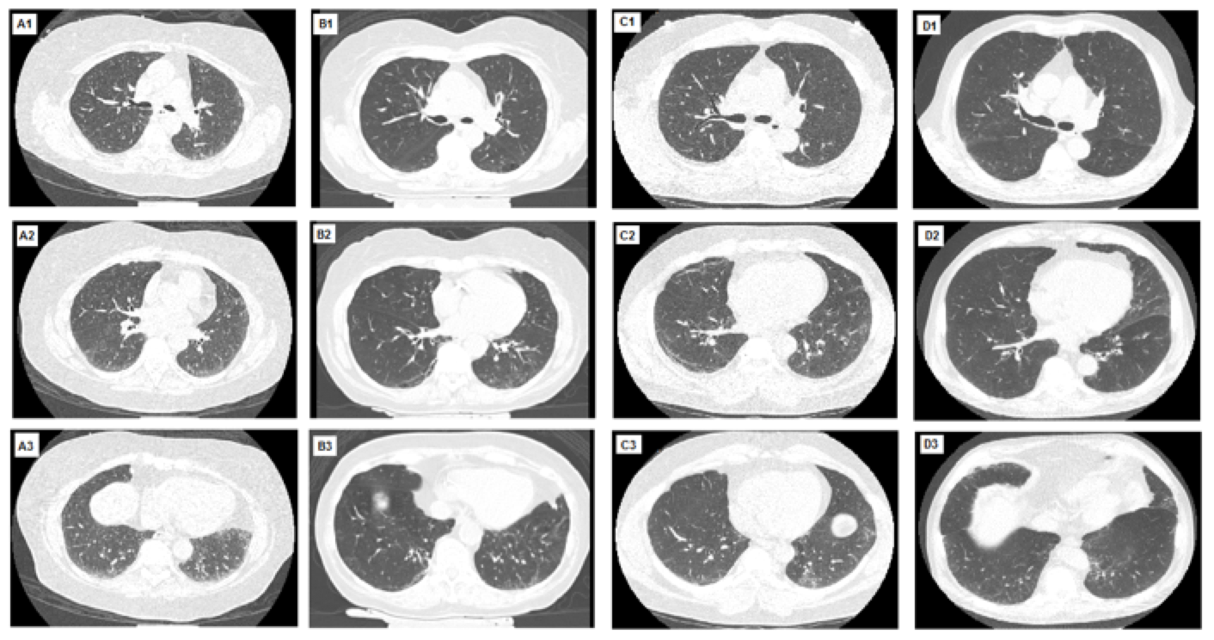
ILA
ILA: nondependent changes affecting more than 5% of any lung zone
Putman RK, JAMA 2016
Notes:
CT scans were reviewed by 3 readers (2 radiologists and 1 pulmonary physician) using a sequential reading method. Quantitative lung volume and emphysema were measured with Airway Inspector. Coronary artery calcium scores were calculated using the Agatston scoring method.

Slide 7
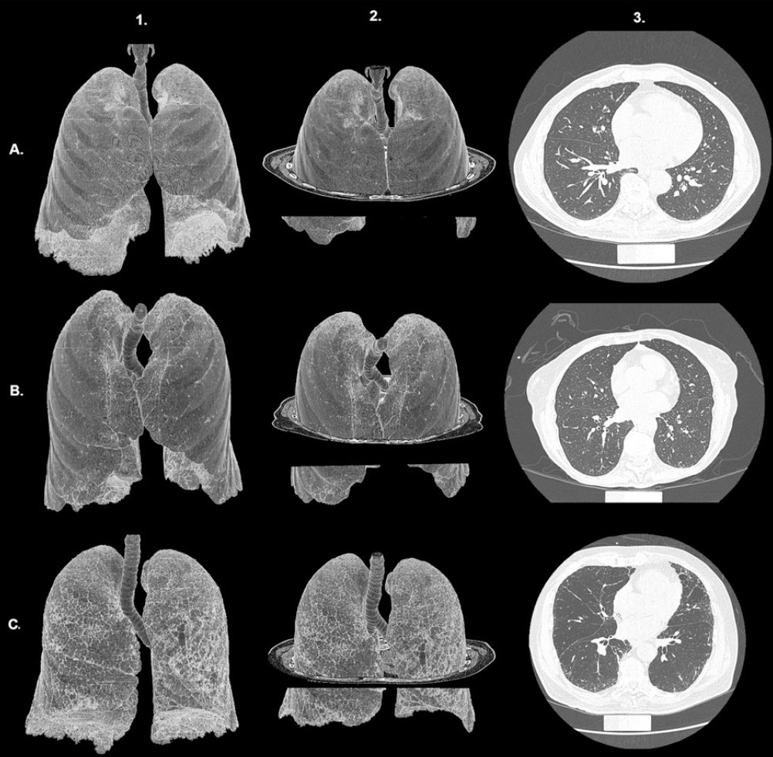
Partly transparent three dimensional reconstructions demonstrate more extensive radiologic abnormalities
Single planar images do not often convey the full extent of these radiologic findings, therefore ILA as a set of subtle radiologic findings may be a misconception.
Hunninghake, NEJM 2013

Slide 8
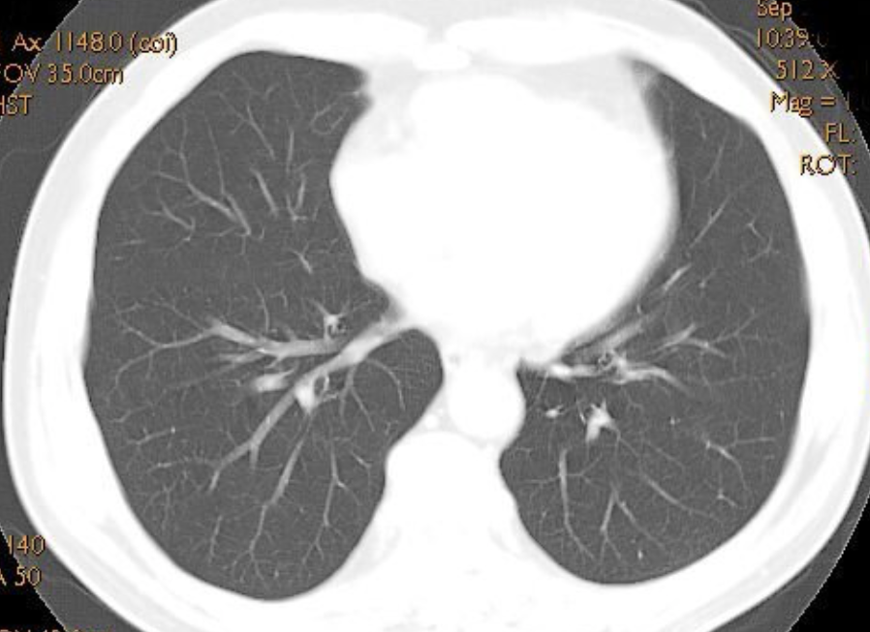
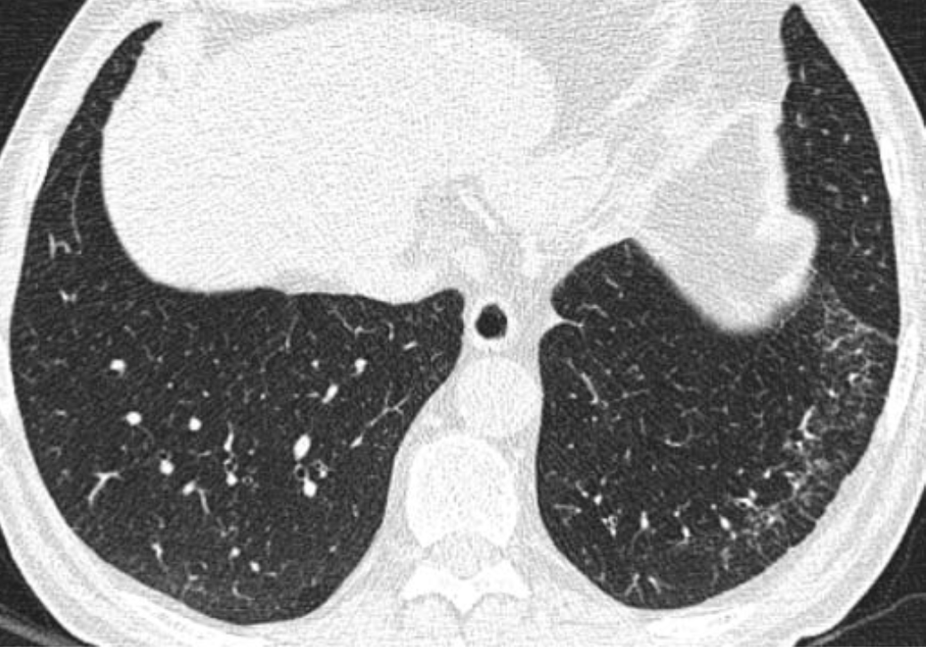
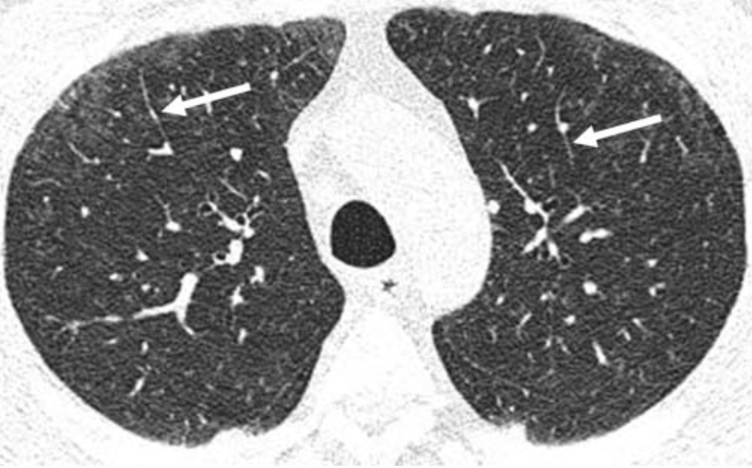
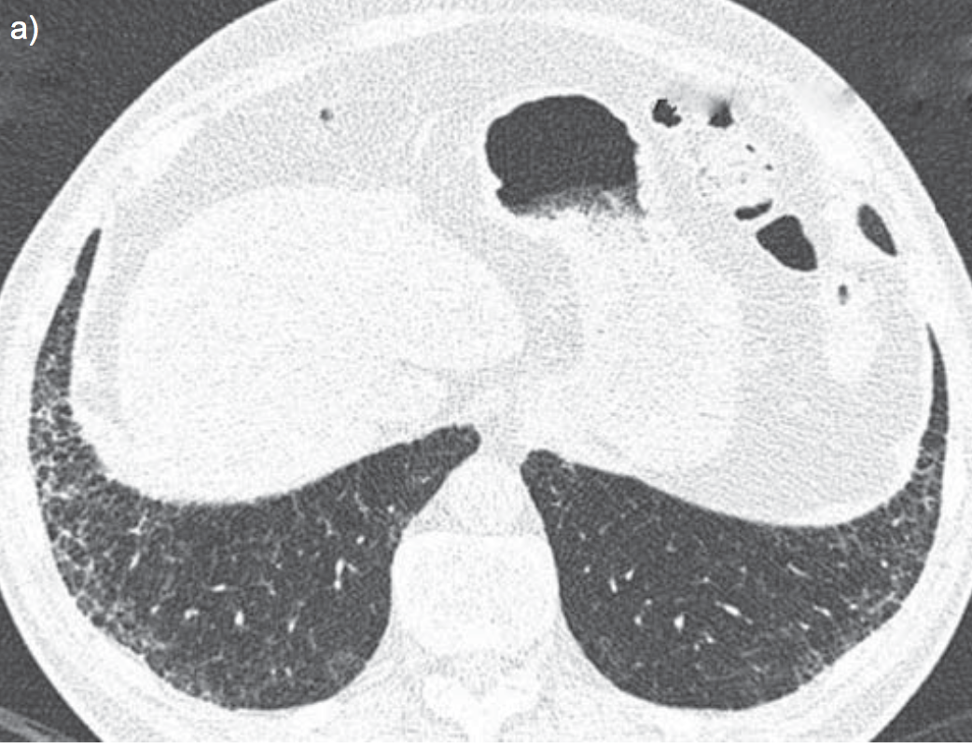
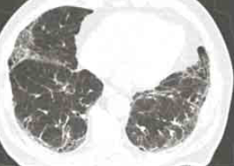
ILA with RB-ILD
NORMAL
INDETERMINATE
The spectrum of radiologic abnormalities
ILA
ILA with fibrosis

Slide 9
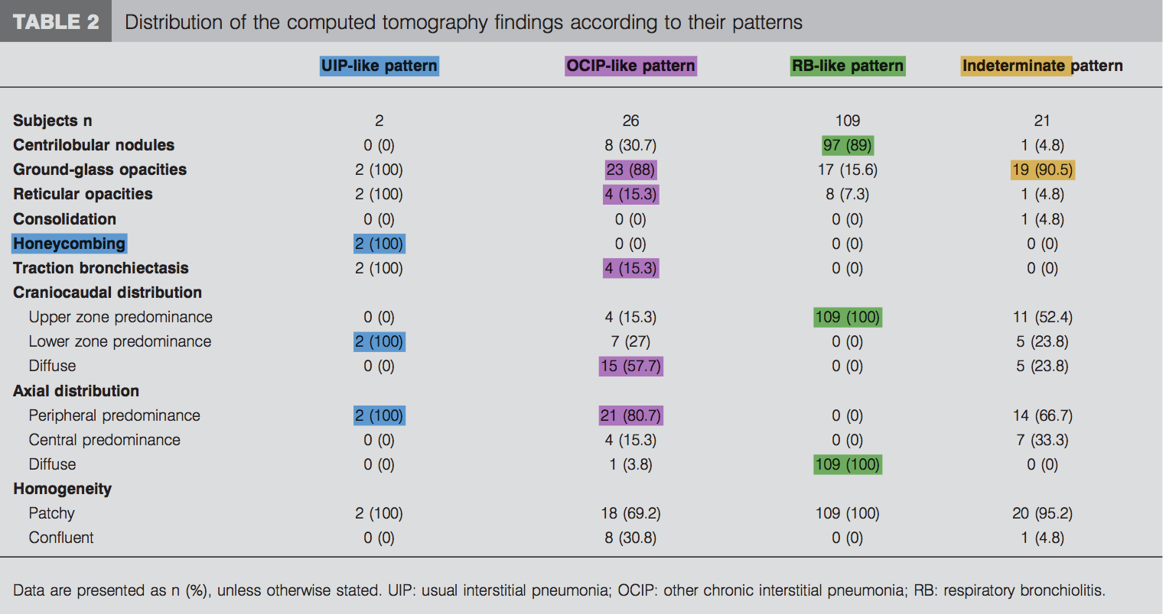
(692 total cases)
0.3%
3.8%
15%
3%
^{Interobserver agreement:}
^{was fair (k} ^{0.3) for RB-like pattern,}
^{moderate (k} ^{0.6) for OCIP-like and (k} ^{0.49) for the indeterminate}
^{excellent (k} 1.00) for the UIP-like pattern.
Sverzellati et al, ERJ 2011

Slide 10
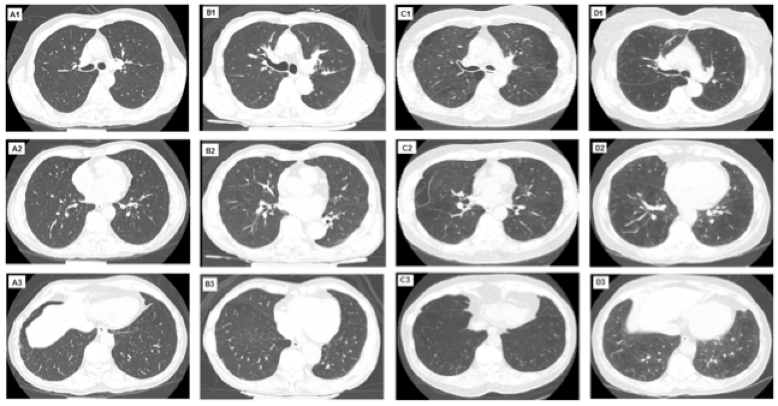
Indeterminate findings
CTs with either focal or unilateral ground-glass attenuation, focal or unilateral reticulation, or patchy ground-glass abnormality (<5% of any lung zone)
Putman RK, JAMA 2016
Notes:
CT scans were reviewed by 3 readers (2 radiologists and 1 pulmonary physician) using a sequential reading method. In the AGES-Reykjavik cohort, of the CT scans scored by at least two readers (2836), 1623 (57%) were concordant reads. Of the 1213 discordant reads, 1155 (95%) involved one indeterminate read, while a discrepancy between those with and without ILA was less common (58 [5%]). In the ECLIPSE cohort, of the CT scans scored by at least two readers (1868), 1240 (66%) were concordant reads. Of the 628 discordant reads, 617 (98%) involved one indeterminate read, while a discrepancy between those with and without ILA was rare (9 [1%]). These findings are mostly consistent with levels of discordant reads we have noted in previous evaluations.

Slide 11
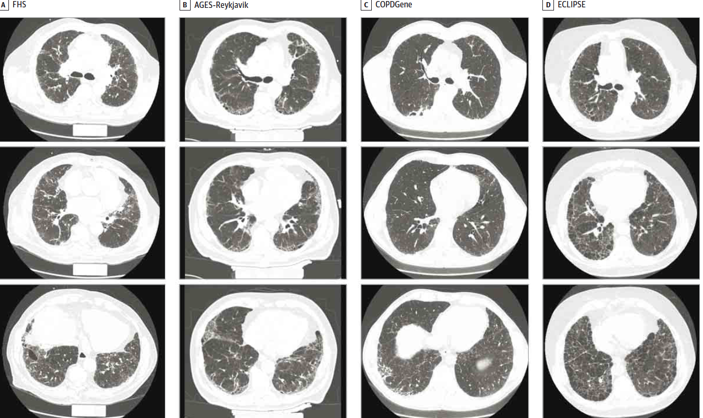
ILA with definite fibrosis
defined as pulmonary parenchymal architectural distortion diagnostic of fibrotic lung disease
Putman RK, JAMA 2016

Slide 12
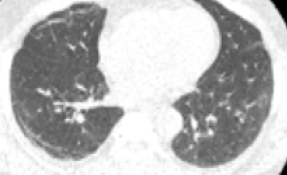
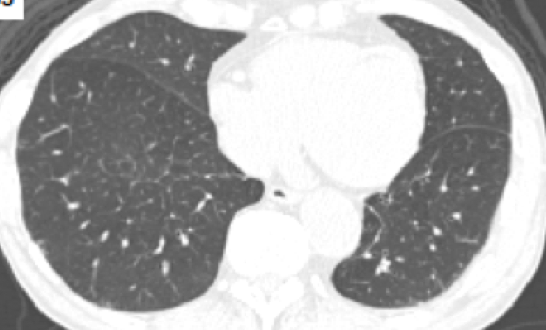
The boundaries of ILA
CT reviewed by 3 readers (2 radiologists and 1 pulmonary physician) using a sequential reading method.
discrepancy between normal and ILA is uncommon 5%-1% (58 in AGES-Reykjavik and 9 in The ECLIPSE).
NORMAL
ILA
ILA with definite fibrosis
57% and 66% were concordant reads (1623/2836 in the AGES-Reykjavik cohort, and 1240/1868 in the ECLIPSE cohort).
95% and 98% of the discordant reads involved one indeterminate read (1155/1213 in the AGES-Reykjavik and 617/628 in the ECLIPSE)
INDETERMINATE
Putman RK, JAMA 2016

Slide 13
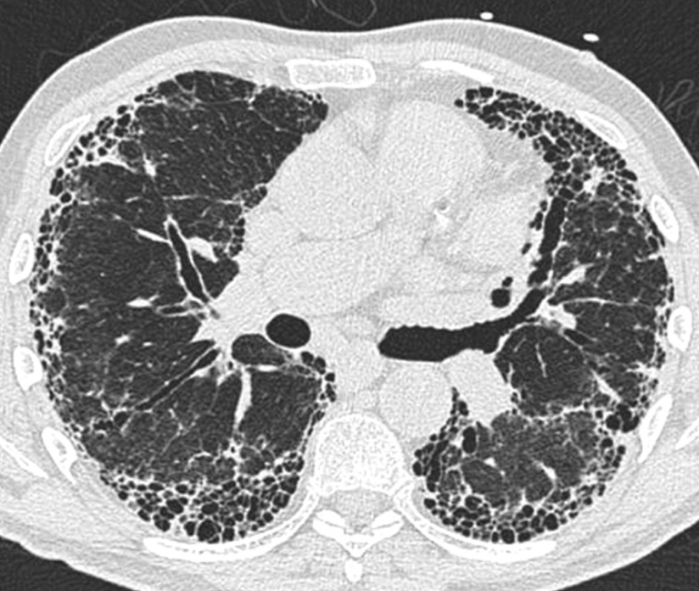
Discriminating ILA from IPF
Where is the boundary?
ILA
ILA with definite fibrosis
IPF
Putman RK, AJRCCM 2014

Slide 14
ILA definition
ILA is not a disease, but a radiologic (CT) entity
Distinction of ILA from indeterminate cases may be challenging
The boundaries between ILA and fibrotic lung disease (particularly IPF) are unclear.

Slide 15
ILA
Definition
ILA characteristics (demographics, lung function, genetic background, pathology)
Prevalence
ILA natural history
ILA clinical relevance and future directions

Slide 16
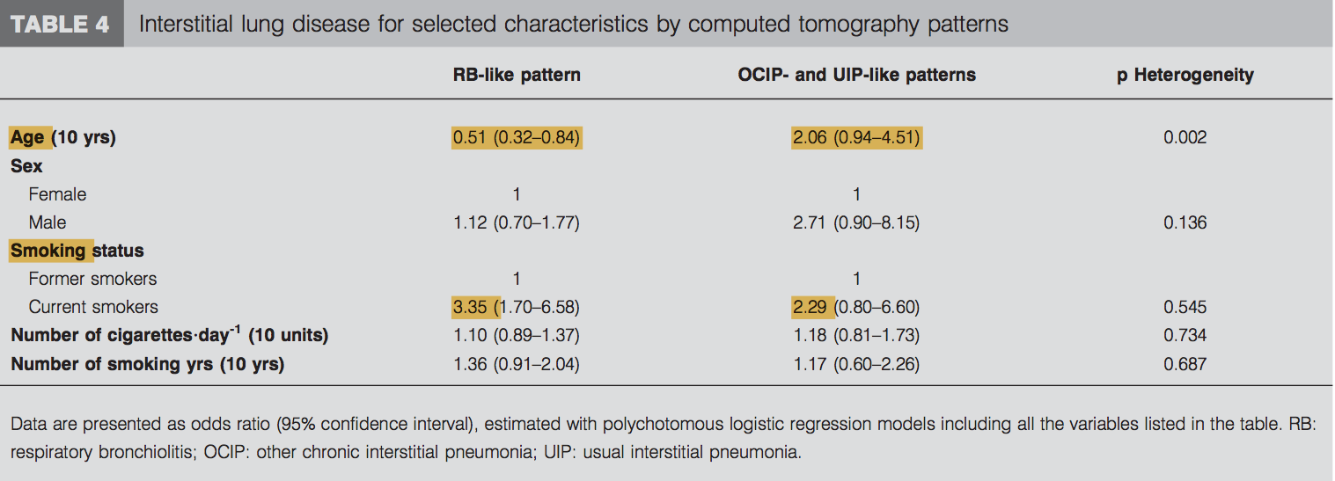
Risk pattern heterogeneity among different ILA pattern
ILA with RB-ILD
ILA with fibrosis
Sverzellati et al, ERJ 2011
Notes:
the risk for the presence of UIP/OCIP-like patterns was directly associated with age (OR 2.06 for 10 yrs (95% CI 0.94–4.51)), male sex (OR 2.71 (95% CI 0.90–8.15)) and current smoking status (OR 2.29 (95% CI 0.80–6.60)), whereas the RB-like pattern was inversely asso- ciated with age (OR 0.51 for 10 yrs (95% CI 0.32–0.84)) and directly associated with current smoking status (OR 3.35 (95% CI 1.70–6.58)). Heterogeneity between the RB-like pattern risk and the UIP/OCIP-like pattern risk was observed for age (p 0.002), but not for smoking status (p 0.545).

Slide 17
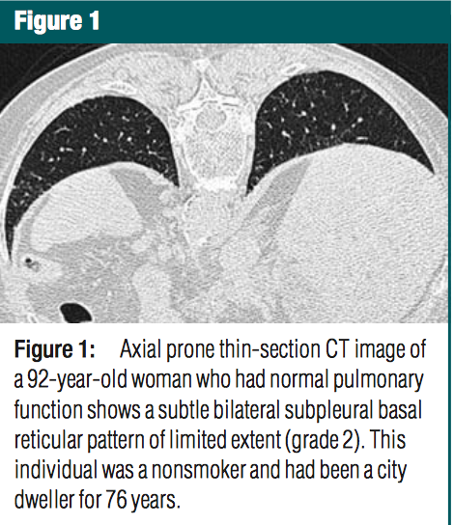
ILA are frequently seen in asymptomatic elderly individuals and may not necessarily represent clinically relevant disease.
* Median age 80.6 yo +/- 4.2 and 39.4 yo +/- 7.5
Copley et al, Radiology 2009
Notes:
limited predominantly subpleural basal reticular pattern
was identified in the majority (24 of 40, 60%) of individuals
in the older group and was absent (zero of 16) in the
younger group (P " .001).
Cysts were seen in 10 (25%) of
the 40 subjects in the older group but were seen in none of
the subjects in the younger group (P ! .02).
All findings were independent
of pack-year smoking history with multiple logistic
regression analysis.
We have documented that asymptomatic
older individuals have a relatively
high frequency of a basal subpleural reticular
pattern and cysts, independent
of smoking history.

Slide 18
Comparison between participants with and without ILA
c
Putman RK, JAMA 2016
Notes:
Across all cohort ILA were associated with older age when compared to the absence of ILA.
Among Framingham and AGES-Reykjavik participants there was a higher smoking pack year in the ILA subgroup, whereas the prevalence of COPD was higher in the ILA participants of Framingham but lower in the ILA participants of COPD-gene study.
3. Among ECLIPSE study ILA were associated with less severe airway obstruction as shown by higher FEV1 and higher Tiffenau index. 4. Whereas in the Framigham study the Tiffenau was higher in patients without ILA.

Slide 19
similarities between the clinical phenotype of patients ILA and IPF
Putman RK, AJRCCM 2014
Notes:
As noted in this table, there is now accumulating information about the similarities between the radiologic and clinical phenotype of patients with IPF and research subjects with ILA. Comparable to the similarities we have
noted in radiologic findings, many
similarities exist between the clinical
syndrome and physiologic abnormalities
apparent in both subjects with ILA and
patients with IPF (Table 1).
Advanced age, a common feature of
patients with IPF (1), is strongly associated
with the presence of ILA and has been
a consistent finding across most studies
(14–18). Smoking, an increasingly accepted
risk factor for IPF (20, 21), has now
been associated with ILA in multiple
independent populations and is currently
the most well-replicated risk factor for ILA
(14–18). Subjects with ILA have been
demonstrated to have an increase in
respiratory symptoms (14–16) and physical
examination findings noted in patients with
IPF (15). In addition, statistically significant
reductions in total lung, exercise, and
diffusion capacity have been noted in
subjects with ILA when compared with
subjects without ILA (Table 1) (14, 16, 22). Although relative increases in age,
respiratory symptoms, and physical
examination findings, and relative
reductions in physiologic parameters
suggestive of an early restrictive ventilatory
deficit with impaired exercise capacity
and gas exchange, all suggest that, in
some cases, ILA may be an early stage of
pulmonary fibrosis, it is also important to
comment on the differences noted between
these two phenotypes. Respiratory
symptoms are less common among subjects
with ILA than in patients with IPF

Slide 20
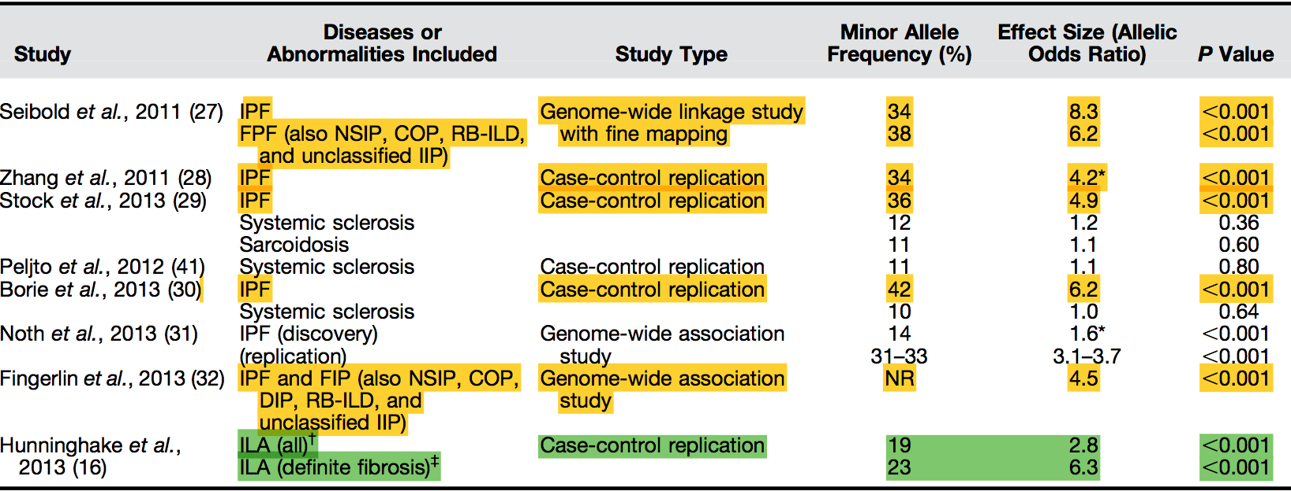
Genetic of ILA
the risk of ILA associated with increasing copies of the MUC5B promoter variant is similar to the risk noted with this variant in IPF
Putman RK, AJRCCM 2014
Notes:
the association between the MUC5B
promoter variant and pulmonary fibrosis is
currently the most consistently reproducible
finding in the genetics of pulmonary fibrosis
(28–30) and remains the dominant genetic
finding for pulmonary fibrosis identified by

Slide 21
Suspected pathologic correlates of ILAs
Early/subclinical UIP/IPF
Smoking related changes (which could overlap with #1)
Others, especially foci of inflammation and organizing pneumonia (since these are frequent minor findings in lobectomies)
Courtesy of TV Colby and S Piciucchi

Slide 22
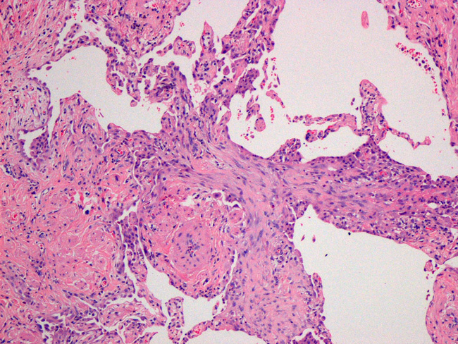
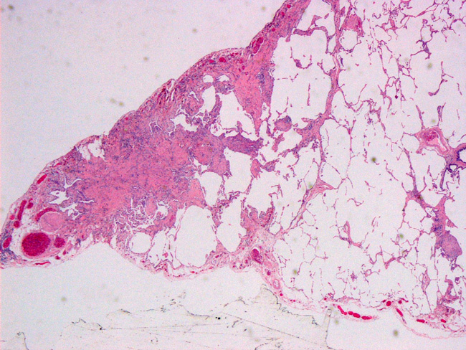
UIP-like foci
Slide courtesy Y Kawabata
This is EARLY UIP as recognized by pathologists
Fibroblast focus

Slide 23
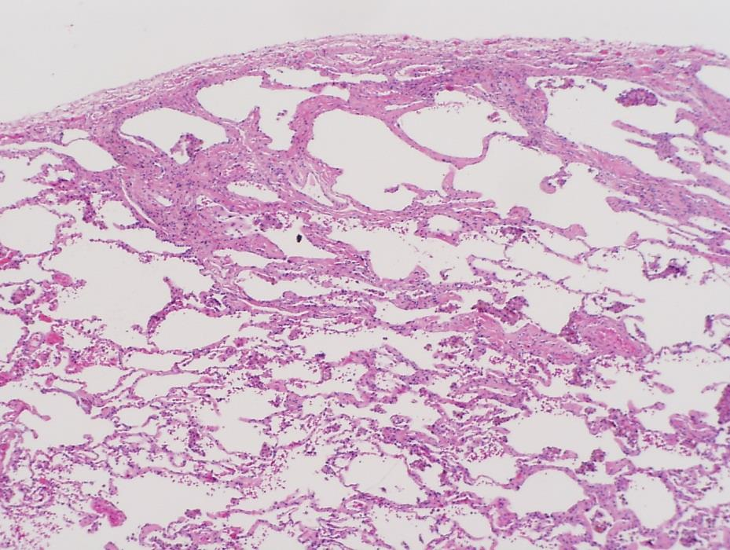
MICROSCOPIC FIBROSIS CAN BE RELATED TO SMOKING (Pathologic studies)
(Yousem SA. Mod Pathol 2006;19:1474)
30 lobectomies from smokers: 13 (43%) with some fibrosis
(No fibrosis in lobectomies from 16 nonsmokers)
(Katzenstein et al in Hum Pathol 2010)
20 lobectomies from smokers: 9 (45%) with fibrosis labeled:
Smoking-related interstitial fibrosis (SRIF)
Can this smoking-related fibrosis be clinically recognized ?? ---Interstitial lung abnormalities (ILA) in CT studies
Courtesy of TV Colby and S Piciucchi

Slide 24
ILA characteristics
Those studies, through the demonstration of similarities in radiologic, physiologic, and genetic features, suggests that ILA may in some cases represent an early stage or mild form of IPF
Lung biopsies studies are lacking and would help to definitively establish the connections between ILA and IPF

Slide 25
ILA
Definition
ILA characteristics
Prevalence
ILA natural history
ILA clinical relevance and future directions

Slide 26
Prevalence of ILA and IPF
Putman RK, AJRCCM 2014

Slide 27
Prevalence of ILA
in 4 prospective cohort study (11.691 participants)
2633 from the FHS (Framingham Heart Study; 2008-2011), to identify risk factors for cardiovascular d. in the general population.
5320 from the AGES-Reykjavik Study (Age Gene/Environment 2002-2006), longitudinal birth cohort from Reykjavik Study.
2068 from the COPDGene Study (2007-2010), to identify risk factors for COPD (all smokers, with and without COPD, any GOLD stage; participants with lung disease other than asthma, emphysema or COPD were excluded).
1670 from ECLIPSE (2005-2006), Evaluation of COPD Longitudinally to Identify Predictive Surrogate Endpoints ( 2,180 COPD, GOLD II-IV and 500 controls smokers and non-smokers).
Putman RK, JAMA 2016
Notes:
To date, studies attempting to identify ILA have primarily relied on chest computed tomograms (CTs) and have included subjects from population samples and smokers participating in
research studies

Slide 28
Prevalence of ILA in 4 studies
^{Framingham Heart Study}
^{N=2764}
^{AGES-Reykjavik Study}
^{N=5764}
^{COPDGene Study}
^{N= 2508}
^{ECLIPSE Study}
^{N=2164}
Excluded (missing chest CT and/or mortality data)
Included
95% (N=2633) 92% (N=5320) 82% (N=2068) 77%(N=1670)
ILA
7% (N=177) 7% (N=378) 7.5% (N=156) 9%(N=157)
INDETERM.
41% (N=1086) 32% (N=1726) 36% (N=739) 59%(N=985)
NO ILA
52% (N=1370) 61% (N=1173) 56.5% (N=3216) 32%(N=528)
Adapted from Putman RK, JAMA 2016

Slide 29
Prevalence of definite fibrosis
^{Framingham Heart Study}
^{N=2633}
^{AGES-Reykjavik Study}
^{N=5320}
^{COPDGene Study}
^{N= 2068}
^{ECLIPSE Study}
^{N=1670}
Included
ILA
7% (N=177) 7% (N=378) 7.5% (N=156) 9%(N=157)
N
(N=44) (N=129) (N=32) (N=28)
DEFINITE
FIBROSIS
% vs ILA
25% 34% 21% 18%
% vs TOTAL
1.6% 2.4% 1.5% 1.6%
Adapted from Putman RK, JAMA 2016
Notes:
Mortality for fibrosis was similar to ILA in the FHS 6%, but higher in the other cohorts
Risk of death after adjusting for age sex pack year smoking status and BMI , was increased only in the reykjiavik and eclipse cohort but not in the FHS and COPD study cohorts.

Slide 30
ILA prevalence
ILA are present in ≈ 2 to 10% of research participants and 7% of the general population.
Definite fibrosis is present in each cohort in ≈ 2% of cases.
There is a large discrepancy between the prevalence of ILA and the prevalence of IPF and ILDs (≈ 0.002%-0.04% of the general population).
Whereas the prevalence of definite fibrosis is similar to that of IPF reported in an autopsy study of 510 cases from New Mexico (1.8%)
^{LedererDJ etalAJRCCM 2009;} ^{WashkoGR et al NEJM 2011;} Sverzellati N et al, ERJ 2011; Jin GY et Radiology. 2013; TsushimaK, Respir Med. 2010; HunninghakeGM,et al, NEJM 2013; PutmanRK,et al, AJRCCM 2014

Slide 31
ILA
Definition
Prevalence
ILA characteristics
ILA natural history
ILA clinical relevance and future directions

Slide 32
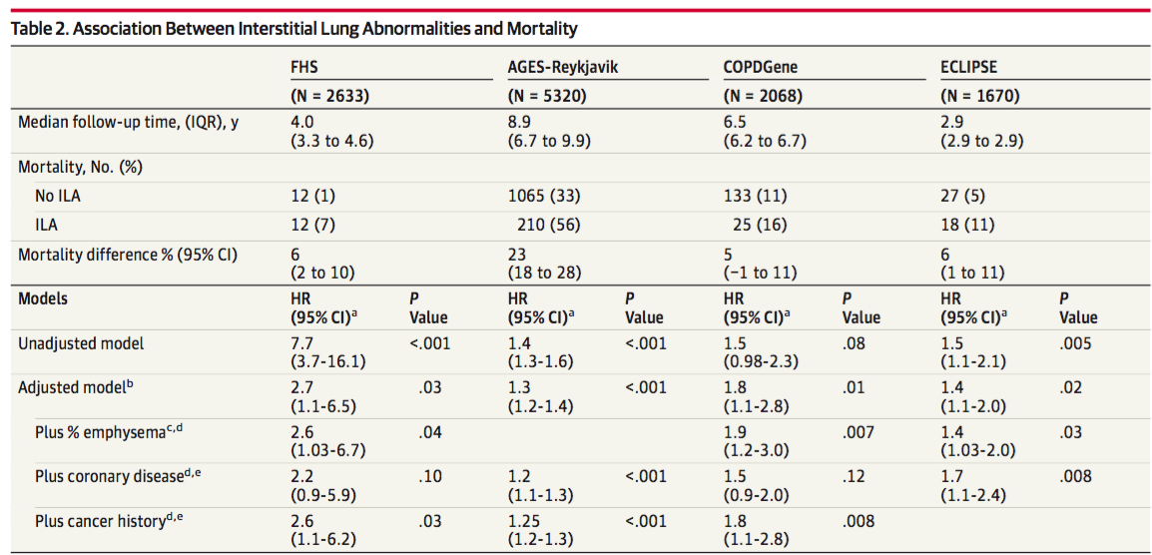
Mortality related ILA in adults is around 7%
Putman RK, JAMA 2016
Notes:
Mortality related ILA in adults is around 7%
For all cohorts except for the COPD gene the absolute mortality rates were significnatly higher among participants with ILA.
. In the FHS 7% of ILA died over 4 years compared to 1% of pts without ILA, with a mortality difference of 6% … repeat the phrase for all 4 studies. The differences in mortality rates are due to difference in recruitment criteria and follow-up time. Higher mortality in COPDgene and ECLIPSE are likely explanied by longer FU and recruitment of COPD patients. The higher mortality in the Reykjavik cohort are likely explaned by longer FU ad higher age.
The association between ILA and mortality remained statistically significant after adjustem for emphysema CAD and cancer, except in the FHS and COPD-gene in wich adjustement for CAD resulted in no association.

Slide 33
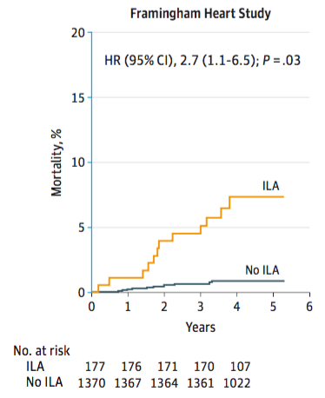
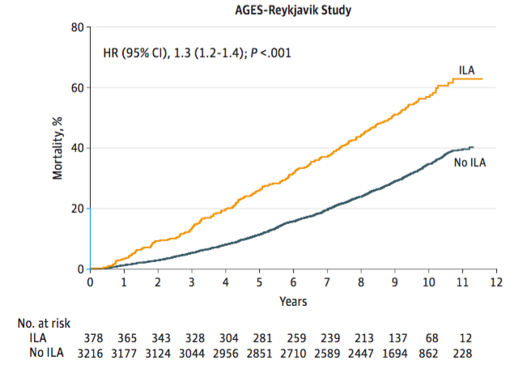
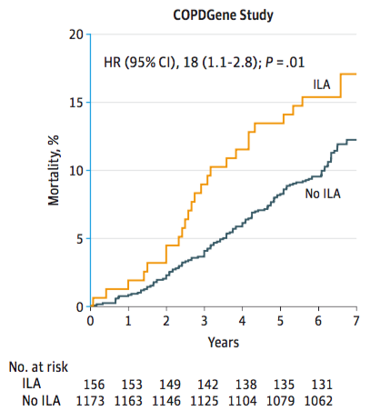
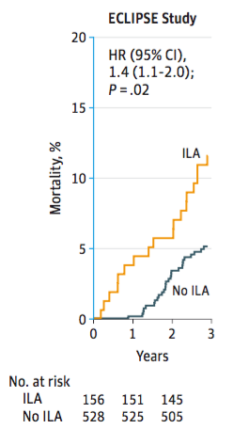
Mortality Rates by ILA status
adjusted Cox proportional hazards model including adjustments for age, sex, race, body mass index, pack-years of smoking, current or former smoking status, and GOLD stage of COPD (except in AGES-Reykjavik N/A).
Putman RK, JAMA 2016

Slide 34
ILA are more likely to die of RESPIRATORY CAUSES WITH AN INCREASED RATE OF DEATH FROM PULMONARY FIBROSIS.*
After adjusting for age, sex, race, BMI, pack-years of smoking, current smoking status, ILA had a higher OR of death from a respiratory cause (OR, 2.4 [95% CI, 1.7-3.4]; P < .001) compared with No-ILA. Results were similar when comparing participants with ILA with those indeterminate.
*Causes of death for the AGES Reykjavik Study
Putman RK, JAMA 2016
Notes:
Participants with ILA were more likely to die of respiratory causes 13%compared to indeterminate and NoILA, WITH AN INCREASED RATE OF DEATH FROM PULMONARY FIBROSIS.
Only if asked: pulmonary fibrosis 5 definite UIP by CT, 2 ILA witout fibrosis + 1 indeterminate
Only if asked: THERE WAS NO ASSOCIATION BETWEEN ILA STATUS AND DEATH DUE TO CAD, CANCER OR OTHER CAUSES.

Slide 35
How does ILA progress?

Slide 36
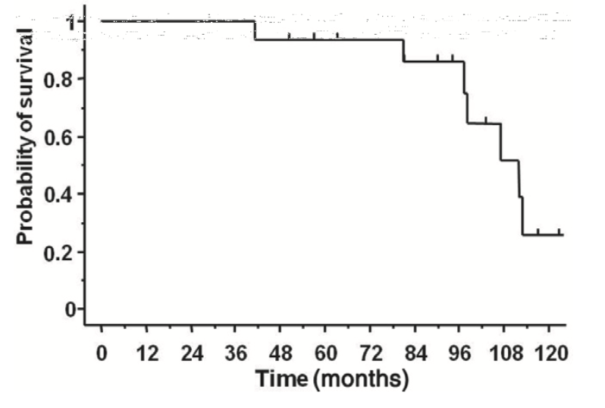
Early IPF compared to advanced IPF, slower progression but still lethal
10% decline in FVC at 1 year was 6.3% (1/16)
The first-year decline of FVC in this study was 83 mL
POD observed in 69% (11/16), over a mean period of 19.9 12.3 months
Risk factors for POD were the presence and extent of honeycombing (%) on high-resolution CT (P = 0.04, OR 2.4 P = 0.017, OR= 5.6)
median survival was 9 years
^{7 deaths:}
⁻ ² ^{chronic RF}
^{2 AE-IPF}
^{2 lung cancer}
^{1 left heart failure}
Kondoh et al, Respirology 2013

Slide 37
ILA progression
AIM: To determine if the progression or development of ILA, defined by serial chest CT examinations, is associated with adverse clinical outcomes defined an accelerated rate of physiologic decline and an increased rate of mortality
ILA were assessed in 1,867 participants who had serial chest computed tomography (CT) scans approximately 6 years apart.
7.8% (148) of participants showed ILA, 2.8% (53) at first CT, 5% (95) developed newly ILA at FU
[763 (41%) were indeterminate, and 970 (52%) normal].
Araki et al, AJRCCM 2016

Slide 38
ILA evolve to fibrosis and UIP in a significant minority of cases
Among 1,867 initial CT 53 (2.8%) had ILA, including 5 (0.2%) definite fibrosis, none with UIP.
[44% indet and 53% norm]
In 6 years 43% (23/53) of ILA had progressed, including all cases that initially showed fibrosis.
91% (21) ultimately had fibrosis
9% (2) developed UIP
Araki et al, AJRCCM 2016

Slide 39
Newly developed ILA
5% (95) developed newly ILA during FU,
12 (13%) definite fibrosis
1 (1%) UIP pattern

Slide 40
Increasing age and increasing copies of the MUC5B promoter polymorphism were associated with ILA progression.
Araki et al, AJRCCM 2016

Slide 41
ILA progression was associated with a greater FVC decline
^{FVC mean decrease per year:}
35 ml (SD 44 ml) participants without ILA
40 ml (SD 44 ml) ILA without progression
64 ml (SD 51 ml) ILA with progression
Araki et al, AJRCCM 2016

Slide 42
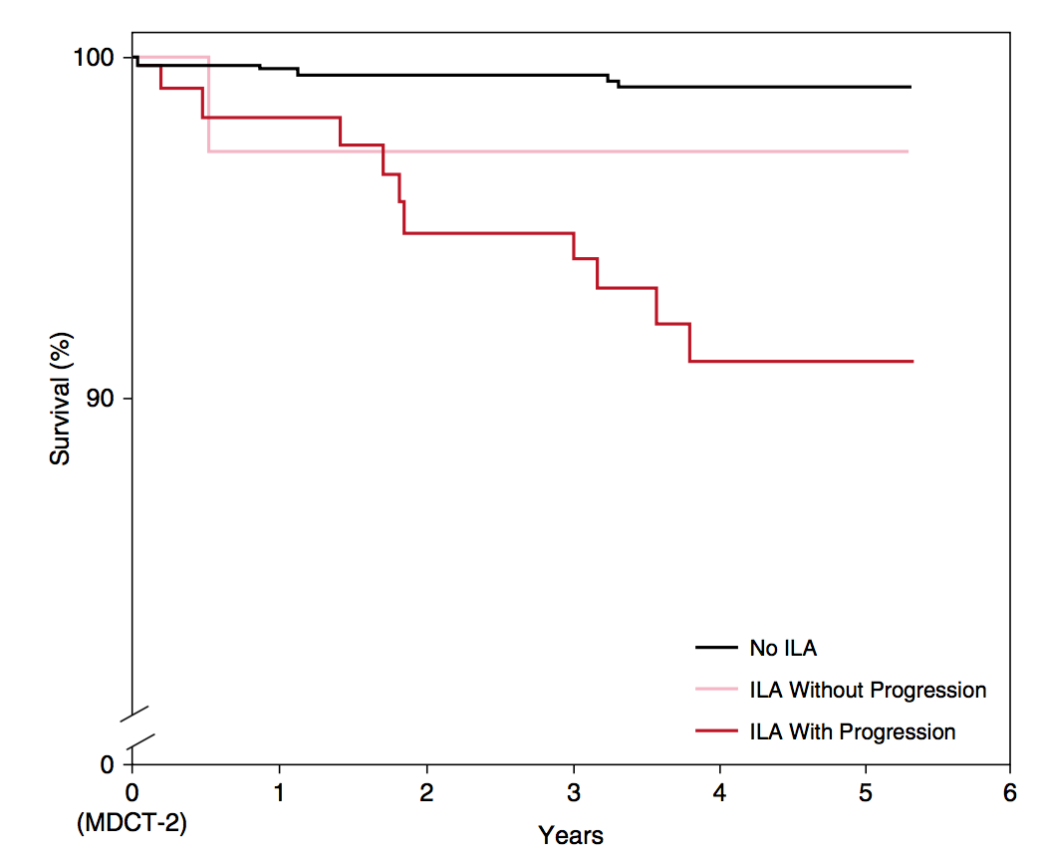
ILA progression is associated with an increase in the risk of death (hazard ratio, 3.9; 95% CI 1.3–10.9; P = 0.01)
^{Death 1% (5 out of 660)}
^{Death 3% (1 out of 37)}
^{Death 8% (10 out of 118)}
Araki et al, AJRCCM 2016

Slide 43
ILA
Definition
Prevalence
ILA characteristics
ILA natural history
ILA clinical relevance and future directions

Slide 44
Interstial Lung Abnormalities: prevalence and clinical relevance
ILA occur in approx 7% of adults
Compared to no-ILA are associated with a higher rate of
Disease progression
All cause mortality (all cohorts)
Death from respiratory failure and fibrosis
Further studies are needed to:
Identify the pathologic and genetic profile of ILA
Clarify the boundaries between ILA and IPF
Describe CT-pathologic findings that may simply reflect a normal variant of the aging lung, smoking related changes, other non-progressive early interstitial changes.
Putman RK, JAMA 2016
Notes:
Despite often being asymptomatic and undiagnosed ILA may be associated with lower survival rates among older persosns
Mortality and repiratory failure rates are lower compared to IPF

Slide 45
Thank you

