Slide 1
Human alveolar type II cells in pulmonary diseases
Beata Kosmider, MS, PhD Department of Physiology Department of Thoracic Medicine and Surgery Center for Inflammation, Translational and Clinical Lung Research Lewis Katz School of Medicine Temple University
Philadelphia, PA
PneumoTrieste
April 3, 2017

Slide 2
Disclosures
No conflict of interest to disclose.

Slide 3
Presentation outline
Studies of ATII cells.
ATII cell injury in IPF.
ATII cell injury in emphysema.
The role of ATII cells in lung regeneration.

Slide 4
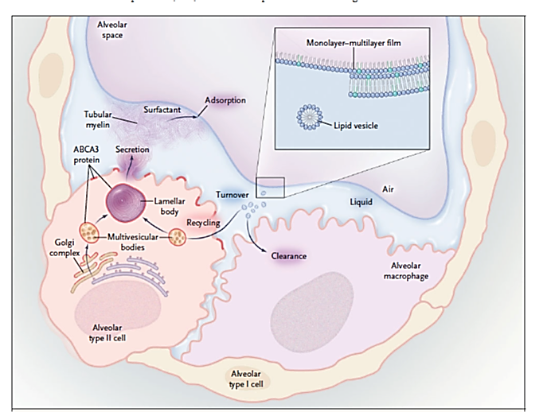
Background
Alveolar type II (ATII) cells make and secrete pulmonary surfactant and they proliferate to restore the epithelium after damage.
Hallman, N Engl J Med, 200
Mason, Respirology, 20064

Slide 5
Studies using human ATII cells
Challenges:
Despite the worldwide increasing incidence in emphysema and lung fibrosis, a global approach focused on ATII cell research is limited.
Human lung tissue is often unavailable to large portions of the scientific community due to a lack of network between clinical and research centers.
Quality of both available data and matching samples may be limiting.
ATII cell isolation is costly, time- and labor-consuming procedure.
This results in:
Limitation in study of potential therapeutics or diagnostics in ATII cells in preclinical research.
Suboptimal infrastructure to conduct high-quality and patient-relevant research in lung diseases.
Limitation in cutting edge technologies used to study normal and diseased lungs.
Limitation in a multinational research platform capable of collecting, storing, and distributing samples with clinical information.
White, ES et al. AJRCCM, 2016
Bahmed K et al, AJRCMB, 2016

Slide 6
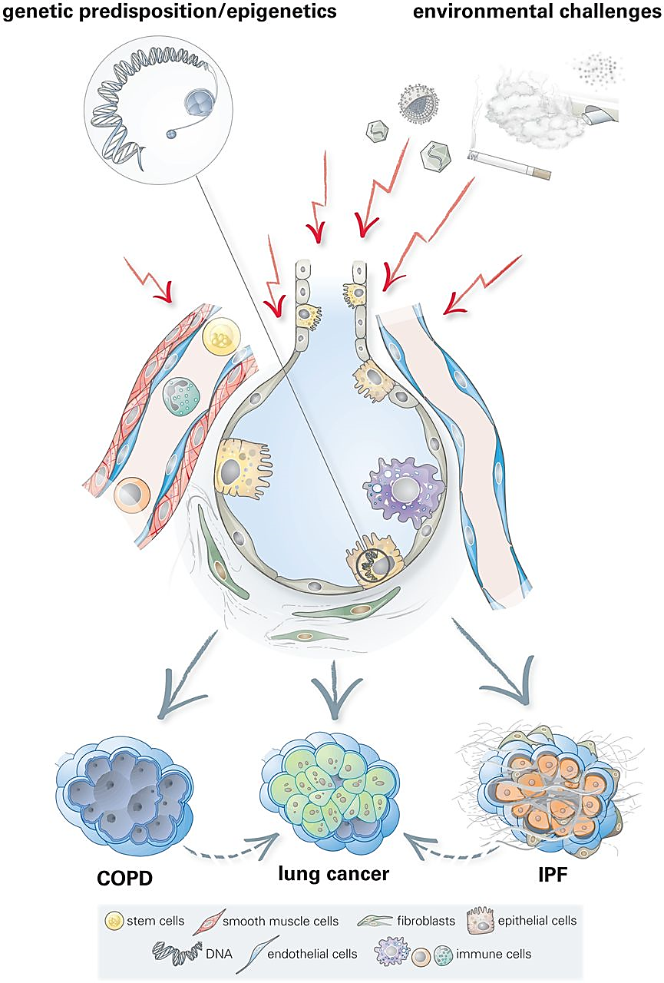
Meiners et al. ERJ, 2015

Slide 7
Presentation outline
Studies of ATII cells.
ATII cell injury in IPF.
ATII cell injury in emphysema.
The role of ATII cells in lung regeneration.

Slide 8
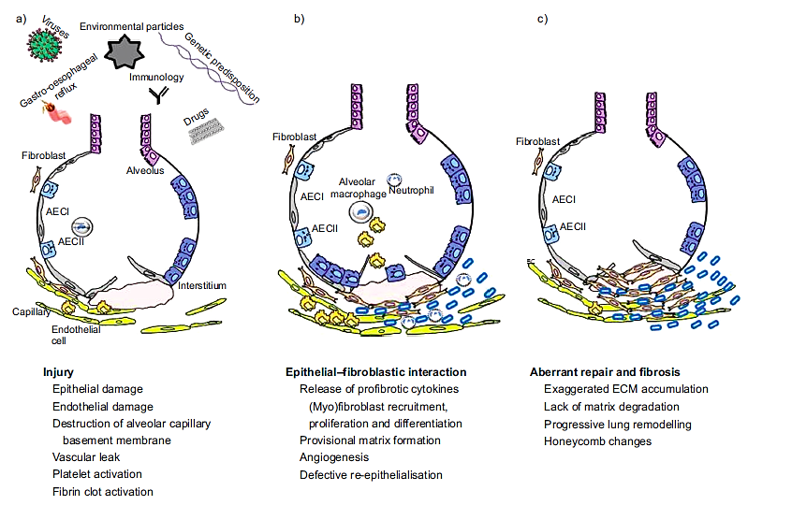
Pathogenesis of IPF
Wuytus et al, ERJ, 2010

Slide 9
ATII cell injury in IPF
Oxidative stress leads to telomere shortening, unfolded protein response and endoplasmic reticulum stress in ATII cells.
Telomerase abnormalities can contribute to the impairment of the ATII cell function.
ATII cells are the principle target of apoptosis and/or premature senescence.
Mutations in surfactant protein genes affect ATII cell transdifferentation to ATI cells after damage.
Damaged ATII cells induce abnormal signaling, which contribute to the pathogenesis of IPF.
Chilosi, Translational Research, 2013
Xu et al, JCI, 2016
Armanios, Mutat. Res. 2012

Slide 10
The role of hyaluronan in ATII cells in IPF
Hyaluronan (HA) is a glycosaminoglycan polymer and it is synthesized by membrane-bound synthases. HAS2 synthase 2 (HAS2) is most critical for development.
HA on the surface of ATII cells functions as a renewal signal.
Liang et al, Nature Medicine, 2016

Slide 11
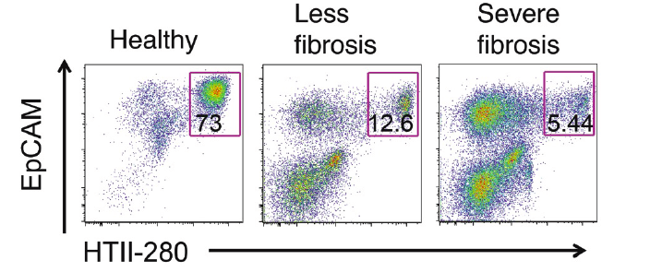
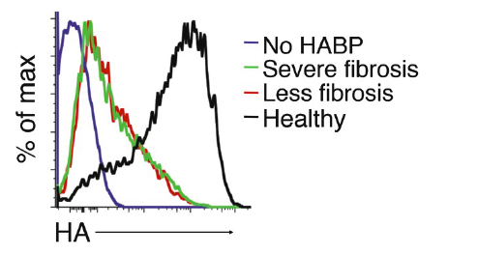
Low HA expression in ATII cells in IPF
Control IPF
Control IPF
Liang, Nature Medicine, 2016

Slide 12
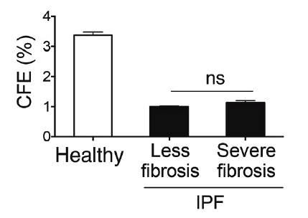
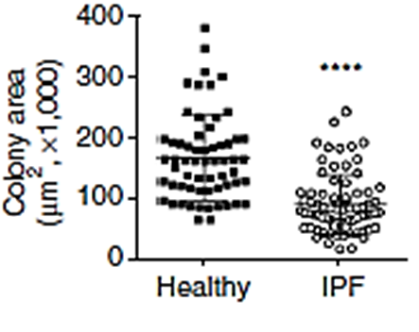
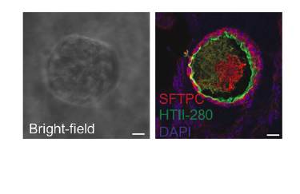
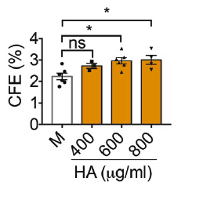
Impaired CFE in ATII cells in IPF
Control IPF
Liang, Nature Medicine, 2016

Slide 13
Conclusions
IPF is a primarily a disease of ATII cell failure.
The loss of HA-synthesizing enzyme in ATII cells contributes to susceptibility to fibrosis.
Restoring cell surface HA on ATII cells may lead to new therapeutic approaches.
Liang, Nature Medicine, 2016

Slide 14
Presentation outline
Studies of ATII cells.
ATII cell injury in IPF.
ATII cell injury in emphysema.
The role of ATII cells in lung regeneration.

Slide 15
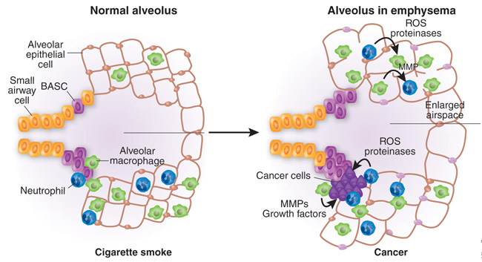
ATII cell injury in emphysema
Emphysema is caused by smoking and consists of a unique pattern of alveolar wall destruction.
Hogg et., Annu Rev Pathol. 2009
Houghton et al. , Nature Medicine, 2008

Slide 16
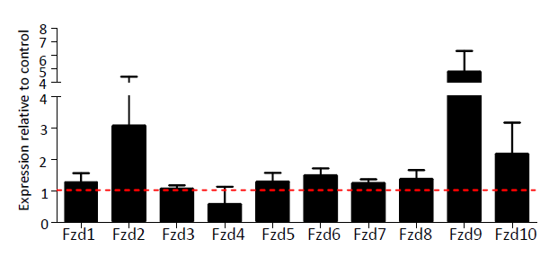
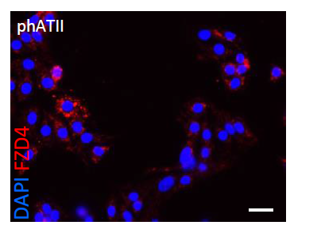
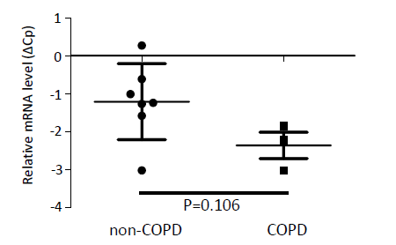
ATII cell injury in emphysema
WNT/β-catenin signaling is reduced in the human lung epithelium of emphysematous lung tissue.
Study the role of FZD (Frizzled) receptors that control downstream WNT signaling.
Skronska-Wasek, et al, AJRCCM, 2017

Slide 17
Conclusions
FZD4 is the first WNT receptor identified to be involved in ATII cell repair.
Valproic acid increases FZD4-dependent induction of WNT signal activity and may be used to treat ATII cells in COPD.
Skronska-Wasek, et al, AJRCCM, 2017

Slide 18
Presentation outline
Studies of ATII cells.
ATII cell injury in IPF.
ATII cell injury in emphysema.
The role of ATII cells in lung regeneration.

Slide 19
The role of ATII cells in lung regeneration
Following injury, the alveolar epithelium is repaired by the proliferation and transdifferentiation of ATII cells into new ATI cells.
McElroy, Kasper, ERJ, 2004

Slide 21
ATII cells form self-renewing colonies
Barkauskas et al., JCI, 2013

Slide 22
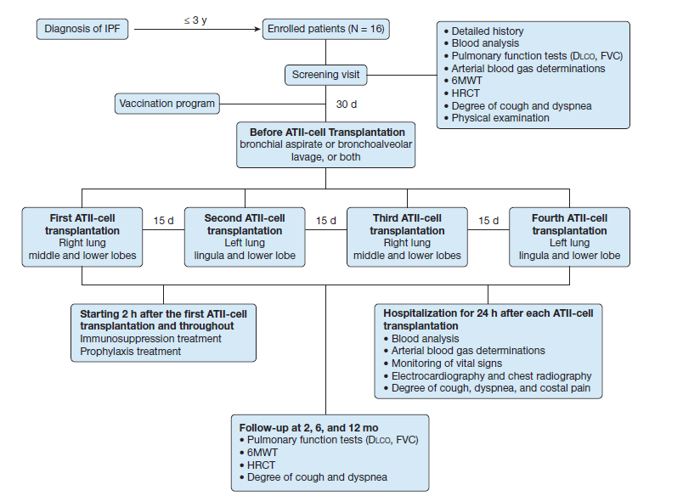
ATII cell transplantation
Fiber-optic bronchoscopy
ATII cell transplantation was safe and well tolerated
Serrano-Mollar et al., Chest 2016

Slide 23
ATII cell studies
We isolate ATII cells and other lung cell types from human lungs.
We have access to medical information.
To date we have processed 337 lungs obtained from:
Control organ donors
COPD
IPF
CPFE
ILD
Sarcoidosis
UIP

Slide 24
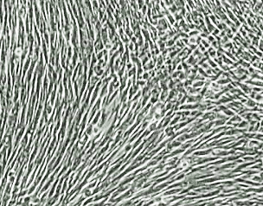
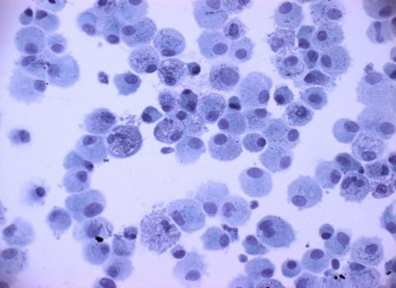
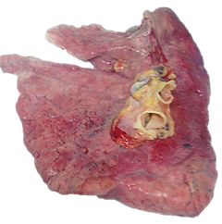
Lung cell isolation
Alveolar type II cells Airway epithelial cells Fibroblasts Alveolar macrophages Endothelial cells Cell suspension
Lung tissue Lymph nodes Mucus Aorta Airways Paraffin blocks Blood/Plasma BAL
Alveolar type I-like cells

Slide 25
Purified human ATII cells
Cytokeratin
EpCAM
CD45
EpCAM
N=6

Slide 26
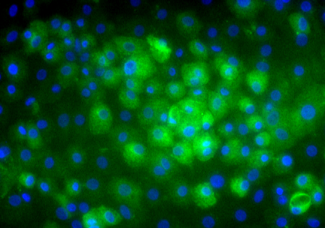
Human ATII cells maintained in culture
1 2 3
Brightfield
SP-B
SP-A
proSP-B
SP-B
proSP-C
SP-C
GAPDH
SP-A
proSP-C
Lane 1 - freshly isolated ATII cells
Lane 2 - 1% FBS
Lane 3 - 2 days K, 2 days KIAD
N=6

Slide 27
Projects
Oxidative stress-induced ATII cell injury in emphysema.
The impairment of antioxidant defense systems in ATII cells in emphysema.
ATII cell damage in IPF.
Mechanisms involved in ATII cell renewal.

Slide 28
Thank you

