Slide 1

RECENTI AVANZAMENTI IN MEDICINA INTERNA E PNEUMOLOGIA
PneumoTrieste 2017
Trieste 4 Aprile 2017
Leonardo M. Fabbri, MD, FERS, AE
Professor of Respiratory and Internal Medicine (-2016)
University of Modena and Reggio Emilia

Slide 2

LEADING CAUSES OF DEATH IN U.S.
  Myocardial
  Infarction
  Cancer
  Cerebrovascular
  Diseases
  COPD
Cigarette Related Diseases
Leading Causes of
Death Worldwide 2010
Notes:
2

Slide 3
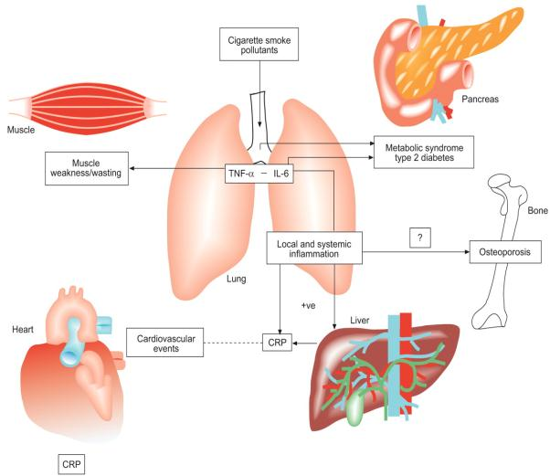
COMPLEX CHRONIC
CO-MORBIDITIES OF COPD
Fabbri, Beghe, Luppi and Rabe, Eur Respir J 2008;31:204-212

Slide 4
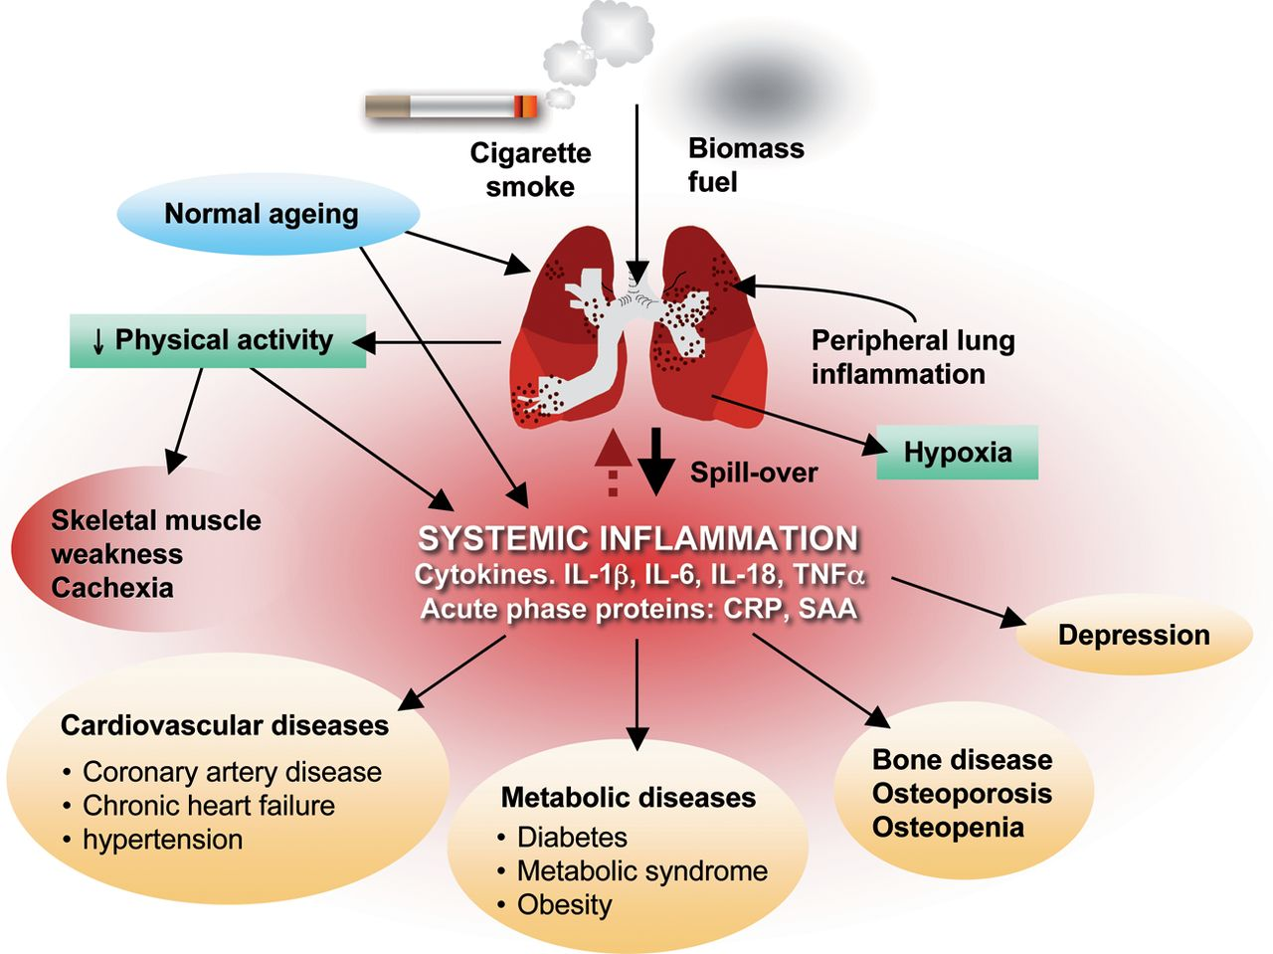
INFLAMMATORY PATHWAYS INVOLVED IN THE CARDIOPULMONARY CONTINUUM
Hawkins N … and Ceconi C. Eur Heart J. 2013 Sep;34:2795-803

Slide 5
HEART FAILURE AS A SYSTEMIC DISEASE WITH COMORBIDITIES
Myocardial infarction causes the release of inflammatory cells from the spleen and bone marrow and their myocardial infiltration
This leads to an accumulation of monocytes in the heart, predominantly located in the infarct border zone, and a decrease of monocytes in the spleen and bone marrow
This may be mediated by activation of the sympathetic nervous system, angiotensin II, and/ or cytokine release.
Hofmasnn and Frantz. Eur Heart J 2014; 35: 314-5.

Slide 6
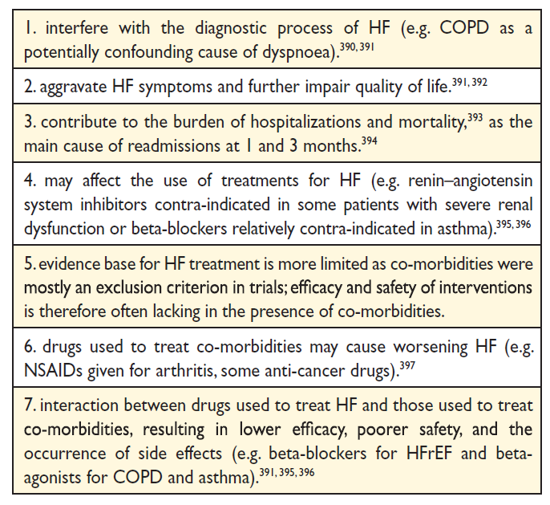
Importance of co-morbidities in patients with HF
Notes:
HF ¼ heart failure; COPD ¼ chronic obstructive pulmonary disease; HFrEF ¼
heart failure with reduced ejection fraction; NSAIDs ¼ non-steroidal
anti-inflammatory drugs.

Slide 7
Importance of co-morbidities in patients with HF
Notes:
HF ¼ heart failure; COPD ¼ chronic obstructive pulmonary disease; HFrEF ¼
heart failure with reduced ejection fraction; NSAIDs ¼ non-steroidal
anti-inflammatory drugs.

Slide 8
Co-morbidities to consider in HF & important studies
CAD / ischemia & Hypertension
Diabetes mellitus & Metabolic syndrome
Sleep apnoea
Depression & Stroke
Anemia and iron deficiency
Renal dysfunction and kidney injury
COPD
Liver & bowel dysfunction
Cachexia & muscle wasting
consider
empagliflozin
EMPA-REG-Outcome
consider
SERVE-HF
consider
CONFIRM-HF
consider
Hyperkalaemia
(Patiromer, ZS-9)
Notes:
HF ¼ heart failure; COPD ¼ chronic obstructive pulmonary disease; HFrEF ¼
heart failure with reduced ejection fraction; NSAIDs ¼ non-steroidal
anti-inflammatory drugs.

Slide 9
NUMBER OF CHRONIC DISORDERS BY AGE-GROUP
100
90
0 disorders
1 disorder
2 disorders
3 disorders
4 disorders
5 disorders
6 disorders
7 disorders
≥ 8 disorders
80
70
60
Patients (%)
50
40
30
20
10
0
0-4
5-9
10-14
15-19
20-24
25-29
30-34
35-39
40-44
45-49
50-54
55-59
60-64
65-69
70-74
75-79
80-84
85+
Age groups (years)
Barnett, K et al, 2012 Jul 7;380(9836):37-43

Slide 10
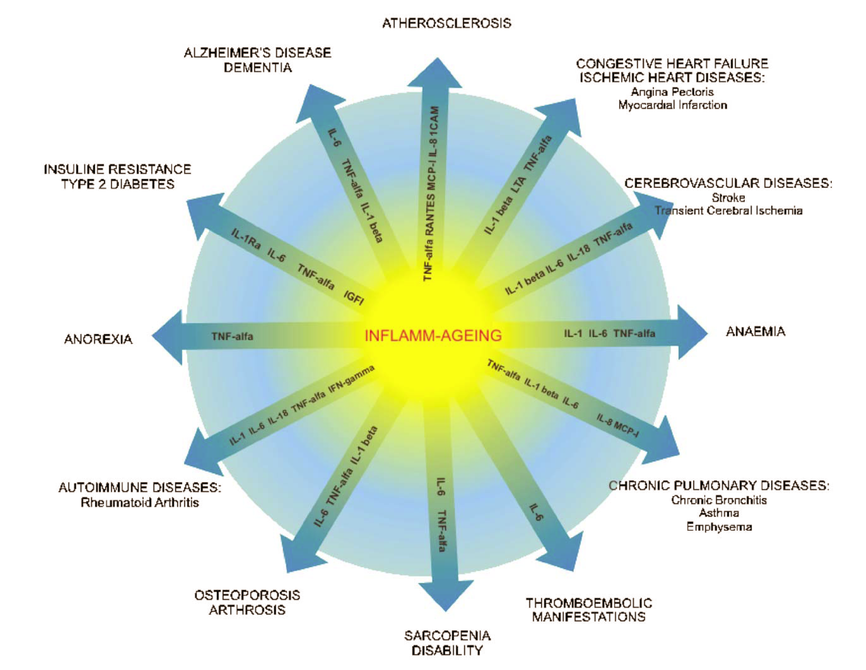
Martinis M et al. Exp. Mol. Pathol. 80 (3):219-227, 2006
Notes:
10

Slide 11
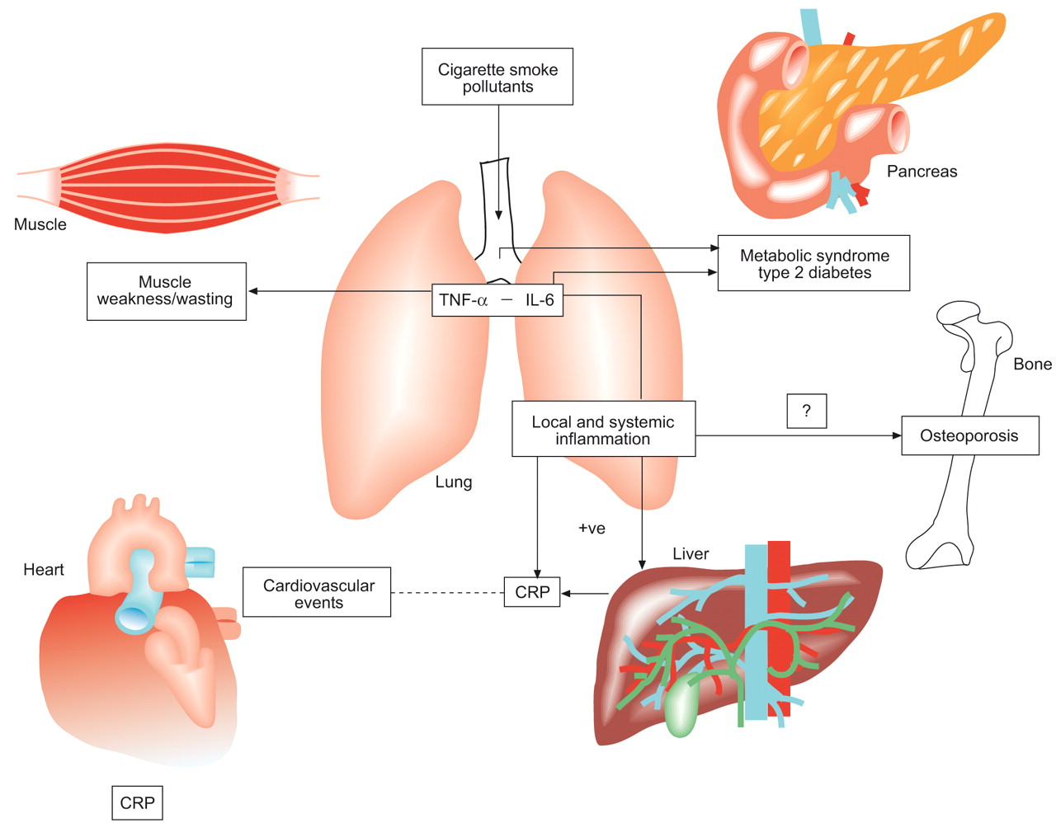
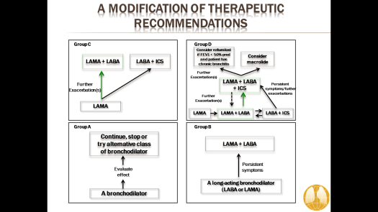
COPD AS THE PULMONARY
COMPONENT OF MULTIMORBIDITY
Fabbri LM, Luppi F, Beghe B, and Rabe KF - Eur Respir J 2008;31:204-212

Slide 12
C.R. 20 October 2015
Male, 88 year
Moderate dyspnea on exercise
No chronic bronchitis
No occupational exposure
Ex-smoker (20 p/y).
Diagnosis of COPD 6 months ago in conjunction with an AECOP requiring hospitalization
Recommended regular inhalation treatment with aerosolied bronchodilator/steroids (not taken)

Slide 13
HOSPITALIZED AND TREATED FOR EXCERBATION OF COPD
Three days admission 6 months ago, after few days of cough, sputum, dyspnea, fever
Normal chest X-Ray
No fever, cyanosis, nor edema at admission

Slide 14
HOSPITALIZED AND TREATED FOR EXCERBATION OF COPD
Sa02 87% (no arterial blood gases available)
CRP 8.8 mg/dL (0-0.5) - < 0.6 at discharge
proBNP ECLIA 2515 pico gr/ml (0-194)
Troponin T hs 13 ng/L (50 ng/L)
No spirometry before, during or after admission

Slide 15
COMORBIDITIES
Obese (BMI=36)
Diabetes
Arterial hypertension
Dyslipidemia
Atrial fibrillation
Ischaemic heart disease
Heart failure with increased PaP (55mmHg)
Benign Prostatic Hypertrophy

Slide 16
TREATMENT
Metformin
Olmesartan
Medoximil
Larcanedipin
Carvedilol
Finasteride
Silodosin
Warfain

Slide 17
C.R. 20 October 2015
Since 1 year:
Moderate progressive dyspnoea on exercise (mMRC2)
Dyspnea in the early morning
Occasional cough, no purulent sputum
Reduced fremitus, in/espiratory ronchi, bilateral basal in/espiratory crackles

Slide 18
SPIROMETRY
(not diagnostic for COPD)
C.R. 20 October 2015
FEV1: 1.37 L (50% predicted)
Post-BD FEV1=1.40 L (+2%)
FVC: 2.05 L 54% predicted)
FEV1/FVC: 68 %
RV: 2.95 L (104 % predicted)
RV/TLC: 59 %
6MWT: 280 m, SaO2 95%-88%

Slide 19
SIX MINUTE WALKING TEST (6MWT)
SaO2 pre: 95%
SaO2 post: 88%
PA pre 140/85 mm Hg
PA post 160/80 mm Hg
FC pre 70/min
FC post 85/min
Meters: 280
Meters: ≥350 Good
250–349 Mild impairment
150–249 Moderate
≤149 Severe

Slide 20
CONCLUSIONS AND RECOMMENDATIONS AT FIRST VISIT
Tiotropium 2.5 ug 2 inhalation in the evening
Recommended rehabilitation, including weight reduction
Confirmed ongoing treatment of comorbidities
Weekly telephone contact
Hematochemical exams + chest X ray
Clinical control at 1 month

Slide 21
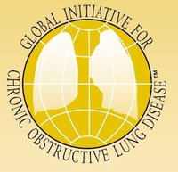
GLOBAL STRATEGY FOR DIAGNOSIS, MANAGEMENT AND PREVENTION OF COPD
DEFINITION OF COPD 2016
COPD, a disease, is characterized by persistent airflow limitation, ie FEV1/FVC < 70%
Notes:
21

Slide 22
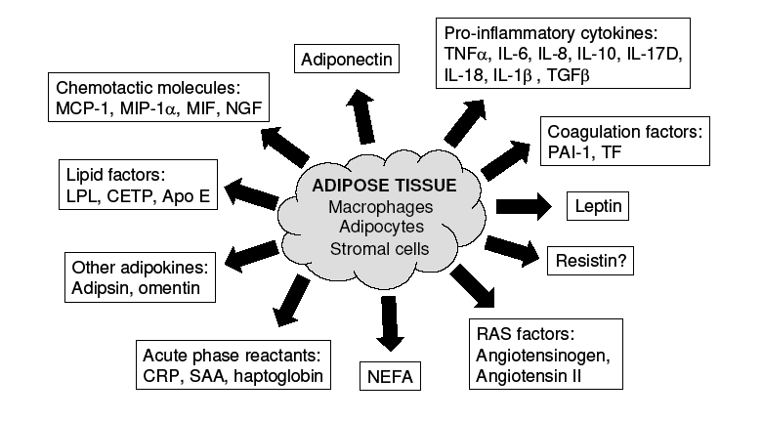
METABOLIC SYNDROME IS FREQUENT IN PATIENTS WITH COPD
Watz H, et al Chest. 2009;136:1039-46

Slide 23
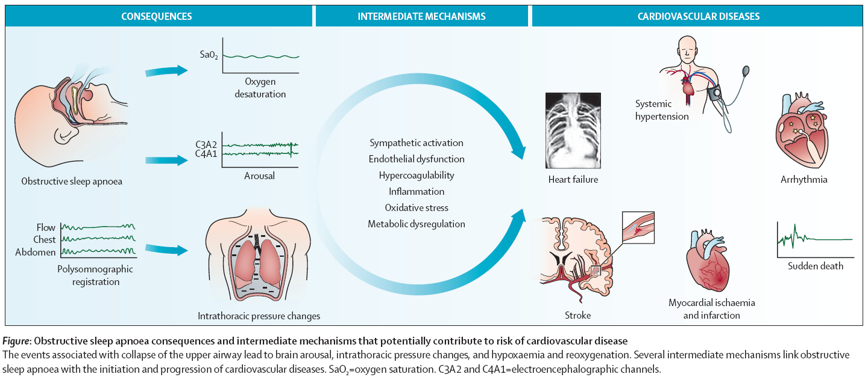
OSA AND RISK OF CARDIOVASCULAR DISEASES
Barbe et al, Lancet Respir Med 2013;1: 61-72

Slide 24
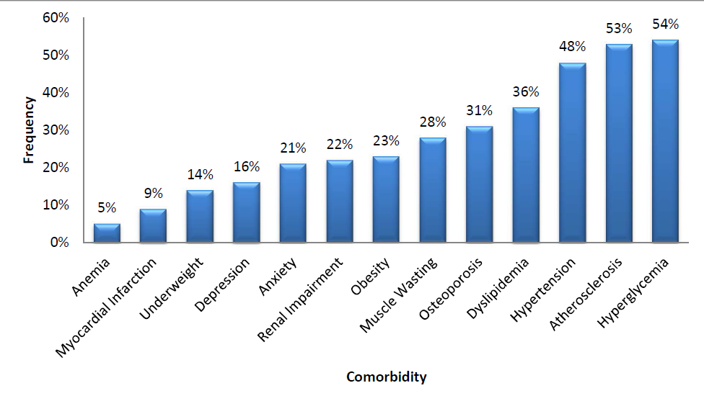
FREQUENCIES OF OBJECTIFIED COMORBIDITIES
Vanfleteren L.E.G.W., et al. AJRCCM 2013 Apr;187(7):728-35.

Slide 25
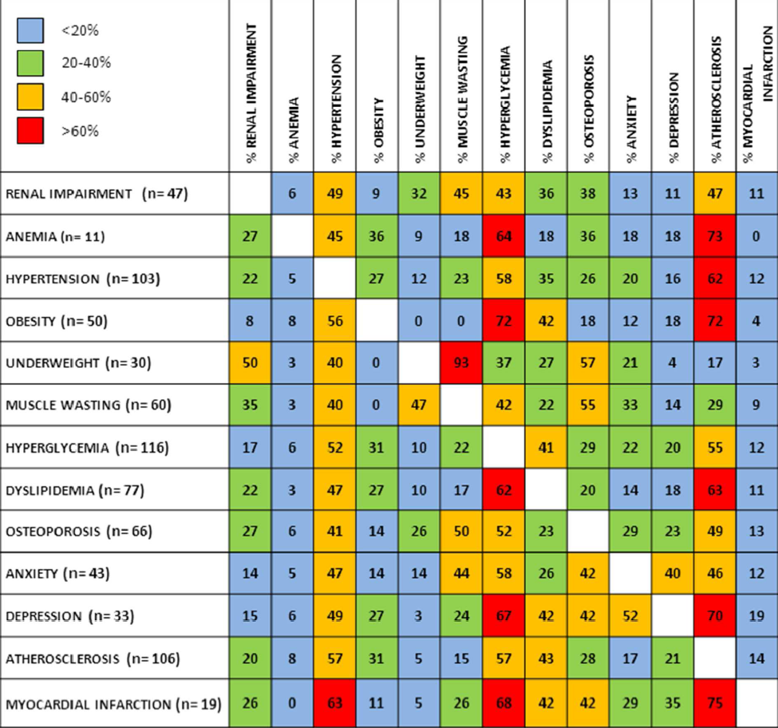
FROM COMORBIDITIES TO MULTIMORBIDITY
Vanfleteren LEGW et al. AJRCCM 2013 Apr;187(7):728-35

Slide 26

SIMULTANEOUS DEVELOPMENT OF CHRONIC DISEASES
Courtesy of K.F. Rabe, 2014

Slide 27
YEAR IN REVIEW IN
RESPIRATORY MEDICINE
Leonardo M. Fabbri, MD, FESC, FERS
  Non Small Cell Lung Cancer
  Asthma
  COPD
  Multimorbidity
Commentary by Vanfleterern , Spruit and Franssen, Eur Resp J 2016 , in press

Slide 28
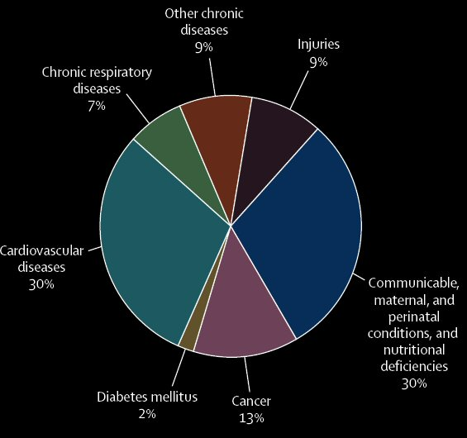
Chronic diseases represent a huge proportion of human illness
58 million deaths in 2005:
Cardiovascular disease 30%
Cancer 13%
Chronic respiratory diseases 7%
Diabetes 2%
Beaglehole R et al. Lancet 2007;370:2152-57.
Notes:
28
Chronic diseases like cardiovascular disease, respiratory diseases, cancers and diabetes represent a very significant proportion of human illness. And while they are leading causes of death and disability, they are badly neglected by the global health agenda.
Of all worldwide deaths in 2005, 60% were a result of chronic disease, with 32% attributed to cardiovascular disease and diabetes, 13% to cancer, and 7% to chronic respiratory illnesses. If global goals for prevention and control of chronic diseases were realized, 36 million deaths could be averted by 2015.
We must consider the complexity of chronic diseases – they present a major challenge and are considered a significant problem in an ageing population.
1. Beaglehole R et al on behalf of the Chronic Disease Action Group. Prevention of chronic diseases: a call to action. Lancet 2007;370:2152-57.

Slide 29
NONCOMMUNICABLE DISEASES
Noncommunicable diseases will be the predominant global public health challenge of the 21st century
Prevention of premature deaths due to noncommunicable diseases and reduction of related health care costs will be the main goals of health policy.
Improving the detection and treatment of noncommunicable diseases and preventing complications and catastrophic events will be the major goals of clinical medicine.
Hunter DJ and Reddy KS. N Engl J Med 2013; 369:1336-1343

Slide 30
EPIDEMIOLOGY OF MULTIMORBIDITY AND IMPLICATIONS FOR HEALTH CARE, RESEARCH, AND MEDICAL EDUCATION: A CROSS-SECTIONAL STUDY
Our findings challenge the single-disease framework by which most health care, medical research, and medical education is configured. A complementary strategy is needed, supporting generalist clinicians to provide personalised, comprehensive continuity of care, especially in socioeconomically deprived areas.
Barnett, K et al, 2012 Jul 7;380(9836):37-43

Slide 31
EXACERBATIONS OF RESPIRATORY SYMPTOMS IN PATIENTS WITH COPD MAY NOT BE EXACERBATIONS OF COPD
Beghé B, Verduri A, Roca M and Fabbri LM. Eur Respir J 2013; 41: 993-5
Roca M, Verduri A, Clini EM, Fabbri LM and Beghé B. Eur J Clin Invest, 2013;43:510

Slide 32
DIFFERENTIAL DIAGNOSIS OF ACUTE EXACERBATIONS OF COPD
AECOPD is a clinical diagnosis, defined as worsening of respiratory symptoms and change in medication and/or hospital admission
However, there is no defined etiology (usually, airway inflammation and bronchitis)
Role of cardiac comorbidities as putative triggers of AECOPD is currently under investigation
Beghé B et al, Eur Respir J 2013; 41: 993-5
Roca M et al, Eur J Clin Invest, 2013;43:510

Slide 33
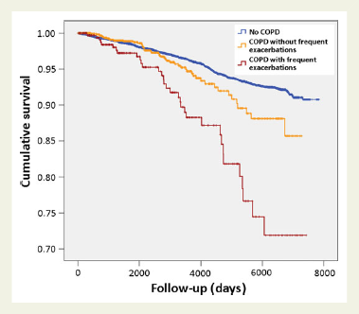
CHRONIC OBSTRUCTIVE PULMONARY DISEASE AND SUDDEN CARDIAC DEATH
Chronic obstructive pulmonary disease is associated with an increased risk for SCD
The risk especially increases in persons with frequent exacerbations 5 years after the diagnosis of COPD.
This risk indicator could provide new directions for better-targeted actions to prevent SCD
Lahousse et al, Eur Heart J, 2016; 36: 1754

Slide 34
COMORBIDITIES AND SUBGROUPS OF PATIENTS SURVIVING SEVERE ACUTE HYPERCAPNIC RESPIRATORY FAILURE IN THE ICU
Multimorbidity was associated with longer time to hospital discharge
Hospital readmission or death occurred in 46% of patients over 3.5 months post-discharge
Multi-morbidity is common, most often unrecognized, and may be associated with poor outcome
Brochard L et al, Am J Respir Cr Care Med, 12 Feb 2017, on line

Slide 35
BIOCHEMICAL MARKERS OF CARDIAC DYSFUNCTION PREDICT MORTALITY IN ACUTE EXACERBATIONS OF COPD
> troponin
Chest pain
7
4
4
7
56
56
6
6
7
7
55
55
54
54
ECG changes
McAllister et al. Eur Respir J 2012; 3:1097-103

Slide 36
BIOCHEMICAL MARKERS OF CARDIAC DYSFUNCTION PREDICT MORTALITY IN ACUTE EXACERBATIONS OF COPD
Raised troponin, chest pain and serial
ECG changes are common in patients admitted
to hospital with exacerbation of COPD
Overall, 20/242, ie 1/12 patients with ECOPD
met the criteria for myocardial infarction
Whether these patients would benefit from further cardiac investigation is unknown
McAllister et al. Eur Respir J 2012; 3:1097-103

Slide 37
BIOCHEMICAL MARKERS OF CARDIAC DYSFUNCTION PREDICT MORTALITY IN ACUTE EXACERBATIONS OF COPD
Elevated levels of NT-proBNP and troponin T
are strong predictors of early mortality among patients admitted to hospital with acute exacerbations of COPD independently
of other known prognostic indicators
The pathophysiological basis for this is unknown, but indicates that cardiac involvement in exacerbations of COPD may be an important determinant of prognosis
Chang CL et al, Thorax. 2011 Sep;66(9):764-8.

Slide 38
NATRIURETIC PEPTIDE TESTING FOR PREDICTING ADVERSE EVENTS FOLLOWING HEART FAILURE HOSPITALIZATION
Changes in BNP or NT-proBNP following
treatment should be considered an important
part of the pre-discharge decision making
for patients hospitalized with AHF
Jannuzzi JL et al. Congest Heart Fail. 2012 Sep;18 Suppl 1:S9-S13
Thygesen C et al, Recommendations for the use of natriuretic peptides in acute cardiac care. Eur Heart J 2012; 33: 2001-2006

Slide 39
COPD vs CHF
  Up to 1\5 of elderly pts. with COPD have CHF
  Up to 1\3 of elderly pts. with CHF have COPD
14 million
Americans have
COPD
The risk ratio of developing HF
in COPD pts is 4.5
The rate-adjusted hospital prevalence of CHF is 3 times greater among pts. discharged with a diagnosis of COPD compared with patients discharged without mention of COPD
CHF
and
5 million have
Padeletti-LeJemtel et al. Int. J Cardiology, 2008
Notes:
Questi sono dati statunitensi in cui si stima che circa 14 milioni di soggetti sono affetti da COPD e 5 da CHF.
Circa 173 dei pazienti con scompenso cardiaco è probabile che abbiano la COPD e che un !75 della popolazione con COPD abbia anche lo scompenso cardiaco

Slide 40
HEART FAILURE:
TIMELINE OF AN EVOLVING THERAPY
Cardiac glycosides and diuretic agents were the oldest cornerstones of HF therapy, focusing on the heart
Value in prolonging survival in HF not established
Glycosides potentially dangerous, diuretics only symptomatic
The modern history of therapy for HF begins with the vasodilatation (V-HeFT I study 1986), particularly ACE inhibitors, shifting the target from myocardium to circulation
N Engl J Med 2014; 371:989-991

Slide 41
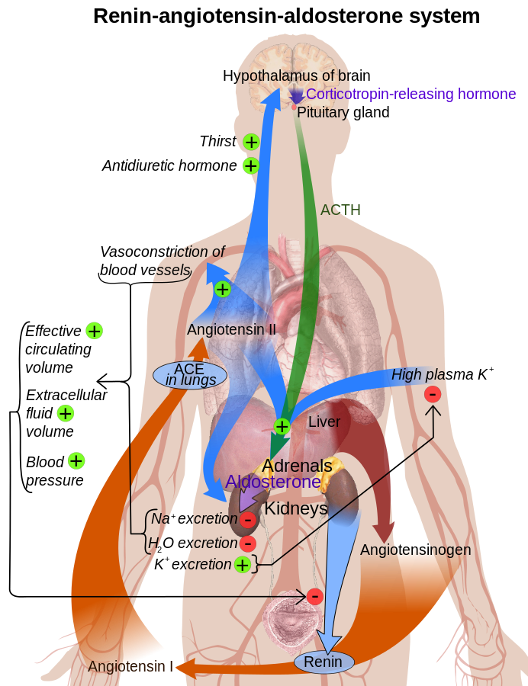
Vasodilatation acting on the renin-angiotension aldosteron system
From the ‘90, ACE inhibition became the centerpiece of heart-failure therapy
ACE inhibitors reduce mortality

Slide 42
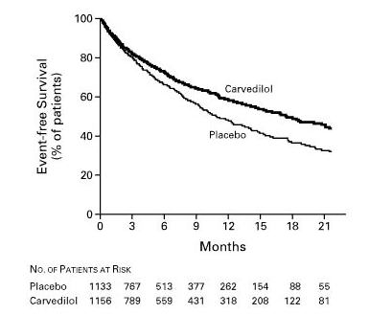
HEART FAILURE:
TIMELINE OF AN EVOLVING THERAPY
Beta-blocker therapy was at first considered counterintuitive, BUT then shown to reduce mortality by putting the heart at rest and reducing arrhythmias
Nature Clinical Practice Cardiovascular Medicine (2005) 2, 475-483
N Engl J Med 2001; 344:1651-1658

Slide 43
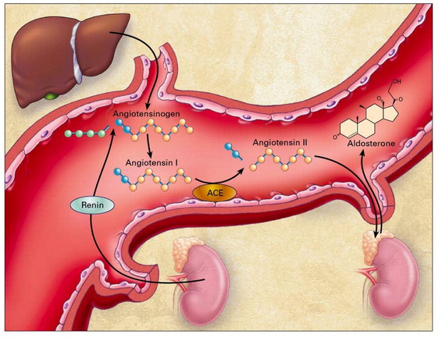
HEART FAILURE:
TIMELINE OF AN EVOLVING THERAPY
POTENTIATION OF ACE INHIBITORS WITH ALDOSTERON ANTAGONISTS
Another step in HF therapy: the RALES trial with spironolactone (30% reduction in mortality)
Similar findings for eplerenone (EMPHASIS-HF, EPHESUS)
N Engl J Med 2014; 371:989-991

Slide 44
HEART FAILURE:
TIMELINE OF AN EVOLVING THERAPY
NO SUBSTANTIAL CHANGES IN HF MEDICAL OPTIONS IN THE LAST 10 YEARS
The phosphodiesterase inhibitor milrinone, compared with placebo, increased mortality among patients with heart failure by 28%
Novel inotropic agents generally proved disappointing
Standstill in HF therapy
N Engl J Med 2014; 371:989-991
Notes:
No new drugs for HF
Research was exploring other types of interventions: pacing, heart pumps ecc.

Slide 45
HEART FAILURE:
THE SEARCH FOR NEW TARGETS
NATRIURETIC PEPTIDES
promote vasodilatation and natriuresis
inhibit abnormal growth, RAAS, vasopressin and the sympathetic nervous system
degraded by neutral endopeptidase (NEP), eg neprilysin
BLOCKADE OF NATRIURETIC PEPTIDE BREAKDOWN
Novel therapeutic approach to increase natriuretic peptides
European Journal of Heart Failure (2013)15 , 1062–1073

Slide 46
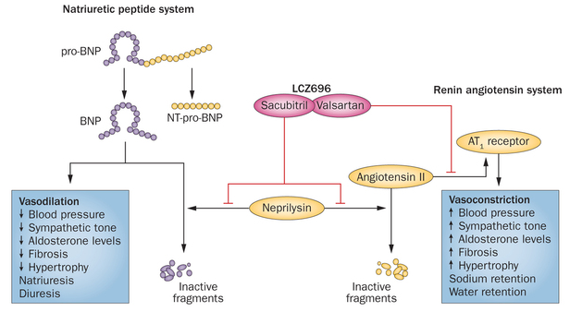
HEART FAILURE:
THE BREAKING NEWS
Nature Reviews Cardiology 12, 73–75 (2015)
Notes:
NEW MODEL → find a drug that replaces ACE-I

Slide 47
ANGIOTENSIN–NEPRILYSIN INHIBITION VERSUS ENALAPRIL IN HEART FAILURE
LCZ696, a dual inhibitor of angiotensin II receptor and neprilysin, may prove to be the first disruptive agent to the heart-failure treatment algorithm, which has remained essentially unchanged for a decade
McMurray JJV et al N Engl J Med 2014; 371(11):993-1004
Notes:
A positive aspect of a more comprehensive approach is suggested by a post-hoc analysis of studies. This analysis suggests, in fact, that patients with COPD and significant comorbidities (hypertension or chronic heart failure) treated with statins, angiotensin-converting enzyme (ACE) inhibitors and/or angiotensin receptor blockers (ARBs) may actually, particularly in severe COPD, benefit from this treatment in the COPD aspect of the disease.
This treatment seems to reduce mortality, morbidity and hospitalization in these patients.
Obviously this data needs to be confirmed by further studies. But it does suggest that if we treat a COPD patient – not only for COPD, but also for chronic comorbidities – we may achieve better outcomes for the patient and provide better treatment overall.
Mancini JB et al. Reduction of morbidity and mortality by statins, angiotensin-converting enzyme inhibitors, and angiotensin receptor blockers in patients with chronic obstructive pulmonary disease. J Am Coll Cardiol 2006;47(12):2554-60.

Slide 48

BREAKTHROUGH IN HEART FAILURE:
THE PARADIGHM TRIAL
“PARADIGM SHIFT”
not adding another drug, but replacing a drug (i.e. targeting another pathway)
it proposes a change to the established treatment
McMurray JJV et al N Engl J Med 2014; 371(11):993-1004
Notes:
NEW MODEL → find a drug that replaces ACE-I

Slide 49
ANGIOTENSIN–NEPRILYSIN INHIBITION VERSUS ENALAPRIL IN HEART FAILURE
We compared the angiotensin receptor–neprilysin inhibitor LCZ696 with enalapril in patients who had heart failure with a reduced ejection fraction
LCZ696 was superior to enalapril in reducing the risks of death and of hospitalization for heart failure
McMurray JJV et al N Engl J Med 2014; 371(11):993-1004
Notes:
A positive aspect of a more comprehensive approach is suggested by a post-hoc analysis of studies. This analysis suggests, in fact, that patients with COPD and significant comorbidities (hypertension or chronic heart failure) treated with statins, angiotensin-converting enzyme (ACE) inhibitors and/or angiotensin receptor blockers (ARBs) may actually, particularly in severe COPD, benefit from this treatment in the COPD aspect of the disease.
This treatment seems to reduce mortality, morbidity and hospitalization in these patients.
Obviously this data needs to be confirmed by further studies. But it does suggest that if we treat a COPD patient – not only for COPD, but also for chronic comorbidities – we may achieve better outcomes for the patient and provide better treatment overall.
Mancini JB et al. Reduction of morbidity and mortality by statins, angiotensin-converting enzyme inhibitors, and angiotensin receptor blockers in patients with chronic obstructive pulmonary disease. J Am Coll Cardiol 2006;47(12):2554-60.

Slide 50
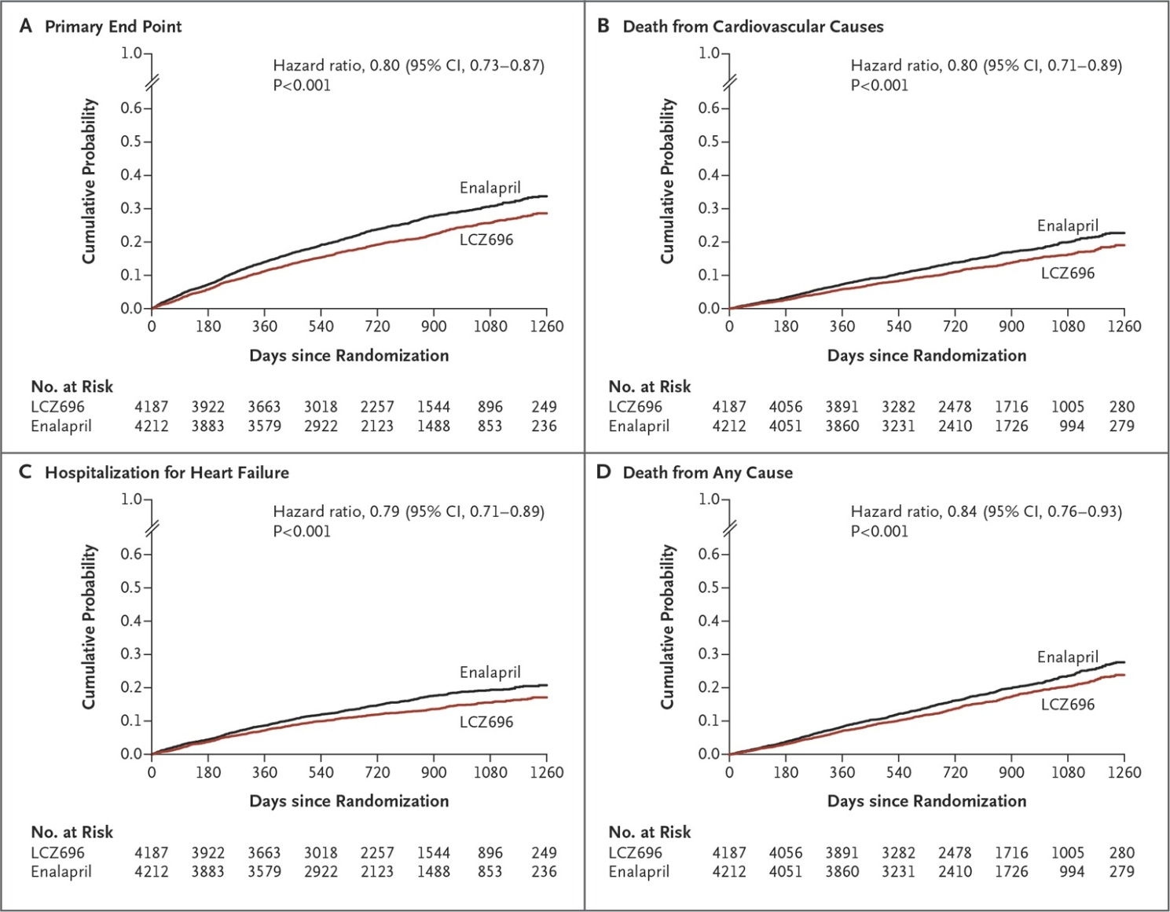
ANGIOTENSIN–NEPRILYSIN INHIBITION VERSUS ENALAPRIL IN HEART FAILURE
McAllister et al. Eur Respir J 2012; 3:1097-103
Notes:
A positive aspect of a more comprehensive approach is suggested by a post-hoc analysis of studies. This analysis suggests, in fact, that patients with COPD and significant comorbidities (hypertension or chronic heart failure) treated with statins, angiotensin-converting enzyme (ACE) inhibitors and/or angiotensin receptor blockers (ARBs) may actually, particularly in severe COPD, benefit from this treatment in the COPD aspect of the disease.
This treatment seems to reduce mortality, morbidity and hospitalization in these patients.
Obviously this data needs to be confirmed by further studies. But it does suggest that if we treat a COPD patient – not only for COPD, but also for chronic comorbidities – we may achieve better outcomes for the patient and provide better treatment overall.
Mancini JB et al. Reduction of morbidity and mortality by statins, angiotensin-converting enzyme inhibitors, and angiotensin receptor blockers in patients with chronic obstructive pulmonary disease. J Am Coll Cardiol 2006;47(12):2554-60.

Slide 51
SACUBRITIL-VALSARTAN:THE NEWEST ADDITION TO THE TOOLBOX FOR GUIDELINES DIRECTED MEDICAL THERAPY FOR HEART FAILURE
American College of Cardiology/American Heart Association/Heart Failure Society of America recently updated guideline recommendations for Stage C patients with heart failure with reduced ejection fraction to recommend
angiotensin converting enzyme inhibitors
angiotensin receptor blockers
sacubitril/valsartan
in conjunction with other evidence-based therapies to reduce morbidity and mortality
Rodgers et al, Am J Medicine , 2017, in press
Notes:
A positive aspect of a more comprehensive approach is suggested by a post-hoc analysis of studies. This analysis suggests, in fact, that patients with COPD and significant comorbidities (hypertension or chronic heart failure) treated with statins, angiotensin-converting enzyme (ACE) inhibitors and/or angiotensin receptor blockers (ARBs) may actually, particularly in severe COPD, benefit from this treatment in the COPD aspect of the disease.
This treatment seems to reduce mortality, morbidity and hospitalization in these patients.
Obviously this data needs to be confirmed by further studies. But it does suggest that if we treat a COPD patient – not only for COPD, but also for chronic comorbidities – we may achieve better outcomes for the patient and provide better treatment overall.
Mancini JB et al. Reduction of morbidity and mortality by statins, angiotensin-converting enzyme inhibitors, and angiotensin receptor blockers in patients with chronic obstructive pulmonary disease. J Am Coll Cardiol 2006;47(12):2554-60.

Slide 52
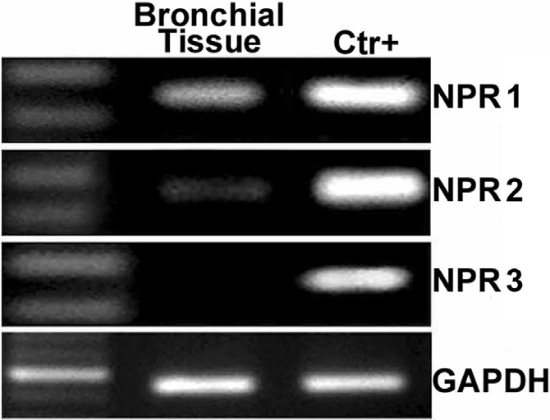
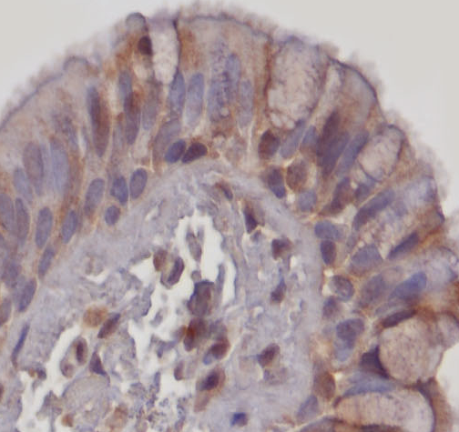
EXPRESSION OF BRAIN NETRIURETIC PEPTIDE RECEPTORS (NPRS) IN HUMAN AIRWAYS
NPR-A is localized in the airway epitelium, not in the airway smooth muscle cells
Matera et al, Br J Pharmacol 2011

Slide 53
B-TYPE NATRIURETIC PEPTIDE – NOT ONLY A BIOMARKER
Increased levels of BNP may have beneficial effects not only in patients with chronic heart failure but also in patients with COPD
Cazzola and Matera J Parmacol Exp Ther 2016

Slide 54
EFFECT OF SACUBITRIL/VALSARTAN VERSUS ENALAPRIL ON GLYCAEMIC CONTROL IN PATIENTS WITH HEART FAILURE AND DIABETES
Patients with diabetes and HFrEF enrolled in PARADIGM-HF who received sacubitril/valsartan had a greater long-term reduction in HbA_{1c} than those receiving enalapril
These data suggest that sacubitril/valsartan might enhance glycaemic control in patients with diabetes and HFrEF
Seferovic et al, Lancet Endocrinol Diabet, 2017
Fernández-Ruiz I. Diabetes: Nat Rev Cardiol, 2017
Notes:
A positive aspect of a more comprehensive approach is suggested by a post-hoc analysis of studies. This analysis suggests, in fact, that patients with COPD and significant comorbidities (hypertension or chronic heart failure) treated with statins, angiotensin-converting enzyme (ACE) inhibitors and/or angiotensin receptor blockers (ARBs) may actually, particularly in severe COPD, benefit from this treatment in the COPD aspect of the disease.
This treatment seems to reduce mortality, morbidity and hospitalization in these patients.
Obviously this data needs to be confirmed by further studies. But it does suggest that if we treat a COPD patient – not only for COPD, but also for chronic comorbidities – we may achieve better outcomes for the patient and provide better treatment overall.
Mancini JB et al. Reduction of morbidity and mortality by statins, angiotensin-converting enzyme inhibitors, and angiotensin receptor blockers in patients with chronic obstructive pulmonary disease. J Am Coll Cardiol 2006;47(12):2554-60.

Slide 55
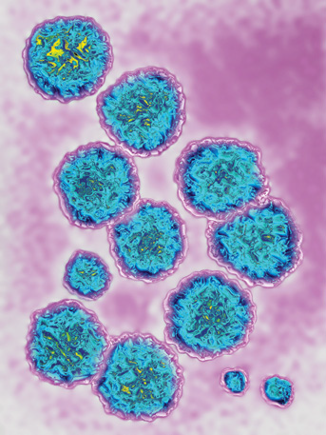
BREAKTHROUGHS FOR HEPATITIS C
New anti-viral drugs have improved efficacy and tolerability for both previously untreated patients and previous interferon non-responders
Interferon-sparing regimens will probably be replaced in 2015 by interferon-free regimens
The Lancet,, 2015, Vol 385 March 21

Slide 56
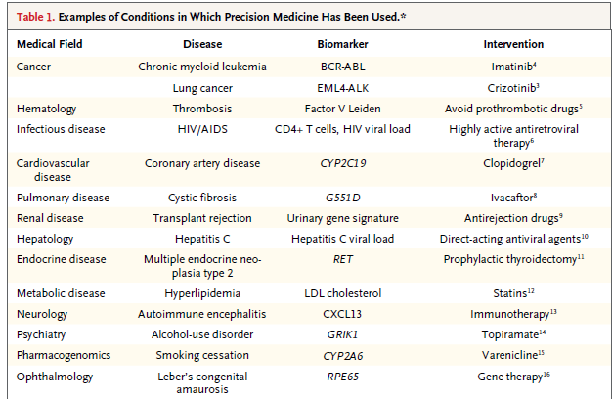
PRECISION MEDICINE — PERSONALIZED, PROBLEMATIC, AND PROMISING
PERSONALIZED MEDICINE IS TODAY
New anti-viral drugs combination have very specific indications for different genotypes of C virus Hepatitis
Jamerson and Longo N Engl J Med May 27, 2015;

Slide 57
RECURRENT WHEEZE AFTER RESPIRATORY SYNCYTIAL VIRUS (RSV) INFECTION
Respiratory syncytial virus (RSV) bronchiolitis may interfere with normal lung development or immune maturation and subsequently cause recurrent episodes of wheezing
RSV infection may be the earliest stimulus for wheezing in children who are predisposed (genetic susceptibility or preexisting abnormal lung function), and could be related to subsequent development of asthma
N Engl J Med 2013;368:1791-9

Slide 58
THE MODEL OF HEPATITIS C:
SIMILARITIES WITH RECURRENT WHEEZE
VIRAL RESPIRATORY TRACT ILLNESSES AND WHEEZING ILLNESSES IN PRESCHOOL CHILDREN
RSV frequently associated with the development of persistent wheezing and childhood asthma
As in hepatitis C, antiviral drugs that prevent the infection could reduce the risk of these respiratory diseases
N Engl J Med 2013;368:1791-9
Notes:
Distinction in groups ABCD is not present in ESC guidelines
However, the concept is still debated

Slide 59

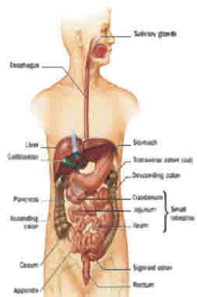
CROHN’S DISEASE
Crohn’s disease (CD) is a chronic relapsing inflammatory condition usually with flare-ups alternating with periods of remission, and an increasing disease severity and incidence of complications as time goes on.
It can affect any part of the gastrointestinal tract from the mouth to the anus. For typical sites & proportion of patients affected see below:
Terminal Ileum only
– 20%
Extensive Small Bowel – 5%
Colon only– 25%
Other: anorectal, gastroduodenual, oral only – 5%
Ileocaecal – 45%
Nielsen OH. N Engl J Med 2013;369:754-762

Slide 60
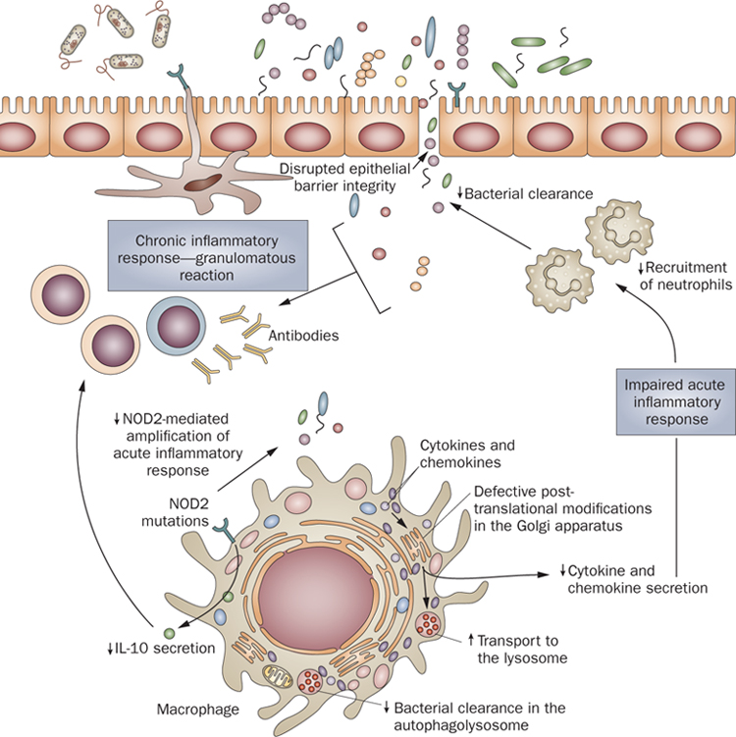
CROHN’S DISEASE: PATHOGENESIS
Pre and post-translational defects in macrophages lead to reduced bacterial clearance with overstimulation of the immune response and inflammation with
marked expansion of the lamina propria
high levels of cytokines (e.g. TNF-α)
recruitment of additional leukocytes
Fava F, Nat. Rev. Gastroenterol. Hepatol 2010; 254 1003:1011
Abraham C, N Engl J Med 2009; 361:2066-2078.
Notes:
During intestinal inflammation, several events contribute to increased bacterial exposure, including disruption of the mucus layer, dysregulation of epithelial tight junctions, increased intestinal permeability, and increased bacterial adherence to epithelial cells. There is marked expansion of the lamina propria, with increased numbers of CD4+ T cells, especially proinflammatory T-cell subgroups, which also secrete increased levels of cytokines and chemokines. Increased production of chemokines results in recruitment of additional leukocytes, resulting in a cycle of inflammation.

Slide 61
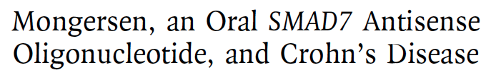
BREAKTHROUGH IN CROHN’S DISEASE
SMAD7
TGF-β1
Mongersen
Inflammation
Monteleone G et al, N Engl J Med 2015;372:1104-13
Notes:
Rationale: Crohn’s disease–related inflammation is characterized by reduced activity of the immunosuppressive cytokine transforming growth factor β1 (TGF-β1) due to high
levels of SMAD7, an inhibitor of TGF-β1 signaling. Preclinical studies and a phase 1 study have shown that an oral SMAD7 antisense oligonucleotide, mongersen, targets
ileal and colonic SMAD7.

Slide 62
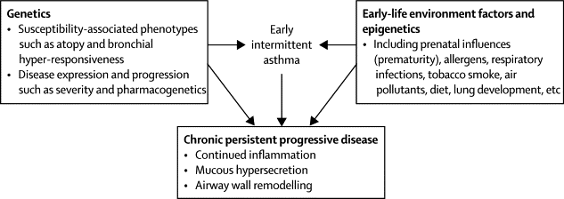
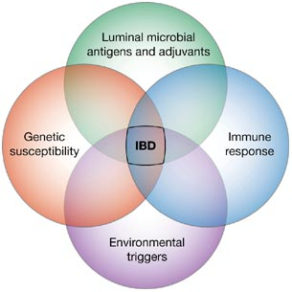
THE MODEL OF CROHN’S DISEASE: SIMILARITIES WITH ASTHMA
Meyers DA, The Lancet Respiratory Medicine 2014 2, 405-415
Notes:
Asthma model compared to Crohn’s disease.

Slide 63
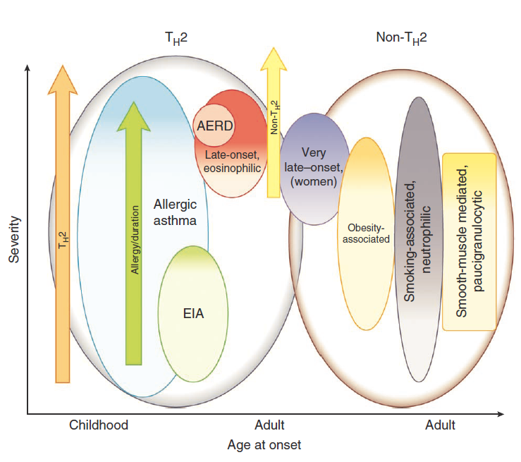
THEORETICAL GROUPING OF EMERGING ASTHMA PHENOTYPES BASED ON THE DISTINCTION BETWEEN TH2-HIGH ASTHMA AND NON-TH2 ASTHMA
Wenzel S et al, Nat Med. 2012;18(5):716-25

Slide 64
Targetting
INTERLEUKINS/CYTOKINES
TSLP
Th2 (ILC2) T2
Non-T2
AMG157
IL-5
IL-13
IL-4Rα
IL-17
TNFα
CXCR8
IgE
IL-5Rα
IL-4
IL-13
GSK679586
Lebrikizumab
Tralokinumab
Mepolizumab
Reslizumab
Brodalumab
Benralizumab
AMG317
Dupilumab
Etanercept
Golimumab
CXCR2
Antagonist
(SCH527123)
Omalizumab
QGE031
Quilizumab

Slide 65
DUPILUMAB EFFICACY AND SAFETY IN ADULTS WITH UNCONTROLLED PERSISTENT ASTHMA
DUPILUMAB
increases lung function
reduces severe exacerbations
in patients with uncontrolled persistent asthma uncontrolled by optimal inhaled combination therapy, irrespective of baseline eosinophil count
Wenzel S et al., Lancet. 2016 Apr 26

Slide 66
DUPILUMAB
Asthma
Atopic dermatitis
Rhinosinusitis
Nasal Polyps
Fernandes JM et al, Immunol Allergy Clin North Am. 2017 May;37:315-327

Slide 67
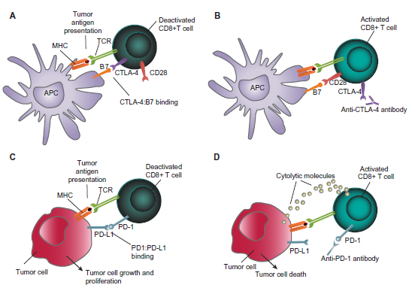
Tumor Immunology in Lung Cancer:
Concept of immunoterapy in NSCLC
Davies M et al Cancer Management and Research 2014; 6: 63-75

Slide 68
CHECKPOINT BLOCKADE IN LUNG CANCER AND MESOTHELIOMA
NIVOLUMAB
Lung Cancer and Mesothelioma
Uroepithelial cancer
Hodgkin’s Lymphoma
Melanoma
Lievense LA et al, Am J Respir Cr Care Med 2017 March, online

Slide 69
CHECKPOINT BLOCKADE IN LUNG CANCER AND MESOTHELIOMA
NIVOLUMAB ADVERSE EVENTS
Skin reactions
Colitis
Hepathitis
Nephritis
Pneumonia
hyper-, hypothyroidism and hypophysitis
Lievense LA et al, Am J Respir Cr Care Med 2017 March, online

Slide 70
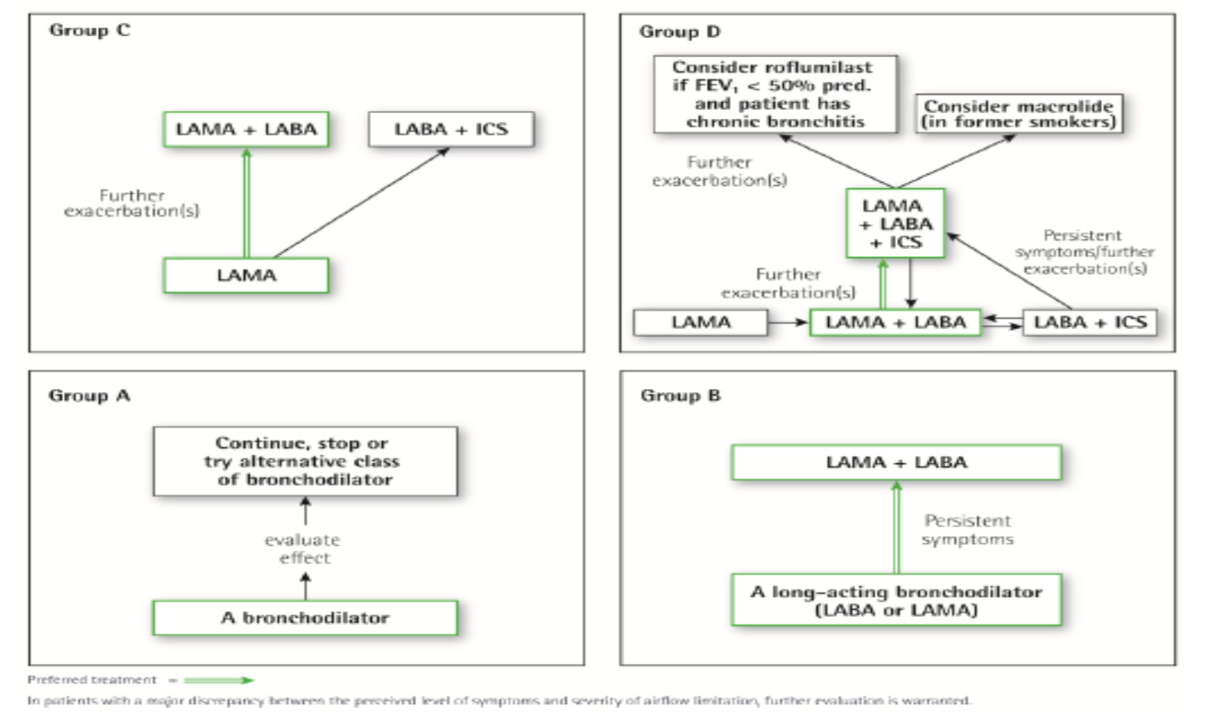
COPD AS THE PULMONARY
COMPONENT OF MULTIMORBIDITY
Fabbri LM, Luppi F, Beghe B, and Rabe KF - Eur Respir J 2008;31:204-212

Slide 71
EXACERBATIONS OF RESPIRATORY SYMPTOMS IN PATIENTS WITH COPD MAY NOT BE EXACERBATIONS OF COPD
Beghé B, Verduri A, Roca M and Fabbri LM. Eur Respir J 2013; 41: 993-5
Roca M, Verduri A, Clini EM, Fabbri LM and Beghé B. Eur J Clin Invest, 2013;43:510

Slide 72
RECENTI AVANZAMENTI IN MEDICINA INTERNA E PNEUMOLOGIA
PneumoTrieste 2017
Trieste 4 Aprile 2017
Leonardo M. Fabbri, MD, FERS, AE
Professor of Respiratory and Internal Medicine (-2016)
University of Modena and Reggio Emilia

