Slide 1



UPDATE SULLA TERAPIA DELL’ASMA
Università degli
Studi di Pisa
Azienda Ospedaliera Pisana
Pierluigi Paggiaro
Chairman GINA Italy
Cardio-Thoracic and Vascular Department, University of Pisa
Pneumotrieste 2017
Trieste, 3-5 aprile 2017

Slide 2

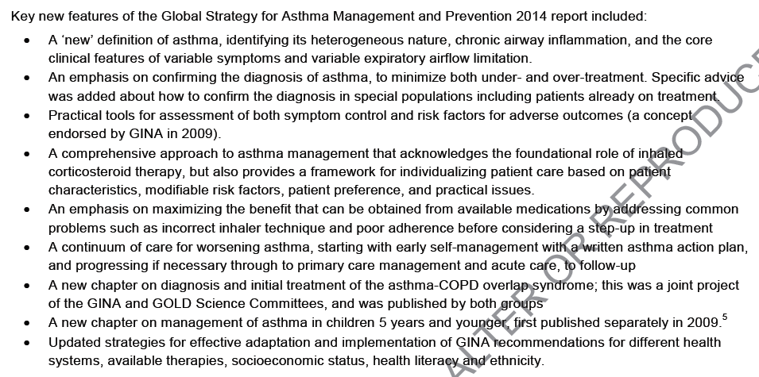
GINA 2014 major revision

Slide 3
New aspects of asthma assessment and management: application in clinical practice
Better definition of diagnosis and phenotyping
  Need for functional evaluation
  Future risk as additional feature for assesssing outcome
  Non-eosinophilic asthma: always ICS ?

Slide 4
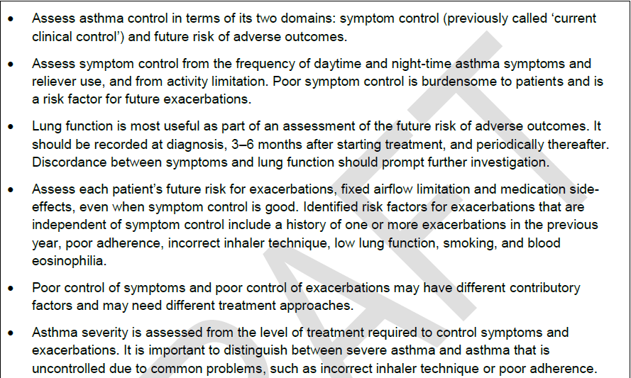
Assessment of asthma – key points
GINA 2014

Slide 5
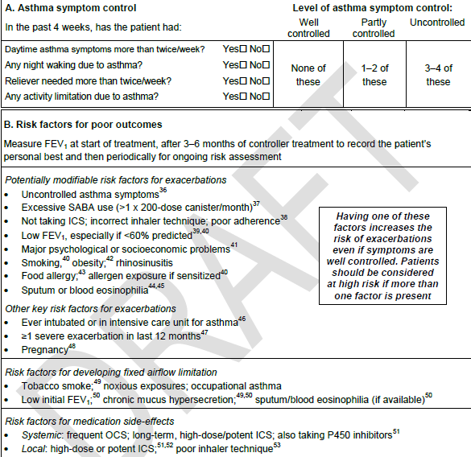
Symptom control vs future risk
GINA 2014

Slide 6
Symptom control vs future risk
GINA 2014

Slide 7
Measurement of lung function - changes
Frequency of measurement of lung function
  “Lung function should be assessed at diagnosis or start of treatment; after 3–6 months of controller treatment to assess the patient’s personal best FEV₁; and periodically thereafter”
‘Periodically’ has been clarified
  Most adults: lung function should be recorded at least every 1-2 yrs
  More frequently in higher risk patients
  More frequently in children based on severity and clinical course
Lung function trajectories
  Children with persistent asthma may have reduced growth in lung function, and some are at risk of accelerated decline in lung function in early adult life [McGeachie, NEJMed 2016]
Low resource areas
  Poverty is commonly associated with spirometric restriction, so where possible, both FEV₁ and FVC should be recorded
What’s new in GINA 2017?

Slide 8

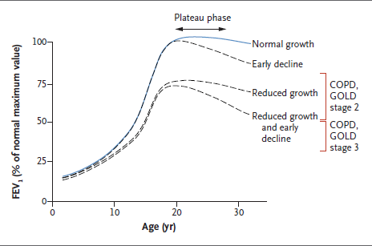
McGeachie et al, NEJM 2016

Slide 9

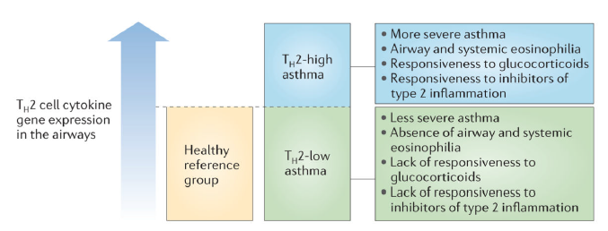
Fahy, Nat Rev Immunol 2015

Slide 10
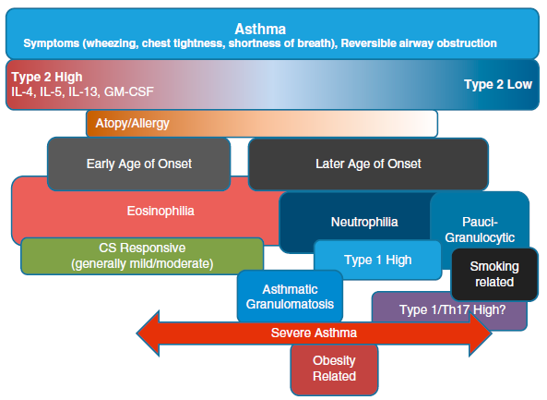
Current asthma phenotypes
Gauthier et al, AJRCCM 2016

Slide 11
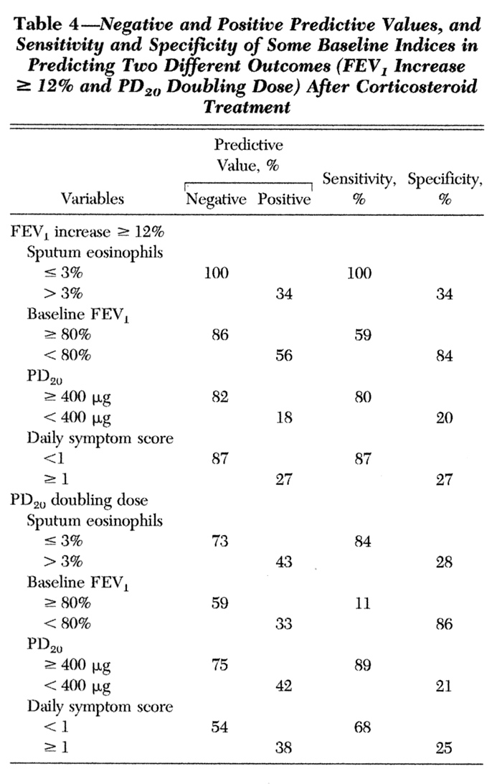
Absence of sputum eosinophilia
in corticosteroid”naive” asthmatics
predicts a poor short-term response to ICS
Bacci et al, Chest 2006

Slide 12
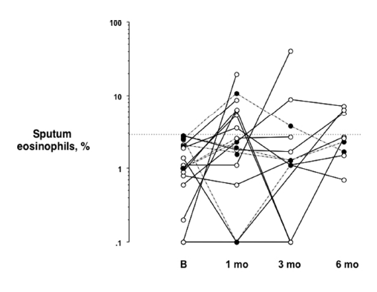
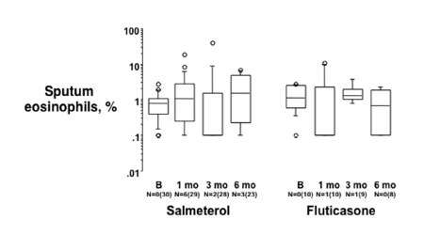
Steroid-naif symptomatic noneosinophilic asthma
may remain stable over 6 months
Bacci et al, Respirology 2012

Slide 13
Non-eosinophilic but neutrophilic asthmatics show a good response to tiotropium
Iwamoto et al, ERJ 2009

Slide 14
New aspects of asthma assessment and management: application in clinical practice
Better definition of diagnosis and phenotyping
  Need for functional evaluation
  Future risk as additional feature for assesssing outcome
  Non-eosinophilic asthma: always ICS ?
Asthma therapy
  Regular ICS also in mild asthma vs ICS/SABA as needed ?
  ICS/LABA in the majority of moderate asthmatics
  Personalised therapy: ITS for HDM allergic asthma

Slide 15


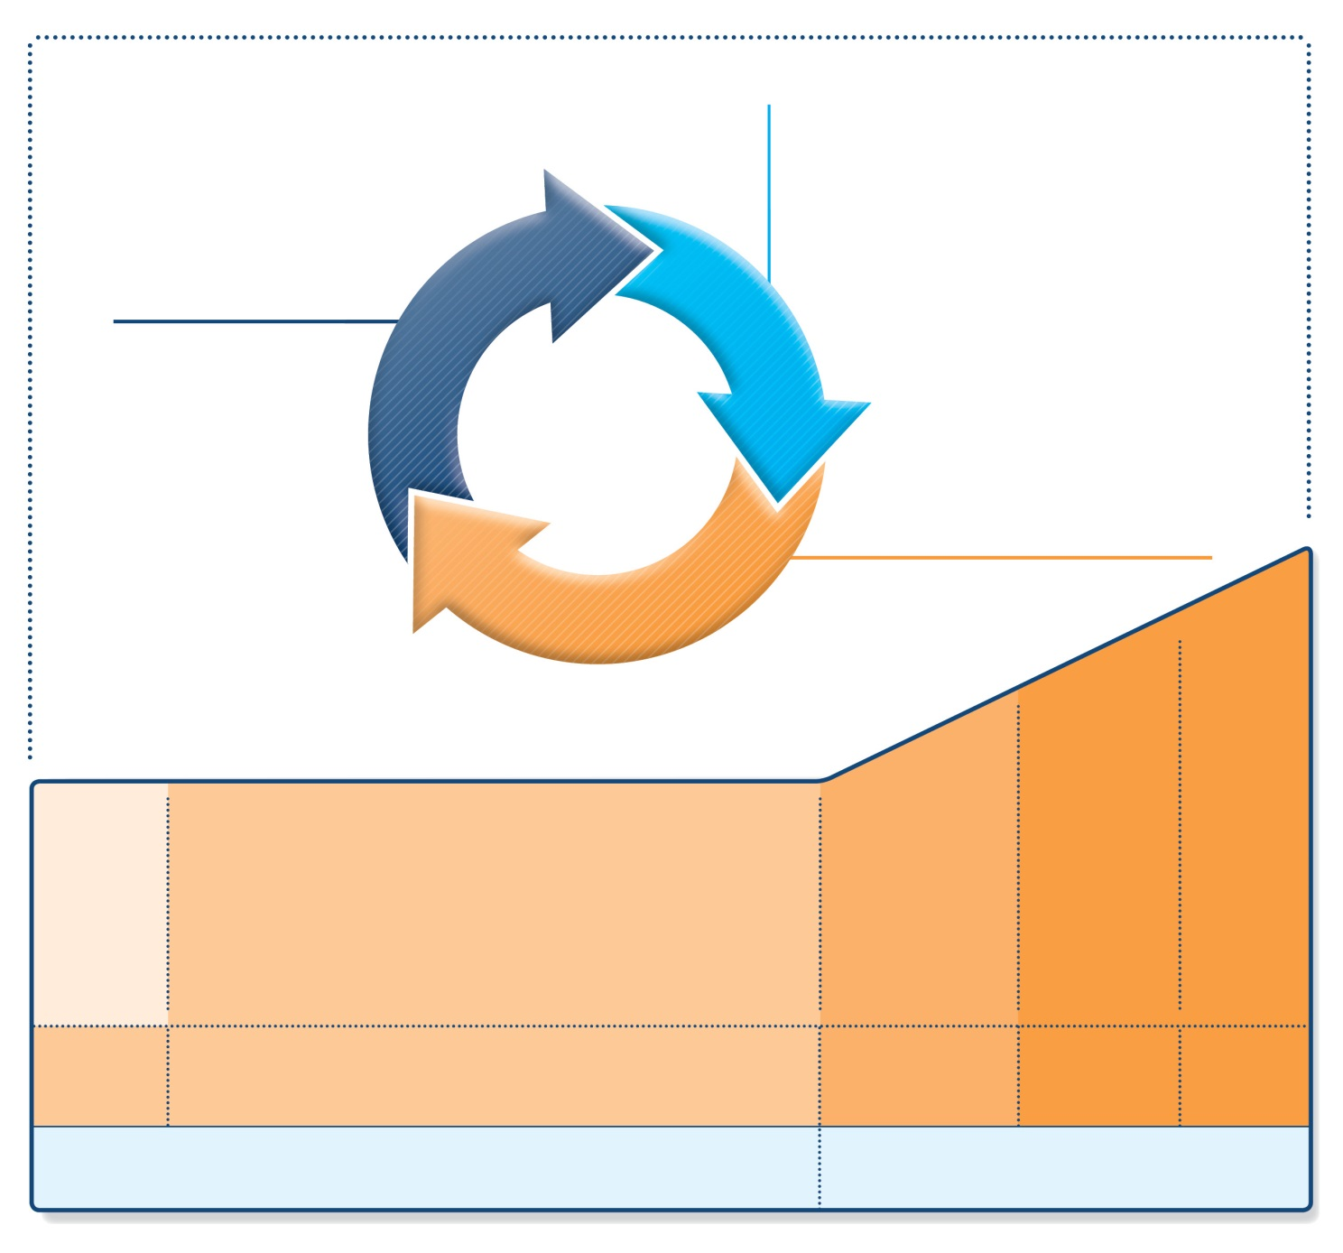
Stepwise management - pharmacotherapy
Diagnosis
Symptom control & risk factors
(including lung function)
Inhaler technique & adherence
Patient preference
UPDATED!
ASSESS
REVIEW RESPONSE
Symptoms
Exacerbations
Side-effects
Patient satisfaction
Lung function
ADJUST TREATMENT
Asthma medications
Non-pharmacological strategies
Treat modifiable risk factors
STEP 5
STEP 4
STEP 1
STEP 2
STEP 3
Refer for add-on treatment
e.g.
tiotropium,* omalizumab, mepolizumab*
*Not for children <12 years
**For children 6-11 years, the preferred Step 3 treatment is medium dose ICS
#For patients prescribed BDP/formoterol or BUD/ formoterol maintenance and reliever therapy
 Tiotropium by mist inhaler is an add-on treatment for patients ≥12 years with a history of exacerbations
PREFERRED
CONTROLLER
CHOICE
Med/high
ICS/LABA
Low dose ICS
Low dose
ICS/LABA**
Other
controller
options
Consider low dose ICS
Leukotriene receptor antagonists (LTRA)
Low dose theophylline*
Med/high dose ICS
Low dose ICS+LTRA
(or + theoph*)
Add tiotropium*
High dose ICS
+ LTRA
(or + theoph*)
Add low
dose OCS
RELIEVER
As-needed short-acting beta²-agonist (SABA)
As-needed SABA or
low dose ICS/formoterol#
GINA 2016, Box 3-5 (2/8) (upper part)

Slide 16
Treatment – other changes in 2017
Step 5 treatment for severe asthma
  Anti-IL5: reslizumab (IV) added to mepolizumab (SC) for ≥18 years
Step-down from low-dose ICS (Box 3-7)
  Add-on LTRA may help
  Insufficient evidence for step-down to as-needed ICS with SABA
What’s new in GINA 2017?

Slide 17

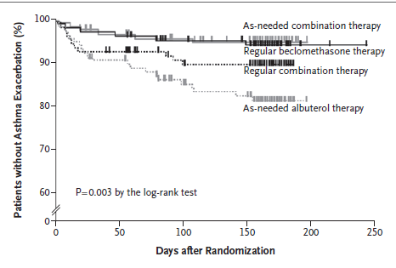

Slide 18
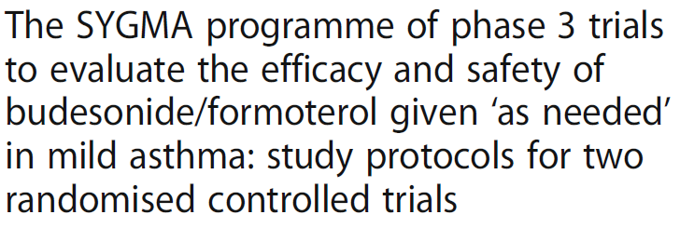
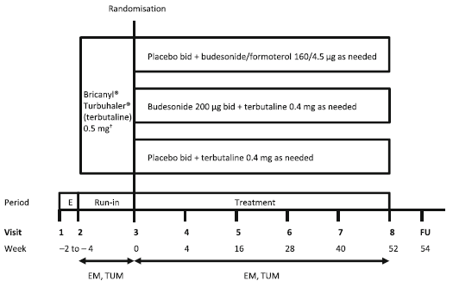
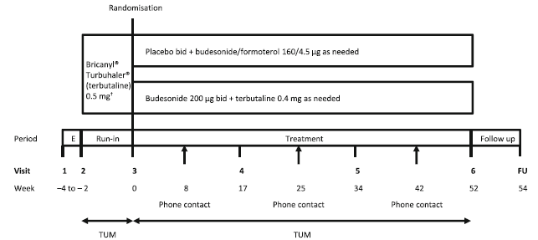
O’Byrne et al,
Trials 2017

Slide 19
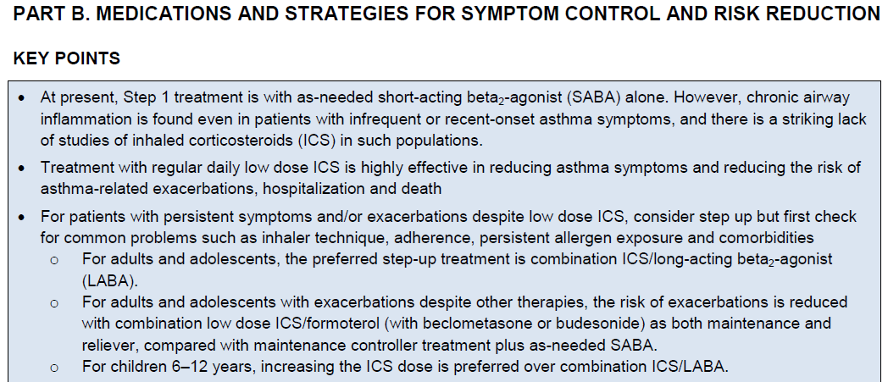
Regular treatment with ICS or combinations is the recommended treatment in almost all treatments steps
GINA 2014

Slide 20
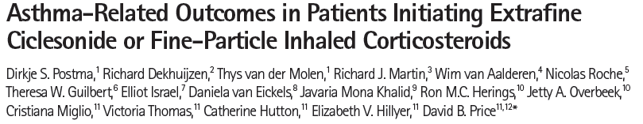
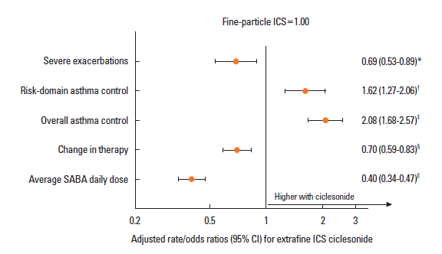

Slide 21
ICS/LABA combination therapy
Different ICS/LABA combinations
    Fluticasone propionate/salmeterol MDI and DPI
      Different strenght, standard dosing
    Budesonide/formoterol DPI
      Single strenght, different dosing
    BDP/formoterol MDI and DPI
      Single strenght, different dosing
    Fluticasone propionate/formoterol MDI
      Different strenght, standard dosing
    Fluticasone furoate/vilanterol DPI
      Different strenght, once daily
Different indications
  Traditional treatment vs maintenance and reliever treatment
  Different severity ?

Slide 22
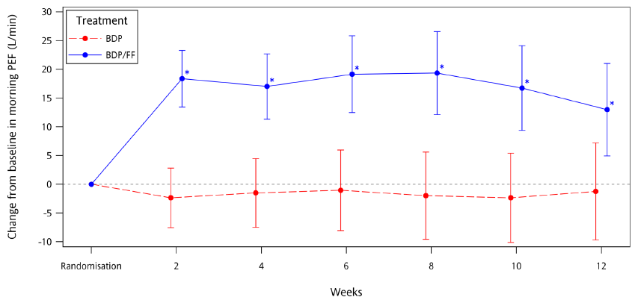
Paggiaro et al, BMC Pulm Med 2016

Slide 23
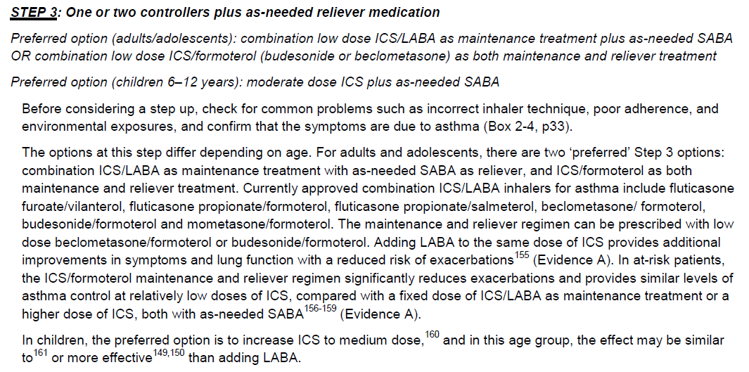
Role of combination therapy
GINA 2014

Slide 24

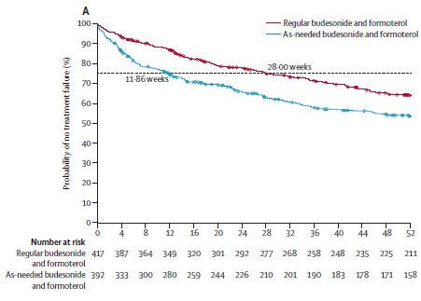
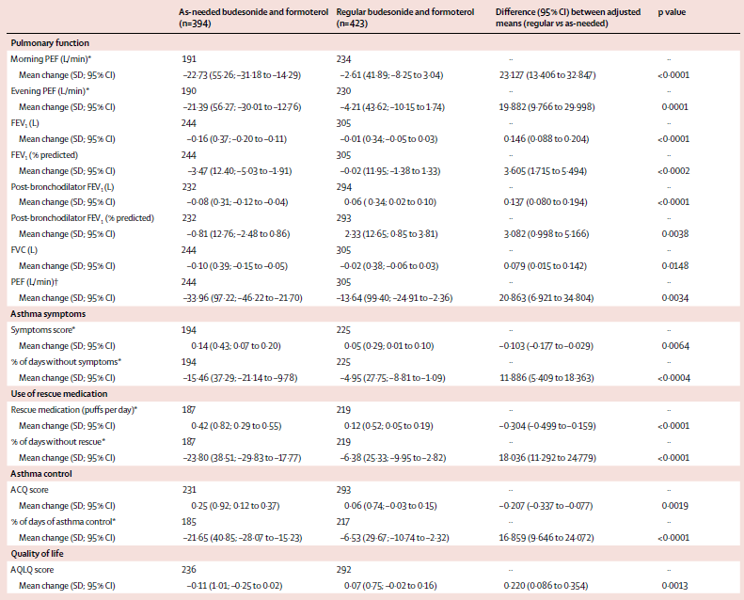

Slide 25

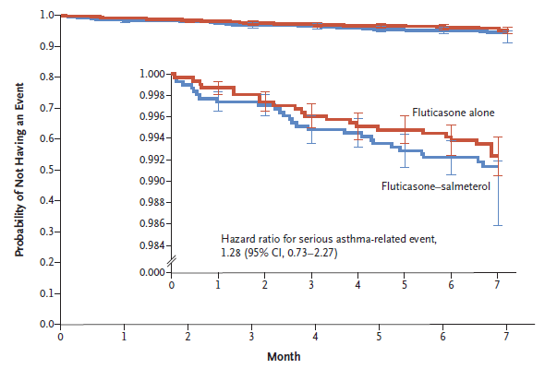
Stempel et al, NEJM 2016

Slide 26
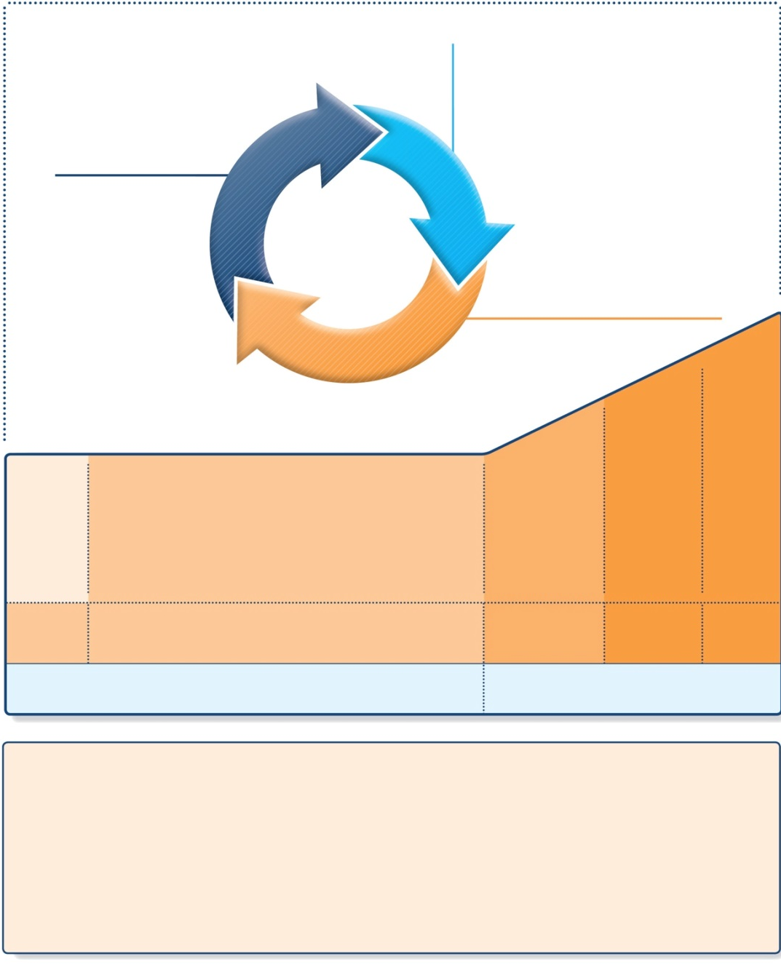
Stepwise approach to control asthma symptoms and reduce risk
Diagnosis
Symptom control & risk factors
(including lung function)
Inhaler technique & adherence
Patient preference
ASSESS
REVIEW RESPONSE
Symptoms
Exacerbations
Side-effects
Patient satisfaction
Lung function
ADJUST TREATMENT
Asthma medications
Non-pharmacological strategies
Treat modifiable risk factors
STEP 5
STEP 4
PREFERRED
CONTROLLER
CHOICE
STEP 1
STEP 2
STEP 3
Refer for add-on treatment
e.g.
tiotropium,*
anti-IgE,
anti-IL5*
Med/high
ICS/LABA
Low dose ICS
Low dose
ICS/LABA**
Other
controller
options
Consider low dose ICS
Leukotriene receptor antagonists (LTRA)
Low dose theophylline*
Med/high dose ICS
Low dose ICS+LTRA
(or + theoph*)
Add tiotropium*
High dose ICS
+ LTRA
(or + theoph*)
Add low dose
OCS
RELIEVER
As-needed short-acting beta₂-agonist (SABA)
As-needed SABA or
low dose ICS/formoterol#
REMEMBER
TO...
• Provide guided self-management education (self-monitoring + written action plan + regular review)
• Treat modifiable risk factors and comorbidities, e.g. smoking, obesity, anxiety
• Advise about non-pharmacological therapies and strategies, e.g. physical activity, weight loss, avoidance of sensitizers where appropriate
• Consider stepping up if … uncontrolled symptoms, exacerbations or risks, but check diagnosis, inhaler
technique and adherence first
• Consider adding SLIT in adult HDM-sensitive patients with allergic rhinitis who have exacerbations despite ICS treatment, provided FEV1 is >70% predicted
• Consider stepping down if … symptoms controlled for 3 months + low risk for exacerbations.
Ceasing ICS is not advised.
SLIT added as an option
GINA 2017, Box 3-5 (1/8)
© Global Initiative for Asthma

Slide 27

Stepwise management, SLIT as an add-on option for some patients
• Provide guided self-management education
• Treat modifiable risk factors and comorbidities
• Advise about non-pharmacological therapies and strategies
• Consider stepping up if … uncontrolled symptoms, exacerbations or risks,
but check diagnosis, inhaler technique and adherence first
• Consider adding SLIT in adult HDM-sensitive patients with allergic rhinitis who have exacerbations despite ICS treatment, provided FEV₁ is 70% predicted
• Consider stepping down if … symptoms controlled for 3 months
+ low risk for exacerbations. Ceasing ICS is not advised.
REMEMBER
TO...
SLIT: sublingual immunotherapy
GINA 2017, Box 3-5 (3/8) (lower part)

Slide 28
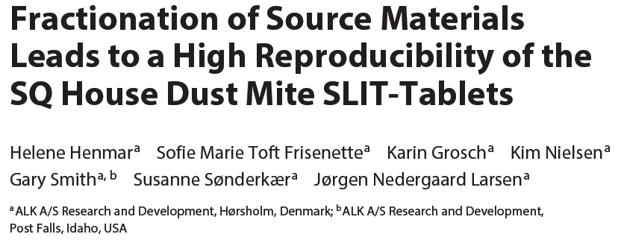
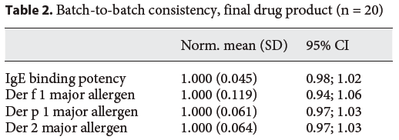
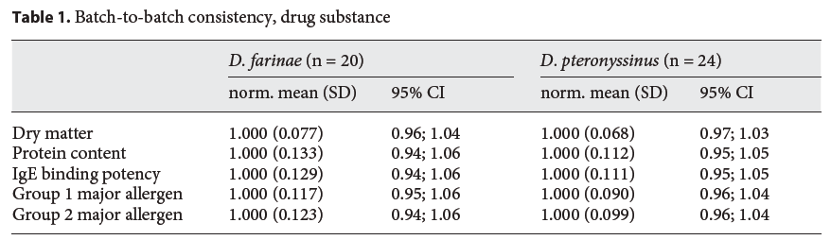

Slide 29

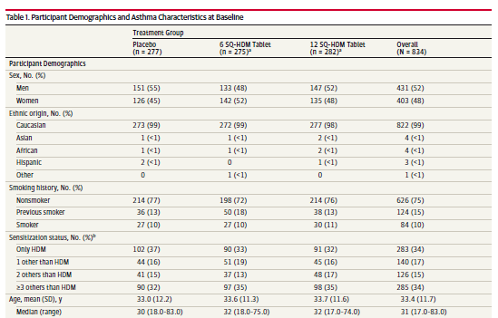
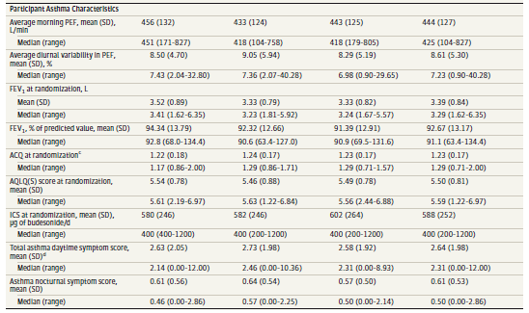
Major points:
HDM well characterized major allergen
Rapidly dissolving oral lyophilised
Primary outcome:
Rate of asthma exacerbations after ICS reduction/ or withdrawal

Slide 30
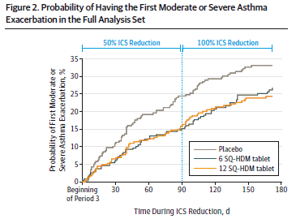
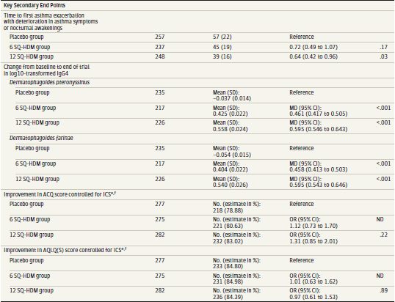

Slide 31
Treatment – other changes in 2017
Side-effects of oral corticosteroids
  When prescribing short-term OCS, remember to advise patients about common side-effects (sleep disturbance, increased appetite, reflux, mood changes); references added
Vitamin D
  To date, no good quality evidence that Vitamin D supplementation leads to improved asthma control or fewer exacerbations
Chronic sinonasal disease
  Treatment with nasal corticosteroids improves sinonasal symptoms but not asthma outcomes
What’s new in GINA 2017?

Slide 32

The control-based asthma management cycle
Diagnosis
Symptom control & risk factors
(including lung function)
Inhaler technique & adherence
Patient preference
ASSESS
REVIEW RESPONSE
Symptoms
Exacerbations
Side-effects
Patient satisfaction
Lung function
ADJUST TREATMENT
Asthma medications
Non-pharmacological strategies
Treat modifiable risk factors
GINA 2016, Box 3-2

Slide 33

Reviewing response and adjusting treatment
ASSESS
REVIEW RESPONSE
How often should asthma be reviewed?
  1-3 months after treatment started, then every 3-12 months
  During pregnancy, every 4-6 weeks
  After an exacerbation, within 1 week
Stepping up asthma treatment
  Sustained step-up, for at least 2-3 months if asthma poorly controlled
    Important: first check for common causes (symptoms not due to asthma, incorrect inhaler technique, poor adherence)
  Short-term step-up, for 1-2 weeks, e.g. with viral infection or allergen
    May be initiated by patient with written asthma action plan
  Day-to-day adjustment
    For patients prescribed low-dose ICS/formoterol maintenance and reliever regimen*
Stepping down asthma treatment
  Consider step-down after good control maintained for 3 months
  Find each patient’s minimum effective dose, that controls both symptoms and exacerbations
ADJUST TREATMENT
*Approved only for low dose beclometasone/formoterol and low dose budesonide/formoterol
GINA 2016

Slide 34
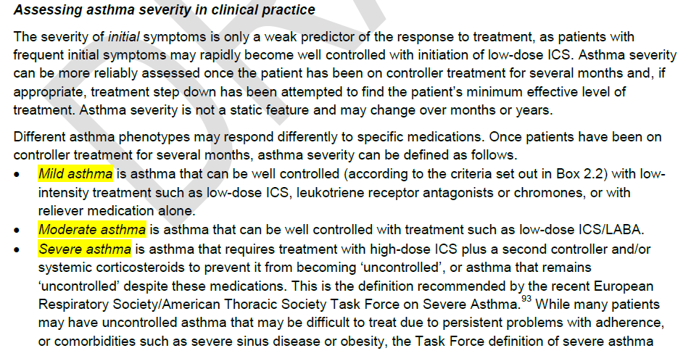
Assessment of asthma severity
GINA 2014

Slide 35
General principles for stepping down controller treatment
Aim
  To find the lowest dose that controls symptoms and exacerbations, and minimizes the risk of side-effects
When to consider stepping down
  When symptoms have been well controlled and lung function stable for
  ≥3 months
  No respiratory infection, patient not travelling, not pregnant
Prepare for step-down
  Record the level of symptom control and consider risk factors
  Make sure the patient has a written asthma action plan
  Book a follow-up visit in 1-3 months
Step down through available formulations
  Stepping down ICS doses by 25–50% at 3 month intervals is feasible and safe for most patients (Hagan et al, Allergy 2014)
  See GINA 2016 report Box 3-7 for specific step-down options
Stopping ICS is not recommended in adults with asthma because of risk of exacerbations (Rank et al, JACI 2013)
GINA 2016, Box 3-7

Slide 36
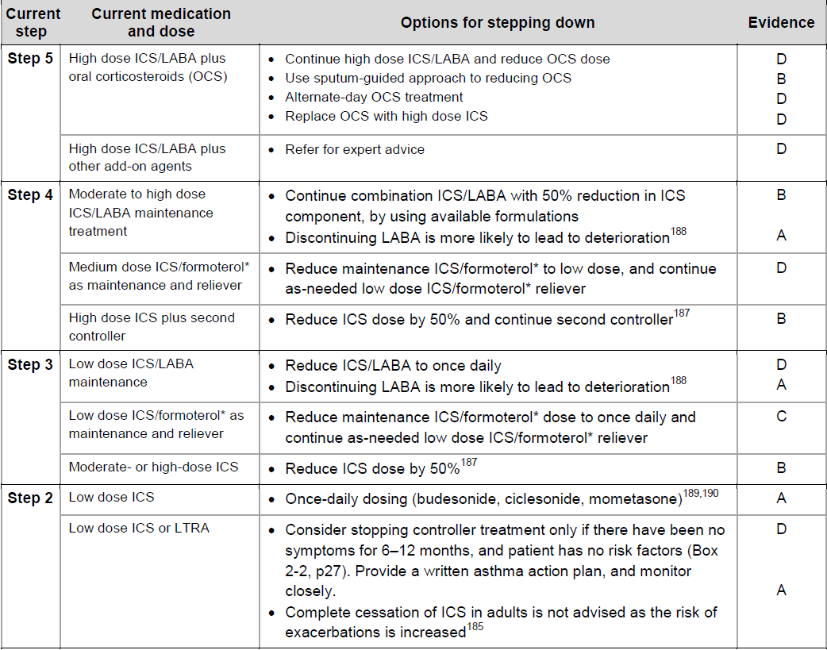
When and how stepping down
GINA 2014

Slide 37
Treating modifiable risk factors
Provide skills and support for guided asthma self-management
  This comprises self-monitoring of symptoms and/or PEF, a written asthma action plan and regular medical review
Prescribe medications or regimen that minimize exacerbations
  ICS-containing controller medications reduce risk of exacerbations
  For patients with ≥1 exacerbations in previous year, consider low-dose ICS/formoterol maintenance and reliever regimen*
Encourage avoidance of tobacco smoke (active or ETS)
  Provide smoking cessation advice and resources at every visit
For patients with severe asthma
  Refer to a specialist center, if available, for consideration of add-on medications and/or sputum-guided treatment
For patients with confirmed food allergy:
  Appropriate food avoidance
  Ensure availability of injectable epinephrine for anaphylaxis
*Approved only for low dose beclometasone/formoterol and low dose budesonide/formoterol
GINA 2016, Box 3-8

Slide 38
Non-pharmacological interventions
Avoidance of tobacco smoke exposure
  Provide advice and resources at every visit; advise against exposure of children to environmental tobacco smoke (house, car)
Physical activity
  Encouraged because of its general health benefits. Provide advice about exercise-induced bronchoconstriction
Occupational asthma
  Ask patients with adult-onset asthma about work history. Remove sensitizers as soon as possible. Refer for expert advice, if available
Avoid medications that may worsen asthma
  Always ask about asthma before prescribing NSAIDs or beta-blockers
Remediation of dampness or mold in homes
  Reduces asthma symptoms and medication use in adults
(Allergen avoidance)
  (Not recommended as a general strategy for asthma)
See GINA Box 3-9 and online Appendix for details
UPDATED!
This slide shows examples of interventions with high quality evidence
GINA 2016, Box 3-9

Slide 39
Check adherence with asthma medications
Poor adherence:
  Is very common: it is estimated that 50% of adults and children do not take controller medications as prescribed
  Contributes to uncontrolled asthma symptoms and risk of exacerbations and asthma-related death
Contributory factors
  Unintentional (e.g. forgetfulness, cost, confusion) and/or
  Intentional (e.g. no perceived need, fear of side-effects, cultural issues, cost)
How to identify patients with low adherence:
  Ask an empathic question, e.g. “Do you find it easier to remember your medication in the morning or the evening?”, or
  “Would you say you are taking it 3 days a week, or less, or more?”
  Check prescription date, label date and dose counter
  Ask patient about their beliefs and concerns about the medication
GINA 2016, Box 3-12

Slide 40
Stepwise management - pharmacotherapy
Diagnosis
Symptom control & risk factors
(including lung function)
Inhaler technique & adherence
Patient preference
UPDATED!
ASSESS
REVIEW RESPONSE
Symptoms
Exacerbations
Side-effects
Patient satisfaction
Lung function
ADJUST TREATMENT
Asthma medications
Non-pharmacological strategies
Treat modifiable risk factors
STEP 5
STEP 4
STEP 1
STEP 2
STEP 3
Refer for add-on treatment
e.g.
tiotropium,* omalizumab, mepolizumab*
*Not for children <12 years
**For children 6-11 years, the preferred Step 3 treatment is medium dose ICS
#For patients prescribed BDP/formoterol or BUD/ formoterol maintenance and reliever therapy
 Tiotropium by mist inhaler is an add-on treatment for patients ≥12 years with a history of exacerbations
PREFERRED
CONTROLLER
CHOICE
Med/high
ICS/LABA
Low dose ICS
Low dose
ICS/LABA**
Other
controller
options
Consider low dose ICS
Leukotriene receptor antagonists (LTRA)
Low dose theophylline*
Med/high dose ICS
Low dose ICS+LTRA
(or + theoph*)
Add tiotropium*
High dose ICS
+ LTRA
(or + theoph*)
Add low
dose OCS
RELIEVER
As-needed short-acting beta²-agonist (SABA)
As-needed SABA or
low dose ICS/formoterol#
GINA 2016, Box 3-5 (2/8) (upper part)

Slide 41
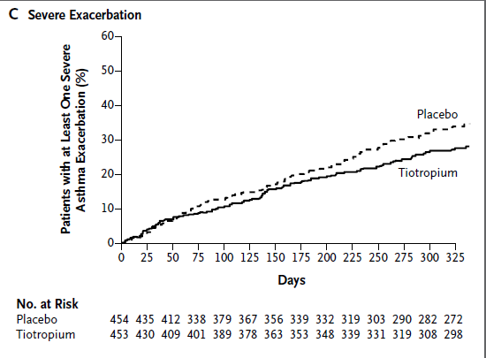
Third coprimary endopoint
(severe exacerbations)
Severe exacerbation rate
- 21%
Time to first ex: + 56 days
NNT: 15
Minor changes in symptoms
- ACQ7
  -0.09 in trial 1 (n.s.)
  -0.13 in trial 2 (p=0.06)
- AQLQ
  -0.04 in trial 1 (n.s.)
  -0.18 in trial 2 (p=0.02)
Kerstjens et al, NEJM 2012

Slide 42

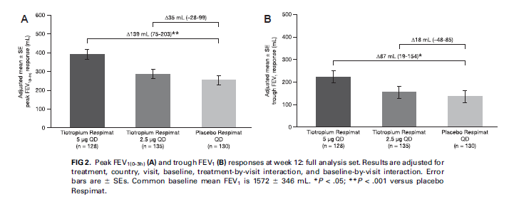
Szefler et al, JACI 2017

Slide 43
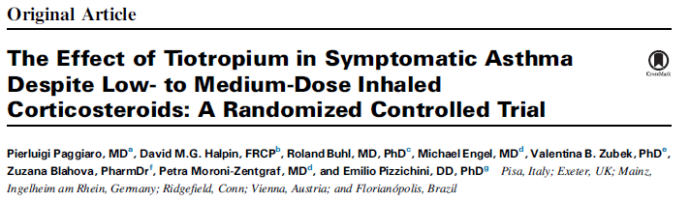

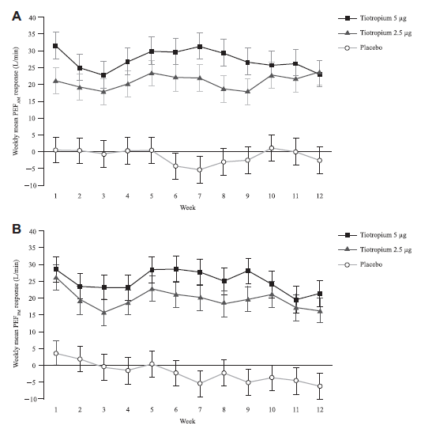
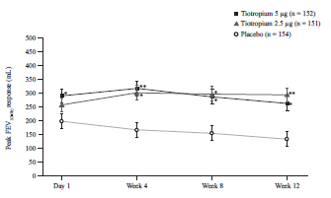
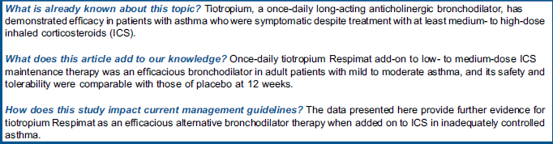

Slide 44
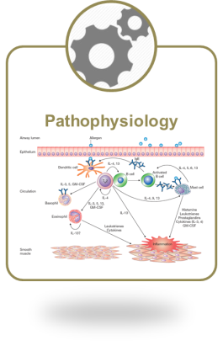
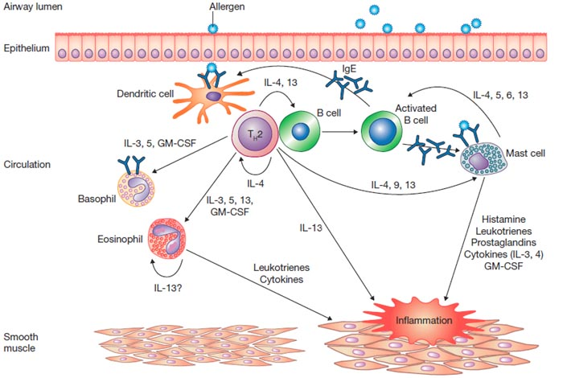
Effects of blocking IgE on allergic inflammatory cascade
x
NON è un singolo effetto!
Bloccare le IgE induce ad effetti diretti e indiretti agendo su molte componenti cellulari legate alla risposta immune Th2 mediata
x
Le IgE sono un attore chiave nell’induzione e nel mantenimento della risposta allergica (infiammazione): rappresentano IL target primario della terapia farmacologica
Modificato da Humbert et al JACI Pract 2014;2:525
Impact on
T-lymphocytes
and
B-lymphocytes⁵
Binds free IgE and down-regulates IgE receptors (FcεRI) on mast cells, basophils and DCs
IL-2, IL-4,
IL-5, IL-13
and GM-CSF^{1–4}
Peripheral, sputum
and sub-mucosal
eosinophilia¹

Slide 45
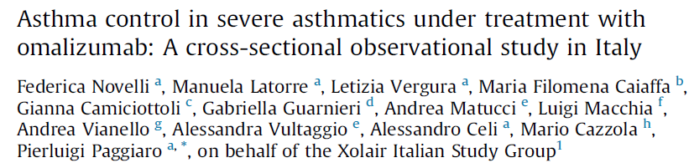
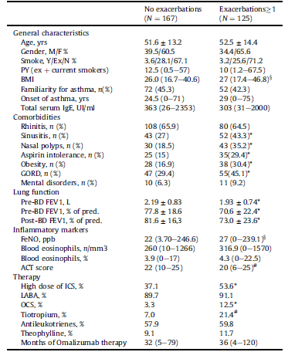
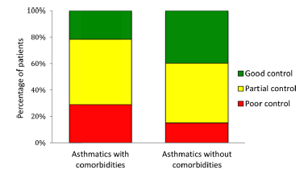
Pulm Pharm Ther 2014

Slide 46

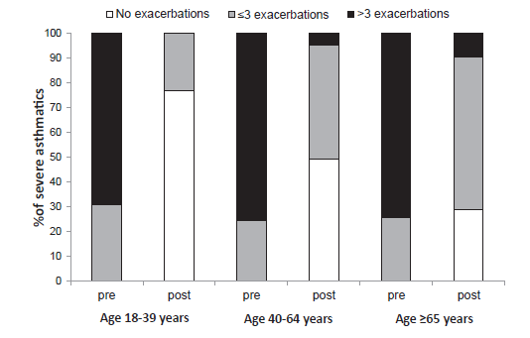
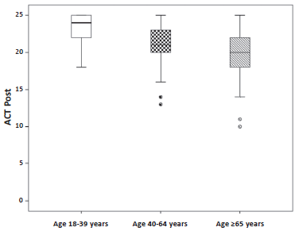
Respir Med 2016

Slide 47

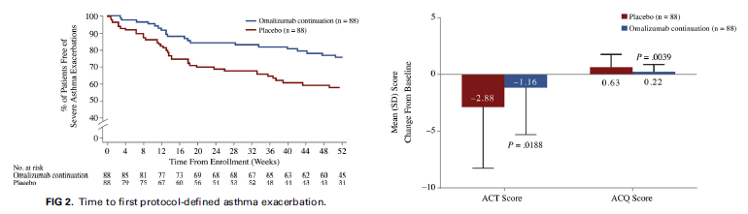
J Allergy Clin Immunol 2017

Slide 48
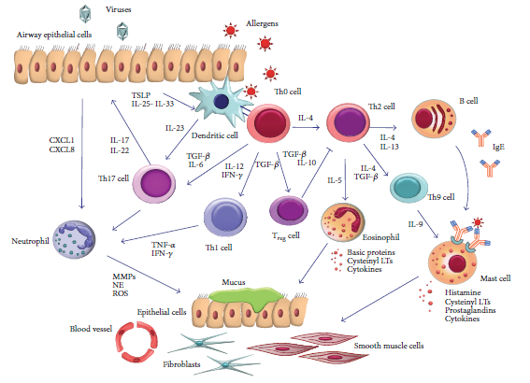
Different targets for intervention on the «inflammatory cascade»
Pelaia et al, Med Inflamm 2015

Slide 49
Future biologic drugs in asthma
Name | Target | Phase | Biomarkers
Mepolizumab | IL-5 | On the market | Blood eos
Benralizumab | IL-5 R | Phase III | Blood eos
Reslizumab | IL-5 | Phae III | Blood eos
Lebrikizumab | IL-13 | Phase III → stop | Periostin
Tralokinumab | IL-13 | Phase II-III | DPP-4, periostin (?)
Dupilumab | IL-4 | Phase III | FeNO
Brodalumab | IL-17 | Phase II → stop | ??
??
Fevipiprant | CRTH2 | Phase III | Blood eos

Slide 50
Treatment – other changes in 2017
Step 5 treatment for severe asthma
  Anti-IL5: reslizumab (IV) added to mepolizumab (SC) for ≥18 years
Step-down from low-dose ICS (Box 3-7)
  Add-on LTRA may help
  Insufficient evidence for step-down to as-needed ICS with SABA
What’s new in GINA 2017?

Slide 51


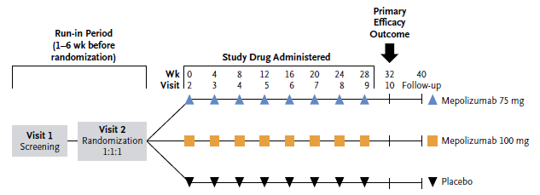
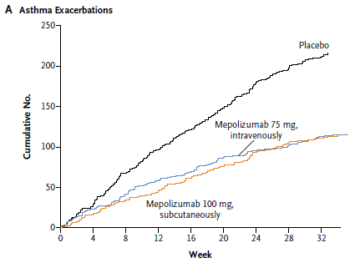
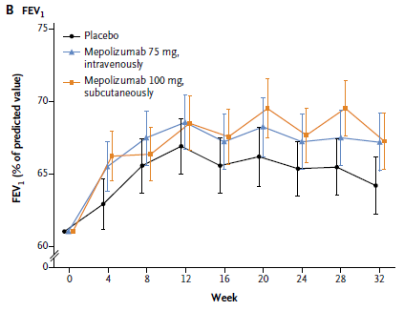

Slide 52



Castro et al,
Lancet RespirMed 2015

Slide 53




Slide 54
Different targets for intervention on the «inflammatory cascade»
Pelaia et al, Med Inflamm 2015

Slide 55



Slide 56




Slide 57




Slide 58


Slide 59
Main evolution in asthma guideline:
«Asthma as a heterogeneous disease»
Identification of different phenotypes
  According to etiology
  According to pathogenesis
  According to severity
Implication for treatment («target therapy»)
  With current drugs
  With biologic drugs
  With allergen-immunotherapy
  With thermoplasty
«tailoring» asthma approach

Slide 60

Asthma: from population-level to patient-level
«personalized therapy»
GINA 2014

Slide 61
Documento GINA 2016-2017
Chairman: P. Paggiaro
Scientific board: E. Bacci, F. Dente, M. Latorre
Faculty: E. Baraldi, B. Beghé, M. Bonini, F. Braido, M. Bresciani, C. Bucca, C. Calabrese, C. Capristo, E. Carpagnano, A. Celi, N. Crimi, S. DelGiacco, MP. Foschino, S. Frateiacci, M. Giovannini, G. Guarnieri, G. Liccardi, S. Lagrutta, L. Macchia, M. Malerba, G. Pelaia, G. Piacentini, P. Pignatti, F. Ricciardolo, F. Santamaria, N. Scichilone, G. Senna, A. Spanevello, A. Vatrella, G. Verlato, G. Viegi
Meetings: Firenze, 14° december 2016 and 9 march 2017

Slide 62

GINA Italy group 2016-2017

