Slide 1
Community-acquired Pneumonia
Glucocorticoid Treatment pathophysiological rationale and updated literature
G. Umberto Meduri M.D.
Memphis VA Medical Center
Academic Freedom Saves Lives

Slide 2
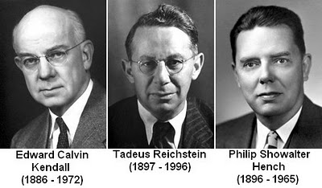

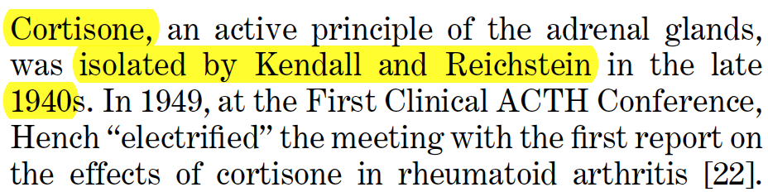
CAP: GC Rx RCTs
1950.
Sepsis 1999; 3: 21-38.

Slide 3
CAP: GC Rx RCTs

Slide 4
Components of Pneumonia
Pathogens invade the sterile lower respir. tract
    Activation of the innate immune response
    Local and systemic inflammation
Disease Elements
Temporal Course
Pneumonia
Pathogens
Acute
Chronic
Inflammation
Pneumonia
Academic Freedom Saves Lives

Slide 5
Present Treatment
Directed predominantly at:
Eradicating the etiologic agent(s)
Disease Elements
Temporal Course
Pneumonia
Pathogens
Acute
Chronic
Inflammation
Present Treatment

Slide 6
Pathogens – Antibiotic Rx
Antibiotics alone are insufficient
1940-50s introduction: reduction in acute mortality ¹
In 24 hours: causative bacteria are largely eradicated from tracheal secretions and blood ²
Deaths occur after eradication of bacteria ³
1950-2010: No additional reduction in acute mortality
For many patients, death is only delayed
Armstrong GL, et al. Trends in infectious disease mortality in the United States during the 20th century. JAMA 1999;281:61-6.
Musher DM, et al. Diagnostic value of microscopic examination of Gram-stained sputum and sputum cultures in patients with bacteremic pneumococcal pneumonia. Clin Infect Dis 2004;39:165-9.
Corrales-Medina VF, Musher DM. Immunomodulatory agents in the treatment of community-acquired pneumonia: a systematic review. J Infect 2011;63:187-99.

Slide 7

What leads to excess mortality?

Slide 8
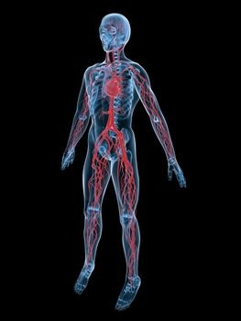
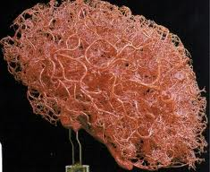
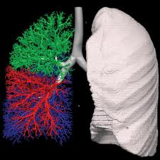
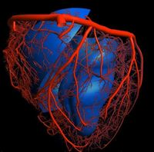
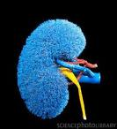
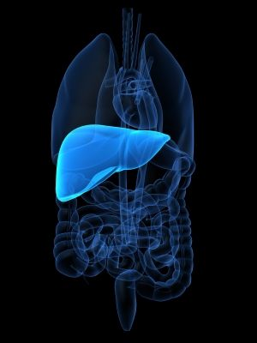
Dysregulated Syst. Inflammation
In pneumonia of varied etiology:
  Bacterial, Viral, Fungal
Central pathogenetic process for morbidity and mortality:
  Short-term [hospital] and
  Long-term [post-hospitalization]
Persistent elevation in circulation of inflammatory and hemostasis mediators

Slide 9

Syst. Inflammation: HSP admission
Higher IC levels are associated with:
  presence of bilateral pneumonia
  bacteremia
  higher Pneumonia Severity Index (PSI)
  higher APACHE II and MODS scores
  higher risk for treatment failure
  higher risk for ARF (MV) and ARDS
  higher hospital and long-term mortality
  worsen long-term function

Slide 10
Plasma levels at ICU admission [N= 375]
Systemic inflammation
  ▲C-reactive protein, IL-6, IL-8, and matrix metalloproteinase [MMP]-8
Activation of coagulation system
  ▲ D-dimer, PT, APTT
  ▼ anticoagulants: protein C and antithrombin
Endothelial cell activation
  ▲ soluble E-selectin, soluble intercellular adhesion molecule-1, and angiopoietin-2 levels
Disturbed vascular integrity
  ▼ angiopoietin-1 [maturation and stability]

Slide 11

Syst. Inflammation: CRP over time
Failure to decrease CRP levels by:
  Day 2 to 4 ¹⁻³ and 7⁴ is associated with increased ICU⁴ or 30 days mortality ¹⁻³
  Day 3 ^{5,6} and 7 ⁶ is independently associated with a higher risk of any treatment failure ^{5,6}
Rate of reduction (slow vs. rapid) is associated with increased mortality
1. Am J Med 2008;121:219-25. -- 2. J Crit Care 2013;28:291-5. -- 3. Infect Dis 2016:1-10.
4. Crit Care 2012;16:R53. -- 5. Thorax 2008;63:447-52. -- 6. Eur Respir J 2008;32:726-32.

Slide 12

Severe CAP admitted to ICU (n=191)
▼CRP reduction preceded ▼ SOFA score
Similar CRP at admission
Rapid responders
  D5 CRP < 0.4 of D1 CRP
  ICU Mort: 4.8%
Slow responders
  D5 CRP > 0.4 of D1 CRP
  ICU Mort: 17.3%
Non responders
  D7 CRP > 0.8 of D1 CRP
  ICU Mort: 36.4%
Start Rx?

Slide 13
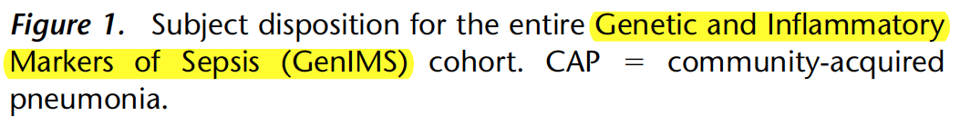
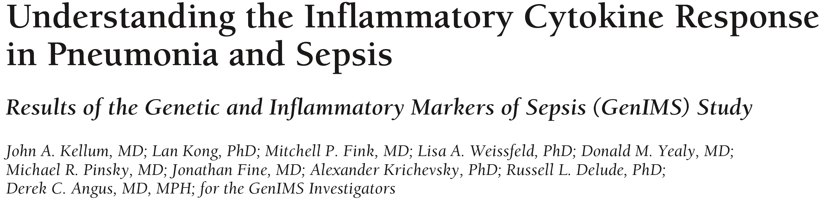
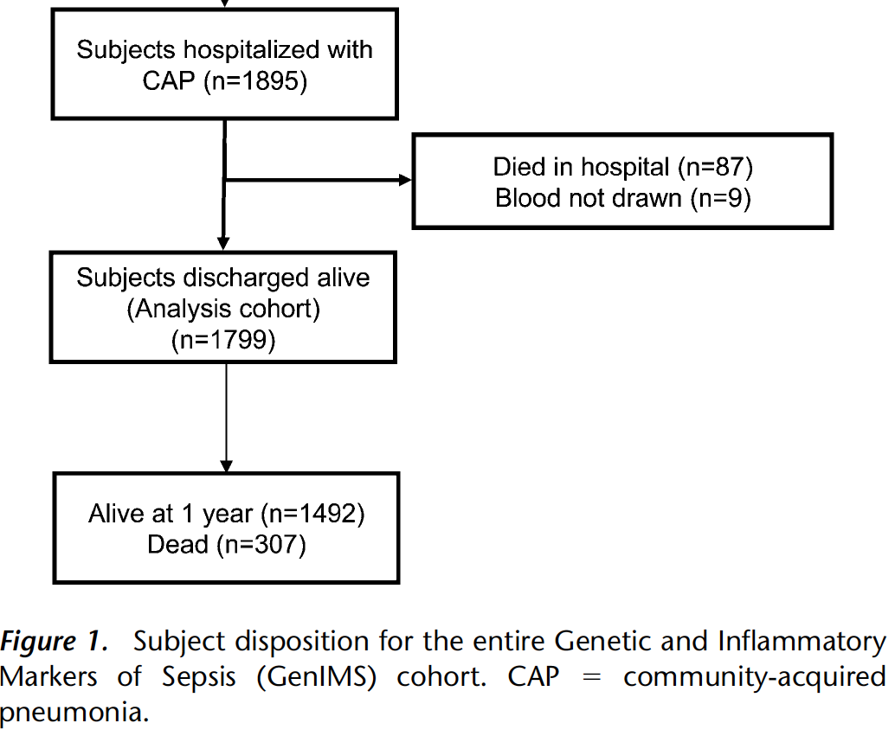
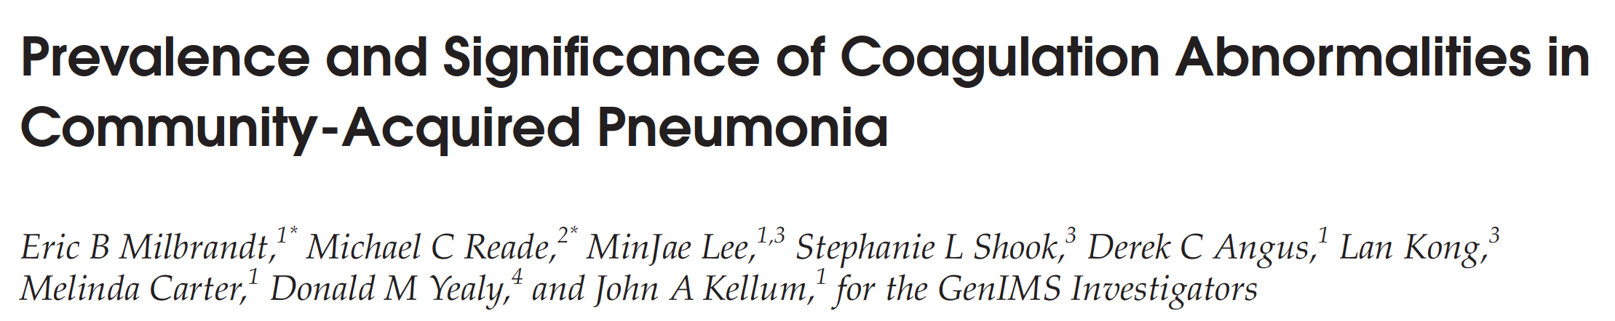
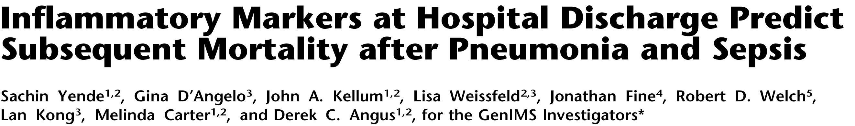
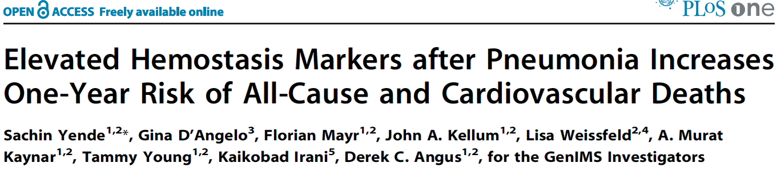
Systemic Inflammation: GenIMS
Abnormal vital signs (SIRS)
Fever: 0.8%
Tachycardia: 8.7%
Tachypnea: 2.3%
5%
16.2%
Kellum JA, et al. Arch Intern Med 2007; 167: 1655-63.
Millbrand EB, et al. Mol Med 2009; 15: 438-445
2. Yende S, et al. AJRCCM 2008; 177: 1242-7.
3. Yende S, et al. PLoS ONE 2011; 6: 847.

Slide 14
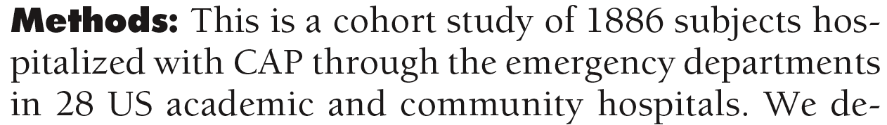
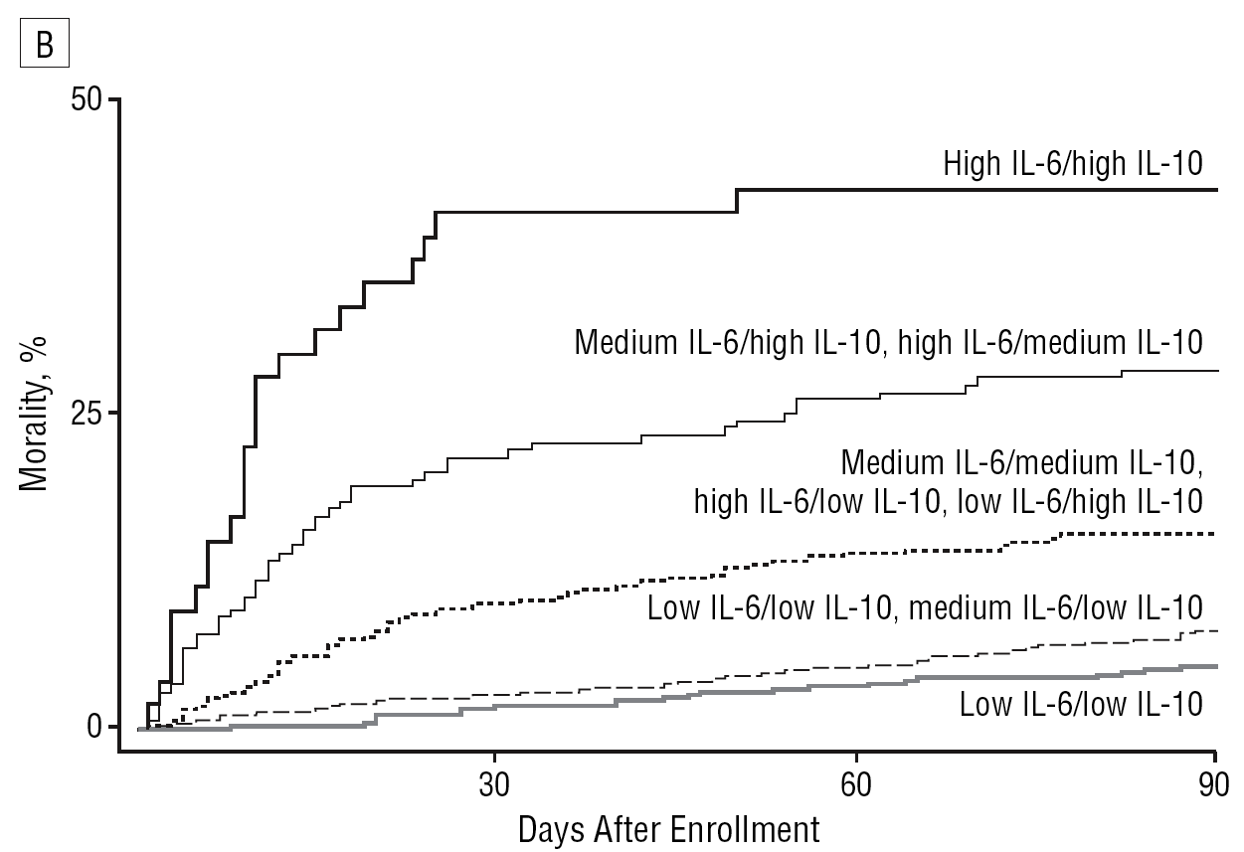
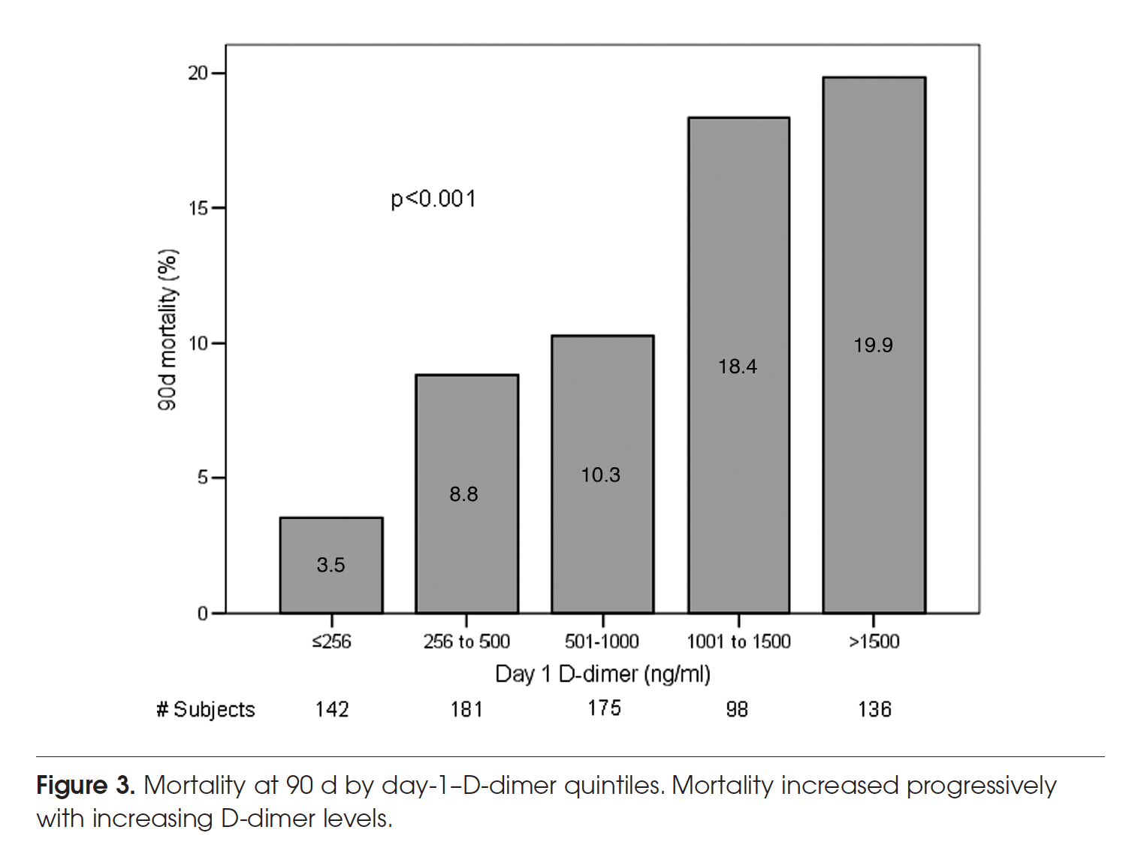
Hospital Admission ➔30-90 D Outcome
D- dimer
Hospital admission IL-6/IL-10
Arch Intern Med 2007;167:1655-1663.
Mol Med 2009; 15: 438-445

Slide 15
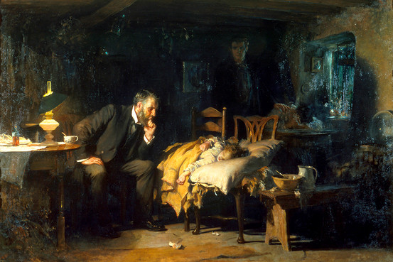
Clinical Criteria
Clinical criteria for systemic inflammation
  Fever
  Leukocytosis
  Tachypnea
  Tachycardia
Traditional pathophysiological model of pneumonia
Clinical criteria for “Syst. Inflammatory Response Syndrome”
  Duration of biologically significant (damaging
  to the host) systemic inflammation
=
A doctor tends to a mortally ill child in Sir Luke Fildes’s 1891 painting ‘The Doctor.’

Slide 16
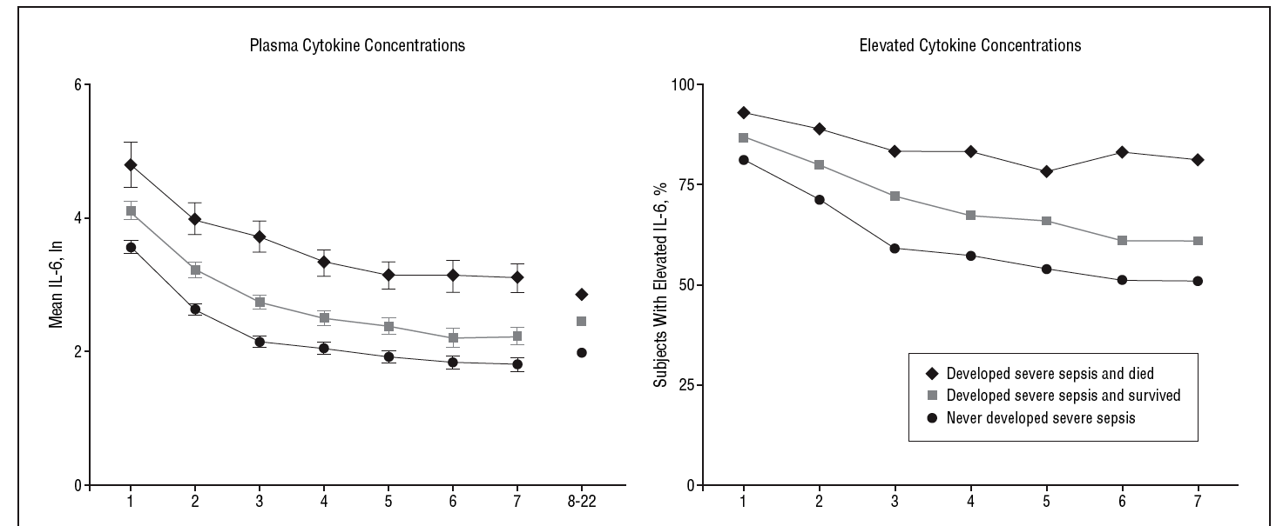
Clinical ≠ Biological Resolution
N = 1,463
Natural log
SIRS
resolution
Inflammatory cytokine elevation persisted for weeks after resolution of clinical signs of inflammation (SIRS), irrespective of initial severity
Argument: are they important for lung repair or damaging to the host?
Arch Intern Med 2007;167:1655-1663.

Slide 17
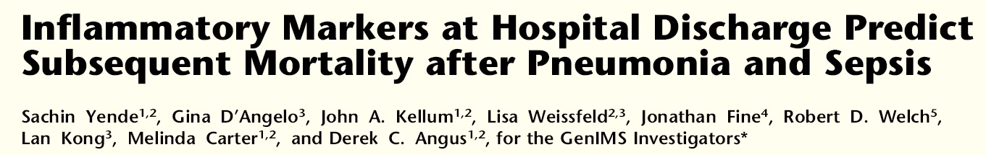
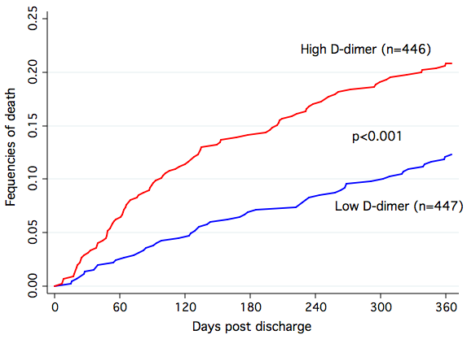
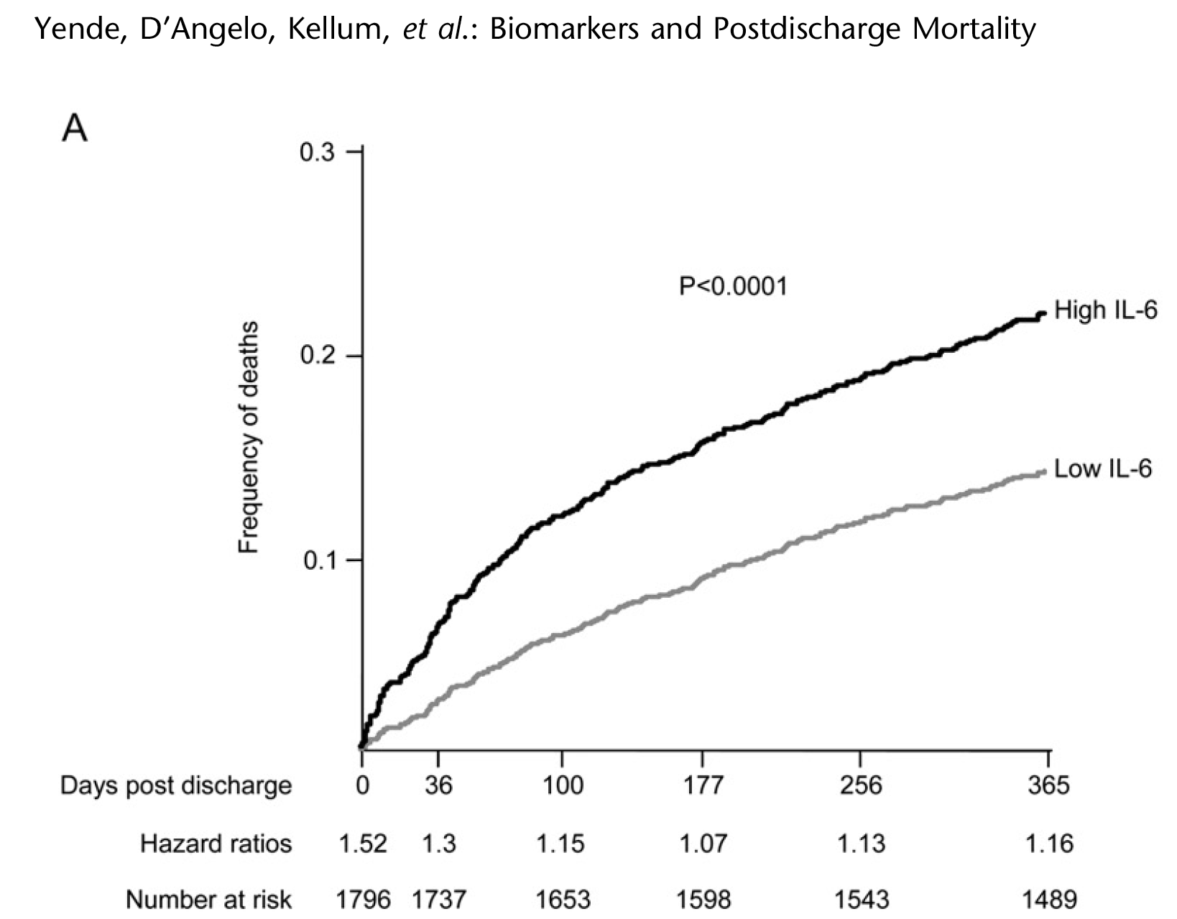
Hospital discharge IL-6
Hospital discharge
D-dimer
AJRCCM 2008; 177: 1242-7.
PLoS ONE 2011; 6: 847

Slide 18
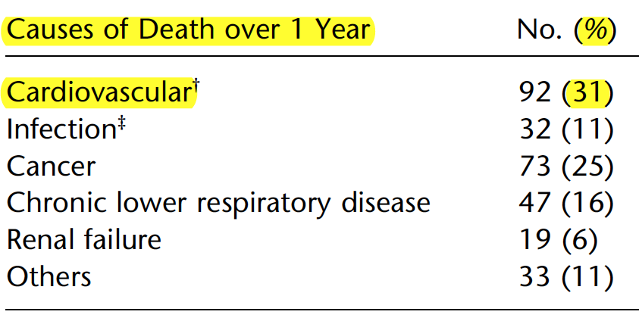
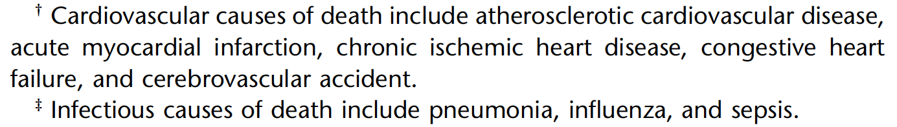
Causes of Death over 1 Year
60% without pre-existing CV disease
Yende S, et al. AJRCCM 2008; 177: 1242-7.

Slide 19
Teachable Moments
GC Rx ► central pathogenetic mechanism
Short-term benefits: ▲ in sicker pts
Long-term survival – important outcome
Early initiation of treatment – important
Clinical criteria inadequate
Low-grade subclinical SI at hsp DC
Academic Freedom Saves Lives

Slide 20
Community-acquired Pneumonia
How the updated pathophysiological model
may impact the design of GC Rx protocol

Slide 21

Within the new pathophysiological model, the duration of glucocorticoid treatment directed at achieving clinical resolution should be deemed inadequate.
A longer duration of glucocorticoid treatment —similar to those for ARDS and Pneumocystis jirovecii pneumonia — would maximize the improvement in morbidity and mortality during and after hospitalization.

Slide 22
GC Rx RCTs over time : 1970-2016
Daily Dose* | Duration | Effect On Inflammation
120 mg/kg | 24-48 h | None – to - transient reduction
0.5-2 mg/kg | 3-7 days | Reduction during Rx➔ rebound
1-2 mg/kg | 21-28 days | Reduction during Rx* ➔ w/o rebound
Dictated by faulty laboratory model
Systemic Inflammation
Directed to ≈ clinical resolution
Directed to ≈ biological resolution
Limited data from ARDS trials (N = 322)
  JAMA 1998; Chest 2007; EJCDT 2013
No data available for Pneumocystis J.
1970
1980
1990
2015
1990 – 2016*
Day
* Methylprednisolone equivalent

Slide 23
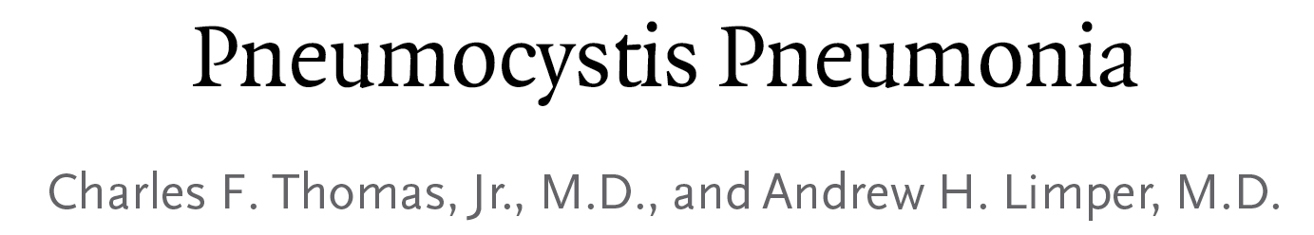
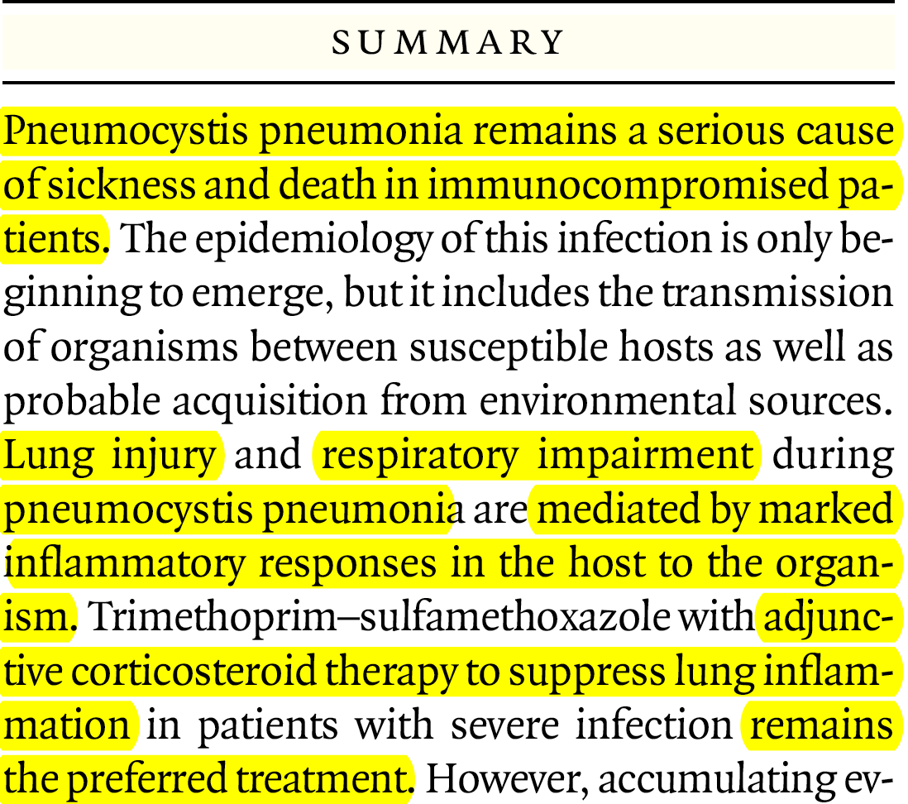
Pneumocystis Jiroveci Pneu.
* Prednisone 80mg, 40mg, 20mg

Slide 24
Need for M. Ventilation
Death at 3-4 months
6% vs. 16%
18% vs. 27%
The Cochrane Library 2015, Issue 4

Slide 25
CSP #574 Treatment Protocol
Bolus
Achieve
anti-
inflammatory
response
Maintain
anti-
inflammatory
response
Taper to avoid
rebound
Taper
Secondary prevention:
  Infusion (in ICU) to avoid glycemic variability
  Infection surveillance for early identification of NI
  Tapering over 6 days to avoid rebound
Academic Freedom Saves Lives

Slide 26
Prolonged Glucocorticoid Treatment in Patients
Hospitalized with
Community-acquired Pneumonia
Literature Update
February 2017

Slide 27
Experimental Pneumonia
GC Rx vs. placebo = significant
  ▼ circulating and pulmonary IC levels ¹⁻⁶
  ▼ histopathological severity score ^{2-4,6,7}
  ▼ pulmonary bacterial burden ^{2,6}
Large study – mice E. coli pneumonia
  ▼ risk of death following challenge with both low or high organisms load ¹
Others reported improved outcome
  in severe and not mild pneumonia ^{5,7}
1. Intensive Care Med 2007;34:568-77. - 2. Eur Respir J 2008;32:1037-46. - 3.T he Journal of infectious diseases 2008;198:1180-8. 4. FEMS Immunol Med Microbiol 2011;62:182-9. - 5. Intensive Care Med 2012;38:2063-71. - 6. Am J Pathol 2013;183:868-80.
7. The Journal of infectious diseases 2013;209: 1459-68

Slide 28
Randomized Trial (N=13)
CAP – Not severe
7 RCTs (N= 1627)
CAP - Severe
6 RCTs (N= 390)

Slide 29
Randomized Trial (N=13)
Results positive for outcome: primary, secondary, none

Slide 30
Duration of Treatment
1-7 days (1 had tapering)
Directed to ≈ clinical resolution
Tapering

Slide 31
Investigated Drug
Hydrocortisone 6
Prednisolone 4
Methylprednisolone 2
Dexamethasone 1

Slide 32
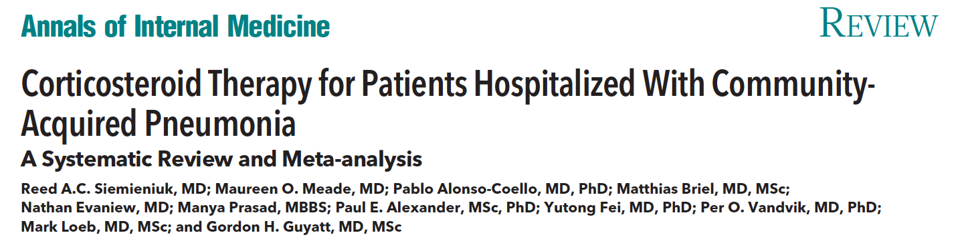

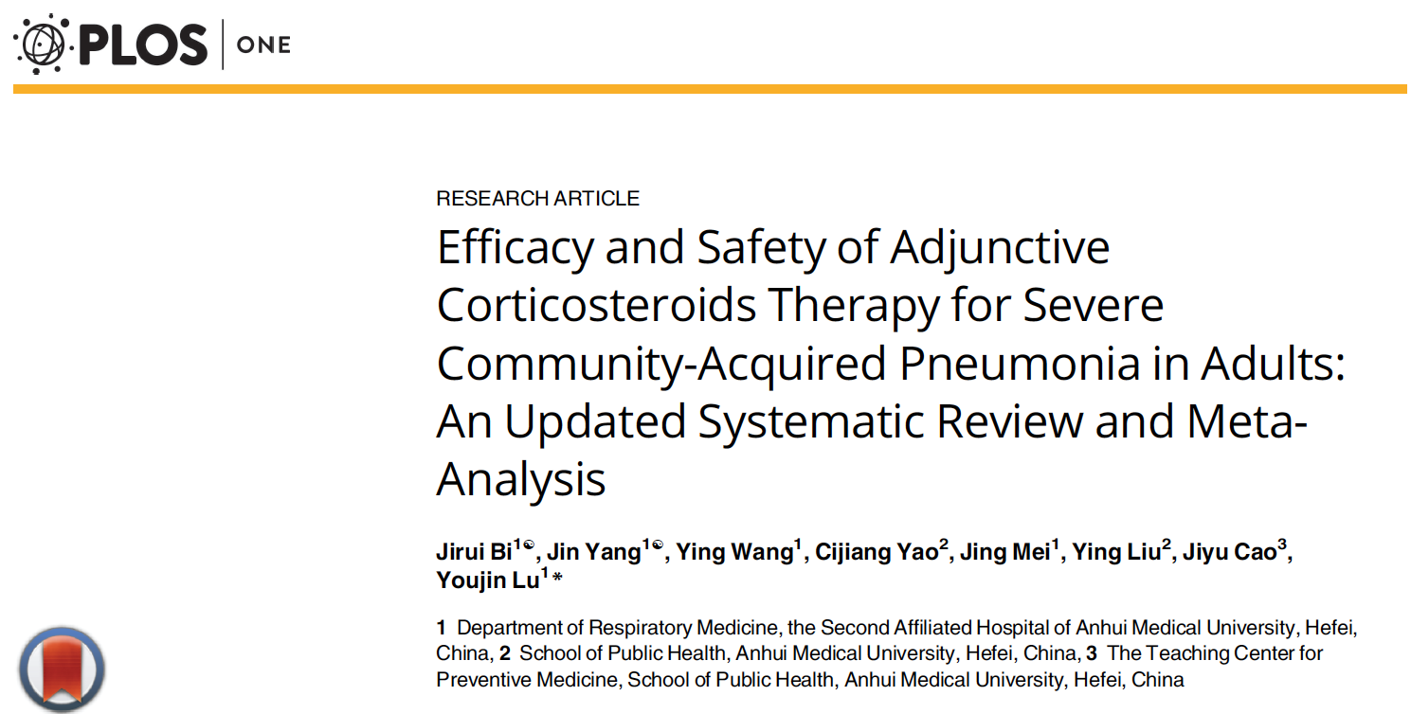
CAP- GC Rx - Meta-analyses

Slide 33
Estimation of absolute effect = from the median absolute effect of control groups of included studies

Slide 34
CAP - Hospitalized : Mortality
Mortality 7.9% vs. 5.3%; RR=0.67 (0.45 - 1.01)
Moderate evidence = CI crossed 1; possible subgroup effect.
Ann Intern Med. 2015;163:519-528

Slide 35
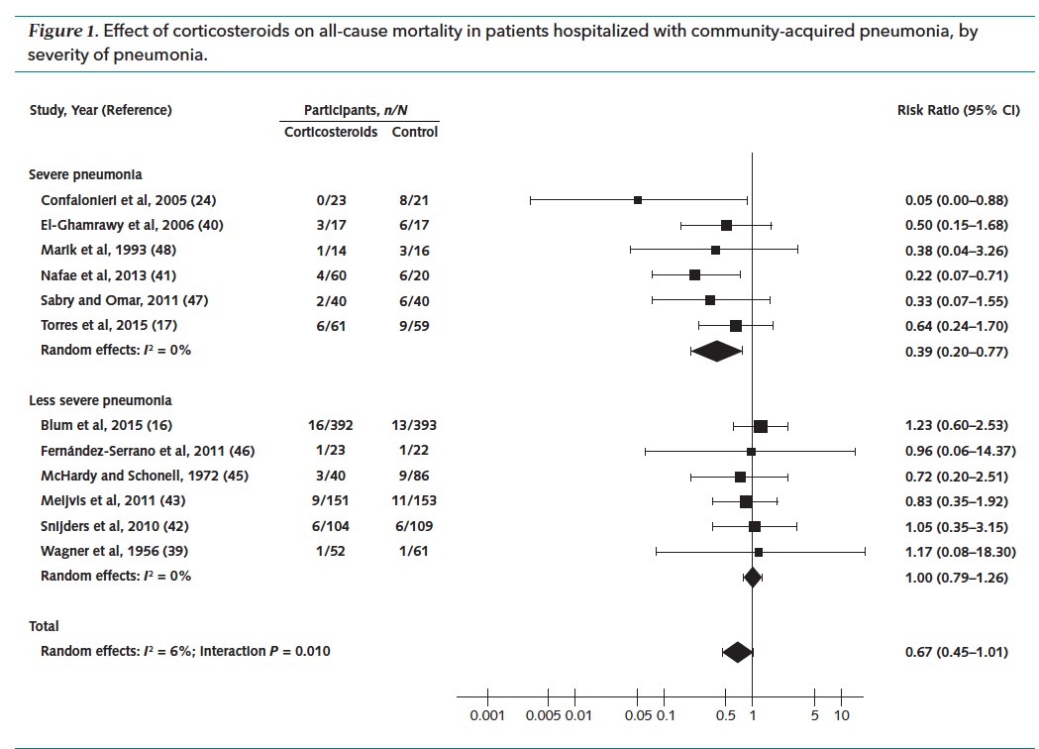
CAP - not severe: Mortality
RR = 1.00 (CI, 0.79 - 1.26); I² = 0%
N=
762
N=
824
Ann Intern Med. 2015;163:519-528

Slide 36
CAP – Severe: Mortality
RR = 0.39 (CI, 0.20 - 0.77); I² = 0%
N=
213
N=
177
Ann Intern Med. 2015;163:519-528

Slide 37
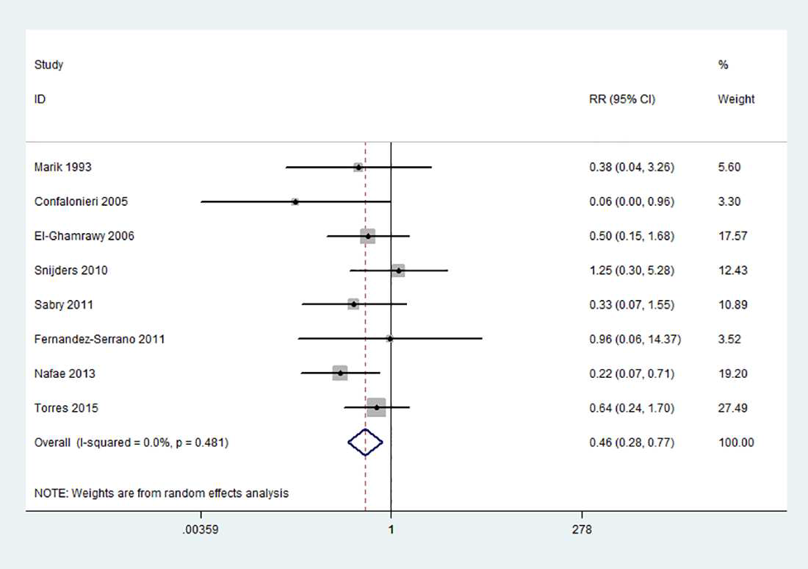
CAP – Severe: Mortality
8 RCTs, RR = 0.46 (CI, 0.28 - 0.77) p = 0.003, I² =0%

Slide 38
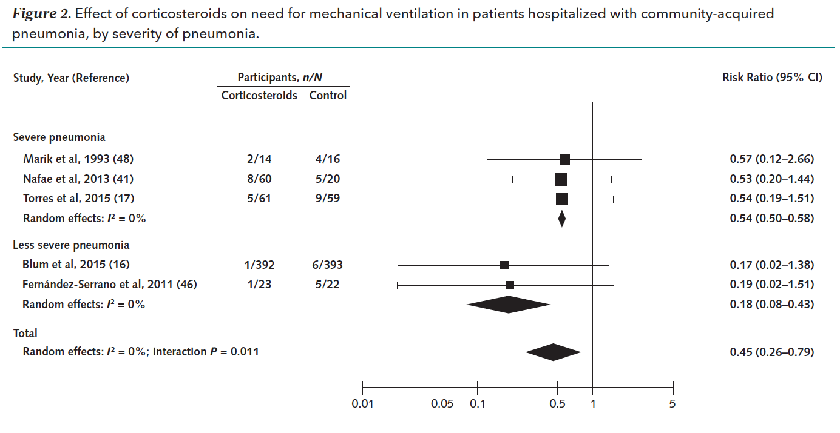
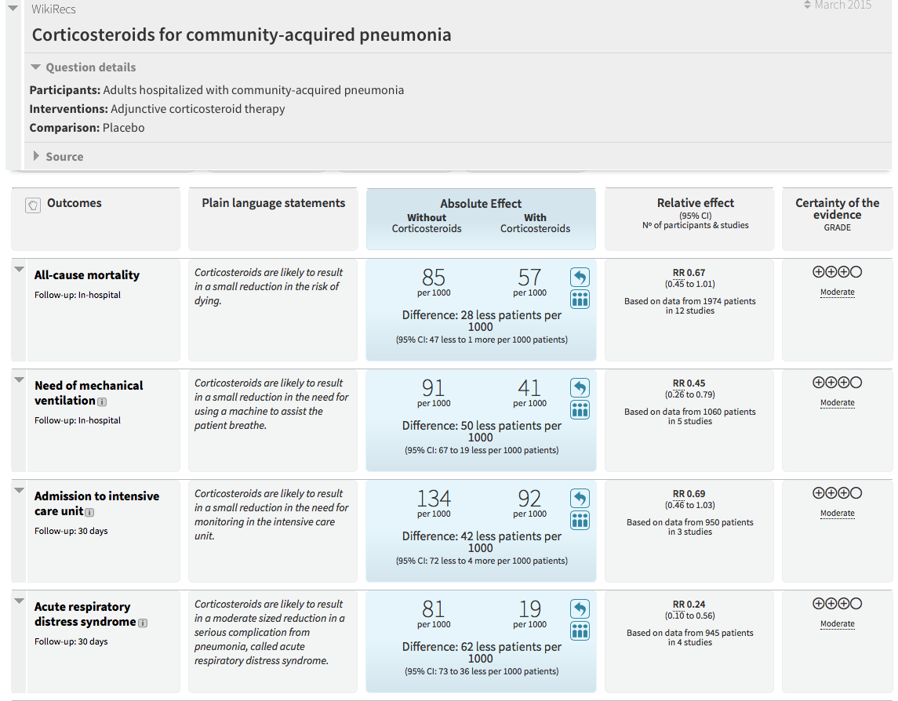
Progression to Mech. Vent.
RR = 0.45 (CI, 0.26 - 0.79); I2 = 0%
Moderate evidence = small No. of events (46)
17/550
29/510
Ann Intern Med. 2015;163:519-528

Slide 39
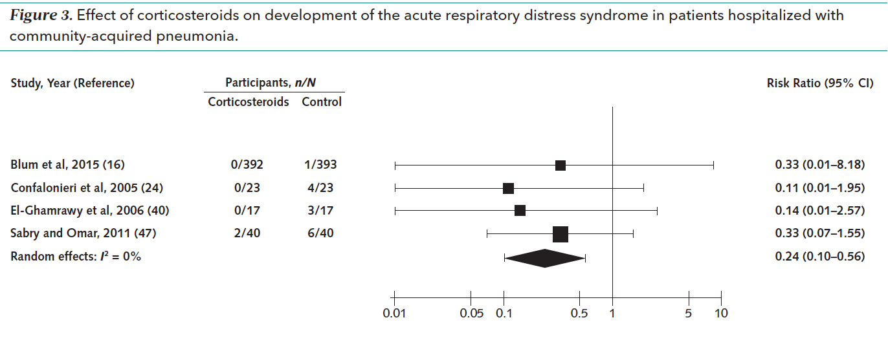
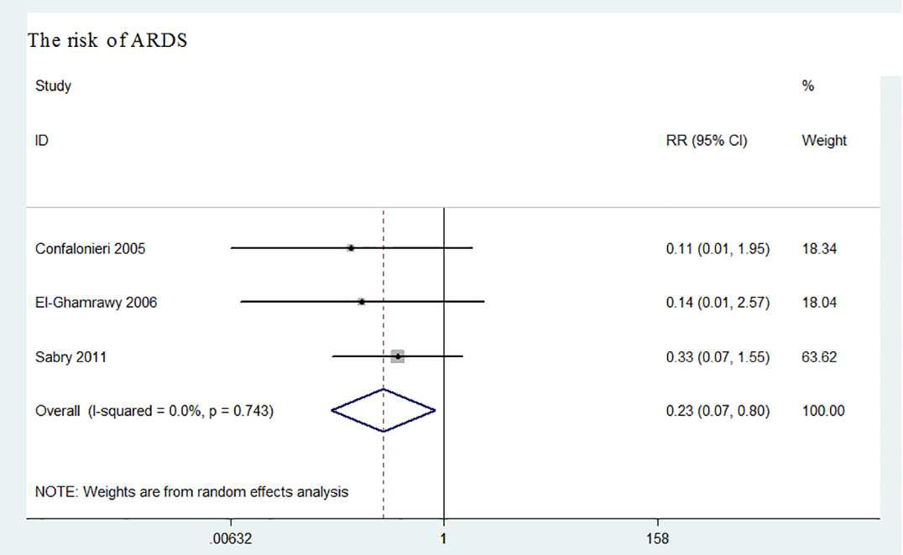
Progression to ARDS
Overall vs. pts with severe CAP
Ann Intern Med. 2015;163:519-528

Slide 40
Duration of Hospitalization
Mean difference, 1.00 day (CI, 1.79 - 0.21); I2 = 0%
High certainty

Slide 41
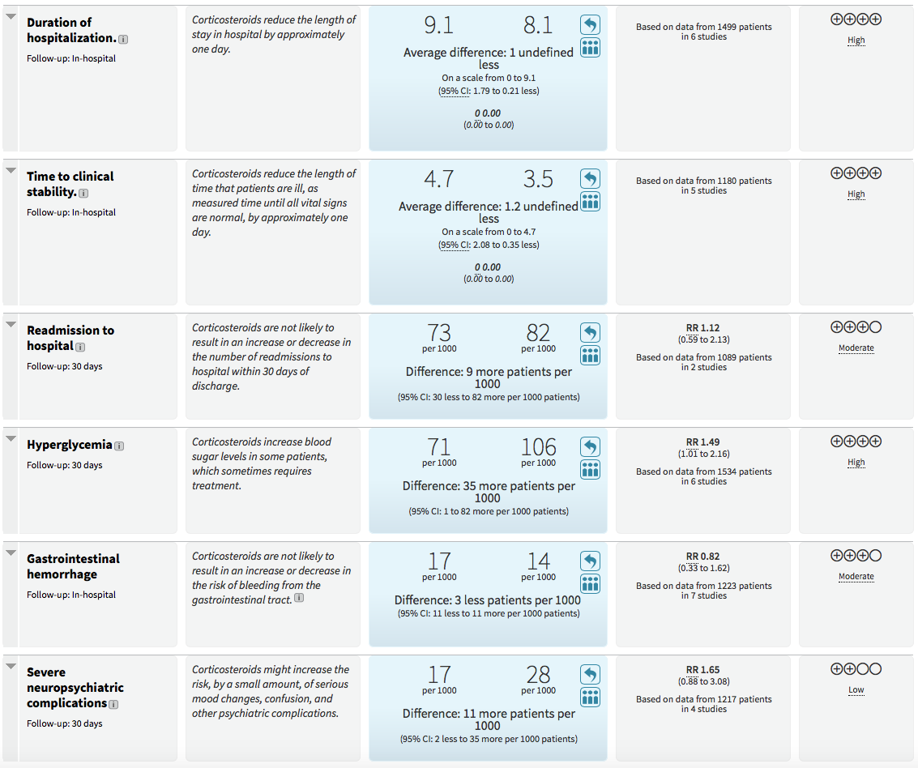
Complications: Hyperglycemia
RR, 1.49 (CI, 1.01 - 2.19); I2 = 6%
High certainty

Slide 42
Prolonged Glucocorticoid Treatment in Patients
Hospitalized with
Community-acquired Pneumonia
What to do?

Slide 43
CAP – admitted to the ward
Hospital Admission
  Prednisone, 40mg oral daily for 7d ¹ – taper over 6 days [risk/benefit]
  CRP and D-dimer - Monitor CRP daily
  Assess ASCVD risk factors > optimize Rx
Hospital DC
  CRP, D-dimer- instructions on AI – ASA [Dr. Oz]
Outpatient
  RTO in 2-4 weeks > hsCRP- D-dimer- consider Coronary Ca+ scan
  RTO Q 3 months
1. Blum 2015: Prednisone, 50mg oral daily for 7d

Slide 47
Registered Randomized Trials
Acronym (Country) | Identifier | Patient population | Intervention/ Comparison | Primary outcome | Target sample size | Start
ESCAPe (United States) | NCT 01283009 | Hospitalised veterans with severe CAP | Methylprednisolone for 20 days vs Placebo | All-cause mortality at day 60 | 1450 – slow recruitment Stop at 580 pts | January 2012
Santeon-CAP (Netherlands) | EUCTR 2011-004566-14-NL | Hospitalised patients with CAP | Dexamethasone vs Placebo | Length of hospital stay | 600 | January 2012
Peking Union (China) | NCT 02552342 | Severe CAP | Methylprednisolone vs Saline | All-cause mortality at day 30 | 610 | May 2015
CAPE COD (France) | EUCTR2015-001239-19-FR NCT02517489 | Severe CAP | Hydrocortisone for 8-14 days vs Placebo | All-cause mortality at day 28 | 1200 | August 2015
AD-SCAP (Netherlands) | EUCTR2015-002340-14-NL | Intensive care patients with severe CAP | Adaptive trial with 7 arms; one arm includes Hydrocortisone | In-hospital mortality up to day 60 | 4000 | September 2015

Slide 48

GRAZIE
MARCO

Slide 50
IPD – meta-analysis
CAP – Not severe
4 RCTs (N= 1357)
CAP - Severe
2 RCTs (N= 166)

Slide 51
IPD meta-analysis
30 day mortality:
  5.0% vs. 5.9% - OR = 0.75 (0.46-1.21); p=0.24
Time to clinical stability
  Diff: -1.03 days; (-1.62, -0.43); p=0.001
Length of hospital stay
  Diff: -1.15 days; (-1.75, -0.55); p<0.001
Hyperglycemia requiring insulin*
  22 % vs 12 % - OR = 2.15 (1.60 – 2.90); p<0.001
CAP-related re-hospitalization < 30 days
  50% vs 27% - OR = 1.85; (1.03-3.32); p=0.04
* raise in glucose level was only transient

Slide 52
IPD meta-analysis -1
TTCS: T < 37.8 C ; HR < 100 bpm; RR= < 24 bpm; SBP > 90mm Hg ; MS= baseline; intake = p.o. ; O2 sat > 90% on RA

Slide 53
IPD meta-analysis-2

Slide 54
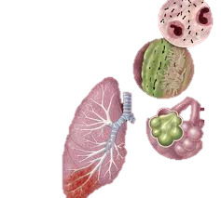
Community-acquired Pneumonia
Updated
Pathophysiological Model

Slide 55

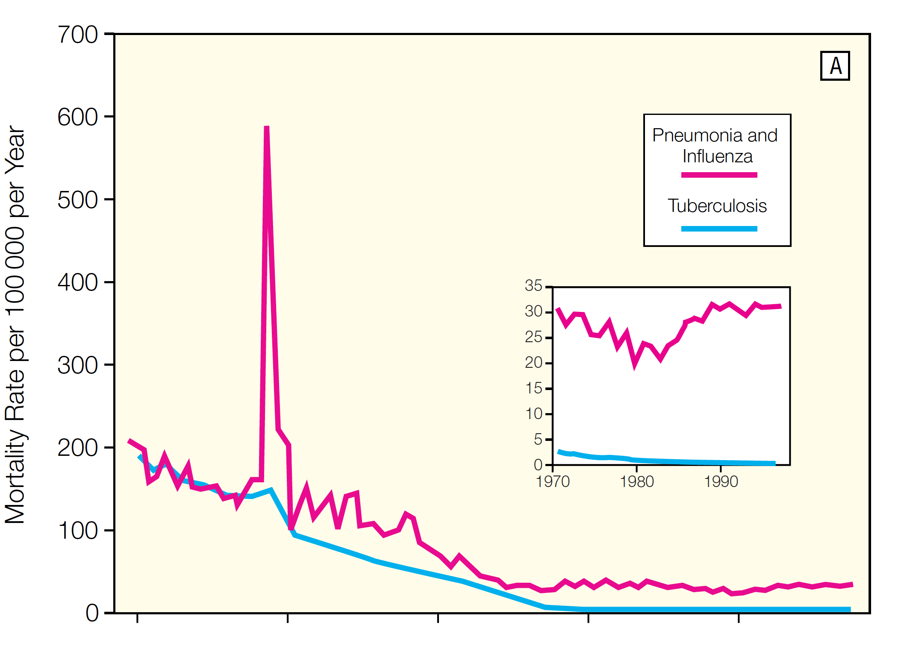

1918

Slide 56
Components of Pneumonia
Disease Elements
Temporal Course
Pneumonia
Pathogens
Acute
Chronic
Inflammation
Pneumonia
Academic Freedom Saves Lives
Notes:
After this brief introduction on the limitations of ATB RX – we move to the “Temporal Course” of Pneumonia.

Slide 57


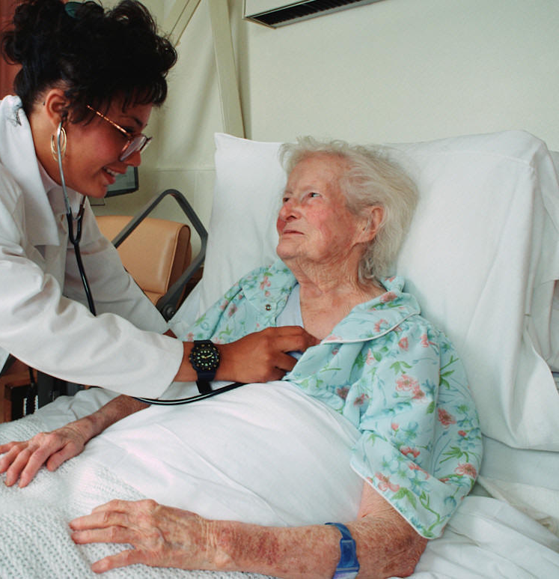



Temporal Course – Acute
5-6 million/year
5%
87%
Ward
6.5%
≈ 55-65,000 deaths/yr
13%
18%
1.1 million/year
ICU

Slide 58
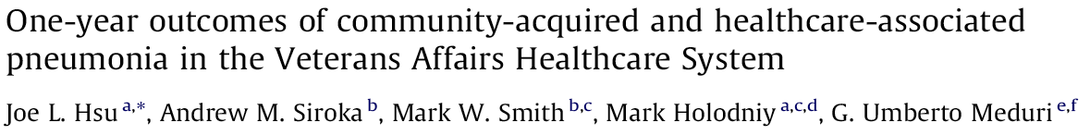
Temporal Course – Chronic
VA 2006 – 1 year mortality
Is the increased mortality related to age and comorbidities?
25%
25%
(N = 14,163)
(N = 3,727)

Slide 59

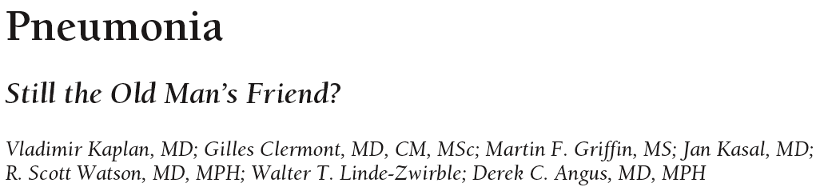
Temporal Course – Chronic
for Age And Comorbidities
(N = 158,900)
Continued excess adjusted mortality
Continued excess adjusted mortality after:
eradication of pathogens (day 1-3)
completion of antibiotic treatment (day 7-10)
hospital discharge (day 7-14)
Hsp DC
Kaplan V,, et al. Pneumonia: still the old man's friend? Arch Intern Med 2003;163:317-23.

Slide 60
CAP 1-year Mortality
≈
20-30%
Yende S, et al. Inflammatory markers at hospital discharge predict subsequent mortality after pneumonia and sepsis. Am J Respir Crit Care Med. 2008; 177: 1242-7
Hsu JL, et al. One-Year outcomes of community-acquired and health care-associated pneumonia in the Veterans Affairs health care system. 2011; 15: e382-e387
Kaplan V,, et al. Pneumonia: still the old man's friend? Arch Intern Med 2003;163:317-23.

Slide 61
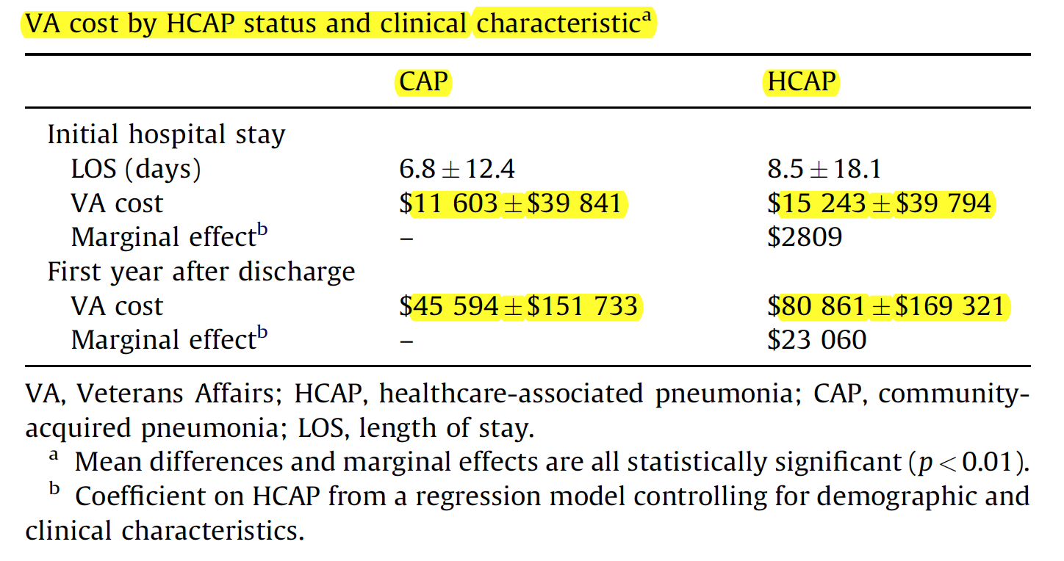
1-year Outcome – Cost
Cost first year after discharge
  > 4 times initial hospital cost for CAP/HCAP
X 4
X 5

Slide 62
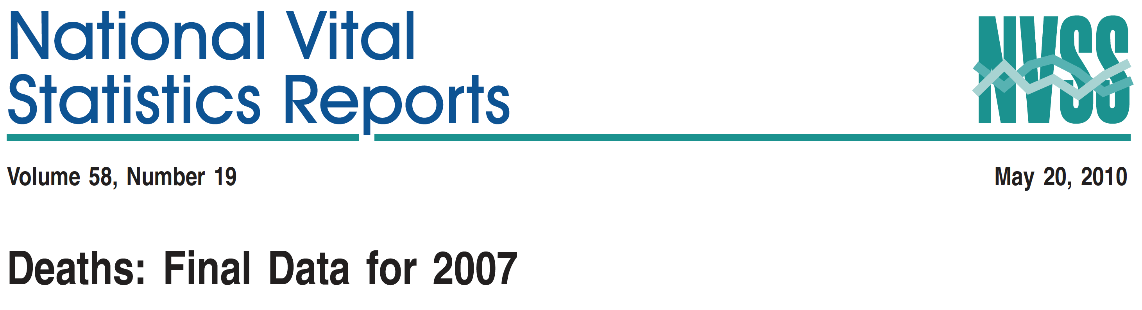

Acute Mortality
1-year Mortality
8
7
6
5
4
3
2
1
1.100,000 x 0.2 = 220,000*
3

Slide 63
Conclusions -1
Crude 1- year mortality (20-30%)
  Third leading cause of death in the US
  > 70 % die after initial hospital discharge
  Higher in those with > 1 comorbidity
Crude post hospital discharge mortality
  Similar for patients with and without severe CAP
Excess 1- year mortality (12%)*
  Adjusted for age, gender, and comorbidities
  Greater in those with < 1 comorbidity
* Excess = CAP – control 1-year mortality = 12 % (Kaplan et al. AIM. 2003; 163:317)
Data generated by study that do not differentiate CAP from HCAP

Slide 64
Factors affecting Treatment Response
Glucocorticoid Treatment -1
Timing of Initiation
Prevention of Complications*
Infection Surveillance
Prevent – Monitor and Treat Rebound Inflammation
Minimize Glycemic Variability
Minimize Paralysis
Dosage
Duration of Treatment
Glucocorticoid Treatment -2
* Pts. on ETI-MV

Slide 65
Teachable Moments
GC Rx ► central pathogenetic mechanism
Short-term benefits: ▲ in sicker pts
Long-term survival – important outcome
Early initiation of treatment – important
Academic Freedom Saves Lives

Slide 66
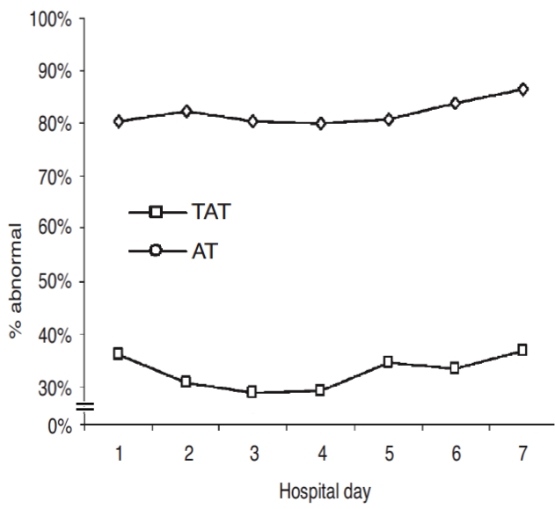
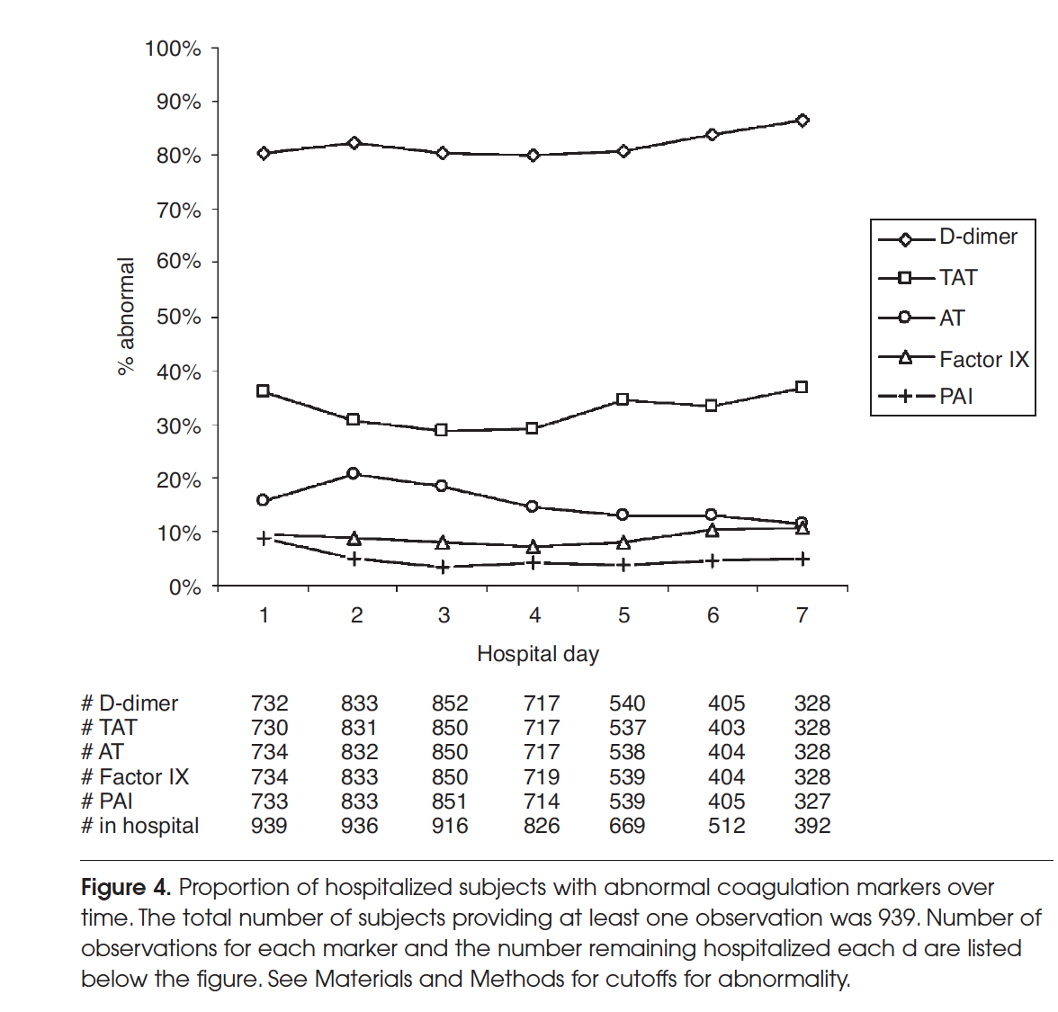
Hospital Admission ➔90d Outcome
Thrombin-Antithrombin Complex

