Slide 1
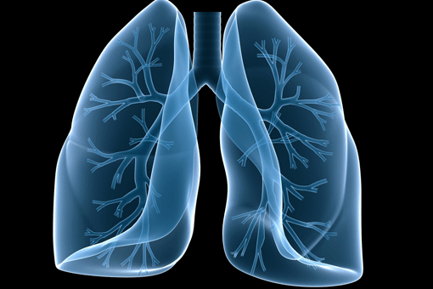
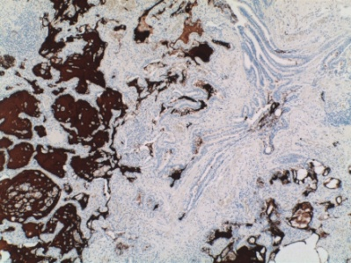
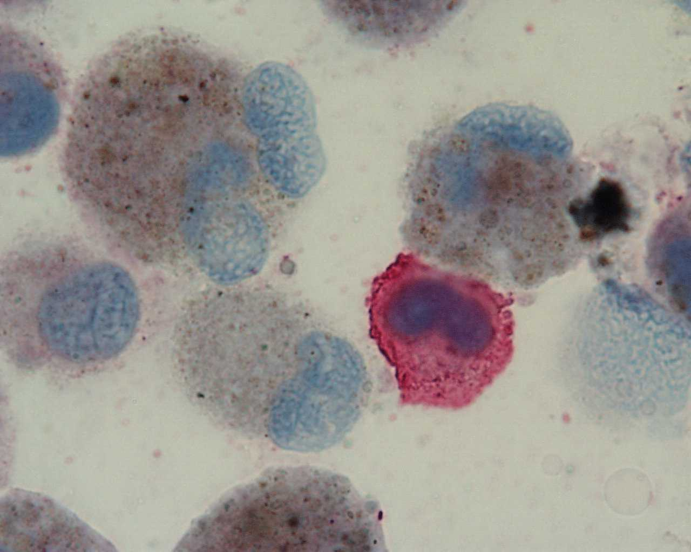
IPF:
Pathological and molecular features
Marco Chilosi, Verona

Slide 2
IPF
Pathology & Molecular Pathology
1. Diagnosis
2. Differential diagnosis
3. Prognosis 4. Research
- Pathogenesis
- Therapy

Slide 3
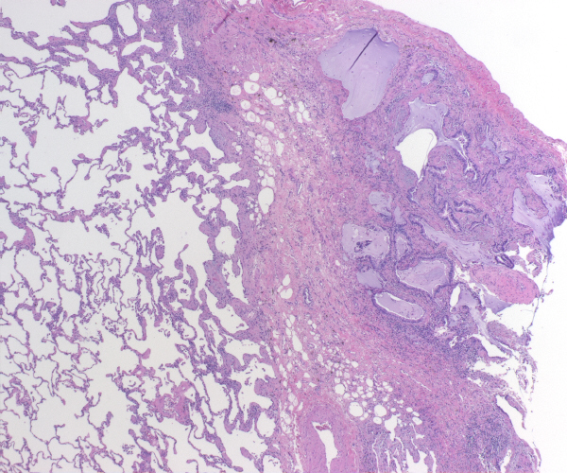
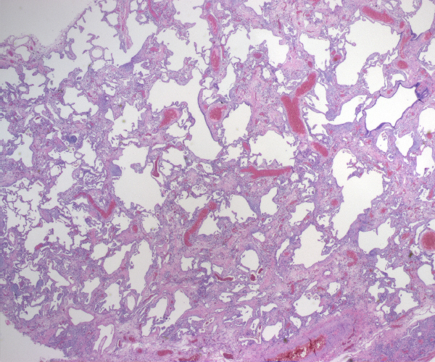

Slide 4
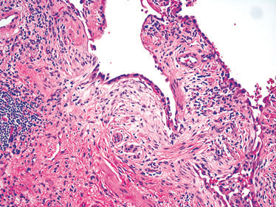
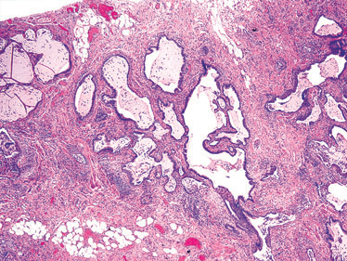

Slide 5
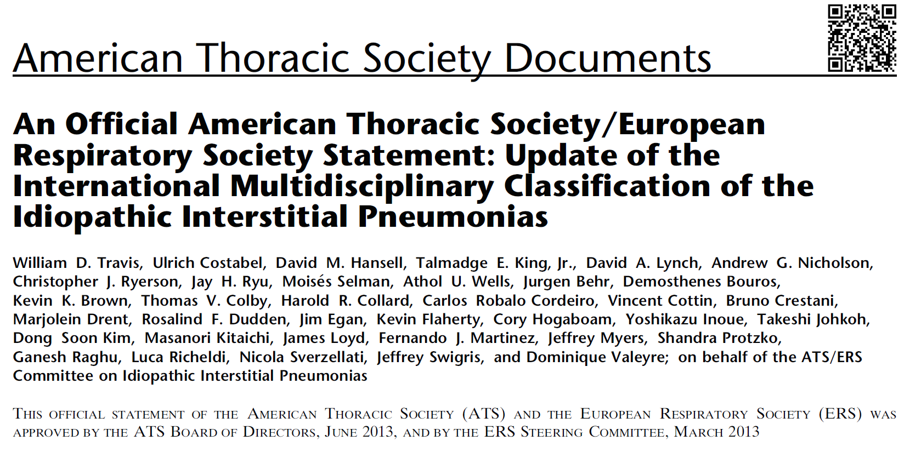
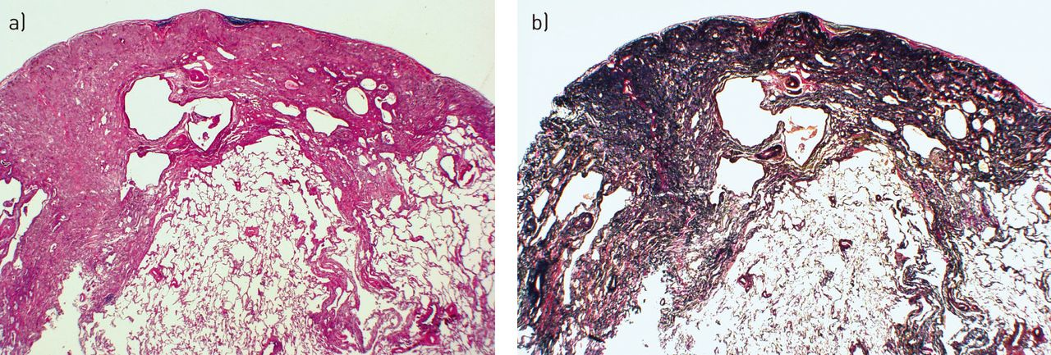

Slide 6
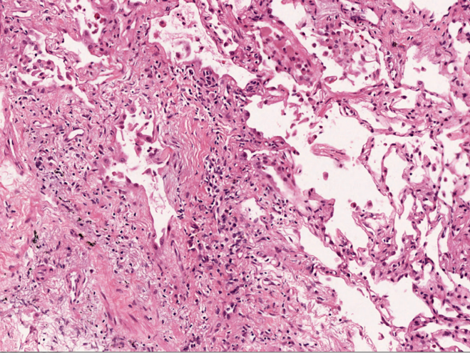
IPF
Pathology & Molecular Pathology
1. Diagnosis
2. Differential diagnosis
3. Prognosis
Biopsy
Surgical
Transbronchial
Cryobiopsy
MORPHOLOGY E&E

Slide 7
Surgical biopsy is dangerous
Respir Med 2006 Oct;100(10):1753-9.
Intern Med 50: 77-85, 2011)

Slide 8
Conclusion: Cryobiopsy is safe and has lower complication and mortality rates compared to SLB.

Slide 9
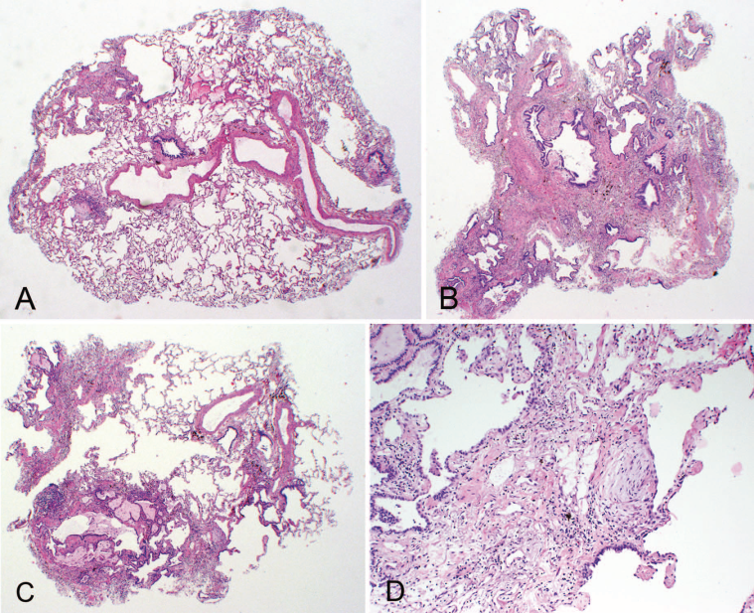

Slide 10
Am J Respir Crit Care Med Vol 183. pp 788–824, 2011

Slide 11
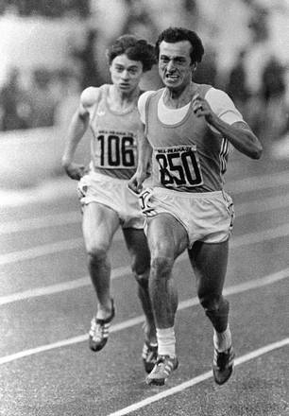
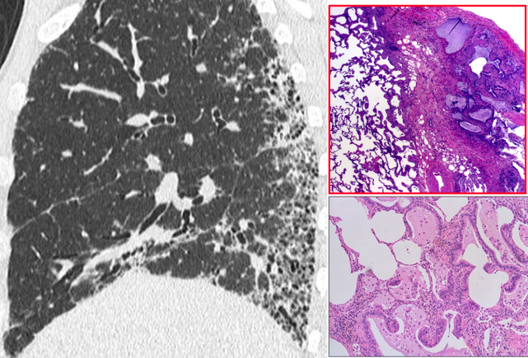
IPF
Pathology & Molecular Pathology
1. Diagnosis
2. Differential diagnosis
3. Prognosis
MORPHOLOGY vs IMAGING

Slide 13
AJR 2013; 200:W458–W467
Fibrosis without Honeycombing
FnoH

Slide 14
AJR:206, March 2016

Slide 15
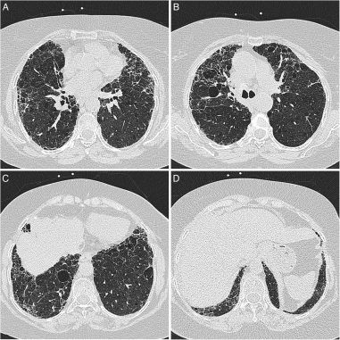
Walsh SLF, et al. Thorax 2015;0:1–7.
Interobserver agreement for the current ATS/ERS/JRS/ALAT CT criteria for UIP is only moderate among thoracic radiologists, irrespective of their
experience…..

Slide 16
AJR 2018; 210:1–8
CONCLUSION.
A substantial minority of cases cannot be confidently categorized according to current guidelines for IPF and differ diagnostically from the possible UIP and UIP CT categories. The term “inconsistent with UIP” is misleading and should be renamed.

Slide 17
Eur Respir J 2016; 47: 1189–1197

Slide 19
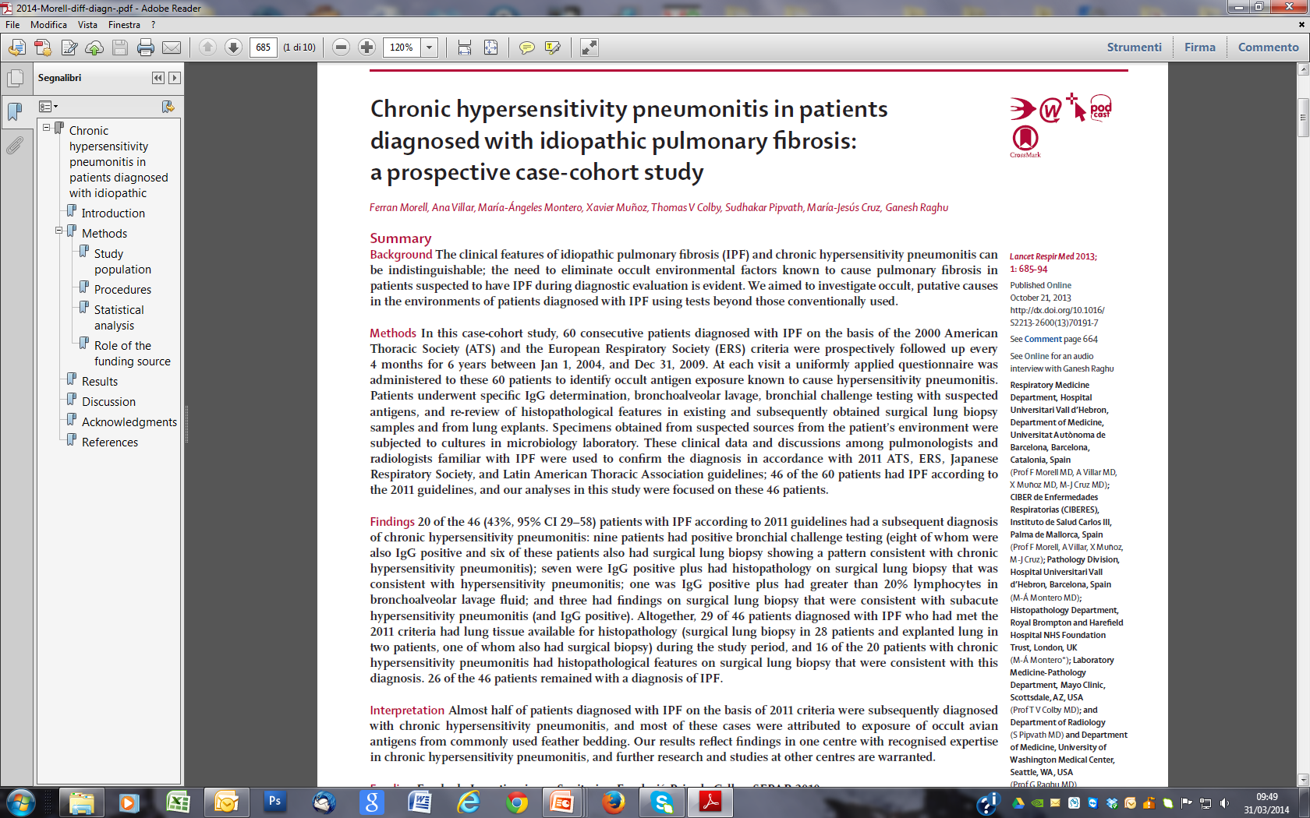

Slide 20
Improving histological diagnosis
New morphological criteria
New methods : Immunohistochemistry

Slide 22
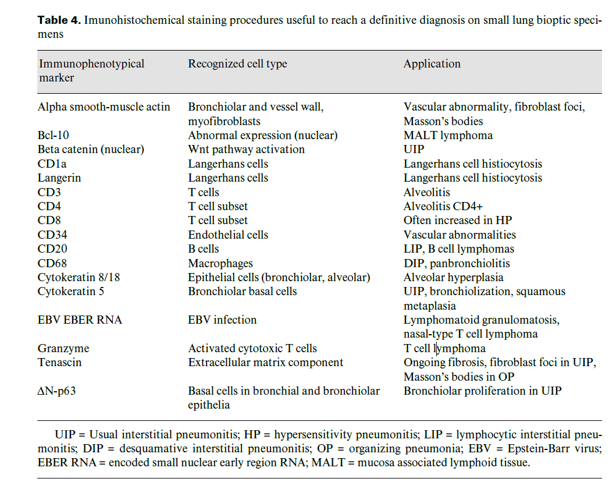

Slide 23
IPF
Pathology &
Molecular Pathology
1. Molecular Morphology
2. Genetic analysis
3. Gene Profiling 4. miRNA analysis
5. Proteomic analysis
- Pathogenesis
- Diagnosis
- Therapy

Slide 24
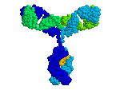
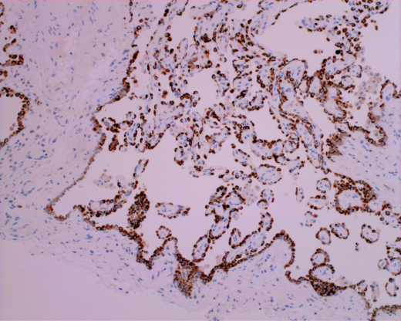
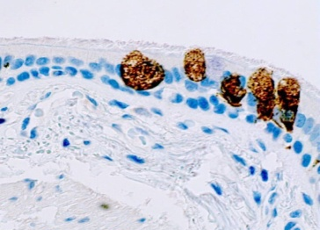
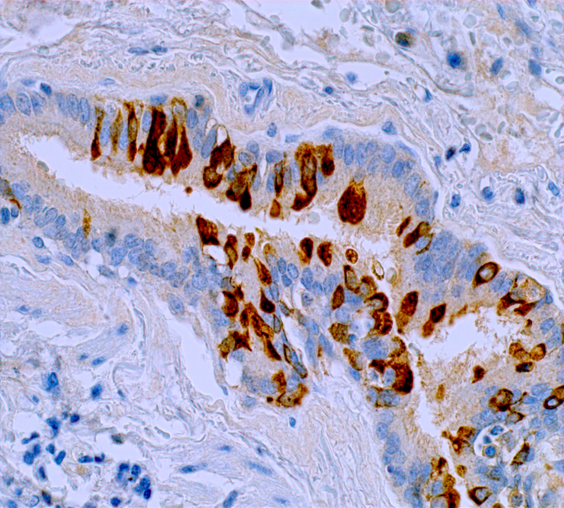
Immunohistochemistry In situ proteomic analysis
Epithelial cells
Alveolar: pneumocytes type I and II
Bronchiolar: basal cells, ciliated, neuroendocrine, Clara cells
CK 7
TTF1
Surfactant-Protein-A
Napsin-A
CD208
Cytokeratin 5/6
P40
MUC5AC
CC10
Pneumocytes
Basal cells
Goblet cells

Slide 26
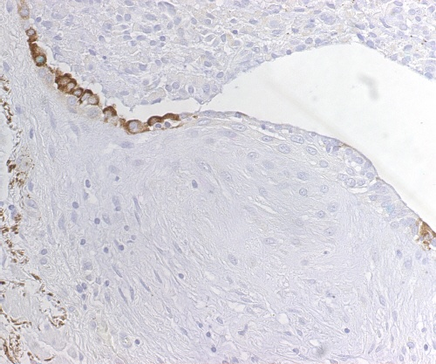
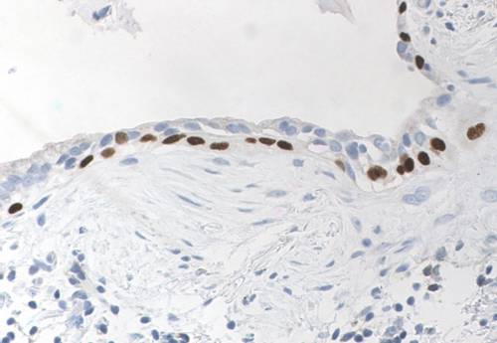
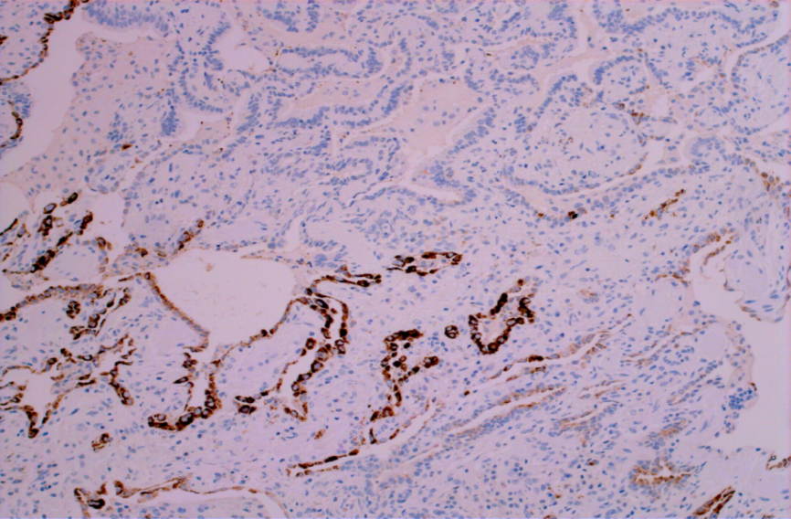
Fibroblast foci at abnormal bronchiolo-alveolar junctions
SP-A
ff
ff
ΔN-p63
Bronchiolar epithelium is a major target of injury in IPF
CD208

Slide 27
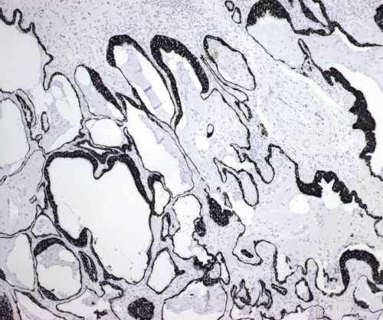
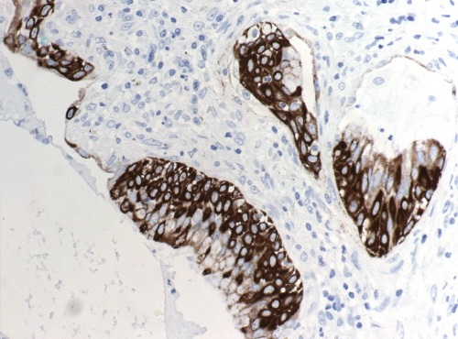
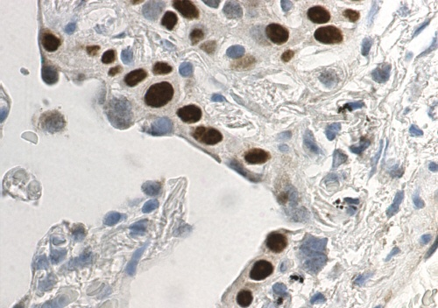
Honeycombing: bronchiolar dysplasia ?
CK8
Basal cell hyperplasia and atypia
CK5
ΔN-p63

Slide 28
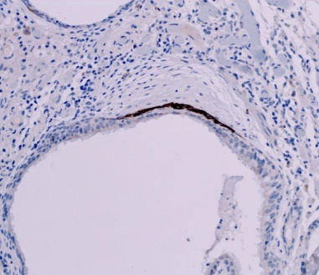
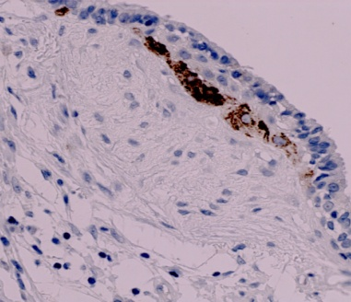
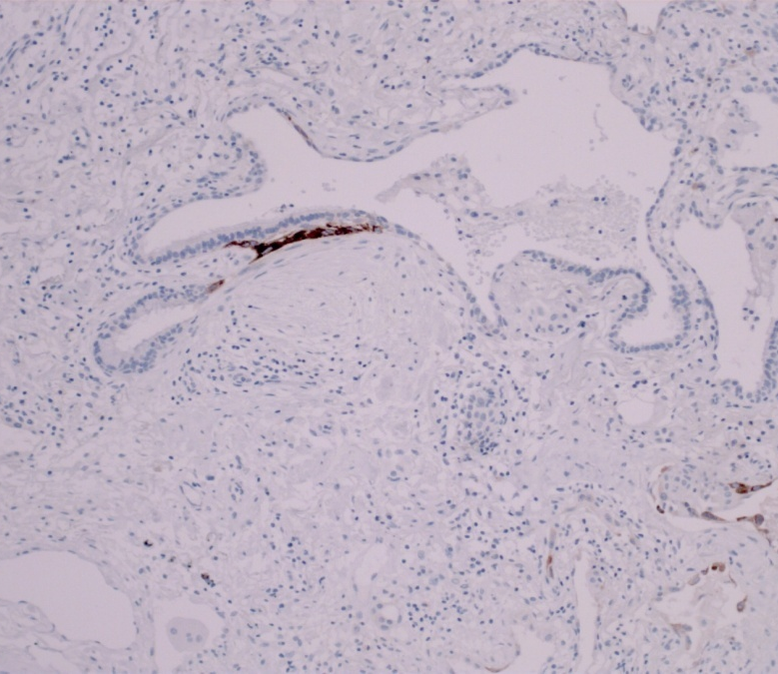
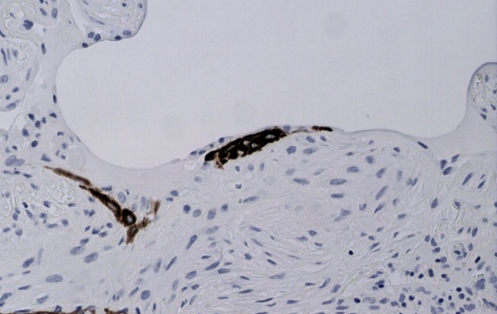
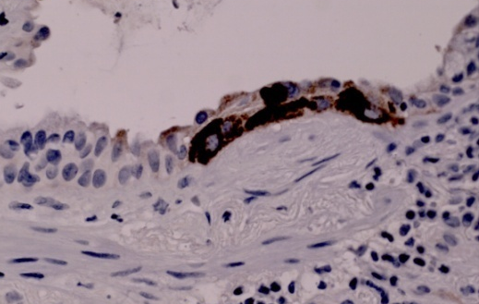
d
FF
FF
a
b
FF
e
FF
FF
f
FF
c

Slide 29
IPF
- nuclear expression of beta-Catenin in proliferative bronchiolar lesions and honeycoming.
- abnormal expression of WNT-target proteins
(MMP7, cyclin-D1)
in bronchiolar basal cells
Chilosi et al. Am J Pathol ;162: May 2003

Slide 30
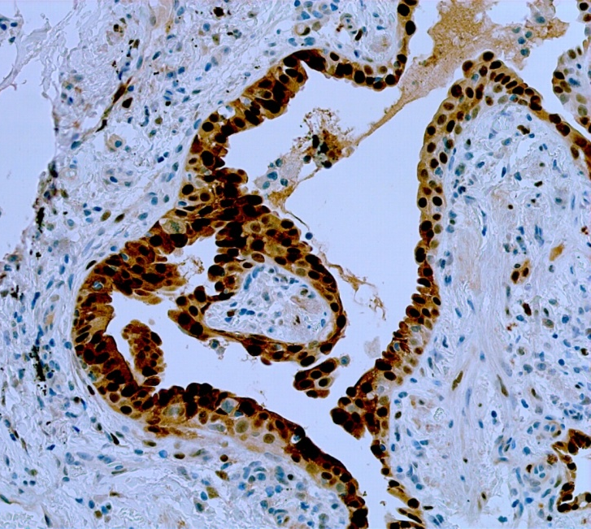
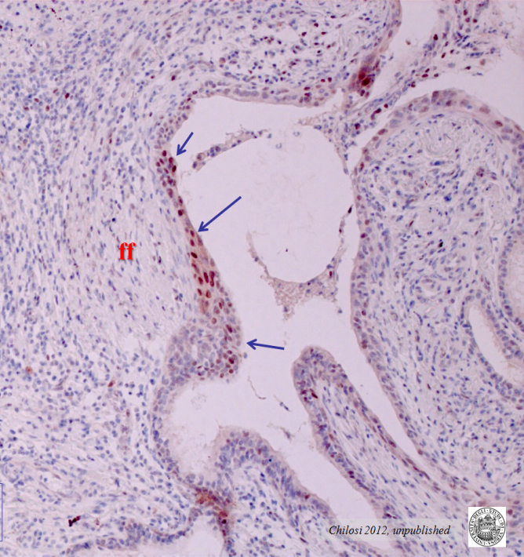
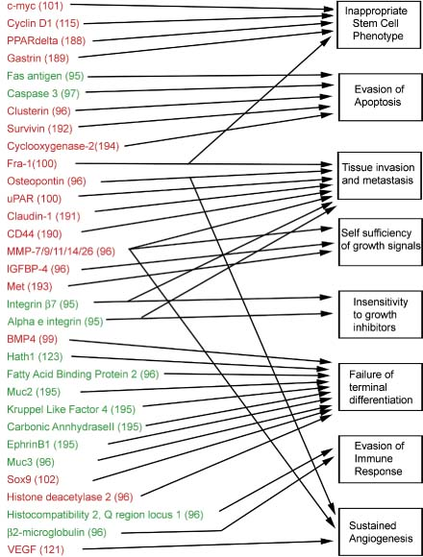
Cyclin-D1
C-MYC
Aberrant
WNT signaling

Slide 31
PLoS One. 2008 May 14;3(5):e2142
J Clin Invest 2009;119:772–787.
PNAS. 2010 ;107(32):14309-14
Respiratory Research (2016) 17:39
Ann Am Thorac Soc. 2016:S411-S416

Slide 32
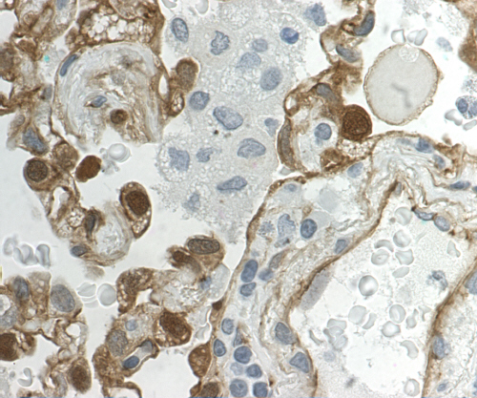
Much evidence suggests that the study of the molecular pathways regulating lung development and morphogenesis may provide important information regarding the pathogenesis of pulmonary diseases. Early phases of lung development are dependent on complex molecular networks that include a series of stimulatory and inhibitory pathways including Fgf, Egf, TGF/Activin, Wnt, Hedgehog, Hox, SOX, sprouty, and others.17–22 It is reasonable to hypothesize that these molecular pathways can in part be recapitulated during postnatal life, because the complex lung architecture can reform precisely after extensive damage, as observed in various pulmonary diseases.
American Journal of Pathology, Vol. 162, No. 5, May 2003

Slide 33
Here we show that beta-catenin signaling is required for the formation of the distal, but not the proximal, airways.
beta-Catenin

Slide 34
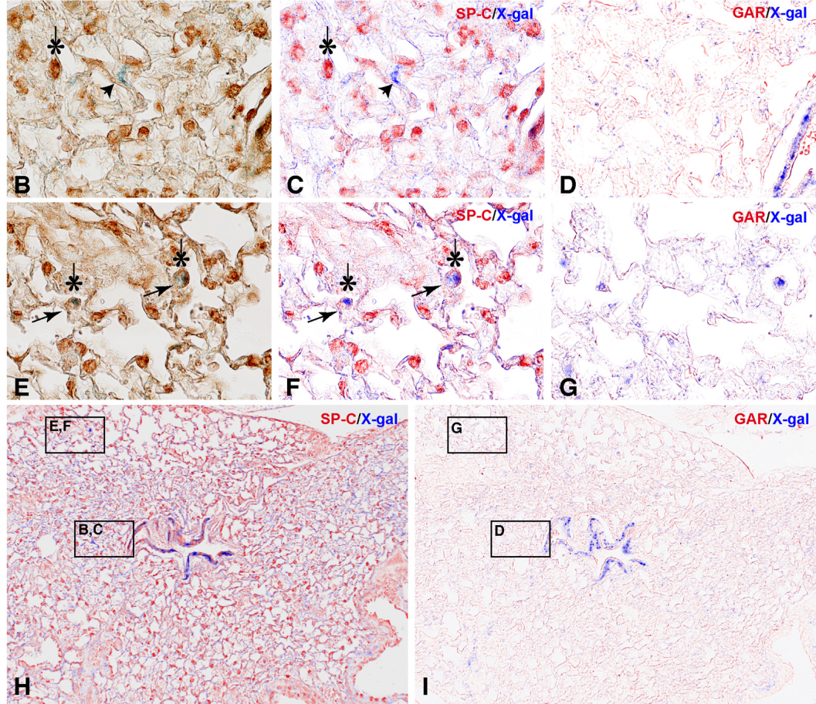

Slide 35
Markers of pneumocyte damage and regeneration Tubβ3, Lam5γ2chain, ph-mTOR
Tubβ3

Slide 36
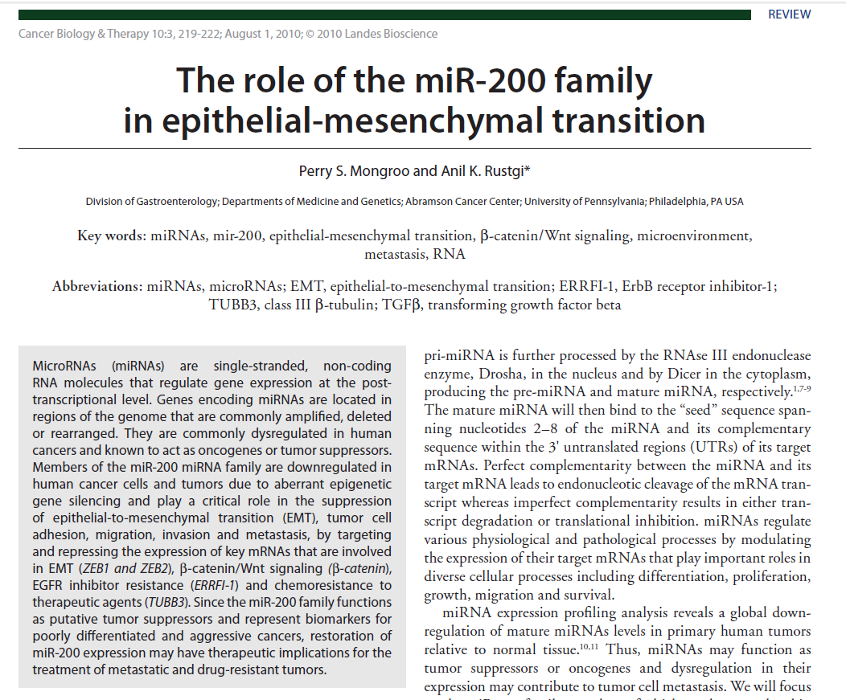
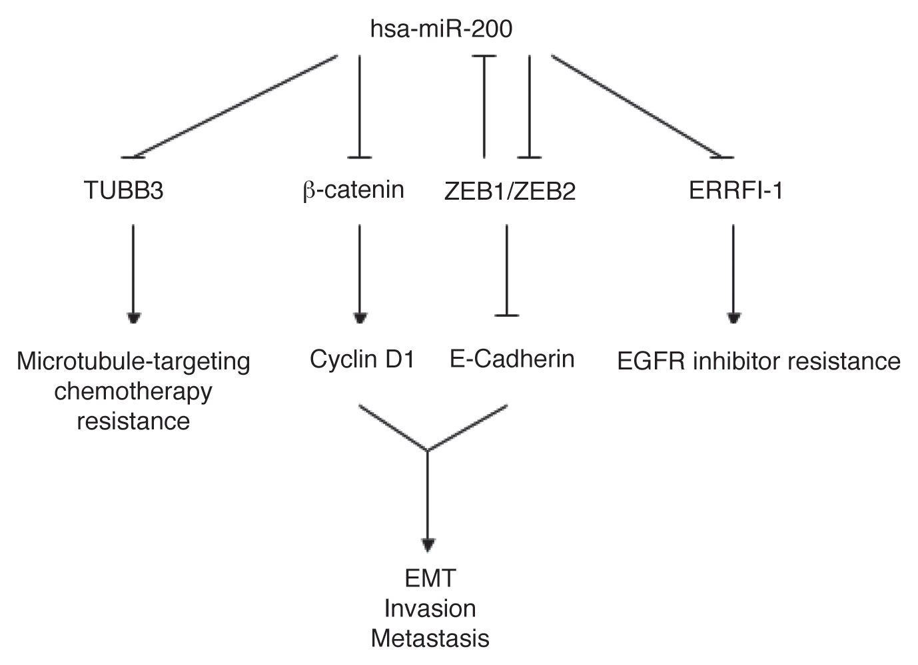

Slide 37
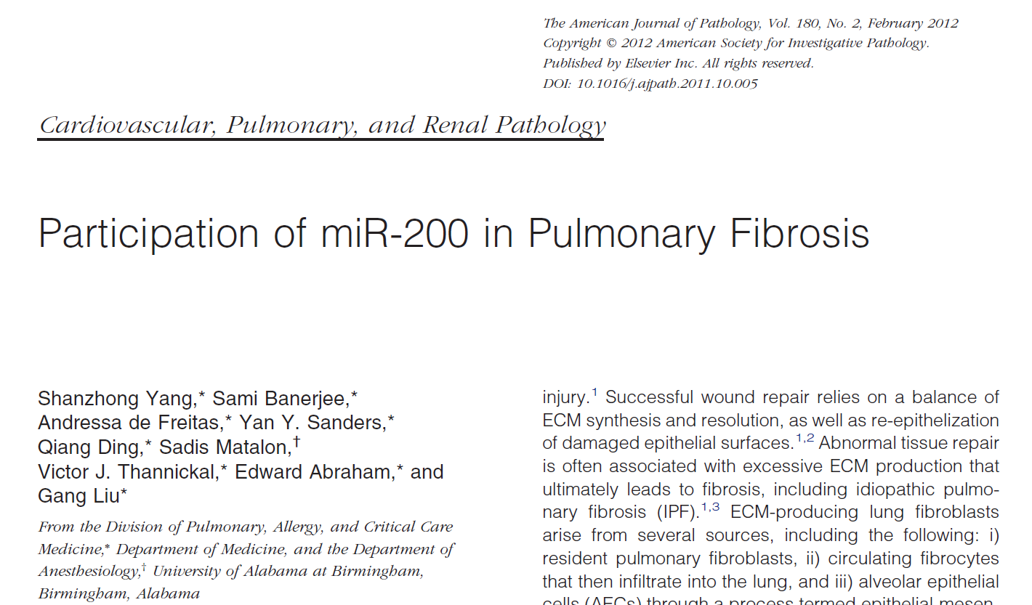

Slide 38
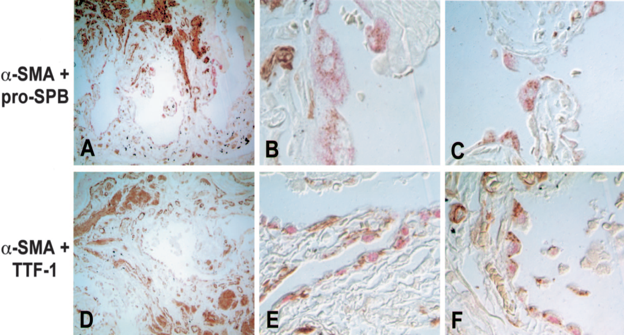

Slide 39
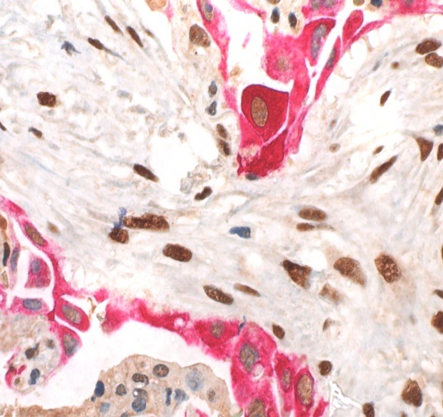
EMT in Pneumocytes-II in UIP/IPF
CK8/18
ZEB1
Nuclear ZEB1 immunofluorescence expression is evidenced in both myofibroblasts and regenerating pneumocytes, as confirmed by double immunostaining (ZEB1-green, cytokeratin 8-orange) (arrows, 40x).
Chilosi et. al. 2016 Mod. Pathol

Slide 40
Science. 2007 Aug 10;317(5839):803-6.

Slide 41
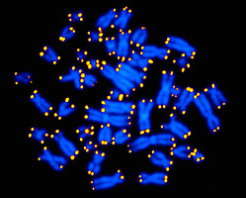
Cell senescence
is a permanent state of cell cycle arrest unresponsive to growth factors that can be triggered by different mechanisms including:
replicative telomere erosion
cellular stresses,
DNA damage,
oncogene activation,

Slide 42
Proc Am Thorac Soc Vol 8. pp 158–162, 2011
Telomere dysfunction
Endoplasmic reticulum stress (unfolded proteins)
Epithelial stem cell exhaustion

Slide 43
Mitogenic stimuli
Markers of senescence

Slide 44
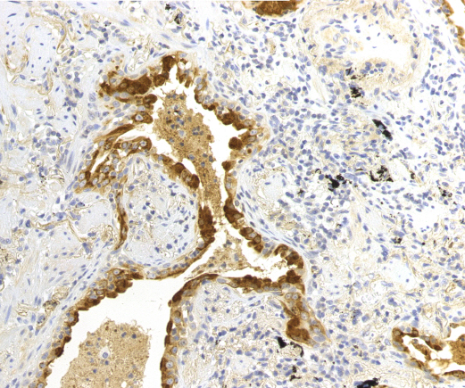
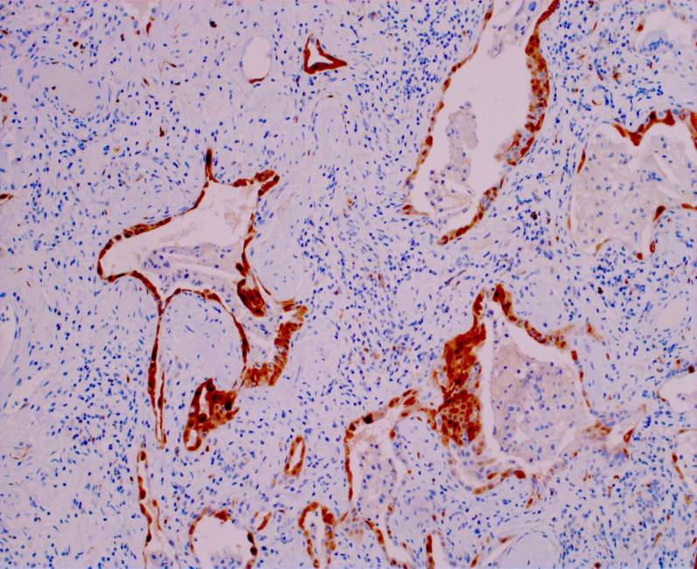
IPF
the first stage
Cell senescence marker expression in AECII
Surf-Prot-A1
p16^{INK4B}

Slide 45
IPF pathogenesis

Slide 46
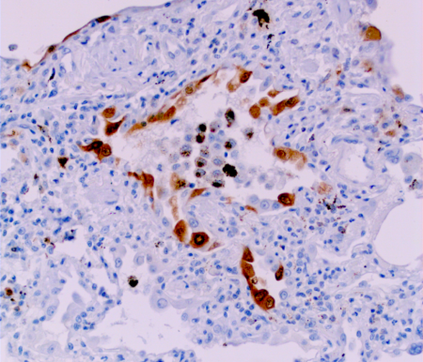
EMT

Slide 48
Accelerated lung senescence
WNT
EMT
OIS
SASP
INDUCTION
HONEYCOMB
Beta-Catenin
OIS → SASP
Bronchiolar dysplasia
Honeycombing

Slide 49
Myofibroblasts –
Fibrosis
WNT
Abnormal activation
Osteoblasts –
ossification
SASP
MSC
Pericytes –
neo-angiogenesis
Smooth muscle
hyperplasia

Slide 51
3. Gene Profiling 4. miRNA analysis
5. Proteomic analysis

Slide 52
BMC Pulm Med. 2017 Jan 12;17(1):15

Slide 54
To further investigate tissue distribution and localization of significantly altered matrisome proteins, we used anti-asporin antibodies to stain tissue sections for asporin (ASPN). ASPN is an extracellular proteoglycan of the small leucine rich repeat protein family (SLLRP) that are regulators of collagen fibril assembly [60]. Previous reports have shown that ASPN regulates TGF-beta signaling by inhibiting SMAD2 phosphorylation and epithelial-mesenchymal transition in breast cancer [61]. There is additional evidence that ASPN is a downstream target of canonical TGF-beta signaling, suggesting a regulatory feedback loop [62]. Staining for ASPN in the control tissue sections revealed a primary localization of ASPN in peribronchiolar regions and occasionally in the adventitia of blood vessels, but was absent in alveoli (Fig. 5c). In COPD patient samples, strong ASPN staining was found in the tunica media of pulmonary arterioles but not in other compartments. In IPF patient samples, ASPN staining was stronger and more abundant; moreover, strong extracellular staining was found in scattered areas with low cell density within honeycombing structures, as well as in fibroblast foci. These data suggest that ASPN increases in tissues that are subjected to remodeling. This is the case for IPF, where altered ASPN abundance reflects the heterogenic compartments of the diseased tissue. These disease-specific staining patterns may explain the difference in solubility of ASPN between COPD and IPF as shown in Fig. 4b.
asporin (ASPN).

Slide 55
JCI Insight. 2018;3(6):e98738.

Slide 59
Senescence
WNT - TGF-β - HHG
EMT
OIS
SASP
INDUCTION
HONEYCOMB

Slide 61
PLOS 2012:e41394
PLOS 2013:e61017

Slide 62
Conclusions:
Nintedanib down-regulates ECM production and induces non-canonical AUTOPHAGY

Slide 64
IPF pathogenesis and Therapy
Anti-fibrotic, regulators of autophagy
Anti-aging, geroprotectors, senolytic drugs
Inhibitors/regulators of signaling pathways (WNT, TGF-beta, etc.)

