Slide 1
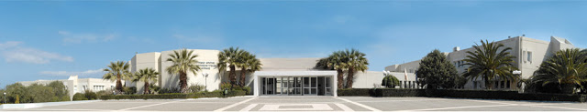

The role of mitochondria in IPF pathogenesis
Katerina Antoniou, MD, PhD
Associate Prof of Respiratory Medicine
ERS Assembly 12 Secretary
Head of Laboratory of Cellular and Molecular Pulmonology
Dept. of Thoracic Medicine, University Hospital of Herakleion.
University of Crete, Herakleion, Greece.

Slide 2
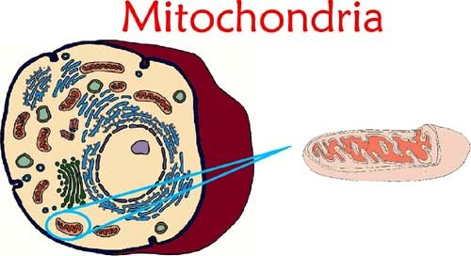
Mitochondria are double membrane-bound organelles that exist in all eukaryotic organisms.
An essential cellular function of mitochondria is to generate energy in the form of adenosine triphosphate (ATP).
This function makes mitochondria the “powerhouse” of the cell.
In addition to supplying ATP, mitochondria are also involved in other tasks, such as signaling, cellular differentiation, cell cycle regulation and cell growth.

Slide 3
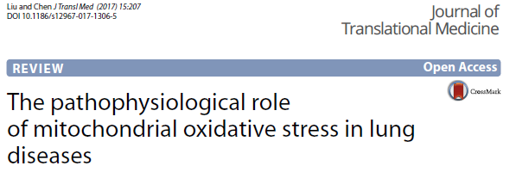
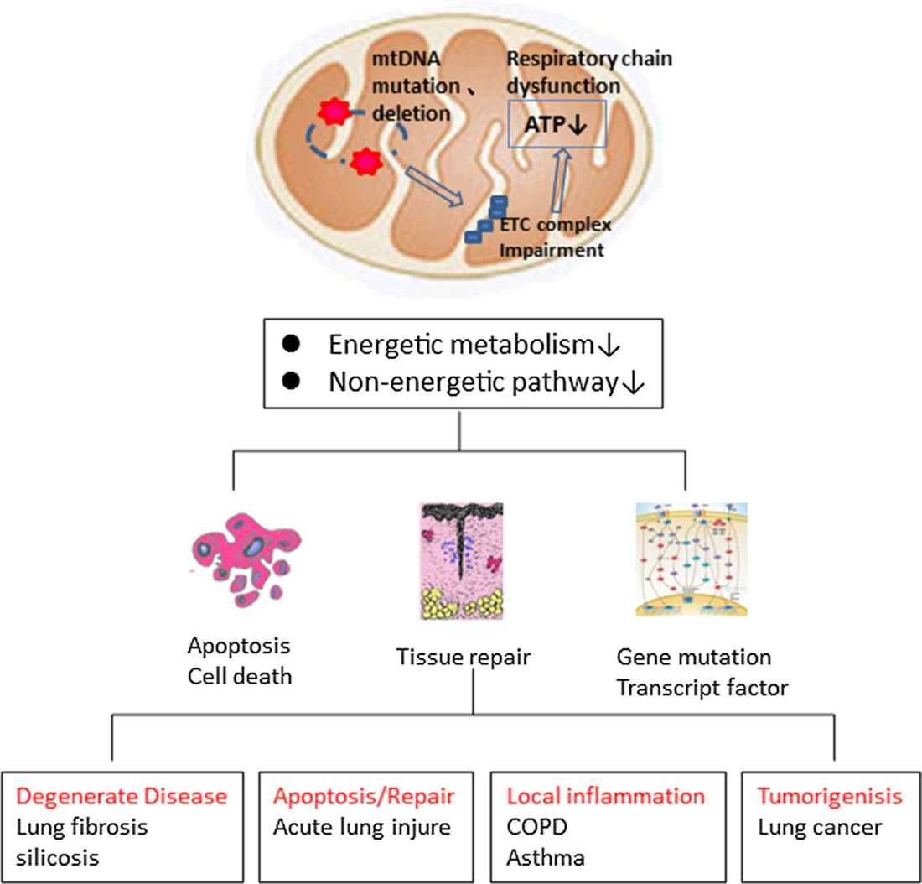
Notes:
Mitochondria are double membrane-bound organelles that exist in all eukaryotic organisms. e essential cellular function of mitochondria is to generate energy in the form of adenosine triphosphate (ATP). is function makes mitochondria the “powerhouse” of the cell.
In addition to supplying ATP, mitochondria are also involved in other tasks, such as signaling, cellular differentiation, cell cycle regulation and cell growth.
Mitochondrial dysfunction and diverse lung diseases.
Mitochondrial dysfunction and mitochondrial DNA mutations and deletions can cause defects in energy metabolism and impair non-energetic pathways.
Mitochondrial dysfunction is also associated with lung alveolar epithelial cell and alveolar macrophage apoptosis, which hinders lung repair and influences the expression of various reactive oxygen species-related genes.
Thus, mitochondrial dysfunction can induce diverse degenerative lung diseases.

Slide 4
Increased number of cells positive for p21 and Sen-β-Gal activity in the bronchial epithelium of patients with IPF (Minagawa et al., 2011), in AECs of the IPF lung (Kuwano et al., 1996) & in fibroblasts isolated from the lungs of IPF patients (Yanai et al., 2015).
Increased p16 and p21 levels in AECs present in ex vivo lung tissue from patients with IPF, p16 levels negatively correlating with disease severity (Lehmann et al., 2017).
Severity-dependent increase in p16 in the lungs of patients with IPF (Schafer et al., 2017)
The bronchial epithelium of patients with IPF, there is an increased number of cells positive for p21 and Sen-β-Gal activity (Minagawa et al., 2011) &
in alveolar epithelial cells of the IPF lung (Kuwano et al., 1996) and in fibroblasts isolated from the lungs of IPF patients (Yanai et al., 2015).
Increased p16 and p21 levels in AECs present in ex vivo lung tissue from patients with IPF
p16 levels negatively correlating with DLCO, suggesting that p16 levels correlate with disease severity (Lehmann et al., 2017).
Severity-dependent increase in p16 in the lungs of patients with IPF (Schafer et al., 2017)

Slide 6
Crosstalk between telomeres and the mitocondria

Slide 7

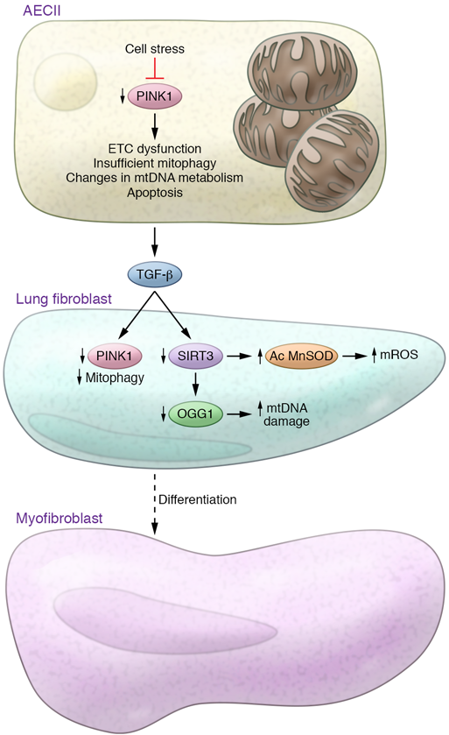
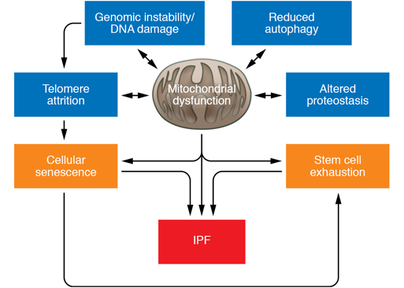
J Clin Invest. 2017;127(2):405–414.
Notes:
Mechanisms of aging and the pathogenesis of IPF.
Several of the aging cell perturbations associated with IPF lungs converge to produce
mitochondrial dysfunction, including DNA damage/genomic instability, altered proteostasis, reduced autophagy, and telomere attrition. Additionally,
mitochondrial dysfunction can lead to cellular senescence and stem cell exhaustion. It currently suggested that mitochondrial dysfunction plays a central
role in the process of aging and the pathogenesis of IPF.
-Aging and ER stress cause mitochondrial dysfunction in type II alveolar epithelial cells (AECIIs) by diminishing the expression of the mitochondrial homeostasis regulator PINK1. Deficiency of PINK1 causes mitochondrial dysfunction, which is characterized by low activity of the electron transport chain (ETC) complexes I and IV, alterations in mtDNA metabolism, and insufficient mitophagy, leading to increased susceptibility to apoptosis and induction of TGF-β.
TGF-β stimulation of lung fibroblasts has been shown to decrease PINK1 levels and promote insufficient mitophagy and myofibroblast
differentiation.
Additionally, aging and TGF-β stimulation reduce the expression of SIRT3. SIRT3 deficiency increases levels of acetylated (Ac) MnSOD and consequently increases mitochondrial ROS levels and mtDNA damage, which are also related to low expression of the DNA repair enzyme 8-oxoguanine-DNA glycosylase-1 (OGG1).

Slide 8
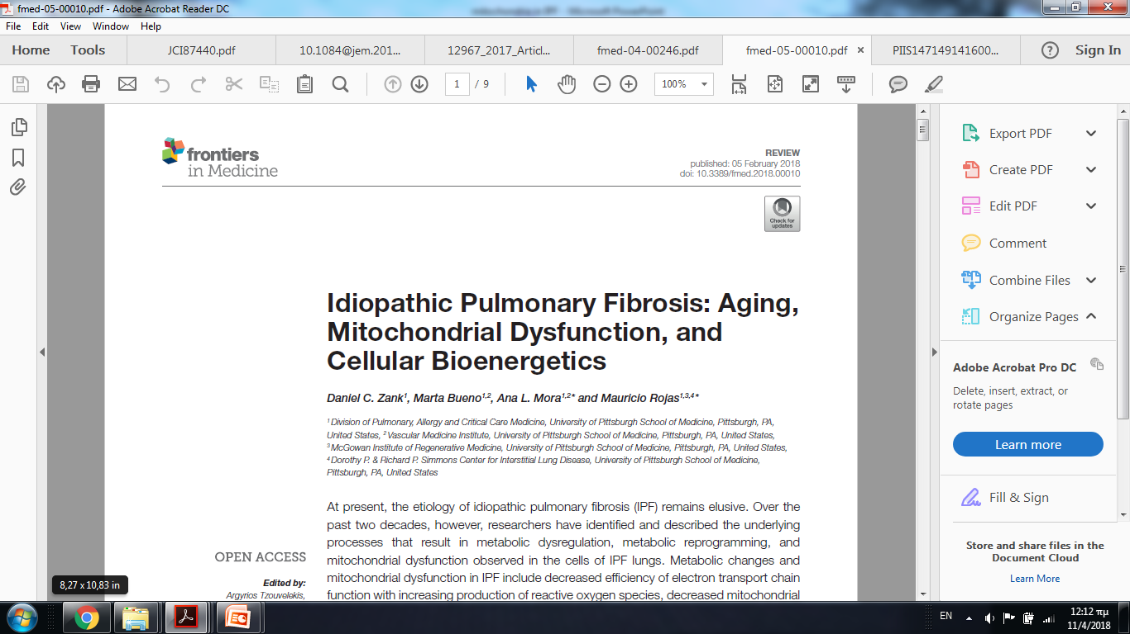

Slide 9
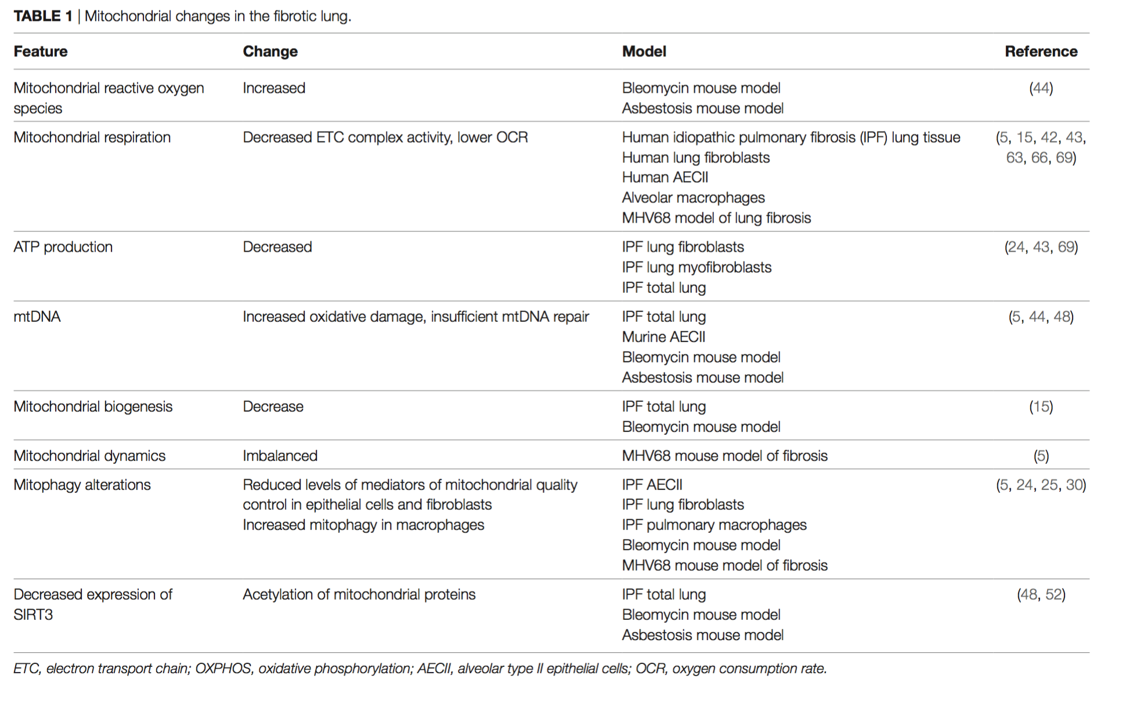
Notes:
Over the past two decades, researchers have identified and described the underlying processes that result in metabolic dysregulation, metabolic reprogramming, and mitochondrial dysfunction observed in the cells of IPF lungs.
Increased mt ROS
Decreased mitochondria respiration
Lower ATP production
Increased oxidative damage
….table
?? Increased mitophagy in macrophages…??

Slide 10
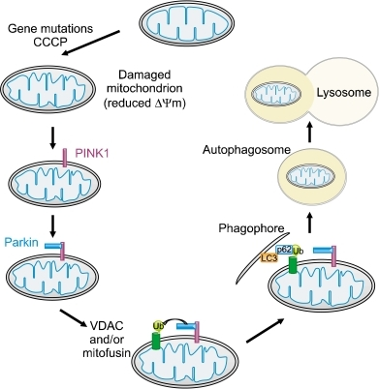
MITOPHAGY mediators of mitochondrial quality PINK-1 and Parkin
PINK1/PARKIN:
well documented markers for evaluating the autophagy of mitochondria
Son JH et al. Exp. Mol. Med. (2012)
Notes:
Damaged mitochondria associate with PINK1 followed by Parkin
Figure 3.
PINK1 and parkin-mediated mitophagy. In the current model of
the PINK1/parkin-mediated mitophagy, PINK1, implicated in familial PD,
is normally maintained at low levels on mitochondria by voltage-dependent
proteolysis, which is mediated by the mitochondrial presenilin-associated
rhomboid-like protein (PARL) present in the inner mitochondrial membrane.
In the absence of PARL, the constitutive degradation of PINK1 is in-hibited and a 60-kD form
of PINK1 is stabiliz
ed inside mitochondria.
When the mitochondrial membrane potential is dissipated, PINK1 accu-
mulates as a 63-kD full-length form in the outer mitochondrial membrane.
Thus, accumulation of mitochondrial damage by gene mutations or car-
bonyl cyanide m-chloro phenyl hydrazone (CCCP), a mitochondrial un-
coupling agent, facilitates the rapid
accumulation of
PINK1 and the sub-sequent PINK1 accumulation in the mitochondria recruits parkin to ubiq-
uitinate VDAC (and/or mitofusin) on the mitochondrial outer membrane,
which becomes a target for mitophagy. The ubiquitin-binding adaptor p62
(also known as sequestosome 1) recruits ubiquitinated cargo into auto-
phagosomes by binding to LC3.

Slide 11
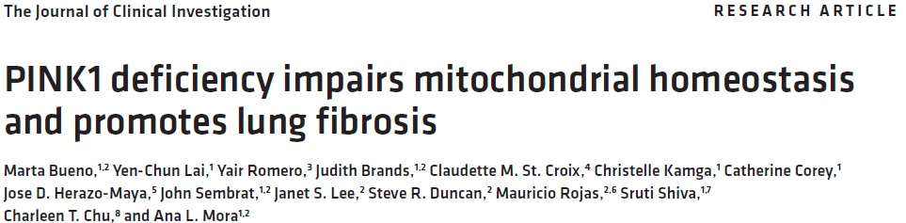
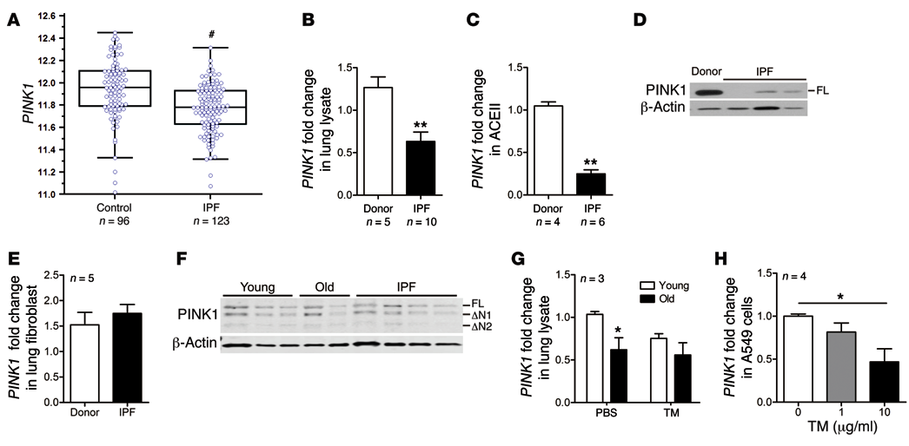
PINK1 deficiency in IPF
PINK1 downregulation in AECIIs
J Clin Invest. 2015;125(2):521–538
Notes:
KEY study detected accumulation of dysfunctional mitochondria and impaired autophagy in IPF lungs. Interestingly, they demonstrated decreased expression of PINK1 in AECIIs of IPF patients, They proposed that PINK1 def in BLM mouse model promotes lung fibrosis.

Slide 12
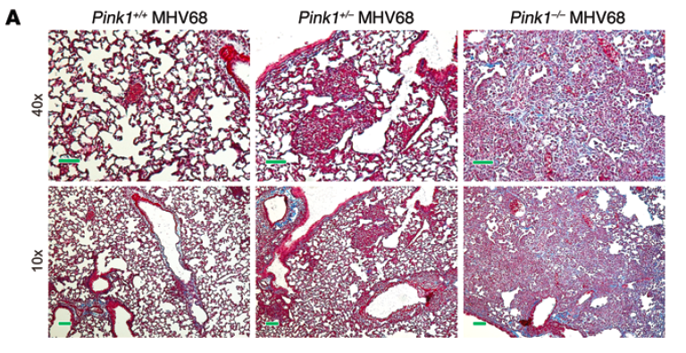
Pink1 deletion in mice:
fibrosis susceptibility
Bueno, J Clin Invest 2015
Notes:
PINK1 deletion in mice increases the susceptibility of fibrosis in mice challenged with murine herpes virus 68 (fibrosis model)

Slide 13
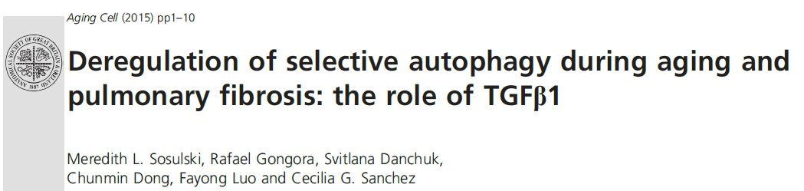
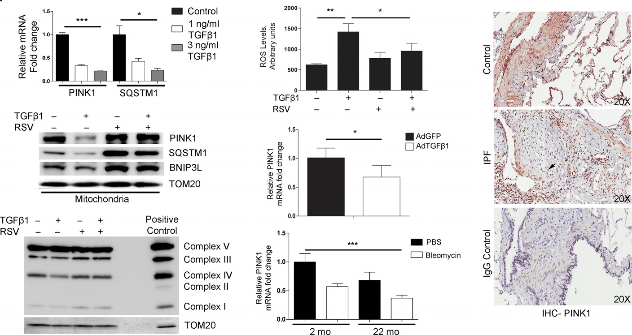
reduced PINK1 expression in BLM mouse model
low levels of PINK1 in IPF lungs
Notes:
Recent data showed defective mitophagy in aging lungs of mice after BLM treatment along with a reduction of PINK1 mRNA levels. They also found lower levels of PINK1 in lung tissues of IPF patients compared with control subjects.

Slide 14
Excessive plasma mtDNA is predictive of all-cause mortality in two independent cohorts

Slide 16
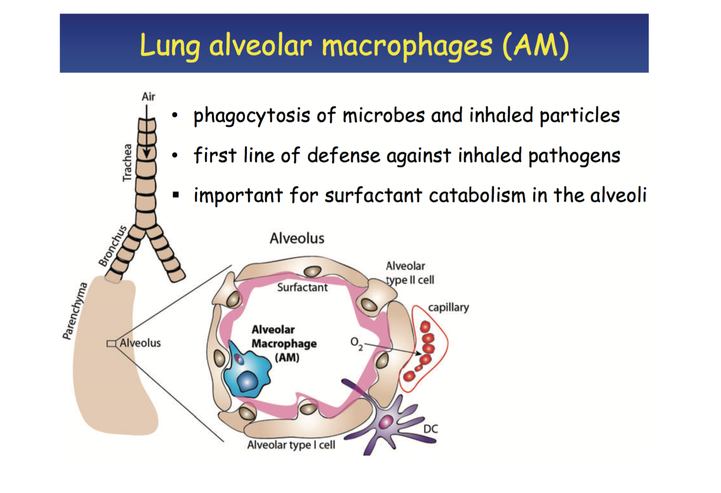
Notes:
role

Slide 17
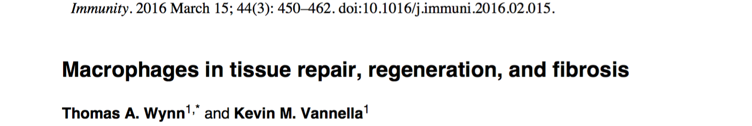
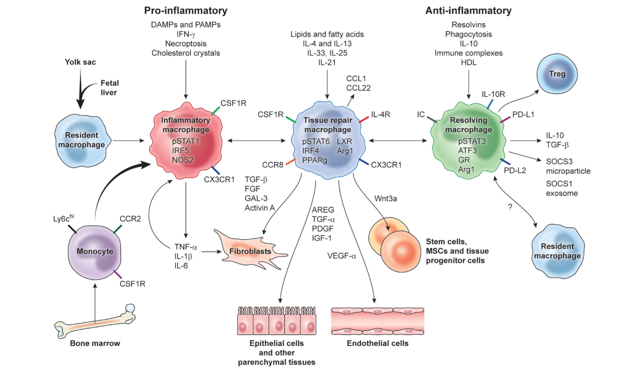
Notes:
Current model for macrophage polarisation and wound healing

Slide 18

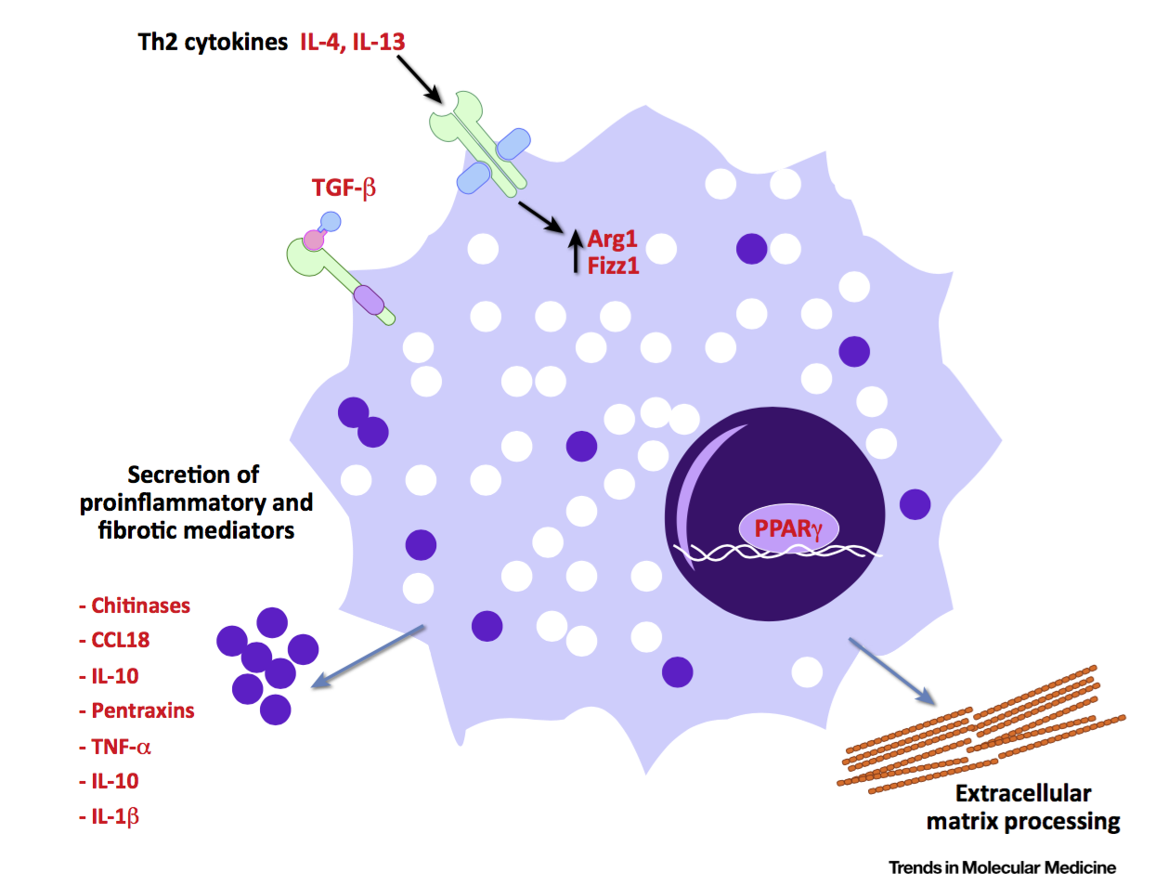

Notes:
Figure 2. Macrophage-Derived Molecular Targets for the Treatment of Interstitial Lung Disease (ILD).
Macrophage-driven, immune-regulated pathways appear to be central to all stages of the fibrotic process. Modulation of macrophages may therefore provide excellent opportunities for therapeutic intervention, particularly with inhaled compounds. This cartoon summarizes potential macrophage-specific therapeutic targets for the treatment of fibrotic lung disease. Abbreviations: Arg, arginase; FIZZ, found in inflammatory zone; GM-CSF, granulocyte-macrophage colony stimulating factor; IL, interleukin; IRF, interferon regulatory factor; PPARg, peroxisome proliferator activated receptor g; TGF, transforming growth factor; TNF, tumor necrosis factor.

Slide 19
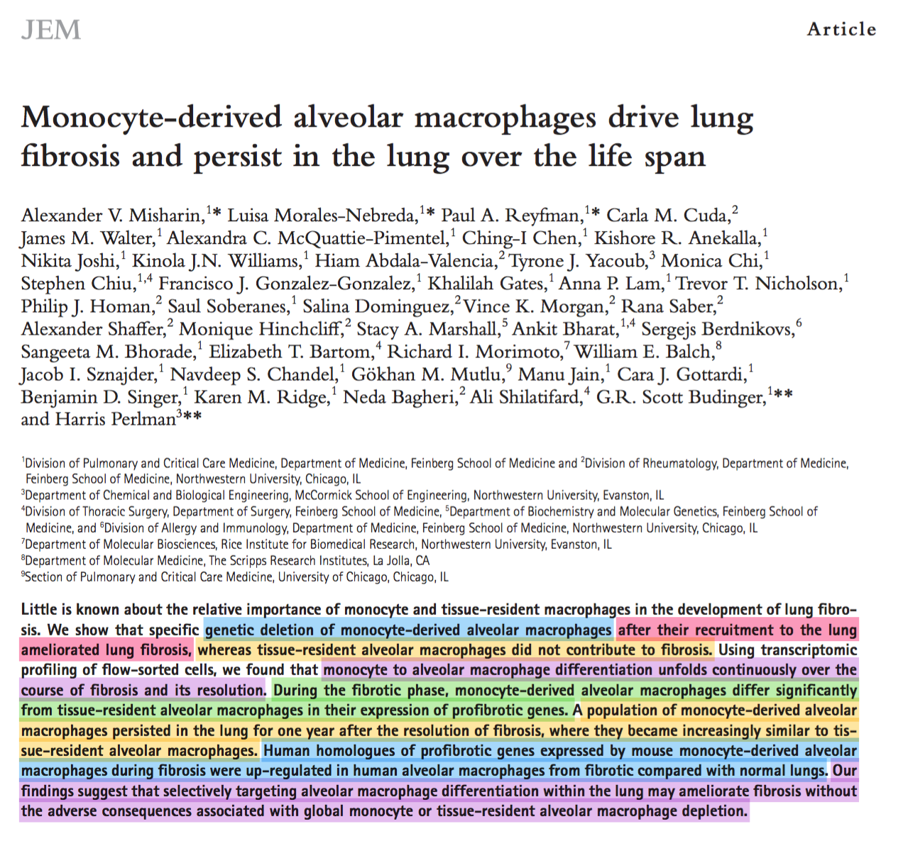
Notes:
Profibrotic genes are over-expressed by human alveolar macrophages compared to normal lungs.

Slide 20
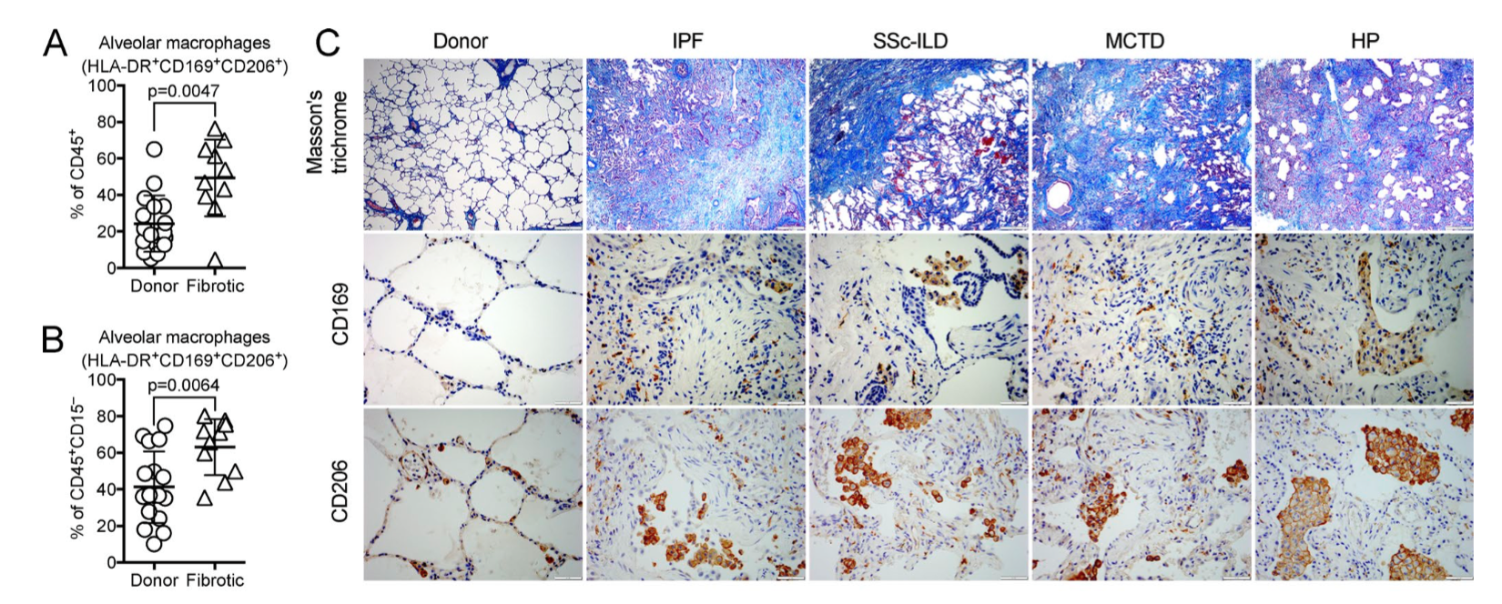
Notes:
Alveolar macrophages are expanded in patients with lung fibrosis and exhibit a profibrotic gene expression signature similar to mouse Mo-AMs during lung fibrosis.

Slide 21
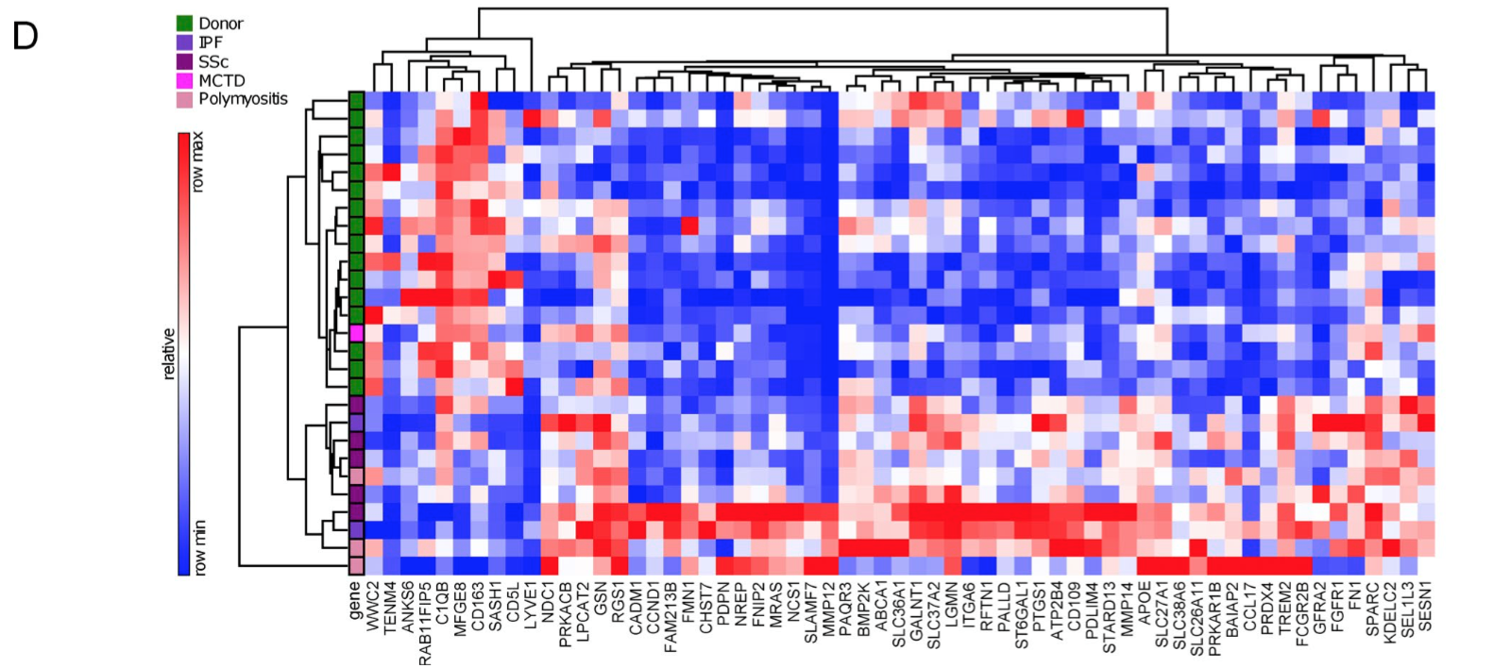
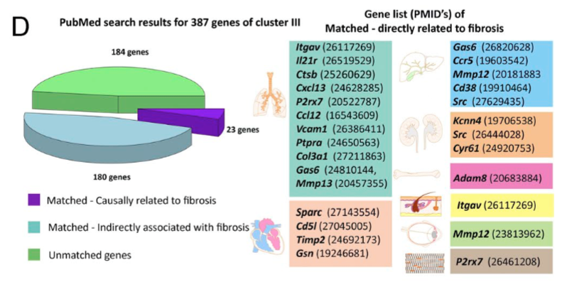
Notes:
Collagen genes for examples

Slide 22
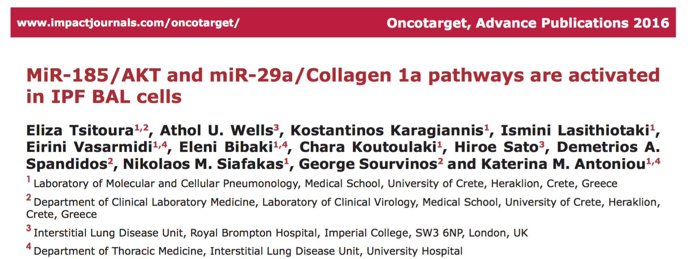
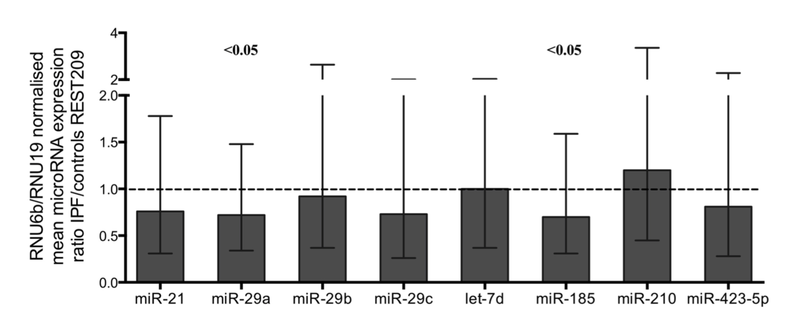

Slide 23
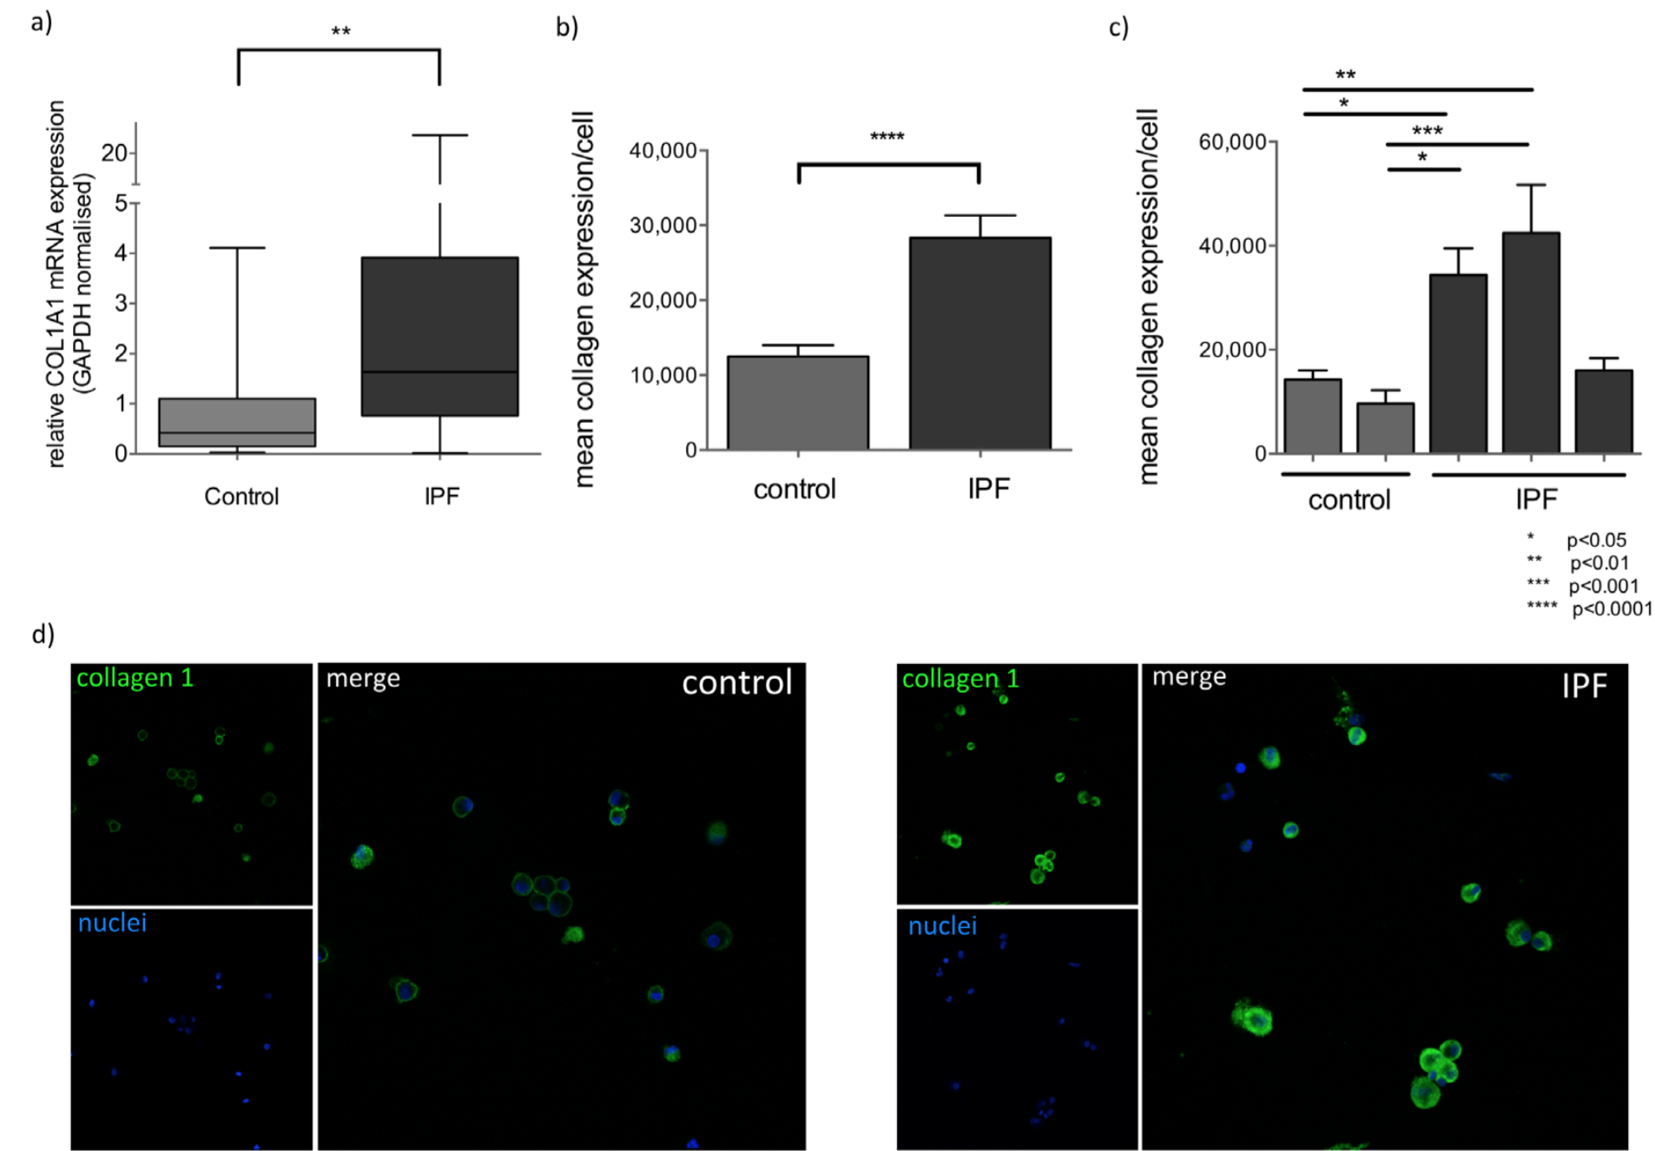
miR-29a/Collagen 1a pathway activated in IPF BAL cells

Slide 24
A primarily pro-fibrotic M2-like profile that was distinct from the well-defined M1 or any of the M2 subtype
Fibrotic lung alveolar macrophages assumed augmented glycolysis, which was likely attributed to enhanced expression of multiple key glycolytic mediators.
We also found that fatty acid oxidation was upregulated in these cells.
However, the pro-fibrotic M2-like profile of fibrotic lung alveolar macrophages was not dependent on fatty acid oxidation and synthesis or lipolysis, but instead on glycolysis, in contrast to the typical IL-4 induced macrophages M(IL-4).
Additionally, glutaminolysis, a key metabolic program that has been implicated in numerous pathologies, was not required for the pro-fibrotic M2-like phenotype of these macrophages.
Notes:
In IPF BAL, AMs were the most abundant immune cell type and multiple genes involved in OXPHOS were downregulated in IPF AMs compared to healthy controls, including LDH, SDHD, MDH1 and PDHB, while IDH2 was increased.

Slide 25
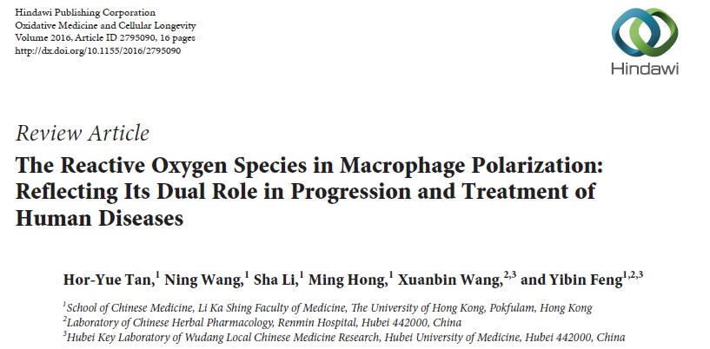
Mitochondrial homeostasis in alveolar macrophages
of IPF patients

Slide 26
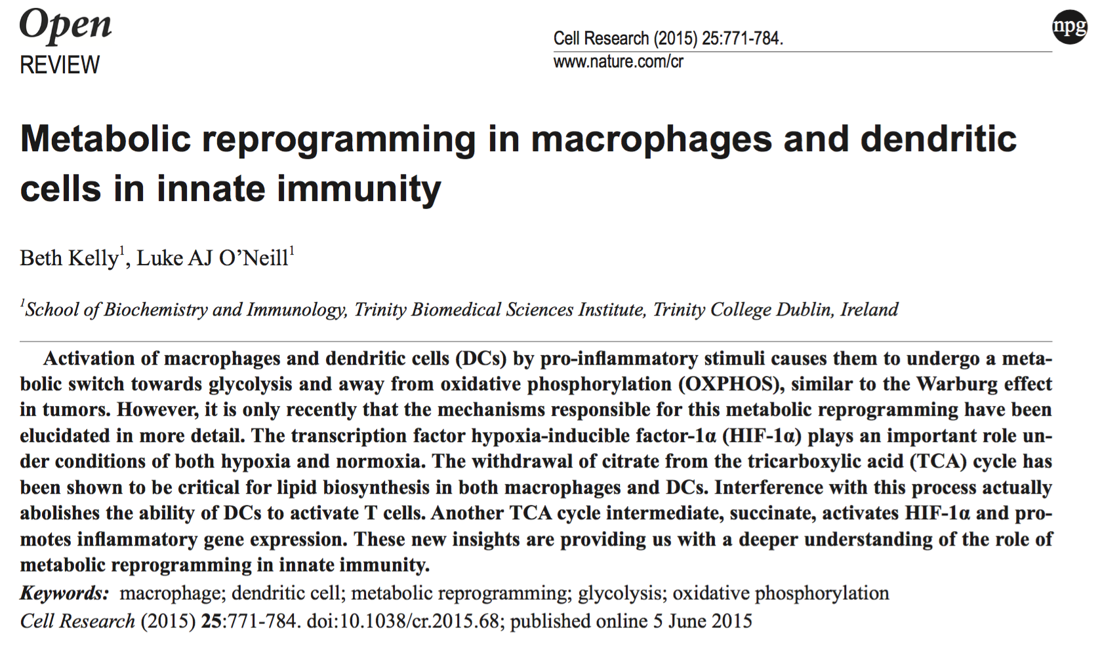
Notes:
In the last decade it has become clear that immune cell activation relies on the regulation of metabolic pathways.

Slide 27
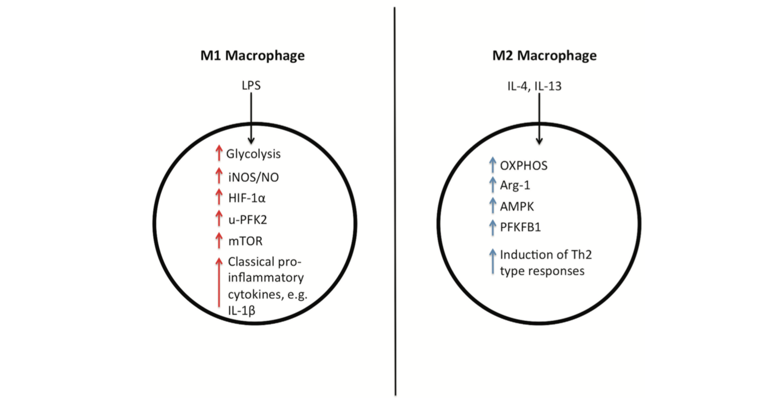
Mitochondrial homeostasis in alveolar macrophages
of IPF patients
Notes:
The various immune cell subsets exhibit a reliance on distinct mitochondria metabolic pathways to promote cell survival, lineage generation and function.
Metabolic differences between M1 and M2 macrophages.
M1 macrophages rely on glycolysis for ATP production and have increased levels of iNOS, HIF-1α and u-PFK2 (ubiquitous Phosphofructokinase 2) ,
while M2 macrophages are fueled by OXPHOS (oxidative phosphorylation and have increased levels of Arg-1, AMPK and PFKFB1.
M1 macrophages release pro-inflammatory cytokines such as IL-1β, while M2 macro- phages are involved in the response to parasite infection, as well as in wound healing, and they release the anti-inflammatory cytokine IL-10.
In fact, it is thought that a spectrum of macrophage activation exists, with different populations of macro- phages exhibiting different in inflammatory and metabolic phenotypes.

Slide 28
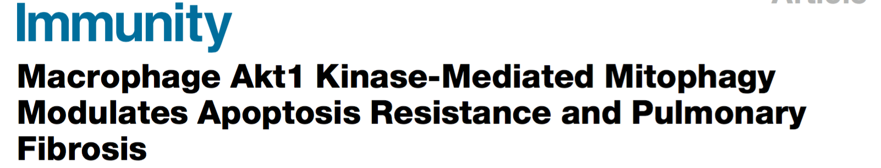
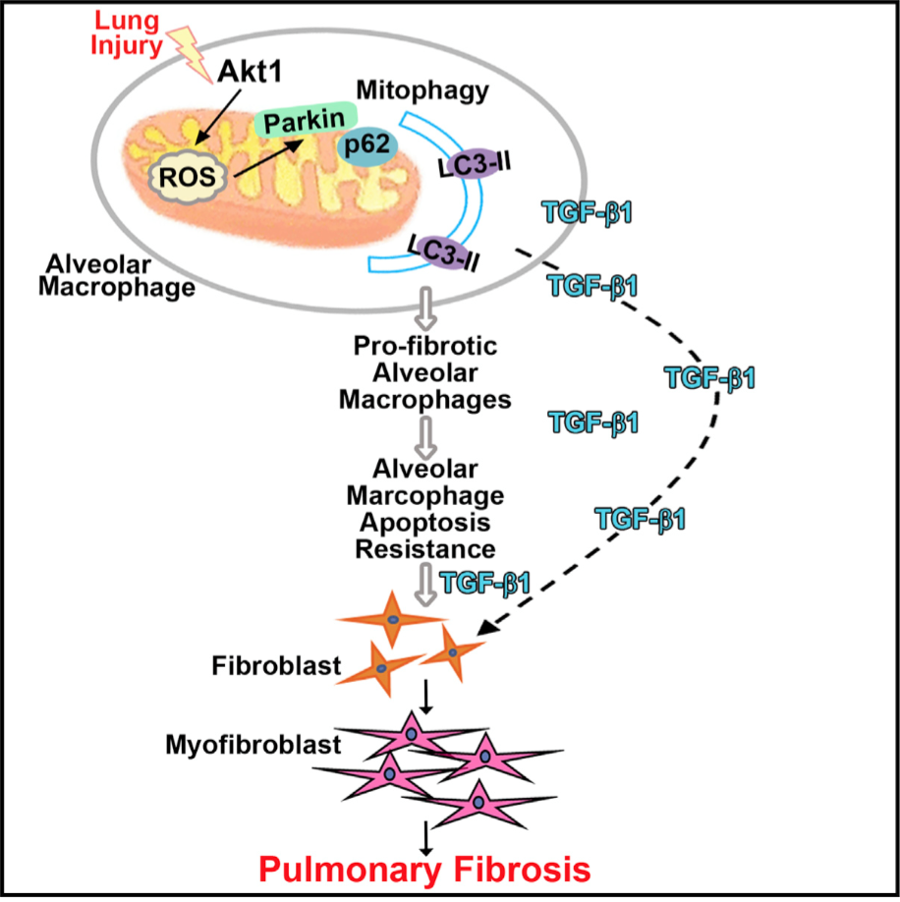

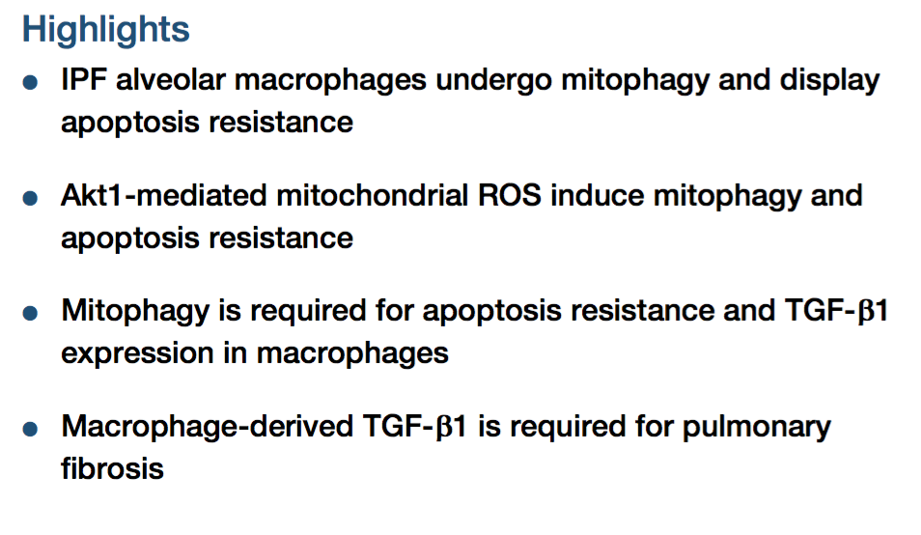
Notes:
Although recent studies propose a significant link between mitochondrial dysfunction and the induction of fibrosis and defective autophagy/mitophagy have been demonstrated in aging murine lungs and biopsies from IPF patients, a study using a limited number of patients have shown an increase in mitophagy and autophagy in IPF alveolar macrophages that is associated with escape from apoptosis in these cells and increased fibrosis in animal models. In this study mitochondria in IPF show increased association with PINK1 and increased mitophagy leading to apoptosis resistance and tgfb production.

Slide 29
Rationale
Recent studies propose a significant link between mitochondrial dysfunction and the induction of fibrosis.
Defective autophagy and mitophagy have been demonstrated in aging murine lungs and biopsies from IPF patients.
Deficiency in PINK1, a mediator of mitophagy is associated with aging and may lead to fibrosis.

Slide 30


RESULTS…

Slide 31
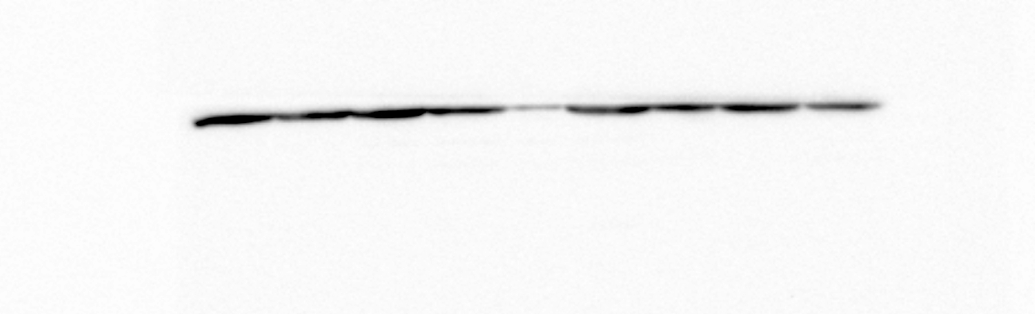
PINK1 and Parkin expression in IPF BALF cells
Normal
IPF
PINK1
Actin
Notes:
In view of these apparently contradictory findings, we sought to evaluate mitochondrial homeostasis in macrophages isolated from BALF from a larger IPF patient cohort and compare with control cells.
The levels of two key molecules in mitochondrial homeostasis, PINK1 and Parkin, were assessed in IPF BALF cells. PINK1 protein levels were significantly decreased in IPF when compared with normal subjects (figure 1a,b and sup fig1) while PINK1 mRNA levels did not show significant differences (figure 1c). Furthermore, Parkin mRNA was found downregulated in IPF BALF cells (figure 1d) and positively correlated with PINK1 mRNA levels (p<0.01, r=0.62).

Slide 32
Detection of mitochondrial ROS in BALF macrophages using MitoSox
BALF cells were stained with CD45 pan leukocyte marker and MitoSox red (5μΜ).
CD45 positive-high forward scatter cells was the gating strategy for the analysis of MitoSox positive cells.
Notes:
Mean c=10.68
Mean IPF=21.24
p=0.0257

Slide 33
Oxidized mitochondria in IPF alveolar macrophages
NS
Notes:
Freshly isolated alveolar macrophages from control (n=15) and IPF (n=36) patients were stained with red fluorescence MitoSOX to estimate mitochondrial superoxide production By Flow cytometry.
Increased percentage (b) of MitoSOX positive macrophages (p=0.02)(b) and Mean Fluorescence Intensity (MFI) (p=0.0001) (c) were observed in IPF.
apoptotic cells in the balf using Propidium Iodide staining, revealed no difference between the IPF and control groups

Slide 34
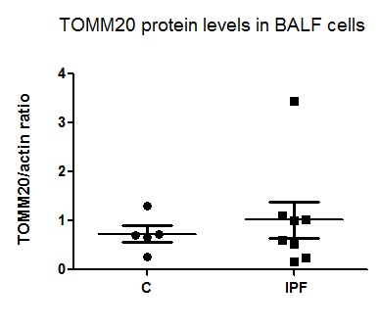
Evaluation of mitochondria mass in IPF BALF
Normal
IPF
Tomm20
Actin
ND1
ND5
Notes:
(a,b) Mitochondrial cell content was assessed by total TOMM20 protein by westernblot. Tomm20 is part of a transporter protein complex on the outer mitochondria membrane and usually serves as mitochondria marker in westernblot and immunofluorescence.
Levels of mitochondria DNA were measured by PCR of mitochondria encoded genes ND1 and ND5 normalised to a genomic locus (haemoglobin gene HGB) in BALF cells.
However we did not observe a significant accumulation of mitochondria in the BALF cells, although this is a relatively indirect measurement as we did not isolate alveolar macrophages.

Slide 35
TEM: Dysmorphic mitochondria in IPF macrophages.
normal
IPF

Slide 36
Dysmorphic mitochondria in IPF alveolar macrophages
TEM
control
Notes:
However,
Further evaluation of mitochondria morphology was performed using transmission electron microscopy (TEM). Morphological analysis revealed that in IPF alveolar macrophages mitochondria were dysmorphic and swollen, with disorganised cristae (figure 3a). Quantitative morphometry confirmed significantly increased frequency of larger mitochondria in alveolar macrophages of IPF samples than these of the control group (figure 3b).

Slide 37
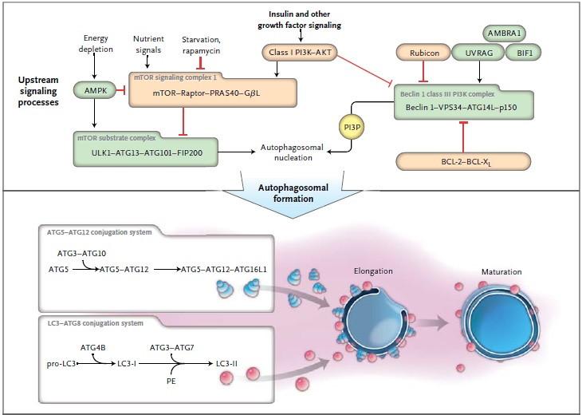
AUTOPHAGY
p62
NEJM,2013

Slide 38
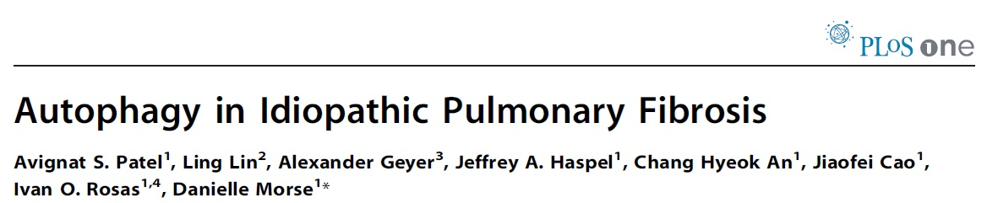
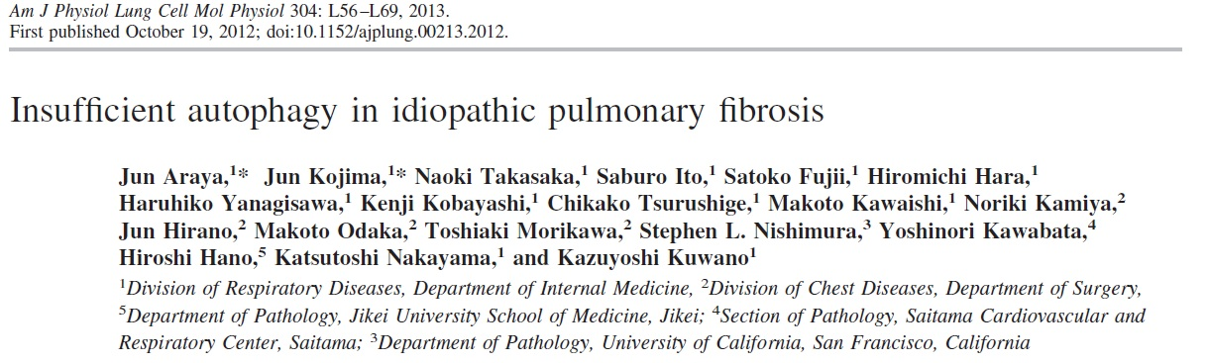
Autophagy and IPF
2012
Whole lung tissue - Autophagy is not induced
Defective autophagy in AECIIs and in IPF fibroblasts
Notes:
However, mitochondrial accumulation and mitochondrial turnover depends on the autophagic machinery. And it is currently known that autophagy is defective in AECIIs and fibroblasts in IPF, thus we decided to evaluate the autophagy levels in BALF cells.

Slide 39

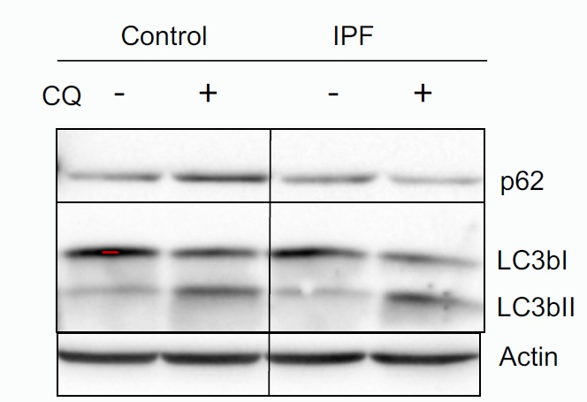
Autophagy in IPF BALF cells similar to controls
Control IPF
LC3B-I
LC3B-II
actin
Notes:
We next analysed autophagy levels in IPF cells as possible defect in autophagy could explain the accumulation of oxidisesd mitochondria in AMs.
For the assessment of the autophagy process in BALF cells, protein levels of LC3 and the adaptor protein p62 were measured. Western Blot analysis showed no significant difference in commonly used markers for the evaluation of the autophagy status in fresh cells between IPF patients and healthy subjects.
Increased levels of LC3II correlate with increased number of autophagic vesicles, whereas increased levels of p62 are associated with a defect in autophagy mechanism, due to the accumulation of aggregated proteins or damaged organelles that interact with p62. However we observed no differences in LC3b while p62 tended to be lower in IPF .
Examination of autophagy flux using a lysosome inhibitor(chloroquine) showed similar levels of accumulated LC3b II ie the autophagic vesicle associated LC3b form between IPF and controls.

Slide 40
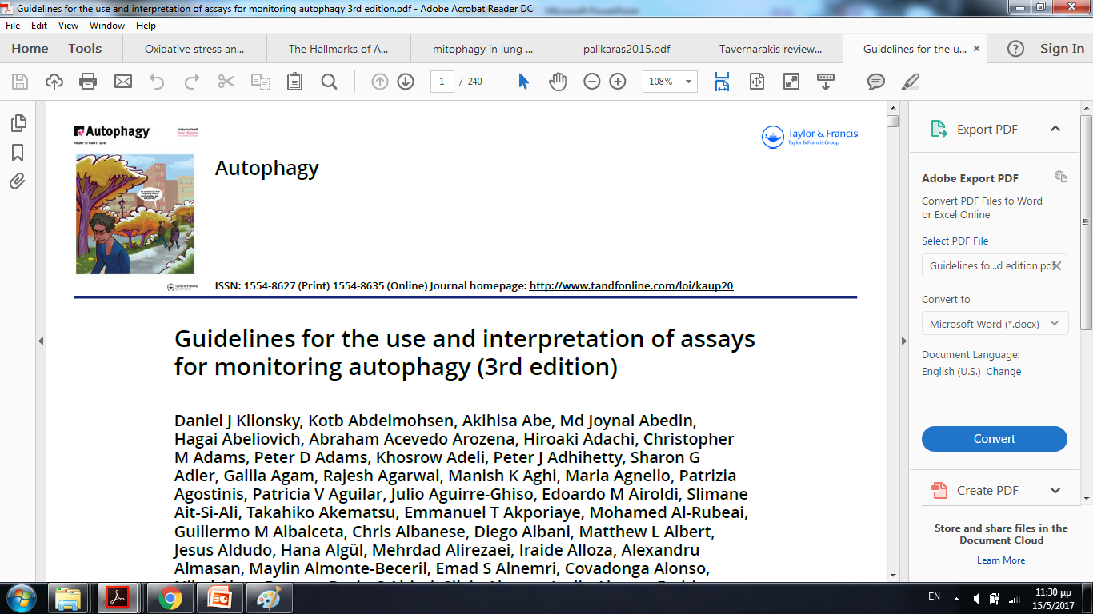
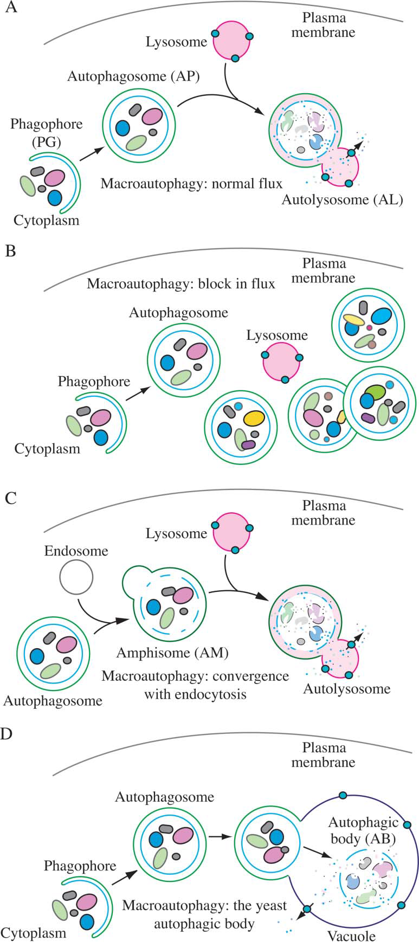

Slide 41
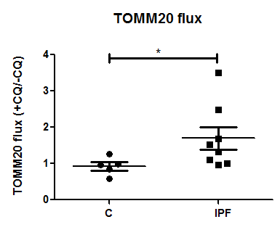
Mitochondria degradation in lysosomes is increased
in IPF BALF cells
Notes:
However, mitochondria degradation appears to increase in IPF cells!!! This could be attributed to increased mitophagy as previously suggested…

Slide 42
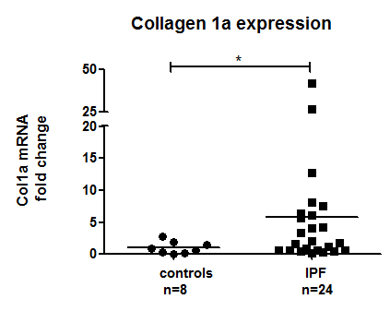
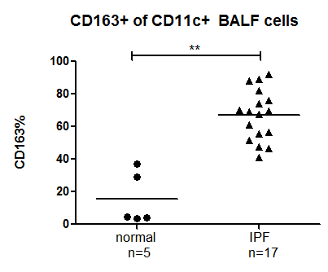
Oxidised mitochondria levels did not correlate with profibrotic gene expression or CD163 surface expression
Notes:
Oxidised mitochondria levels did not correlate with profibrotic gene expression or CD163 surface expression although both were elevated in the matched IPF samples relative to the controls.

Slide 43
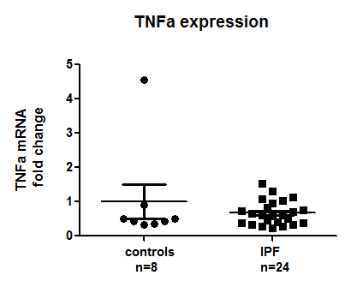
Oxidised mitochondria levels did not correlate with pro-inflammatory gene expression in matched samples

Slide 44
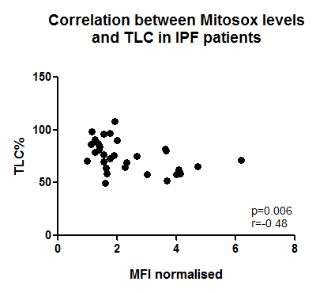
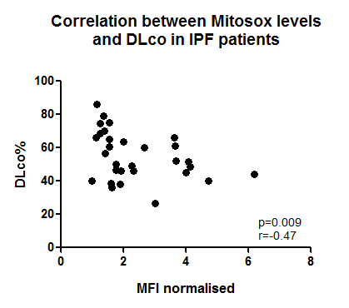
Mitochodria ROS is negatively correlated with TLC and DLCO in IPF.
Mild inverse correlation between MitoSOX levels and the Total Lung Capacity – TLC (p<0.05, r=-0.48)
Inversed correlation of almost the same degree was detected between MitoSOX levels and the DLco (p<0.01, r=-0.47)
Notes:
Mitochodria ROS is negatively correlated with TLC and DLCO in IPF.
MitoSOX levels in BALF cells were not correlated with age or smoking history.

Slide 45
summary
Mitochondria ROS is elevated in IPF AMs and may be associated with decreased lung function.
We observed a significant decrease of PINK1 protein levels in IPF patients relative to controls coupled to downregulation of Parkin mRNA levels in IPF similarly to previous observations in AECs and lung tissue.

Slide 46
summary
In contrast to previous observations the protein levels of the autophagy markers LC3b-I, LC3b-II and p62, showed no significant differences in IPF BAL cells relative to controls
The process of mitophagy remains enigmatic although we observed an increased accumulation of TOMM20 following treatment with the lysosome inhibitor chloroquine, suggesting an increased catabolic flux of mitochondria proteins through the lysosome.
Notes:
We are currently investigating other techniques to analyse this process.

Slide 48
Faculty of Medicine, University of Crete
Collaborators
Laboratory of Molecular and Cellular Pneumonology, UOC
Katerina Antoniou MD, PhD
Eliza Tsitoura, PhD
George Margaritopoulos, MD, PhD
Eirini Vasarmidi, MD, MSc
Kostas Karagiannis, MD
Eleni Bibaki, MD
Stelios Michelakis, MD
Athina Trachalaki, MD
George Papastratigakis
Department of Respiratory Medicine, University Hospital of Heraklion
Nikos Tzanakis
Sophia Schiza
Ioanna Mitrouska
Irini Lambiri
George Pitsidianakis
Laboratory of Clinical Virology, UOC
George Sourvinos
Laboratory of Parassitology, UOC
George Chamilos
Laboratory of Histopathology, UOC
Anastassios Koutsopoulos
Eleni Lagoudaki
Royal Brompton Hospital
and Harefield NHS Trust
Athol Wells
Maria Kokosi

Slide 49


