Slide 1


“Ruolo del Next Generation Sequencing nella diagnosi e nel controllo della tubercolosi”
DM Cirillo, MD, PhD
WHO Collaborating Centre for TB Laboratory Strengthening ITA-98
Supranational Reference Laboratory Milan
Emerging Bacterial Pathogens Unit,
San Raffaele Scientific Institute, Milan

Slide 2
SOMMARIO
INTRODUZIONE
  La diagnosi di tubercolosi e le problematiche correlate
  NUOVI TEST PER MDR TB RACCOMANDATI DAL WHO
Whole Genome Sequencing PER LA DIAGNOSI E SORVEGLIANZA DI MDRTB
  RESEQ-TB E CRYPTIC
  Mutation Encyclopedia
  STANDARDIZZAZIONE DEL REFERTO
ANALISI MOLECOLARE PER INDIRIZZARE UN TRATTAMENTO APPROPRIATO
Whole Genome Sequencing PER L’IDENTIFICAZIONE DELLE TRASMISSIONI
CONCLUSIONI

Slide 3
COI
DC è coinvolta della validazione di nuovi diagnostici per conto di FIND
DC è parte di Reseq TB e Cryptic

Slide 4
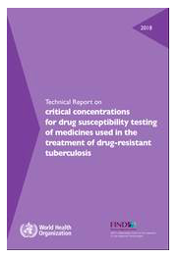
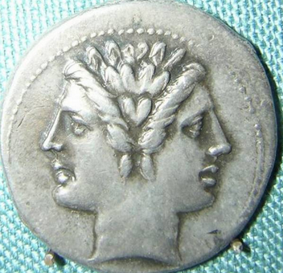
FENOTIPO O GENOTIPO?
FENOTIPO
Lunghi tempi di crescita
Strumentazione, training, BSL3
Concentrazioni Critiche spesso non corrette
GENOTIPO
Rapido
BSL2 o BSL1
Completamente automatizzabile
Sensibilità?
IL PUNTO NON E’ COME : CONTANO ACCURATEZZA E RAPIDITA’

Slide 5

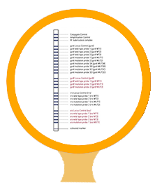
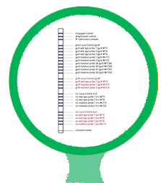
MoleculaR diagnostics WHO-endorsed
Xpert ULTRA
MTBDRplus
MTBDRsl
Integrated/automated qPCR
Fully nested amplification
Results in 1h17m
Technical expertise: none
TB detection by targeting two different multi-copy genes (IS6110 & IS1081)
High-resolution melt curve analysis for rpoB detection
Additional PCR modifications to improve sensitivity and specificity
Reverse hybridization, colorimetric reaction
Results in 6-7 h
Technical expertise: some
Biosafety lev 2
Detect resistance in TB to Rifampicine (RpoB gene) and Isoniazide (InhA, KatG genes),
Reverse hybridization, colorimetric reaction
Results in 6-7 h
Technical expertise: some
Biosafety lev 2
Detect resistance in TB to the fluoroquinolones (FQs; ofloxacin, moxifloxacin and levofloxacin) and the second-line injectable drugs (SLIDs; amikacin, kanamycin and capreomycin),

Slide 6
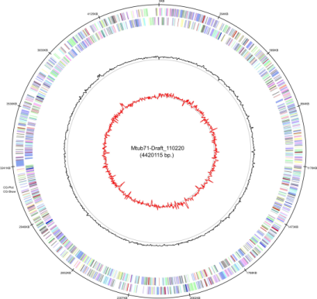
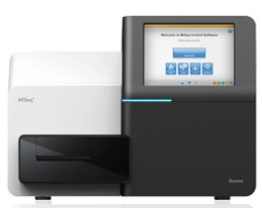

CHALLENGES OF MOLECULAR DIAGNOSTICS
  The endorsed molecular tests (GeneXpert, LPA 1st line-2nd line) target only “hot-spot regions” including the majority of mutations for only few drugs (RIF, INH, FQ, SLID)
  Extensive mutations (pncA)?
  Resistance markers in multiple genes?
  Probe-based: Can only detect known determinants
  Silent and not relevant mutations?
  Heteroresistance
Next generation sequencing

Slide 7
WGS through NGS: key points
Massively parallel generation of millions of short sequencing reads:
Isolation of genomic (=high quality/pure) DNA
Library preparation
Generation of relatively short reads (up to 400bps depending on technology employed)
Reads are mapped to a reference genome
Analysis (relatedness/drug resistance prediction/speciation etc)

Slide 8
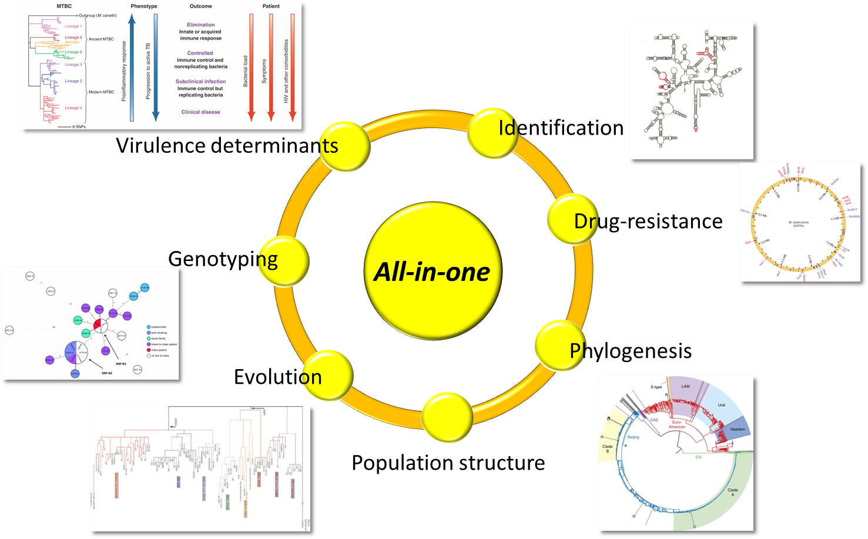
WGS: applications in the field
Surveillance
Diagnosis

Slide 9


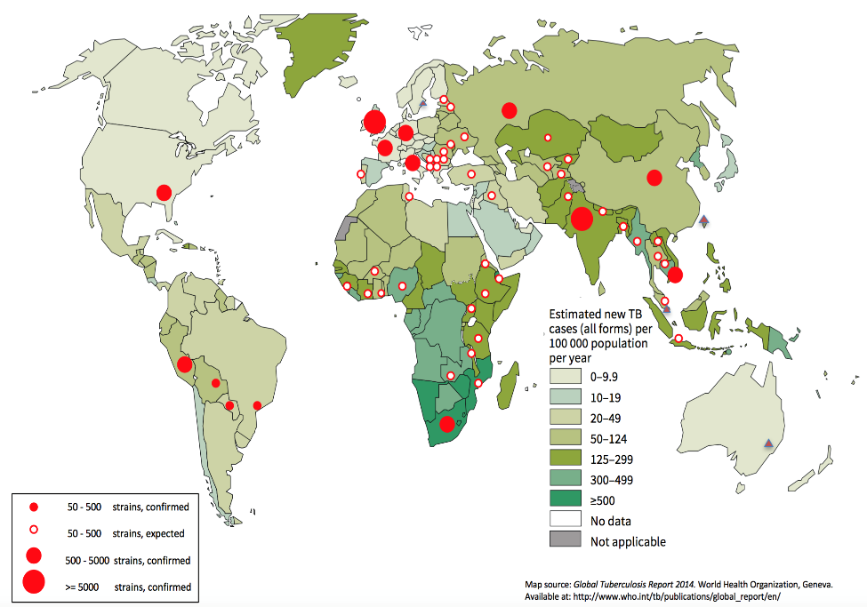
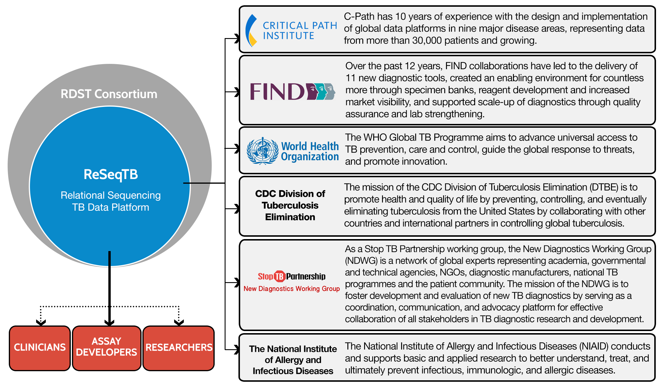

INIZIATIVE “Game-changing”
Analisi di 100.000 genomi
“machine learning “ analisi

Slide 10
A standardised method for interpreting the association between mutations and phenotypic drug resistance in
Mycobacterium tuberculosis
Miotto, ERJ 2017

Slide 11
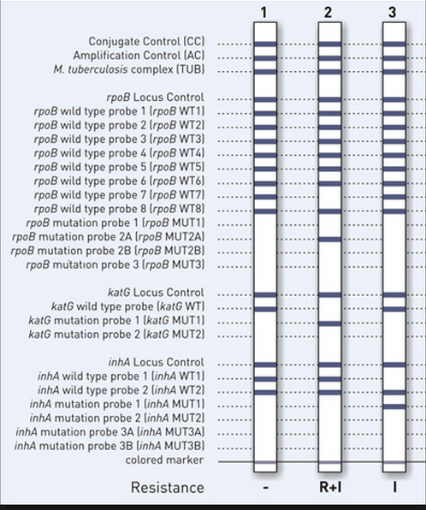
LPA: Interpretation and Reporting
Two internal controls on the strip:
  Conjugate Control CC
  Amplification Control AC
  MTB complex band
Three genes locus control
WT reactions zones
MUT reactions zones
RED and BLUE patterns are NOT equivalent for patients management
Notes:
The molecular LPA can therefore be divided into three procedures (Figure 13):
1. DNA extraction from NaOH-NALC decontaminated smear positive specimens, or
from cultured isolates (solid or liquid media);
2. A multiplex PCR with conditions that are specific for the type of specimen that
was extracted and;
3. Reverse hybridization, where probes (reaction zones or bands) on the strips are
used to interrogate the M. tuberculosis target DNA associated with RMP and INH
resistance by detecting sequences complementary to the probes on the strip.

Slide 12
MIC distribution based on mutation
The MIC of H37Rv : 0.03 (ug/ml)
Plus coding region
Additional mutations outside the main targets increase the mic

Slide 13
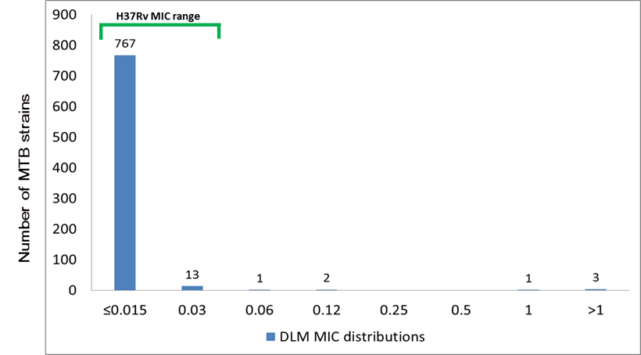
WGS analysis
results: SNPs/MIC correlation
Delamanid MICs distributions on 787 MTBC clinical strains
EUCAST breakpoint
0,06 µg/ml
DLM MIC ≤ 0,015 µg/ml
gene | SNP (codon) | N. of strains mut.
ddn | Trp20_STOP (tgg/tAg) | 1
ddn | Pro5fs (g-> ga) | 1
ddn + fbiB | Leu90fs (ac->c) + Lys448Arg (aag/aGg) | 1
wt | - | 1 (25 %)
DLM MIC 0,03 µg/ml
DLM MIC 1 µg/ml
gene | SNP (codon) | N. of strains mut.
ddn | Pro59Gln (ccg/cAg) | 1
ddn | prom g-26t | 2
ddn + fbiC | Asp113Asn (gac/Aac) + prom a-32g | 1
fbiA | Thr302Met (acg/aTg) | 5
fbiA | prom a-97g | 1
fbiA | Ser184Thr (agc/aCc) | 1
fbiA | Ala178Thr (gcc/Acc) | 1
fbiA | Arg304Gln (cgg/cAg) | 1
fbiA | Ile208Val (atc/Gtc) | 2
fbiA | prom del (gcgtgt-64g) | 1
fbiA | Gln120Arg (cag/cGg) | 1
fbiA + fbiB | Ala232Glu (gcg/gAg) + Lys448Arg (aag/aGg) | 1
fbiA + fbiB | Val47Ile (gtc/Atc) + Lys448Arg (aag/aGg) | 1
fbiA + fbiB | Thr4Asn (acc/aAc) + Val192Ile (gtc/Atc) | 1
fbiB | Arg409Ser (cgc/Agc) | 1
fbiB | Thr268Ile (acc/aTc) | 1
fbiB | Ala380Ser (gcc/Tcc) | 1
fbiB | Lys448Arg (aag/aGg) | 71
fbiB | His370Arg (cac/cGc) + Lys448Arg (aag/aGg) | 1
fbiB | Ala200Glu (gcg/gAg) | 1
fbiB | Leu447Arg (ctg/cGg) | 1
fbiB + fgd1 | Leu284Val (ctc/Gtc) + Lys270Met (aag/aTg) | 1
gene | SNP (codon) | N. of strains mut.
fbiC | Ala659Val (gcc/gTc | 1
fbiC | Pro420Ser (ccg/Tcg) | 1
fbiC | Pro334Ala (ccg/Gcg) | 1
fbiC | Glu813Asp (gag/gaC) | 1
fbiC | Asp427His (gac/Cac) | 1
fbiC | Gly135Ser (ggt/Agt) | 1
fbiC | Arg159Pro (cgc/cCc) | 1
fbiC | Val94Ala (gtc/gCc) | 1
fbiC | Thr273Ala (acg/Gcg) | 1
fbiC | Trp678Gly (tgg/Ggg) | 2
fbiC | Gly839Asp (ggc/gAc) | 1
fbiC | prom a-32g | 1
fbiC | prom ins a -14 | 1
fbiC + fbiB | Ile693Val (atc/Gtc) + Lys448Arg (aag/aGg) | 2
fbiC + fbiA | Thr687Met (acg/aTg) + a-97t | 3
fgd1 | Thr255Ala (aca/Gca) | 3
fgd1 | Ala256Thr (gct/Act) | 1
fgd1 | Tyr118Ser (tac/tCc) | 2
fgd1 | Lys270Met (aag/aTg) | 56
fgd1 | Lys296Arg (aag/aGg) | 1
fgd1 | prom g-12a | 1
fgd1 | prom t-27g | 5
fgd1 + fbiC | Lys296Glu (aag/Gag) + prom a-32g | 1
fgd1 + fbiC | Lys270Met (aag/aTg) + Thr257Ala (acc/Gcc) | 1
fgd1 + fbiC | Lys270Met (aag/aTg) + prom g-11a | 2
wt | - | 575 (75%)
gene | SNP (codon) | N. of strains mut.
ddn | prom g-26t | 1
fbiB | Lys448Arg (aag/aGg) | 2
fbiC | Thr273Ala (acg/Gcg) | 1
wt | - | 9 (69,23%)
Four DLM-R strains (≥ 1 µg/ml): 3 are mutated in ddn gene (STOP codon and frameshift) and 1 strain without SNPs in candidate genes;
2 strains at 0,12 µg/m, and only 1 at 0,06 µg/ml;
>99% of strains have an MIC ≤ 0,015.

Slide 14
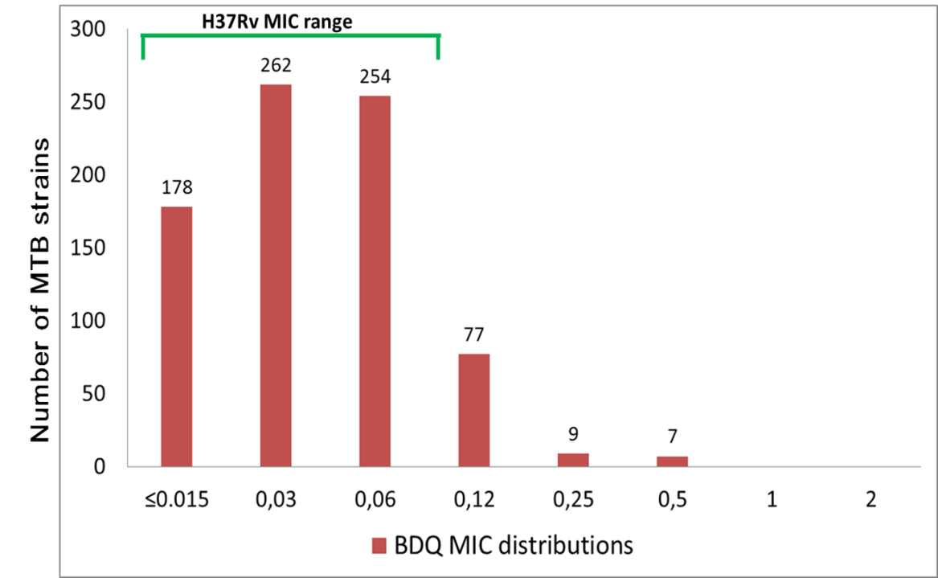
WGS analysis
results: SNPs/MIC correlation
Bedaquiline MICs distributions on 787 MTBC clinical strains
EUCAST breakpoint
0,25 µg/ml
≤ 0,015 µg/ml |  |  | 0,03 µg/ml |  |  | 0,06 µg/ml |  |  | 0,12 µg/ml |  |  | 0,25 µg/ml |  |  | 0,5 µg/ml
gene | SNP (codon) | N. of strains mut. | gene | SNP (codon) | N. of strains mut. | gene | SNP (codon) | N. of strains mut. | gene | SNP (codon) | N. of strains mut. | gene | SNP (codon) | N. of strains mut. | gene | SNP (codon) | N. of strains mut.
Rv0678 | Met17Val (atg/Gtg) | 1 | Rv0678 | Ser2Arg (agc/agA) | 2 | atpE | Ala18Ser (gcc/Tcc) | 1 | Rv0678 | Asn4Thr (aac/aCc) | 2 | Rv0678 | Leu117Arg (ctg/cGg) | 1 | Rv0678 | Arg38fs c->cg | 1
Rv0678 | prom a-36g | 1 | Rv0678 | Asn4Thr (aac/aCc) | 2 | Rv0678 | Ser2Arg (agc/agA) | 2 | Rv0678 | Ser68Ile (agc/aTT) | 1 | Rv0678 | Ile67fs c->cg | 1 | Rv0678 | Ile67fs c->cg | 1
Rv0678 | prom c-11a | 1 | Rv0678 | prom c-31g | 2 | Rv0678 | Asp8Gly (gat/gGt) | 1 | Rv0678 | Arg134Gly (cga/Gga) | 3 | Rv0678 | Arg134Gly (cga/Gga) | 1 | Rv0678 | Leu136Pro (ctg/cCg) | 1
pepQ | Gln5Arg (cag/cGg) | 1 | Rv0678 | prom c-39t | 1 | Rv0678 | Arg134Gly (cga/Gga) | 1 | Rv0678 | Val20Ala (gtc/gCc) | 1 | Rv0678 | prom g-14a | 1 | Rv0678 | Gly121Arg (ggg/Agg) | 1
pepQ | Ala24fs g->del | 1 | pepQ | Leu179Pro (ctg/cCg) | 1 | Rv0678 | Ser2Arg (agc/agA) | 1 | Rv0678 | prom c-31g | 1 | wt | - | 5 (55,5%) | wt | - | 3 (42,8%)
wt | - | 173 (97,2%) | pepQ | Asp26Gly (gac/gGc) | 1 | Rv0678 | Asn98Asp (aac/Gac) | 1 | pepQ | Arg7Gln (cga/cAa) | 1
 |  |  | pepQ | Ala227Asp (gcc/gAc) | 1 | Rv0678 | prom c-30g | 1 | pepQ | Ile193Thr (atc/aCc) | 3
 |  |  | pepQ | Lys367Asn (aaa/aaC) | 1 | pepQ | Arg7Gln (cga/cAa) | 2 | wt | - | 65 (84,41%)
 |  |  | pepQ | Pro69Leu (cca/cTa) | 1 | pepQ | Val104Leu (gtg/Ctg) | 1
 |  |  | wt | - | 250 (95,4%) | pepQ | Met180Val (atg/Gtg) | 1
 |  |  |  |  |  | pepQ | Val104Leu (gtg/Ctg) | 1
 |  |  |  |  |  | pepQ | Gly41Asp (ggc/gAc) | 1
 |  |  |  |  |  | wt | - | 240 (94,5%)
7 BDQ-R strains at 0,5 µg/ml: 4 are mutated in Rv0678 gene;
9 strains have MIC at 0,25 µg/ml (breakpoint);
>98% of strains have an MIC ≤ 0,12 µg/ml.

Slide 15
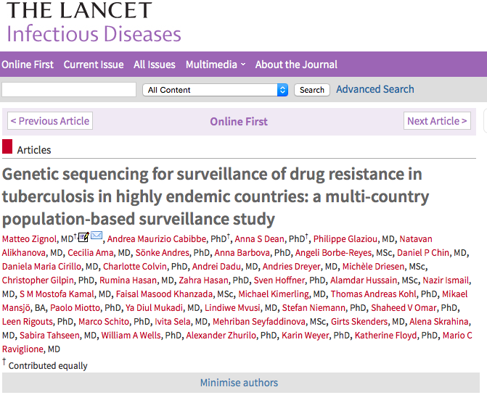
WGS based is the most efficient tool to collect population based surveillance data

Slide 16
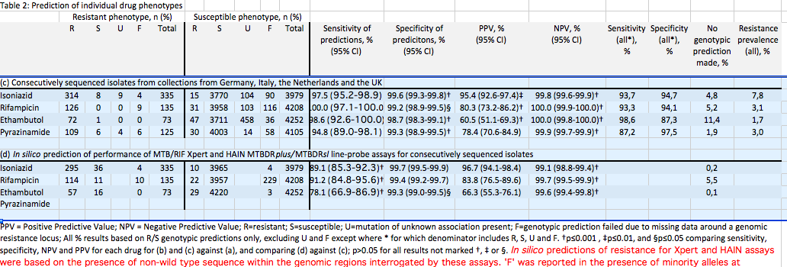
“DNA Sequencing Predicts 1st-Line Tuberculosis Drug Susceptibility Profiles” Walker et al submitted

Slide 17
WGS: applications in the field

Slide 18
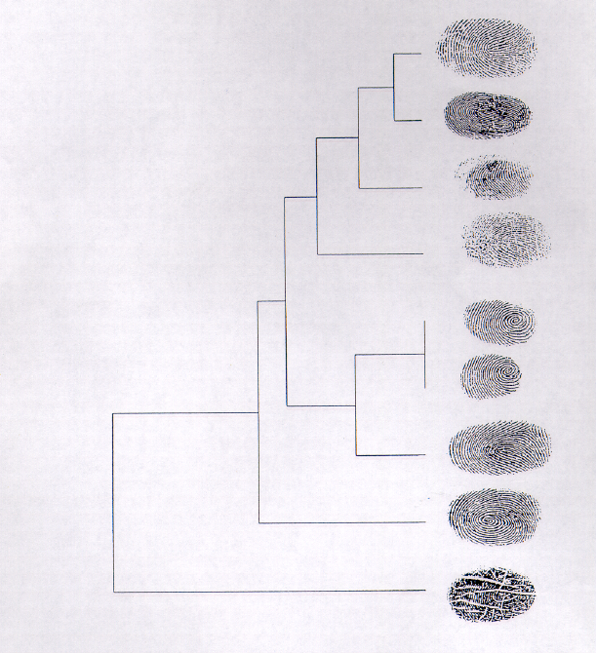
Genotyping: general principles
Differentiation of strains of Mycobacterium tuberculosis is based on strain specific differences and frequencies and order of certain DNA sequences in M. tuberculosis genome
“Conventional” typing methods:
  Interrogates tiny portion(s) of the genome
Next generation/Whole Genome Sequencing
  Interrogates entire genome
Standard (24 VNTR) sets and hypervariable loci (Supply et al., 2006; Allix-Beguec et al., 2013)
Current standard in many EU countries and worldwide

Slide 19
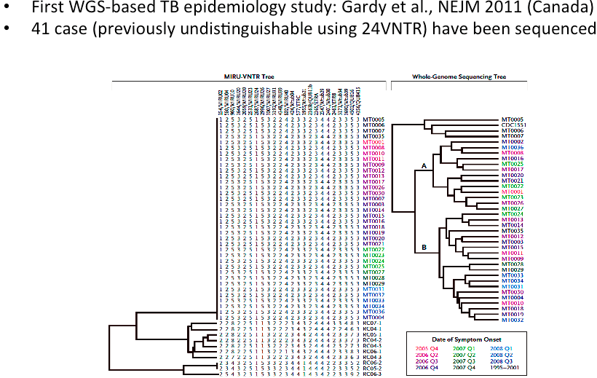
Role of WGS in TB epidemiology
Walker et al., Lancet ID 2013;
Walker et al., Nature Genetics 2014

Slide 20
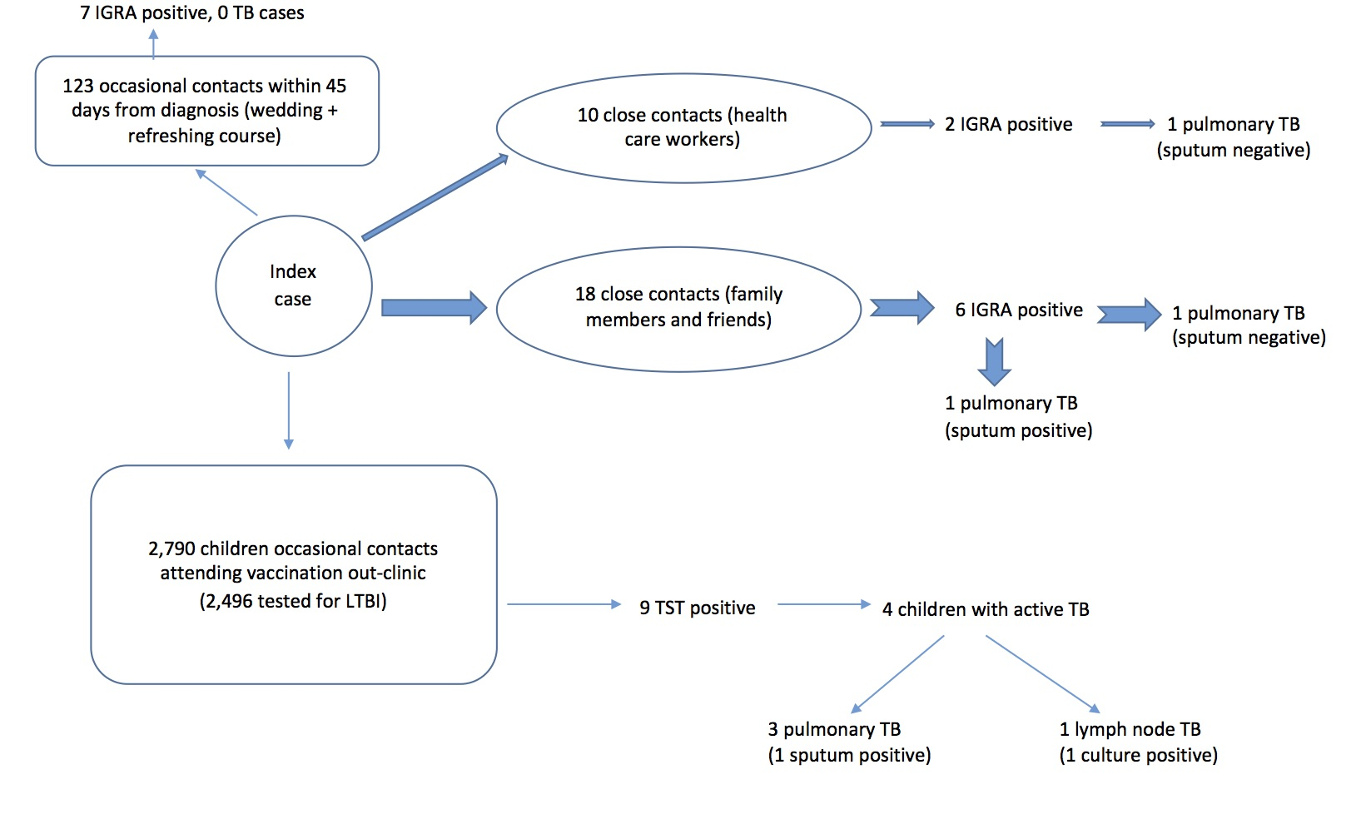
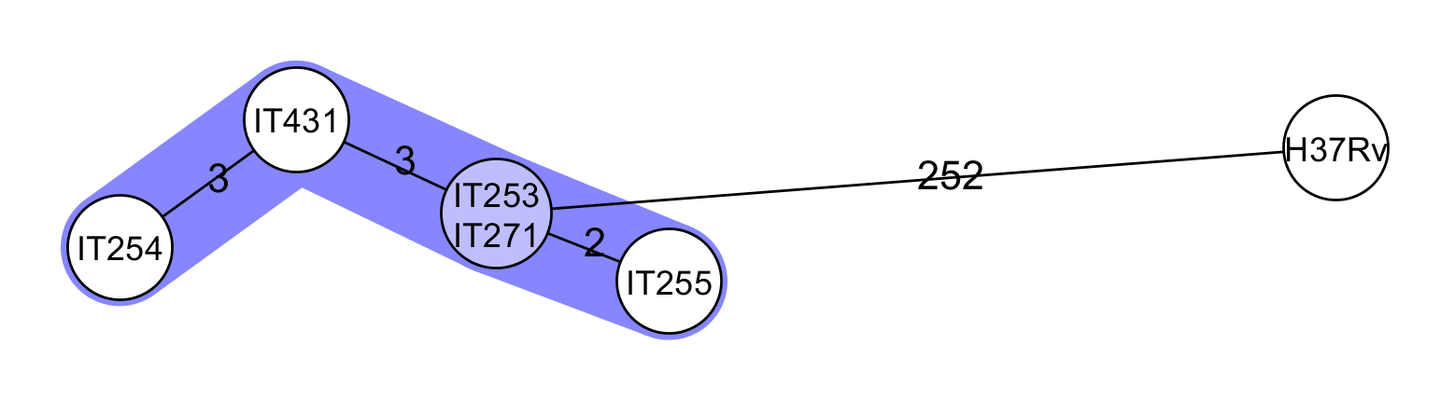
Luzzati R, Migliori GB, Zignol M, et al. Children under 5 years are at risk for
tuberculosis after occasional contact with highly contagious patients: outbreak from a smear-positive
healthcare worker. Eur Respir J 2017; 50: 1701414
253

Slide 21
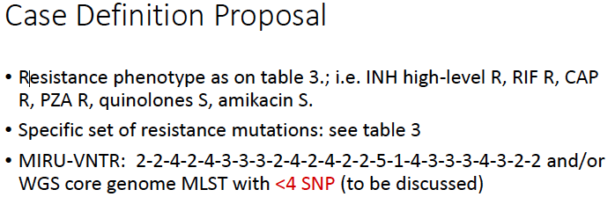
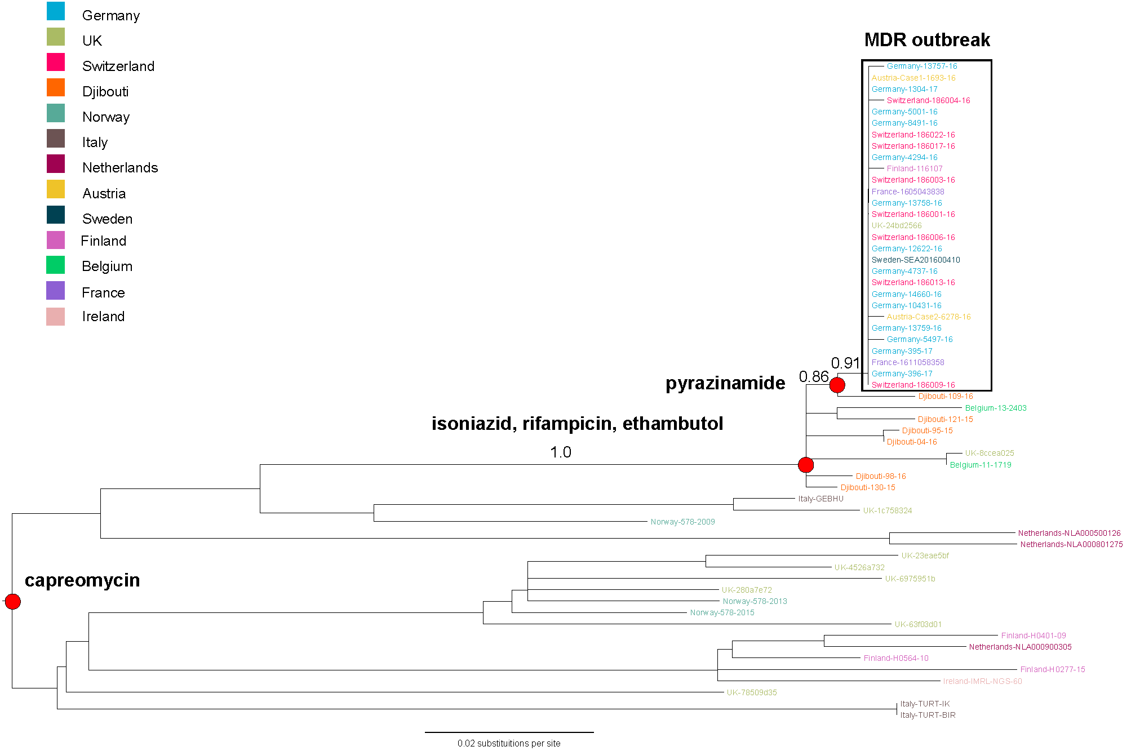
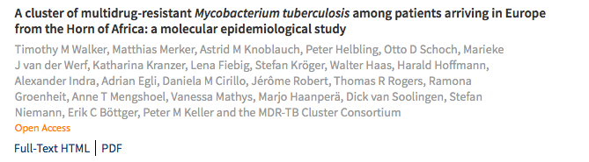
CROSS BORDER CLUSTER ANALYSIS
2016 Milano
2017 Lamezia Terme
Lancet ID 2018, Walker T

Slide 22
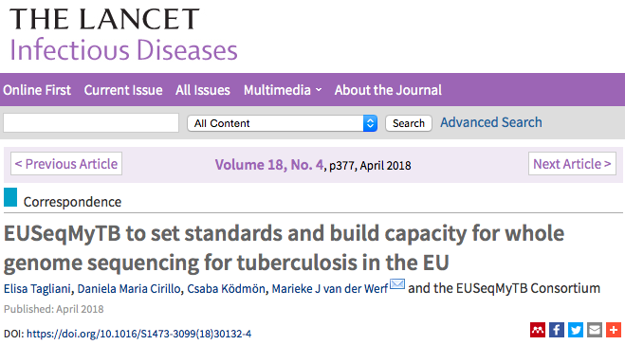
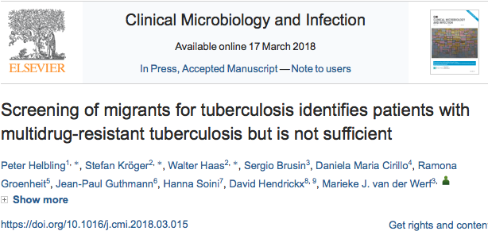

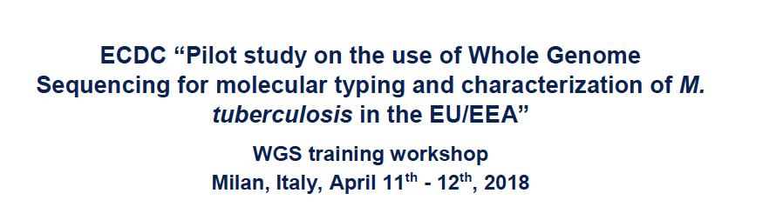

Slide 23
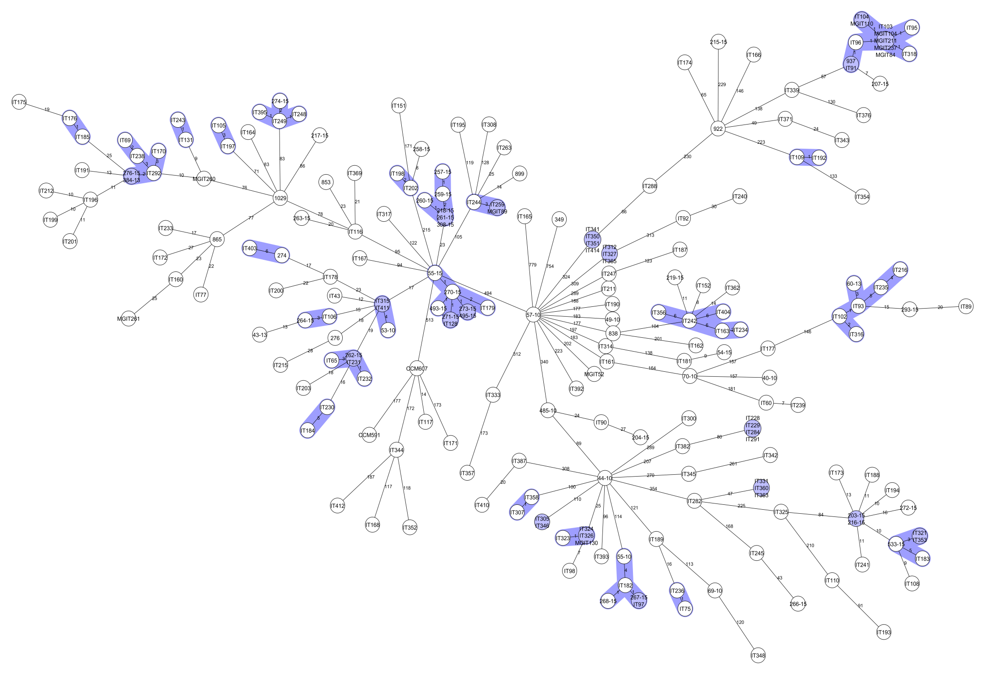
CLUSTER ANALYSIS: MDR ITALIANI 2010-2017
LAM 13,2 %
M. africanum
0,9 %
CAMEROON
0,9 %
S-TYPE
0,9 %
EURO-AMERICAN 22,8 %
BEIJING 37,9 %
GHANA
0,9 %
DELHI/CAS 3,7%
TUR
0,9 %
HAARLEM 11%
URAL 6,8%

Slide 24
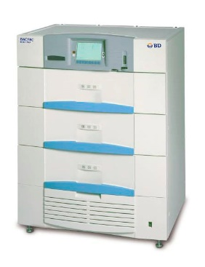


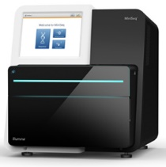
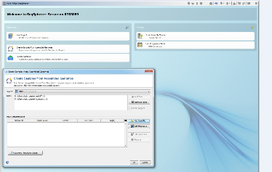

Cabibbe AM, Trovato A, De Filippo MR, et al. Countrywide implementation of whole genome sequencing: an opportunity to improve tuberculosis management, surveillance and contact tracing in low incidence countries. Eur Respir J 2018; in press (https://doi.org/10.1183/13993003.00387-2018).
Clinical Microbiology and Virology Unit, Florence Careggi University Hospital
Decontamination, culturing, heat-inactivation for shipment, DST on MGIT960 (SIRE, PZA)
6-10 days for culture positivity
Mean 28 days for 1st line DST (range 6-402*)
* M. africanum
6-10 days for culture positivity
3 days for 1st, 2nd line resistance prediction and outbreak analysis
Sample collection: Tuesday mid-day
gDNA extraction 1st part (lysozyme): Tuesday o/n
gDNA extraction 2nd part (Maxwell) – 1h: Wednesday
Nextera XT (Illumina) 1st part – 3h: Wednesday
Nextera XT (Illumina) 2nd part – 2h: Thursday
MiniSeq (Illumina) - 24h: Thursday o/n
Downstream analysis - 2h: by Friday evening
Emerging Bacterial Pathogens Unit, IRCCS San Raffaele Scientific Institute
Illumina Inc.
A total of 328 MTBC positive samples identified between February 2016 and September 2017

Slide 25
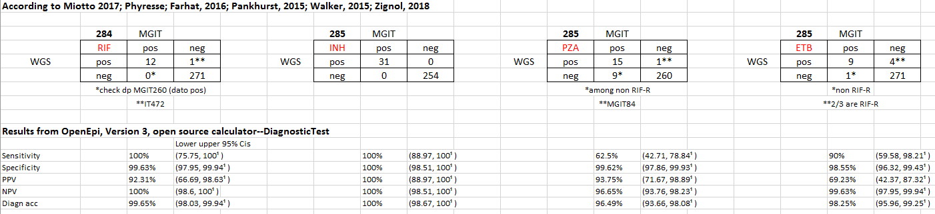
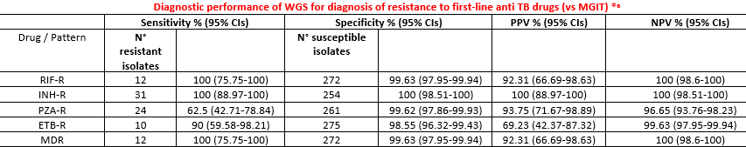
Drug resistance analysis
D435Y
K48T
Same for MDR detection
One XDR only: phenotypic resistance to CAP missed by WGS (rrs, tlyA: wt, eis: Thr269fs). MGIT testing performed in Pisa and not repeated in Florence
14 cases of resistance (11 patients) to FQs informed by WGS (12 cases (10 patients) in non-MDR isolates): 12 gyrA high confidence, 2 gyrB previously reported (Asn499Thr)

Slide 26
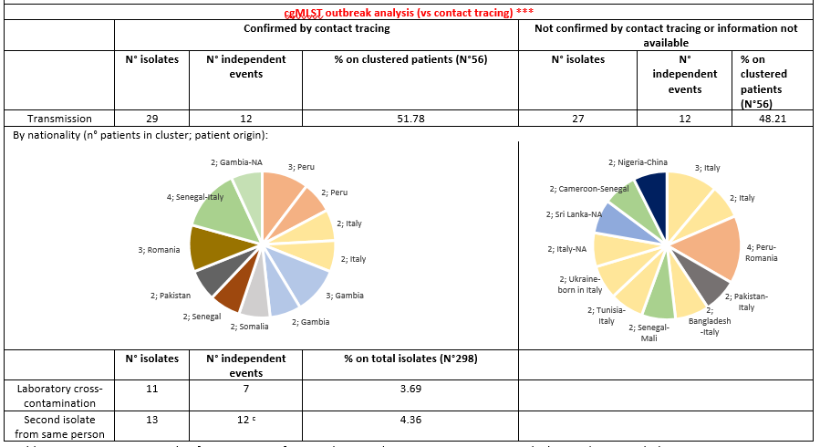
Epidemiological investigation
56 patients involved in transmission events with a clustering percentage of 12%
Mixed clusters involving Italian-born and foreigners were identified in 25% (14/56) cases
Notes:
According to Small, 1994: (n° clustered strains-n° clusters)/total n° strains, i.e. (56-24)/274=0.117

Slide 27
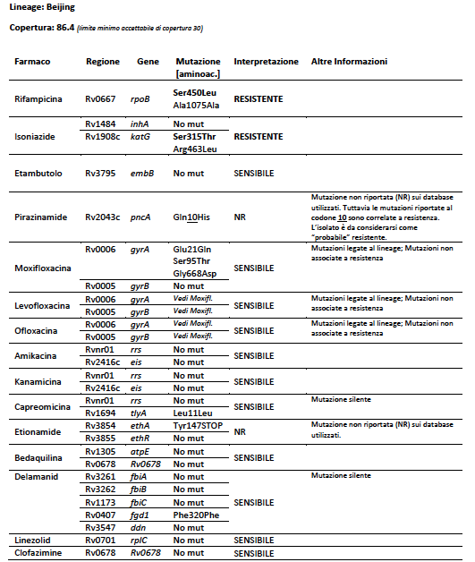
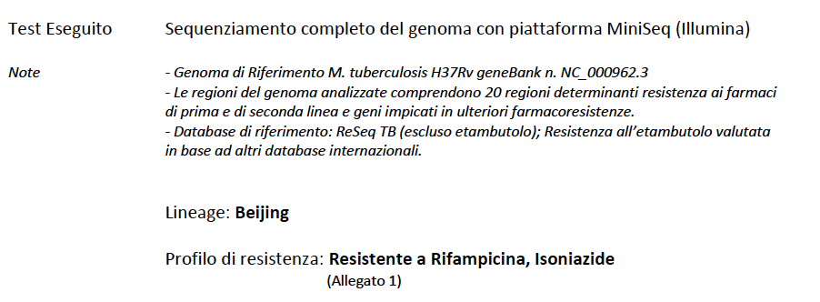
REPORTING WGS

Slide 28
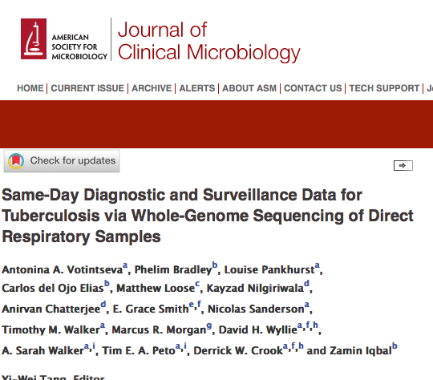
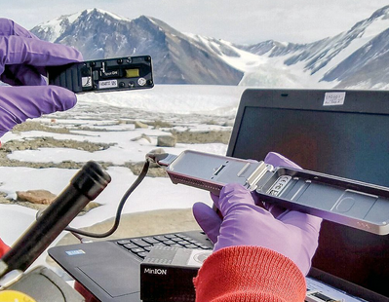
WGS from sputum
Not there yet!

Slide 29
Deeplex MycTB (Genoscreen) da campione biologico Target associati Alla resistenza ai principali antitubercolari
Species ID
Mycobacterial species (hsp65, rrs, rplC, rrl)
Drug | Gene target
Rifampicin | rpoB
Isoniazid | inhA, fabG1, katG, ahpC
Ethionamide | ethA, inhA
Pyrazinamide | pncA
Ethambutol | embB
Streptomycin | rpsL, rrs, gidB
Amikacin | rrs
Kanamycin | rrs, eis
Capreomycin | rrs, tlyA
Fluoroquinolones | gyrA, gyrB
Linezolid | rrl, rplC
Bedaquiline | Rv0678
Clofazimine | Rv0678
MTBC genotyping
Spoligotyping
CRISPR/DR region
Phylogenetic SNPs

Slide 30
CONCLUSIONI
L’accuratezza diagnostica del WGS per molti farmaci è simile a quella dei test fenotipici
Specifiche mutazioni possono predire la mic ed essere utilizzate per utilizzare farmaci e dosaggi adeguati
Per Bedaquilina e Delamanid siamo all’inizio ma sarà possibile rapidamente esaminare dati retrospettivi
Piattaforme WGS con analisi standardizzate dei dati permettono di ottenere dati utilizzabili per:
  Ottimizzazione della terapia a livello individuale
  Sorveglianza delle resistenze
  Sorveglianza delle trasmissioni a livello locale, nazionale ed internazionale
“target NGS “ è oggi il miglior compromesso per la diagnosi da campione
  RETE DI SORVEGLIANZA MOLECOLARE NAZIONALE E INTERNAZIONALE

Slide 31
RINGRAZIAMENTI
Riccardo Alagna,
Lucia Barcellini
Simone Battaglia
Emanuele Borroni
Andrea Cabibbe
Matteo Chiacchiaretta
Maria Rosaria De Filippo,
Lucinda Furci,
Arash Ghodousi,
Floriana Gona,
Giovanna Graziano,
Riccardo Ligresti,
Paola Mantegani
Paolo Miotto
Camilla Riva
Marco Rossi
Giovanna Stancanelli
Elisa Tagliani
Enrico Tortoli
Alberto Trovato
Emerging Bacterial Pathogens Unit
Federica Cugnata
Paola Rancoita
Clelia di Serio
CUSSB
FIND/NDWG
WHO
M.Zignol
ECDC
OSR Genomic Center
D. Goletti
E Girardi
IMNI
A.Matteelli
University of Brescia WHOCC
WHOCC TRADATE
GB Migliori
S D’Amato
Ministero della Salute
L Fattorini
ISS
SMIRA
L. Codecasa M Ferrarese E Mazzola
Lombardia Regional TB center
GM Rossolini and coll,
Careggi ,Florence
S Niemann and coll,
F.Drobniewsky, V. Nikolayesky
D.Van Soolingen, A, ER Anthony
ERLN TB Network
P.Supply
University of Lille
E-detect TB consortium
Partners and experts from
ReSeq TB
Cryptic Consortium members
D.Crook
A. Gibertoni Cruz
T.Walker

Slide 32















RINGRAZIAMENTI

