Slide 1
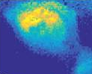
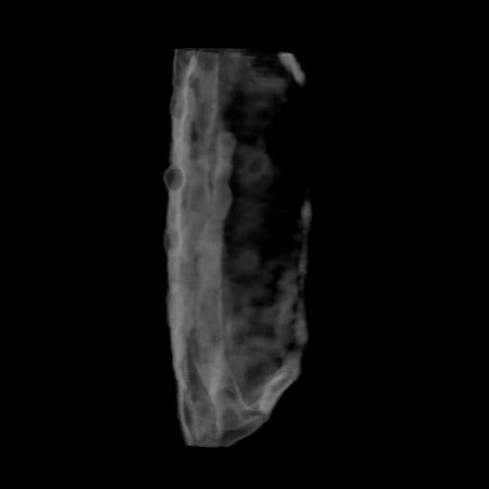
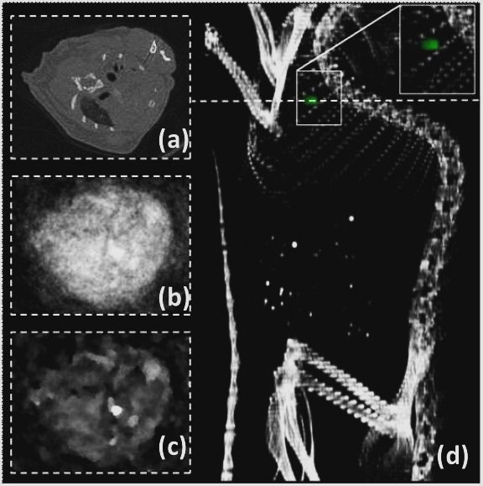

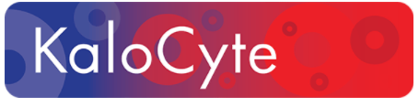
Engineering and Medicine Coming Together to Cure Cancer
Prof. Dipanjan Pan, PhD, FRSC, FAHA, FACC
Associate Professor & Director of Professional Masters Program in Bioengineering
University of Illinois at Urbana-Champaign; dipanjan@Illinois.edu; 217-244-2938

Slide 2
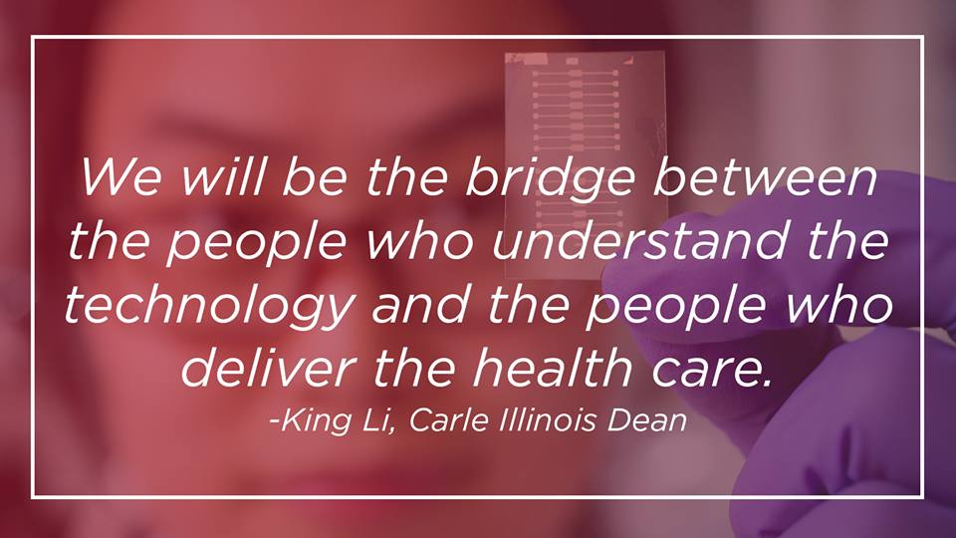

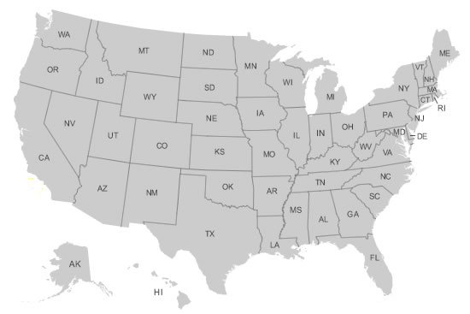
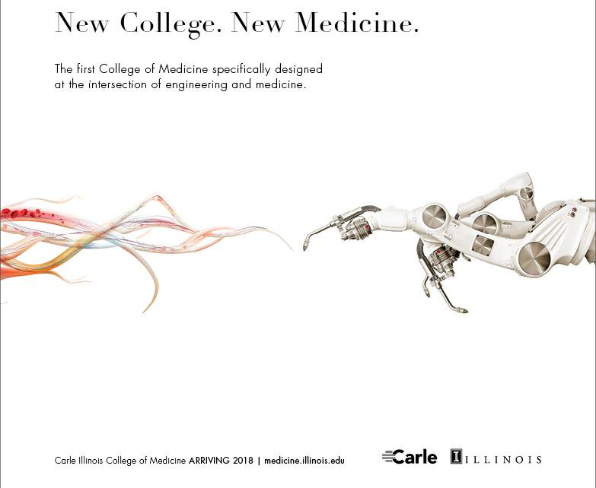
Engineering and Medicine Integrated

Slide 3
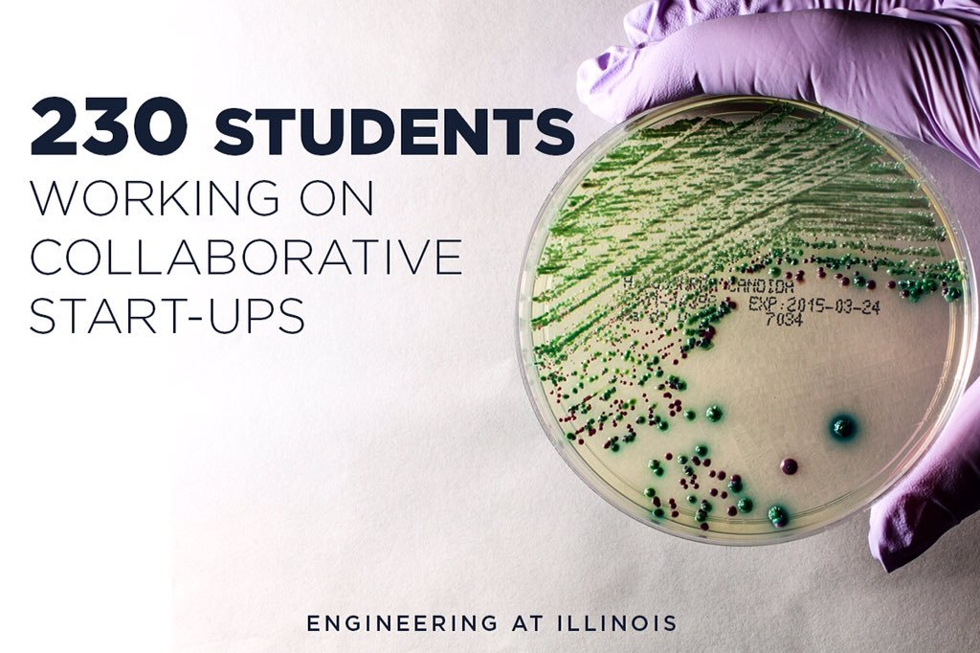
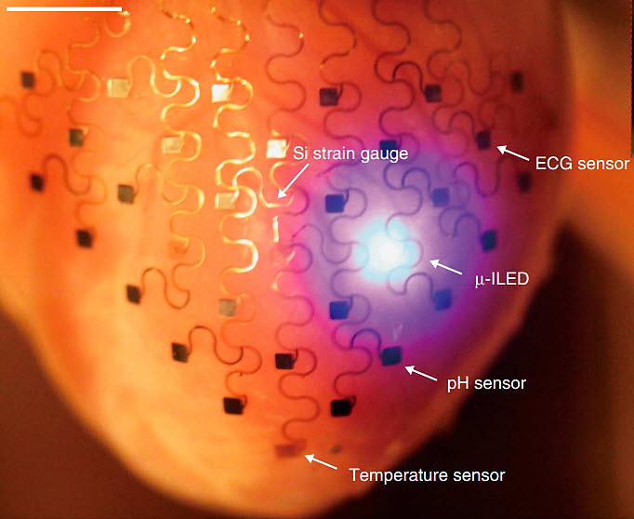
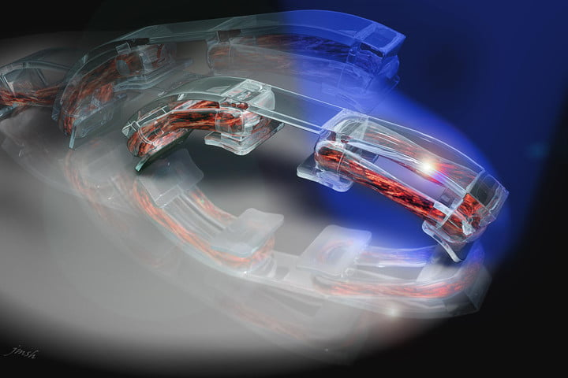
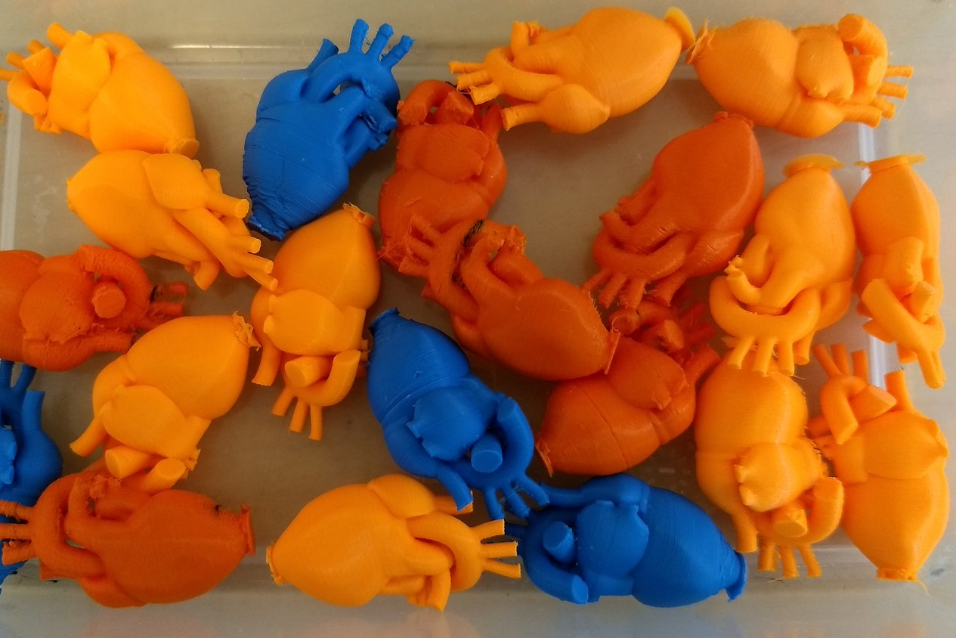
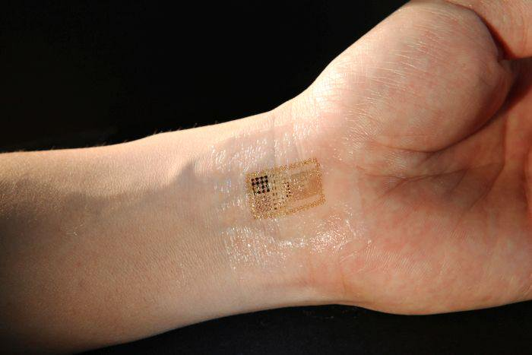
Next Generation Medicine
3D printed heart socks to continuously monitor the heart’s electrical activity
Wireless heart monitoring, improved IV lines, HIV detection
Muscle powered biobots walk on commands
Tattoos that could block seizures
3D Printed Hearts
Courtesy:
John Rogers,
Rashid Bashir

Slide 4
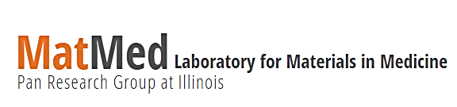
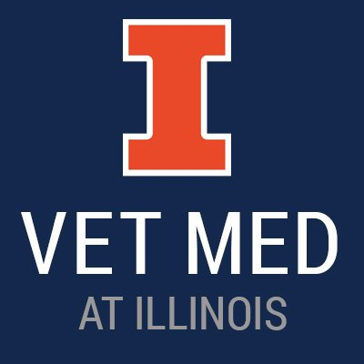
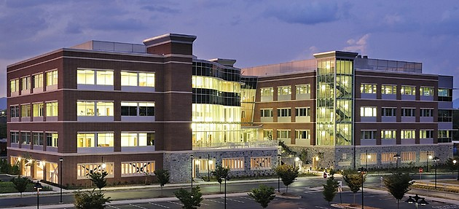

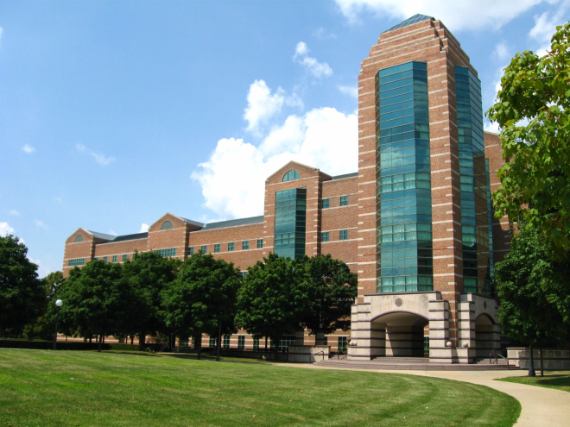


Chemistry Basis, Medicine Centric & Eng Philosophy
Wet lab, In vitro, Ex vivo Studies, Clinical collaboration
Large animal studies (Pig)
Clinical trials: 2
Start-ups: 3
Probes in the market: 2
Companion pet study: 1
Several patents
Technology licensing: 4
Preclinical imaging
http://pan.bioengineering.illinois.edu

Slide 5
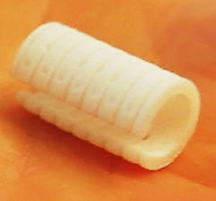
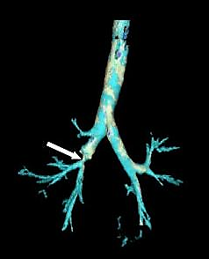
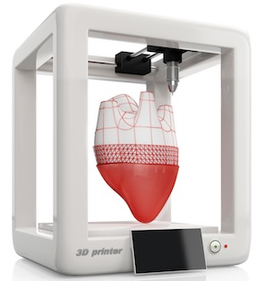
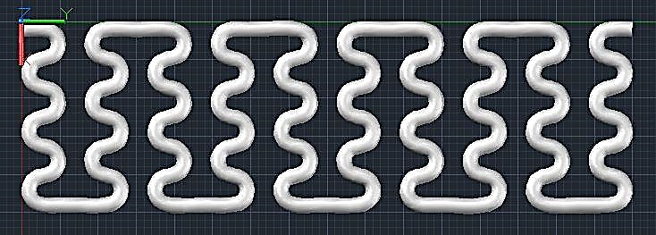
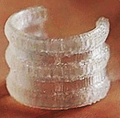
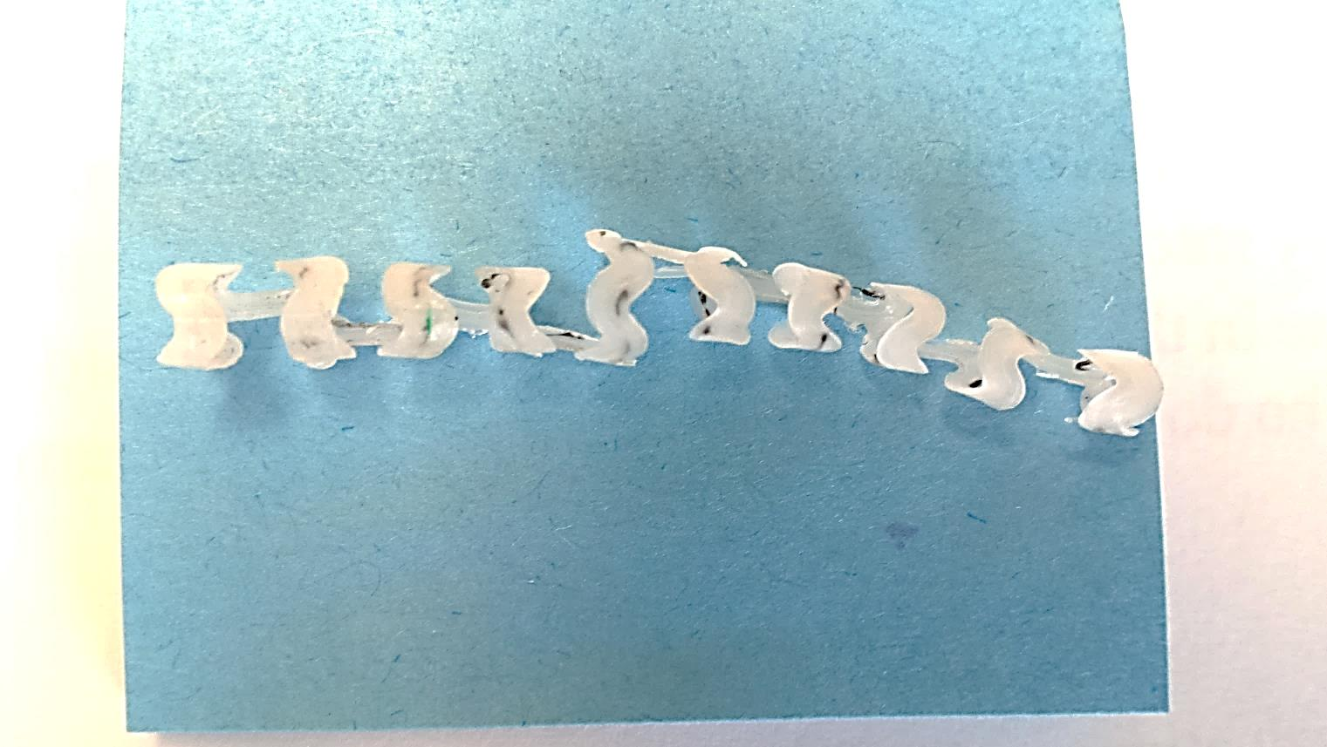
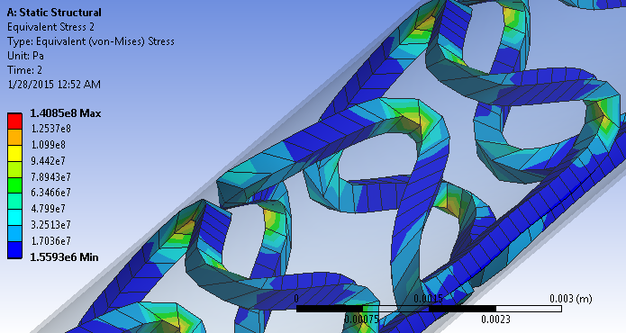
Personalized, Degradable 3D Printed Trachea Stents
CT image of tracheal stenosis
CAD design and 3D Printing at UoI
3D Printed Stents
Traditional airway stents are made of silicone, metal, or hybrid materials--limited by their cost and complications such as migration and granulation tissue formation related to inaccurate stent size and shape. CT scanners extract 3D models of a patient’s trachea to guide the design of custom stent that are anatomically accurate with seamless surfaces that follow the contours of a patient’s airway
5

Slide 6
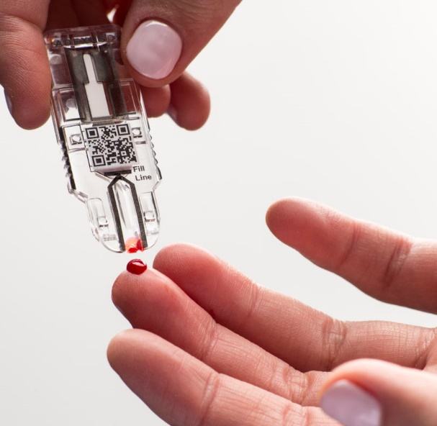
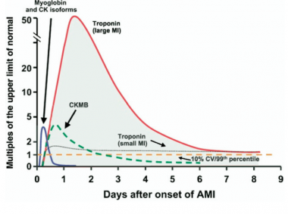
Point of Care Diagnostics for Pulmonary Embolism
Current approach
Cardiac enzymes : markers found in the blood
Tested when Myocardial Infarction (MI) is suspected
Typically elevation of one of these markers are tested (heart muscle damage)
New approach:
Simultaneous detection of 4 biomarkers & B-type natriuretic peptide (BNP)
Better prediction
Accurate analysis
Better management
6

Slide 7
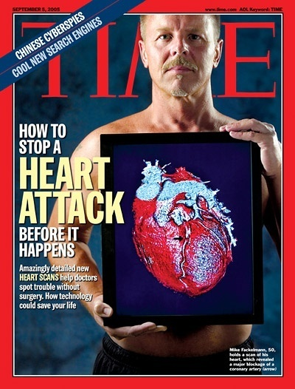
From Symptomatic to Pre-emptive Medicine
Disease progression
Current symptomatic medicine
leads to chronic disease
Clinical Symptoms
Symptoms
Preemptive medicine
Early
Diagnosis
Preventive
Treatment
Screening
Time
Functional and quantitative imaging localizing the disease
Minimally invasive treatment
Follow response to therapy
management tailored to the patient

Slide 8

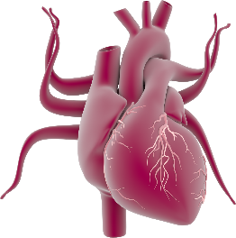
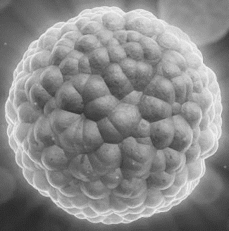
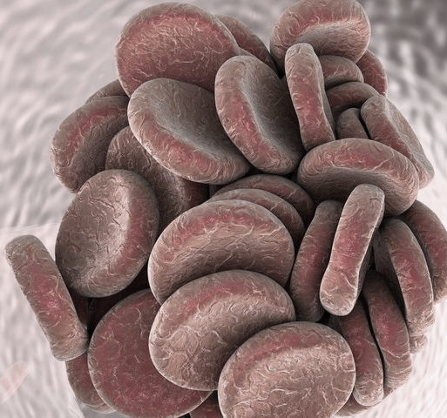

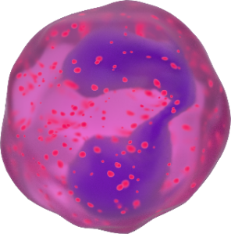
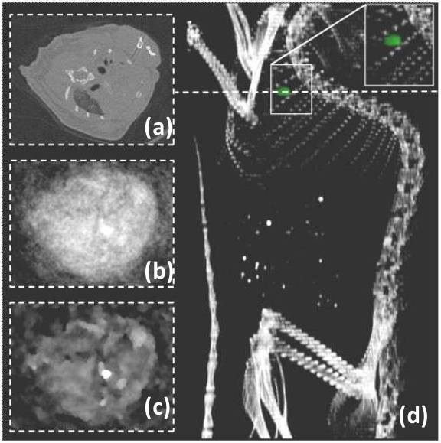
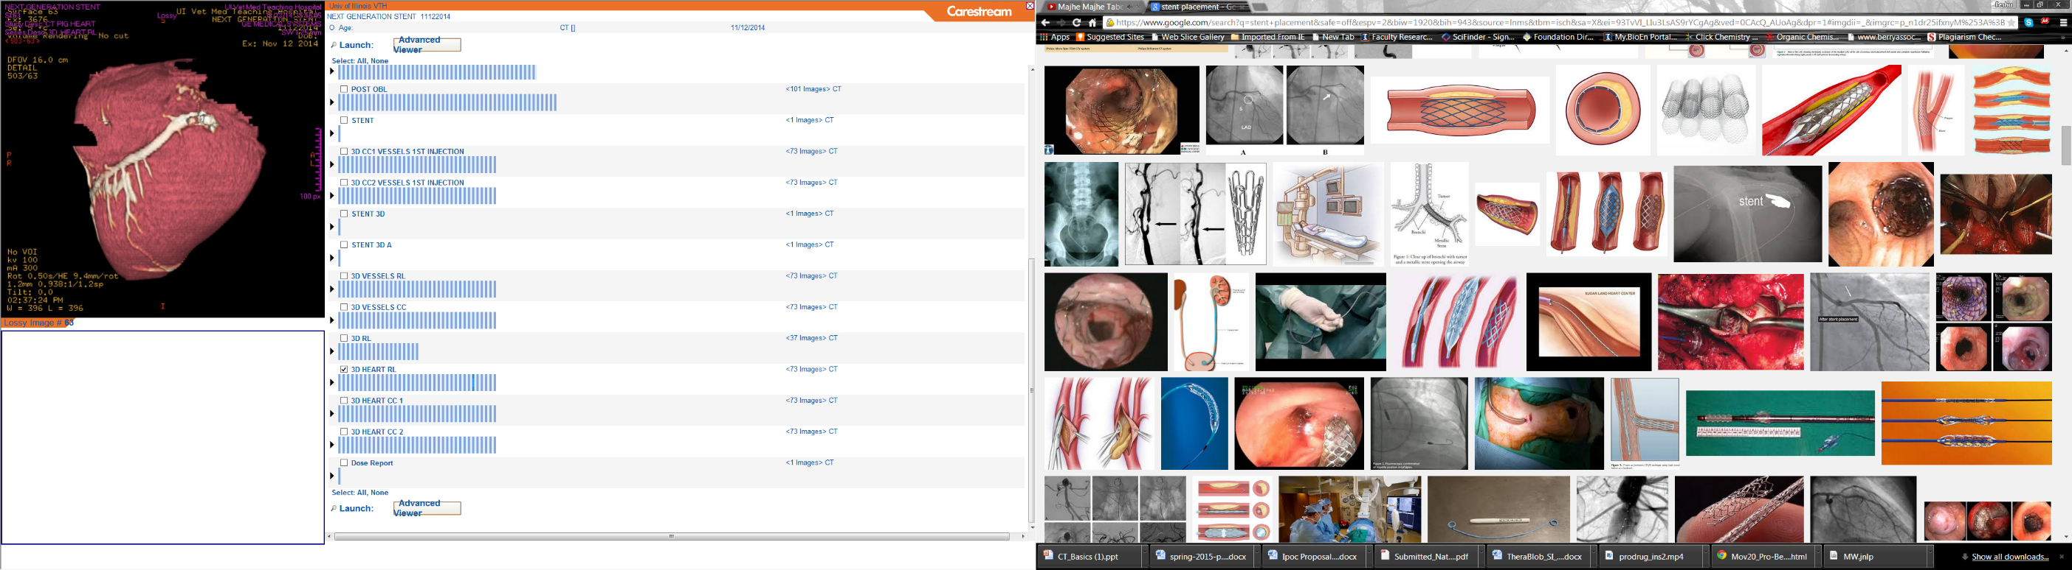
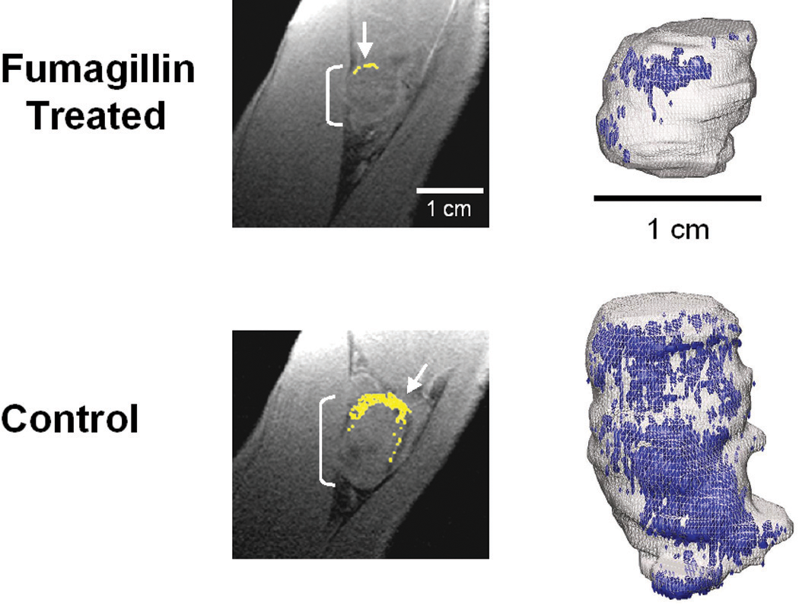
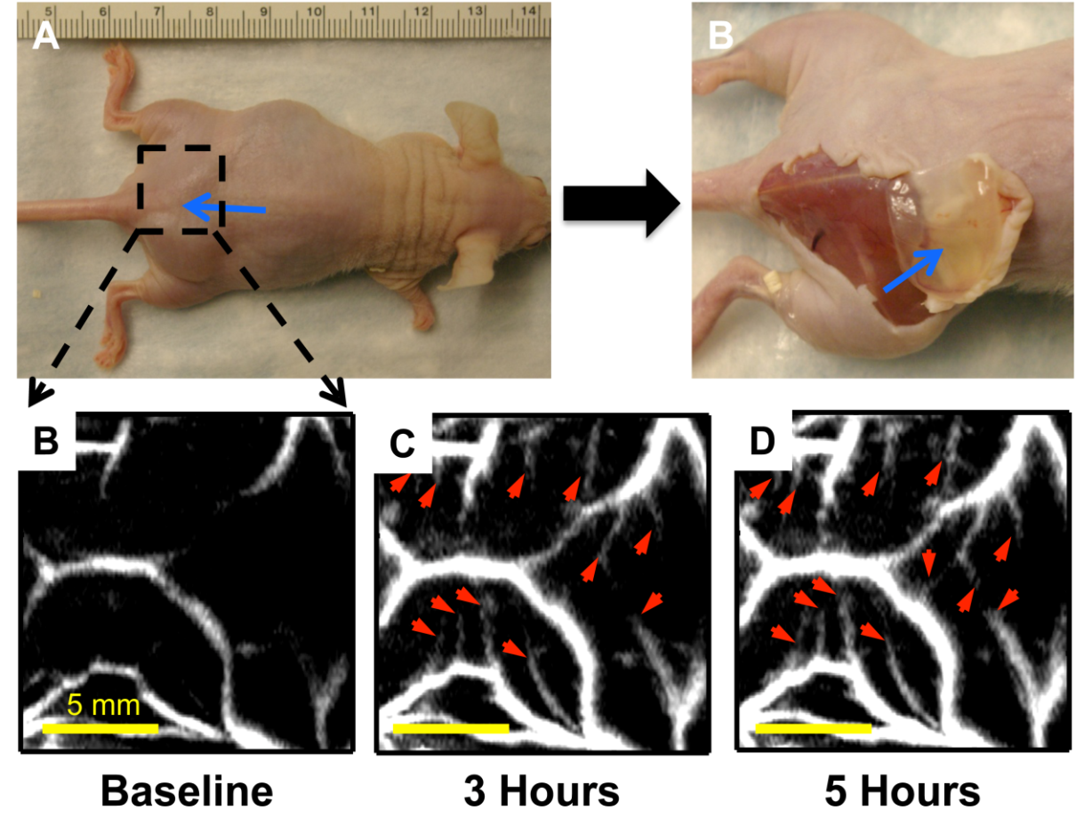
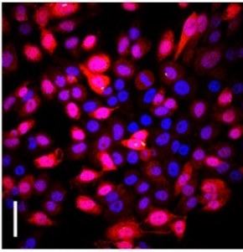
Translational Nanomedicine
Multidisciplinary approach to early detection
Whole body Organ Tumor Blood Clot Angiogenesis Cells
Angew Chem 2009; 2010
JACS 2008; 2009; 2010; 2011; 2012; 2017
ACS Nano 2011; 2012; 2015

Slide 9
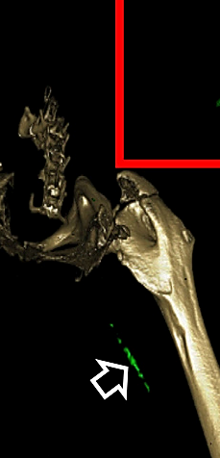
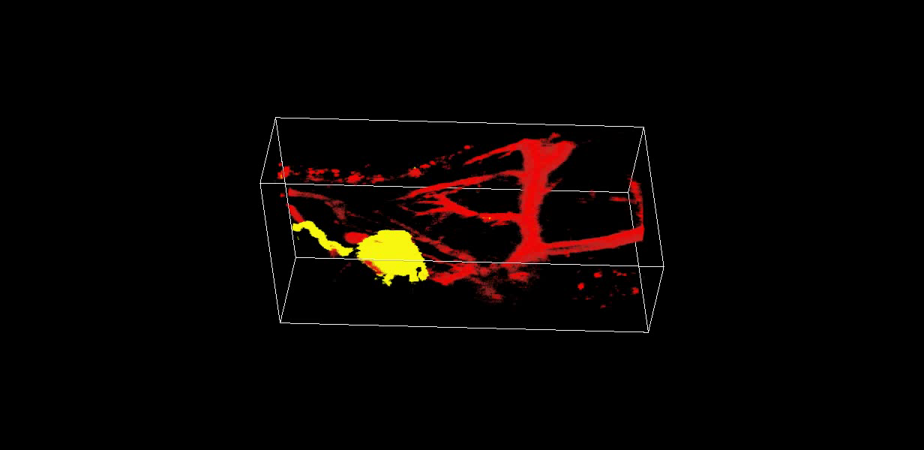
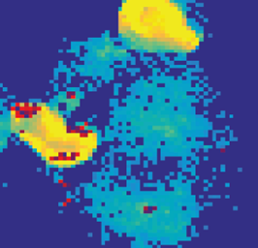
Molecular Imaging
Drug Release
Intra-cellular
Atherosclerosis
Thrombus
Nanomedicine. 2015; 11(3):569-78.
ACS Nano. 2012;6(4):3364-70.
JACS. 2012;134(25):10377-80.
Collaborator: Philips, Lanza, Wickline
Collaborator: Philips, Lanza, Wickline
Sci Rep. 2016; 6:29299.
Molecular Imaging
Small. 2015;11(36):4691-703.
Collaborator: Rohit Bhargava
Sentinel Lymph Node
Angiogenesis
Imaging
Probes (Exploratory)
LV
SLN
Theranostics. 2013;3(9):677.
Sci Rep. 2015; 5:14986.
Small. 2016
ACS Nano. 2012; 6(2):1260.
Nanoscale, 2016, 8, 2826-2831
Angew Chem 2010;49(50):9635.
Collaborator: Rohit Bhargava
JACS. 2011;133(24):9168-71.
Collaborator: Lihong Wang

Slide 10
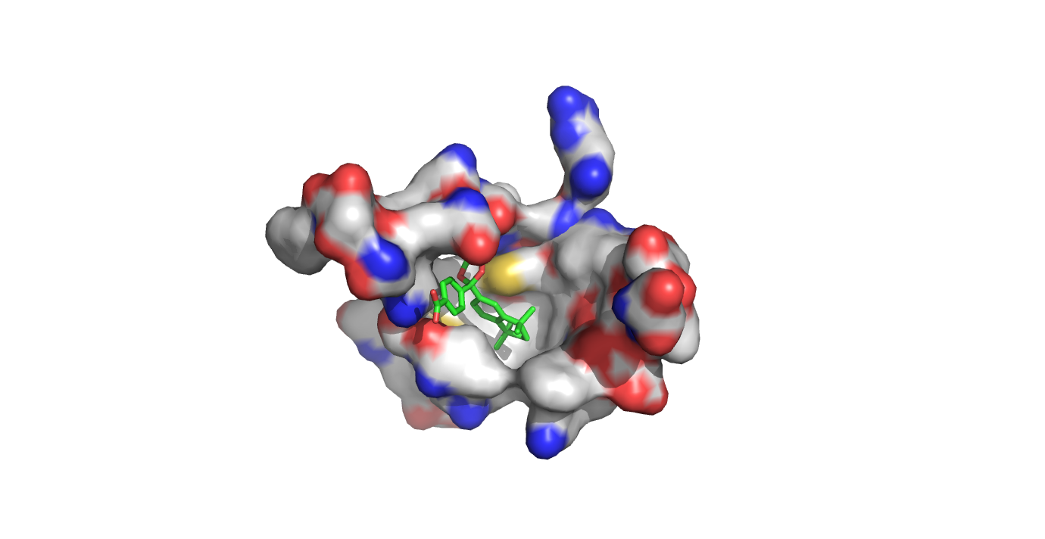
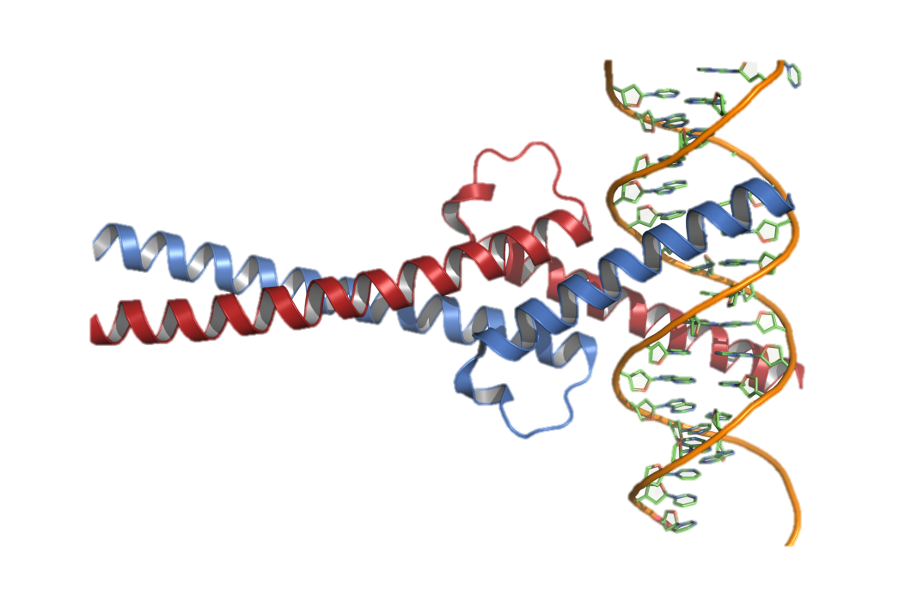
Therapeutics
Transcription factors
Oncogenes
Trans arterial chemo-embolization (TACE) for liver cancer
Prevent/Block Cell Growth
ACS Nano 2015
Sci Rep 2016
Immuno therapy
Thrombus
Stem-like Cells
Mol Can Ther 2017
Biomaterials 2010
Therapy
Apoptosis
Target defects in cancer cells
Signaling pathways inhibition by stem cell targeting
Carry other drugs to a tumor
ACS Applied Mat Int, 2017
Metabolic therapy
pH therapy
Nuclear Receptor
Locally delivered US ablation
Sci Rep 2014
Sci Rep 2016
Sci Rep 2015
Combinatorial therapy

Slide 11
How Early We are Able to Detect?

Slide 12
Is it Possible to Detect Neo-angiogenesis?
Early detection of immature, nascent angiogenic
vessels with Photo-acoustics Imaging and GNB!
Au
MATRIGEL MOUSE MODEL
720 nm
720 nm
720 nm
The specificity of αvβ3-integrin-NP was demonstrated by inhibiting αvβ3-transfected K293 cell binding to vitronectin. Effective affinity = 50 pM (per particle).
300 copies / Gold Nanoparticle
14 days
80-150nm
Integrin a_{v}b₃-Targeted
Gold NanoBeacons (GNB)
α_{v}β₃-GNB
FASEB J, 25, 875-882
Red arrows denote small neovascular sprouts arising from immature angiogenic vessels with only nascent blood flow.

Slide 13
Early Neovascular Response to Acute Lung Ischemia using Simultaneous ¹⁹F/¹H MR Molecular Imaging

Slide 14
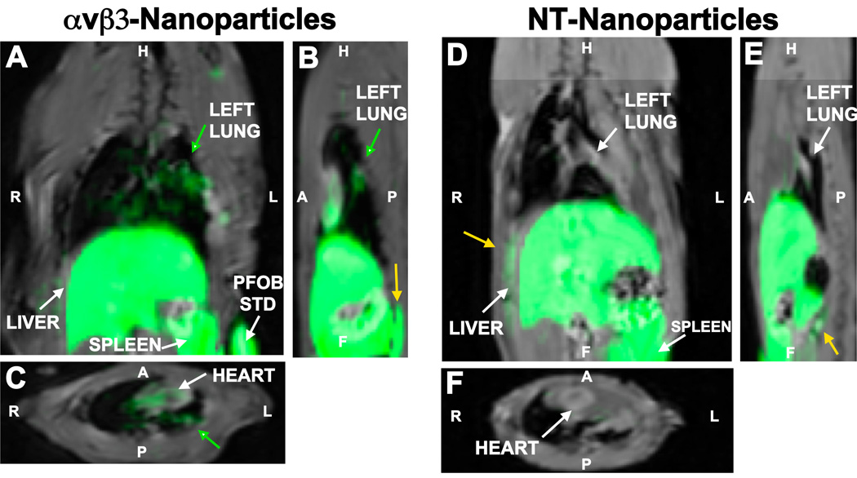
Whole body 19F/1H images of Rat Thorax & Abdomen
A. Coronal plane of rat showing accumulation in left lung near the pulmonary artery ligation site (adjacent to heart) and diffuse accumulation in the lung parenchyma. Minimal signal was detected in the right lung.
B. Sagittal view. C. Transverse view at the level of the heart showing bound nanoparticles in the left but not in the right lung.
D. Coronal plane of rat following NT-nanoparticles showing no visual accumulation in the injured left lung adjacent to heart, but with significant RES clearance of particles into the liver and spleen.
αvβ3-targeted nanoparticles can be used to directly measure neovascularity in a rat left pulmonary artery ligation (LPAL) model employed to create pulmonary ischemia and induce angiogenesis.
Angiogenesis 2014

Slide 15
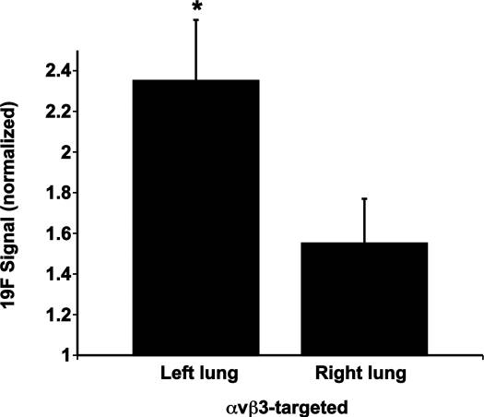
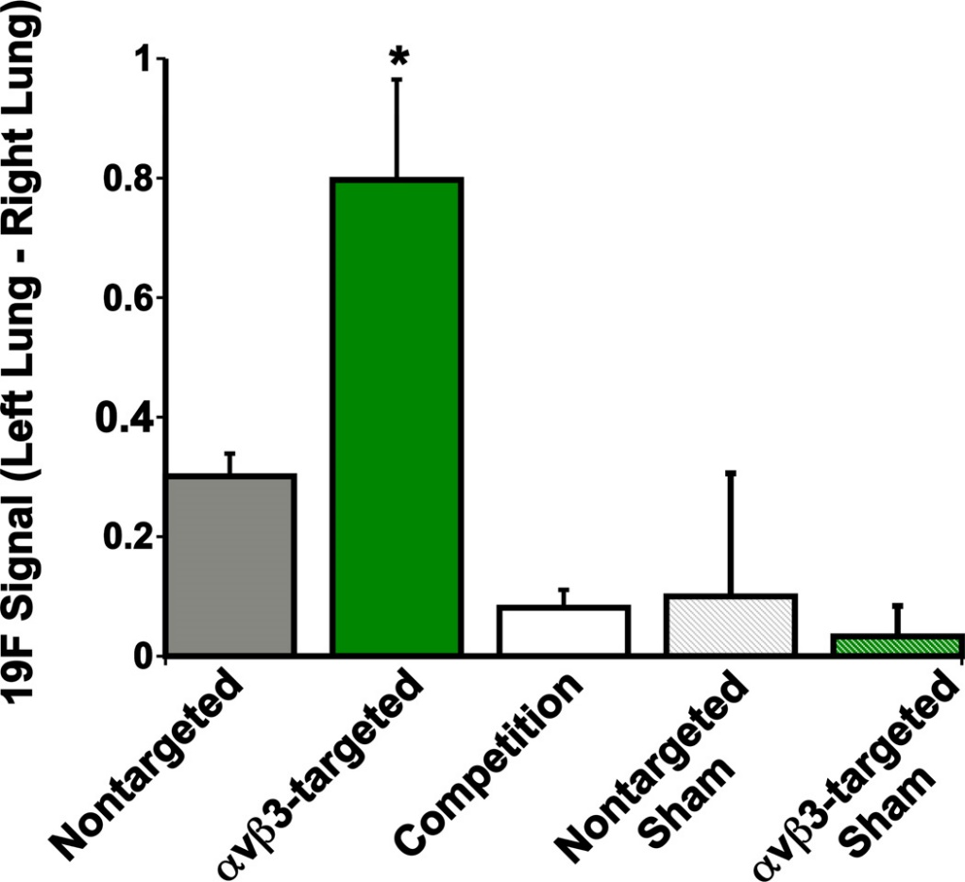
Whole body ¹⁹F/¹H images of Rat Thorax & Abdomen
Comparison of left and right lung 19F signal normalized to background noise within injured rats receiving αvβ3-targeted perfluorocarbon nanoparticles. Left lung 19F signal is significantly greater (p=0.009) than right lung contrast.
Comparison of left-right lung signal in day 3 LPAL rats, and sham-operated rats, administered nontargeted, α_{v}β₃-targeted, or competitive-inhibited α_{v}β₃-targeted nanoparticles after two hours.
Angiogenesis 2014

Slide 16
TACE for Lung Cancer

Slide 17
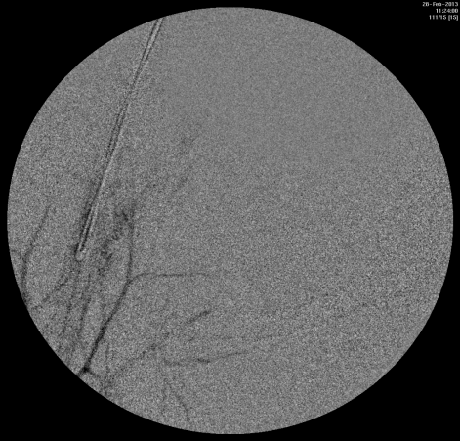
Transarterial Chemo Embolization in Lung Cancer
Patients with advanced or recurrent lung cancer have lesions invading the mediastinum with serious symptoms. Selective arterial infusion of antineoplastic agents will concentrate the drugs in the target lesion and reduces systemic exposure
Volume rendered overlay of selective signal of contrast (yellow) in its spatial relation to surrounding bone structures (rabbit)
Radio-opaque Thermo-responsive Polymeric Agent for Occlusion
A
Fluoroscopy (X-ray)
B
K-edge Imaging (Color CT)

Slide 18
Radiofrequency Ablation (RFA) and Repurposed Drug for Non-Small Cell Lung Cancer

Slide 19
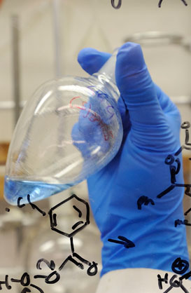
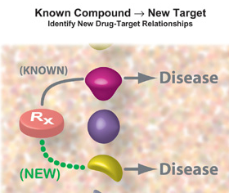
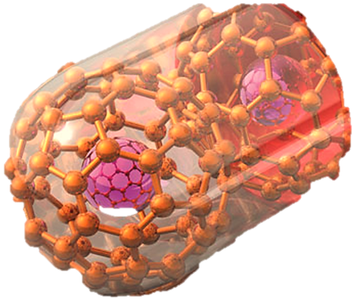
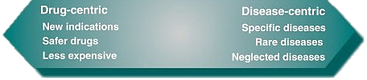
Retinoid X Receptor (RXR)
PRODRUG STRATEGY
+ MAGIC BULLET
New Drug
Discovery
Drug Repurposing
NANO
MEDICINE
Orphan Nuclear Receptor
Cancer

Slide 20
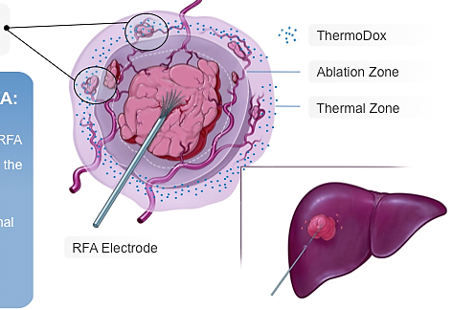
RFA limitations and Advantage of Trimodal Therapy
RFA misses micro-metastases outside ablation zone
Therablob
Therablob + RFA:
Trimodal therapy: hyperthermia+ sonoporation + chemo
Image-guided catheter-based delivery of prodrug-nanobubbles
Patented self-assembled prodrug nanobubble therapy
Drug concentrates in the “Thermal Zone”
Ablation releases selective drug expanding treatment area and destroying micro-metastases
Ablation Zone
Thermal Zone
RFA Electrode

Slide 21

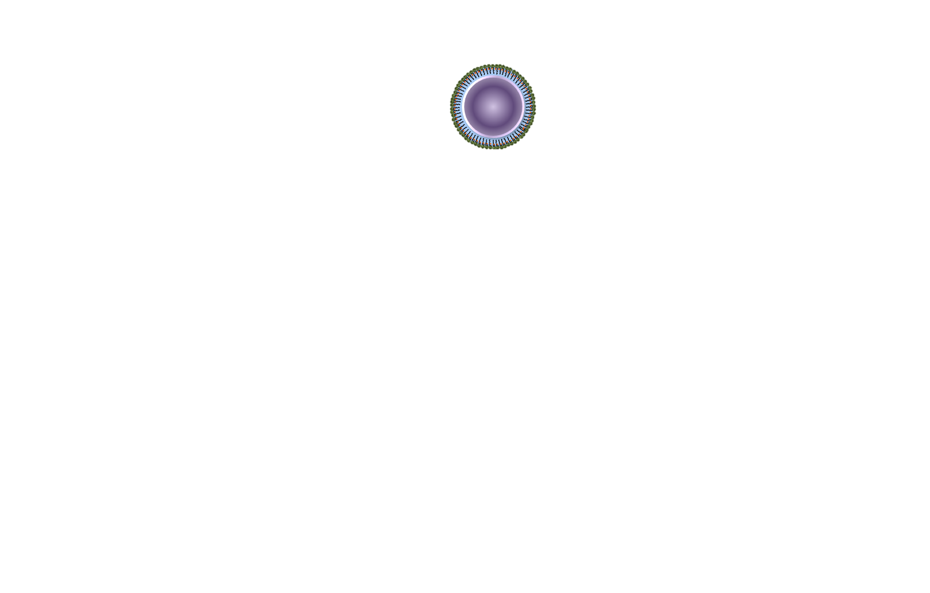







Nanobubbles Derived from Activatable Prodrug
This treatment might be an option for some people some small lung tumors that are near the outer edge of the lungs, especially if they can’t tolerate surgery.
Derived from repurposed FDA approved agents
Remarkable specificity
(Bexarotene)
Treatment for Cancer
ACS Nano 2015

Slide 22



US Triggered Delivery
New class of nanobubble derived from SN2 RXR prodrug
A
Fluoroscopy (X-ray)
Rodent
Pig

Slide 23


Ultrasound Induced Bursting
(Collaborator: K. Schulten, E. Tajkhorshid)
Shock wave
0 ns 60 ns 62 ns 63 ns 65 ns

Slide 24

Membrane Funnel Formation, No Pore
Jet flow membrane “punching”
Prodrug spontaneous insertion
Prodrug post-ultrasound delivery relies on spontaneous membrane insertion!

Slide 25
Cell Internalization Mechanism
Inhibitor pre-incubation
study.
(B-D) Cell TEM of Prodrug-NP after 30 min of incubation showing position of membrane fusion as mode of cellular entry.
Cell with rhodamine alone (E, F) and Rh-Pro-NPs (G, H). E&G: DAPI stained cellular nucleus; F &H: Rh distributed in intracellular space (4h).

Slide 26

Flexible Catheter Based US Ablation System
Catheter-Based Ultrasound (CBUS) Applicators for Percutaneous Conformal Hyperthermia and Thermal ablation to Targets in Soft Tissue

Slide 27

Flexible Catheter Based US Ablation System
Injecting Therablob
(b) US B-mode image of the tissue (yellow arrow indicate the release of the TheraBlob into the tissue as can be visualized in the B-mode image,
(c) applicator
(b)
(a)
(c)
Collaborator: Acoustic Medsystem

Slide 28

Remarkable Efficacy in Transgenic Pig Model
Histopathology images of (a) normal tissue,
(c) treated with US only, and (g, h, i) US + TheraBlob.

Slide 29
New Chemotherapeutics

Slide 30

From RXR Discovery to Controlled Delivery (Preclinical)
Progression of computational, chemical and biological experiments
Hetero-dimerization capacity with RAR, LXR, PPAR, etc.
Transcriptional activation to induce apoptosis, cellular differentiation
Current RAR-drugs in clinical trials: 11; RXR-drugs in clinical trials: 2
Rexinoids (RXR selective ligands): activities on multiple pathways.
Collaborator: Larry Schook (Oncopig)
High selectivity (from RAR) is the key factor for the new design of RXR ligands with less toxicity

Slide 31

In vivo Tumor Regression Studies in Mouse Xenograft
Tumor volume regression post treatment with RXR and Nano-RXR whereas nanoparticles alone (RCM) or untreated animals were used as controls.
Protein expression in tissues collected from treated and untreated group of animals.
1: Buffer; 2: RCM; 3: RXR and 4: Nano-RXR from (i) tumor tissue and (ii) tissue from liver.
Post effects on protein expression

Slide 32

In vivo Tumor Regression Studies in Transgenic Pig
a) Timeline of in vivo experiment in onco-pig model. Tumor appearance on (b) day 1 of buffer injection.
(c) Tumor volume regression post treatment with RXR and Nano-RXR whereas animals treated with buffer were used as controls.

Slide 33
Post Effects on Protein Expression
Day 1
Day 13
Protein expression in tissues collected from treated and untreated group of animals.
1: Buffer; 2: RCM; 3: RXR and 4: Nano-RXR as obtained from (i) tumor tissue and (ii) tissue collected from liver.
Buffer
Nano-RXR
US imaging to follow tumor growth

Slide 34
Drug Metabolism Genes in Liver and Tumor
RXR and Nano-RXR induced transcriptional alteration of genes involved in phase-I and phase-II drug metabolism, phase-III transport and nuclear receptors in liver and tumor measured by qPCR.
Liver: CYP2C33, CYP2E1 and PXR were downregulated, SULTA1, FXR and PPARγ were unchanged and the rest of the genes were upregulated.
Tumor: FXR was downregulated, CYP1A2 was unchanged and all the other genes were upregulated by treatment.

Slide 35







Acknowledgement
Start-ups
Collaborators
Peter J Stang, PhD (OSU)
Allan Doctor, MD (WUSM)
Sam Wickline, MD (WU/USF)
Greg Lanza, MD, PhD (WUSM)
Babak Razani, MD (WUSM)
Pritesh Patel, MD (UIC)
Damiano Rondelli, MD (UIC)
Rohit Bhargava, PhD (UIUC)
Larry Schook, PhD (UIUC)
Klaus Schulten, PhD (UIUC)
Blair Rowitz, MD (Carle)
Leanne Labriola, DO (Carle)
Rashid Bashir (UIUC)
Joseph Irudayaraj (UIUC)
Michael Oelze (UIUC)
Pan Lab @ Illinois
Funding
http://pan.bioengineering.Illinois.edu

Slide 36

Thank You
Look forward to answering questions and collaboration
http://pan.bioengineering.Illinois.edu

