Slide 1
IPF SUBSETS
Venerino Poletti
Department of Diseases of the Thorax, Ospedale GB Morgagni, Forlì (I)
Department of Respiratory Diseases & Allergy, Aarhus University Hospital, Aarhus (DK)

Slide 2
COI
BI
ROCHE
ERBE

Slide 3
OUTLINE
Pathogenetic clues
Rapid vs Slow Progressors
Inflammation & IPF
Familial PF
IPF & peculiar comorbities

Slide 4
Lysil Oxidase
IL7, IL13…
Immunoaging/inflammation/
chronic colonization

Slide 5
RAPID vs SLOW PROGRESSORS

Slide 6
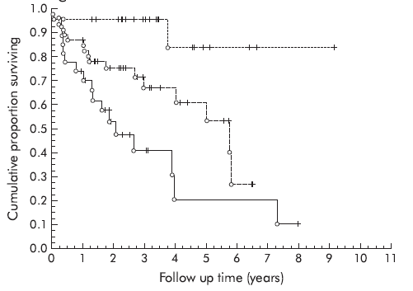
Patients with a typical HRCT appearance of UIP experience the highest mortality.
Histological NSIP
Histological UIP, HRCT NSIP
Histological UIP, HRCT UIP
Flaherty, Thorax 2003

Slide 7
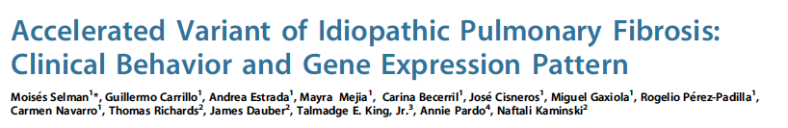
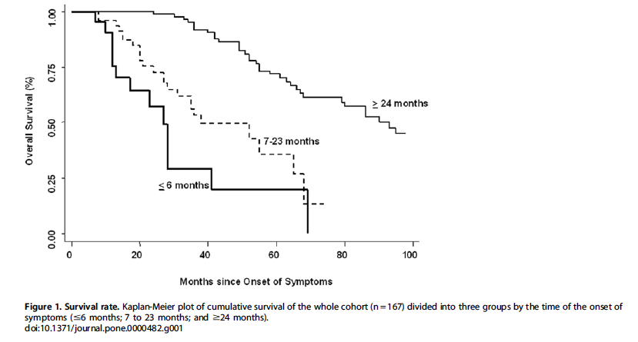
Selman M, et al. 2008

Slide 8
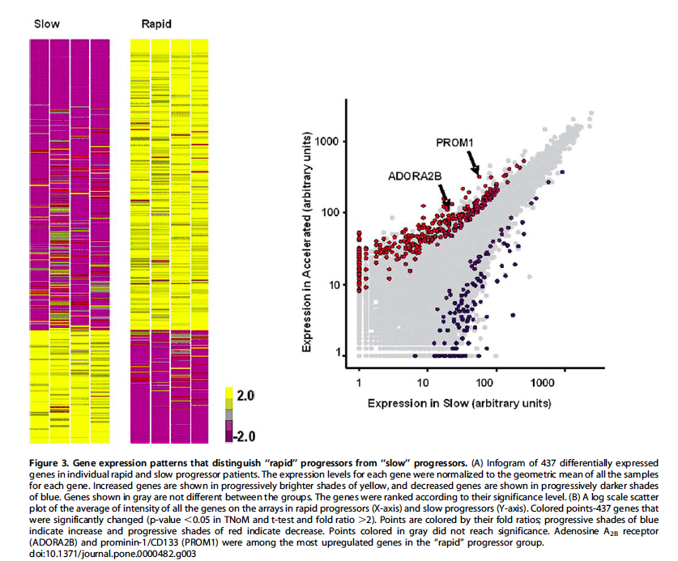

Slide 9
HSP47 in lung fibroblasts is a predictor of survival in IPF
Amenomori, Resp Res 2010

Slide 10
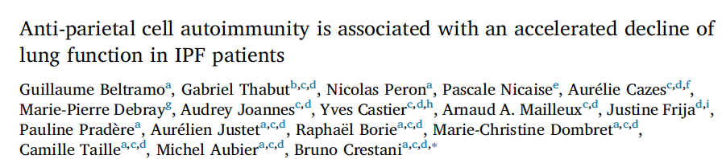
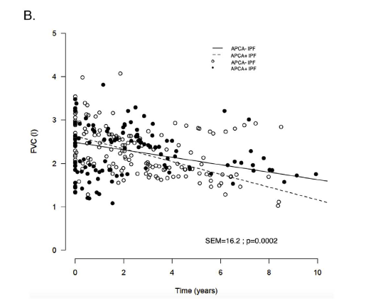

Respir Med, 2018

Slide 11
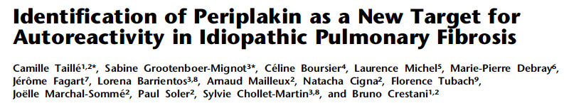
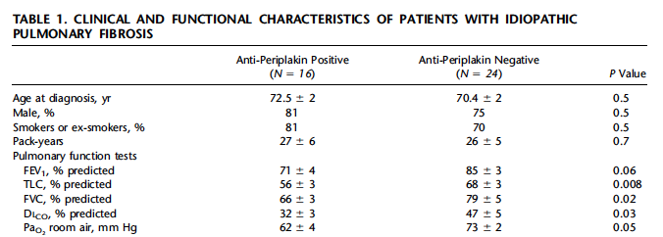
AJRCCM, 2011

Slide 12
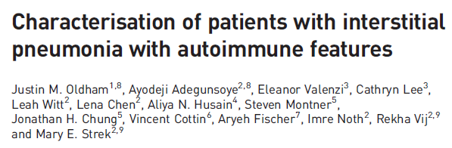
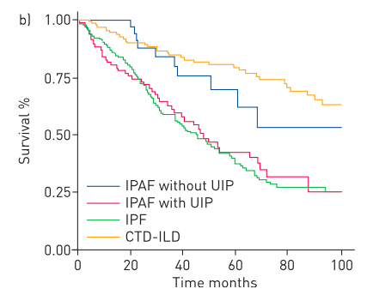
IPAF with UIP has the same mortality as IPF
IPAF without UIP has the same mortality as CTD-ILD
Oldham et al.
Notes:
Furthermore, stratifying the patients according to the presence/absence of UIP, survival significantly improved among IPAF patients with a non-UIP pattern

Slide 13
AUTOIMMUNITY & SENESCENCE
Myelodisplastic syndrome
IPF

Slide 14
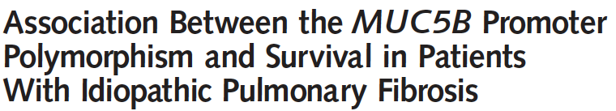
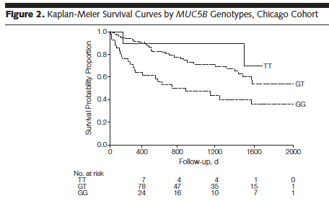
JAMA 2013

Slide 15
INFLAMMATION & IPF
(probably not as an expression of senescence)

Slide 16
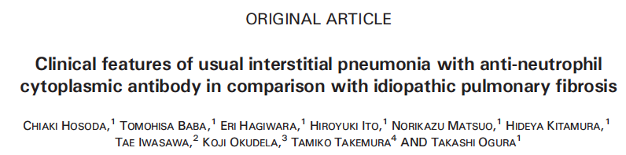
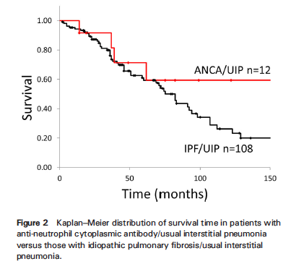
Interstitial inflammation
Lymphoid follicles
Cellular bronchiolitis

Slide 17
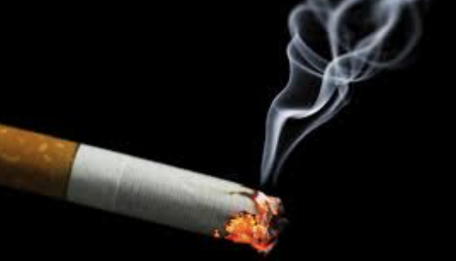
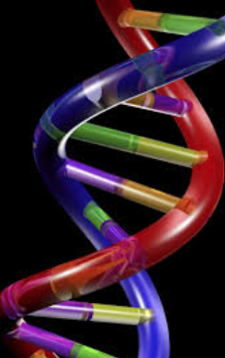
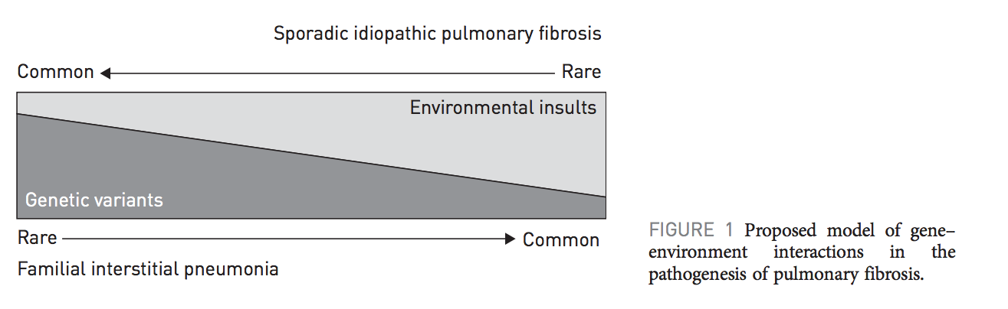
Familial cases
Kropski et al., ERJ 2015
Mathai et al, ERJ 2015

Slide 18
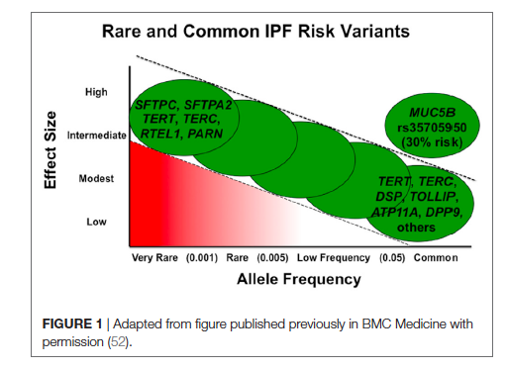

Slide 19
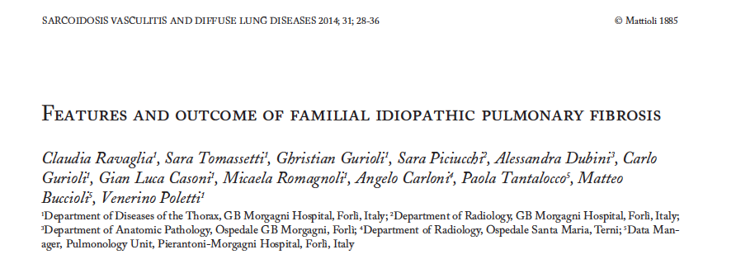


Slide 20
CT Imaging phenotypes of pulmonary fibrosis in the MUC5B promoter
Site polymorphism.
514 homozygous for the major allele (G group)
977 were heterozygous or homozygous for the minor allele( (T group)
GROUND GLASS OPACITIES SUBPLEURAL AXIAL DISTRIBUTION
G Group 62.1% 62.3%
T group 54.2% 42.2%
DEFINITE UIP PATTERN
G Group 20.3%
T Group 30.5%
CHEST 2016\

Slide 21
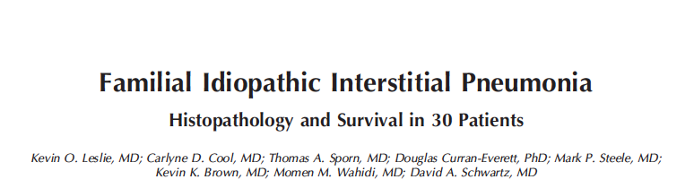
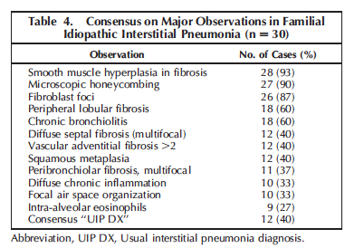

Slide 22
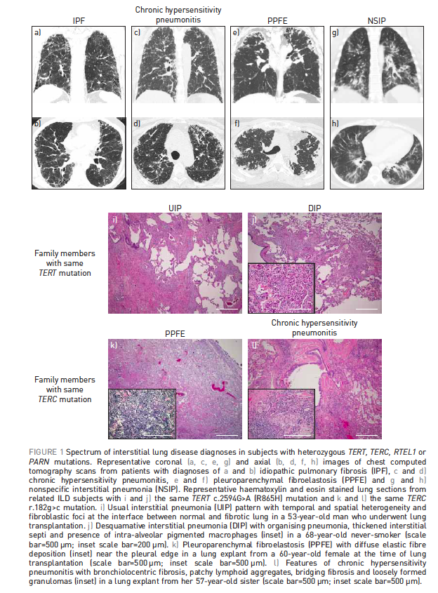
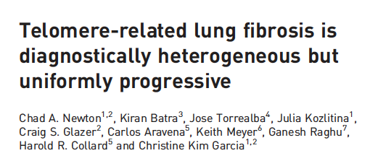
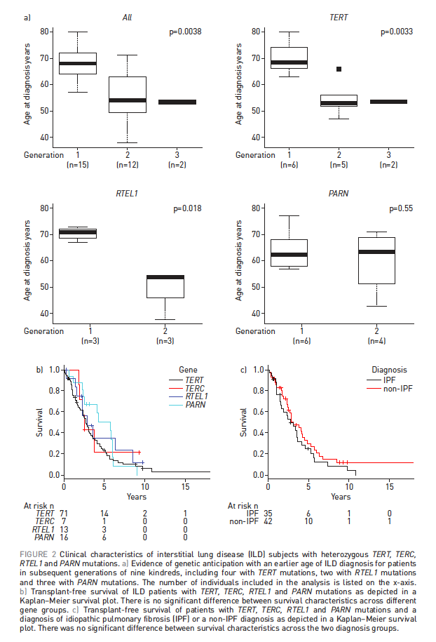
ERJ 2016
115 Pts: MDD Diagnosis
IPF 44%
Unclassif 20%
cHP 12%
PPFE 10%
IPAF 7%
IIP 4%
CVD-ILD 3%

Slide 23
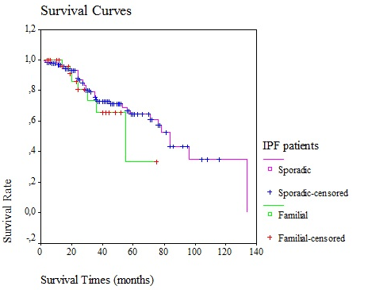
IPF Mortality
Ravaglia et al., Sarc Vasc Diff Lung Dis, 2014

Slide 24
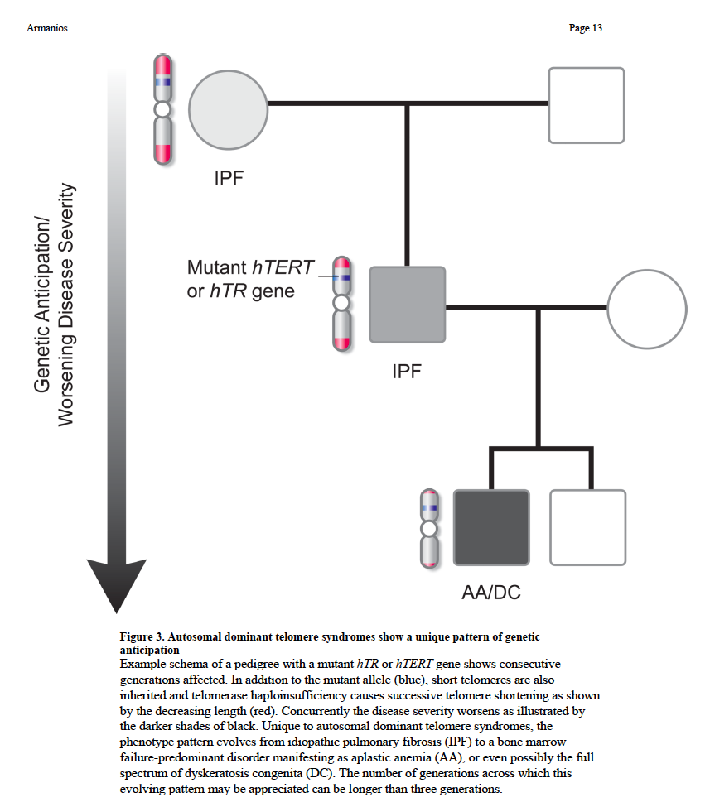

Slide 25
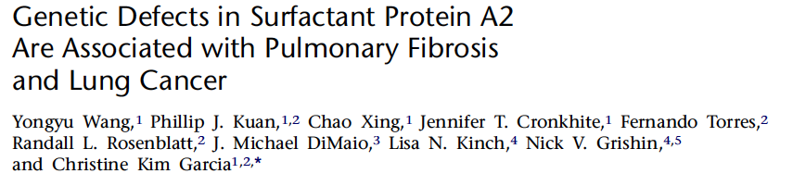
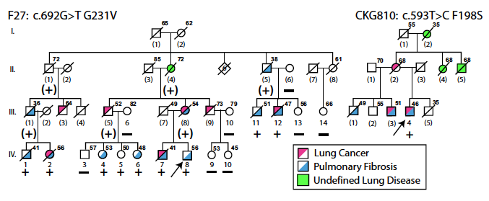

Slide 26
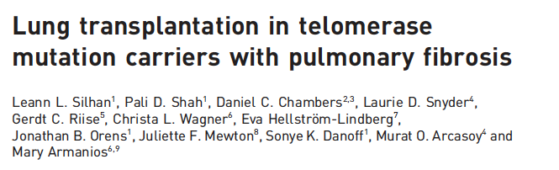
ERJ, 2014

Slide 27
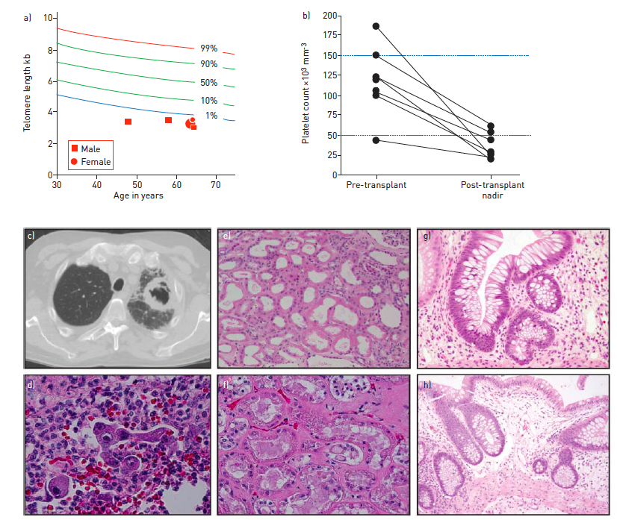

Slide 28
COMORBIDITIES: ADDING PIECES TO THE COMPLEX PUZZLE OF IPF CLINICAL PROFILE

Slide 29
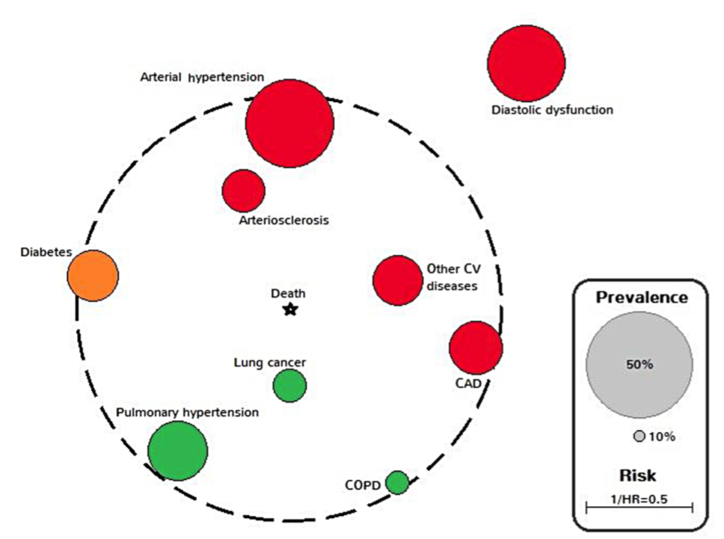
Comorbidities influence survival in IPF
Kreuter et al, PLOSone 2016

Slide 30
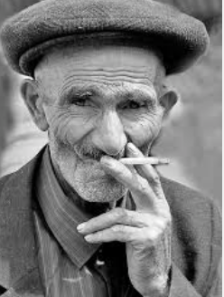
chronic obstructive pulmonary disease,
coronary artery disease, diabetes, osteoporosis,
^{gastroesophageal reflux,}
^{lung cancer,}
^{sleep-disorders,}
^{Infections.}
AGING
IPF
older age and a history of smoking

Slide 31
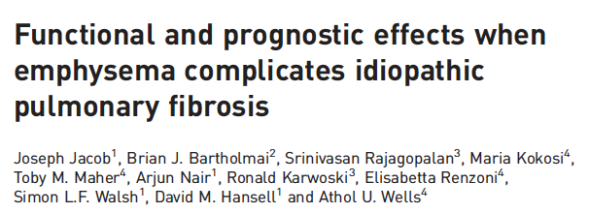
ERJ, 2017

Slide 32
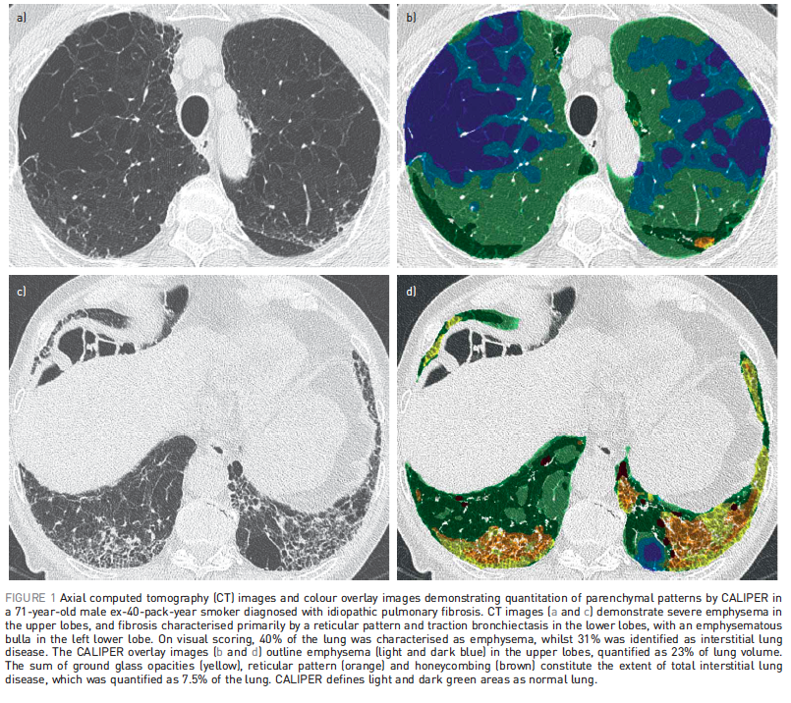

Slide 33
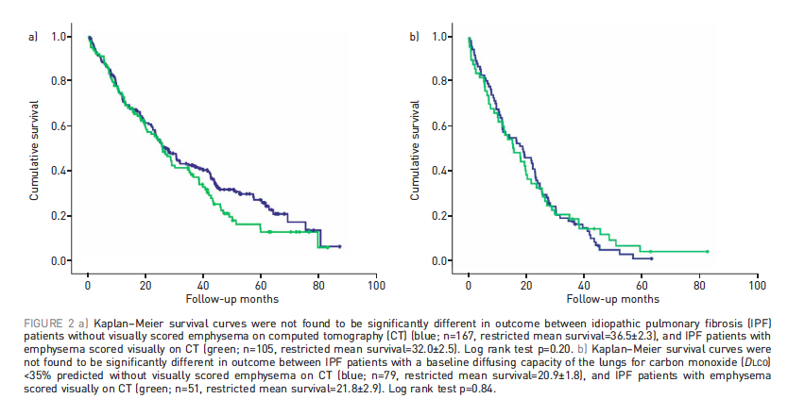

Slide 34
Lung cancer and IPF

Slide 35
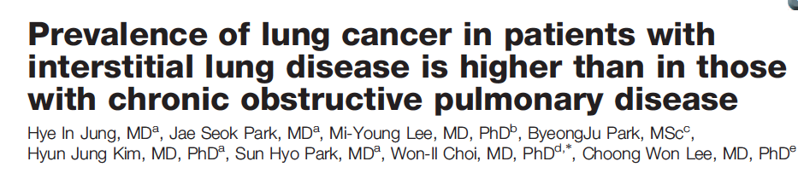
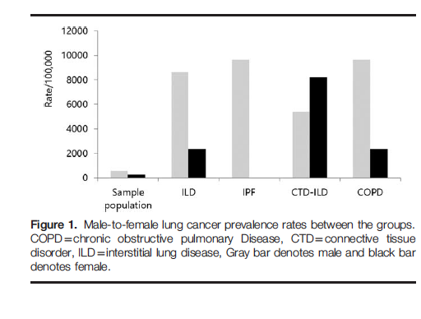
2018

Slide 36
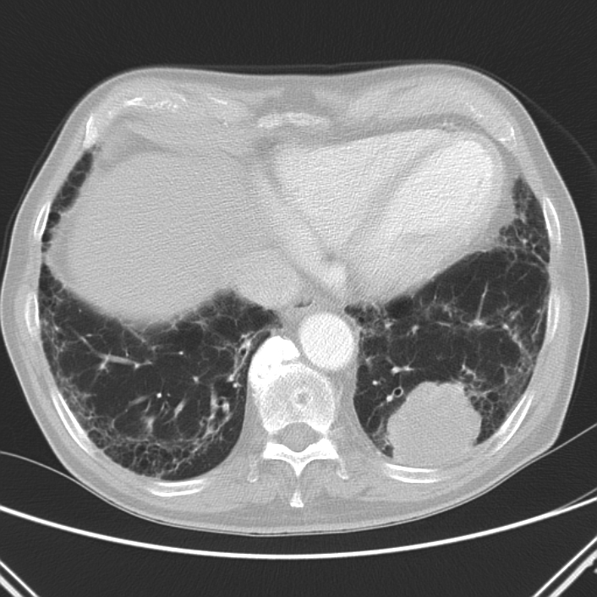

Slide 37
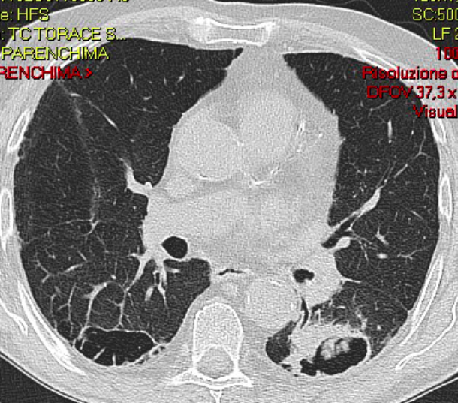

Slide 38
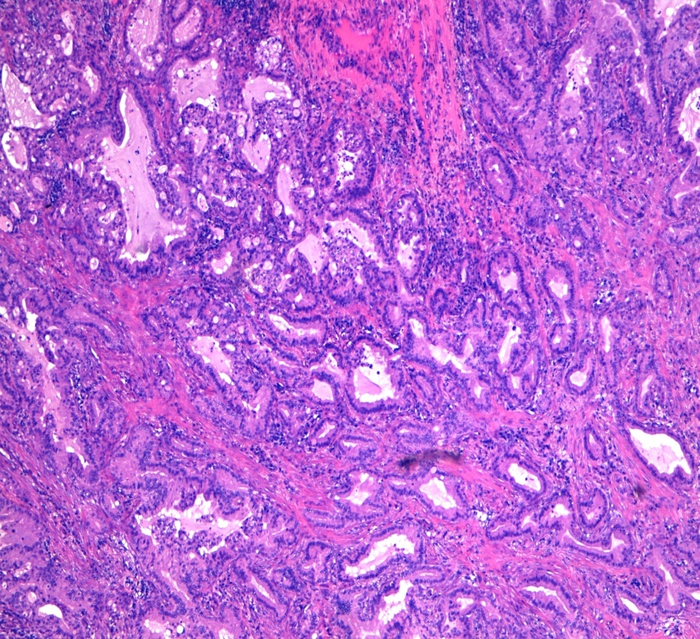
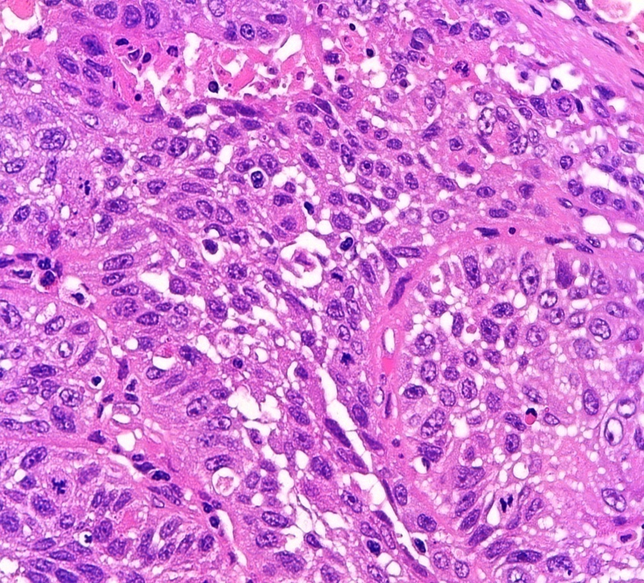
Adenocarcinoma Squamous cell carcinoma
Notes:
38

Slide 39
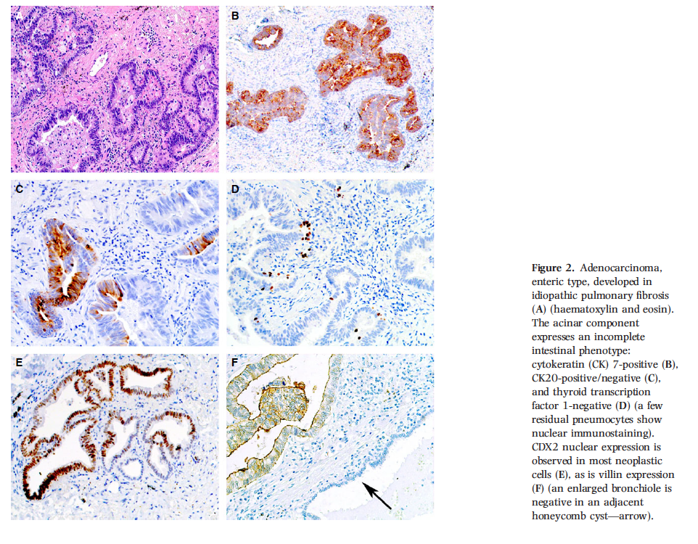
Histopathology, 2017

Slide 40
LC in IPF: mutation analysis
One or more mutations were found in 25/27 samples (93%).
LC in IPF:
  TP53 (n = 11, 73%),
  MET (n = 3, 20%),
  PTEN, SMAD4, FBXW7, STK11, PIK3CA and EGFR amplification (n = 1, 7%)
LC in non-IPF:
  TP53 (n = 8, 67%),
  BRAF (n = 3, 25%),
  FGFR3 and PIK3CA (n = 2, 17%),
  STK11, DDR2, MET, KRAS, ERBB4 and CTNNB1 (n = 1, 8%).
Guyard et al, Res Res 2017
Notes:
MET inhibitor crizotinib foretinib onartuzumab rilortunumab
The hepatocyte growth factor (HGF) receptor, encoded by
the MET oncogene, is a receptor tyrosine kinase that plays a
fundamental role in regulating development and cell growth.
Upon stimulation, MET induces a cellular program known
as invasive growth, which promotes mitogenesis, motility,
invasion, and morphogenesis. Pathologic activation of MET,
through both gene copy-number amplifi cation and point
mutation, is a well-characterized driver of oncogenesis that
occurs in many different types of tumor s . In cancer, activation
of MET promotes tumor proliferation, invasive growth,
and angiogenesis ( 2 ).

Slide 41
LC-IPF influence mortality, but not IPF progression
Median time to disease progression was 20.3 months in the study group and 21.4 months in the control group
One and three year survival among the two groups were 78% and 52% in the study group and 92% and 70% in the control group.
40% of LC-IPF patients die of IPF
1/5 die of LC progression
1/5 die of complications of LC treatment
S Tomassetti, C Gurioli et al., Chest 2014

Slide 42
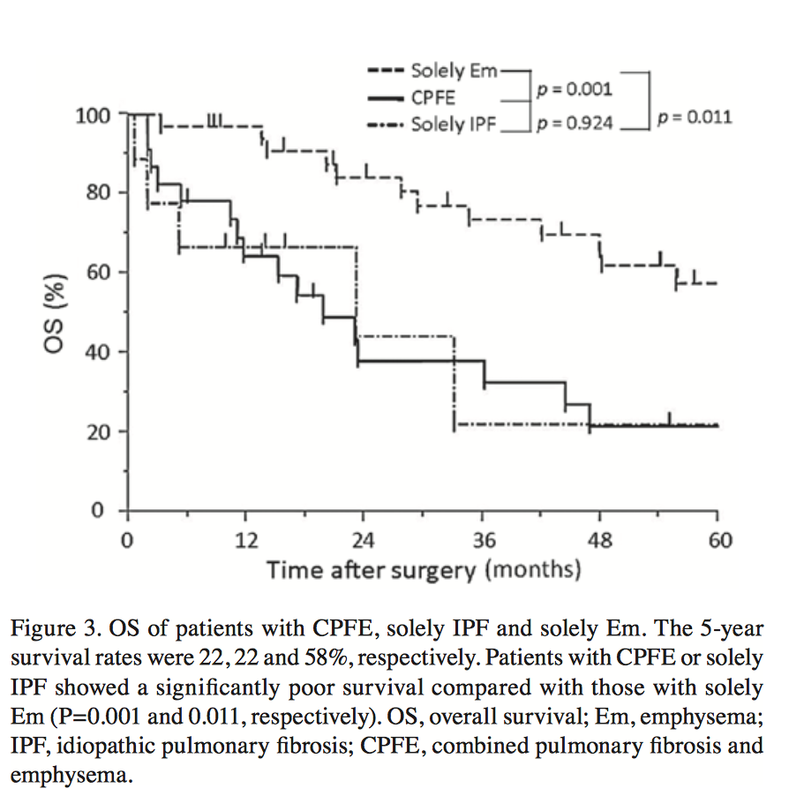
Outcome of surgery for LC in IPF
OTSUKA et al, MOLECULAR AND CLINICAL ONCOLOGY 5: 273-278, 2016
Notes:
CPFE was diagnosed by chest high-reso- lution computed tomography (HRCT) images showing emphysema involving >25% of both upper lobes and a usual interstitial pneumonia (UIP) pattern of brosis in the lower lobes

Slide 43
Sleep-disordered breathing

Slide 44
Sleep-disordered breathing
The frequency of OSA in 62cases of ILDs (17 IPF, 15 sarc, 18 sclerod) was 68 %
OSA was more common in IPF patients (p = 0.009) and in patients with a disease severity index ≥3 (p = 0.04).
Pihtili A, Sleep Breath. 2013;17:1281-8
12 IPF and moderate-severe OSA pts were treated with CPAP with significant improvement in daily living activities based on the Functional Outcomes in Sleep Questionnaire (FOSQ).
Despite intense follow-up two patients had difficulty complying with CPAP and stopped treatment after the first month.
Mermigkis C, Sleep Breath. 2013 Dec;17(4):1137-43.
Notes:
ILD are characterized by reduced lung volumes, abnormal ventilation/perfusion relationships (V/Q), . In sleep, there is a progressive decrease of compensatory mechanisms, from NREM to REM, with consequent reduction of alveolar ventilation and appearance of hypoxic and hypercapnic respiratory failure.

Slide 45
OSAHS AND PROLONGED OXYGEN DESATURATION DURING SLEEP ARE STRONG PREDICTORS OF POOR OUTCOME IN IPF.
25/35 IPF patients(71.4%) were diagnosed as OSAHS: 14/35(40%) mild, 7/35(20%) moderate and 4/35(11.5%) severe.
Using AASM definition of sleep -related desaturation, 9/35 patients (25.7%) were classified as sleep-related desaturators .
According to the presence/absence of SBD, it was possible to classify patients into 4 subgroups:
  NO-SBD group (25.7%),
  OSAHS group (48.5%),
  Overlap group (22.8%),
  Sleep Related Desaturator group (2.8%).
  SBD subgroups characterized by prolonged sleep-related desaturation showed worse functional impairment compared with OSAHS and NO-SBD subgroups.
Patients with excessive sleepiness were found only in Overlap subgroup;
Quality of life was poor and progressively worsening with the severity of the SBD.
Bosi M et al, Lung 2017

Slide 46
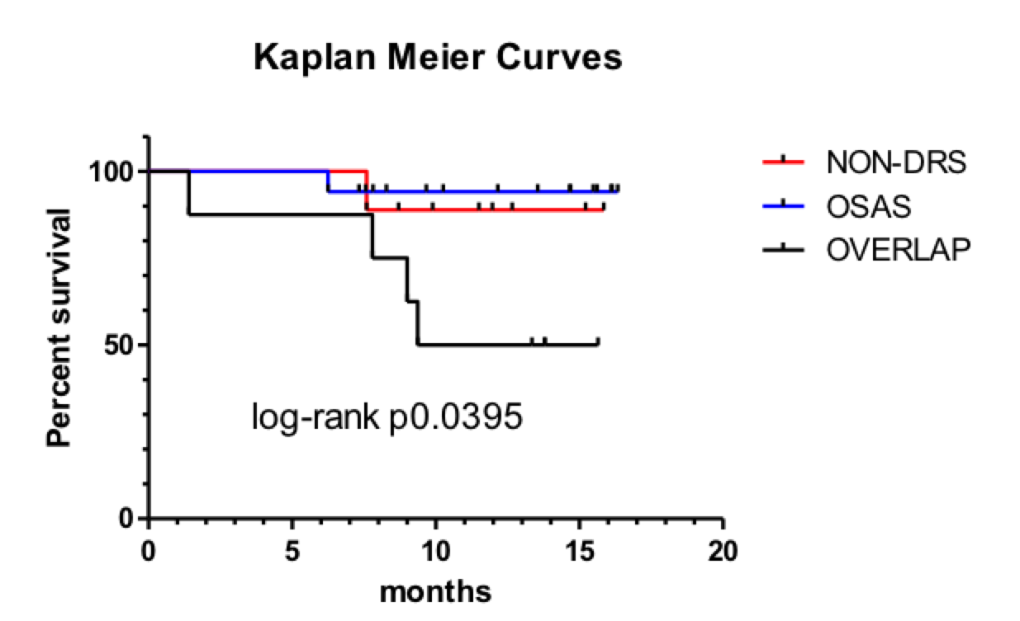
The subgroup with OSAHS and prolonged sleep desaturation was associated with higher mortality.
Bosi M et al, Lung 2017

Slide 47
Infections

Slide 48
Infections
mortality of IPF is greater in the winter even when recognised infection is excluded [Olson AL, Chest 2009;136:16–22].
infections can trigger acute decline in IPF leading to death [Huie TJ. Respirology 2010;15:909–17; Song, Eur Respir J 2011; 37: 356–363].
36% of non-immunosuppressed IPF patients without clinical features of a respiratory tract infection grew pathogenic bacteria from their bronchoalveolar lavage fluid compared with none of the controls. [Richter AG. Thorax 2009;64:692–7]. Pneumocystis jirovecii colonisation (23.3%) among patients with IPF and collagen vascular disease. [Shimizu Y. BMC Infect Dis 2009;9:47]
IPF is characterized by an increased bacterial burden in BAL that predicts decline in lung function and death. [Molyneaux; AJRCCM 2014].

Slide 49
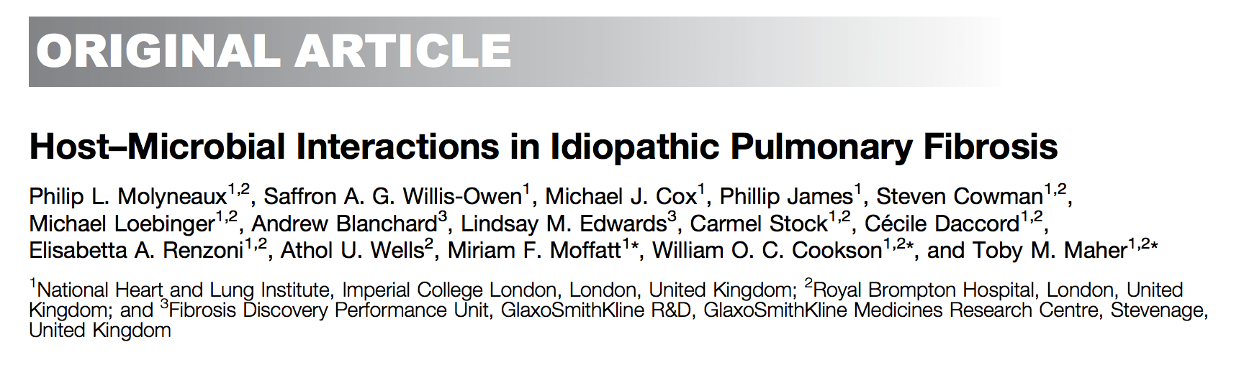
Objectives: To explore the host–microbial interactions in IPF.
^{Methods: 60 IPF}, ^{20 matched control subjects.}
BAL and blood (pax gene) at 1, 3, and 6 months and (if alive) 1 year. Gene expression profiles were generated using Affymetrix Human Gene 1.1 ST arrays.
^{Conclusions:} analysis demonstrated an apparent host response to the presence of an altered or more abundant microbiome.
These responses remained elevated in longitudinal follow-up, suggesting that the bacterial communities of the lower airways may act as persistent stimuli for repetitive alveolar injury in IPF.
AJRCCM 2017

Slide 50
IPF SUBSETS
Markers for identification of rapid vs slow progressors
Genetic markers for identification of specific subscptibilities
Emphysema & IPF
IPF & Lung Cancer
Sleep related disorders & IPF

Slide 51
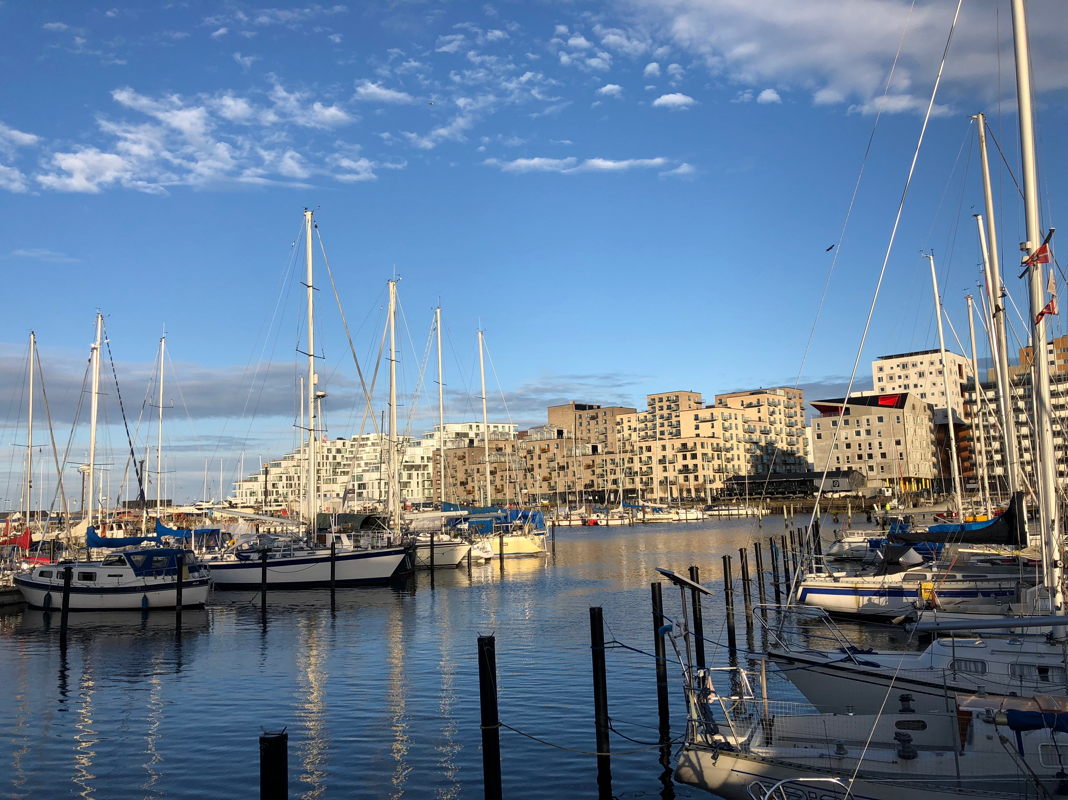

Slide 52
