Slide 1
Cystic Lung Diseases Spectrum of Clinico-radiologic Features
Jay H. Ryu, M.D.
Division of Pulmonary and Critical Care Medicine
Mayo Clinic, Rochester, Minnesota, USA

Slide 2
Cystic Lung Diseases Outline
Distinguish Cyst vs Cavity
Cystic lung diseases
Focal / multi-focal
Diffuse cystic lung diseases
Acute/subacute
Chronic
Notes:
Focal/multifocal cysts - Bullae/bleb or pneumatocele, Congenital, Infections, Traumatic
Focal/multifocal cavities – Neoplastic, Infections, Immunologic/inflammatory, Embolism – septic, PMF, Bronchiectasis, Congenital

Slide 3
Cysts and Cavities in Lung Radiologic Definitions
Cyst = a round parenchymal lucency with a well-defined thin-wall (<2 mm), usually contain air.
Cavity = a lucency within pulmonary consolidation, a mass, or a nodule. (thick wall).
(Fleischner Society 2008)
Notes:
Cyst (pathology) - any round circumscribed space that is surrounded by an epithelial or fibrous wall of variable thickness.
Cyst (radiology) - occur without associated pulmonary emphysema.
Cavity (radiology) - a gas-filled space, seen as a lucency or low-attenuation area, within pulmonary consolidation, a mass, or a nodule
In the case of cavitating consolidation, the original consolidation may resolve and leave only a thin wall.

Slide 4
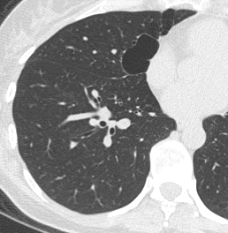
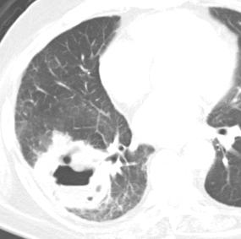
Focal Cyst or Cavity
Cyst (bulla)
Cavity (cancer)
Notes:
Cyst (pathology) - any round circumscribed space that is surrounded by an epithelial or fibrous wall of variable thickness.
Cyst (radiology) - occur without associated pulmonary emphysema.
Cavity (radiology) - a gas-filled space, seen as a lucency or low-attenuation area, within pulmonary consolidation, a mass, or a nodule
In the case of cavitating consolidation, the original consolidation may resolve and leave only a thin wall.

Slide 5
Cysts and Cavities in Lung Radiologic Definitions
Emphysema = focal areas of low attenuation usually without visible walls.
Bronchiectasis = irreversible localized or diffuse bronchial dilatation
Honeycombing = clustered cystic air spaces, typically of comparable diameters on the order of 3–10 mm but occasionally as large as 2.5 cm
(Fleischner Society 2008)
Notes:
Emphysema (radiology) - focal areas or regions of low attenuation, usually without visible walls.
In the case of panacinar emphysema, decreased attenuation is more diffuse.
“Bronchiectasis is irreversible localized or diffuse bronchial dilatation, usually resulting from chronic infection, proximal airway obstruction, or congenital bronchial abnormality.”
“Traction bronchiectasis and traction bronchiolectasis respectively represent irregular bronchial and bronchiolar dilatation caused by surrounding retractile pulmonary fibrosis.”
Dilated airways are usually identifiable as such but may be seen as cysts (bronchi) or microcysts (bronchioles in the lung periphery).
The juxtaposition of numerous cystic airways may make the distinction from “pure” fibrotic honeycombing difficult.
Honeycombing (radiology) = appearance is of clustered cystic air spaces, typically of comparable diameters on the order of 3–10 mm but occasionally as large as 2.5 cm
Honeycombing is usually subpleural and is characterized by well-defined walls.
It is a CT feature of established pulmonary fibrosis.

Slide 6
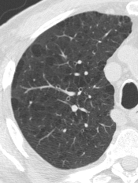
Bronchiectasis
(CF)
Honeycombing
(IPF)
Emphysema
Notes:
Emphysema (radiology) - focal areas or regions of low attenuation, usually without visible walls.
In the case of panacinar emphysema, decreased attenuation is more diffuse.
“Bronchiectasis is irreversible localized or diffuse bronchial dilatation, usually resulting from chronic infection, proximal airway obstruction, or congenital bronchial abnormality.”
“Traction bronchiectasis and traction bronchiolectasis respectively represent irregular bronchial and bronchiolar dilatation caused by surrounding retractile pulmonary fibrosis.”
Dilated airways are usually identifiable as such but may be seen as cysts (bronchi) or microcysts (bronchioles in the lung periphery).
The juxtaposition of numerous cystic airways may make the distinction from “pure” fibrotic honeycombing difficult.
Honeycombing (radiology) = appearance is of clustered cystic air spaces, typically of comparable diameters on the order of 3–10 mm but occasionally as large as 2.5 cm
Honeycombing is usually subpleural and is characterized by well-defined walls.
It is a CT feature of established pulmonary fibrosis.

Slide 7
Cysts in the Lung Diagnostic Approach
Radiologic abnormalities
Type = cysts
Distribution: focal/multifocal vs diffuse
Associated findings
Tempo: acute/subacute, chronic
Clinical Context
Notes:
Integrate clinical context and tempo of the disease process.
Acute diffuse cystic lung diseases are usually infectious - necrotizing pneumonias (incl. fungal, Pneumocystis), septic embolism
Radiologic (HRCT) findings: pattern of opacities, distribution, associated findings.

Slide 8
Focal or Multi-focal Cystic Lung Disease
Bleb
Bulla
Pneumatocele
Infections – cocci, Pneumocystis, hydatid
Congenital - bronchogenic cyst, CPAM (CCAM)
Traumatic cysts, others
Notes:
Bleb – a small gas-containing space within the visceral pleura or in the subpleural lung, ≤1 cm.
Bulla – an airspace measuring >1 cm, sharply bounded by a thin wall that is ≤1 mm; usually associated with emphysema.
Pneumatocele – a thin-walled, gas-filled space in the lung; most frequently caused by acute pneumonia, trauma, or aspiration of hydrocarbon fluid.
Bronchogenic cyst - Majority located mediastinum, most commonly in the subcarinal or paratracheal regions.
Up to 15% arise in the lung.
Infections
Coccidioidomycosis – cavitation is a major characteristic; wall may be thick or thin.
Pneumocystis – cystic lesions usually associated with HIV; predisposes to pneumothorax.
Hydatid disease – one or fluid-filled masses; cyst rupture can lead to air-fluid level, crescent sign, water lilly sign.
Congenital pulmonary adenomatoid malformation (CPAM, previously CCAM) - Usually diagnosed in neonatal period (expanding mass)
~10% after 1st year of life (recurrent respiratory infections).
Usually, multicystic hamartomatous mass.

Slide 9
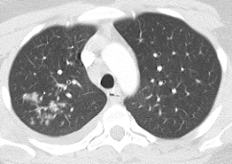
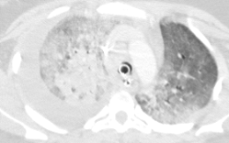
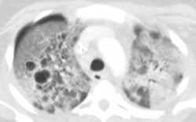
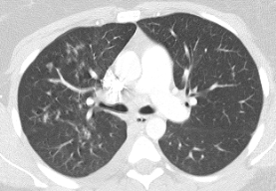
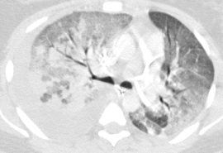
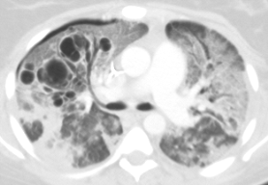
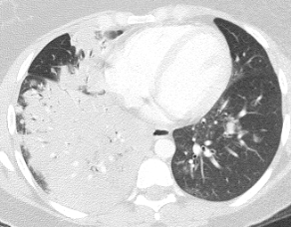
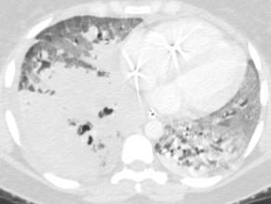
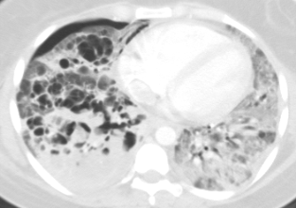
Group A Strep Pneumonia
24F
4/6/09
4/12/09
4/22/09
Notes:
7-063-996 Nastrom, Janelle (4/09 Bauer, SMH) – 24F with cavitary/cystic streptococcal pneumonia; died 5/5/09

Slide 10
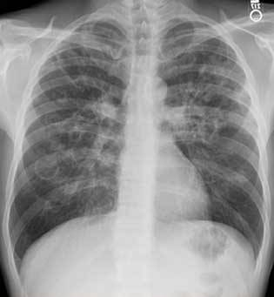
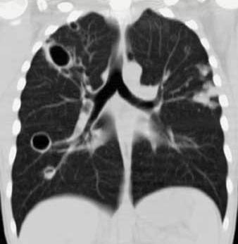
Pneumocystis
48M with HIV

Slide 11
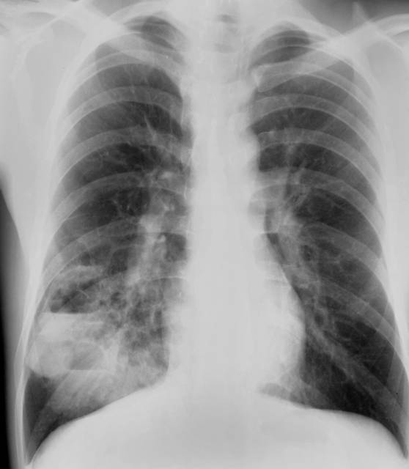
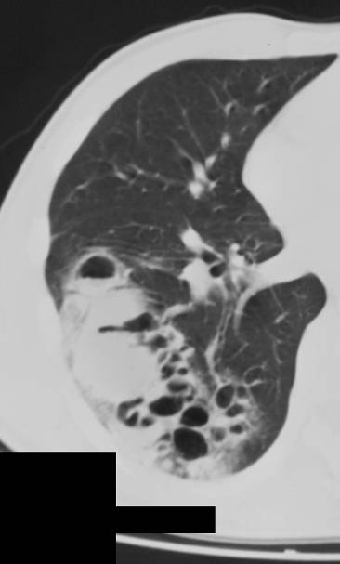
CPAM, type II - 20M Recurrent pneumonias
Notes:
20M with CPAM, type II

Slide 12
Diffuse Cystic Lung Disease Tempo
Acute/Subacute: necrotizing pneumonias (incl. fungal, Pneumocystis), septic embolism
Chronic: LAM, PLCH, Birt-Hogg-Dubé, LIP, amyloidosis, light chain deposition disease, bronchiolitis, other genetic syndromes (neurofibromatosis, Ehlers-Danlos, Marfan) metastatic disease, DIP, HP

Slide 13
Diffuse Cystic Lung Diseases (Chronic)
Major Causes
Lymphangioleiomyomatosis (LAM)
Pulmonary Langerhans’ cell Histiocytosis (PLCH)
Birt-Hogg-Dubé (BHD)
Lymphoid interstitial pneumonia (LIP)
Amyloidosis
Notes:
Integrate clinical context and tempo of the disease process.
Acute diffuse cystic lung diseases are usually infectious - necrotizing pneumonias (incl. fungal, Pneumocystis), septic embolism
Radiologic (HRCT) findings: pattern of opacities, distribution, associated findings.

Slide 14
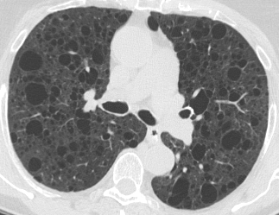
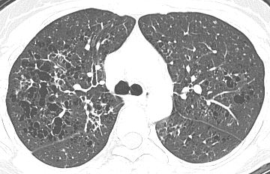
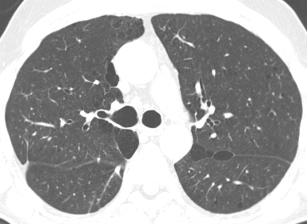
39F
78F
58M
60F

Slide 15
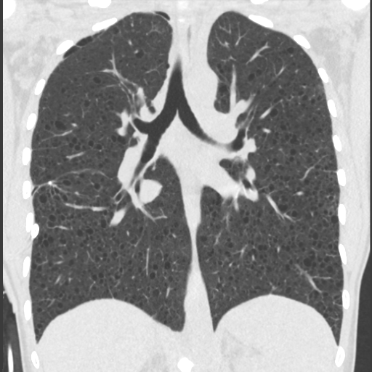
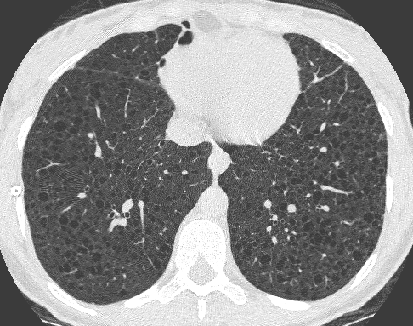
Sporadic LAM
37F nonsmoker
PFTs normal
Notes:
37F family physician with LAM, normal PFTs

Slide 16
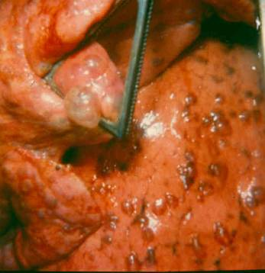
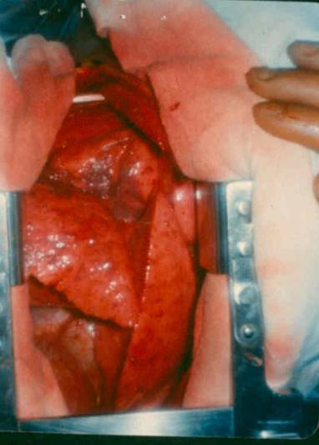
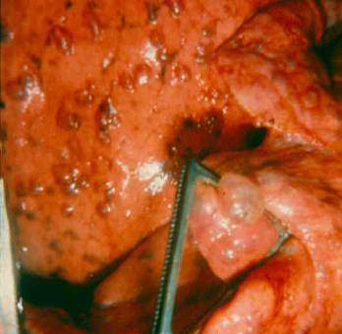
LAM
26F L Thoracotomy

Slide 17
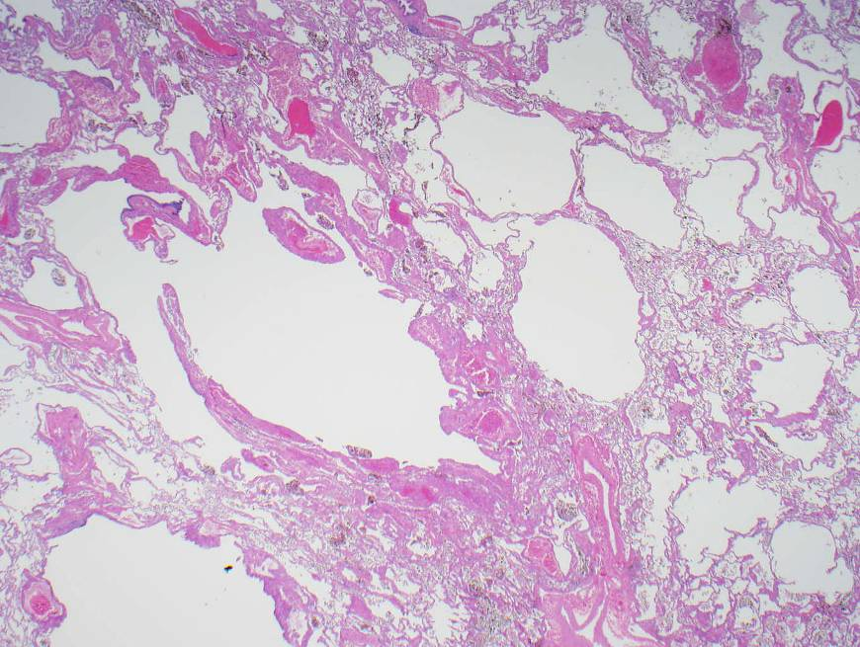
41F LAM
Lung explant

Slide 18
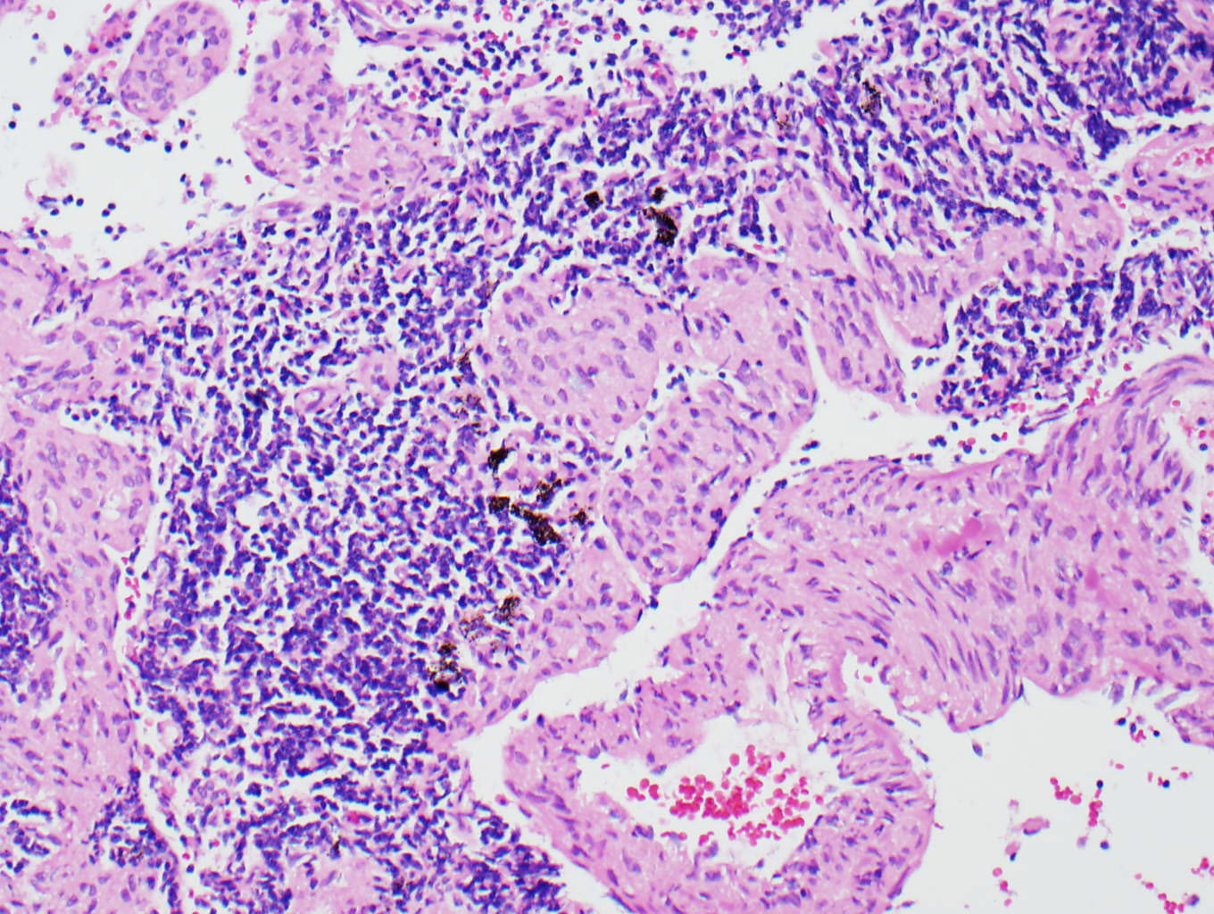
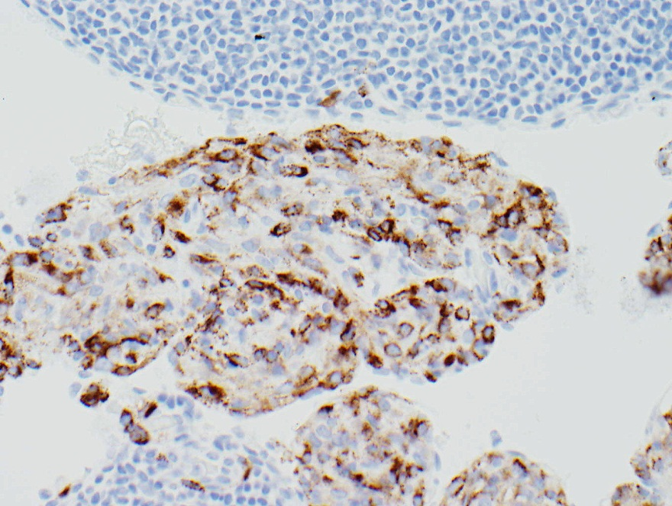
HMB-45
Notes:
Haphazard arrangement of atypical oval and spindle cells; cells are positive for smooth muscle markers and HMB-45.

Slide 19
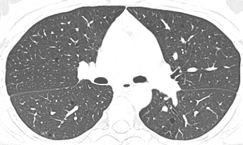
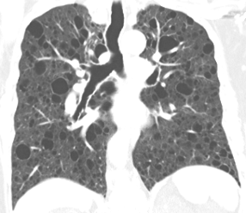
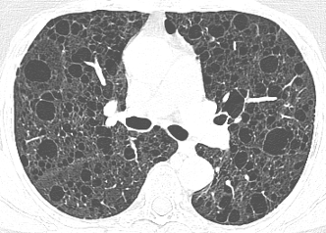
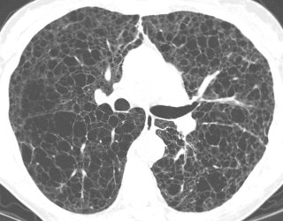
32F Sporadic LAM
FVC 84%
FEV₁ 80%
DL_{CO} 90%
76F Sporadic LAM
FVC 79%
FEV₁ 46%
DL_{CO} 60%
41F TSC-LAM
FVC 34%
FEV₁ 12%
DL_{CO} 24%

Slide 20
Lymphangioleiomyomatosis (LAM)
Proliferation of abnormal smooth muscle cells (LAM cells – HMB45+); cystic lung disease
Sporadic and TSC-related LAM
Caused by mutation in the TSC genes ⇒ mTOR dysregulation
“Low-grade, metastasizing neoplasm”
Mostly women; dyspnea, pneumothorax
PFT: typically obstructive
HRCT: diffuse cystic changes
Notes:
Identical TSC mutations are found in AML and LAM cells – from a common progenitor cell

Slide 21
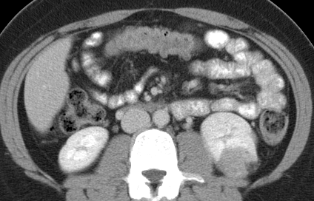
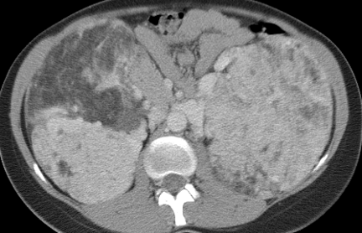
Renal Angiomyolipoma (AML)
24F Sporadic LAM
30F TSC-LAM

Slide 22
Pulmonary LAM
Diagnosis: characteristic CT chest findings plus any one or more of the following:
Biopsy of lung or extrapulmonary LAM
Renal angiomyolipomas (AML)
Chylothorax
Tuberous sclerosis complex (TSC)
Serum VEGF-D level
Treatment: sirolimus (rapamycin), lung transplant
(McCormack et al. AJRCCM 2016)
Notes:
With a cutoff value for VEGF-D of 574 pg/mL, test sensitivity for sporadic lymphangioleiomyomatosis was 86%, the specificity was 91%, and the positive likelihood ratio was 9.6 (compared to healthy controls, emphysema, lymphangiomatosis, PLCH).

Slide 23
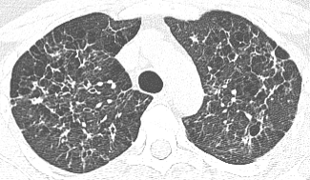
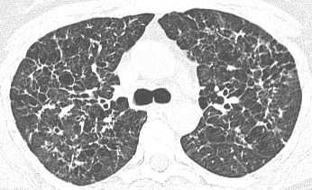
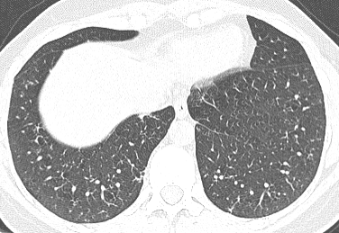
Pulmonary Langerhans Cell Histiocytosis
39F Smoker

Slide 24
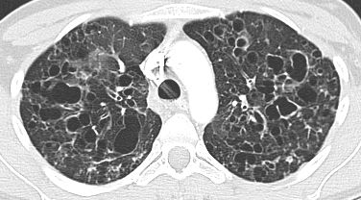
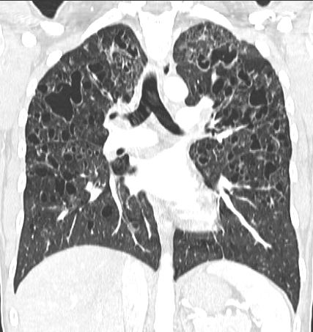
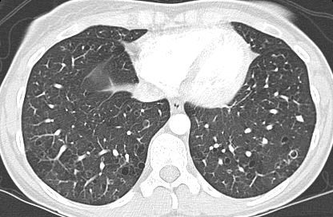
Pulmonary LCH
31F smoker
Notes:
(A) High-resolution CT scan of a 31-year-old woman, smoker, with pulmonary Langerhans’ cell histiocytosis. There are multiple cystic lesions, some of irregular shape, in both lungs.
In addition, there are many nodules in both lungs as well.
(B) Coronal view demonstrating prominent involvement of upper and mid lung zones with relative sparing of the lung bases.

Slide 25
Pulmonary LCH
Young adult smokers
Bronchiolocentric, destructive lesions containing Langerhans’ cells
Smoking history (smoking-related ILD)
Cough, dyspnea, pneumothorax
Lungs sound clear, digital clubbing rare
PFTs: obstructive or mixed
HRCT: diffuse irregular cysts with nodules ± cavitation, reticular opacities; basilar sparing
Notes:
Pneumothorax occurred in 16% (16/102) in Mayo series.
In 11/16 (69%) it was the initial manifestation.
In 2/16 (13%) the initial episode of pneumothorax was bilateral. 10/16 (63%) had >1 episode.
Without pleurodesis, the recurrence rate was 58%.
Cystic bone lesions - about 10%.
Diabetes insipidus - in up to 10%.

Slide 26
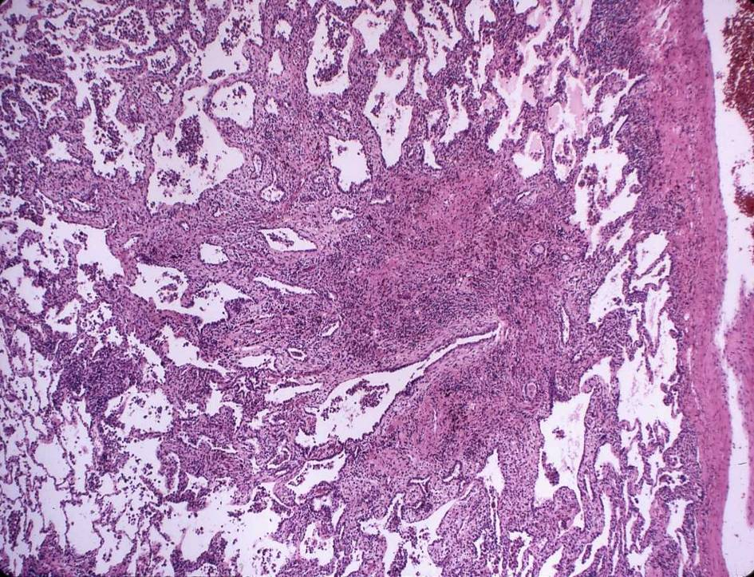
Pulmonary LCH
Notes:
Stellate lesion of PLCH.

Slide 27
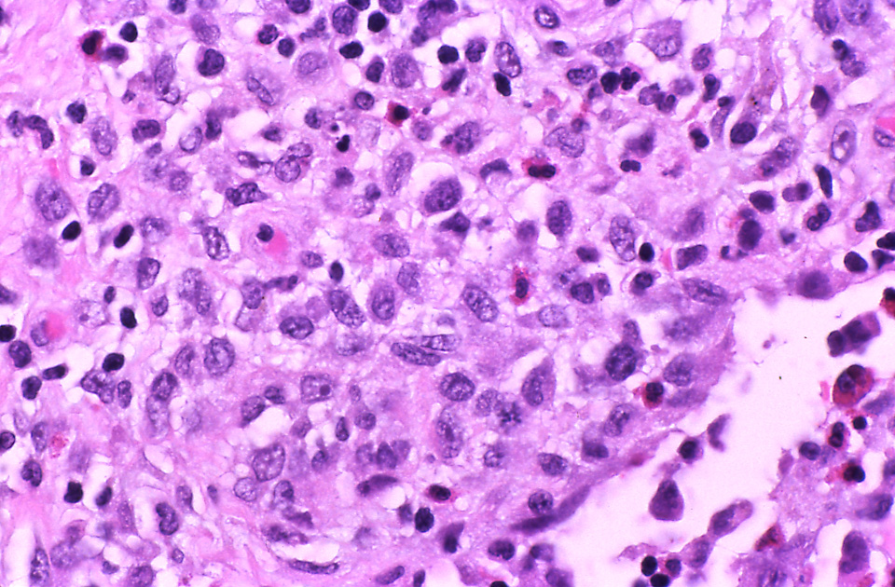
Pulmonary LCH
Notes:
Cells with large, elongated, grooved nuclei and a higher nuclear-to-cytoplasmic ratio than typical macrophages – suggestive of Langerhans’ cells.
CD1a, S-100 and langerin-positive cells

Slide 28
Pulmonary LCH
PET scan can be positive in PLCH.
BAL: ≥5% CD1a cells
Lung biopsy: bronchoscopic or VATS
Treatment: Stop smoking.
Sometimes, 2-chlorodeoxyadenosine (2-CdA, cladribine).
Corticosteroids? B-Raf inhibitors?
Treat pulmonary hypertension
Prognosis: variable, risk of malignancy
Notes:
PET scan can be positive in PLCH, particularly in early nodular phase of the disease compared to cystic disease (5/11 in Mayo series).
Treatment: Cladribine is a purine analog.
28% of patients with PLCH have BRAF V600E mutation (Roden 2014)
BRAF gene makes B-Raf protein (serine/threonine-protein kinase) – send signals directing cell growth.
Sorafenib (V600E mutant B-Raf inhibitor), vemurafenib (V600 mutant B-Raf inhibitor)
Prognosis: variable, risk of malignancy

Slide 29
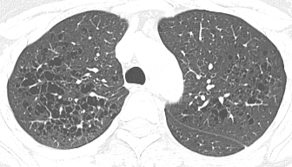
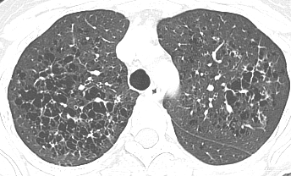
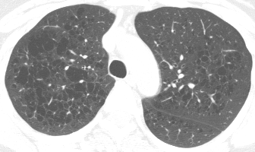
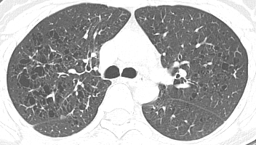
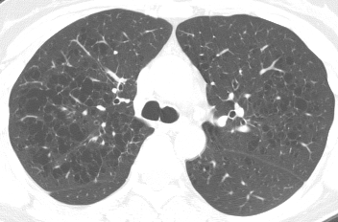
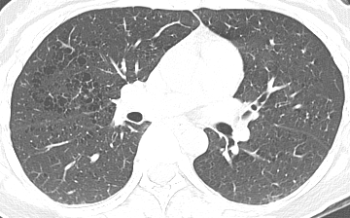
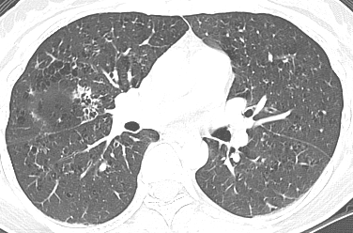
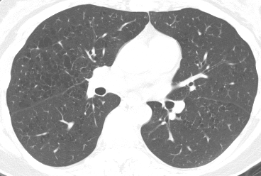
Pulmonary Langerhans Cell Histiocytosis
36F Smoker
(quit smoking 5/02)
12/97
2/01
10/03

Slide 30
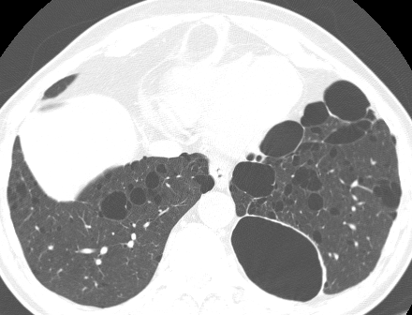
Birt-Hogg-Dube
58M
Notes:
Characteristic chest CT findings in BHD are multiple thin-walled pulmonary cysts of various sizes (few mm to > 2 cm), predominantly distributed to the lower medial and subpleural regions of the lung.
Cysts in BHD are less in number and extent, larger, less circular in shape, less homogeneous in distribution (more commonly seen in medial and lower lung zones).

Slide 31
Birt-Hogg-Dubé
72F nonsmoker
FVC 62%, FEV₁ 56%, DL_{CO} 70%
Notes:
72F, with BHD, Oct. 2015; FVC 62%, FEV1 56%, DLCO 70%

Slide 32
Birt-Hogg-Dubé syndrome: Fibrofolliculoma
Notes:
Fibrofolliculomas - multiple, firm, white papules on the jaw line and neck.
Ayo et al. - 5 patients, all had cystic lung disease.

Slide 33
Birt-Hogg-Dubé syndrome: Fibrofolliculoma
38M

Slide 34
Birt-Hogg-Dubé syndrome
Rare, inheritable disorder (autosomal dominant)
Germline mutations in the BHD (FLCN) gene - encodes folliculin
Clinical manifestations:
Fibrofolliculomas – appear during 3rd & 4th decades
Cystic lung disease (90%) and pneumothoraces (25-40%)
Propensity for renal tumors (5-30%)
Notes:
Skin lesions appear during the 3rd or 4th decade; predominantly face, scalp, neck, upper chest - firm, dome-shaped papules
Renal tumors are most commonly (2/3) a hybrid of oncocytoma and chromophobe histologic cell types (oncocytic hybrid tumor), chromophobe renal cell carcinoma (1/4), renal oncocytoma, and other types.
Characteristic skin lesions, propensity for renal neoplasms (sometimes absent)

Slide 35
Birt-Hogg-Dubé
20F
Notes:
20F (nonsmoker) with BHD and 2nd episode of L pneumothorax; positive FH of BHD (niece of 8-751-271 Loock)

Slide 36
Birt-Hogg-Dubé
Notes:
57F with BHD, recurrent pneumothoraxes , prior pleurodesis
Histologic sections show benign lung parenchyma with widespread emphysematous changes.
“hamartoma-like cystic alveolar formation associated with deranged mTOR signaling” – Furuya et al 2012.

Slide 37
Birt-Hogg-Dubé syndrome Management
Pneumothorax – chest tube, bullae resection, pleurodesis
Renal tumors – renal imaging surveillance q. 2-3 yrs; nephron-sparing surgery
Genetic counseling

Slide 38
Idiopathic LIP
73M (May 2013)
Notes:
78M ex-smoker (quit 1982) with slowly progressive DOE idiopathic LIP, extensive cystic lung disease on MCA CT; 2013 BLTx; PFTs 3/13/12 – TLC 84%, FVC 79%, FEV1 63%, DLCO 40%

Slide 39
Idiopathic LIP
May 2006 (66M)
Oct 2010
May 2013 (73M)
Notes:
78M ex-smoker (quit 1982) with slowly progressive DOE idiopathic LIP, extensive cystic lung disease on MCA CT; 2013 BLTx; PFTs 3/13/12 – TLC 84%, FVC 79%, FEV1 63%, DLCO 40%

Slide 40
Lymphoid Interstitial Pneumonia (LIP) Definition
LIP is a histologic variant of diffuse pulmonary lymphoid hyperplasia with predominantly interstitial changes - diffuse interstitial infiltration with mostly T lymphocytes, plasma cells, and macrophages
(ATS/ERS. AJRCCM 2002)

Slide 41
Lymphoid Interstitial Pneumonia
100x
Notes:
Diffuse interstitial infiltration of involved areas
Predominantly alveolar septal distribution
Infiltrates comprise mostly T-lymphocytes, plasma cells and macrophages
Lymphoid hyperplasia (MALT hyperplasia) - frequent

Slide 42
Lymphoid Interstitial Pneumonia (LIP) Associated clinical conditions
Associations
Connective tissue disorders
Immunodeficiency
Infections
Drugs/toxins
Miscellaneous conditions
None = idiopathic LIP

Slide 43
Revised Classification of IIPs (2013)
Major Idiopathic Interstitial Pneumonias
Idiopathic pulmonary fibrosis (idiopathic UIP)
Idiopathic nonspecific interstitial pneumonia
Respiratory bronchiolitis-interstitial lung disease
Desquamative interstitial pneumonia
Cryptogenic organizing pneumonia
Acute interstitial pneumonia
Rare Idiopathic Interstitial Pneumonias
Idiopathic lymphoid interstitial pneumonia
Idiopathic pleuroparenchymal fibroelastosis
Unclassifiable idiopathic interstitial pneumonias

Slide 44
Pulmonary Amyloidosis
55F
Notes:
58F nonsmoker, physicist, referred for evaluation of abnormal CXR, CT chest – Aug. 2009.
4 yrs before, R axillary nodal mass resected ⇒ amyloid.
Small monoclonal IgA lambda.
Diagnosed to have limited AL amyloidosis.
No change on yearly reassessment.
CT performed for new opacity RUL on CXR.
No relevant exposures, drugs, other illnesses, negative FH.
Lab: small monoclonal IgA lambda in serum & urine
PFTs: moderate airflow obstruction (FEV₁ 53% pred.)

Slide 45
4 yrs before
55F
Notes:
55F referred for abnormal CT chest.
Enlarged axillary LN noted on screening mammogram – amyloid, and small amount of monoclonal protein in serum, “limited amyloidosis.”
BM showed lambda immunoglobin light chain restricted plasma cells occupy 2-3% of the marrow cellularity.
Followed x 4 years, cysts enlarging.

Slide 46
Notes:
Amorphous hyaline material on light microscopy.

Slide 47
Congo Red
Notes:
Apple-green birefringence on polarized microscopy with Congo Red stain.

Slide 48
Pulmonary Amyloidosis
Intrathoracic patterns of involvement
Airway - focal nodules/plaques or diffuse submucosal infiltration
Parenchyma - single or multiple nodules, cysts (e.g., in Sjögren's), or diffuse parenchymal infiltrates.
Mediastinal and/or hilar adenopathy
Pleural effusion
Management: depends on site and severity, underlying cause / disease
Notes:
OSA
Baqir et al. Respir Med 2013
8 subjects (7F, 1M) with Sjögren's syndrome and pulmonary amyloid proved by lung biopsy; age 32-75 yrs.
HRCT – nodules and cysts in all.
3 had associated MALToma.
Cystic lung disease in patients with Sjögren's syndrome can represent amyloidosis, not lymphoid interstitial pneumonia (LIP).

Slide 49
Diffuse Cystic Lung Diseases
Rare Causes
Light chain deposition disease
Bronchiolitis - follicular or constrictive
Hereditary syndromes (Marfan, NF-1, Ehlers-Danlos, Proteus)
Metastatic cancer
Cysts as a Minor feature
Advanced fibrotic lung - eg, IPF
DIP
Hypersensitivity pneumonitis
Emphysema
Infections – e.g., cocci, paracocci, pneumocystis
(Ryu et al. Front Med 2013)

Slide 50
LCDD
Notes:
LCDD in lung
Pulmonary light chain deposition disease
Monoclonal plasma cell proliferation localized to lung (more commonly involve kidneys, heart, liver)
Non-amyloid light chain deposits (no β-pleated sheet configuration and negative Congo red staining) in the walls of alveoli, small airways, vessels
Macrophages express metalloproteinases ⇒ elastolysis and cyst formation
Progressive cysts and airflow obstruction; can lead to respiratory failure
Treatment: chemotherapy, hematopoietic stem cell transplant

Slide 51
Pulmonary Light Chain Deposition Disease
Case #2 39F
Case #1 36F
3 yr later
3 yr later
(Columbat et al Am J Respir Crit Care Med 2006)
Notes:
Elastolysis associated with release of matrix metalloproteinases (MMPs) from macrophages.
Pulmonary light chain deposition disease
Monoclonal plasma cell proliferation localized to lung (more commonly involve kidneys, heart, liver)
Non-amyloid light chain deposits (no β-pleated sheet configuration and negative Congo red staining) in the walls of alveoli, small airways, vessels
Macrophages express metalloproteinases ⇒ elastolysis and cyst formation
Progressive cysts and airflow obstruction; can lead to respiratory failure
Treatment: chemotherapy, hematopoietic stem cell transplant

Slide 52
Constrictive Bronchiolitis
(Kawano-Dourado et al. AJRCCM 2012)
Notes:
(A–C) Chest high-resolution computed tomography: scattered thin-walled, regular-shaped cysts in both lungs.
(D–F) Photomicrographs of the surgical lung biopsy: constrictive bronchiolitis.
(D) Constricted airway (arrow) and area of peribronchiolar overdistension with tissue disruption and air trapping (*).
(E) Constricted airways (arrow) and diffuse parenchymal overinflation.
(F) Distorted, thickened, and constricted small airways (arrow), with focal areas of lung tissue collapse (col) contrasting with regions of peribronchiolar overdistension (*). Large areas of overdistension with tissue disruption may correspond to cystic changes on high-resolution computed tomography. Scale bar in D = 1,000 μm; scale bars in E and F = 250 μm.

Slide 53
Miscellaneous Cystic Lung Diseases
31F Marfan
46M NF-1 Smoker
Notes:
31F with Marfan, no h/o pneumothorax. (4.8% of 166 adult Marfan patients had a h/o pneumothorax; 9.6% had apical blebs or bullae)
46M with NF-1. (In 6/156, 4%, patients, cystic airspaces or bullae were seen by chest radiography or CT scan. All 6 patients had a history of smoking.
Marfan: prevalence 1 in 3,000 to 5,000 or 200-300 per 100,000. 75,000 in US.
NF: prevalence 1 in 4,000 or 250 per 100,000. >100,000 in US.
Ehlers-Danlos (all types): prevalence 1 in 5,000 or 200 per 100,000. 60,000 in US.

Slide 54
62M 5/03 Metastatic colon cancer

Slide 55
62M Metastatic colon cancer
8/02
12/02
5/03
Notes:
Died 6/05.

Slide 56
Hypersensitivity Pneumonitis
59F nonsmoker
Notes:
Cause of HP unknown.
1/22/99 PFTs: TLC 3.93 (75%), FVC 2.11 (63%), FEV1 1.57 (59%), FEV1/FVC 74.5, DLCO 11.4 (51%), SaO2 92/72.

Slide 57
LAM
PLCH
39F
78F
LIP
MALToma
BHD
58M
60F

Slide 58
Major Causes of Diffuse Cystic Lung
 | LAM | PLCH | BHD | LIP | Amyloid
Clinical context | Women, TSC, renal AML, pnthx, | Younger adults, smokers, pnthx | Hereditary,pnthx, renal tumors | CTD, immuno-deficiency | Systemic amyloid, CTD (esp. Sjögren's)
HRCT | Round cysts, diffuse | Irreg cysts, cavitating nodules, basilar sparing | Varying sizes & shapes, more lower lobes, medial | Varying sizes & shapes; with GGOs, nodules, septal thickening | Varying sizes & shapes, with nodules
Grazie mille

