Slide 1
The utility of PET/CT scan in sarcoidosis
Marjeta Terčelj
University Medical Centre Ljubljana
Clinical Department for Respiratory Diseases and Allergy
April 2018

Slide 2
Sarcoidosis
Sarcoidosis is a multisystemic granulomatosis which results in a wide variety of clinical and biological presentations.
Symptoms are often nonspecific, and an incidental abnormal findings on chest radiology is rather common.
Although sarcoidosis resolves favorably in more than half cases, some localizations can provoke functional impairment or even impact on patients‘ prognosis.

Slide 3
Sarcoidosis
Gauging the activity and extent of granuloma accumulation in affected organs is a challenge for clinicians involved in the management of the disease.
Decision for treatment with immunosuppressive and/or anti-inflammatory medication is difficult and there are no precise guidelines.
Monitoring disease activity in sarcoidosis remains a clinical challenge as there is no gold standard.

Slide 4
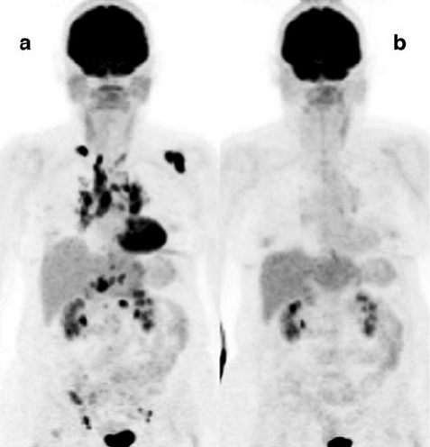
¹⁸F-FDG PET and sarcoidosis
It has been well studied that 18F-fluorodeoxyglucose positron emission tomography/computed tomography (FDG-PET/CT) is clearley taken up by activated immune cells such as macrophages and CD4 T lymphocytes, underlying the ability of FDG to account for disease activity.
However, because of the radiation dose and high cost, indications for its use must be well defined.

Slide 5
Sarcoidosis
Owing to the ability to detect inflammation through the body with high sensibility, FDG-PET/CT gaind a central role in sarcoidosis because it can suggests the diagnosis in certain clinical context, giude biopsy, evaluate the extent of the disease, help assess the prognosis, and monitor immunosuppressive therapy.
This review will briefly describe clinical and typical findings of conventional imaging according to organ involvement, in order to highlight the additional information provided by nuclear imaging.

Slide 6
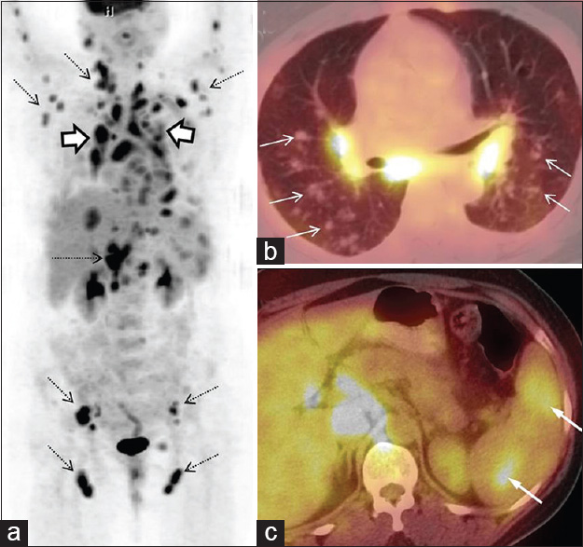
¹⁸F-FDG PET and CT scan in sarcoidosis
Dose radiation: PET 3 - 7 mSv and CT 2 - 3 mSv
thogether 5 - 10 mSv
Everage dose in one year from environment = 2,4 mSv
¹⁸F-FDG PET combined with computered tomography (CT) provides a more detailed PET image through complementary CT information.
Combined PET/CT delivers several advantages, some of which are a fusion of function and structure and better spatial resolution.
It provides possibilities for robust quantitative assessment.

Slide 7
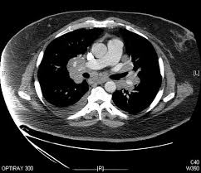
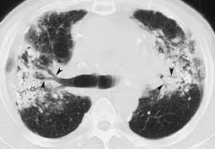
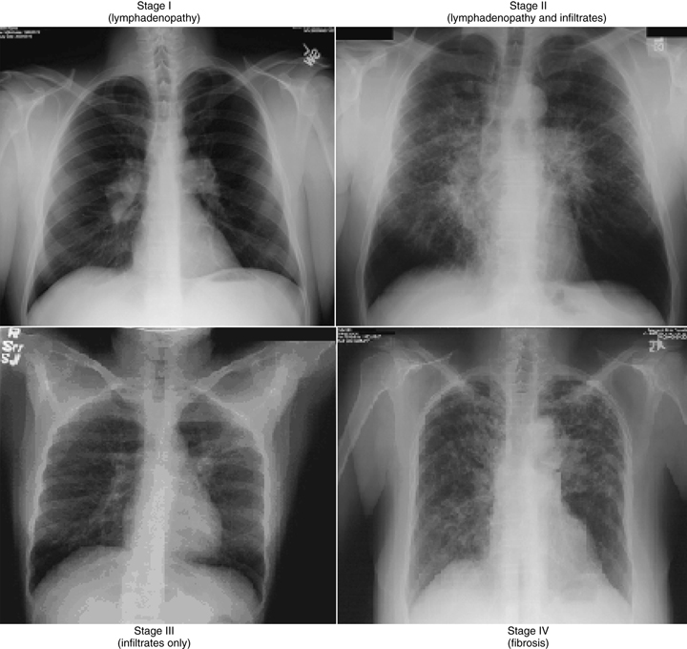
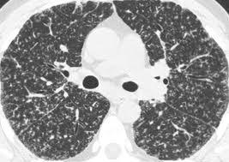
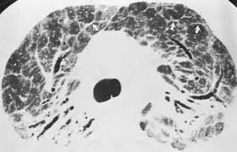
Chest radiogram: Stages I-IV Thoracic sarcoidosis including pulmonary and mediastinal lymph node involvement is the most frequent location observed, ranging from 84% to 97% of patients. The use of chest X-ray contributed to the descriptions of four pulmonary-mediastinal stages
Stage I Stage II
Stage III Stage IV

Slide 8
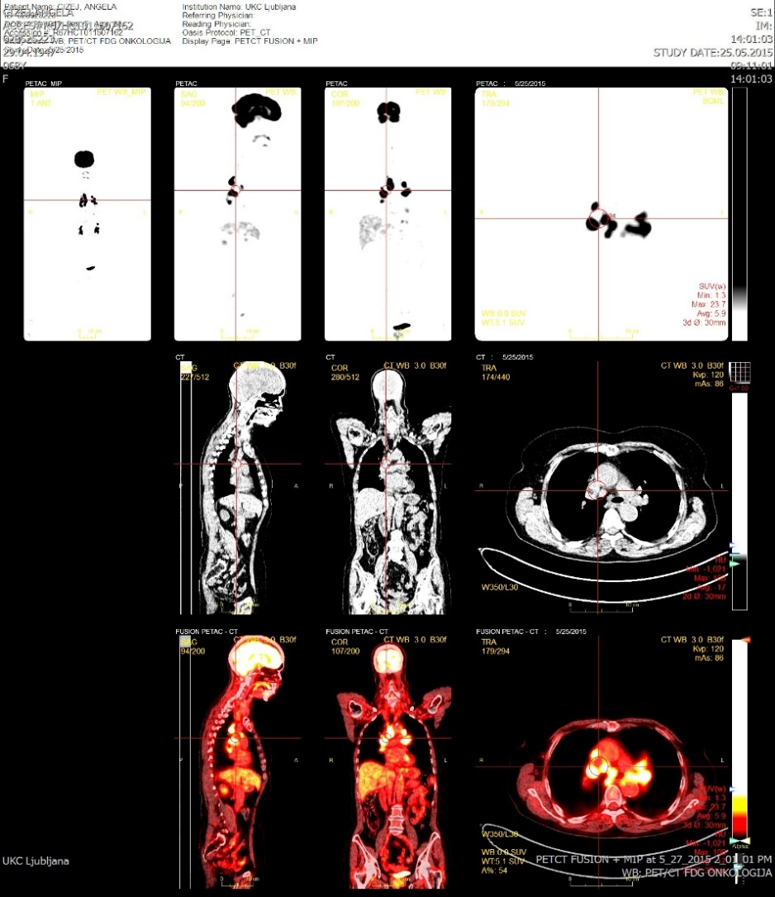
Patient, age 56, with granulomatous inflammation in the eye PET/CT scan proves lymph node involvement and with Stage I
Stage 0

Slide 9
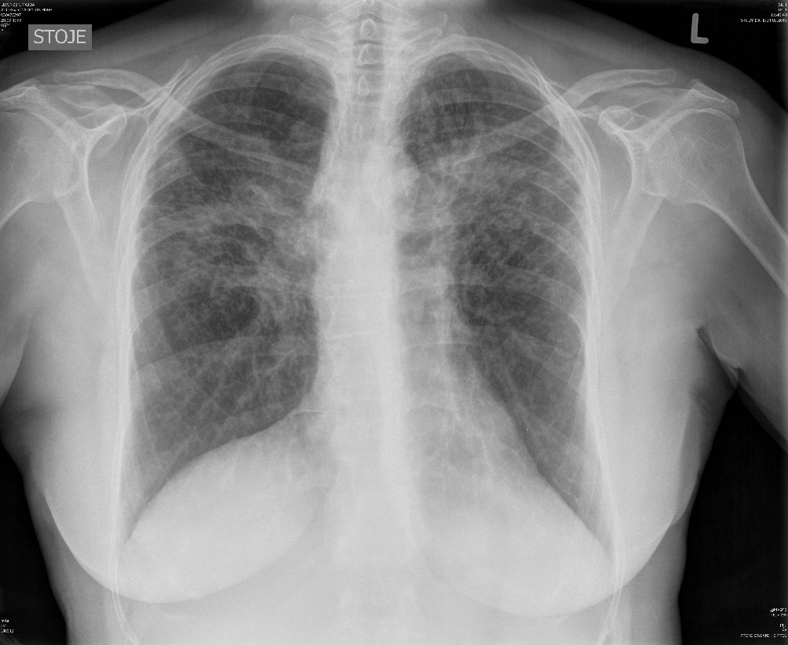
Patient, age 65, with chronic sarcoidosis for more than 10 years, Stage IV and ¹⁸F-FDG PET/CT shows more activity in the lung

Slide 10
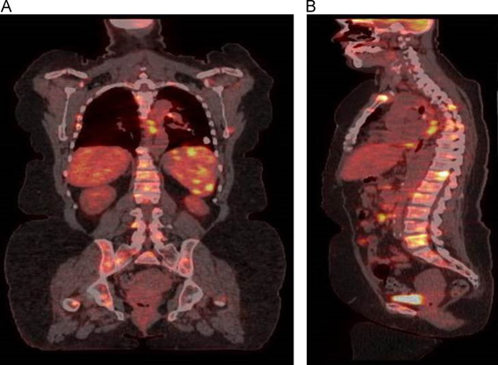
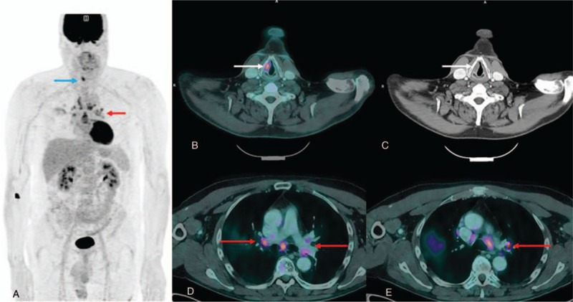
PET/CT scan of a patients demonstrated active metabolism in multiple involved organs, including the bone and atypical locations.

Slide 11
Systematic use of FDG PET/ CT are not recommended
Even though routine PET/CT scaning is not currently recomended as a part of the initial evaluation, it has a high sensitivity comapred with other pulmonary imaging modalities in detecting inflammatory activity within lungs and thoracic lamph nodes (up to 97% sensitivity) and therefore helps reveal sites suitable for biopsy.
It could identify occult previously undetectable activity in up to 15% of patients

Slide 12
Systematic use of FDG PET/ CT are not recommended
PET/CT may be used as a prognostic marker of pulmonary function, and to evaluate inflammatory activity in patients with pulmonary fibrosis, that was present in 93% of patients with Stage IV pulmonary sarcoidosis
It could also help follow-up under treatment: a reduction of FDG uptake correlated with improvements in symptoms, radiological findings and physiological data
One study found that a mediastinal SUV Max superior or equal to 6 at baseline was associated with relaps

Slide 13
Heart Cardiac involvement of sarcoidosis is a key in the evaluation of prognosis and contributes to a major part of the disease morbidity or mortality. It has been suggested that some sarcoidosis may present as exclusive involvement of the heart. The presence of granuloma in miocardial tissue that can lead to miocardial tissue scarring – fibrosis.

Slide 14
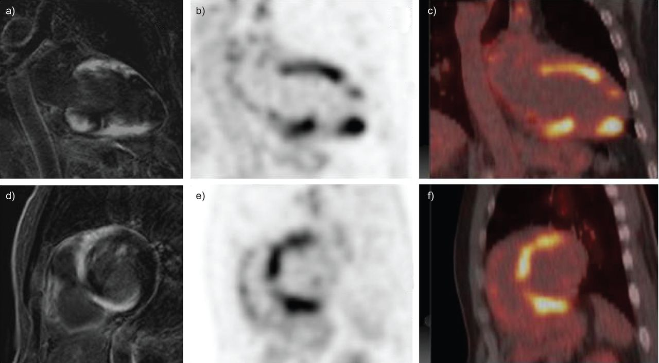
Heart
The myocardial localization of granuloma is most often encountered in the left ventricle free wall, interventricular septum.
Clinical presentation consists of cardiomyopathy with loss of muscle function or tachyarrhythmias, bradyarrhythmias, sudden death.
Cardiac sarcoidosis can be asymptmatic – the evaluation of cardiac involvement is therefore a key parameter as it has major prognostic impact and requires treatment.
MRI and PET/CT scan are critical for its evaluation and to guide immunosuppressive therapy and thereafter to monitor treatment responce.

Slide 15
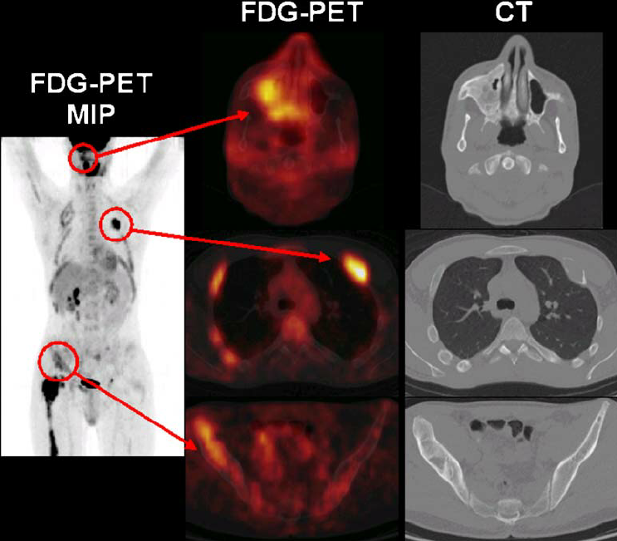
Bone and bone marrow
The distribution of lesions on PET/CT is variable but most frequent active inflammatory sites are pelvis, spine, ribs.
Bone sarcoidosis was previously considered uncommon, but due to the increasing use of MRI and PET/CT, bone involvement is more frequently detected - 20% prevalence.
It is almost always associated with lymph node and pulmonary manifestations.
Bone sarcoidosis is usually asymptomatic except in the presence of synovial involvement.
Bone marrow is also rare in sarcoidosis and is associated with extra pulmonary sarcoidosis with higher incidence of leucopenia, lymphopenia, anemia and hypercalcemia.

Slide 16
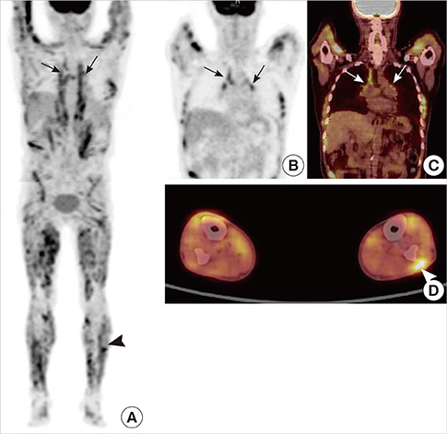
Skeletal muscle
Although muscle involvement is described in up to 80% of patients, clinically myositis is rare.
Symptoms are only abut 3%.

Slide 17
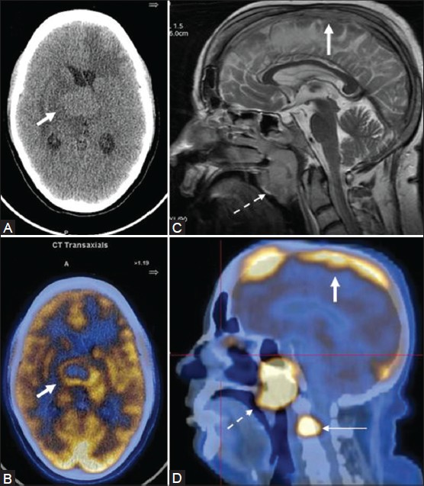
Neuro sarcoisosi
Involvement of the central nervous system may present very diversely as neurosarcoidosis and can affects meninges, brain, medulla, and is present in up to 25% of patients with sarcoidosis, undergoing autopsy with clinical symptoms in up to 10% of patients.
The diagnostic work-up of neurosarcoidosis should include an evaluation for potential extra-neural involvement and hystologic confirmation of sarcoidosis, using for instance, whole body PET/CT.

Slide 18
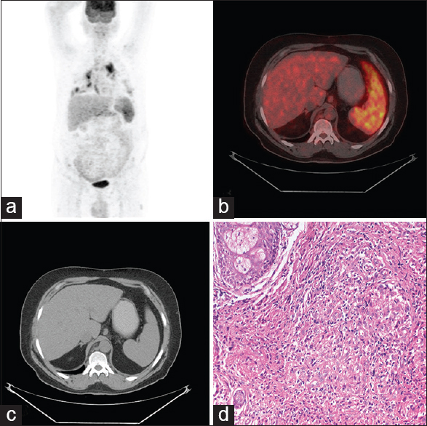
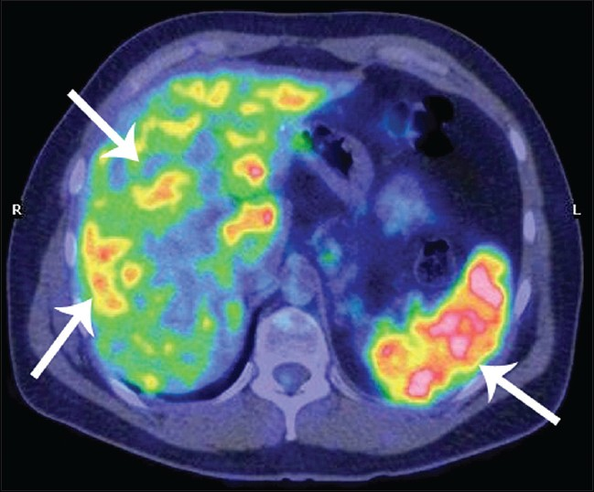
Abdominal involvement
Diagnosis of abdominal sarcoidosis can be difficult because lesions are less characteristic and can mimic more commonly neoplastic or infectious diseases
About 8 to 25% patients were reported to have extratoracic or hepatic sarcoidosis without thoracic or pulmonary sarcoidosis.
Because of nonspecific imaging findings, tissue biopsy may be necessary.
Splenic involvement has been reported in 24-60% of cases: infiltration can be homogeny, or with multiple nodules.

Slide 19
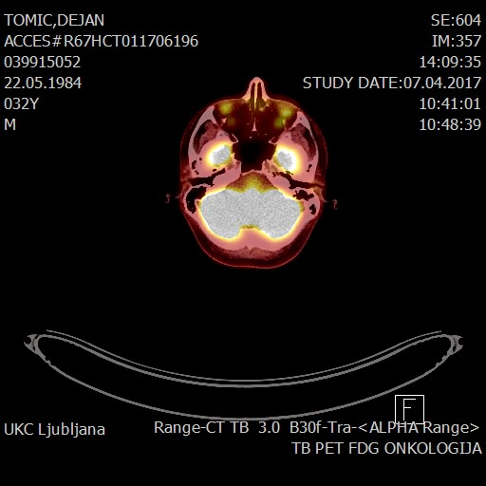
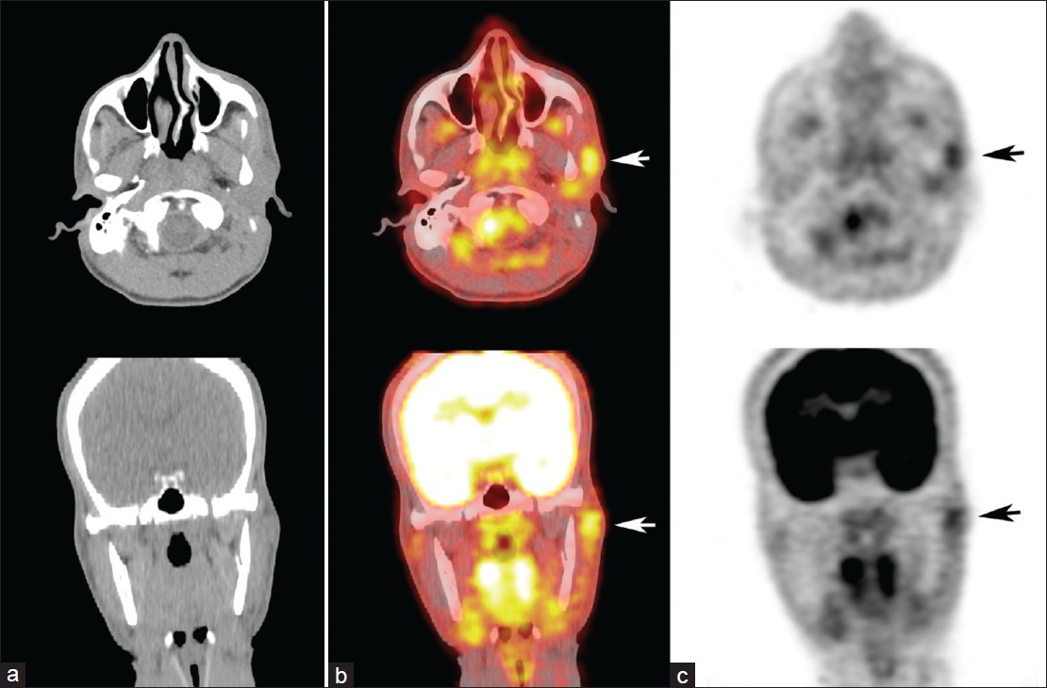
Ocular sarcoidosis

Slide 20
PET/CT scan and follow-up under treatment
PET/CT scan allows for follow-up under treatment to assess for persistent inflammatory activity and metabolic response correlates with clinical outcomes.
Maturu et al, showed that in PET/CT scan no responder patients undergoing steroid therapy, even though clinical remission was obtained at the time of PET/CT scan, relapse rate at 12 months was significantly higher that in PET/CT scan responders.
Some studies had already shown the ability of PET/CT scan to monitor treatment efficiency

Slide 21
Perspectives of PET/CT scan
Despite the very high sensitivity of PET/CT in detecting inflammation, its diagnostic values is limited in organs that
spontaneous present a high signal due either to physiological uptake of FDG reflecting the important contribution of glucose as a metabolic substrate such as the brain and to a lesser extent the myocardium,
or due to the blood clearance of the tracer by the kidneys and its elimination through the urinary tract.
The currently most promising imaging agent targets somatostatin SSTR2 receptors.
This diagnostic approach appears to be more specific than the FDG approach, but the sensitivity must be confirmed in future studies.

Slide 22
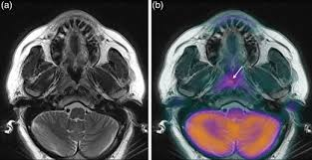
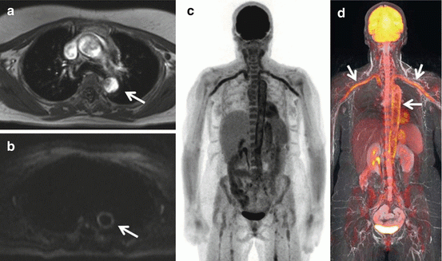
Combined PET/MRI
The complementarity of the information obtained by PET/CT scan and MRI has been illustrated.
Granuloma inflammation during the active phase of the disease is detected with great sensitivity by PET but tissue remodeling associated with the development of granuloma, progressively leading to the formation of fibrosis, is well characterized by MRI.
There is a hybrid combining PET/MRI scan is a real opportunity for sarcoidosis imaging.

Slide 23
¹⁸F-FDG PET/CT scan
I discuss the current ¹⁸F-FDG PET/CT scan in imaging in sarcoidosis and highlight its potential role in diagnostic work-up, making therapeutic decisions and some our study results and suggestions for further clinical research.
I present our clinical experience with clinical work-up with Sarcoidosis patients from March 2010 till February 2018

Slide 24
The aims of our study are to show
¹⁸F-FDG PET/CT scan is a better diagnostic methods for:
assessing the prevalence and disease activity than the currently established imaging methods and blood markers;
assessing the prevalence of disease in other organs in addition to the lung;
tracking the course of the disease and monitoring the effectiveness of treatment than the currently established methods;
predicting the course of the disease than the currently established method.

Slide 25
¹⁸F-FDG PET/CT scan in SA This prospective study was conducted prospectively, from March 2010 to February 2018, which include na¨ive symptomatic sarcoidosis patients.
PET/CT scan in sarcoidosis patients
¹⁸F-FDG PET/CT No. of patients
PET/CT1 166 (at the time of the diagnosis)
PET/CT2 87 (at the follow-up about aproximately in one year later)

Slide 26
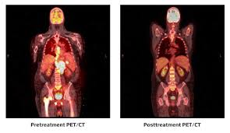
¹⁸F-FDG PET/CT scan in SA
¹⁸F-FDG PET/CT SUV:
Measures in four diferent location
MaxSUV …………………………. max SUV at any location
Max Paren_lung ………………….….. max SUV in lung parenchyma
Max_L_nodes_in_chest ………. max SUV in lymph nodes in chest
Max_organ_outsite_chest ……. max SUV in parenchymal organ in abdomen
Max_L_nodes_outsite_chest …. max SUV in lymph nodes in extra pulmonary location

Slide 27
¹⁸F-FDG PET/CT scan in SA
Pulmonary function: FVC, DLco
Chest radiogram in two projections
Markers:
chitotriosidase (CTO),
serum angiotenzin converting enzym (sACE),
cytokines: in blood IL-2R, TNF-α, IL-6 and TNF-α, IL-6 in BAL

Slide 28
Demografic characteristics of sarcoidosis patients
Demografic characteristics of sarcoidosis patients.
Parameters | N
n | 166
age | 47.4±12.3
Females % | 53.6%
CD4/CD8 | 7.5 (0.7)
Stage: 0 I. II. III. | 4 (2.4%) 8 (4.8%) 139 (83.4%) 15 (9.0%)
X-ray score: 0 1. 2. 3. 4. | 12 (7.2%) 41 (24.7%) 51 (30.7%) 45 (27.1%) 17(10.2%)
parameter | Mean/SEM
sACE1 | 0.43±0.02
CTO1 | 652.7±83.5
VC1 | 97.4±1,9
DLco | 85.9±0,4
Plasma IL-6 | 1.4±0.2
BAL IL-6 | 10.8±1.4
Plasma TNF-α | 24.3±1.6
BAL TNF-α | 2.6±0.3
Plasma IL-2R | 1098.0±75.5

Slide 29
The first results Measured radiation values of SUV on ¹⁸F-FDG PET/CT1, at individual sites in the body at the time of the sarcoidosis diagnosis
PET/CT scan SUV (166 pts) | Mean±SEM mSv | Minimum mSv | Maximum mSv
MaxSUV1 | 12,4±0,8 | 0,5 | 58,10
MaxParenP1 | 4,1±0,4 | 0,60 | 20,0
Max_L_nodes_chest1 | 10,9±0,9 | 0,5 | 58,10
Max_organ_outside_chest1 | 4,2±0,2 | 0,50 | 15,90
Max_L_nodes_outside_chest1 | 8,4±0,7 | 0,56 | 26,20

Slide 30
PET/CT scan in correlation to stages of sarcoidosis at the time of diagnosis
Measured radiation values on ¹⁸F-FDG PET/CT1, expressed by SUV (mean/SEM), at individual sites in the body following the stages of sarcoidosis
Stage: 0-III | MaxSUV1 mean/SEM | MaxParenP1 mean/SEM | Max_L_nodes_in_chest1 mean/SEM | MaxBezgExPK mean/SEM | MaxExPkOrgan mean/SEM
0. (4) | 3.7±0.7 | 0.6±0.03 | 2.9±0.9 |  | 3.1±0.03
I. (8) | 8.8±1.8 | 1.7±0.6 | 8.1±1.7 | 11.6±0.1 | 3.7±0.3
II. (139) | 13.2±1.2 | 3.5±0.4 | 12.5±1.2 | 10.0±0.9 | 4.5±0.3
III. (15) | 11.6±2.7 | 11.2.6±3.1 | 4.2±1.4 | 8.9±5.3 | 6.1±1.1
Total (166) | 12.4±0.8 | 3.6±0.4 | 10.9±0.9 | 10±0.9 | 4.5±0.2
Notes:
Stages turn out to be insufficient for determining the precise activity of the disease in the lung

Slide 31
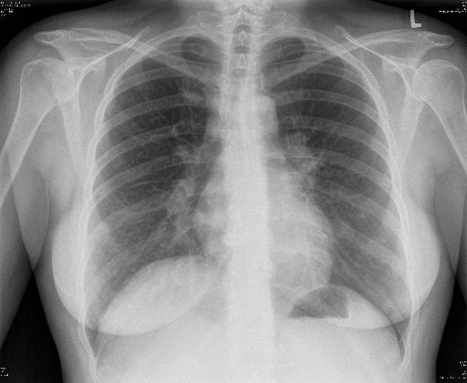
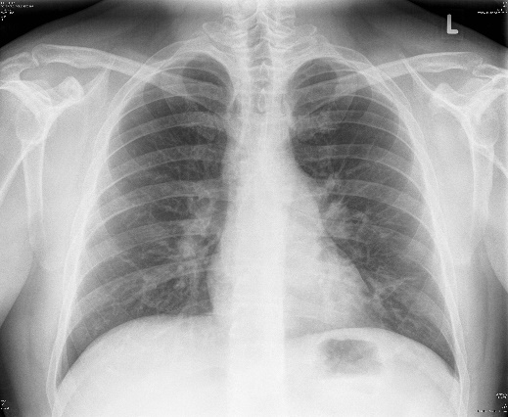
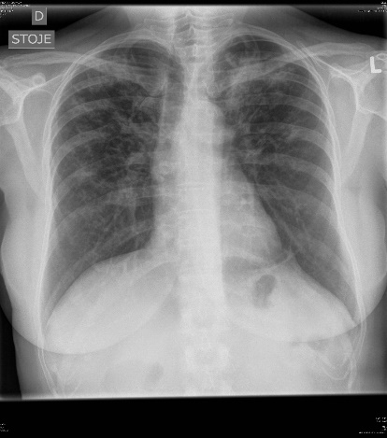
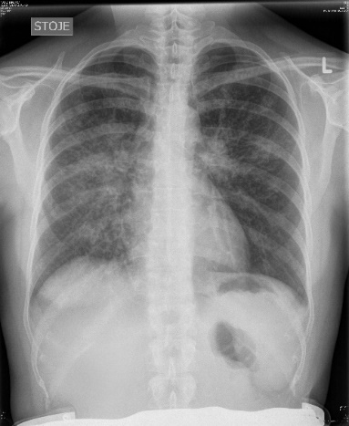
Chest radiogram Stage and/or X-ray score
X-ray score: a numerical score (0–4) judging the size and extent of the granuloma infiltration
X-ray score: % of lung field involved regardless of the chest X-ray stages I-IV.
0. no 0%
1. about 25%
2. up to 50%
3. up to 75%
4. up to 100% virtually the whole lung field involved
X-ray score1 X-ray score2 X-ray score3 X-ray score4

Slide 32
A question or a dilemma about „proper classification“ of sarcoidosis on the basis of chest X-ray imaging Hamlet: "To be or not to be that is the question!"
Are there any differences between Scading by stages and x-ray scoring in PET/CT results?
Scading by stages (0. to IV.) in radiogram images (lymph nodes, lung parenchyma, lung fibrosis)
or
X-ray scoring (0. to IV.) by the volume of granuloma infiltration and fibrosis in lung parenchyma in radiogram images

Slide 33
Measured radiation values on ¹⁸F-FDG PET/CT1, expressed by SUV, mean/SEM, at individual sites in the body following the X-ray score
X-ray score/No | MaxSUV1 mean/SEM | MaxParenP1 mean/SEM | Max_L_nodes_in_chest1 mean/SEM | MaxBezgExPK mean/SEM | MaxExPkOrgan mean/SEM
0/12 | 7.8±2.4 | 1.4±0.5 | 9.8±2.0 | 8.5±3.1 | 3.5±0.2
1/41 | 9.2±6.6 | 2.1±0.3 | 8.5±1.2 | 8.4±1.6 | 3.8±0.2
2/51 | 15.7±2.6 | 2.9±0.4 | 13.9±2.1 | 11.1±1.7 | 4.7±0.5
3/45 | 13.6±1.8 | 5.1±0.7 | 11.2±2.1 | 11.2±2.3 | 5.0±0.4
4/17 | 16.7±3.9 | 8.5±1.5 | 10.6±2.5 | 10.1±2.5 | 5.3±1.4
Total/166 | 12.6±1.0 | 3.6±0.4 | 11.0±0.9 | 10.0±0.9 | 4.5±0.2
p=0.007; r=0.25 p=0.000; r=0.54
SUVmax ≥ 6.0 have significantly higher chance of relapse
Ref.: Vorselaars AD, et al. Eur Respir J 2014

Slide 34
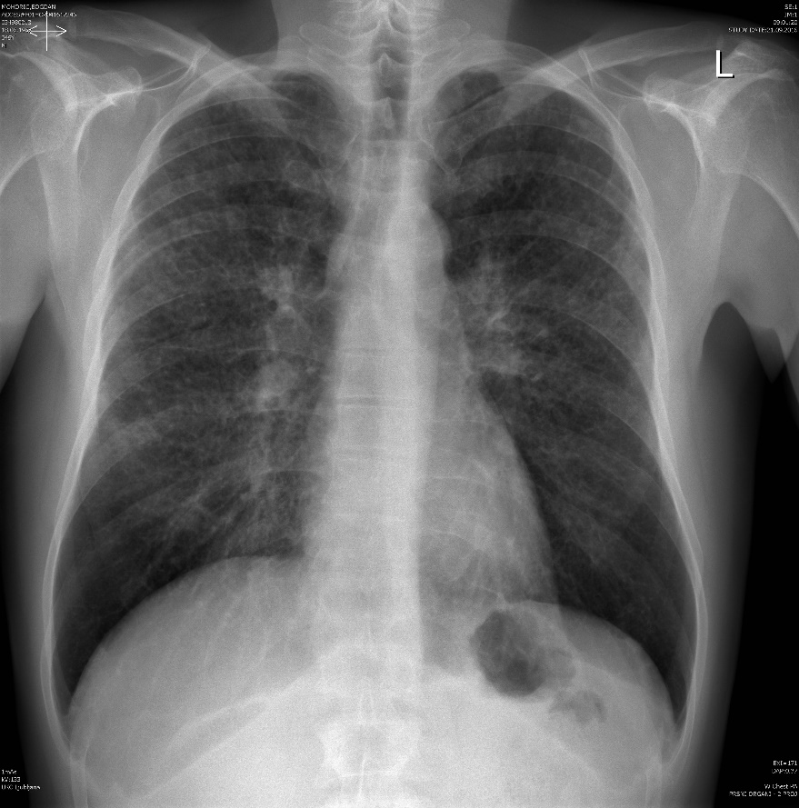
Patient, male age 42, Stage II., X-ray score 4.

Slide 35
Patient, age 65, with chronic sarcoidosis for more than 10 years, Stage IV and ¹⁸F-FDG PET/CT shows more activity in the lung

Slide 36
PET/CT scan in correlation to stages of sarcoidosis at the time of diagnosis
Chest radiography is still frequently used in the diagnosis of SA because it is cost effective and readily available,
BUT
PET/CT can be positive at any stage of sarcoidosis, hilar adenopathy can be found in 85-95%, and pulmonary parenchymal involvement is only present in 20% PET/CT in stage 0, but 85% PET/CT scan positivity was found in patients with stage IV. There is a lack of correlation between radiological findings based on the descriptive classification by radiological stages 0 to IV.
WHILE
X-ray score offers a significant correlation with PET/CT scan (MaxParen1 readings) actual disease activity shown by PET/CT scan.

Slide 37
PET/CT scan compared to chest X-ray
From this, it may be concluded that PET/CT scan is superior to chest radiography in the evaluation of active parenchymal and/or lymph node involvement of sarcoidosis and is a better predictor for recurrence regardless of stages.
Keir G, Wells AU. Assessing pulmonary disease and response to therapy: which test? Semin Respir Crit Care Med 2010.
Human A, et al. FDG PET for Gauging of Sarcoidosis Disease Activity. Semin Respir Crit Care Med 2014.
Ref.: Mostard RL, et al. Severity of pulmonary invovement and 18F-FDG PET. Respir Med. 2013
Stefano Palmucci, et al. Clinical and radiological features of extra-pulmonary sarcoidosis: a pictorial essay. Insghts Imaging, 2016.

Slide 38
Correlation between ¹⁸F-FDG PET/CT scan and biomarkers
Biomarkers either in BAL or in blood
BAL CD4/CD8
sIL-2R
sACE
CTO
TNF-α (blood + BAL)
IL-6 (blood + BAL)

Slide 39
Correlation between ¹⁸F-FDG PET/CT and biomarkers of disease activity
 | MaxSUV1 | MaxParenP1 | Max_L_nodes_in_ chest1 | Max_L_nodes_outside_chest1 | Max_organ_outside_chest1
Plasma IL-6 | NS | NS | NS | NS | NS
BAL IL-6 | NS | NS | p=0.025; r= 0.29 | NS | NS
Plasma TNF-α | p= 0.003 r=0.38 | NS | p=0.013; r=0.317 | NS | NS
BAL TNF-α | NS | p=0.044; r= - 0.266 | NS | NS | NS
Plasma IL-2R | p=0.0001; r=0.49 | NS | p=0.001; r=0.43 | p=0.011; r=0.28 | NS
sIL-2R positively correlated with MaxSUV1 ¹⁸F-FDG PET/CT in 92-94%,
but only with lymph nodes in chest and abdomen

Slide 40
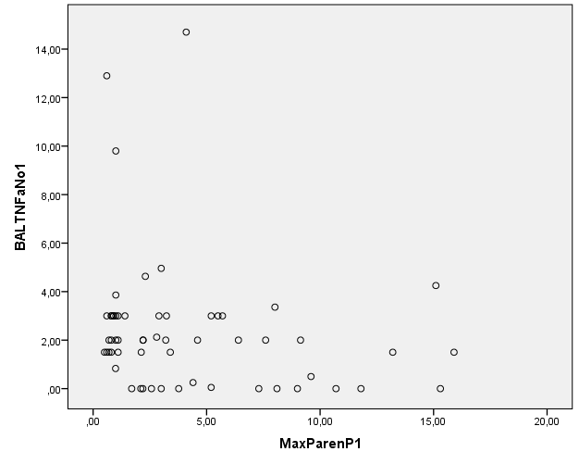
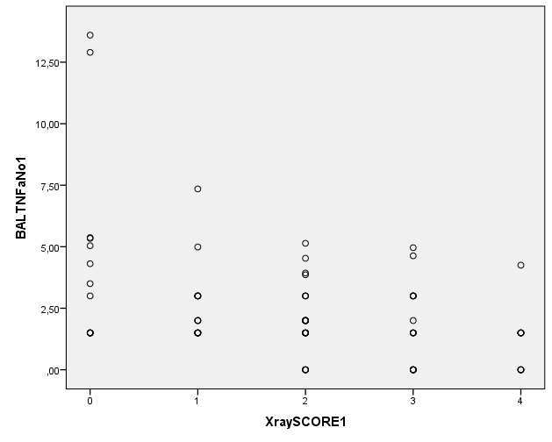
Graf 1. Negative correlation between SUV in MaxParenP1 and BAL TNF-α1 (r = - 0,266; p = 0,044)
Graf 2. BAL TNF-α1 in relation of X-ray score (r = - 0,317; p = 0,003)

Slide 41
Correlation between PET/CT scan and biomarkers: CTO, sACE, BALF CD3/CD4
 | MaxSUV1 | MaxParenP1 | MaxBezgVpk1 | MaxBezgExPK1 | MaxExPkOrgan1 | sACE
sACE1 | p=0.017 r=0.266 | NS | NS | NS | NS
sCTO1 | p=0.000 r=0.483** | p=0.004 r=0.338** | p=0.000 r=0.417** | NS | NS | r=0,382 p= 0,001
BAL CD4/CD8 |  | p=0.042 r=0.75*
sACE positively correlated with PET/CT in 51% patients
BAL - 93-96% specifity has higher SUV in PET/CT scan activity

Slide 42
Usefulness of PET/CT scan in the monitoring of the disease
MaxSUV in different locations in PET/CT1 and in PET/CT2 scan
PET/CT 87 pts | MaxSUV | MaxParenP | Max_L_nodes_in_ chest | Max_L_nodes_outside_chest | Max_organ outside_chest
PET/CT1 | 14.2±1.4 | 4.8±0.7 | 12.4±1.5 | 9.3±1.1 | 4.5±0.31
PET/CT2 | 9.7±1.0 | 3.4±0.6 | 8.1±1.1 | 7.2±1.0 | 4.2±0.3

Slide 43
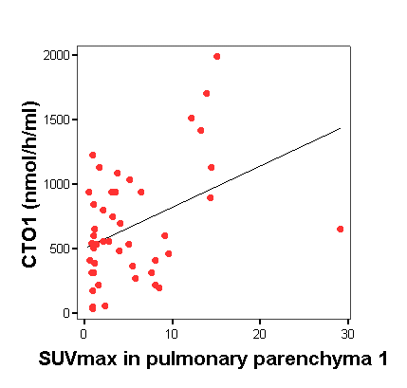
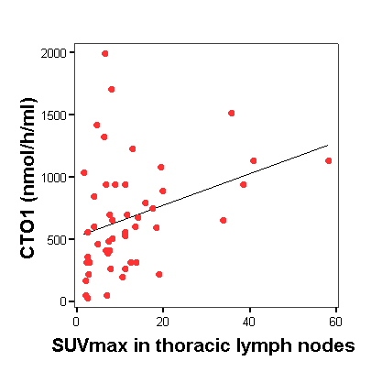
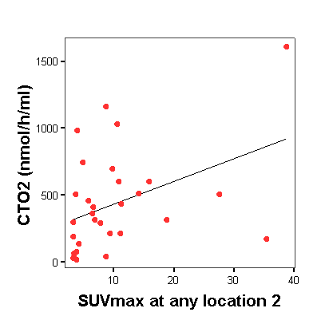
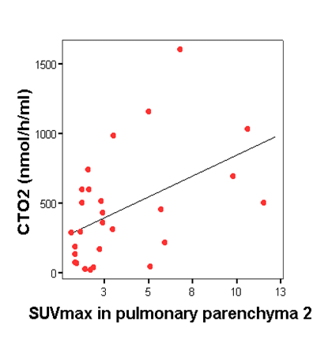
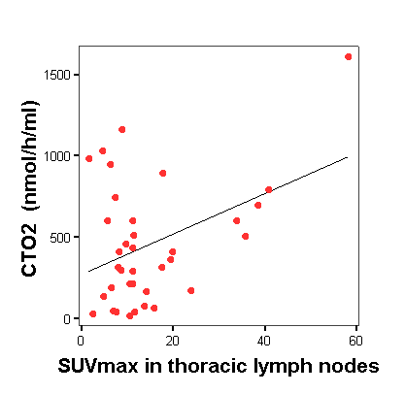
CTO1 (nmol/h/ml) in relation to MaxSUV1 at any location1 (left), to pulmonary parenchyma1 (in the middle) and thoracic LN1 (right)
CTO2 (nmol/h/ml) in relation to MaxSUV2 at any location (left), to pulmonary parenchyma2 (in the middle) and thoracic LN2 (right)

Slide 44
MaxSUV in PET/CT1 and in PET/CT2 scan better predicting the course of the disease than the currently established method. Remission: >75% reduction of clinical symptomes partial remissin: less than 75% reduction of clinical symptomes relaps: is worsening of clinical symptomes and their ymptoms responded to steroids/steroid sparing agents
 | Complete remission | Partial remission | Recurrence | Chronic course | Progress
MaxSUV1 (mean/SEM) MaxSUV2 (mean/SEM) | 8,1±0.9 4.3±0.9 | 13.2±2.4 7.2±0.6 | 20,9±7.3 12.7±5.4 | 18.7±7.9 10.1±2.3 | 23.6±6.2 14.5±3.9 | P=0,001 R=0.36
CTO1 | 499.6±104 | 689.1±106 | 1544±84.7 | 533±172.1 | 1256±332 | P<0.015 R=0.361
sACE1 | 0.41±0.08 | 0.46±0.06 | 0.58±0.1 | 0.32±0.07 | 0.45±0.06 | NS
TNF-alpha in BAL | 2.9±0.7 | 1.3±0.4 | 1.5±0.3 | 0.29±0.2 | 0.9±0.4 | P<0.05 R=- 0.40

Slide 45
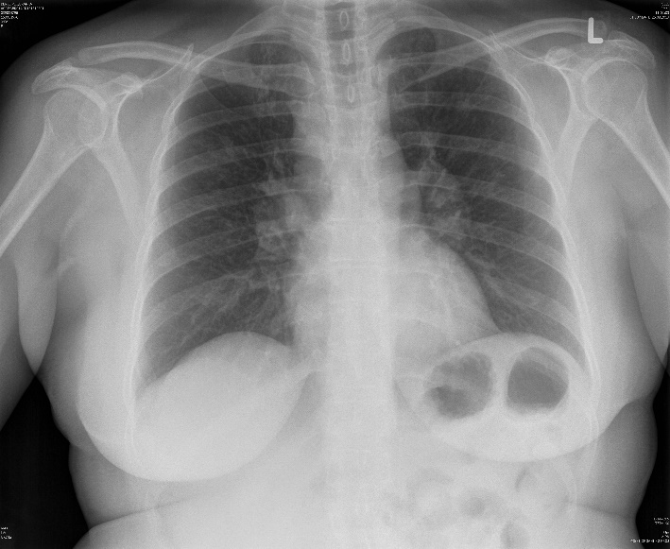
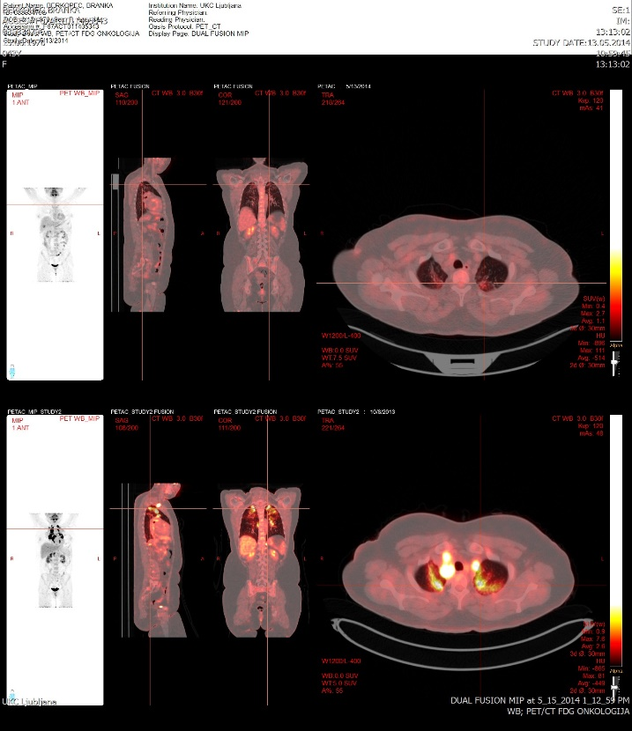
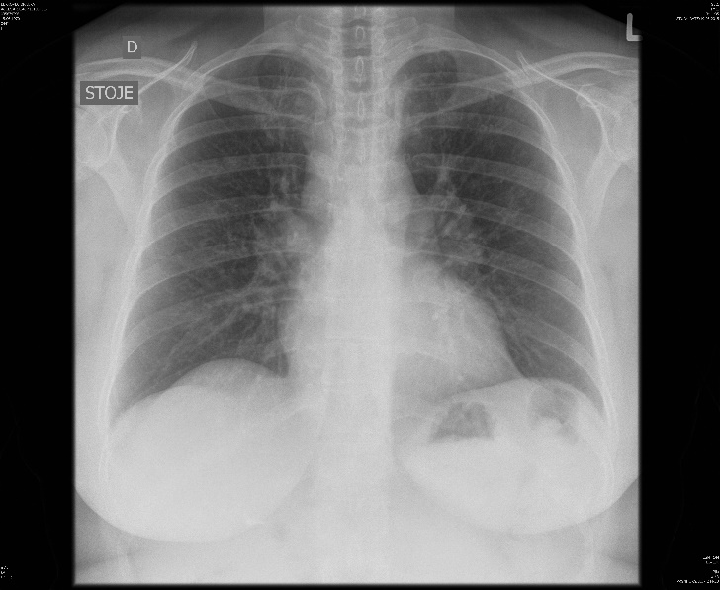
Usefulness for assessment of therapy Patient before and after treatment

Slide 46
¹⁸F-FDG PET/CT scan in therapeutic decision making
Are these markers enough to make a decision regarding treatment (to stop or to continue) or can we provide additional proof with PET/CT scan?

Slide 47
PET/CT2 scan and some markers of sarcoidosis activity at follow-up, with or without treatment
SuvMax2 | X-ray score2 | sACE2 | CTO2 | FVC2
MaxSUV2 | p=0.000; r=0.35 | NS | p=0.004; r=0.28 | NS
MaxParen2 | P=0.004; r=0.26 | NS | NS | p=0.012; r= - 0.28
Max_L_nodes_in_chest2 | P=0.013; r=0.22 | NS | p=0.026; r=0.22 | NS
Max_L_nodes_outside_chest2 | NS | NS | NS | NS
Max_outside_chest2organ_ | Ns | NS | NS | NS

Slide 48
PET/CT scan before and after therapeutic decision
No therapy
Corticosteroids
Antimycotics
All thogether

Slide 49
PET/CT scan before and after therapeutic decision

Slide 50
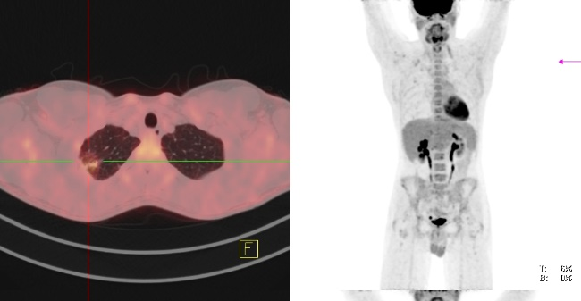
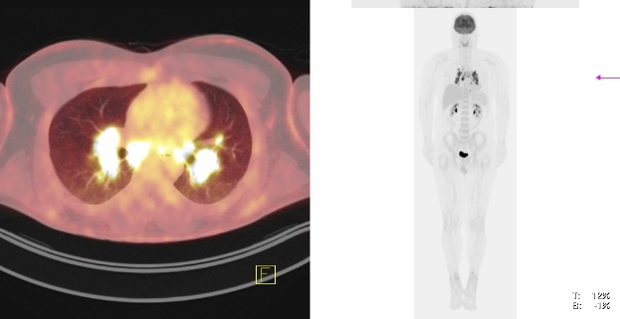
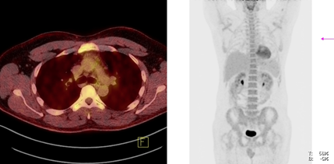
¹⁸F-FDG PET-scan Analysis Confirms Beneficial Effects Of Antifungal Treatment In Sarcoidosis
The results support earlier observations that sarcoidosis can be successfully treated with antifungal medication but not in all patients.
Further work is required to identify the clinical and environmental characteristics of these patients.

Slide 51
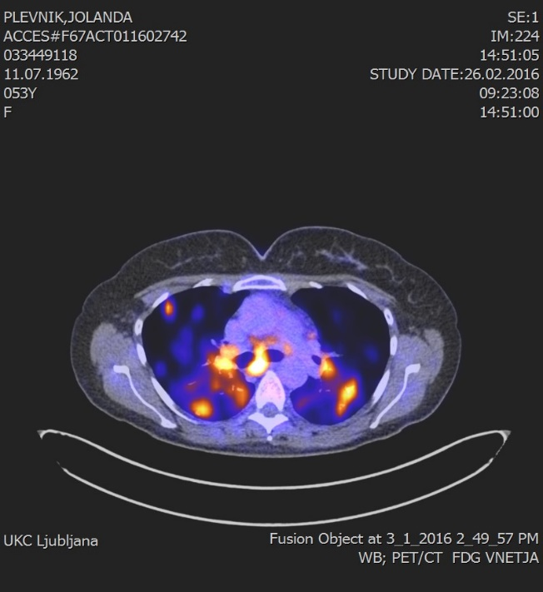
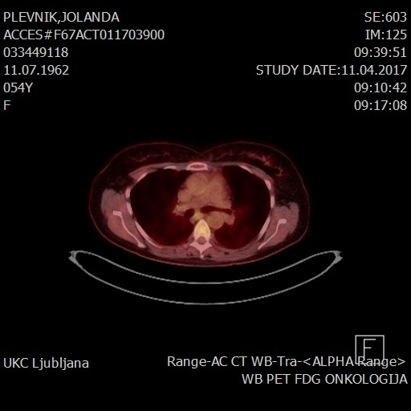
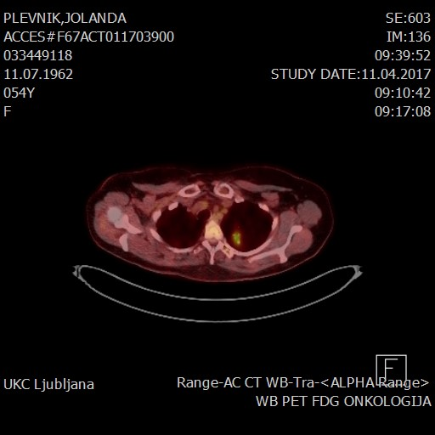
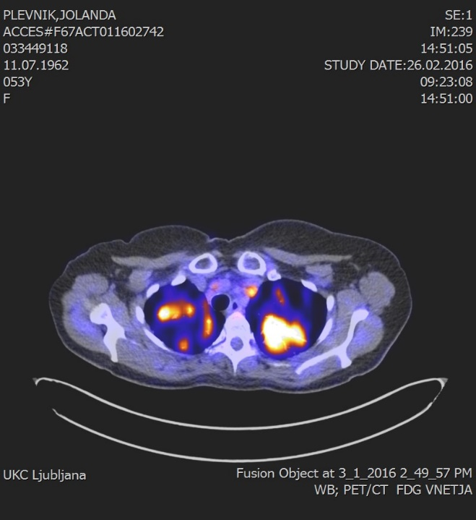

Slide 52
Suggested roles for FDG-PET/CT in the diagnosis and management of the patients with sarcoidosis
Identification of sites of active disease, amenable to biopsy
Evaluation of activity in patients with persistent symptoms and negative serological markers of dieseases activity
Identification of active disease in sarcoid patients with lung fibrosis
Identification of extra thoracic sites of active disease in chronic sarcoidosis
Evaluation of treatment response in chronic refractory sarcoidosis

Slide 53
Recommendations based on our Clinical Experience
Based on the literature and our experience of the application of the PET/CT scan in diagnostic work-up and management of sarcoidosis we would like to propose several recommendations for the implementation:
At diagnostic work-up it is more sensitive than other biomarkers for evaluation of active disease outside of the thorax and shows some more correlation with CTO marker
I suggest reevaluating the Scading stages of SA because it does not show the precise condition of the disease in the lung
while X-ray scoring correlates not only to PET/CT scan but also to the markers of the disease activity
PET/CT scan shows the effects of different treatments more precisely than other markers

Slide 54
Recommendations based on our Clinical Experience
PET/CT scan has been shown to be a very sensitive technique for the assessment of inflammatory activity in sarcoidosis by detecting and quantifying the degree of inflammatory and granulomatous reactions that occur in the lungs.
In view of the radiation dose and costs, defining appropriate indications for PET/CT scanning in sarcoidosis patients is vital.

Slide 55
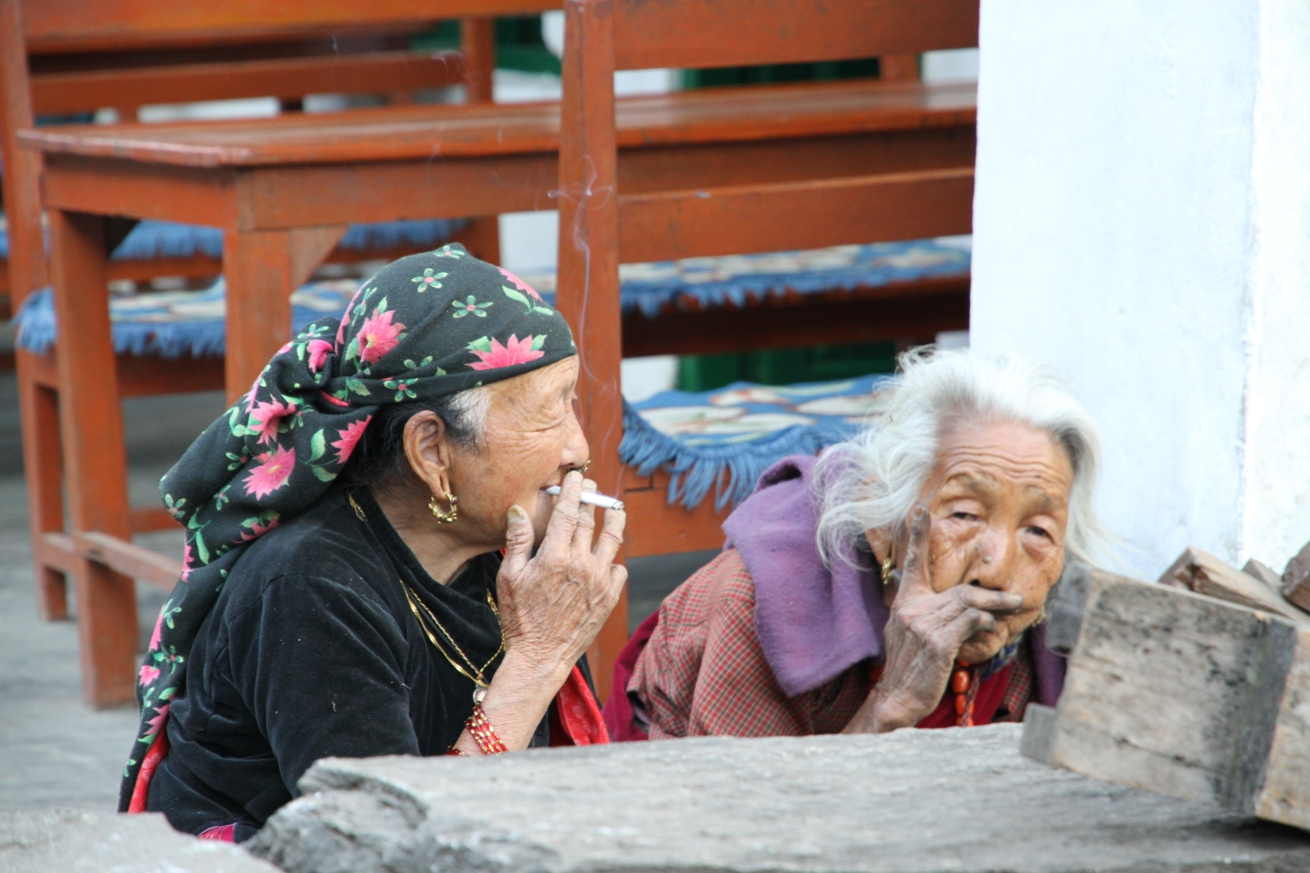
Grazie mille per la vostra attenzione!

