Slide 1
CLINICAL CASE Claudia Ravaglia – 17/4/2018

Slide 2
Clinical case
Female
24 years
Student (drama, art and music studies)
Non smoker, but exposed to passive smoking
Family history: negative for autoimmune/pulmonary diseases
Exposures: mold (house), wood carving (hobby)

Slide 3
Past medical history
Congenital alopecia
Congenital dysplasia of 2nd,3rd and 4th fingers of both hands (4 surgeries from the age of 18 months up to 3 years of age)
Hashimoto's thyroiditis from the age of 18
Mild chronic anemia from the age of 18
Laparoscopic cholecystectomy for gallbladder lithiasis
Current medication: levothyroxine 125 mcg/die

Slide 4
1 month ago access to the emergency room for tachycardia.
She also complained of increasing fatigue, evening fever and mild cough (sometimes dry sometimes productive).
No other respiratory symptoms, no hemoptysis, no dyspnea, no chest pain
No arthralgia or other CTDs signs/symptoms

Slide 5
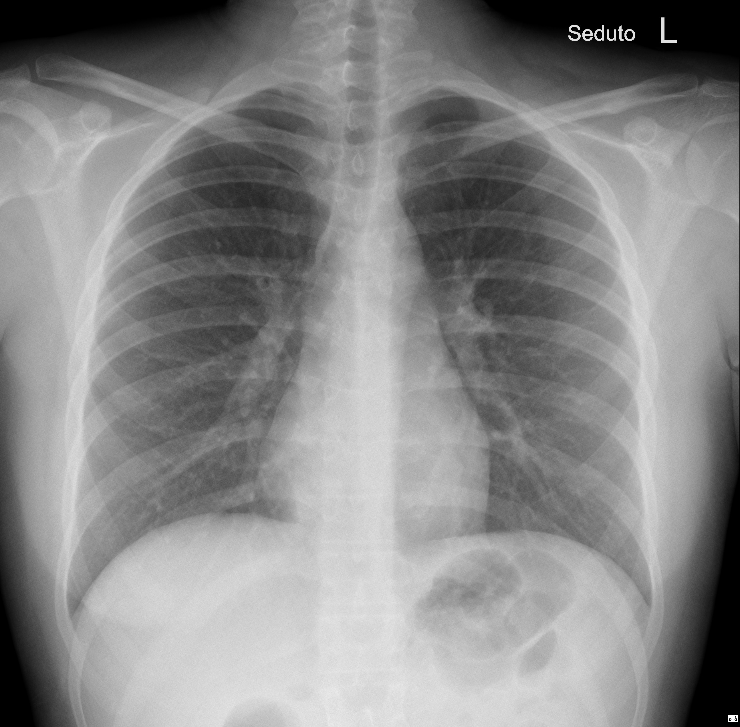
SpO2 99% RA
Chest examination: negative
RR 14-16 b/min
Notes:
In the emergency room, a chest X ray was performed which did not show any infiltrates. Chest examination was unremarkable, SpO2 was 99% in RA.

Slide 6
Blood
Hb 4,9 gr/dl ↓
MCV – MCH normal
PLT 443.000/mL
FIBRINOGEN normal
IRON 25ug/dl↓ - FOLATE normal
FERRITIN 435ug/L ↑ - TRANSFERRIN 1,20 g/L ↓
RETICULOCYTES 18,2x1000/mmc ∼↓ - HAPTOGLOBIN 2,96 g/L ↑
COOMBS TEST (direct and indirect) negative
OTHER ROUTINE BLOOD TESTS UNREMARKABLE (WBC, ALT, LDH, Creatinine …)
Notes:
The routine blood tests showed a significant sideropaenic anaemia, with normal MCV and MCH, negative coombs test, with other routine tests unremarkable

Slide 7
Further procedures
Gastroscopy: negative
Colonoscopy: negative
Abdominal ultrasound: negative
Urine analysis: negative
Microbiological tests: negative
Notes:
To investigate the anaemia, some investigations were performed:

Slide 8
Blood transfusion of 3 units of compatible RBCs
Hb 9,2 g/dl
Discharged after course of antibiotics (cefixime) and iron injections
No steroids

Slide 9
After 10 days, persistent low grade fever and fatigue
Reduced appetite and contraction of diuresis with foamy urines
Bloods:
Creatinine 4 mg/dl
Hb 7 g/dl
CRP 80 mg/L
Renal ultrasound showed normal sized kidneys (right and left kidney around 7.2 cm) with increased cortical echogenicity bilaterally.
Patient admitted to hospital

Slide 10
Does this patient have an autoimmune disease?
Yes
No
I don’t know

Slide 11
Blood tests requested
Rheumatoid Factor
ANA reflex
ANCA
anti-ENA Abs
LAC
ANTICARDIOLIPIN Abs
anti-GBM Abs
CIRCULATING IMMUNE COMPLEXES
URINALYSIS
Immunoglobulins
SERUM LIGHT CHAINS
C3 and C4
CRYOGLOBULINS
Notes:
Emocromo di II livello: "Anisopoichilocitosi moderata; alcuni dacriociti; lieve frammentazione eritrocitaria. Anisocromia”Non schizociti

Slide 12
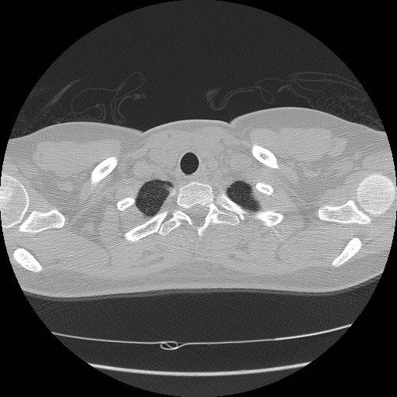

Slide 13
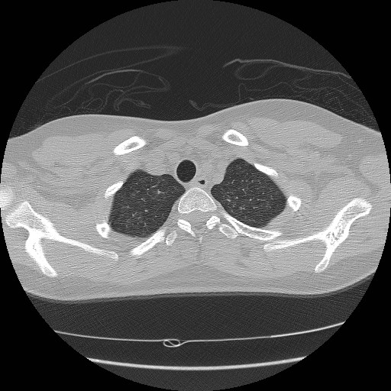

Slide 14
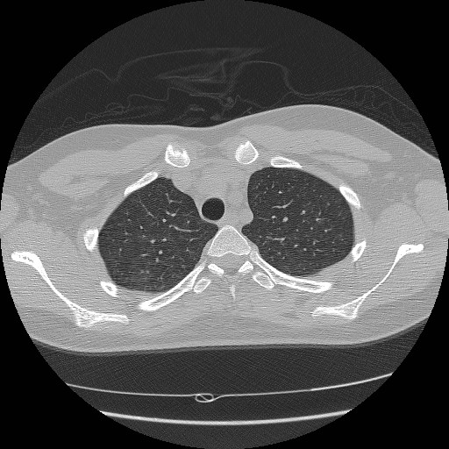

Slide 15
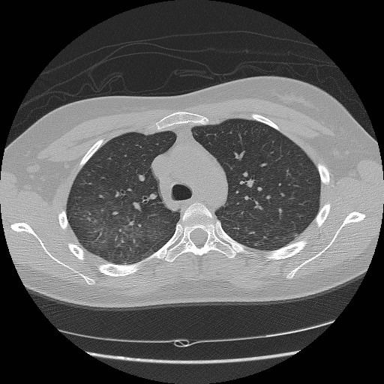

Slide 16
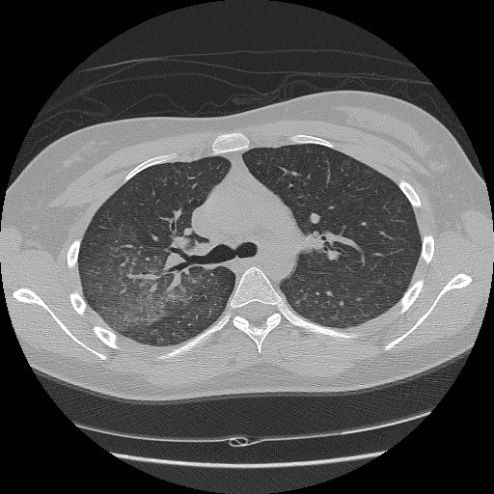

Slide 17
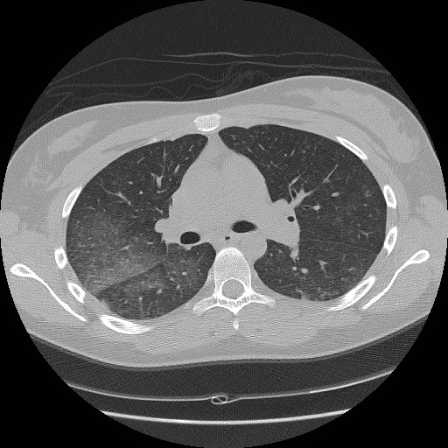

Slide 18
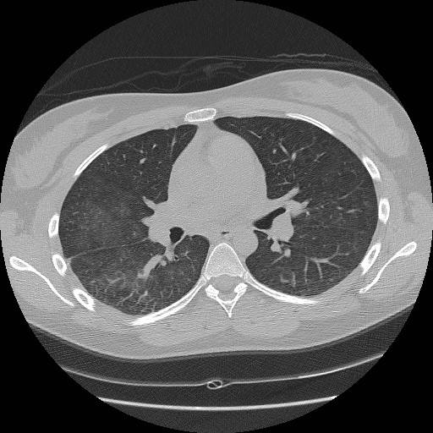

Slide 19
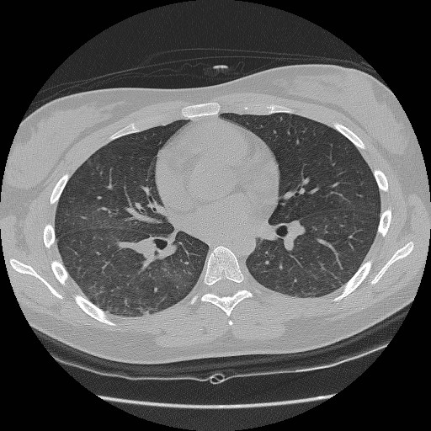

Slide 20
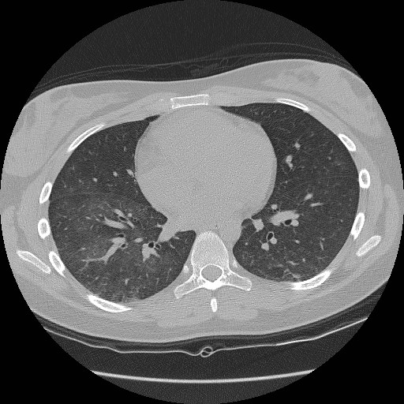

Slide 21
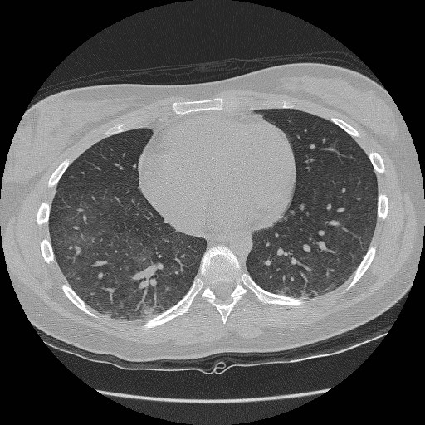

Slide 22
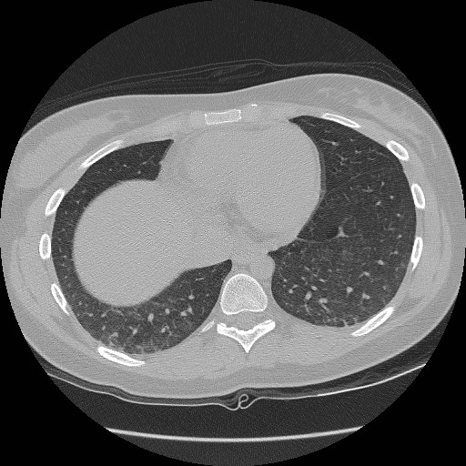

Slide 23
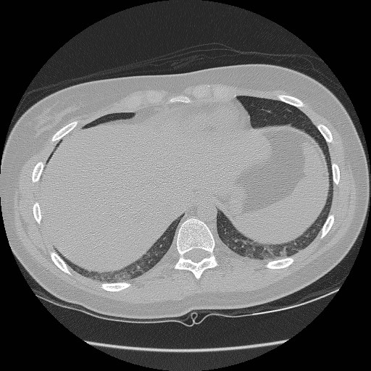

Slide 24
What diagnosis is on top of your differential?
Vasculitis
Lymphoproliferative disorder
Opportunistic infection
CTD

Slide 25
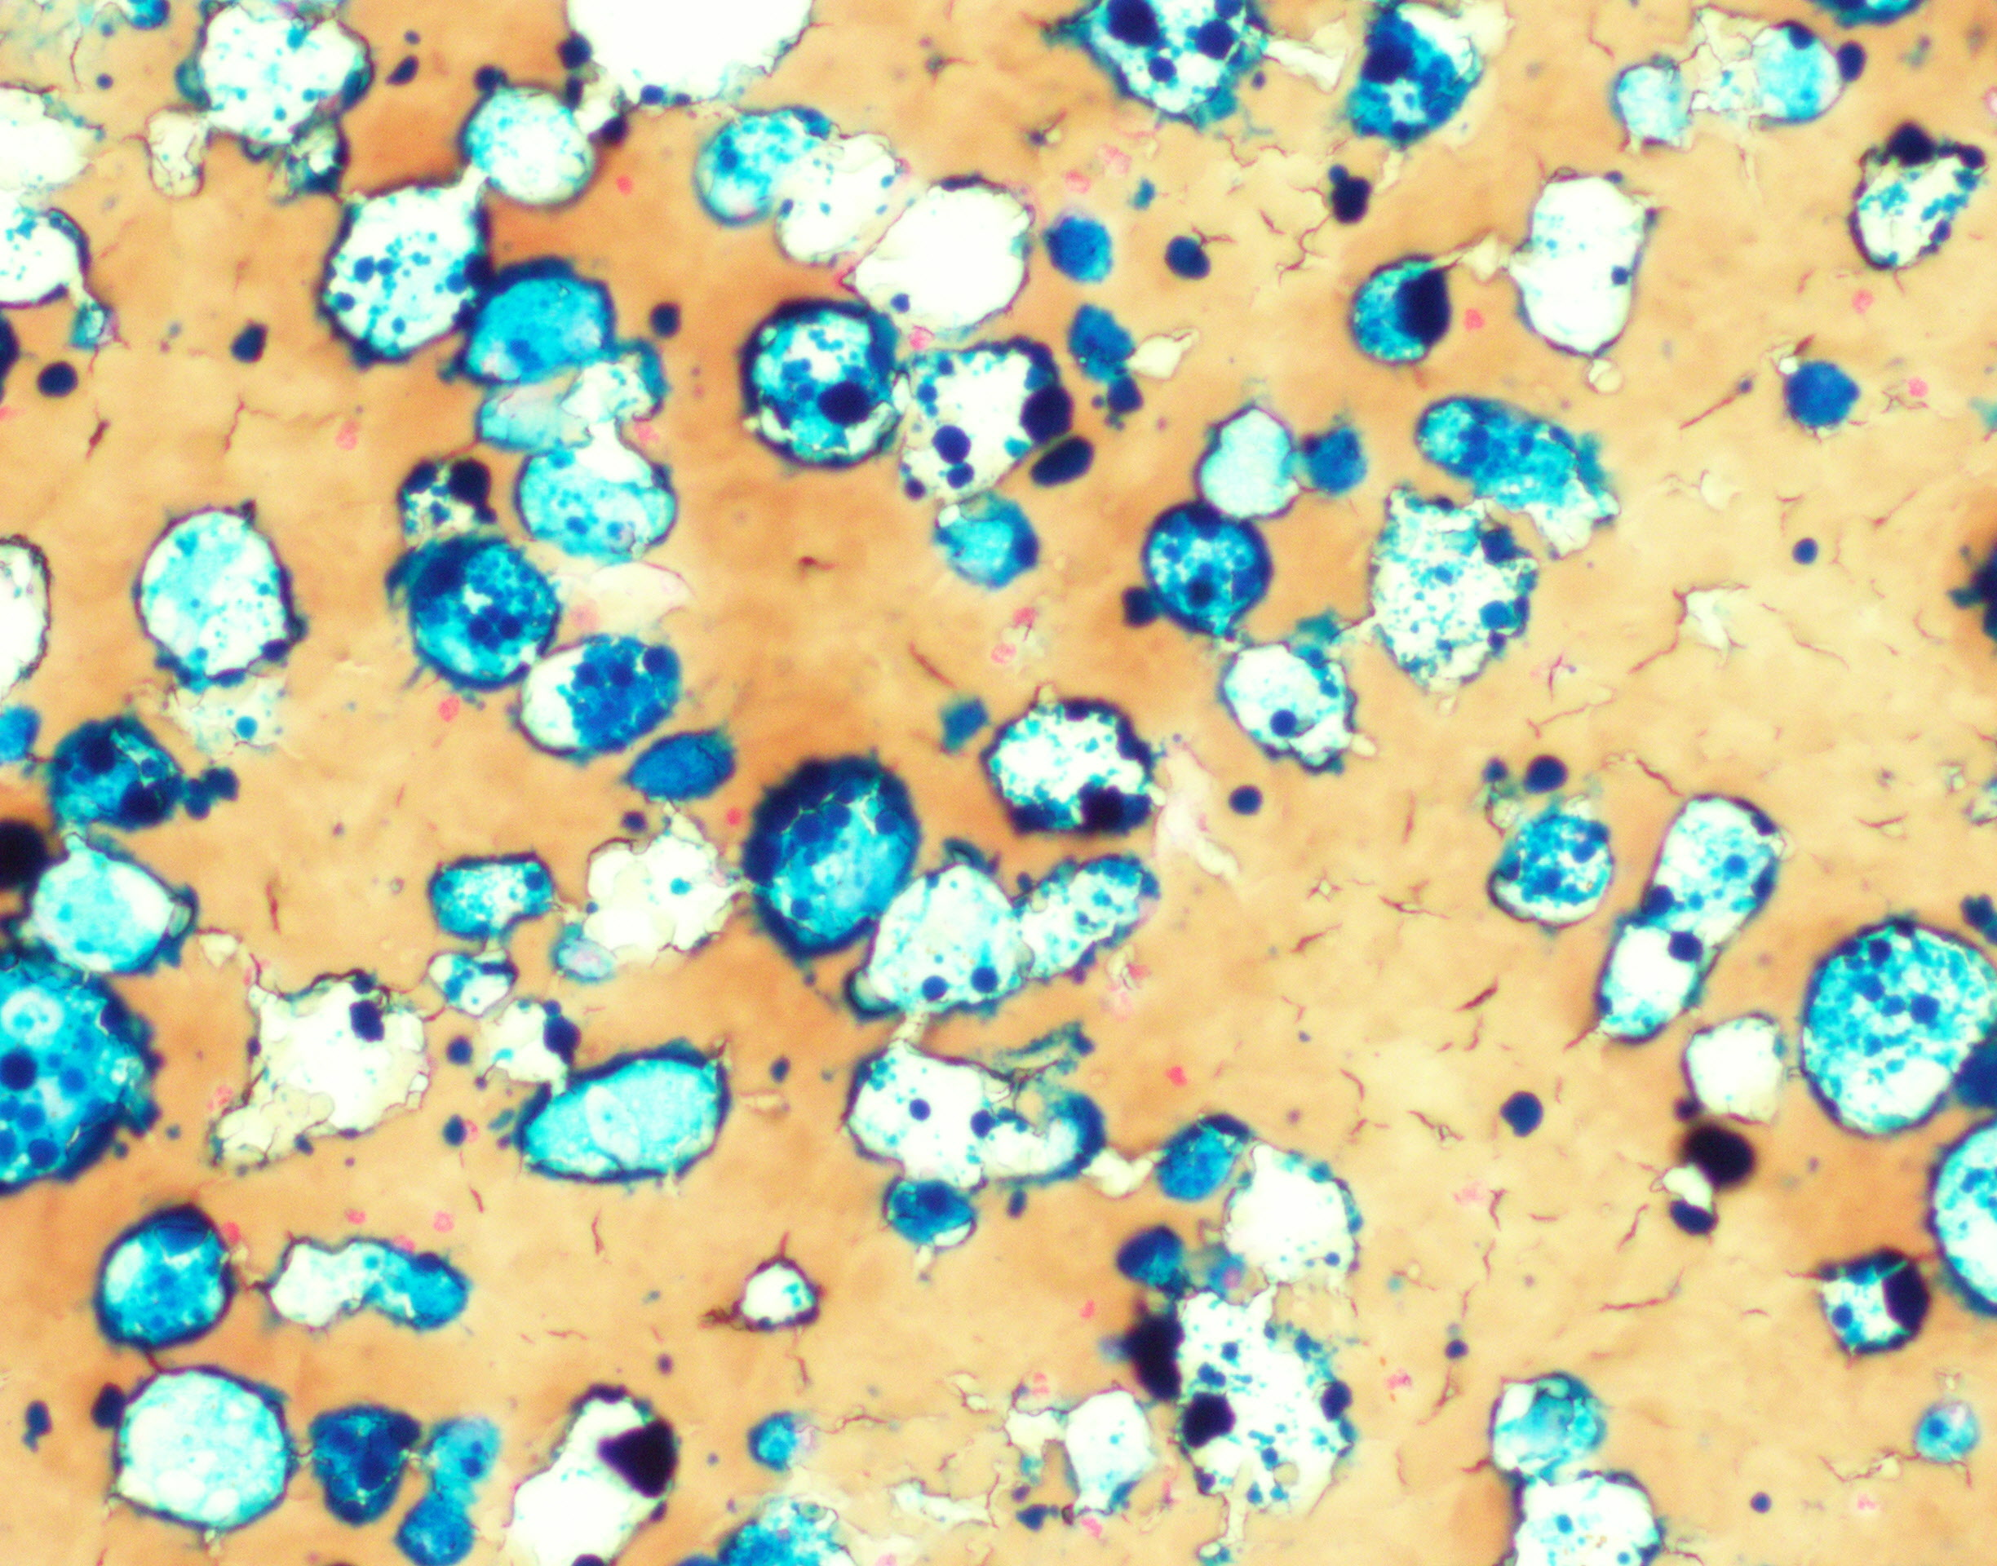
BAL
Total cells 740x10^6/L
Neutrophils 25.0%
Lymphocytes 15.0%
Eosinophils 2.0 %
Macrophages 58.0 %
Some DAD cells
(diffuse alveolar damage cells)
Macroscopically haemorrhagic BAL
Perls staining showing haemosiderin-laden macrophages
Notes:
… indicating ALVEOLAR HAEMORRAGE

Slide 26
Blood tests
Rheumatoid Factor negative
ANA reflex negative – anti-ENA Abs negative
S-MPO-ANCA 7,6 KUI/L ↑
anti-GBM Abs 38,0 KUI/L ↑
LAC positive – ANTICARDIOLIPIN negative
CIRCULATING IMMUNE COMPLEXES 3,27UR/ml ↑
Immunoglobulins negative
SERUM LIGHT CHAINS Kappa 97,4 mg/L ↑, Lambda 103,0 mg/L ↑
C3 and C4 negative
CRYOGLOBULINS negative
Urinalysis: PROTEINURIA 75 mg/dl ↑ and MICROHEMATURIA.
24 hours PROTEINURIA: 0,51 g ↑
Notes:
Emocromo di II livello: "Anisopoichilocitosi moderata; alcuni dacriociti; lieve frammentazione eritrocitaria. Anisocromia”Non schizociti

Slide 27
What is your diagnosis?
Granulomatosis with Polyangiitis
Goodpasture’s disease
Undifferentiated CTD
Systemic lupus erythematosus

Slide 28
What is your diagnosis?
Granulomatosis with Polyangiitis
Goodpasture’s disease
Undifferentiated CTD
Systemic lupus erythematosus

Slide 29
Goodpasture’s disease
0,5-1 cases per million inhabitants per year.
2 peaks: 20-30 years (> prevalence in men) and 60-70 years (males = females).
Vasculitis affecting glomerular capillaries, pulmonary capillaries or both with GBM deposition of anti-GBM autoantibodies.
Organ-specific autoimmune disease:
LUNG HAEMORRHAGE
RENAL FAILURE
ANTI-GBM ANTIBODIES
Hellmark T et al. Journal of Autoimmunity 2014
Notes:
IN 95% OF CASES, THE SYNDROME IS ASSOCIATED WITH CIRCULATING ANTIBODY THAT BINDS TO GLOMERULAR BASEMENT MEMBRANE (ANTI-GBM).
It is important that the alpha3 NC1 domain area of collagen IV be used as the target in this assay as false positives may be seen in less specific testing.
Autoantibodies (IgG) are produced against the non-collagenous domain 1 of the a3-chain of type IV collagen: a3(IV)NC1. This is expressed in a few specialized basement membranes: glomerular basement membrane (GBM), alveolar basement membrane, basement membranes in the testis, the inner ear, the eye and the choroid plexus. Although basement membranes are ubiquitous, only the alveolar and glomerular basement membranes are affected clinically. The binding of the IgG Abs to the basement membrane => activation of the complement system => starting a neutrophil dependent inflammation.

Slide 30
Goodpasture’s disease
0,5-1 cases per million inhabitants per year.
2 peaks: 20-30 years (> prevalence in men) and 60-70 years (males = females).
Vasculitis affecting glomerular capillaries, pulmonary capillaries or both with GBM deposition of anti-GBM autoantibodies.
Organ-specific autoimmune disease:
LUNG HAEMORRHAGE
RENAL FAILURE
ANTI-GBM ANTIBODIES: ELISA highly sensitive (> 95%) and specific (> 97%). Titer is a measure of disease severity correlating with renal outcomes (prognostic importance). Quantitative titers are followed during treatment phases to guide treatment decisions.
Hellmark T et al. Journal of Autoimmunity 2014
Notes:
*) Autoantibodies (IgG) are produced against the non-collagenous domain 1 of the a3-chain of type IV collagen: a3(IV)NC1. This is expressed in a few specialized basement membranes: glomerular basement membrane (GBM), alveolar basement membrane, basement membranes in the testis, the inner ear, the eye and the choroid plexus. Although basement membranes are ubiquitous, only the alveolar and glomerular basement membranes are affected clinically. The binding of the IgG Abs to the basement membrane => activation of the complement system => starting a neutrophil dependent inflammation.

Slide 31
The relationship between renal and pulmonary disease varies between patients both regarding severity and temporal aspects.
60-80% manifestations of pulmonary and renal disease
20-40 % renal manifestations alone
< 10 % only pulmonary manifestations
Symptoms may either start slowly, gradually affecting the lungs and the kidneys, or they may progress rapidly, becoming severe in a matter of days.
Pulmonary symptoms may start weeks-months before renal disease, but also after patients have begun dialysis treatment.
Notes:
Many other types of presentations have been described and most patients report some form of general prodromal symptoms such as fatigue and malaise, usually confined to the preceding few weeks or months; however, constitutional symptoms (malaise, chills, fever, arthralgias, fatigue, weakness, lethargy, nausea/vomiting, loss of appetite, unhealthy pale appearance) may precede or be concurrent with pulmonary or renal manifestations. The symptoms are problematic to interpret only when features of other diseases simultaneously are present.

Slide 32
RENAL INVOLVEMENT
PULMONARY INVOLVEMENT
Acute renal failure is common
(rapid glomerulonephritis)
Rarely, renal function is preserved for several months.
Microscopic haematuria
(< macroscopic)
Proteinuria (< nephrotic syndrome)
Foamy urine, swelling of the hands and feet, high BP, back pain
Hemoptysis is common
< Dry cough, SOB, hypoxia, chest pain
Alveolar hemorrhage may become life- threatening
Severe anaemia
Patients can be asymptomatic and up to 18% of patients may have normal chestXray!
Notes:
Many other types of presentations have been described and most patients report some form of general prodromal symptoms such as fatigue and malaise, usually confined to the preceding few weeks or months; however, constitutional symptoms (malaise, chills, fever, arthralgias, fatigue, weakness, lethargy, nausea/vomiting, loss of appetite, unhealthy pale appearance) may precede or be concurrent with pulmonary or renal manifestations. The symptoms are problematic to interpret only when features of other diseases simultaneously are present.

Slide 33
In the appropriate clinical setting, the detection of circulating anti-GBM antibodies allows the clinician to make a firm diagnosis of anti-GBM disease.
This obviates lung or kidney biopsy!
Notes:
The presence of anti-GBM antibodies is pathognomonic and distinguishes this disease from the other causes of the pulmonary-renal syndrome.
A false-positive rate of less than 1% is attributable to the detection of antibodies directed against other chains of type IV collagen.
The question of whether or not a biopsy is needed after positive serological test- ing is a recurring one.
ELISA = enzyme-linked immunosorbent assay
EIA = enzyme immunoassay
The general principle involves fixing an antigen of interest to a surface, then applying a test specimen over this surface. If an antibody to that antigen is present it will bind to the surface.
irculating anti-GBM antibodies can be detected with indirect IF, western blotting or ELISA.
ELISAs for anti-GBM anti- bodies are highly sensitive (> 95 %) and specific (> 97 %).
The titer of circulating anti-GBM autoantibodies (as measured by ELISA) is considered a measure of disease severity correlating with renal outcomes (prognostic importance).
Low levels of circulating autoantibodies can usually not be detected with indirect IF

Slide 34
RENAL BIOPSY : LIGHT MICROSCOPY – IMMUNOFLUORESCENCE
Fibrinoid necrosis of GBM, cellular crescentic formation and periglomerular lymphomonocytic infiltration
Fine linear pattern along GBM stained with anti-GBM antibody (IgG)
Autoimmunity Reviews 14 (2015) 246–253
Notes:
ELISA = enzyme-linked immunosorbent assay
EIA = enzyme immunoassay
The general principle involves fixing an antigen of interest to a surface, then applying a test specimen over this surface. If an antibody to that antigen is present it will bind to the surface.
irculating anti-GBM antibodies can be detected with indirect IF, western blotting or ELISA.
ELISAs for anti-GBM anti- bodies are highly sensitive (> 95 %) and specific (> 97 %).
The titer of circulating anti-GBM autoantibodies (as measured by ELISA) is considered a measure of disease severity correlating with renal outcomes (prognostic importance).
Low levels of circulating autoantibodies can usually not be detected with indirect IF

Slide 35
1/3 of patients may have circulating ANCAs in addition to anti-GBM antibodies, mostly with specificity for myeloperoxidase (MPO-ANCA).
Double positivity is indicative of a worse renal prognosis.
All double-positive patients have severe renal disease, require aggressive immunosuppression, have a relevant risk of relapse (while Goodpasture Disease is generally considered a non-relapsing illness…) and higher mortality
DE Zoysa J et al. Nephrology 2011
Notes:
It is postulated that the renal involvement in ANCA vasculitis leads to the exposure of antigens from the basement membrane and the formation of antibodies.
In most cases, ANCAs are detectable several months to years before the development of the disease.

Slide 36
Therapy
Rapid removal of circulating antibodies: PLASMAPHERESIS.
Pharmacological IMMUNOSUPPRESSION
Pulse methylprednisolone: 1 g/day for 3 days, followed by a gradual corticosteroid taper High-dose corticosteroids
Cyclophosphamide (2mg/kg orally or 1mg/mq iv and repeated 3-4 weeks later)
REMOVAL OF THE OFFENDING AGENTS that may have triggered the antibody production.
Lahmer T et al. Autoimmun Rev 2012
Notes:
Plasmapheresis reduces anti-GBM levels quickly to minimize progression of tissue damage. The extent and duration of plasmapheresis is not known, but 4-liter plasma exchanges daily or every other day is usually performed and this is continued for 2–3 weeks or until the patient's clinical course has improved and serum anti-GBM antibodies are not detected.
IMMUNOSUPPRESSION: to prevent further production of antibodies and rebound hypersynthesis, which may occur following discontinuation of plasma exchange
Therapy is usually very successful if started early.
The duration of immunosuppressive therapy is not well established. Anti-GBM antibody levels must be monitored at regular intervals. Azathioprine may be substituted for cyclophosphamide. Rituximab has been used in several case reports. Prophylaxis with trimethoprim-sulfamethoxazole 3 times per week.

Slide 37
In our case …
Pulse methylprednisolone 1 g/day for 3 days, followed by 60mg/die
Cyclophosphamide 100mg/day orally
Pantoprazole 40 mg
Plasmapheresis (daily for 4 days, then every other day for 2 weeks)

Slide 38
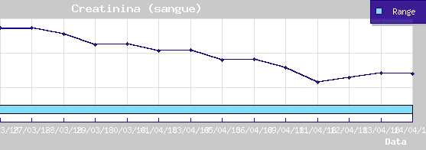
SCHEMATIC OUTLINE OF THE CREATININE LEVEL DURING THE PLASMA EXCHANGE

Slide 39
SCHEMATIC OUTLINE OF THE ANTI-GBM ANTIBODIES LEVEL DURING THE PLASMA EXCHANGE.

Slide 40
