Slide 1




Pneumotrieste 2018
Trieste 16-18 Aprile 2018
UPDATE DELLE LINEE GUIDA BPCO
Leonardo M. Fabbri, MD, FERS
Professor of Respiratory and Internal Medicine, University of Modena and Reggio Emilia, (-2016)
Eminent Scholar of Respiratory and Internal Medicine, University of Ferrara
Visiting Professor of Respiratory and Internal Medicine, COPD Center, University of Gothenburg

Slide 2
UPDATE DELLE LINEE GUIDA BPCO
Leonardo M. Fabbri, MD, FERS
The changes in the definition and assessement of severity of COPD
The recent studies of efficacy and safety of triple therapy in a single inhaler is likely to introduce major changes in the pharmacologic management of COPD
Studies of efficacy and safety of triple therapy in a single inhaler in moderate-severe asthma are also urgently required
TREAT THE PATIENT WITH COPD NOT JUST COPD

Slide 3
UPDATE DELLE LINEE GUIDA BPCO
Leonardo M. Fabbri, MD, FERS
The changes in the definition and assessement of severity of COPD
The recent studies of efficacy and safety of triple therapy in a single inhaler is likely to introduce major changed in the pharmacologic management of COPD
Studies of efficacy and safety of triple therapy in a single inhaler in moderate-severe asthma are also urgently required
TREAT THE PATIENT WITH COPD NOT JUST COPD

Slide 4

COPD Definition
Chronic Obstructive Pulmonary Disease (COPD) is a common, preventable and treatable disease that is characterized by persistent respiratory symptoms and airflow limitation that is due to airway and/or alveolar abnormalities usually caused by significant exposure to noxious particles or gases
© 2018 Global Initiative for Chronic Obstructive Lung Disease

Slide 5
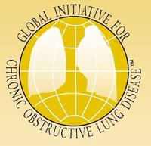
COPD
DEFINITION OF COPD 2011-2018
2011
2017
Chronic Obstructive Pulmonary Disease (COPD) is a common, preventable and treatable disease that is characterized by progressive airflow limitation that usually progressive and associated with and abnormal and excessive chronic airway and lung inflammation usually caused by significant exposure to cigarette smoking and/or noxious particles or gases
The severity and prognosis of individual patients may be affected by exacerbations and comorbidities
Chronic Obstructive Pulmonary Disease (COPD) is a common, preventable and treatable disease that is characterized by persistent respiratory symptoms and airflow limitation that is due to airway and/or alveolar abnormalities usually caused by significant exposure to noxious particles or gases
Notes:
5

Slide 6
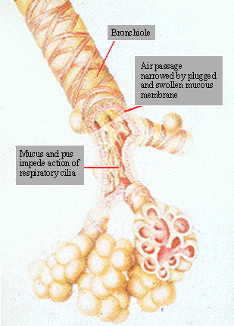
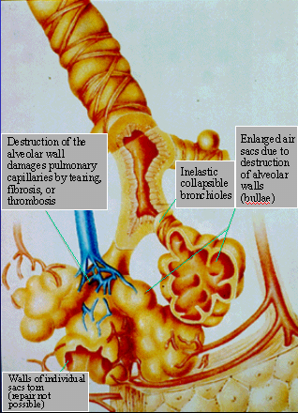
COPD
Small Airway
Obstruction
Emphysema
  GOLD Definition: the presence of airflow limitation that is not fully reversible and a history of exposure to a noxious agent / risk factor (cigarette smoke)
  Airflow limitation
    Small airways
      Remodeling, fibrosis
    Alveoli: Emphysema
      Destruction and enlargement
      of mature Airspace distal to
      terminal bronchioles
Notes:
6

Slide 7
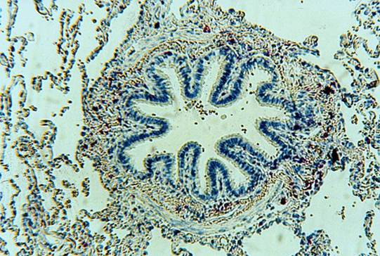
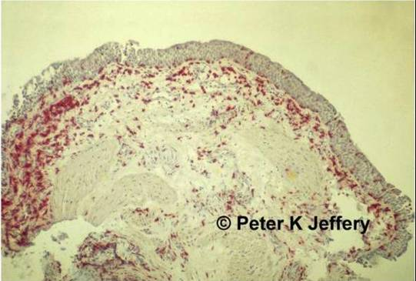
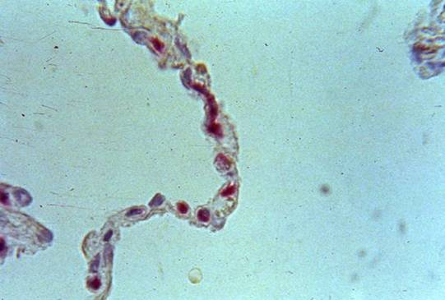
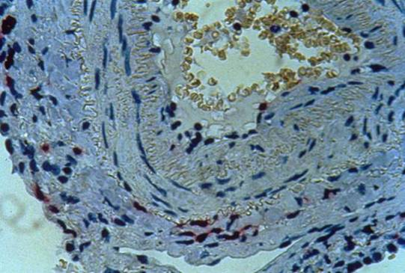
INFLAMMATION IN STABLE COPD
Smokers who develop COPD have increased infiltration of CD8+ T-lymphocytes throughout the airways and lung parenchyma.
Bronchiole
Bronchus
Courtesy of Dr Marina Saetta
Jeffery PK. Chest. 2000; 117: 251S-260S.
CD4+, CD8+, Emphysema, Gamma-Delta, Smoking
L
Alveoli
I
Pulmonary artery
E
Saetta M …. And Fabbri LM. Am J Respir Crit Care Med. 1999;160:711-717. Reproduced with permission from American Thoracic Society.

Slide 8
THE CONTRIBUTION OF SMALL AIRWAY OBSTRUCTION TO THE PATHOGENESIS OF CHRONIC OBSTRUCTIVE PULMONARY DISEASE
Hogg JC, Paré PD, Hackett TL. Physiol Rev 97: 529–552, 2017

Slide 9
Global Strategy for Diagnosis, Management and Prevention of COPD
Diagnosis of COPD
EXPOSURE TO RISK
FACTORS
SYMPTOMS
shortness of breath
tobacco
chronic cough
occupation
sputum
indoor/outdoor pollution
SPIROMETRY: Required to establish diagnosis
© 2018 Global Initiative for Chronic Obstructive Lung Disease
Notes:
9

Slide 10
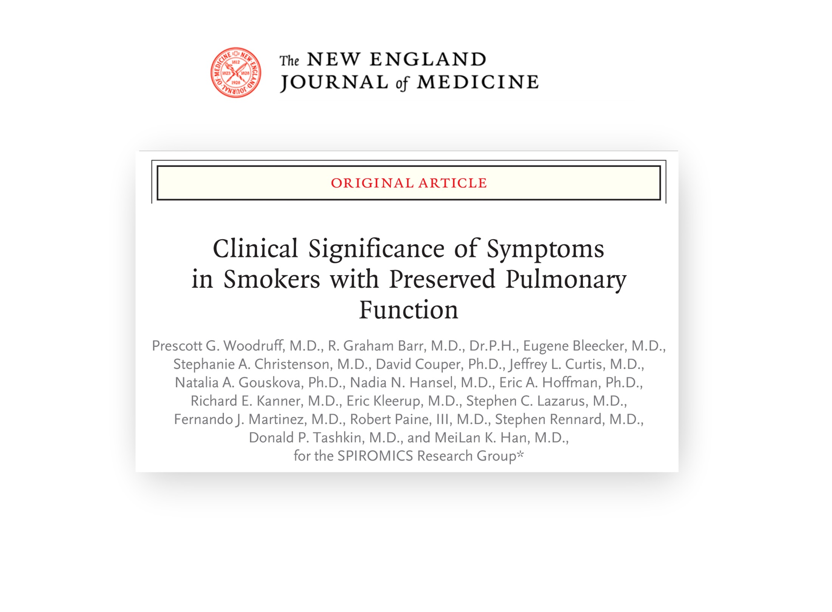

Slide 11
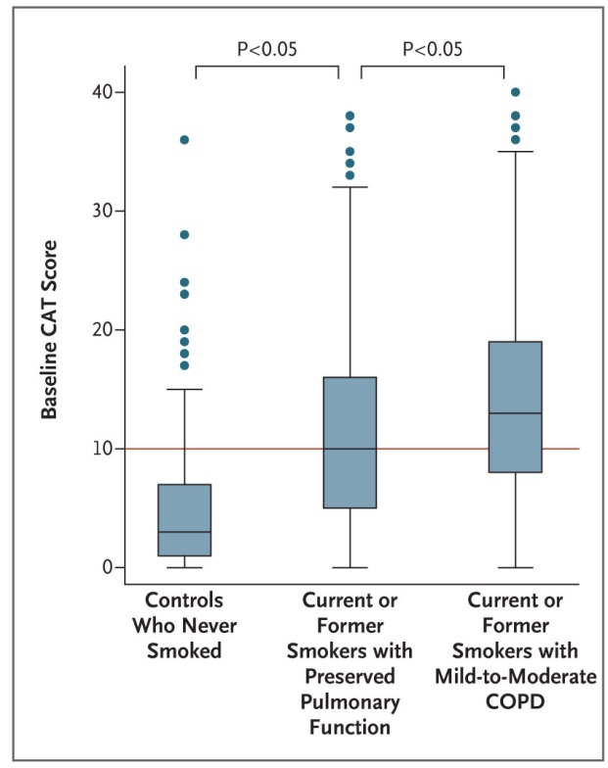
SYMPTOMS (CAT≥10) ARE COMMON IN SMOKERS WITH PRESERVED PULMONARY FUNCTION

Slide 12
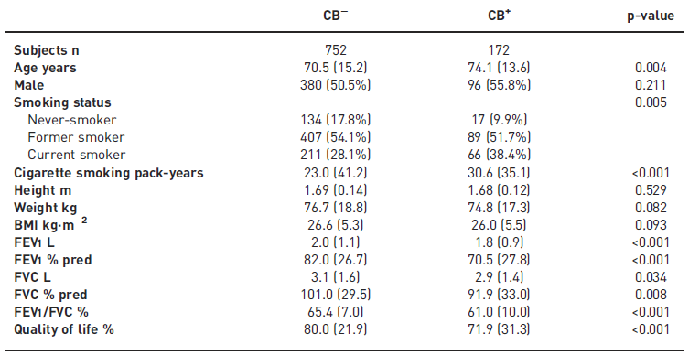
Baseline characteristics of chronic obstructive pulmonary disease subjects without chronic bronchitis (CB⁻) and with chronic bronchitis (CB⁺)
Lahousse L. et al. Eur Respir J. 2017 Aug 10;50(2). pii: 1602470

Slide 13
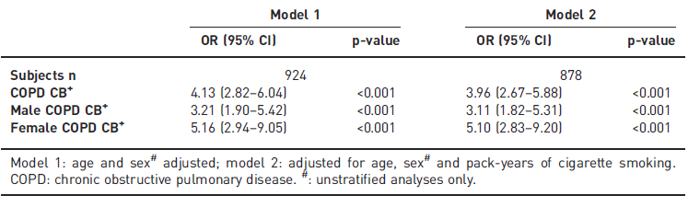
ASSOCIATION BETWEEN CHRONIC BRONCHITIS (CB+) AND THE FREQUENT EXACERBATOR PHENOTYPE
Lahousse L. et al. Eur Respir J. 2017 Aug 10;50(2). pii: 1602470

Slide 14
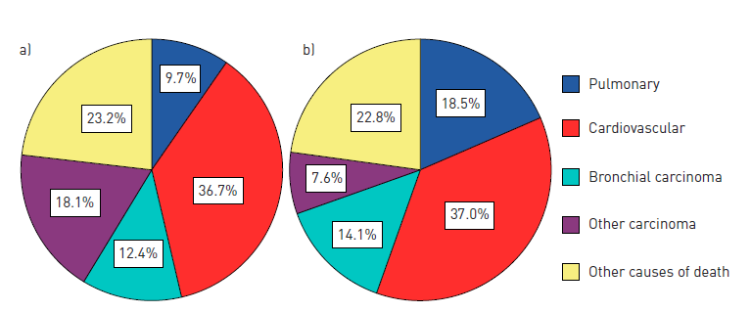
MAJOR CAUSES OF DEATH ACCORDING TO CHRONIC OBSTRUCTIVE PULMONARY DISEASE A) WITHOUT CHRONIC BRONCHITIS (N=752) OR B) WITH CHRONIC BRONCHITIS (N=172)
Lahousse L. et al. Eur Respir J. 2017 Aug 10;50(2). pii: 1602470

Slide 15
Association between chronic bronchitis (CB+) and the frequent exacerbator phenotype
Lahousse L. et al. Eur Respir J. 2017 Aug 10;50(2). pii: 1602470

Slide 16
UPDATE DELLE LINEE GUIDA BPCO
Leonardo M. Fabbri, MD, FERS
The changes in the definition and assessement of severity of COPD
The recent studies of efficacy and safety of triple therapy in a single inhaler is likely to introduce major changes in the pharmacologic management of COPD
Studies of efficacy and safety of triple therapy in a single inhaler in moderate-severe asthma are also urgently required
TREAT THE PATIENT WITH COPD NOT JUST COPD

Slide 17
Manage stable COPD: Pharmacologic therapy
FIRST CHOICE FOR INITIAL TREATMENT
C
D
GOLD 4
ICS + LABA
or
LAMA
ICS + LABA
or/and
LAMA
> 2
GOLD 3
Exacerbations per year
A
B
GOLD 2
SAMA prn
or
SABA prn
LABA
or
LAMA
1
GOLD 1
0
mMRC 0-1
CAT < 10
mMRC > 2
CAT > 10

Slide 18
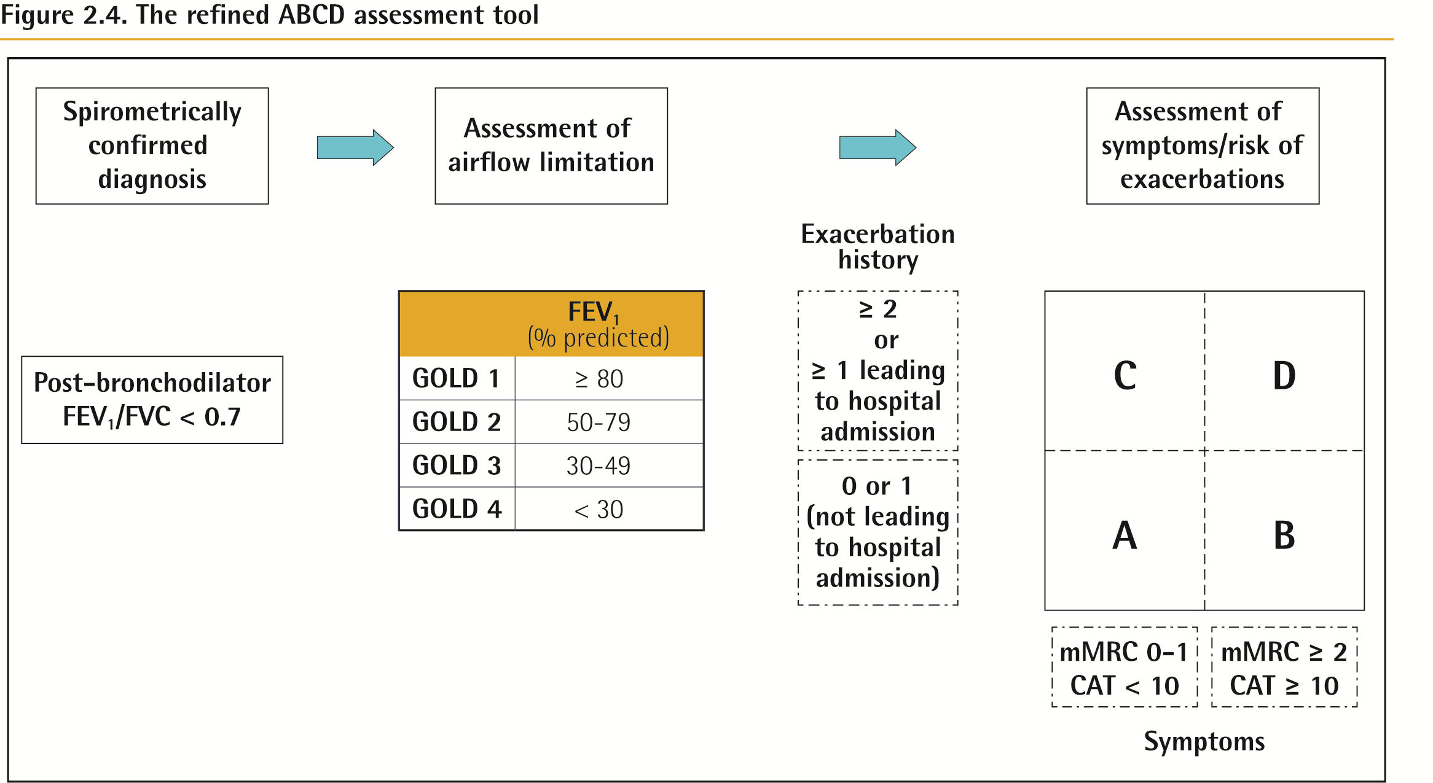
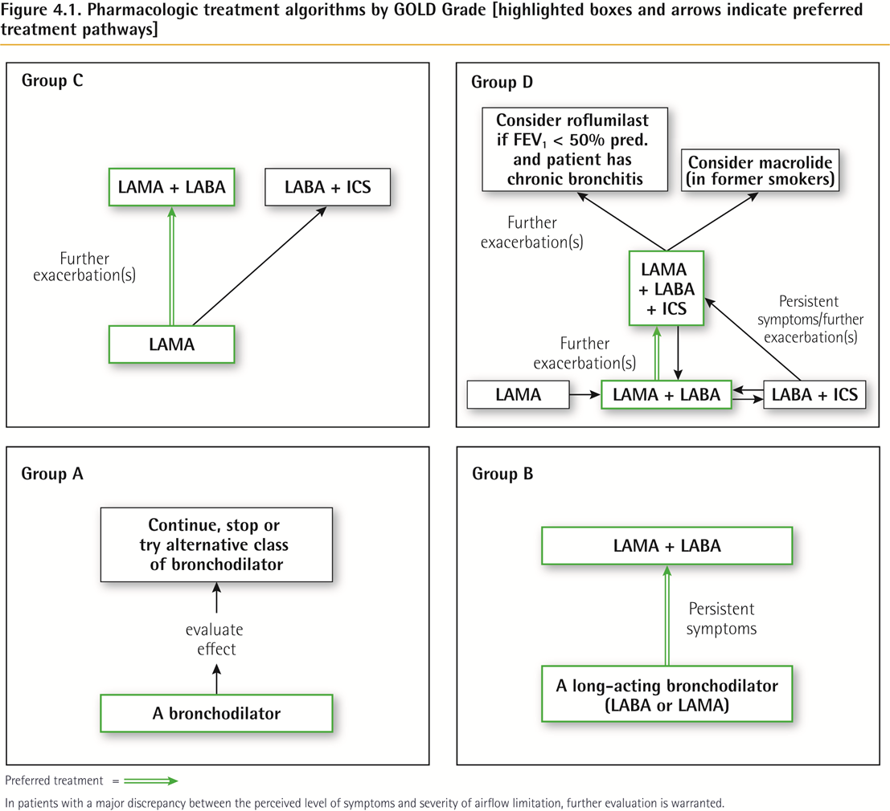
ABCD Assessment Tool
© 2018 Global Initiative for Chronic Obstructive Lung Disease

Slide 19
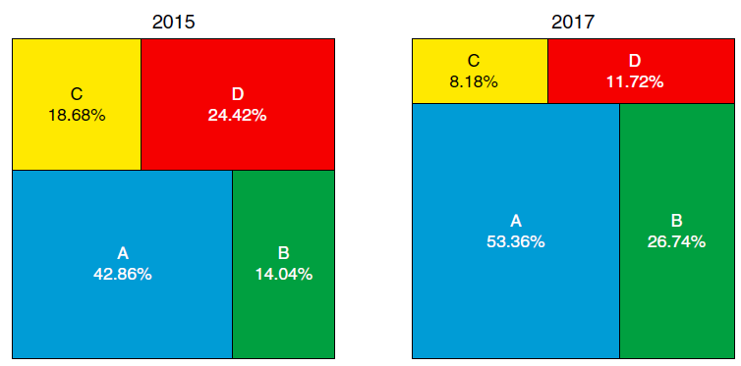
DISTRIBUTION OF THE SAME PATIENTS WITH CHRONIC OBSTRUCTIVE PULMONARY DISEASE IN THE DIFFERENT ABCD GLOBAL INITIATIVE FOR CHRONIC OBSTRUCTIVE LUNG DISEASE GRADING GROUPS USING THE 2011 VERSION VERSUS THE NEW 2017 VERSION
2011
2017
Cabrera López C et al., Am J Respir Crit Care Med. 2018 Feb 15;197(4):463-469

Slide 20
Manage stable COPD: Pharmacologic therapy
FIRST CHOICE (2017)
Group C
Group D
Consider roflumilast if FEV1 < 50% pred and patient has chronic bronchitis
LAMA + LABA
LABA + ICS
Consider macrolide
Further
Exacerbation(s)
Further
Exacerbation(s)
LAMA + LABA + ICS
Persistent
symptoms/further
exacerbations
Further
Exacerbation(s)
LAMA
LAMA
LAMA + LABA
LABA + ICS
Group A
Group B
Continue, stop or
try alternative class
of bronchodilator
LAMA + LABA
Persistent
symptoms
Evaluate
effect
A long-acting bronchodilator
(LABA or LAMA)
A bronchodilator

Slide 21
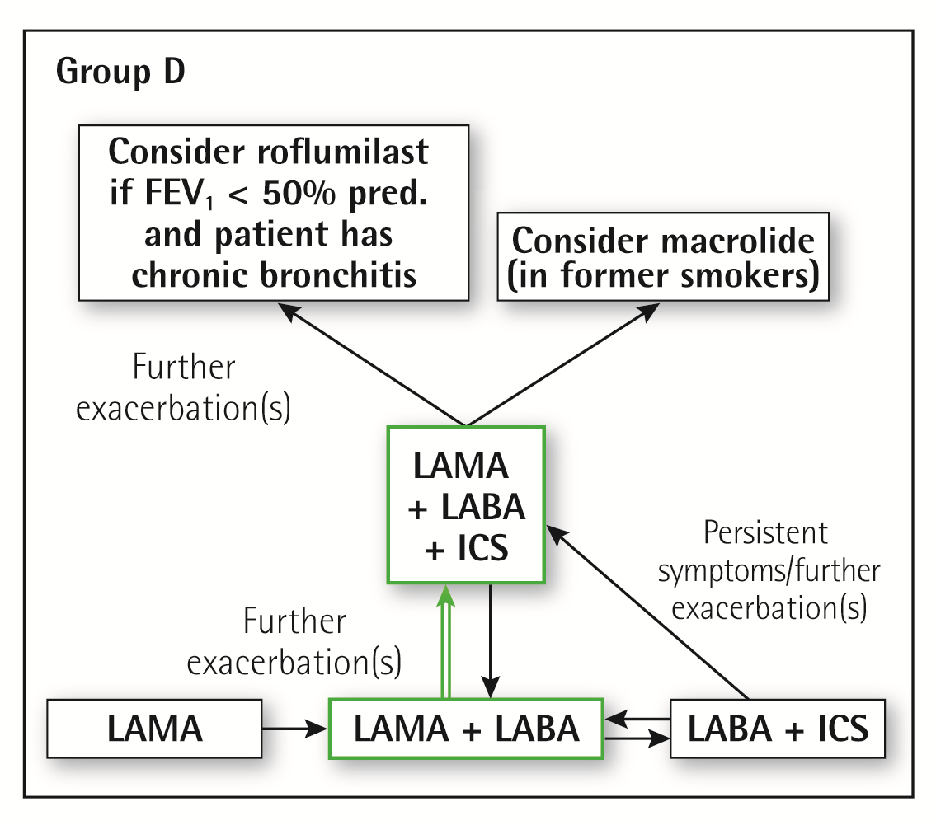

Pharmacologic treatment algorithms
Group D
We recommend starting therapy with a LABA/LAMA combination because:
  In studies with patient reported outcomes as the primary endpoint LABA/LAMA combinations showed superior results compared to the single substances. If a single bronchodilator is chosen as initial treatment, a LAMA is preferred for exacerbation prevention based on comparison to LABAs (for details see GOLD 2017 Chapter 3).
  A LABA/LAMA combination was superior to a LABA/ICS combination in preventing exacerbations and other patient reported outcomes in Group D patients (for details see GOLD 2017 Chapter 3).
  Group D patients are at higher risk of developing pneumonia when receiving treatment with ICS.
© 2017 Global Initiative for Chronic Obstructive Lung Disease

Slide 22
COMPARISON OF INDACATEROL/GLYCOPYRROMNIUM COMBINATION (110/50 µg) versus SALMETEROL/FLUTICASONE (50/500 µg) BID FOR THE ROW
52-week, multicenter, randomized, double-blind, parallel-group, double-dummy study
Prerandomization period
Double-blind treatment period
(52 weeks)
30-day safety follow-up
IND/GLY 110/50 μg q.d.
Screening period
Run-in period
SFC 50/500 µg b.i.d.
Day –35 to
Day –29
Day –28 to
Day –1
Day 1 to Day 365
Day 366 to
Day 395
Randomization
Visit 1
Visit 101
Visit 201
12 clinic visits
Wedzicha JA, et al. N Engl J Med 2016 Jun 9;374(23):2222-34
Notes:
Abbreviations
b.i.d. = twice daily
COPD = chronic obstructive pulmonary disease
GLY = glycopyrronium
IND = indacaterol
q.d. = once daily
SFC = salmeterol/fluticasone propionate combination

Slide 23
IND/GLY SHOWED SUPERIORITY IN REDUCING THE ANNUAL RATE OF ALL EXACERBATIONS (MILD, MODERATE AND SEVERE) VERSUS SFC
SFC 50/500 μg b.i.d. (N=1544)
IND/GLY 110/50 μg q.d. (N=1518)
5.0
RR (95% CI)
0.89 (0.83, 0.96), P=0.003
4.0
11% reduction
3.0
All exacerbations (annualized rate)
2.0
1.0
0
Wedzicha JA, et al. N Engl J Med 2016 Jun 9;374(23):2222-34
Notes:
Abbreviations
b.i.d. = twice daily
CI = confidence interval
GLY = glycopyrronium
IND = indacaterol
q.d. = once daily
RR = rate ratio
SFC = salmeterol/fluticasone propionate combination
23

Slide 24
TRIPLE IN A SINGLE INHALER IS SUPERIOR TO LABA/LAMA IN REDUCING EXACERBATIONS IN D AND B COPD
1.0
0.9
RR 0.848
(0.723-0.995)
p=0.043
RR 0.866
(0.723-1.037)
p=0.118
RR 0.787
(0.551-1.125)
p=0.189
0.8
0.7
0.59
(0.53-0.67)
0.6
0.50
(0.45-0.57)
0.47
(0.41-0.54)
0.41
(0.36-0.47)
0.5
Rate of exacerbations over 52 weeks
0.4
0.3
0.2
0.09
(0.07-0.12)
0.07
(0.06-0.10)
0.1
0
Moderate to severe
Moderate
Severe
BDP/FF/G (n=764)
Exacerbation severity
IND/GLY(n=768)
Papi et al, The Lancet, Lancet 2018 Mar 17;391(10125):1076-1084

Slide 25
IMPACT STUDY, Press release 18 sept 2017
Δ=12%
Annual rate of moderate/severe exacerbations
GSK press release, manuscript submitted for publication
Notes:
The opposite way

Slide 26
TRIPLE IN A SINGLE INHALEDR IS SUPERIOR TO LABA/ICS IN REDUCING EXACERBATIONS IN D AND B COPD
0.6
0.56
BDP/FF/GB
BDP/FF
0.5
0.45
0.43
0.4
0.33
0.3
Annualised exacerbation rate
0.2
0.12
0.14
0.1
0
Moderate/severe exacerbations
Moderate exacerbations
Severe exacerbations
Singh D et al., Lancet 2016; 388: 963–73

Slide 27
TRIPLE IN A SINGLE INHALER IS SUPERIOR TO TIOTROPIUM IN REDUCING EXACERBATIONS IN D AND B COPD
1.0
Primary: RR 0.80
(95% CI 0.69-0.92); p=0.0025
0.9
RR 1.01
(95% CI 0.85-1.21); p=0.89
0.8
RR 0.79
(95% CI 0.66-0.94); p=0.0095
0.7
0.6
0.5
Annualised exacerbation rate
0.57
(0.52-0.63)
0.4
0.46
(0.41-0.51)
0.45
(0.39-0.52)
0.3
0.2
0.1
0
Fixed triple (n=1077)
Tiotropium (n=1074)
Open triple (n=538)
Vestbo J. et al., Lancet 2017; 389: 1919–29

Slide 28
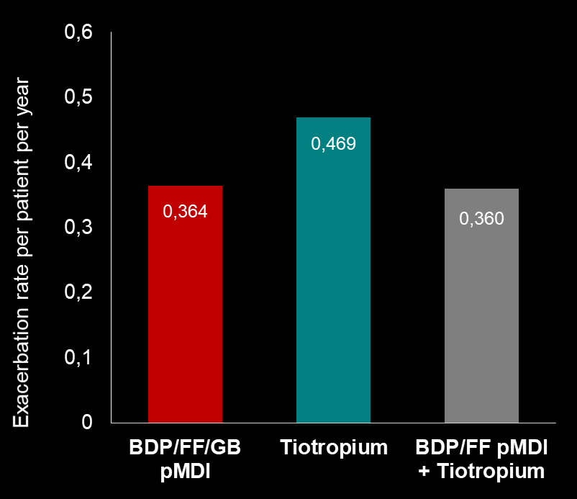
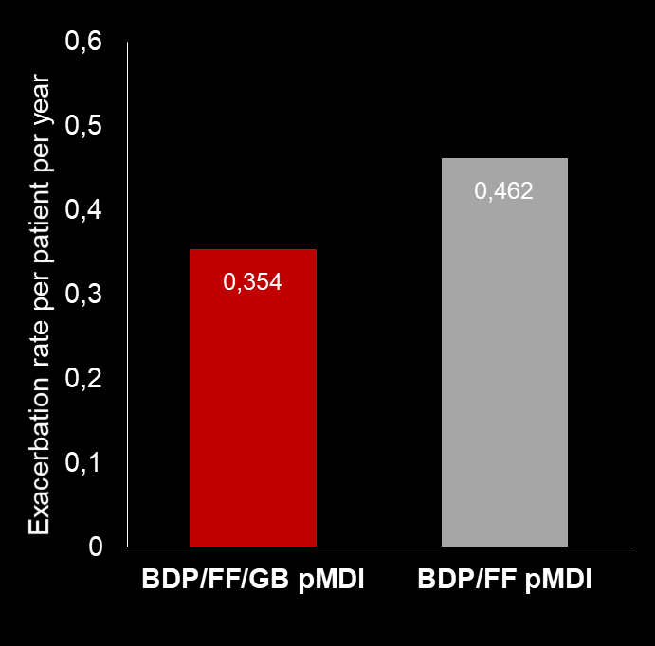
Moderate/severe COPD exacerbation rate in GOLD B patients
Rate ratio: 0.766
(95% CI: 0.592, 0.991); p=0.042
Rate ratio: 0.776
(95% CI: 0.624, 0.965); p=0.023
Trilogy
Trinity
LATE BREAKING ABSTRACT – Scuri et al, OA2898 ERS 2017

Slide 29
Pharmacologic treatment algorithms for
Patients with COPD of severity B,C,D
Groups B, C, D
Suggestied algoritm to the Global Initiative for Chronic Obstructive Lung Disease

Slide 30
INITIAL TREATMENT ALGORITHM FOR A SYMPTOMATIC COPD PATIENT
LAMA
Symptom persistence
no asthma
History of asthma and/or
Risk of exacerbations
LAMA/LABA
LABA/ICS
Symptoms/exacerbations persistence
Symptoms/exacerbations persistence
LAMA+LABA+ICS
Inadequate control
Inadequate control
Adapted by LMFabbri from Vogelmeier 2015
Add
Roflumilast
And/or
Macrolide
LABA: Long Acting Beta2 Agonist
LAMA: Long Acting AntiMuscarinic
ICS: Inhaled Corticosteroid
AT DOCTOR’S DISCRETION, DEPENDING ON CONDITIONS AT THE MOMENT OF THE FIRST TIME THE DOCTOR SEE THE PATIENT (eg after an acute exacerbation, uncontrolled under any type of regular treatment), PATIENTS CAN BE PUT DIRECTLY IN LAMA, LABA/ICS, TRIPLE OR EVEN ICS ONLY (if arrhythmia, chronic heart failure and ischemi heart disease)
Notes:
30

Slide 31
TREATMENT ALGORYTHM FOR SYMPTOMATIC COPD PATIENTS WITH OR WITHOUT RISK OF EXACERBATIONS
PRN SABA
If history of asthma
Symptom persistence
no history of asthma
LAMA
LAMA/LABA
LABA/ICS
LAMA+LABA+ICS
Symptoms/
exacerbations persistence
Symptoms/exacerbations persistence
LAMA+LABA+ICS
Adapted by LMFabbri from Vogelmeier 2015
Add
Roflumilast
And/or
Macrolide
LABA: Long Acting Beta2 Agonist
LAMA: Long Acting AntiMuscarinic
ICS: Inhaled Corticosteroid
AT DOCTOR’S DISCRETION, DEPENDING ON CONDITIONS AT THE MOMENT OF THE FIRST TIME THE DOCTOR SEE THE PATIENT (eg after an acute exacerbation, uncontrolled under any type of regular treatment), PATIENTS CAN BE PUT DIRECTLY IN LAMA, LABA/ICS, TRIPLE OR EVEN ICS ONLY (if arrhythmia, chronic heart failure and ischemi heart disease)
Notes:
31

Slide 32
TREATMENT-EMERGENT ADVERSE EVENTS
TRIBUTE
Patients with | BDP/FF/G N = 764 | IND/GLY N = 768
AEs | 490 (64.1%) | 516 (67.2%)
ADRs | 43 (5.6%) | 37 (4.8%)
SAEs | 117 (15.3%) | 130 (16.9%)
Serious ADRs | 1 (0.1%) | 1 (0.1%)
AEs leading to discontinuation | 37 (4.8%) | 47 (6.1%)
AEs leading to death | 16 (2.1%) | 21 (2.7%)
Any pneumonia | 28 (3.7%) | 27 (3.5%)
Papi et al, The Lancet, Lancet 2018 Mar 17;391(10125):1076-1084

Slide 33
ADVERSE EVENTS AND SERIOUS ADVERSE EVENTS
RISK REDUCTION FOR HYPERTENSION, IHD, MI, ATRIAL FIBRILLATION IN TRIBUTE
Number (%) of patients | BDP/FF/G (N=764) | IND/GLY (N=768)
Adverse events | 490 (64.1) | 516 (67.2)
COPD worsening | 273 (35.7) | 288 (37.5)
Pneumonia | 28 (3.7) | 27 (3.5)
Hypertension | 15 (2.0) | 26 (3.4)
Cough | 13 (1.7) | 25 (3.3)
Ischemic heart disease | 8 (1.0) | 16 (2.1)
Serious adverse events | 117 (15.3) | 130 (16.9)
COPD worsening | 61 (8.0) | 69 (9.0)
Death | 3 (0.4) | 8 (1.0)
Ischemic heart disease | 2 (0.3) | 11 (1.4)
Myocardial infarction | 1 (0.1) | 8 (1.0)
Atrial fibrillation | 0 | 7 (0.9 )
Papi et al, The Lancet, Lancet 2018 Mar 17;391(10125):1076-1084

Slide 34
TREATMENT-EMERGENT ADVERSE EVENTS
TRIBUTE
Number (%) of patients | BDP/FF/G (N=764) | IND/GLY (N=768)
Treatment-related adverse events | 12 (1.6) | 6 (0.8)
Oral candidiasis | 12 (1.6) | 6 (0.8)
Dry mouth | 3 (0.4) | 6 (0.8)
Cough | 1 (0.1) | 7 (0.9)
Treatment-related serious adverse events | 1 (0.1) | 1 (0.1)
Severe adverse events | 86 (11.3) | 87 (11.3)
Adverse events leading to death | 16 (2.1) | 21 (2.7)
Papi et al, The Lancet, Lancet 2018 Mar 17;391(10125):1076-1084

Slide 35
Pool data on Mortality (ATS abstract submitted)
ATS 2018 Abstract
Possible to show another post-hoc on mortality presented a during ERS2018?

Slide 36
QUARTER-DOSE QUADRUPLE COMBINATION THERAPY FOR INITIAL TREATMENT OF HYPERTENSION
Quarter-dose quadpill therapy could be additive across classes and might confer a clinically important reduction in blood pressure
Further examination of the quadpill concept is needed to investigate effectiveness against usual treatment options and longer term tolerability
Chow CK et al, Lancet, 12 Feb 2017, on line

Slide 37
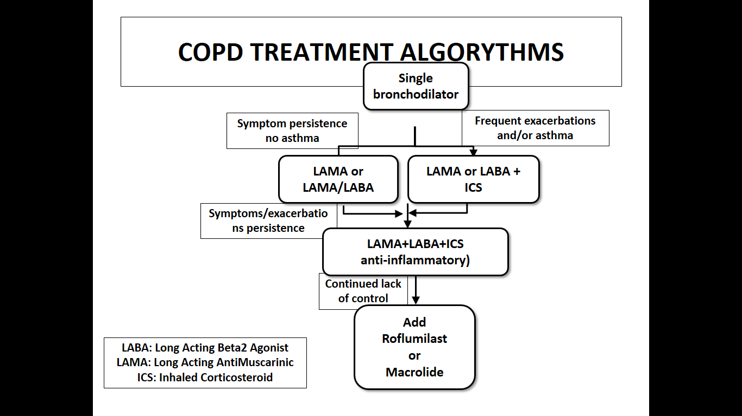
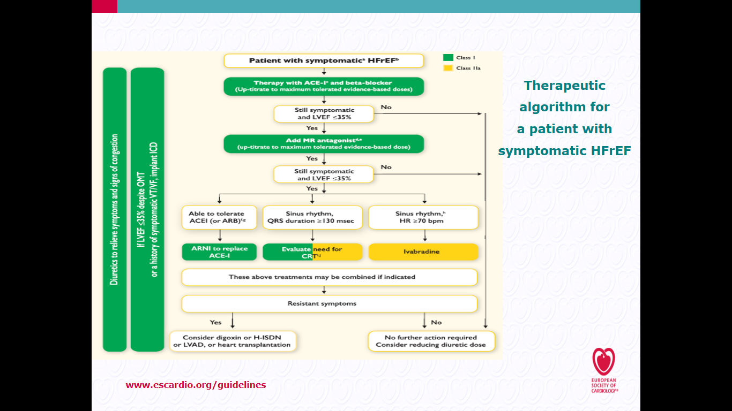

COPD CHF TREATMENT ALGORYTHMS
YEAR IN REVIEW IN
RESPIRATORY MEDICINE
Leonardo M. Fabbri, MD, FESC, FERS
  Non Small Cell Lung Cancer
  Asthma
  COPD
  Multimorbidity
2016 ESC Guidelines on CHF

Slide 38
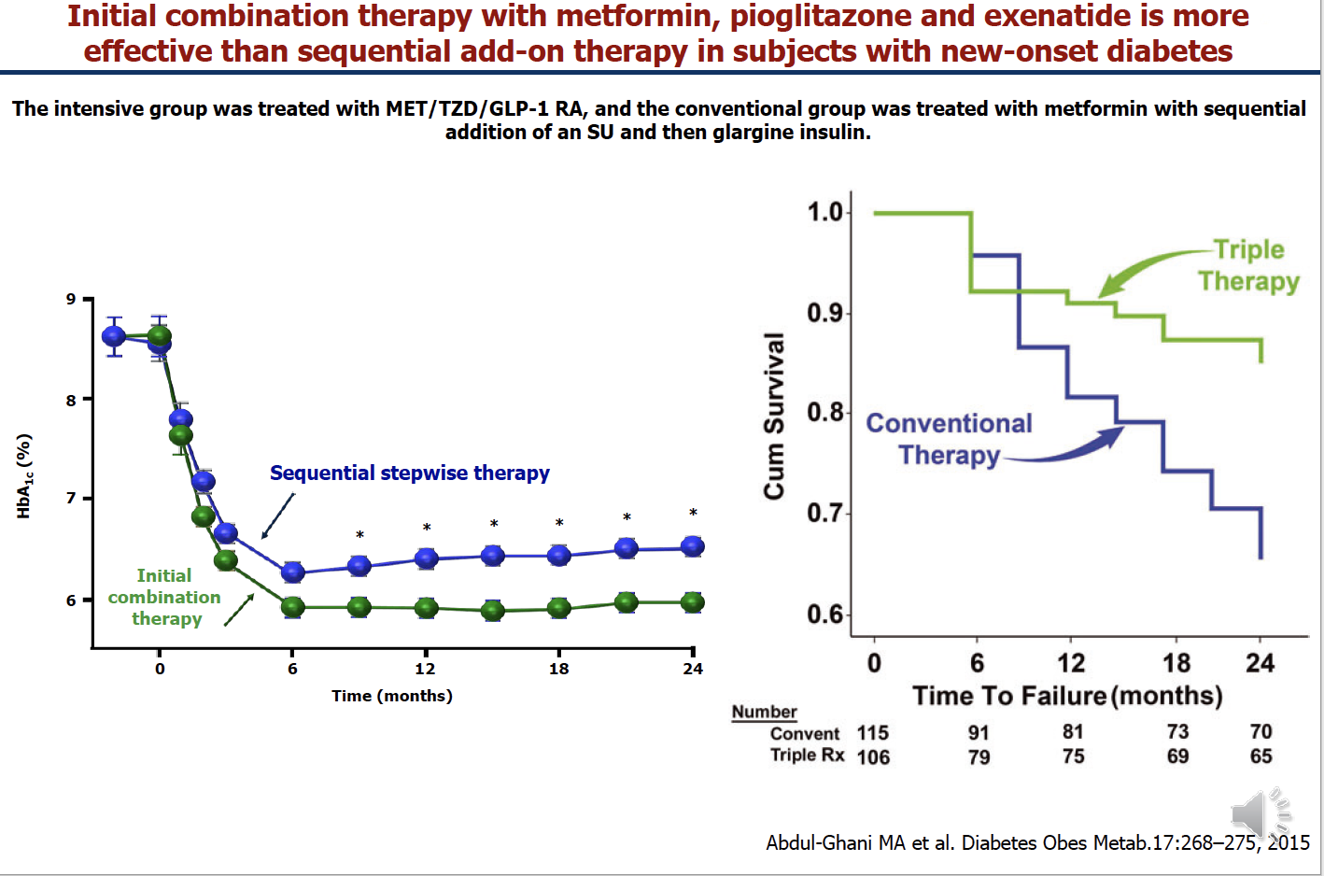

Slide 39
UPDATE DELLE LINEE GUIDA BPCO
Leonardo M. Fabbri, MD, FERS
The changes in the definition and assessement of severity of COPD
The recent studies of efficacy and safety of triple therapy in a single inhaler is likely to introduce major changes in the pharmacologic management of COPD
Studies of efficacy and safety of triple therapy in a single inhaler in moderate-severe asthma are also urgently required
TREAT THE PATIENT WITH COPD NOT JUST COPD

Slide 40
UPDATE DELLE LINEE GUIDA BPCO
Leonardo M. Fabbri, MD, FERS
The changes in the definition and assessement of severity of COPD
The recent studies of efficacy and safety of triple therapy in a single inhaler is likely to introduce major changed in the pharmacologic management of COPD
Studies of efficacy and safety of triple therapy in a single inhaler in moderate-severe asthma are also urgently required
TREAT THE PATIENT WITH COPD NOT JUST COPD

Slide 41


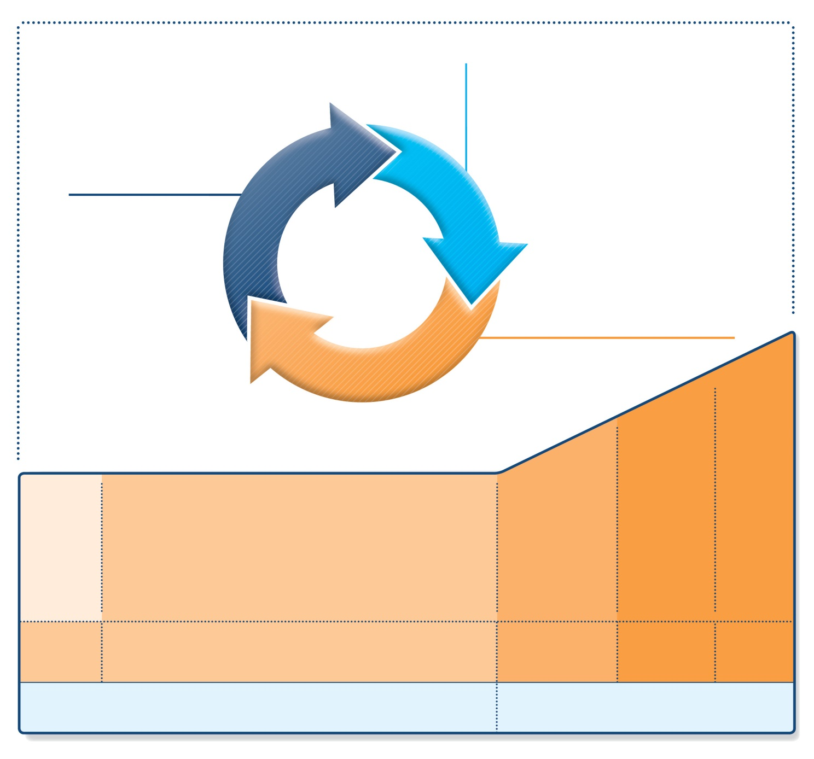
Stepwise management - pharmacotherapy
UPDATED!
Diagnosis
Symptom control & risk factors
(including lung function)
Inhaler technique & adherence
Patient preference
ASSESS
REVIEW RESPONSE
Symptoms
Exacerbations
Side-effects
Patient satisfaction
Lung function
ADJUST TREATMENT
Asthma medications
Non-pharmacological strategies
Treat modifiable risk factors
Future role of triple therapy in asthma
STEP 5
STEP 4
STEP 1
STEP 2
STEP 3
Med/high
ICS/LABA
Refer for add-on treatment
e.g.
tiotropium,* omalizumab, mepolizumab*
*Not for children <12 years
**For children 6-11 years, the preferred Step 3 treatment is medium dose ICS
#For patients prescribed BDP/formoterol or BUD/ formoterol maintenance and reliever therapy
 Tiotropium by mist inhaler is an add-on treatment for patients ≥12 years with a history of exacerbations
PREFERRED
CONTROLLER
CHOICE
Low dose ICS
Low dose
ICS/LABA**
Other
controller
options
Consider low dose ICS
Leukotriene receptor antagonists (LTRA)
Low dose theophylline*
Med/high dose ICS
Low dose ICS+LTRA
(or + theoph*)
Add tiotropium*
High dose ICS
+ LTRA
(or + theoph*)
Add low
dose OCS
RELIEVER
As-needed short-acting beta²-agonist (SABA)
As-needed SABA or
low dose ICS/formoterol#
GINA 2018 Box 3-5 (2/8) (upper part)

Slide 42
UPDATE DELLE LINEE GUIDA BPCO
Leonardo M. Fabbri, MD, FERS
The changes in the definition and assessement of severity of COPD
The recent studies of efficacy and safety of triple therapy in a single inhaler is likely to introduce major changed in the pharmacologic management of COPD
Studies of efficacy and safety of triple therapy in a single inhaler in moderate-severe asthma are also urgently required
TREAT THE PATIENT WITH COPD NOT JUST COPD

Slide 43
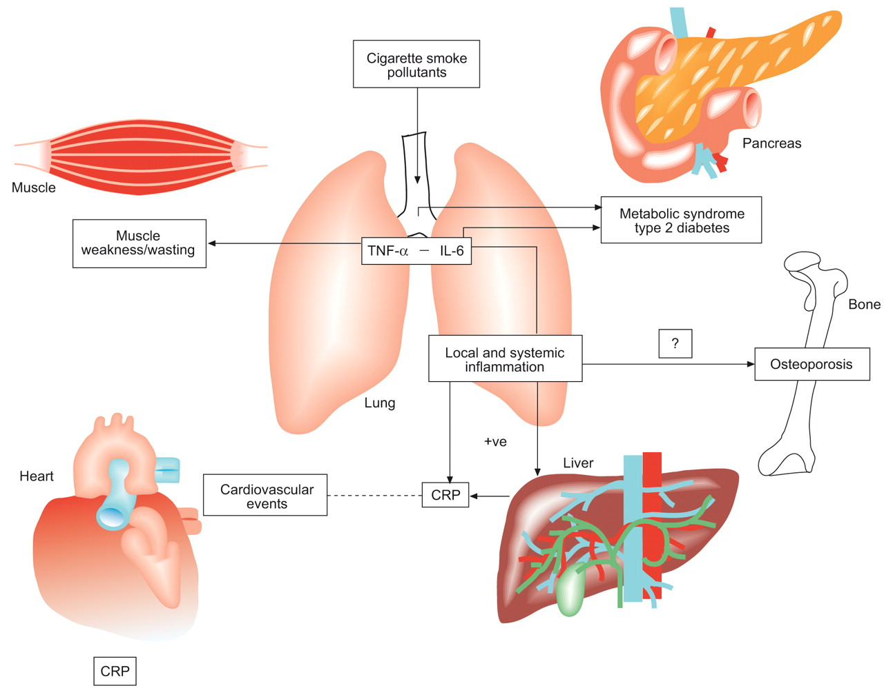
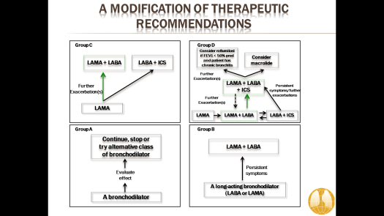
COPD AS THE PULMONARY
COMPONENT OF MULTIMORBIDITY
Fabbri LM, Luppi F, Beghe B, and Rabe KF - Eur Respir J 2008;31:204-212

Slide 44
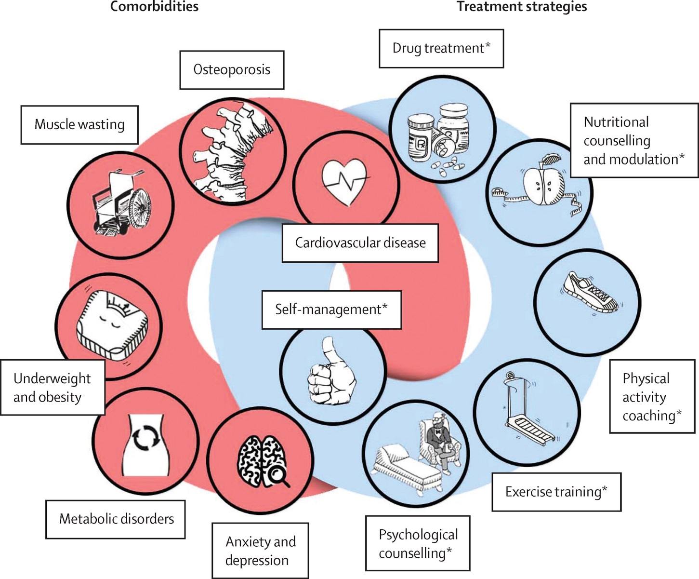
Figure 1
Vanfleteren et al. Lancet Respir Med 2016 Nov;4(11):911-924
Notes:
Management of COPD beyond the lungs
*Part of a comprehensive pulmonary rehabilitation programme.

Slide 45
REDUCTION OF MORBIDITY AND MORTALITY BY STATINS, ACE INHIBITORS, AND ARBS IN PATIENTS WITH COPD
These agents may have dual cardiopulmonary protective properties, thereby substantially altering prognosis of patients with COPD
These findings need confirmation in randomized clinical trials
Mancini JB et al. J Am Coll Cardiol 2006;47(12):2554-60
Notes:
A positive aspect of a more comprehensive approach is suggested by a post-hoc analysis of studies. This analysis suggests, in fact, that patients with COPD and significant comorbidities (hypertension or chronic heart failure) treated with statins, angiotensin-converting enzyme (ACE) inhibitors and/or angiotensin receptor blockers (ARBs) may actually, particularly in severe COPD, benefit from this treatment in the COPD aspect of the disease.
This treatment seems to reduce mortality, morbidity and hospitalization in these patients.
Obviously this data needs to be confirmed by further studies. But it does suggest that if we treat a COPD patient – not only for COPD, but also for chronic comorbidities – we may achieve better outcomes for the patient and provide better treatment overall.
Mancini JB et al. Reduction of morbidity and mortality by statins, angiotensin-converting enzyme inhibitors, and angiotensin receptor blockers in patients with chronic obstructive pulmonary disease. J Am Coll Cardiol 2006;47(12):2554-60.

Slide 46
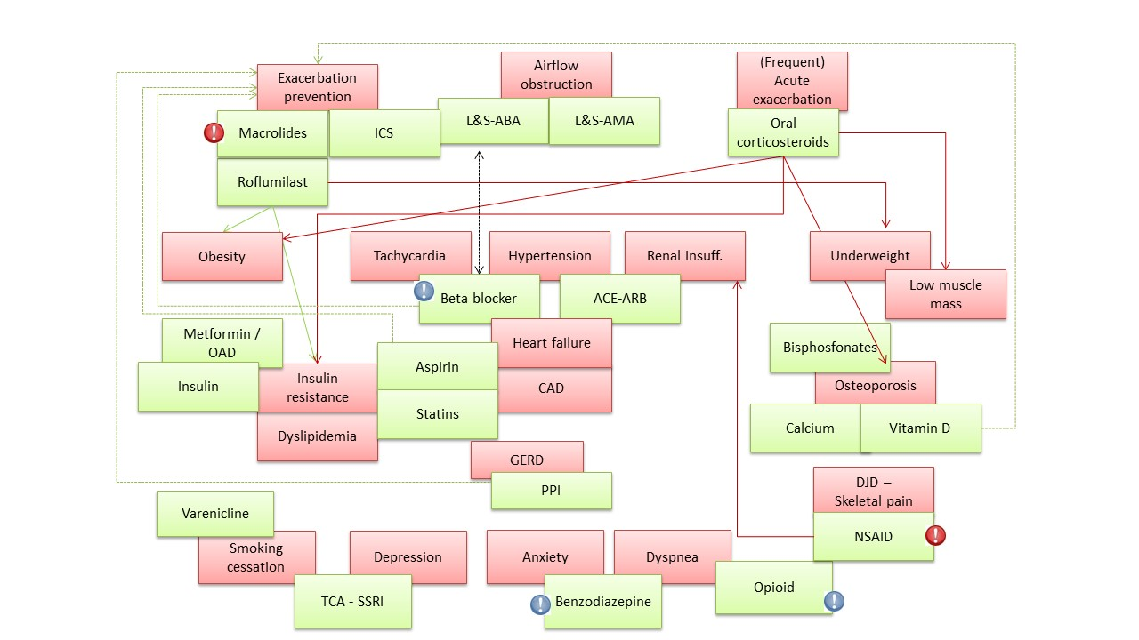
THE PHARMACOLOGICAL PERSPECTIVE FOR AN INTEGRATED MANAGEMENT OF COPD AND ITS COMORBIDITIES
Vanfleteren et al. Lancet Respir Med 2016

Slide 47
ANTIINFLAMMATORY THERAPY WITH
CANAKINUMAB FOR ATHEROSCLEROTIC DISEASE
Antiinflammatory therapy targeting the interleukin-1β innate immunity pathway
with canakinumab at a dose of 150 mg every 3 months led to a significantly lower
rate of recurrent cardiovascular events than placebo, independent of lipid-level lowering.
Ridker PM et al, NEJM 2017 in press

Slide 48
PROGRAM OF INTEGRATED CARE FOR PATIENTS WITH CHRONIC OBSTRUCTIVE PULMONARY DISEASE AND MULTIPLE COMORBIDITIES (PIC COPD+): A RANDOMIZED CONTROLLED TRIAL
Our model resulted in
fewer ED presentations
2. hospital admissions
3. Estimated risk of death in the intervention group was nearly half that of the control
Usual care
PIC COPD+
Survival probability
Istanboulian et al, Am J Respir Cr Care Med, April 2017, Abstract 6739

Slide 49
TIME FOR A LONGER AND BETTER LIFE FOR PATIENTS WITH COPD
In this issue of the journal are two important management studies consistently showing a considerable reduction of mortality in patients comprehensively treated with management plans that address not only the COPD component but also the complexity of multimorbidities
We believe it is time to conduct a properly designed and powered study with the goal of combining all these positive observations to achieve a better quality of life for patients with severe multimorbidities. Let’s move this forward.
Vanfleteren, Ullman, Fabbri, Eur Respir J, January 2018

Slide 50
UPDATE DELLE LINEE GUIDA BPCO
Leonardo M. Fabbri, MD, FERS
The changes in the definition and assessement of severity of COPD
The recent studies of efficacy and safety of triple therapy in a single inhaler is likely to introduce major changed in the pharmacologic management of COPD
Studies of efficacy and safety of triple therapy in a single inhaler in moderate-severe asthma are also urgently required
TREAT THE PATIENT WITH COPD NOT JUST COPD

Slide 51
Pneumotrieste 2018
Trieste 16-18 Aprile 2018
UPDATE DELLE LINEE GUIDA BPCO
Leonardo M. Fabbri, MD, FERS
Professor of Respiratory and Internal Medicine, University of Modena and Reggio Emilia, (-2016)
Eminent Scholar of Respiratory and Internal Medicine, University of Ferrara
Visiting Professor of Respiratory and Internal Medicine, COPD Center, University of Gothenburg

