Slide 3
Changes in trough FEV₁: Combination vs monotherapy
Changes in trough FEV1 for combination vs monotherapy from all studies (range 45-95 ml)
95
90
88
85
82
70
71
Δ FEV₁, ml
52
50
45
AC/FF
vs FF
AC/FF
vs FF
QVA149
vs IND
QVA149
vs GLY
UME/VI
vs UME
UME/VI
vs VI
TIO/OLO
vs OLO
TIO/OLO
vs TIO
TIO/OLO
vs OLO
TIO/OLO
vs TIO
Singh D et al. BMC Pulm Med 2014 2) D’Urzo AD et al. Resp Res 2014 3) Bateman et al Eur Respir J. 2013
4) Donohue J et al. 5) Buhl R et al. Eur Resp J 2015.

Slide 4
A Systematic Review With Meta-Analysis of Dual Bronchodilation With LAMA/LABA for the Treatment of Stable COPD
Calzetta L, et al. Chest 2016

Slide 5
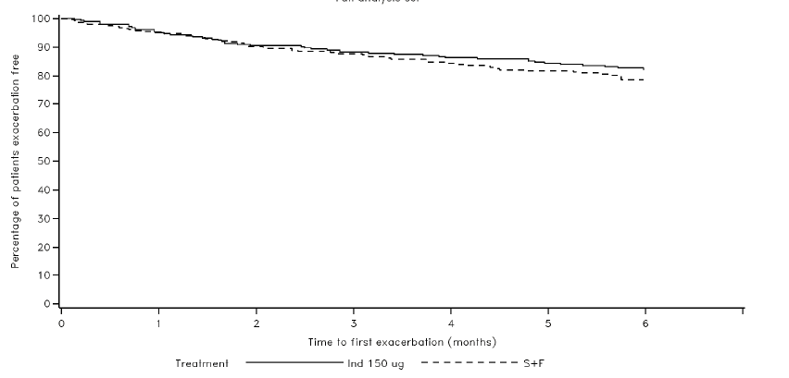
Rossi A et al. ERJ 2014

Slide 7
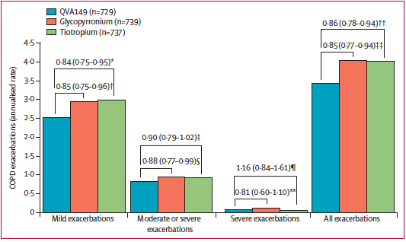

Slide 8
Calverley PMA et al. Lancet respire Med 2108

Slide 10
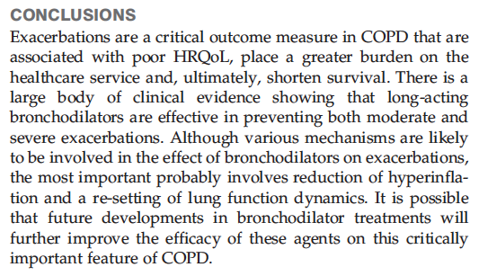

Slide 13
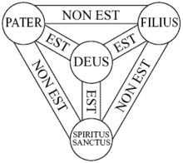
TRE numero perfetto
Pitagora: somma del pari 2 e del dispari 1
Religioni: Trinità

Slide 16
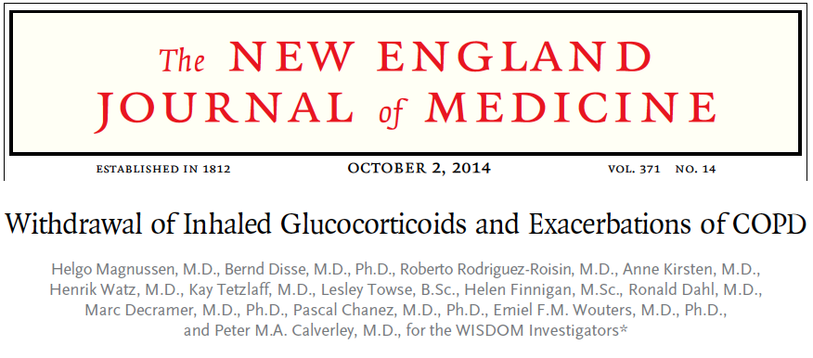
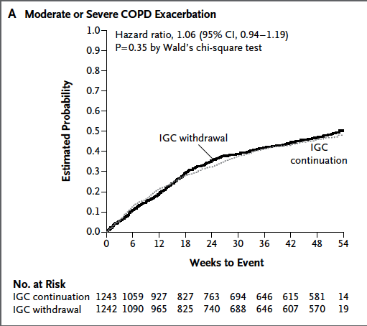

Slide 17
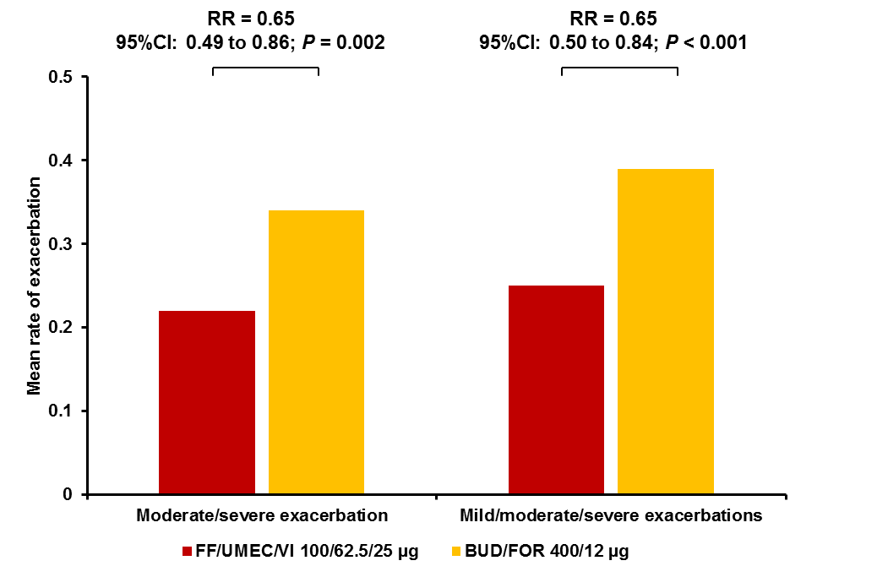
Significant reduction in annualized rate of exacerbations with FF/UMEC/VI (single inhaler) versus BUD/FOR – The FULFIL study
A 24-week, randomized, double-blind, double-dummy study
Annualized exacerbation rates at Week 24 (ITT population)
Single-inhaler triple therapy with FF/UMEC/VI offered clinically important benefits by significantly reducing the rates of exacerbations when compared with BUD/FOR therapy in symptomatic patients with COPD
Lipson DA, et al. Am J Respir Crit Care Med. 2017
BUD, budesonide; CI, confidence interval; FF, fluticasone furoate; FOR, formoterol; ITT, intent to treat; RR, rate ratio; UMEC, umeclidinium; VI, vilanterol
Notes:
Reference:
1) Lipson DA, Barnacle H, Birk R et al. FULFIL Trial: Once-Daily Triple Therapy in Patients with Chronic Obstructive Pulmonary Disease. Am J Respir Crit Care Med. 2017

Slide 18
Vestbo J et al.
The Lancet 2017

Slide 19
The Lancet 2018

Slide 20
Singh D et al. TRILOGY. BDP/FF/GB vs BDP/FF. Lancet 2016
Vestbo J et al. TRINITY. BDP/FF/GB vs TIO vs BDP/FF+TIO. Lancet 2017
Papi A. et al. TRIBUTE. BDP/FF/GB vs IND/GLY. Lancet 2018
LABA-ICS
ICS-LAMA
LAMA-LABA

Slide 23
ECLIPSE.
the “frequent
exacerbator
phenotipe”

Slide 24
Kardos P et al. Respiratory Medicine 2017

Slide 25
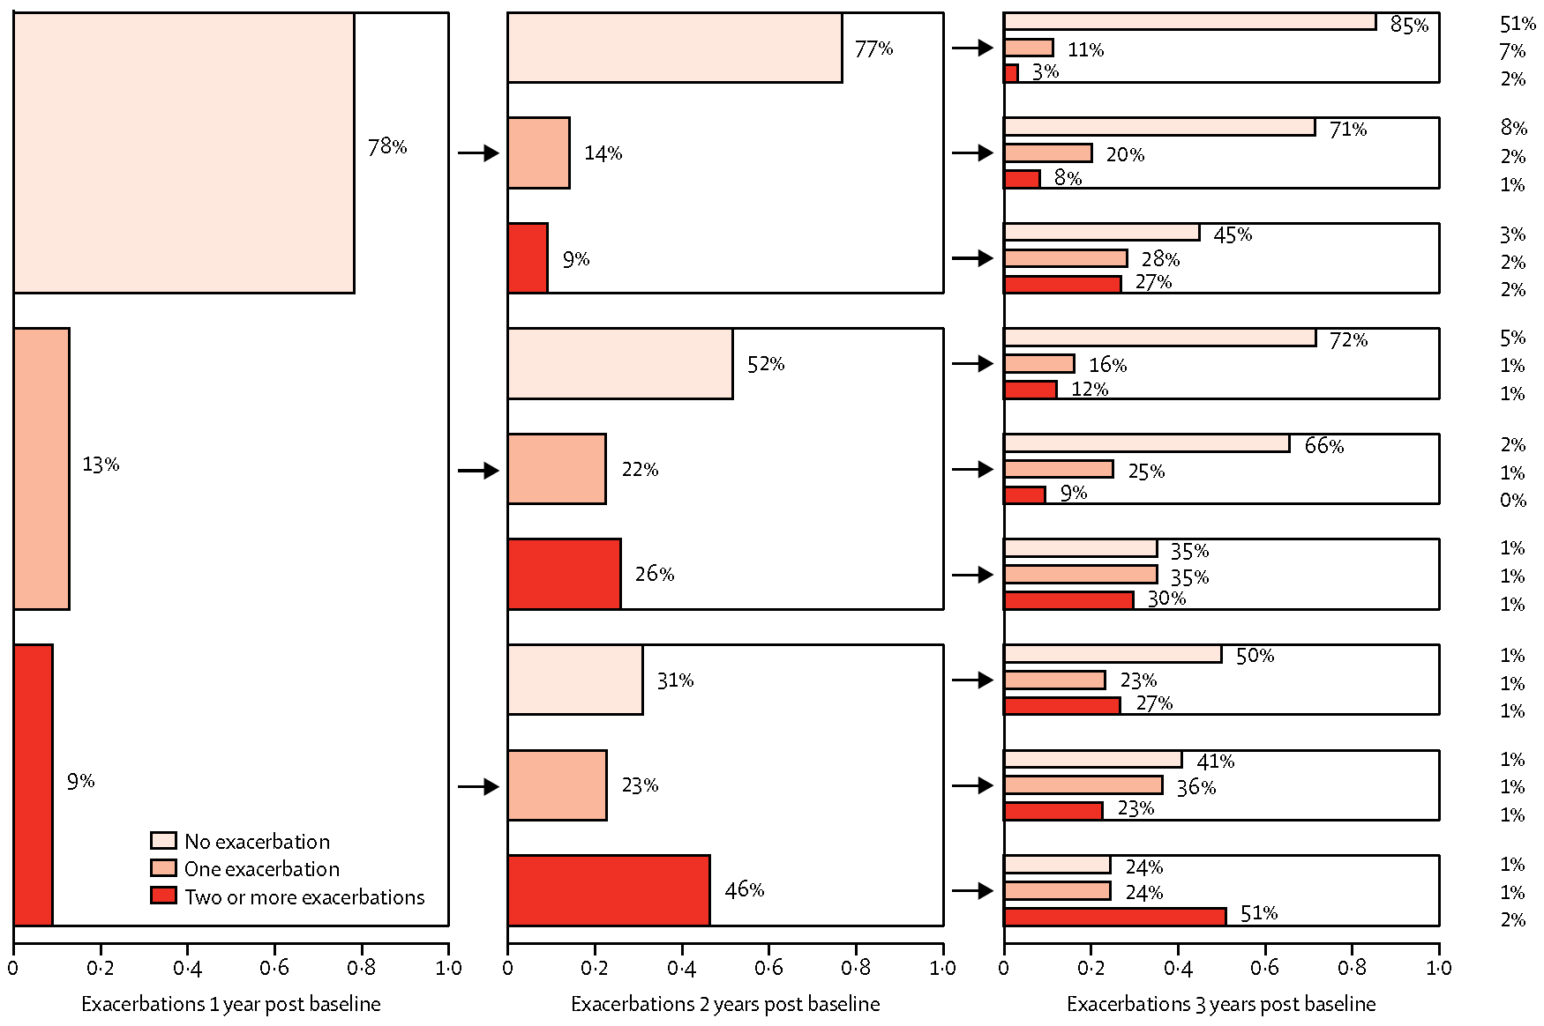
Anche se le riacutizzazioni sono comuni, lo stato di riacutizzatore della maggior parte delle persone varia notevolmente di anno in anno. Tra i pazienti che hanno avuto riacutizzazioni nei 3 anni, solo pochissimi hanno presentato ripetutamente due o più eventi per anno.

Slide 27
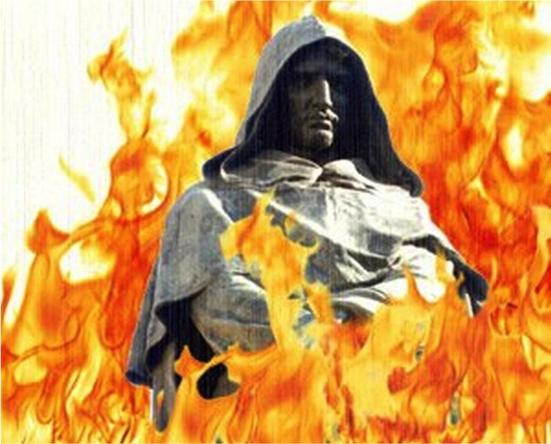
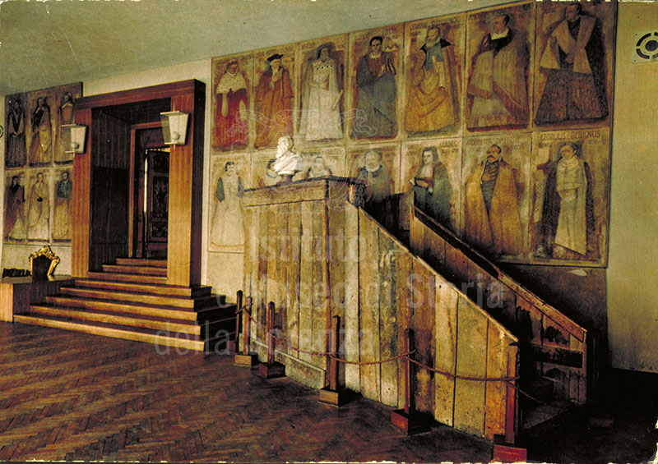
Campo de’ fiori
17.02.1600

Slide 29
Vital Capacity
FEV.1/Vital Capacity
pulsoximetry O2
Lung Volumes
Dlco - Kco
CPET
EGA
FEV1/VC <lln
The lower limit of normal versus a fixed
ratio to assess airflow limitation: will the
debate ever end? ERJ 2018;51:1800403

Slide 33
Adjusted rate ratios for moderate-to-severe COPD exacerbations

Slide 35
 | FLAME | IMPACT
Group B | 81% | 30%
Group D | 19% | 70%

