Slide 1
Pneumo Trieste 2018
Prof. Gianfranco Sinagra, MD FESC
Direttore Dipartimento Cardiotoracovascolare, ASUITS
Scuola di Specializzazione Malattie Cardiovascolari
Università di Trieste

Slide 2
Scompenso Cardiaco: aspetti fisiopatologici
Sindrome e non «malattia»;
SC come «punto di partenza»;
eterogeneità delle eziologie di base e dei modelli «fisiopatologici»;
Ruolo dei fattori concomitanti e precipitanti, delle comorbidità e del danno d’organo, nel condizionare l’esordio, le terapie e l’evoluzione nel singolo «malato»

Slide 3
CHF - A complex clinical syndrome
Forward failure
Renal perfusion
Neurohumoral activation
Renin, Angiotensin II
Adrenergic activation
Aldosterone
Vasoconstriction
Na⁺ and
H₂O retention
LV function
Increased LV afterload,
increased O2 demand

Slide 4
Definition of heart failure with preserved (HFpEF), mid-range (HFmrEF) and reduced ejection fraction (HFrEF)
EHJ. 2016;37:2129-200

Slide 5
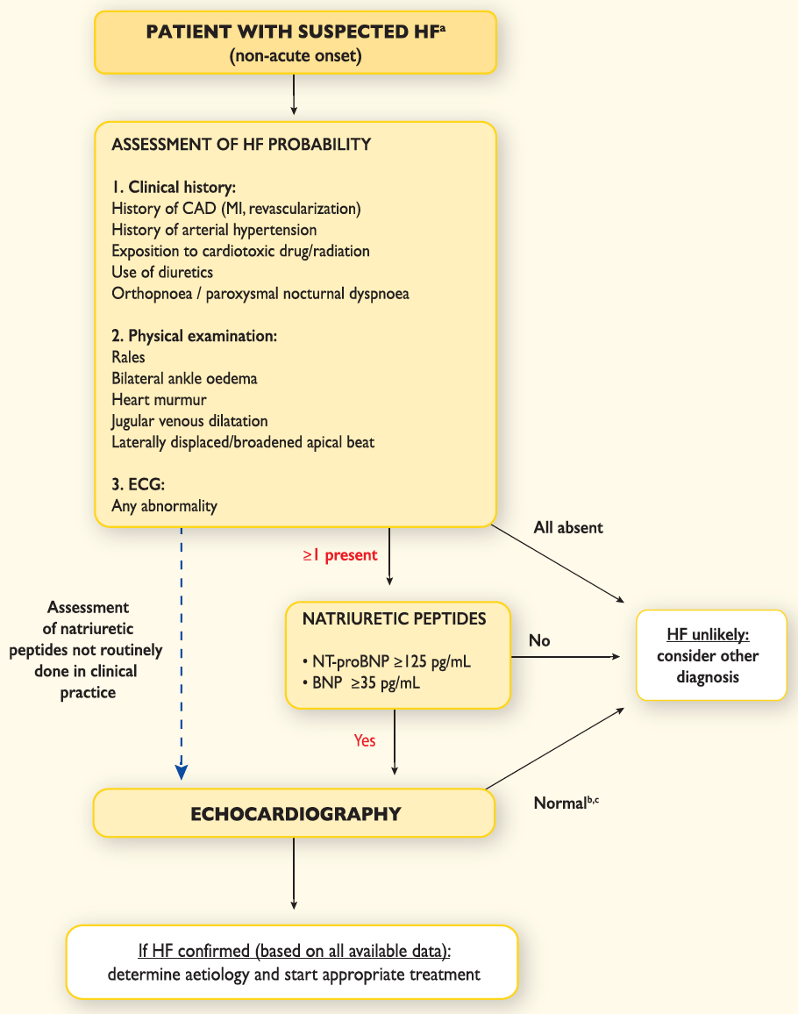
Diagnostic algorithm for a diagnosis of heart failure of non-acute onset
EHJ. 2016;37:2129-200

Slide 6
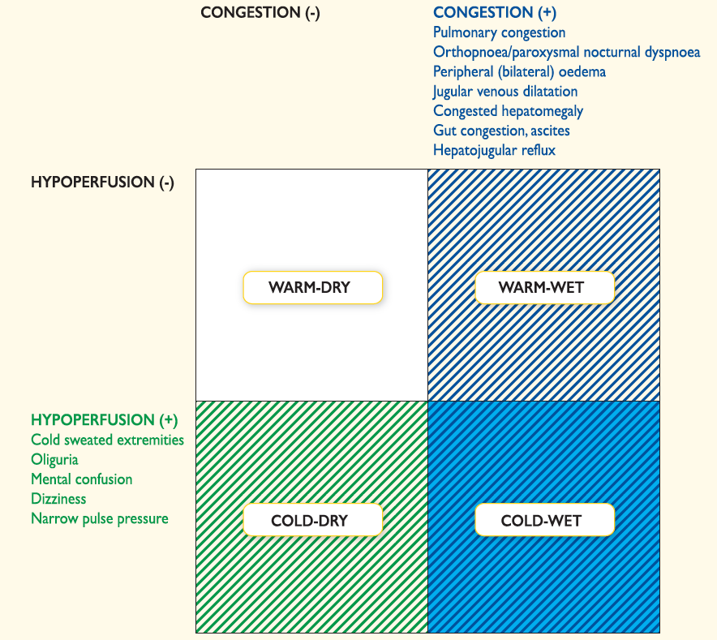
EHJ. 2016;37:2129-200

Slide 7
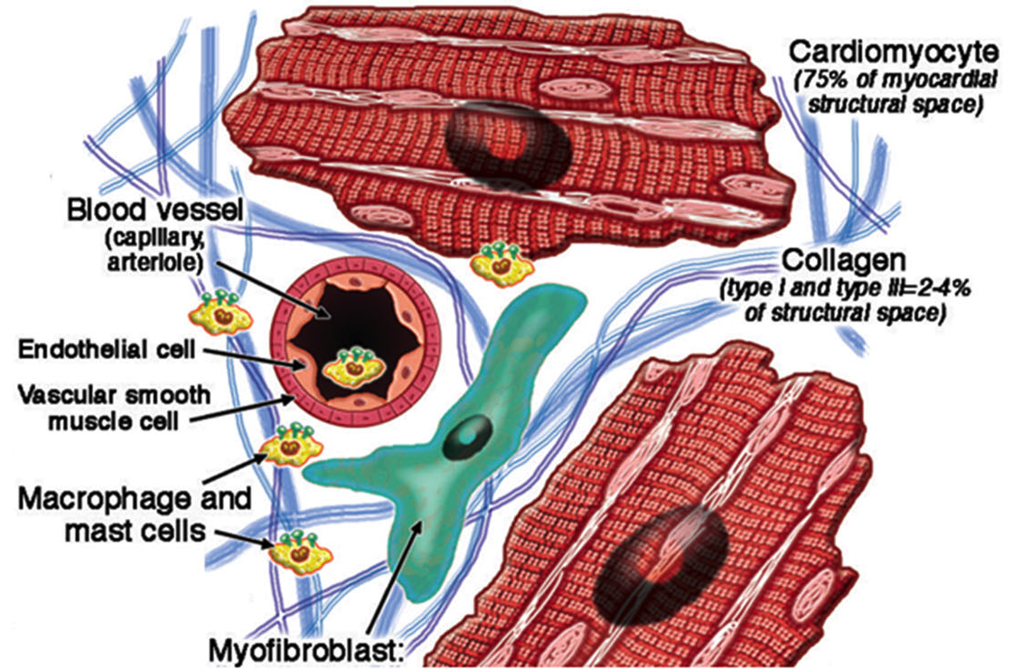
Components of the Normal Myocardium
Normal Heart is composed not only by Cardiomyocytes but by a complex interaction of different cell types.
J Am Coll Cardiol 57:891–903.

Slide 8
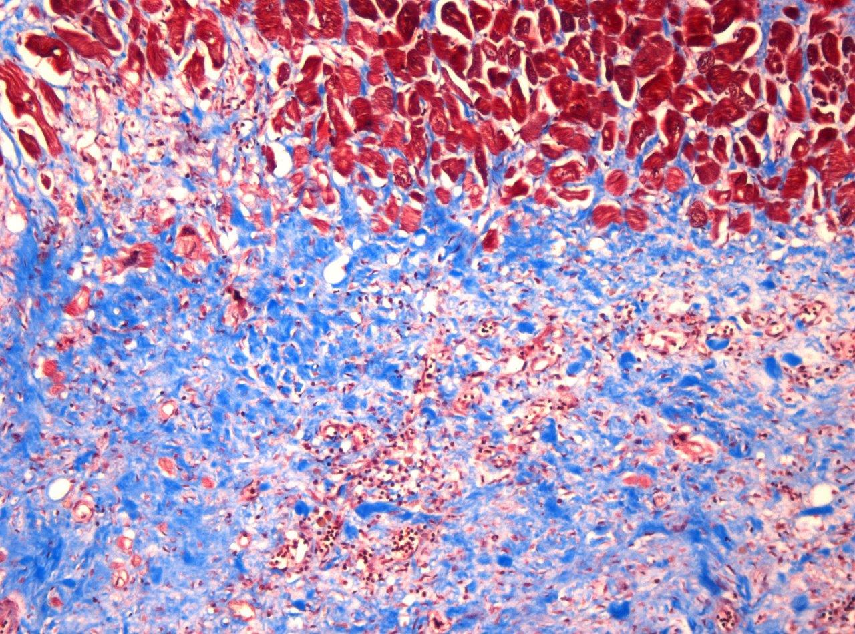
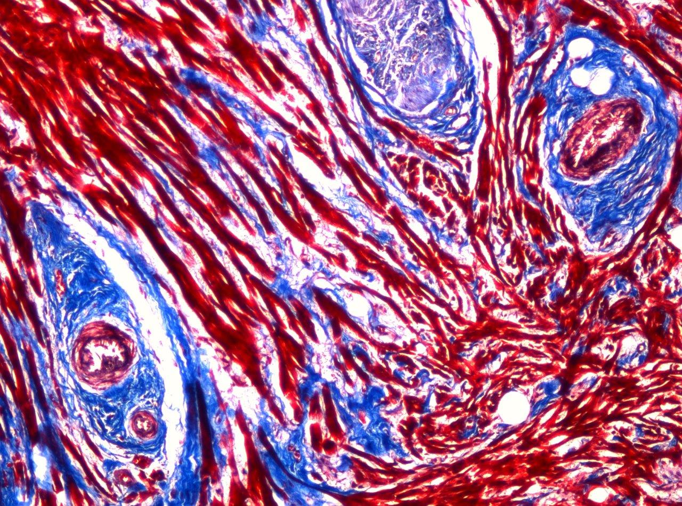
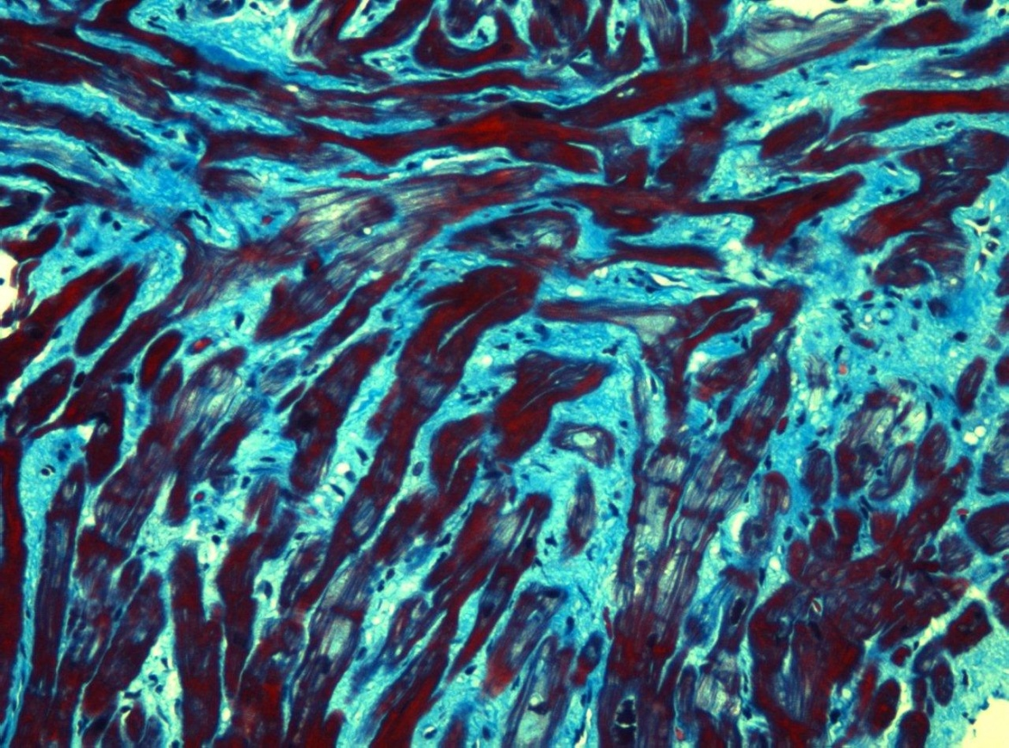
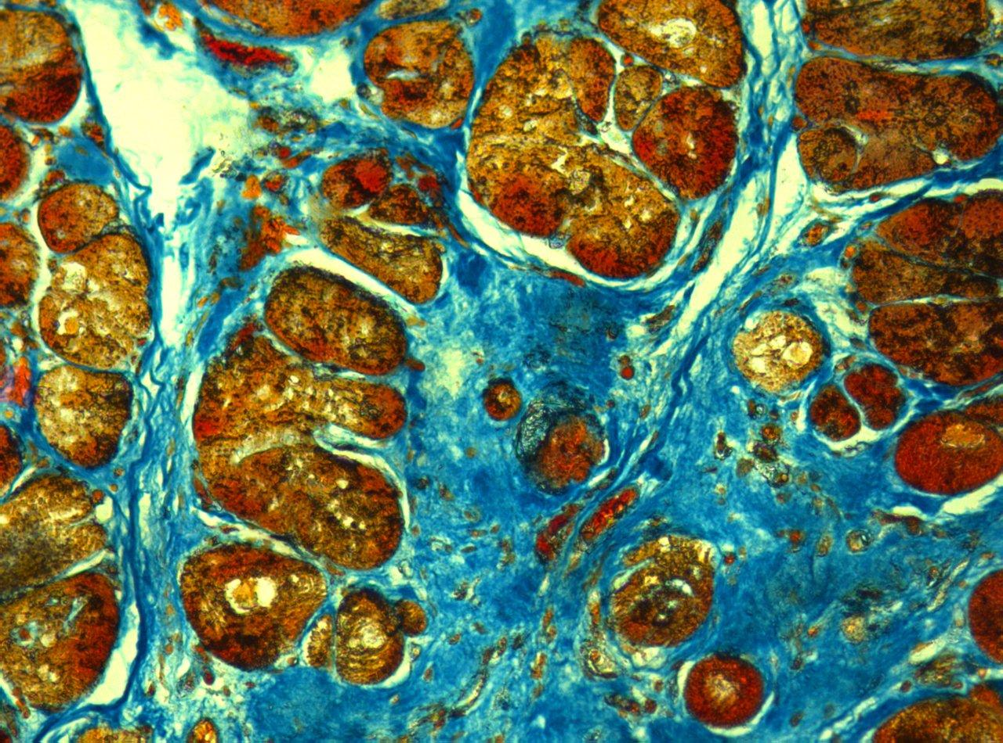

Slide 12
Notes:
Lualdi - Vers peri

Slide 13
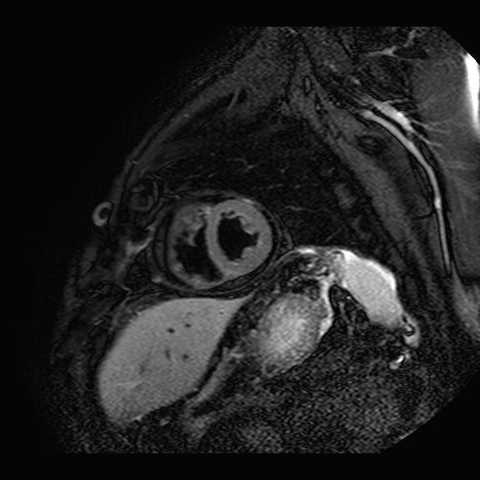
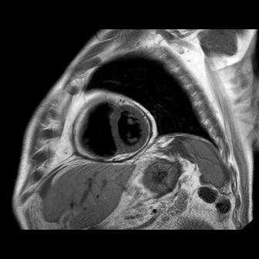
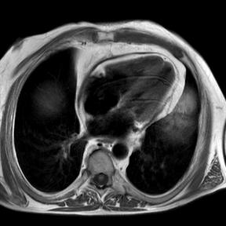
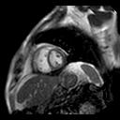
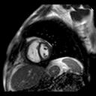
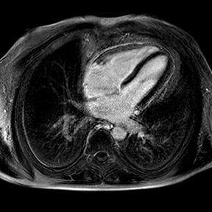
A
B
C
D - ESPIRIO
E - INSPIRIO
F
Notes:
6. Immagini di risonanza magnetica cardiaca in pericardite costrittiva. A: imaging con pesatura in T2 in asse corto medio-ventricolare, assenza di iperintensità significativa (assenza di edema/flogosi). B e C: imaging con pesatura in T1, ispessimento circonferenziale del pericardio (ipointensità) in asse corto medio-ventricolare (B) e 4 camere (C). D e E: imaging in “real time steady state free precession” o cine-risonanza, spostamento del setto interventricolare verso sinistra durante l’inspirio profondo. F: imaging tardivo dopo mezzo di contrasto che mostra late enhancement o iperintensificazione tardiva, espressione di fibrosi del pericardio circonferenziale in sezione 4 camere.

Slide 14
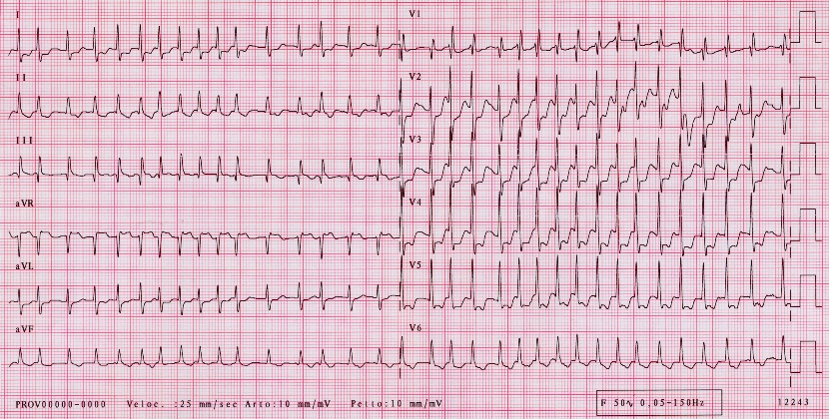
75 aa; Ipertensione, DM; EPA; FEVsin 60%

Slide 16
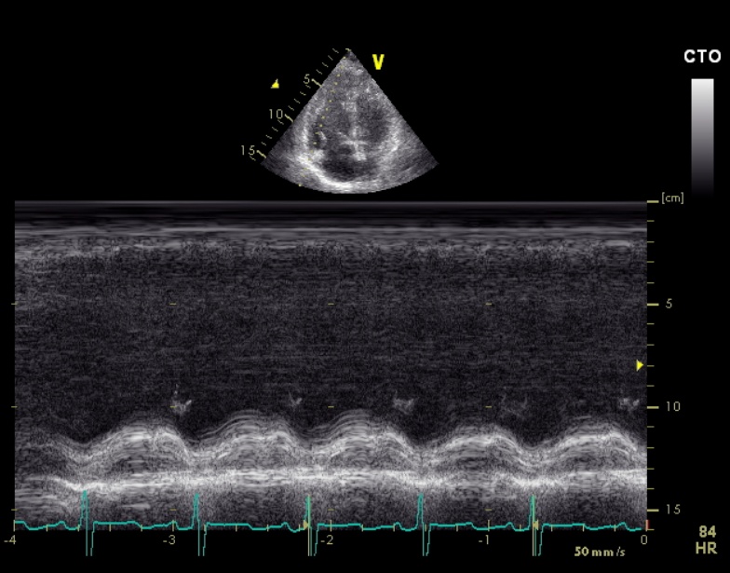

Slide 17
CMP-R

Slide 18
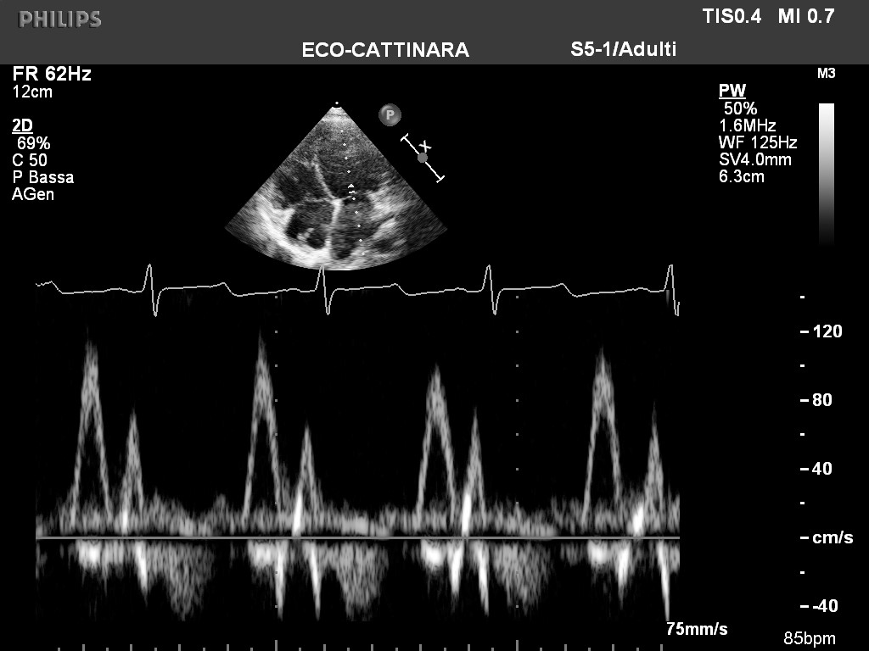
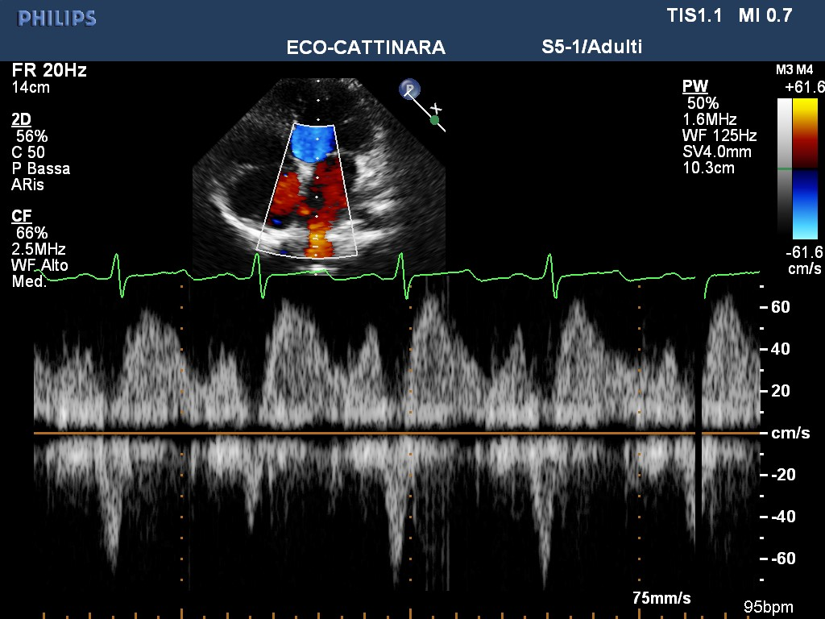
DOPPLER TRANSMITRALICO
DOPPLER VENE POLMONARI
Notes:
Curva Doppler transmitralica con tempo di decelerazione dell'onda E ridotto (70 ms) e presenza di piccole onda retrograde meso- e telediastolica. Dato compatibile con "pattern restrittivo" suggestivo di ridotta "compliance" ventricolare sinistra.
Curva Doppler venosa polmonare con prevalenza dell'onda sistolica rispetto alla diastolica; durata dell'onda A retrograda maggiore rispetto alla durata dell'onda A al doppler transmitralico, dato compatibile con aumento della pressione telediastolica in ventricolo sinistro.
Vene polmonari
Vel. Max onda S: 0,63 m/s
Vel. Max onda D: 0,49 m/s
Durata A: 137 msec
Integrale sistolico: 16,2 cm
Integrale diastolico: 6,4 cm
Durata AVP-AVM: 67 msec
Fraz. sistolica: 72

Slide 19
Acute CHF Diagnosis of different clinical syndromes
Acute CHF
Pulmonary
edema
Cardiogenic shock
Hypertensive
AHF
High output
failure
Exacerbated
CHF
RV failure

Slide 20
Acute HF: All-cause mortality*:
Overall and by clinical profile at entry
32.5%
25.9%
17.4%
18.5%
17.0%
13.3%
(n. 1892)
(n. 40)
(n. 232)
(n. 83)
(n. 81)
(n. 1308)
*median follow-up 356 days [325-366]
CS=Cardiogenic shock; PE=Pulmonary edema; RV=Right ventricular

Slide 21
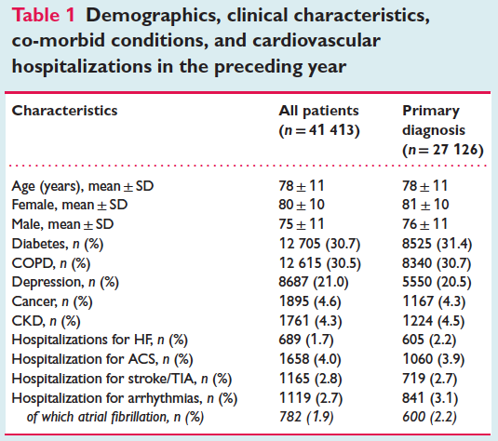
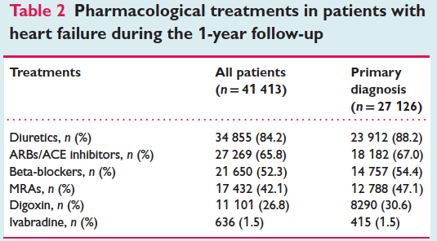
Maggioni AP et al. European Journal of Heart Failure (2016) 18, 402–410

Slide 22
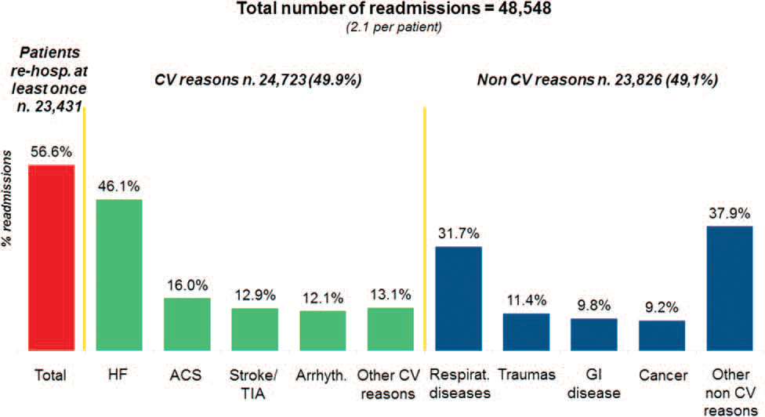
Rate and causes of hospital re-admissions.
Maggioni AP et al. European Journal of Heart Failure (2016) 18, 402–410

Slide 24
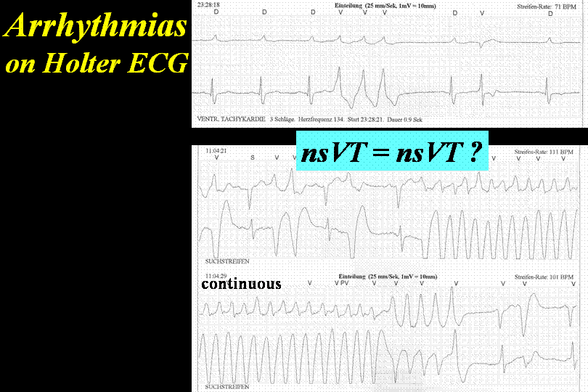

Slide 25
Biomarkers
University Medical Center Groningen

Slide 26
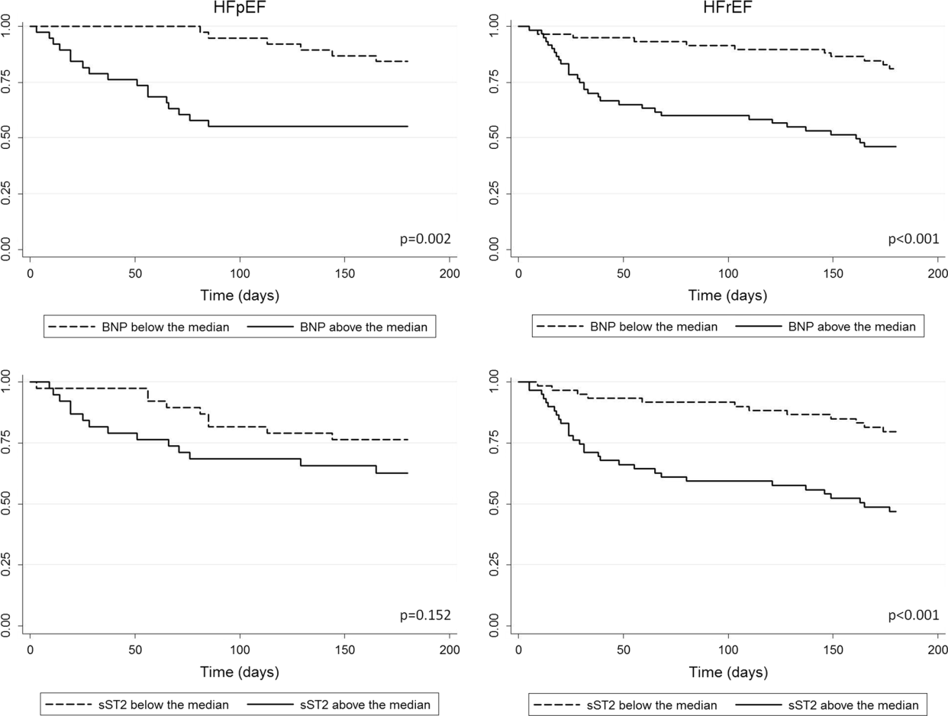
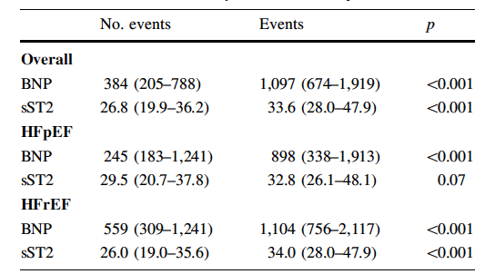
Clin Res Cardiol (2015) 104:491–499
Biomarker levels in patients with and without the composite endpoint all-cause death or hospital readmission for heart failure within 6 months, overall and by left ventricular ejection fraction.
Kaplan–Meier estimates of hospitalization-free survival for heart failure within 6 months, according
sST2 provides robust prognostic information in acute heart failure with HFrEF, while this pattern was less clear in HFpEF. When sST2 was measured together with BNP, it improved prognostic accuracy in both groups, more clearly in HFrEF.

Slide 27
AHA/ACC 2017 - Biomarkers Indications for Use
*Other biomarkers of injury or fibrosis include soluble ST2 receptor, galectin-3, and high-sensitivity troponin.
ACC indicates American College of Cardiology; AHA, American Heart Association; ADHF, acute decompensated heart failure; BNP, B-type natriuretic peptide; COR, Class of Recommendation; ED, emergency department; HF, heart failure; NT-proBNP, N-terminal pro-B-type natriuretic peptide; NYHA, New York Heart Association; and pts, patients.

Slide 28
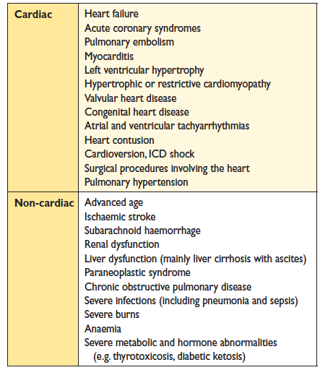
Causes of elevated concentrations of
natriuretic peptides
EHJ. 2016;37:2129-200

Slide 29
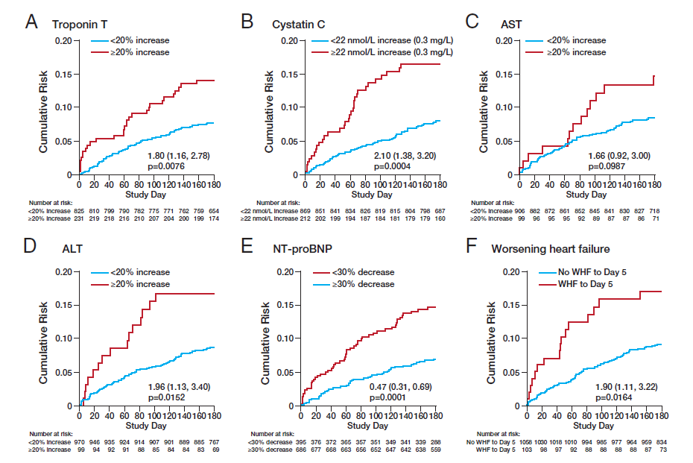
Risk of death by early changes in markers of organ function, damage, and congestion
Troponin T
Cystatin C
AST
ALT
NT-proBNP
Worsening of heart failure
Metra M et al. J Am Coll Cardiol. 2013 Jan 15;61(2):196-206.
Notes:
All-cause death through day 180 in Relaxin in Acute Heart Failure study patients subdivided by percentage change in troponin T from baseline to day 2 (A), absolute change in cystatin-C from baseline to day 2 (B), percentage increases in serum aspartate transaminase (AST) (C) and serum alanine transaminase (ALT) (D) from baseline to day 2, decrease in N-terminal pro– brain natriuretic peptide (NT-proBNP) from baseline to day 2 (E), and worsening heart failure (WHF) by day 5 (F).

Slide 30
ADHERE CART: Predictors of Mortality

Slide 31
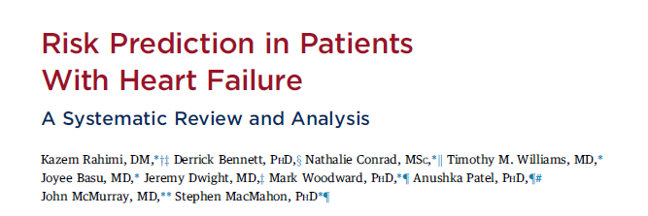
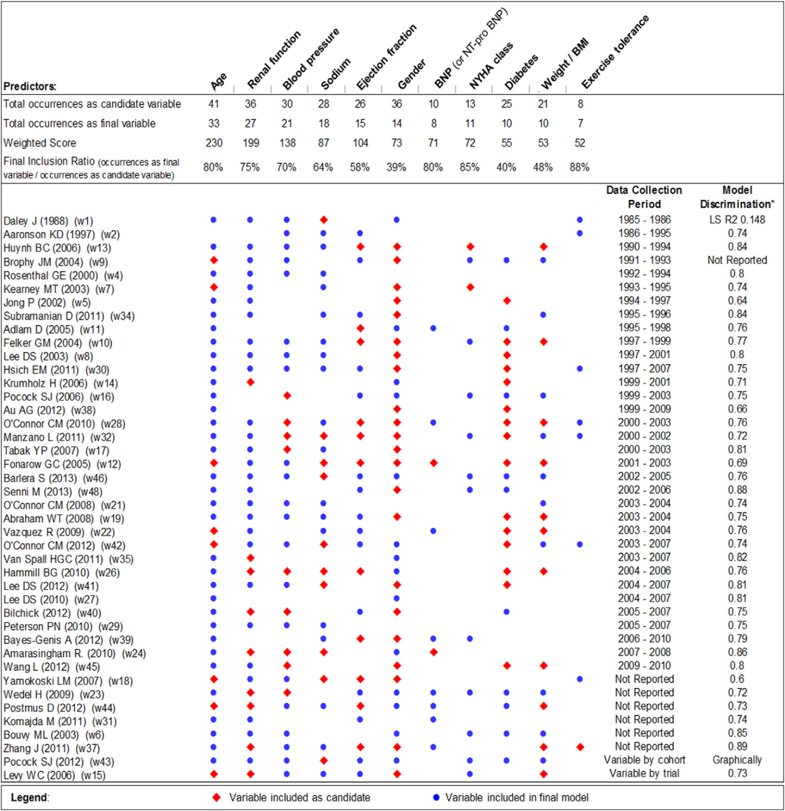
J Am Coll Cardiol HF 2014;2:440–6

Slide 32
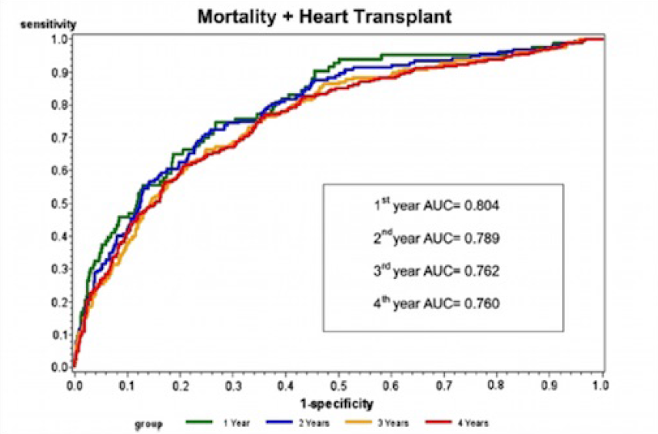
MECKI score (Metabolic Exercise and Cardiac and Kidney Indexes
2716 HF patients
VO2 di picco %
VE/VCO2 slope
HGB
Sodiemia
FE
GFR (MDRD)
www.cardiologicomonzino.it/Clinica/Cardiologia/Pages/MeckiScore.aspx
Agostoni P et al. Int J Cardiol 2013; 167:2710-18
Notes:
L’ultimo nato tra gli score prognostici
dello scompenso è il MECKI score (Metabolic Exercise and Cardiac and Kidney Indexes). Lo score ha
preso in considerazione diversi parametri demografici, clinici, ecocardiografici, di laboratorio e del test
da sforzo cardiopolmonare, su una popolazione di 2716 pazienti con scompenso cardiaco cronico da
disfunzione sistolica provenienti da 13 centri italiani, e identificando quelli che mantenevano un valore
predittivo indipendente all’analisi multivariata. Sono stati così individuati 6 parametri dotati di forte
valore predittivo indipendente e che sono stati inseriti nel calcolo dello score tenendo conto del loro
peso specifico nel determinare la prognosi:
VO2 di picco espresso come percentuale del predetto, pendenza della relazione VE/VCO2,
concentrazione dell’emoglobina plasmatica, sodiemia, frazione di eiezione ventricolare sinistra e filtrato
glomerulare (calcolato mediante formula MDRD). Il MECKI score costituisce un modello di valutazione
prognostica fortemente fondato su parametri del test da sforzo cardiopolmonare, considerando sia il
VO2 di picco che l’efficienza ventilatoria, e costituisce al momento lo score dotato della più alta AUC
all’analisi ROC tra gli score disponibili per la valutazione prognostica a lungo termine dello scompenso
a funzione sistolica depressa (vedi figura 6). Il dato che si ottiene dallo score è il rischio percentuale di
morte o trapianto cardiaco urgente in due anni. Il suo calcolo è reso facile e intuitivo dalla disponibilità
di un calcolatore online: https://www.cardiologicomonzino.it/Clinica/Cardiologia/Pages/MeckiScore.aspx

Slide 33
Ouwerkerk W et al. J Am Coll Cardiol HF 2014;2:429–36)
Notes:
The present paper systematically reviews and compares existing prediction models in order to establish the strongest
variables, models, and model characteristics in patients with heart failure predicting outcome. To improve decision
making accurately predicting mortality and heart-failure hospitalization in patients with heart failure can be important for
selecting patients with a poorer prognosis or nonresponders to current therapy, to improve decision making. MEDLINE/
PubMed was searched for papers dealing with heart failure prediction models. To identify similar models on the basis of
their variables hierarchical cluster analysis was performed. Meta-analysis was used to estimate the mean predictive value
of the variables and models; meta-regression was used to find characteristics that explain variation in discriminating
values between models. We identified 117 models in 55 papers. These models used 249 different variables. The strongest
predictors were blood urea nitrogen and sodium. Four subgroups of models were identified. Mortality was most accurately
predicted by prospective registry-type studies using a large number of clinical predictor variables. Mean C-statistic
of all models was 0.66 0.0005, with 0.71 0.001, 0.68 0.001 and 0.63 0.001 for models predicting mortality,
heart failure hospitalization, or both, respectively. There was no significant difference in discriminating value of models
between patients with chronic and acute heart failure. Prediction of mortality and in particular heart failure hospitalization
in patients with heart failure remains only moderately successful. The strongest predictors were blood urea nitrogen
and sodium. The highest C-statistic values were achieved in a clinical setting, predicting short-term mortality with
the use of models derived from prospective cohort/registry studies with a large number of predictor variables.
(J Am Coll Cardiol HF 2014;2:429–36)

Slide 34
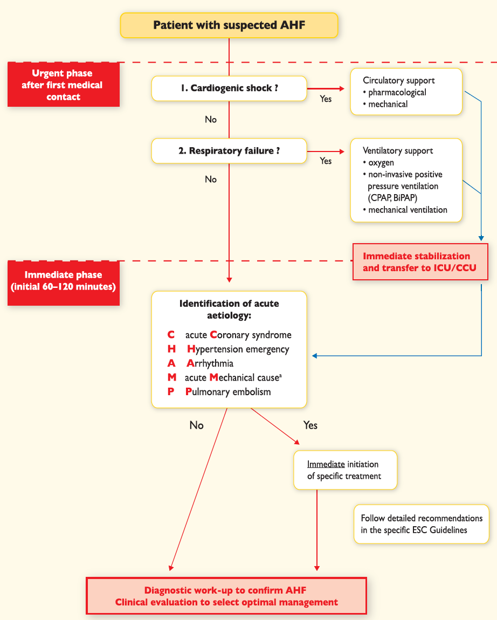
Initial management of a patient with acute heart failure
EHJ. 2016;37:2129-200
Notes:
Acute mechanical cause: myocardial rupture complicating acute coronary syndrome (free wall rupture, ventricular septal defect, acute mitral regurgitation), chest trauma or cardiac intervention, acute native or prosthetic valve incompetence secondary to endocarditis, aortic dissection or thrombosis

Slide 35
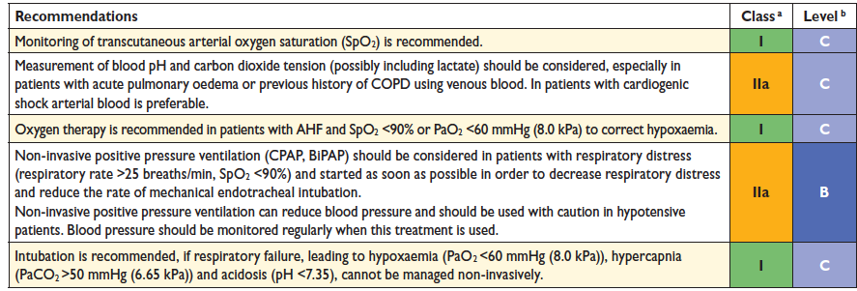
Recommendations for the management of patients with acute heart failure: oxygen therapy and ventilatory support
EHJ. 2016;37:2129-200

Slide 36
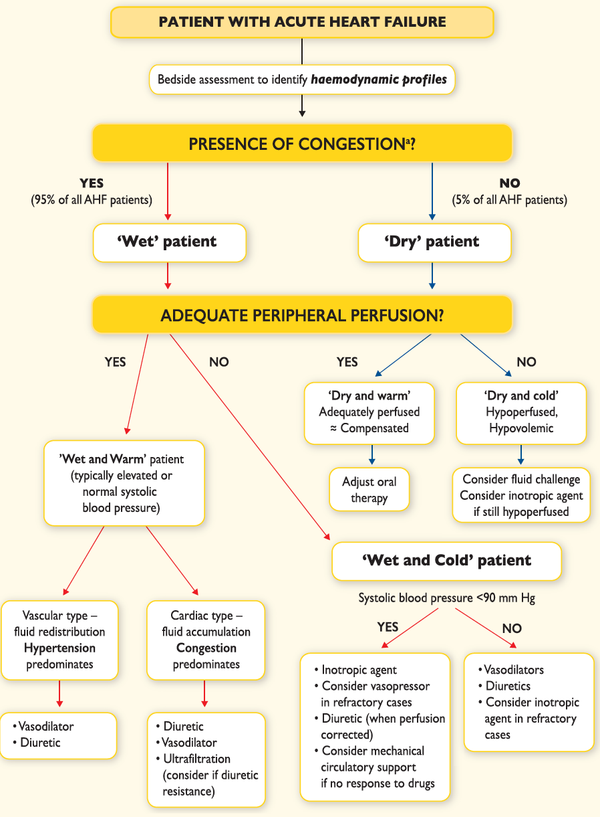
Management of patients with acute heart failure based on clinical profile during an early phase
EHJ. 2016;37:2129-200

Slide 37
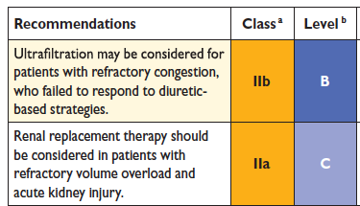
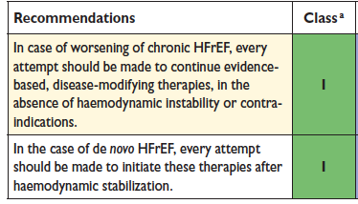
Renal replacement therapy
oral evidence-based disease-modifying therapies in patients with acute heart failure
EHJ. 2016;37:2129-200

Slide 38
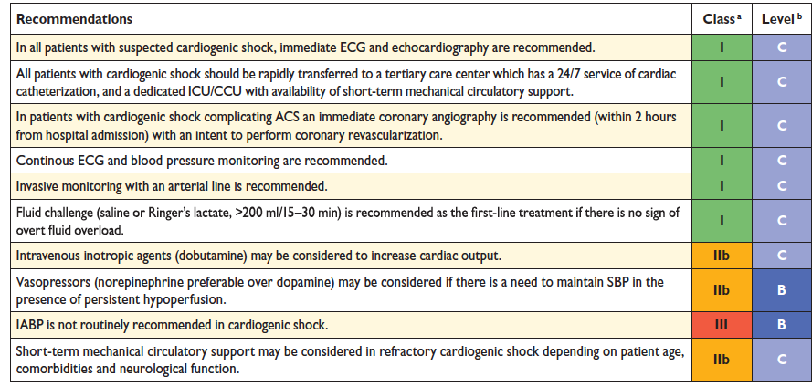
Cardiogenic Shock
EHJ. 2016;37:2129-200

Slide 39
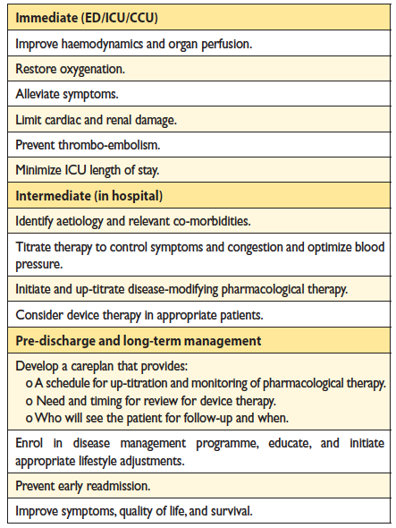
Goals of treatment
EHJ. 2016;37:2129-200

Slide 40
Josè Perez. Un giorno in ospedale, 1929

