Slide 1



Capire e interpretare le curve sul ventilatore
Fabiano Di Marco
Università degli Studi di Milano
Pneumologia
Ospedale Papa Giovanni XXIII – Bergamo
fabiano.dimarco@unimi.it

Slide 2
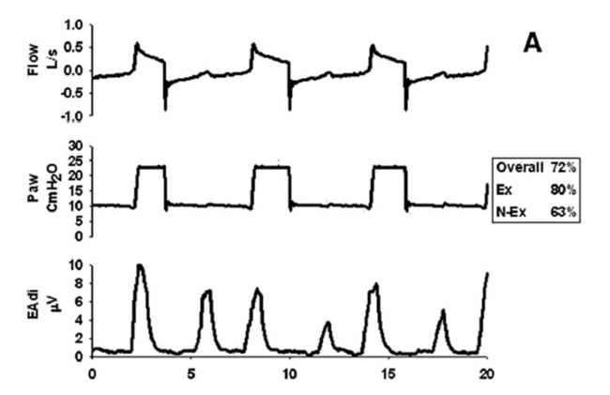
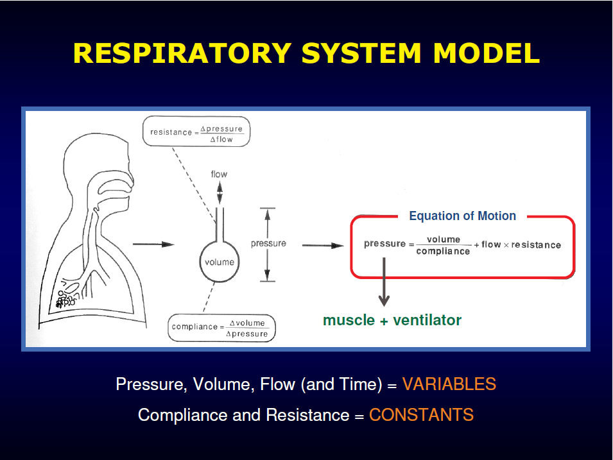
Respiratory system model

Slide 3
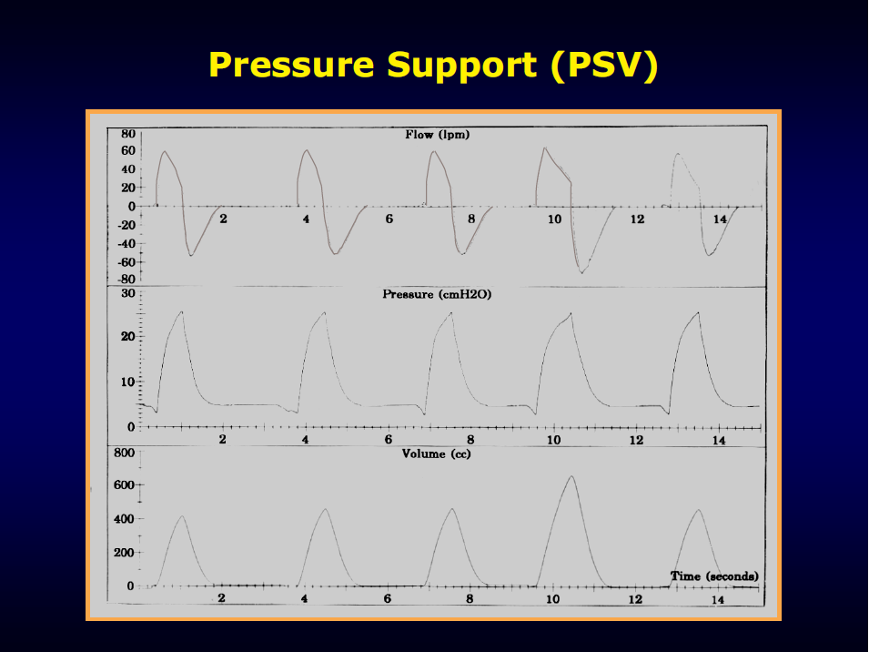
Is this a COPD patient?
Notes:
How to suspect COPD by waveform interpretation?

Slide 4
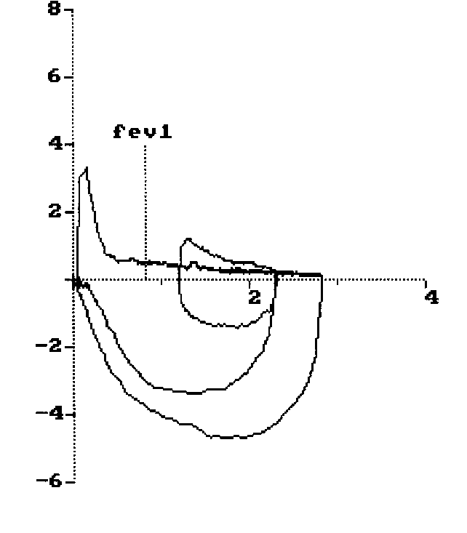
Is this a COPD patient?
Notes:
If you are used to perform /spairometri/, you know in case of COPD usually you can find a concavity of expiratory flow

Slide 5
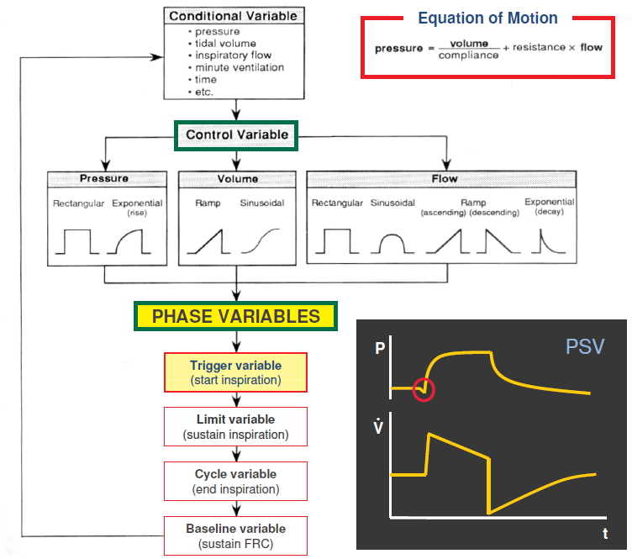
Phase variables
of mechanical ventilation
Notes:
The interaction between these two pumps leads to the generation of flow, pressure and volume changes.
I will discuss with you mainly flow and pressure waveforms, since volume is merely calculated as the integration of the flow over time

Slide 6
Trigger variable
Begins inspiration when one of the measured variable (time, pressure, flow or volume) reaches a preset value.
The patient effort required to trigger inspiration is determined by the ventilator’s sensitivity.

Slide 7
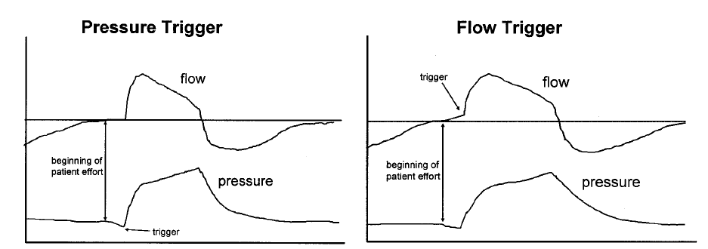
Flow and pressure
inspiratory trigger
Hess DR. Respiratory Care 2005
Notes:
Dare un’occhiata….take a look at these two waveforms.
A portion of the flow generated by the ventilator is stolen by the patient
So we are now able to identify patients’ triggered cycles, and to distinguish between a pressure and flow trigger

Slide 8
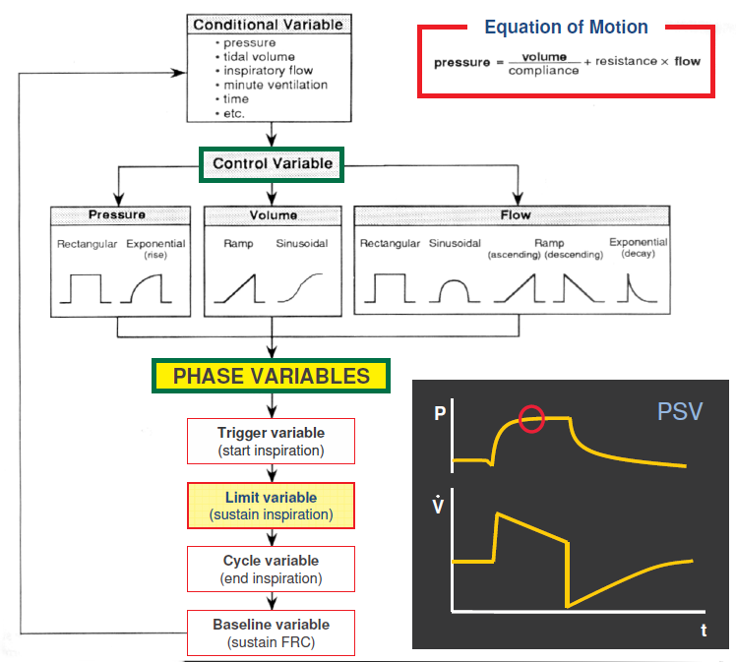
Phase variables
of mechanical ventilation

Slide 9
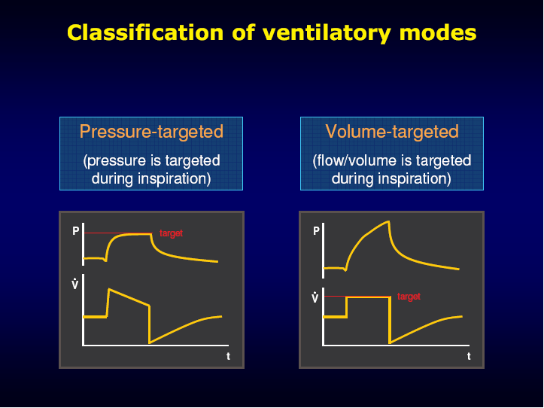
The “limit variable”
Notes:
To understand whether the mode of ventilation is pressure-targeted or volume-targeted we have to looking for a flat topped wave (this is not all the time true), since for example we can have different flow pattern: not only constant, but also accelerating, decelerating or even sinusoidal.

Slide 10
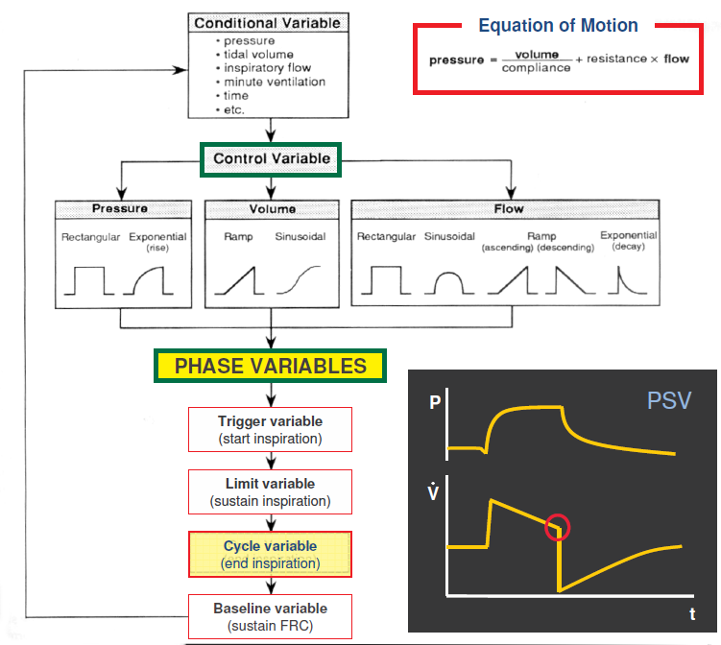
Phase variables
of mechanical ventilation

Slide 11
Cycle variable
Inspiration ends when one of the measured variable (time, pressure, flow or volume) reaches a preset value.

Slide 12
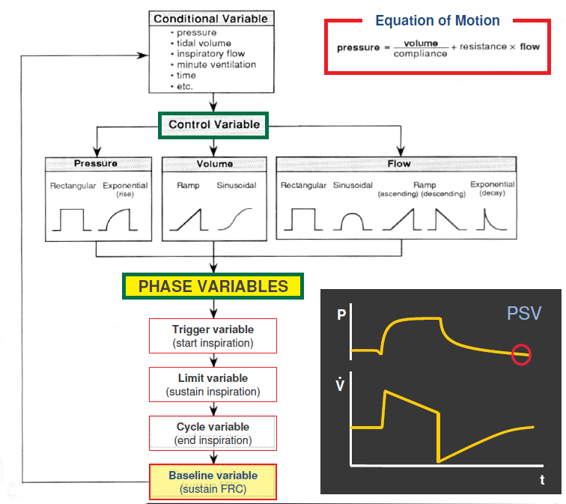
Phase variables
of mechanical ventilation

Slide 13
Baseline variable
The variable (pressure, flow, or volume) controlled during the expiration time;
Pressure is the baseline variable (PEEP) in most cases.

Slide 14
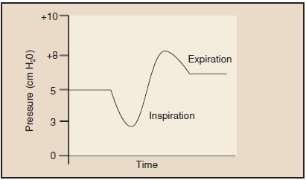
How to judge a CPAP system?
High resistance ineffective
expiratory valve
Increased work of breathing
Negative transpleural pressure
Notes:
I need only few minutes to discuss with you how to judge a CPAP system.
Why pressure wave should be flat? Because ..

Slide 15
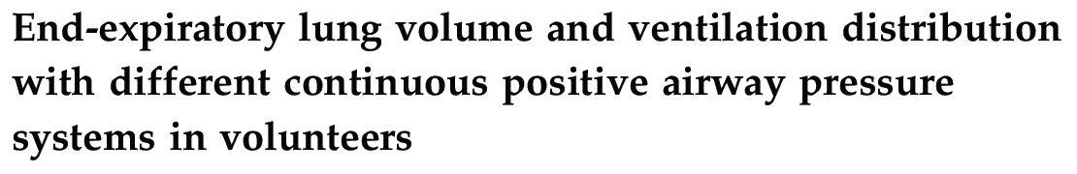
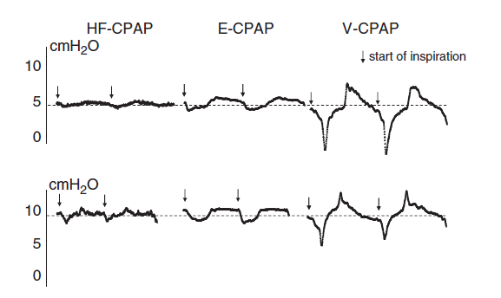
High flow CPAP
Ventilator
Notes:
This is a very bad CPAP system, since there a dramatic decrease of pressure during inspiratory, and an increase of pressure during expiration

Slide 16
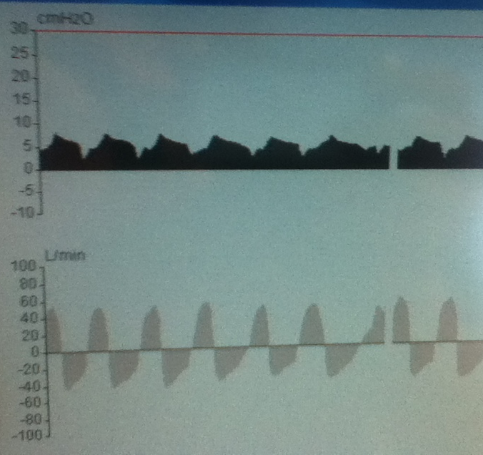
How to judge a CPAP system?

Slide 17
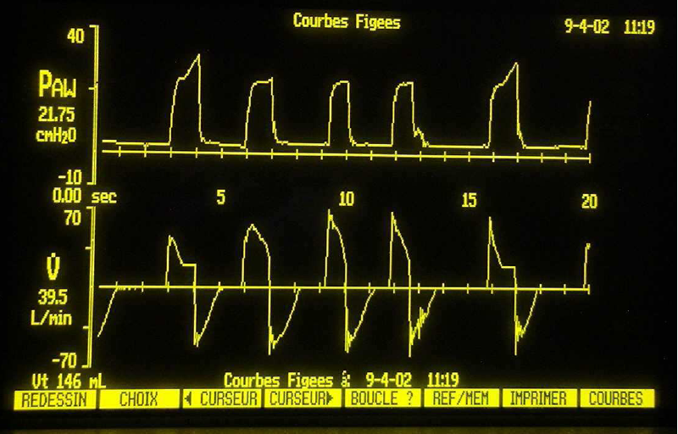
Dual control-modes of ventilation
Notes:
Anyone trying to selling you a dual control mode of ventilation should be ….

Slide 18
Why are we interested in
patient-ventilator asynchrony?
Patients with an asynchrony index >10% are characterized by a:
    longer duration of mechanical ventilation;
    prolonged ICU stay
    reduced number of ventilator-free days
    higher rate of tracheostomy
    lower probability of home discharge
    lower survival

Slide 19
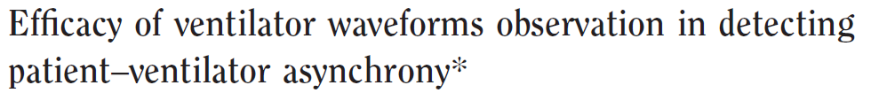

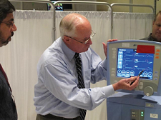
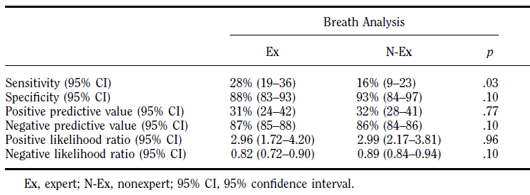


Slide 20
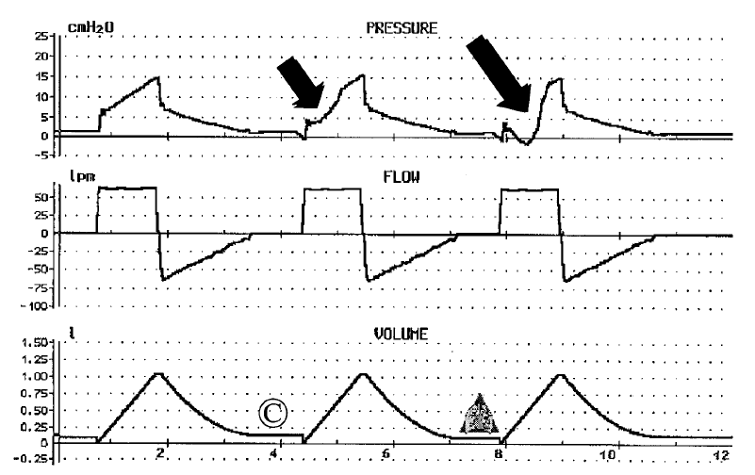
Are two waveforms enough?

Slide 21
Types of
patient-ventilator asynchronies
Trigger asynchrony (Phase 1)
Flow asynchrony (Phase 2)
  Flow-asynchrony during volume-controlled ventilation
  Rising time asynchrony
Termination asynchrony (Phase 3)
  Delayed termination
  Premature termination
Expiratory asynchrony (Phase 4)

Slide 22
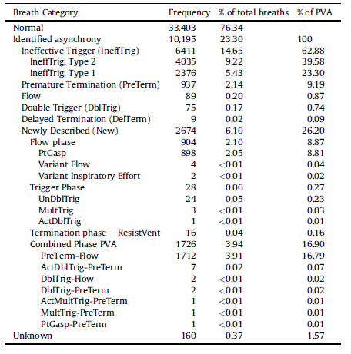
Frequency of
patient-ventilator asynchronies
Notes:
What is an ineffective effort: a muscular effort without ventilator trigger

Slide 23
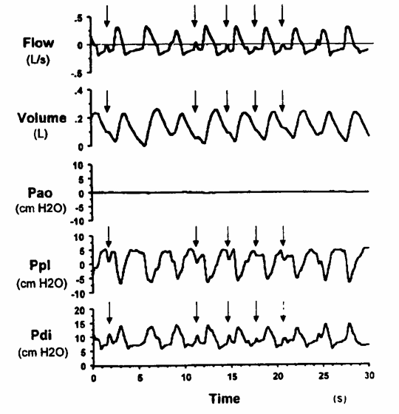
Ineffective efforts
Purro, ARJCCM; 2000

Slide 24
Ineffective efforts during expiration
Flow
L/sec
Decrease of expiratory flow
Decrease of pressure
P
cmH₂O

Slide 25
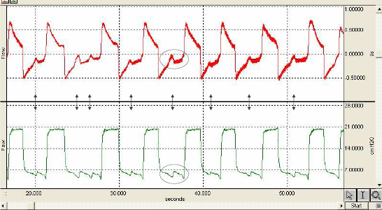
Ineffective efforts

Slide 26
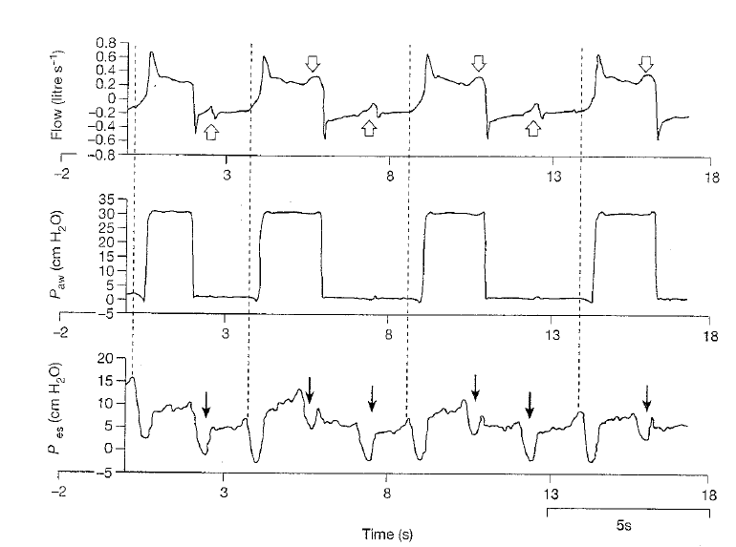
Ineffective efforts during inspiration
Respiratory rate underestimation (13 vs 33)
Nilsestuen et al. Resipr Care 2005; 50:202-232

Slide 27

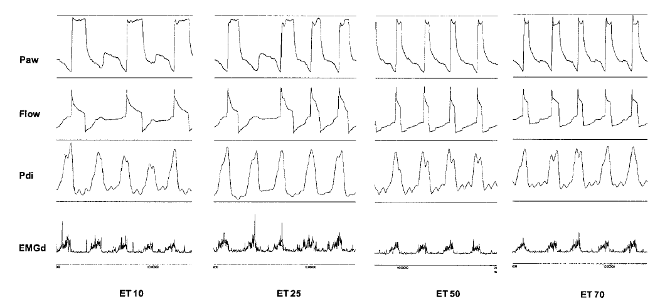

Slide 28
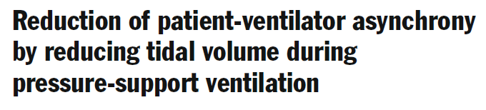
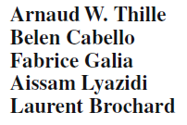
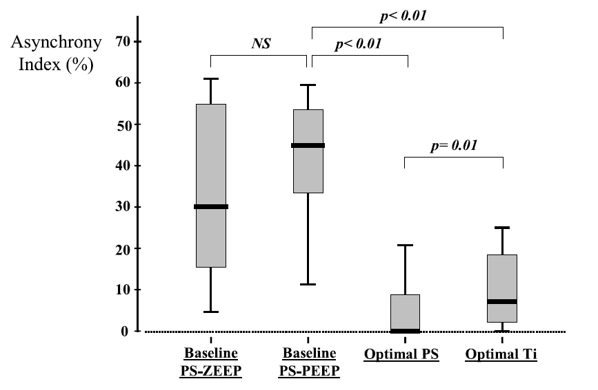

Slide 29
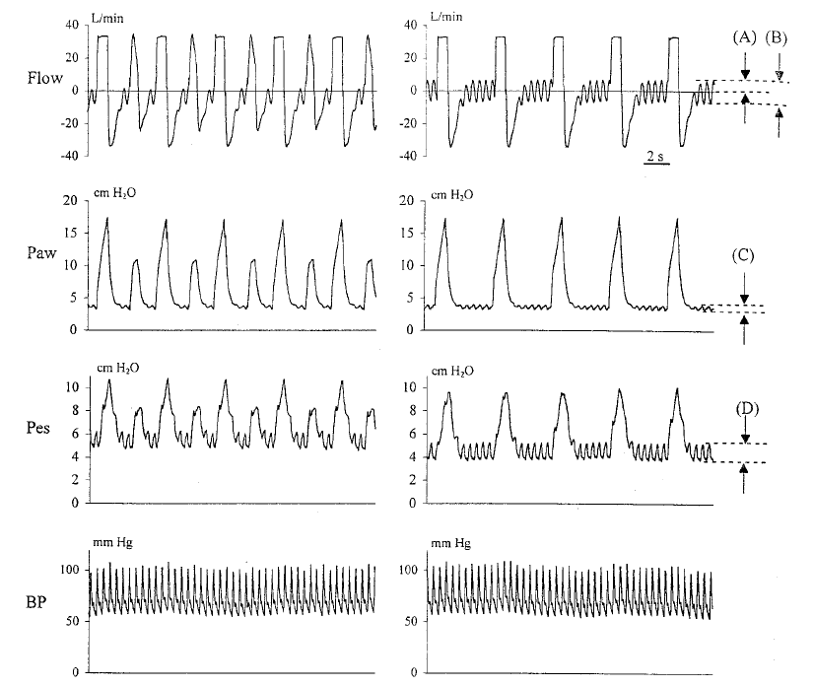
Autotriggering
1 L/min
4 L/min
Nilsestuen et al. Resipr Care 2005; 50:202-232

Slide 30
Inspiratory trigger setting
trigger
asynchrony
insensitive
trigger
Sensitive
trigger
auto-
triggering
trigger sensitivity to low
high level of PSV
hypercapnic encephalopathy
sedation
sleep
intrinsic PEEP (COPD)
leakages (NIV)
tubing obstruction
trigger sensitivity to high
resistance changes
tubing leakage
cardiac oscillation

Slide 31
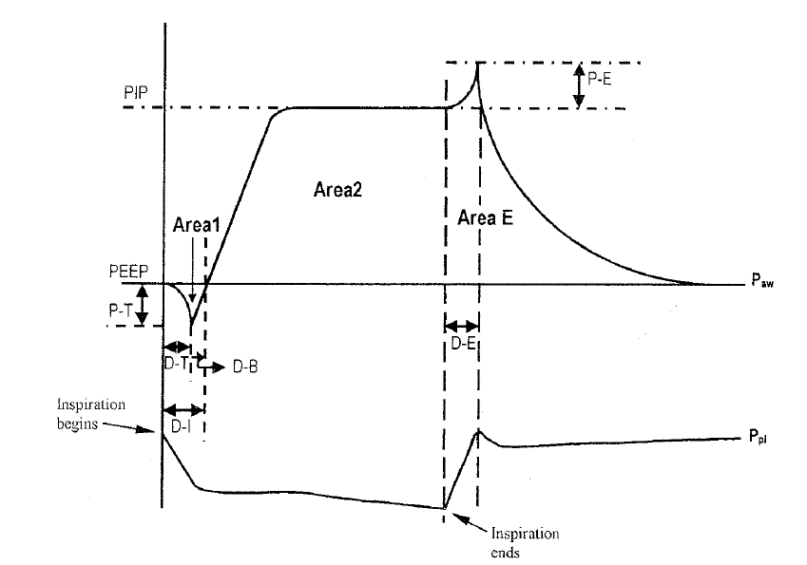
Expiratory trigger setting:
delayed termination

Slide 32
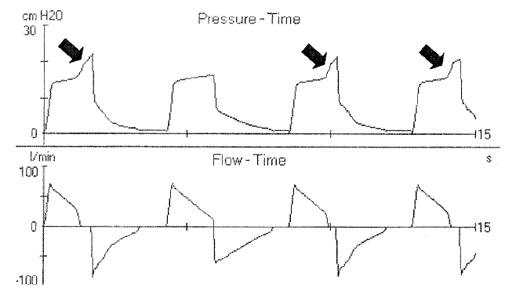
Expiratory trigger setting:
delayed termination
Nilsestuen et al. Resipr Care 2005; 50:202-232

Slide 33
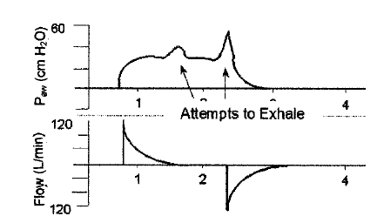
Expiratory trigger setting:
delayed termination
Nilsestuen et al. Resipr Care 2005; 50:202-232
Notes:
Which mode of ventilation is this?
Spontaneous, assisted or controlled?
Pressure or volume/flow limited?
The shape of flow wave is….

Slide 34
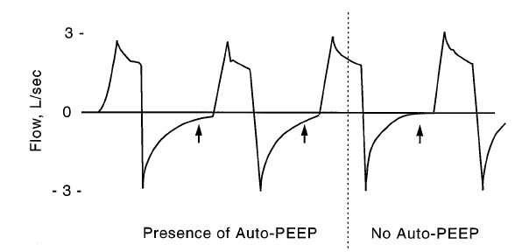
Expiratory asynchrony
Expiratory flow that doesn’t reach zero

Slide 35
Expiratory asynchrony
Inspiration
Normal
Patient
Time
Flow (L/min)
Air-trapping
AUTO PEEP
Expiration

Slide 36
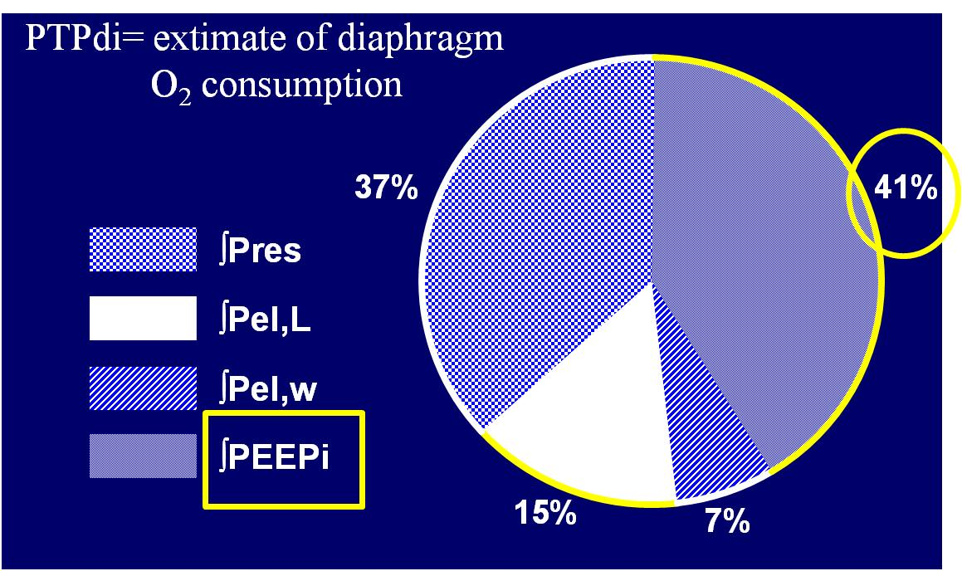
Work of Breathing for intrinsic PEEP in COPD patients
Appendini L. et al. AJRCCM 1996; 154:1301-1309

Slide 38
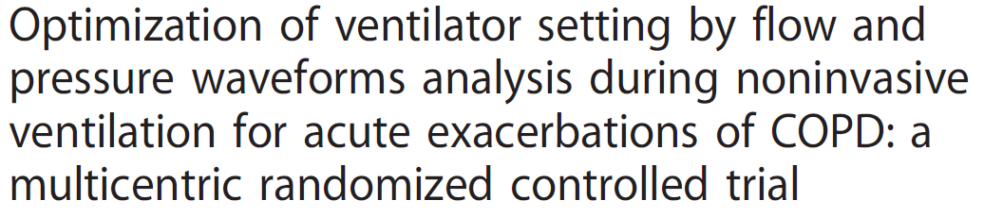
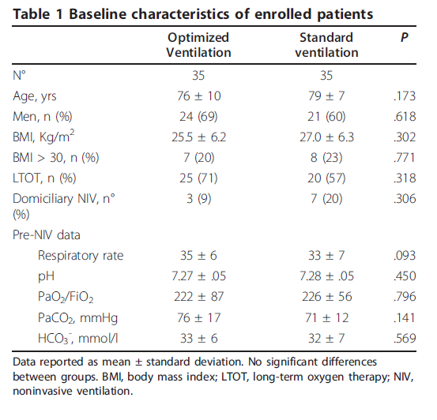

Slide 39
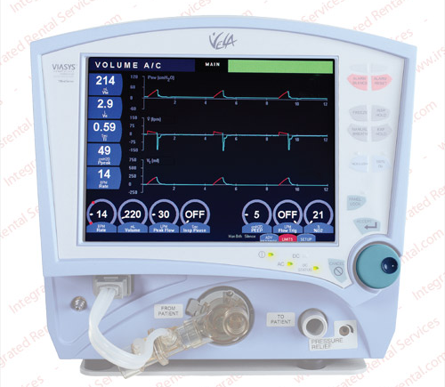
Waveforms driven setting

Slide 40

Standard setting with ventilator
screen obscured
Numerical data
always available
Screen
obscured

Slide 41
“Typical” waveforms driven setting approach
Individuation of autotriggering:
  reduction of air leaks, and/or reduction of inspiratory trigger sensitivity.

Slide 42
“Typical” waveforms driven setting approach
Individuation of ineffective efforts:
  titration of pressure support, inspiratory and expiratory triggers, and PEEPext.

Slide 43
“Typical” waveforms driven setting approach
Signs of potential late cycling-off (pressure increase at the end of inspiratory cycle or flow and pressure prolonged plateau):
  reduction of air leaks and/or titration of expiratory trigger, or setting of maximal inspiratory time.
Notes:
/taitration/

Slide 44
“Typical” waveforms driven setting approach
Potential early cycling-off (convex pattern of expiratory flow waveform and concavity of pressure waveform):
  Action: titration of expiratory trigger.

Slide 45
“Typical” waveforms driven setting approach
Signs of potentially not balanced PEEPi (expiratory flow that does not reach zero prior to inspiration or ineffective efforts):
  Action: titration of PEEPext.

Slide 46
“Typical” waveforms driven setting approach
As a general rule changes in PEEP and PS were carried out by steps of 2 cmH₂O, and changes in inspiratory and expiratory triggers by steps of 5 to 10%.

Slide 47
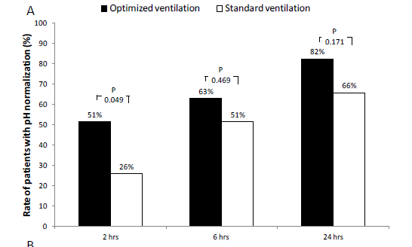

Slide 48
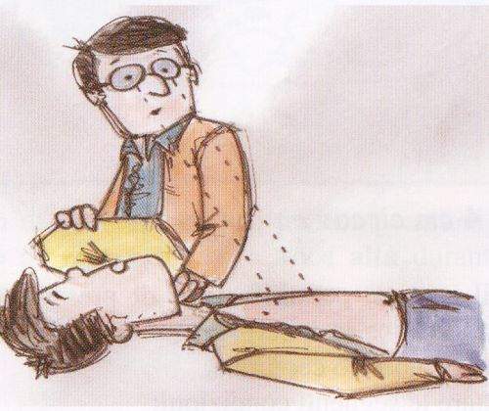
How to detect ineffective efforts if we are not expert in waveforms interpretation?

Slide 49
Capire e interpretare le curve sul ventilatore
Fabiano Di Marco
Università degli Studi di Milano
Pneumologia
Ospedale Papa Giovanni XXIII – Bergamo
fabiano.dimarco@unimi.it

Slide 50


Slide 51
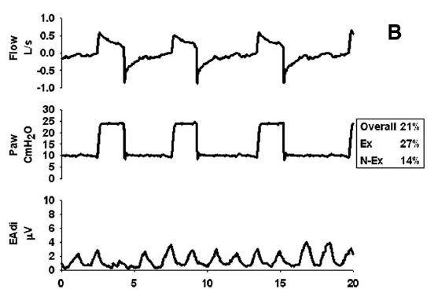

Slide 52
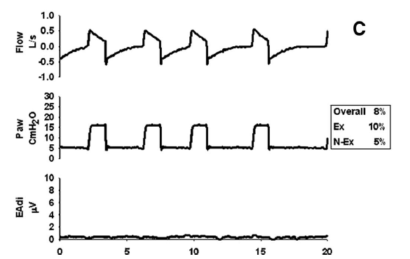

Slide 53
