Slide 1

NIV a domicilio su misura per il paziente
Michele Vitacca MD FERS
ICS Maugeri IRCCS Pavia

Slide 2
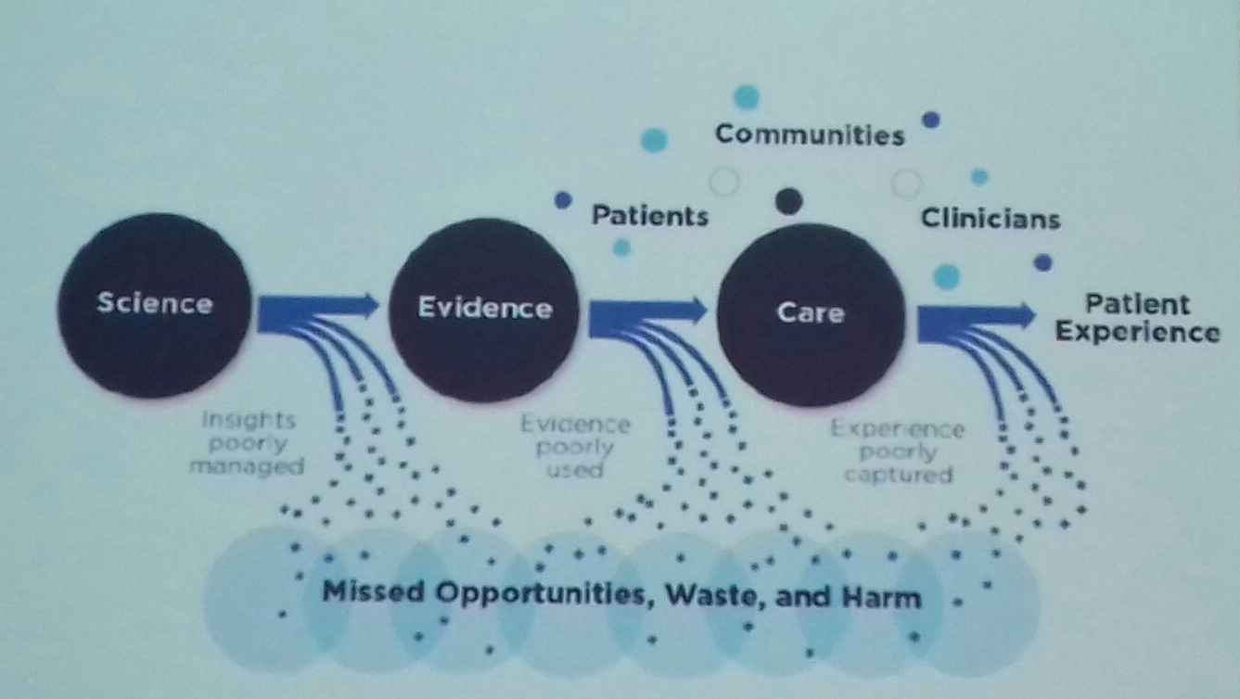
Cosa rimane al paziente della ricerca ?
Insights
Poorly managed
evidence
Poorly used
Experiences
Poorly captured
MISSED OPPORTUNITIES, WASTE, AND HARM

Slide 3
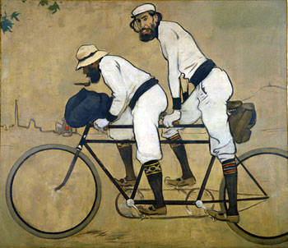
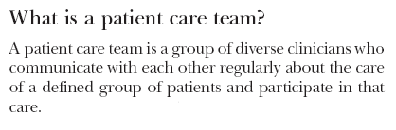
NIV Home team
Wagner. BMJ 2000;320:569-72.
ADI
Medico MMG
NIV hospital team
Caregivers/
Paziente
SSN (ASST)
Home care provider
R. Casas & P Romeu (1897)

Slide 4
Why monitoring NIV?
Persisting hypoventilation
Repetitive leaks
Upper airway instability
Residual obstructive events
Recurrent decreases in respiratory command
Patient ventilator asynchrony

Slide 5

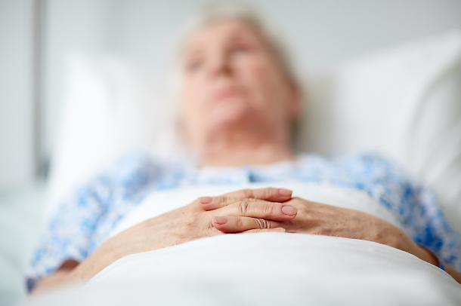
Patient’s point of view:
  Dyspnoea,
  daytime sleepiness, sleep fragmentation,
  Fatigue
  mobility
  Severe muscle weakness lower limbs and trunk,
  weak upper limbs
  Snoring
  HRQL
  exercise tolerance
  Disability
  Sputum encumbrance
  morning headaches
  Anxiety & depression,
  Exacerbation frequency and hospitalisations
  Frailty
Doctor’s point of view
Pulmonary function tests
Respiratory muscle strength
ABG
PCEF
Diagnostic sleep study
Setting
Monitoring
Follow-up

Slide 6

Red Flag: worsening condition and instructions on how to respond to them.
Coleman 2006
Disfagia
Insufficienza respiratoria
Incompetenza delle vie aeree
Riduzione capacità comunicative
Incremento dipendenza
Ingombro secretivo
Riduzione forza muscoli respiratori
PEG
Ventilazione meccanica
Tracheostomia
Ausili comunicazione
Ausili per l’indipendenza
Cough-assist
Ventilazione meccanica
Farmacologia (morfina etc)
SINTOMI
TRATTAMENTI

Slide 7
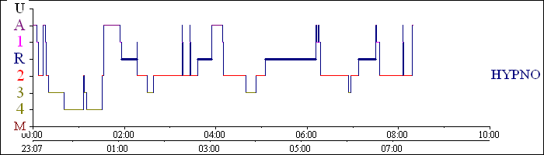
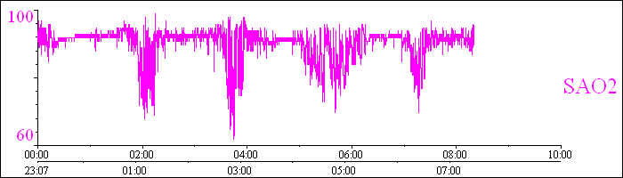
Pulse oxymetry

Slide 8
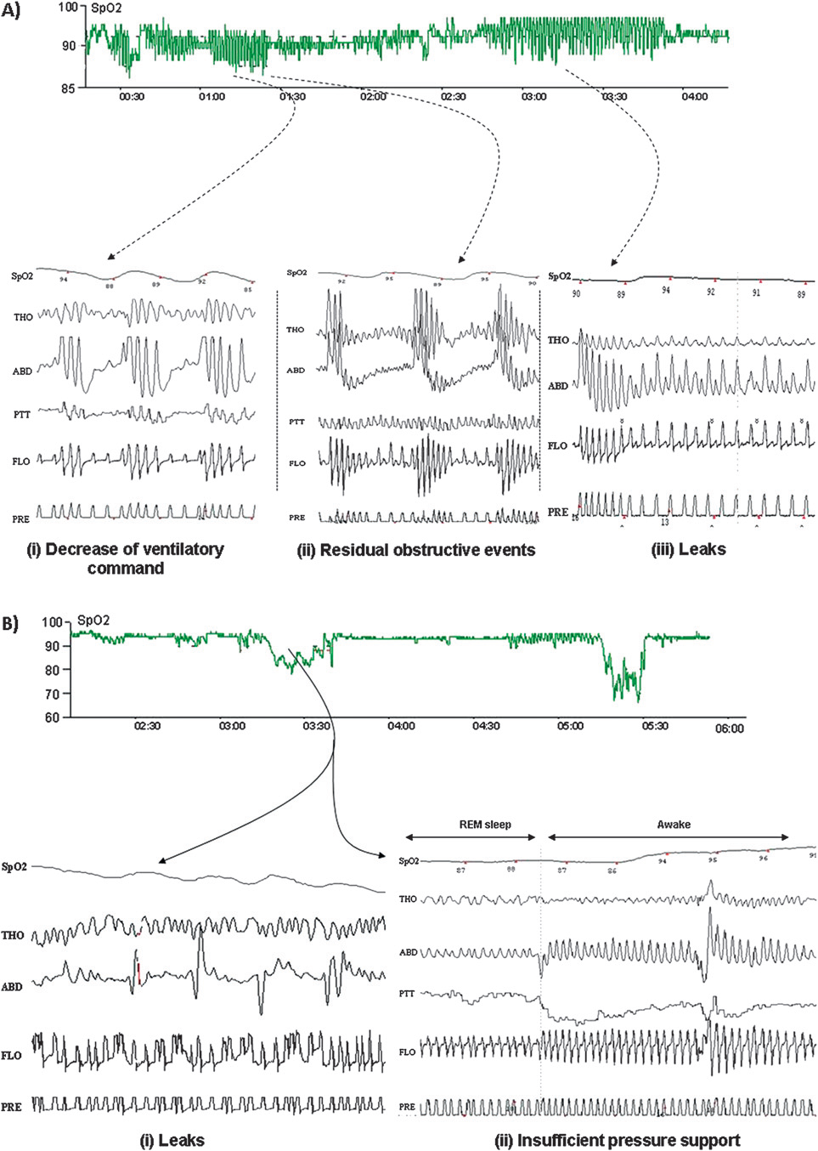
… SomnoVNI Group
… Janssens, Thorax 2011

Slide 9
BLOOD GAZES
Partial arterial pressure of CO2 >45 mmHg
Usual definition: daytime
Diurnal or nocturnal
Arterial or capillary?

Slide 10
Prevalence of hypoventilation
N=232 unventilated
Daytime partial arterial pressure of CO2 >45 mmHg
Daytime base excess ≥4 mmol/l
Nocturnal SpO2 ≤88% for 5 consecutive minutes
Mean nocturnal SpO2 <90% or SpO2 <90% during ≥10% of the recording time
TcCO2 >55 mmHg for ≥10 minutes
Increase in TcCO2 ≥10 mmHg (in comparison to an awake supine value) to a value exceeding 50 mmHg for ≥10 minutes
Peak TcCO2 ≥49 mmHg
Mean TcCO2 >50 mmHg
Ogna et al., JIVD 2014

Slide 11
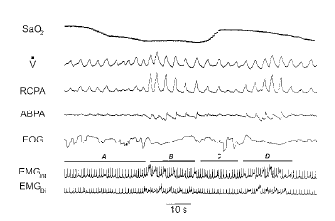
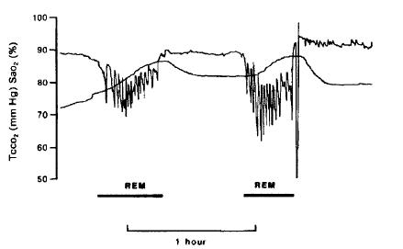
Prevalence of hypercapnia
PtCO2
SaO2

Slide 12
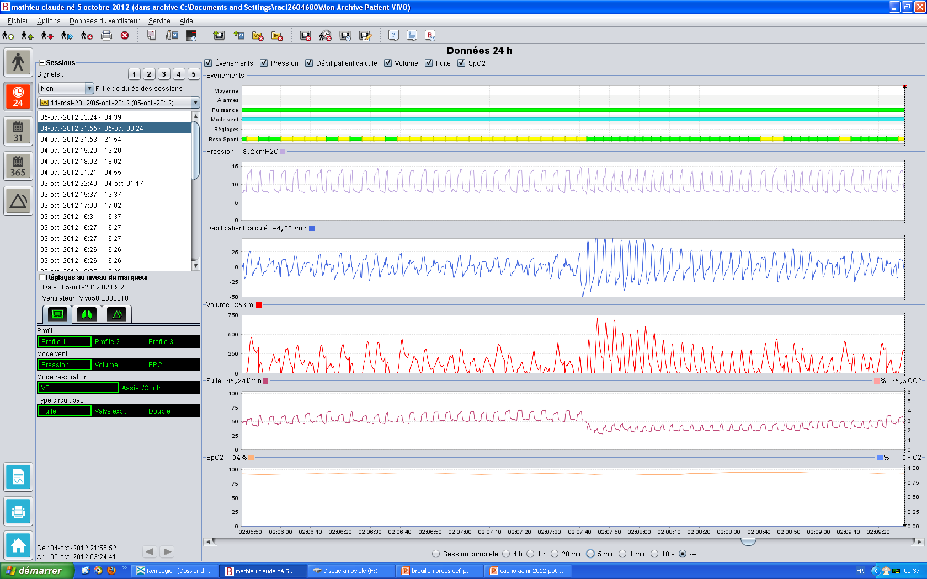
«no triggered »
(asynchrony)
triggered
Pr
Flo
MV
resynchronisation
Asynchrony
No leaks
Leak
Leaks
SpO2
2’ page

Slide 13
DMD

Slide 14
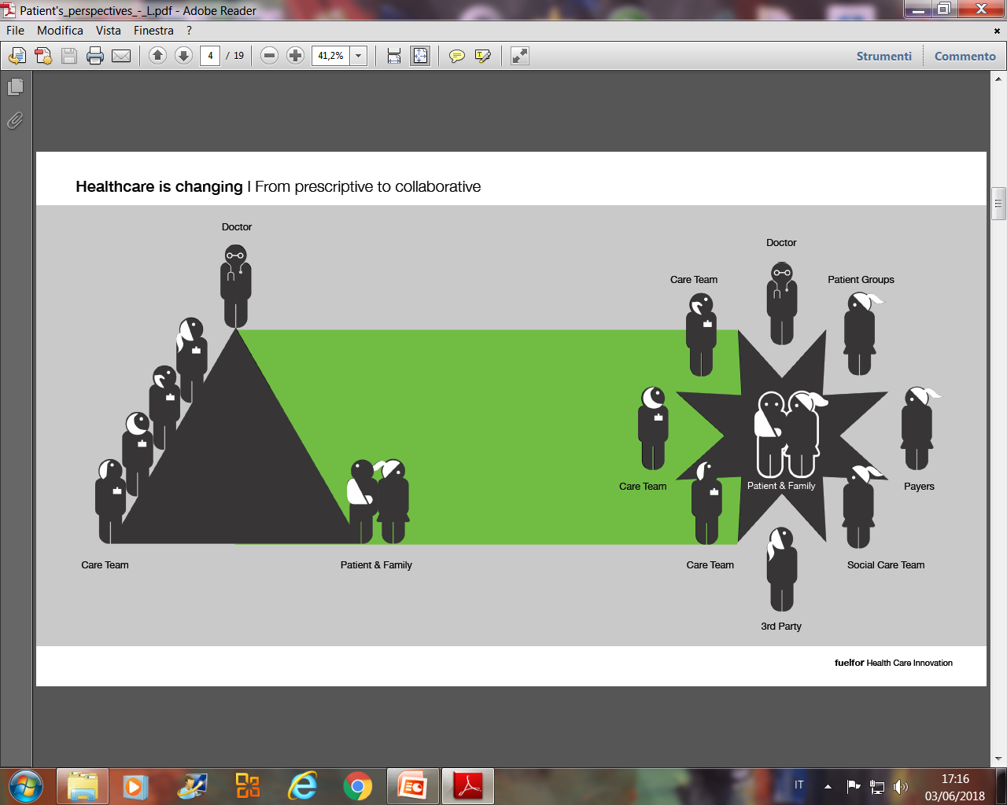
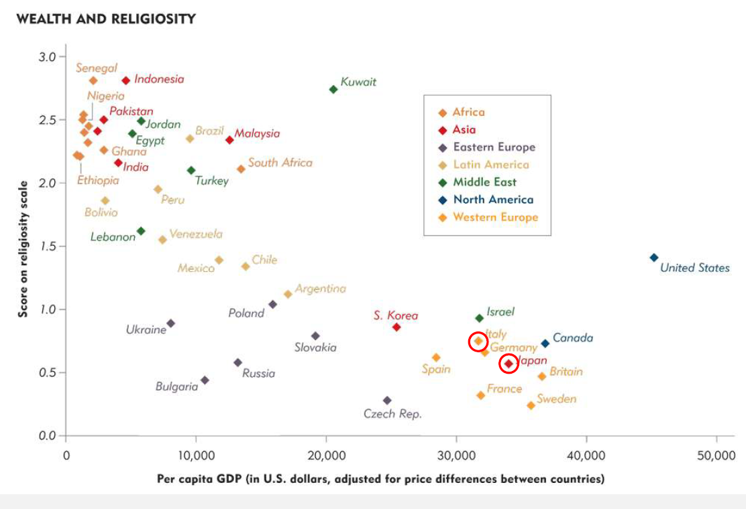

COMUNICAZIONE
CHI DECIDE PER LA VMD ?
TEMI ETICI
CHI E COINVOLTO ?
IN QUALE CONTESTO ?

Slide 15
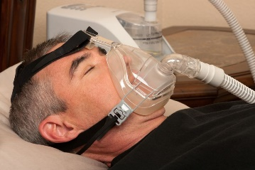
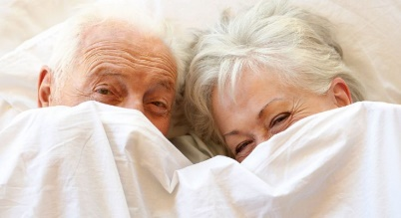

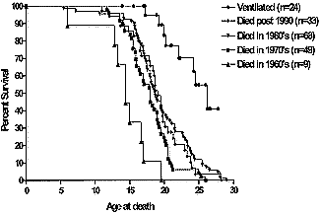
Nocturnal NIV improves
Total sleep
NREM total
REM
TST
sleep efficiency
Sexuality
HMV users (n= 383, 45% COPD, 68% male) were 34% sexually active.
Changes in sexual activity after NIV initiation were reported as:
“Nothing changed” = 46.3%; “Less active” = 35.8%;
“More active” = 12.6%; and “Fantasy increased” = 10.5%.
Elliott MW. et al. Thorax 1992; 85:59S–60S
Meecham Jones et al.1995:152:538-544
Schönhofer B et al. Thorax 2000; 55:308-313
Schonhofer et al Am J Respir Crit Care Med; 164: 1612–1617, 2001
M. EAGLE Neuromusc Dis 2002;12:926-929

Slide 16
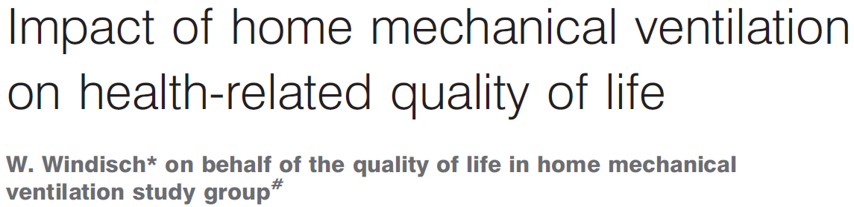
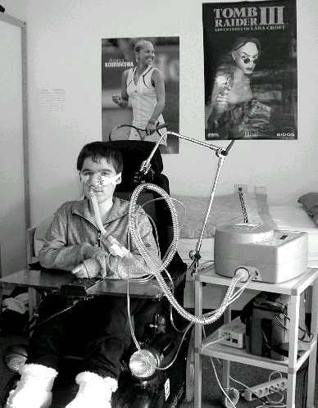
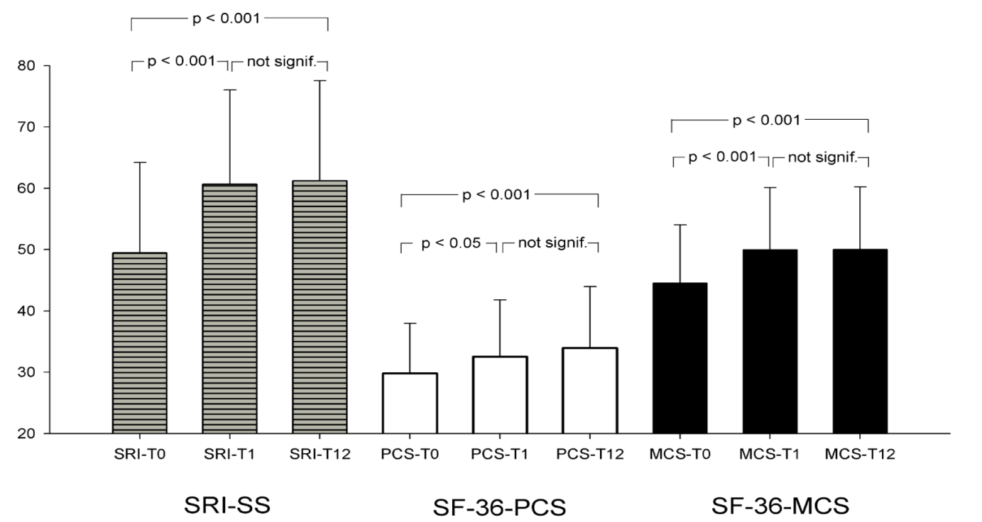
N = 137
COPD
Restrictive thoracic diseases
Obesity-
Hypoventilations-Syndrome
Neuromuscular disorders
Miscellaneous
Windisch W. Eur Respir J 2008; 32:1328-1336

Slide 17
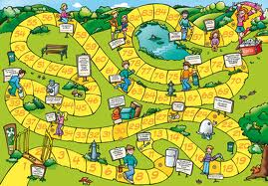
Il giro dell’oca del paziente
FASE DELLA PRESCRIZIONE E ADATTAMENTO (SETTINGS)
QUALE SETTINGS
PROCEDURE BUROCRATICHE
CONTATTI CON MMG
ANSIE ANGOSCIE
UTILITA?
UTILIZZO NEL BREVE TEMPO: AMICO O NEMICO ?
PREFERENZE
ADATTAMENTO
CONTATTI CON UFFICIO PROTESI
FAMIGLIA
PROSPETTIVE
RIBELLIONE
SONNO
RIPOSO
FASTIDIO
BENESSERE
RASSEGNAZIONE

Slide 18


E al caregiver chi ci pensa?
DEVE
PRENDERSI
CURA
HA NECESSITÀ
DI CURA
CAREGIVER
Notes:
18
18

Slide 19
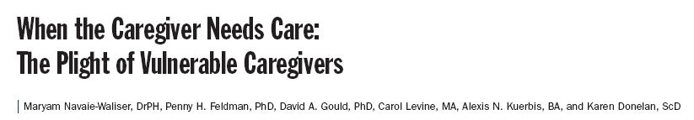
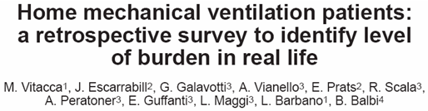
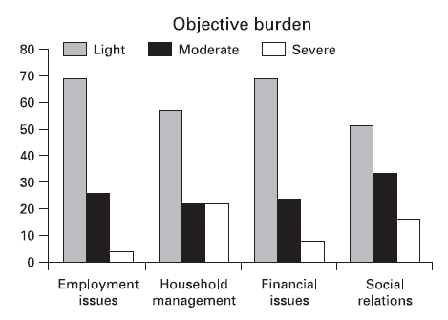
Don’t forget the caregiver!
Am J Public Health 2002;92:409-13
Monaldi Arch Chest Dis 2007; 67: 3, 0-00
N° 792 home ventilated pts
Tsara V. Respiration 2006;73:61-7
The burden criteria were:
High dependency,
tracheostomy,
necessity of more than 12 hrs of MV,
distance from Hospital more than 30 km,
presence of frequent hospitalisations.

Slide 20
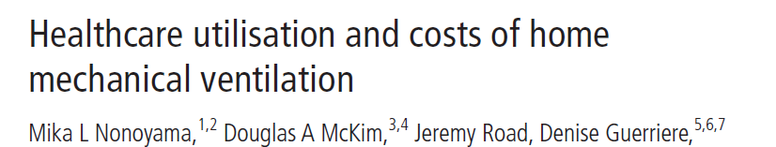
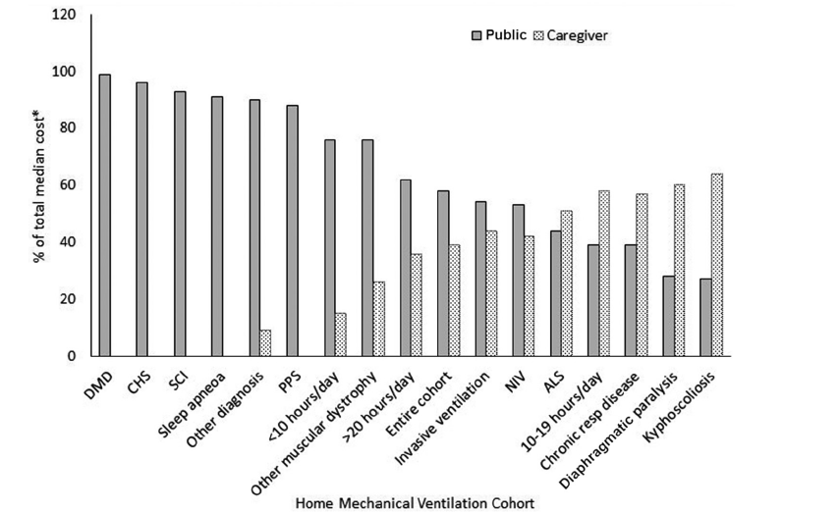
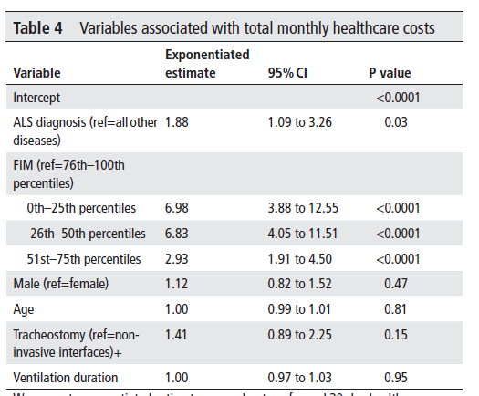
Range 591€ to 13.000€ (OSAS vs ALS)

Slide 21
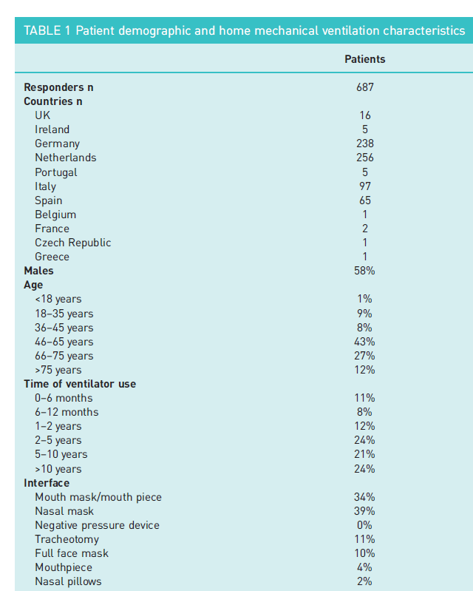
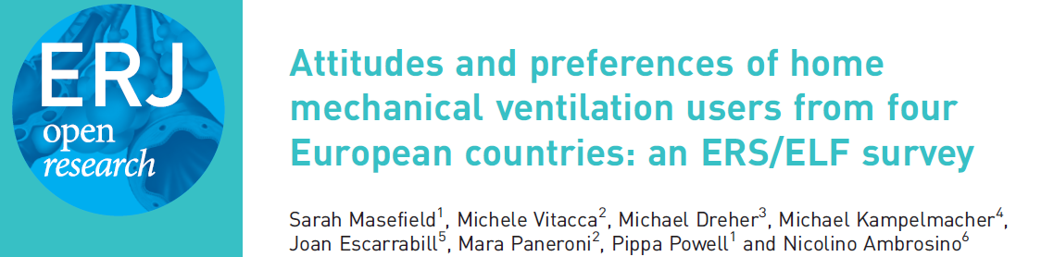
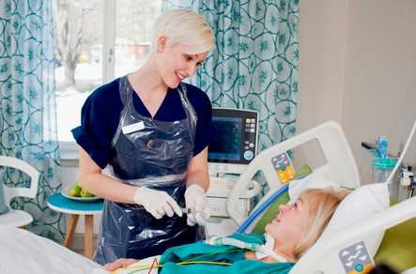

Slide 22
How important are comfort and lifestyle factors?
Rank | Priority | %
1 | Being able to fall asleep easily and stay asleep whilst using my ventilator | 96.6
2 | Having smooth, ‘natural feeling’ breathing | 93.8
3 | How comfortable the mask is | 86.0
4 | Being able to travel with it (such as by car and by air) | 81.0
5 | Reducing dryness of mouth and eyes | 80.4
6 | How noisy the ventilator is | 79.7
7 | Being able to speak and be heard whilst using my ventilator | 64.7
8 | How big it is | 63.1
9 | Reducing nasal secretions | 61.3
10 | How heavy it is | 56.6

Slide 23
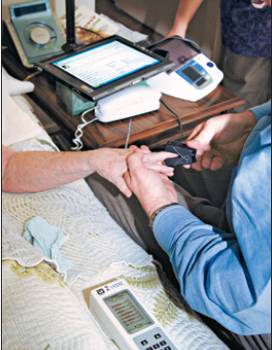
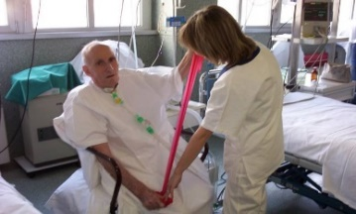
Rationale for TM
Increase of aging, chronic diseases, technological advances, health care consumerism and health care costs (SH Landers NEJM 2010)
Number of HMV pts is increasing around Europe (Lloyed-Owen SJ. Eur Respir J 2005)
Mismatching between pt and machine during HMV application in particular during night (F Fanfulla AMJCCM 2005)
Discrepancies between prescribed MV setting and home setting (Farré R. Intensive Care Med 2003)
Risk management in HMV pts ( AK Simonds )
Increasing difficulty in discharge planning (J Escarrabill 2009)
Tremendous physical and psychological burden for HMV caregivers
(Vitacca ERJ 2009, Vitacca Monaldi Arch Resp. Dis 2007)
Chronic respiratory patient presents complexity, comorbidity, disability and frailty (Vitacca 2011, Vitacca 2014)
Push for adherence, falls risk, frailty, integrated care , independent living, age friendly (EU action plan for cronicity 2020)

Slide 24



TELEASSISTANCE
TELENURSE
NETWORK
Oxymetry
Patient/ Caregiver at home
GP, NURSE & COMMUNITY SOCIAL SERVICE
In-Hosp Sanitary Staff
Call Center
Third generation system:
Constant analytical and decision making support.
Monitoring centres are physician led, staffed by specialist nurses, and have full therapeutic authority 24 h per day, seven days per week.
 | TA | Ctr
# | 118 | 102
COPD (%) | 48 | 43
ALS (%) | 10.2 | 9.8
NM (%) | 20 | 26
Restrictive (%) | 12 | 14
Other (%) | 9.3 | 7.9
IMV (%) | 22 | 21
NIV (%) | 42 | 51
70% under LTOT,
2 relapses/y, 1 H/y
40% with ICU admission

Slide 25
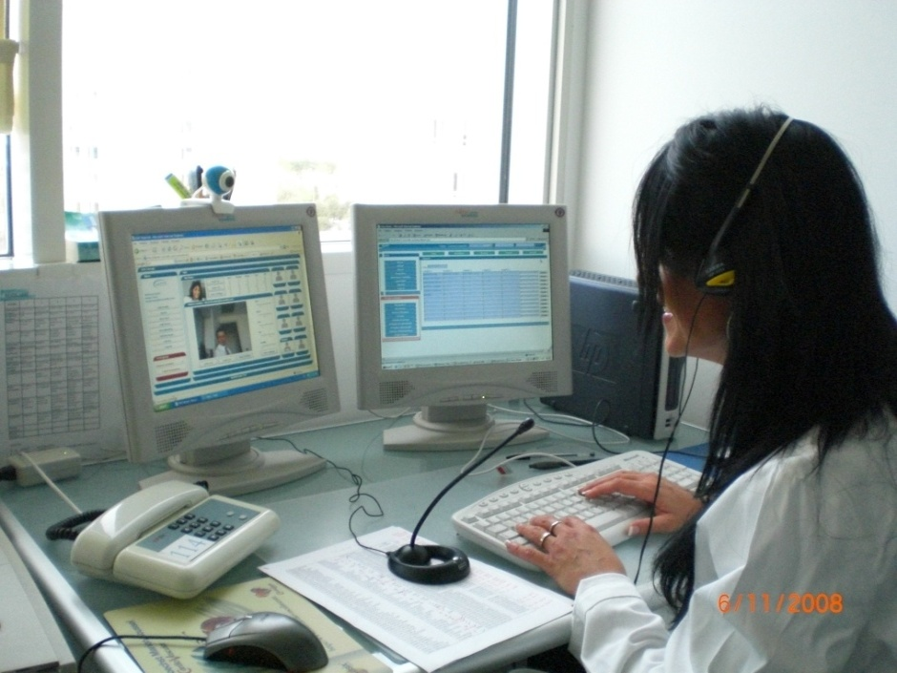
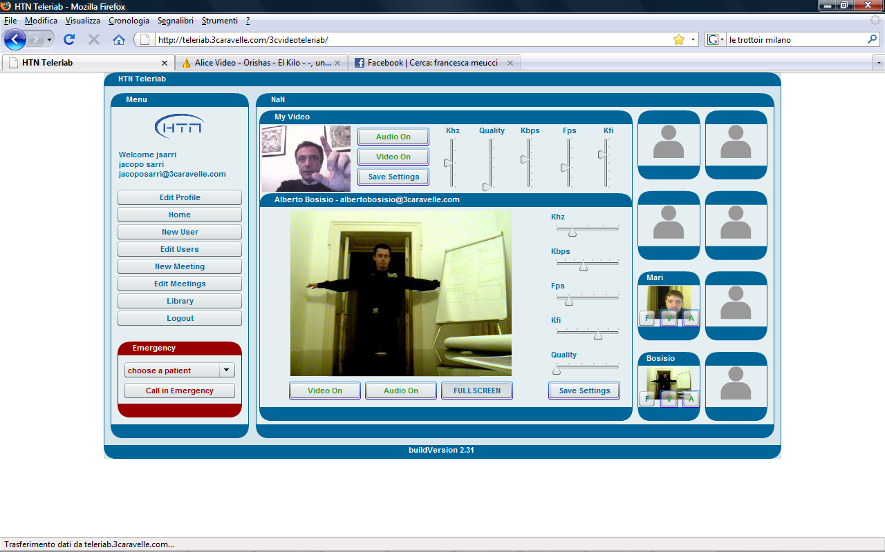
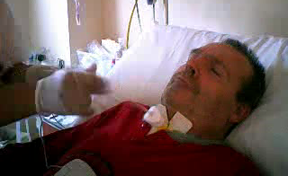
HMV patients
  Clinical examination
  Material checking
  Ventilator, circuit, interface
  NIV compliance
  Alarms
  patient-ventilator interactions
  education
  telerehabilitation

Slide 26

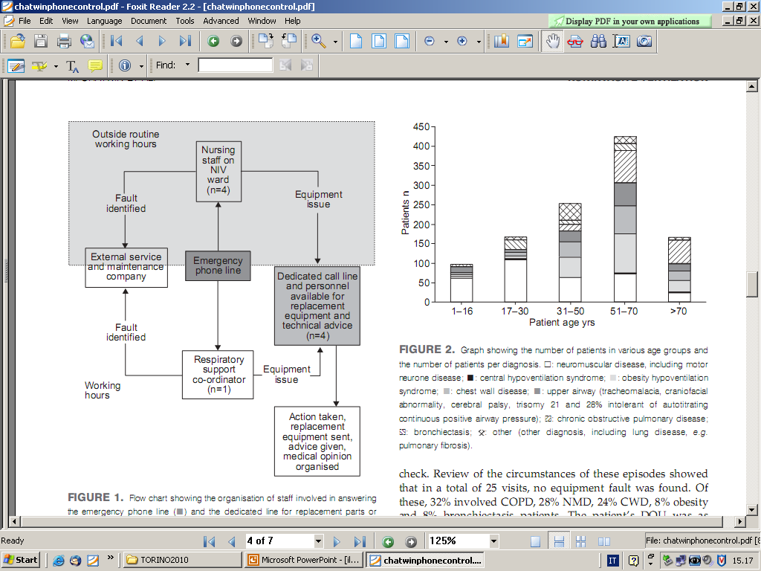

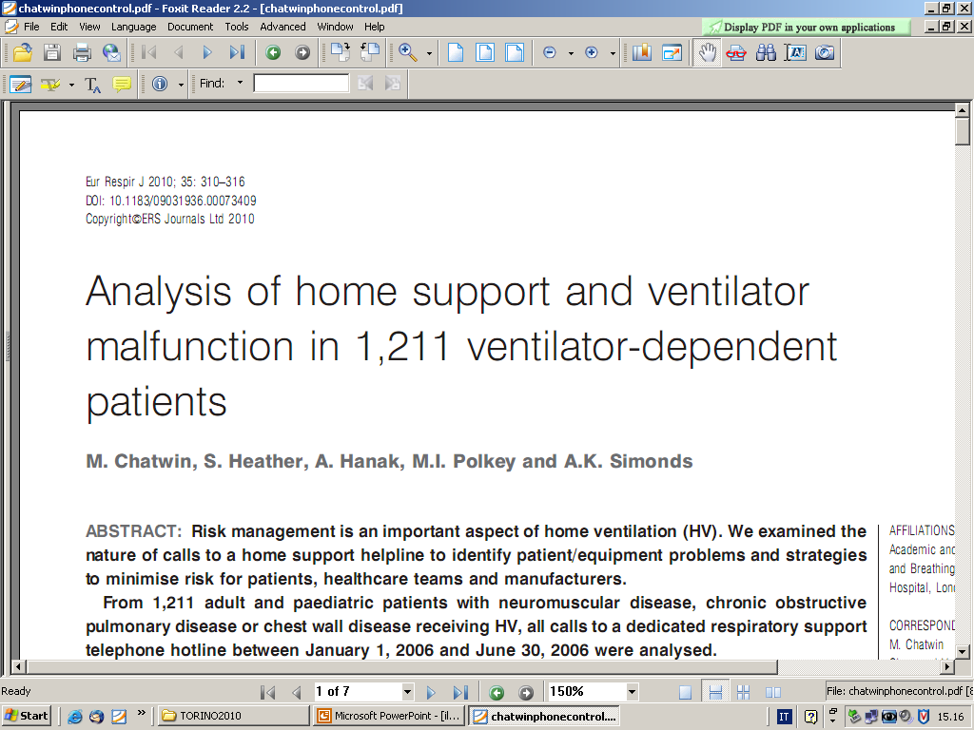
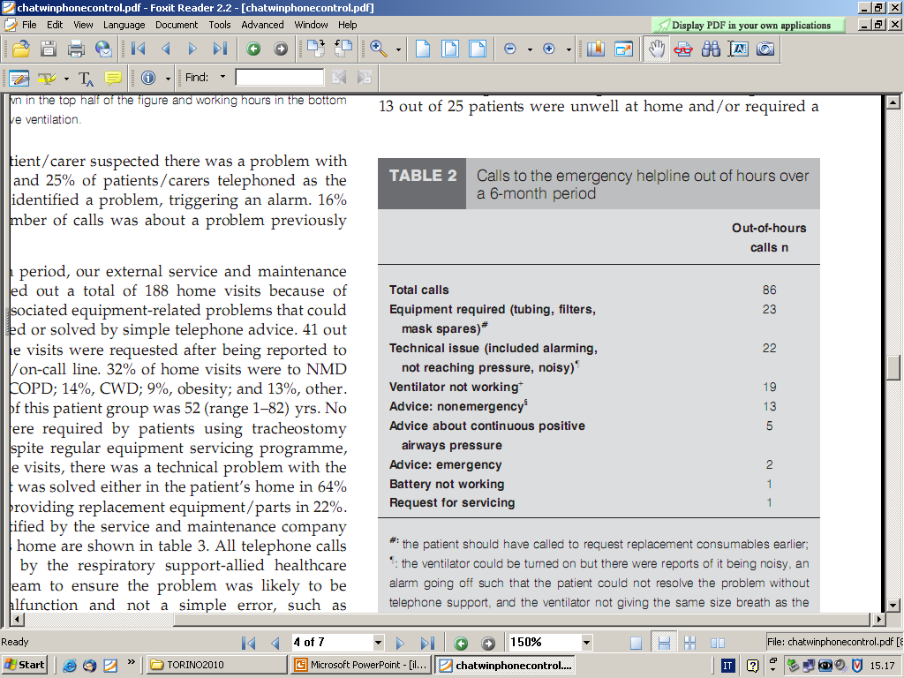
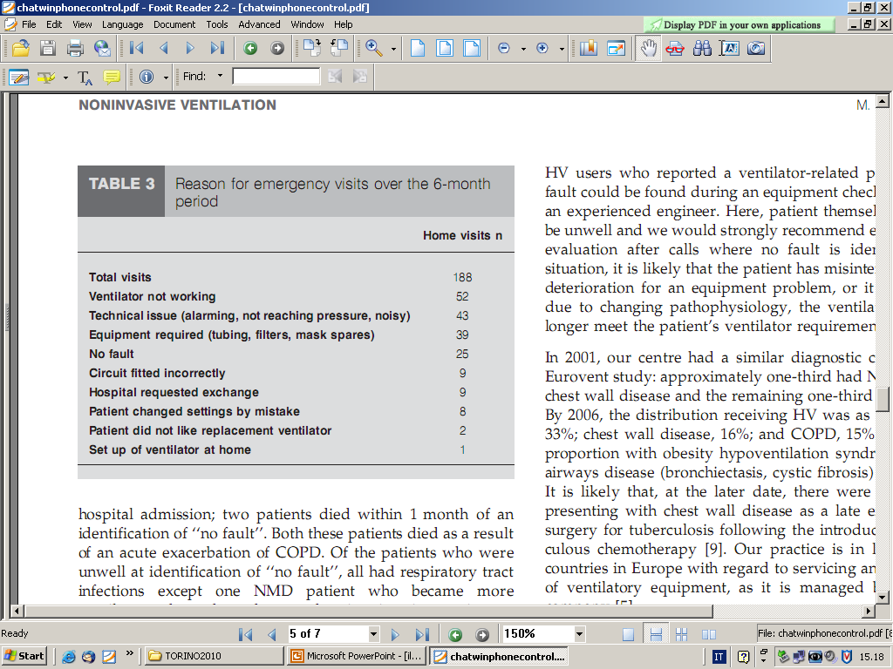
1,199 patients received NIV, 12 tracheostomy vent;
149 had two ventilators for 24-h ventilator dependency.
There was a mean of 528 daytime calls per month and
14 calls a month at night.
HMV quality control network (H and Service Company)

Slide 27
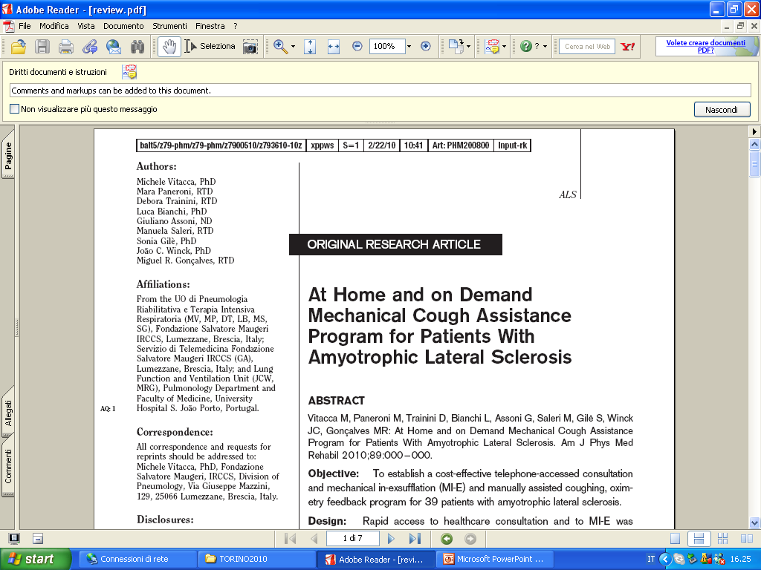

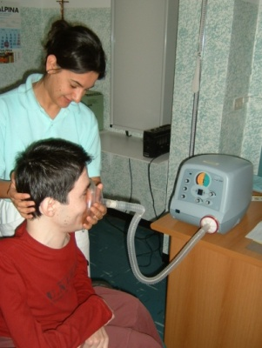
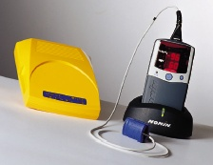
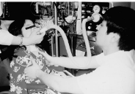
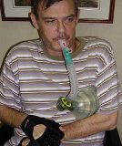
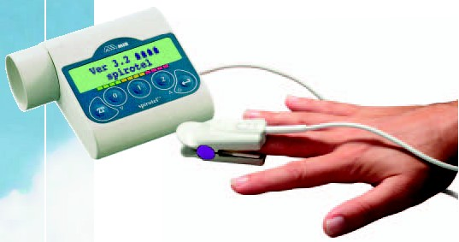
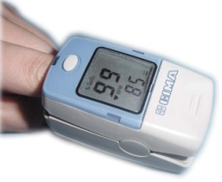
Activation on demand
Cough assist device plus
RT home visits
+
Educational
Hospital training
Telemedicine
with pSatO2
Notes:
27

Slide 28
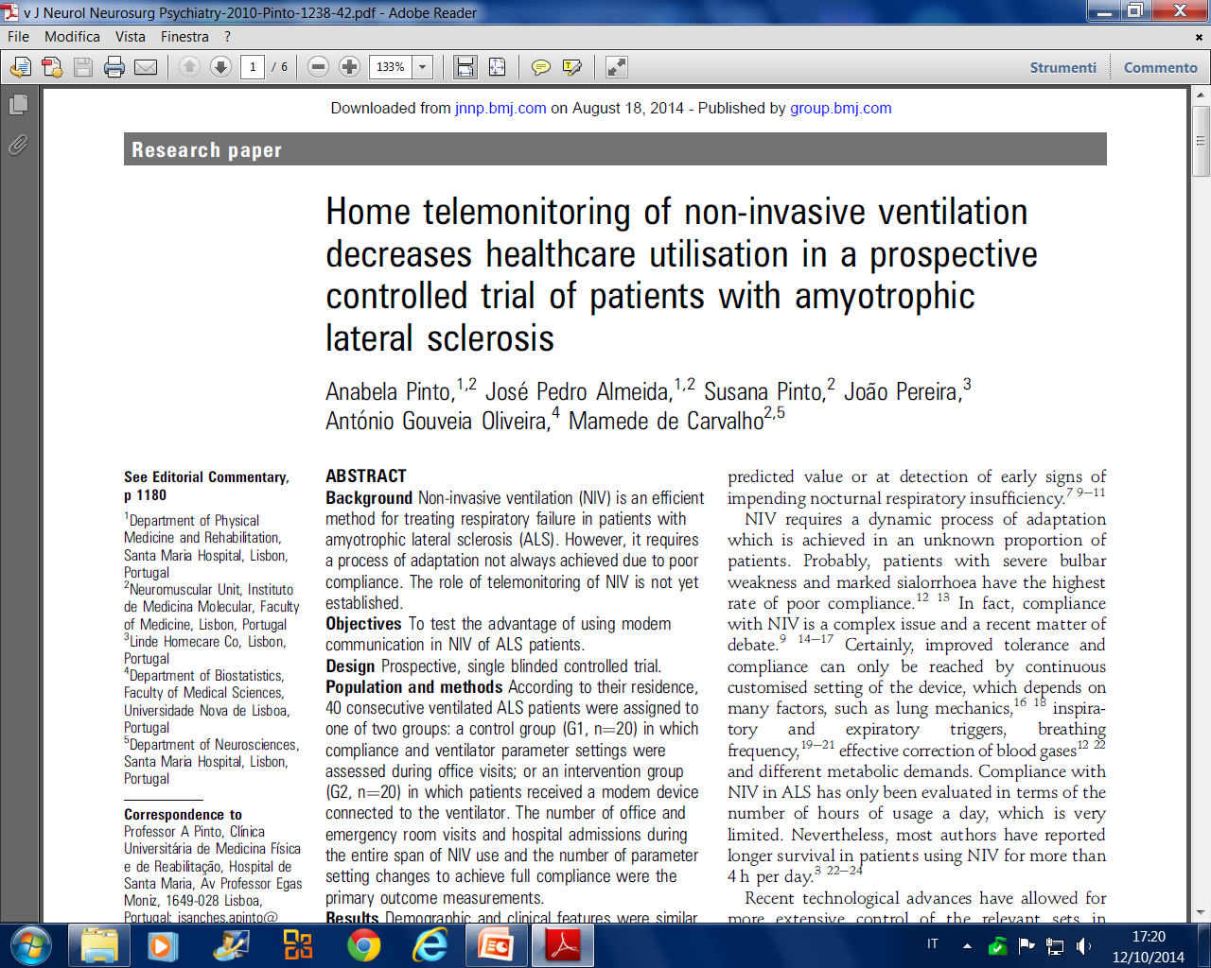

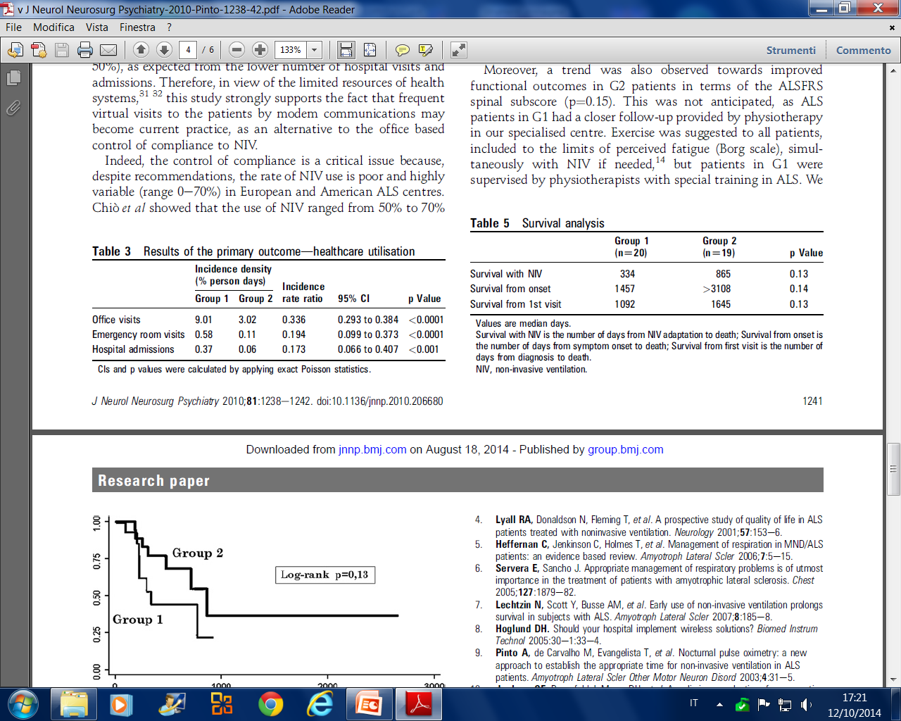
J Neurol Neurosurg Psychiatry 2010;81:1238e1242. doi:10.1136/jnnp.2010.206680
40 consecutive ventilated ALS patients were assigned to one of two groups:
1. control group in which compliance and ventilator parameter settings were assessed during office visits;
2. an intervention group in which patients received a modem device connected to the ventilator.

Slide 29
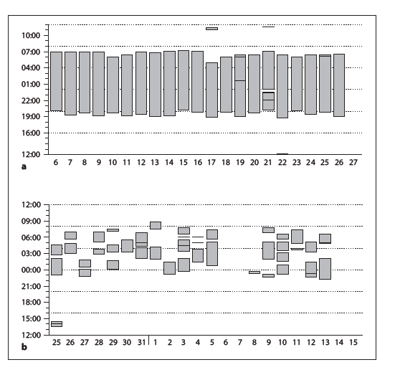
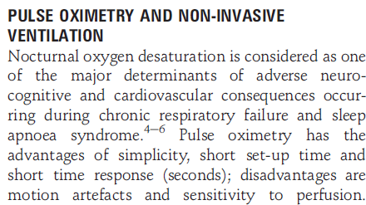

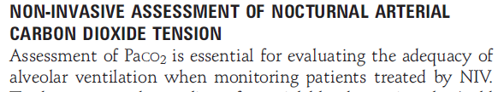
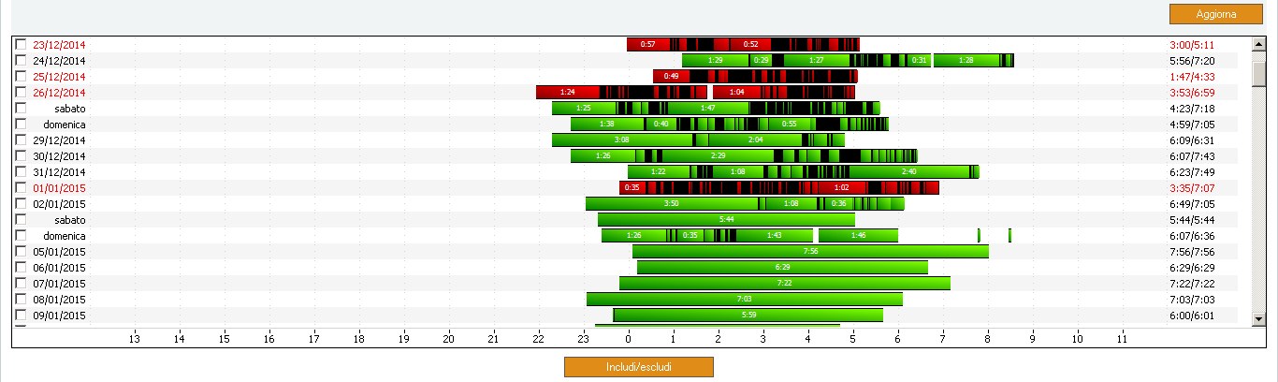

Razionale
NIV compliance
IPAP/EPAP
Frequenza respiratoria
Respiratory rate and percentage of spontaneus vs imposed respiratory cycle
Stima volume corrente
Atti resp. attivati dal pz
Picco di flusso
Perdite
Ventilazione minuto
Stima AHI

Slide 30




Razionale
Patient – ventilator synchronization
AHI NIV
AHI PLG
Leaks

Slide 31

Ventilator data download

Slide 32







Wireless real time oximetry telemonitoring in patients with Chronic Respiratory Failure (under 24h HMV): n= 25
With dr Winck courtesy
Winck JC et al, Eur Respir J. 2009;34 Suppl 53 131s.
Notes:
Plataforma integrada através de cominucação celular e oximetro com bluetooth acessível via internet

Slide 33

In the TeleCRAFt trial, a high number of “red” alerts related to low SpO2 levels generated frequent home visits in patients with chronic respiratory failure
Crucial input is required in the decision-making part

Slide 34


European lung foundation (ELF) survay on ventilator at home: 812 pts
Data 2016
Reasons for answering ‘no’:
  Feels like ‘big brother’
  Concerns about privacy of personal information/data
  Anxiety about fewer visits as a result/ enjoy personal contact
  Settings feel good and don’t want then adjusted
  Useful for dependent patients but others like sense of control/responsibility
  More information needed to make a decision

Slide 35
Ther Adv Respir Dis 2018, Vol. 12: 1–19
IDENTIFICARE L’OBIETTIVO
Telemonitoring does not have the unique aim to avoid hospitalization per se but rather to control the progression of the disease, which sometimes will mean accelerating hospitalization, face-to-face visits or home care visits
DIVERSIFICARE L’INTERVENTO
The ‘one glove fits all’ approach in offering telemonitoring for COPD seems too simplistic for a heterogeneous population such as these patients.
PERSONALIZZARE NON SOLO LA TERAPIA MA ANCHE IL MONITORAGGIO

Slide 36







OPPORTUNITA’
Cough assist
outdoor
Wireless ventilatory monitoring system
School
travel
ADL

Slide 37

MISSING THEMES
Managing Home equip. in Hospital
Quality control /risks/safety
Sustainability/equity/rembursement
Centers’ expertize
Where H admissions for ARF
Comparative effectiveness
Travels/pts transport/mobility

Slide 38



A new paradigm for health value
Ciascuno ha i suoi obiettivi e risultati attesi
Chi riceve
Chi eroga
Chi paga

