Slide 1
Antibioticoterapia per le polmoniti nosocomiali MDR
Antonio Vena
Infectious Diseases Division
Santa Maria Misericordia University Hospital
Udine, Italy

Slide 2
One Message
Spare our weapons...and optimize the way we are using them
Rate of NP due to MDR organisms is increasing...and is due to antibiotic overconsumption
Unlike bloodstream infection, there are opportunities to decrease antibiotic consumption and optimize antibiotic treatment
Notes:
LA MIA PRESENTAZIONE SARA VERAMENTE SEMPLICE
HO SOLO UN MESSAGGIO PER VOI
SOBBIAMO ASSOLUTAMENTE RISPARMIARE IL NOSTRO ARMAMENTARIO ANTIBIOTICO…..

Slide 3
Nosocomial pneumonia and MDR
Definitions and pathogens of interest
Clinical impact of MDR-NP
When to start therapy?
How to optimize the treatment?
Conclusions
Notes:
E COME POSSIAMO PENSARE DI OTTIMIZZARE LA TP ANTIBIOTICA E QUINDI RISPARMIARE LE ARMI CHE ABBIAO A NOSTRA DISPOSIZIONE?

Slide 4
Nosocomial pneumonia and MDR
Definitions and pathogens of interest
Clinical impact of MDR-NP
When to start therapy?
How to optimize the treatment?
Conclusions

Slide 5
Nosocomial pneumonia
HAP: Pneumonia NOT incubating at the time of hospital admission and occurring 48 hrs or more after admission
VAP: Pneumonia occurring >48 hrs after endotracheal intubation
Kalil et al Clin Infect dis 2016;63:e61-111

Slide 6
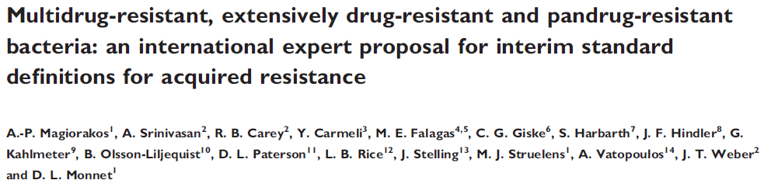
MDR: Resistance to at least one agent in 3 or more antibiotic categories
XDR: The isolate remain susceptible to only one or two families
PDR: Resistance to all agents in all categories.
Notes:
OK….
LA DEFINIZIONE DI MDR CHE GENERALMENTE UTILIZZIAMO è QUELLA PROPOSTA DA UN GRUPPO DI ESPERTI CAPEGGIATA DA MAGIORAKOS.
A DIRE LA VERITà PERSONALMENTE LA VEDO PIUTTOSTO COMPLESSA E DI DIFFICILE INTERPRETAZIONE….

Slide 7
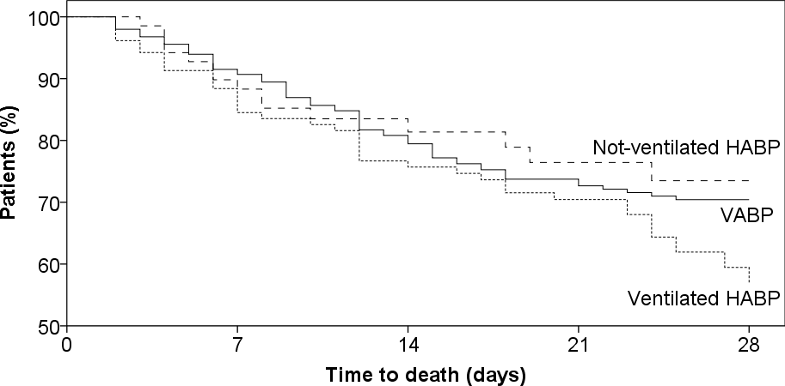
Kaplan-Meier Curve for All Cause Mortality
Kaplan–Meier: Survival 28 days Mortality: HAP, VAP, V-HAP
Kalil et al Clin Infect dis 2016;63:e61-111

Slide 8
Etiology of pneumonia in hospital and critical care setting
Bassetti M, Welte T, Wunderink RG. Crit Care. 2016;20(1):19.

Slide 9
Top 3 Most Prevalent NP Pathogens in European Countries
Country | n (%) | Documented Etiology, n (%) | Pathogen 1 (%) | Pathogen 2 (%) | Pathogen 3 (%)
Spain | 176 (21.3) | 133 (75.6) | S. aureus (29.6) | P. aeruginosa (17.6) | Haemophilus (11.4)
Germany | 138 (16.7) | 84 (60.9) | Escherichia coli (21.7) | S. aureus (15.9) | Klebsiella (10.9)
Greece | 117 (14.1) | 74 (63.2) | Acinetobacter (33.3) | P. aeruginosa (19.7) | S. aureus (8.6)
France | 111 (13.4) | 88 (79.3) | S. aureus (37.8) | P. aeruginosa (18.9) | Haemophilus (14.4)
Turkey | 91 (11.0) | 81 (89.0) | Acinetobacter (52.7) | S. aureus (24.2) | P. aeruginosa (16.5)
Belgium | 74 (8.9) | 38 (51.4) | S. aureus (12.2) | E. coli (10.8) | P. aeruginosa (9.5)
Italy | 65 (7.8) | 40 (61.5) | P. aeruginosa (27.6) | S. aureus (26.2) | Klebsiella (12.3)
Portugal | 37 (4.5) | 25 (67.6) | P. aeruginosa (16.2) | S. aureus (21.6) | Klebsiella (8.1)
Ireland | 18 (2.2) | 12 (66.7) | S. aureus (22.2) | E. coli (16.7) | P. aeruginosa (11.1)
Koulenti D et al. Crit Care Med. 2009;37(8):2360-2368.
Notes:
The top 3 most frequent isolates for each country are detailed on this slide.

Slide 10
Bad bugs in pneumonia
Enterococcus faecium VR
Staphylococcus aureus MR
Klebsiella pneumoniae KPC
Acinetobacter baumannii MDR
Pseudomonas aeruginosa MDR
Enterobacteriaceae ESBL
The ESKAPE bugs cause the majority of hospital infections and they escape the effects of antibiotics
Rice LB. J Infect Dis. 2008;197:1079; Boucher HW, et al. Clin Infect Dis. 2009;48:1;
Peterson, LR. Clin Infect Dis. 2009;49(6):992-3
Notes:
10
Slide 10
In 2008, Rice first identified the “ESKAPE bugs:” Enterococcus faecium, Staphylococcus aureus, Klebsiella pneumoniae, Acinetobacter baumanni, Pseudomonas aeruginosa, and Enterobacter species.¹ [Rice, p.1079]
The late-stage clinical development pipeline for antibacterials remains unacceptably lean. Although some important molecules are in late-stage development for treatment of infection due to problematic pathogens, such as MRSA, few novel molecules have been advanced for treatment of the other ESKAPE pathogens.² [Boucher, p.9]
Importantly, no drugs have reached advanced stages of development for infection due to MDR gram-negative bacilli, such as A. baumannii and P. aeruginosa, and none represents more than an incremental advance over currently available therapies.² [Boucher, p.9]
Reference
Rice LB. Federal Funding for the Study of Antimicrobial Resistance in Nosocomial Pathogens: No ESKAPE. J Infect Dis. 2009;197:1079-1081.
Boucher HW, Talbot GH, Bradley JS, et al. Bad bugs, no drugs: no ESKAPE! An Update from the Infectious Diseases Society of America. Clin Infect Dis. 2009;48:1-12.
Rice, p.1079
Boucher, p.9

Slide 11
Nosocomial pneumonia and MDR
Definitions and pathogens of interest
Clinical impact of MDR-NP
When to start therapy?
How to optimize the treatment?
Conclusions

Slide 12
Nosocomial pneumonia and MDR
Definitions and pathogens of interest
Clinical impact of MDR-NP
When to start therapy?
How to optimize the treatment?
Conclusions

Slide 13
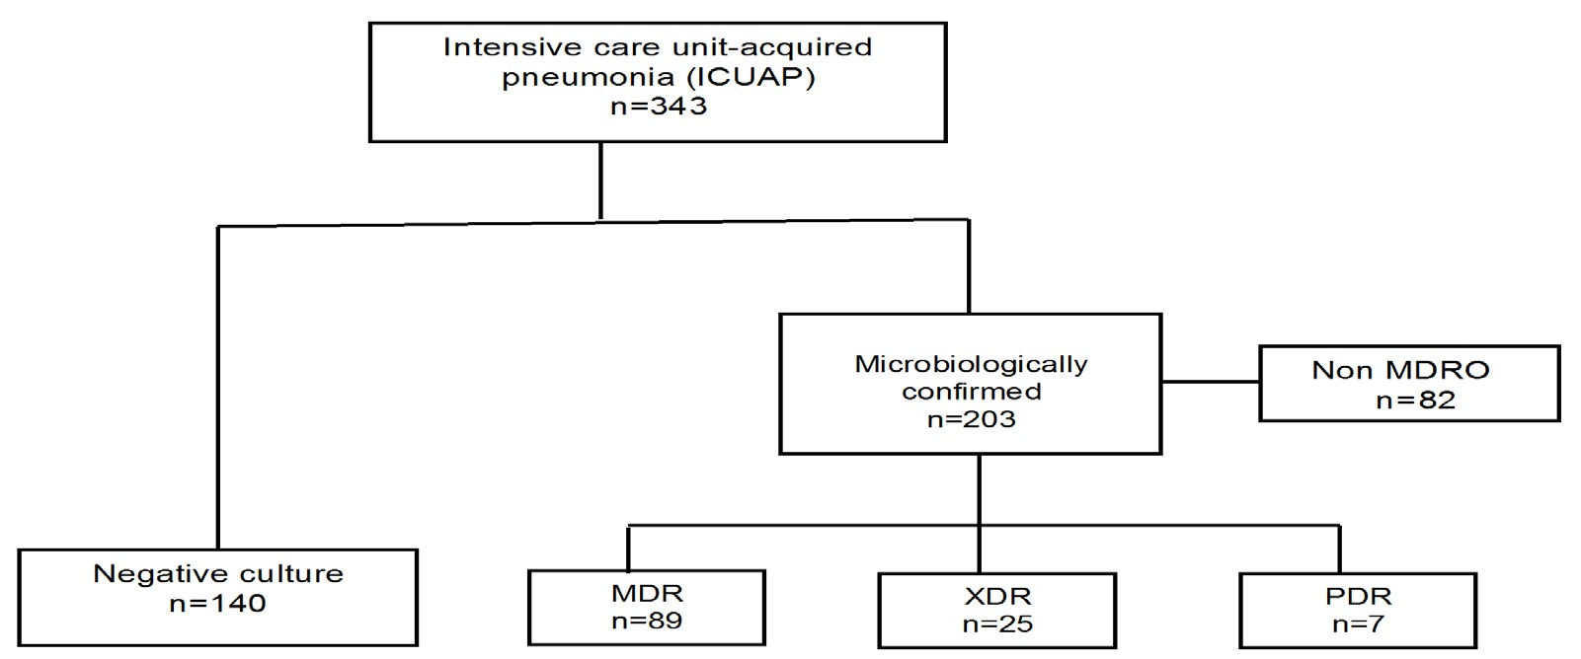
Resistance patterns and outcome in Intensive care unit (ICU)- acquired pneumonia f
Validation of multidrug resistant organism based on the European Centre for Disease Prevention and Control (ECDC) and the Centers for Disease Control and Prevention (CDC) classification.
40% HAP
60% MDR isolates
MDR: Non susceptible to at least 1 agent in 3 or more AB class
XDR: Non susceptible to all but two or fewer AB class
PDR: Non susceptible to all
Martin- Loeches I. J Infect 2015;70-213-22

Slide 14
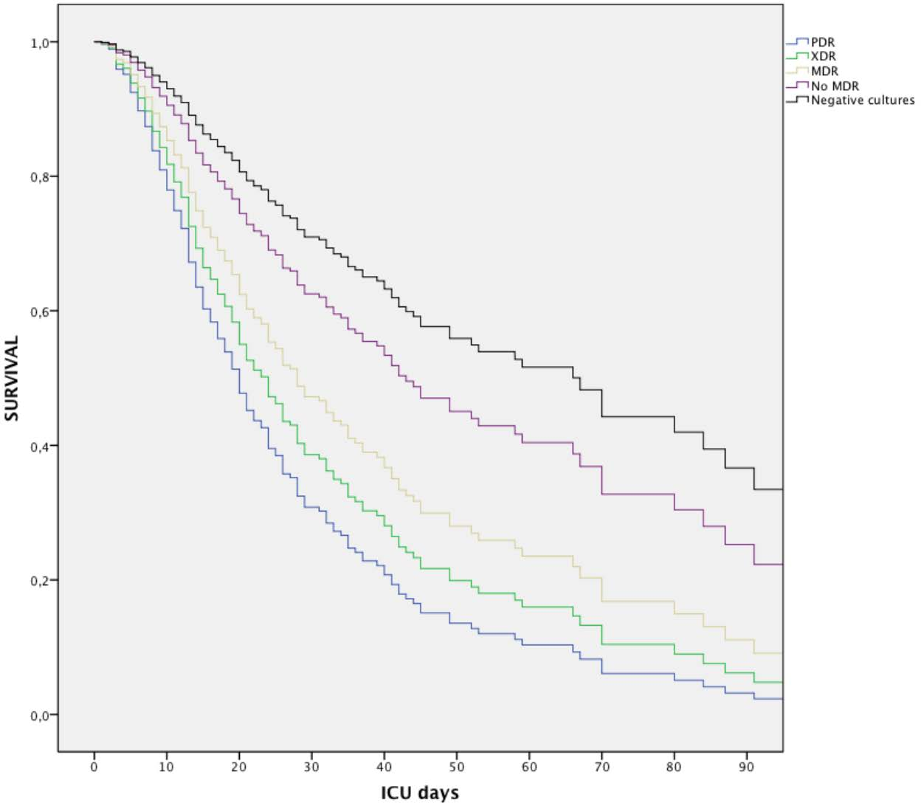
Differences in HAP/VAP: PDR, XDR MDR vs No
Negative
No MDR
MDR
XDR
PDR

Slide 15
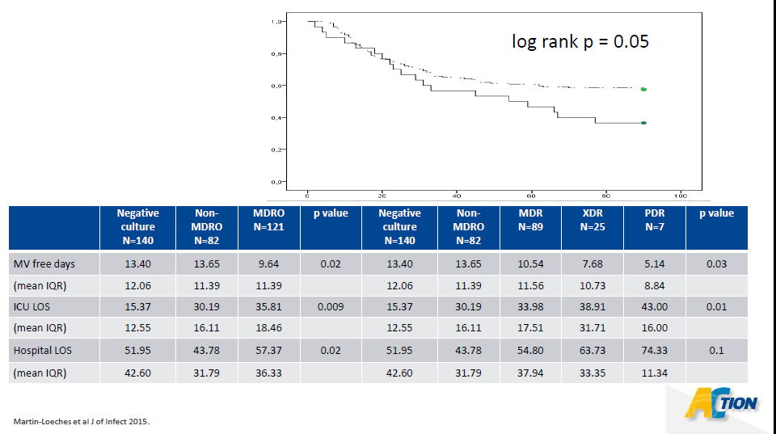
IMPACT of MDR- NP on resource utilization

Slide 16
Nosocomial pneumonia and MDR
Definitions and pathogens of interest
Clinical impact of MDR-NP
When to start therapy?
How to optimize the treatment?
Conclusions

Slide 17
Nosocomial pneumonia and MDR
Definitions and pathogens of interest
Clinical impact of MDR-NP
When to start therapy?
How to optimize the treatment?
Conclusions

Slide 18
The real issue is to be able to rapidly and specifically identify patients with true NP, in order to treat them, and only them, with appropriate antibiotics.
When to start therapy?
Notes:
LA DOMANDA ALLA RISPOSTA è
SOLO I PAZIENTI CON POLMONITE NOSOCOMIALE.
ESISTONOO DIVERSI MODI DI DIAGNOSTICARE LA POLMONITE N,, MA IL PROBLEMA REALE è QUELLO DI IDENTIFICARE RAPIDAMENTE E CON ELEVATA SPECIFICITà QUEI PAZIENTE CHE VERAMENTE HANNO UNA POLMONITE NOSOCOMIALE IN MANIERA DA TRATTARE LORO E SOLAMENTE LORO CON LA TERAPIA ANTIBIOTICA ADEGUATA.

Slide 19

Inappropriate Initial Antibiotic Therapy Leads to Increased Mortality
Micek (2012)¹
a
Joo (2011)²
a
Kumar (2009)³
a
Valles (2003)⁴
a
Dupont (2001)⁵
Ibrahim (2000)⁶
a
Ruiz (2000)⁷
Kollef (1999)⁸
a
Rello (1997)⁹
a
Luna (1997)¹⁰
a
ªP < 0.05.
Inappropriate initial antibiotic therapy is defined as an antibiotic regimen that lacks in vitro activity against the isolated organism(s) responsible for the infection.
1. Micek et al. BMC Infect Dis. 2012;12:56. 2. Joo et al. Infection. 2011;39:309-18. 3. Kumar et al. Chest. 2009;136:1237-48.
4. Valles et al. Chest. 2003;123:1615-24. 5. Dupont et al. Intensive Care Med. 2001;27:355-62. 6. Ibrahim et al. Chest. 2000;118:146-55. 7. Ruiz et al. Am J Respir Crit Care Med. 2000;162:119-25. 8. Kollef et al. Chest. 1999;115:462-74. 9. Rello et al. Am J Respir Crit Care Med. 1997;156:196-200. 10. Luna et al. Chest. 1997;111:676-85.
Notes:
Numerous studies have shown that inappropriate initial antimicrobial therapy has an independent adverse effect on mortality.¹⁻¹⁰ This remains true when controlling for confounders such as infection type, pathogen, and Acute Physiology and Chronic Health Evaluation II (APACHE II) score.
References
Micek et al. BMC Infect Dis. 2012;12:56.
Joo et al. Infection. 2011;39:309-18.
Kumar et al. Chest. 2009;136:1237-48.
Valles et al. Chest. 2003;123:1615-24.
Dupont et al. Intensive Care Med. 2001;27:355-62.
Ibrahim et al. Chest. 2000;118:146-55.
Ruiz et al. Am J Respir Crit Care Med. 2000;162:119-25.
Kollef et al. Chest. 1999;115:462-74.
Rello et al. Am J Respir Crit Care Med. 1997;156:196-200.
Luna et al. Chest. 1997;111:676-85.
Micek 2012
Slide + speaker notes
Page 1, abstract. Results section
Joo 2011
Slide + speaker notes
Page 309, abstract. Results section
Kumar 2009
Slide + speaker notes
Page 1237, abstract. Results section
Valles 2003
Slide + speaker notes
Page 1619, abstract
Page 1619, Table 4
Dupont 2001
Slide + speaker notes
Page 360, Table 7
Ibrahim 2000
Slide + speaker notes
Page 149, column 2, paragraph 1
Ruiz 2000
Slide + speaker notes
Page 122, column 2, paragraph 4
Kollef 1999
Slide + speaker notes
Page 469, column 1, “hospital mortality” section, paragraph 1
Rello 1997
Slide + speaker notes
Page 196, abstract
Luna 1997
Slide + speaker notes
Page 676, abstract

Slide 20
Appropriate Initial Therapy
An earlier study of septic shock (n = 2,731) explicitly demonstrated the importance of antimicrobial timing
100
10
Odds Ratio of Death
(95% Confidence Interval)
1
Time From Hypotension Onset (hr)
1-1.99
2-2.99
3-3.99
4-4.99
5-5.99
6-8.99
9-11.99
12-23.99
>36
24-35.99
Every hour’s delay until appropriate therapy resulted in a 12% increase in mortality
Compared with starting appropriate therapy within 1 hour of the onset of hypotension, the OR for mortality increased from 1.67 in Hour 2 to 92.54 with delays >36 hours
Kumar A, et al. Crit Care Med. 2006;34:1589-1596.
Notes:
In an earlier study with a similar design (n = 2,731),¹ Kumar et al more explicitly demonstrated the importance of timing with respect to the appropriateness of antimicrobial therapy. Every hour’s delay until appropriate therapy was started was associated with a 1.119-fold increased risk of mortality (95%CI 1.103–1.136, P < .0001). In other words, every hour delay resulted in an approximate 12% increased probability of death. Compared with initiating appropriate therapy within 1 hour of the onset of hypotension, the odds ratio for mortality increased from 1.67 in the second hour to 92.54 with delays >36 hours.
Other studies have also demonstrated the adverse impact of inappropriate initial therapy for specific infections such as bacteremia and pneumonia²; for specific organisms such as P aeruginosa and ESBL-producing Enterobacteriaceae²; and on other outcomes such as hospital LOS, ICU LOS, and ventilator-days.²⁻⁴
References:
1. Kumar A, et al. Crit Care Med. 2006;34:1589-1596. 2. Kollef MH. Clin Infect Dis. 2008;47(Suppl 1):S3-S13. 3. Kollef MH, et al. Chest. 1999;115:462-474. 4. Ibrahim EH, et al. Chest. 2000;118:146-155.

Slide 21
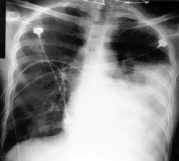
Clinical Dx of NP
Clinical: fever, WBC, sputum;
New & persistent infiltrate
Dx = poor specificity
Empyema

Slide 22
Scheme of AMS in hospital setting
Bassetti M et al. Intensive Care Med. 2017 Sep 12. doi: 10.1007/s00134-017-4922-x
Notes:
COME TUTTI VOI SAPETE… PRIMA DI INIZIARE UN TRATTAMENTO ANTIBIOTICO è NECESSARIO OTTENERE CAMPIONI MICROBIOLOGICI.

Slide 23
Clinical vs “Invasive” Dx: Outcomes
* P <0.05
*
*
  Fagon et al Ann Intern Med 2000; 132: 621
Notes:
CI SONO DIVERSI MODI DI DIAGNOSTICARE UNA POLMONITE NOSOCOMIALE…. BAL, ESPETTORATO, MA DAL MIO PUNTO DI VISTA SOPRATTUTTO SE SOSPETTIAMO UN GERME MDR DOVETE ESSERE SICURI DI TRATTARE SOLO I PAZIENTI CON POLMONITE RELE.
IO SONO A FAVORE DI DIAGNOSI INVASIVE…

Slide 24
Nosocomial pneumonia and MDR
Definitions and pathogens of interest
Clinical impact of MDR-NP
When to start therapy?
How to optimize the treatment?
Conclusions

Slide 25
Nosocomial pneumonia and MDR
Definitions and pathogens of interest
Clinical impact of MDR-NP
When to start therapy?
How to optimize the treatment?
Conclusions
  Empirical Tx?
  Combo Tx?
  New antibiotics?
  Nebulizing Tx?
  Lenght of therapy Tx?

Slide 26
2016 IDSA/ATS guidelines. Algorithm for Initiating Empiric Antibiotic Therapy for HAPand VAP
HAP or VAP
Risk factors for MDR
Ventilation support for pneumonia or septic shock
Pts with bronchiectasis or CF
ICU units > 10-20% MRSA or unknown
No
Yes
Antibiotic Therapy:
Pipracillin/tazobactam
Cefepime
Levofloxacin
Carbapenem
If res. Rate < 10% for all
Double coverage for Gram-negative
+ Vancomycin or Linezolid
Kalil Ac et al. Clin Infect Dis 2016; 63: e61-e111.
Notes:
When making the first decisions about which antibiotics to prescribe for suspected hospital-acquired pneumonia (HAP) or ventilator-associated pneumonia (VAP), first establish whether the disease episode is late onset (at least 5 days after hospitalization) or whether the patient has risk factors for multidrug-resistant (MDR) pathogens. If either of these situations is present, broad-spectrum antibiotic therapy for MDR pathogens should be prescribed.¹
Limited-spectrum antibiotic therapy refers to: Streptococcus pneumoniae, Haemophilus influenzae, methicillin-resistant Staphylococcus aureus, and antibiotic-sensitive gram-negative bacilli (Escherichia coli, Klebsiella pneumoniae, Enterobacter species, Proteus species, Serratia marcescens).
The following broad-spectrum antibiotics and their respective adult doses are recommended by the American Thoracic Society/Infectious Diseases Society of America (ATS/IDSA).¹
Antipseudomonal cephalosporins (cefepime 1–2 g every 8–12 hours, ceftazidime 2 g every
8 hours), carbapenems (imipenem 500 mg every 6 hours or 1 g every 8 hours, meropenem 1 g every 8 hours), beta-lactam/beta-lactamase inhibitors (piperacillin-tazobactam 4.5 g every 6 hours), aminoglycosides (gentamicin 7 mg/kg every day, tobramycin 7 mg/kg every day, amikacin 20 mg/kg every day), antipseudomonal quinolones (levofloxacin 750 mg every day, ciprofloxacin 400 mg every 8 hours), vancomycin 15 mg/kg every 12 hours, and linezolid 600 mg every 12 hours.
These dosages are based on normal renal and hepatic function.¹
Trough levels for gentamicin and tobramycin should be less than 1 µg/mL, and for amikacin they should be less than 4 µg/mL to 5 µg/mL. Trough levels for vancomycin should be 15 µg/mL to 20 µg/mL.¹
Reference:
1. ATS/IDSA. Guidelines for the management of adults with hospital-acquired, ventilator-associated, and
healthcare-associated pneumonia. Am J Respir Crit Care Med. 2005;171:388–416.

Slide 27
Combination therapy?
Yes or No?

Slide 28
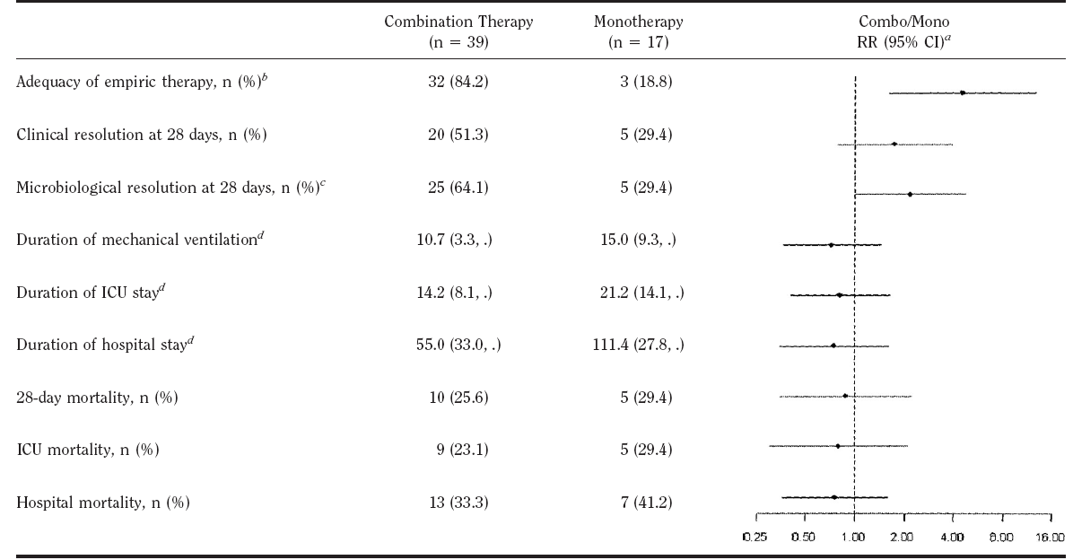
Mono or combo in empiric therapy of VAP: P.aeruginosa, Acinetobacter and MDR
Heyland et al. Crit Care Med 2008; 36:737–744

Slide 29
Our personal opinion on combination therapy
Due to the greater mortality associated with delays in appropriate and effective antimicrobial treatment, initiating broad-spectrum empiric antimicrobial treatment (which often means combination therapy) is prudent.
For patients at risk of MDRGN infections treatment should include coverage of pathogens that may be resistant to previously administered antibiotics, and empiric combination therapy may be appropriate.
However the antimicrobial regimen should be promptly narrowed or discontinued based on the patient's clinical course and culture and susceptibility profile results.

Slide 30
New antibiotics???
 | ESBL | AmpC | KPC | OXA | MBL
Ceftazidime-avibactam | + | + | + | + | -
Ceftolozane-tazobactam | + | +/- | - | - | -
Ceftaroline-avibactam | + | +/- | + | - | -
Aztreonam-avibactam | + | + | + | + | +
Imipenem-relebactam | + | + | + | - | -
Meropenem/nacubactam | + | + | + | + | +
Lagace-Wiens et al. Infect Drug Res 2014;9:13-25
Castanheira et al. AAC 2012;56:4779-85
Livermore et al. AAC 2011; 55:390-4
Hong et al. Infect Drug Res 2013;6:215-23
Livermore et al. JAC 2013;68:2286-90
Notes:
Ceftolozane-tazo not affected by PA porin loss or efflux. Active against Amp-C hyperproducing PA but not de-repressed mutants. Poor anaerobic and SA activity - Ceftolozane-tzb Hong et al. Infect Drug Res 2013;6:215-23
Avibactam KPC, ESBL and AmpC. Does not overcome PA efflux.
Ceftarolin anti-MRSA
CAZ-avibactam Lagace-Wiens et al. Infect Drug Res 2014;9:13-25
Ceftaroline-avibactam Castanheira et al. AAC 2012;56:4779-85
Azt-avi Livermore et al. AAC 2011; 55:390-4
Imp-MK-7655 Livermore et al. JAC 2013;68:2286-90
AmpC +/- means:
Ceftaroline-avi not in PA with reduced permeability + AmpC production
Ceftolozane-tazo not for derepressed mutants
None of them is good for MDR-ACB, MBL-producing GNB

Slide 31
Ceftazadime/Avibactam
(Cephalosporin/Inhibitor)
Approved for:
  Complicated intra-abdominal infection (cIAI)
  Complicated urinary tract infection (cUTI), including pyelonephritis
  Hospital-acquired pneumonia (HAP), including ventilator associated pneumonia (VAP)
  indicated for the treatment of infections due to aerobic Gram-negative organisms in adult patients with limited treatment options
GNB coverage:
  ESBL-producing Enterobacteriaceae including class A, C, and some D (e.g. OXA-48)
  CREs – KPCs and others
  Pseudomonas sp. with class A/C beta-lactamases
Gaps
  ESBL-Acinetobacter, Burkholderia, Stenotrophomonas, NDM, Pseudomonas with ceftaz-efflux pumps, anaerobes, MRSA
Lagace-Wiens et al. Infect Drug Res 2014;9:13-25

Slide 32
Plasma and ELF concentration–time profiles
Phase I study in healthy volunteers
Geometric mean (SD) plasma and median ELF concentrations (semi-log scale)
Cohort A: AVI 500 mg+CAZ 2000 mg
Cohort B: AVI 1000 mg+CAZ 3000 mg
1000
Plasma geometric mean concentration (n=22)
1000
Plasma geometric mean concentration (n=20)
ELF median concentration (n=5)*
ELF median concentration (n=5)
100
Individual ELF data
100
Individual ELF data
CAZ
10
10
Concentration (mg/L)
Concentration (mg/L)
1
1
0.1
0.1
0.01
0
4
8
12
16
20
24
0.01
0
4
8
12
16
20
24
Time after start of infusion (h)
Time after start of infusion (h)
100
Plasma geometric mean concentration (n=22)
100
Plasma geometric mean concentration (n=20)
ELF median concentration (n=5)*
ELF median concentration (n=5)
10
Individual ELF data
10
Individual ELF data
AVI
1
1
Concentration (mg/L)
Concentration (mg/L)
0.1
0.1
0.01
0.01
0.001
0
4
8
12
16
20
24
0.001
0
4
8
12
16
20
24
Time after start of infusion (h)
Time after start of infusion (h)
Ceftazidime and avibactam penetrated well into human ELF; plasma and ELF concentrations increased approximately dose-proportionally for both agents
Plasma levels of ceftazidime-avibactam are a good surrogate measure for lung penetration
Nicolau D et al. ICAAC 2013; Poster A-1027
Notes:
Phase I, open-label study (Study 0009; NCT01395420) in healthy volunteers.
Forty-three healthy adult males were enrolled into two cohorts:
Cohort A (n=22) received AVI 500 mg+CAZ 2000 mg.
Cohort B (n=21) received AVI 1000 mg+CAZ 3000 mg (one subject was withdrawn due to a protocol violation).
Both regimens administered q8h by IV infusion over 2 h for 3 days (total nine doses).
A single bronchoscopy with bronchoalveolar lavage was performed on each subject.
PK parameters were estimated from total individual plasma concentrations and a composite ELF concentration–time profile.
Plasma and ELF concentrations increased proportionally with dose for both AVI and CAZ.
Median urea-corrected ELF concentrations of AVI and CAZ were proportionally lower than their respective plasma concentrations.
Elimination patterns were similar between the ELF and plasma concentration–time profiles for both drugs.
The results suggest that CAZ and AVI can penetrate into human ELF.
Abbreviations
AVI, avibactam; CAZ, ceftazidime; ELF, epithelial lining fluid; IV, intravenous; PK, pharmacokinetic; q8h, every 8 h; SD, standard deviation.

Slide 33

REPROVE
REPROVE was a prospective, multicentre, international, randomised, double-blind, double-dummy, Phase 3 study, evaluating efficacy and safety of ceftazidime-avibactam compared with meropenem
Primary endpoint: clinical cure at the TOC visit in the co-primary cMITT and CE populations
1:1 randomisation
EOT
(within 24 h of last IV infusion)
Hospitalised patients aged ≥18 years with NP,† including VAP
Diagnosis based on:
clinical assessment (new worsening infiltrate on chest X-ray within 48 h of randomisation), and
≥2 respiratory signs of pneumonia‡
Ceftazidime-avibactam
2000–500 mg by 2-h IV infusion q8h
12.5% NI
margin
TOC
FPFU
21–25 days
after randomisation
28–32 days
after randomisation
Meropenem
1000 mg by 30-min IV infusion q8h
†Defined as pneumonia with onset ≥ 48 hours after admission or <7 days after discharge from an inpatient care facility; ‡A respiratory specimen for Gram stain and culture was required within 48 hours of randomisation. Open-label linezolid (or vancomycin) was given for Gram-positive coverage, and/or open-label amikacin (or other aminoglycoside) for Gram-negative coverage for a minimum of
48–72 h in patients awaiting identification or susceptibility results from the baseline culture at randomisation
CE, clinically evaluable; cMITT, clinically modified intent-to-treat; EOT, end-of-treatment; FPFU, final protocol follow-up; IV, intravenous; NI, non-inferiority; NP, nosocomial pneumonia; q8h, every 8 hours; TOC, test-of-cure; VAP, ventilator-associated pneumonia from an inpatient acute or chronic care facility
Torres Et al. Lancet Infect Dis 2018; 18: 285–95 Published Online December 15, 2017 http://dx.doi.org/10.1016/ S1473-3099(17)30747-8
Notes:
Secondary endpoints (incl.): Clinical cure rate at EOT (cMITT, CE) and clinical cure rate at EOT and TOC (mMITT, eME, ME); all-cause mortality at TOC and at Day 28 (CE, cMITT, mMITT); clinical cure rate at EOT and TOC in subjects with ceftazidime-non-susceptible pathogens (CE, cMITT, ME); per-patient and per-pathogen microbiological responses at EOT and TOC (mMITT, ME and eME)
Safety evaluations (incl.): Monitoring of AEs, clinical laboratory assessments, electrocardiograms, mortality
AE, adverse event; CE, clinically evaluable; cMITT, clinically modified intention-to-treat; eME, extended microbiologically evaluable; EOT, end of treatment; ME, microbiologically evaluable; mMITT, microbiologically modified intention-to-treat; TOC, test of cure.

Slide 34
Key patient and disease characteristics at baseline (cMITT population)
Parameter | Ceftazidime-avibactam (N=356) | Meropenem (N=370)
Age, years, mean (SD) | 62.1 (16.6) | 61.9 (17.4)
Male, n (%) | 268 (75) | 274 (74)
Race, n (%)
White | 150 (42) | 163 (44)
Black or African American | 1 (<1) | 2 (1)
Asian | 201 (56) | 199 (54)
Other | 4 (1) | 6 (2)
Body mass index, kg/m², mean (SD) | 24.0 (6.1) | 23.9 (5.2)
APACHE II score category, n (%)
<10 | 1 (<1) | 1 (<1)
10–19 | 309 (87) | 316 (85)
20–30 | 46 (13) | 53 (14)
Estimated CrCl, mL/min, mean (SD) | 102.6 (67.5) | 100.1 (53.1)
Renal status, n (%)
Normal renal function or mild impairment (CrCl 50–150 mL/min) | 286 (80) | 292 (79)
Moderate or severe impairment (CrCl 16–50 mL/min) | 18 (5) | 18 (5)
Augmented (CrCl >150 mL/min) | 50 (14) | 58 (16)
NP subtype, n (%)
VAP | 118 (33) | 128 (35)
Non-VAP | 238 (67) | 242 (65)
Mechanical ventilation at baseline, n (%)
Ventilated | 154 (43) | 159 (43)
Non-ventilated | 202 (57) | 211 (57)
Prior systemic antibiotic use (in the 48 hours before randomisation), n (%)
None | 122 (34) | 117 (32)
>0 to ≤24 hours | 185 (52) | 209 (56)
>24 to ≤48 hours | 49 (14) | 44 (12)
Torres Et al. Lancet Infect Dis 2018; 18: 285–95 Published Online December 15, 2017 http://dx.doi.org/10.1016/ S1473-3099(17)30747-8

Slide 35
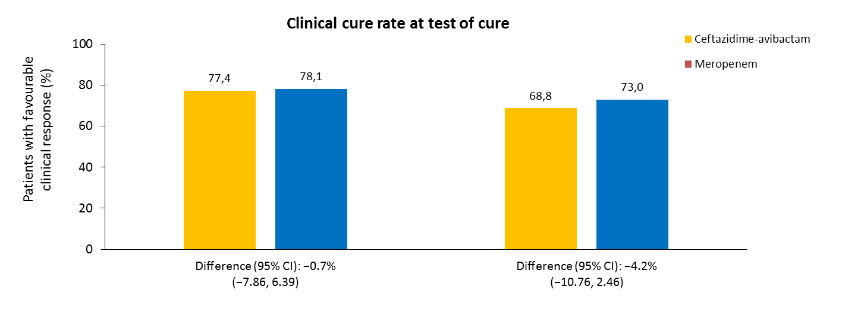
Primary endpoint efficacy: Clinical cure rates at TOC
(CE and cMITT populations)
Ceftazidime-avibactam was non-inferior to meropenem for the treatment of HAP/VAP in this setting
CE population
cMITT population
(n=199/257)
(n=211/270)
(n=245/356)
(n=270/370)
CE, clinically evaluable; CI, confidence interval; cMITT, clinically modified intention-to-treat; HAP, hospital-acquired pneumonia; TOC, test of cure; VAP, ventilator-associated pneumonia.
Torres Et al. Lancet Infect Dis 2018; 18: 285–95 Published Online December 15, 2017 http://dx.doi.org/10.1016/ S1473-3099(17)30747-8
Notes:
Subgroup analyses of primary endpoint
No trends associated with various patient factors, including:
Baseline renal status
Prior systemic antibiotic use
Type of infection (non-VAP or VAP and early vs late VAP)
APACHE II score category
APACHE, Acute Physiology and Chronic Health Evaluation; VAP, ventilator-associated pneumonia.

Slide 36
Ceftazidime-avibactam
Pros
Limitations
Predictable PK
Rapid tissue distribution - lung
Renal excretion
Safety profile
Inhibits ESBLs, AmpC, KPC, OXA-48
Pseudomonas aeruginosa and Enterobacteriaceae enhanced activity
Approved for empiric and targeted therapy
Carbapenem sparing
Does not inhibit class B enzymes & many class D enzymes
Not susceptible: Acinetobacter spp., Anaerobes
Avoid if β-lactam allergy (10% of patients)
Salvage vs. empiric TX
Better in combination
ESBL: Extended spectrum β-lactamase ; KPC: Klebsiella pneumoniae carbapenemase;
OXA: Oxacillinase, PK: Pharmacokinetics, Tx: Treatment
Presenter opinion
Notes:
• Anaerobes
• Enterococcus spp.
• Stenotrophomonas maltophilia

Slide 37

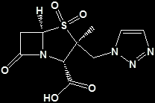
Ceftolozane/Tazobactam Overview
Class
Antipseudomonal cephalosporin + β-lactamase inhibitor
Fixed 2:1 ratio
Mechanism of action
Rapidly bactericidal
Inhibits cell wall synthesis
Active against organisms with porin deficiencies or mutations
Inhibits β-lactamases, broadens coverage to most ESBL-producing Enterobacteriaceae
In vitro activity
Pseudomonas aeruginosa, including drug-resistant strains
Escherichia coli, including ESBL-positive strains
Klebsiella pneumoniae, including ESBL-positive strains
Minimal activity against Gram-positive bacteria
Limited activity against anaerobes
No activity against KPC, MBL
Development stage
Approved in >60 countries for treatment of cIAI and cUTI
Phase 3 trial for nosocomial pneumonia completed
In vivo efficacy
Activity in mouse models of sepsis, pneumonia, urinary tract infection, burn wound infection, and thigh infection
Positive outcomes and adhered to an expected safety profile in Phase 2 and 3 trials in adult patients with cUTI and cIAI
Pharmacokinetics
Linear PK
Lung penetration
Rapid tissue distribution
Minimal accumulation
Extensive renal excretion
Low protein binding
Minimal CYP450 drug-drug interactions
+
Zhanel et al. Drugs. 2014;74:31-51.
Notes:
Ceftolozane exerts bactericidal activity by inhibiting essential penicillin-binding proteins (PBPs), resulting in inhibition of cell-wall synthesis.¹ Ceftolozane enters the cell independently of the OprD channel, therefore, is active against organisms with porin deficiencies or mutations.² It has a low affinity for pseudomonal AmpC β‑lactamase.³
Tazobactam inhibits most class A β-lactamases and some class C β-lactamases,⁴ protects ceftolozane from hydrolysis, and broadens coverage to include most ESBL-producing Enterobacteriaceae.⁵
In vitro studies have shown that ceftolozane/tazobactam is active against Pseudomonas aeruginosa and Enterobacteriaceae, including resistant strains. Ceftolozane/tazobactam has activity against Bacteroides fragilis; however, its activity is limited against other anaerobes.
In animal models of infection, ceftolozane/tazobactam demonstrated efficacy similar to or superior to that of other β-lactams.
Ceftolozane/tazobactam is currently being studied in Phase 3 clinical trials for the treatment of cUTI, cIAI, and nosocomial pneumonia (NP).
References
Moya et al. Antimicrob Agents Chemother. 2010;54:3933-7.
Livermore et al. Int J Antimicrob Agents. 2009;34:402-6.
Takeda et al. Int J Antimicrob Agents. 2007;30:443-5.
Zosyn® [prescribing information]. Wyeth Pharmaceuticals, Inc., Philadelphia, PA, USA.
Livermore et al. J Antimicrob Chemother. 2010;65:1972-4.
cIAI, complicated intra-abdominal infections; cUTI, complicated urinary tract infection; DDI, drug-drug interaction; ESBL, extended spectrum β-lactamase; KPCs, Klebsiella pneumoniae carbapenemases; MBLs, metallo-β-lactamases; PK, pharmacokinetics.

Slide 38
What Makes Ceftolozane/Tazobactam Different? Activity vs. Pseudomonas aeruginosa
Ceftolozane
Stable against common P. aeruginosa resistance mechanisms, including loss of outer membrane porin (OprD), chromosomal AmpC, and up-regulation of efflux pumps (MexXY, MexAB)¹
Isolates resistant to other cephalosporins may be susceptible, although cross-resistance may occur²
Resistance Mechanisms | Outer Membrane Porin Loss | β-lactamase Enzyme | Efflux Pump | Efflux Pump
 | OprD | AmpC | MexXY | MexAB
Ceftolozane
Ceftazidime
Cefepime
Piperacillin/tazobactam
Imipenem
Meropenem
Activity greatly decreased >> Retains activity
1. Castanheira M, et al. Antimicrob Agents Chemother. 2014;58:6844-6850.
2. Ceftolozane/Tazobactam prescribing information.
Table adapted from Castanheira M, et al. 2014

Slide 39
Clinical results of C/T in phase 2 and 3 trials
Bassetti M, Righi E. Future Microbiol. 2015;10(2):151-60

Slide 40
ASPECT-NP RESULTS

Slide 41
Ceftolozane/Tazobactam Real World Experience against P. aeruginosa (PsA)
Citation | Study type | n | Infection type | Immuno-compromised (n) | Clinical / microbiogical cure | 30-day all cause mortality
Caston | Multicenter retrospective | 12 | Mixed MDR PsA | 4 | 83% | 25% (3/12)
Munita | Multicenter retrospective | 35 | Mixed Carb-R PsA | 10 | 74% Combo= 87% cure | 23% in hospital
Dinh | Retrospective compassionate access | 15 | Mixed XDR PsA | 10 | 67% | 27% in hospital
Haidar | Case series | 21 | Mixed MDR PsA | 9 | 71% | 10%
Diaz-Canestro | Prospective, observational | 58 | Mixed 97% MDR PsA | 7 | 64% | 28% (16/58)
Escola-Verge | Retrospective single center | 38 | Mixed XDR PsA | 20 | 87% | 13%
Xipell | Case series | 23 | Mixed MDR-PsA | 10 | 87.5% | 22% at 6 weeks
Caston JJ et al. Antimicrob Agents Chemother 2017;61:e02136-16
Munita JM et al. Clin Infect Dis 2017;65:158-61
Dinh A et al. Int J Antimicrob Agents 2017;49:579-88
Haidar G et al. Clin Infect Dis 2017;65:110-20
Diaz-Canestro et al. EJCMID 2018
Escola-Verge et al. Infection 2018
Xipell X et al. J Glob Antimicrob Res 2018 in press

Slide 42
Ceftolozane/tazobactam for the treatment of serious P. aeruginosa infections: a multicenter nationwide clinical experience- Ceftabuse
Retrospective study in 22 Italian hospitals - June 2016
March 2018
101 patients
  Nosocomial pneumonia (31.7%)
  acute bacterial skin and skin structure infections (30.8%)
  cUTI (13.8%)
  cIAI (12.8%)
  bone infections (8.9%)
  primary bacteraemia (7.9%)
  Almost half of P.aeruginosa strains were XDR (51%), with 78% of the isolates resistant to at least one carbapenem.
Bassetti M and Vena A. Int J Antimicrob Agents. 2018 Nov 8.

Slide 43
Clinical success rates according to susceptibility profile of P.aeruginosa (non-MDR, MDR, XDR/PDR)
Bassetti M et al. Int J Antimicrob Agents. 2018 Nov 8. pii: S0924-8579(18)30326-1

Slide 44
Nebulizing antibiotics… Why?
To achieve high antibiotic concentrations at the site of infection
Because some drugs have poor lung penetration
    Aminoglycosides
    Colistin
Kalil et al Clin Infect dis 2016;63:e61-111

Slide 45
Nebulizing antibiotics… Evidence?
Systematic review including 9 studies (5 RCT)
ABs: Tobramycin, gentamicin and colistin
MDR K.pneumoniae, P.aeuruginosa and A. baumannii
Relative impact on clinical cure rate, but NOT for mortality or nefrotoxicity.
Kalil et al Clin Infect dis 2016;63:e61-111

Slide 46
Determining Optimal Duration of Therapy for VAP
Failure
Relapse
Control of
antimicrobial
resistance
Reduction of
side effects
Risks
Benefits
Reduction
of costs

Slide 47
Duration of Antibiotic therapy for VAP
401 pts with VAP (bronchoscopy diagn.)
197 pts 8 days therapy
204 pts 15 days therapy
Primary outcome measures:
  death
  microbiologically documented pulmonary infection recurrence
  antibiotic free days
Chastre J et al. JAMA 2003; 290: 2588-2598

Slide 48
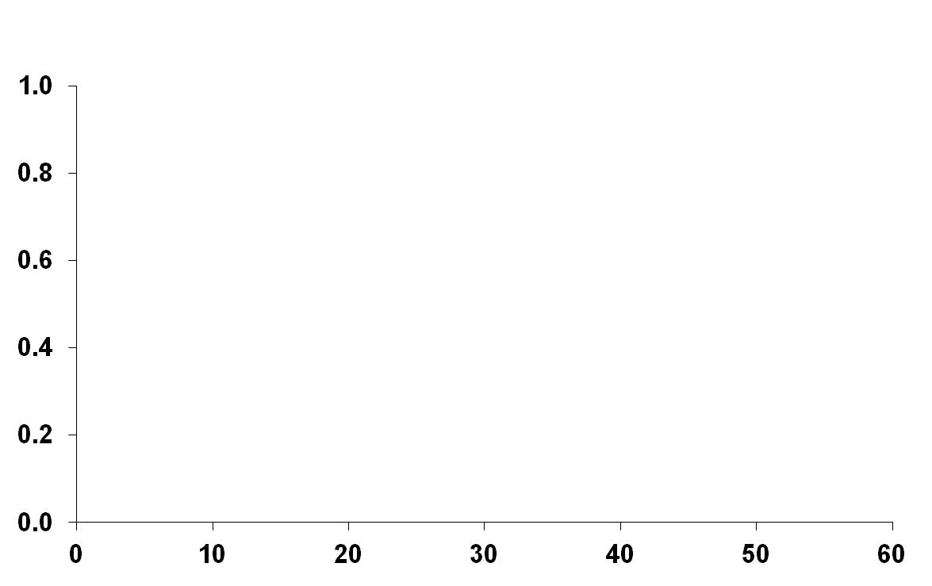
Comparable Clinical Effectiveness Against VAP With 8- and 15-Day Antibiotic Regimens
Kaplan-Meier Estimates of Probability of Survival*
8 Days vs 15 Days of Antibiotic Therapy
Probability of Survival
MRSA comprised ~7% of microbiologically documented pathogens (both groups)
Antibiotic Regimen
8-Day
15-Day
Log-rank P=.65
Days After
Bronchoscopy
No. at Risk
8-day 197 187 172 158 151 148 147
15-day 204 194 179 167 157 151 147
*Probability of survival is for 60 days after VAP onset as function of the duration of antibiotic administration.
Chastre J et al. JAMA. 2003;290(19):2588-2598.
Copyright © 2003 American Medical Association. All rights reserved.
Notes:
Comparable Clinical Effectiveness Against VAP with 8- and 15-day Antibiotic Regimens¹
Given the risk of initial inadequate therapy, the optimal duration of antimicrobial treatment for VAP has been the subject of considerable debate.
These are the findings from a randomized trial comparing the outcomes of therapy with an 8-day or 15-day antibiotic regimen in ICU patients with VAP as confirmed by quantitative culture results of bronchoscopic specimens.
MSSA and MRSA comprised 13.6% and 7.0% of microbiologically documented pathogens, respectively, from bronchoscopic specimens in patients treated with 8 days of antibiotics, and 11.7% and 7.3% in patients treated with a 15-day regimen.
As shown by the Kaplan-Meier curves, patients treated for 8 days did not experience excess mortality, when compared with those treated for 15 days. Nor did the 8-day-treated patients experience more recurrent infections; however, their antibiotic use, as measured by mean antibiotic-free days, was significantly less (P<.001).
Reference
Chastre J, Wolff M, Fagon JY, et al; PneumA Trial Group. Comparison of 8 vs 15 days of antibiotic therapy for ventilator-associated pneumonia in adults: a randomized trial. JAMA. 2003;290(19):2588-2598.

Slide 49
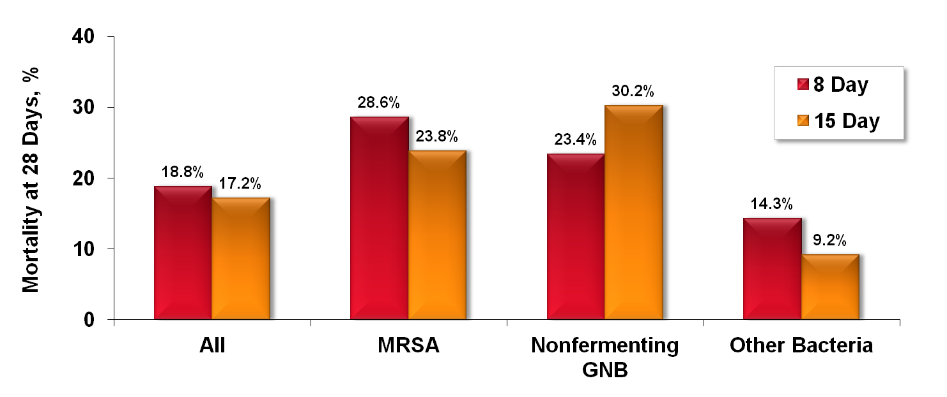
Shorter Duration of Antimicrobial Therapy May Be Acceptable
Mortality 28 Days After Bronchoscopy as a
Function of Antibiotic Administration Duration
Comparable 28-day mortality with 8- or 15-day
MRSA comprised ~7%
of microbiologically documented pathogens (both groups)
Chastre J et al. JAMA. 2003;290(19):2588-2598.
Notes:
Shorter Duration of Antimicrobial Therapy May Be Acceptable¹
Here are findings from the same study showing mortality 28 days after bronchoscopy as a function of antibiotic administration duration.
With the possible exception of nonfermenting Gram-negative bacillus infections, comparable mortality (28 days after bronchoscopy) in VAP was observed with 8- and 15-day treatment regimens including in patients MRSA VAP.
Thus, a shorter duration of antimicrobial therapy may be acceptable in this setting.
Reference
Chastre J, Wolff M, Fagon JY, et al; PneumA Trial Group. Comparison of 8 vs 15 days of antibiotic therapy for ventilator-associated pneumonia in adults: a randomized trial. JAMA. 2003;290(19):2588-2598.

Slide 50
LONGER THERAPY?
ICP patients
Pts with higher probability of relapse
Pts with difficult to threat pathogens ( P. aeruginosa, Acinetobacter, MRSA)?????

Slide 51
Nosocomial pneumonia and MDR
Definitions and pathogens of interest
Clinical impact of MDR-NP
When to start therapy?
How to optimize the treatment?
Conclusions

Slide 52
Nosocomial pneumonia and MDR
Definitions and pathogens of interest
Clinical impact of MDR-NP
When to start therapy?
How to optimize the treatment?
Conclusions

Slide 53
Key rules for the management of pneumonia with MDR rods
WE HAVE TO SPARE OUR WEAPONS AND USE THEM PROPERLY!!! AVOID starting antimicrobials if useless
STOP early empirical treatment; Maximal effort for diagnosing infection BEFORE treatment
De-escalate (as often as possible respecting PD rules)
Duration of treatment
  Should be shorter than originally stated
Cautiously
  Inadequate initial treatment
  MDR/XDR organisms-→ ID IS YOUR BEST FRIEND!

