Slide 1
Conflict of interest statement
Speaker's hononaria from: Astra Zeneca, BI, Pfizer, GSK, Valeas, MSD, Menarini, Novartis, Chiesi, Almiral, Zambon, Dompè, Guidotti, Malesci and Teva.
Consultant for training: Almiral, Novartis, Dompè, UCB.
Research grant: Novartis, BI.

Slide 2



Trattamento quotidiano del paziente con BPCO di grado lieve-moderato
Fabiano Di Marco
Università degli Studi di Milano
Pneumologia
Ospedale Papa Giovanni XXIII, Bergamo
fabiano.dimarco@unimi.it

Slide 3
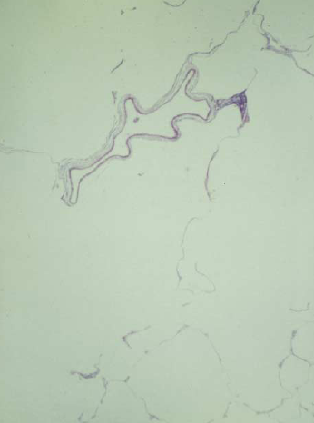
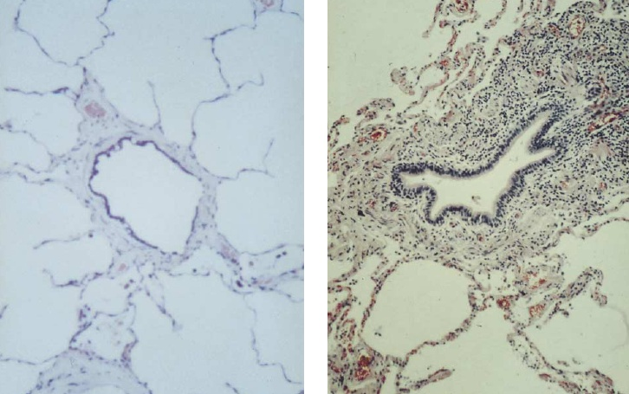
Why are airflows reduced in COPD?
Elastic recoil
Flow
Flow =
Resistance
Volume

Slide 4

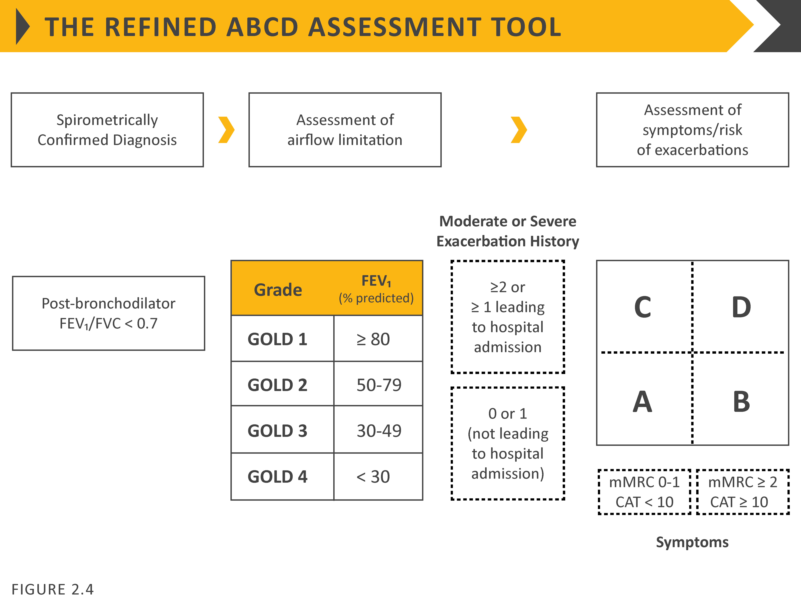
ABCD assessment tool
© 2019 Global Initiative for Chronic Obstructive Lung Disease

Slide 5
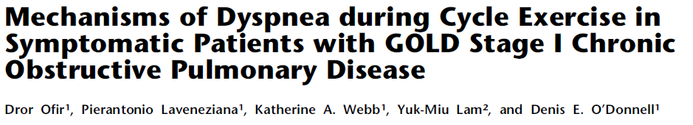
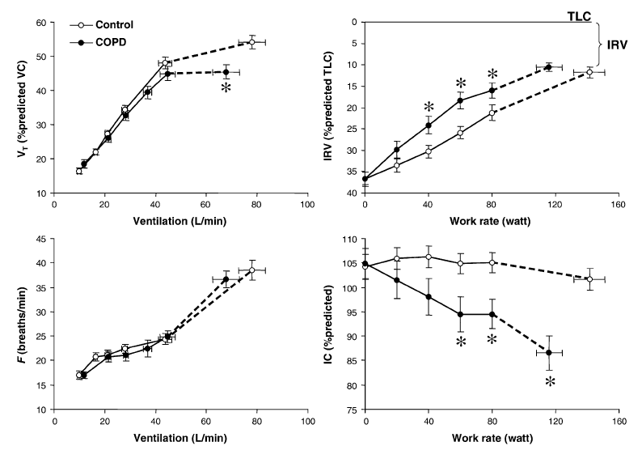

Slide 6
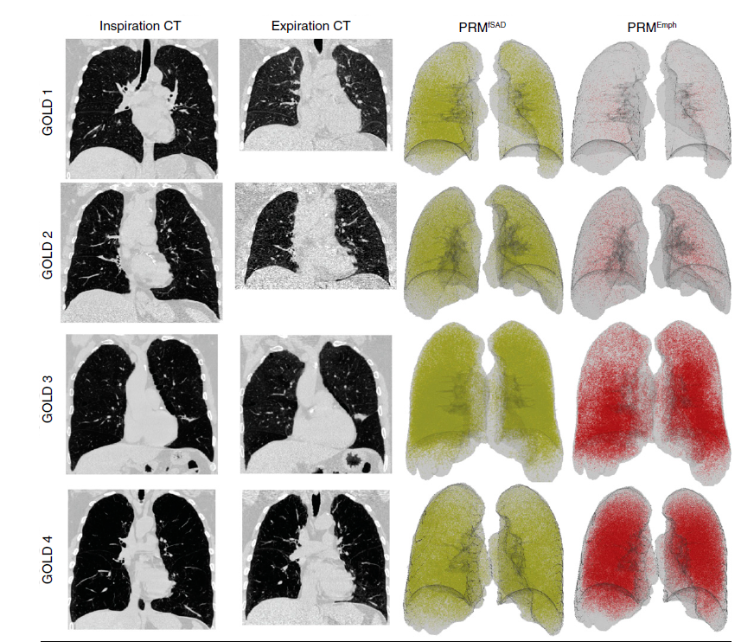

Slide 7
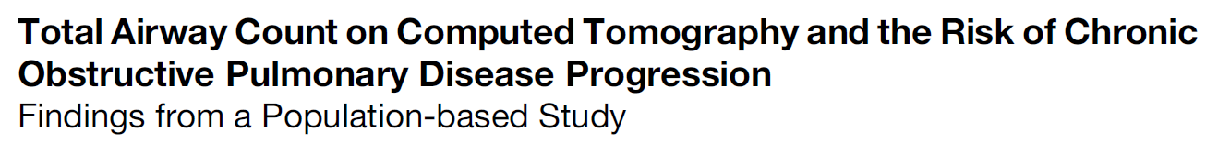
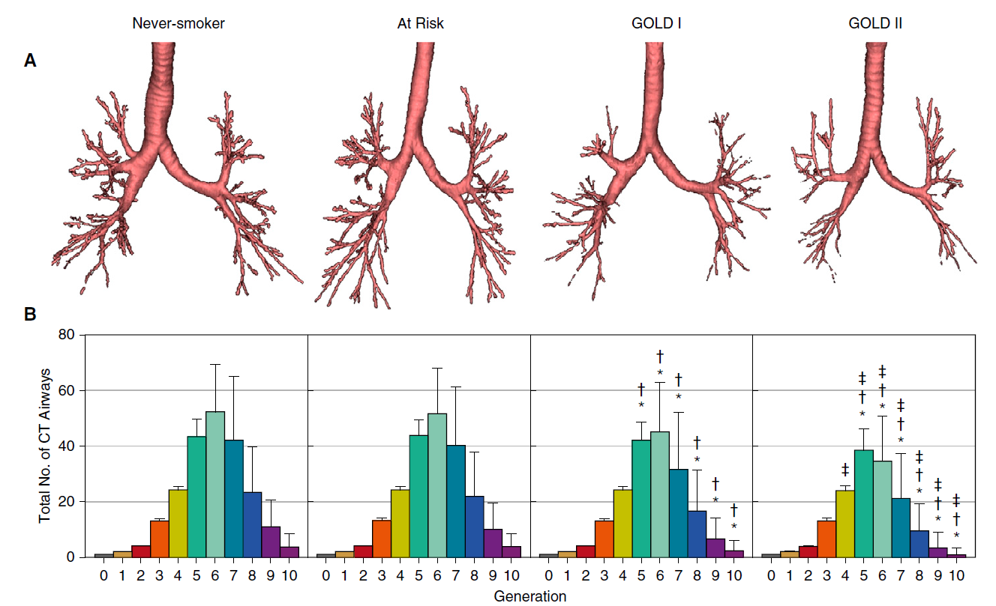

Slide 8
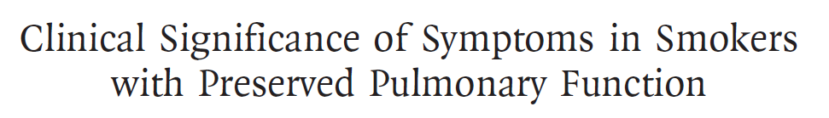
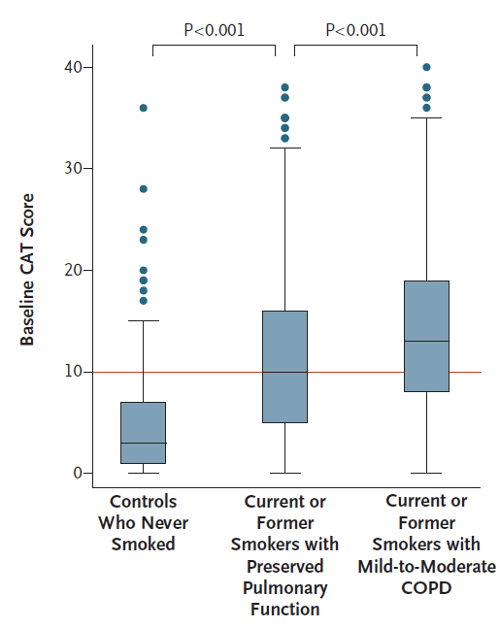

Slide 9
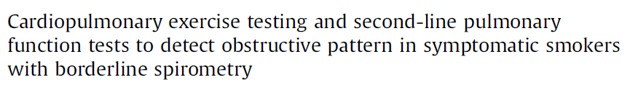
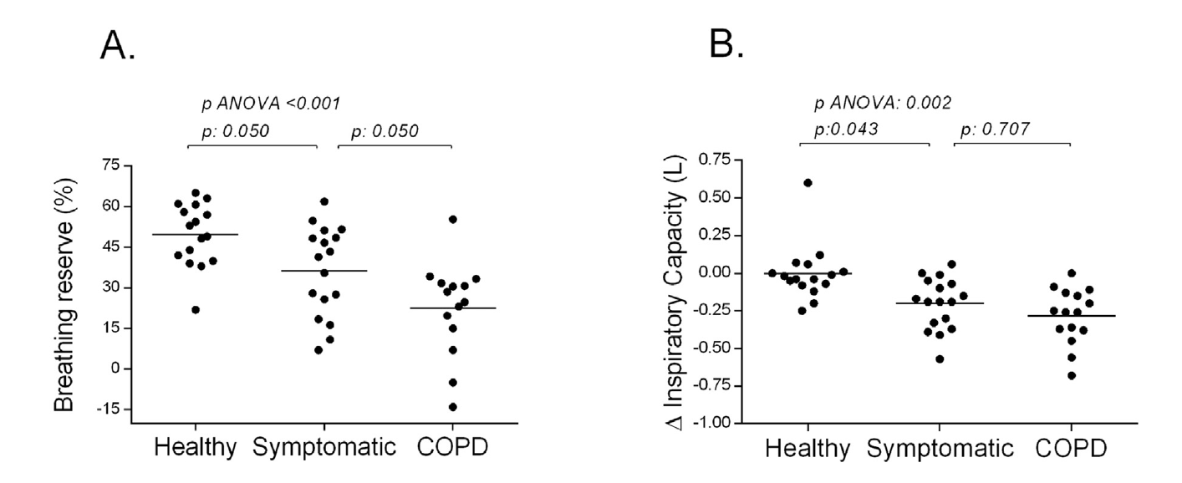

Slide 10
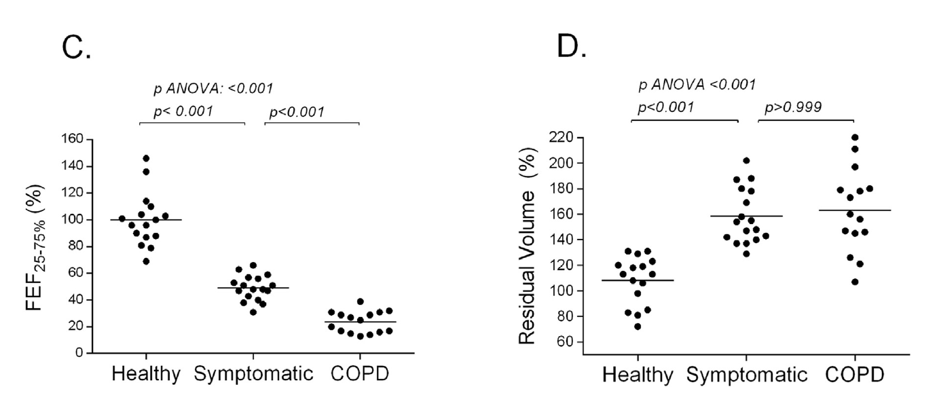

Slide 11
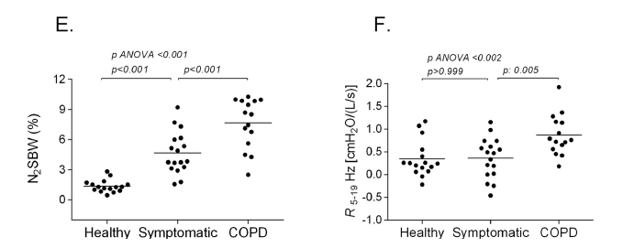

Slide 12
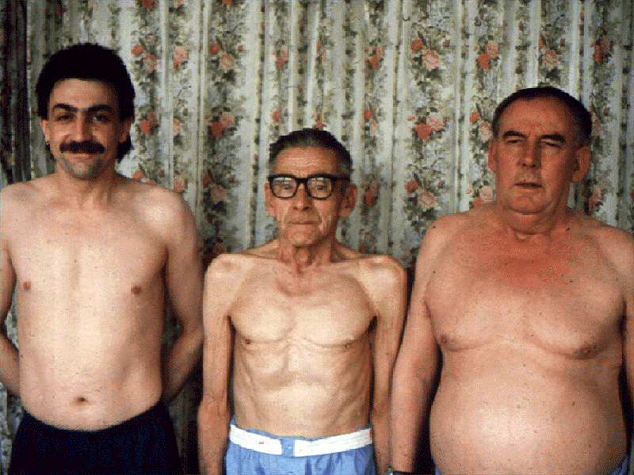
The many faces of COPD

Slide 13
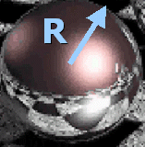
Iperinflazione e scambi gassosi
D_{L,CO} proportional with area and thus R²
Sphere:
Surface Area = 4πR²
Sphere:
Volume = 4/3πR³
VA proportional with R³

Slide 14
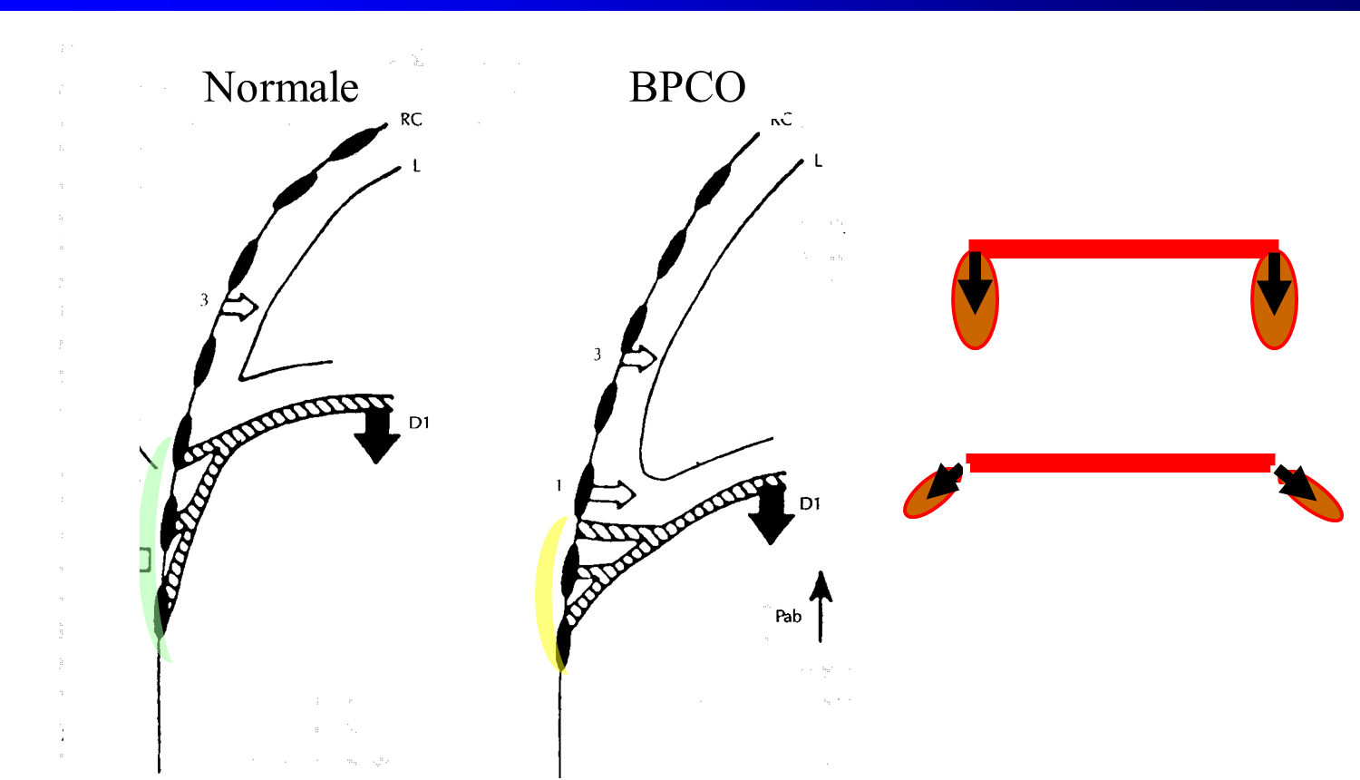
Iperinflazione
e posizione del diaframma

Slide 15
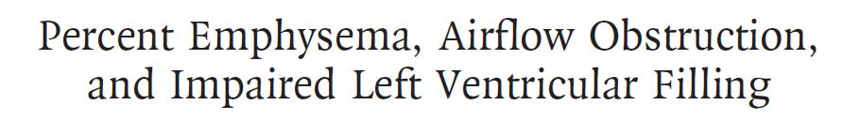
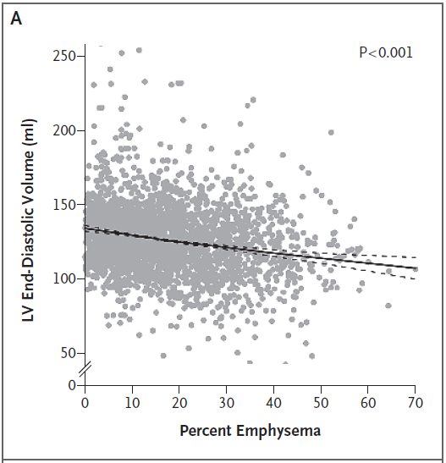
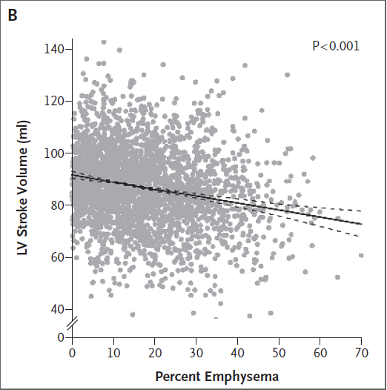

Slide 16
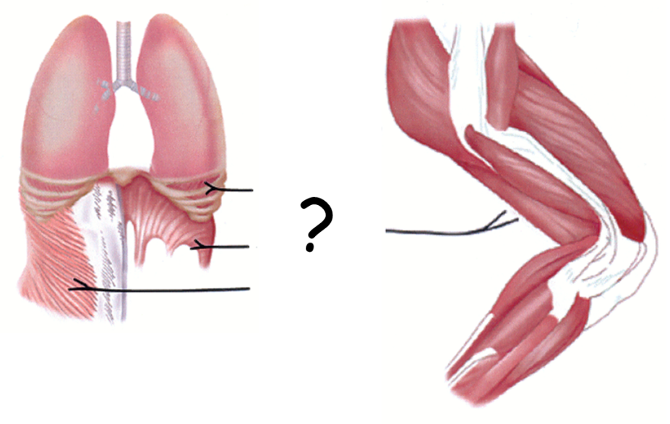
Aliverti A, Macklem PT, JAP 2008

Slide 17
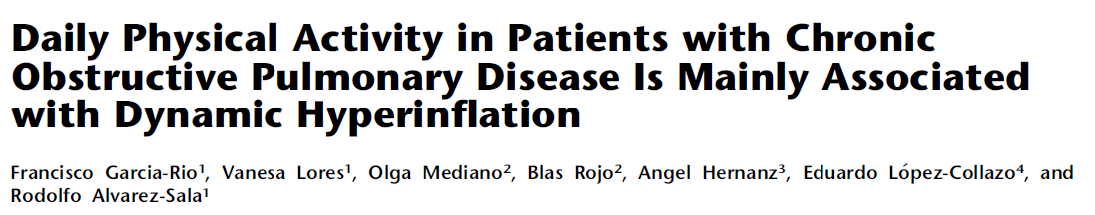
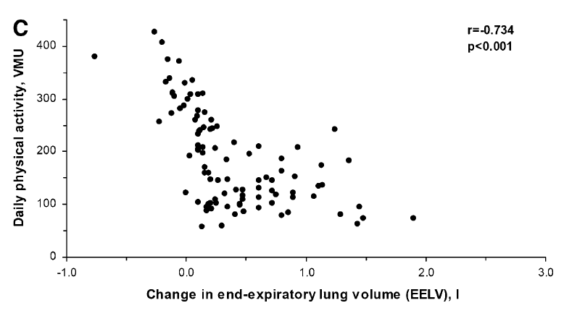

Slide 18
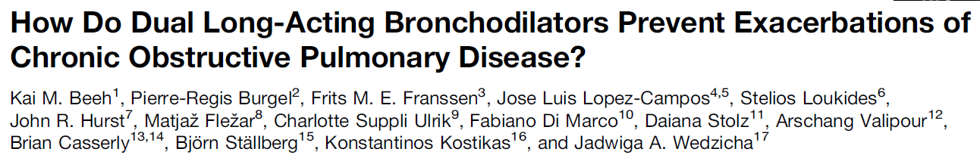
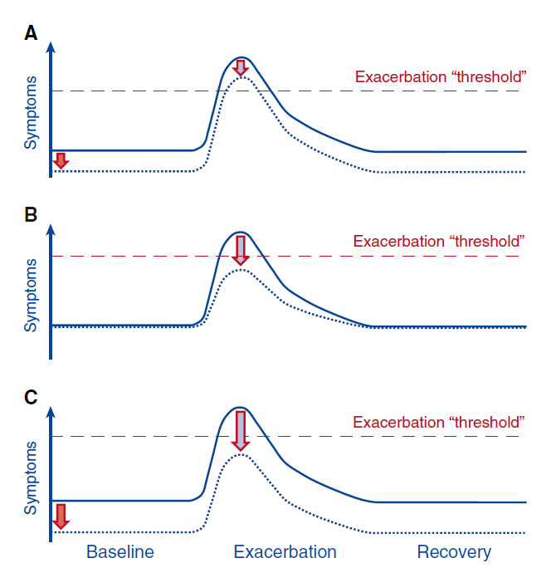

Slide 19
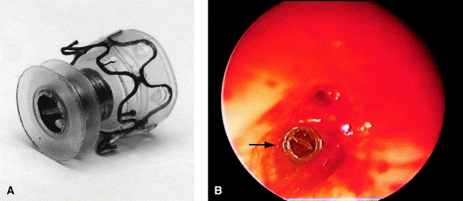
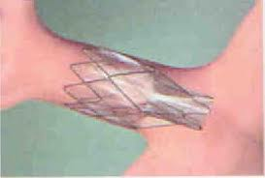
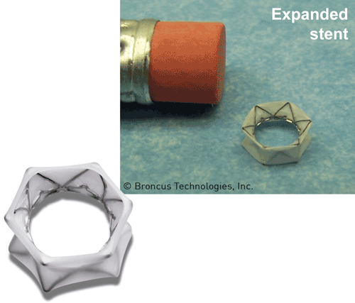
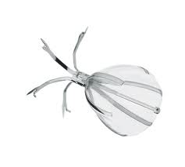
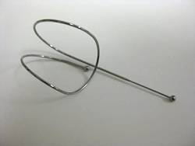
Tutti i modi non farmacologici per ridurre il volume polmonare

Slide 20
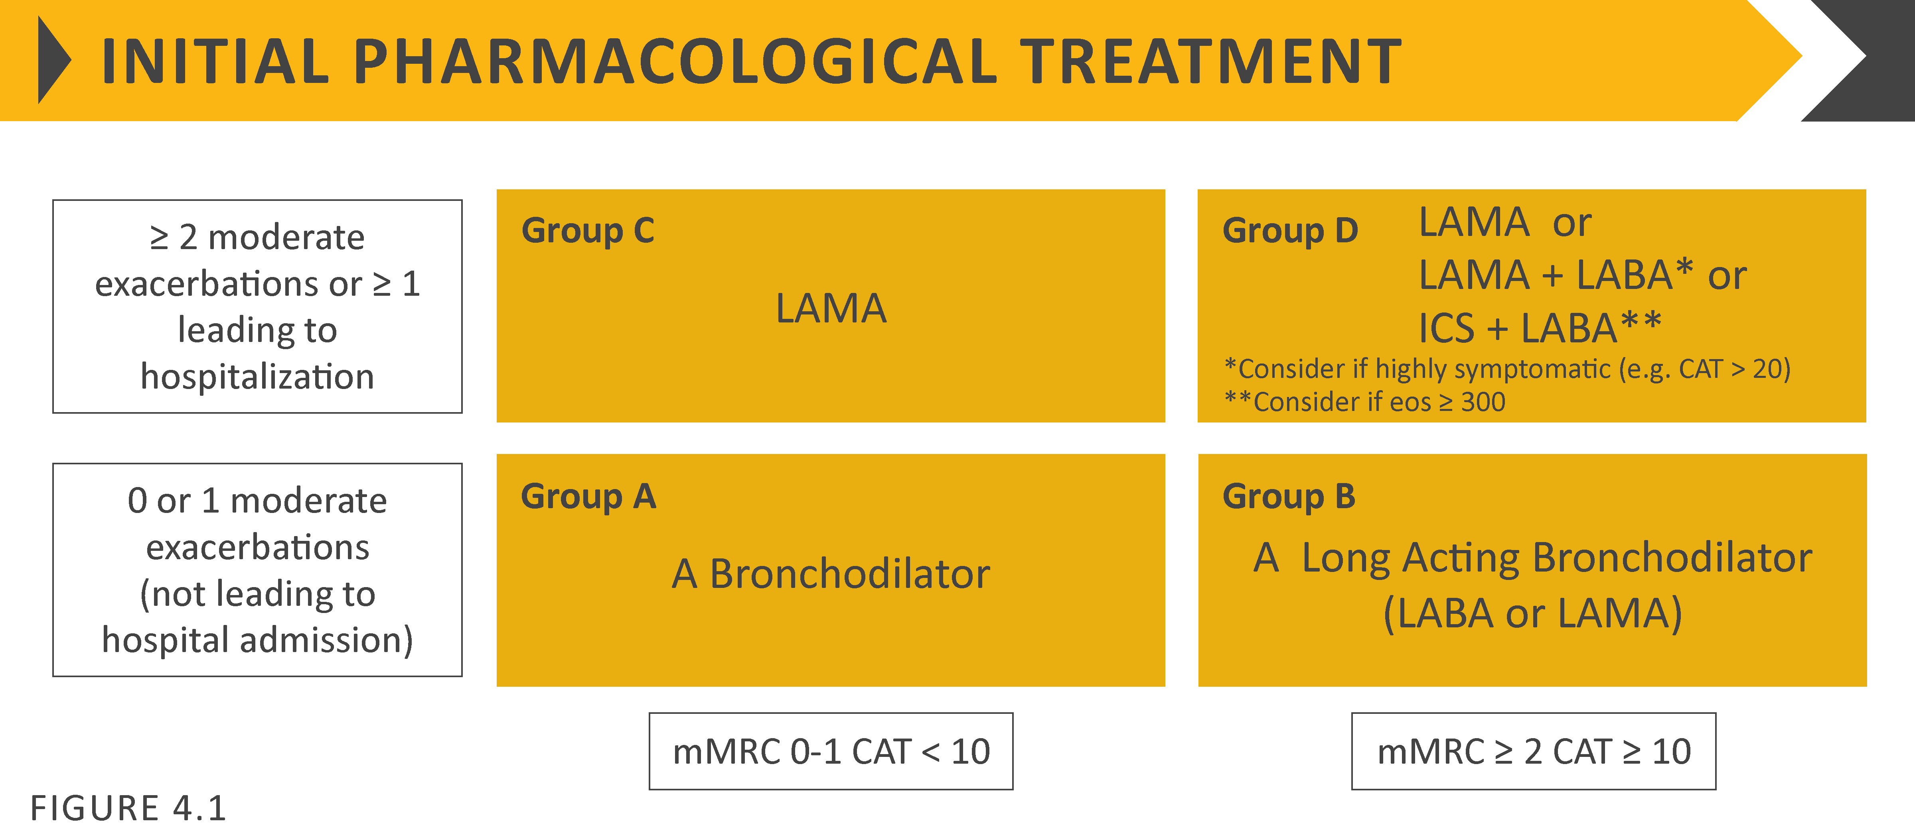
Treatment of stable COPD
Definition of abbreviations: eos: blood eosinophil count in cells per microliter; mMRC: modified Medical Research Council dyspnea questionnaire; CAT™: COPD Assessment Test™.
© 2017 Global Initiative for Chronic Obstructive Lung Disease
© 2019 Global Initiative for Chronic Obstructive Lung Disease

Slide 21
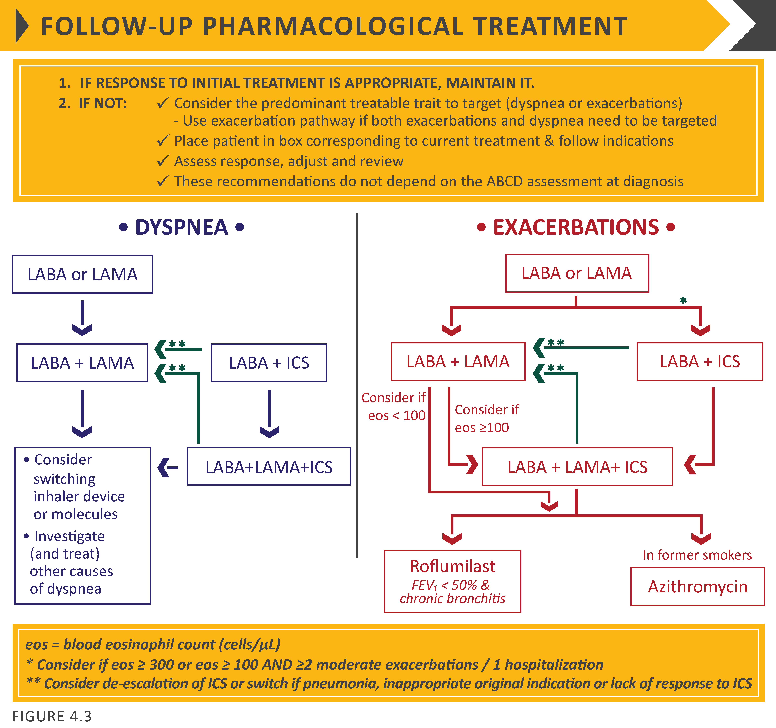
© 2017 Global Initiative for Chronic Obstructive Lung Disease
© 2019 Global Initiative for Chronic Obstructive Lung Disease

Slide 22
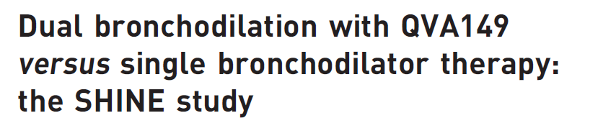
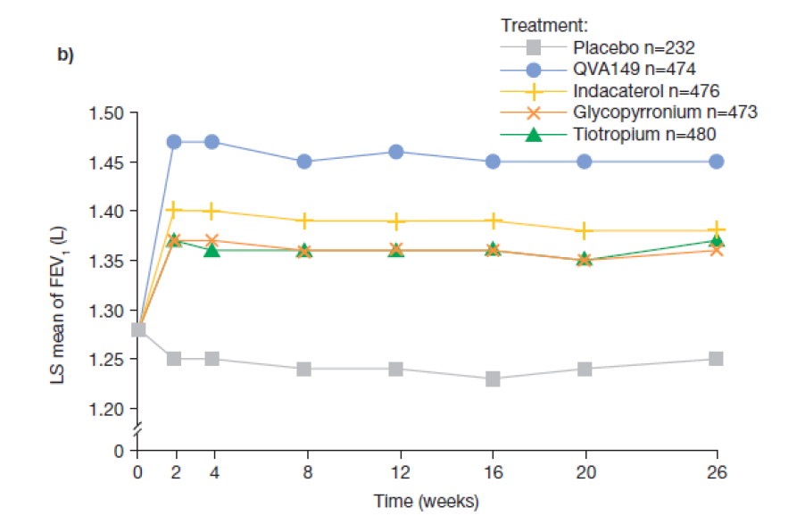


Slide 23
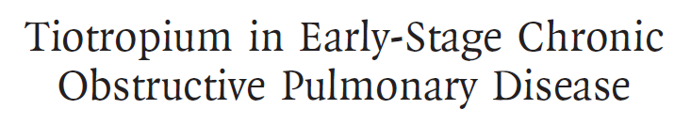
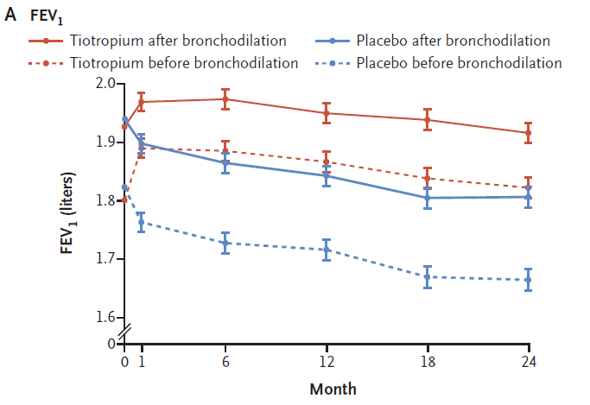

Slide 24
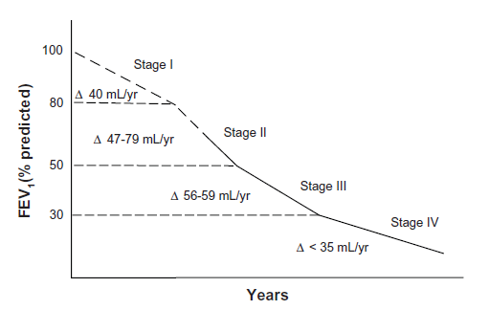
Notes:
Di che la cosa è stata introdotta dallo studio UPLIFT

Slide 25
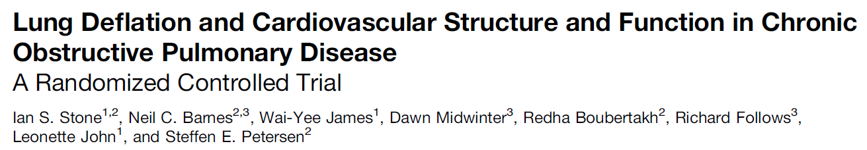
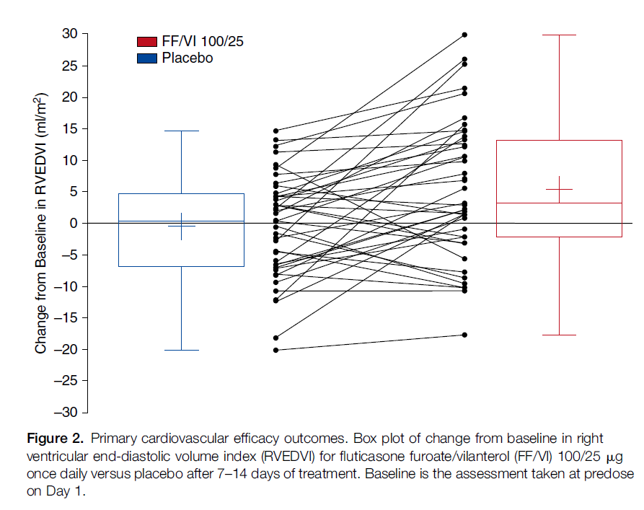

Slide 26
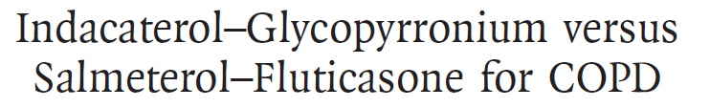
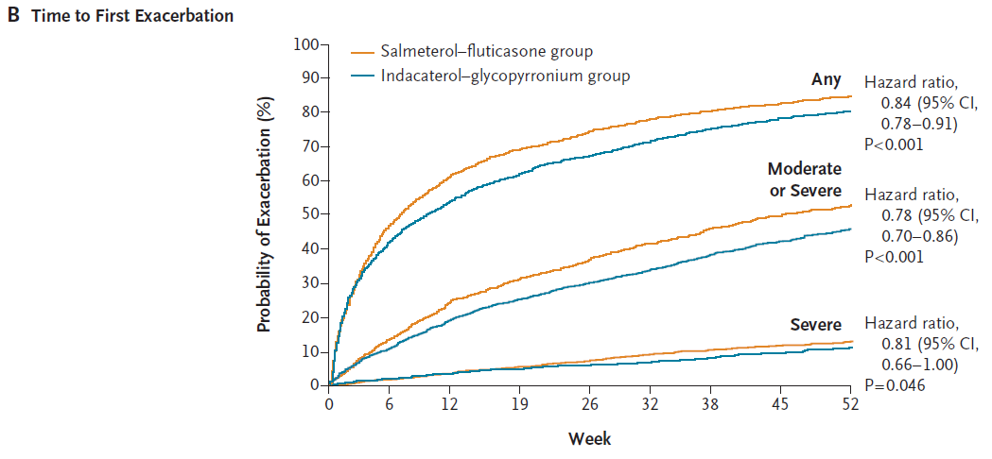
The incidence of pneumonia was 3.2% in the indacaterol-glycopyrronium group and 4.8% in the salmeterol-fluticasone group (P=0.02).
Notes:
Due to the observed different percentages of patients with a history of exacerbation at baseline in treatment groups (16.4% of QVA149 and 25.2% of SFC), post-hoc analyses were performed on subgroups of patients with or without a baseline history of exacerbation. The rate of moderate or severe COPD exacerbations was analyzed in these subgroups of patients with the same negative binomial model used for the overall population, except without the baseline COPD exacerbation history term in the model.
In patients with a history of moderate or severe exacerbations at baseline, the annualized rate of moderate or severe COPD exacerbations was 40% lower in the QVA149 treatment arm compared with SFC treatment arm (rate ratio 0.60 with 95% CI, 0.33-1.08). In only those patients without a history of moderate or severe exacerbations at baseline, the annualized rate of moderate or severe COPD exacerbations was 34% lower in the QVA149 treatment arm compared with SFC treatment arm (rate ratio 0.76; 95% CI, 0.46- 1.24).
Reference
Zhong N, Wang C, Zhou X, Zhang N, Humphries M, Wang L, Thach C, Patalano F, Banerji D. LANTERN: a randomized study of QVA149 versus salmeterol/fluticasone combination in patients with COPD. International Journal of Chronic Obstructive Pulmonary Disease. 2015 (In press )

Slide 27
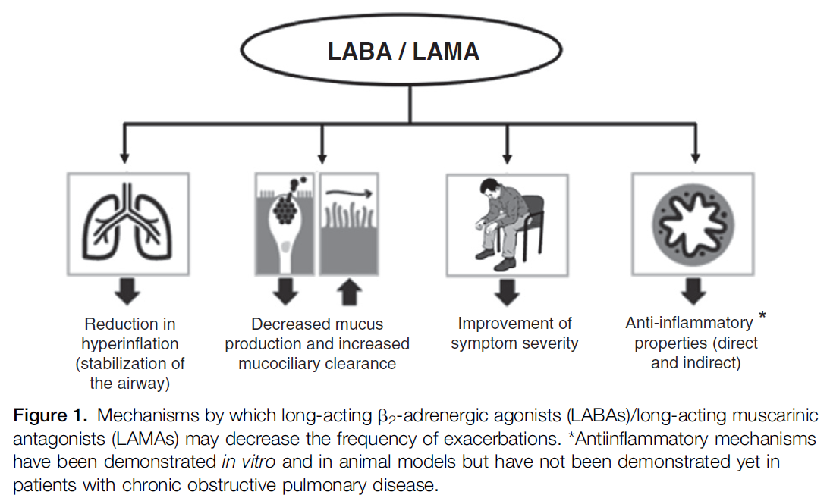

Slide 28
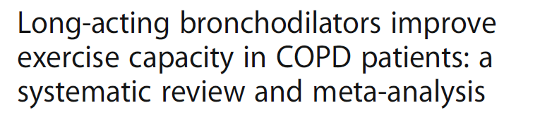
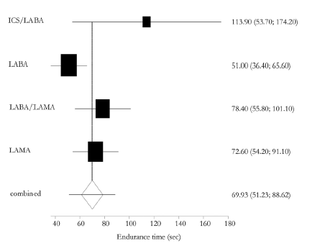

Slide 29
Treatment of stable COPD
Definition of abbreviations: eos: blood eosinophil count in cells per microliter; mMRC: modified Medical Research Council dyspnea questionnaire; CAT™: COPD Assessment Test™.
© 2017 Global Initiative for Chronic Obstructive Lung Disease
© 2019 Global Initiative for Chronic Obstructive Lung Disease

Slide 30
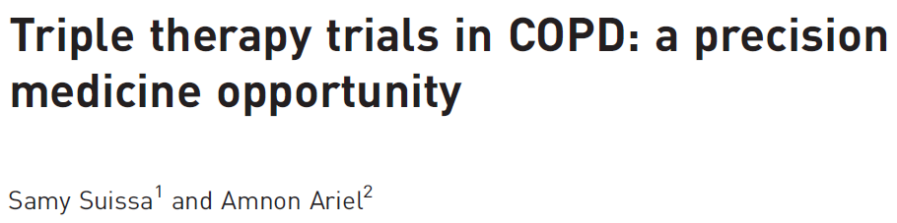
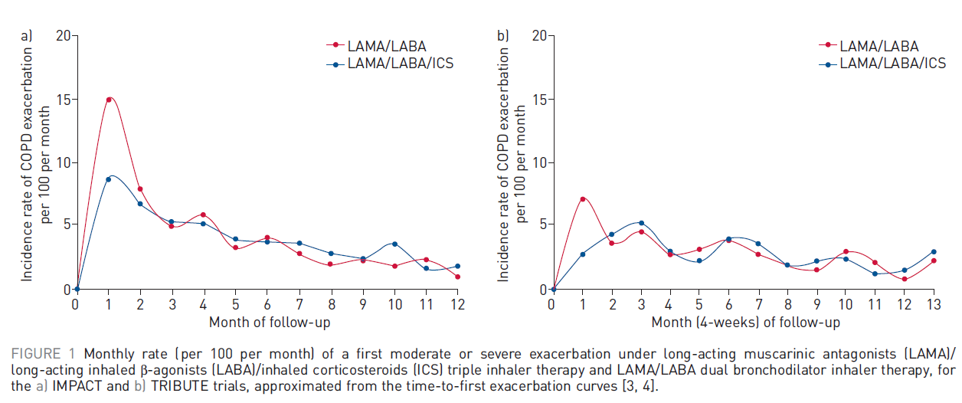

IMPACT
TRIBUTE

Slide 31
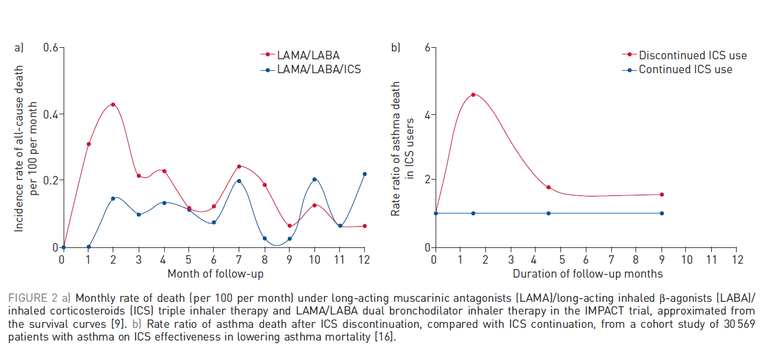

Slide 32
We demonstrated that the timing of the exacerbations in these trials presents a particularly informative pattern. It shows that the lower rate of a first exacerbation with triple therapy is exclusively due to a lower rate in the first month of follow-up, while the rate was comparable to LAMA/LABA in the subsequent 11 months. This pattern of “depletion of susceptibles” suggests that there is a subset of patients who could benefit from triple therapy, while the remaining patients benefit equally from LAMA/LABA.

Slide 33
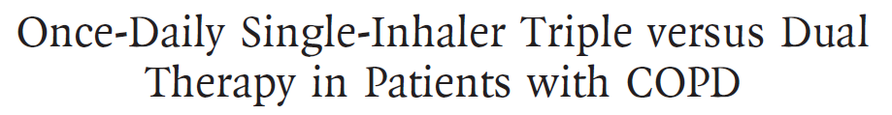


…. patients with a history of asthma have been included …..

Slide 34
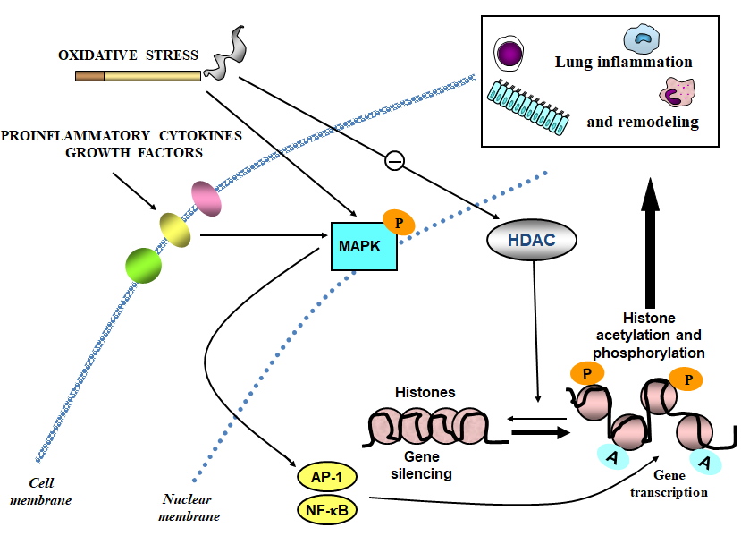
Notes:
Due to the observed different percentages of patients with a history of exacerbation at baseline in treatment groups (16.4% of QVA149 and 25.2% of SFC), post-hoc analyses were performed on subgroups of patients with or without a baseline history of exacerbation. The rate of moderate or severe COPD exacerbations was analyzed in these subgroups of patients with the same negative binomial model used for the overall population, except without the baseline COPD exacerbation history term in the model.
In patients with a history of moderate or severe exacerbations at baseline, the annualized rate of moderate or severe COPD exacerbations was 40% lower in the QVA149 treatment arm compared with SFC treatment arm (rate ratio 0.60 with 95% CI, 0.33-1.08). In only those patients without a history of moderate or severe exacerbations at baseline, the annualized rate of moderate or severe COPD exacerbations was 34% lower in the QVA149 treatment arm compared with SFC treatment arm (rate ratio 0.76; 95% CI, 0.46- 1.24).
Reference
Zhong N, Wang C, Zhou X, Zhang N, Humphries M, Wang L, Thach C, Patalano F, Banerji D. LANTERN: a randomized study of QVA149 versus salmeterol/fluticasone combination in patients with COPD. International Journal of Chronic Obstructive Pulmonary Disease. 2015 (In press )

Slide 35
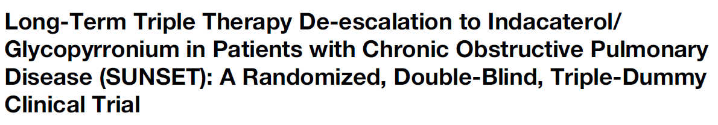


Slide 36
The many faces of COPD

Slide 37
Trattamento quotidiano del paziente con BPCO di grado lieve-moderato
Fabiano Di Marco
Università degli Studi di Milano
Pneumologia
Ospedale Papa Giovanni XXIII, Bergamo
fabiano.dimarco@unimi.it

Slide 38




Slide 39
Why are airflows reduced in COPD?
Elastic recoil
Flow
Flow =
Resistance
Volume

Slide 40
oxidative stress
pro-inflammatory cytokines
growth factors
Cell membrane
MAPKKK
TAK1
ASK1
Ras
Common
pathways
Raf
MKK 4/7
MKK 3/6
MEK 1/2
MAPK
JNK 1, 2, 3
MAPK
p38 α, β, γ, δ
MAPK
ERK 1, 2
INFLAMMATION
APOPTOSIS
PROLIFERATION
Transcription factors (NF-κB, AP-1)
Nuclear membrane
Gene transcription
Pelaia G, Cuda G, Vatrella A, Gallelli L, Caraglia M, Marra M, Abbruzzese A, Caputi M, Maselli R, Costanzo FS, and Marsico SA. J Cell Physiol 202:642-653, 2005

Slide 41

Sputum p38 MAPK activity is inversely correlated with FEV₁% in COPD
Huang C, Xie M, He X, Gao H. Med Sci Monit 19:1229-1235, 2013

Slide 42
Glucocorticoid
β₂-agonist
β₂-AR
Gs
AC
Cytoplasm
cAMP
PKA
+
GR
mRNA
Nuclear membrane
Nucleus
β₂-AR gene
GRE
GRE
GRE
Pelaia G et al. Expert Opin Pharmacother 16:2009-2021, 2015

Slide 43


ICS in COPD
Patients with at least one exacerbation
(%)
(Pauwels et al. NEJM 1999)
(Paggiaro et al. Lancet 1998)

Slide 44

% of patients ≥ 1 exacerbation
Exacerbation/year
62%
59%
1.32
1.28
Tiotropium
SFC
Tiotropium
SFC
1500 patients with history of exacerbations, FEV1<50% and reversibility<10%

Slide 45



Slide 46


Slide 48

Post Bronchodilator FEV₁ (mL)
100
50
0
Adj. Mean Change FEV₁
-50
-100
Plc
SAL
FP
SFC
-150
0
24
48
72
96
120
156
Time (Weeks)
Number
of Subjects
1524
1521
1534
1533
1248
1317
1346
1375
1128
1218
1230
1281
1049
1127
1157
1180
979
1054
1078
1139
906
1012
1006
1073
819
934
908
975
Vertical bars represent standard errors
Calverley PMA et al, N Engl J Med. 356(8): 775-89.
Notes:
ITT Pop, Source figure: 7.4.004

Slide 50


Slide 51
Il ruolo dello steroide inalatorio nella terapia della BPCO
«Mamma diceva sempre: la vita è come una scatola di cioccolatini, non sai mai quello che ti capita.» (Forrest Gump)

Slide 52

OXIDATIVE STRESS
Lung inflammation
and remodeling
PROINFLAMMATORY CYTOKINES
GROWTH FACTORS
P
HDAC
MAPK
Histone acetylation and phosphorylation
P
P
Histones
Gene silencing
A
A
Cell
membrane
AP-1
Gene transcription
Nuclear
membrane
NF-κB

Slide 53
Corticosteroid resistance in COPD patients
HDAC activity
150
100
HDAC activy
(dpm/µg protein)
P<0.01
50
0
Non-sm
Smoker
COPD
Ito K et al: FASEB J 2001

Slide 54


Long-term inhaled corticosteroid treatment affects bacterial load in stable COPD.

Slide 55

The GLUCOLD (Groningen Leiden Universities Corticosteroids in Obstructive Lung Disease) project enrolled patients with COPD who were aged 45 to 75 years, were current or former smokers, had smoked for 10 or more pack-years, and had lung function levels compatible with Global Initiative for Chronic Obstructive Lungn Disease (GOLD) stages II and III. Exclusion criteria were asthma and receipt of ICS within 6 months before random assignment.

Slide 56


Slide 57


Slide 58
Our patients had predominantly moderate degrees of airway obstruction and most demonstrated airway hyperresponsiveness or modest reversibility of FEV1. Recent studies show that these characteristics, previously attributed to asthma alone, can also be components of COPD.

Slide 59



(Magnussen et al. NEJM 2014, The WISDOM study)

Slide 60



Slide 61

Lower eosinophil counts are associated with increased airway bacterial load.

Slide 62
This 26-week, randomized, double-blind, triple-dummy study assessed the direct change from long-term triple therapy to indacaterol/glycopyrronium (110/50 μg once daily) or continuation of triple therapy (tiotropium 18 μg once daily plus combination of salmeterol/fluticasone propionate [50/500 μg] twice daily) in non-frequently exacerbating patients with moderate-to-severe COPD. Primary endpoint was non-inferiority on change from baseline in trough forced expiratory volume in 1 second (FEV1). Moderate or severe exacerbations were predefined secondary endpoints.

Slide 63


Slide 64


Slide 65



Slide 66


Slide 67



Slide 69



Slide 70
La triplice associazione: indicazioni e limiti
Fabiano Di Marco
Università degli Studi di Milano
Pneumologia
Ospedale Papa Giovanni XXIII, Bergamo
fabiano.dimarco@unimi.it

Slide 71



Slide 72
In summary, using the large and comprehensive phenotypic characterisation of the SPIROMICS cohort, we show that stratification by increased sputum eosinophil inflammation identified a subgroup with more severe COPD, decreased lung function, worse emphysema and air trapping, and more COPD exacerbations. Peripheral blood eosinophil counts identified a subgroup with decreased lung function without other indices of more severe COPD, specifically exacerbations, unless examined on the background of increased sputum eosinophils. Furthermore, blood eosinophil counts did not accurately predict sputum eosinophil counts.

Slide 73



FEV₁
n = 65
FEV₁ = 57 % pred.
after prednisone
(30 mg/d x 3 weeks)
AJRCCM 2009, 180;846-852
Notes:
73

Slide 74
Il ruolo dello steroide inalatorio nella terapia della BPCO
«Mamma diceva sempre: la vita è come una scatola di cioccolatini, non sai mai quello che ti capita.» (Forrest Gump)

Slide 75
BDP/F vs F IN COPD: the FORWARD Study
co-primary endpoints
↑ FEV₁
Exacerbations
+69 mL
1.2
EXACT-PRO
90
P<0.001
1.0
P<0.001
60
0.8
- 28%
Mean ↑ in FEV₁ (mL)
Exacerbation rate / patient / year
0.6
30
0.4
0.2
0
0
BDP/F
400/24
Formoterol
24
BDP/F
400/24
Formoterol
24
Wedzicha JA et al: Resp Med 2014
Notes:
The FORWARD (Foster 48-week Trial to Reduce Exacerbations in COPD) clinical trial in severe COPD patients is a comparison of extrafine beclomethasone dipropionate and formoterol in a combination inhaler with extrafine formoterol; the co-primary end-points are exacerbation rates over 48 weeks and improvement in forced expiratory volume in 1 s over 12 weeks.
The ITT population included 1186 patients
Foster può essere usato anche per il trattamento dei sintomi della broncopneumopatia cronica ostruttiva grave (BPCO) in pazienti adulti. La BPCO è una malattia cronica delle vie aeree a livello polmonare che è causata principalmente dal fumo di sigaretta.

Slide 76

Studio COSMIC: sintomi
Percentuale dei giorni liberi da farmaco al bisogno:
47% salmeterolo vs 53 % Salm/FP
(p=0.014)
Salmeterolo
Salm/FP
Salmeterolo
Punteggio della dispnea:
Differenza tra Salm/FP e salmeterolo = 0.17 (p< 0.001).
Salm/FP
Percentuale di notti con risvegli
Differenza tra Salm/FP e salmeterolo = 6% (p< 0.001)
Salmeterolo
Salm/FP
Wouter et al., Thorax 2005

Slide 77



Slide 79



Slide 80



Slide 81


Rogliani, Di Marco et al. ERS 2018

Slide 82

0.86**
(0.78, 0.94)
0.84*
(0.75, 0.95)
0.85††
(0.77, 0.94)
0.85†
(0.75, 0.96)
0.90‡
(0.79, 1.02
0.88§
(0.77, 0.99)
1.16¶
(0.84, 1.61)
0.81||
(0.60, 1.10)
Values are rate reduction (95% CI); n numbers per treatment group: QVA149 n=729; glycopyrronium n=739; tiotropium n=737.
*p=0.0052,†p=0.0072,‡p=0.096,§p=0.038,¶p=0.36,||p=0.18,**p=0.0017,††p=0.0012.

Slide 83

Outcome of LAMA/LABA FDC compared with LABA/ICS
History of 1 exacerbation in the previous year
Lantern study. Zhong et al. Int J COPD, 2015

Slide 84

Notes:
Due to the observed different percentages of patients with a history of exacerbation at baseline in treatment groups (16.4% of QVA149 and 25.2% of SFC), post-hoc analyses were performed on subgroups of patients with or without a baseline history of exacerbation. The rate of moderate or severe COPD exacerbations was analyzed in these subgroups of patients with the same negative binomial model used for the overall population, except without the baseline COPD exacerbation history term in the model.
In patients with a history of moderate or severe exacerbations at baseline, the annualized rate of moderate or severe COPD exacerbations was 40% lower in the QVA149 treatment arm compared with SFC treatment arm (rate ratio 0.60 with 95% CI, 0.33-1.08). In only those patients without a history of moderate or severe exacerbations at baseline, the annualized rate of moderate or severe COPD exacerbations was 34% lower in the QVA149 treatment arm compared with SFC treatment arm (rate ratio 0.76; 95% CI, 0.46- 1.24).
Reference
Zhong N, Wang C, Zhou X, Zhang N, Humphries M, Wang L, Thach C, Patalano F, Banerji D. LANTERN: a randomized study of QVA149 versus salmeterol/fluticasone combination in patients with COPD. International Journal of Chronic Obstructive Pulmonary Disease. 2015 (In press )

Slide 85

Notes:
Due to the observed different percentages of patients with a history of exacerbation at baseline in treatment groups (16.4% of QVA149 and 25.2% of SFC), post-hoc analyses were performed on subgroups of patients with or without a baseline history of exacerbation. The rate of moderate or severe COPD exacerbations was analyzed in these subgroups of patients with the same negative binomial model used for the overall population, except without the baseline COPD exacerbation history term in the model.
In patients with a history of moderate or severe exacerbations at baseline, the annualized rate of moderate or severe COPD exacerbations was 40% lower in the QVA149 treatment arm compared with SFC treatment arm (rate ratio 0.60 with 95% CI, 0.33-1.08). In only those patients without a history of moderate or severe exacerbations at baseline, the annualized rate of moderate or severe COPD exacerbations was 34% lower in the QVA149 treatment arm compared with SFC treatment arm (rate ratio 0.76; 95% CI, 0.46- 1.24).
Reference
Zhong N, Wang C, Zhou X, Zhang N, Humphries M, Wang L, Thach C, Patalano F, Banerji D. LANTERN: a randomized study of QVA149 versus salmeterol/fluticasone combination in patients with COPD. International Journal of Chronic Obstructive Pulmonary Disease. 2015 (In press )

Slide 86




Slide 87


Slide 88


Slide 90



Slide 91




Slide 94
Le diverse facce della BPCO
Normale
Bronchiolite cronica fibrosante
Enfisema
Notes:
La BPCO include quindi diverse patologie che coinvolgono le vie aeree (malattia delle piccole vie aeree) ed il parenchima polmonare (enfisema che può essere parasettale, centrolobulare o panlobulare). Le forme a prevalente enfisema sono più rare (<10%).

Slide 95



Slide 96

To evaluate the superiority of the BDP/FF/GB over IND/GLY in COPD patients – The TRIBUTE study
A 52-week, double-blind, randomized, 2-arm, parallel-group study
Sample size – 1534
Target Population – Patients with severe and very severe COPD (GOLD 2014)
Arm 1 – BDP/FF/GB (100/6/12.5 µg) (2 puffs b.i.d.) + placebo
Arm 2 – IND/GLY (85/43 µg) q.d. + placebo
Primary endpoint
To demonstrate the superiority of BDP/FF/GB (400/24/50 µg) over IND/GLY (85/43 µg) in terms of moderate and severe COPD exacerbation rate over 52 weeks of treatment
https://clinicaltrials.gov/ct2/show/NCT02579850
BDP, beclometasone dipropionate; b.i.d., twice-daily; FF, fluticasone furoate; GB, glycopyrronium bromide;
GLY, glycopyrronium; GOLD, Global Initiative for Chronic Obstructive Lung Disease; IND, indacaterol;
q.d., once daily

Slide 97


Slide 98



Slide 99
Study interpretation
In severe COPD patients (FEV1 ≤50%), with symptoms of chronic bronchitis, and a history of at least two exacerbations in the previous year despite ICS/LABA(LAMA) combination, roflumilast 500 μg leads to:
13-14% reduction of moderate to severe exacerbation;
24% reduction of severe exacerbation and exacerbation necessitating hospital admission
No change of symptoms

Slide 100



Slide 101



Slide 102



Slide 103



All patients
COPD

Slide 104

Authors’ conclusions
In participants with chronic bronchitis or COPD, we are moderately confident that treatment with mucolytics may produce a small reduction in acute exacerbations and a small effect on overall quality of life. Our confidence in the results is reduced by the fact that effects on exacerbations shown in early trials were larger than those reported by more recent studies, possibly because the earlier smaller trials were at greater risk of selection or publication bias, thus benefits of treatment may not be as great as was suggested by previous evidence.

Slide 105


Slide 106



Slide 107



Slide 108

Bacteria-exacerbations

Slide 109

Virus-exacerbations

Slide 110

Eosinophil-exacerbations

Slide 111



Slide 112


Slide 113


Slide 114


Slide 115


Slide 116



Pity the poor clinical researcher who is charged with identifying and quantifying chronic obstructive pulmonary disease (COPD) exacerbation events in clinical trials. An exacerbation of COPD is a clinical event that: 1) has no standard, consensus definition [1]; 2) often goes unreported and undetected if patients choose to stay at home instead of presenting to a healthcare provider [2]; 3) often occurs suddenly with little or no warning [3]; and 4) is subject to diagnostic uncertainty and is easily confused with pulmonary embolism, congestive heart failure or pneumonia [4–6].
At present, it is difficult to conclude that EXACT is effective at measuring COPD exacerbation events, especially when the study by MCKAY et al. [10] suggests that EXACT is missing two-thirds of the clinically important events in question. One cannot measure something if one does not know that it is there.

Slide 117


Conclusion: Patients with AECOPD display heterogeneous inflammation, and the profiles of sputum inflammatory cells may be used as valuable biomarkers for the classification of AECOPD patients.

Slide 118



Slide 119


Slide 121


Dyspnea

Slide 122



Slide 124
Trattamento quotidiano del paziente con BPCO di grado lieve-moderato
Fabiano Di Marco
Università degli Studi di Milano
Pneumologia
Ospedale Papa Giovanni XXIII, Bergamo
fabiano.dimarco@unimi.it

Slide 125

WITHDRAWAL OF INHALED CORTICOSTEROID TREATMENT IN COPD
Wouters et al, Thorax 2005

Slide 126
BDP/F vs F IN COPD: the FORWARD Study
co-primary endpoints
↑ FEV₁
+69 mL
90
P<0.001
60
Mean ↑ in FEV₁ (mL)
30
0
BDP/F
400/24
Formoterol
24
Wedzicha JA et al: Resp Med 2014
Notes:
The FORWARD (Foster 48-week Trial to Reduce Exacerbations in COPD) clinical trial in severe COPD patients is a comparison of extrafine beclomethasone dipropionate and formoterol in a combination inhaler with extrafine formoterol; the co-primary end-points are exacerbation rates over 48 weeks and improvement in forced expiratory volume in 1 s over 12 weeks.
The ITT population included 1186 patients
Foster può essere usato anche per il trattamento dei sintomi della broncopneumopatia cronica ostruttiva grave (BPCO) in pazienti adulti. La BPCO è una malattia cronica delle vie aeree a livello polmonare che è causata principalmente dal fumo di sigaretta.

Slide 127
BDP/F IN COPD: lung function
12-months, 718 patients with severe COPD: FEV₁ ~42% pred
Post-bronchodilator FEV₁
Forced vital capacity
No significant difference
between BDP/F and BUD/F
Change from baseline (mL)
350
300
250
200
50
100
P<0.005
*
80
*
60
n.s.
Change from baseline (mL)
40
BDP/Form 400/24μg
BUD/Form 800/24μg
Formoterol 24μg
n.s.
20
0
BDP/F BUD/F Form
400/24μg 800/24μg 24μg
0 4 24 48
Weeks
Calverley P et al: Resp Med 2010

Slide 128

ICS and COPD
VIVACE Study
TORCH Study
5
Budesonide/
Formoterolo
Budesonide
Formoterolo
+1.5%
0
1.2
1.13
Exacerbation/Patient/year
0.97*
0.93*
–5
1
0.85*†‡
–7.5%
–10
0.8
Hazard rate of time to first severe exacerbation
vs placebo (%)
0.6
–15
0.4
–20
0.2
–25
0
Placebo
SALM
FP
SALM/FP
–30
–28.5%
**
Kardos P et al, AJRCCM 2007
Calverley NEJM 2007;356:775-89.
–35
(Calverley et al., Eur Resp J 2003)
Notes:
Seretide è indicato per il trattamento sintomatico di pazienti con BPCO, con una FEV1<60% del normale previsto (pre-broncodilatatore) ed una storia di riacutizzazioni ripetute, che abbiano sintomi significativi nonostante la terapia regolare con broncodilatatori
Symbicort Turbohaler è indicato negli adulti di età superiore ai 18 anni, per il trattamento sintomatico di pazienti con broncopneumopatia cronica ostruttiva grave (FEV₁ < 50% del normale) e storia di ripetute riacutizzazioni, con sintomi significativi nonostante la terapia regolare con broncodilatatori a lunga durata d’azione.

Slide 129
Extrafine BDP/FF in COPD
Extrafine BDP/F significantly reduces exacerbations compared to formoterol
1.2
1.0
- 28%
*
0.8
Exacerbation rate per patient per year
0.6
0.4
RR Extrafine BDP/F vs formoterol 0.719 (0.619; 0.837)
* p<0.001
0.2
0
Extrafine BDP/F
Formoterol
FORWARD study: Agusti et al, ERS 2013

Slide 130

Once-daily inhaled fluticasone furoate and vilanterol versus vilanterol only for prevention of exacerbations of COPD: two replicate double-blind, parallel-group, randomised controlled trials.
Study 1
Study 2
Overall
Dransfield M et al., Lancet Respir Med 2013; 1: 210–23
Notes:
Relvar Ellipta è indicato per il trattamento sintomatico degli adulti con BPCO con FEV₁<70% del normale predetto (post-broncodilatatore) con una storia di riacutizzazioni nonostante la terapia regolare con broncodilatatori.

Slide 132



Slide 133


Slide 134


Slide 135


The role of small airways in COPD
Gold stage 0
Gold stage 1
Gold stage 2 and 3
Gold stage 4
Airways with measurable cells (%)
(Hogg et al NEJM 2004)

Slide 136



Slide 137


Slide 138


Slide 139
The annual rate of severe exacerbations during treatment was 0.13 among patients assigned to triple therapy, 0.15 among those assigned to fluticasone furoate–vilanterol (rate ratio with triple therapy, 0.87; 95% CI, 0.76 to 1.01; 13% difference; P = 0.06), and 0.19 among those assigned to umeclidinium–vilanterol (rate ratio with triple therapy, 0.66; 95% CI, 0.56 to 0.78; 34% difference; P<0.001). Thus, the rate was not significantly lower with triple therapy than with fluticasone furoate–vilanterol but was significantly lower with triple therapy than with umeclidinium–vilanterol.

Slide 140
For the spirometric outcome of the mean change from baseline in trough FEV1, the difference between the triple-therapy and fluticasone furoate–vilanterol groups was 97 ml (95% CI, 85 to 109; P<0.001), and the difference between the triple-therapy and umeclidinium–vilanterol groups was 54 ml (95% CI, 39 to 69; P<0.001).

Slide 141
The annual rate of moderate or severe exacerbations was lower with triple therapy than with either dual-therapy combination, regardless of eosinophil level, although a greater reduction in the exacerbation rate was observed in patients with eosinophil levels of at least 150 cells per microliter. Among patients with eosinophil levels of less than 150 cells per microliter, the annual rate of moderate or severe exacerbations was 0.85 (95% CI, 0.80 to 0.91) with triple therapy, 1.06 (95% CI, 0.99 to 1.14) with fluticasone furoate–vilanterol, and 0.97 (95% CI, 0.88 to 1.07) with umeclidinium–vilanterol. Among patients with eosinophil levels of at least 150 cells per microliter, the annual rate was 0.95 (95% CI, 0.90 to 1.01) with triple therapy, 1.08 (95% CI, 1.02 to 1.14) with fluticasone furoate–vilanterol, and 1.39 (95% CI, 1.29 to 1.51) with umeclidinium–vilanterol.

Slide 142


Slide 144


Slide 145
Sputum eosinophilia and response
to budesonide in COPD
With sputum eosinophilia
Changes in post-bronchodilator FEV₁ in patients with or without sputum eosinophilia
Without sputum eosinophilia
0.15
*,#
*,#
0.10
ΔPost-BD FEV₁ (L)
0.05
0.00
-0.05
*p<0.05 within group (sputum eosinophilia) vs placebo
#p<0.05 between groups
Placebo
Budesonide
Prednisone
Leigh et al. ERJ 2006;27:964-971
Notes:
145

Slide 146
(Magnussen et al. NEJM 2014, The WISDOM study)

Slide 147


Slide 148


Slide 149


Slide 150
Conflict of interest statement
Speaker's hononaria from: Astra Zeneca, BI, Pfizer, GSK, Valeas, MSD, Menarini, Novartis, Chiesi, Almiral, Zambon, Dompè, Guidotti, Malesci and Teva.
Consultant for training: Almiral, Novartis, Dompè, UCB.
Research grant: Novartis, BI.

Slide 151

Ruolo della broncodilatazione nei diversi fenotipi dell’ASMA, della
BPCO e nell’ACOS
Fabiano Di Marco
Università degli Studi di Milano
Pneumologia
Ospedale Papa Giovanni XXIII, Bergamo
fabiano.dimarco@unimi.it

Slide 152
Ruolo della broncodilatazione nei diversi fenotipi dell’ASMA, della
BPCO e nell’ACOS
Fabiano Di Marco
Università degli Studi di Milano
Pneumologia
Ospedale Papa Giovanni XXIII, Bergamo
fabiano.dimarco@unimi.it

Slide 153



Slide 154



Slide 155


Slide 156


Slide 158



Slide 159

Progressione della BPCO nel tempo
Macklem PT. Eur Respir J 2010

Slide 160



Notes:
Panel C shows the association between total wall thickness, measured as the ratio of the volume to the surface area
(V:SA), and forced expiratory volume in one second (FEV
1
) for all 159 patients.

Slide 161


