Slide 1




COPD TREATMENT: LOOKING FORWARD
PNEUMOTRIESTE 2019
Hotel Savoia Excelsior Palace, Trieste 2 April 2019
Il contesto per una triplice terapia in BPCO
Leonardo M. Fabbri, MD, FERS
Professor of Respiratory and Internal Medicine, University of Modena and Reggio Emilia, (-2016)
Eminent Scholar of Respiratory and Internal Medicine, University of Ferrara, 2017 to date
Visiting Professor of Respiratory and Internal Medicine, COPD Center, University of Gothenburg, 2017 to date

Slide 2
Il contesto per una triplice terapia in BPCO
Leonardo M. Fabbri, MD, FERS
BPCO come componente polmonare della multimorbidità
Obiettivi del trattamento della BPCO
Quali sono state le premesse per arrivare ad una triplice terapia inalatoria in un singolo inalatore nella BPCO
Il futuro del trattamento del paziente con BPCO

Slide 3
Il contesto per una triplice terapia in BPCO
Leonardo M. Fabbri, MD, FERS
BPCO come componente polmonare della multimorbidità
Obiettivi del trattamento della BPCO
Quali sono state le premesse per arrivare ad una triplice terapia inalatoria in un singolo inalatore nella BPCO
Il futuro del trattamento del paziente con BPCO

Slide 4
Il contesto per una triplice terapia in BPCO
Leonardo M. Fabbri, MD, FERS
BPCO come componente polmonare della multimorbidità
Obiettivi del trattamento della BPCO
Quali sono state le premesse per arrivare ad una triplice terapia inalatoria in un singolo inalatore nella BPCO
Il futuro del trattamento del paziente con BPCO

Slide 5
Obiettivi del trattamento
Ridurre
I sintomi
Il rischio futuro
Ridurre I sintomi quotidiani
Migliorare la tolleranza allo sforzo
Migliorare lo stato di salute
Prevenire le riacutizzazioni
Prevenire la progressione della malattia
Ridurre la mortalità

Slide 6
Il contesto per una triplice terapia in BPCO
Leonardo M. Fabbri, MD, FERS
BPCO come componente polmonare della multimorbidità
Obiettivi del trattamento della BPCO
Quali sono state le premesse per arrivare ad una triplice terapia inalatoria in un singolo inalatore nella BPCO
Il futuro del trattamento del paziente con BPCO

Slide 7

Manage stable COPD: Pharmacologic therapy
FIRST CHOICE
C
D
GOLD 4
ICS + LABA
or
LAMA
ICS + LABA
or/and
LAMA
> 2
GOLD 3
Exacerbations per year
A
B
GOLD 2
SAMA prn
or
SABA prn
LABA
or
LAMA
1
GOLD 1
0
mMRC 0-1
CAT < 10
mMRC > 2
CAT > 10

Slide 8
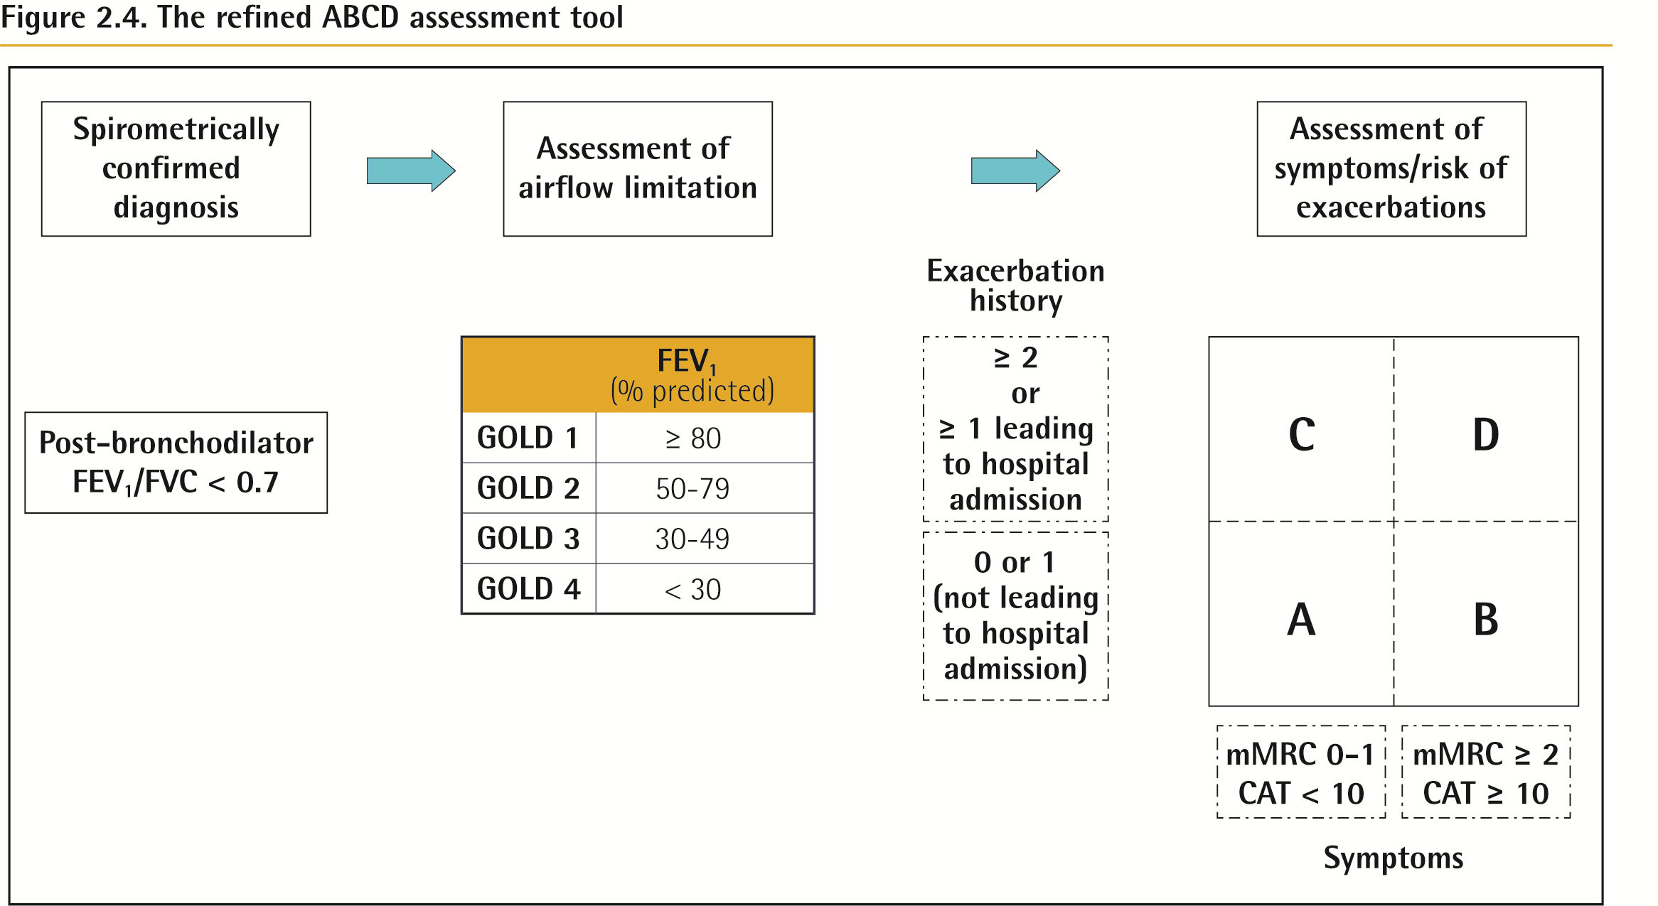
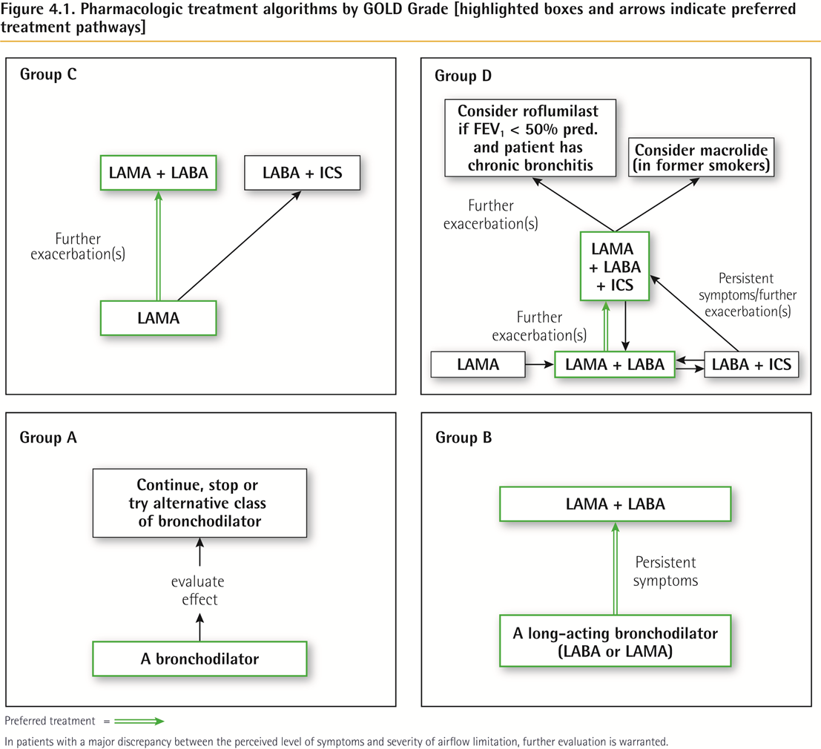
ABCD Assessment Tool
© 2018 Global Initiative for Chronic Obstructive Lung Disease

Slide 9
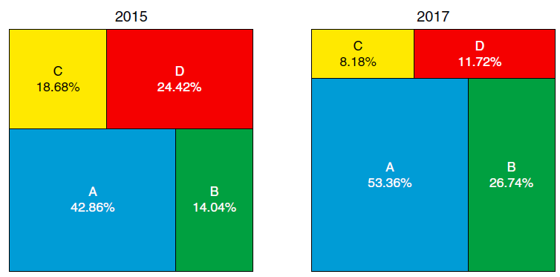
DISTRIBUTION OF THE SAME PATIENTS WITH CHRONIC OBSTRUCTIVE PULMONARY DISEASE IN THE DIFFERENT ABCD GLOBAL INITIATIVE FOR CHRONIC OBSTRUCTIVE LUNG DISEASE GRADING GROUPS USING THE 2011 VERSION VERSUS THE NEW 2017 VERSION
2011
Cabrera López C et al., Am J Respir Crit Care Med. 2018 Feb 15;197(4):463-469

Slide 10
Manage stable COPD: Pharmacologic therapy
FIRST CHOICE (2017)
Group C
Group D
Consider roflumilast if FEV1 < 50% pred and patient has chronic bronchitis
LAMA + LABA
LABA + ICS
Consider macrolide
Further
Exacerbation(s)
Further
Exacerbation(s)
LAMA + LABA + ICS
Persistent
symptoms/further
exacerbations
Further
Exacerbation(s)
LAMA
LAMA
LAMA + LABA
LABA + ICS
Group A
Group B
Continue, stop or
try alternative class
of bronchodilator
LAMA + LABA
Persistent
symptoms
Evaluate
effect
A long-acting bronchodilator
(LABA or LAMA)
A bronchodilator

Slide 11
COMPARISON OF INDACATEROL/GLYCOPYRROMNIUM COMBINATION (110/50 µg) versus SALMETEROL/FLUTICASONE (50/500 µg) BID FOR THE ROW
52-week, multicenter, randomized, double-blind, parallel-group, double-dummy study
Prerandomization period
Double-blind treatment period
(52 weeks)
30-day safety follow-up
IND/GLY 110/50 μg q.d.
Screening period
Run-in period
SFC 50/500 µg b.i.d.
Day –35 to
Day –29
Day –28 to
Day –1
Day 1 to Day 365
Day 366 to
Day 395
Randomization
Visit 1
Visit 101
Visit 201
12 clinic visits
Wedzicha JA, et al. N Engl J Med 2016 Jun 9;374(23):2222-34
Notes:
Abbreviations
b.i.d. = twice daily
COPD = chronic obstructive pulmonary disease
GLY = glycopyrronium
IND = indacaterol
q.d. = once daily
SFC = salmeterol/fluticasone propionate combination

Slide 12
IND/GLY showed superiority in reducing the annual rate of moderate or severe exacerbations (healthcare utilization) versus SFC
SFC 50/500 μg b.i.d. (N=1656)
IND/GLY 110/50 μg q.d. (N=1651)
1.5
1.25
- 17%
1.0
Moderate or severe exacerbations (annualized rate)
0.75
0.5
0.25
0
Total number of events: IND/GLY = 1,265 (includes 209 severe events)
SFC = 1,452 (includes 241 severe events)
Analysis of the modified intention-to-treat set (mITT)
Wedzicha JA, et al. N Engl J Med. Online May 15, 2016
Wedzicha JA, et al. N Engl J Med. Online May 15, 2016 Supplementary appendix
Notes:
Abbreviations
b.i.d. = twice daily
CI = confidence interval
GLY = glycopyrronium
IND = indacaterol
q.d. = once daily
RR = rate ratio
SFC = salmeterol/fluticasone propionate combination

Slide 13
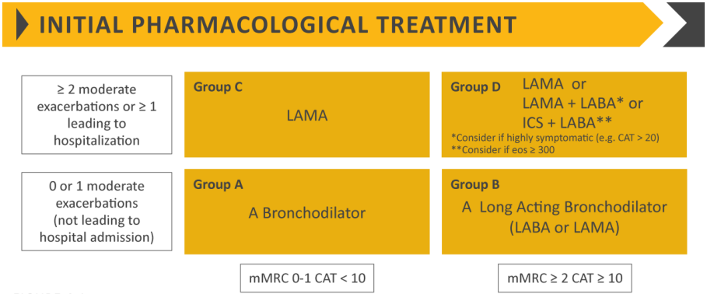
GOLD 2019 (Initial choice)
GOLD 2019 Report: Available from http://goldcopd.org/gold-2019-global-strategy-diagnosis-management-prevention-copd

Slide 14
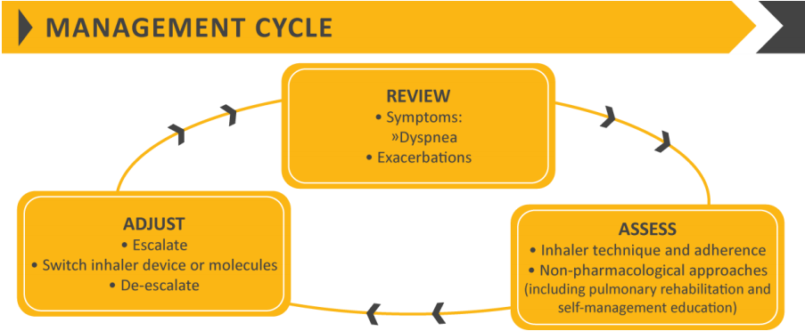
GOLD 2019 (Management Cycle)
GOLD 2019 Report: Available from http://goldcopd.org/gold-2019-global-strategy-diagnosis-management-prevention-copd

Slide 15
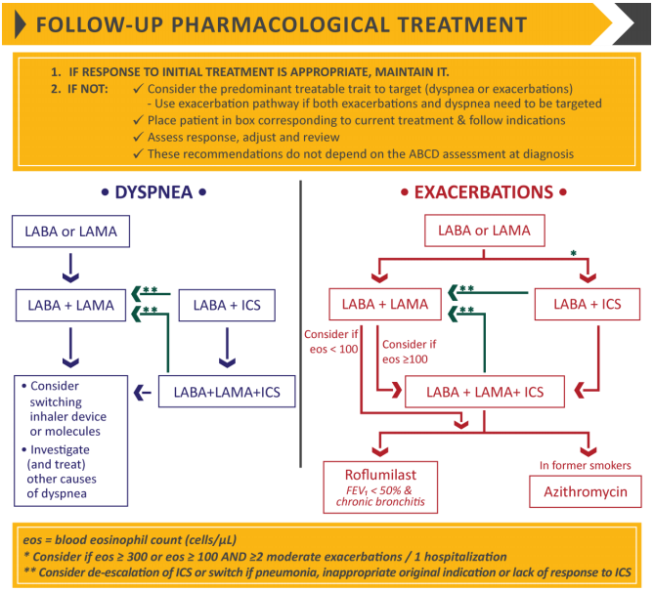
GOLD 2019 Follow-up treatment
GOLD 2019 Report: Available from http://goldcopd.org/gold-2019-global-strategy-diagnosis-management-prevention-copd

Slide 16
TRIPLE IN A SINGLE INHALER IS SUPERIOR TO LABA/LAMA IN REDUCING EXACERBATIONS IN D AND B COPD
1.0
0.9
RR 0.848
(0.723-0.995)
p=0.043
RR 0.866
(0.723-1.037)
p=0.118
RR 0.787
(0.551-1.125)
p=0.189
0.8
0.7
- 15%
0.59
(0.53-0.67)
0.6
0.50
(0.45-0.57)
0.47
(0.41-0.54)
0.41
(0.36-0.47)
0.5
Rate of exacerbations over 52 weeks
0.4
0.3
0.2
0.09
(0.07-0.12)
0.07
(0.06-0.10)
0.1
0
Moderate to severe
Moderate
Severe
BDP/FF/G (n=764)
Exacerbation severity
IND/GLY(n=768)
Papi A et al. Lancet 2018 ; 391(10125): 1076-1084

Slide 17
TRIPLE IN A SINGLE INHALER IS SUPERIOR TO LABA/ICS IN REDUCING EXACERBATIONS IN D AND B COPD
0.6
0.56
BDP/FF/GB
BDP/FF
0.5
0.45
0.43
0.4
0.33
0.3
Annualised exacerbation rate
0.2
0.12
0.14
0.1
0
Moderate/severe exacerbations
Moderate exacerbations
Severe exacerbations
Singh D et al. Lancet 2016; 388: 963–73

Slide 18
TRIPLE IN A SINGLE INHALER IS SUPERIOR TO TIOTROPIUM IN REDUCING EXACERBATIONS IN D AND B COPD
1.0
Primary: RR 0.80
(95% CI 0.69-0.92); p=0.0025
0.9
RR 1.01
(95% CI 0.85-1.21); p=0.89
0.8
RR 0.79
(95% CI 0.66-0.94); p=0.0095
0.7
0.6
0.5
Annualised exacerbation rate
0.57
(0.52-0.63)
0.4
0.46
(0.41-0.51)
0.45
(0.39-0.52)
0.3
0.2
0.1
0
Fixed triple (n=1077)
Tiotropium (n=1074)
Open triple (n=538)
Vestbo J. et al., Lancet 2017; 389: 1919–29

Slide 19
EXTRAFINE TRIPLE THERAPY IN PATIENTS WITH SYMPTOMATIC COPD AND HISTORY OF ONE MODERATE EXACERBATION
The results of these post-hoc analyses, in patients with symptomatic COPD, severe or very severe airflow limitation, and who had one moderate exacerbation in the previous year despite receiving regular inhaled maintenance therapy with single long-acting bronchodilator or dual combination therapy prior to entering the study, showed that inhaled triple therapy with extrafine BDP/FF/G provided clinical benefits compared with LAMA, ICS/LABA and LABA/LAMA.
Singh D, Fabbri LM et al, Eur Respir J, 2019; DOI: 10.1183/13993003.00235-2010

Slide 20
ONCE-DAILY SINGLE-INHALER TRIPLE THERAPY VERSUS DUAL THERAPY IN COPD
Lipson et al, New E J Med 18 April 2018

Slide 21
ONCE-DAILY SINGLE-INHALER TRIPLE THERAPY VERSUS DUAL THERAPY IN COPD
Lipson et al, New E J Med 18 April 2018

Slide 22
ONCE-DAILY SINGLE-INHALER TRIPLE THERAPY VERSUS DUAL THERAPY IN COPD
Lipson et al, New E J Med 18 April 2018

Slide 23
KRONOS: 24-WEEK STUDY OF TRIPLE FIXED-DOSE COMBINATION BUDESONIDE/GLYCOPYRRONIUM/FORMOTEROL (BGF) MDI VIA CO-SUSPENSION DELIVERY TECHNOLOGY VERSUS GLYCOPYRRONIUM/FORMOTEROL (GFF) MDI, BUDESONIDE/FORMOTEROL (BFF) MDI AND BFF INHALATION POWDER IN COPD
Gary T Ferguson,¹ Klaus F Rabe,² Fernando J Martinez,³ Leonardo M Fabbri,⁴ Chen Wang,⁵ Masakazu Ichinose,⁶ Eric Bourne,⁷ Shaila Ballal,⁸ Kiernan DeAngelis,⁷ Magnus Aurivillius,⁹ Paul Dorinsky⁷
¹Pulmonary Research Institute of Southeast Michigan, Farmington Hills, MI, USA; ²LungenClinic Grosshansdorf and Christian-Albrechts University Kiel, Airway Research Center North, Member of the German Center for Lung Research (DZL), Germany; ³Joan and Sanford I. Weill Department of Medicine, Weill Cornell Medicine, New York, NY, USA;⁴Sahlgrenska University Hospital, Gothenburg, Sweden; ⁵National Clinical Research Centre for Respiratory Diseases, China-Japan Friendship Hospital, Beijing, China; ⁶Department of Respiratory Medicine, Tohoku University Graduate School of Medicine, Sendai, Japan; ⁷Pearl – a member of the AstraZeneca Group, Durham, NC, USA; ⁸Pearl – a member of the AstraZeneca Group, Morristown, NJ, USA; ⁹AstraZeneca Gothenburg, Mölndal, Sweden
Ferguson G et al, Lancet Resp Med 2018; 10: 747-58

Slide 24
Study Design: KRONOS (NCT02497001)
Superiority comparisons of BGF MDI (ICS/LAMA/LABA) with:
  Glycopyrronium/formoterol
  fumarate dihydrate (GFF) MDI
  (LAMA/LABA)
  Budesonide/formoterol
  fumarate dihydrate (BFF) MDI
  (ICS/LABA)
  Open-label budesonide/
  formoterol fumarate
  dihydrate dry powder inhaler
  (BUD/FORM DPI)
  (active comparator)
24-week treatment period
BGF MDI 320/14.4/10 μg (N=640)
Follow-up
14 days
Screening
GFF MDI 14.4/10 μg (N=627)
or
BFF MDI 320/10 μg (N=316)
Regional
safety
extension
Open-label BUD/FORM DPI 400/12 μg (N=319)
Day –28
to –9
Visit 1
Day –21 to –2 /
Day –19 to –1
Visit 2 / Visit 3
Day 1
Randomization (2:2:1:1)
Visit 4
Week 4
Visit 5
Week 8
Visit 6
Week 12
Visit 7
Week 16
Visit 8
Week 20
Visit 9
Week 24
Visit 10a
Ferguson G et al, Lancet Resp Med 2018; 10: 747-58

Slide 25
Entry Criteria
Key entry criteria:
  40–80 years of age
  Current/former smoker (smoking history ≥10 pack years)
  Post-bronchodilator FEV₁ ≥25% and <80% predicted normal
  Symptomatic (COPD Assessment Test score ≥10) despite receiving two or more inhaled maintenance therapies
  No requirement for a history of COPD exacerbations in the prior year
Key exclusion criteria
  Current diagnosis of asthma, COPD due to α₁-antitrypsin deficiency, or any other respiratory disease
Ferguson G et al, Lancet Resp Med 2018; 10: 747-58

Slide 26
Rate of Moderate/Severe COPD Exacerbations over 24 Weeks
 | BGF MDI 320/14.4/10 μg (N=639) | GFF MDI 14.4/10 μg (N=625) | BFF MDI 320/10 μg (N=314) | BUD/FORM DPI 400/12 μg (N=318)
Subjects with moderate/severe COPD exacerbations, n (%) [events] | 108 (16.9) [132] | 157 (25.1) [228] | 65 (20.7) [74] | 61 (19.2) [77]
Adjusted annual rate (SE) of moderate/severe COPD exacerbations | 0.46 (0.05) | 0.95 (0.09) | 0.56 (0.08) | 0.55 (0.08)
 | BGF MDI vs GFF MDI | BGF MDI vs BFF MDI | BGF MDI vs BUD/FORM DPI | BFF MDI vs BUD/FORM DPI (Non-inferiority)
Rate ratio (95% CI) | 0.48 (0.37, 0.64) p<0.0001* | 0.82 (0.58, 1.17) p=0.2792 | 0.83 (0.59, 1.18) p=0.3120 | 1.09 (0.72, 1.65) p=0.6793
Ferguson G et al, Lancet Resp Med 2018; 10: 747-58

Slide 27
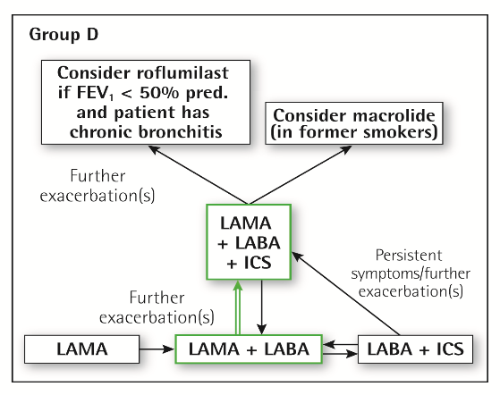
ABCD ASSESSMENT TOOL
TREATMENT RECOMMENDATIONS
Group D
Group B
Suggestions to the Global Initiative for Chronic Obstructive Lung Disease

Slide 28
TREATMENT ALGORYTHM FOR SYMPTOMATIC COPD PATIENTS WITH OR WITHOUT RISK OF EXACERBATIONS
PRN SABA
If history of asthma
Symptom persistence
no history of asthma
LAMA
LAMA/LABA
LABA/ICS
LAMA+LABA+ICS
Symptoms/
exacerbations persistence
Symptoms/exacerbations persistence
LAMA+LABA+ICS
Adapted by LMFabbri from Vogelmeier 2015
Add
Roflumilast
And/or
Macrolide
LABA: Long Acting Beta2 Agonist
LAMA: Long Acting AntiMuscarinic
ICS: Inhaled Corticosteroid
AT DOCTOR’S DISCRETION, DEPENDING ON CONDITIONS AT THE MOMENT OF THE FIRST TIME THE DOCTOR SEE THE PATIENT (eg after an acute exacerbation, uncontrolled under any type of regular treatment), PATIENTS CAN BE PUT DIRECTLY IN LAMA, LABA/ICS, TRIPLE OR EVEN ICS ONLY (if arrhythmia, chronic heart failure and ischemi heart disease)
Notes:
28

Slide 29
TRIPLE THERAPY TRIALS IN COPD: A PRECISION MEDICINE OPPORTUNITY
The TRIBUTE and IMPACT trials reported that triple therapy, compared with a LAMA/LABA bronchodilator, lowered the incidence of COPD exacerbations over a 1-year follow-up.
We demonstrated that the timing of the exacerbations in these trials shows that
the lower rate of a first exacerbation with triple therapy is exclusively due to a lower rate in the first month of follow-up, while the rate was comparable to LAMA/LABA in the subsequent 11 months.
This pattern of “depletion of susceptibles” suggests that there is a subset of patients who could benefit from triple therapy, while the remaining patients benefit equally from LAMA/LABA.
Suissa S and Ariel A, Eur Respir J, 2018; 52: 1801848

Slide 30
TRIPLE THERAPY TRIALS IN COPD: A PRECISION MEDICINE OPPORTUNITY
We submit that the history of asthma and the prior use of ICS, withdrawn at randomisation, could be two important factors of interest in identifying such subsets of responders.
Another could be the unusually overrepresented patients in IMPACT with FEV1>50% predicted and two or more exacerbations in the previous year.
Suissa S and Ariel A, Eur Respir J, 2018; 52: 1801848

Slide 31
TRIPLE THERAPY FOR ALL PATIENTS WITH SEVERE SYMPTOMATIC COPD AT RISK OF EXACERBATIONS
In response to the comments of SUISSA and ARIEL [1], we conducted additional post hoc analyses of the time to first moderate-or-severe chronic obstructive pulmonary disease (COPD) exacerbation in TRIBUTE.
Only one patient had a history of asthma; it was therefore not possible to perform analyses stratified by this factor, but intrinsically this rules out the possibility that, at least in TRIBUTE, the observed early effect on exacerbations was due topatients with a history of asthma.
When stratifying according to baseline blood eosinophil count (cut-off point 300 cells·μL−1), a very similar pattern was observed in the first months in the two subgroups.
Papi ….. And Fabbri LM (Letter of response), April 2019, in press

Slide 32
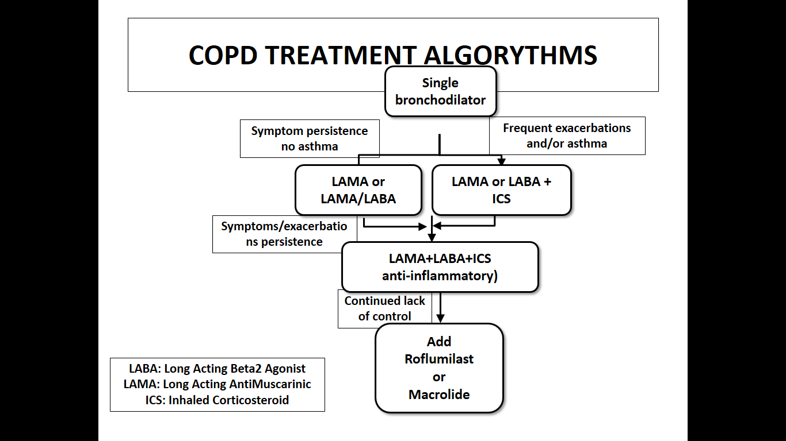
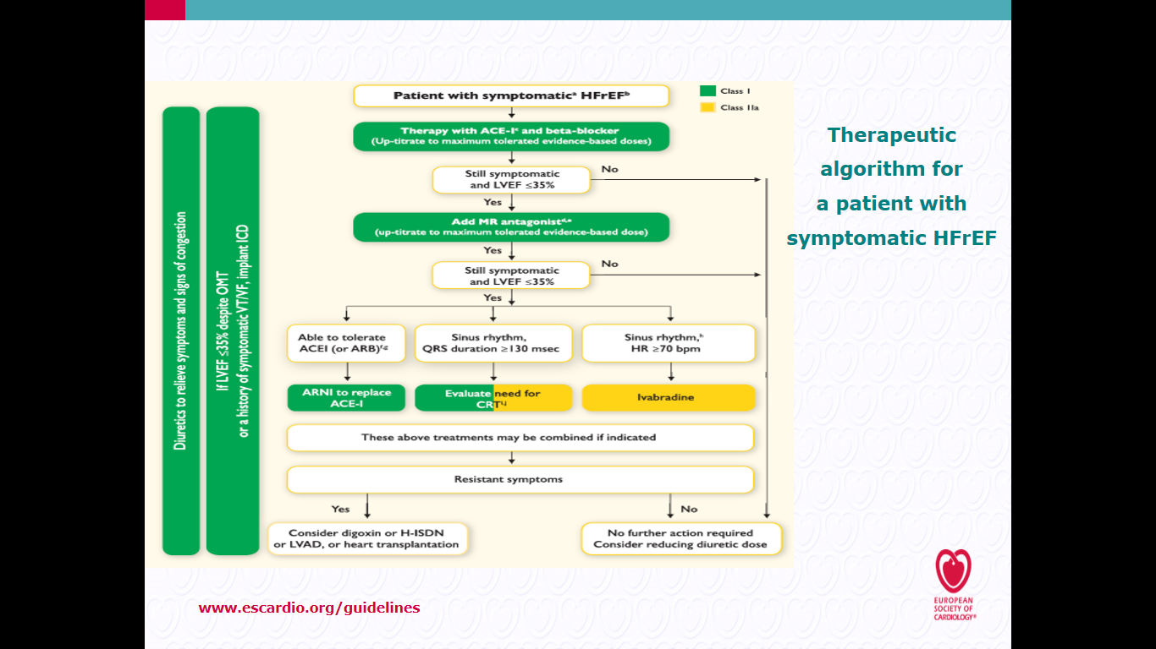

COPD CHF TREATMENT ALGORYTHMS
YEAR IN REVIEW IN
RESPIRATORY MEDICINE
Leonardo M. Fabbri, MD, FESC, FERS
  Non Small Cell Lung Cancer
  Asthma
  COPD
  Multimorbidity
2016 ESC Guidelines on CHF

Slide 33
QUARTER-DOSE QUADRUPLE COMBINATION THERAPY FOR INITIAL TREATMENT OF HYPERTENSION
Quarter-dose quadpill therapy could be additive across classes and might confer a clinically important reduction in blood pressure
Further examination of the quadpill concept is needed to investigate effectiveness against usual treatment options and longer term tolerability
Chow CK et al, Lancet, 12 Feb 2017, on line

Slide 34
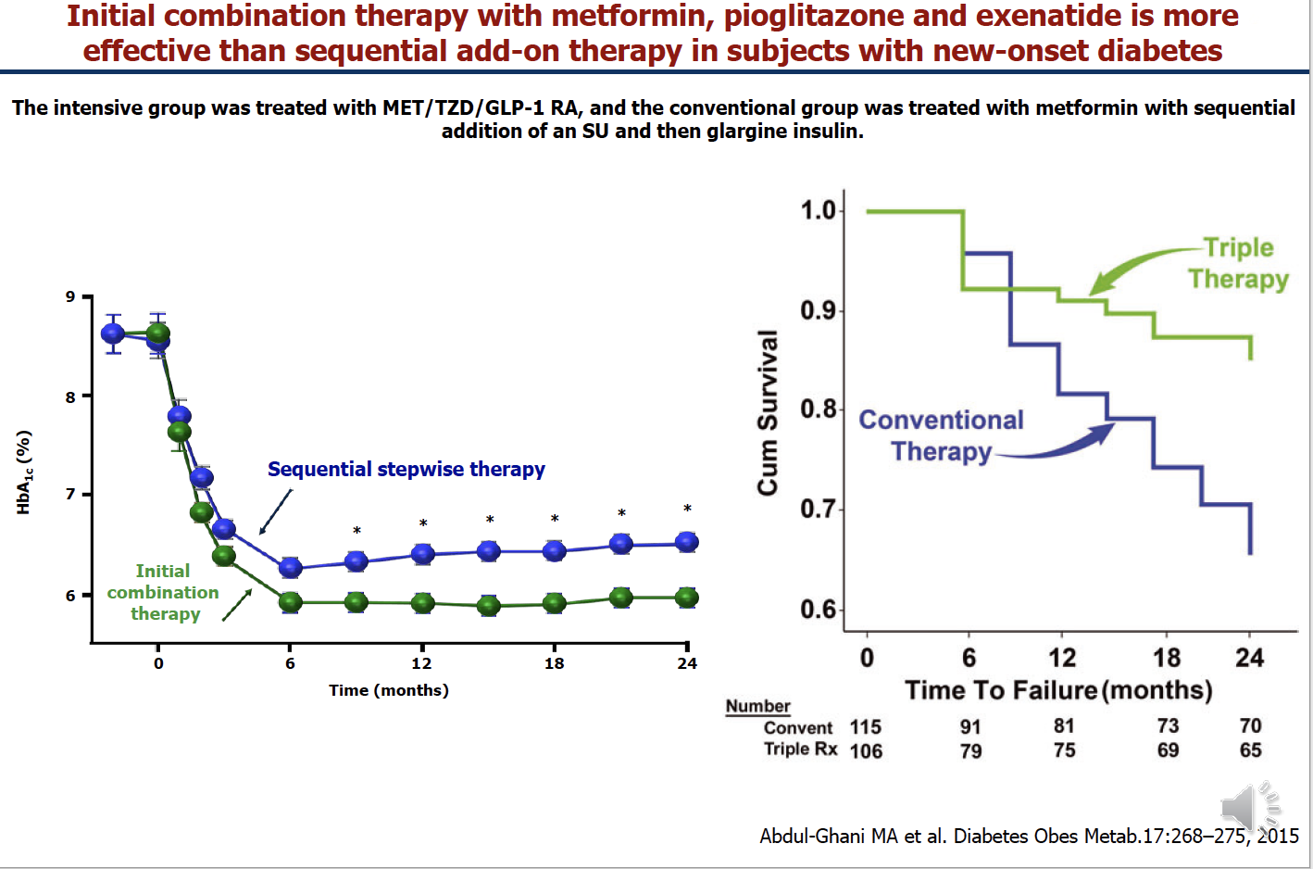

Slide 35
VX-659–TEZACAFTOR–IVACAFTOR IN PATIENTS WITH CYSTIC FIBROSIS AND ONE OR TWO PHE508DEL ALLELES
Robust in vitro activity of VX-659–tezacaftor–ivacaftor targeting Phe508del CFTR protein translated into improvements for patients with Phe508del–MF or Phe508del– Phe508del genotypes.
VX-659 triple-combination regimens have the potential to treat the underlying cause of disease in approximately 90% of patients with cystic fibrosis
Davies JC et al, N Engl J Med 2018; on line 18 October 2018

Slide 36
TRIPLE CFTR MODULATOR THERAPY FOR CYSTIC FIBROSIS
These reports represent a major breakthrough in cystic fibrosis therapeutics, with the potential for improving health and possibly survival in all patients who carry the most common CFTR mutation
It is unclear whether the effects on lung function can be sustained for longer periods of treatment or whether these compounds will effectively reduce exacerbation rates and address other meaningful outcomes, such as weight gain
These questions should soon be answered in the ongoing phase 3 trials of these regimens
Holgiun C N Engl J Med 2018; on line 18 October 2018

Slide 37
MORTALITY IN INSPIRE
*up to 2 weeks after treatment cessation; 7 patients excluded from analysis (3 SFC, 4 TIO)
7
6
52% risk reduction
p=0.012
5
4
Probability of Event (%)
3
2
Treatment
1
TIO
0
SFC
Number
at Risk
0 13 26 39 52 65 78 91 104
Time to Event (Weeks)
 | Hazard Ratio | 95% CI | p-value
SFC vs TIO | 0.48 | (0.27, 0.85) | 0.012
Wedzicha JA, et al. AJRCCM 2008

Slide 38
SINGLE-INHALER TRIPLE LABA/LAMA/ICS AND LABA/ICS REDUCE MORTALITY COMPARED TO LABA/LAMA DUAL THERAPY IN COPD B AND D PATIENTS
Lipson et al, New E J Med 18 April 2018

Slide 39
IMPACT MORTALITY (dati on-treatment)
2.0
FF/UMEC/VI vs UMEC/VI
42.1%
HR 0.58
(95% CI: 0.38, 0.88)
p=0.011
FF/UMEC/VI
1.5
FF/VI
UMEC/VI
1.0
Probablità dell’evento (%)
0.5
FF/VI vs UMEC/VI
38.7%
HR 0.61
(95% CI: 0.40, 0.93)
p=0.022
0
0
28
56
84
112
140
168
196
224
252
280
308
336
364
Tempo dell’evento (giorni)
Numero di soggetti a rischio
FF/UMEC/VI | 4151 | 4082 | 3968 | 3898 | 3838 | 3752 | 3714 | 3690 | 3613 | 3581 | 3545 | 3486 | 3454 | 3346
FF/VI | 4134 | 3984 | 3798 | 3694 | 3619 | 3496 | 3443 | 3391 | 3291 | 3258 | 3230 | 3182 | 3152 | 3044
UMEC/VI | 2070 | 1993 | 1880 | 1820 | 1769 | 1713 | 1685 | 1656 | 1612 | 1595 | 1578 | 1548 | 1531 | 1485
FF: fluticasone furoate; UMEC: umeclidinio bromuro; VI: vilanterolo trifenatato; HR: hazard ratio
Lipson DA et al NEJM 2018
DoF RF/TLY/0096/17

Slide 40
TREATMENT-EMERGENT ADVERSE EVENTS - TRIBUTE
Patients with | BDP/FF/G N = 764 | IND/GLY N = 768
AEs | 490 (64.1%) | 516 (67.2%)
ADRs | 43 (5.6%) | 37 (4.8%)
SAEs | 117 (15.3%) | 130 (16.9%)
Serious ADRs | 1 (0.1%) | 1 (0.1%)
AEs leading to discontinuation | 37 (4.8%) | 47 (6.1%)
AEs leading to death | 16 (2.1%) | 21 (2.7%)
Any pneumonia | 28 (3.7%) | 27 (3.5%)
Papi A et al. Lancet 2018; 391(10125): 1076-84

Slide 41
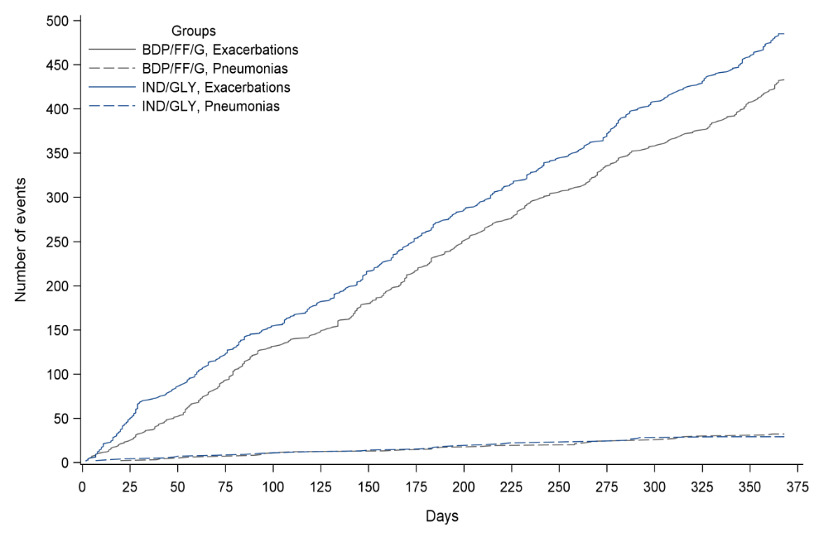
RISK-BENEFIT RATIO (COPD EXACERBATIONS AND PNEUMONIAS)
IN TRILOGY, TRINITY AND TRIBUTE STUDIES
TRILOGY
TRINITY
Pneumonia (100 pts/yr)*
Trilogy | BDP/FF/GB | 3.9
Trilogy | BDP/FF | 2.9
Trinity | BDP/FF/GB | 2.9
Trinity | Tiotropium | 1.9
Trinity | BDP/FF +TIO | 2.5
Tribute | Inda/Glyco | 4.4
Tribute | BDP/FF/GB | 4.1
TRIBUTE
Singh D et al., Lancet 2016;
Vestbo J et al., Lancet 2017;
Papi A et al., Lancet 2018

Slide 42
ADVERSE EVENTS AND SERIOUS ADVERSE EVENTS
RISK REDUCTION FOR HYPERTENSION, IHD, MI, ATRIAL FIBRILLATION IN TRIBUTE
Number (%) of patients | BDP/FF/G (N=764) | IND/GLY (N=768)
Adverse events | 490 (64.1) | 516 (67.2)
COPD worsening | 273 (35.7) | 288 (37.5)
Pneumonia | 28 (3.7) | 27 (3.5)
Hypertension | 15 (2.0) | 26 (3.4)
Cough | 13 (1.7) | 25 (3.3)
Ischemic heart disease | 8 (1.0) | 16 (2.1)
Serious adverse events | 117 (15.3) | 130 (16.9)
COPD worsening | 61 (8.0) | 69 (9.0)
Death | 3 (0.4) | 8 (1.0)
Ischemic heart disease | 2 (0.3) | 11 (1.4)
Myocardial infarction | 1 (0.1) | 8 (1.0)
Atrial fibrillation | 0 | 7 (0.9 )
Papi et al, The Lancet, Lancet 2018 Mar 17;391(10125):1076-1084

Slide 43
TREATMENT-EMERGENT ADVERSE EVENTS
TRIBUTE
Number (%) of patients | BDP/FF/G (N=764) | IND/GLY (N=768)
Treatment-related adverse events | 12 (1.6) | 6 (0.8)
Oral candidiasis | 12 (1.6) | 6 (0.8)
Dry mouth | 3 (0.4) | 6 (0.8)
Cough | 1 (0.1) | 7 (0.9)
Treatment-related serious adverse events | 1 (0.1) | 1 (0.1)
Severe adverse events | 86 (11.3) | 87 (11.3)
Adverse events leading to death | 16 (2.1) | 21 (2.7)
Papi et al, The Lancet, Lancet 2018 Mar 17;391(10125):1076-1084

Slide 44
POOL DATA ON MORTALITY (ATS/ERS ABSTRACT)
Vestbo, Fabbri et al, Eur Respir J, Letter on line, Sept 12, 2018
 | BDP/FF/G, BDP/FF, BDP/FF+TIO (n=3745) | TIO, IND/GLY (N=1844)
 | N of patients with events (%) |  | HR (95%, CI), p-value
RESPIRATORY | 19 (0.5%) | 9 (0.5%) | 1.01 (0.45; 2.22) p=0.990
NON-RESPIRATORY | 56 (1.5%) | 41 (2.2%) | 0.65 (0.43; 0.97) p=0.037

Slide 45
GOLD 2019 Follow-up treatment
GOLD 2019 Report: Available from http://goldcopd.org/gold-2019-global-strategy-diagnosis-management-prevention-copd

Slide 46
Moderate and/or severe COPD exacerbation rates per annum by treatment and thresholds of EOS level
EOSINOPHILS IN BLOOD AND RESPONSE TO ICS TREATMENT IN COPD
Pascoe S et al 2015

Slide 47
Modelling peripheral blood eosinophils to identify response to ICS/LABA vs LABA alone in COPD
LABA
ICS/LABA
P
Blood eosinophil count (x10⁹ cells)
After: Bafadhel et al. Lancet Respir Med 2018; 6: 117–26

Slide 48
MEPOLIZUMAB FOR EOSINOPHILIC CHRONIC OBSTRUCTIVE PULMONARY DISEASE
Mepolizumab at a dose of 100 mg was associated with a lower annual rate of moderate
or severe exacerbations than placebo among patients with COPD and an eosinophilic
Phenotype
This finding suggests that eosinophilic airway inflammation contributes
to COPD exacerbations.
Pavord et al, N Engl J Med 2017; 377:1613-1629

Slide 49
ASTRAZENECA PRESS RELEASE
30 MAY 2018
TERRANOVA TRIAL DID NOT MEET THE PRIMARY ENDPOINT OF A STATISTICALLY-SIGNIFICANT REDUCTION OF EXACERBATIONS IN PATIENTS WITH CHRONIC OBSTRUCTIVE PULMONARY DISEASE
AstraZeneca and MedImmune, its global biologics research and development arm, today announced top-line results from TERRANOVA, the second of two pivotal Phase III trials for Fasenra (benralizumab) in patients with moderate to very severe chronic obstructive pulmonary disease (COPD)
The trial did not meet the primary endpoint of a statistically-significant reduction of exacerbations. This news follows the announcement earlier this month that the first pivotal Phase III trial, GALATHEA, did not meet its primary endpoint

Slide 50
BENEFIT–RISK RATIO OF INHALED CORTICOSTEROIDS IN PATIENTS WITH COPD ACCORDING TO THE LEVEL OF BLOOD EOSINOPHILS IN STABLE DISEASE
Agusti, Fabbri et al, Inhaled corticosteroids in COPD: friends or foes? Eur Res J 2018, in press 6 sept 2018
Fabbri et al, Diagnosis and treatment of COPD in the real world, Lanc Resp Med, 2018, in press

Slide 51
Il contesto per una triplice terapia in BPCO
Leonardo M. Fabbri, MD, FERS
BPCO come componente polmonare della multimorbidità
Obiettivi del trattamento della BPCO
Quali sono state le premesse per arrivare ad una triplice terapia inalatoria in un singolo inalatore nella BPCO
Il futuro del trattamento del paziente con BPCO

Slide 52
TIME FOR A LONGER AND BETTER LIFE FOR PATIENTS WITH COPD
In this issue of the journal are two important management studies consistently showing a considerable reduction of mortality in patients comprehensively treated with management plans that address not only the COPD component but also the complexity of multimorbidities
We believe it is time to conduct a properly designed and powered study with the goal of combining all these positive observations to achieve a better quality of life for patients with severe multimorbidities. Let’s move this forward.
Vanfleteren, Ullman, Fabbri, Eur Respir J, January 2018

Slide 53
Il contesto per una triplice terapia in BPCO
Leonardo M. Fabbri, MD, FERS
BPCO come componente polmonare della multimorbidità
Obiettivi del trattamento della BPCO
Quali sono state le premesse per arrivare ad una triplice terapia inalatoria in un singolo inalatore nella BPCO
Il futuro del trattamento del paziente con BPCO

Slide 54
COPD TREATMENT: LOOKING FORWARD
PNEUMOTRIESTE 2019
Hotel Savoia Excelsior Palace, Trieste 2 April 2019
Il contesto per una triplice terapia in BPCO
Leonardo M. Fabbri, MD, FERS
Professor of Respiratory and Internal Medicine, University of Modena and Reggio Emilia, (-2016)
Eminent Scholar of Respiratory and Internal Medicine, University of Ferrara, 2017 to date
Visiting Professor of Respiratory and Internal Medicine, COPD Center, University of Gothenburg, 2017 to date

