Slide 1
La terapia del tumore polmonare guidata dalla medicina molecolare: un ruolo per il pneumologo?
Dr. Claudio Micheletto
UOC di Pneumologia
Azienda Ospedaliera Universitaria Integrata
Verona
claudio.micheletto@univr.it

Slide 2
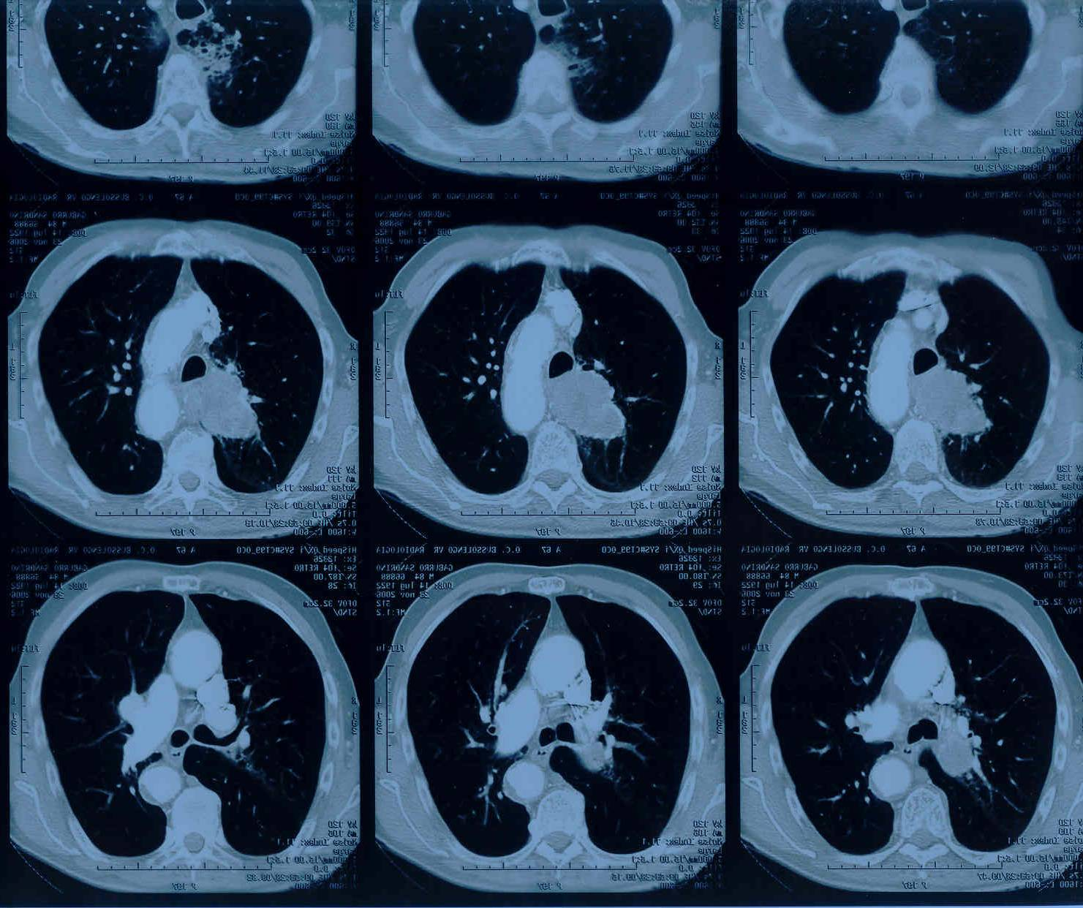
Introduzione
Lung cancer is the leading cause of cancer mortality in the world. It greatly affects the patients’ quality of life through debilitating symptoms, such as breathlessness and hemoptysis, and through common comorbidities, such as COPD, that further diminish performance status.
Gaga M, et al. Am J Resp Crit Care Med 2013

Slide 3
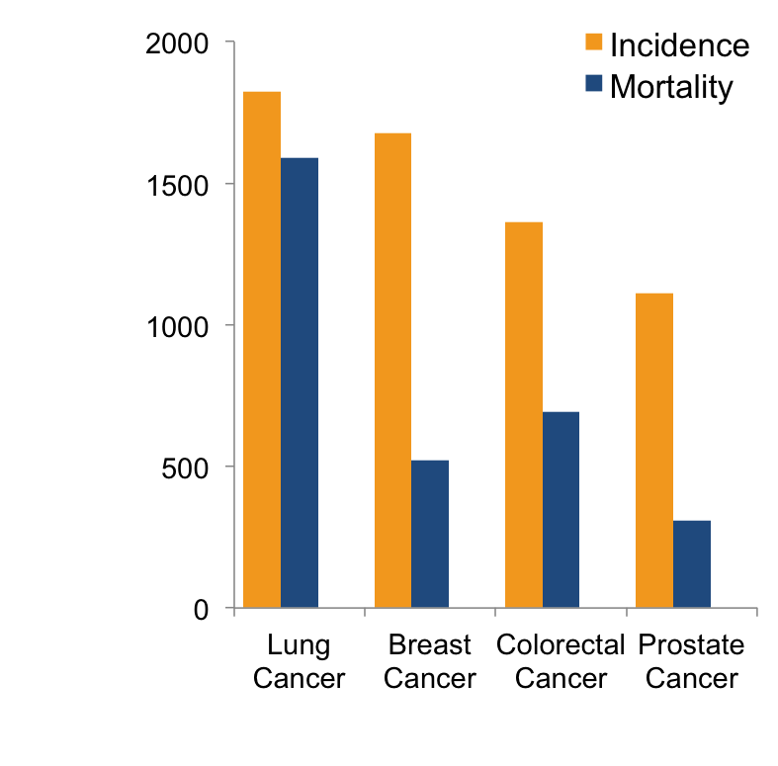
Lung cancer: most common malignancy and leading cause of cancer-related mortality
GLOBOCAN 2012 (worldwide, both sexes)¹
  1.82 million¹
  estimated new cases worldwide
  1.59 million¹
  (1 in 5) estimated deaths worldwide
  More people die from lung cancer than breast, colorectal and prostate cancers combined¹
  Within Europe, ~1,000 people die from lung cancer every day^{1,2}
Istituto Toscano Tumori –Livorno, Italy
1. Ferlay J, et al. GLOBOCAN 2012 v1.0, Cancer Incidence and Mortality Worldwide: IARC CancerBase No. 11[Internet]. Lyon, France:
International Agency for Research on Cancer; 2013. Available from: http://globocan.iarc.fr. Accessed March 2014;
2. Ferlay J, et al. Eur J Cancer. 2013;49:1374–1403.

Slide 4
Evaluation, staging and treatment
After the diagnosis of lung cancer, therapy is tailored according to stage, performance status, and histological and molecular clas- sification of the disease. Pertinent diagnostic algorithms now rec- ommend the routine use of positron emission tomography in combination with computed tomography (PET-CT), or endo- bronchial ultrasound
Gaga M, et al. Am J Resp Crit Care Med 2013

Slide 5
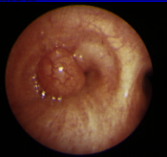
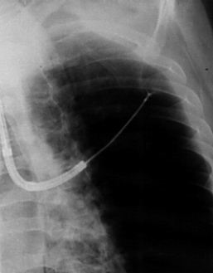
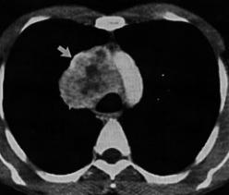
BRONCHOSCOPIC BIOPSY TECHNIQUES
CENTRAL LESIONS
(in the visible range of bronchoscope)
PERIPHERAL LESIONS
(outside the visible range of bronchoscope)
HILAR MEDIASTINAL LESIONS
(outside the tracheobronchial tree)

Slide 6
Lung Cancer - New perspectives
Early Detection / Screening
Bio-molecular Profiling
Targeted Therapy
Immune Therapy

Slide 7
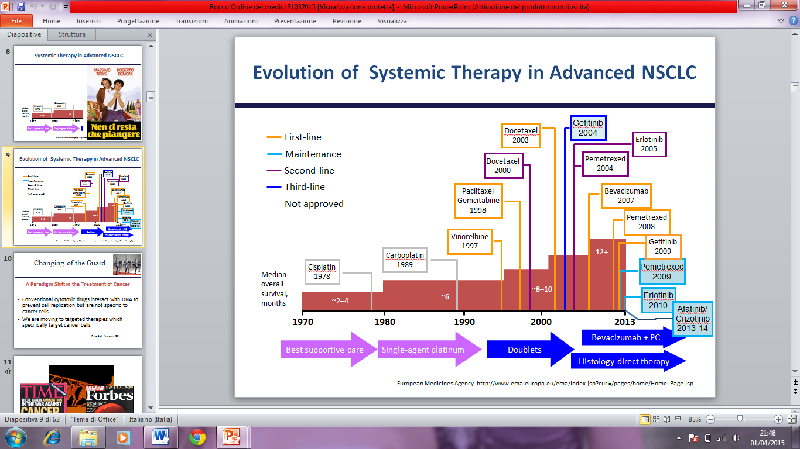
Evoluzione della Terapia Sistemica nel NSCLC
Immuno 2015-16

Slide 8
Oncogenic drivers in Lung Adenocarcinoma
Oncogenic Drivers with available Targeted agents:
  EGFR Mutations
  Alk (anaplastic lymphoma kinase ) Translocation
  ROS1 Mutations

Slide 9
Pathological Features
A pathological diagnosis should be established in accordance with the 2015 World Health Organization classification, since major treatment options are determined on the basis of histologic features.
Travis WD, Brambilla E, Burke AP, Marx A, Nicholson AG. WHO classification of tumours of the lung, pleura, thymus and heart. 4th ed. Geneva: World Health Organization, 2015.

Slide 10
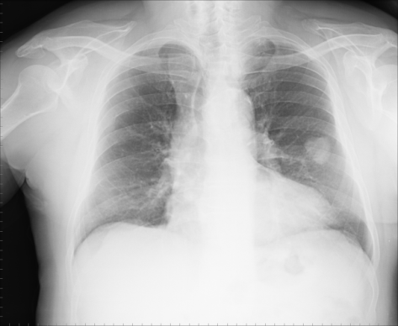
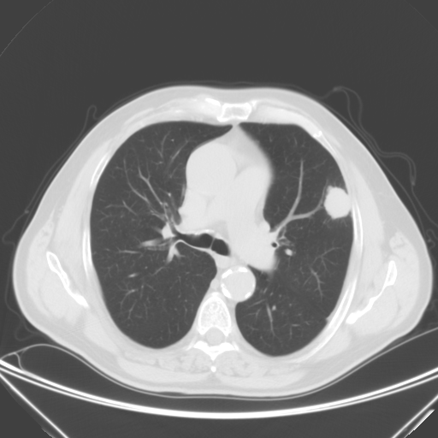
Single Pulmonary Nodule
Is a very common finding in radiological practice:
1 nodule every 47 patients undergoing Chest Radiographs
1 nodule every 6 patients undergoing CT in a routine clinical setting
Gomez-Saez N, 2014, EUR RADIOL
Cancer incidence among pulmonary nodules (10-70%) widely changes in the literature
Among benign lesions Granulomas are more frequent (about 80%); Hamartomas 10%
CHEST 2003; 123:89S-96S
Notes:
Now, what SPN Epidemiology is?
Coin lesion is a very common finding in our radiological activity.
Everyone may find one nodule………
These numbers show the size of the problem.
Besides, we know that cancer incidence among pulmonary nodules has a wide range.
Instead, among benign lesions certainly granulomas are more frequent - about 80% -
while on contrary amartomas are uncommon -10% -
10

Slide 11
When tissue samples of lung cancer (obtained by means of bronchoscopy or surgical biopsy) or cytologic samples (effusion, aspirates, or brushings) show clear morphologic features of adenocarcinoma or squamous- cell carcinoma, the diagnosis can be firmly established, and in these cases, immunocytochemical or immunohistochemical analysis is not routinely needed.
If morphologic evaluation reveals neuroendocrine features, the tumor may be classified as SCLC or NSCLC (probably large-cell neuroendocrine carcinoma). If there is no clear morphologic evidence of adenocarcinoma or squamous-cell carcinoma, the tumor is classified as NSCLC, not otherwise specified (NOS).
N Engl J Med 2017;377:849-61

Slide 12
Endoscopic bronchial ultrasonography (EBUS) and endoscopic esophageal ultrasonography (EUS) are endoscopic approaches for the diagnosis of lung cancer, lymph-node metastases, and adrenal metastases. The lymph-nodes shown in orange can be accessed by either technique, those shown in yellow can be accessed primarily by means of EBUS, and those shown in blue can be accessed primarily by means of EUS. Nodes that are clinically relevant and are often decision makers are encircled.
L denotes left, and R right.
N Engl J Med 2017;377:849-61

Slide 13
Staging of lung cancer
If imaging studies strongly suggest mediastinal or hilar lymph-node involvement, endo-sonography (endobronchial or esophageal ultra- sonography or the two combined) with needle aspiration is recommended over surgical staging as the best initial means of validation.
N Engl J Med 2017;377:849-61

Slide 14
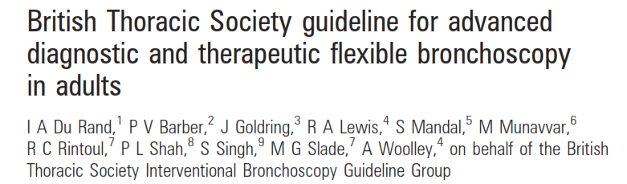

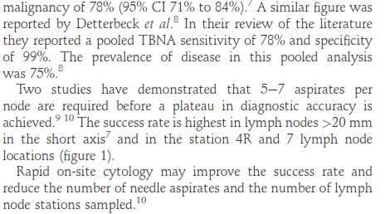
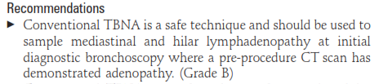
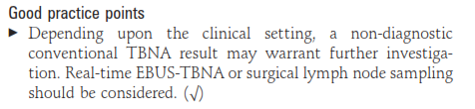

Slide 15
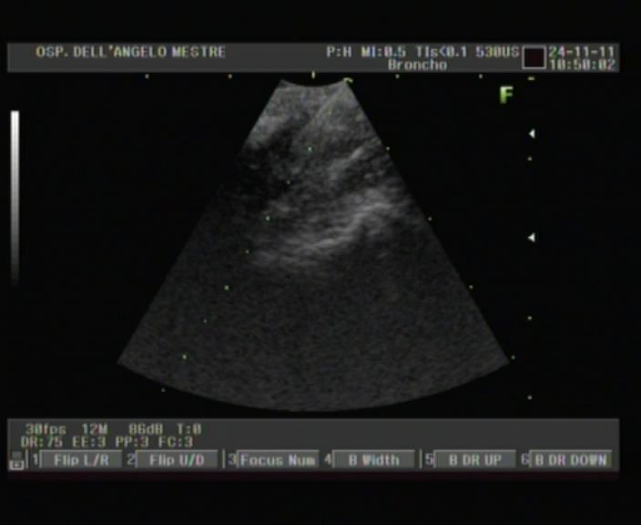
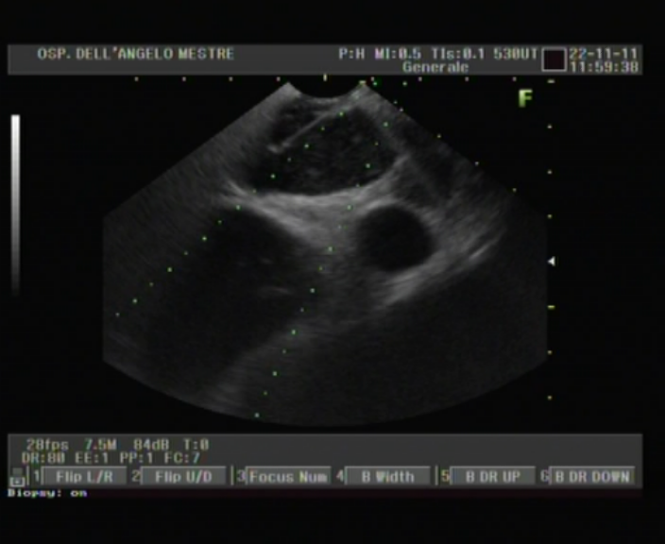
EVIDENZE
EBUS-TBNA ed EUS-FNA
Tecniche dotate di una sensibilità tra 85% e 95% e di una specificità prossima a 100%
Raggiungono sedi non accessibili alla mediastinoscopia
Sono superiori alla PET nell’escludere localizzazioni mediastiniche da ADK (valore predittivo negativo superiore)

Slide 16
Staging of lung cancer
For mediastinal nodal staging in patients with suspected or proven NSCLC and abnormal mediastinal or hilar nodes on CT or PET-CT, endosonography is recommended over surgical staging as the initial procedure.
N Engl J Med 2017;377:849-61

Slide 17
Staging of lung cancer
If the clinical suspicion of mediastinal-node involvement remains high after a negative result with the use of a needle technique, surgical staging is recommended.
N Engl J Med 2017;377:849-61

Slide 18
Evaluation, staging and treatment
Until recently, surgical mediastinoscopy was the preferred initial approach for staging the mediastinum. EBUS-TBNA has gained wide acceptance as an alternative procedure for sampling mediastinal lesions in patients with suspected or known lung cancer, now often sup- planting mediastinoscopy as a first-line approach for diagnosis and staging.
Gaga M, et al. Am J Resp Crit Care Med 2013

Slide 19
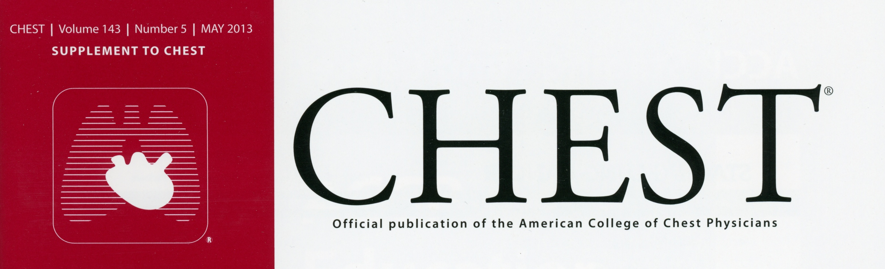
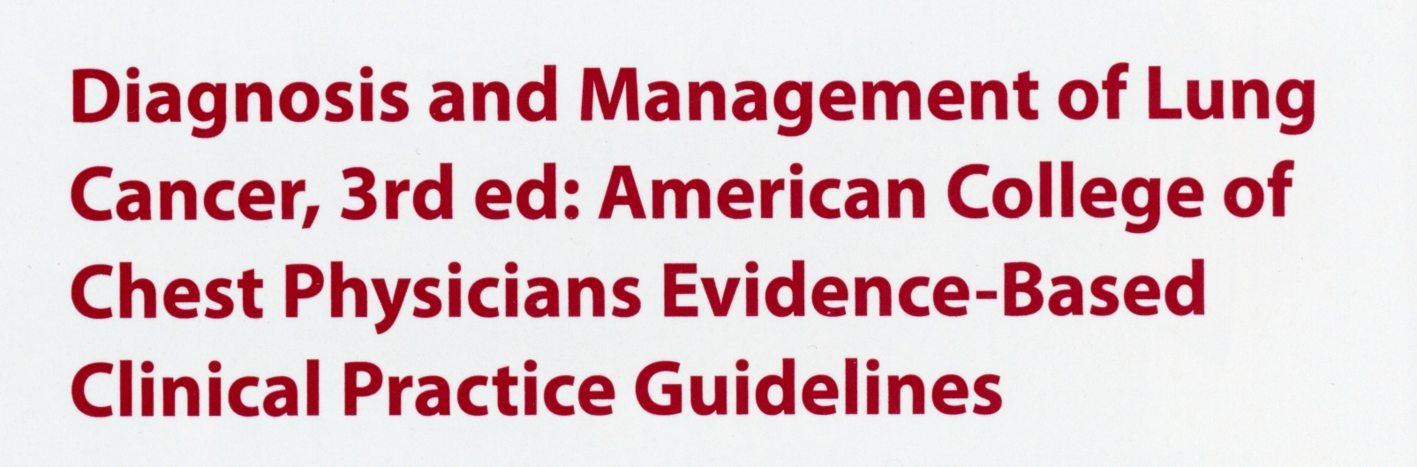
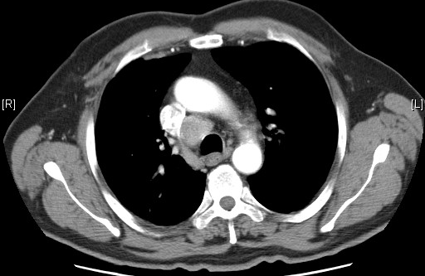
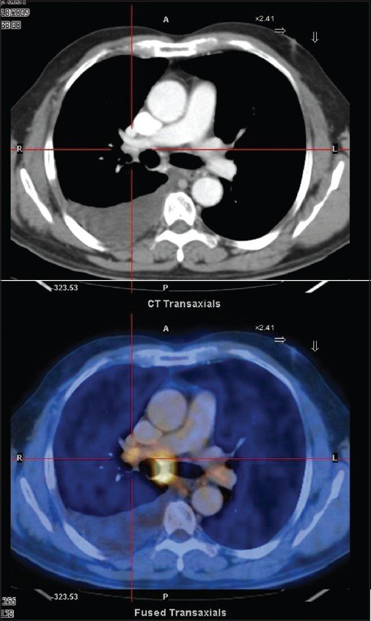
Chest 2013; 143:19s
In patients with high suspicion of N2, N3 involvement,
either by discrete mediastinal lymph node enlargement or
PET uptake, a needle technique (EBUS, EUS-FNA or combined)
is recommended over surgical staging as a best first test
EBUS / EUS-B-FNA

Slide 20
Chest 2016

Slide 21
Group A involves patients with mediastinal infiltration; discrete lymph nodes can no longer be discerned or measured. Diagnosis is necessary, but mediastinal involvement is implied, and thus a mediastinal staging procedure is not indicated

Slide 22
Group B involves patients with mediastinal node enlargement, in whom the size of the discrete nodes can be measured. These patients require pathologic confirmation (ie, invasive staging).

Slide 23
In Group C, the mediastinal lymph nodes are normal, but there is a high risk for occult N2/N3 disease based on the presence of suspected N1 disease (C)

Slide 24
In Group C, the mediastinal lymph nodes are normal, but there is a high risk for occult N2/N3 disease based on the presence of suspected N1 disease (C) or a central tumor (D). These patients also need invasive staging prior to surgery.

Slide 25
E Group is composed of patients with a peripheral clinical stage I tumor (the mediastinal, hilar, and interlobar nodes are normal on PET-CT scan). Invasive staging prior to surgery is not recommended in this group

Slide 26
Non invasive and invasive staging modalities prior to thoracotomy
Chest 2016

Slide 27
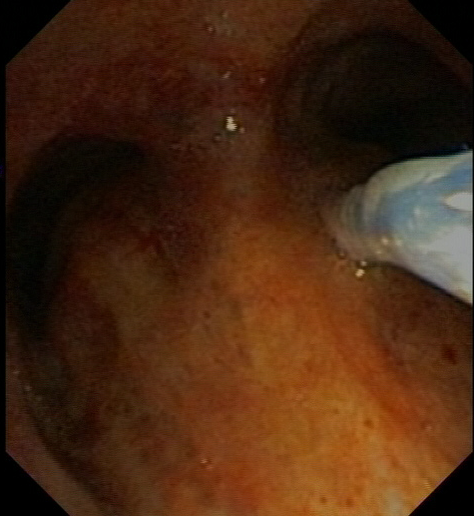

Slide 28
Pivotal role of pulmonologists
Pulmonologists are pivotal in lung cancer staging as they interpret the imaging tests and provide tissue for pathological examination.
They also perform:
the preoperative physiological evaluation,
provide postresection surveillance,
treat the patients’ most common comorbidities, such as COPD, pleural effusions, lung infections, and respiratory failure.
These comorbidities also affect the performance status of patients and their ability to undergo surgery
Gaga M, et al. Am J Resp Crit Care Med 2013

Slide 29
TORACOSCOPIA MEDICA
Si intende per toracoscopia medica l’esame endoscopico del cavo pleurico condotto da Pneumologi, solitamente in anestesia locale, in una sala endoscopica, dopo pneumotorace indotto o spontaneo, mediante una o due porte di entrata e strumentario semplice pluriuso.
Casalini G. Pneumologia Interventistica. Springer 2008

Slide 30
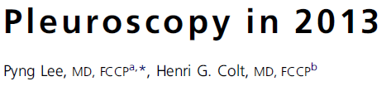
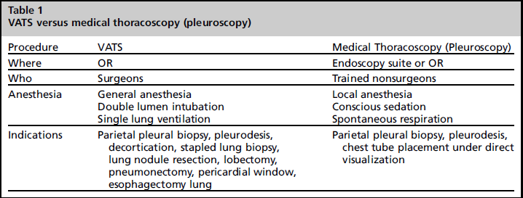
Clin Chest Med 2013;34, 81-91

Slide 31
Ruolo della toracoscopia medica
- L’esplorazione della cavità pleurica rappresenta lo standard di riferimento per la diagnosi istologica;
- La biopsia toracoscopica sotto controllo visivo eguaglia l’accuratezza della toracotomia
- L’esame endoscopico consente di valutare l’estensione endocavitaria della neoplasia
Casalini G. Pneumologia Interventistica. Springer 2008

Slide 32
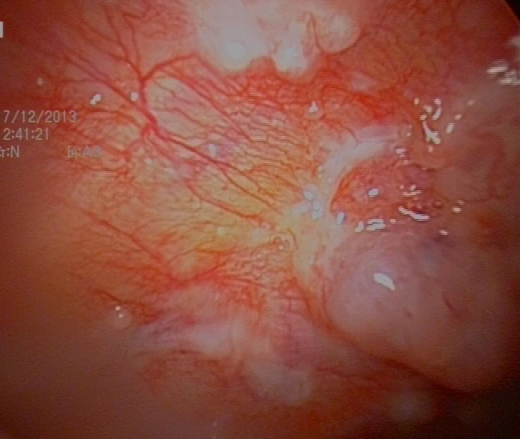
Vantaggi della toracoscopia medica rispetto a quella chirurgica
- Semplicità di esecuzione
- Minor costo
- Buona tollerabilià da
parte dei pazienti

Slide 33
TORACOSCOPIA MEDICA
Indicazioni
- Versamenti pleurici essudativi o trasudativi di incerta
origine
- Pneumotorace
- Empiema nelle fasi precoci e versamenti pleurici complicati
- Emotorace
- Ispessimenti pleurici di etiologia non specificata
- Pleurodesi di ricorrenti versamenti o pneumotorace
- Biopsie della pleura parietale per la diagnosi di patologie
pleuropolmonari
HG Colt & PN Mathur. Manual of Pleural Procedures. Lippincott Williams & Wilkins, Philadelphia 1999.

Slide 34
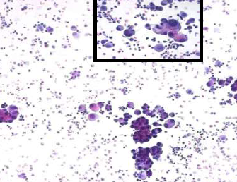
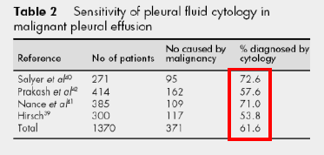
Citologia pleurica
Sensibilità 40 – 70 %, in relazione all’estensione della neoplasia, dell’istotipo e del grado di esfoliazione.
Ripetute toracentesi per analisi citologica si liquido pleurico determinano un modesto incremento della resa diagnostica

Slide 35
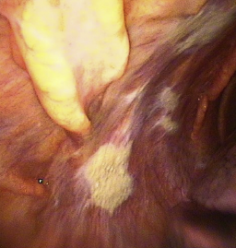
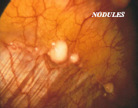
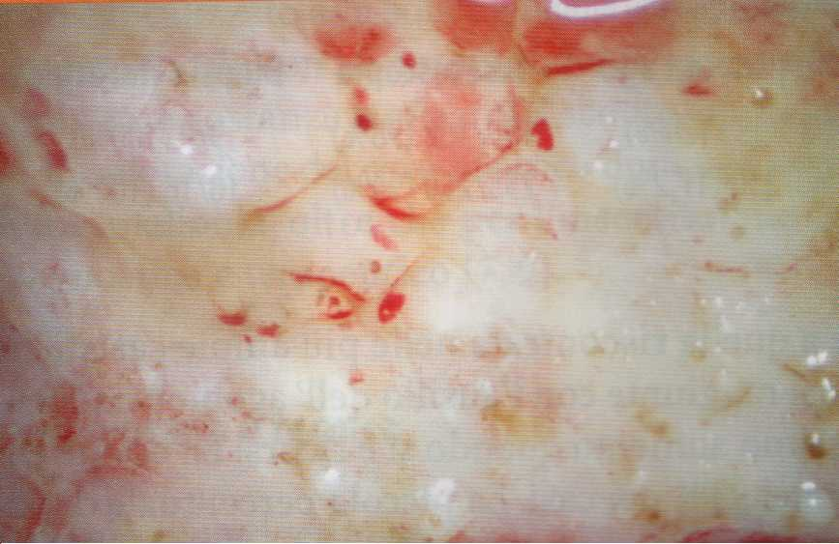
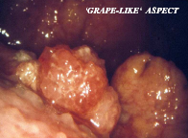
Esame sistematico della cavità pleurica:
semiologia endoscopica del mesotelioma
Ispessimento pleurico
Noduli
Pachipleurite
Aspetto a grappoli

Slide 36
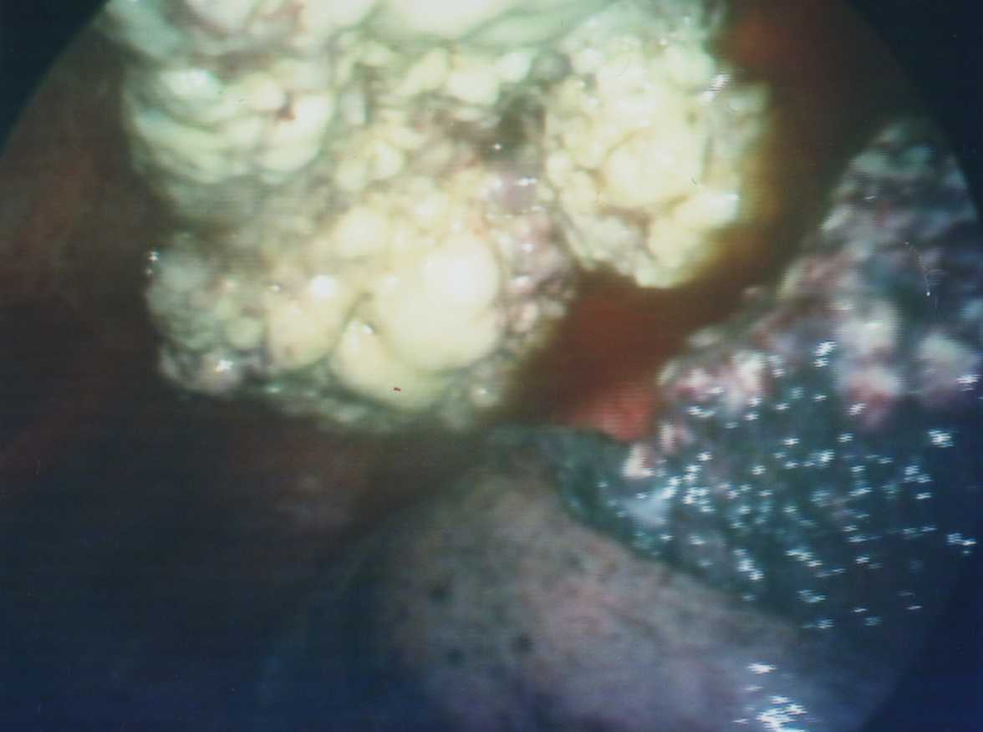
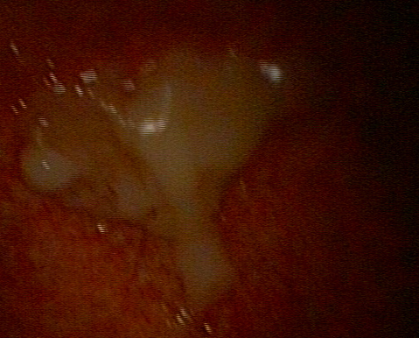
Esame sistematico della cavità pleurica

Slide 37
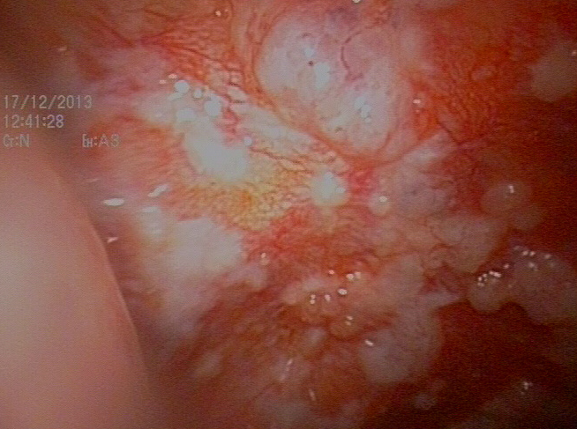
Esame sistematico della cavità pleurica

Slide 38
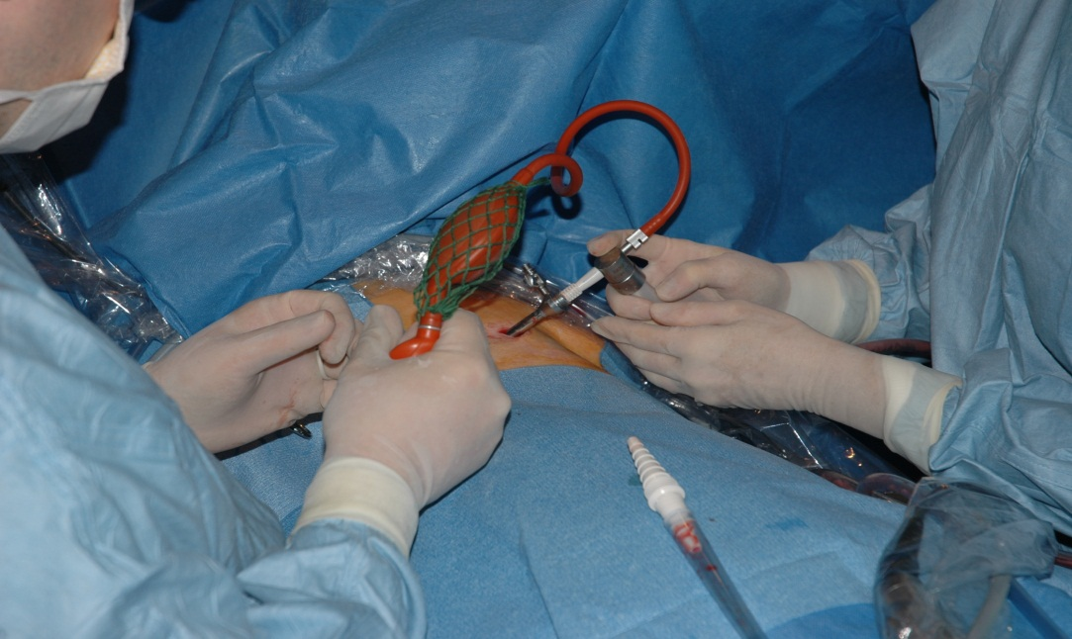
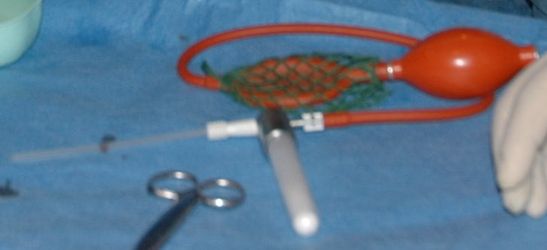
Talcaggio
1-2 grammi nel pneumotorace
4 grammi nel versamento pleurico

Slide 39
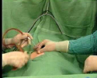


Pleurodesi

Slide 40
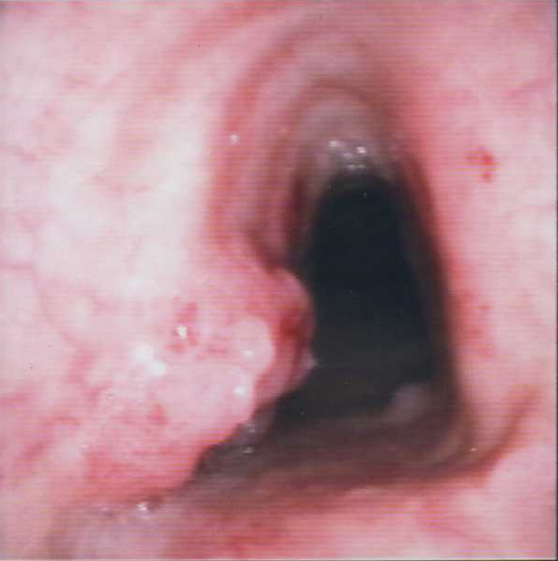
Pivotal role of pulmonologists
Pulmonologists can provide treatment by local and endoscopic approaches, such as laser and cauterization, and they can treat early-stage central lung cancer by established endobronchial techniques such as photodynamic therapy.
Pulmonologists can alleviate inoperable endobronchial obstruction through the use of stents or other techniques.
Gaga M, et al. Am J Resp Crit Care Med 2013

Slide 41
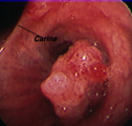
Quality of life
Performance status
Possibility to performe
oncological therapy
Life-threatening
Survival
LUNG CANCER
30-40%
occurs in central airways
(trachea and main bronchi)
symptoms related to
tracheobronchial obstruction
dyspnea, cough
postobstructive pneumonia
haemoptysis

Slide 42
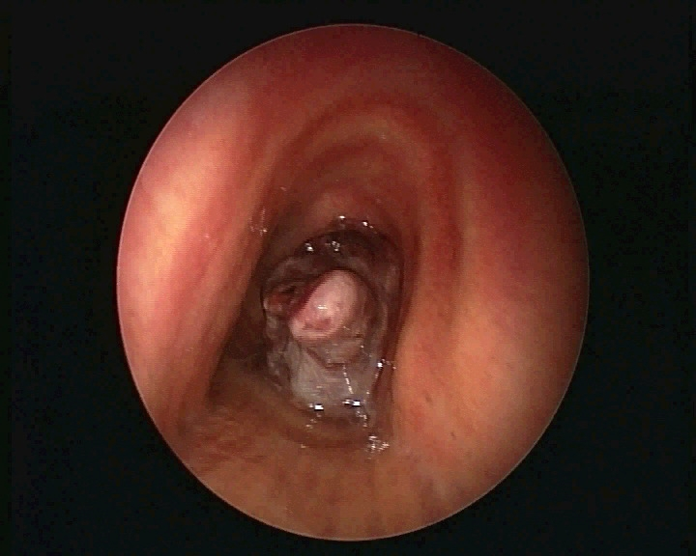
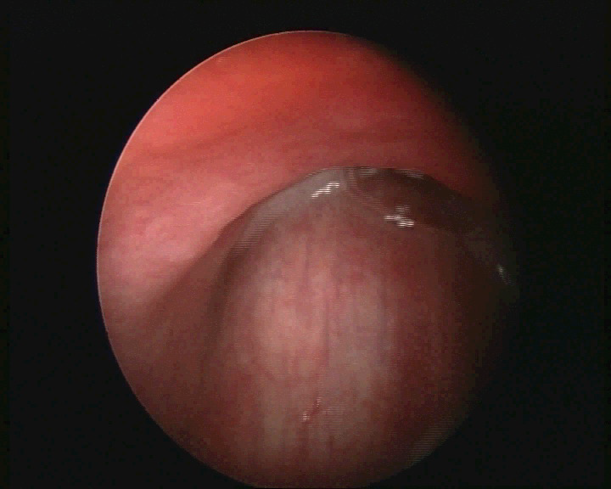
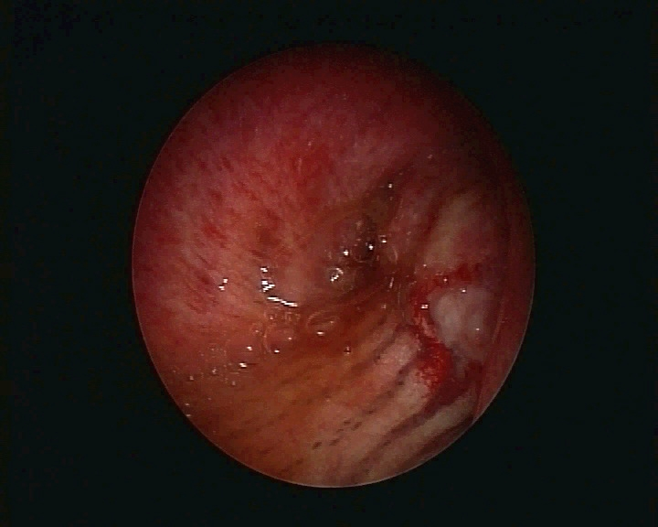
1) IDENTIFY THE TYPE OF STENOSIS
INTRALUMINAL TUMOUR
EXTRINSIC COMPRESSION
MIXED STENOSIS

Slide 43
Pivotal role of pulmonologists
Pulmonologists also may manage treatment-related side effects, such as postradiation pneumonitis and other systemic side effects, and they provide general supportive and palliative care.
Gaga M, et al. Am J Resp Crit Care Med 2013

Slide 44
Multidisciplinary teams
Lung cancer care does not involve pulmonologists alone. Data show that multidisciplinary teams provide improved adherence to evidence-based guidelines, better treatment decisions, and better clinical outcomes with longer survival for oncologic patients, and specifically for patients with lung cancer.
Gaga M, et al. Am J Resp Crit Care Med 2013

Slide 45
Multidisciplinary teams
The European Respiratory Society/European Society of Thoracic Surgeons (ERS/ESTS) guidelines for fitness for radical therapy of lung cancer recommend that the management of patients with lung cancer be performed by multidisciplinary teams (pulmonologists, thoracic surgeons specialized in lung cancer, medical oncologists, and radiation oncologists).
The American College of Chest Physicians (ACCP) has proposed similar recommendations for patients with potentially respectable lung cancer.
Gaga M, et al. Am J Resp Crit Care Med 2013

Slide 46
Multidisciplinary teams
Lung cancer prognosis and outcomes depend not only on histological characteristics and staging of the cancer but also on the presence and proper management of comorbidities, local symptoms, treatment-related morbidity, and quality of life.
Data show that high-volume centers and multidisciplinary teams are more efficient at managing patients with lung cancer than low-volume or nonmultidisciplinary centers by providing more complete staging, better adherence to guidelines, and increased survival.
Gaga M, et al. Am J Resp Crit Care Med 2013

Slide 47
Multidisciplinary team management in thoracic oncology: more than just a concept?
MDT meetings may differ in their focus and may include:
discussion of all patients at the point of referral;
discussions limited to patients with a histological diagnosis, those where the next diagnostic step is not clear,
those for whom it is not appropriate to pursue a tissue diagnosis;
discussion of post-operative outcomes, including a review of the surgical resection specimens to provide feedback to the MDT on the treatment decision and an opportunity to decide whether adjuvant therapy should be offered;
rediscussions where clinicians may consult the MDT again if their patient is not fit enough for, or declines, the recommended treatment.
Eur Respir J 2014; 43: 1776–178

Slide 48
Multidisciplinary team management in thoracic oncology: more than just a concept?
Pathway for patients with suspected or confirmed thoracic malignancy. Solid lines represent common routes, dotted lines represent alternative or additional routes. MDT: multidisciplinary team; GP: general practitioner.
Eur Respir J 2014; 43: 1776–178

Slide 49
The MDT report
The outcome of the MDT meeting should be recorded and made accessible to all healthcare professionals involved in the patient’s care.
The nature of MDT reports varies considerably but should ideally include the following:
demographics and the results of investigations;
naming of stage-dependent guideline recommended treatment;
treatment plan and reasons for nonadherence to guideline recommendations;
whether the MDT made a unanimous or a majority decision;
common treatment side-effects and recommended management for these;
a clear indication of the likely prognosis and follow-up strategy
Eur Respir J 2014; 43: 1776–178

Slide 50
Advantages and disadvantages of multidisciplinary team (MDT) management for thoracic malignancies
Eur Respir J 2014; 43: 1776–178

Slide 51
Multidisciplinary team management in thoracic oncology: more than just a concept?
Eur Respir J 2014; 43: 1776–178

Slide 52
The importance of multidisciplinary team management of patients with non- small-cell lung cancer
PM Ellis. Current Oncol 2012

Slide 53
Attendance at meetings
MDT members need allocated protected time to attend meetings and it is important that all specialities are represented at each meeting, if not in person then by tele- or videoconferencing. In a survey of attendees at an Australian lung cancer conference in 2010 more than 20% of the respondents indicated that improvement in attendance at their multidisciplinary meeting was required for palliative care physicians, pathologists and cardiothoracic surgeons, and a qualitative study from Spain found that that MDT members did not feel their MDT time was recognised by management as ‘‘real work’’.
Eur Respir J 2014; 43: 1776–178

Slide 54
Conclusions
Optimal treatment of patients with lung cancer requires a thoracic oncology center and specialists who care for a significant number of patients on a regular basis. The multidisciplinary team should include representatives of all specialties concerned in the management of thoracic malignancies: pulmonologists, thoracic surgeons, medical oncologists, radiation oncologists, pathologists, radiologists, and nuclear medicine specialists, as well as nurses, pharmacists, physiologists, and palliation specialists.
Treatment plans using surgical, radiotherapeutic, and pharmacologic approaches should be reviewed by the team.
Gaga M, et al. Am J Resp Crit Care Med 2013

Slide 55
Conclusions
As a key member of these multidisciplinary teams, pulmonologists are responsible for and involved with the lung cancer patient from initial diagnosis and staging through treatment, restaging, support, and often palliative care.
Diagnosis and management of lung cancer require the competent use of endoscopic procedures to acquire specimens that can stage and guide targeted therapy while minimizing respiratory side effects and complications.
Gaga M, et al. Am J Resp Crit Care Med 2013

