Slide 1



OSSIDO NITRICO
2 APRILE 2019
Prof. Fabio LM Ricciardolo, MD, PhD.
Scuola di Medicina
Dipartimento di Scienze Cliniche e Biologiche
Università degli Studi di Torino

Slide 2
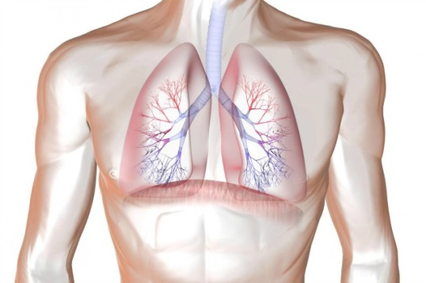

NITRIC OXIDE SYNTHESIS
EXHALED NO
Lumen
IL-4, IFN-γ,TNF-α
Agonists
Epithelial cells
Transcription factors
[Ca²⁺]
NO
ADMA
NO
Host defence
Inflammatory cell
infiltration
Th2-driven
inflammation
iNOS
CAT
L-Arginine
CAT
cNOS
Th2 cytokines,
Gene polymorphisms
NO
Arginase
I and II
NO
NO₂⁻
O₂⁻
Mucosa
NO₃⁻
ONOO⁻
Ornithine
R-SH
sGC
Proline
Polyamines
GTP
cGMP
NITRATIVE STRESS
R-SNO
Airway remodeling
Smooth muscle contraction
Mucus production
Cell damage
DNA, mitochondrial and
protein dysfunction
Airway hyperresponsiveness
Bronchodilation
Bronchoprotection
Anti-inflammatory effects
Ricciardolo et al. Allergologia et Immunopathologia 2015

Slide 3
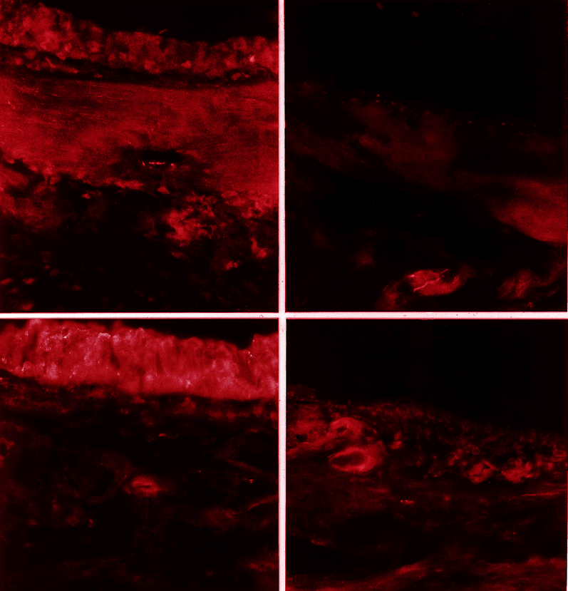
Immunohistochemical Distribution of
nNOS and ecNOS in guinea pig trachea
Intact
Epithelium-denuded
nNOS
ecNOS
Ricciardolo et al. Am J Respir Cell Mol Biol 2000

Slide 4





*P < 0.01
*
log PD₂₀ FEV₁ BK (nmol)
Mild asthma
Moderate to Severe Asthma

Slide 5
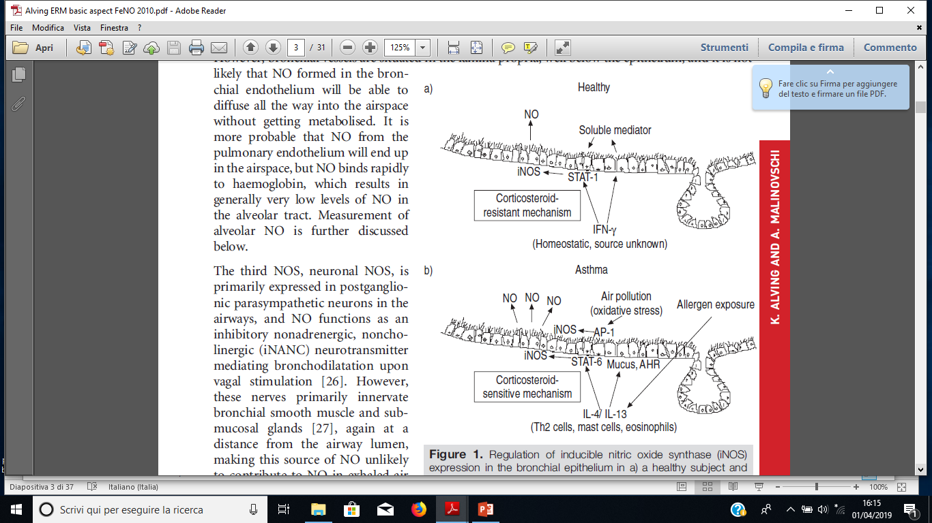
Regulation of iNOS in bronchial epithelium
Fe
Alving and Malinovschi. Eur Respir Mon 2010
Fe

Slide 6
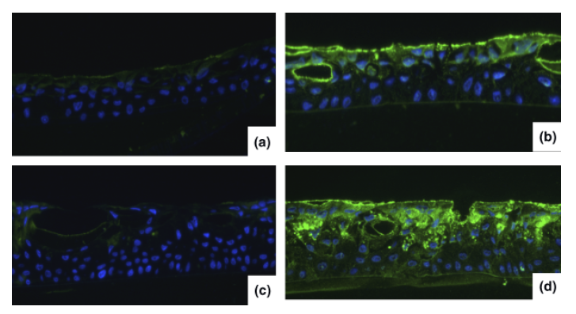
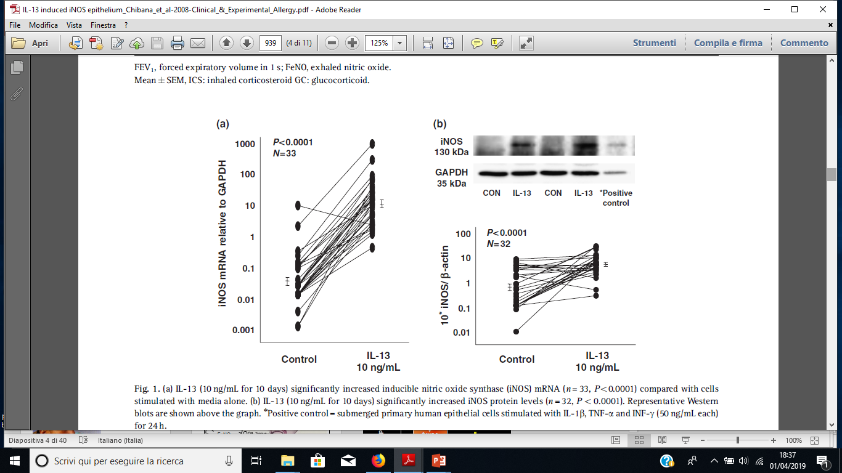
IL-13 induced iNOS expression in bronchial epithelial cells
Basal expression of iNOS at day 10
IL-13-induced iNOS expression at day 10
Chibana, Wenzel et al. CEA 2008

Slide 7
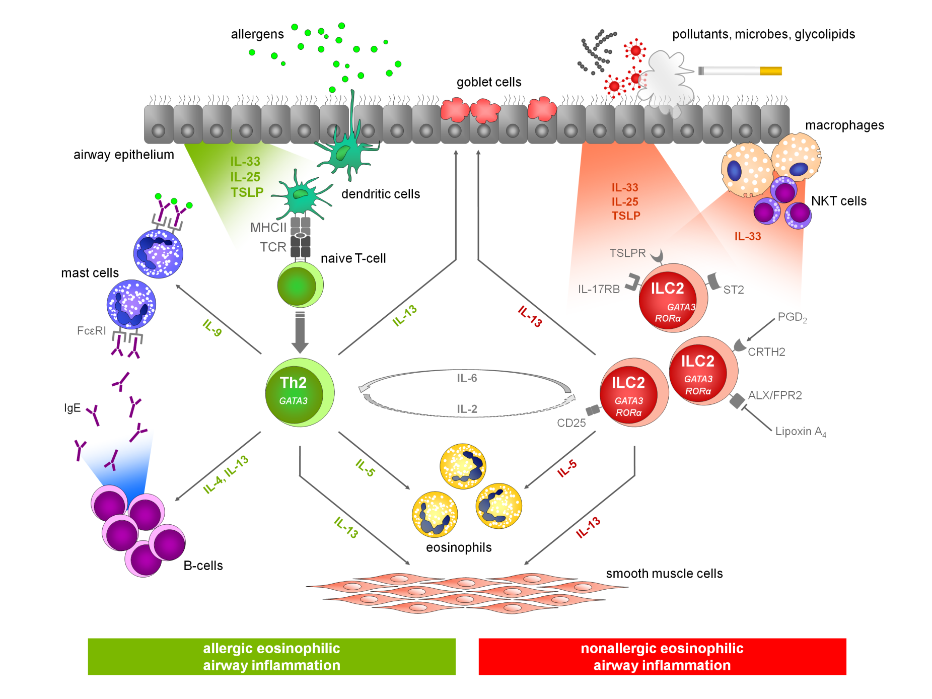
Heterogeneity of eosinophilic asthma
FeNO
iNOS
Brusselle G. et al. Nat Med 2013.
Notes:
Reference
Brusselle G, Maes T, Bracke KR. Eosinophils in the spotlight: Eosinophilic airway inflammation in nonallergic asthma. Nat Med 2013;19(8):977–9.

Slide 8
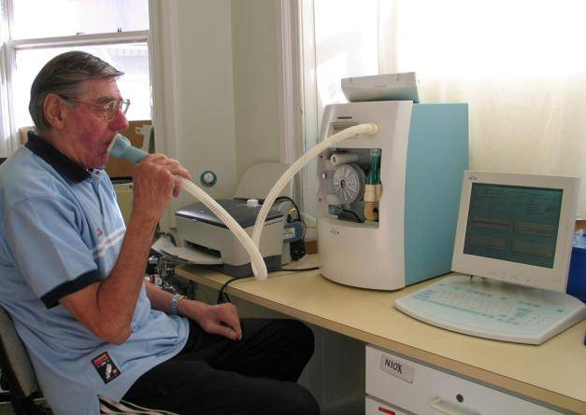
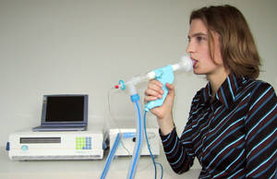
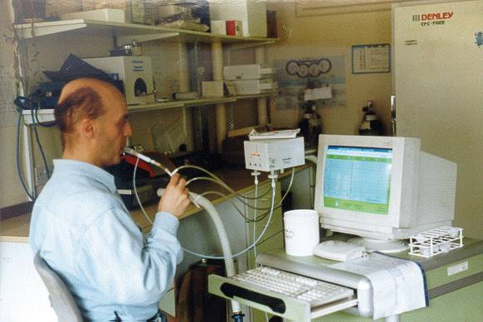

Slide 9
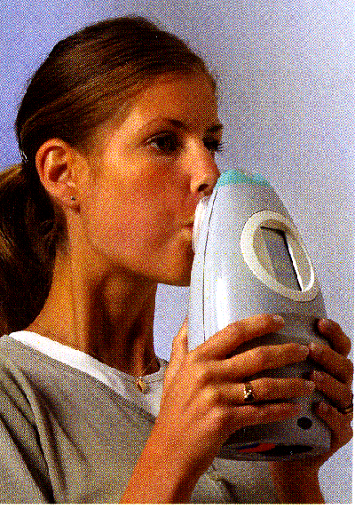
Hand-held
analyzer
new

Slide 10
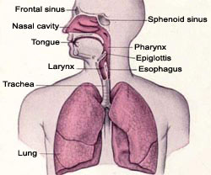
Factors affecting FeNO
FeNO
High FeNO
Old Age
Height
Gender (Male)
Ethnicity (Chinese)
Atopy
Rhinitis
Viral infections
Low FeNO
Smoking
Passive smoke exposure
Obesity
Acute bronchoconstriction
Ricciardolo et al. Allergologia et Immunopathologia 2015

Slide 11
INCREASED EXHALED NO IN ASTHMA
150
Inflammation
↑ iNOS
↑ NO
p<0.001
100
Exhaled NO (ppb)
50
0
Control
Asthma
Kharitonov et al. Lancet 1994;343:133-5.

Slide 12
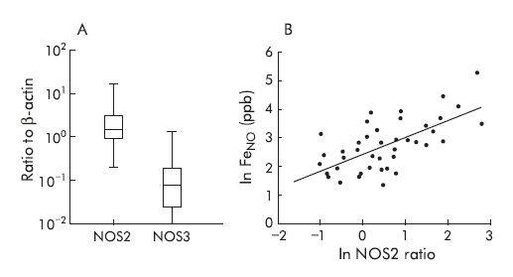
iNOS expression and FeNO
24 Healthy;10 atopic healthy;9 atopic asthmatics
Brushing in distal trachea
R=0.67 in all subjects
R=0.83 in asthmatics
mRNA expression by RT-PCR
Lane et al. Thorax 2004

Slide 13
EFFECT OF AN iNOS INHIBITOR ON EXHALED NO
L-N⁶-(1-iminoethyl)lysine (L-NIL): 200mg orally
ASTHMA
35
NORMAL
35
30
30
25
25
PLACEBO
Exhaled NO (ppb)
20
20
15
15
10
PLACEBO
10
L-NIL
5
L-NIL
5
0
0
0
2
4
6
8
12
24
48
72
0
2
4
6
8
12
24
48
72
Hours
Hours
Hansel T et al: FASEB J 2003

Slide 14
ALLERGEN CHALLENGE AND EXHALED NO
**
500
n=16
**
6
**
**
*
**
Exhaled NO (ppb)
FEV₁ (L)
250
4
Early
Late
0
2
0
2
4
6
8
10
20
25
30
Time (hours)
Kharitonov SA et al: AJRCCM 1995

Slide 15

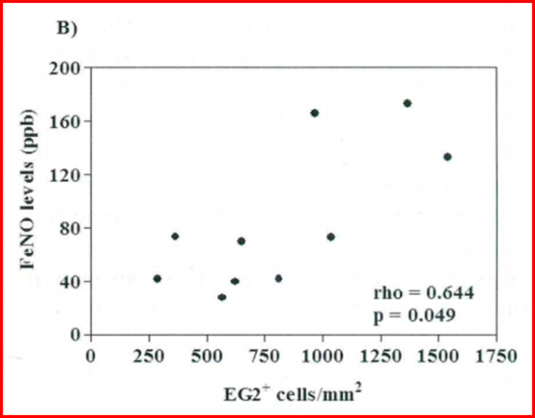
FeNO and sputum/bronchial EOS in atopic asthma
35 stable atopic asthmatics
not on ICS
10 atopic mild asthmatics 48 hrs
after allergen challenge
Jatakanon et al. Thorax 1998; 53:91-95.
Ricciardolo et al. Int J Imm Pharm 2012;25:175-182.

Slide 16
EFFECT OF AN INHALED STEROID ON EXHALED NO
Mild asthma patients: n=12/group
50
Budesonide / Placebo
Steroid stopped
40
30
Placebo
20
10
Exhaled NO (% change)
0
Budesonide 100µg daily
-10
-20
-30
*
-40
Budesonide 400µg daily
*
-50
*
*
0
3
6
9
12
15
18
21
24
27
30
Kharitonov S et al: Thorax 2002
Days

Slide 17
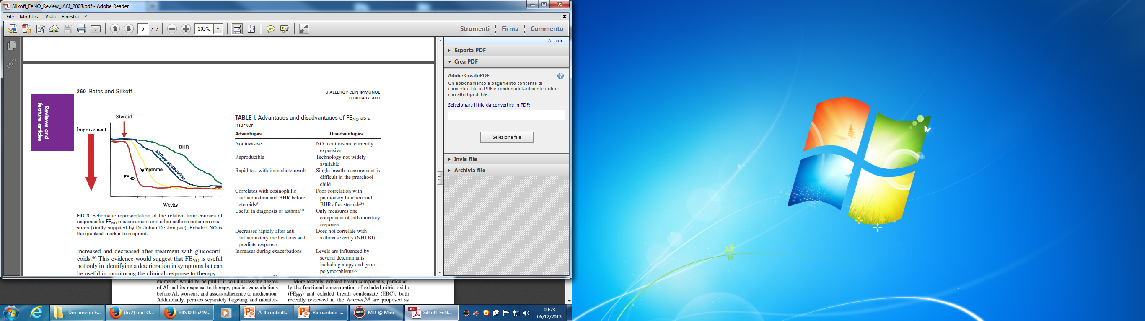
FeNO and ICS response
Bates and Silkoff. JACI 2003; 111:256-262.

Slide 18
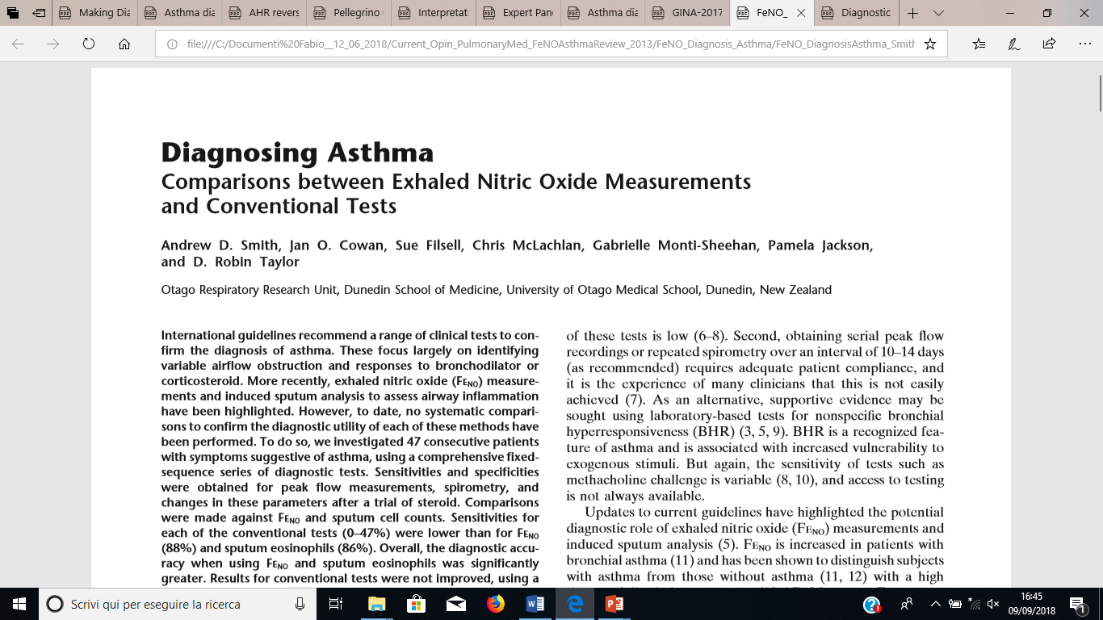
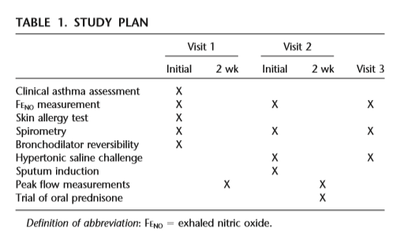
N = 47 patients with symptoms suggestive asthma
AJRCCM 2004; 169:473-8.

Slide 19
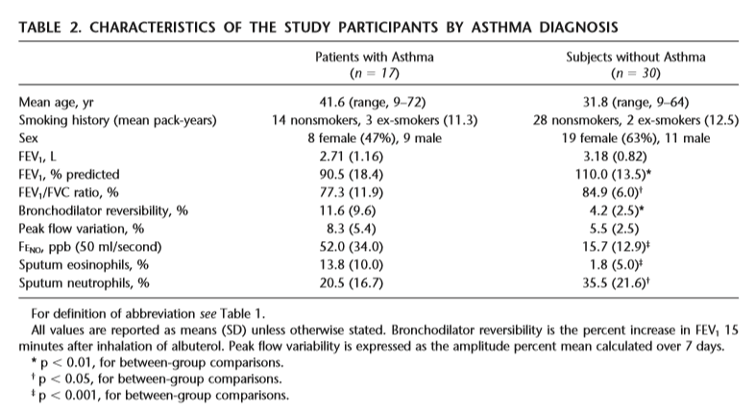
AJRCCM 2004; 169:473-8.

Slide 20
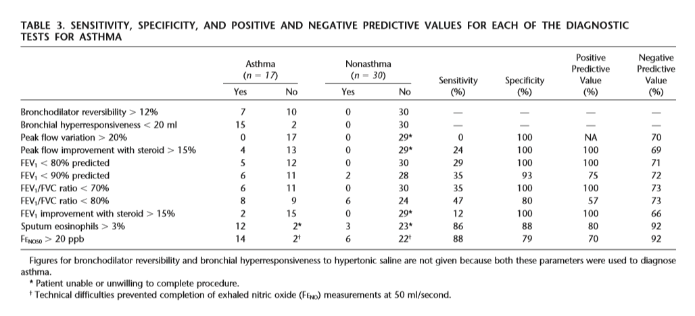
AJRCCM 2004; 169:473-8.

Slide 21

FeNO and asthma diagnosis: cut-off 26 ppb vs sputum eosinophila >3%
Negative Predictive
Value = 85%
Shaw et al. AJRCCM 2007;176:231-7.

Slide 22
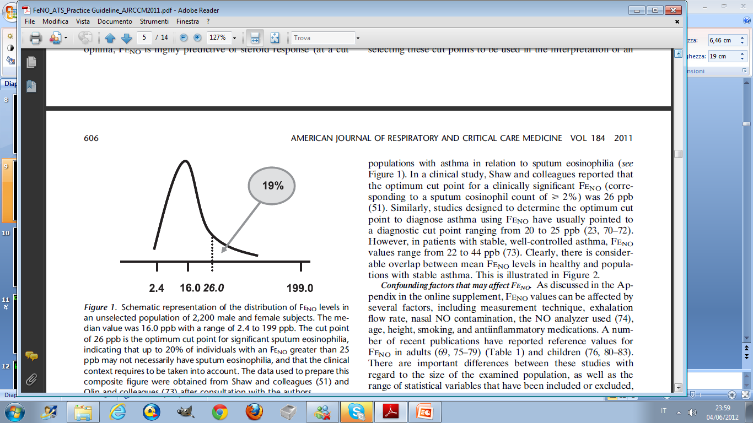
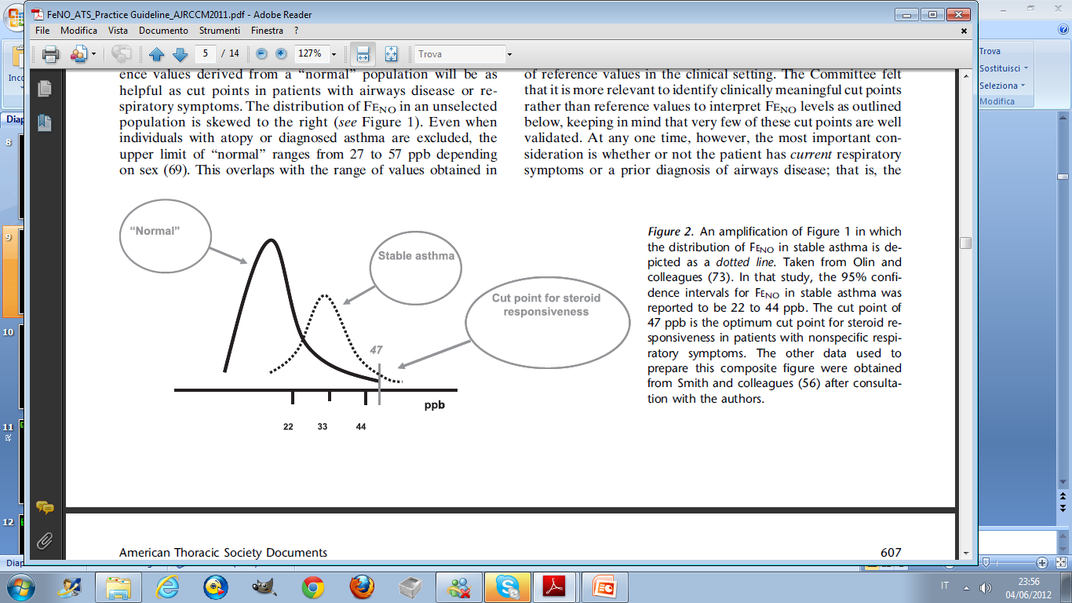
F_{E}NO: cut points
Dweik et al: AJRCCM 2011;184:602-615.

Slide 23

FeNO as predictor of steroid response
52 subjects with undiagnosed respiratory symptoms
Placebo vs Fluticasone 500 mcg/day
Smith et al. AJRCCM 2005;172:453-9.

Slide 24
Ricciardolo et al. Allergy Asthma Proc 2015;36:e1-8
ASTHMA DIAGNOSIS
Unlikely eosinophilic airways inflammation
Unlikely corticosteroid responsiveness
Alternative Diagnosis:
Non-eosinophilc Asthma (neutrophilic inflammation)
Wheezy Bronchitis
Gastroesophageal Reflux disease
Rhinosinusitis
COPD
Vocal Cord Dysfunction
Bronchiectasis, Cystic Fibrosis, Primary Ciliary Dyskinesia
FeNO <25 ppb
(< 20 ppb children)
Symptomatic Patient
(chronic cough and/or wheeze and/or breathlessness for > 6 weeks)
FeNO 25-50 ppb
(20-35 ppb children)
Caution in diagnostic decisioning
Clinical assessment
Shortly re-evaluation
FeNO>50 ppb
(>35 ppb children)
Likely eosinophilic airways inflammation
Likely corticosteroid responsiveness.

Slide 25
Ricciardolo et al. Allergy Asthma Proc 2015;36:e1-8
ASTHMA MONITORING
Unlikely response to increasing ICS dose
Consider Alternative Diagnosis
Consider LABA, anti-LT, macrolide
FeNO <25 ppb
(< 20 ppb children)
Persistent Allergen Exposure
Poor Adherence and/or Inhaler Tecnique
Inadequate ICS dose
Consider: increase ICS dose, add LABA or anti-LT
YES
FeNO 25-50 ppb
(20-35 ppb children)
High Persistent Allergen Exposure
No Adherence and/or Inhaler Tecnique
Inadequate ICS dose
Steroid-resistant Asthma
Exacerbation Risk
Consider: increase ICS dose, add LABA or anti-LT
FeNO>50 ppb
(>35 ppb children)
Asthma Symptoms
Patient treated with ICS
Good ICS adherence
Adequate ICS dose
Consider: tapering ICS dose
FeNO <25 ppb
(< 20 ppb children)
NO
Good ICS adherence
Adequate ICS dose
Monitoring FeNO
FeNO 25-50 ppb
(20-35 ppb children)
Poor compliance
Comorbidity (Allergic Rhinitis)
ICS withdraw may cause exacerbation
Steroid insensitivity due to constitutive NOS sources
FeNO>50 ppb
(>35 ppb children

Slide 26
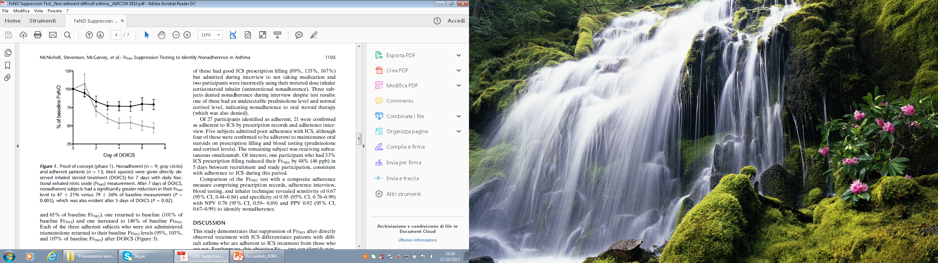
FeNO suppression test in
non-adherent difficult asthma
Adherent
Nonadherent
Directly observed inhaled steroid treatment for 7 days with daily FeNO measurement.
ICS: Budesonide 1.600 (mcg/day)
McNicholl et al. AJRCCM 2012;186:1102

Slide 27



FeNO and asthma control: a real life study
N = 363 patients
Ricciardolo et al. Allergol Immunopathol 2016; 44:197-205.

Slide 28
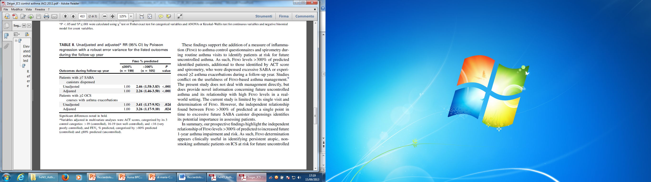
FeNO and future risk in asthma
Zeiger et al. JACI 2011; 128:412-414.

Slide 29
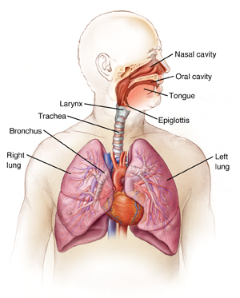
FeNO
↑ FeNO:
Children developing asthma
Allergic asthma
Eosinophilic refractory asthma
Non atopic severe asthma
Poorly controlled/exacerbated asthma
ASA-Intolerant asthma
↓ FeNO:
Non atopic asthma
Smoking asthma
Obese asthma
Neutrophilic severe asthma
Neonatal respiratory disorders with asthma
Ricciardolo et al. Allergy Asthma Proc 2015;36:e1-8

Slide 30



Severe adult-onset asthma phenotype: Clinical and inflammatory markers
Amelink et al. 2013;132:336-41.

Slide 31

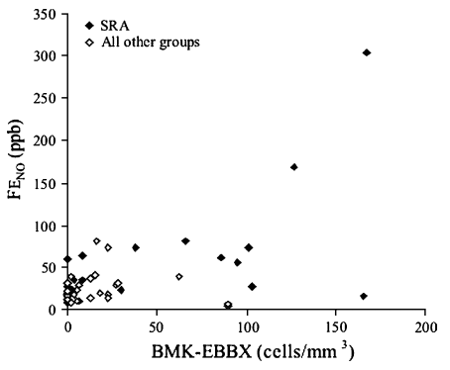
FeNO identifies the eosinophilic phenotype in
severe refractory asthma
p=0.01
p=0.0084
p=0.001
BMK: eosinophil major basic protein
EBBX: endobronchial biopsy
SRA: oral prednisone 10 mg/day or high ICS dose
+ FEV1<70%pred + 2 urgent care visit in previous year
Silkoff et al. 2005;116:1249-55.

Slide 32
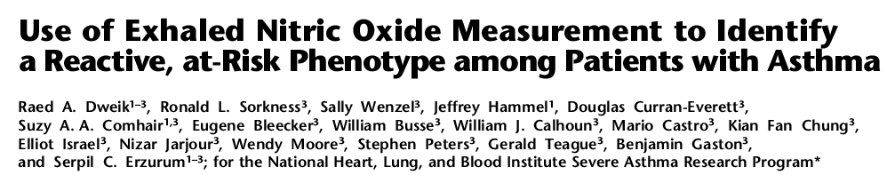
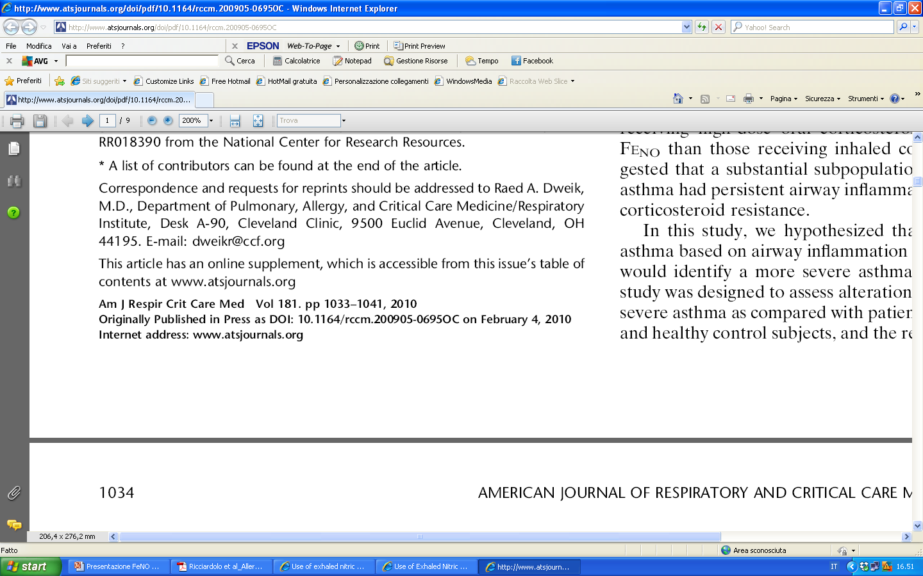
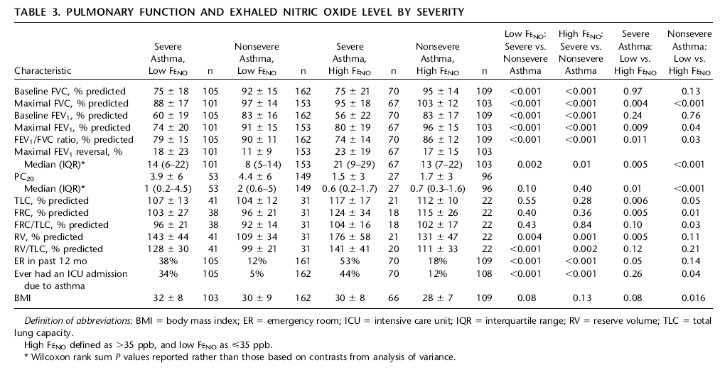

Slide 33
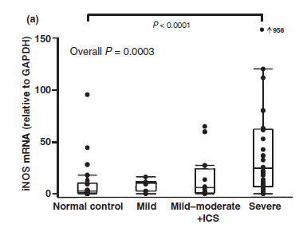
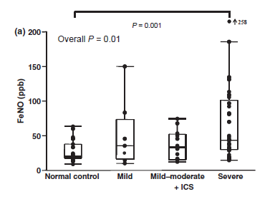
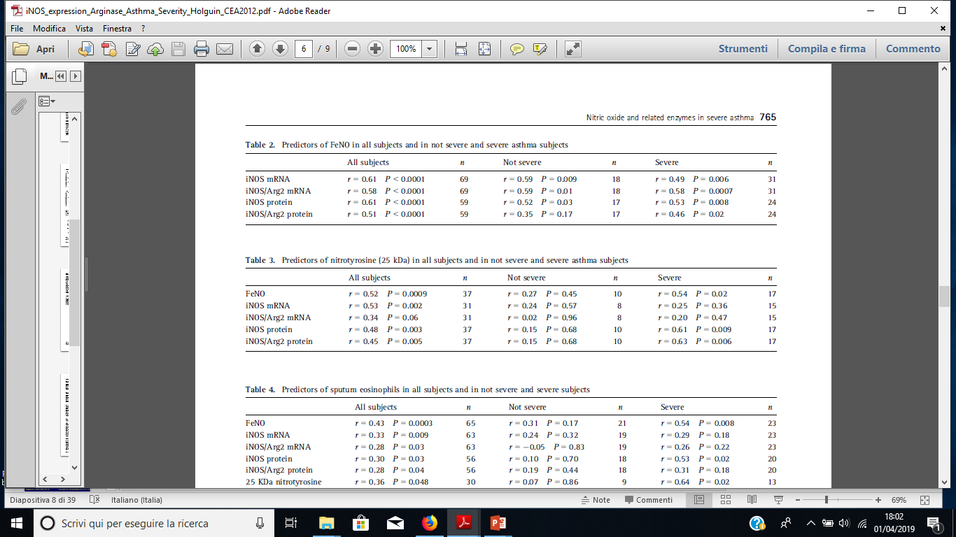
iNOS and FeNO in Severe Asthma
Bronchoscopy: bronchial brushings
Reverse trascription RT-PCR
Yamamoto, Wenzel et al. CEA 2012

Slide 34


FeNO–driven asthma management does not result in
fewer asthma exacerbations or in use of less treatment
Patients: 118 (FeNO group=58; BTS control group=60)
Primary outcome: number of severe exacerbations
Treatment adjustment: control group (Juniper Score); FeNO group (26ppb or 16ppb)
Control
group
FeNO
group
Open circle: control group
Closed circle: FeNO group
Shaw et al. AJRCCM 2007;176:231-7.

Slide 35



FeNO-based treatment can reduce
asthma exacerbations during pregnancy
220 Pregnant with asthma
Powell et al. Lancet 2011;378:983-90.

Slide 36
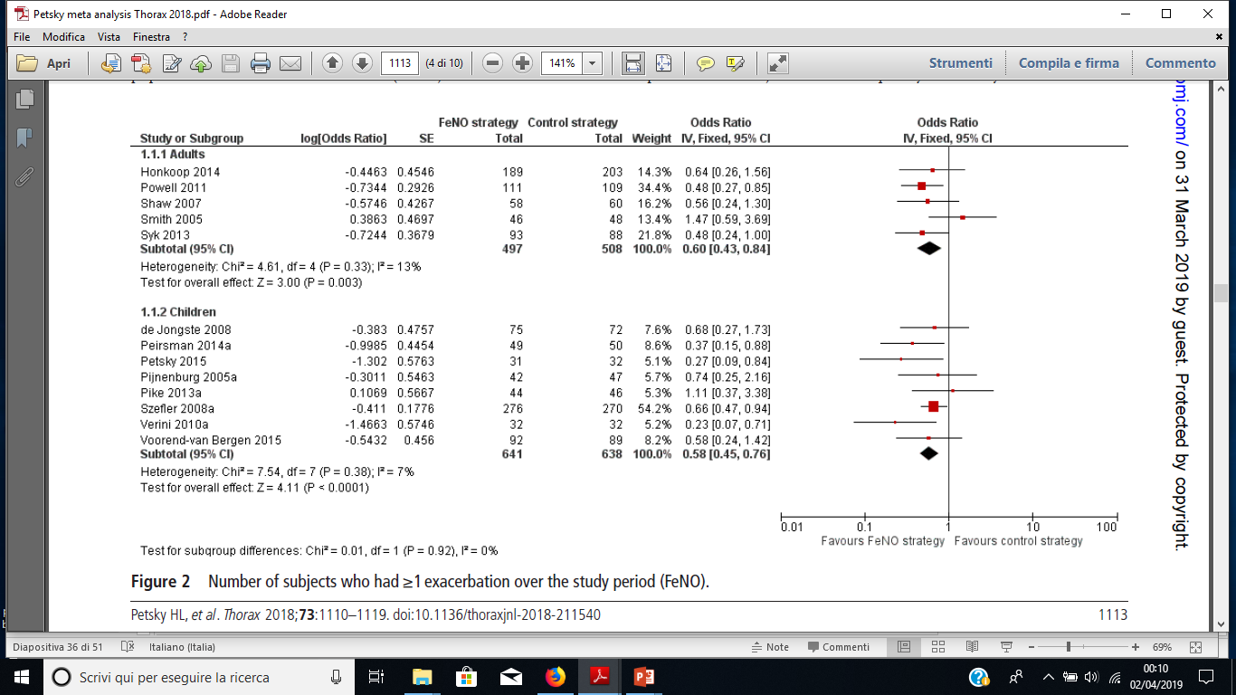
FeNO and Asthma Management:
Meta-analysis
(16 studies on FeNO-based management)

Slide 37
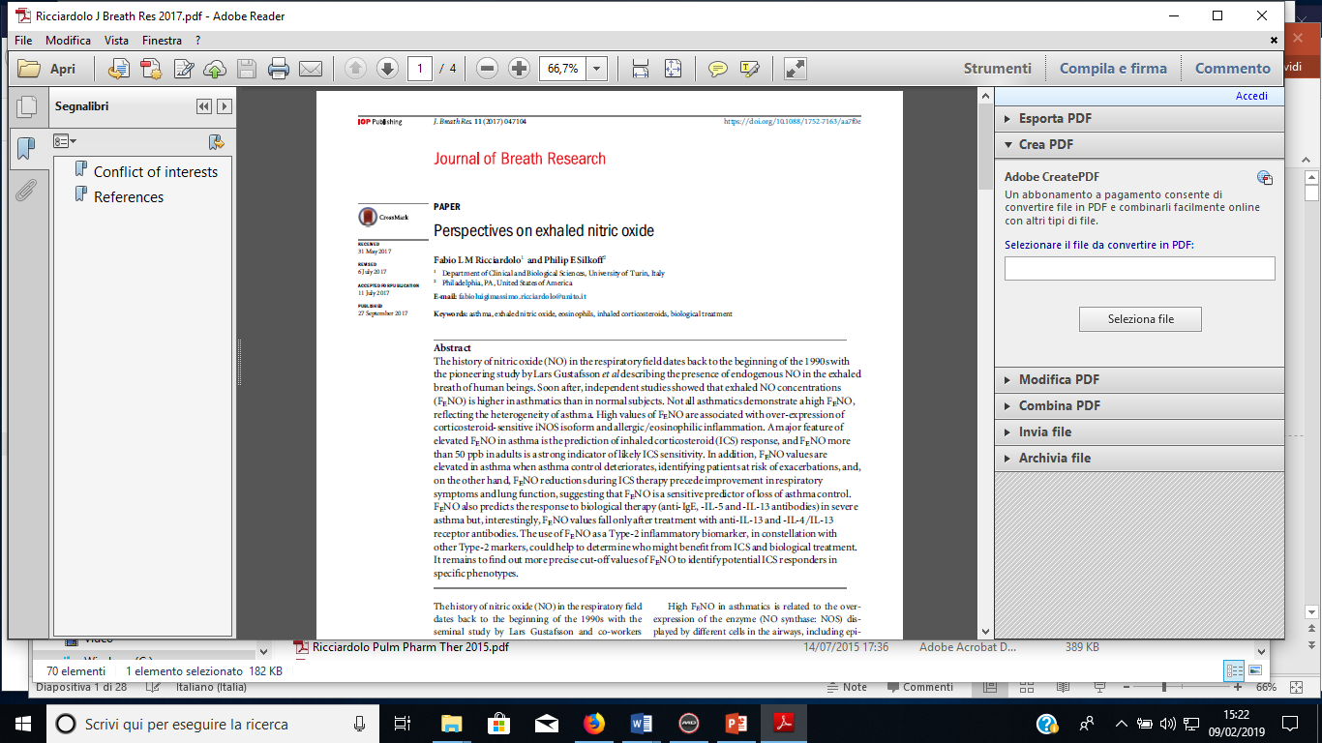

Slide 38
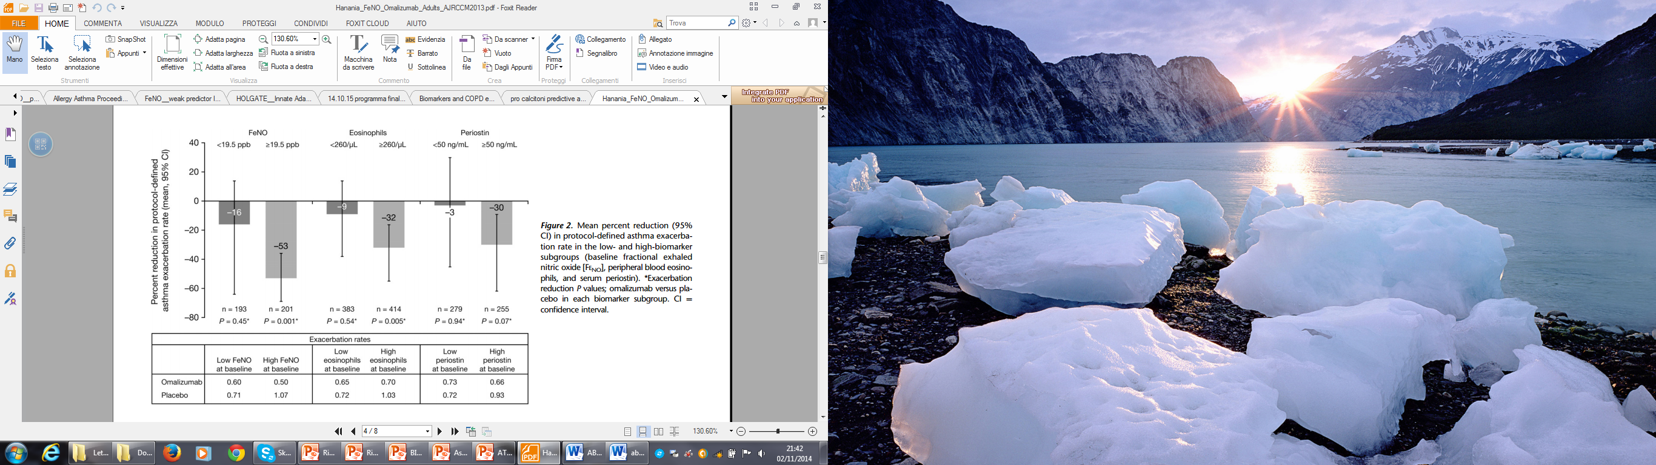
Biomarkers as predictors for omalizumab
Hanania et al. AJRCCM 2013;187:804-811.

Slide 39






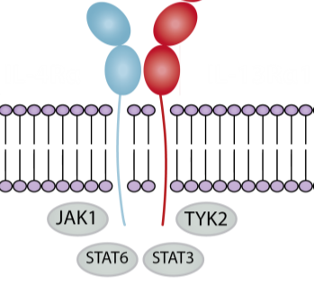
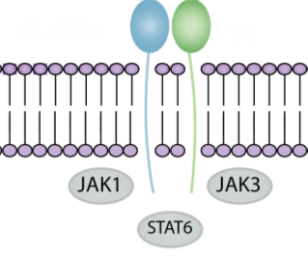
Anti-IL4Rα monoclonal antibody dupilumab: mechanism of action
Dupilumab is a fully human IL-4Rα monoclonal antibody inhibiting IL-4 and IL-13 signaling pathways, key drivers of Type 2 inflammation.
Dupilumab is approved for the treatment of adults with moderate-to-severe atopic dermatitis; and has also shown efficacy in patients with other Type 2 inflammatory diseases including nasal polyposis with chronic rhinosinusitis.
IL-4
IL-13
IL-4
IL-13
IL-4
IL-4Rα
γc
IL-4Rα
IL-13Rα1
Type I receptor
B cells, T cells, monocytes, eosinophils, fibroblasts
Type II receptor
Epithelial cells,
smooth muscle cells, fibroblasts, monocytes, activated B cells
Notes:
IL-4Rα, interleukin-4 receptor alpha.
Gandhi NA, et al. Expert Rev Clin Immunol. 2017.
Bachert C, et al. JAMA. 2016.
Hirano I, et al. Presented at WCOG/ACG 2017.

Slide 40
Anti-IL4 receptor (IL4R) monoclonal antibody dupilumab
FeNO
iNOS
Allergen-specific IgE
Anti-IL4R
↓
IL-4
↓
Polyclonal IgE
Anti-IL4R
Brusselle G. et al. Nat Med 2013.
Notes:
Reference
Brusselle G, Maes T, Bracke KR. Eosinophils in the spotlight: Eosinophilic airway inflammation in nonallergic asthma. Nat Med 2013;19(8):977–9.

Slide 41
Dupilumab prevents exacerbations in uncontrolled moderate-to-severe asthma
NO minimum requirement for blood eosinophil count or FENO.
LIBERTY ASTHMA QUEST study. Castro M. et al, NEJM 2018.

Slide 42
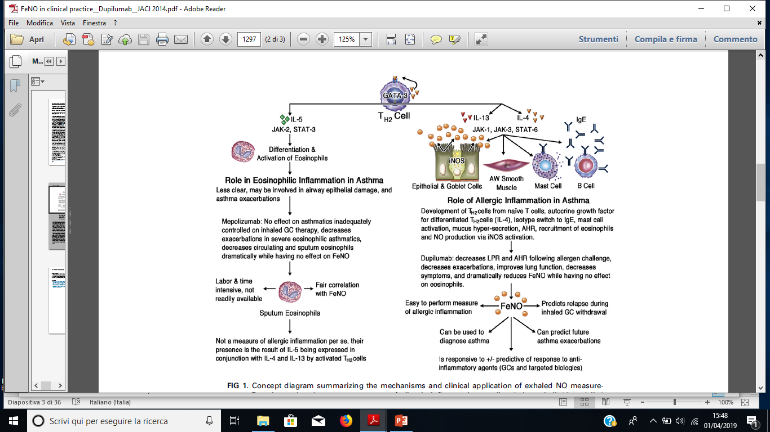
Biologics and FeNO in severe asthma
Spahn et al. JACI 2016; 138:1296-8.

Slide 43
Conclusions
FeNO is an easy-to-obtain and non-invasive biomarker for allergic/eosinophilic airway inflammation in T2-high asthma;
FeNO is useful for diagnosis, severe asthma phenotyping, prediction of the loss of control and exacerbation, monitoring ICS and biologic therapy efficacy in selected asthmatics.

Slide 46
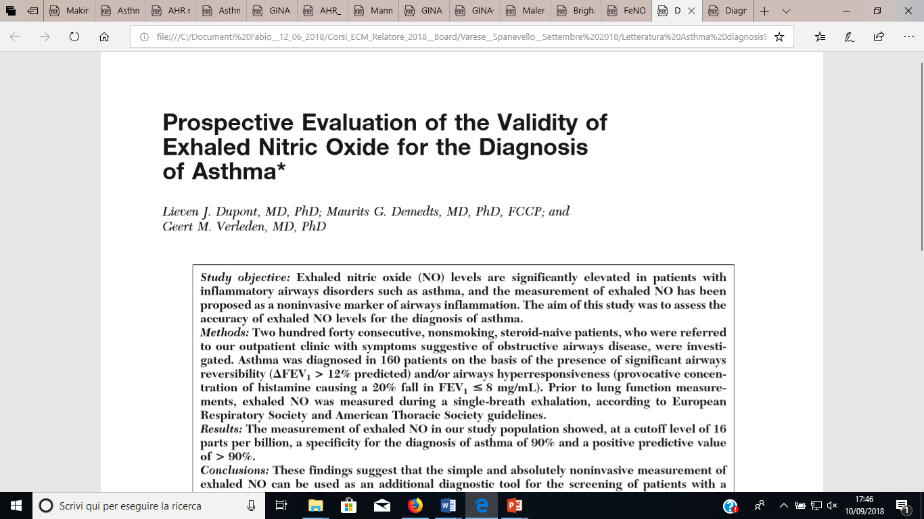
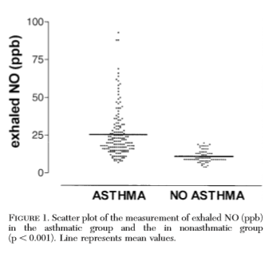

240 steroid-naive non-smoking subjects with symptoms suggestive of asthma
Constant Flow=200ml/s
Chest 2003; 123:751-6.

Slide 47
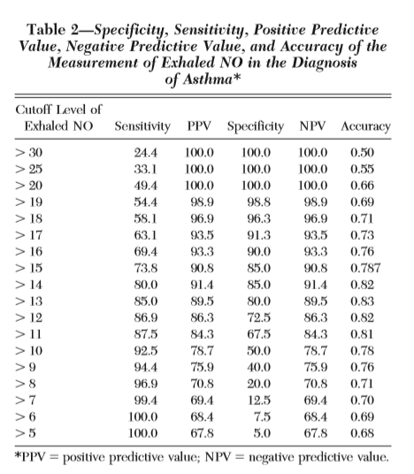
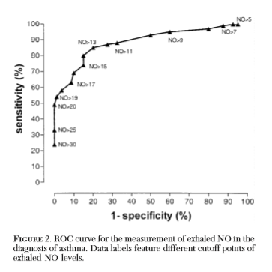
Chest 2003; 123:751-6.

Slide 48
Anti-IL4R dupilumab improves lung function in uncontrolled moderate-to-severe asthma
Adolescents and adults with uncontrolled asthma (ACQ-5 > 1.5)
on medium-to-high dose ICS plus up to two additional controllers
and ≥ 1 severe exacerbation in the previous year;
NO minimum requirement for blood eosinophil count or FENO.
LIBERTY ASTHMA QUEST study. Castro M. et al, NEJM 2018.

Slide 49
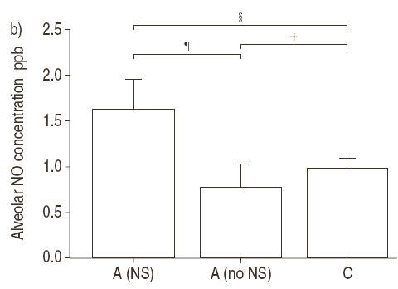
L’ossido nitrico alveolare correla con i sintomi
p=0.032
p=0.012
p=0.453
Concentrazione di NO alveolare
A(NS): asmatici con sintomi notturni
A(no NS): asmatici senza sintomi notturni
C: Controllo (soggetti non asmatici)
30. Lehtimaki L et al. Eur Respir J. 2002
Notes:
L’infiammazione del distretto distale, rilevata dalla misura della concentrazione in NO alveolare esalato, è correlata con il grado di controllo della patologia. I dati riportati mostrano una differenza significativa nelle concentrazioni di NO esalato tra pazienti asmatici con sintomi notturni [A (NS)] e senza sintomi notturni [A (no NS)] e tra pazienti asmatici con sintomi notturni [A (NS)] e il gruppo controllo [C] costituito da soggetti non asmatici.

Slide 50
L’ossido nitrico alveolare
è aumentato nell’asma refrattaria
p<0.001
30
p<0.001
25
20
NS
15
Concentrazione alveolare di NO (ppb)
10
5
0
Normale
Asma
lieve-moderato
Asma
refrattario
No trattamento con steroidi
Trattati solo con steroidi inalatori
Trattati con steroidi inalatori e orali
31. Berry M et al., Eur Respir J 2005
Notes:
50
L’NO esalato può riflettere la severità della malattia asmatica, dimostrando così che l’interessamento delle vie aeree periferiche svolge un ruolo centrale nel determinismo della severità di malattia. In pazienti con asma persistente più severa, i processi infiammatori delle vie aeree possono oltrepassare questa sensibilità dell’NO agli steroidi, conducendo a livelli aumentati di NO esalato persino durante il trattamento con dosi elevate di corticosteroidi orali o inalatori.

Slide 51
Alveolar nitric oxide is associated with loss of asthma control in mild asthmatics
r=0.15
p=0.18
r=0.24
p=0.03
30
30
25
25
20
20
ASTHMA CONTROL TEST (ACT)
ASTHMA CONTROL TEST (ACT)
15
15
10
10
5
5
0
0
0
20
40
60
80
100
120
-5
0
5
10
15
20
25
30
Bronchial NO (nL/min)
Alveolar NO (ppb)
Scichilone N et al. JACI 2013

