Slide 1
Department of Medical, Surgical and Experimental Sciences
University of Sassari - Italy
Epidemiologia delle NTM
Giovanni Sotgiu
Trieste, 1-3/Apr/2019

Slide 2
I declare that I have no competing interests.

Slide 3
Epidemiology
Italy

Slide 4
NTM
Risk factors
Burden
Environment
Host

Slide 5
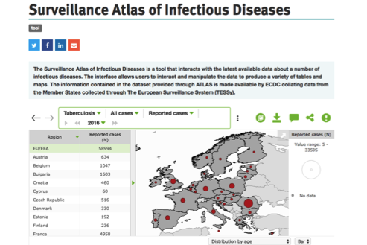

Slide 6
NTM in Italy
 | Year | 0 - 14 | 15 - 24 | 25 - 64 | >64 | Unknown | Total
 | 2007 | 3 | 5 | 139 | 172 |  | 319
 | 2008 | 4 | 6 | 114 | 153 |  | 277
 | 2009 | 6 | 5 | 99 | 142 | 1 | 253
 | 2010 |  | 5 | 109 | 164 |  | 278
 | 2011 | 3 | 4 | 126 | 137 | 1 | 271
 | 2012 | 40 | 6 | 137 | 155 | 2 | 340
 | 2013 | 52 | 8 | 148 | 157 | 1 | 366
 | 2014 | 10 | 11 | 144 | 153 | 33 | 351
 | 2015 | 11 | 18 | 132 | 199 | 34 | 394
 | 2016 | 9 | 3 | 108 | 140 | 74 | 334
Ministero della Salute - Direzione Generale della Prevenzione Sanitaria - Ufficio 5 Prevenzione Malattie Trasmissibili e Profilassi

Slide 7
Italian Notification System
Decreto Ministeriale 15 dicembre 1990 Sistema informativo delle malattie infettive e diffusive (1) Pubblicato nella Gazz. Uff. 8 gennaio 1991, n. 6.
CLASSE TERZA: Malattie per le quali sono richieste particolari documentazioni:
39) AIDS;
40) lebbra;
41) malaria;
42) micobatteriosi non tubercolari;
43) tubercolosi.

Slide 8
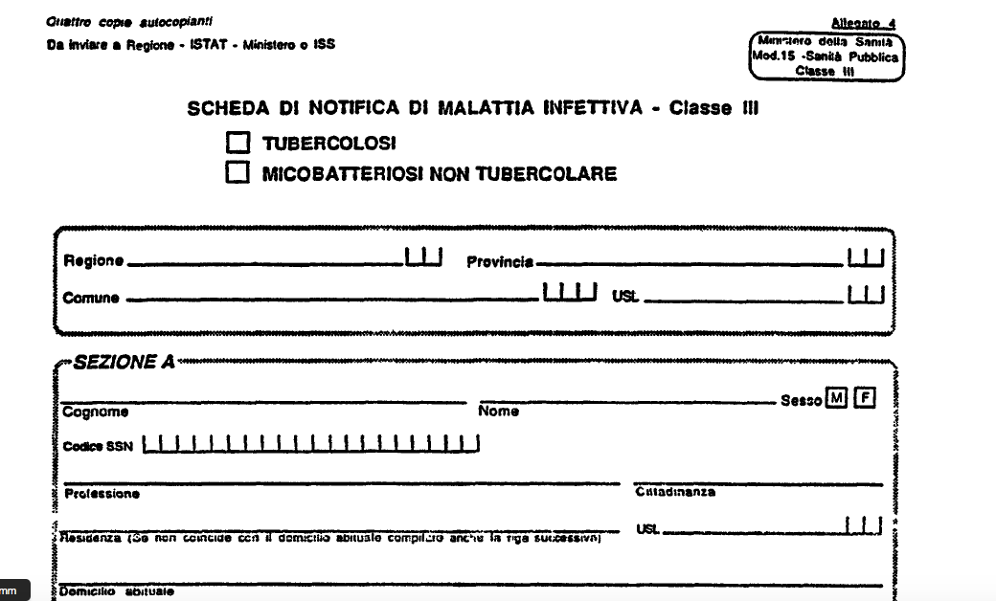
Italian Notification System

Slide 9
Survey
More detailed information than is available in routine systems;
Can be tailored to specific program needs;
Quality control may be easier than in routine systems.
Survey sampling design and analysis may be complex;
Expensive, time-consuming;
Sustainability concerns;
Less connected to ongoing program decision-making;
Information rapidly outdated, unless repeated – not available regularly.

Slide 10
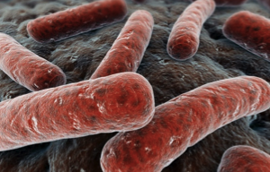
NTM and PD
>180 species (only a few pathogenetic);
Widely distributed in the environment;
Model of transmission unclear (person-to-person uncommon);
Clinical syndromes: Fibro-cavitary/consolidation (Europe); Nodular bronchiectatic (US).
Stout JE. Int J Infect Dis. 2016

Slide 11
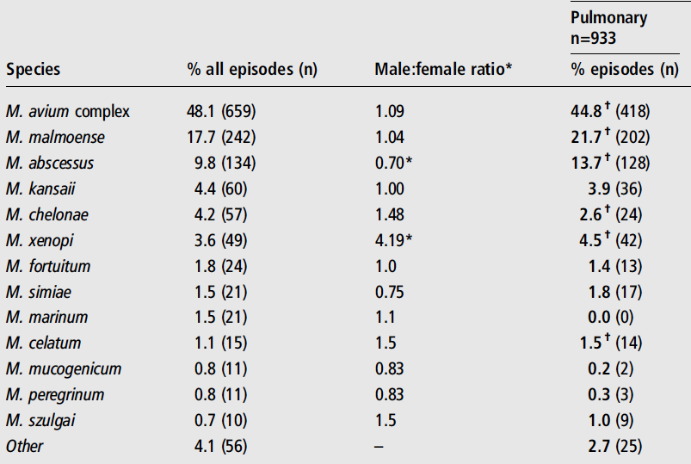
NTM And PD
Russell CD. Thorax. 2014
Notes:
There is growing recognition of the clinical importance of
non-tuberculous mycobacteria (NTM), a group of
versatile opportunistic bacterial pathogens. We describe
the characteristics of NTM isolates in Scotland over an
11-year period using data held by the Scottish
Mycobacteria Reference Laboratory. American Thoracic
Society microbiological criteria were used to evaluate the
clinical significance of isolates. Data presented include
analysis of trends across time, species/body site
associations, gender and age differences, geographical
variations and the association between cystic fibrosis and
Mycobacterium abscessus. We emphasise the need for
standardised reporting criteria for NTM isolates to ensure
optimal surveillance of NTM disease

Slide 12
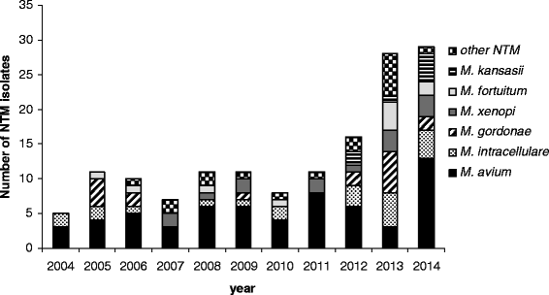
NTM and PD
Increase in non-tuberculous mycobacteria isolated from humans in Tuscany, Italy, from 2004 to 2014 (76.2% PD)
Rindi L. BMC Infect Dis. 2016

Slide 13
Environmental sources
Natural waters;
Drinking water distribution systems;
Biofilms in drinking water distribution systems;
Building, hospital, and household plumbing;
Hot tubs and spas;
Natural and household⁄building aerosols;
Boreal forest soils and peats;
Acidic, brown-water swamps;
Potting soils;
Metal removal fluid systems.
Notes:
The source of NTM that cause lung disease is still assumed to be the environment, with increasing concern that biofilms that form in municipal water sources may be a significant source for NTM.
These provocative data support the contention that at least some patients acquire NTM pathogens including M. avium from household
plumbing. It is still unknown, however, how much of a risk NTM in municipal water and household plumbing present and whether these water sources are a significant or common source of NTM for the majority of patients with NTM lung disease.
Interventions such as increasing the temperature of the hot water heater to 130 Fahrenheit or changing shower heads at regular intervals might decrease risk of NTM transmission but the impact of these steps is not known
In our opinion it is too early to make broad conclusions or recommendations about the risk of showering, or other municipal water exposure, in patients with NTM lung disease and underlying diseases such as bronchiectasis. Concerned patients could consider raising hot water heater temperatures, treating shower heads with bleach monthly or even changing shower heads at regular intervals although the effectiveness of these interventions for preventing NTM lung disease is unknown.

Slide 14
Prevalence of NTM-PD
Europe
2.9-7 per 100,000
US
8.6-22 per 100,000
Central/South America
1 per 100,000
Australia/NZ
3 per 100,000
Stout JE. Int J Infect Dis. 2016; Shah NM. BMC Infect Dis . 2016
Marras T. Thorax. 2007; Adjemian AJRCCM. 2012.
Notes:
14→ ai quei tempi TB era 5
Another commonly used measure is isolate incidence (number of individuals with NTM newly isolated from a respiratory source during a time period, without regard to disease status). NTM disease incidence (defined as the number of persons with a new diagnosis of NTM pulmonary disease by a standardized definition) is rarely reported because it is challenging to meaningfully describe given uncertainties in timing of disease onset and variable timing and rate of ascertainment after onset
A recent analysis for 2007–2012 identified a doubling of the incidence of pulmonary
Mycobacterium avium complex (MAC) among men and women (figure 1) [5], continuing the trend
reported previously

Slide 15
Incidence of NTM-PD
Annual increase: 8.2%
US Medicare
Brode SK. Int J Tuberc Lung Dis. 2014
Notes:
What is happening on annual basis
Over 8% increase per year. shocking
Another commonly used measure is isolate incidence (number of individuals with NTM newly isolated from a respiratory source during a time period, without regard to disease status). NTM disease incidence (defined as the number of persons with a new diagnosis of NTM pulmonary disease by a standardized definition) is rarely reported because it is challenging to meaningfully describe given uncertainties in timing of disease onset and variable timing and rate of ascertainment after onset
A recent analysis for 2007–2012 identified a doubling of the incidence of pulmonary
Mycobacterium avium complex (MAC) among men and women (figure 1) [5], continuing the trend
reported previously

Slide 16
NTM/TB Trend
Brode SK. Int J Tuberc Lung Dis. 2014
Notes:
22 reports
SR
Same countries NTM was increasing and TB was going down
Not association but intersteing

Slide 17
NTM-PD Mortality
Japan
3.6-fold increased risk of death for NTM-PD (Germany, 3-y follow-up);
w COPD: 41% vs. w/o COPD 14%
39-46% (Denmark)
Stout JE. Int J Infect Dis. 2016; Shah NM. BMC Infect Dis . 2016
Marras T. Thorax. 2007; Adjemian AJRCCM. 2012.
Notes:
Multiple report across the world that are failry inconvincing tehy are increasing
Another commonly used measure is isolate incidence (number of individuals with NTM newly isolated from a respiratory source during a time period, without regard to disease status). NTM disease incidence (defined as the number of persons with a new diagnosis of NTM pulmonary disease by a standardized definition) is rarely reported because it is challenging to meaningfully describe given uncertainties in timing of disease onset and variable timing and rate of ascertainment after onset
A recent analysis for 2007–2012 identified a doubling of the incidence of pulmonary
Mycobacterium avium complex (MAC) among men and women (figure 1) [5], continuing the trend
reported previously

Slide 18
Survival and NTM species
1.00
0.75
0.50
Survival distribution function
Rapid-growth mycobacteria Non-rapid-growth mycobacteria M. gordonae M. avium complex M. malmoense M. xenopi
0.25
0
0
10
20
30
40
50
60
1,282 Danish patients between 1997-2008
M. xenopi infection results in increased mortality
Andréjak C. Am J Respir Crit Care Med. 2010
Gommans EP. Respir Med 2015

Slide 19
Adequate Therapy and Mortality
100
90
80
70
Survival Probability (%)
60
5-year survival (Croatia)
50
Adequate (n-31) Inadequate therapy (n=38)
Short therapy (n=12) TB therapy (n=33)
40
30
0
12
24
36
48
60
72
84
96
108
120
132
144
Time (months)

Slide 20
Mortality and Cavitary Disease
100
ns
80
p<0.001
60
Estimated survival (%)
40
Total (n=634)
Multivariate analysis of risk factors* Hazard Ratio [95% confidence interval]
FC (± NB): 5.3 [2.634-10.763], p<0.001
BMI < 18.5 kg/m²: 4.3 [1.655-11.270], p=0.003
Nodular-bronchiectatic (NB) (n=482)
20
Fibrocavitary (FC) or fibrocavitary + nodular-bronchiectatic (n=135)
Other (n=17)
0
0
2
4
6
8
10
12
Year
Fibrocavitary or fibrocavitary + nodular-bronchiectatic disease and low BMI: > mortality
Hayashi M. Am J Respir Crit Care Med. 2012

Slide 21
Geographical Distribution
Europe
North America
South America
Australia
Asia
South Africa
Hoefsloot W. ERJ. 2013
Notes:
This snapshot illustrates that the species distribution among NTM isolated from
pulmonary specimens in the year 2008 differs by region and differs by country within these regions
It is now generally accepted that NTM species differ in their
ability to cause lung disease in humans [3–6] and that the clinical relevance of a particular species can differ
in different parts of the world [7, 8]. The species distribution presented in this study can help in identifying
factors associated with human NTM infection, such as climate differences, population density or host
factors.

Slide 22
Exposure
Great exposure to aerosols
Change in plumbing
Diagnostic
More sensitive culture methods
More CT scans
Organisms
Increased virulence?
Host factors
Aging population
More immunosuppressed patients
Decreasing cross-immunity to MTB
Why Are NTM Increasing?
Notes:
Multiple report across the world that are failry inconvincing tehy are increasing
Another commonly used measure is isolate incidence (number of individuals with NTM newly isolated from a respiratory source during a time period, without regard to disease status). NTM disease incidence (defined as the number of persons with a new diagnosis of NTM pulmonary disease by a standardized definition) is rarely reported because it is challenging to meaningfully describe given uncertainties in timing of disease onset and variable timing and rate of ascertainment after onset
A recent analysis for 2007–2012 identified a doubling of the incidence of pulmonary
Mycobacterium avium complex (MAC) among men and women (figure 1) [5], continuing the trend
reported previously

Slide 23
Pre-existing lung disease
Systemic immune deficiency
COPD, asthma, bronchiectasis, lung cancer, smoking, recurrent aspiration with gastro-oesophageal reflux disease, inhaled corticosteroids, pulmonary fibrosis, cystic fibrosis, thoracic deformities such as ankylosing spondylitis, scoliosis, previous tuberculosis, postinfectious residual cavitation, bulla or cyst,
pneumoconiosis, alveolar proteinosis
HIV infection, status after organ transplantation, malignancies, alcoholism, cachexia, immunosuppressive therapy, teething, age, male gender, diabetes mellitus, renal failure
Interferon gamma receptor gene, interleukin-12 receptor gene, signal transducer and activator of transcription 1 (STAT 1) transmembrane conductance regulator gene (cystic fibrosis), alpha 1-antitrypsin gene
Increased genetic susceptibility
Notes:
Predisposing factors of mycobacteriosis
This snapshot illustrates that the species distribution among NTM isolated from
pulmonary specimens in the year 2008 differs by region and differs by country within these regions
It is now generally accepted that NTM species differ in their
ability to cause lung disease in humans [3–6] and that the clinical relevance of a particular species can differ
in different parts of the world [7, 8]. The species distribution presented in this study can help in identifying
factors associated with human NTM infection, such as climate differences, population density or host
factors.

Slide 24
Host Risk Factors
Host risk factor | RR, OR, relative prevalence
COPD | 2–10
Bronchiectasis | 44–187.5
Thoracic skeletal abnormalities | 5.4
Low body weight | 9.09
Immunomodulatory drugs/anti-TNF agents | 1.3 (not defined)/2.2 (Anti-TNF ingredients)
Steroid use | 1.6–8
Gastro-esophageal reflux disease | 1.5–5.3
Hydroxychloroquine treatment | 1.6
Leflunomide treatment | 2.7
Prevots DR. Clin Chest Med. 2015; Andrejak C. Thorax. 2013
Brode SK. Thorax 2015
Notes:
Prevots 2015/p24/A

Slide 25
Epidemiological Challenges
Presence in the environment hinders meaning of a positive culture;
Reporting of the disease is not required or performed in many settings;
Disease definition based on scant evidence.
Notes:
In Queensland, Australia,
notification of NTM infections is required; reporting is electronic and laboratory-based [2]. In several
states within the USA, NTM isolates or cases are listed as notifiable conditions [3, 4], although in Oregon,
only extrapulmonary isolates are listed as notifiable [3]. Although reporting might not be complete, and
the system may have biases related to healthcare-seeking behaviour and physician awareness, these data are
essential to elucidating the epidemiology of NTM PD

Slide 26
Diagnosis = Treatment ???
Colonization?
Infection
Disease (treatment)
Notes:
The NTM share an important characteristic: they are all found in the environment so that isolation of any NTM species can be the onsequence of environmental contamination, especially contamination by nonsterile (tap) water sources including shower heads as well as other household water, municipal water and environmental sources. Hence, diagnostic criteria for respiratory NTM isolates remain necessary to help determine which NTM isolates are clinically significant
Non è mai stata dimostrata la condizione di “colonizzazione senza infezione” (cioè senza danno tissutale); non vi sono dati che escludano che la condizione di colonizzazione non sia un’infezione lentamente progressiva o indolente

Slide 27
Diagnostic criteria for NTM-LD
Radiological criteria
Microbiological criteria
Clinical criteria
Nodular or cavitary structures on chest radiograph
or
Multifocal bronchiectasis with multiple small nodules on the HRCT scan
and
Exclusion of other causes
Three positive sputum cultures
or
Positive culture from bronchoalveolar lavage
or
Transbronchial / other lung biopsy with mycobacterial histopathological features and positive culture or biopsy with mycobacterial, histopathological features and ≥ 1 positive culture from sputum / bronchoalveolar lavage
Bronchopulmonary symptoms
and
Exclusion of other diseases
BAL when patients cannot produce sputum, or their specimens do not grow mycobacteria
Griffith DE. Am J Crit Care Med. 2007
van Ingen J. Clin Chest Med. 2015

Slide 28
NTM Drug-Resistance
Innate
Not associated with in vitro MIC
Inducible macrolide resistance (erm) gene
Acquired
Selection of isolates
Associated with TB therapy

Slide 29
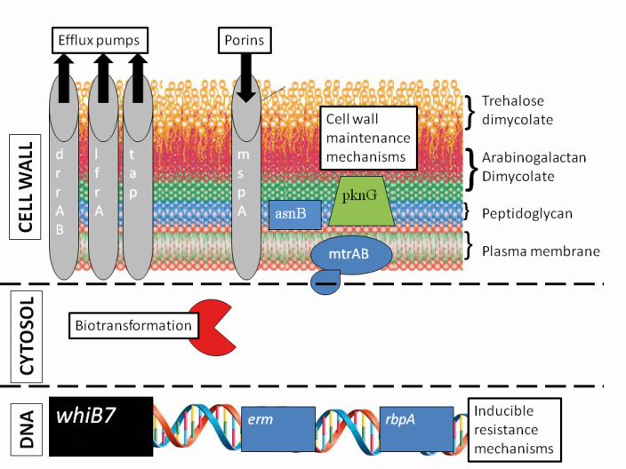
Natural Resistance
Cell wall impermeability
Rifamycins, β-lactams, quinolones
Efflux pumps
Tetracyclins, quinolones
Biotransformation
Aminoglycosides, β-lactams, quinolones
WhiB7 ‘resistome’: inducible
Macrolides (erm), rifamycins (rbpA)
van Ingen J, Drug Resist Update. 2012

Slide 30
Macrolide Resistance
Retrospective study with clarithromycin-resistant patients with MAC >15 years
Patients treated with macrolide monotherapy or macrolide + quinolone (n=51)
Patients treated with three-drug-therapy (n=303)
4 %
Development of macrolide resistance
No resistance
15-30% of MAC patients with macrolide resistance underwent sputum culture conversion
Macrolide monotherapy is key
. Griffith DE. Am J Respir Crit Care Med. 2006

Slide 31
Reinfection in MAC-LD
180 patients who had completed > 12 months of macrolide-azalide multidrug therapy
Culture status after >12 months of therapy
Microbiologic recurrence in culture-negative patients
Reinfection rate in patients with recurrence
86%
48%
75%
Negative
Recurrence
Reinfection*
Positive
No recurrence
Relapse#
Reinfection is common after completion of multidrug therapy, and may reflect an underlying predisposing condition
Wallace RJ. Chest. 2014
Griffith DE. Am J Respir Crit Care Med. 2007

Slide 32
NTM isolation with Bronchiectasis
Prospective observational study in Italy (N=261)
In 12% BE patients, at least one NTM was isolated
12 %
In 8.8% BE patients, a diagnosis of NTM-LD was reached
8.8 %
8.3 %
Retrospective multicenter observational study in Spain (N=218)
Meta-analysis of 8 studies (N=1492)
9.3 %
Faverio P. Int J Mol Sci. 2016; Máiz L. BMC Infect Dis. 2016
Chu H. Arch Med Sci. 2014
Notes:
Aksamit 2017/o4/A, p10/A
Faverio 2016/p1A, p7/A; Maiz 2016/p1/A
Chu 2014/p661/A, p663/A, p665/A
Mirsaeidi 2013/pe1000/A, pe1002/A,B
Andrejak 2013/p256/A; p257/A,B

Slide 33
NTM isolation with Bronchiectasis
The combined prevalence of NTM was 9.3% in patients with bronchiectasis (but higher in studies with sample size ≥100)
The authors attribute the increased rate after 2002 to:
active searching for NTM
improvements in culture techniques
factors that favour transmission - e.g., contaminated air and water supplies
a more susceptible host reflecting increasing NTM infection in the general population
Chu H. Arch Med Sci. 2014
Notes:
Internal Use, Educational Purposes Internally for Discussion only. Permissions requested for owned figures.

Slide 34
NTM with COPD and ICS
Exposure | Case patients (n=112) | Population controls (n=1120) | Unadjusted OR (95% CI) | Adjusted OR* (95% CI)
Current ICS use (within 6 months), n/N (%) | 38/41 (92.7) | 26/36 (72.2) | 30.4 (15.9–58.0) | 29.1 (13.3–63.8)
Low daily use (0–799 μg/day over 1 year) | 15/38 (39.4) | 15/26 (57.7) | 21.9 (9.4–50.7) | 28.1 (10.7–73.4)
High daily use (≥800 μg/day over 1 year) | 7/38 (18.4) | 3/26 (11.5) | 52.7 (12.1–230.0) | 47.5 (9.5–236.7)
Andrejak C. Thorax 2013.

