Slide 1

Principi Fisiopatologici di un sintomo
Dr. Josuel Ora
Fondazione Policlinico Tor Vergata

Slide 2
OUTLINE
Aspetti multidimensionali della dispnea
Meccanismi dell’intensità e della qualità della dispnea
Componente affettiva nella dispnea

Slide 3
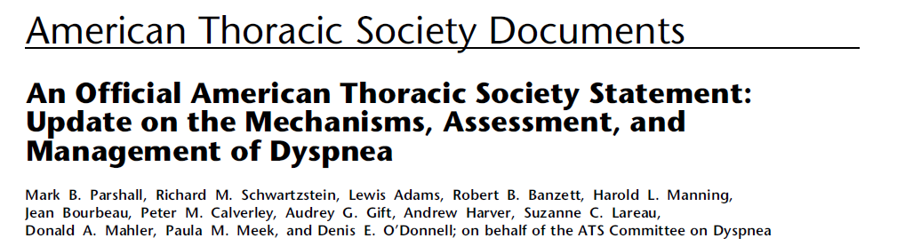
“Un’esperienza soggettiva di un respiro alterato che consiste di sensazioni qualitativamente distinte che variano in intensità”.
Corollario:
L’esperienza della dispnea deriva da interazioni tra multipli fattori fisiologici, psicologici, sociali ed ambientali e possono indurre risposte fisiologiche e comportamentali.

Slide 4
Dyspnea Measurement (Parshall MB, et al; ATS 2012)
Domain | Definition | Measurement examples
Sensory-perceptual experience | Measures of what breathing feels like | Intensity ratings (i.e., Borg scale, VAS) of dyspnea and its qualitative dimensions during and/or at the end of CPET, 6MW, ESWT, etc. Selection of dyspnea descriptors
Affective distress | Measures of how distressing breathing feels. Focus can be either immediate (e.g., unpleasantness) or evaluative (e.g., judgments of meaning or consequences) | COPD self-efficacy score Anxiety intensity ratings (i.e., Borg scale, VAS) during exercise
Symptom impact or burden | Measures of how dyspnea affects functional ability, employment (disability), quality of life or health status | MRC dyspnea scale BDI / TDI CRQ SGRQ

Slide 5
Definizione e misurazione
Feeling Scale (FS)
(Hardy & Rejeski, 1989)
+5 Very good
+4
+3 Good
+2
+1 Fairly good
0 Neutral
-1 Fairly bad
-2
-3 Bad
-4
-5 Very bad
(Cabanac, 1974)

Slide 6
Domains of Dyspnea Measurement (ATS 2012)
Domain | Definition | Measurement examples
Sensory-perceptual experience | Measures of what breathing feels like | Intensity ratings (i.e., Borg scale, VAS) of dyspnea and its qualitative dimensions during and/or at the end of CPET, 6MW, ESWT, etc. Selection of dyspnea descriptors
Affective distress | Measures of how distressing breathing feels. Focus can be either immediate (e.g., unpleasantness) or evaluative (e.g., judgments of meaning or consequences) | COPD self-efficacy score Anxiety intensity ratings (i.e., Borg scale, VAS) during exercise
Symptom impact or burden | Measures of how dyspnea affects functional ability, employment (disability), quality of life or health status | MRC dyspnea scale BDI / TDI CRQ SGRQ

Slide 7
Sensory-Perceptual Intensity

Slide 8
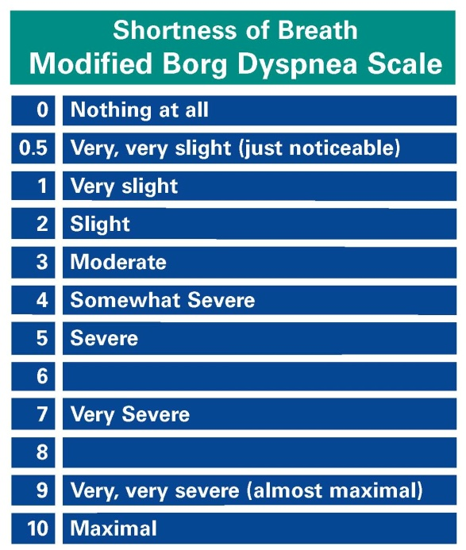
Intensity
L'entità della sensazione respiratoria dovrebbe, a priori, essere ancorata ad entrambe le estremità della scala
(10 rappresenta la difficoltà di respirazione massima vissuta o immaginata di vivere)
Mahler, measurements of dyspnea, 2005
Precisare al partecipante la sensazione respiratoria che si vuole valutare (ad esempio fame d'aria, difficoltà inspiratoria ...)
La dispnea è riproducibile durante CPET
O’Donnell ERJ 2009
Borg, Med Sci Sport Exerc 1982

Slide 9
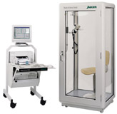
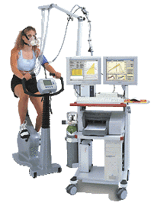
8
6
4
2
0
Flow (L/s)
-2
IC
-4
-6
-8
7
6
5
4
3
2
1
Volume (L)
Notes:
9
Change the values

Slide 10
Intensità della dispnea durante lo sforzo
8
7
“very severe”
6
Normal
5
“severe”
GOLD I Mild
Dyspnea (Borg)
4
“moderate”
n=21 per gruppo
3
2
1
0
0.0
0.5
1.0
1.5
2.0
2.5
Values are means ± SEM.
Mild > Normal slopes (p<0.05).
VO₂ (L/min)
Ofir D, et al. AJRCCM 2008

Slide 11
Dyspnea Intensity with Increasing COPD Severity
8
Normal
7
COPD (FEV₁ quartile):
“very severe”
IV (worst)
6
III
II
5
I (mildest)
4
Dyspnea (Borg Scale)
3
2
1
0
0
20
40
60
80
Ventilation (L/min)
O’Donnell DE, et al. Chest 2011.
Notes:
Slide Objective: We then present change in Borg Scale across COPD severity during CWR exercise.

Slide 12
Respiratory Muscle Pressures during Exercise
-20
-15
inspiratory
-10
Normal
-5
Mild
tidal swing
Moderate
Pes (cmH₂O)
0
Severe
V. severe
5
10
expiratory
15
20
0
10
20
30
40
50
60
70
80
Ventilation (L/min)
O’Donnell DE, et al. Chest 2011.
Notes:
Slide Objective: We then present change in Borg Scale across COPD severity during CWR exercise.

Slide 13
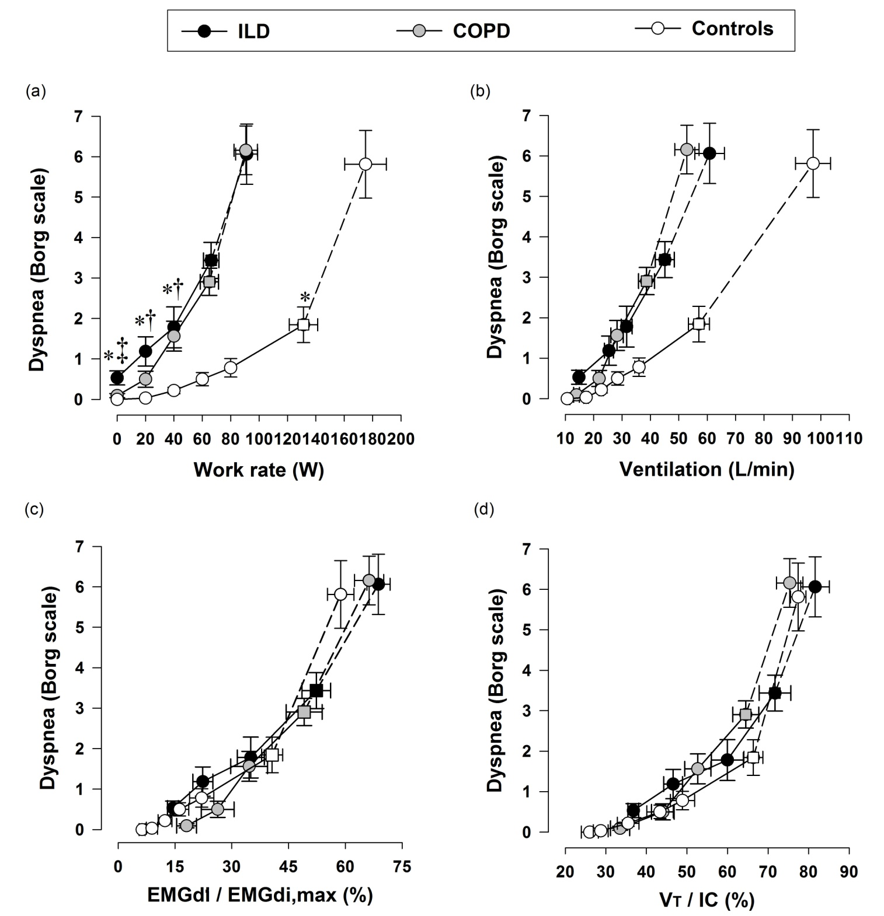
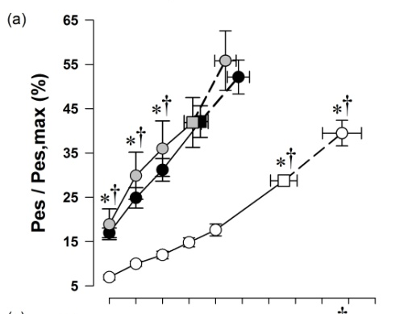
ILD and Dyspnea during Exercise
Faisal et al. AJRCCM 2016

Slide 14
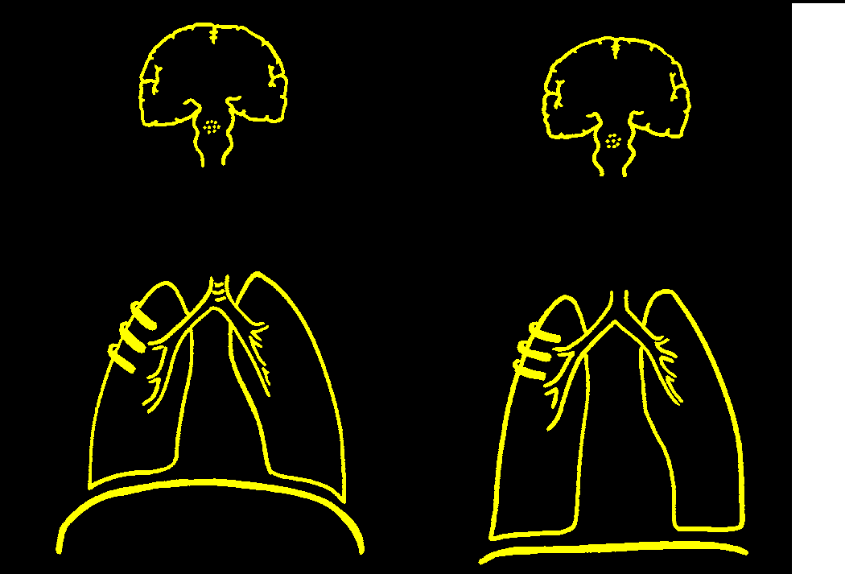
Sensory Intensity
Corollary Discharge
Feedback
Motor Output
Mechanical Response
Airways
Lungs
↑work/effort of breathing
Muscles

Slide 15
Dispnea e aumento del senso del lavoro respiratorio
Si ritiene che la percezione dell’aumento sforzo/lavoro respiratorio rifletta sia la consapevolezza dell’aumentato output dei centri di comando dei muscoli respiratori sia l’aumento della via secondaria (corollary discharge) dai centri motori respiratori alla corteccia somato-sensoriale.
Gandevia SC. Brain 1982; 105: 151-159.
Chen Z, et al. Respir Physiol 1992; 90: 99-113.

Slide 16
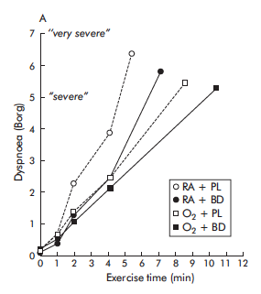
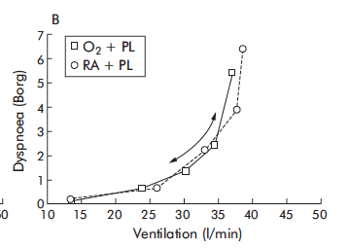
Dyspnea and oxygen
RA
Oxy
Peters et al. Thorax 2006

Slide 17
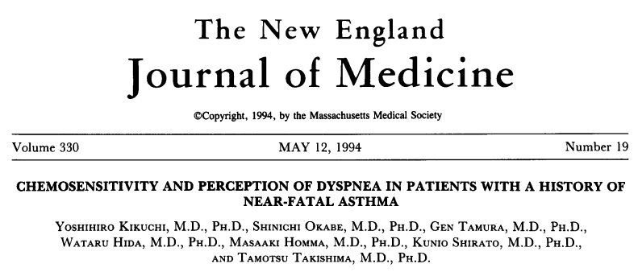
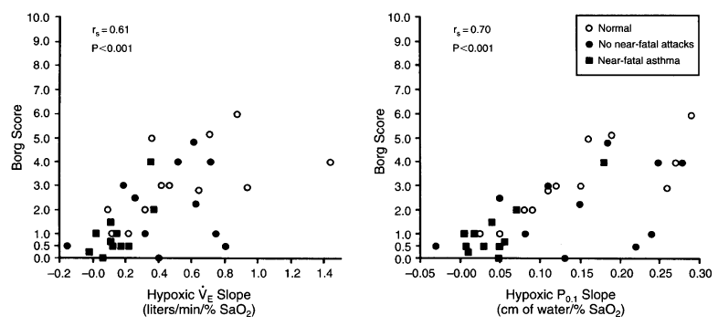
Ridotta chemosensibilità allo stmolo ipossico ed una ridotta percezione della dispnea che possono essere le cause di attacchi d’asma fatali

Slide 18
Sensory-Perceptual Quality

Slide 19
Quality of Respiratory Symptoms in Health
Increased
Work/Effort
Unsatisfied
Inspiration
Inspiratory
Difficulty
Heavy
Shallow
Rapid
Expiratory
Difficulty
0
20
40
60
80
Selection Frequency (%)

Slide 20
Dyspnea Intensity-
Work rate Relationships
Quality of Dyspnea
during Exercise
Increased
Work/Effort
Breathing discomfort
(Borg scale)
Unsatisfied
*
Inspiration
maximal
10
Inspiratory
*
very, very severe
9
Difficulty
8
Heavy
very severe
7
6
ILD
Shallow
severe
5
Health
somewhat severe
Rapid
*
4
moderate
3
slight
Tight Chest
2
Health
very slight
1
Expiratory
ILD
none
Difficulty
0
0
20
40
60
80
100
0
20
40
60
80
100
Work rate (% predicted maximum)
Selection frequency (% of group)
* ^{p<0.05 vs Health}
O’Donnell DE, et al. AJRCCM 1997;155:109-15.

Slide 21
Dyspnea Intensity-
Work rate Relationships
Quality of Dyspnea
during Exercise
Increased
Work/Effort
Breathing discomfort
(Borg scale)
Unsatisfied
*
Inspiration
maximal
10
Inspiratory
*
very, very severe
9
Difficulty
8
Heavy
very severe
7
6
COPD
Shallow
*
severe
5
Health
somewhat severe
4
Rapid
moderate
3
slight
Tight Chest
2
Health
very slight
1
Expiratory
COPD
none
Difficulty
0
0
20
40
60
80
100
0
20
40
60
80
100
Work rate (% predicted maximum)
Selection frequency (% of group)
* ^{p<0.05 vs Health}
O’Donnell DE, et al. AJRCCM 1997;155:109-15.

Slide 22
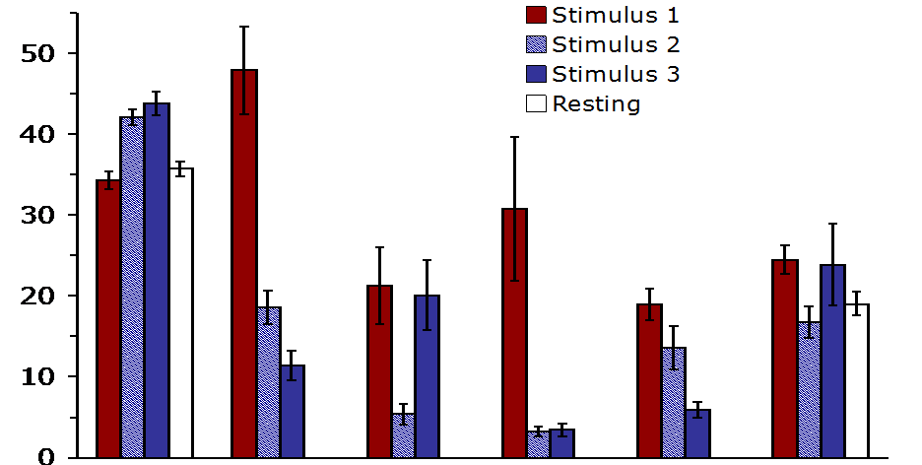
Ratings of qualities of respiratory sensation
MVV (eupnoico)
Ipercapnia (strap)
Ipercapnia (tighter strap)
PETCO₂
PTP
WOB
VT
f_{R}
VE
Banzett et al AJRCCM 2008
Notes:
RATIONALE:
It is hypothesized that the affective dimension of dyspnea (unpleasantness, emotional response) is not strictly dependent on the intensity of dyspnea.
OBJECTIVES:
We tested the hypothesis that the ratio of immediate unpleasantness (A(1)) to sensory intensity (SI) varies depending on the type of dyspnea.
METHODS:
Twelve healthy subjects experienced three stimuli: stimulus 1: maximal eucapnic voluntary hyperpnea against inspiratory resistance, requiring 15 times the work of resting breathing; stimulus 2: Pet(CO(2)) 6.1 mm Hg above resting with ventilation restricted to less than spontaneous breathing; stimulus 3: Pet(CO(2)) 7.7 mm Hg above resting with ventilation further restricted. After each trial, subjects rated SI, A(1), and qualities of dyspnea on the Multidimensional Dyspnea Profile (MDP), a comprehensive instrument tested here for the first time.
MEASUREMENTS AND MAIN RESULTS:
Stimulus 1 was always limited by subjects failing to meet a higher ventilation target; none signaled severe discomfort. This evoked work and effort sensations, with relatively low unpleasantness (mean A(1)/SI = 0.64). Stimulus 2, titrated to produce dyspnea ratings similar to those subjects gave during stimulus 1, evoked air hunger and produced significantly greater unpleasantness (mean A(1)/SI = 0.95). Stimulus 3, increased until air hunger was intolerable, evoked the highest intensity and unpleasantness ratings and high unpleasantness ratio (mean A(1)/SI = 1.09). When asked which they would prefer to repeat, all subjects chose stimulus 1.
CONCLUSIONS:
(1) Maximal respiratory work is less unpleasant than moderately intense air hunger in this brief test; (2) unpleasantness of dyspnea can vary independently from perceived intensity, consistent with the prevailing model of pain; (3) separate dimensions of dyspnea can be measured with the MDP.

Slide 23
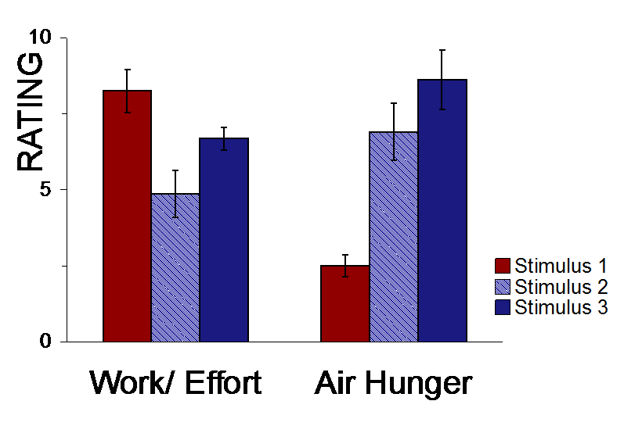
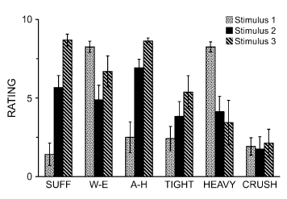
Different Stimuli –
Different Sensory Qualities (SQ)
Banzett et al AJRCCM 2008
Notes:
Ratings of qualities of respiratory sensation (mean 6 SE)
during the rating focus periods for stimulus 1, normocapnic hyperpnea
with inspiratory resistance; stimulus 2, hypercapnia with moderate
restriction of ventilation; stimulus 3, hypercapnia with severe restriction
of ventilation. SUFF 5 ‘‘I am smothering, suffocating’’; W-E 5 ‘‘My
breathing requires work or effort’’; A-H 5 ‘‘I cannot get enough air.
I feel hunger for air’’; TIGHT 5 ‘‘My chest and lungs feel tight,
constricted’’; HEAVY 5 ‘‘I am breathing a lot; breathing rapidly, deeply
or heavily’’; CRUSH 5 ‘‘I feel a crushing, heavy sensation in my chest’’.
Scale maximum definition: ‘‘As intense as I can imagine’’. Eight of the
12 subjects completed stimulus 3; all completed stimuli 1 and 2.

Slide 24
Chest Wall Restriction & Dead Space Loading in Healthy Men
8
CWS+DS
60
7
6
50
Control
5
Control
40
CWS+DS
Dyspnea (Borg Scale)
Tidal Volume (%predicted VC)
4
3
30
2
20
1
0
10
0
20
40
60
80
100
0
10
20
30
40
50
60
Work Rate (%predicted maximum)
Pes/PImax (%)
CWS = chest strap to 60% of control VC
DS = 600 mL of added dead space
O’Donnell DE, et al. J Appl Physiol 2000; 88: 1859-69.

Slide 25
Selection Frequency (%)
0
20
40
60
80
100
Increased Work
Inspiratory Difficulty
*
Unsatisfied Inspiration
*
Heavy
*
Shallow
*
Rapid
Expiratory Difficulty
Control
Hunger
CWS+DS
*p<0.05
O’Donnell DE, et al. J Appl Physiol 2000

Slide 26
Volumi statici nei pazienti BPCO n= 2952
TLC (L)
8
20%
IC/TLC%
7
6
28%
5
43%
37%
46%
4
IC
3
FRC
2
1
0
Normal
GOLD I
GOLD II
GOLD III
GOLD IV
predicted
(751)
(1448)
(633)
(120)
Post-bronchodilator value
Deesomchok et al. COPD 2010
Notes:
26
Iperinsufflazione Polmonare: aumento della CPR maggiore del 120%predetto
Iperinsufflazione Toracica: aumento della CPT maggiore del 120%predetto
Intrappolamento Aereo Polmonare: aumento del volume residuo maggiore del 120% del predetto

Slide 27
Operating Lung Volumes during Exercise with Worsening FEV₁ Quartile
140
34 L/min
53 L/min
45 L/min
39 L/min
120
72 L/min
IC
IC
100
80
IRV
Lung volumes (% predicted TLC)
VT
60
EELV
40
20
0
rest
peak
rest
peak
rest
peak
rest
peak
rest
peak
Normal Q1 Q2 Q3 Q4
O’Donnell DE, et al. Chest 2011.

Slide 28
Sensory-Mechanical Relations during Exercise in COPD
Q1
Q2
Q3
Q4
‘mild’
‘severe’
90
8
80
7
70
6
60
5
4
VT / IC (%)
Dyspnea (Borg scale)
50
3
40
2
30
1
20
0
10
20
30
40
50
60
20
40
60
80
100
Ventilation (L/min)
VT / IC (%)
O’Donnell DE, et al. Chest 2011.
Notes:
Dyspnea is up for any given VE reflecting greater intrinsic mechanical loading
Dyspnea increased linearly as VT/ICdyn increased during exercise, reached an inflection point (coinciding with the
VT/VE inflection point), then rose almost vertically to the symptom-limited endpoint of exercise;
this relationship was similar across all quartiles. The dyspnea-VE%peak curves showed a tightly
superimposed curvilinear relationship across all quartiles. Dyspnea-VE, dyspnea-VT/ICdyn and
VT/ICdyn-VE relationships were also remarkably similar across the exercise hyperinflator and
non-hyperinflator subgroups.

Slide 29
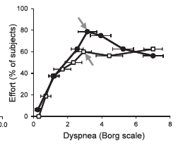
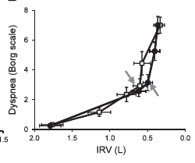
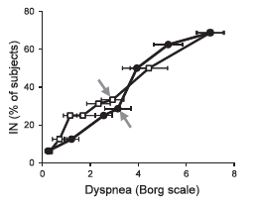
Evolution of Dyspnea during Exercise in COPD
Laveneziana et al. AJRCCM 2011
Notes:
Rationale: Patients with chronic obstructive pulmonary disease
(COPD) primarily describe their exertional dyspnea using descriptors
alluding to increased effort or work of breathing and unsatisfied
inspiration or inspiratory difficulty.
Objectives: The purpose of this study was to examine the impact of
changes in dynamic respiratory mechanics during incremental
(INCR) and high-intensity constant work-rate (CWR) cycle exercise
on the evolution of dyspnea intensity and its major qualitative
dimensions in patients with moderate-to-severe COPD.
Methods: Sixteen subjects with COPD performed symptom-limited
INCR andCWRcycle exercise tests. Measurements included dyspnea
intensity and qualitative descriptors, breathing pattern, operating
lung volumes, and esophageal pressure (Pes).
Measurements and Main Results: During both exercise tests, there
was an inflection in the relation between tidal volume (VT) and ventilation.
This inflection occurred significantly earlier in time during
CWR versus INCR exercise but at a similar ventilation, VT, and tidal
Pes swing. Beyond this inflection, there was no further change in VT
despite a continued increase in ventilationandtidal Pes. During both
tests, “work and effort” was the dominant dyspnea descriptor selected
up to the inflection point, whereas after this point dyspnea
intensity and the selection frequency of “unsatisfied inspiration”
rose sharply.
Conclusions: Regardless of the exercise test protocol, the inflection
(or plateau) in the VT response marked the point where dyspnea
intensity rose abruptly and there was a transition in the dominant
qualitative descriptor choice from “work and effort” to “unsatisfied
inspiration.” Intensity and quality of dyspnea evolve separately and
are strongly influenced by mechanical constraints on VT expansion
during exercise in COPD.

Slide 30
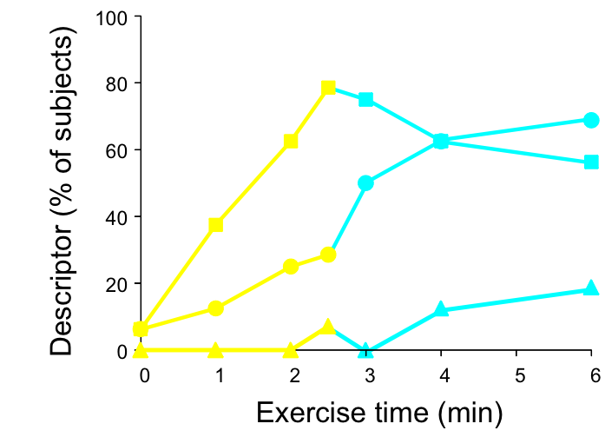
Evolution of Dyspnea during Exercise in COPD
Effort
IN
OUT
IN = “I cannot get enough air in”
Effort = “My breathing requires more work/effort”
OUT = “I cannot get enough air out”
Laveneziana et al. AJRCCM 2011
Notes:
RATIONALE:
Patients with chronic obstructive pulmonary disease (COPD) primarily describe their exertional dyspnea using descriptors alluding to increased effort or work of breathing and unsatisfied inspiration or inspiratory difficulty.
OBJECTIVES:
The purpose of this study was to examine the impact of changes in dynamic respiratory mechanics during incremental (INCR) and high-intensity constant work-rate (CWR) cycle exercise on the evolution of dyspnea intensity and its major qualitative dimensions in patients with moderate-to-severe COPD.
METHODS:
Sixteen subjects with COPD performed symptom-limited INCR and CWR cycle exercise tests. Measurements included dyspnea intensity and qualitative descriptors, breathing pattern, operating lung volumes, and esophageal pressure (Pes).
MEASUREMENTS AND MAIN RESULTS:
During both exercise tests, there was an inflection in the relation between tidal volume (Vt) and ventilation. This inflection occurred significantly earlier in time during CWR versus INCR exercise but at a similar ventilation, Vt, and tidal Pes swing. Beyond this inflection, there was no further change in Vt despite a continued increase in ventilation and tidal Pes. During both tests, "work and effort" was the dominant dyspnea descriptor selected up to the inflection point, whereas after this point dyspnea intensity and the selection frequency of "unsatisfied inspiration" rose sharply.
CONCLUSIONS:
Regardless of the exercise test protocol, the inflection (or plateau) in the Vt response marked the point where dyspnea intensity rose abruptly and there was a transition in the dominant qualitative descriptor choice from "work and effort" to "unsatisfied inspiration." Intensity and quality of dyspnea evolve separately and are strongly influenced by mechanical constraints on Vt expansion during exercise in COPD.

Slide 31

Neuromechanical Coupling
Corollary Discharge
Feedback
Motor Output
Mechanical Response
Airways
Lungs
↑work/effort of breathing
Muscles

Slide 32
Neuromechanical Dissociation
Corollary Discharge
Reflexic Drive
Motor Output
Feedback
Mechanical Response
Airways
Lungs
unsatisfied inspiration
Muscles

Slide 33
Inter-relationships at a Standardized Level of Exercise
Dyspnea
(Borg)
r=0.86
p<0.001
r=0.69
p<0.001
Pes/PImax :V_{T}/VC
ratio
IC
r=0.78
p<0.001
O’Donnell et al. Am J Respir Crit Care Med 1997

Slide 34
Neuromechanical Dissociation
Studi meccanicistici hanno dimostrato che quando l'aumento del VT è vincolato a fronte di un aumento del drive respiratorio, si avverte disagio respiratorio (descritta dal paziente come inspirazione insoddisfacente o fame d'aria).
Wright GW, Branscomb BV. Trans Am Clin Climatol Assoc 1954; 66: 116-25.
Schwartzstein RM, et al. Am Rev Respir Dis 1989; 139: 1231-7.
Mannning HL, et al. Respir Physiol 1992; 90: 19-30.
Harty HR, et al. J Appl Physiol 1999; 86: 1142-50.
O’Donnell DE, et al. J Appl Physiol 2000; 88: 1859-69.
Evans KC, et al. J Neurophysiol 2002; 88: 1500-11.
Banzett RB, et al. Am J Respir Crit Care Med 2008; 17: 1384-90.

Slide 35
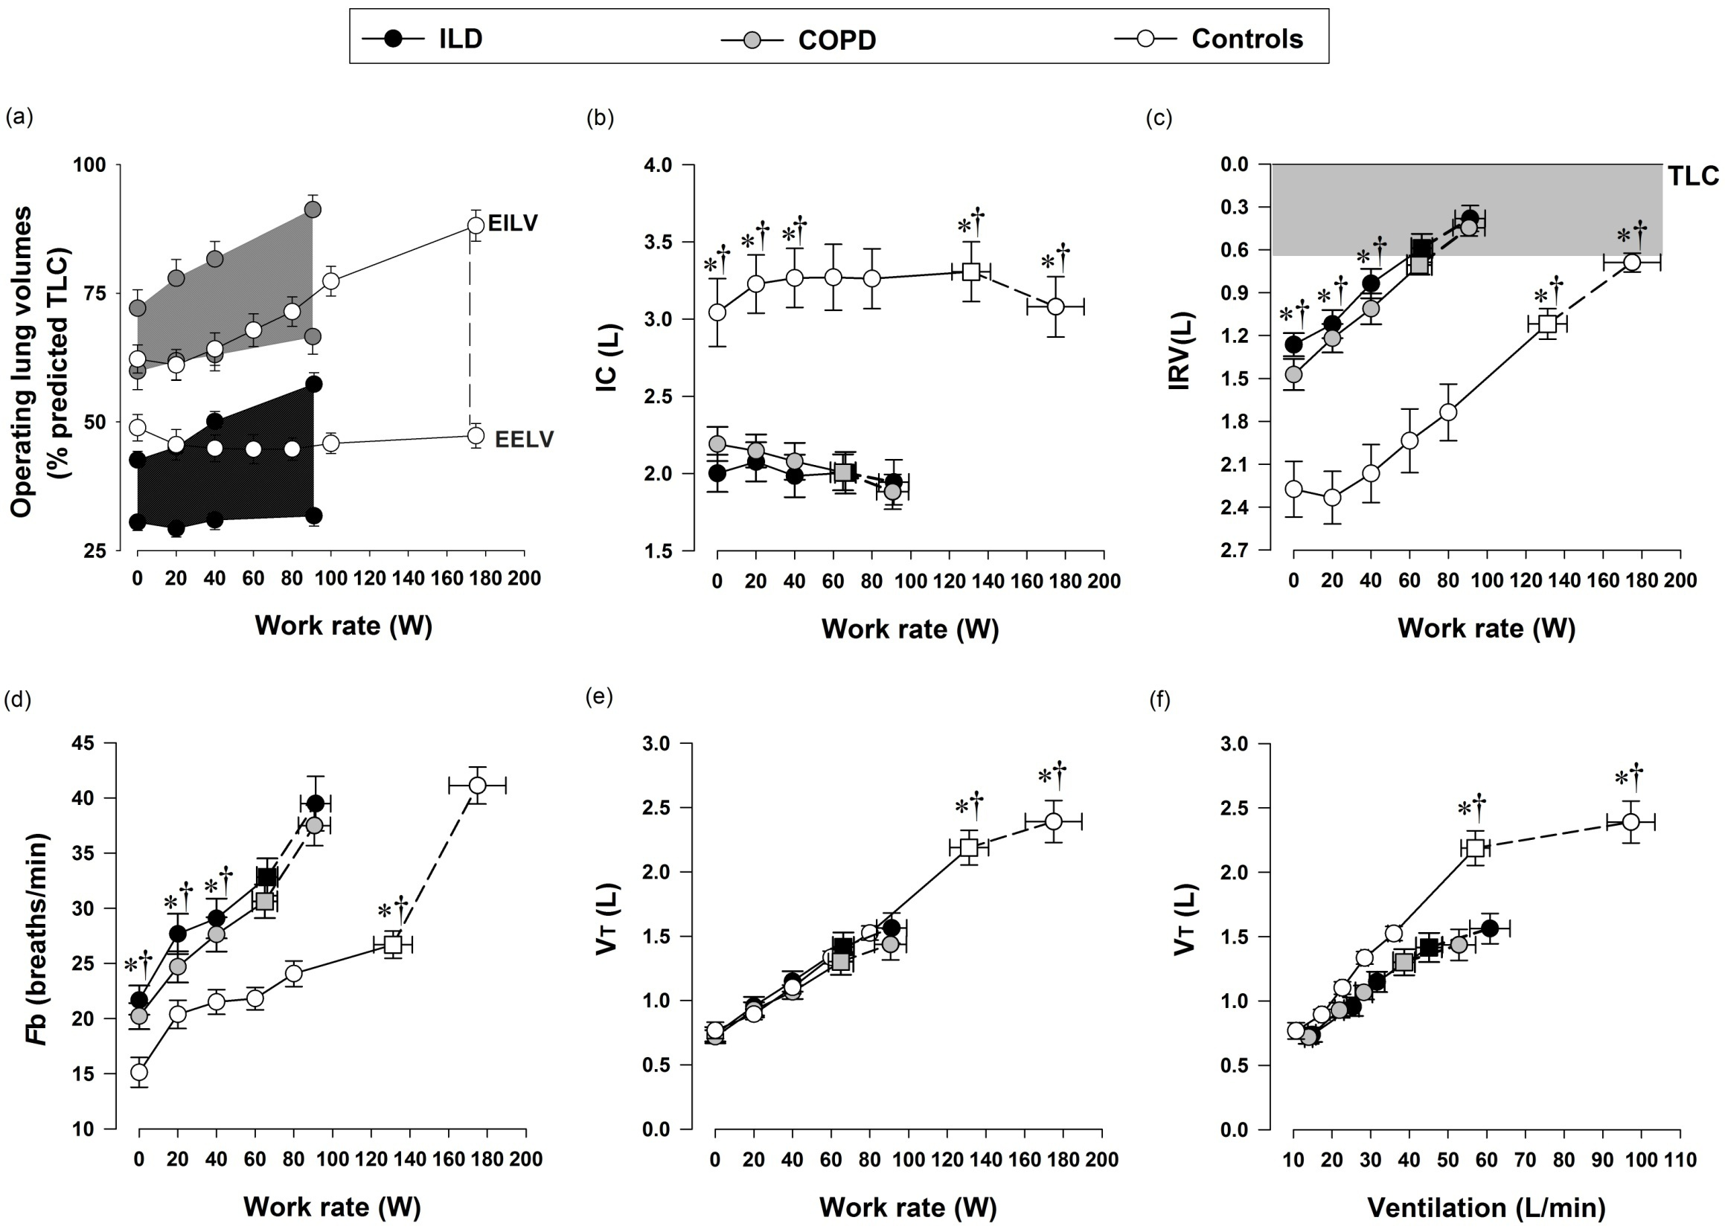
ILD and COPD
Faisal et al. AJRCCM 2015

Slide 36
ILD and COPD
Faisal et al. AJRCCM 2015

Slide 37
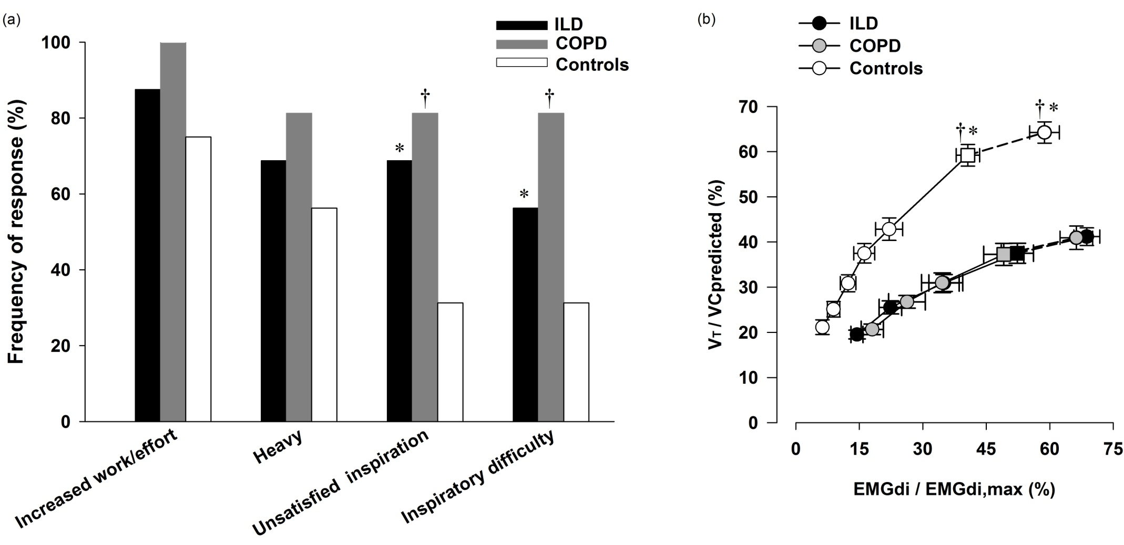
ILD and COPD
Faisal et al. AJRCCM 2015

Slide 38
Obesity and COPD
140
130
120
TLC_{NW}
IC
120
IRV
100
TLC_{OB}
IC
110
VT
80
ERV
Static lung volumes (% predicted TLC)
100
ERV
Operating lung volumes
(% predicted TLC)
60
90
RV
40
80
RV
EELV
70
20
60
0
10
20
30
40
50
NW
OB
Ventilation (L/min)
Ora J. et al. AJRCCM 2009
Notes:
38

Slide 39
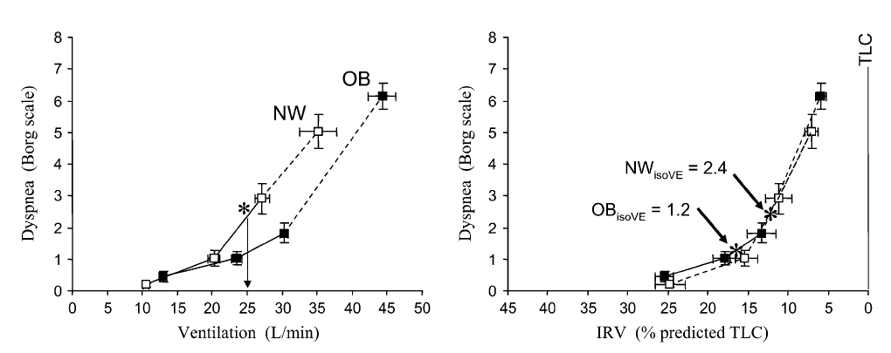
Obesity and COPD
Ora et al. AJRCCM 2009

Slide 40
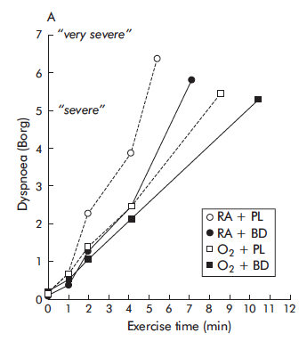
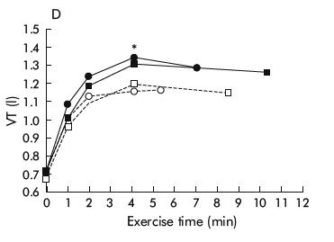
Dyspnea, oxygen and bronchodilators
BD
Oxy
Peters et al. Thorax 2006

Slide 41
Domains of Dyspnea Measurement (ATS 2012)
Domain | Definition | Measurement examples
Sensory-perceptual experience | Measures of what breathing feels like | Intensity ratings (i.e., Borg scale, VAS) of dyspnea and its qualitative dimensions during and/or at the end of CPET, 6MW, ESWT, etc. Selection of dyspnea descriptors
Affective distress | Measures of how distressing breathing feels. Focus can be either immediate (e.g., unpleasantness) or evaluative (e.g., judgments of meaning or consequences) | COPD self-efficacy score Anxiety intensity ratings (i.e., Borg scale, VAS) during exercise
Symptom impact or burden | Measures of how dyspnea affects functional ability, employment (disability), quality of life or health status | MRC dyspnea scale BDI / TDI CRQ SGRQ

Slide 42
Affective Distress
“The Fear Factor”

Slide 43
Air Hunger is more unpleasant
than work/effort
Unpleasantness Rating (A1)
Banzett et al AJRCCM 2008

Slide 44
Air Hunger is more unpleasant
than work/effort
Anxiety
Anger
Fear
Depression
Frustration
Banzett et al AJRCCM 2008

Slide 45
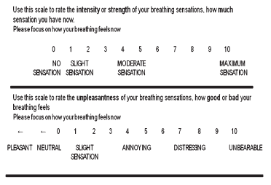
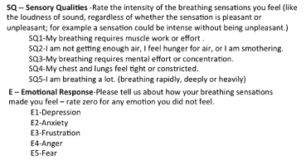
Reliability and Validity of the
Multidimensional Dyspnea Profile
The results of this analysis support the two-domain structure as valid, relatively independent, and stable over time.
Meck et al Chest 2012
Notes:
ABSTRACT Dyspnoea is a prominent symptom of chronic obstructive pulmonary disease (COPD). Recent multidimensional dyspnoea questionnaires like the Multidimensional Dyspnea Profile (MDP) individualise the sensory and affective dimensions of dyspnoea. We tested the MDP in COPD outpatients based on the hypothesis that the importance of the affective dimension of dyspnoea would vary according to clinical characteristics.
A multicentre, prospective, observational, real-life study was conducted in 276 patients. MDP data were compared across various categories of patients (modified Medical Research Council (mMRC) dyspnoea score, COPD Assessment Test (CAT) score, Global Initiative for Chronic Obstructive Lung Disease (GOLD) airflow obstruction categories, GOLD “ABCD” categories, and Hospital Anxiety and Depression Scale (HADS)). Univariate and multivariate regressions were conducted to explore factors influencing the affective dimension of dyspnoea. Cluster analysis was conducted to create homogeneous patient profiles.
The MDP identified a more marked affective dimension of dyspnoea with more severe mMRC, CAT, 12-item Short-Form Health Survey mental component, airflow obstruction and HADS. Multivariate analysis identified airflow obstruction, depressive symptoms and physical activity as determinants of the affective dimension of dyspnoea. Patients clustered into an “elderly, ex-smoker, severe disease, no rehabilitation” group exhibited the most marked affective dimension of dyspnoea.
An affective/emotional dimension of dyspnoea can be identified in routine clinical practice. It can contribute to the phenotypic description of patients. Studies are needed to determine whether targeted therapeutic interventions can be designed and whether they are useful.

Slide 46
Effect of Opioids: Clinical vs Laboratory Model
Clinical
Studies
5 Studies Weighted By N,
Parenteral Opioid
Air Hunger Model
Work/Effort Model
Clinical: Bruera et al 1990; 1993; 2005; Mazzocato et al 1999; Allen et al 2005
Laboratory: Supinski et al 1990; Banzett et al 2011

Slide 47
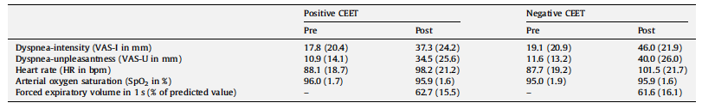
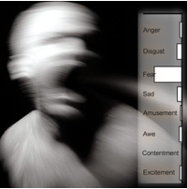
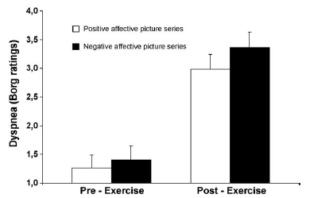
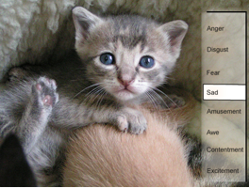
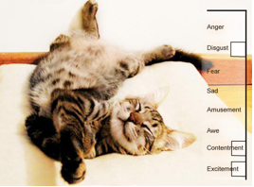
impact of affective states on the perception of dyspnea
Von Leupold A et al. Biol Psychol. 2010
Notes:
Rationale: Opioids are commonly used to relieve dyspnea, but clinical
data are mixed and practice varies widely.
Objectives: Evaluate the effect of morphine on dyspnea and ventilatory
drive under well-controlled laboratory conditions.
Methods: Six healthy volunteers received morphine (0.07 mg/kg)
and placebo intravenously on separate days (randomized, blinded).
We measured two responses to a CO2 stimulus: (1) perceptual response(
breathing discomfort; describedby subjects as “air hunger”)
induced by increasing partial pressure of end-tidal carbon dioxide
(PETCO2) during restricted ventilation, measured with a visual analog
scale (range, “neutral” to “intolerable”); and (2) ventilatory response,
measured in separate trials during unrestricted breathing.
Measurements and Main Results:We determined the PETCO2 that produced
a 60% breathing discomfort rating in each subject before
morphine (median, 8.5 mm Hg above resting PETCO2). At the same
PETCO2 after morphine administration, median breathing discomfort
was reduced by65%of its pretreatment value;P,0.001. Ventilation
fell 28% at the same PETCO2; P , 0.01. The effect of morphine on
breathing discomfort was not significantly correlated with the effect
on ventilatory response. Placebo had no effect.
Conclusions: (1) A moderate morphine dose produced substantial
relief of laboratory dyspnea, with a smaller reduction of ventilation.
(2) In contrast to an earlier laboratory model of breathing effort, this
laboratory model of air hunger established a highly significant treatment
effect consistent in magnitude with clinical studies of opioids.
Laboratory studies require fewer subjects and enable physiological
measurements that are difficult to make in a clinical setting. Withinsubject
comparison of the response to carefully controlled laboratory
stimuli can be an efficient means to optimize treatments before
clinical trials.

Slide 48
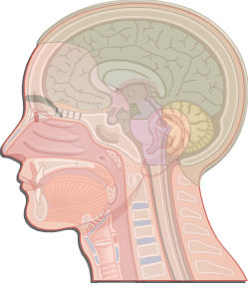
MI Cortex
SI Cortex
Urge
To
Breathe
4. Action
5. Feedback
Action
Evidence
3. Desire
for Action
Cingulate
Thalamus
6. Reward
Amyg
Cognitive
Center
GATE
2. Urge
Insula
CPG
Respiratory
Motor
Output
AFFERENTS
Muscle
Airway
Lung
Chemoreceptors
Adapted from: Davenport, P.W. Clinical cough I: the urge-to-cough: a respiratory sensation. Handbook of Experimental Pharmacology: Pharmacology and Therapeutics of Cough, (187):263-76, 2009.
Notes:
Recettori periferici (muscolari, delle vie aeree, dei polmoni, chemorecettori, spingono il Central pattern generators (CPGs) ad aumentare l’output.

Slide 49
Domains of Dyspnea Measurement (ATS 2012)
Domain | Definition | Measurement examples
Sensory-perceptual experience | Measures of what breathing feels like | Intensity ratings (i.e., Borg scale, VAS) of dyspnea and its qualitative dimensions during and/or at the end of CPET, 6MW, ESWT, etc. Selection of dyspnea descriptors
Affective distress | Measures of how distressing breathing feels. Focus can be either immediate (e.g., unpleasantness) or evaluative (e.g., judgments of meaning or consequences) | COPD self-efficacy score Anxiety intensity ratings (i.e., Borg scale, VAS) during exercise
Symptom impact or burden | Measures of how dyspnea affects functional ability, employment (disability), quality of life or health status | MRC dyspnea scale BDI / TDI CRQ SGRQ

Slide 50
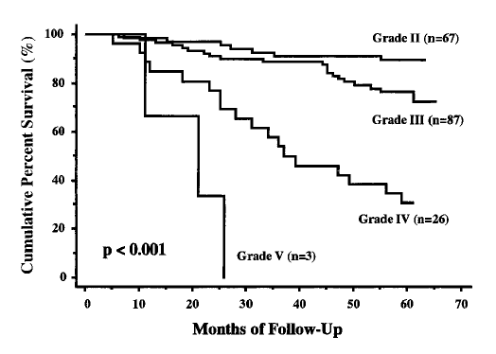
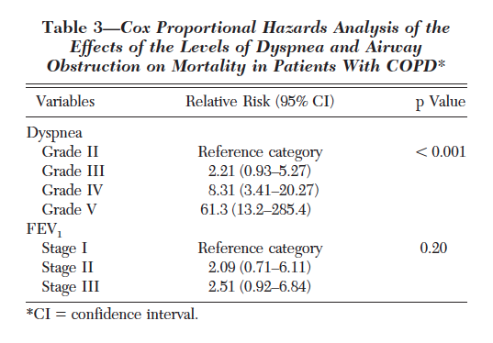
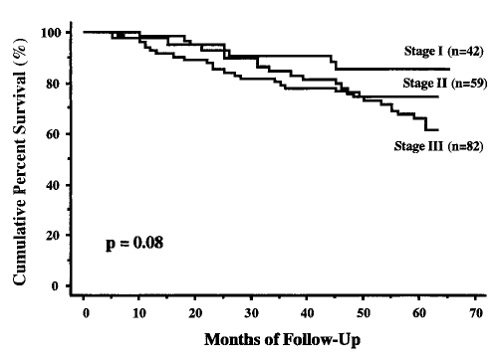
Nishimura Chest 2002
Notes:
Background: FEV1 is regarded as the most significant correlate of survival in COPD and is used
as a measure of disease severity in the staging of COPD. Recently, however, the categorization of
patients with COPD on the basis of the level of dyspnea has similarly been reported to be useful
in the prediction of health-related quality of life and improvement in exercise performance after
pulmonary rehabilitation.
Study objectives: We compared the effects of the level of dyspnea and disease severity, as
evaluated by airway obstruction, on the 5-year survival rate of patients with COPD.
Design and methods: A total of 227 patients with COPD were enrolled in a 5-year, prospective,
multicenter study in the Kansai area of Japan, involving 20 divisions of respiratory medicine from
various university and city hospitals.
Results: After 5 years, 183 patients were available for the follow-up examination (follow-up rate,
81%). The 5-year cumulative survival rate among patients with COPD was 73%. The effect of
disease staging, based on the American Thoracic Society (ATS) guideline as evaluated by the
percentage of predicted FEV1, on the 5-year survival rate was not significant (p 0.08).
However, the level of dyspnea was significantly correlated to the 5-year survival rate (p < 0.001).
The Cox proportional hazards model revealed that the level of dyspnea had a more significant
effect on survival than disease severity based on FEV1.
Conclusions: The categorization of patients with COPD on the basis of the level of dyspnea was
more discriminating than staging of disease severity using the ATS guideline with respect to
5-year survival. Dyspnea should be included as one of the variables, in addition to airway
obstruction, for evaluating patients with COPD in terms of mortality.

Slide 51
Take Home Messages
La dispnea è un sintomo multidimensionale che deve essere valutata nei suoi diversi domini (sensoriale, affettivo e di impatto funzionale)
Ci sono diverse vie neuronali che determinano la dispnea
La dispnea nel paziente respiratorio è sia legata all’aumentata sforzo respiratorio, che alla difficoltà d’inspirare dovuta alla limitazione del volume corrente
E’ possibile ridurre la dispnea agendo su meccanismi diversi

Slide 52

Intensità

Slide 53

Qualità

Slide 54

Affettività
grazie
grazie
grazie
grazie
grazie
grazie
grazie
grazie
grazie
grazie
grazie
grazie
grazie
grazie
grazie

