Slide 1
Corso ERS, Diffuse Parenchymal Lung Diseases Research and Basic Science
Trieste, 1st April 2019
Genetic background
Paolo Spagnolo
Respiratory Disease Unit
Department of Cardiac, Thoracic, Vascular Sciences and Public Health
University of Padova (Italy)

Slide 2
DISCLOSURE
Consulting fees | PPM Services, Roche, Boehringer-Ingelheim, Zambon, Galapagos
Advisory board fees | Roche, Boehringer-Ingelheim, Galapagos, Zambon
Speaker’s fees | Roche, Boehringer-Ingelheim, Zambon, Galapagos, Chiesi

Slide 3
Chronic injury
Tobacco smoke; infection;
gastroesophageal reflux
Intrinsic epithelial vulnerability
Mutations in telomerase complex genes;
MUC5B promoter polymorphisms; others
Aberrant repair
Enhanced AEC apoptosis
Stem cell exhaustion
Aberrant activation of developmental pathways
Release of profibrotic mediators
Normal repair
Basement membrane
disruption
Exaggerated collagen and
extracellular matrix deposition
Progressive lung remodelling
Fibroblast migration,
proliferation and differentiation
Myofibroblasts
Modified from Spagnolo P, Cottin V. J Med Genet 2017; 54: 93-9

Slide 4
FAMILIAR PULMONARY FIBROSIS
NO CONSENSUS DEFINITION
How many members affected?
To what degree of biological relationship?
What type of ILD?
A WIDELY ACCEPTED DEFINITION
At least two members
First degree relatives
Not only IIP

Slide 5
FAMILIAR PULMONARY FIBROSIS
Autosomal dominant inheritance (with variable penetrance)
~10% of cases
~20% of lung transplant referrals
Male : female ratio of 2:1
50% of cases had been smokers
Mean age at diagnosis 55 years
Phenotypic heterogeneity in families
Marshall RP et al. Thorax 2000; 55: 143-6; Hodgson U et al. Thorax 2002; 57: 338-42;
Steele MP et al. Am J Respir Crit Care Med 2005; 172: 1146-52; García-Sancho C et al. Respir Med 2011; 105: 1902-7

Slide 6
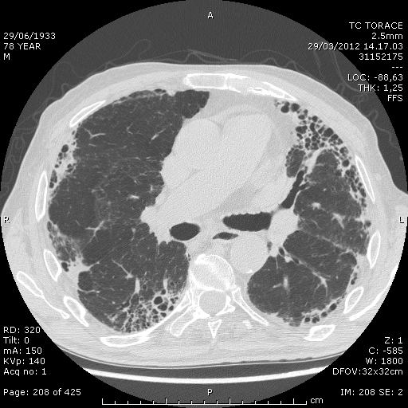
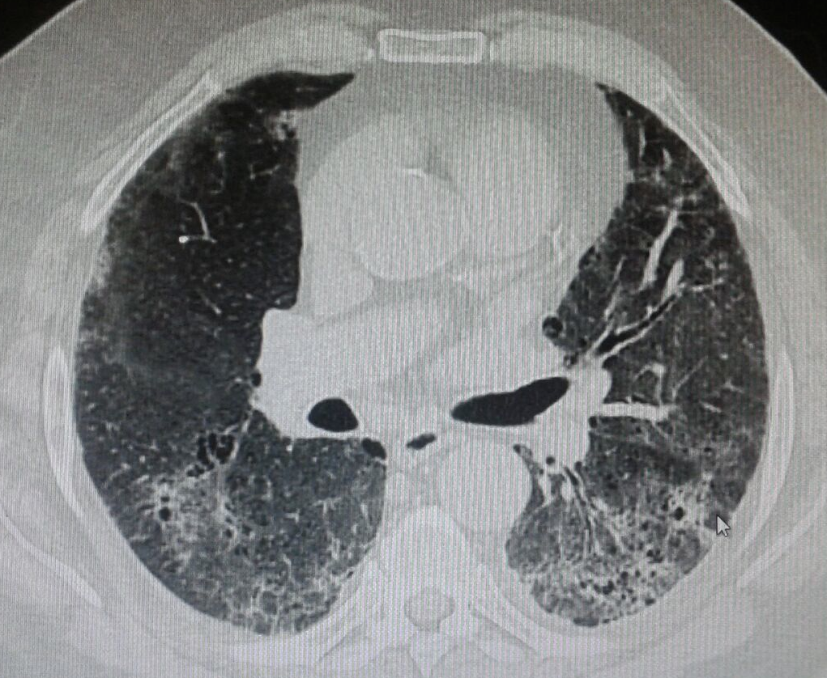
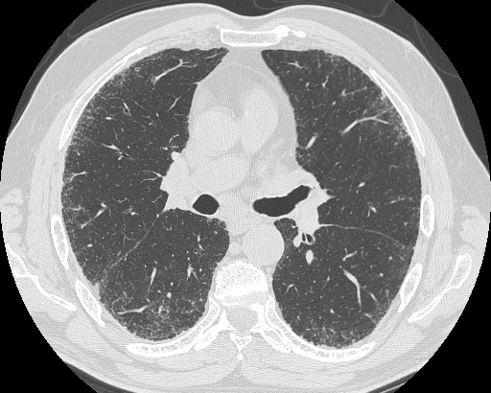
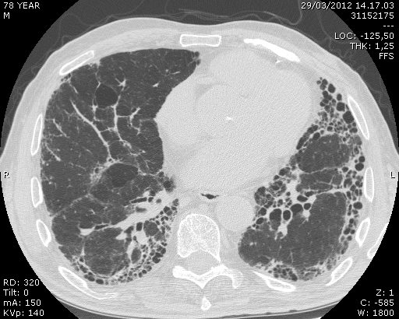
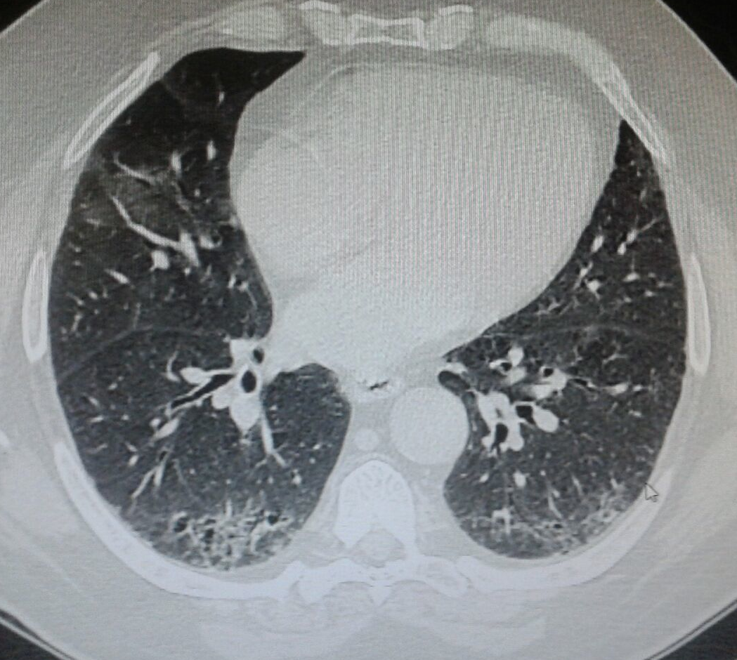
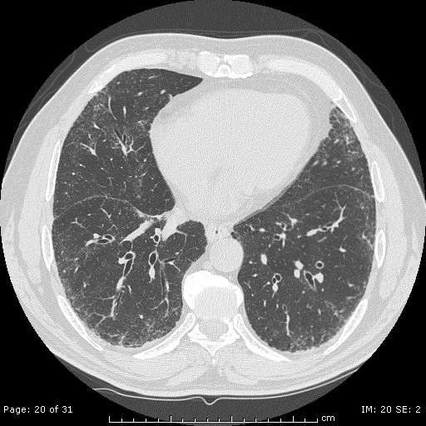
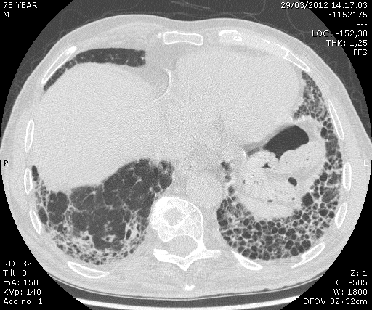
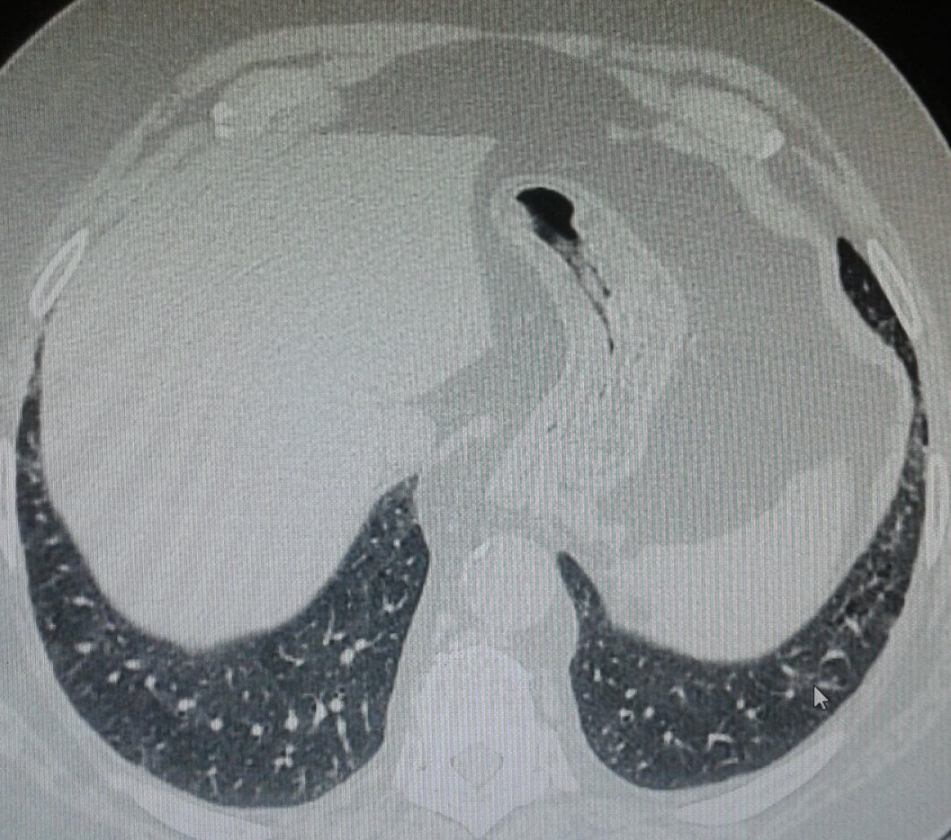
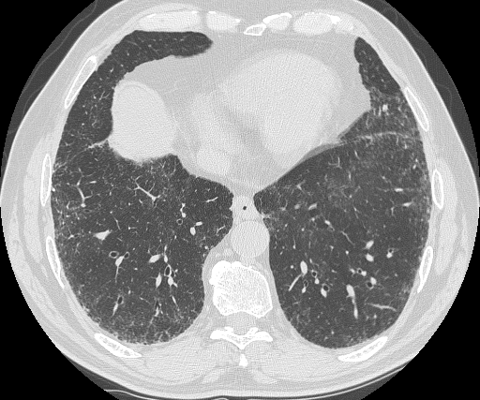

Slide 7
RARE VARIANTS ASSOCIATED WITH FPF
Gene | Gene function | Pathological consequences of mutation
SFTPC | Component of surfactant | Altered trafficking and disrupted proteostasis; increased ER stress
SFTPA2 | Modulation of immune and adaptive immunity | Increased ER stress
ABCA3 | Trasport of liquids across plasma membrane | Retention of lipids in the ER, ER stress and apoptotic signaling
TERT | Enzyme of telomerase complex | Telomere shortening
TERC | Template of telomerase complex | Telomere shortening
DKC1 | Stabilization of the template of the telomerase complex | Telomere shortening
TINF2 | Telomere maintenance | Telomere shortening
RTEL1 | DNA helicase | Telomere shortening
PARN | mRNA stability | Telomere shortening
ALVEOLAR INSTABILITY
CELL SENESCENCE AND
IMPAIRED RESPONSE TO EPITHELIAL INJURY
ER: endoplasmic reticulum

Slide 8
FREQUENCY OF MUTATIONS ASSOCIATED WITH FPF
TERT 15%
TERC 5%
DKC1 1%
TINF2 1%
RTEL1 4%
PARN 4%
?
NAF1 2%
SFPTC/A2 1%
UNKNOWN 67%

Slide 9
SURFACTANT PROTEIN C (SP-C) GENE MUTATIONS
Full term infant diagnosed with NSIP at 6/52 Mother diagnosed with DIP at 1 year
Heterozygous G/A substitution at genomic base 1728 in child and mother
Low/absent SP-C in both individuals’ lungs
DIP: desquamative interstitial pneumonia
Nogee LM et al. N Engl J Med 2001; 344: 573-9
Notes:
This is the first specific disease associated gene variant.
Rare genetic variants in eight genes have been implicated in FIP. These genes broadly fall into two categories: genes related to surfactant protein processing and trafficking, and those linked to telomere biology.

Slide 10
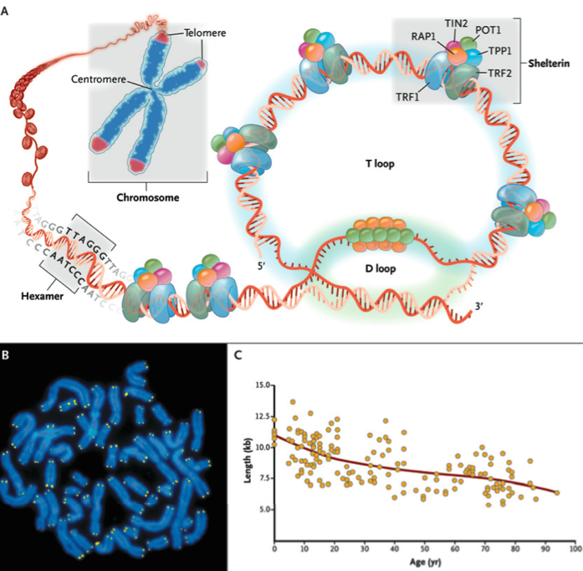
TELOMERE STRUCTURE
repetitive
nucleotide
sequences
Calado TR et al. N Engl J Med 2009;361:2353-65
Notes:
Telomeres are repetitive nucleotide sequences (TTAGGG) that cap the chromosome ends protecting the genome from DNA damage or fusion between chromosomes.
Protective proteins associated with telomere DNA are collectively termed “shelterin”.

Slide 11
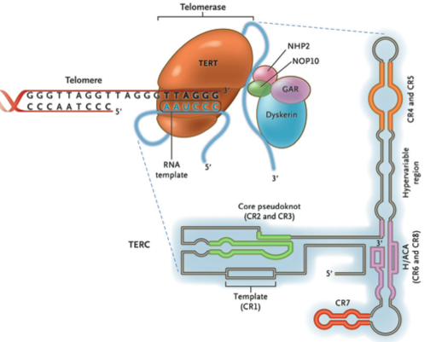
THE TELOMERASE COMPLEX AND ITS COMPONENTS
Calado TR et al. N Engl J Med 2009;361:2353-65
Notes:
Telomerase is an enzyme that catalyzes DNA synthesis to maintain telomere length. Telomerase is composed of TERT, TERC and dyskerin.
Identification of rare loss-of-function genetic variants in telomerase pathway components TERT and TERC implicates telomere maintenance as an important component of the disease process in familial pulmonary fibrosis (FPF). Even in the absence of identified telomerase mutations, short telomeres are frequently observed in PBMCs and lung tissue of patients with FIP and sporadic IPF with at least one-third of these patients having PBMC telomere length shorter than age-matched healthy controls.

Slide 12
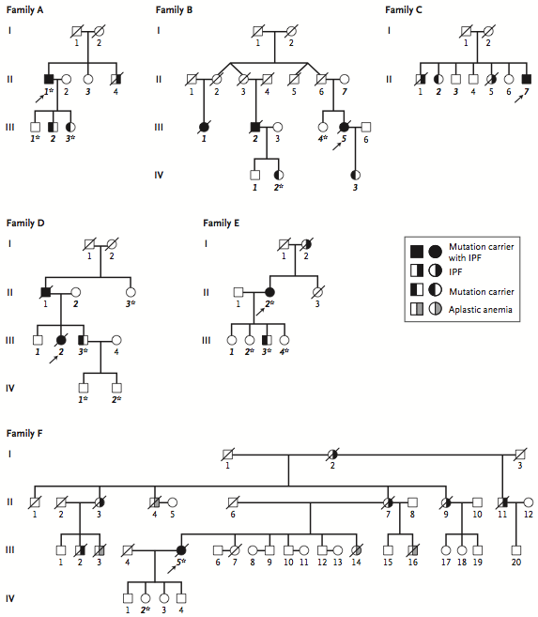
Notes:
Six probands (8%) had heterozygous mutations in hTERT or hTR; mutant telomerase resulted in short telomeres. Asymptomatic subjects with mutant telomerase also had short telomeres, suggesting that they may be at risk for the disease.
In FIP, mutations in TERT and TERC cause autosomal dominant disease with incomplete penetrance. Mutations in telomerase-associated genes account for only a small fraction of sporadic IPF cases (2-3%).

Slide 13
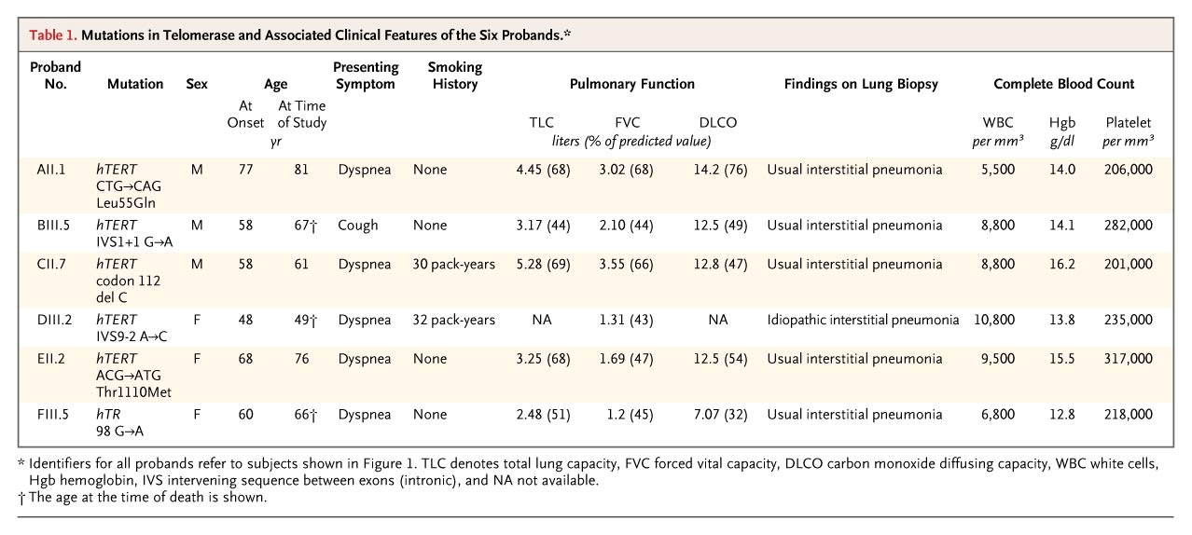
TELOMERASE MUTATIONS IN FAMILIES WITH IPF
Armanios MY et al. N Engl J Med 2007;356:1317-26

Slide 14
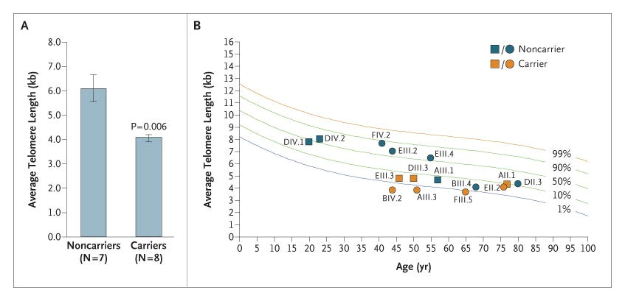
TELOMERE LENGTH IN MUTATION CARRIERS
Armanios MY et al. N Engl J Med 2007;356:1317-26

Slide 15
TELOMERE LENGTH IN IPF PATIENTS AND CONTROLS
6
*
p 0,0007
5
4
Telomere lenght
3
2
1
0
IPF patients
Healthy
controls
Spagnolo P et al. Unpublished

Slide 16
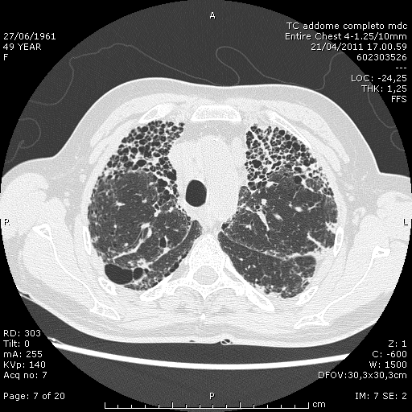
Carulli L et al. Hepatoloy 2012;56:2001-3
Notes:
Cryptogenic liver cirrhosis, pulmonary fibrosis and type 2 diabetes.

Slide 17
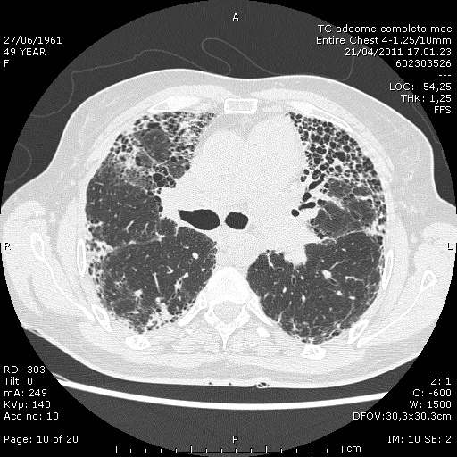
Carulli L et al. Hepatoloy 2012;56:2001-3

Slide 18
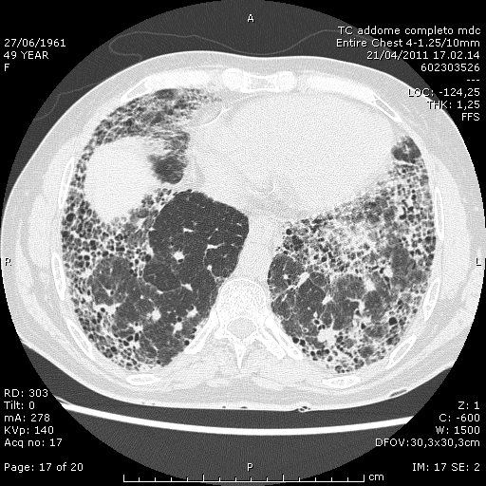
Carulli L et al. Hepatoloy 2012;56:2001-3

Slide 19
SURVIVAL AND TRANSPLANT-FREE SURVIVAL IN PATIENTS WITH CHRONIC HP ACCORDING TO TELOMERE LENGHT
Ley B et al. Lancet Respir Med 2017; 5: 639-47
Notes:
Survival (A) and transplant–free survival (B) in the combined cohort of patients with chronic hypersensitivity pneumonitis with peripheral blood leukocyte telomere less than or greater than the 10th percentile for age.
Unlike in IPF, in patients with chronic HP no association was found between survival and MUC5B rs35705950. conversely, short telomere length was associated with reduced survival.

Slide 20
COMMON VARIANTS ASSOCIATED WITH FPF
Gene | Gene function
IL1RN | Inhibitor of pro-inflammatory effects of IL-1α and IL-1β
IL8 | Pro-inflammatory cytokine
FAM13A | Signal transduction
TLR3 | Pathogen recognition and activation of innate immunity
TERT | Manteinance of telomere length
HLA-DRB1 | Major Histocompatibility complex – immune system
DSP | Tightly linking of adjacent cells
OBFC1 | Stimulation of the activity of DNA polymerase
MUC5B | Regulation of rheological properties of airway mucus, mucociliary transport, airway defense
MUC2 | Mucin production
TOLLIP | Regulation of innate immune responses mediated by Toll-like receptor
ATP11A | Phospholipid translocation
MDGA2 | Cell-cell interaction
MAPT | Regulation of microtubule assembly and stability
SPPL2C | Protein cleavage
DPP9 | Cell-cell adhesion
TGFβ1 | Control of proliferation and differentiation in many cell types
Modified from Adegunsoye A et al. Chest 2019 Jan 17. pii: S0012-3692(19)30001-7. doi: 10.1016/j.chest.2018.12.011

Slide 21
COMMON VARIANTS ASSOCIATED WITH FPF (2)
Gene | Gene function
TP53 | Production of tumor suppressor protein p53
CDKN1A | Involved in cell cycle and response to DNA damage
IVD | Production of isovaleryl-CoA dehydrogenase mitochondrial matrix enzyme
LRRC34 | Production of leucine-rich repeat protein for pluripotent stem cells
AKAP13 | Regulator of profibrotic signalling pathways activation
Modified from Adegunsoye A et al. Chest 2019 Jan 17. pii: S0012-3692(19)30001-7. doi: 10.1016/j.chest.2018.12.011

Slide 22
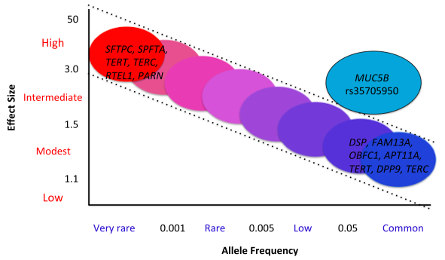
genetic VARIANTS AND IIP
Next-generation sequencing (NGS)
Genome-wide Association Studies (GWAS)
Modified from Mathai SK et al. BMC Medicine 2015;13:191
Notes:
The NGS technology affords the opportunity to sequence the entire genome (whole genome sequencing [WGS]) within a week.
MUC5B rs35705950 ia a common variant with a large effect size, that may account for up to 35% of risk for developing IPF.

Slide 23
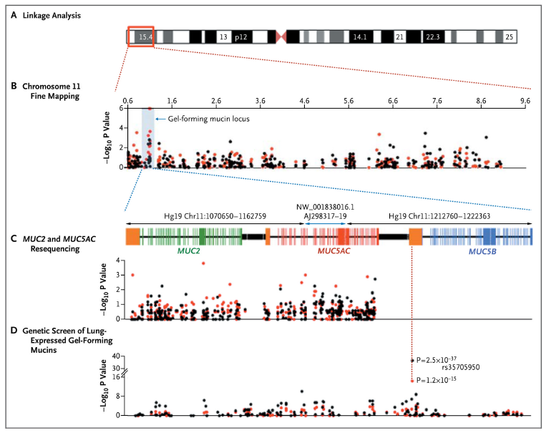
MUC5B VARIANT AND PULMONARY FIBROSIS
SNP | Nucleotide change | Minor Allele frequency |  |  | OR for FIP | P value | OR for sporadic IPF | P value
 |  | FIP (n=83) | Sporadic IPF (n=492) | Controls (n=322)
rs35705950 | G → T | 33.8% | 37.5% | 9.1% | 6.2 | 3.7 x 10⁻¹² | 8.3 | 4.6 x 10⁻³¹
Seibold MA et al. N Engl J Med 2011;364:1503-12
Notes:
Common genetic variants are associated with both familial and sporadic forms of pulmonary fibrosis.
Linkage analysis followed by sequencing. The OR for disease amongst homozygous for the rarer (T) allele were 20.8 for FIP and 21.8 for sporadic IPF.
MUC5B is the the strongest and most replicated genetic risk factor for pulmonary fibrosis.
MUC5B seems to be IPF-specific. Indeed, cohorts with SSc-ILD, asbestosis, sarcoidosis, acute lung injury or ARDS, COPD and asthma have failed to show strong associations between disease and genotype for this variant.
The prevalence of the MUC5B promoter SNP across different populations reflects disease prevalence in different racial or ethnic backgrounds.

Slide 24
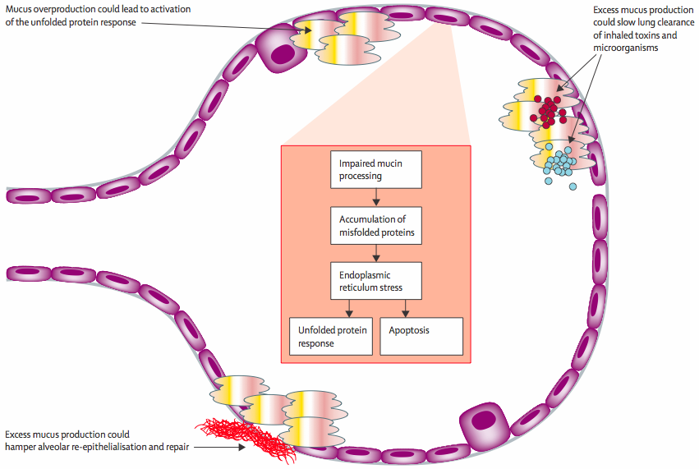
MUC5B AND PULMONARY FIBROSIS
Spagnolo P et al. Lancet Respir Med 2014; 2: 416-28
Notes:
While the MUC5B rs35705950 SNP is associated with increased MUC5B mRNA expression in lungs of control subjects, MUC5B expression is uniformly increased in lungs of IPF patients compared to controls, regardless of whether the MUC5B SNP is present.
The distal airways are the predominant source of MUC5B expression in IPF lung (Conti et al. AJRCCM 2016). Moreover, Nakano and colleagues have recently shown that the minor T allele enhances MUC5B expression in IPF lungs (Nakano AJRCCM 2016).
MUC5B overexpression may, on the other hand, a) reduce fibrogenic signals; b) reduce alveolar obliteration and collapse by acting as a “secondhand surfactant”; c) help reepithelialize damaged alveolar spaces.

Slide 25
THE MUC5B ASSOCIATION IS SPECIFIC OF IPF
IS IT??

Slide 26
PULMONARY FIBROSIS IN RHEUMATOID ARTHRITIS
Spagnolo P et al. Arthritis Rheumatol 2018; 70: 1544-54

Slide 27
MUC5B ASSOCIATION WITH RA-ILD AND RA-UIP
Juge P et al. N Engl J Med 2018; 379: 2209-19

Slide 28
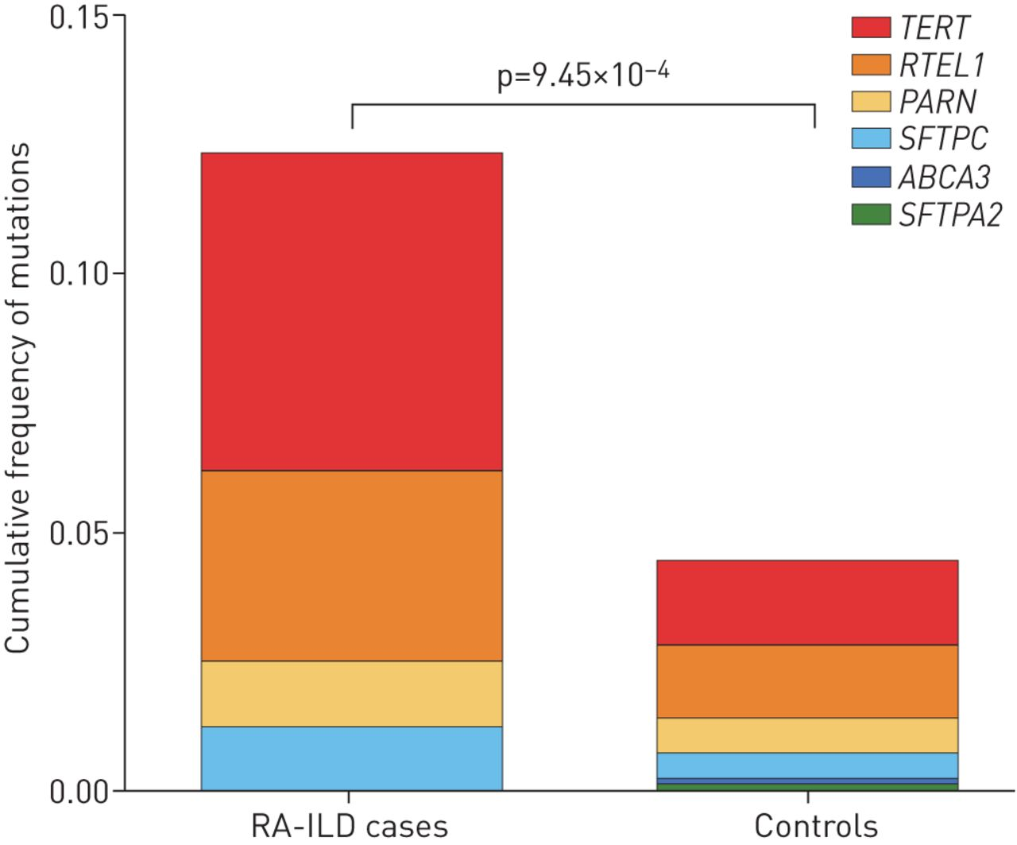
FAMILIAL PULMONARY FIBROSIS-LINKED GENES AND RA-ILD
Juge P et al. Eur Respir J 2017 May 11;49(5). pii: 1602314. doi: 10.1183/13993003.02314-2016

Slide 29
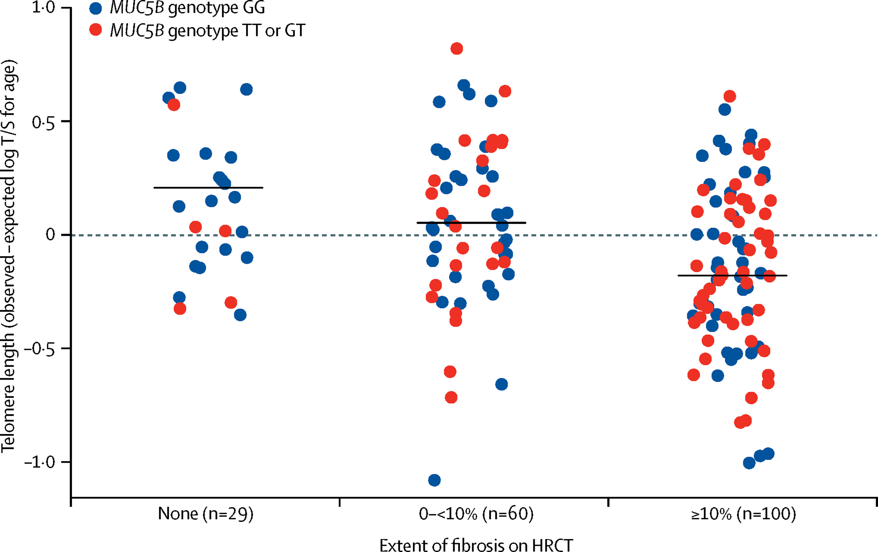
MUC5B RS35705950 GENOTYPE AND TELOMERE LENGTH IN PATIENTS WITH CHRONIC HP
Ley B et al. Lancet Respir Med 2017; 5: 639-47
Notes:
The authors measured two common single-nucleotide polymorphisms associated with IPF (MUC5B rs35705950 and TOLLIP rs5743890) and telomere length in PBMCs, and assessed their associations with chronic HP risk, survival, and clinical, radiographic, and pathological features.

Slide 30
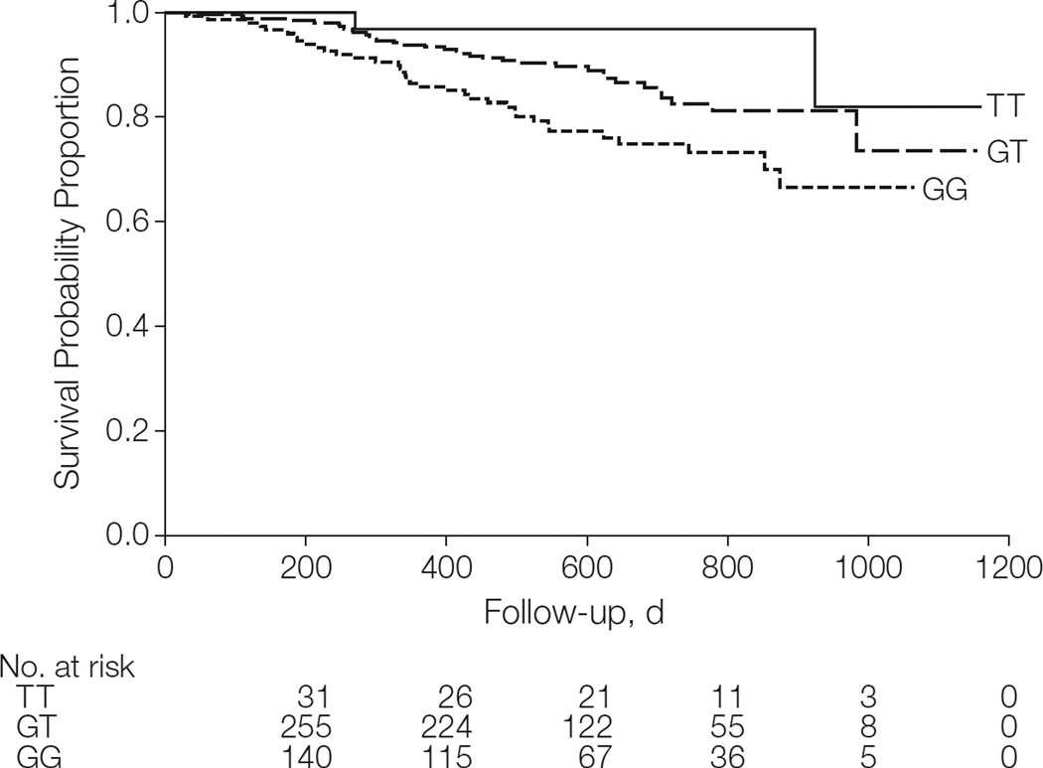
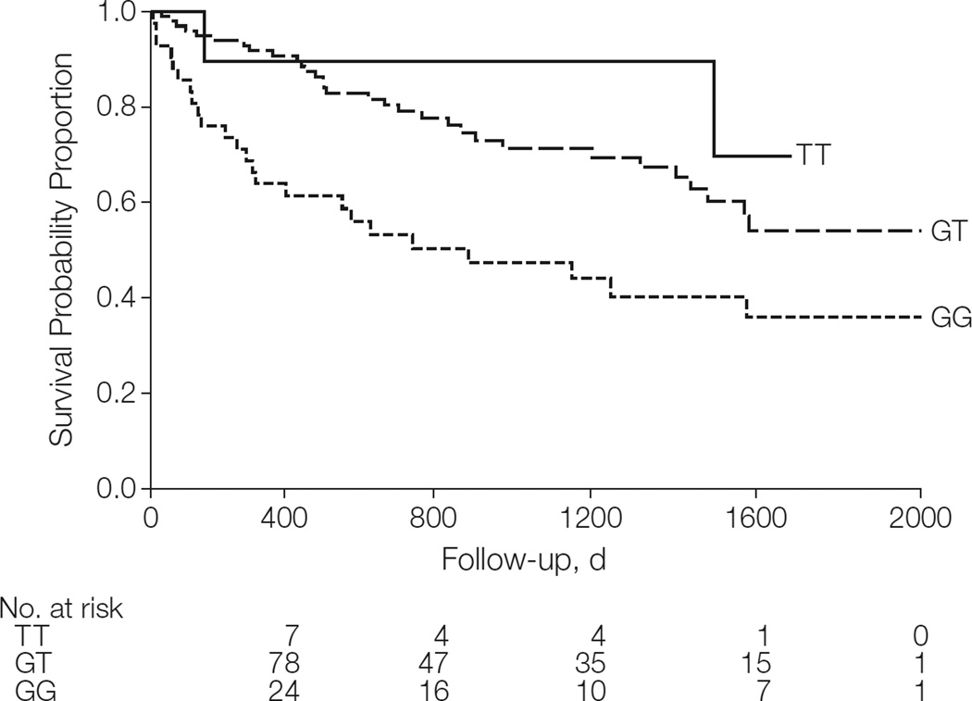
MUC5B IS ALSO A PREDICTOR OF PROGNOSIS
INSPIRE cohort
Chicago cohort
Peljto AL et al. JAMA 2013; 309: 2232-9

Slide 31
CARRIAGE OF MUC5B RS35705950 AND INTERSTITIAL LUNG ABNORMALITIES (ILA)

Slide 32
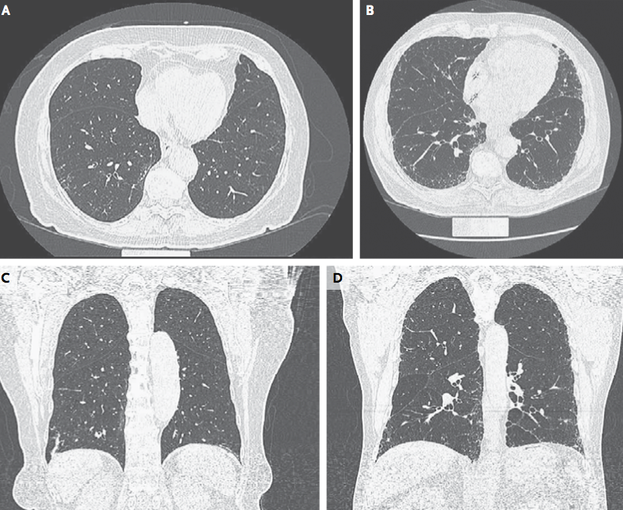

Slide 33
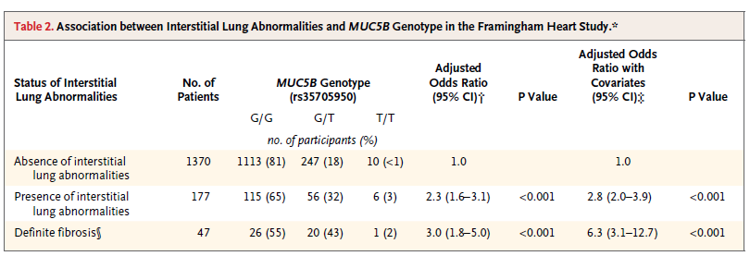
Blinded assessment of interstitial lung abnormalities (ILA)
Study population: participants in the Framingham Heart Study
177 (7%) of the 2633 CT scans showed SILA*
*SILA: subclinical interstitial lung abnormalities
Hunninghake GM et al. N Engl J Med 2013; 368: 2192-200
Notes:
1086 (41%) CT scans were indeterminate.
SILA were present in approximately 9% (and definite fibrosis in approximately 2%) of persons over the age of 50 years.

Slide 34
INCORPORATing GENETIC TESTING RESULTS INTO PATIENT CARE
Notes:
Pharmacogenomics focuses on how a drug influences gene expression across the entire genome.

Slide 35
PANTHER study (part B): results
NAC alone showed no difference in FVC decline or any secondary endpoints compared to placebo
0
−0.05
FVC (liters)
−0.10
Acetylcysteine
−0.15
Placebo
−0.20
Baseline
15
30
45
60
Week
Martinez FJ et al. N Engl J Med 2014;370:2093-2101

Slide 36
NAC EFFECTIVENESS BY TOLLIP GENOTYPE
Composite endpoint of FVC decline, hospitalization, death or transplant
Oldham JM et al. Am J Respir Crit Care Med 2015;192:1475-1482

Slide 37
FVC DECLINE ACCORDING TO TELOMERE LENGTH IN PATIENTS TREATED WITH PIRFENIDONE
Justet A et al. ERJ Express. Published on February 15, 2018 as doi: 10.1183/13993003.01875-2017;
Dressen A et al. Lancet Respir Med 2018; 6: 603-14

Slide 38
Silhan LL et al. Eur Respir J 2014;44:178-87
Notes:
Lung transplantation may be feasible for patients with pulmonary fibrosis from telomerase mutations. However, the clinical course for lung transplant recipients with telomerase mutations tends to be complicated by renal disease, leukopenia with intolerance of lymphocyte anti-proliferative agents, and recurrent lower respiratory tract infections (Tokman S, et al. 2015).

Slide 39
RECOMMENDATIONS FOR DIAGNOSTIC GENETIC TESTING FOR FAMILIAL INTERSTITIAL PNEUMONIA-ASSOCIATED GENETIC VARIANTS
Kropski JA et al. Am J Respir Crit Care Med 2017; 195: 1423-8

Slide 40
TAKE HOME MESSAGES
Genetic factors impact the development and prognosis of pulmonary fibrosis
Understanding of the underlying pathobiologic pathways remains poor
Need to individualize genetic testing based on specific situations

