Slide 1

Up to date on LAM e PLCH
Sergio Harari
U.O. di Pneumologia – UTIR e Medicina Interna
Ospedale San Giuseppe – MultiMedica IRCCS
Milano
Pneumo Trieste
1-3 Aprile 2019

Slide 2
Conflict of interest disclosure
I have the following real or perceived conflicts of interest that relate to this presentation:
Affiliation / Financial interest | Commercial Company
Grants/research support: | Actelion Pharmaceuticals, Boehringer Ingelheim
Honoraria or consultation fees: | Actelion Pharmaceuticals, Boehringer Ingelheim, Roche
Participation in a company sponsored bureau: | No
Stock shareholder: | No
Spouse / partner: | No
Other support / potential conflict of interest: | No

Slide 3
Sirolimus: current indications
ATS/JRS Guidelines
Patients with abnormal lung function
Abnormal lung function: FEV1 less than 70% predicted
Patients whose funtion is declining
Problematic chylous effusions and lymphangioleiomiomas
McCormack FX et al, AJRCCM 2016

Slide 4
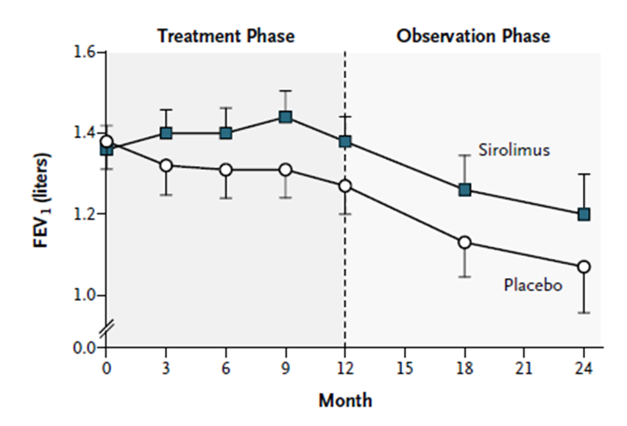
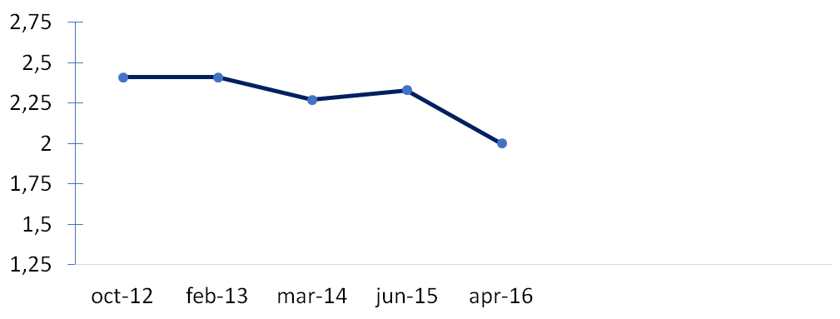
Sirolimus - limits
FEV1 (litres)
After discontinuation of sirolimus, the decline
in lung function resumed and paralleled that
in the placebo group
Decline of FEV1 after an initial stabilization during treatment with sirolimus
McCormack FX et al, NEJM 2011
Personal observation, unpub.

Slide 5
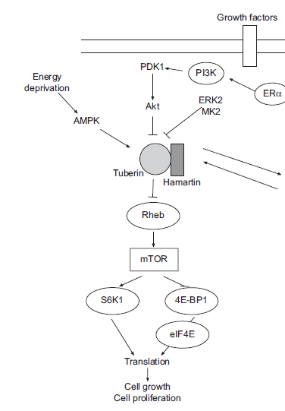
LAM - Pathogenesis
In vivo, hamartin and tuberin are part of a heterotrimer acting upstream of the mTOR, whose major function is regulation of cell growth and proliferation mediated by growth factors, energy and stress signals.
Inactivating mutations of hamartin and tuberin result in a constitutive activation of mTOR pathway leading to enhanced cell growth and proliferation
Harari et al, ERR 2011

Slide 6
LAM - Pathogenesis
PI3K/Akt
TSC1
TSC2
Autophagy allows cells to produce energy and maintain essential molecules through the use of breakdown products.
mTORC1 is a known inhibitor of autophagy
LAM cells are predicted to have low levels of autophagy, because of mTORC1 activation.
Rheb
mTORC1
S6K1
4E-BP1
HIF
Ulk1
Protein translation
Autophagy
Angiogenesis
Lymphangiogenesis
Growth, proliferation, migration

Slide 7
Autophagy and mTORC
In LAM decreased autophagy can reduce cell survival
TSC1/TSC2 mutations
mTORC
Autophagy
decreased cell survival under
conditions of bioenergetic stress
Sirolimus blocks the further growth of LAM cells by inhibiting protein translation, but simultaneously promotes the survival of LAM cells by inducing autophagy.
TSC1/TSC2 mutations
mTORC
Sirolimus
Autophagy
decreased cell survival under
conditions of bioenergetic stress
enhanced tumorigenesis

Slide 8
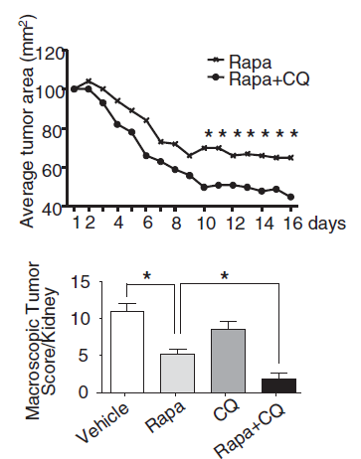
Autophagy and mTORC
The combination of mTORC1 and autophagy inhibition (using rapamycin and chloroquine) is more effective than either treatment alone in inhibiting the survival of tuberin (TSC2)- null cells, growth of TSC2-null xenograft tumors, and development of spontaneous renal tumors in Tsc2+/− mice
Parkhitko A et al, PNAS 2011

Slide 9
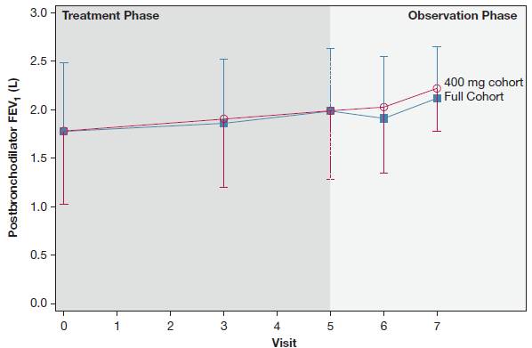
Sirolimus and Autophagy Inhibition in LAM
A phase I clinical trial
A safety and tolerability trial of Sirolimus and hydroxychloroquine (200 and 400mg)
Open label
24 weeks treatment phase followed by 24 weeks observation phase
Results:
___________________________________
Most common adverse events:
mucositis, headache, diarrhea
No drug-related SAEs
Improvement in lung function
at 24 weeks, with a decrease in
lung function at 48-weeks.
When the higher dose of
Hydroxychloroquine was analyzed
separately, FEV1 and FVC remained
Stable at 48 weeks (end of observation)
El-Chemaly S et al, Chest 2017

Slide 10
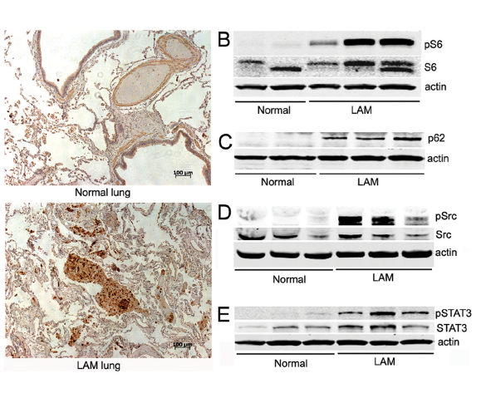
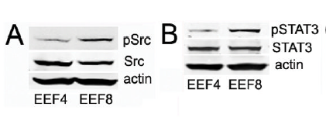
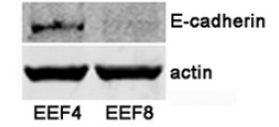

Src Kinase in LAM
Lung tissue
Eker rat embryos fibroblasts (EEF) cells
EEF4: TSC+/+
EEF8: TSC-/-
Staining with HMB45
in LAM nodules
Accumulation of
pS6->activated mTOR
P62->inhibited autophagy
pSrc-> activation of Src
pSTAT3->activated Src pathway
changes in the expression and localization of E-cadherin could account for the decrease in cell adhesion, increased motility, invasiveness and
metastatic potential
Tyryshkin A et al, Cancer Res 2014

Slide 11
LAM - Pathogenesis
PI3K/Akt
TSC1
TSC2
Rheb
mTORC1
S6K1
4E-BP1
HIF
Ulk1
Protein translation
Autophagy
Angiogenesis
Lymphangiogenesis
Src Kinase
Growth, proliferation, migration
motility, invasiveness

Slide 12
Src inhibition in LAM
Completed
“SLAM-1”
phase 1, open label, single arm
Safety of three escalating doses of saracatinib, 50-125-175mg die
Ongoing
“SLAM-2”
Safety and efficacy of 125mg of saracatinib in LAM
phase 2, open label, single arm
Duration of treatment: 9 months
Inclusion criteria: a recent reduction in forced expiratory volume at 1-second (FEV1) of > 50ml/year
Primary Outcome Measures: FEV1
Secondary Outcome Measures: AML measured volumetrically on MRI
Lung Cyst size measured on chest CT
serum VEGF-D levels

Slide 13
LAM - Pathogenesis
Akt/PI3K
TSC1
TSC2
Apoptosis
Rheb
mTORC1
S6K1
4E-BP1
HIF
Ulk1
Protein translation
Autophagy
Angiogenesis
Lymphangiogenesis
Growth, proliferation, migration

Slide 14
LAM - Pathogenesis
Resveratrol
Akt/PI3K
Akt/PI3K
TSC1
TSC2
Apoptosis
TSC1
TSC2
Apoptosis
Rheb
Rheb
mTORC1
Sirolimus
Sirolimus
mTORC1
Ulk1
Ulk1
S6K1
4E-BP1
HIF
S6K1
4E-BP1
HIF
Resveratrol
Protein translation
Autophagy
Protein translation
Autophagy
Angiogenesis
Lymphangiogenesis
Angiogenesis
Lymphangiogenesis
Growth, proliferation, migration
Growth, proliferation, migration
Alayev A et al, Cell cycle 2014

Slide 15
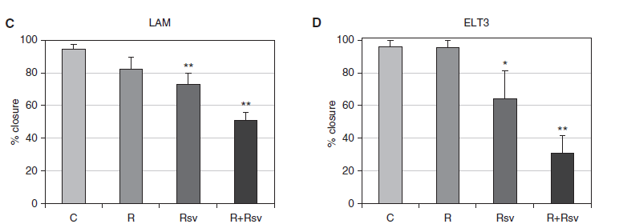
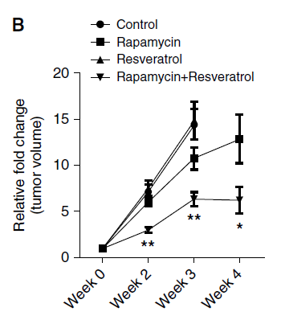
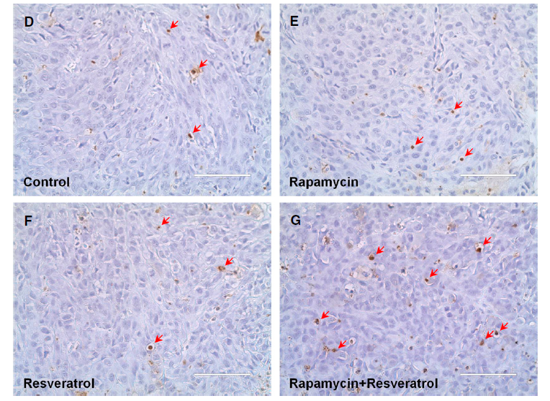
Combination of rapamycin and resveratrol
Rapamycin + resveratrol reduce cell migration of LAM and ELT3 cells
Rapamycin + resveratrol reduce xenograft tumor size
Rapamycin + resveratrol induce apoptosis in xenograft tumors.
Alayev A et al, Am J Respir Cell Mol Biol 2015

Slide 16
Resveratrol and Sirolimus in LAM
Ongoing
“RESULT”
Safety and efficacy of escalating dose (250, 500, 1000mg) of resveratrol in combination with sirolimus
phase 2, open label, single arm,
Duration of treatment: 24 weeks
Inclusion criteria: pts with stable disease with sirolimus for at least 20 weeks
Primary Outcome Measures: serum VEGFD levels
Secondary Outcome Measures: safety
lung function (FEV1,FVC, DLCO)
quality of life

Slide 17
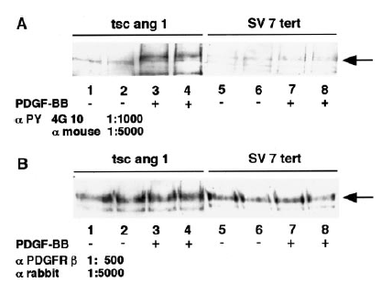
Nintedanib in LAM
Human AML derived cell line and murine TSC2 mutated cells express functional PDGFR
Markedly positive staining of human angiomyolipoma with phosphospecific PDGFR
Arbiser JL et al, Am J Pathol 2002
In TSC2 deficient cells, growth can be enhanced due to a oestrogen-induced activation of a PDGFRb and ERK1/2 signalling pathway
Finlay GA et al, J Biol Chem 2004
The simultaneous inhibition of VEGF, PDGF and FGF signaling pathways reduces tumor angiogenesis in lung.
As angiogenesis and lymphangiogenesis are crucial mechanisms involved in dissemination of LAM cells, potential inhibition by nintedanib may contribute to prevent disease progression in LAM

Slide 18
Nintedanib in LAM
Ongoing
A pilot study of efficacy and safety of nintedanib in LAM
phase 2, open label, single arm
Study duration: 12 months of treatment followed by 12 months of observation
Inclusion criteria: evidence of progression of disease (≥80ml/year or 10%FEV1) or intolerance to sirolimus
Primary Outcome Measures: FEV1
Secondary Outcome Measures: safety
lung function (FEV1,FVC, DLCO)
serum VEGFD levels
quality of life
AML volume

Slide 19
Nintedanib in LAM
Target enrollment: 30 patients
Enrolled to date: 24 patients
1 patients dropped-out after 4 months because of declining lung function
1 patient dropped-out after 3 months for abdominal pain, diarrhea, increased blood pressure
1 patient dropped-out after 5 months for increased ALT, AST (>5 fold ULN)
1 patient withdrawn consent after 8 months
Side effects in first 11 patients who completed 12 months of treatment:
1 SAE not related to drug
2 pts experienced increased ALT, AST with need of temporary stop (> 3 fold ULN).
2 pts experienced increased ALT, AST not clinically significant
1 haemorrhagic cystitis
1 slight increased of blood pressure
1 hypercholesterolemia
4 temporary diarrhea
1 headache
10 patients experienced nausea

Slide 20
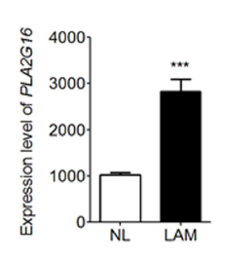
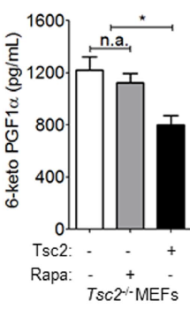
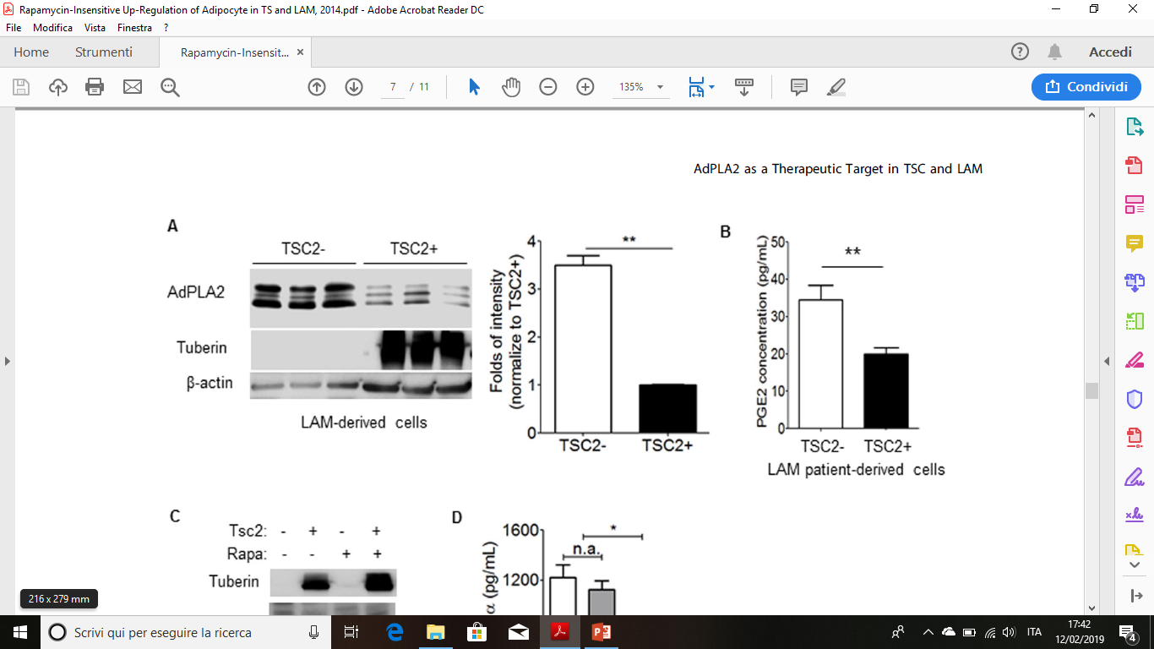
Phospholipase A2 (PLA2) in TS and LAM
PLA2 is the rate-limiting enzyme that catalyzes the conversion of plasma membrane phospholipids into PGs
Non canonical TSC pathways
AdipocytePLA2is upregulated in lung LAM nodule cells compared to non-LAM
TSC2
AdPLA2
cyclooxygenase-2
COX inhibition
Prostaglandins
tumorigenesis
Secreted levels of PGs are higher from TSC2 deficient cells than TSC-addback cells
Secreted levels of PGs metabolite are higher in TSC2 deficient cells and are not affected by rapamycin
Li C et al, PLOS ONE 2014

Slide 21
COX-2 Inhibition in LAM
Ongoing
“COLA”
A Pilot Clinical Trial of COX-2 Inhibition (celecoxib) in LAM and TSC
phase 2, open label, single arm
Duration of study: 6 months treatment period, 6 months follow-up
Inclusion criteria: no mTOR inhibitors, mild disease
Primary Outcome Measures: safety and tolerability
Secondary Outcome Measures: lung function (FEV1)
AML size (MRI)
serum VEGFD levels
Exhaled breath condensate PGs
quality of life

Slide 22
mTOR Inhibition and statins in LAM
Non canonical TSC pathways
Ongoing
“SOS”
Safety of Simvastatin in LAM and TSC patients on a stable dose of sirolimus or everolimus
phase 1-2, open label, single arm
Primary Outcome Measures:
safety and tolerability
Secondary Outcome Measures:
lung function (FEV1, FVc, DLCO)
serum VEGFD levels
quality of life
TSC1
TSC2
Rheb
mTORC2
Statins
Rho-A
Cytoskeleton
Simvastatin inhibited RhoA activity and promoted apoptosis in in vivo and anima models

Slide 23
Pathogenesis: role of estrogen
Female predominance
Frequent occurrence during childbearing age
Decline in lung function is greater in pre-menopausal women than in post-menopausal women
Reported worsening following the administration of estrogens or during pregnancy
Presence of estrogen receptors in LAM cells
In in vitro and animal models estrogen interacts with signaling events
to stimulate growth of human AML cells
to promote the survival and pulmonary metastasis of Tsc 2−/− ELT3 cells

Slide 24
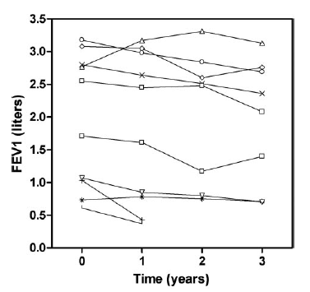
Hormonal treatment
Oophorectomy, anti-estrogen therapy: controversial effects , no objective evidence of improvement
Progesterone: case reports, retrospective studies
Gonadotrophin-releasing hormone (GnRH) analogues: case reports, retrospective studies.
A prospective study of triptorelin in 10 patients showed no effects
on lung function over a 3-year period
Taveira–Dasilva AM et al, Chest 2004
Harari S et al, Chest 2008

Slide 25
Aromatase inhibition in LAM
A phase II clinical trial
Completed
“TRAIL”
Efficacy and safety of the aromatase inhibitor letrozole in postmenopausal women with LAM
Phase2,randomized, double blinded, placebo-controlled
Duration of treatment: 12 months
Primary endpoint: FEV1
Secondary endpoints: pulmonary function
quality of life
serum VEGFD
The target enrollment of 25 patients per arm was not met
(9 patients received letrozole, 8 patients received placebo)
In a post hoc analysis, eight matched letrozole-treated-placebo-treated pairs were constructed, six of which demonstrated better FEV₁ improvement for the letrozole-treated patients
Lu C et al, Ann Am Thorac Soc. 2017

Slide 26
Clinical trials
Name | Drug | Design | Primary endpoint | Status | Results
MILES | Sirolimus | Randomized, d. blind, placebo controlled | FEV1 | Completed | Positive results
 | Everolimus | Open label, dose-escalating | Safety, PK, PD | Completed | Lower safety profile compared to sirolimus
SAIL | Sirolimus plus Hydroxychloroquine | Open label | Safety | Completed | Positive results at higher dose
TRAIL | Letrozole | Randomized, d. blind, placebo controlled | FEV1 | Completed | Failed to enrolled the target n of pts
 | Doxycycline | Randomized, d. blind, placebo controlled | FEV1 | Completed | Negative results
SLAM-2 | Saracatinib | Open label, Single arm | FEV1 | Ongoing
LAM | Nintedanib | Open label Single arm | FEV1 | Ongoing
LAMP1 | Imatinib | Randomized, blind, placebo controlled | VEGFD | Ongoing
RESULT | Sirolimus plus Resveratrol | Open label, Single arm | VEGFD | Ongoing
COLA | Celecoxib | Open label, Single arm | Safety | Ongoing
SOS | mTOR inhibitors plus simvastatin | Open label Single arm | Safety | Ongoing

Slide 27
Take home messages
1. To date mTOR inhibitors are the only proven treatment for LAM
2. Alternatives or combined drugs are currently under investigation
3. An individualized combined or multiple steps treatment is likely the future for LAM patients

Slide 28
Systemic treatments in PLCH
Corticosteroids
  no convincing data on the improvement of lung function
  even correlated with worth outcome in a retrospective study
  Delobbe et al. Eur Respir J 1996
Vinblastine
  Virtually no effects on lung function
FEV₁
Tazi et al. Orphanet J Rare Dis 2017

Slide 29
Cladribine in PLCH
2-CDA: purine analogue
Toxic for resting monocytes and lymphocytes
Highly immunosuppressive (prolonged lymphopenia)
Second-line treatment for MS LCH
Several cases reports on cladribine efficacy in PLCH
  Aerni et al. Respir Med 2008
  Lazor et al. Thorax 2009
  Lorillon et al. Am J Respir Crit Care Med 2012
  Grosbost et al. Orphanet J Rare Disease 2014
  Epaud et al. Eur Respir J 2015
  Nasser et al. ERJ Open Res. 2018

Slide 30
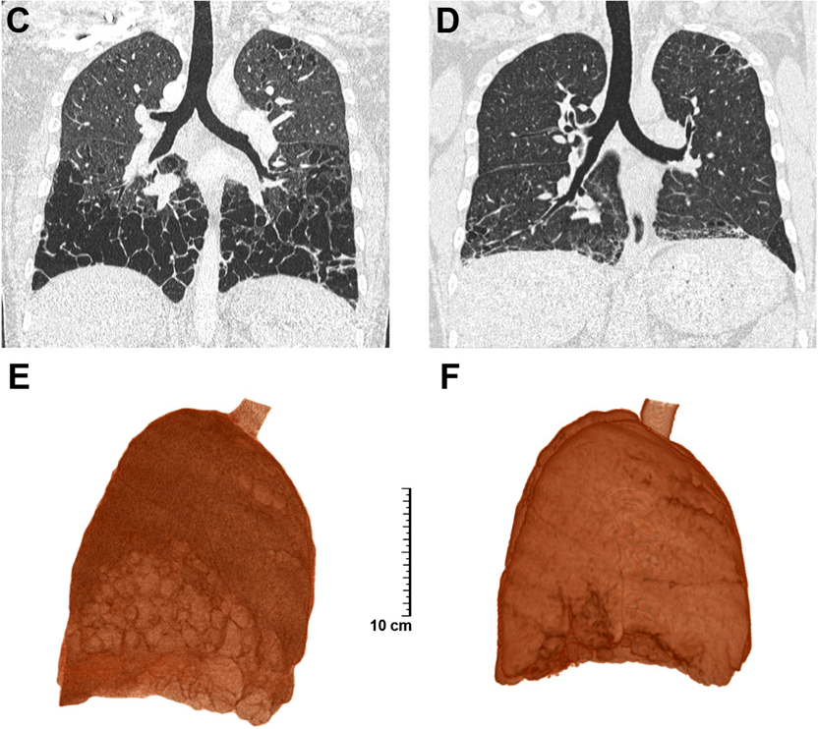
Lorillon et al. AJRCCM 2012

Slide 31
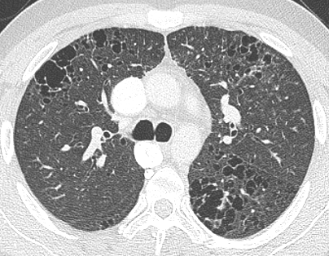
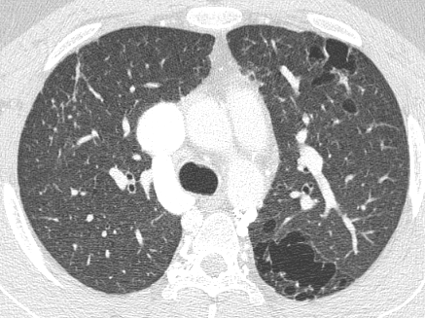
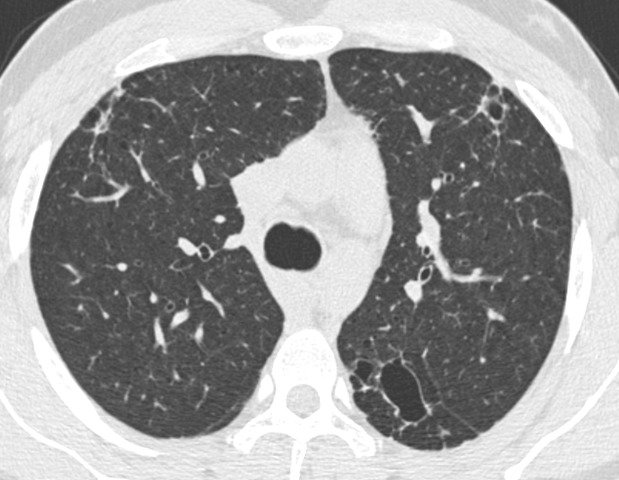
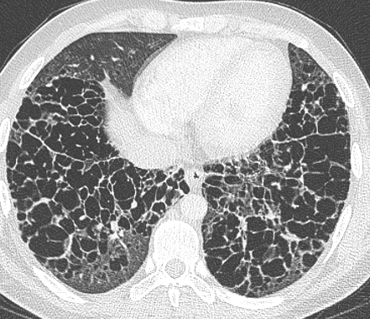
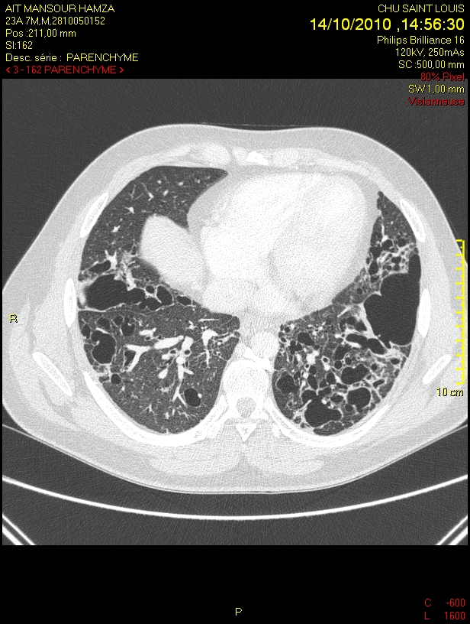
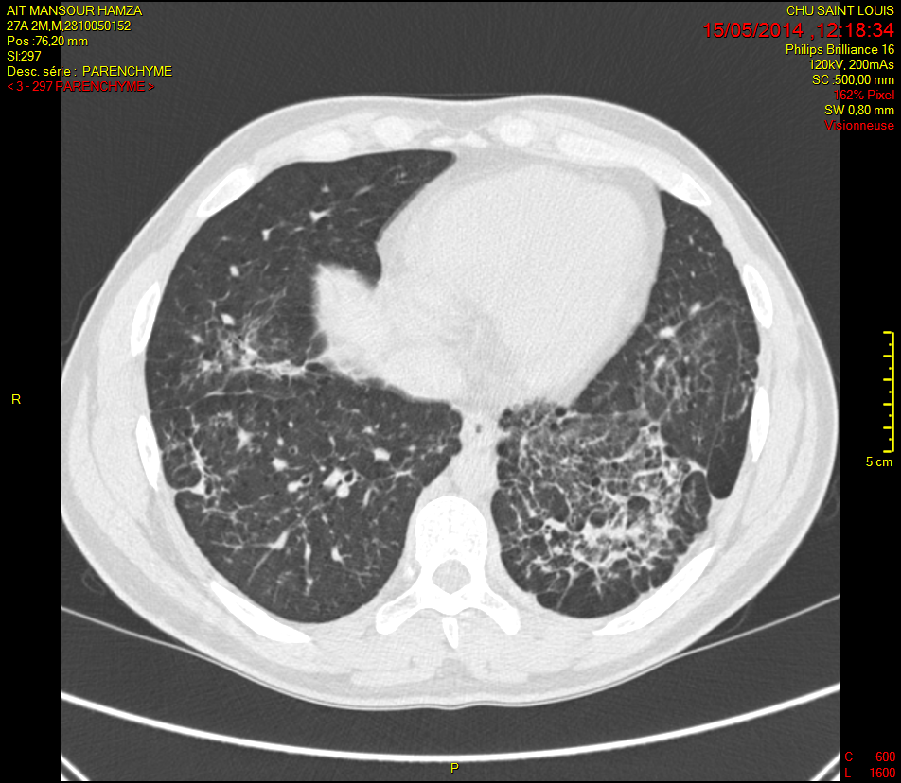
Before treatment
6 months after treatment
4 years after treatment

Slide 32
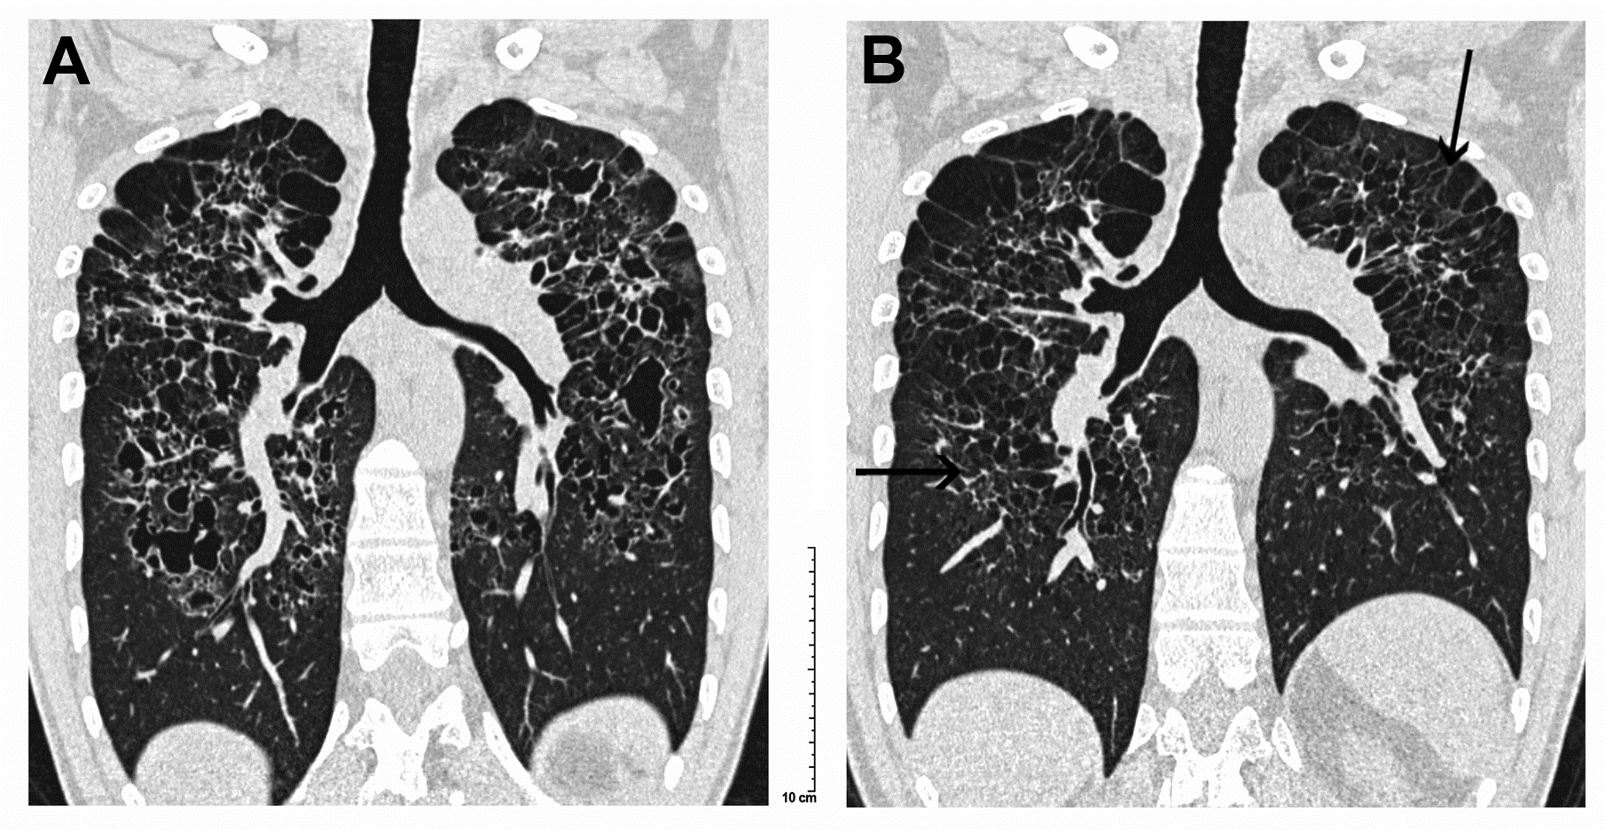

Slide 33
 | Patient 1 |  |  |  |  | Patient 2 |  |  |  |  | Patient 3
PFTs | M0 | M6 | M12 | M48 |  | M0 | M6 | M21* | M48 |  | M0 | M6 | M16 | M-48
TLC | 6360 | 6800 | 7130 |  |  | 7240 | 6810 | 7260 | 7820 |  | 5000 | 4170 | 4980 | 4940
% | 73 | 78 | 83 |  |  | 93 | 88 | 93 | 100 |  | 80 | 67 | 79 | 78
VC | 3830 | 4320 | 4700 |  |  | 4610 | 3920 | 3850 | 3380 |  | 3060 | 2660 | 3030 | 3450
% | 57 | 65 | 71 |  |  | 80 | 69 | 68 | 60 |  | 63 | 55 | 63 | 72
RV | 2520 | 2470 | 2430 |  |  | 2630 | 2890 | 3530 | 4440 |  | 1930 | 1510 | 1950 | 1520
% | 133 | 130 | 126 |  |  | 134 | 146 | 181 | 217 |  | 128 | 100 | 129 | 97
FEV₁ | 2520 | 3090 | 2940 | 3000 |  | 3790 | 2700 | 2470 | 2180 |  | 1840 | 2300 | 2550 | 3030
% | 42 | 53 | 51 |  |  | 78 | 56 | 52 | 46 |  | 46 | 57 | 63 | 78
FEV₁/VC | 66 | 72 | 63 |  |  | 82 | 67 | 64 | 58 |  | 73 | 86 | 84 | 88
DL_{CO} % | 22 | 23 | 26 |  |  | 24 | 35 | 35 | 35 |  | 53 | 53 | 45 | 61
*2 additional courses of cladribine

Slide 34
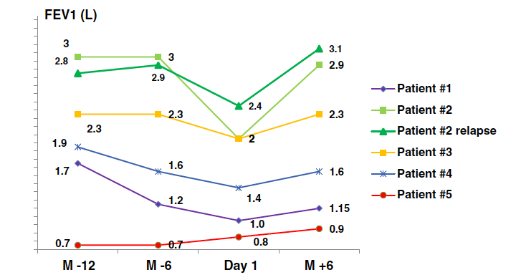
Grobost et al Orphanet J Rare Dis 2014

Slide 35
Evaluation of Efficacy and Tolerance of Cladribine in Symptomatic PLCH (ECLA study “NCT01473797”)
Phase II non-randomized pilot study (n=10); age >16 and ≤ 55 years
Symptomatic PLCH (NYHA class ≥2)
  FEV₁/FVC<70% and post𝛽2 FEV₁=30-70% of predicted
  and/or decrease ≥15% in FEV₁, FVC or DLCO in the year before inclusion
  without respiratory failure or PH
Cladribine (Litak®)
  5 sc consecutive injections (0.1 mg/kg/d)
  4 monthly cycles
  prolonged infection prophylaxis
Primary outcome : cumulated incidence of response at 6 months
  ≥10% improvement of FVC
  and/or ≥10% improvement of post 𝛽2 FEV₁ and ≥200ml
  evaluation at M3,6,9,12,18,24….M48

Slide 36
ECLA Study: preliminary results
FEV₁
Response
ml
Predictive factors?
Months

Slide 37
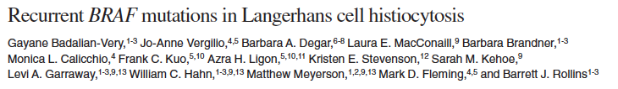
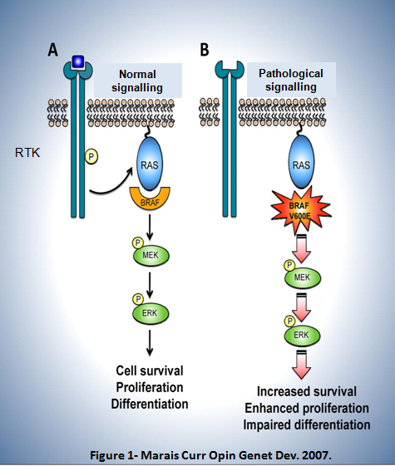
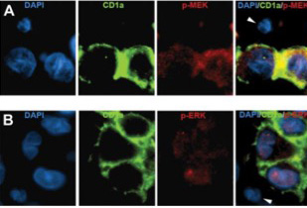
Blood 2010
p-MEK
p-ERK
Brown et al. Blood 2014
Chakraborty et al. Blood 2014
Nichols KE and Arceci RJ Blood 2010

Slide 38
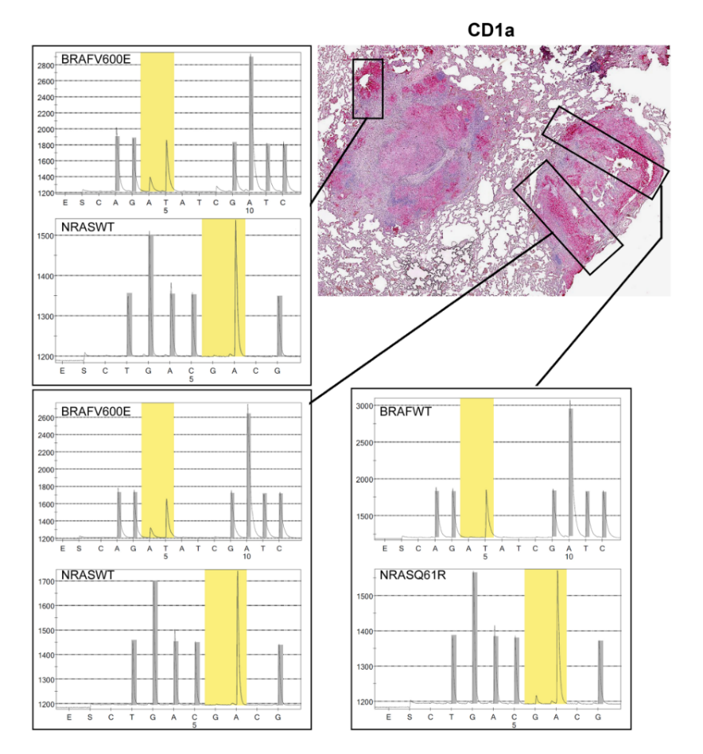
Yousem et al. Chest 2013
Chilosi et al. Leuk Lumphoma 2014
Roden et al. Am J Surg Pathol 2014
Kamionek et al. Histopathology 2016
Zeng et al. Hematol Oncol 2016
Alayed et al. Human Pathol 2016
Mourah et al. Eur Respir J 2016
Mourah et al. Eur Respir J 2016

Slide 39
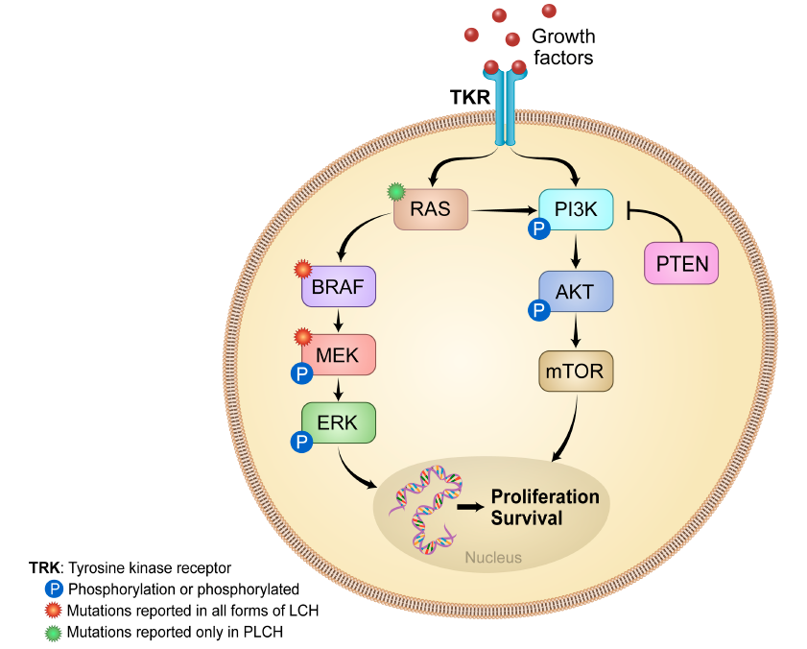
Vassallo R, Harari S, Tazi A. Thorax 2017

Slide 40
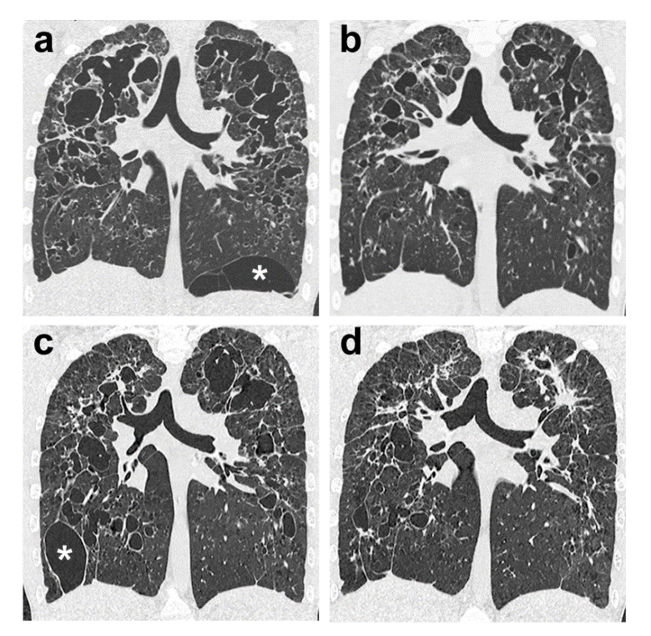
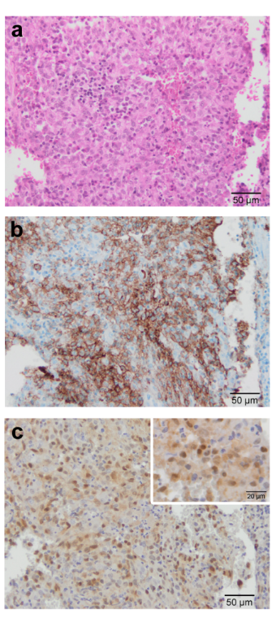
cladribine
HES
CD1a
p-ERK1/2
trametinib
Lorillon et al. AJRCCM 2018

Slide 41
Summary
Better knowledge of short- and middle-term natural history
Progress:
  patients’ monitoring
  treatment
Smoking cessation essential (difficult)
Need for better knowledge of long term outcome (ongoing)
  identification of robust predictive factors (biomarkers)
Pathogenesis of LCH
  myeloid neoplasia of variable severity with inflammation
  MAPK pathway++
  animal model++
  etiology?
MAPK-targeted treatments (BRAF, MEK inhibitors, combination)
  selected patients progressive refractory disease
  duration? side effects++

