Slide 1
PARADOXES AND CRITICISMS OF THE IPF GUIDELINES
Venerino Poletti

Slide 2

Conflicts of Interest
Boerhinger Ing
Roche
ERBE

Slide 6
ICE-CREAM SELLERS PARADOX (Hotelling law- principle of minimum differentiation)

Slide 8
Thorax 2016

Slide 11
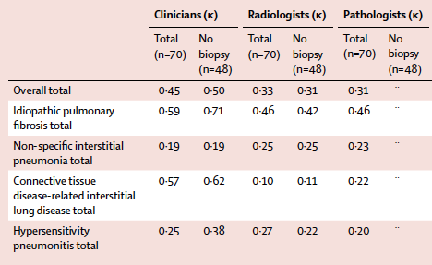
Walsh SL, et al. LRM 2016

Slide 13
WHAT IS MISSING
PATHOGENETIC CONSIDERATIONS (with clinical and pathologic clues)

Slide 14
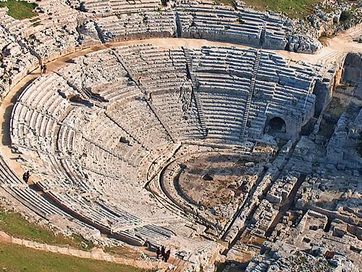
PATHOGENESIS of IPF
Three Act Tragedy
1.
Alveolar loss,stem cell exhaustion
Aberrant signaling [(WNT, Notch,TGF-β)
(pro-fibrotic microenvinroment)]
2.
Remodelling (bronchiolar proliferation- fibrosis)
3.

Slide 15
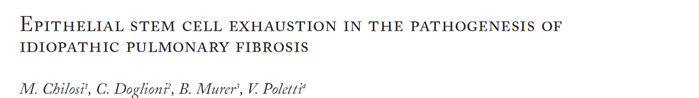
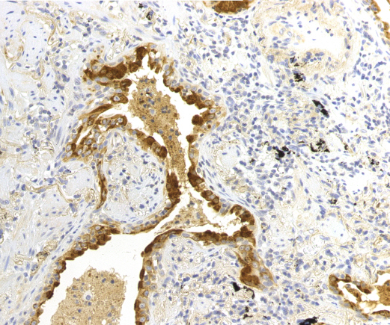
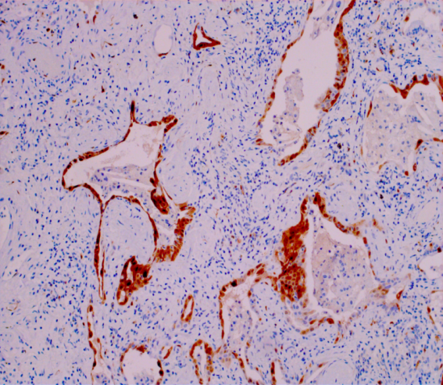
Sarcoidosis Vasc Diffuse Lung Dis. 2010
Sarcoidosis Vasc Diffuse Lung Dis. 2010
Progressive deterioration of type II Pneumocytes
Surf-Prot-A1
*INTRINSIC DEFECTS
«Anatomic» triggers EXTRINSIC INSULTS
Genetic
Telomerase gene mutations
Surfactant gene mutations
Endoplasmic reticulum stress
Aging
Replicative senescence and
Telomere attrition
Anatomy
Mechanical stress
Smoking
Organic dusts?
Pollutions/inorganic dusts
Microbiome
(Oxidative stress, ROS, NOX4)
IPF:
Epithelial stem cell exhaustion
p16^{INK4B}

Slide 16
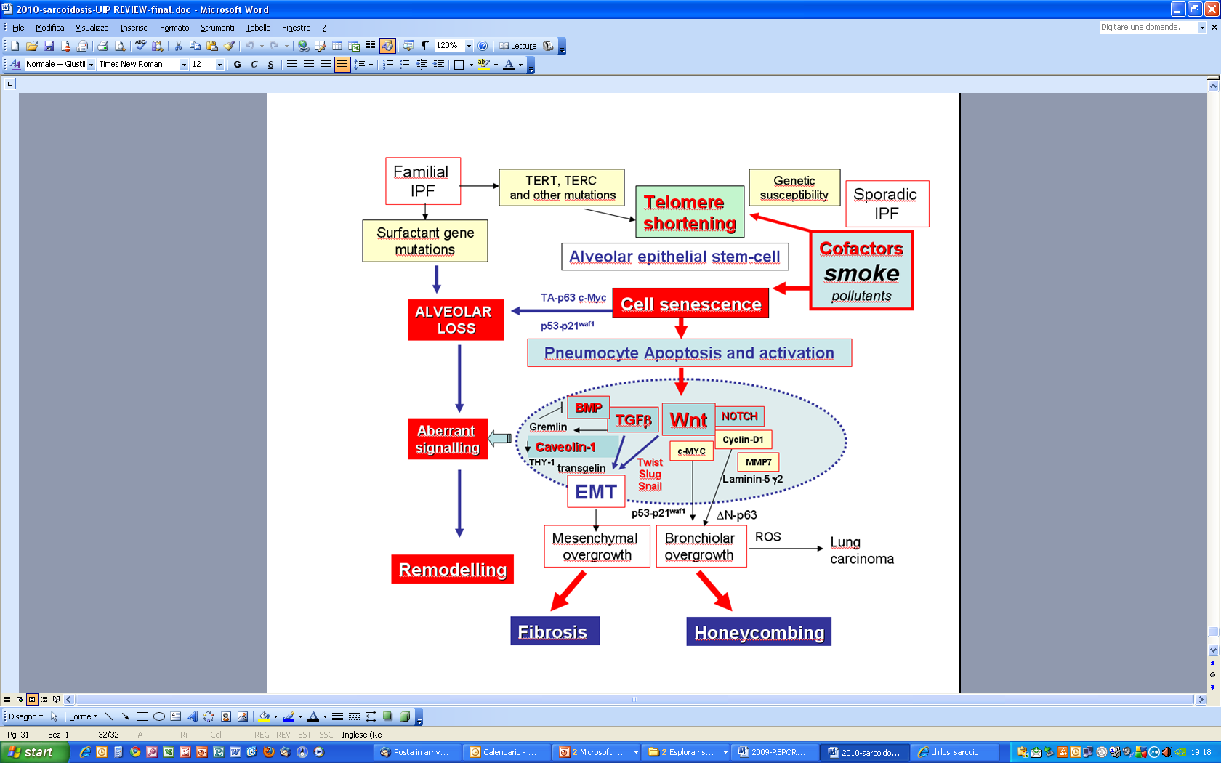
Sarcoidosis Vasc Diffuse Lung Dis. 2010
3.
Remodelling
2.
Aberrant signaling
1.
Alveolar loss

Slide 17
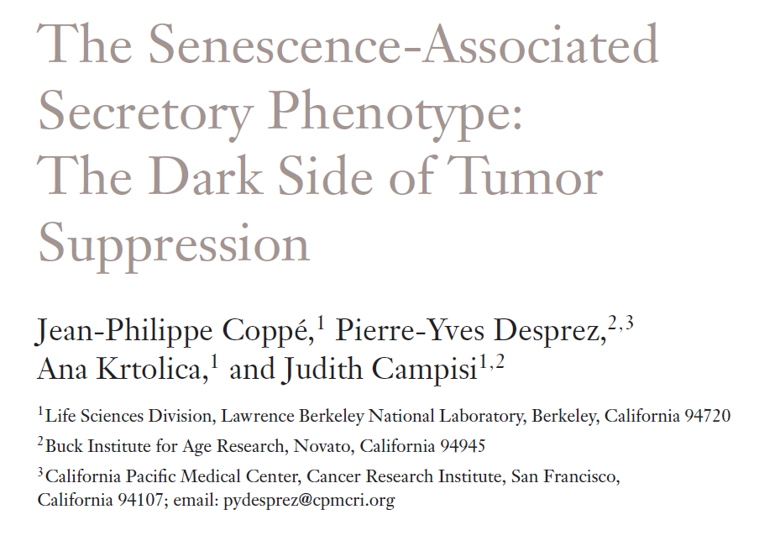
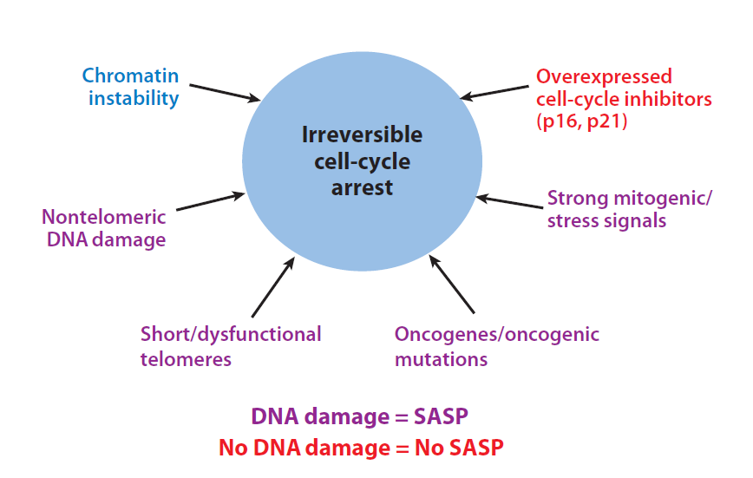
SASP:
Promotes cell proliferation
Stimulates cell motility
(invasion, migration, metastases)
Regulates cell differentiation
Affects leukocyte infiltration and
tumor immunology
The secretory phenotype of senescent cells

Slide 18
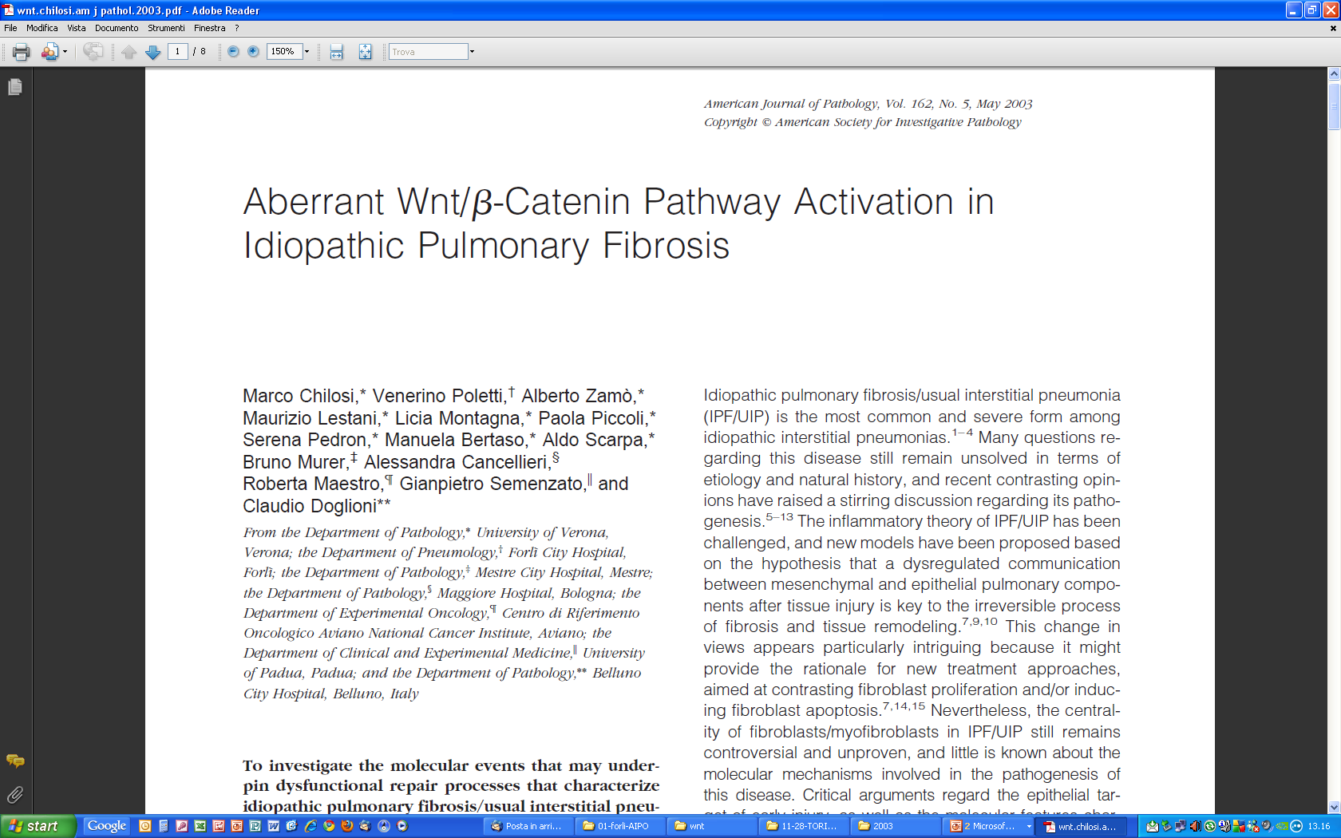
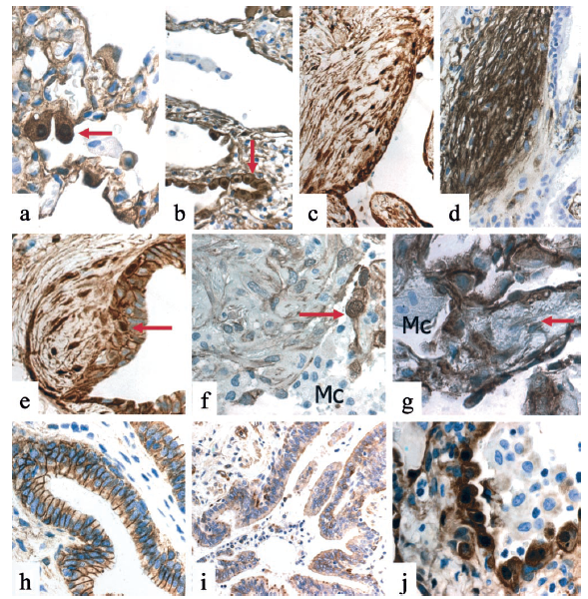

Slide 19

Sarcoidosis Vasc Diffuse Lung Dis. 2010
1.
Alveolar loss
Rigged game
2.
Aberrant signaling
SASP
3.

Slide 20
Different renewal strategies in bronchiolar and alveolar epithelia
TAp63
telomerase
Rigged game
C-Myc
β-catenin
PN-II
Surfactant SPA
PN-I
ΔN-p63
Hsp-27
CK5

Slide 21


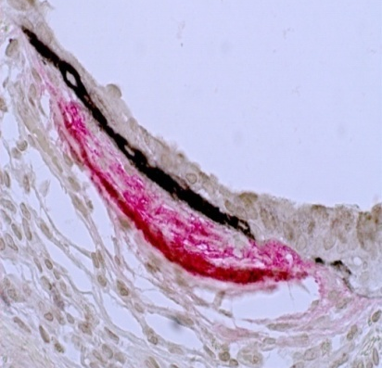
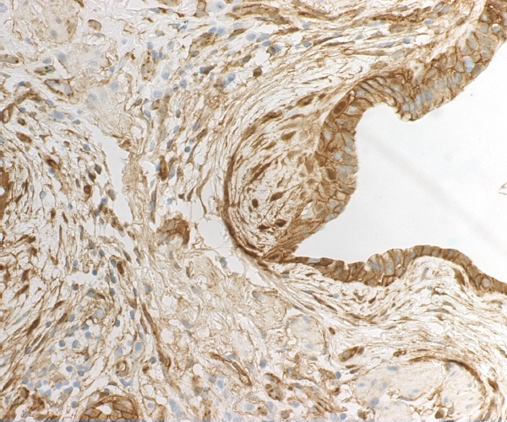
Attempted regeneration
Intrinsic PNII defects
pleura
WNT
Waves of abnormal signaling
OIS
SASP
abnormal Induction
Waves of abnormal mesenchymal cells
bronchioles

Slide 22
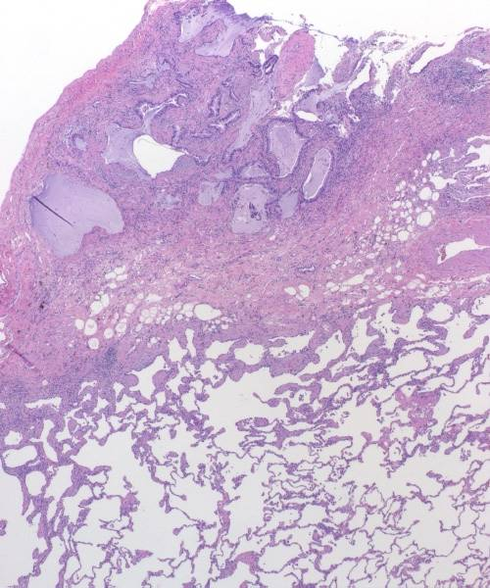
IPF pathogenesis:key points
*Alveolar stem cell
Ex haustion
*Pro-fibrotic microenvinronment/
bronchiolar dysplastic proliferation
*Many of the genes and gene networks
induced or activated in IPF are also
associated with with lung development,
senescence and carcinogenesis.
*It is mainly limited to
the lung
*chronic HP: an IPF subset primed
by inhalation
McDonough JE, et al. Thorax in press
Ley B, et al. LRM 2017
Chilosi M, et al. Transl Res 2013

Slide 23
A 61 y/o male, former smoker (22 p/y)
Dyspnea on effort since 6 months
No evidence of exposures
Velcro sounds
HRCT indeterminate (but centrilobular nodules were reported; not cranio-caudal gradient)
Biopsy: UIP pattern with ancillary findings suggesting chronic HP (centrilobular fibrosis-obliterative bronchiolitis,
scattered giant cells, bridging fibrosis)
DIAGNOSIS?

Slide 24
GENETIC BACKGROUND IN IPF
Garcia-Sancho C, et al. Familial pulmonary fibrosis is the strongest risk factor for idiopathic pulmonary fibrosis.
Respir Med 2011, 105: 1902-1907
In this study we performed a case-control analysis including 100 patients with IPF and 263 controls matched for age sex and place of residence.
The multivariate analysis revealed that family history of pulmonary fibrosis [OR = 6.1, CI95% 2.3-15.9; p < 0.0001] was strongly associated with increased risk of IPF. Actually, 20% of the cases reported a parent or sibling with pulmonary fibrosis.
Gastroesophageal reflux [OR = 2.9, CI: 1.3-6.6; p = 0.007], former cigarette smoking [OR = 2.5, CI: 1.4-4.6, p = 0.003], and past or current occupational exposure to dusts, smokes, gases or chemicals [OR = 2.8, CI: 1.5-5.5; p = 0.002] were also associated with the disease.
These findings indicate that family history of pulmonary fibrosis is a strong risk factor for IPF.
Also, we confirmed that occupational exposures, gastroesophageal reflux and former smoking increase the risk for this disease.

Slide 25
Arch Pathol Lab Med 2012

Slide 26
CHRONIC HP (MDT prone to guidelines)
or
IDIOPATHIC PULMONARY FIBROSIS
(MDT led also by pathogenetic and clinical considerations)

Slide 27
IPF patient
Male
Smoker/former smoker
>65 y/o
Comorbidities

Slide 28
Mortality at 30 days 1.7%
Significantly higher in not elective setting
Higher
*in patients >65 y/o or when a diagnosis of IPF is probable
*Lower pulmonary function

Slide 29
55 patients (35 male) Median (interquartile range) age was 77 (76–80) years.
Forced vital capacity was 70 (61–76)% and DLCO was 48 (42–54)% of predicted.
In total, 37 (67%) patients had IPF, including 61% of those with HRCT findings
inconsistent with UIP.
Thirty-day mortality was 10% and 90-day mortality was 15%.
Conclusion: The high mortality rate of SLB complicates the risk–benefit analysis in elderly patients with IIP.
The expected value of the SLB is probably highest when the HRCT features are inconsistent
with UIP, due to thefrequent (39%) retrieval of patterns other than UIP.

Slide 31
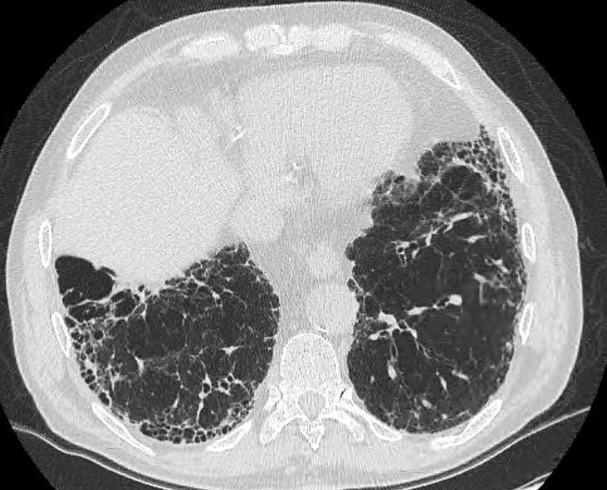
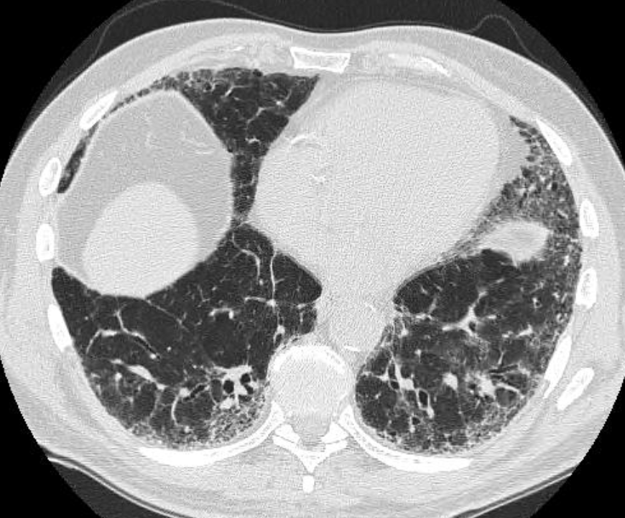
POSSIBLE UIP
Nintedanib: the opportunity to treat a wide spectrum of patients
definite
probable
Raghu, Am J Respir Crit Care Med. 2016

Slide 32
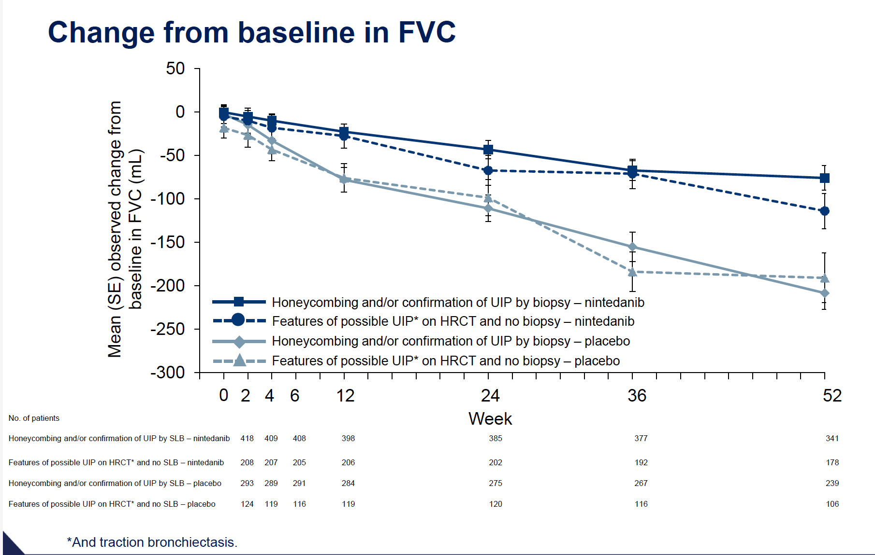
ATS 2015, Meeting Abstracts A1022
Raghu et al, Am J Respir Crit Care Med. 2016

Slide 33
A MINORITY OF PATIENTS WILL AGREE WITH GUIDELINES SUGGESTIONS

Slide 37
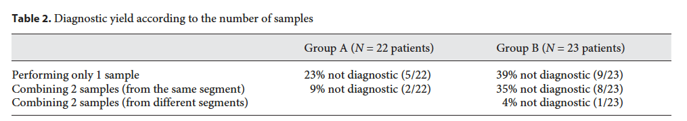
Diagnostic yield (DY): the impotance of strategy
DY 1 sample only | 69%
DY 2 samples | 78%
DY combining B1 + B3 | 96% | (p= 0.004)
AT LEAST ONE SAMPLE from SEGMENT 1 and ONE SAMPLE from an adjacent SEGMENT
Ravaglia et al, Respiration 2017

Slide 38
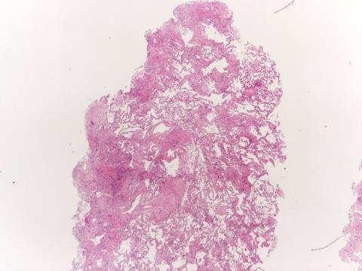
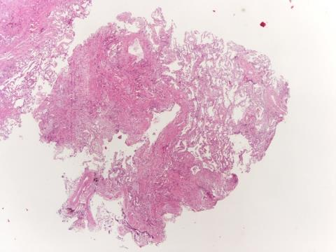
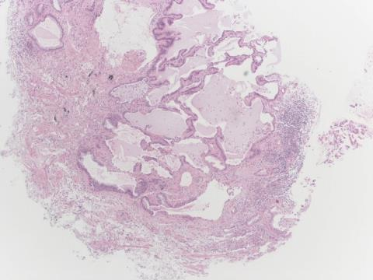
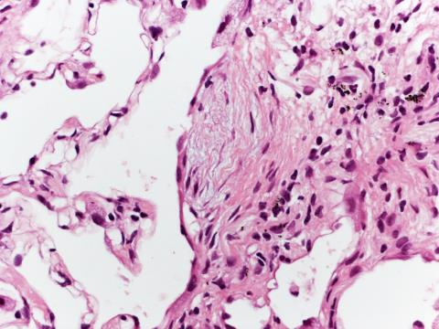
UIP Hi Confidence

Slide 39
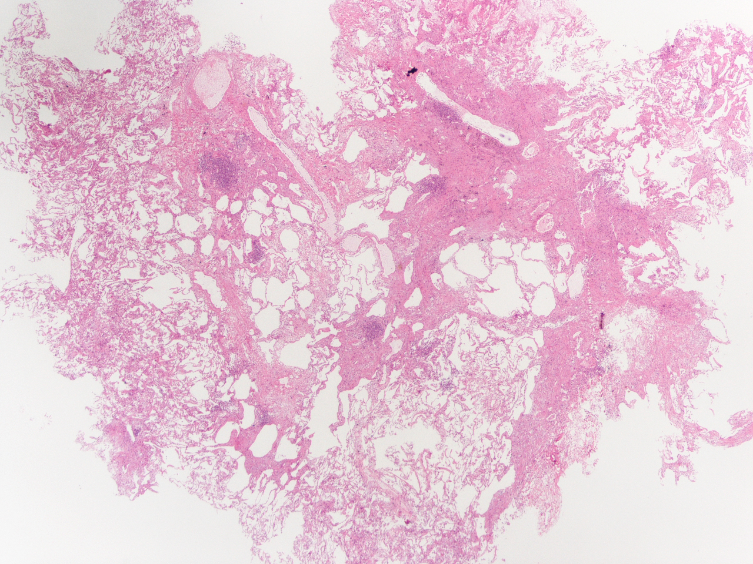
Pathologic interobserver k value>0.70
Tomassetti S et a. AJRCCM, 2016

Slide 41
DPLDs diagnosed by lung Bx performed in the Institute :2008-2016
(POSSIBILITY TO HAVE HISTOLOGICAL DATA in PTS >67 Yrs and with compromised lung function)
GB Morgagni Hospital, Forlì, Italy, Unpublished data

Slide 42
EXPERTS’ OPINIONS AGREEMENT BETWEEN EXPERTS AFTER A SYSTEMATIC ANALYSIS OF LITERATURE

