Slide 1
The lung in blood diseases
Trieste, 2 aprile 2019
Francesco Zaja, SC Ematologia ASUITS

Slide 2
The lung in blood diseases
Infections | Inflammatory | Iatrogenic | Neoplastic
Virus | Chronic GVHD | Antiblastic treatments Radiotherapy | Primary pulmonary lymphoma (PPL) BALT Lymphomatoid G. Other Primary effusion L.
Bacteria | Sarcoidosi | Biological agents (ie. Idelalisib) | Metastatic involvement
Fungal | Other | Immunotherapy (PD1 Inhibitors)
SC Ematologia, ASUITS

Slide 3
Primary pulmonary lymphoma(PPL)
Lymphoid neoplasia with primary involvement of the lung
Heterogenous presentation
Indolent form (BALT lymphoma)
Aggressive form
Rare disease: < 1% of all pulmonary neoplasia
5-10 % of extranodal lymphoma
Main incidence during the sixth decade
Favourably outcome (BALT) if compared with other lymphoma
SC Ematologia, ASUITS

Slide 4
Characteristics at presentation
Incidental finding of one or more pulmonary lesions (asymptomatic patient)
Systemic and/or pulmonary symptoms
Indolent form: possible presentation with either modalities
Aggressive form: frequent symptomatic presentation
SC Ematologia, ASUITS

Slide 5
Possible symptoms at presentation
Cough
Fatigue
Weight loss
Fever
Dyspnea
Hemoptysis
Thoracic pain
SC Ematologia, ASUITS

Slide 6
Distribution of non Hodgkin lymphoma
Diffuse large B-cell 30.6%
Follicular 22.1%
MALT 7.6% (la forma più frequente di PPL= BALT)
Peripheral T-cell 7.0%
Small B-lymphocytic 6.7%
Mantle cell 6.0%
Primary mediastinal large B-cell 2.4%
Others 17.6%
SC Ematologia, ASUITS
NHL Classification Project Blood: 1997

Slide 7
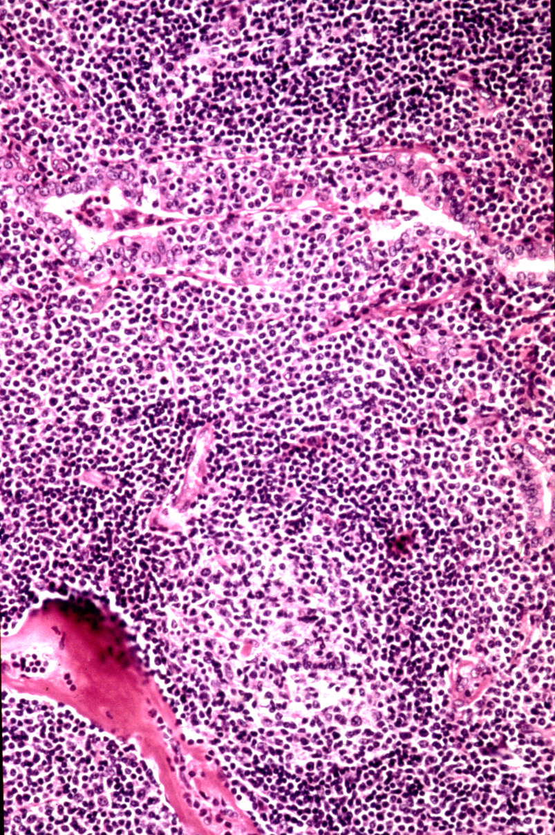
MALT lymphoma
GI Tract 50%
  Stomach 34%
  Intestine 8%
  Stomach & intestine 4%
  GI & non-GI 4%
Head & Neck 11%
Skin 10%
Orbit 10%
Lung (BALT) 9%
Thyroid 4%
Breast 3%
Multiple non-GI 3%
BALT
SC Ematologia, ASUITS
Thieblement & Coiffier 2004, Zucca et al Blood 2003

Slide 8
BALT lymphoma
BALT lymphoma is the most common type of PPL (70-80%)
SEER registry between 2001-2009; 8821 extranodal MALT were registered and 680 (8%) were pulmonary
Slighly more common in females
Associated with autoimmune disease (Sjogren syndrome)
Monoclonal gammapathy may be associate
30% asymptomatic
Histologic transformation of pulmonary BALT lymphoma into high grade tumor has been revealed in approximately 15% of cases
SC Ematologia, ASUITS

Slide 9
Sammassimo et al Hemat Oncol 2016

Slide 10
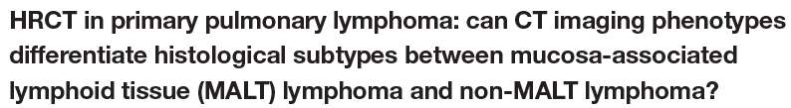
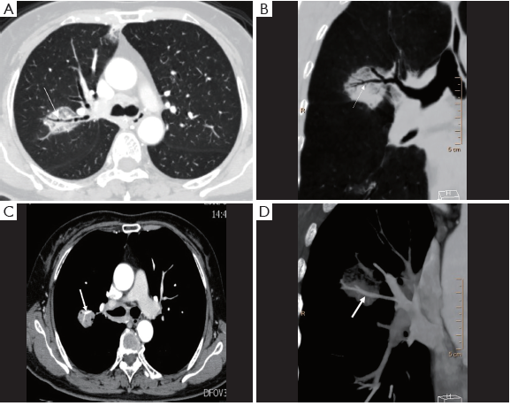
1. Nodular or mass-like
involvement
- air bronchogram
- CT angiogram sign
SC Ematologia, ASUITS
Chen et al. J. Thorac Dis 2018

Slide 11
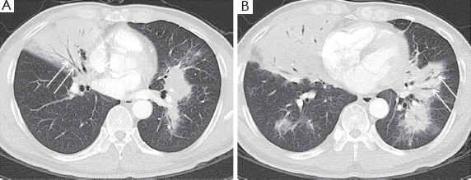
2. Pneumonia-like consolidative patterm
SC Ematologia, ASUITS
Chen et al. J. Thorac Dis 2018

Slide 12
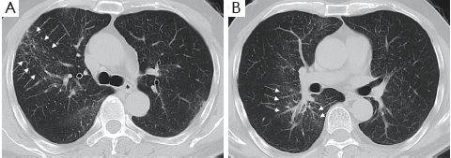
Conclusions:
not characteristic clinical and radiologic
features at presentation
3. Interstitial pattern
SC Ematologia, ASUITS
Chen et al. J. Thorac Dis 2018

Slide 13
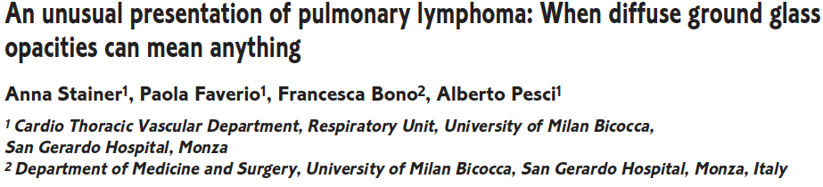
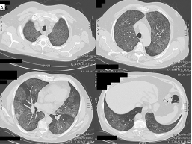
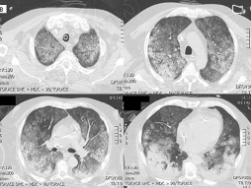
SC Ematologia, ASUITS
Monaldi archives of chest disease 2018

Slide 14

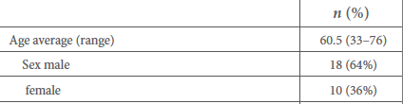
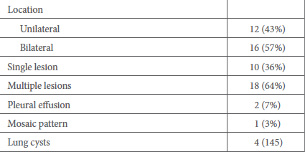
Albano et al 2017

Slide 15
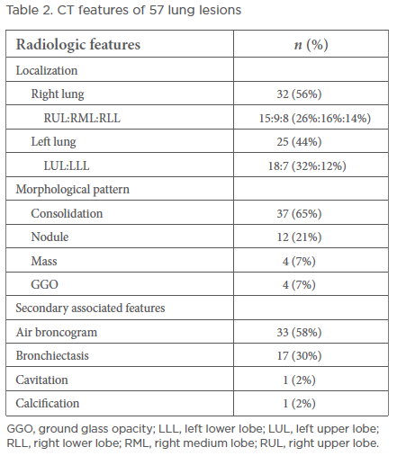
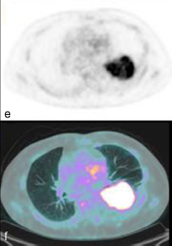
PET features
Patients: 28
Baseline 18F‐FDG PET/CT
positive in 93% patients
positive in 82% lesions
SUV max average: 5.3 (1.1-13)
Albano et al 2017

Slide 16

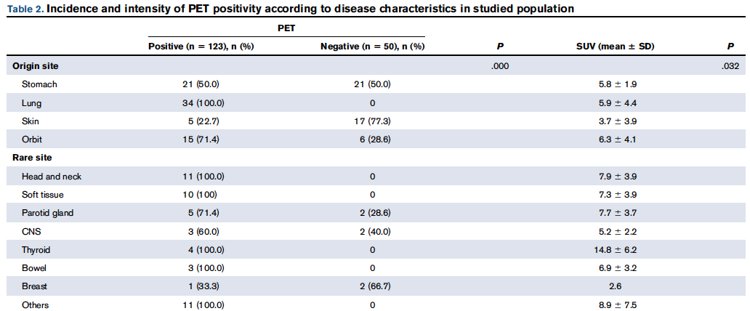
Overall, PET positive in 123 out of 173 MALT (71%); 100% positivity in BALT
The median SUV in the 123 PET positive cases was 6.0 (range: 0.7 to 28.0)
Qi et al. 2018

Slide 17
Indagini patologiche
Agobiopsia transtoracica
Biopsia transbronchiale
Criobiopsia
Toracotomia
Esame citologico, citofluorimetrico, molecolare su BAL
Esame citologico e citofluorimetrico su liquido pleurico
SC Ematologia, ASUITS

Slide 18
SC Ematologia, ASUITS

Slide 19
Lugano Classification, JCO 2014
Diagnosis
Lymphoma reviewed by an experienced lymphoma pathologist
Where appropriate, molecular studies to accurately categorize the lymphoma
A fine needle aspirate is inadequate for initial diagnosis
An incisional or excisional biopsy is preferred
A core needle biopsy can be considered when excisional biopsy is not possible;
however a non-diagnostic sample must be followed by an incisional or
excisional biopsy.
With consent, additional paraffin embedded, fresh frozen tissue, should be
stored for future research.
SC Ematologia, ASUITS

Slide 20
Tipologia di biopsia
Biopsia transtoracica: 22
Biopsia transbrochiale: 26
Chirurgia maggiore: 41
Doppia procedura: 90
Non noto: 26
Sammassimo et al Hemat Oncol 2016

Slide 21
BALT: Bronchus-Associated Lymphoid Tissue
BALT is not present at birth, develops in infants and young children and is again absent in normal healthy adults. It can reappear with antigen stimulation:
- infection
- cigarette smoke
- chronic inflammation
- collagen vascular disease
- AIDS
SC Ematologia, ASUITS

Slide 22
Precursors of MALT lymphoma
Stomach Helicobacter pylori
Small intestine (IPSID) Campylobacter jejuni
Conjunctiva/orbit Chlamydia psittici
Skin Borrelia burgdorferi
Lung Achromobacter xylosoxidans
Many Hepatitis C
Thyroid Hashimoto’s thyroiditis
Salivary gland Sjogren’s disease
SC Ematologia, ASUITS

Slide 23
Pulmonary MALT lymphoma and
Achromobacter (Alcaligenes) Xylosoxidans
Gram negative bacterium
Low virulence
High resistence to antibiotics
Initial study
16S rRNA gene based approach
6/9 cases positive in initial study
Follow up study – 6 European countries (FFPE)
57/124 (46%) MALT lymphoma samples vs 15/82 (18%) control lung tissue (p=0.004)
SC Ematologia, ASUITS
Adam et al Pathologe 2008; BJH 2014

Slide 24
Stadiazione
SC Ematologia, ASUITS

Slide 25
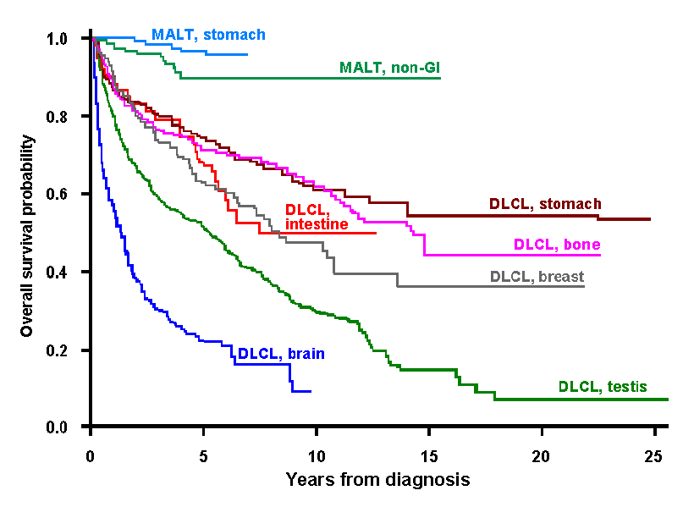
Extranodal Lymphoma Survival by histology and site in the IELSG series
IELSG - INTERNATIONAL EXTRANODAL LYMPHOMA STUDY GROUP
Notes:
20

Slide 26
International Extranodal Lymphoma Study Group - IELSG 19 Randomised Study:
MALT-SPECIFIC PROGNOSTIC INDEX
393 patients
Age > 70 years
Elevated LDH
Ann Arbor stage > 2
Prognostic score
Score 0
Score 1
Score > 1
 | 5-year EFS | 5-year PFS | 5-year OS | P
Score 0 | 72% | 78% | 99% | <.001
Score 1 | 58% | 63% | 92% | <.001
Score > 1 | 26% | 29% | 74% | <.001
SC Ematologia, ASUITS
Thieblemont et al, 13-ICML, Hematol Oncol 2015

Slide 27
How to treat
Treatment choice for PPL should be based on:
Patients’ characteristics, comorbidities
Histology (BALT vs other NHL) and biologic characteristics
Stage
SC Ematologia, ASUITS

Slide 28
Patients: 180
42% chemotherapy (46% with antracyclines)
32% radiotherapy
36% surgery alone
ORR: 93%
CR: 77%
Very long overall survival
(50%)
SC Ematologia, ASUITS
Zucca et al Blood 2003

Slide 29
SC Ematologia, ASUITS
Zucca et al Blood 2003

Slide 30
Three retrospective study
French study: 59 patients
Mayo Clinic: 48 patients
Italian study: 12 patients
CT
RT
Surgery
Combination
None of the therapeutic modalities are superior in term of outcome
The choice of the less toxic treatment is mandatory
SC Ematologia, ASUITS

Slide 31
Final Trial Profile
International Extranodal Lymphoma Study Group - IELSG 19 Randomised Study
SC Ematologia, ASUITS
E. Zucca, 12-ICML, Hematol Oncol 2013. 31(suppl 1):97. Abs 007
Notes:
When the study was initially designed a bit more than a decade ago, single agent Chlorambucil a was considered the standard treatment for indolent lymphomas and single alkylating agents were the only cancer drugs with published data on their specific activity in MALT lymphomas. The study was initially powered to detect a 20% EFS improvement.
After completion of the planned accrual of the 2-arm initial study (n=250, primary endpoint, EFS for all pts), a third arm (i.e., rituximab alone) was introduced with randomization among chlorambucil alone, chlorambucil plus
rituximab and rituximab alone, with an allocation ratio of 1 : 1 : 6.
200 additional pts (for a total of 450) were to be included to have a study powered to compare each of the 2 experimental arms against chlorambucil alone (with alpha 0.05 and 80% power).
The 2-arm analysis in the first 250 pts should to be reported first but recruitment of all 450 pts shoul be completed before any report.

Slide 32
IELSG-19 trial- Treatment arms
(452 patients enrolled)
Zucca et al. JCO 2012
Notes:
32
20

Slide 33
Event-Free Survival
International Extranodal Lymphoma Study Group - IELSG 19 Randomised Study
5-year EFS (95%CI):
Chlorambucil, 52% (42%-60%)
R-Chlorambucil, 70% (61%-77%)
Rituximab, 51% (40%-61%)
SC Ematologia, ASUITS
E. Zucca, 12-ICML, Hematol Oncol 2013. 31(suppl 1):97. Abs 007
Notes:
EFS was the primary endpoint
The study was powered to detect a 20% improvement comparing each experimental arm against chlorambucil alone (with alpha=0.05 and power=80%)

Slide 34
Overall Survival
International Extranodal Lymphoma Study Group - IELSG 19 Randomised Study
5-year OS (95%CI):
Chlorambucil, 89% (82%-94%)
R-Chlorambucil, 89% (82%-94%)
Rituximab, 94% (86%-97%)
SC Ematologia, ASUITS
E. Zucca, 12-ICML, Hematol Oncol 2013. 31(suppl 1):97-98. Abs 007

Slide 35
60 pts
MALT any site, any stage
2-years EFS: 93%
4-years EFS: 88%
SC Ematologia, ASUITS
A. Salar, 12-ICML, Hematol Oncol 2013; Lancet Haematol 2014

Slide 36
PLL: Take home messages (1)
Malattia rara
Presentazione clinica e Rx non specifica
Diagnosi non sempre facile (DD con forme infiammatorie e/o altri
linfomi)
Approccio multidisciplinare (pneumologo, ematologo, radiologo, patologo)
La diagnosi deve essere fatta mediante esame istologico
(esame citologico non sufficiente)
Importanza valutazione da parte di patologo esperto nella
diagnostica dei linfomi
Stadiazione tradizionale (TAC e BOM); PET ?
PET nelle forme DLBCL

Slide 37
PLL: Take home messages (2)
Le forme BALT sono le più frequenti
Presentazione indolente, lunga sopravvivenza a prescindere dalla
scelta terapeutica
Scelta terapeutica in base a caratteristiche del paziente e stadio
malattia (da osservazione a terapia sistemica)
Pochi studi controllati
Bendamustina rituximab oggi probabilmente il programma tx
più adottato ed efficace
Nuovi farmaci biologici disponibili
Trattamento delle forme aggressive (DLBCL) = alle forme sistemiche
(R-CHOP)

