Slide 1
ICS/LABA: Il Razionale di Impiego nel Trattamento dell’Asma e della BPCO
Alfredo Chetta
Sezione di Clinica Pneumologica
Dipartimento di Scienze Cliniche
Università degli Studi di Parma
chetta@unipr.it

Slide 2
Asthma pathophysiology
Smooth Muscle
Dysfunction
Airway
Inflammation
Airway
Remodelling

Slide 4
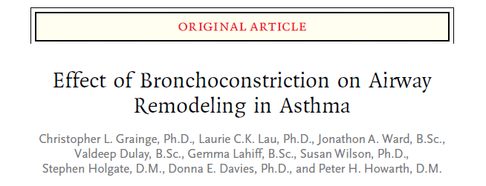
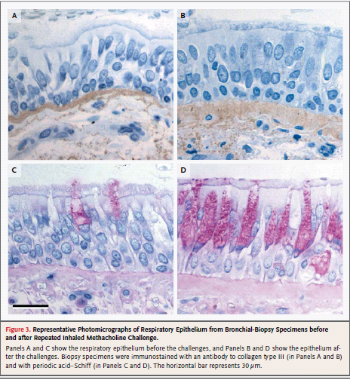

Slide 5
A comparative study of the effects of an inhaled corticosteroid, budesonide, and a beta₂-agonist, terbutaline, on airway inflammation in newly diagnosed asthma: a randomized, double-blind, parallel-group controlled trial.
E
E
BM
BM
Pre and post 3 month treatment with BUD 600 µg bd
Laitinen JACI 1992

Slide 7
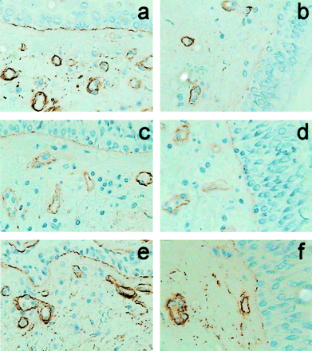
Vascular Remodeling in Asthma is Reduced
by High Dose of Fluticasone
Patient
with Asthma
Healthy
Volunteer
Patient before
FP 200 mcg
Patient after
FP 200 mcg
Patient before
FP 1000 mcg
Patient after
FP 1000 mcg
Chetta A et al AJRCCM 2003

Slide 8
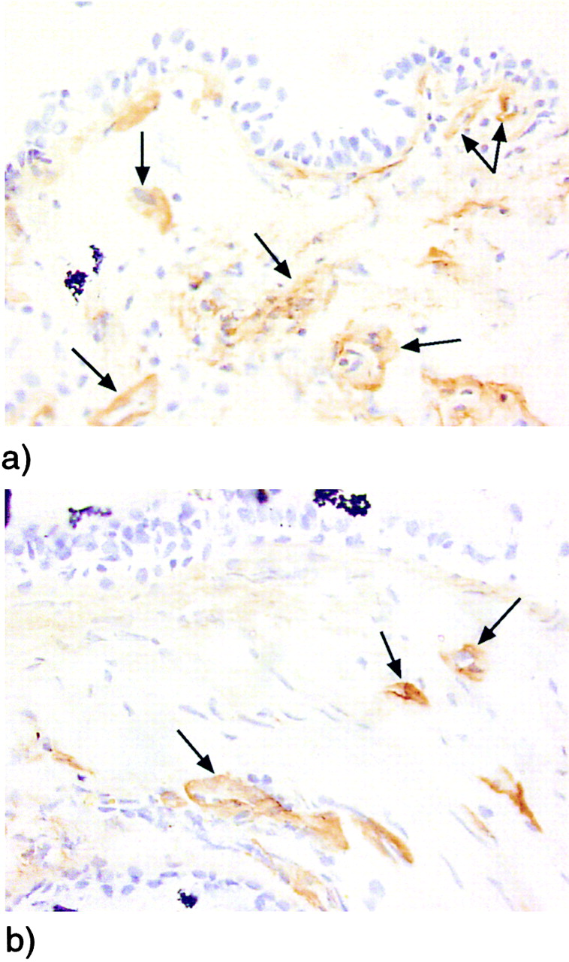
Effect of Salmeterol on Airway
Wall Vascular Remodeling in Asthma
Patient treated with low dose ICS
After 3 mo treatment
with supplementary salmeterol
Orsida et al AJRCCM 2001

Slide 9
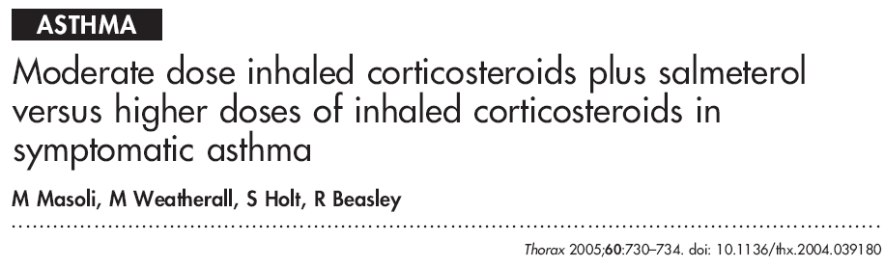
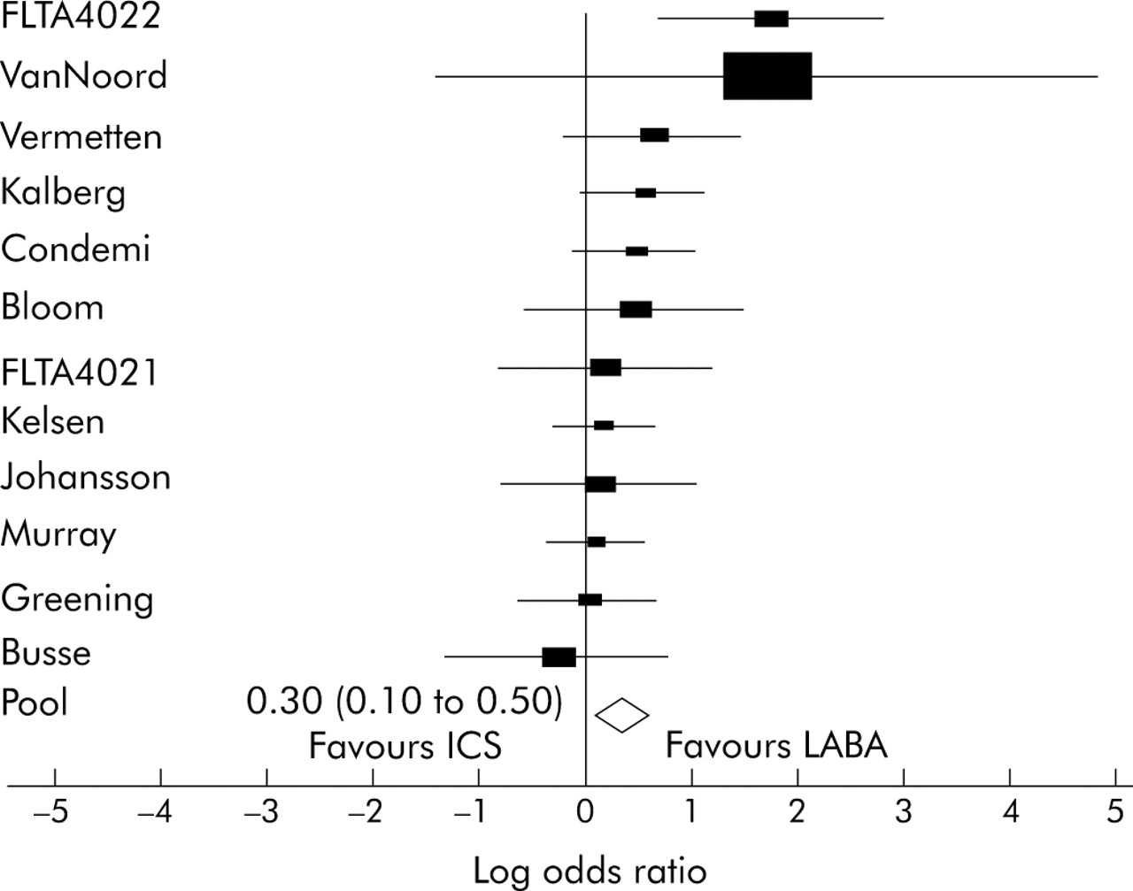
Odds ratio for number of subjects with one or more moderate or severe exacerbation

Slide 10
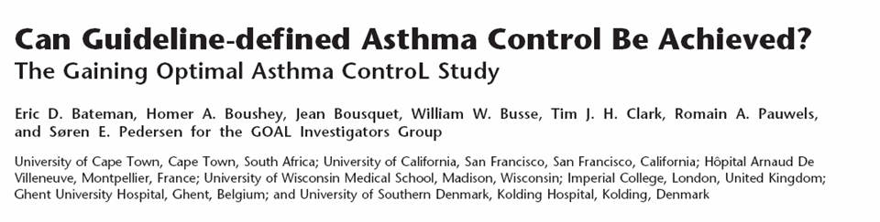
Well Controlled Asthma Achieved with Sustained Treatment
FP Phase II
Seretide Phase II
FP Phase I
Seretide Phase I
80
78%*
75%**
70%
Patients (%)
62%**
60%
60
47%
40
20
0
Steroid-naive (S1)
Low-dose ICS (S2)
Moderate-dose ICS (S3)
* P = 0.003
** P < 0.001
GOAL Study, Bateman E, et al ARJCCM 2004; 170: 836-844

Slide 11
Well Controlled Asthma
Continued Improvements with Sustained Treatment
All strata
100
FP
Seretide
80
60
Patients controlled each week (%)
40
20
0
–4
0
4
8
12
16
20
24
28
32
36
40
44
48
52
Week
GOAL Study, Bateman E, et al ARJCCM 2004; 170: 836-844

Slide 12
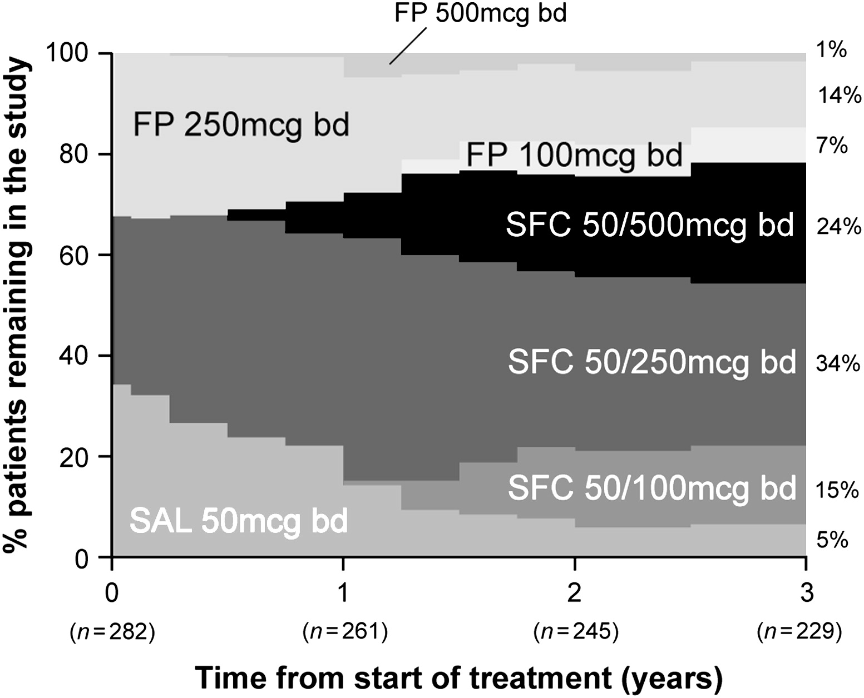
Asthma control over 3 years in a real-life study
Lundback B. et al. Resp Med 2009; 103:348-55
Notes:
12
Gli asmatici che iniziavano il trattamento con la combinazione Fluticasone/SALM avevano una minore probabilità di cambiare terapia a causa del cattivo controllo dell’asma rispetto a quelli in trattamento con il solo ICS o con LABA
Alla fine del periodo di osservazione rimanevano nello studio:
il 73 % (168/229) degli asmatici trattati con l’associazione SALM/FP
Il 21% (49/229)degli asmatici trattati con FP
Il 5 %(12/229) degli asmatici trattati con SALM
I dati di questo studio mettono in evidenza che:
gli asmatici che iniziavano il trattati con l’associazione SALM/FP avevano meno probabilità di richiedere un aumento del dosaggio del farmaco rispetto agli asmatici trattati con FP o SALM
solo il 21% degli asmatici trattati con FP e il 5% di quelli trattati con SALM raggiungevano il controllo.

Slide 13
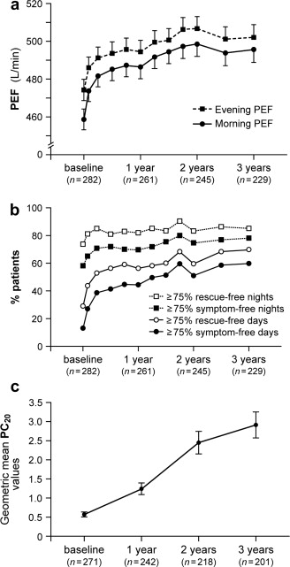
Asthma control over 3 years in a real-life study
Lundback B. et al. Resp Med 2009; 103:348-55

Slide 14
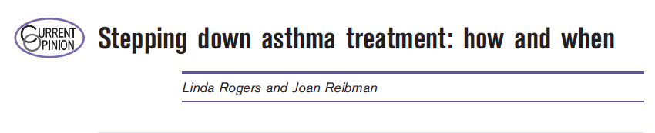

Slide 15
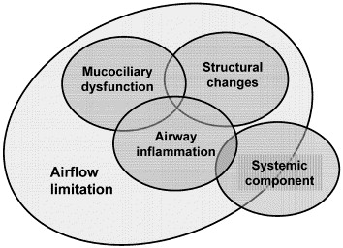
The Multicomponent Nature of COPD
Agusti AGN, 2005

Slide 16
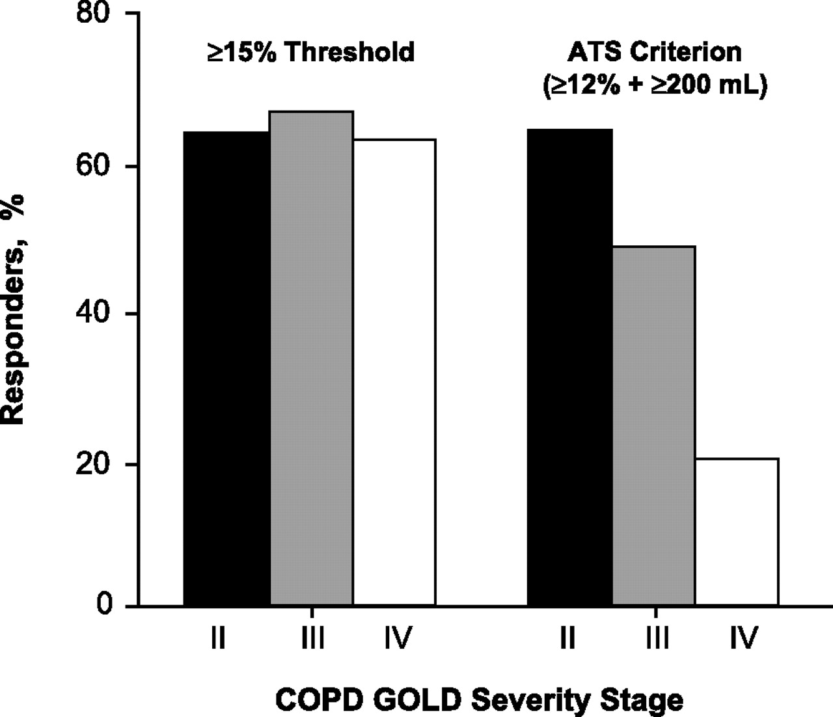
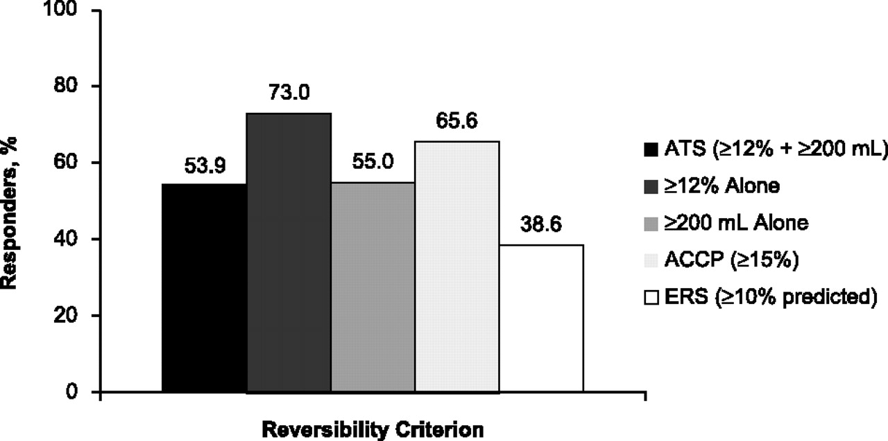
Bronchodilator Reversibility in COPD
Tashkin et al, ERJ 2008

Slide 17

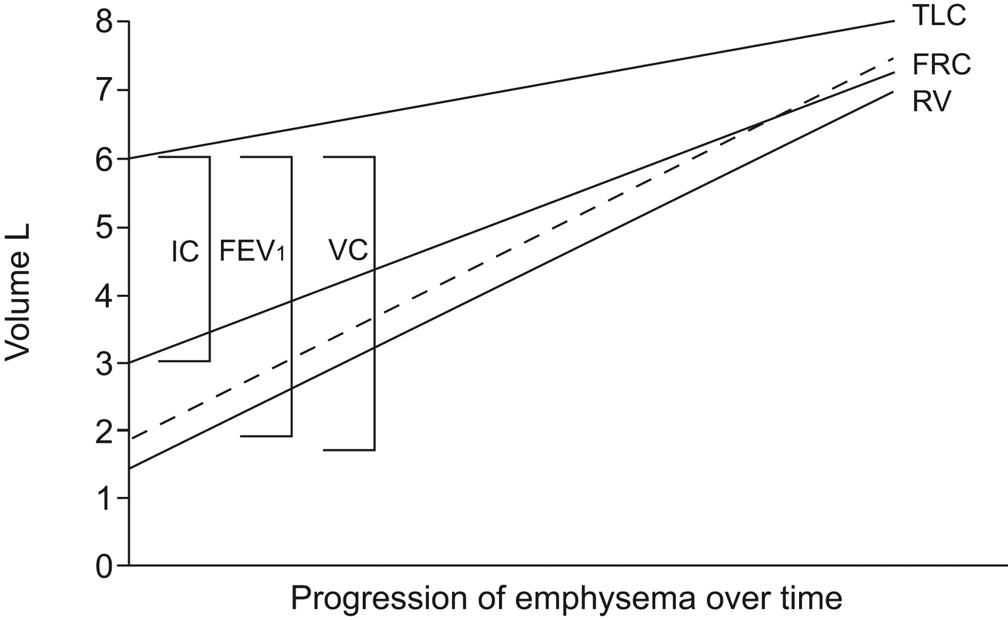
Notes:
Progressiva riduzione della riserva ventilatoria

Slide 18
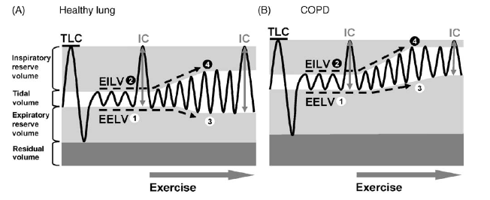
Dynamic Hyperinflation
with Exercise in COPD

Slide 19
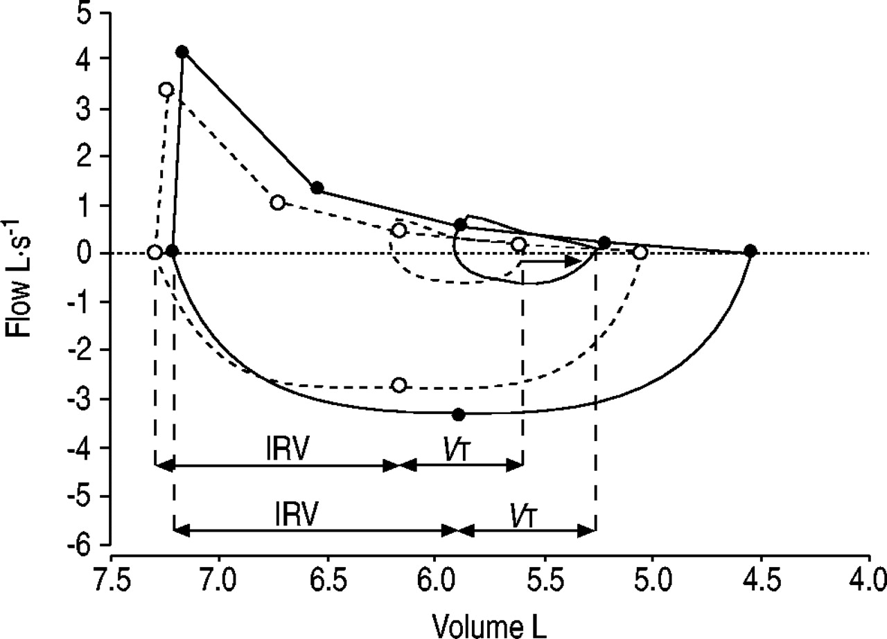

Slide 20
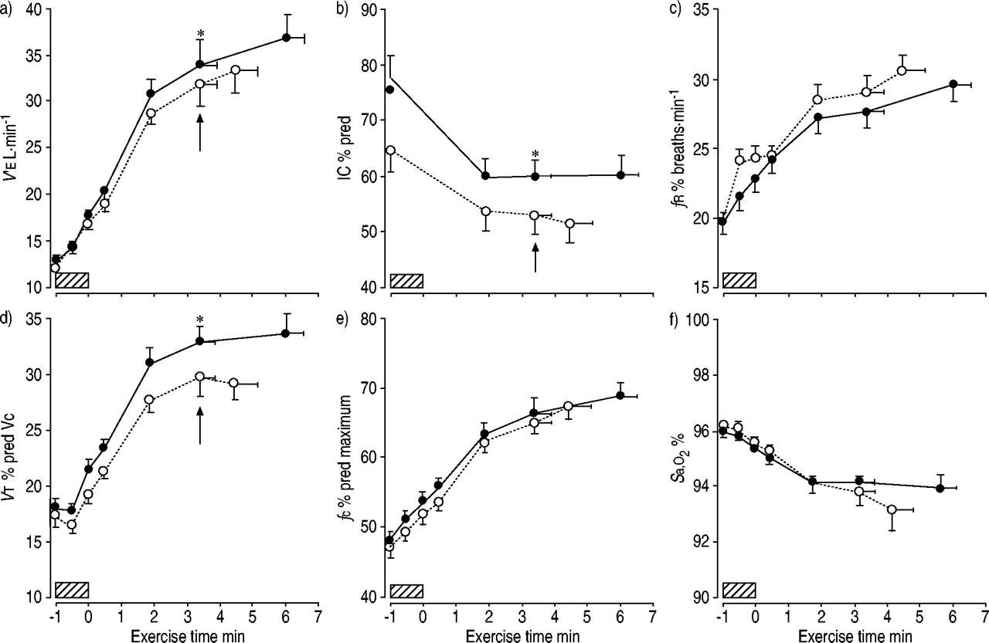

Slide 21
The Nature of Small-Airway Obstruction in COPD
Hogg et al, NEJM 2004

Slide 22
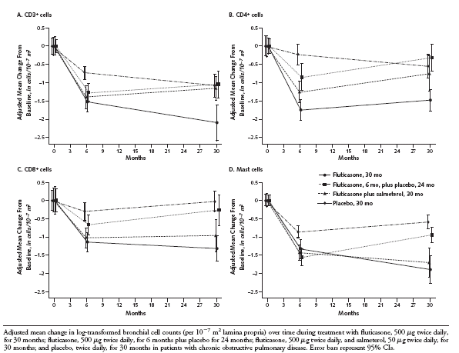
GLUCOLD Study. Pathologic Outcomes
Lapperre et al, Ann Intern Med 2009

Slide 23

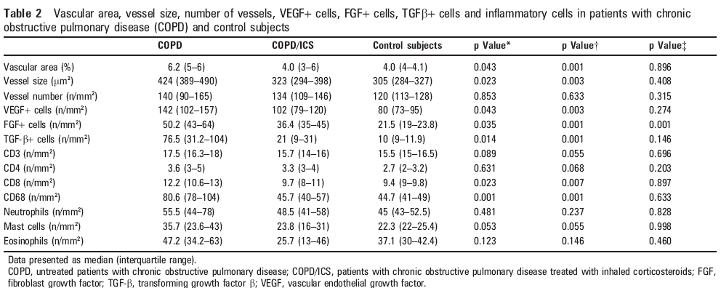

Slide 24
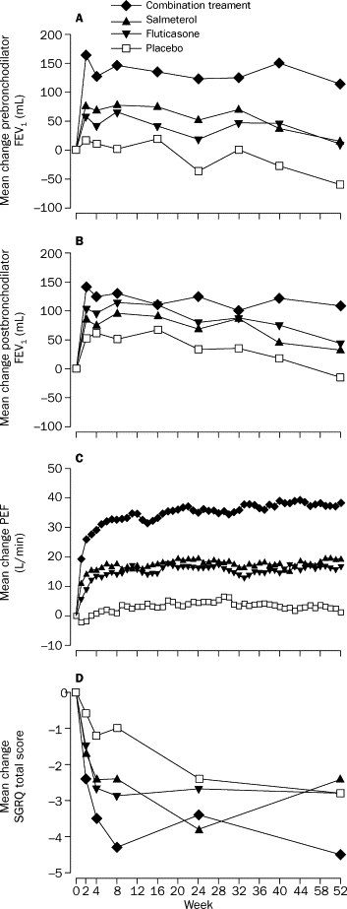
Tristan Study. Effect of Treatment
on Lung Function and Health Status
Calverley P et al, Lancet 2003

Slide 25
TORCH Study: Tasso di riacutizzazioni moderate o gravi in 3 anni
Numero medio di riacutizzazioni/anno
Riduzione del 25%
1.2
1.13
1
0.97*
0.93*
0.85*†‡
0.8
0.6
0.4
*p < 0.001 vs placebo;
†p = 0.002 vs SALM;
‡p = 0.024 vs FP
0.2
0
Placebo
SALM
FP
SALM/FP
Trattamenti
Calverley et al., N Engl J Med 2007
Notes:
24/03/2012 12:43
25
Moderate exacerbations are defined as those which require treatment with systemic corticosteroids and/or antibiotics; severe exacerbations are defined as those which require hospitalisation. The exacerbation rate was calculated as the total number of moderate and/or severe exacerbations experienced by a patient during the treatment period.
The number of exacerbations was analysed using a generalised linear model, assuming the Negative Binomial distribution, with time on treatment as an offset variable. The model included adjustments for the effects of smoking status, age, gender, baseline FEV₁, number of exacerbations reported in the 12 months prior to screening, and region.
SALM/FP significantly lowered the rate of moderate/severe exacerbations compared with placebo (25% reduction, p < 0.001), SALM (12% reduction, p = 0.002) and FP (9% reduction, p = 0.024). SALM and FP also had significantly lower exacerbation rates than placebo (15%, p < 0.001 and 18%, p < 0.001, respectively).
SALM/FP reduced the rate of moderate-to-severe exacerbations to a much greater extent than placebo or either of the component monotherapies.
Exacerbations and hospitalisations predict the risk of dying from COPD over 5 years.¹
Reference
Soler-Cataluna JJ, Martinez-Garcia MA, Roman Sanchez P, et al. Severe acute exacerbations and mortality in patients with chronic obstructive pulmonary disease. Thorax 2005;60:925–31.

Slide 26
TORCH Study: declino del FEV₁ in 3 anni
(analisi post hoc)
Controllo
SALM
FP
SALMm/FP
1350
1300
1250
1200
1150
1100
FEV₁ (mL)
–39 mL/yr
–42 mL/yr
–42 mL/yr
–55 mL/yr
0 24 48 72 96 120 156
Tempo (settimane)
Celli et al. Am J Respir Crit Care Med 2008
Notes:
26

Slide 27
INSPIRE STUDY. Time to Withdrawal
Probability of withdrawal prior to wk 104 SFC 34.5% TIO 41.7%
44
40
TIO 18
36
SFC 50/500
32
28
24
Probability of Event (%)
20
16
12
8
4
Number
at Risk
0
656 560 531 510 494 476 456 445 160 SFC 50/500
663 547 501 474 450 434 415 397 140 TIO 18
0 13 26 39 52 65 78 91 104
Time to Event (Weeks)
Cox Hazard Ratio 95% CI p-value
SFC vs TIO 0.776 (0.651, 0.926) 0.005
Wedzcha et al AJRCCM 2008
Notes:
27

Slide 28
INSPIRE STUDY. Mortality Rate
8
Tio (6%)
7
6
52% RRR
p=0,012
(Cox analysis)
5
Probability of Event (%)
4
3
SFC (3%)
2
1
0
0
13
26
39
52
65
78
91
104
Time to Event (Weeks)
Wedzicha JA et al, AJRCCM, 2008

Slide 29
