Slide 1
Coinvolgimento polmonare nella sclerosi sistemica
Marco Matucci Cerinic
Departments of Rheumatology AVC
BioMedicine & Division of Rheumatology AOUC
Medicine, Denothe Center
University of Florence

Slide 2
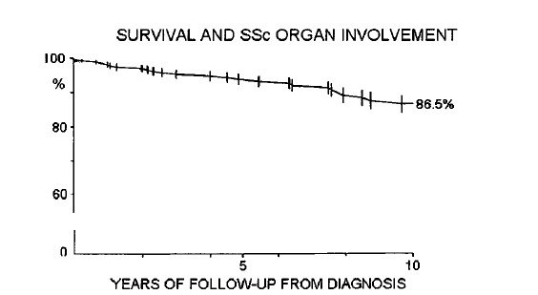
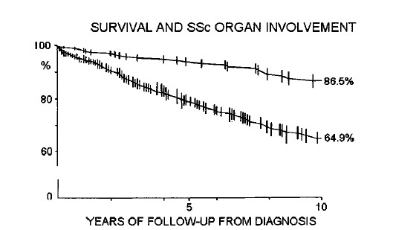
The impact of ILD in Systemic Sclerosis
SSc
SSc-ILD
Ferri C et. al. Medicine 2002;81:139

Slide 3
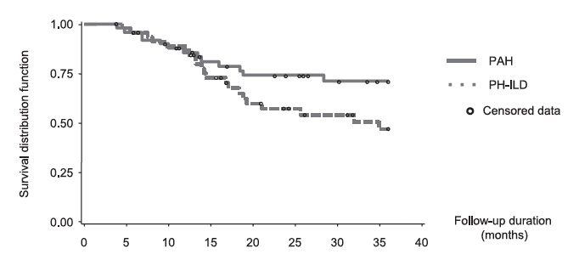
The impact of ILD in SSc with PH
Launay et al, Chest 2011 140 (4):1016-1024

Slide 4
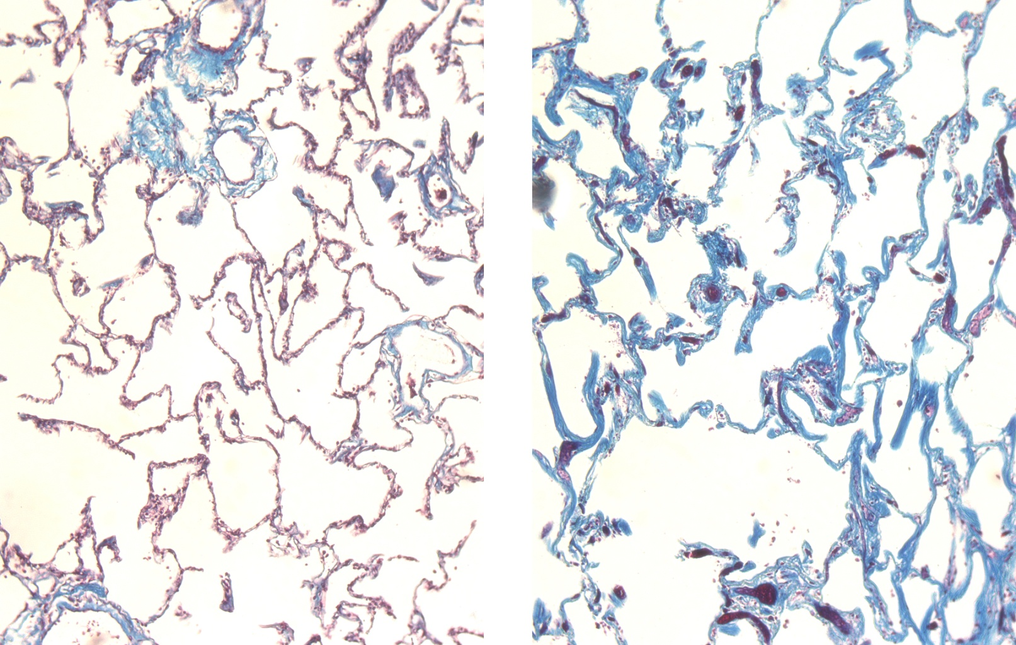
Lung Fibrosis in Scleroderma Impairs Gas Exchange
NORMAL
SCLERODERMA

Slide 5
The disease evolution
lung, heart, GI, kidney
skin
thickness
intermediate
early
late
DIFFUSE SSc
pulmonary hypert., malabsorption
intermediate
late
LIMITED SSc
early
2 5 10 20
disease duration (years)
Medsger T & Steen V, Systemic Sclerosis, 1995, p 51,Williams & Wilkins

Slide 6
Pulmonary function testing
lung volumes
spirometry (pre, post inhaled BD)
conductance/resistance
DLCO
pressure-volume curve

Slide 7
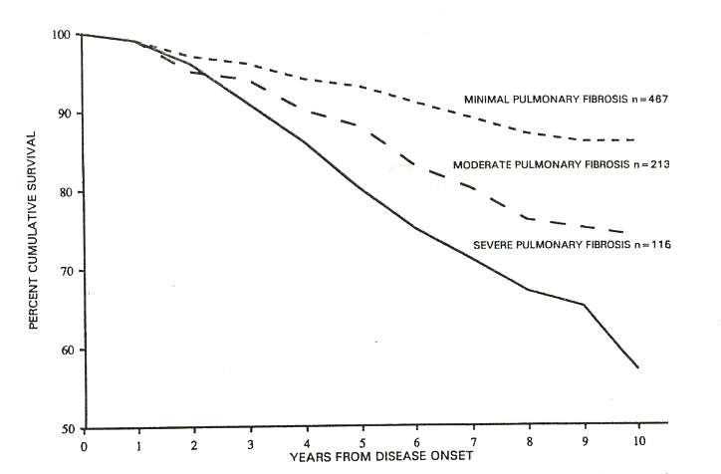
Severity of restriction predicts survival in SSc
Steen VD et al, Arthritis Rheum 1994;37:1283

Slide 8
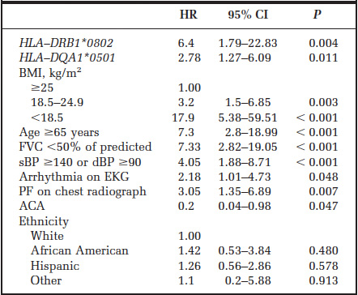
Predictors of Mortality in Early Scleroderma
Assassi et al, Arthritis Rheum 2009

Slide 9
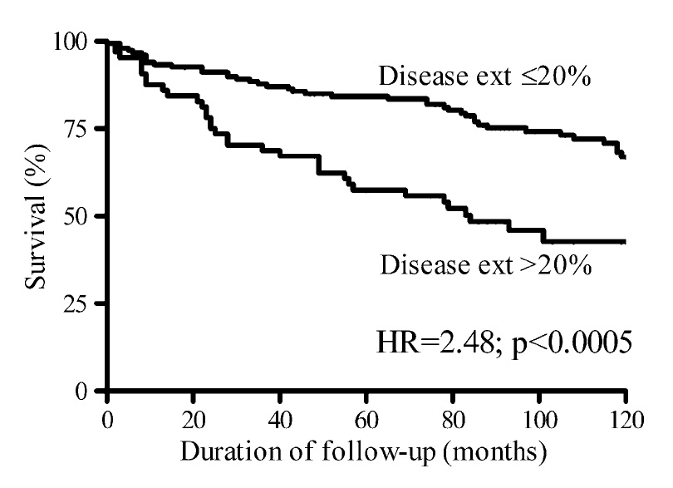
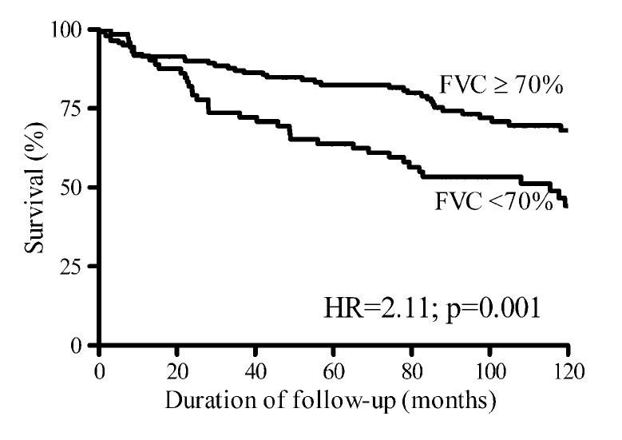
FVC % predicts survival in SSc
Goh et al, Am J Respir Crit Care Med 2008, 177:1248

Slide 10
LUNG-DLco
Dlco is the available technique that seems to best reflect the histopathologic alterations, shown at open-lung biopsy, and correlates with pulmonary disease extension in SSc.
Harrison & al Am Rev Resp Dis 1991,144,706

Slide 11
LUNG-DLco
Diffusing capacity for carbon monoxide is a fundamental tool for the evaluation of alveolo-capillary wall alterations
This technique correlates better than other traditional lung functional tests (FEV, FVC, TLC) with the extent of fibrosing alveolitis detected on lung CT scan
(Wells et al Arthritis Rheum 1997,40,1229 ).

Slide 12
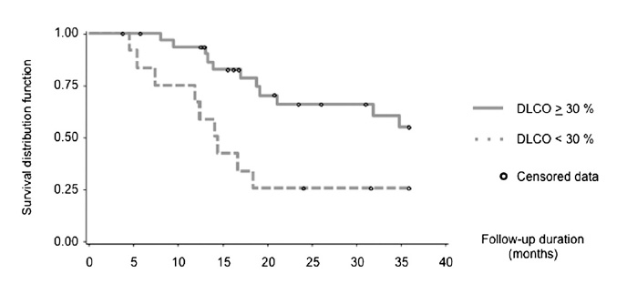
A low DLCO predicts mortality in SSc
Launay et al, Chest 2011 140 (4):1016-1024

Slide 13
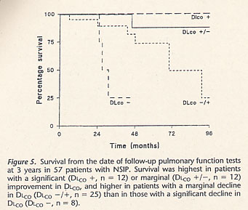
Bouros et al Am J Resp Crit Care Med 2002,165,1581

Slide 14
Serial changes in pulmonary physiology
Bouros D et al, Am J Resp Crit Care Med 2002;165:1581

Slide 15
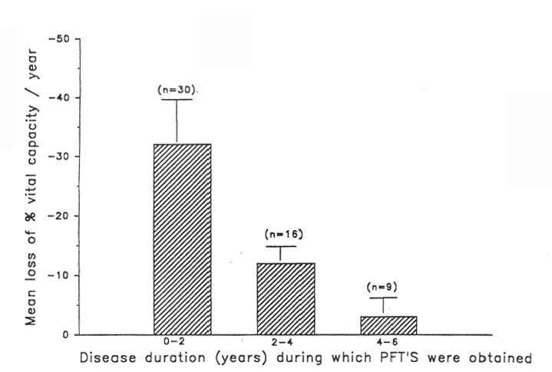
Loss of volume often occurs early in the disease
Steen VD et al, Arthritis Rheum 1994;37:1283

Slide 16
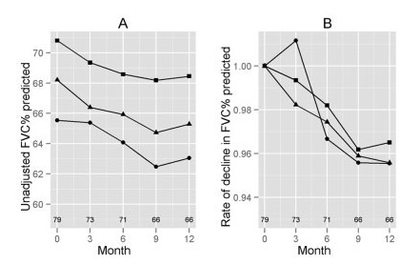
Loss of volume may occur throughout disease course
Khanna D et al, Arthritis Rheum 2011, 63(10):3078-85.

Slide 17
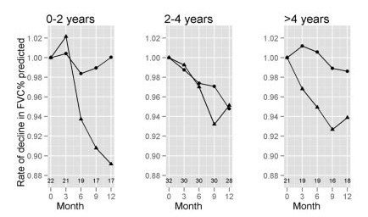
…and may be dependent upon disease extent
Khanna D et al, Arthritis Rheum 2011, 63(10):3078-85.

Slide 18
HRCT disease extent predicts survival in SSc
Goh et al, Am J Respir Crit Care Med 2008, 177:1248

Slide 19
The disease evolution
lung, heart, GI, kidney
skin
thickness
intermediate
early
late
DIFFUSE SSc
pulmonary hypert., malabsorption
intermediate
late
LIMITED SSc
early
2 5 10 20
disease duration (years)
Medsger T & Steen V, Systemic Sclerosis, 1995, p 51,Williams & Wilkins

Slide 20
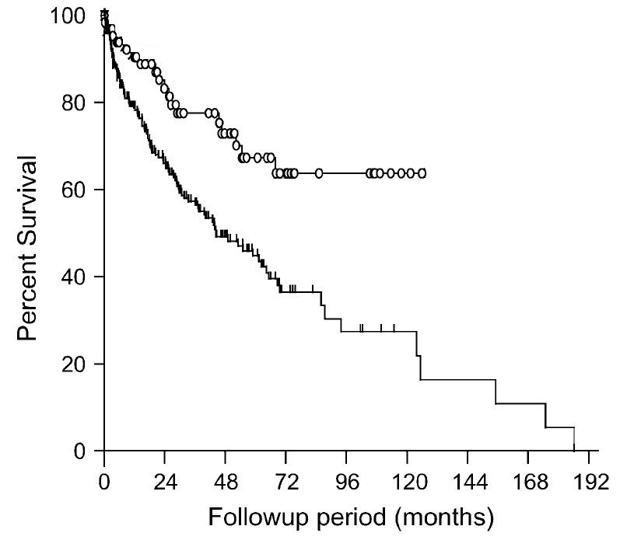
Why the pathologic pattern matters ?
Nonspecific interstitial pneumonia (NSIP)
Usual Interstitial Pneumonia (UIP)
Park et al, Am J Respir Crit Care Med, 2007;175:705

Slide 21
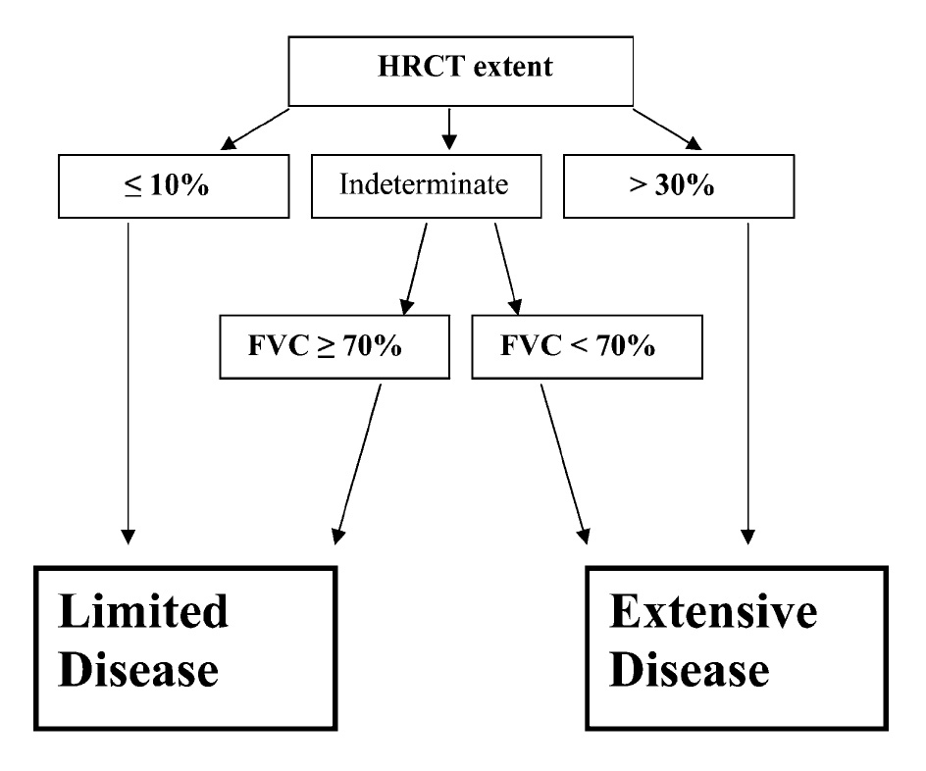
Definition of disease extent in SSc
Goh et al, Am J Respir Crit Care Med 2008, 177:1248

Slide 22
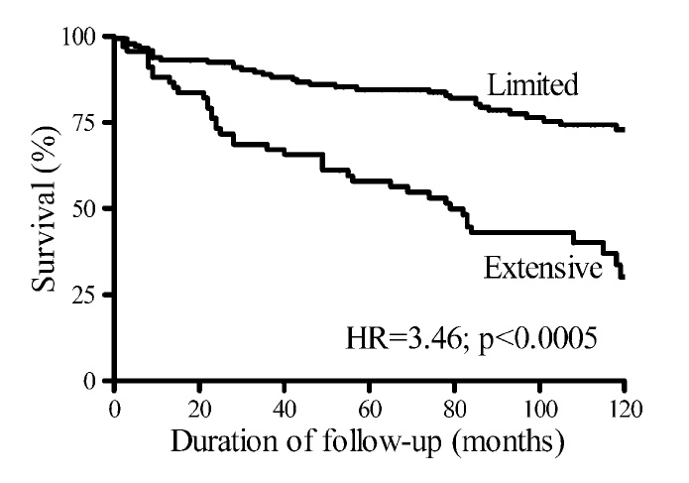
Extent of disease predicts survival in SSc
Goh et al, Am J Respir Crit Care Med 2008, 177:1248

Slide 23
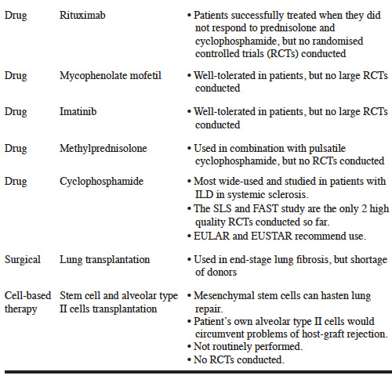
Tan et al, Clin Exp Rheumatol 2011:29(Suppl 65):S66-S74

Slide 24
Summary
Interstitial lung disease is common in Systemic sclerosis but not all patients will present with clinically significant disease
Its presence is most sensitively determined by performing an HRCT
Disease extent by physiology and chest imaging predicts likelihood of progression
Even in the absence of chest symptoms, pulmonary physiology and chest imaging provide clinically useful information.

