Slide 1
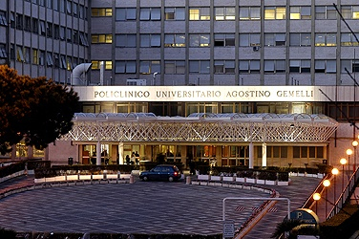
La BPCO nei non fumatori
Riccardo Pistelli
Università Cattolica - Roma

Slide 2

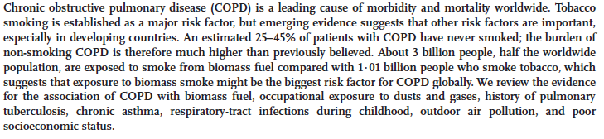

Slide 3
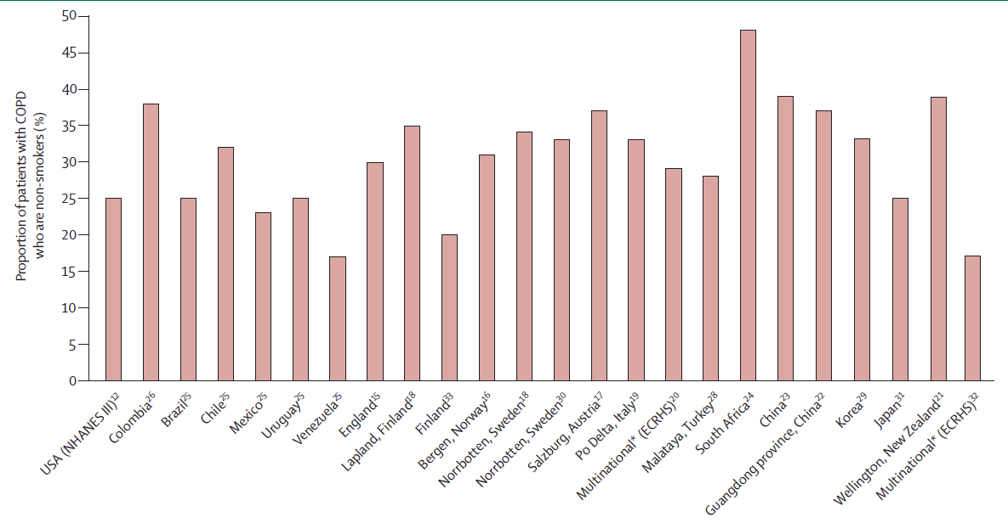

Slide 4
Abitudine al fumo di sigaretta
Pistelli R et al. Tendenze Nuove 2006

Slide 7







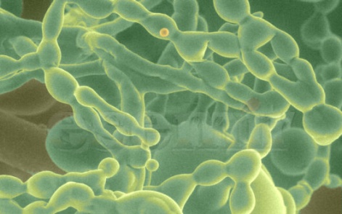
Indoor air pollution evolution
House
dust mites
Individuals spend up to 90% of their time indoors
House
Office/School
Transports
Where:
  More pollutants
  Concentrations (higher than outdoors)
  Environment is confined
Increased indoor air pollution?
Few data on their evolution but… likely increased exposure to indoor air pollutants due to modern lifestyle.
NO₂
Mould

Slide 8
Trans R Soc Trop Med Hyg. 2008 Sep;102(9):843-51. Epub 2008 Jul 17.
Indoor air pollution from biomass fuel smoke is a major health concern in the developing world.
Fullerton DG, Bruce N, Gordon SB.
Liverpool School of Tropical Medicine, Pembroke Place, Liverpool L3 5QA, UK. duncan.fullerton@liverpool.ac.uk
Abstract
One-third of the world's population burn organic material such as wood, dung or charcoal (biomass fuel) for cooking, heating and lighting. This form of energy usage is associated with high levels of indoor air pollution and an increase in the incidence of respiratory infections, including pneumonia, tuberculosis and chronic obstructive pulmonary disease, low birthweight, cataracts, cardiovascular events and all-cause mortality both in adults and children. The mechanisms behind these associations are not fully understood. This review summarises the available information on biomass fuel use and health, highlighting the current gaps in knowledge.

Slide 10
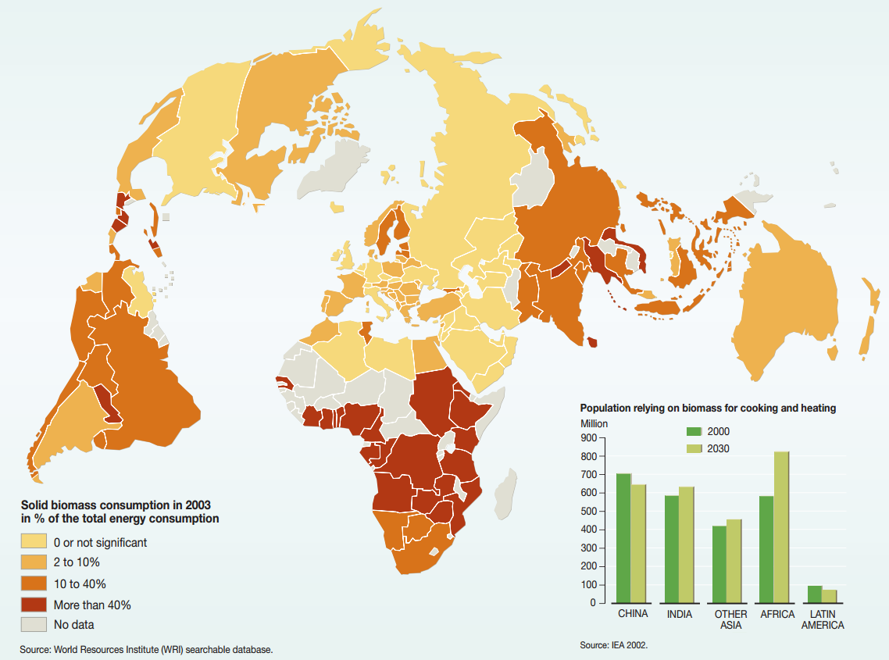

Slide 11
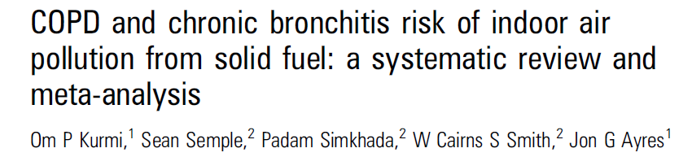
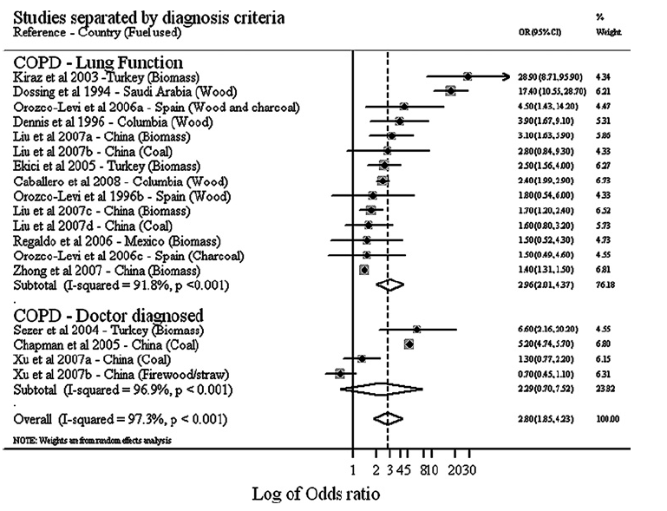

Slide 12
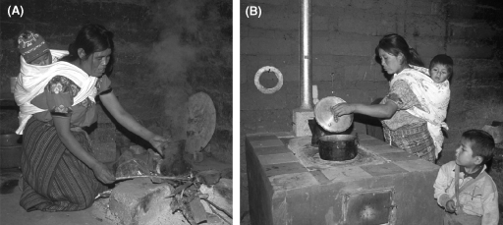
Biomasse

Slide 13
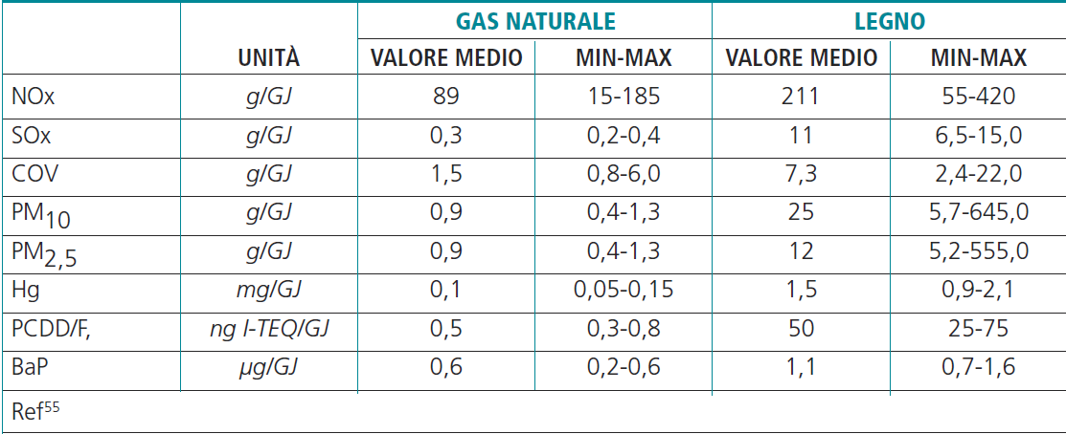
Johansson LS, C Tullin, B Leckner, P Sjovall. Particle emissions from biomass combustion in small combustors. Biomass and Bioenergy 2003;25(4):435-446.

Slide 14
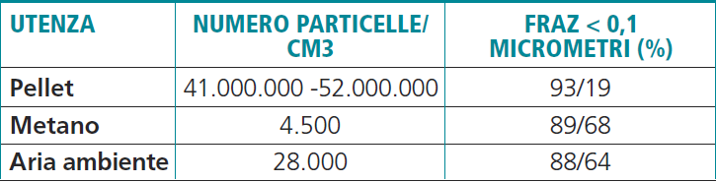
Cernuschi S, M Giugliano, S Consonni. Emissioni di polveri fini e ultrafini da impianti di combustione. 2009. http://www.gecos.polimi.it

Slide 15
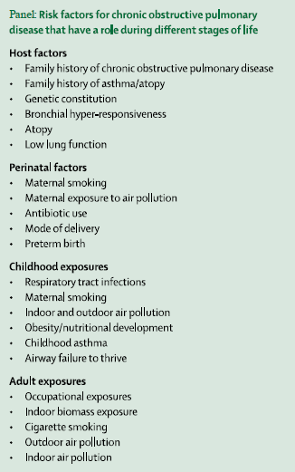

Slide 16
The long history of living in a dangerous environment
The natural catastrophes (up to the early decades of the 19° century AD)
The urban environment in the industrial revolution era (19°-20° century)
The urban environment and the indoor air quality in the last decades
What in the future?

Slide 17
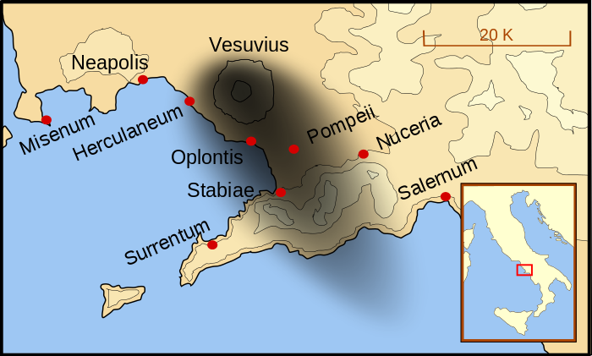
AD 79

Slide 18
A fatal case during a critical environmental episode of pollution
(Vesuvius area, 79 AD)
“Innitentis servolis duobus assurrexit et statim concidit, ut ego colligo, crassiore caligine spiritu obstructo, clausoque stomacho qui illi natura invalidus et angustus et frequenter aestuans erat.”
Plinius Juvenis, to Tacitus, 105 AD.

Slide 19
Urban pollution in the 19° century
Even in the surrounding country it was a foggy day, but there the fog was grey, whereas in London it was, at about the boundary line, dark yellow, and a little within it brown, and then browner, and then browner, until at the heart of the City-which call Saint Mary Axe- it was rusty-black.
Charles Dickens, Our Mutual Friend, 1865

Slide 20
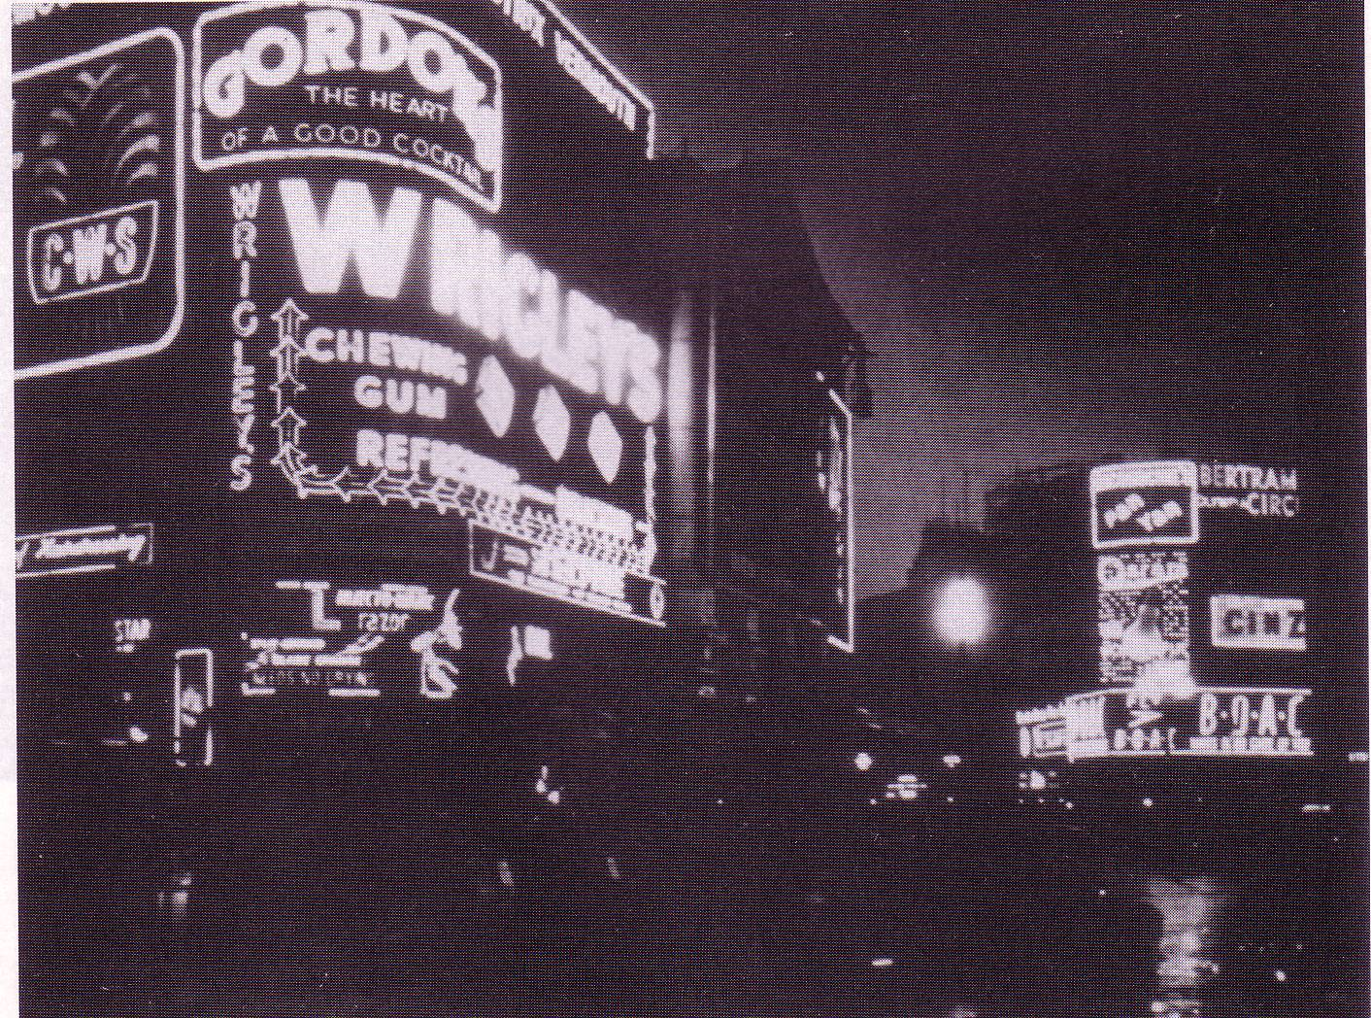

Slide 21
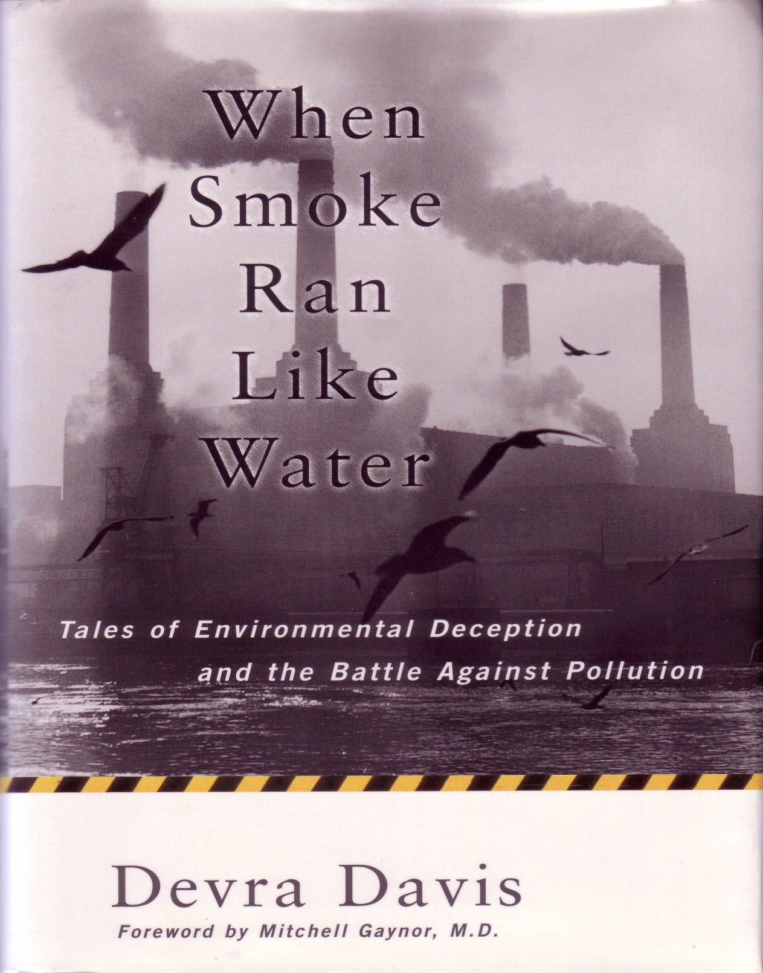

Slide 22
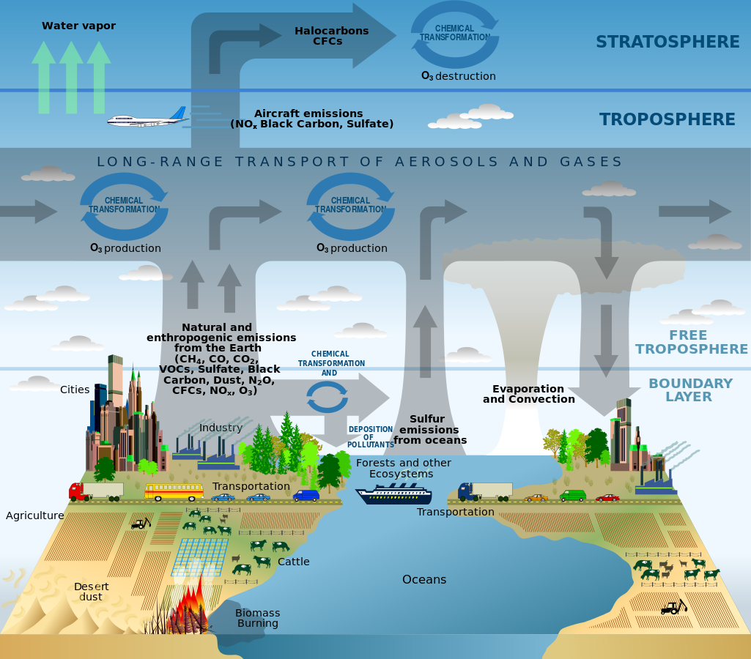

Slide 23
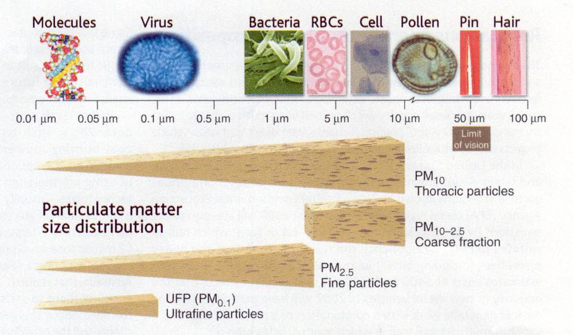
Science 307:1857-1861, News Focus, March 2005

Slide 24

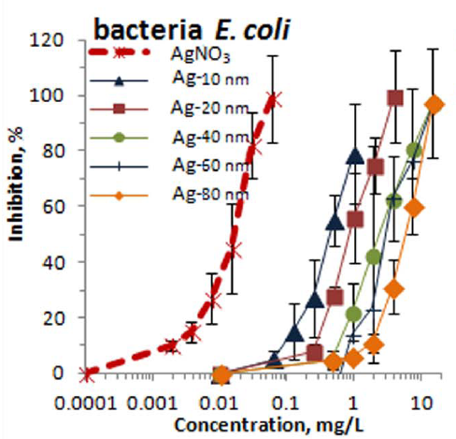

Slide 25
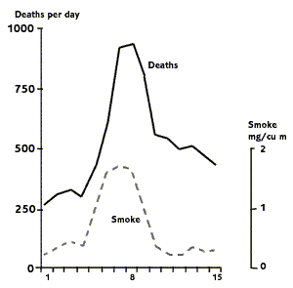
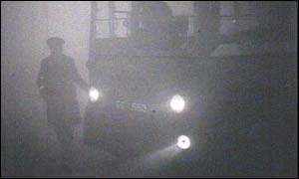

Deaths from London Smog, December 1952

Slide 26
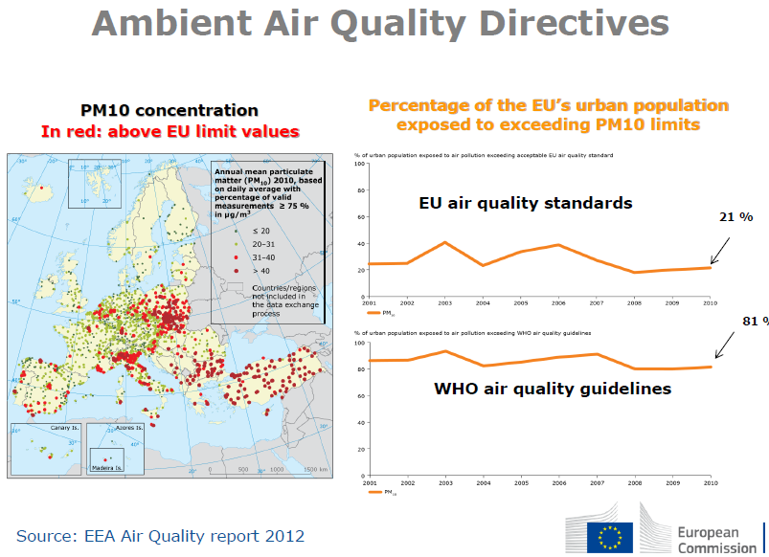

Slide 27
Three mechanisms to reduce FEV1
O’Byrne & Postma, AJRCCM 1999
FEV1
theoretical max.
100%
Early initiation of decline
Accelarated decline
Reduced growth phase
Role of air pollution ?
0 20 80 Age
Courtesy of N Kuenzli
Notes:
Or the effect on levels of lung function and decline ikn adults, or

Slide 28
Air pollution and Reduced growth phase
FEV1
theoretical max.
100%
Air pollution during pregnancy affects lung function in newborns in Switzerland
Latzin et al, ERJ 2009
0 20 80 Age
Courtesy of N Kuenzli
Notes:
Or the effect on levels of lung function and decline ikn adults, or

Slide 29
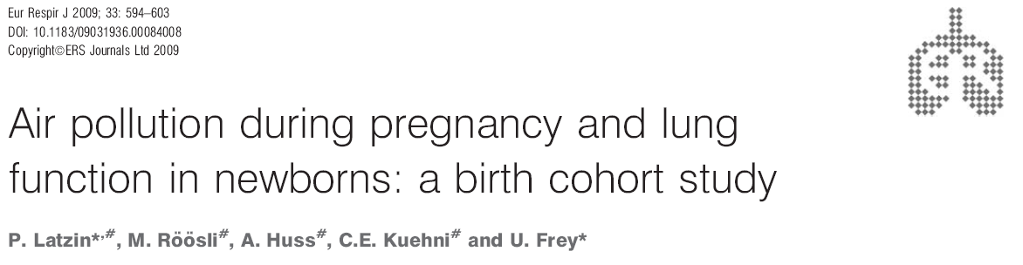
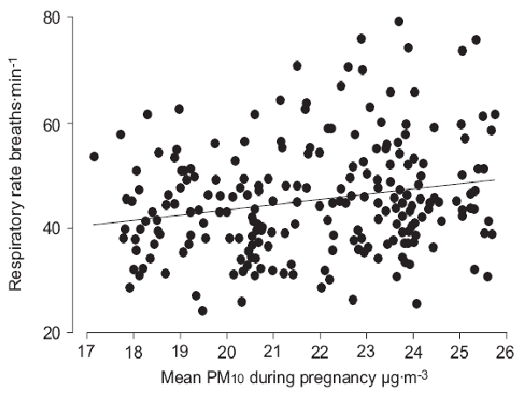
Courtesy of N Kuenzli

Slide 30
Air pollution and Reduced growth phase
FEV1
theoretical max.
100%
0 20 80 Age
Courtesy of N Kuenzli
Notes:
Or the effect on levels of lung function and decline ikn adults, or

Slide 31
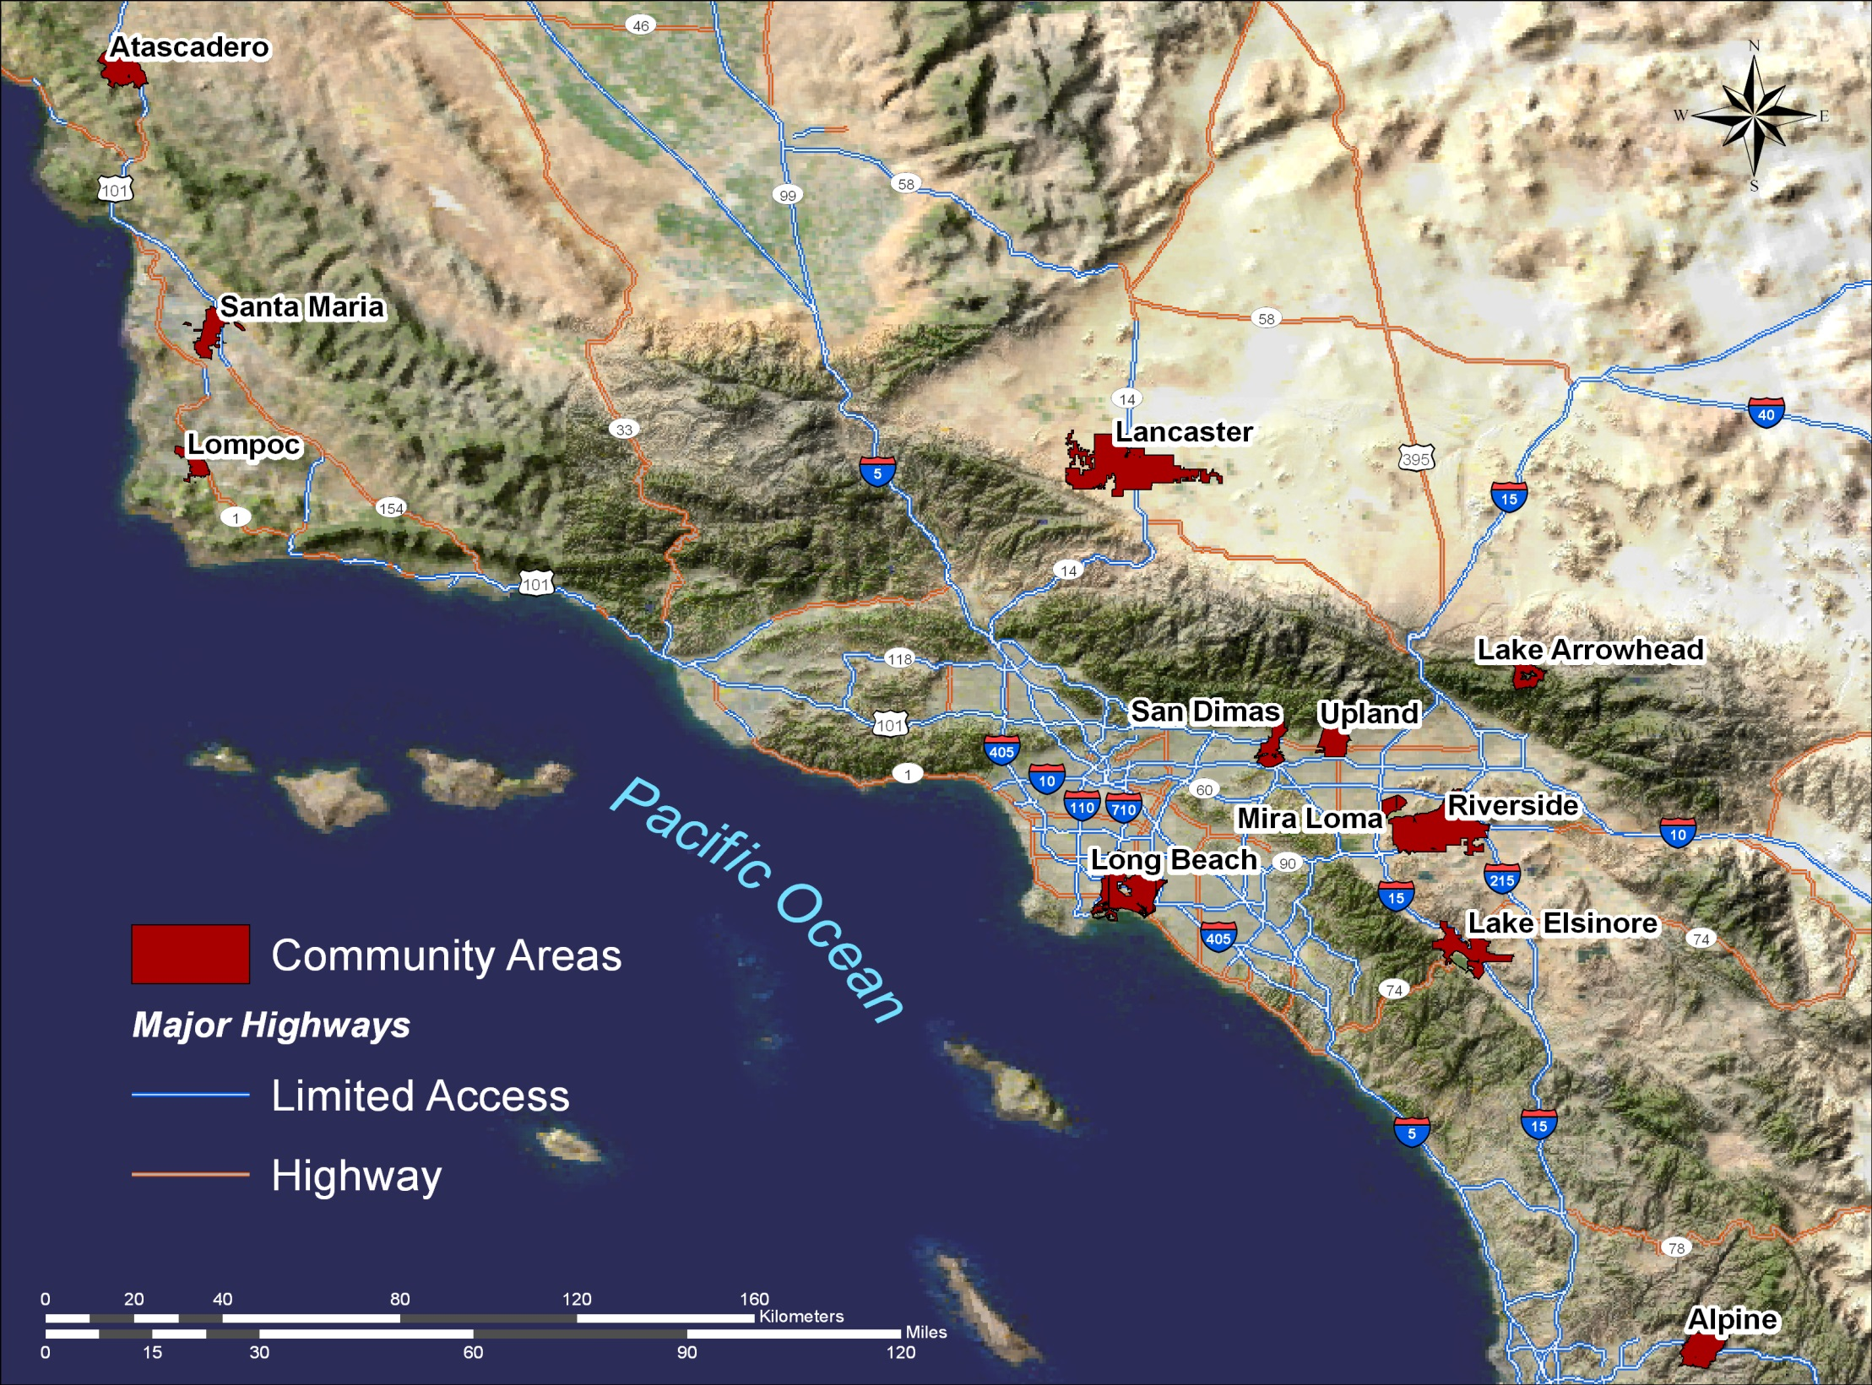
The University of Southern California
Children’s Health Study
Gaudermann et al, New Engl J Med 2004,
Lancet 2007, AJRCCM 2002 & 2000,
Kuenzli et al, Am J Pub Health 2004
Courtesy of N Kuenzli

Slide 32
Chronic effects on lung function growth led to significant deficits at age 18
Gauderman et al, NEJM 2004

Slide 33

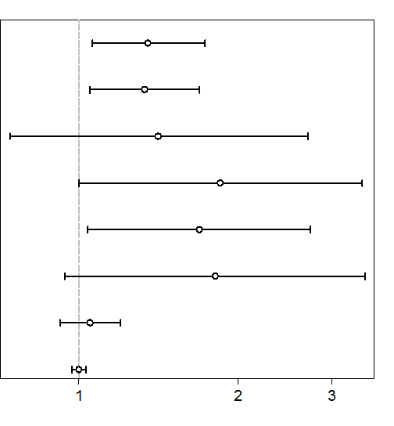
Also confirmed in European ESCAPE study: Probability to have low lung function at 8 yrs of age is associated with air pollution
Results from 5 European birth cohorts
Gehring et al, Env Health Perspect in press
NO2
NOx
PM2.5
PM2.5 traffic (soot)
PM10
PMcoarse
Traffic street
Traffic buffer
1 2
Odds-Ratio for having FEV₁ <85% predicted
Courtesy of N Kuenzli

Slide 34
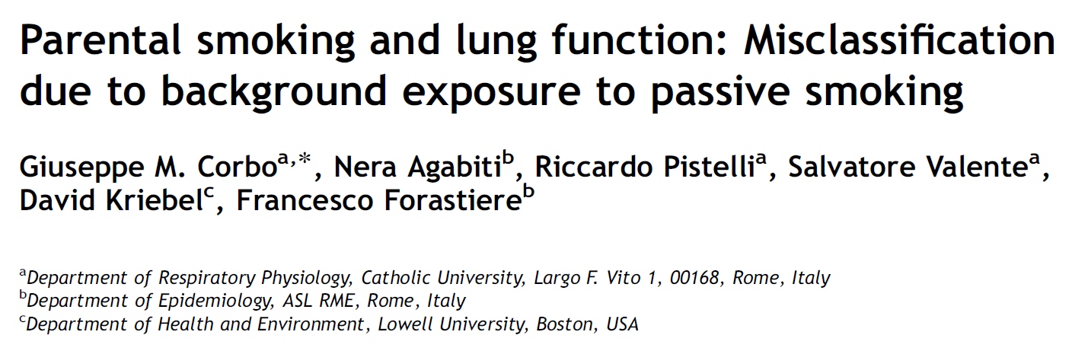
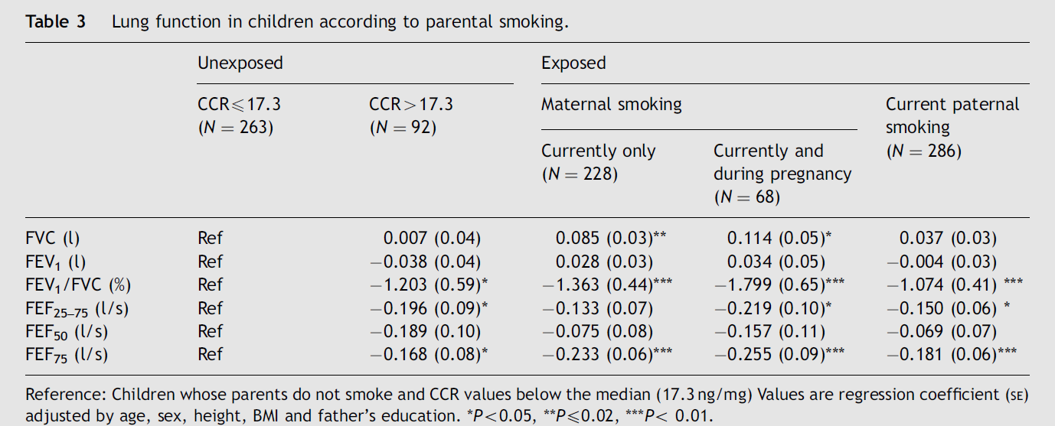

Slide 35

Air pollution and accelerated decline
FEV1
theoretical max.
100%
Early initiation of decline
???
0 20 80 Age
Courtesy of N Kuenzli
Notes:
Or the effect on levels of lung function and decline ikn adults, or

Slide 36

22
Swiss Study on Air Pollution and Lung and Heart Diseases In Adults
SAPALDIA
years
A Cohort Study
SAPALDIA 1 : 1991/92 >9600 Participants (age 18-60)
SAPALDIA 2: 2001/02 >8000 participated again
SAPALDIA 3: 2010/11 >5000 participated a third time
Primary funding: Swiss National Science Foundation
Additional funding: federal and cantonal agencies, Swiss Lung and others

Slide 37
Reduction of lung function decline per 10 μg/m³ reduction in home outdoor PM10 among 2’213 never smokers
(The Swiss SAPALDIA Study)
Downs et al, NewEnglJMed 2007
 | Effect | P-value
FVC | 2.2 ml | 0.43
FEV1 | 4.2 ml | 0.06
FEV1 in % FVC | 0.05% | 0.18
FEF 25-75 | 11.3 ml/s | 0.03

Slide 38
Two London city routes of physical excercise (walking for 2 hours) done by 60 asthmatics
McCreanor, NEJM 2007
Oxfordstr.
DIESEL BUSSE

Slide 39
Lung function (FEV1) significantly decreased among asthmatics while walking in the heavily trafficked (diesel busses) Oxford street as compared to Hyde Park
McCreanor et al, NEJM 2007
Hyde Park
Oxford Street

Slide 40
Date
Lagorio S, Forastiere F, Pistelli R, Iavarone I, Fano V, Incalzi RA, Basso S, Benedetto RT, Della Corte AM, Fuso L, Maiolo C, Sammarro S, Serra M, Spadaro S, Tramaglino LM, Cattani G, Stacchini G, Marconi A, Ziemacki G, Ostro B. Air pollution and cardiac and respiratory function in a panel of patients. Ann Ist Super Sanità. 2003;39(3):395-404.

Slide 41
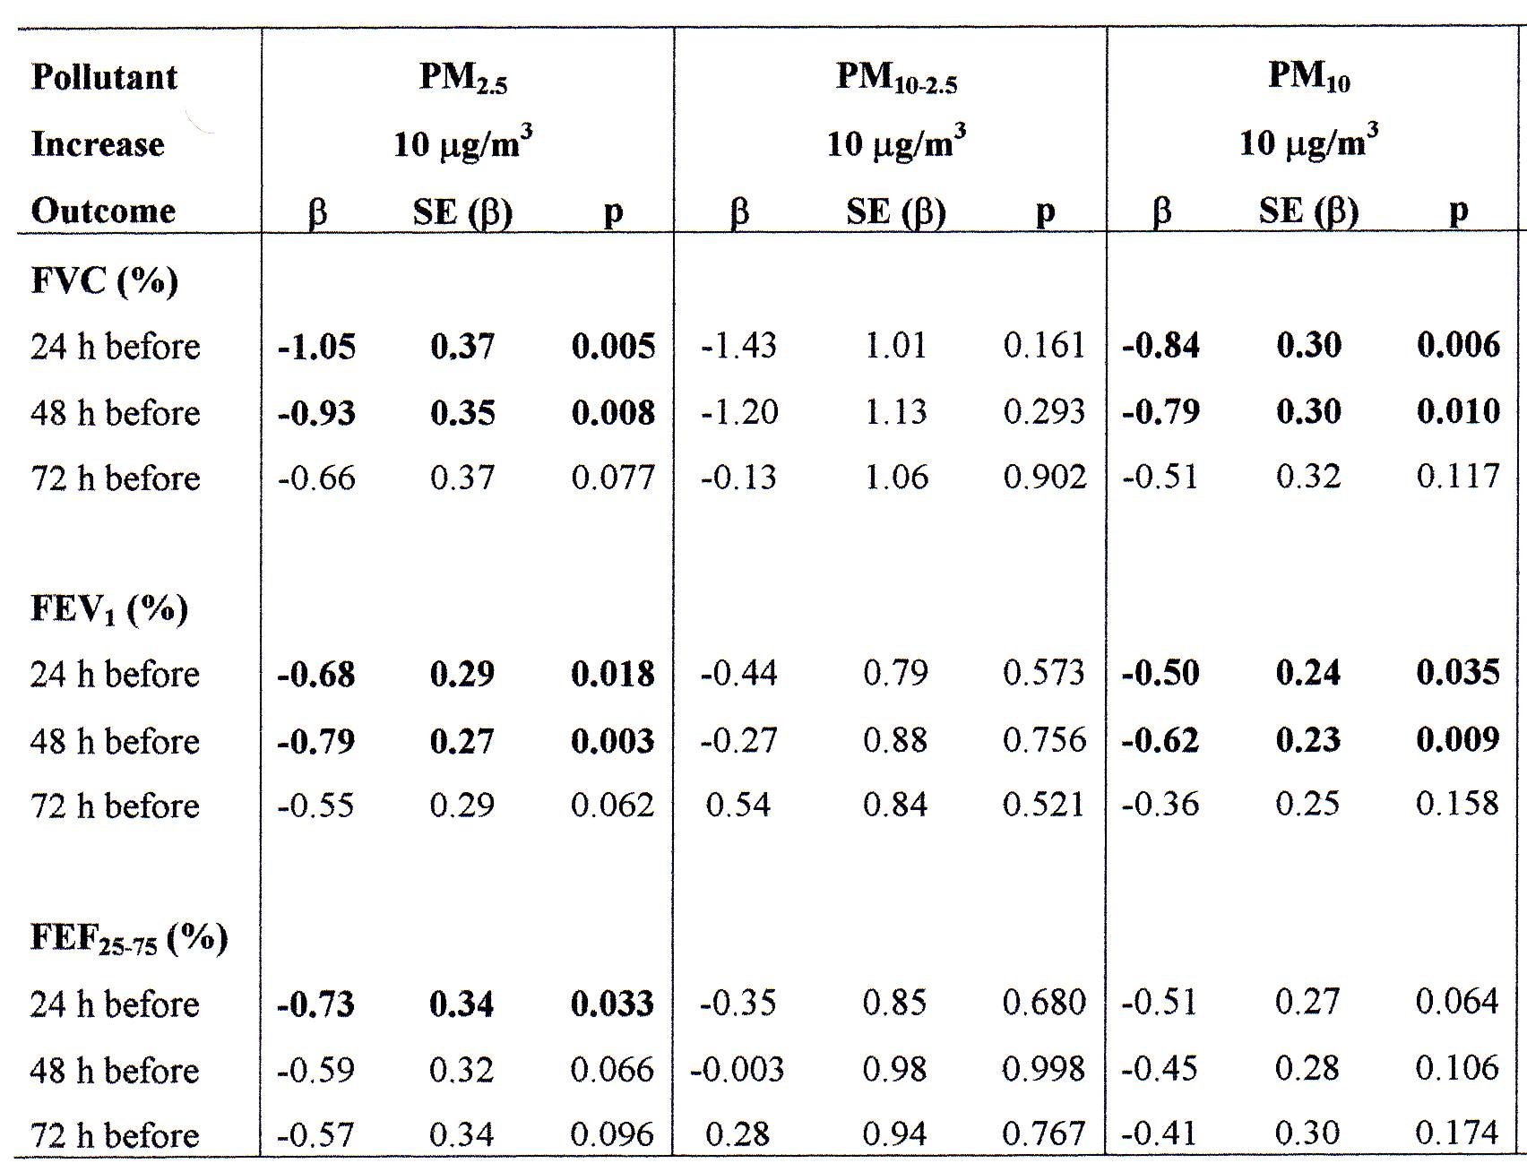

Slide 42
Conclusioni
La frequenza dei non fumatori fra i soggetti affetti da Patologia Ostruttiva Cronica delle vie aeree è più elevata di quanto comunemente atteso.
L’esposizione ad inquinamento causato dalla combustione di biomasse è sicuramente il più importante fattore di rischio per Patologia Ostruttiva Cronica delle vie aeree a livello globale.
L’esposizione all’inquinamento atmosferico nelle aree urbane è un fattore di rischio non definitivamente accertato come causa di Patologia Ostruttiva Cronica delle vie aeree, ma è certamente un determinante delle riacutizzazioni che caratterizzano la BPCO e l’Asma.

Slide 43
Due domande
Una domanda: La BPCO determinata da esposizione a fumo di tabacco (unico soggetto studiato nei più importanti RCT) e le diverse condizioni di Patologia Ostruttiva Cronica delle vie aeree dovute ad altri e numerosi determinanti sono una medesima malattia?
Pensiamo che sia possibile applicare a queste condizioni di Patologia Cronica Ostruttiva le stesse terapie valutate nei RCT sulla BPCO da fumo di tabacco?

