Slide 1
TV15-273
Thomas V. Colby MD
Mayo Clinic in Arizona

Slide 2
Conflicts of Interest (TV Colby MD)
NONE

Slide 3
TV15-273 (Pathologist’s History)
62F with acute respiratory failure
Increased dyspnea, hypoxia
CT peripheral upper lobe and lower lobe honeycombing and ground glass opacities in the mid lung zones
Mediastinal adenopathy
RA diagnosed 1 year ago; started on Methotrexate 8 months ago

Slide 4
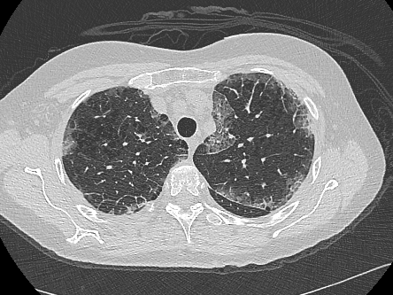
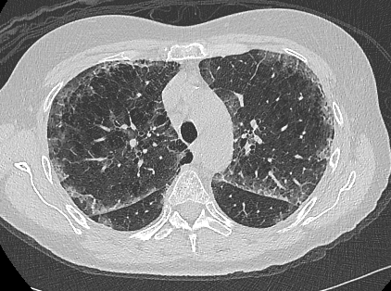
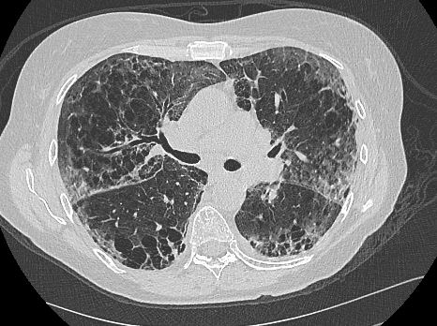
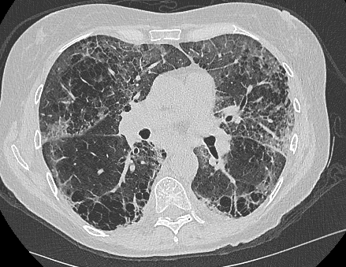

Slide 5
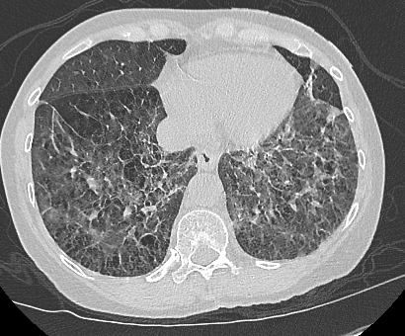
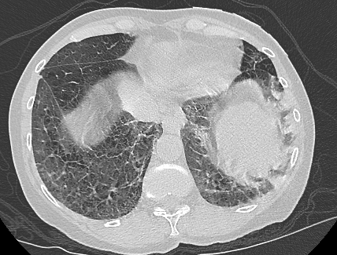
RADIOLOGIC INTERPRETATION (KC)
Looks like patient has emphysema in the upper lobes and has a lot of peripheral ground glass in addition to a component of mild interlobular septal thickening more in the lower lobes. I wonder if this could have represented diffuse alveolar damage.
In the posterior lower lobes extensive cystic change is noted, likely areas of advanced honey combing.
Favor both acute inflammation and combined pulmonary fibrosis and emphysema.
Thus: Acute AND Chronic Changes

Slide 6
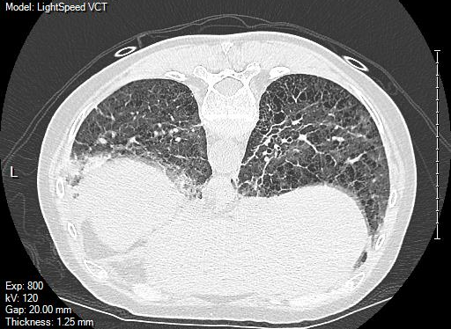

Slide 7
This is a common clinical problem leading to a lung biopsy (RA with new infiltrates)….
Clinical differential
Infection (including opportunistic)
Drug reaction (Methotrexate in this case)
RA-related ILD (acute, subacute, chronic)
Acute exacerbation of the chronic ILD
Other/unrelated
Prior history/radiologic findings are extremely important.

Slide 8
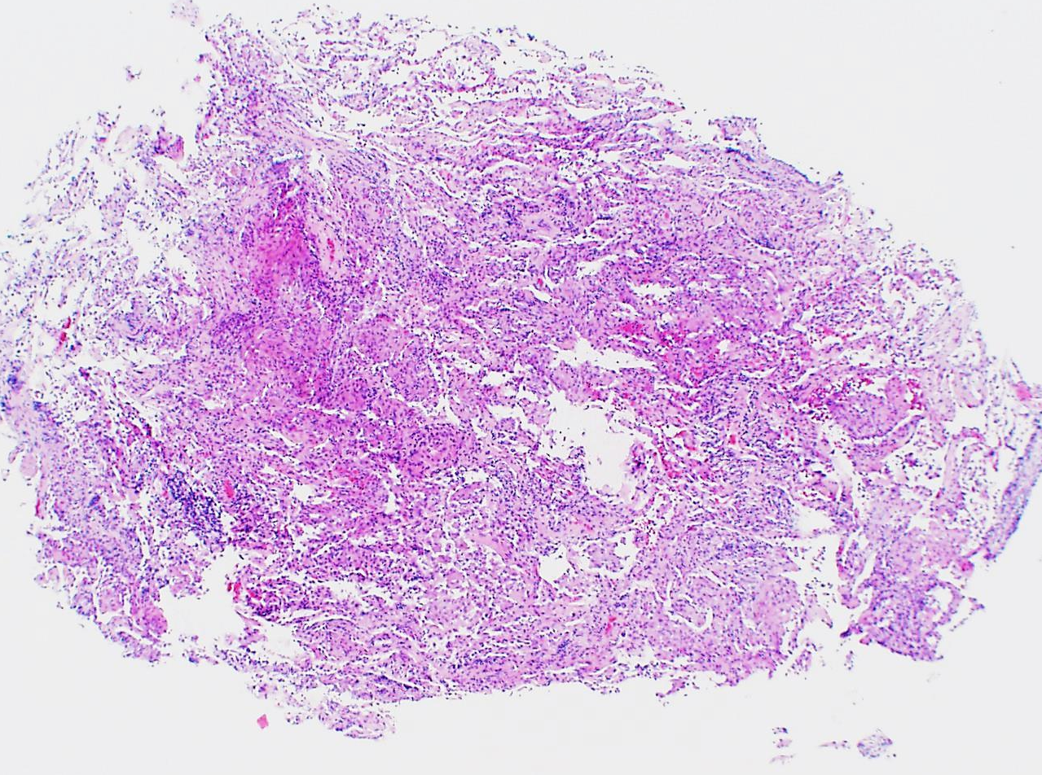
TV15-273
Transbronchial forceps biopsy was performed and provided an excellent specimen…..
Nonfibrotic lung with cellular infiltrates…

Slide 9
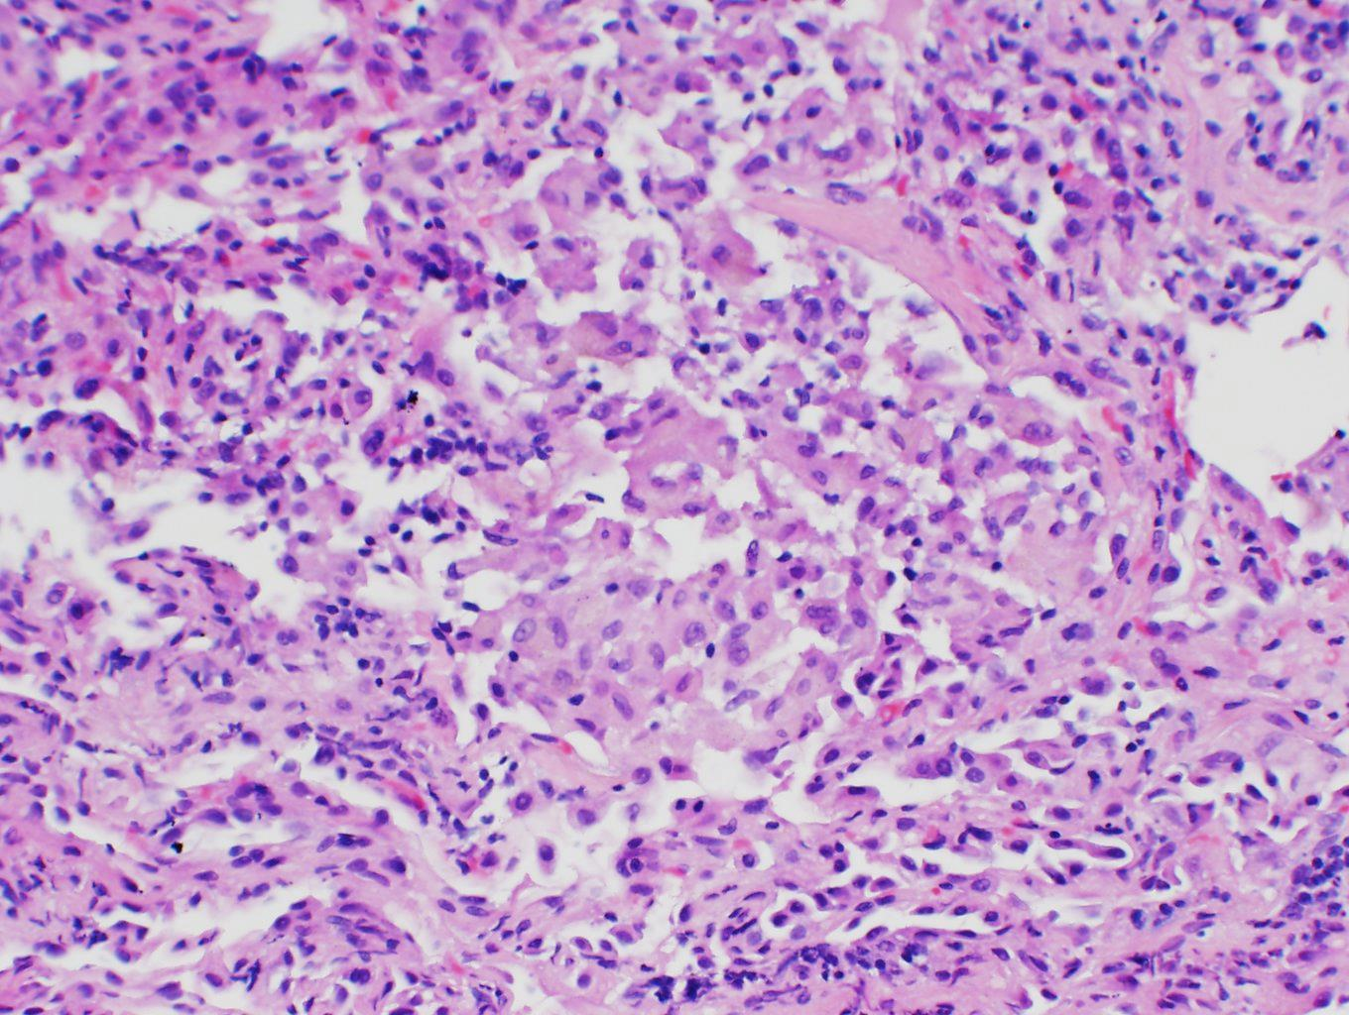
…Airspace macrophages

Slide 10
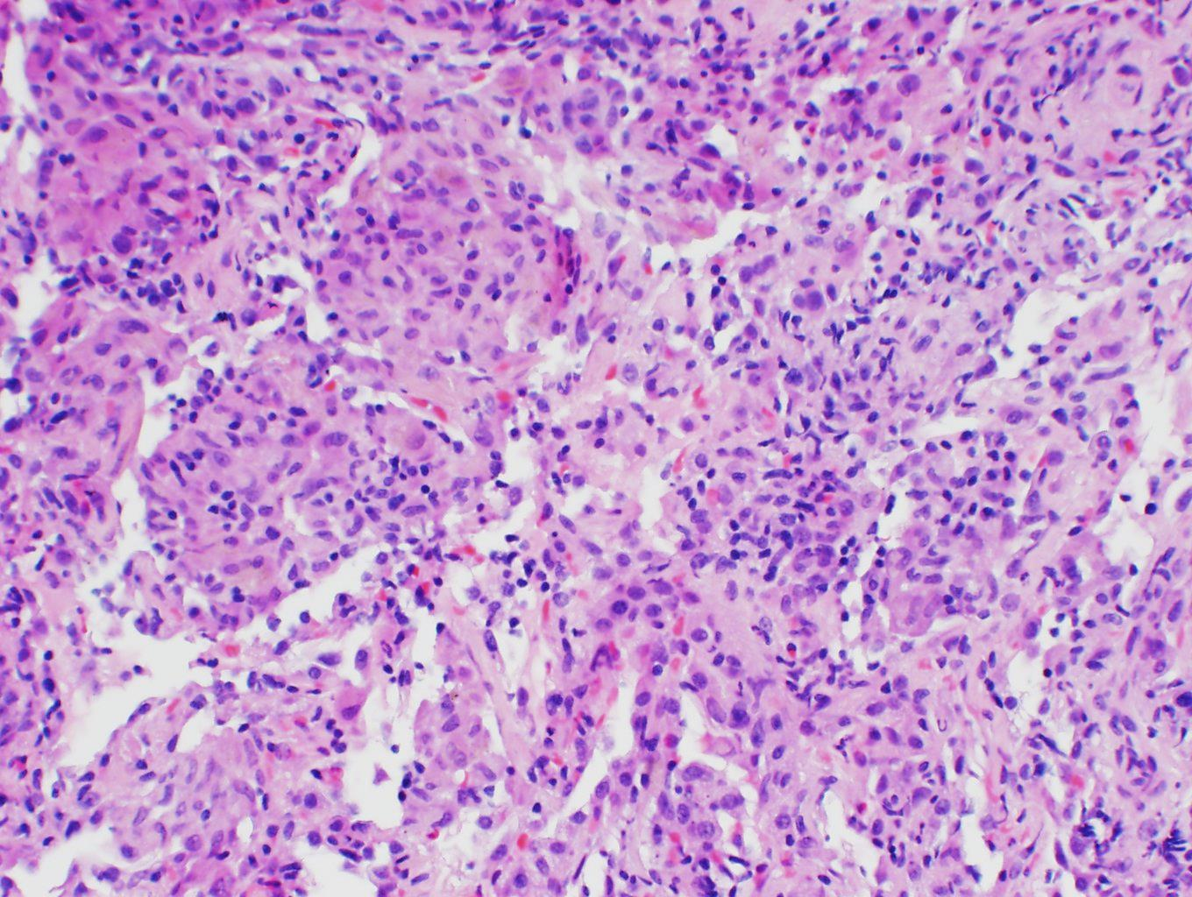
…that are vaguely granulomatous
…and interstitial infiltrates of mononuclear cells

Slide 11
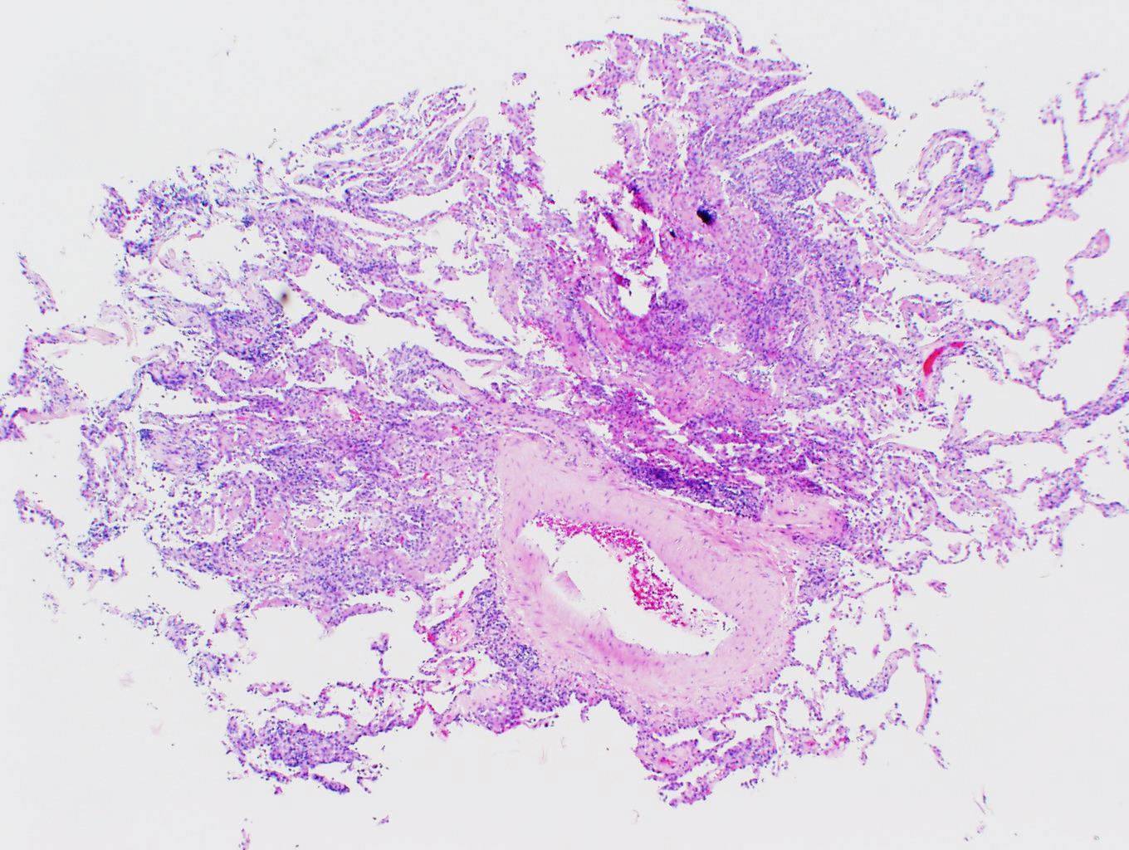
Another piece of nonfibrotic lung with cellular infiltrates…

Slide 12
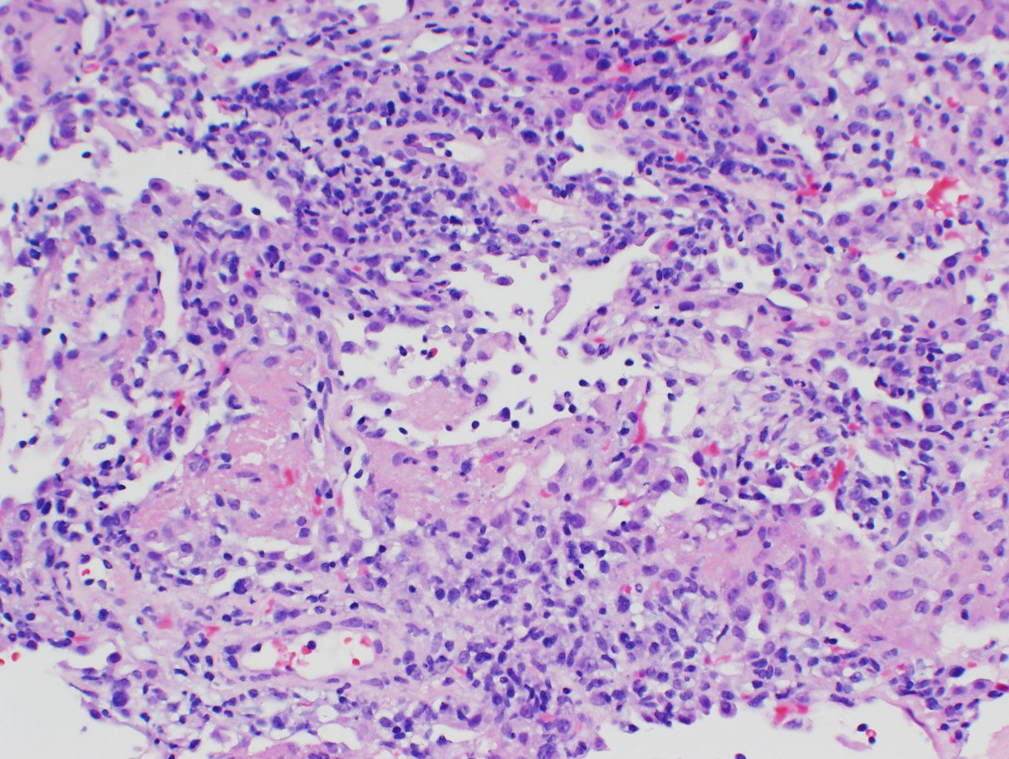
…and some airspace fibrin

Slide 13
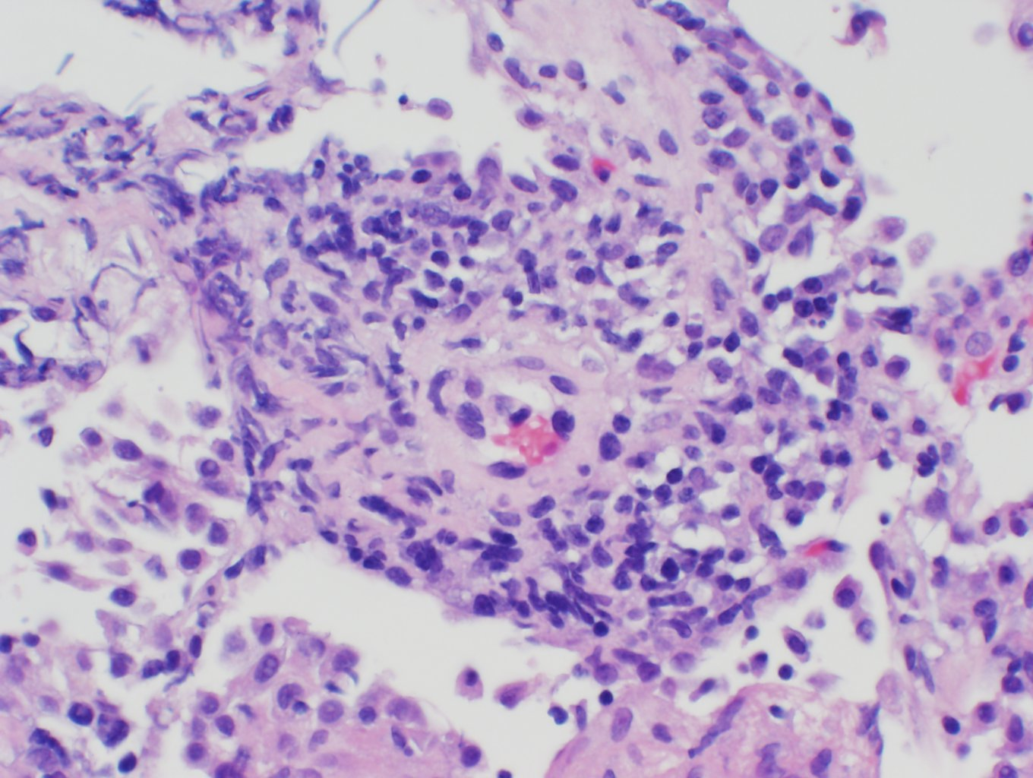
…and perivascular infiltrates but not a true vasculitis

Slide 14
Based on these pathologic findings the differential is still:
Infection (including opportunistic)
Drug reaction (Methotrexate in this case)
RA-related ILD (acute, subacute, chronic)
Other- now less likely
As shown in the following examples…..

Slide 15
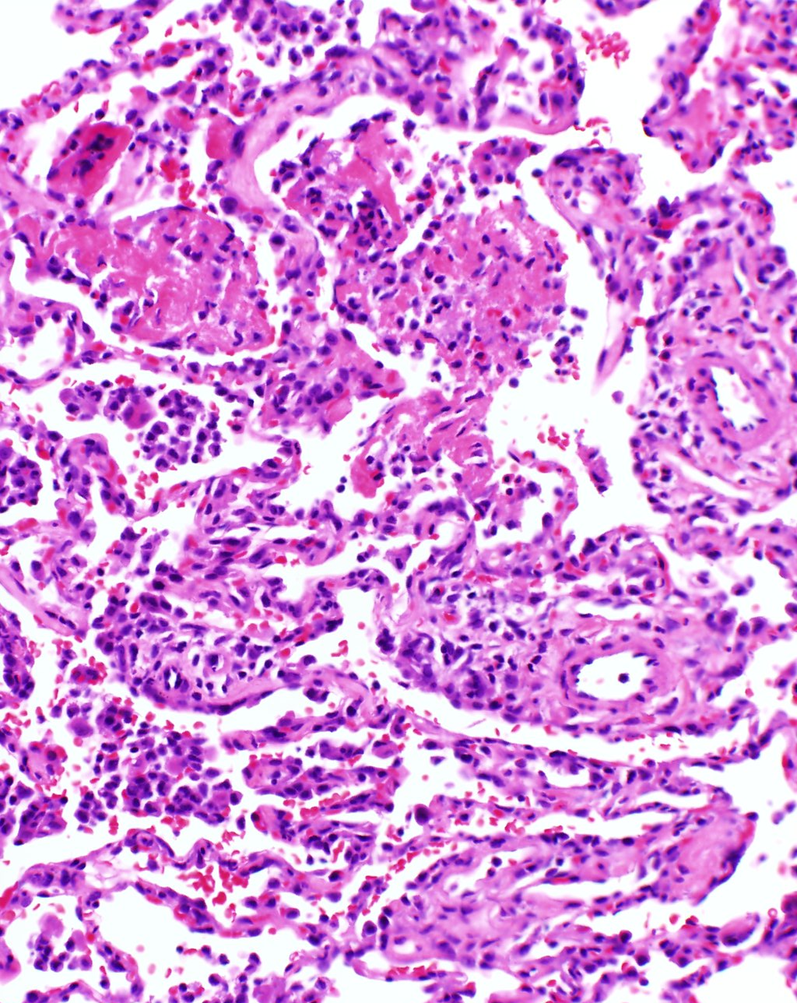
Pneumocystis pneumonia in a patient with RA on low dose Methotrexate
Airspace fibrin and interstitial inflammation
…And in such cases BAL may be negative for PCP

Slide 16
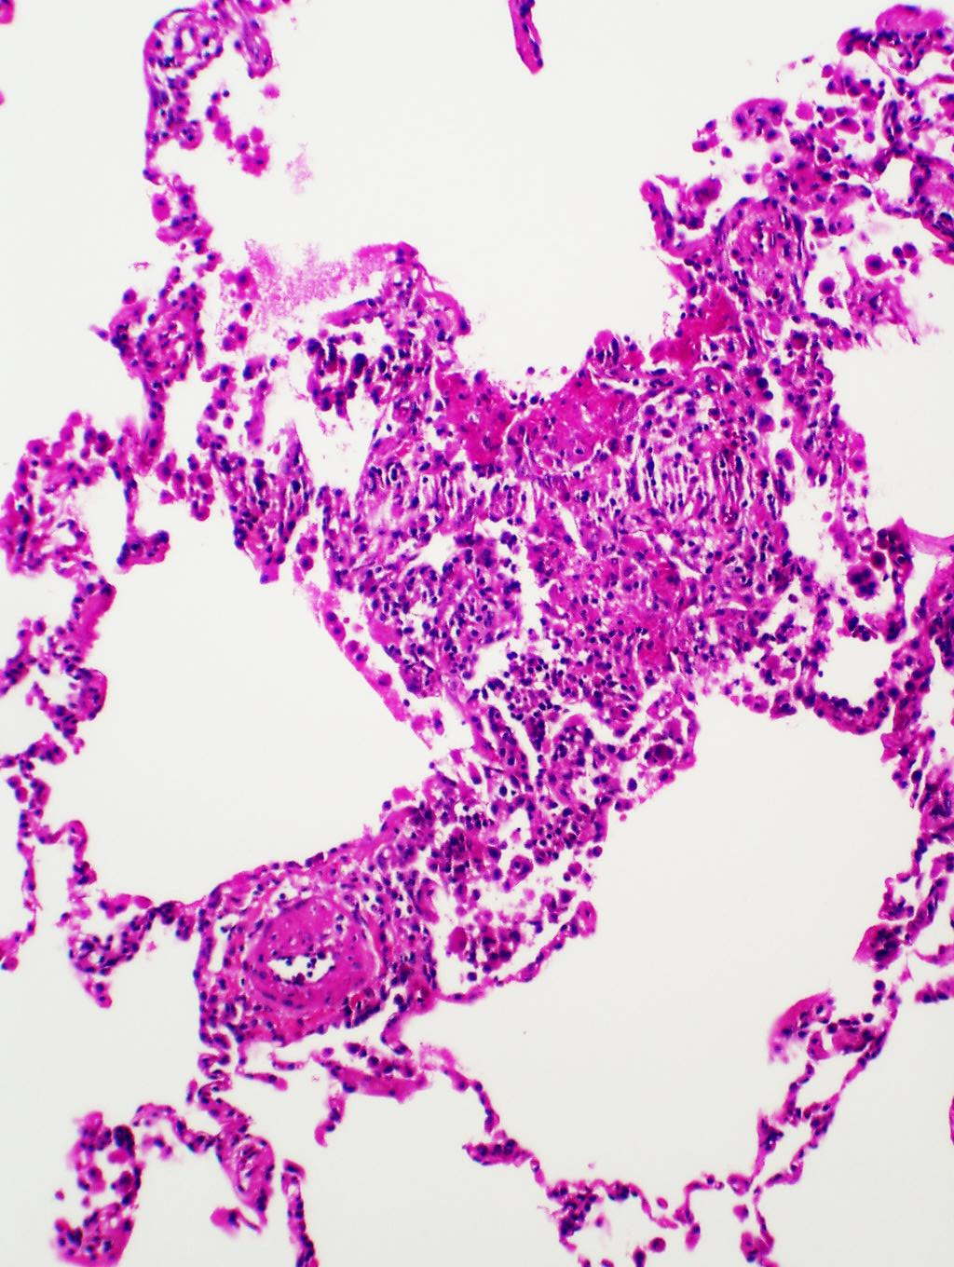
Methotrexate reactions in RA
Airspace fibrin and macrophages and perivascular infiltrates

Slide 17
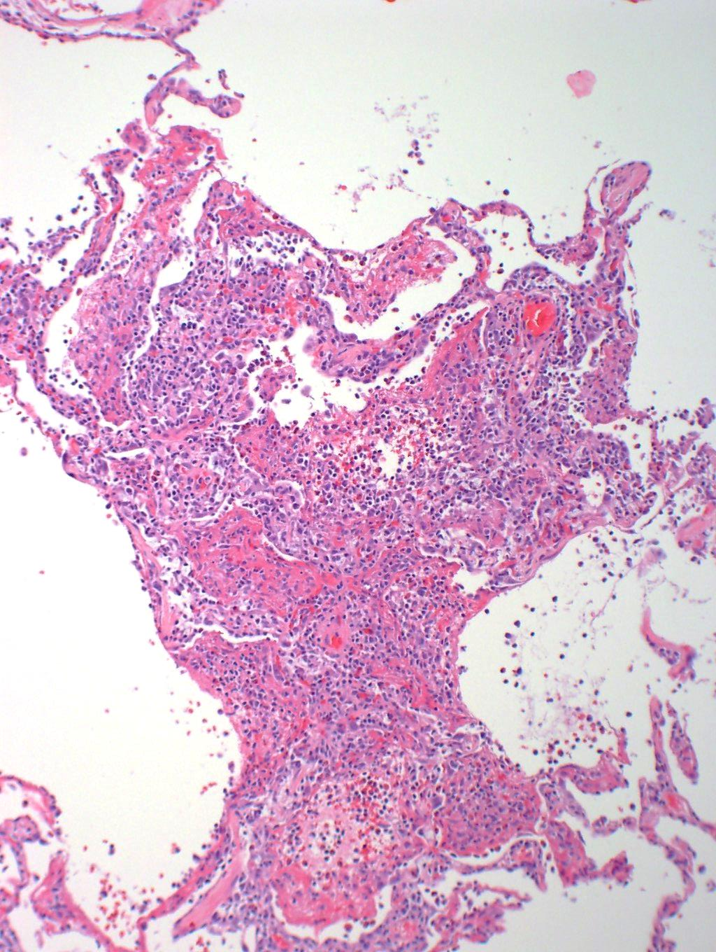
RA-related ILD
Perivascular infiltrates and airspace fibrin

Slide 18
What to do now?
Cultures and stains for micro-organisms
Stains for AFB and fungi are negative
Cultures were also negative
Infection becomes very unlikely
Drug/MTX reaction and RA-ILD remain in the differential
…and these are rarely separable based solely on the histology

Slide 19
What to do now?
Old adage in pathology: Look at ALL the tissue!
There’s one more piece (It was a superb TBBx!)

Slide 20
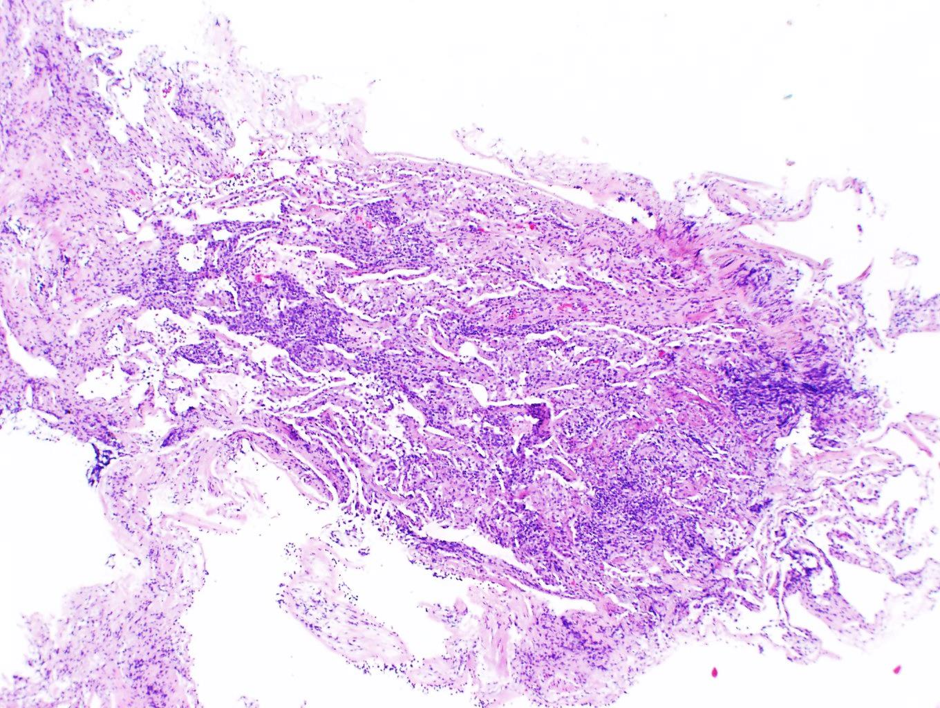
…and here it is
Again…airspace fibrin and interstitial inflammation

Slide 21
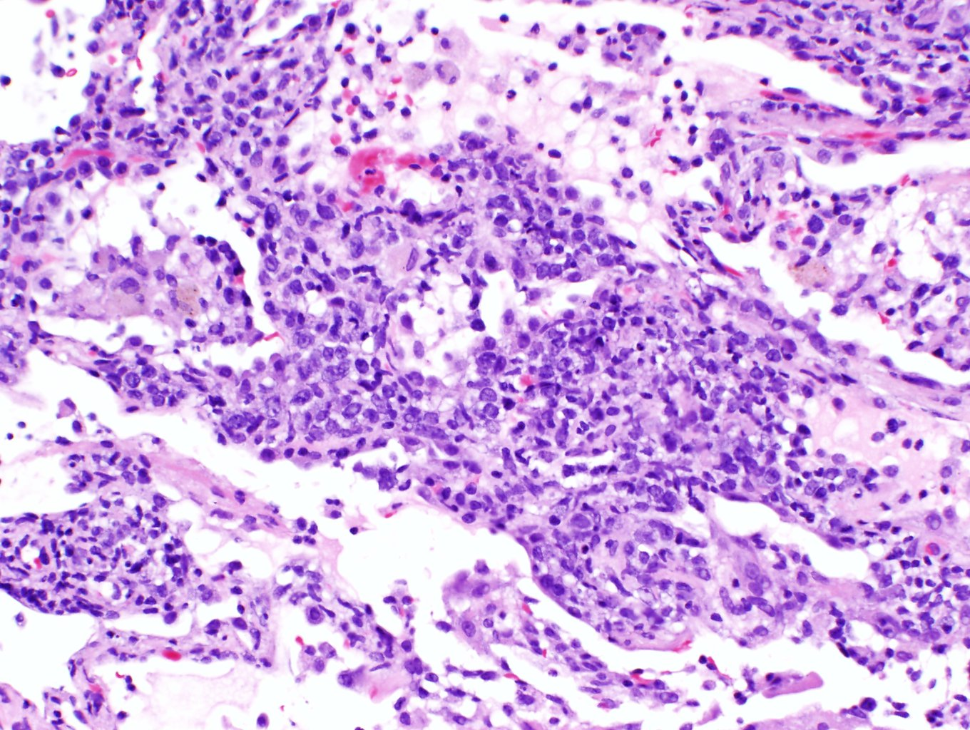
..AND some large lymphoid cells NOT typical of either RA-ILD or MTX reaction !!

Slide 22
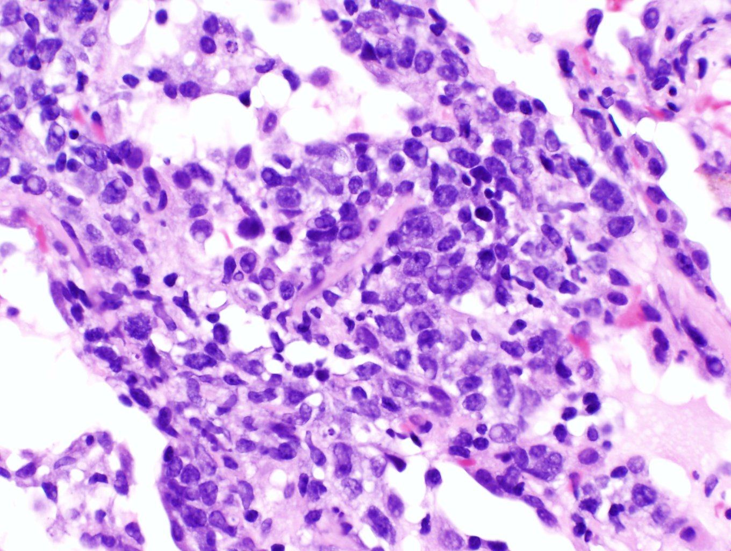
Some large lymphoid cells NOT typical of either RA-ILD or MTX reaction !!

Slide 23
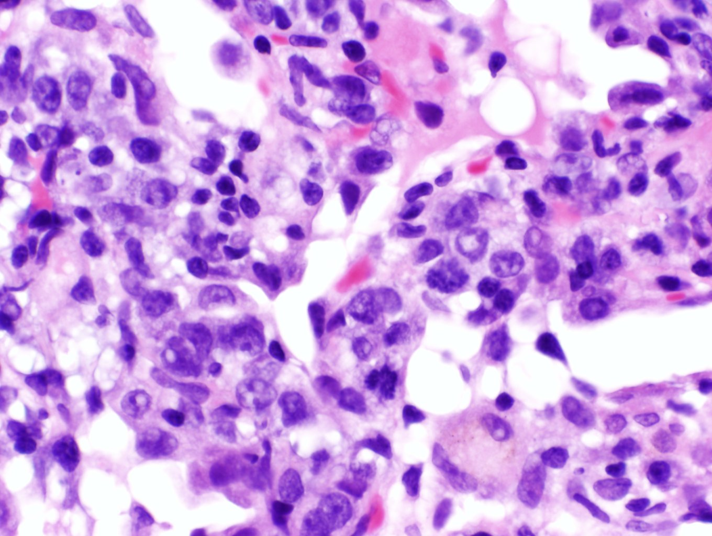
These cells are ABNORMAL and suggest lymphoproliferative disease (incl. Lymphoma)
Mitotic figure
Some large lymphoid cells NOT typical of either RA-ILD or MTX reaction !!

Slide 24
The Differential Expands !!
How to explain the abnormal lymphoid cells?
Atypical reactive proliferation
Lymphoma
Iatrogenic immunodeficiency-associated lympho- proliferative disorder as described with….
Methotrexate
Antagonists of TNFα
Others

Slide 25
Iatrogenic immunodeficiency-associated lymphoproliferative disorders
First reported in RA patients treated with methotrexate
Spectrum of lymphoid proliferations (B > T cell >HL)
Polymorphous, monomorphous, Hodgkin-like
~50% EBV driven
Frequently extranodal (including lung)
Many regress when drug withdrawn
Some behave aggressively
May respond to lymphoma therapy

Slide 26
MTX-Associated LPD
63F with RA
Treated with methotrexate and steroids
Found to have multiple pulmonary nodules
CT scans:

Slide 27
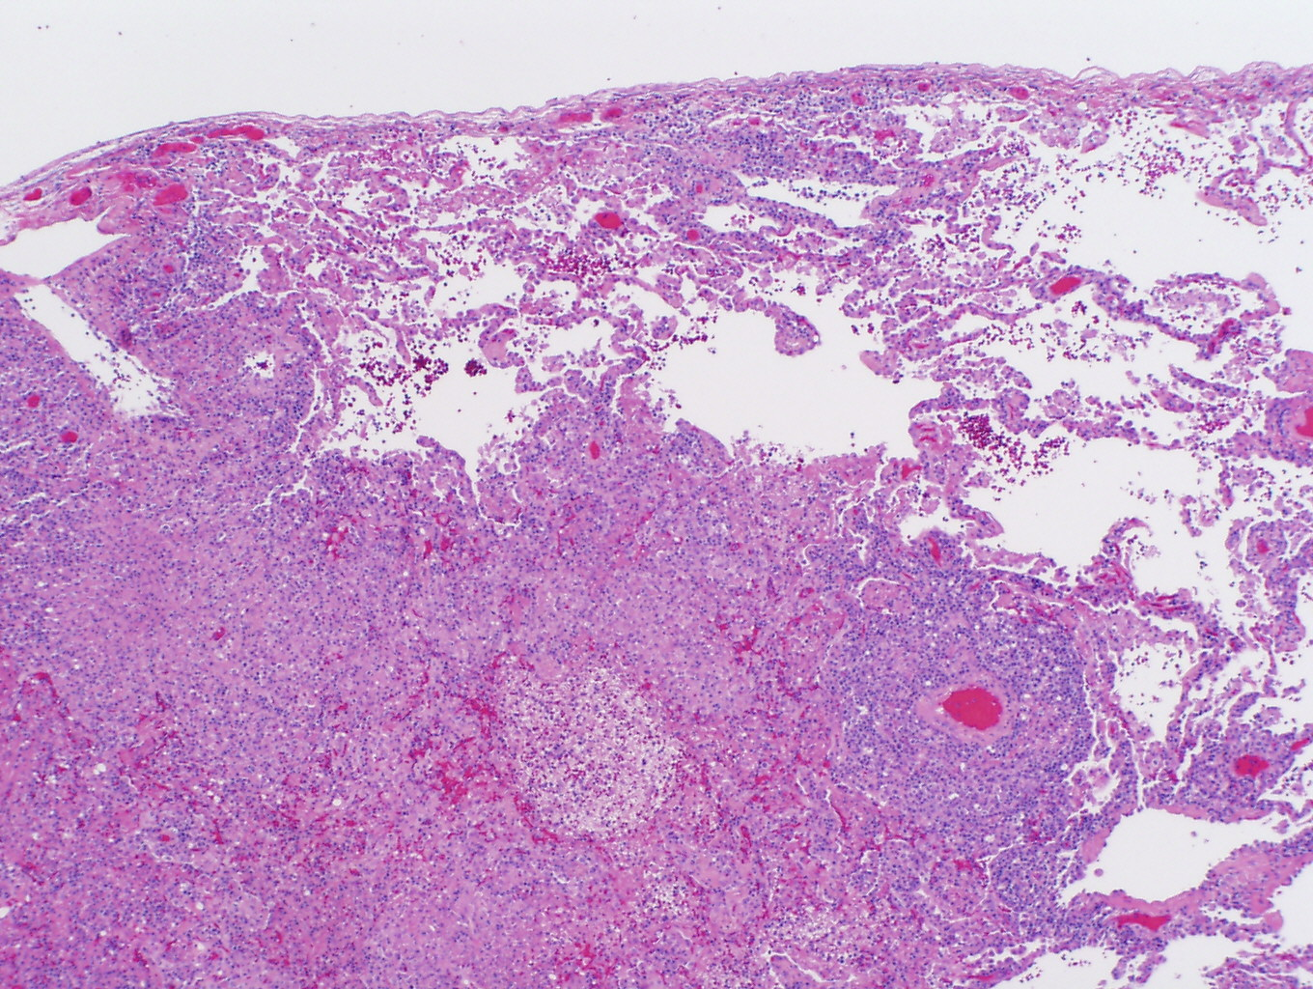
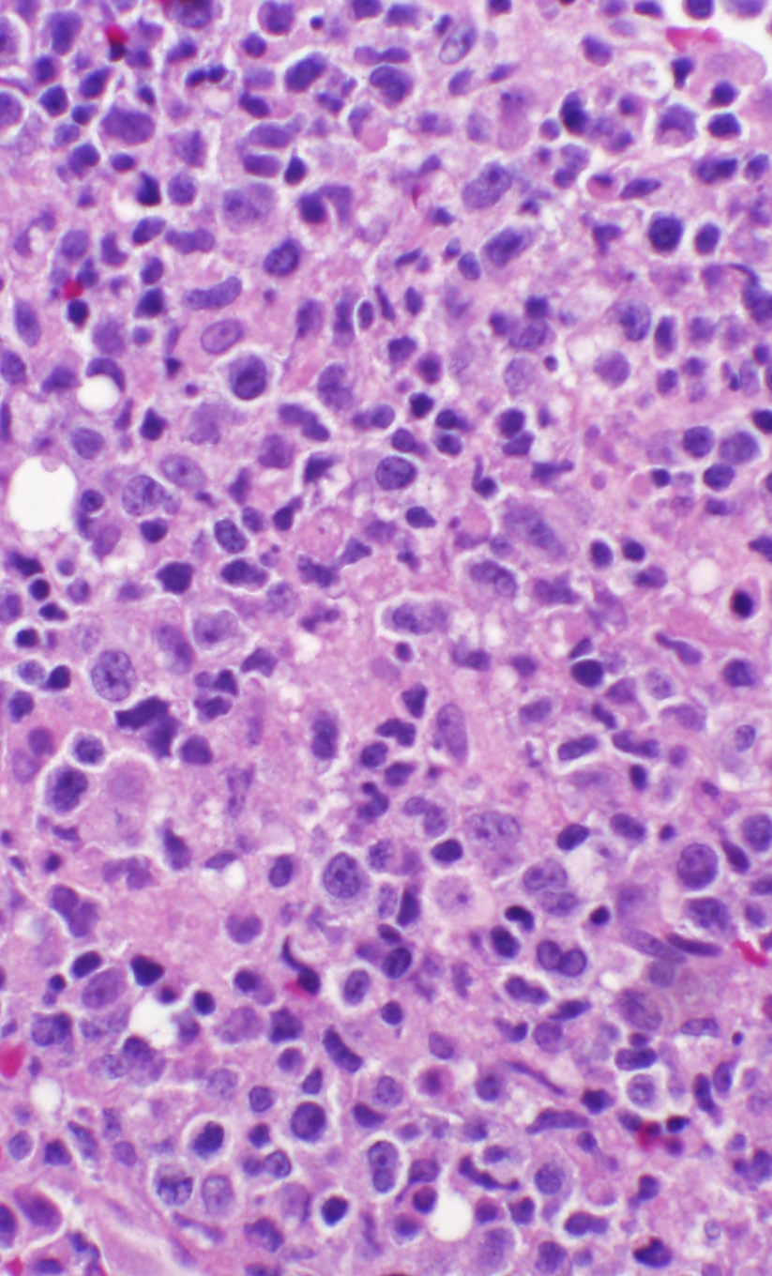
Methotrexate-Associated Lymphoproliferation
EBV ISH
CD20

Slide 28
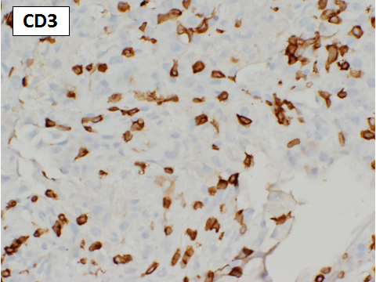
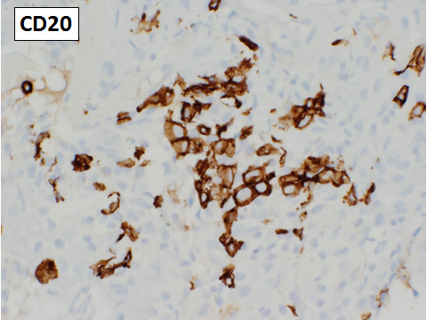
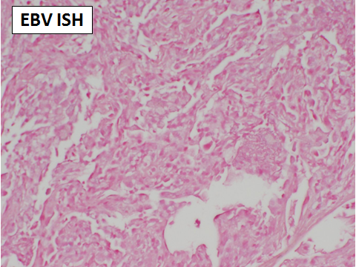
Back to our case
What are the abnormal lymphoid cells ?
Is there evidence of EBV ?
The large cells are, as expected, B-cells.
EBV studies are negative.

Slide 29
TV15-273
DIAGNOSIS
Descriptive: Lymphoid infiltrate and acute lung injury, MTX reaction vs. MTX associated lymphoproliferation
Infection remains in the d/d
RA-related disease remains in the d/d
Does this diagnosis explain the CT findings ??
No !!
Why ??
We don’t see the chronic component

Slide 30
TV15-273 Follow-up
Clinically MTX toxicity was favored
MTX stopped and steroids given
Hypoxia improved and patient off oxygen
Clearing of the ground glass changes on CT
Persistence of the chronic changes on CT
c/w both a drug reaction and RA-ILD
Don’t know what she really had…perhaps an early MTX-associated lymphoproliferation that was reversible…
..But you cannot argue with the outcome !!

Slide 31
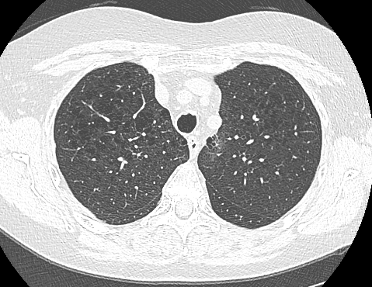
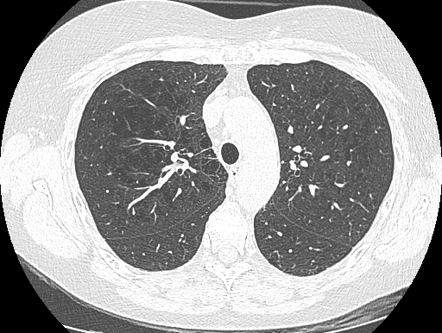
12/15
1/16

Slide 32
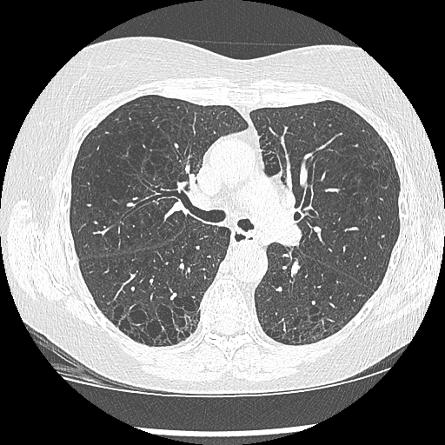
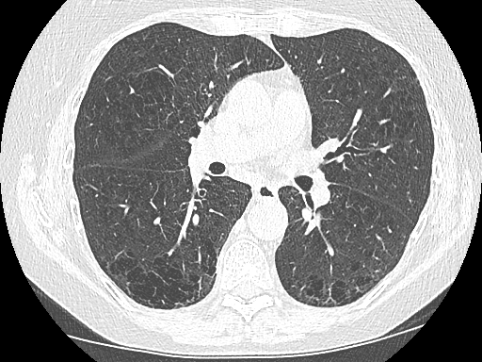
12/15
1/16

Slide 33
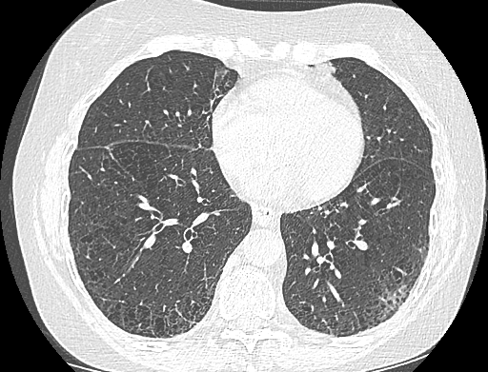
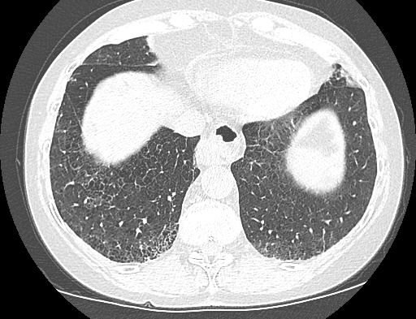
12/15
1/16

Slide 34
Lessons from this case - 1
Transbronchial forceps biopsies can still be useful
Histology does not reliably distinguish a drug reaction from RA-related changes
Usefulness of radiologic findings prior to the drug therapy
Usefulness of CT in putting histology in perspective
ie. We did not get a sample of the chronic changes

Slide 35
Lessons from this case - 2
RA on MTX can lead to a broad D/D.
MTX-associated lymphoproliferations are not that uncommon.
As clinicians know well definitive diagnoses may be elusive and this case is illustrative of that.
THANK YOU FOR YOUR ATTENTION

