Slide 1



Evasion of COPD in
smokers
Manuel G. Cosio
Università di Padova
McGill University

Slide 2
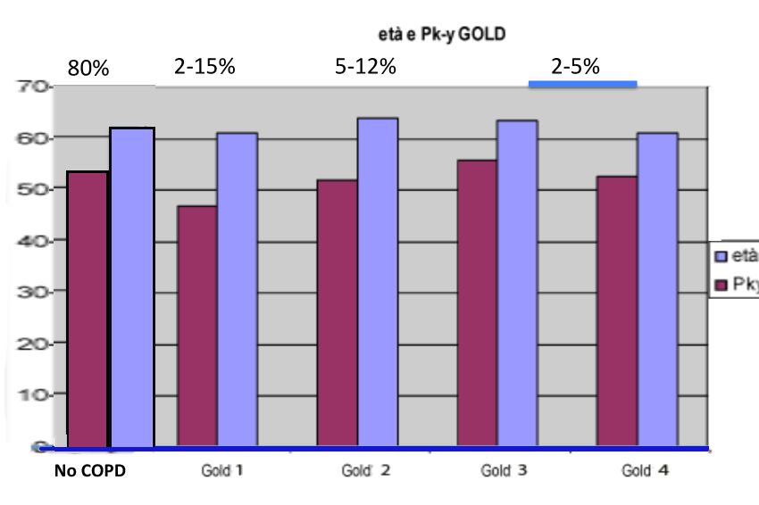
1551 smokers followed for 15 years
AGE and PPY smoked
The EVADERS
The susceptible
It is the failure of EVASION that causes COPD.
Find out what fails!

Slide 3
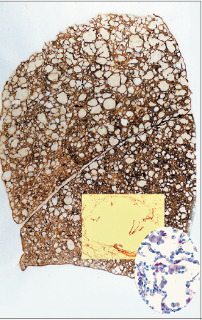
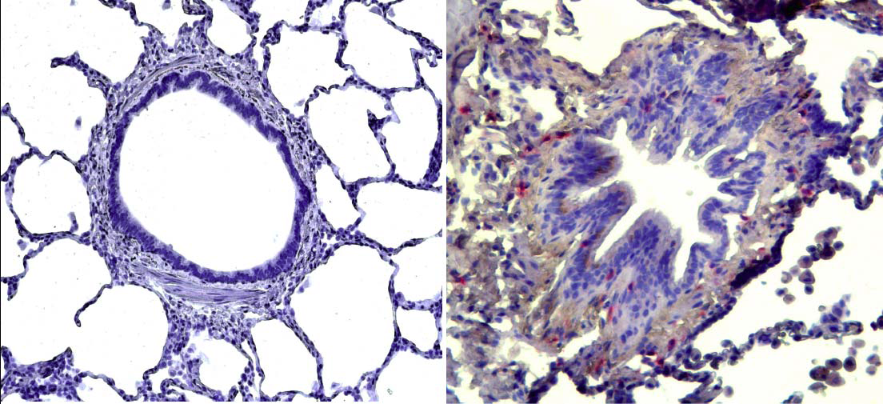
COPD Inflammation and function: CD8+
T (and B cells) mono/oligoclonal
Emphysema models:
CD8+ deficient
Adoptive transfer Tcells.
Cosio M, Saetta M, Agusti A: N Engl J Med 2009;360:2445-54

Slide 4
The autoimmune mechanism in COPD: the “steps” approach.
N Engl J Med 2009;360:2445-54
Notes:
The lack ofinflammation in the smokers without copd is fundamental fact and it could be explained en base a una inflammation de tipo immunitario como hemos descrito que puede suceder en copd.

Slide 5
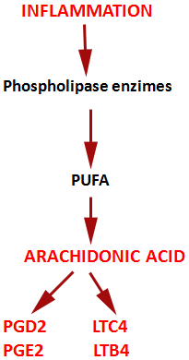
Mechanisms of disease: Immunological aspects of COPD
STEP I The innate immune response:
class-switching
LIPOXINS
ω-3: resolvins
protectins
antigens
Regulons
Inhibiting protein translation.
Promoting mRNA decay
Cosio M, Saetta M, Agusti A: N Engl J Med 2009;360:2445-54
Notes:
5
Figure 3. Initial Response to Cigarette Smoke — Step 1 in the Process Leading to COPD.
Cigarette smoke injures epithelial cells, which release “danger signals” that act as ligands for toll-like receptors (TLRs) in the epithelium.
These actions trigger the production of chemokines and cytokines, which results in an innate inflammation. Products from the inflammatory
cells may injure the extracellular matrix, leading to the release of TLR ligands and consequent TLR activation, which will promote
further inflammation, tissue injury, and the production of antigenic substances. This chain of events may cause dendritic cells to mature
and migrate to local lymph organs, where, if the conditions are favorable, T-cell activation may result, with progression of the disease. If
the innate inflammation in step 1 is minimized or controlled, the inflammation will not progress to adaptive immunity, and the disease
may be arrested. These processes are typical of smokers who do not have COPD Gold stage 1. HSP denotes heat-shock protein. GMCSF
denotes granulocyte-macrophage colony-stimulating factor, HSP heat-shock protein, ICAM-1 intercellular adhesion molecule 1,
MCP-1 monocyte chemoattractant protein 1, and TNF tumor necrosis factor.

Slide 6
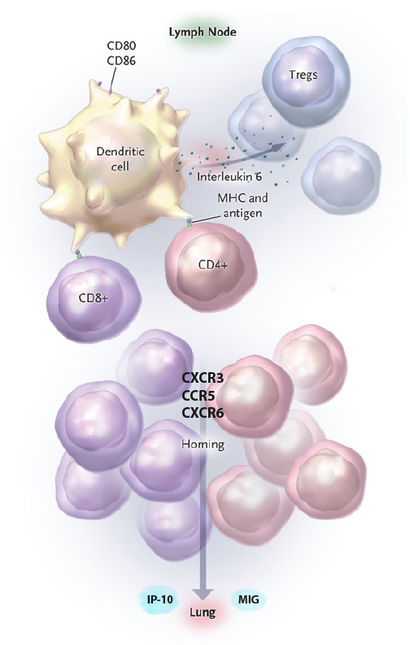
STEP II
The adaptive Immune response: local lymphoid tissue, Dendritic Cells.
regulation
degree of tissue inflammation
Cosio M, Saetta M, Agusti A: N Engl J Med 2009;360:2445-54
Notes:
6
Figure 4. Proliferation of T Cells — Step 2 in the Process Leading to COPD.
When step 1 is successful, mature dendritic cells migrate to local lymphatic
organs, whereupon stimulation by toll-like receptors (TLRs) express costimulatory
CD80–CD86 and cytokines, creating a propitious milieu for T-cell
antigen presentation and proliferation into effector CD4+ type 1 helper (Th1)
T cells and cytolytic CD8+ T cells. Interleukin-6, secreted by the dendritic
cells, favors the production of effector T cells by overcoming the signals from
regulatory T (Treg) cells. Upon activation, effector T cells express tissuespecific
chemokine receptors. Immune regulation or tolerance mechanisms
will determine at this stage the degree of proliferation of T-cell effectors,
homing, and eventually, disease severity. (An absence of tolerance is associated
with Gold stage 3 or stage 4, moderate tolerance with Gold stage 2,
and full tolerance, with Gold stage 1.) MHC denotes major-histocompatibility
complex.

Slide 7
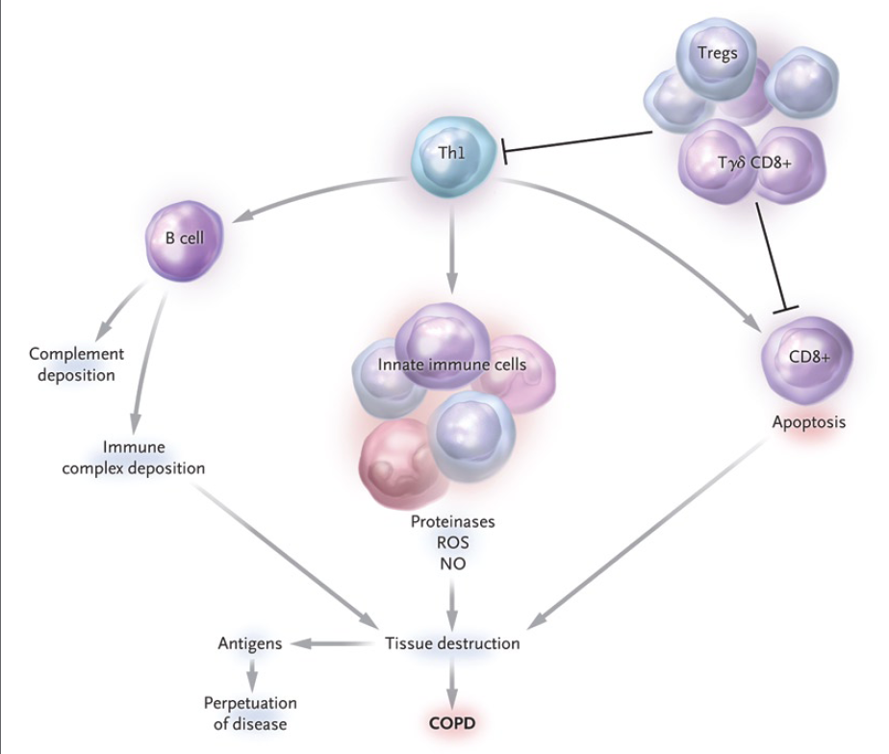
STEP III
Autoimmune lung
Injury.
Cosio M, Saetta M, Agusti A: N Engl J Med 2009;360:2445-54.
Notes:
7
Figure 5. The Adaptive Immune Reaction — Step 3 in the Process Leading to COPD.
With the failure of tolerance or immune regulation in step 2, an adaptive immune inflammation (autoimmune) develops
in the lung, consisting of CD4+ type 1 helper (Th1) T cells, cytolytic CD8+ T cells, and IgG-producing B cells.
Regulatory T cells (Treg) and γδ CD8+ T cells would attempt to modulate the inflammatory process and the severity
of COPD would depend on the balance between effector and regulatory signals. The resulting immune inflammation,
induced by CD4+ Th1 T cells and consisting of activated innate immune cells producing oxidative stress and
proteinases, along with cytolytic CD8+ T cells and B cells, leads to cellular necrosis and apoptosis, immune and
complement deposition, tissue injury with airway remodeling, and emphysema, as well as the release of additional
antigenic material, which perpetuates the process. In step 3, the full autoimmune process has developed, producing
the most severe disease (Gold stage 3 and stage 4). NO denotes nitric oxide and ROS reactive oxygen species.

Slide 8
Immune system in smokers
Immunosuppressed:
DC presenting and maturation
PMNs and AMs
T-cell anergy
B-cells
Immunoglobulins
Markers and mediators
Martin R. Stämpfli: NATURE Reviews Immunology; volume 9 | May 2009 | 377

Slide 9
Smoking, immunity, COPD and cancer.
Working Hypothesis.
Active adaptive immunity is important to defend against the development of malignancy.
If normal smokers suppress immunity to avoid COPD, they would develop more cancers than smokers with severe COPD, who have very active adaptive immunity

Slide 10
Lung cancer in COPD
A cohort of 2588 patients with COPD and without initial clinical or radiological evidence of lung cancer was followed for 62±38 months.
A total of 222 of the 2588 COPD patients developed lung cancer for an incidence density of 15.8 cases/1000 persons year
From Torres, Marin,… Saetta, Cosio, Celli ; Am J Respir Crit Care Med 2011: 184, 913-919

Slide 11
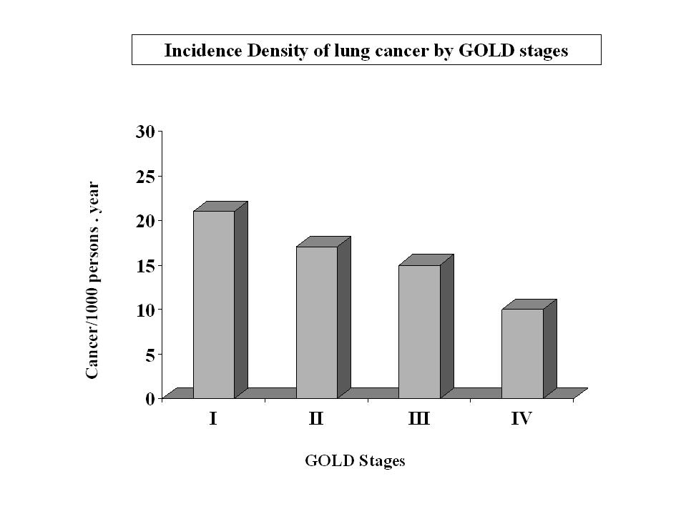
Torres, Marin,… Saetta, Cosio, Celli ; Am J Respir Crit Care Med 2011: 184, 913-919

Slide 12
CANCER
COPD

Slide 13
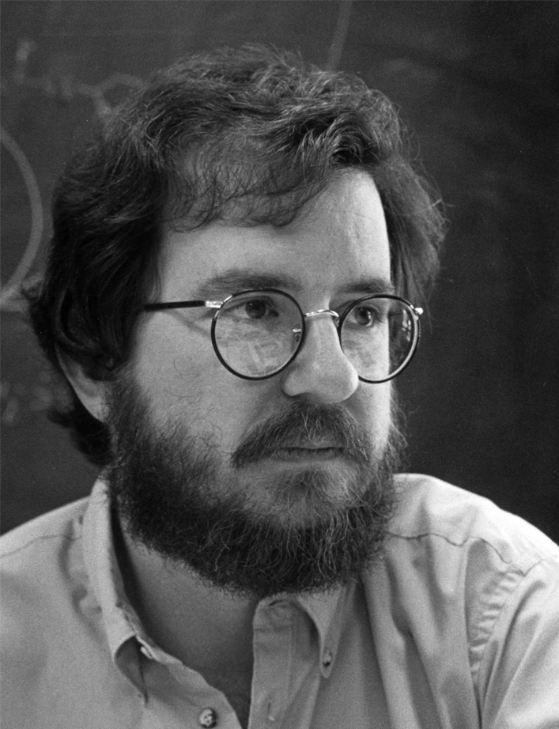
James P. Allison
Discovered the rules of T-cell activation and suppression.
Discovered that unleashing an immune response against cancer, curing cancer will soon become reality.
IT HAS!
James P. Allison. SCIENCE: 2015. 348, 56-61

Slide 14
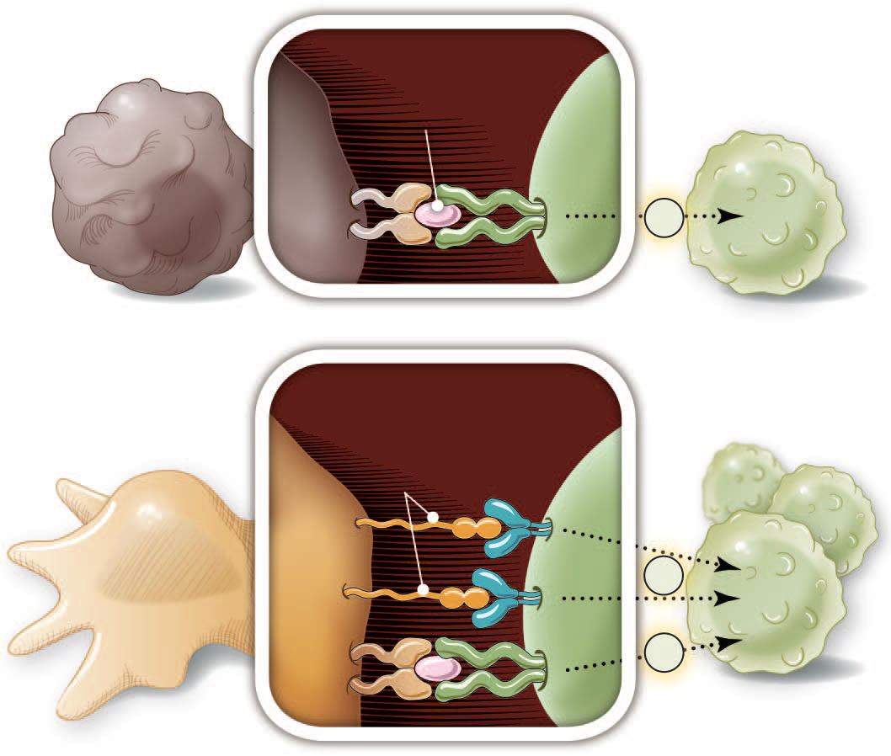
Tumor or
epithelial cells
TCR signal only
No T cell
proliferation
Defined the structure of the T-cell receptor (TCR) that specifically recognizes antigens. (Signal 1)
Antigen
+
TCR
MHC
T cell
proliferation
Positive costimulation
Demonstrated that the T-cell molecule CD28 provides costimulatory signals necessary for full T-cell activation. ( Signal 2)
APC’s
(dendritic cells,
macrophages)
2
B7 CD28
1
Cytokines
James P. Allison. SCIENCE: 2015. 348, 56-61
Notes:
Fig. 1. Activation of T cells requires two signals. T cell activation occurs
only after interaction between Tcell receptor (TCR) and antigen in the context of
MHC (signal 1) plus CD28 costimulation (signal 2).

Slide 15
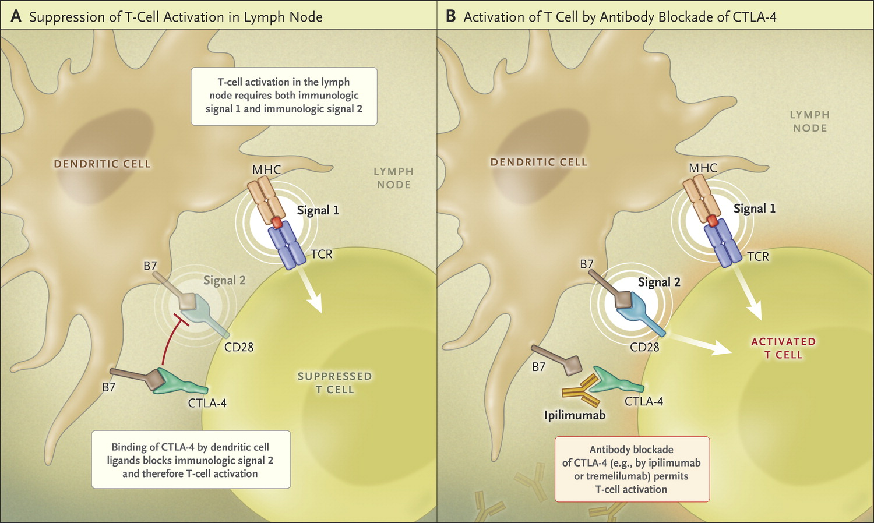

Ribas A. N Engl J Med 2015;373:1490-1492.
T-cell Activation in the Lymph Node.
Described the inhibitory function of the checkpoint molecule 2 cytotoxic T-lymphocyte-associated protein 4 (CTLA-4), which blocks immunologic signal 2 and thereby prevents T-cell from becoming fully activated.
Discovered that blocking CTLA-4 could unleash an immune response against cancer and “cure” cancer.
A “blocked T-cell” to a given antigen can spread the block to other T-cells activated to other antigens. They are contagious!
James P. Allison. SCIENCE: 2015. 348, 56-61
Notes:
Figure 1. T-cell Activation in the Lymph Node. Two immunologic signals are required for T-cell activation in the lymph node: stimulation of the T-cell receptor (TCR) by the MHC (immunologic signal 1), and stimulation of CD28 by the B7 costimulatory molecules (immunologic signal 2). However, binding of the B7 costimulatory molecules to CTLA-4 blocks immunologic signal 2, and therefore blocks T-cell activation. Antibody blockade of CTLA-4, for example, by ipilimumab, derepresses signaling by CD28, permitting T-cell activation.

Slide 16
Can T-cells be “naturally” released from their checkpoint block by CTLA-4?

Slide 17
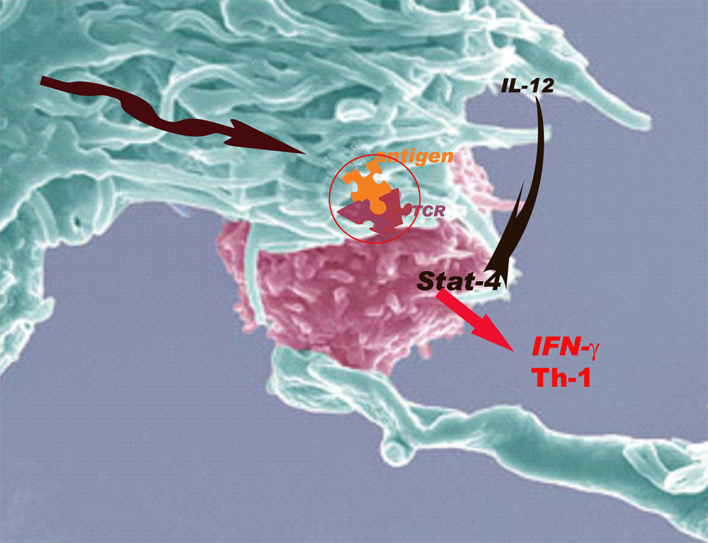
Increased immunoreactivity for STAT4 in
BAL-derived lymphocytes of COPD patients.
CTLA-4
Di Stefano A, Caramori G, Capelli A. et al. ERJ 2004 24: 78-85
G. Zhu*, A. Agusti…D. Lomas. Eur Respir J 2009; 34: 598–604

Slide 18
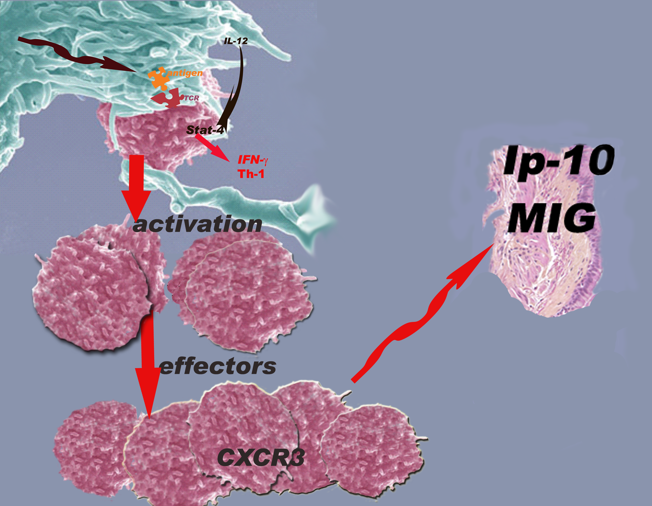
Saetta m. Am J Respir Crit Care Med2002 May 15;165(10):1404-9
Notes:
CXCR3 is a chemokine receptor preferentially expressed on lymphocytes, particularly on type-1 T-lymphocytes. Smokers who develop chronic obstructive pulmonary disease (COPD) have a chronic bronchopulmonary inflammation that is characterized by an increased infiltration of T-lymphocytes, particularly CD8(+), in the airways and lung parenchyma. To investigate the expression of CXCR3 and its ligand (IP-10) interferon-induced protein 10/CXCL10 in COPD, we counted the number of CXCR3(+) cells and analyzed the expression of CXCL10 in the peripheral airways of 19 patients undergoing lung resection for localized pulmonary lesions. We examined lung specimens from seven smokers with fixed airflow limitation (COPD), five smokers with normal lung function, and seven nonsmoking subjects with normal lung function. The number of CXCR3(+) cells was immunohistochemically quantified in the epithelium, in the submucosa, and in the adventitia of peripheral airways. The number of CXCR3(+) cells in the epithelium and submucosa was increased in smokers with COPD as compared with nonsmoking subjects, but not as compared with smokers with normal lung function. Immunoreactivity for the CXCR3-ligand CXCL10 was present in the bronchiolar epithelium of smokers with COPD but not in the bronchiolar epithelium of smoking and nonsmoking control subjects. Most CXCR3(+) cells coexpressed CD8 and produced interferon gamma. These findings suggest that the CXCR3/CXCL10 axis may be involved in the T cell recruitment that occurs in peripheral airways of smokers with COPD and that these T cells may have a type-1 profile. MIG /ccxl9

Slide 19

COPD: EVASION AND PROGRESSION
STEP 1
STEP 2
STEP 3
innate immunity
Adaptive immunity
Tolerance failure.
Tregs
CTLA-4
Resolution of inflammation
SEVERE DISEASE
Persistent inflammation:
MILD
SEVERE
tolerance
i m m u n i t y
Notes:
19
Summary slide proposing how the STEPS relate to GOLD stages and the possible mechanisms of evasion We do not think there is necessarily a progression in Gold stages. Gold I II would probably allways remain there and only the ones to be GOLDIV would succesfully go through all the steps.What makes some stop at STEP I is the key issue.

Slide 21
T-cell inflammation in COPD: Emphysema
CD8+ Tcell
Cosio M, Saetta M, Agusti A: N Engl J Med 2009;360:2445-54

Slide 22
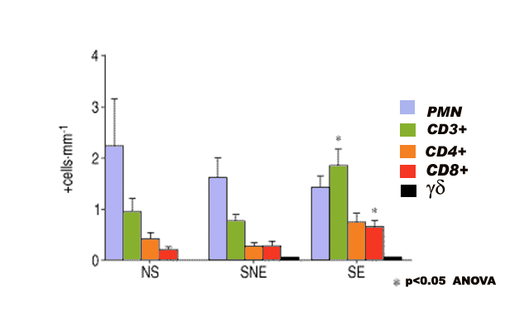
Alveolar wall inflammation.
*
*
*
*
Majo J, Ghezzo H, Cosio M. Eur Respir J, 2001;17:946-953
Saetta M Di Stefano A, Turato G et al: Am J Resp Crit Care Med;1998, 157: 822

Slide 23
STEP III
Autoimmune lung
Injury.
Cosio M, Saetta M, Agusti A: N Engl J Med 2009;360:2445-54.
Notes:
23
Figure 5. The Adaptive Immune Reaction — Step 3 in the Process Leading to COPD.
With the failure of tolerance or immune regulation in step 2, an adaptive immune inflammation (autoimmune) develops
in the lung, consisting of CD4+ type 1 helper (Th1) T cells, cytolytic CD8+ T cells, and IgG-producing B cells.
Regulatory T cells (Treg) and γδ CD8+ T cells would attempt to modulate the inflammatory process and the severity
of COPD would depend on the balance between effector and regulatory signals. The resulting immune inflammation,
induced by CD4+ Th1 T cells and consisting of activated innate immune cells producing oxidative stress and
proteinases, along with cytolytic CD8+ T cells and B cells, leads to cellular necrosis and apoptosis, immune and
complement deposition, tissue injury with airway remodeling, and emphysema, as well as the release of additional
antigenic material, which perpetuates the process. In step 3, the full autoimmune process has developed, producing
the most severe disease (Gold stage 3 and stage 4). NO denotes nitric oxide and ROS reactive oxygen species.

Slide 24
The natural resolution of inflammation
1) Removal of the initial stimulus which is critical. Many chronic ongoing inflammatory conditions are probably driven mostly by persistence of the offending agent or/and autoimmunity: cigarettes!
2) Removal of the inflammatory cells and cell debris to allow the final repair to occur.
3) Decrease of the proinflammatory mediators involved in attracting new inflammatory cells to the lesions and the persistence of the inflammation
Henson PM. Nature Immunol. 2005: 6; 1179-1181
Noguera et al. Respiratory Research 2012, 13:101

Slide 25
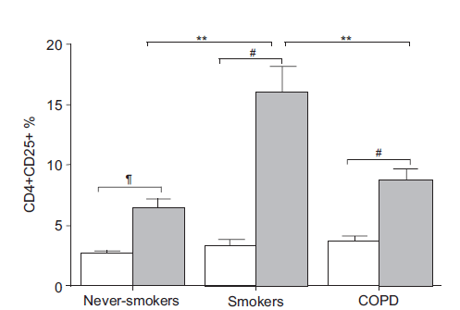
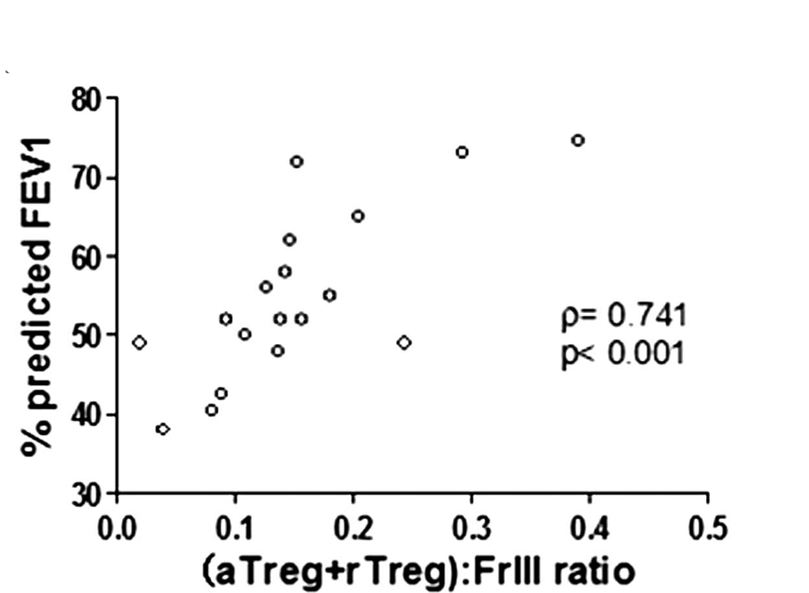
CD4+CD25+ T-cells (Tregs) in COPD
blood
BAL
Barcelo B... Agusti AG. Eur Respir J 2008;31:555-62
.
Lee SH, . Nat Med 2007; 13: 567-569
JHou J, et al. Thorax 2013;68:1131–1139
Notes:
(b,c) Cumulative data
(mean ± s.d.) from control and emphysemic subjects showing percentage of
TR cells in peripheral blood and lung. *P ¼ 0.013.
autoimmunity
is characterized by a lack of regulatory T (TR) cells, a subset of
TH cells that play key roles in modulating inflammation in autoimmunity7.
We reasoned that TH1 responses to elastin peptides in the
lungs of emphysema subjects might be the result of a lack of either
TR-cell populations and/or TR function. We conducted a functional
analysis of TR cells in emphysema and control subjects, using several
effector:target ratios (that is, CD4+CD25+:CD4+CD25–). We found that autologous target T-cell proliferation and cytokine secretion were
markedly inhibited in both groups of subjects, indicating normal
TR-cell function in peripheral blood of emphysema subjects (Supplementary
Fig. 3 online).
We next determined the abundance of TR cells in peripheral
blood and whole lungs of both groups of subjects. TR cells (CD4+/
CD25hi/CD62L+) were present at the same frequency in the peripheral
blood of control and emphysema subjects, although they comprised
only approximately 2% of all peripheral blood mononuclear cells
(Fig. 2a–c). However, we found that significantly fewer TR cells were
present in the lungs of subjects with emphysema relative to control
subjects. We also found significantly less mRNA for FOXP3,
a transcription factor that is critical for the development of TR
cells, and less IL-10 secretion from the whole lung of subjects
with emphysema as compared to control subjects
Agusti: white peripheral blood grey Bal

