Slide 1


Tumori del polmone: la terapia oncologica attuale personalizzata e non
Dott. Domenico Galetta
Prof. Giampietro Gasparini
IRCCS Istituto Tumori Giovanni Paolo II
BARI
Trieste 11 aprile 2016

Slide 2

NSCLC: STADI E TRATTAMENTI PREVALENTI
CHIRURGIA CHEMIO RADIO
IA
IB
IIA
IIB
IIIA N1
mN2
b N2
IIIB N3 controlaterale
T4 chirurgico
N3 sovraclaveare
IV (metastatico)
C
U
R
A
T
I
V
A
A
D
I
U
V
A
N
T
E
N
E
O
A
D
i
U
V
A
N
T
E
P
A
L
L
I
A
T
I
V
A
TNM 7^ Ed Goldstraw et al, JTO 2007
Notes:
Thoracic irradiation has been the mainstay of treatment for inoperable stage III disease. However its curative potential is extremely poor with 5-year survival of 3-10%

Slide 3
34 RCTs – 8447 pts [F.U. 5.5 yrs]
HR 0.86 (95% CI, 0.81-0.92; P<.0001)
AB at 5 yrs of 4%
HR 0.88 (95% CI, 0.81-0.97; P=.009)
13 RCTs – 2660 pts [F.U. 6.4 yrs]
AB at 5 yrs of 4%
NSCLC MACG, Lancet 2010

Slide 4
R
A
N
D
OM I
Z
E
1:1
Arm A:
Chemotherapy
X 4 cycles*
ELIGIBLE:
Resected
Stage IB (>/= 4cm)-IIIA
6-12 weeks post-op
(AJCC 6th edition)
STRATIFIED:
1) Cisplatin Doublet*
2) Stage
3) Histology
4) Gender
Arm B:
Chemotherapy
x 4 cycles* +
Bevacizumab
X 1 year
*Investigator Choice of 4 chemotherapy regimens
21 day cycles all with Cisplatin given at 75 mg/m² on day 1
Cisplatin /Vinorelbine: 30 mg/m2 day 1, 8
Cisplatin /Docetaxel 75 mg/m2 day 1
Cisplatin /Gemcitabine 1200 mg/m2 day 1,8
  Cisplatin /Pemetrexed 500 mg/m2 day 1 (2009 amendment)
  Bevacizumab 15 mg/kg IV q 3 weeks for up to 1 year
Followed for Survival/Recurrence
CXR/exam q 3 months x 2 years,
then q 6 months through year 5
then annually through year 10

Slide 5
Overall Survival Disease Free Survival
OS hazard ratio (B:A): 0.99
95% CI: (0.81-1.21)
p=0.93
DFS hazard ratio (B:A): 0.98
95% CI: (0.84-1.14)
p=0.75

Slide 6
NSCLC: STADI E TRATTAMENTI PREVALENTI
CHIRURGIA CHEMIO RADIO
IA
IB
IIA
IIB
IIIA N1
mN2
b N2
IIIB N3 controlaterale
T4 chirurgico
N3 sovraclaveare
IV (metastatico)
C
U
R
A
T
I
V
A
A
D
I
U
V
A
N
T
E
N
E
O
A
D
i
U
V
A
N
T
E
P
A
L
L
I
A
T
I
V
A
TNM 7^ Ed Goldstraw et al, JTO 2007
Notes:
Thoracic irradiation has been the mainstay of treatment for inoperable stage III disease. However its curative potential is extremely poor with 5-year survival of 3-10%

Slide 7
Concurrent versus sequential chemoradiation: meta analysis of survival
Auperin et al J Clin Oncol 2010; 28:2181

Slide 8
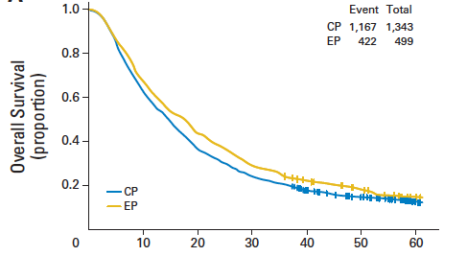
OS with CDDP-VP16 versus CBDCA-Paclitaxel concomitant with RT
14.6 mos
17.3 mos
HR, 0.88; 95% CI, 0.79 to 0.99; p= 0.0209
Santana-Davila et al. JCO 2014

Slide 9
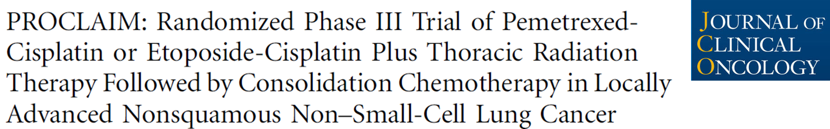
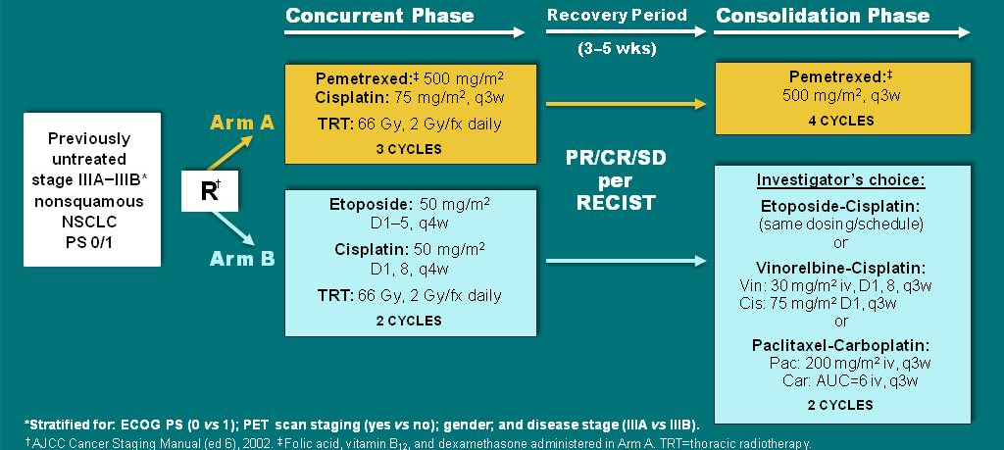
PROCLAIM: Study Design
Senan S, et al J Clin Oncol 2016;34:953-962

Slide 10
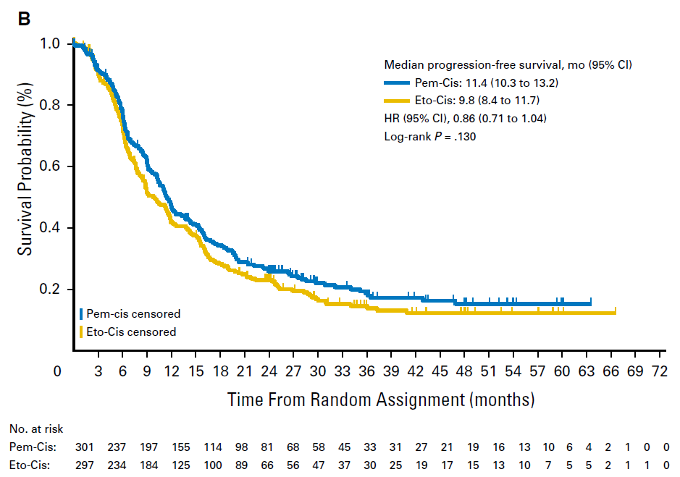
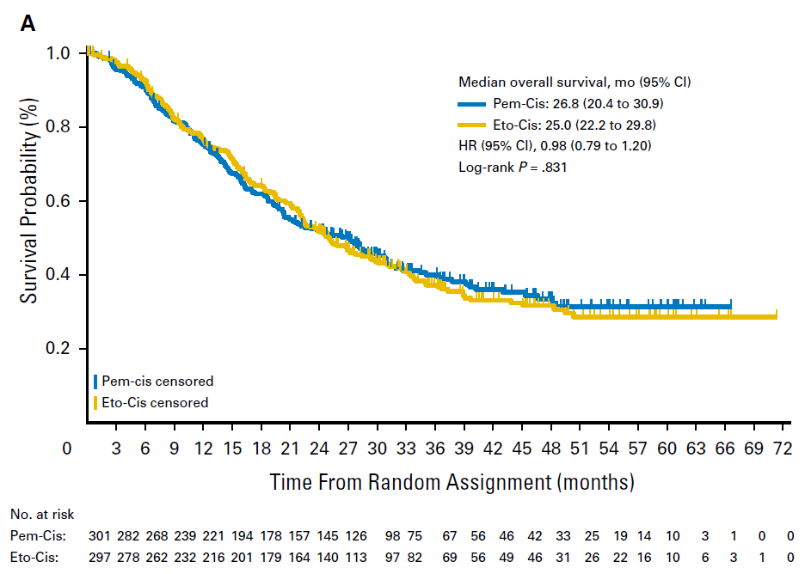
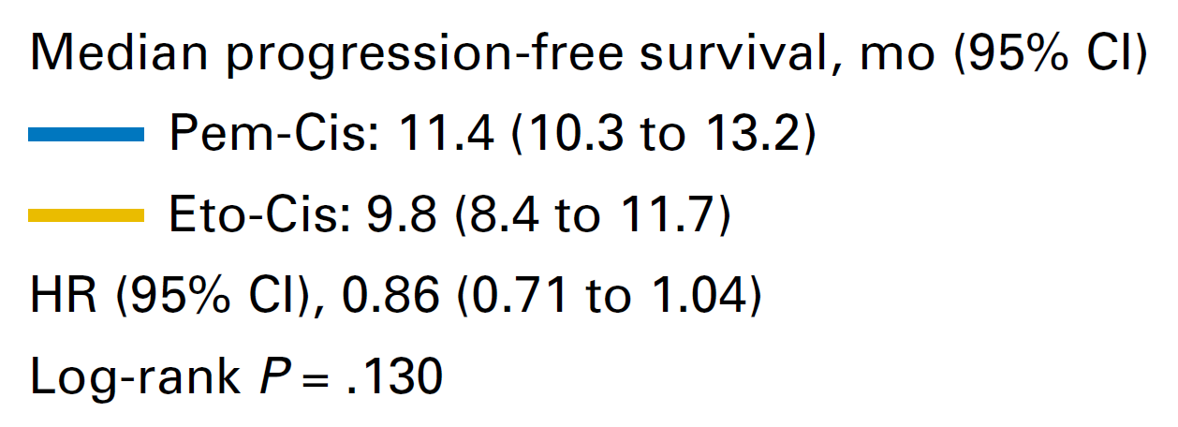
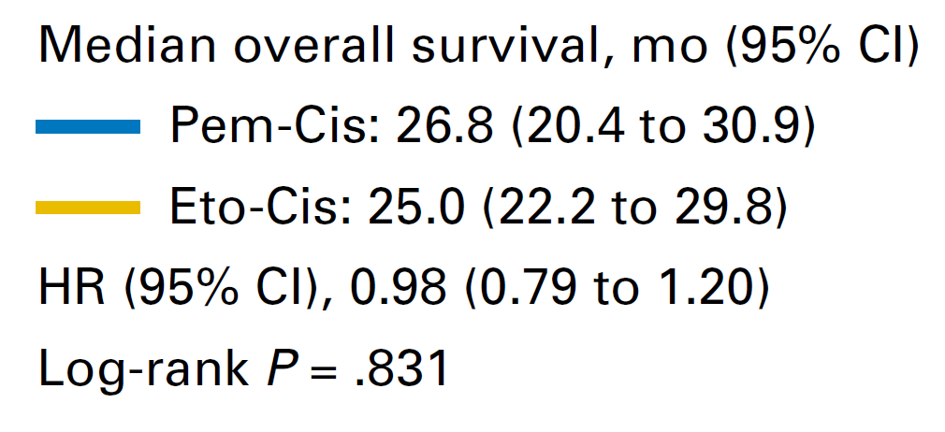
Overall Survival
Progression Free Survival
Senan S, et al J Clin Oncol 2016;34:953-962

Slide 11
NSCLC: STADI E TRATTAMENTI PREVALENTI
CHIRURGIA CHEMIO RADIO
IA
IB
IIA
IIB
IIIA N1
mN2
b N2
IIIB N3 controlaterale
T4 chirurgico
N3 sovraclaveare
IV (metastatico)
C
U
R
A
T
I
V
A
A
D
I
U
V
A
N
T
E
N
E
O
A
D
i
U
V
A
N
T
E
P
A
L
L
I
A
T
I
V
A
TNM 7^ Ed Goldstraw et al, JTO 2007
Notes:
Thoracic irradiation has been the mainstay of treatment for inoperable stage III disease. However its curative potential is extremely poor with 5-year survival of 3-10%

Slide 12
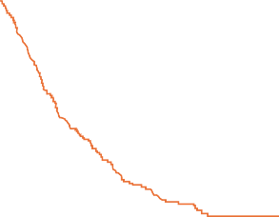
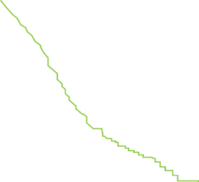


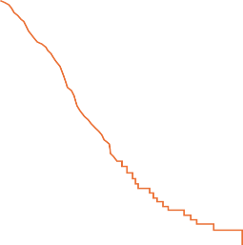
1st-LINE PLATINUM-BASED CT in A-NSCLC
Efficacy Plateau
100
Pacli + carbo (PCb)
Cis + vin (CV)
1.0
Pacli + cis (PC)
Gem + cis (GC)
Doc + cis (DC)
Pacli + carbo (PCb)
1.0
Pacli + carbo (PCb)
Gem + cis (GC)
Cis + vin (CV)
0.9
0.9
80
0.8
0.8
0.7
0.7
Median Overall Survival: ≈ 10 months
60
0.6
0.6
0.5
Overall survival
Overall survival %
Overall survival
0.5
40
0.4
0.4
0.3
0.3
20
0.2
0.2
0.1
0.1
0
0
0
0
5
10
15
20
25
30
0
5
10
15
20
25
30
0
5
10
15
20
25
30
Months
Months
Months
Study arm | OS (mo) | 1 year (%)
PCb | 8.6 | 38
CV | 8.1 | 36
Study arm | OS (mo) | 1 year (%)
PC | 7.8 | 31
GC | 8.1 | 36
DC | 7.4 | 31
PCb | 8.1 | 34
Study arm | OS (mo) | 1 year (%)
PCb | 9.9 | 43
GC | 9.8 | 37
CV | 9.5 | 37
K Kelly et al, JCO 2001 J Schiller et al, NEJM2002 GV Scagliotti et al, JCO 2002
OS, overall survival

Slide 13

H
Hystology = Major Changes²

Slide 14


Bevacizumab in Non-squamous NSCLC
Key Results
 | ECOG 4599 |  | AVAIL
 | PCB | PC | CGB (7.5) | CGB (15) | CG
* mg/kg | Paclitaxel Carboplatin Bevacizumab (15)* | Paclitaxel Carboplatin | Cisplatin Gemcitabin Bevacizumab (7,5)* | Cisplatin Gemcitabin Bevacizumab (15)* | Cisplatin Gemcitabin
RR | 35% | 15% | 34.1% | 30.4% | 20.1%
p-value | <0.001 |  | <0.0001 (7.5) 0.0023 (15)
PFS (m) | 6.2 | 4.5 | 6.7 | 6.5 | 6.1
HR / p-value | 0.66 (<0.001) |  | 0.75 (0.003) / 7.5 0.82 (0.03) / 15
OS (m) | 12.3 | 10.3 | 13.6 | 13.4 | 13.1
HR / p-value | 0.79 (0.003) |  | 0.93 (ns) / 7.5 1.03 (ns) / 15
Sandler, et al. N Engl J Med 2006;355:2542-2550.
Reck, et al. J Clin Oncol 2009;27:1227-1234.
Reck, et al Ann Oncol 2010

Slide 15
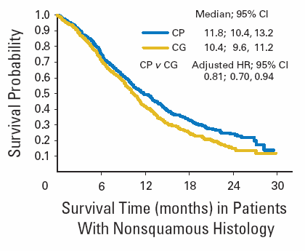
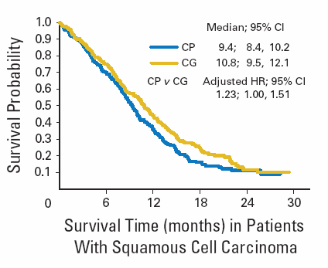
Scagliotti GV et al, JCO 2008

Slide 16

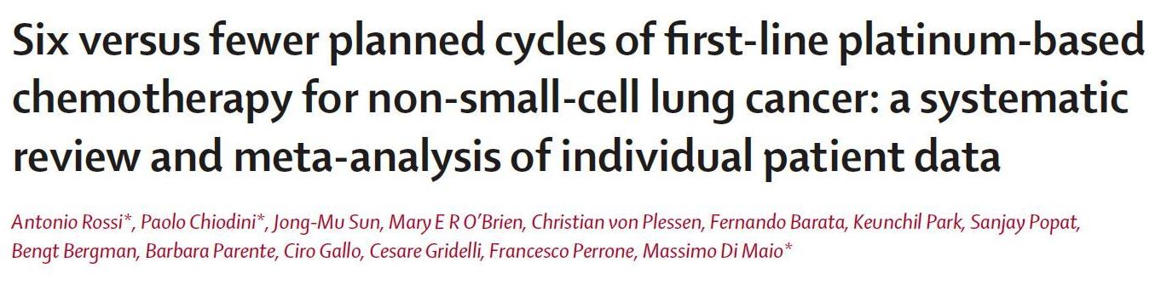
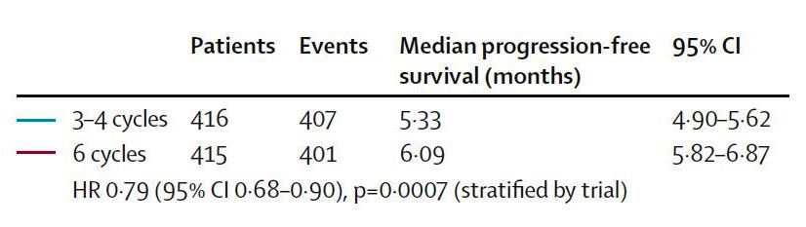
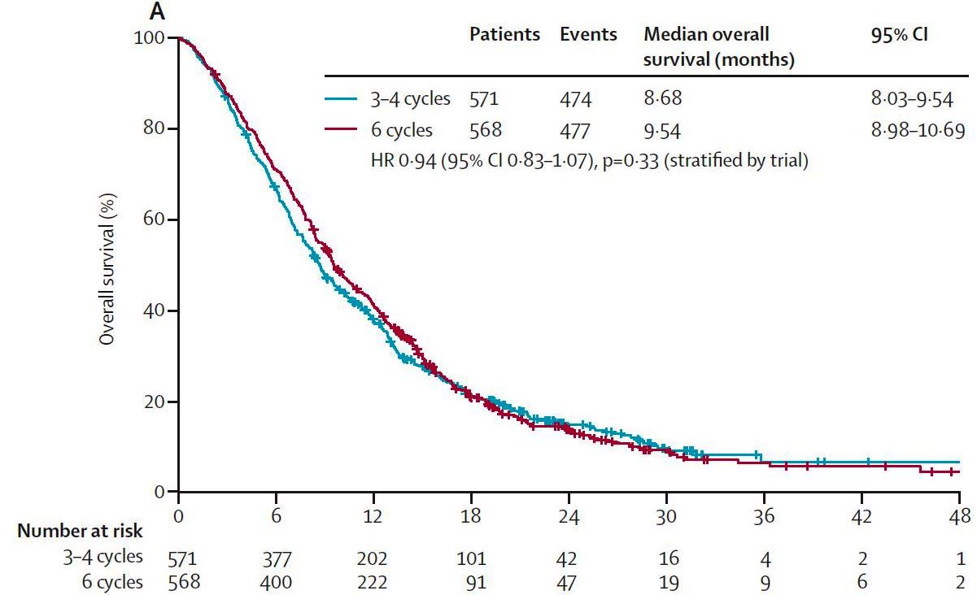
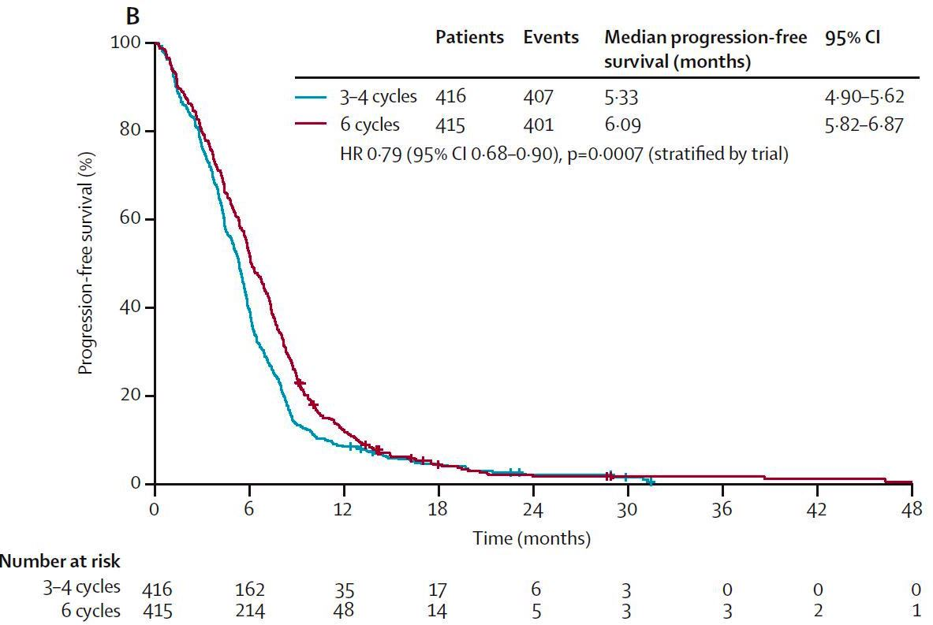
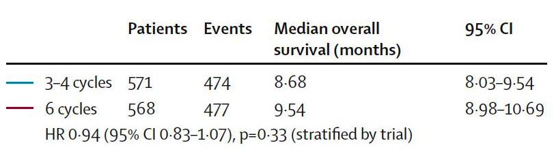
Lancet Oncol. 2015 Feb;16(2):118-9.

Slide 17
Continuation maintenance trials
First author | No. pts enrolled | Maintenance therapy | PFS (mos) from random (p) | PFS (mos) from induction (p) | OS (mos) from random (p) | OS (mos) from induction (p)
Brodowicz, 2006 | 138 68 | Gemcitabine vs BSC | 3.6 (< .01) 2.0 | 6.6 (< .001) 5.0 | 10.2 (.172) 8.1 | 13 (.19) 11
Belani, 2010 | 128 127 | Gemcitabine vs BSC | 3.9 (.575) 3.8 | 7.7 (.57) 7.4 | 8.0 (.838) 9.3 | NR
Belani, 2003 | 65 65 | Paclitaxel vs Observation | 38 wks 29 wks | 9.5 7.2 | 75 wks 60 wks | 18.7 15
Paz-Ares, 2012 (PARAMOUNT) | 359 180 | Pemetrexed vs Placebo | 4.1 (.00006) 2.8 | 6.9 (<.0001) 5.6 | 13.9 (.019) 11 | 16.9 (.019) 14
Barlesi, 2014 (AVAPERL) | 128 125 | Pemetrexed + Bevacizumab vs Bevacizumab | 7.4 (< .001) 3.7 | 10.2 (< .001) 6.6 | 17.1 (.29) 13.2 | 19.8 (.32) 15.9
Lu, 2013 (TFINE) | 123 61 | Docetaxel vs BSC | 5.4 (.002) 2.7 | NR | 14.1 (.77) 14.1 | NR
Perol, 2012 | 154 155 | Gemcitabine vs Observation | 3.8 (<.001) 1.9 | NR | 12.1 (.38) 10.8 | NR

Slide 18
Continuation maintenance trials
First author | No. pts enrolled | Maintenance therapy | PFS (mos) from random (p) | PFS (mos) from induction (p) | OS (mos) from random (p) | OS (mos) from induction (p)
Brodowicz, 2006 | 138 68 | Gemcitabine vs BSC | 3.6 (< .01) 2.0 | 6.6 (< .001) 5.0 | 10.2 (.172) 8.1 | 13 (.19) 11
Belani, 2010 | 128 127 | Gemcitabine vs BSC | 3.9 (.575) 3.8 | 7.7 (.57) 7.4 | 8.0 (.838) 9.3 | NR
Belani, 2003 | 65 65 | Paclitaxel vs Observation | 38 wks 29 wks | 9.5 7.2 | 75 wks 60 wks | 18.7 15
Paz-Ares, 2012 (PARAMOUNT) | 359 180 | Pemetrexed vs Placebo | 4.1 (.00006) 2.8 | 6.9 (<.0001) 5.6 | 13.9 (.019) 11 | 16.9 (.019) 14
Barlesi, 2014 (AVAPERL) | 128 125 | Pemetrexed + Bevacizumab vs Bevacizumab | 7.4 (< .001) 3.7 | 10.2 (< .001) 6.6 | 17.1 (.29) 13.2 | 19.8 (.32) 15.9
Lu, 2013 (TFINE) | 123 61 | Docetaxel vs BSC | 5.4 (.002) 2.7 | NR | 14.1 (.77) 14.1 | NR
Perol, 2012 | 154 155 | Gemcitabine vs Observation | 3.8 (<.001) 1.9 | NR | 12.1 (.38) 10.8 | NR

Slide 19
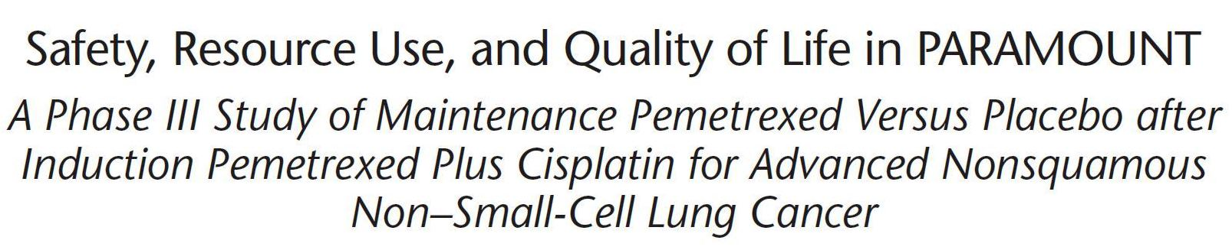
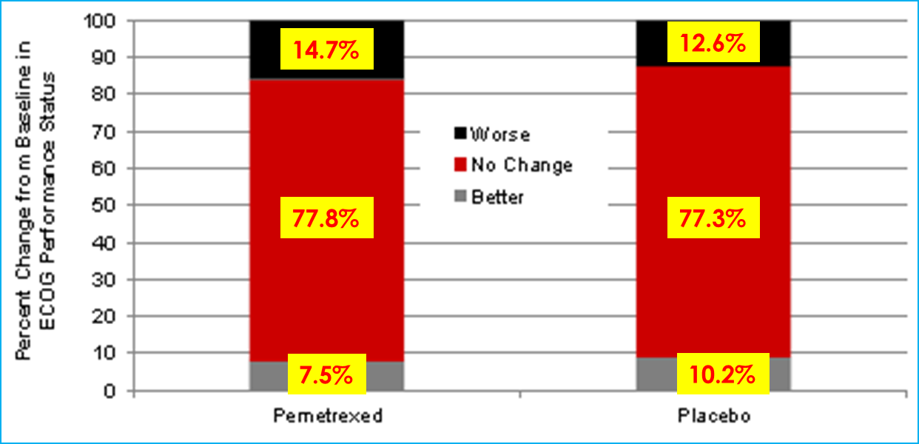
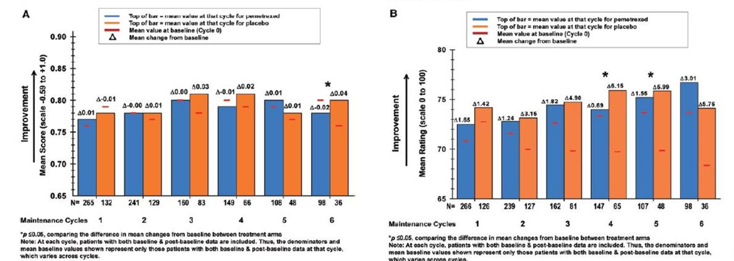
Change in ECOG PS from randomisation to last maintenance treatment
^{A, EQ-5D index score}
^{B, EQ-5D VAS rating}
C. Gridelli et al J Thorac Oncol. 2012;7: 1713–1721

Slide 20
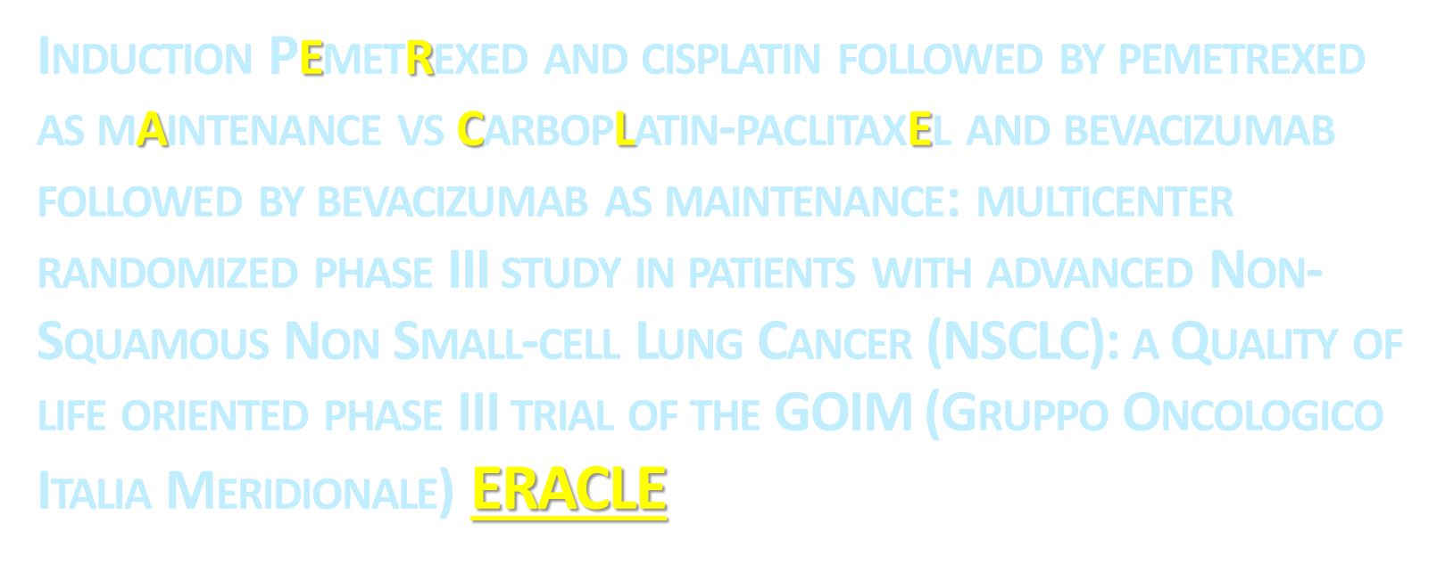

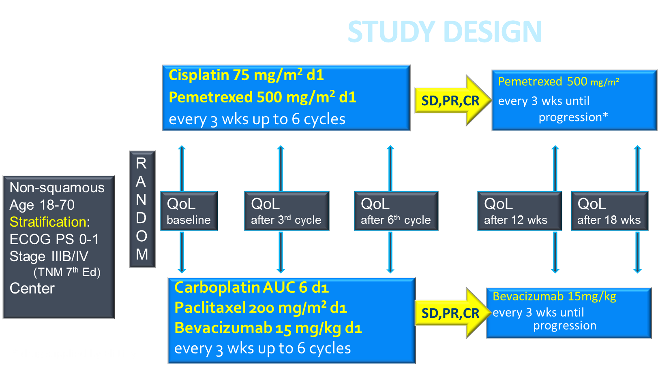

Slide 21
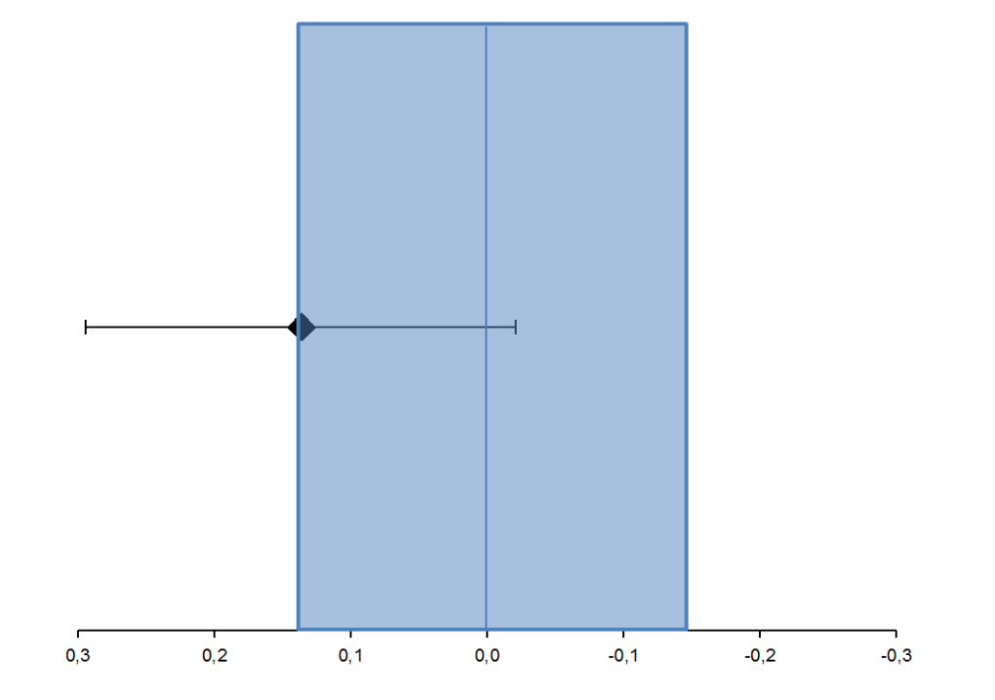
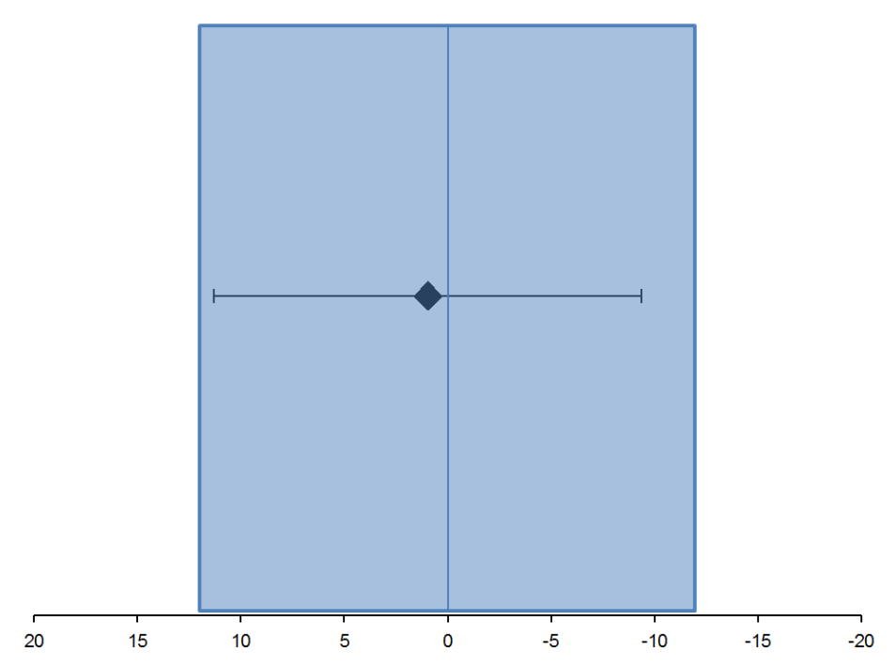
RESULTS
EQ5D-I
EQ5D-VAS
M.I.D. (±0.137)
M.I.D. (±12.0)
CP better
CbTB better
CP better
CbTB better
 | CP (n=38) | CbTB (n=29)
Mean change | -0.04 | -0.177
between means (95% CI) | 0.1365 (-0.021; 0.294)
Student’s t test | p = 0.088
Mann – Whitney test | p = 0.078
Linear model adjusted by baseline value | p = 0.058
 | CP (n=37) | CbTB (n=29)
Mean change | -2.892 | -3.862
between means (95% CI) | 0.97 (-9.374; 11.314)
Student’s t test | p = 0.85
Mann – Whitney test | p = 0.41
Linear model adjusted by baseline value | p = 0.30
Galetta D et al Clin Lung Cancer. 2015 Jul;16(4):262-73

Slide 22
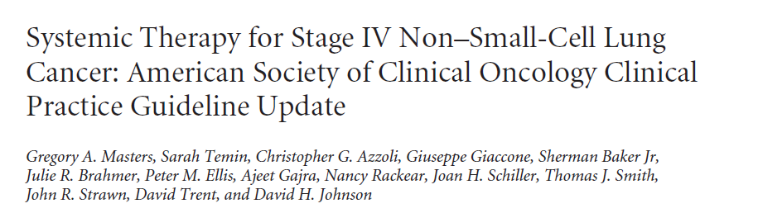
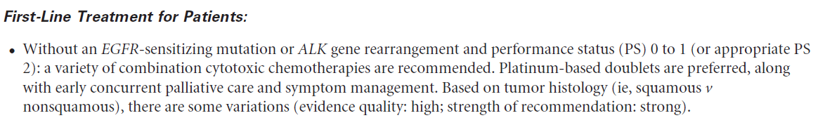
Published Ahead of Print on August 31, 2015 as 10.1200/JCO.2015.62.1342

Slide 23
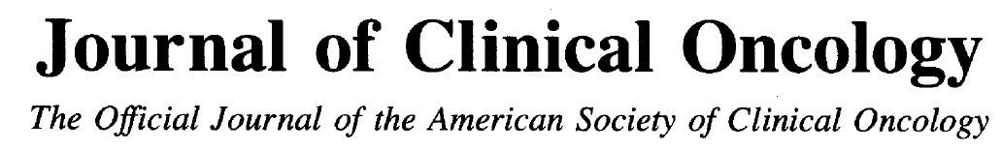


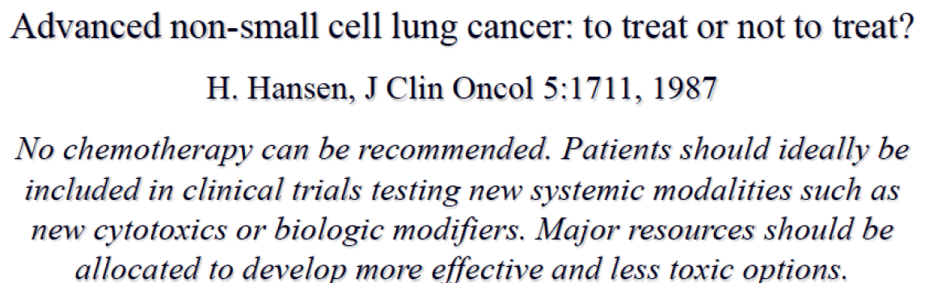

Slide 24



Slide 25
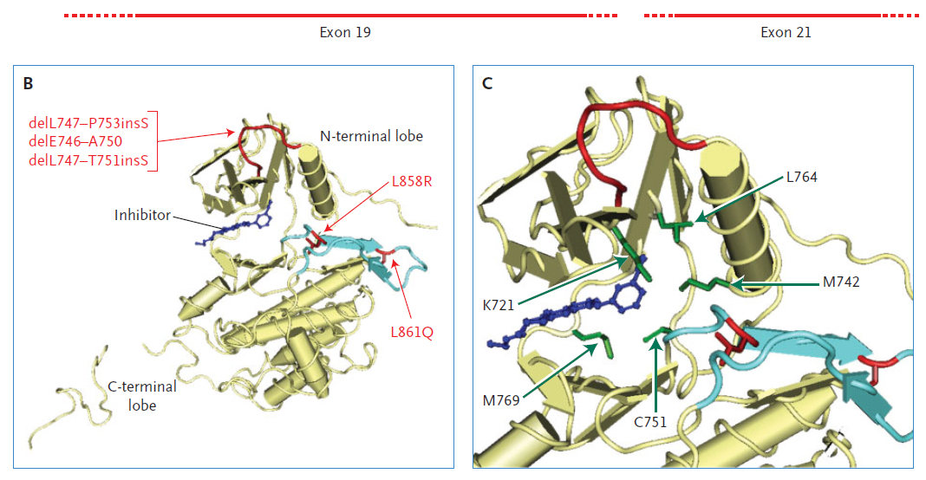
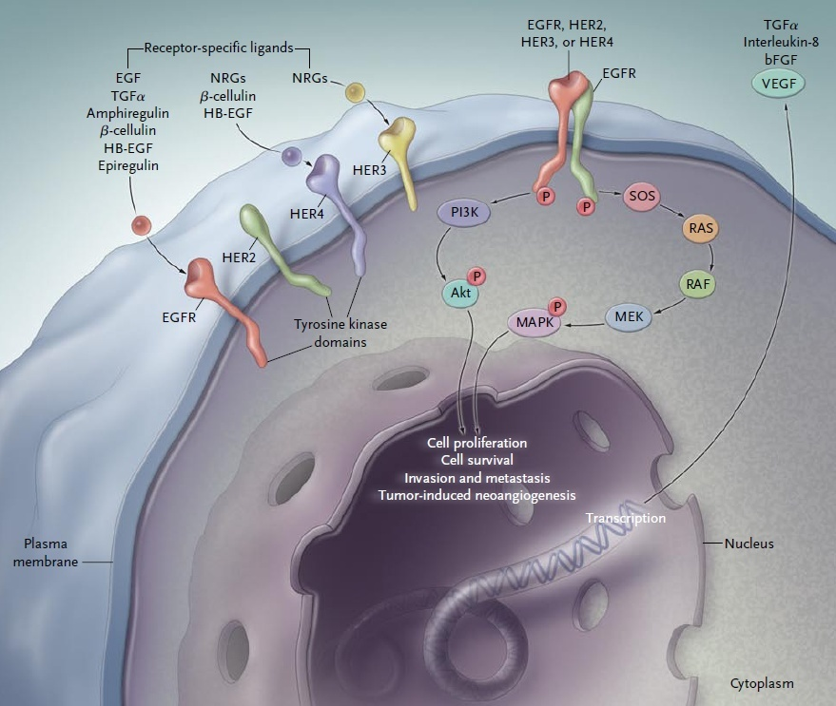
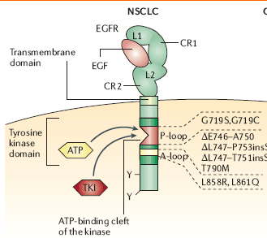
Courtesy of prof. Ciardiello F, from NEJM 2009

Slide 26
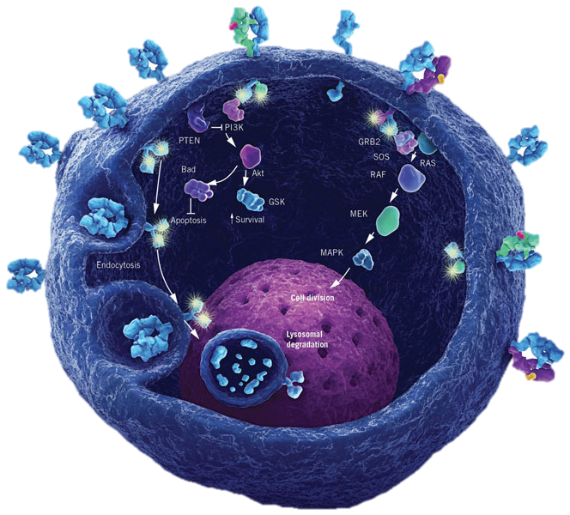
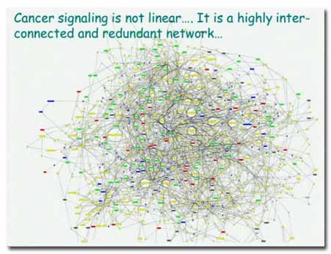
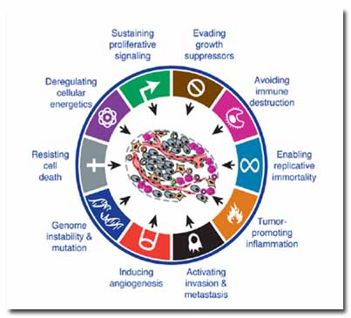
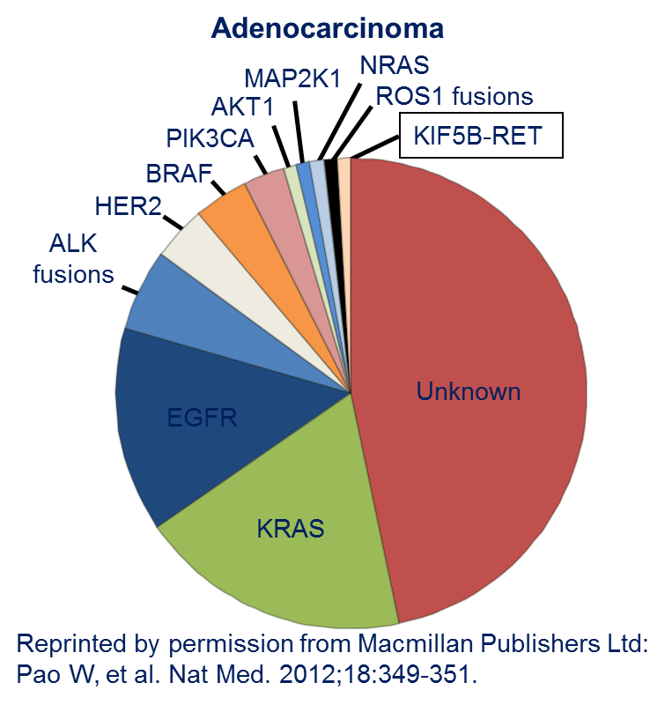
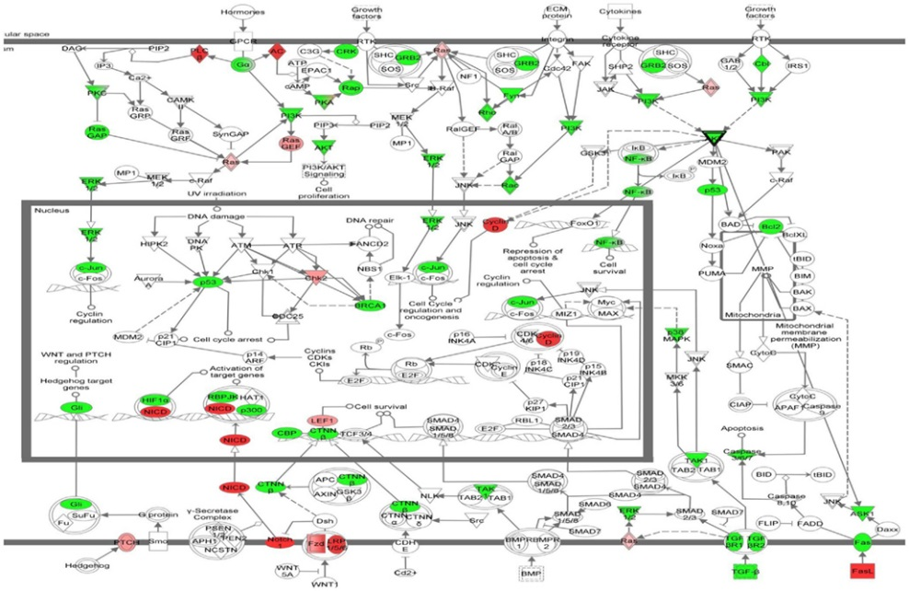

Slide 27
Metastatic NSCLC Today
NSCLC
12 months
80%
No clear driver or oncogenic event
24-36 months
LARGE CELL
ADENOCARCINOMA
SQUAMOUS
20%
NSCLC
Oncogene
addicted
Cisplatin
+
Pemetrexed
Doublet
+
Bevacizumab
Platinum
doublet
ALK traslocated:
Crizotinib/Ceritinib
EGFR mutated:
Erlotinib, Gefitinib, Afatinib

Slide 28
Metastatic NSCLC Today
NSCLC
12 months
12 months
80%
No clear driver or oncogenic event
80%
No clear driver or oncogenic event
24-36 months
LARGE CELL
ADENOCARCINOMA
LARGE CELL
SQUAMOUS
SQUAMOUS
20%
NSCLC
Oncogene
addicted
Cisplatin
+
Pemetrexed
Doublet
+
Bevacizumab
Platinum
doublet
ALK traslocated:
Crizotinib/Ceritinib
EGFR mutated:
Erlotinib, Gefitinib, Afatinib

Slide 29
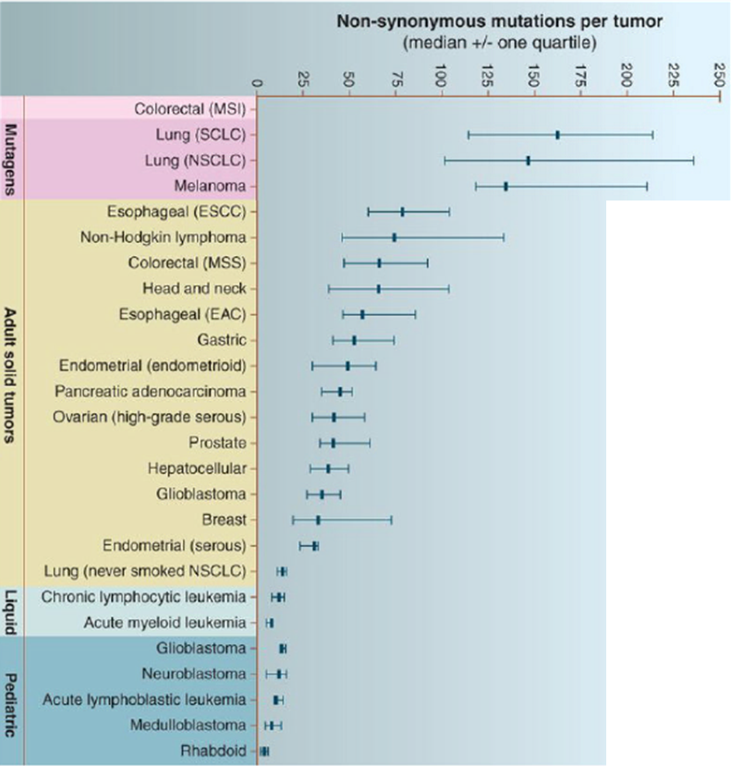
Non-synonymous mutations per tumor
Smart Cancer
Multiple mutational drivers
Large Mutational load
Multi-targeted therapy
Resistance common, early
NON-ONCOGENE ADDICTION
Stupid Cancer
Single Dominant Mutation
Small Mutational Load
Monotherapy is effective
Resistance rare, late
ONCOGENE ADDICTION
Courtesy of Emilio Bria

Slide 30
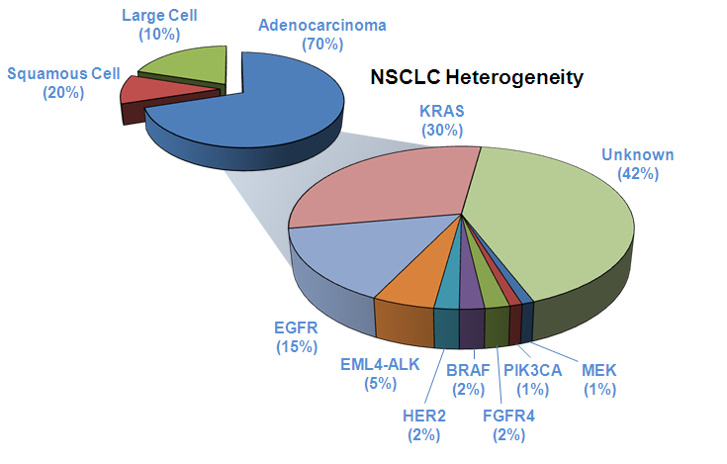
NSCLC Heterogeneity: oncogenic targets and different therapeutical approach

Slide 31

Agenda
Targeted Therapies of NSCLC
  EGFR
  ALK/ROS/MET
  B-RAF
  HER2
  RET
  NTRK
  (KRAS)
  (PI3K)

Slide 32
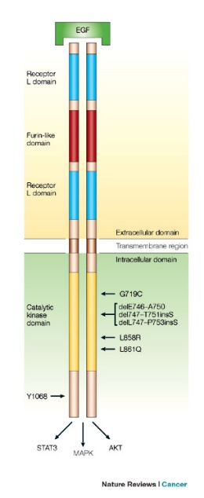
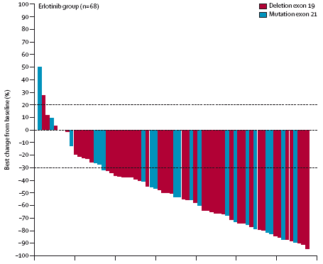
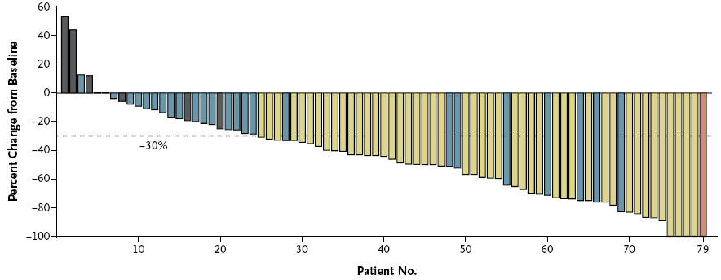
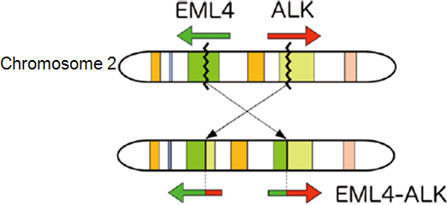
Dependence on oncogenic drivers
EGFRmut
Predominantly Adenocarcinomas
EML4-ALK
Kwak et al, N Engl J Med 2010;363:1693-703 Rosell et al, Lancet Oncol 2012; 13: 239–46

Slide 33
EGFR-TKIs and EGFR Mutation-Directed Frontline Studies
Study | Treatment | N (EGFR mut+) | RR (%) (TKI vs CT) | PFS mos (EGFR mut+) | HR for PFS (EGFR mut +) | p-value PFS | OS mos (EGFR mut+) | HR for OS (EGFR mut+)
IPASS Mok ¹ 2009 | Gefitinib Chemo | 132 129 | 71.2 47.3 | 9.5 6.3 | 0.48 (0.36-0.66) | <0.0001 | 21.6 21.9 | 0.91* (0.76-1.10) *overall population
First SIGNAL Han JY² 2012 | Gefitinib Chemo | 26 16 | 84.6 37.5 | 8.0 6.3 | 0.54 (0.26-1.10) | <0.086 | 27.2 25.6 | 1.043 (0.49-2.18)
NEJ002 Maemondo 2010 | Gefitinib Chemo | 114 110 | 73.7 30.7 | 10.8 5.4 | 0.30 (0.22-0.41) | <0.001 | 30.5 23.6 | 0.887 (0.63-1.24)
WJTOG3405 Mitsudomi T 2010 | Gefitinib Chemo | 86 86 | 62.1 32.2 | 9.2 6.3 | 0.49 (0.34-0.71) | <0.001 | 35.5 38.8 | 1.185 (0.76-1.82)
OPTIMAL Zhou 2011, 2015 | Erlotinib Chemo | 82 72 | 83 36 | 13.7 4.6 | 0.16 (0.10-0.26) | <0.001 | 22.8 27.2 | 1.19 (0.83-1.71)
EURTAC Rosell 2012 Benlloch 2014 | Erlotinib Chemo | 86 87 | 58 15 | 9.7 5.2 | 0.37 (0.25-0.54) | <0.0001 | 25.8 20.8 | 0.86 (0.54-1.38)
ENSURE Wu 2015 | Erlotinib Chemo | 110 107 | 62.7 33.6 | 11.0 5.5 | 0.34 (0.22-0.51) | <0.0001 | 26.3 25.5 | 0.91 (0.63-1.31)
LUX LUNG 3 Sequist 2013 Yang 2015 | Afatinib Chemo | 230 115 | 56 23 | 11.1 6.9 | 0.58 (0.43-0.78) | <0.001 | 28.2 28.2 | 0.88 (0.66-1.17)
LUX LUNG 6 Wu 2014 Yang 2015 | Afatinib Chemo | 242 122 | 66.9 23.0 | 11.0 5.6 | 0.28 (0.20-0.39) | <0.0001 | 23.1 23.5 | 0.93 (0.72-1.22)
Clinical selection
Bio selection
1st or 2nd g EGFR TKI
ORR: 55 to 85%
Median PFS 8,5 to 13,5 months
No OS benefit (cross over)
¹Asiatic, never- & light –smokers, adenocarcinoma (EGFR mut + 59.7%)
²Adenocarcinoma, Never-smokers (EGFR mut + 44%)

Slide 34
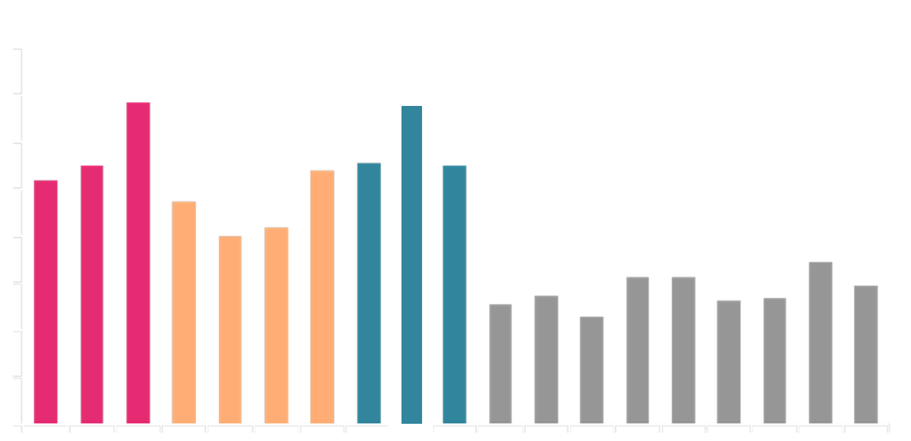
Median PFS with EGFR-TKIs in first-line EGFR Mut+ studies
16
14
13.7
13.6
12
11.0
11.0
11.1
10.4
10.8
10
9.5
8.4
8.0
8
Median PFS (months)
6.9
6.3
5.5
6.3
5.4
5.6
6
5.1
5.3
4.6
4
2
0
EURTAC
LUX-
LUNG 3
^{common}
ENSURE
OPTIMAL
IPASS
First-
SIGNAL
WJTOG
3405
NEJSG
002
LUX-
LUNG 3
LUX-
LUNG 6
EURTAC
ENSURE
OPTIMAL
IPASS
First-
SIGNAL
WJTOG
3405
NEJSG
002
LUX-
LUNG 3
LUX-
LUNG 6
Erlotinib
Gefitinib
Afatinib
Platinum-doublet chemotherapy

Slide 35
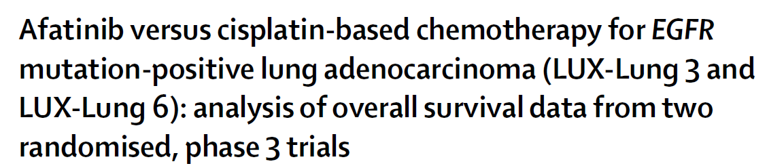
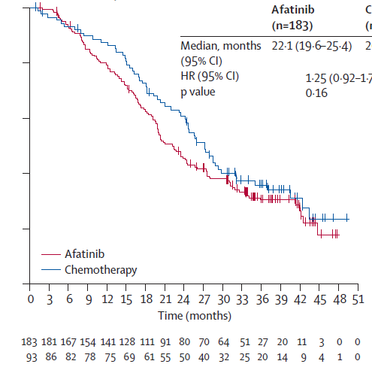
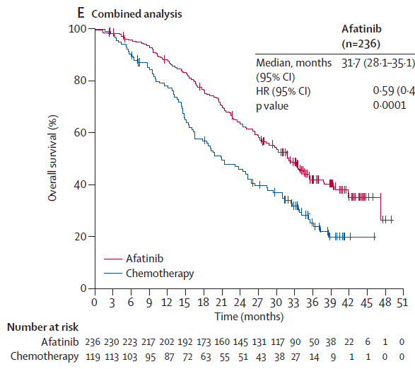
Del19 | Afatinib n=236 | Chemo n=119
Median, months | 31.7 | 20.7
HR (95%CI), p-value | 0.59 (0.45–0.77), p=0.0001
L858R | Afatinib n=183 | Chemo n=93
Median, months | 22.1 | 26.9
HR (95%CI), p-value | 1.25 (0.92–1.71), p=0.1600
Yang et al Lancet Oncol 2015

Slide 36
NSCLC oncogene addicted
Direct comparisons
LUX Lung 7: phase IIb trial of afatinib vs gefitinib
Patients with
  Advanced lung adenocarcinoma
  Documented common EGFR mutations (del19 or L858R)
  First line (no prior treatment)
N = 264
Randomization
Afatinib 40 mg
Gefitinib 250 mg
Primary endpoint: PFS and disease control rate at 12 months
Notes:
36

Slide 37
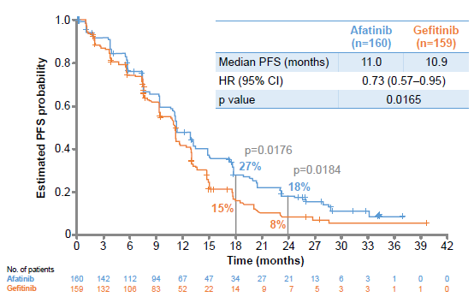
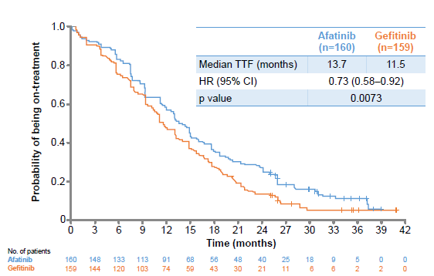
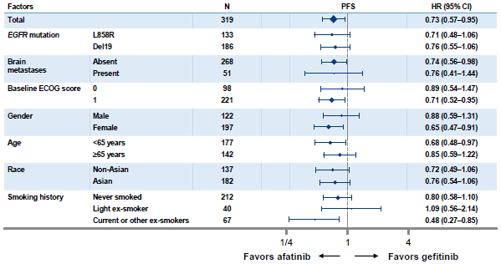
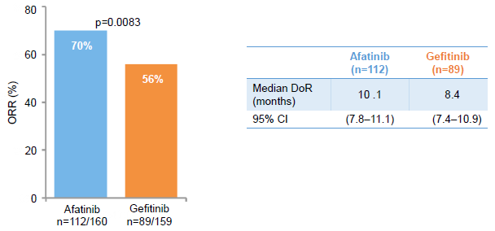
NSCLC oncogene addicted
LUX Lung 7: phase IIb trial of afatinib vs gefitinib
PFS by independent review
Time to treatment failure
PFS in prospectively defined subgroups
Objective response and duration of response (independent review)
Park K. et al
Singapore 2015 ESMO

Slide 38


NSCLC oncogene addicted
LUX Lung 7: phase IIb trial of afatinib vs gefitinib
Efficacy in patients with Del19 mutation
Efficacy in patients with L858R mutation
Park K. et al
Singapore 2015 ESMO

Slide 39


NSCLC oncogene addicted
Linee guida
NEOPLASIE DEL POLMONE
Edizione 2015
Notes:
39

Slide 40


ALK rearrangements: clinico-pathologic characteristics
Global incidence: ~ 5%; ++ EML4-ALK
Determination with FISH (and with IHC)
++ never-smoker or light-smoker; ++ young pts
Similar incidence in Caucasians and Asiatic pts
++ adenocarcinoma (in particular signet ring-type cells)
Mutually exclusive with EGFR, K-ras mut
Factor of EGFR-TKI resistance; data of higher response to pemetrexed
Notes:
40

Slide 41
PROFILE 1014 study design
Key entry criteria
ALK-positive by central FISH testingª
Locally advanced, recurrent, or metastatic non-squamous NSCLC
No prior systemic treatment for advanced disease
ECOG PS 0−2
Measurable disease
Treated brain metastases allowed
1:1
    Crizotinib
    250 mg BID PO,
    continuous dosing
    (N=167)
Crizotinib continued after PD
if ongoing clinical benefit
R
A
N
D
O
M
I
Z
E
Pemetrexed
500 mg/m²
+
cisplatin 75 mg/m²
OR
carboplatin AUC 5–6 q3w for ≤6 cycles
(N=167)
Crossover to
crizotinib permitted after PD^{b}
N=334
Randomization stratified by:
ECOG PS (0/1, 2),
Race (Asian, non-Asian),
Brain metastases (present, absent)
ªALK status determined using standard ALK break-apart FISH assay
^{b}Assessed by independent radiologic review
Salomon B et al: ESMO 2014

Slide 42
PFS by Independent Radiologic Review
(All Patients)
 | All patients
 | Crizotinib (N=172) | Chemo. (N=171)
Events, n (%) | 100 (58) | 137 (80)
Median, mo | 10.9 | 7.0
HR (95% CI) | 0.45 (0.35−0.60)
Pª | <0.0001
100
80
60
PFS probability (%)
40
20
0
0 5 10 15 20 25 30 35
At risk (ALL)
Crizotinib
Chemotherapy
Time (months)
172 120 65 38 19 7 1 0
171 105 36 12 2 1 0 0
ª1-sided stratified log-rank test
Notes:
Median PFS 10.9 vs. 7.0 months (crizotinib vs. chemotherapy; HR, 0.45; P<0.0001)
Median duration of follow-up for OS: 17 months in both treatment arms
With 68% of patients still in follow-up, median OS was not reached in either arm

Slide 43
Analysis of OS
100
80
60
 | All patients
 | Crizotinib (N=172) | Chemo. (N=171)
Events, n (%) | 44 (26) | 46 (27)
Median, mo | NR | NR
HR (95% CI) | 0.82 (0.54–1.25)
Pª | 0.180
Survival probability (%)
40
20
0
0 5 10 15 20 25 30 35
At risk
Crizotinib
Chemotherapy
Time (months)
172 152 123 80 44 24 3 0
171 146 112 74 47 21 4 0
With only 26% of OS events, median OS was not reached in either arm
  120/171 chemo. patients (70%) received subsequent crizotinib treatment
Analysis was not adjusted for the potentially confounding effects of crossover
NR, not reached; ª1-sided stratified log-rank test
Notes:
Median PFS 10.9 vs. 7.0 months (crizotinib vs. chemotherapy; HR, 0.45; P<0.0001)
Median duration of follow-up for OS: 17 months in both treatment arms
With 68% of patients still in follow-up, median OS was not reached in either arm

Slide 44



It is worthwhile finding an actionable genetic alteration in Lung Cancer
Using Multiplexed Assays of Oncogenic Drivers in Lung Cancers to Select Targeted Drugs
ECOG 1594
Schiller et al, NEJM 2002
Figure Legend:
Survival ComparisonsALK indicates anaplastic lymphoma kinase gene; EGFR(s), epidermal growth factor receptor gene (sensitizing); EGFR(o), epidermal growth factor receptor gene (other); KRAS, Kirsten rat sarcoma; NA, not applicable.A, Median survival (95% CI): oncogenic driver + no targeted therapy, 2.38 (1.81-2.93); oncogenic driver + targeted therapy, 3.49 (3.02-4.33); no oncogenic driver, 2.08 (1.84-2.46). B, Survival by oncogenic driver detected for patients with the 5 most frequent oncogenic drivers and targeted treatment. Median survival (95% CI): EGFR(s), 3.78 (2.77-NA); EGFR(o), 2.70 (1.42-NA); ALK, NA (2.80-NA); KRAS, 4.85 (1.30-NA); doubletons (oncogenic drivers in 2 genes), 2.69 (1.94-NA). Vertical tick marks are censoring events.
Kris M et al JAMA. 2014;311(19):1998-2006

Slide 45

Mechanism of acquired resistance
Camidge R et al Nat Rev Clin Oncol. 2014 Aug;11(8):473-81

Slide 46


Slide 47
Rociletinib and AZD9291
 |  |  | Rociletinib¹
 |  |  | TIGER-X Phase 1/2 (n=119) |  | TIGER-X Phase 1/2 (n=236)
 | Dose |  | 500mg BID |  | 625mg BID
T790M+ | PFS, median, months |  | 8.0 (overall) 10.3 (no history of CNS disease) 35% maturity
 | ORR, % |  | 60 |  | 54
T790M- | PFS, median, months⁴ |  | 5.06 |  | Not reported
 | ORR, % |  | 37
AZD9291^{2,3}
AURA Phase 1 (n=103)
80mg
10.9 (IA) 13.5 (IRC)
66
2.8 (N=62)³
21 (N=29)
AZD9291⁵
AURA Phase 2E (n=103)
80mg
Not reported 21% mature
58 (IRC) / 68 (IA)
Not reported
Not reported
AZD9291⁶
AURA Phase 2 (n=210)
80mg
Not reported 20% mature
64 (ICR) / 64 (IA)
Not reported
Not reported
1. Sequist et al. 2015 ASCO Annual Meeting; 2. Janne et al. 2015 ELCC Annual Meeting:
3. Janne et al. NEJM 2015; 372:1689-99; 4. Sequist LV, et al. N Engl J Med. 2015; 372:1700-09
5. Yang et al. 2015 WCLC Annual Meeting; 6. Ramalingam et al. 2015 WCLC annual Meeting

Slide 48


Rociletinib and AZD9291 in patients EGFR^{T790M+}
AZD9291
Janne PA, NEJM 2015
RR:61%
Rociletinib
Sequist L, ASCO 2015
RR:53%

Slide 49





Slide 50

PER FAVORE SIGNOR
P (patologo, pneumologo …)
NE POSSO AVERE DELL’ALTRO?

Slide 51



Il Programma di Precision Medicine di Alleanza Contro il Cancro
Giampietro Gasparini
Direttore Scientifico IRCCS Istituto Tumori “Giovanni Paolo II” Bari

Slide 52

Moore’s Law vs Sequencing costs
Notes:
Nel 1965, Moore ipotizzò che le prestazioni dei microprocessori sarebbero raddoppiate ogni 12 mesi circa. Nel 1975 questa previsione si rivelò corretta e prima della fine del decennio i tempi si allungarono a due anni, periodo che rimarrà valido per tutti gli anni ottanta. La legge, che verrà estesa per tutti gli anni novanta e resterà valida fino ai nostri giorni, viene riformulata alla fine degli anni ottanta ed elaborata nella sua forma definitiva, ovvero che le prestazioni dei processori raddoppiano ogni 18 mesi.
The Illumina HiSeq X Ten will be released in March 2014 at $1m each. The new machine from Illumina, on the other hand, scans the entire human genome, all 3.2 billion base pairs. Five complete genomes can be delivered in a day, or potentially 1,825 per year. Several advanced design features are utilised to generate this massive throughput, an order of magnitude faster than before: patterned flow cells (which contain billions of nanowells at fixed locations), combined with a new clustering chemistry (for high occupancy and monoclonality), and state-of-the art optics.

Slide 53
ACC Genomics & NSCLC program
Preclinical
To develop a preclinical platform for in vitro screening of cancer drugs followed by simulation of clinical trials in avatar models to provide solid bases for clinical trials
Clinical Phase I
Analyze by NGS tumors from 1,000 NSCLC and 1,000 breast cancer patients through the characterization of all actionable genomic aberrations
Clinical Phase II
To use the validated panels routinely in all the ACC Institutes treating lung cancer patients within the current reimbursement of the NHS

Slide 54



AIM: identification of specific serum and tissue miRNA expression profile
33 NSCLC patients (14 male and 19 female median age of 63.3 yrs); smokers were 66%. 88% of patients had tumors at advanced stage (III-IV) of whom 23 diagnosed as adenocarcinomas and 10 as squamous cell carcinomas
Petriella, Galetta, Tommasi 2015

Slide 55


miRNA as prognostic biomarkers in the surgical treatment of NSCLC
N=16 early stage NSCLC patients underwent to surgery
serum samples pre-surgery (S)
serum samples post-surgery (1-3 months) (P)
surgically resected samples (T)
miRNA expression profile through Ion Torrent sequencing (PGM)
Bioinformatic analysis
Petriella D, Lacalamita R, et al. Personal communication 2016

Slide 56
Immunotherapy strategies for NSCLC
Immunotherapy
Active
Designed to act on the immune system itself
Passive (adoptive)
Designed to act at tumor,
immune-based mechanism
Antigen dependent
Antigen independent
Anti-tumor mAbs
Adoptive
Enhancing immune
cell function
Therapeutic vaccines
Modulate T cell function
FAILED
FAILED
Cytokines
GSK1572932A
TG4010
Belagenpumatucel-L
Tergenpumatuce-L
Racotumomab
L-BLP25
CIMAvax
Immunechechpoint
CTLA-4 inhibition
PD-1 inhibition
PD-L1 inhibition
Bavituximab
EGFR inhibition
Adoptive
cell transfer
EGFR = epidermal growth factor receptor
www.clinicaltrials.gov. Accessed September 2014; NCCN Guideline. Non-small cell lung cancer. V3.2014; Peters S et al. Ann Oncol. 2012; 23.vll56-vll64

Slide 57

Releasing the Brakes on the Immune System

Slide 58


Treatment strategies in advanced NSCLC in 2016
Chemotherapy
Chemotherapy +Biological
Patients without driver mutation
Immunotherapy
Patients with driver mutation
80-85%
15-20%
Targeted therapy

Slide 59

CheckMate 017
Stage IIIb/IV SQ NSCLC
1 prior platinum doublet-based chemotherapy
ECOG PS 0–1
Pre-treatment (archival or fresh) tumor samples required for PD-L1 analysis
N = 272
Nivolumab
3 mg/kg IV Q2W
until PD or unacceptable toxicity
n = 135
Primary Endpoint:
OS
Additional Endpoints:
  Investigator-assessed ORR
  Investigator-assessed PFS
  Correlation between PD-L1 expression and efficacy
  Safety
  Quality of life (LCSS)
Randomize 1:1
Docetaxel
75 mg/m² IV Q3W
until PD or unacceptable toxicity
n = 137
Patients stratified by region
and prior paclitaxel use
One pre-planned interim analysis for OS
At time of DBL (December 15, 2014), 199 deaths were reported (86% of deaths required for final analysis)
The boundary for declaring superiority for OS at the pre-planned interim analysis was P <0.03
Spigel DR , ASCO 2015

Slide 60


Check Mate 017: PFS and OS
Brahmer J, NEJM 2015; Reckamp K, WCLC 2015

Slide 61
CheckMate 057 (NCT01673867) study design
Stage IIIB/IV non-SQ NSCLC
Pre-treatment (archival or recent) tumor samples required for PD-L1
ECOG PS 0–1
Failed 1 prior platinum doublet
Prior maintenance therapy allowedª
Prior TKI therapy allowed for known
ALK translocation or EGFR mutation
N = 582
Nivolumab
3 mg/kg IV Q2W
until PD or
unacceptable toxicity
n = 292
Primary Endpoint
OS
Additional Endpoints
ORR^{b}
PFS^{b}
Safety
Efficacy by tumor PD-L1 expression
Quality of life (LCSS)
Randomize 1:1
Docetaxel
75 mg/m² IV Q3W
until PD or
unacceptable toxicity
n = 290
Patients stratified by prior maintenance therapy
and line of therapy (second- vs third-line)
PD-L1 expression measured using the Dako/BMS automated IHC assay^{14,15}
  Fully validated with analytical performance having met all pre-determined acceptance criteria for sensitivity, specificity, precision, and robustness
ª Maintenance therapy included pemetrexed, bevacizumab, or erlotinib (not considered a separate line of therapy); ^{b} Per RECIST v1.1 criteria as determined by the investigator.
Paz-Ares L , ASCO 2015

Slide 62



CheckMate 057: PFS and OS
Borghaei H , NEJM 2015; Horn L , ECCO/ESMO 2015

Slide 63


CheckMate 057: OS by PD-L1 expression and treatment effect on OS according to subgroups
Borghaei H , NEJM 2015; Horn L , ECCO/ESMO 2015

Slide 64


Quantitative Assessment of the Heterogeneity of PD-L1 Expression in Non–Small-Cell Lung Cancer
Mc Laughlin J et al JAMA Oncol. 2016;2(1):46-54

Slide 65

PD-L1 BLUEPRINT EXTENDED TEAM

Slide 66


Progression with anti-PD1-inhibitors?

Slide 67

Biopsy is like the blind man and the elephant
http://www.ashishchowdhury.com/wp-content/uploads/2012/05/BlindMenElephant.jpg

Slide 68

Diagnosis of lung cancer has changed….
Reck M, Heigener DF, Mok T, Soria JC, Rabe KF, Lancet 2013; 382: 709-19

Slide 69
Conclusions
First-line therapy:
In EGFR WT patients with non-squamous histology is platinum-pemetrexed or carboplatin-paclitaxel-bevacizumab (in well selected patients)
Maintenance:
Maintenance strategy becomes a new therapeutic approach for the management of advanced non-squamous NSCLC although not all patients are candidates for maintenance therapy and Quality of life is a clinical relevant key endpoint in choosing a maintenance treatment
Oncogene Addiction:
EGFR activating mutation and ALK/ROS1 translocation are established targets for which therapies exist therefore EGFR and ALK testing should be prioritized over other proposed molecular markers in lung adenocarcinoma
Acquired resistance, defined as progression after initial benefit to targeted therapies, inevitably occurs
Strategies to overcome resistance to established targeted therapies are steadily increasing and patients with acquired resistance are ideal candidates for clinical trials when available.
Emerging new targets (B-RAF, HER2, RET, NTRK) are under clinical evaluation

Slide 70





Chi vede nella tecnologia un fattore di disumanizzazione, e teme che la geometrica potenza degli effetti speciali sfratti dallo schermo la semplicità dei sentimenti, vada a vedere Avatar Michele Serra: Repubblica
Sigourney Weaver
2154…. «chi ha preso la mia dannata sigaretta?»

Slide 71







2016 State-of-the-Art first-line treatment of advanced NSCLC
70%
20%
Notes:
71

