Slide 1
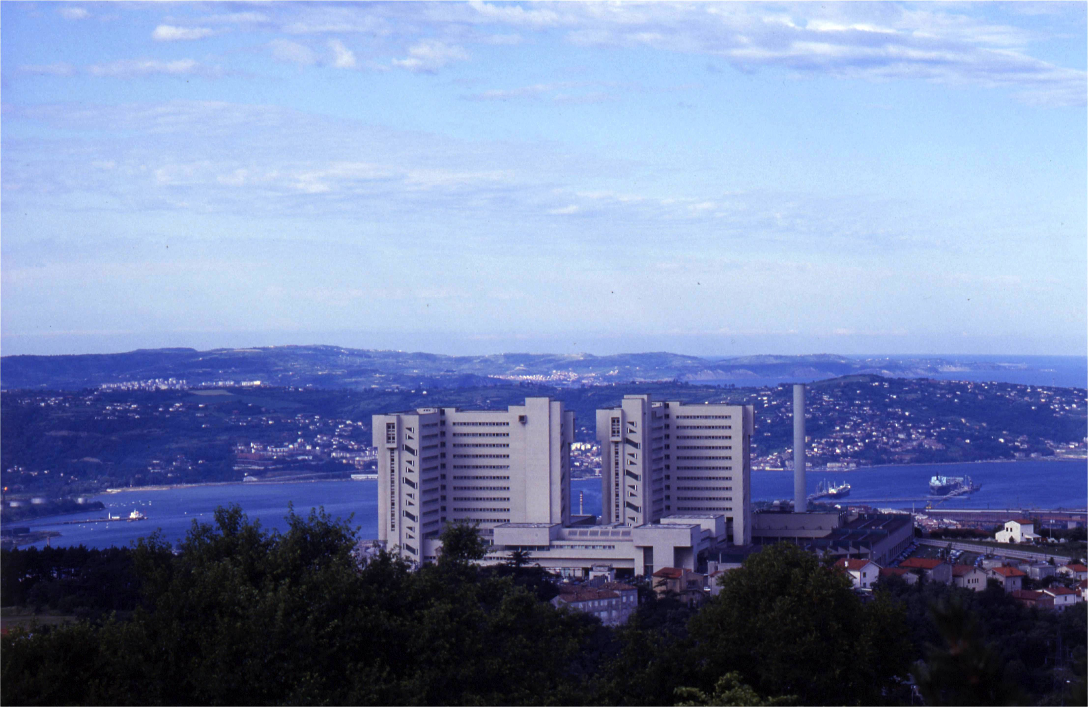


PNEUMO TRIESTE 2016
Trieste, 13 aprile 2016
Attenti al lupo!
Riconoscere il paziente a potenziale pericolo di vita (da quello che non lo è)
Azienda Ospedaliero-Universitaria Ospedali Riuniti di Trieste
Dipartimento di Medicina Perioperatoria, Terapia Intensiva ed Emergenza
Università degli Studi di Trieste
Umberto Lucangelo MD, PhD

Slide 2



Slide 3

Frankfurt am Main 2013
The referring scenario was a small but busy ICU
of a community hospital with limited technology, where a young doctor on duty
on a Friday night, admits a patients with ARDS.

Slide 4

Friday night ventilation:
a safety starting tool kit for
mechanically ventilated patients
L. GATTINONI, E. CARLESSO, L. BRAZZI , M. CRESSONI, S. ROSSEAU, S. KLUGE, A. KALENKA, M. BACHMANN , L. TOEPFER, H. WRIGGE, F. REDAELLI, C. VETTER , M. WYSOCKI.
The primary goal is the early treatment to keep
the patient alive
while inducing
the lowest harm possible.
Minerva Anestesiol 2014;80:1046-57

Slide 5
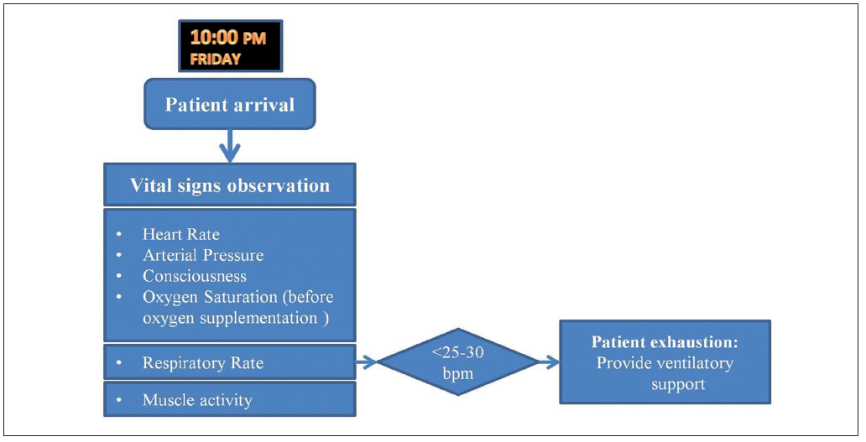
1.—Patient’s arrival.
L. Gattinoni et al. Minerva Anestesiol 2014;80:1046-57

Slide 6
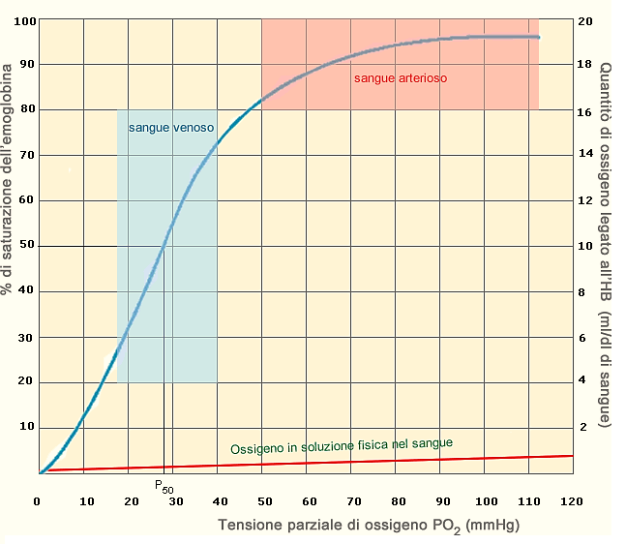

Slide 7
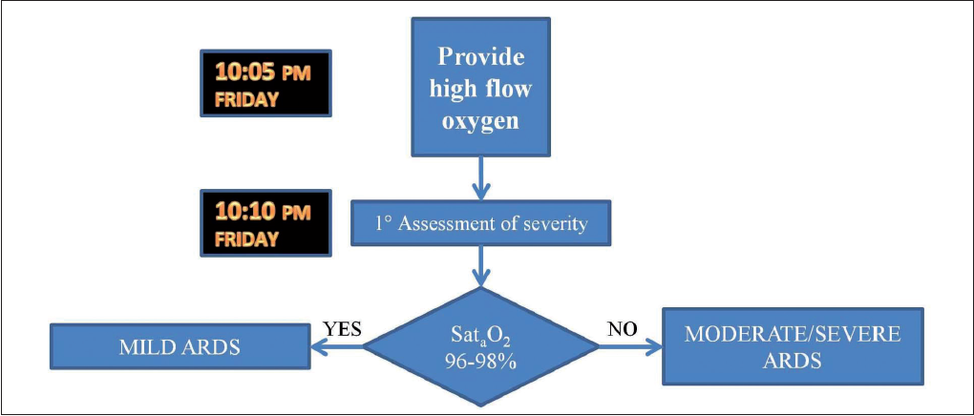
2.—Oxygen supplementation and assisted ventilation
L. Gattinoni et al. Minerva Anestesiol 2014; 80:1046-57

Slide 8
INFLUENZA DELLO SHUNT SUL RAPPORTO PaO₂ / FiO₂
120
PaO₂
(mmHg)
SHUNT
10%
100
20%
80
60
30%
40
50%
20
40
60
80
100
FiO₂ %

Slide 9
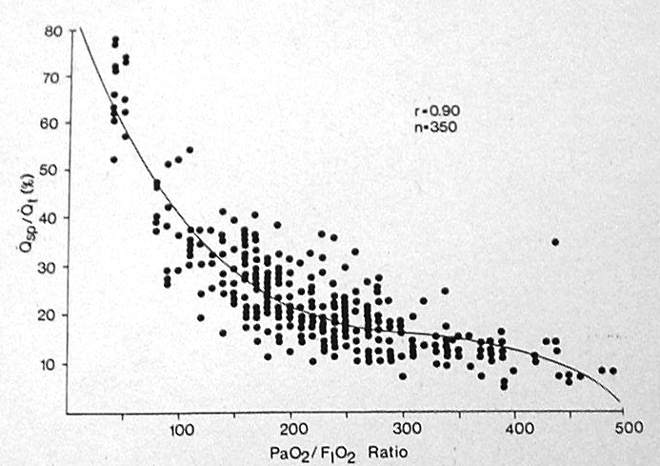
Oxygen derived variable in acute respiratory failure
Covelli HD et al Crit Care Med 1983

Slide 10
INFLUENZA DELLO SHUNT SUL RAPPORTO
PaO₂ / FiO₂
PaO₂/FiO₂ | Shunt %
< 200 | > 20
>200 | < 20

Slide 11
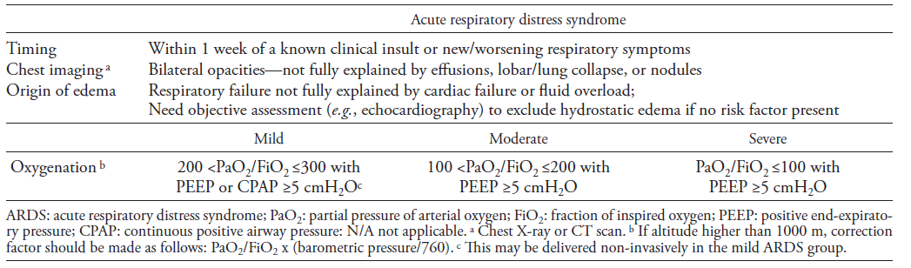
Acute respiratory distress syndrome: the Berlin definition
Force ADT, Ranieri VM, Rubenfeld GD et al. (2012). JAMA 307:2526–2533

Slide 12
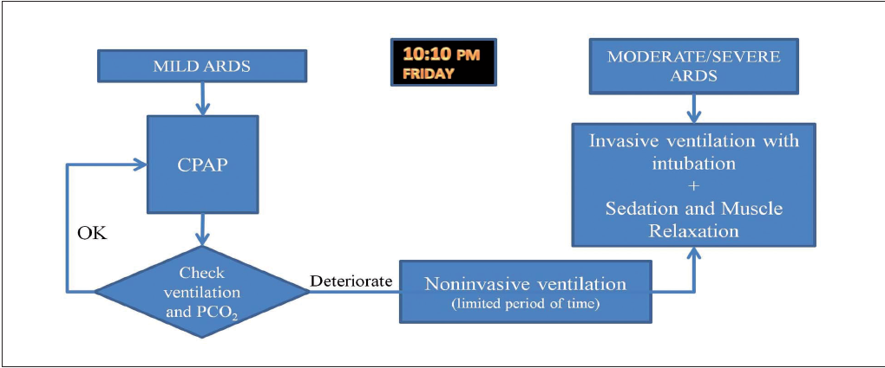
3.—CPAP and non-invasive ventilation.
L. Gattinoni et al. Minerva Anestesiol 2014;80:1046-57

Slide 13
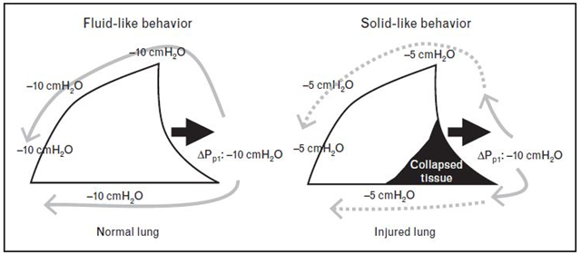
Balancing neuromuscular blockade versus preserved muscle activity
Hraiech S et al. Curr Opin Crit Care 2015 Feb;21(1):26-33

Slide 14
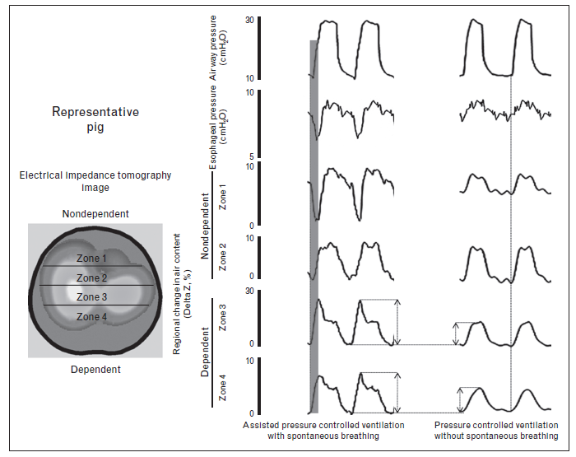
Hraiech S et al. Curr Opin Crit Care 2015 Feb;21(1):26-33

Slide 15
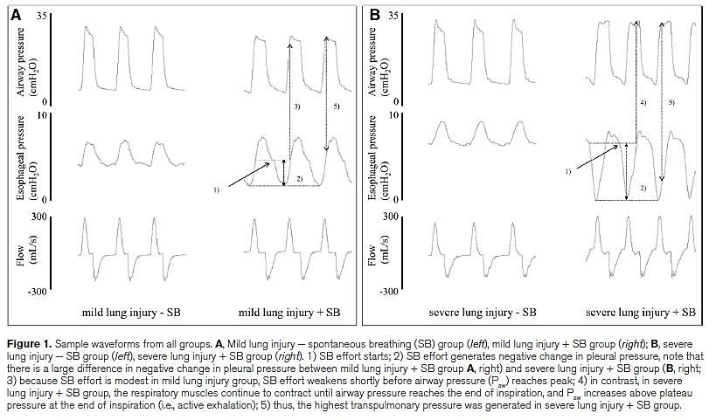
Yoshida T et al. The comparison of spontaneous breathing and muscle paralysis in two different severities of experimental lung injury. Crit Care Med 2013 Feb;41(2):536-45

Slide 16
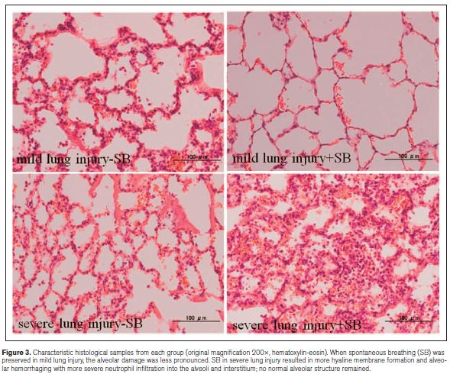
Yoshida T et al. The comparison of spontaneous breathing and muscle paralysis in two different severities of experimental lung injury. Crit Care Med 2013 Feb;41(2):536-45
Notes:
Evidenziato che nella mild lung injury c’è meno danno con il respiro spontaneo mentre nella severe injury è meglio la ventilazione controllata

Slide 17
Spontaneous breathing
PROS
maintains EELV (lung recruitment) and better gas exchange in less severe ARDS
Mild/moderate
spontaneous efforts
Recruitment
CONS
Severe ARDS = high
spontaneous efforts
Overstretch and Pendelluft
Notes:
2015 hraiech COCC

Slide 18
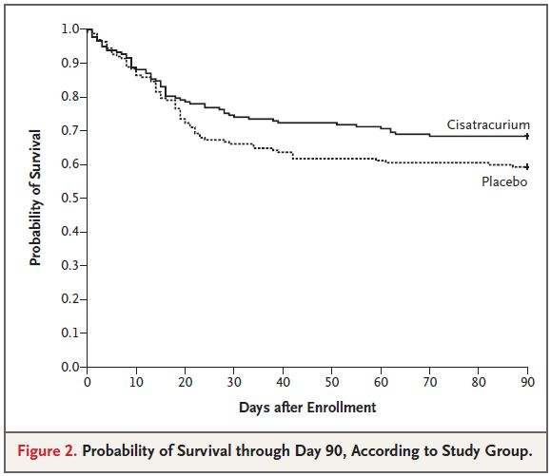
Cisatracurium infusion for 48 h in early severe ARDS
(PaO₂/FiO₂ < 120)

Slide 19
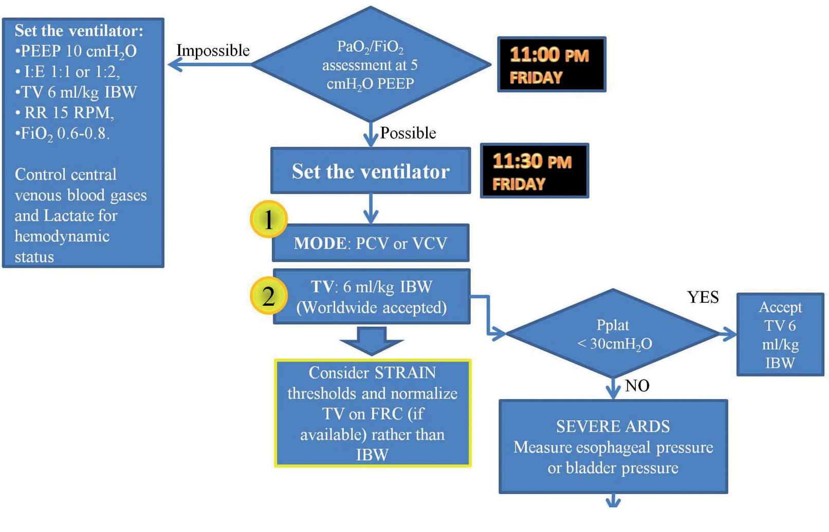

Slide 20


Slide 21
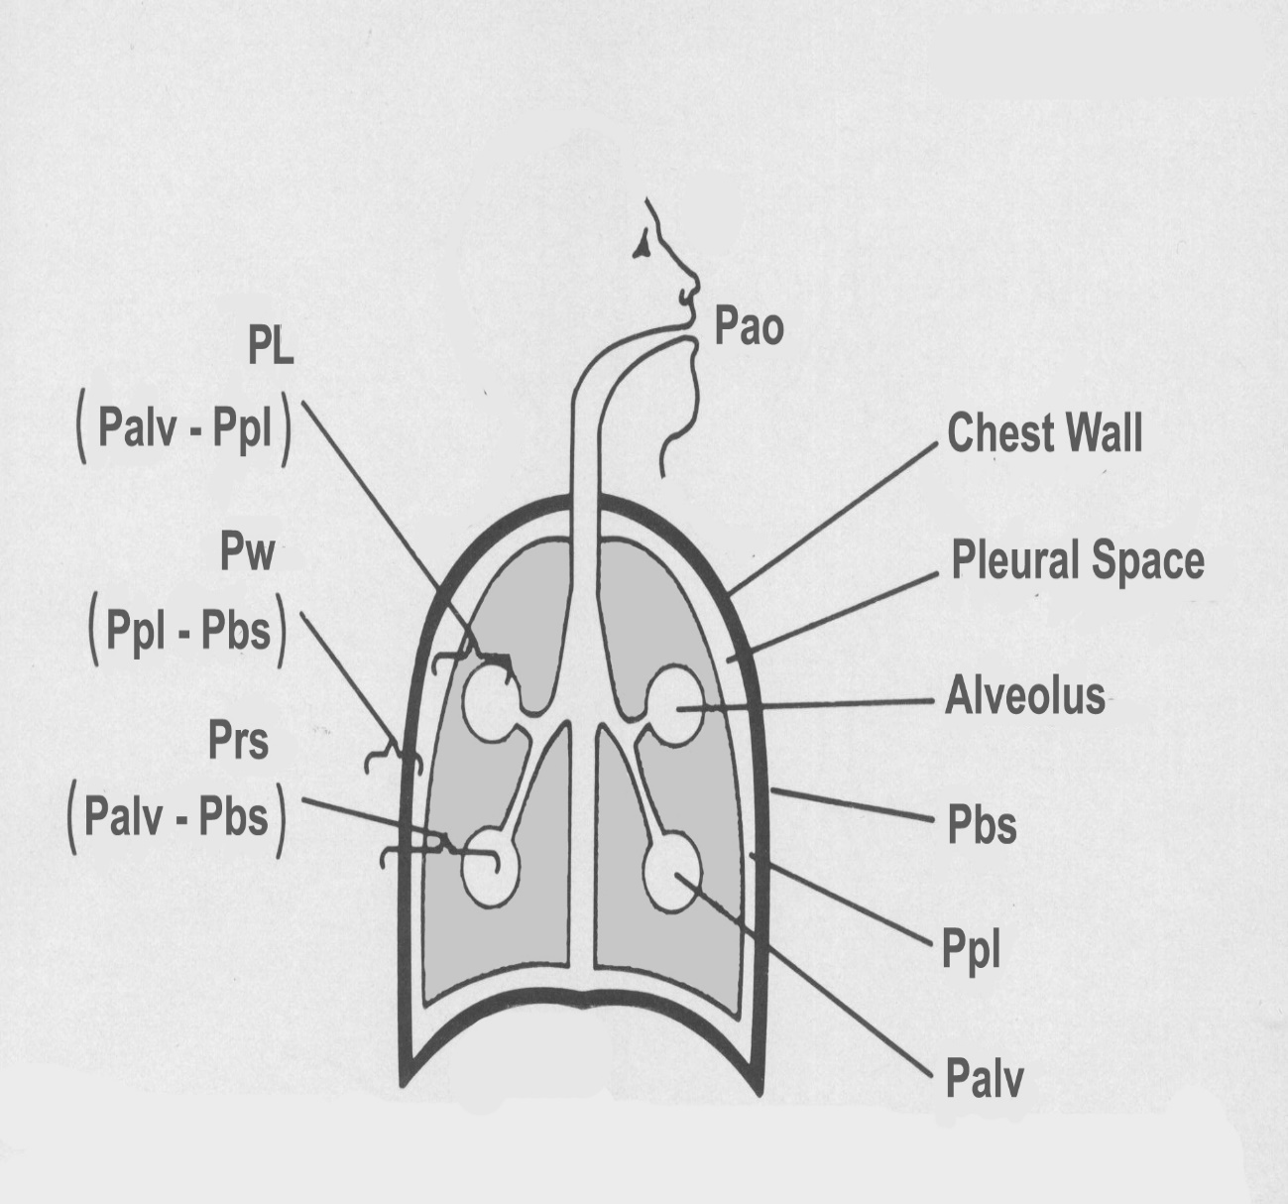
Pleural Pressure
Pleural pressure separates respiratory system mechanical properties into their pulmonary and chest wall components.

Slide 22
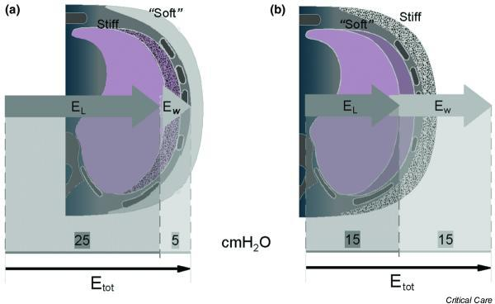
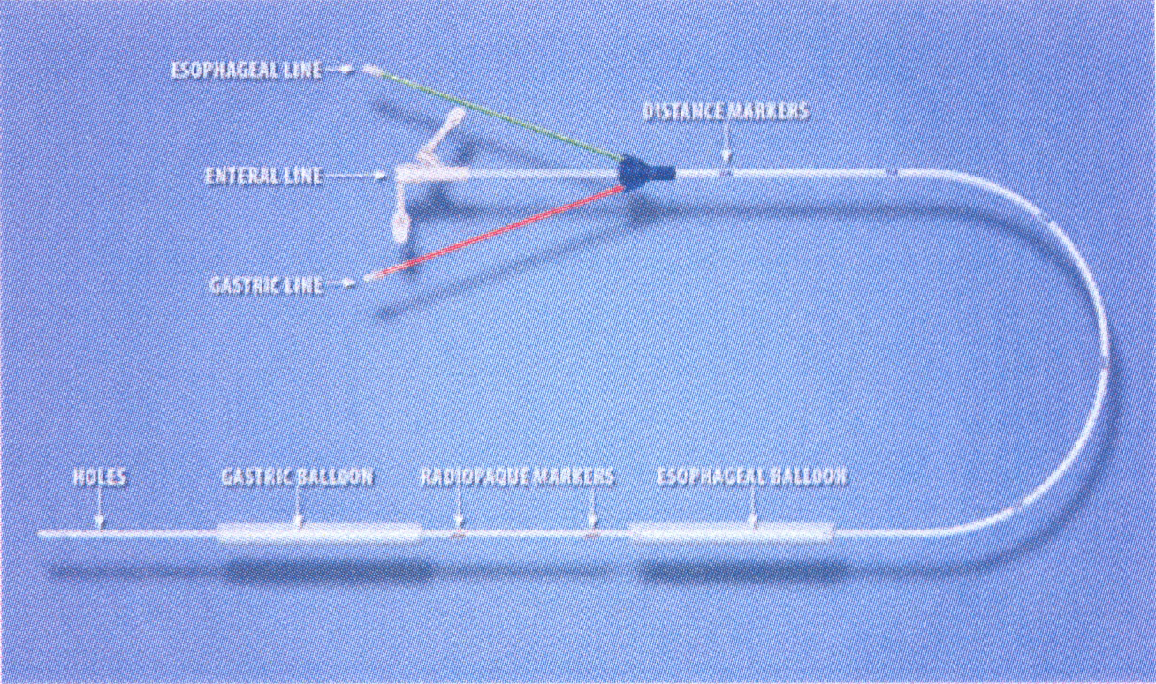

Slide 23
Esempio di polmoni non complianti e di una parete toracica normalmente compliante.
Dalla PL ≅ 0 si evince che non serve incrementare la PEEP.
T. Sarge, D. Talmor 2009

Slide 24
ARDS extrapolmonare, con una parete toracica non compliante e polmoni complianti.
Dalla PL << 0 si evince che serve incrementare la PEEP !!
T. Sarge, D. Talmor 2009

Slide 25
Use of Pes in ARDS Patients
The new england
journalof medicine
established in 1812 november 13, 2008 vol. 359 no. 20
Mechanical Ventilation Guided by Esophageal Pressure
in Acute Lung Injury
Daniel Talmor, M.D., M.P.H., Todd Sarge, M.D., Atul Malhotra, M.D., Carl R. O’Donnell, Sc.D., M.P.H.,
Ray Ritz, R.R.T., Alan Lisbon, M.D., Victor Novack, M.D., Ph.D., and Stephen H. Loring, M.D.

Slide 26
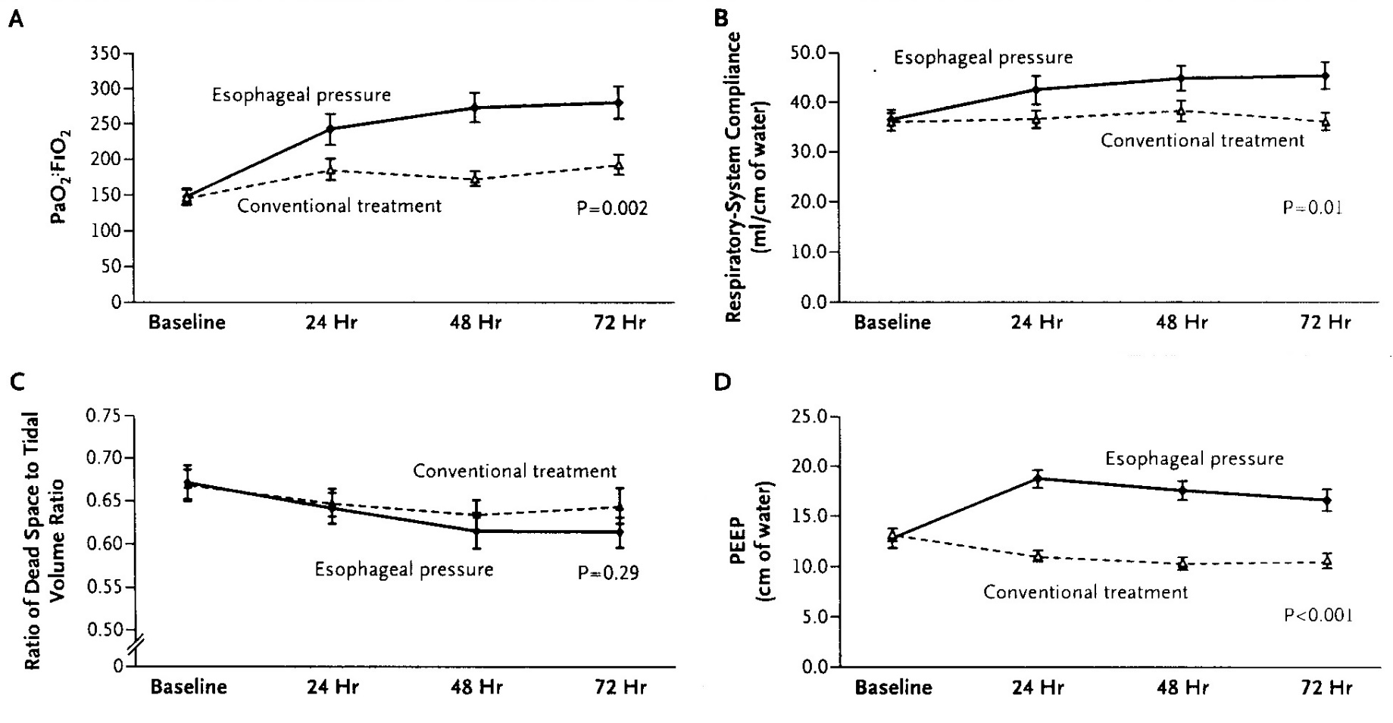
28-day mortality (17% vs 35% p= 0,055) !!!
D Talmor et al. NEJM. 359:2095, 2008

Slide 27
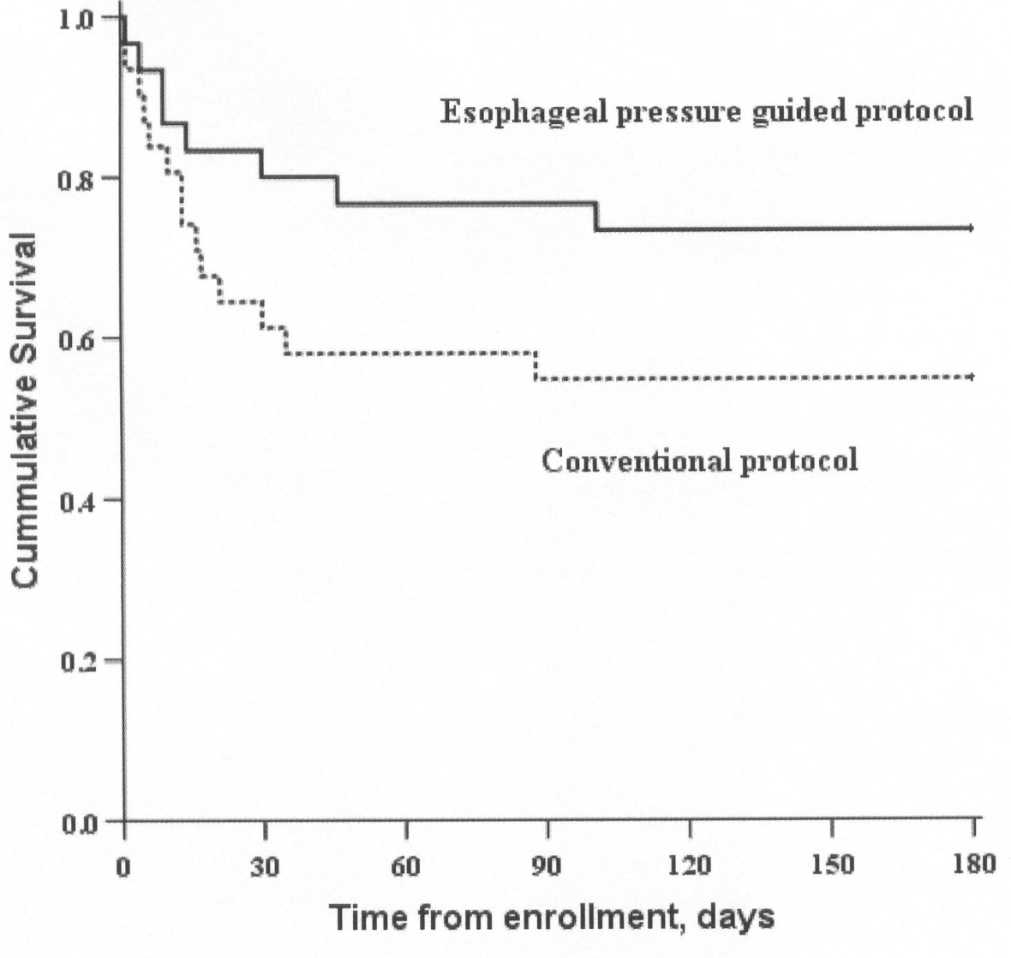
D Talmor et al. NEJM. 359:2095, 2008

Slide 28
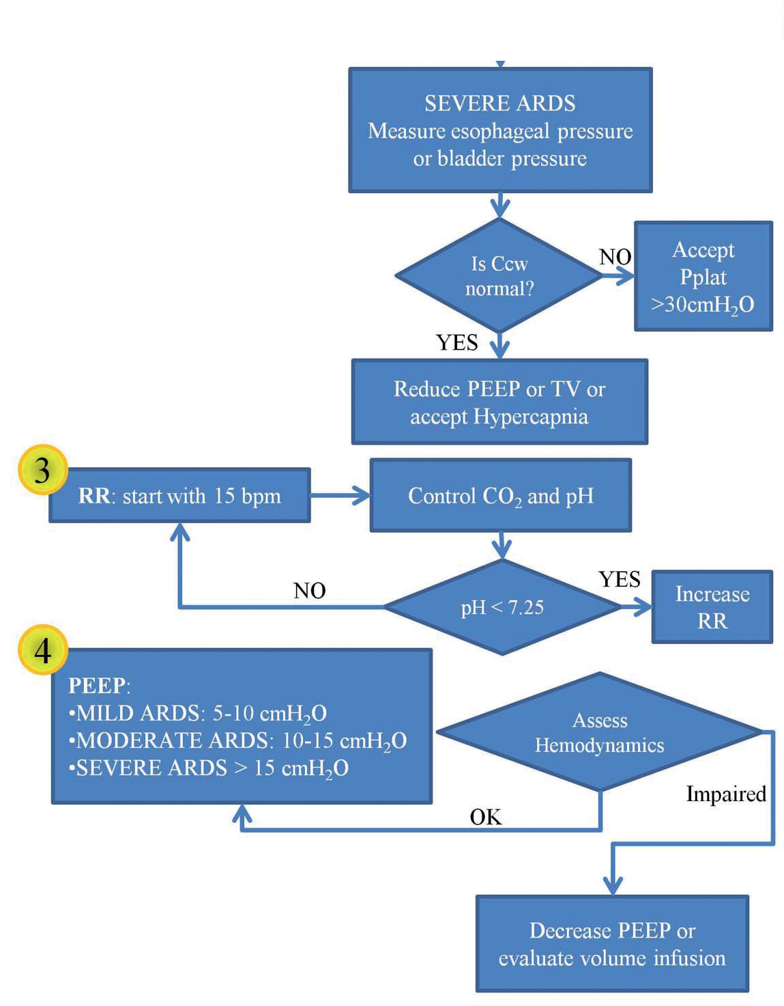
Pplat <30 cmH₂O ?

Slide 29
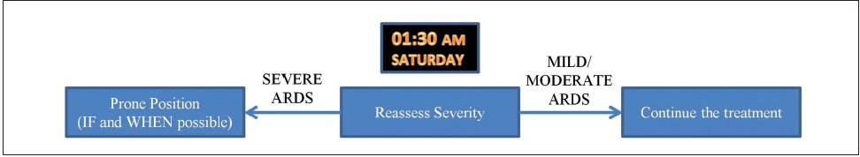
5.—Monitoring ARDS course.
If in the hospital in which the patient is actually admitted the prone position is used routinely, the maneuver should be applied immediately.
However, a higher complication rate may occur in ICUs in which prone position has never been implemented.
In this case, risks and benefits must be carefully weighted.
L. Gattinoni et al. Minerva Anestesiol 2014; 80:1046-57

Slide 30

6.—Keep or transfer the patient.
Severe ARDS patients occur in a normal hospital only in very few cases/year, so they must be concentrated in referral centers with high volume of activity and experience in sophisticated techniques,
as prone position or extracorporeal lung support.
L. Gattinoni et al. Minerva Anestesiol 2014; 80:1046-57

Slide 31

Keep in mind
that asking for help
is not shameful,
but a sign of intelligence.
L. Gattinoni et al. Minerva Anestesiol 2014; 80:1046-57

Slide 33
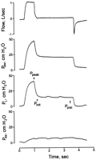
ECMO criteria for influenza A (H1N1)- associated ARDS:
role of transpulmonary pressure
Grasso S, Terragni P, Birocco A, Urbino R, Del Sorbo L, Filippini C, Mascia L, Pesenti A, Zangrillo A, Gattinoni L, Ranieri VM.
PPLAT_{L} = PPLAT_{RS} - PPLAT_{CW}
PPLAT_{CW} = (E_{CW} /E_{RS}) X PPLAT_{RS}
This may be clinically relevant because
(a) several studies suggest that mechanical ventilation
should be titrated to PPLAT_{L} rather than to PPLAT_{RS}
(b) it has been suggested that the upper
physiological limit of PPLAT_{L} that optimizes alveolar recruitment is 25 cmH₂O
Intensive Care Med. 2012 Mar;38(3):395-403

Slide 34
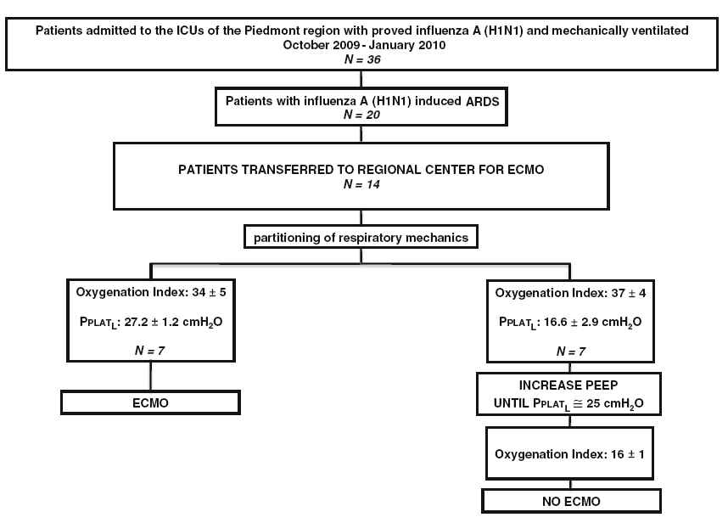
(PPLATRs = 31 cmH₂O)
Intensive Care Med. 2012 Mar;38(3):395-403

Slide 35
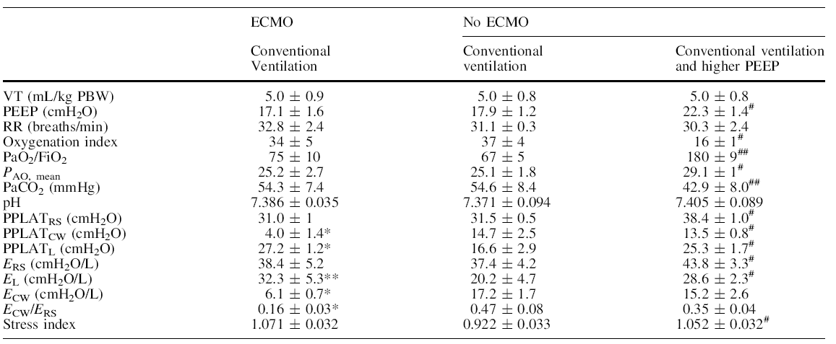
* P = 0.0001; ** P = 0.001 ECMO vs. no ECMO
# P = 0.0001 ## P = 0.001 Conventional ventilation vs. Conventional ventilation and higher PEEP
Intensive Care Med. 2012 Mar;38(3):395-403

Slide 36
Conclusions
Abnormalities of chest wall mechanics may be presentin some patients with influenza A(H1N1)-associated ARDS.
These abnormalities may not be inferred from measurements of
end-inspiratory plateau pressure of the respiratory system (PPLAT_{RS}).
In these patients,
titrating PEEP to PPLAT_{RS} may overestimate the incidence
of hypoxemia refractory to conventional ventilation
leading to inappropriate use of ECMO!!
Intensive Care Med. 2012 Mar;38(3):395-403

Slide 37
QUANDO RICORRERE ALL’ECMO?
CASO CLINICO 1
Maschio, 58 anni, BMI 27,7
Ipertensione arteriosa, fibrillazione atriale parossistica, insufficienza valvolare mitralica e aortica moderate
Broncopolmonite bilaterale
Tampone nasale positivo per influenza virus A (H1N1)

Slide 38
QUANDO RICORRERE ALL’ECMO?
CASO CLINICO 1
Temperatura inguinale = 37.5°C
Globuli bianchi = 12.96 x 10³ cells/ml
PCR = 351.81 mg/dL
Procalcitonina = 0.5 ng/mL
Pressione arteriosa media = 93 mmHg
Indice cardiaco = 3.5 L/min/m²

Slide 39
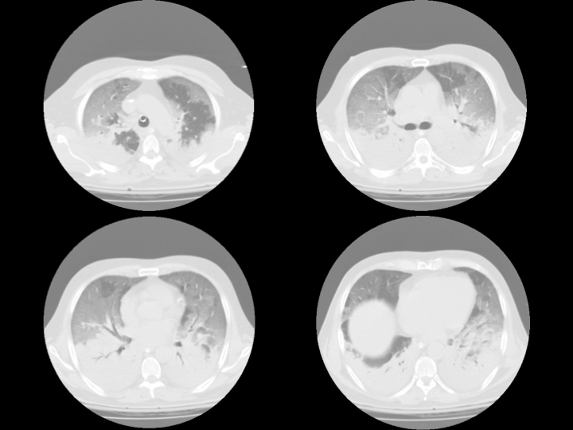

Slide 40
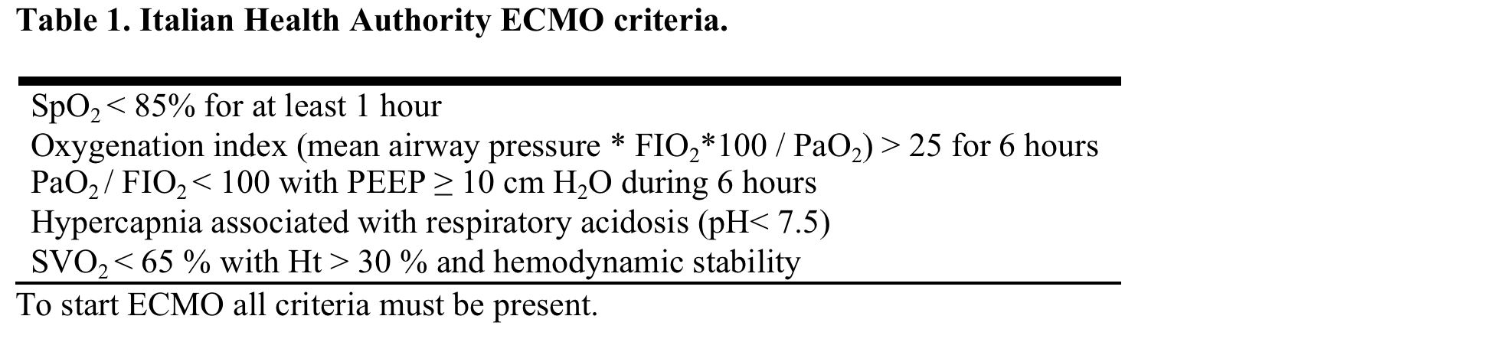
QUANDO RICORRERE ALL’ECMO?
CASO CLINICO 1
pH 7.310
PaCO2 62.5 mmHg
PaO2 46.8 mmHg
HCO3⁻ 26.7 mEq/L
BE 4.5 e SaO2 77.2 %
Oxygenation index = 39
Lung injury score = 3.25

Slide 42
QUANDO RICORRERE ALL’ECMO?
CASO CLINICO 1
PCV
Pwork = 27 cmH₂O
Pplat = 27 cmH₂O
PEEP = 15 cmH₂O
Pmean = 19 cmH₂O
Compliance = 56 mL/cmH₂O
HFPV
Pmean = 19 cmH₂O
PEEP = 15 cmH₂O
Percussion frequency = 700 cpm
Nessuna complicanza dopo il passaggio all’HFPV

Slide 43
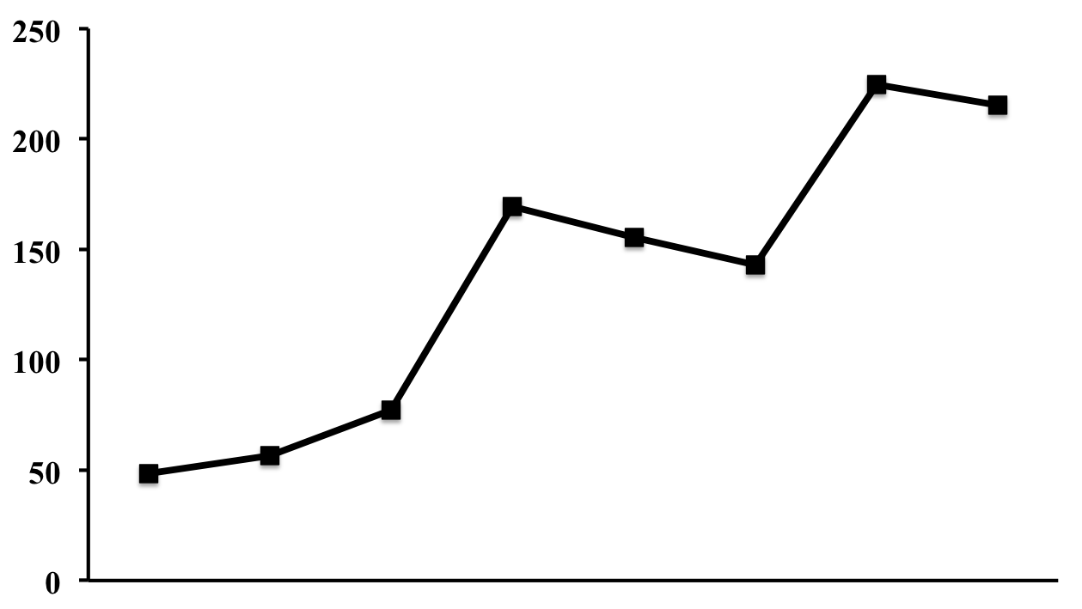
QUANDO RICORRERE ALL’ECMO?
CASO CLINICO 1
PaO₂/FiO₂
PaO₂/FiO₂
Baseline
2h
4h
6h
8h
10h
12h
Post
Baseline
2h
4h
6h
8h
10h
12h
Post

Slide 44
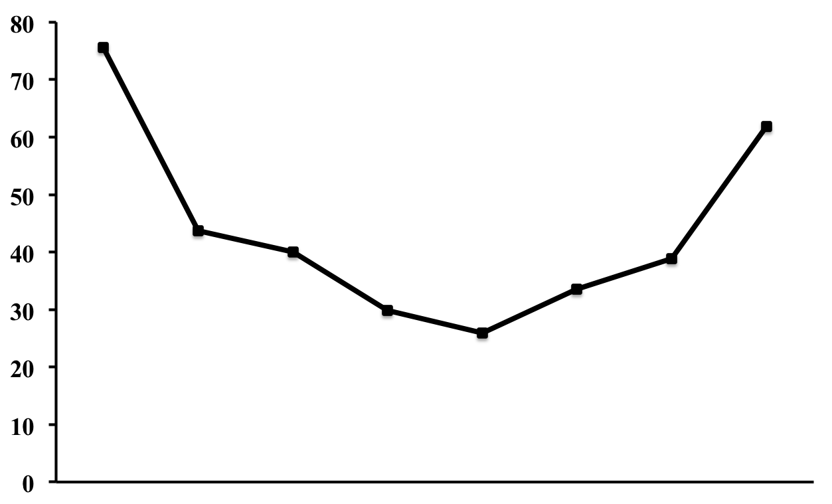
QUANDO RICORRERE ALL’ECMO?
CASO CLINICO 1
PaCO₂
PaCO₂
Baseline
2h
4h
6h
8h
10h
12h
Post
Baseline
2h
4h
6h
8h
10h
12h
Post

Slide 45
QUANDO RICORRERE ALL’ECMO?
CASO CLINICO 1
Parameters | Baseline | HFPV 2h | HFPV 4h | HFPV 6h | HFPV 8h | HFPV 10 | HFPV 12h | Post
MAP (mmHg) | 93 | 87 | 78 | 68 | 67 | 90 | 100 | 106
CI (L/min/m² | 3.5 | 3.2 | 2.8 | 2.4 | 3.6 | 4.1 | 4.8 | 5.2
PCV
Pwork = 27 cmH₂O
Pplat = 26 cmH₂O
PEEP = 15 cmH₂O
Pmean = 20 cmH₂O
Compliance = 88 mL/cmH₂O

Slide 46
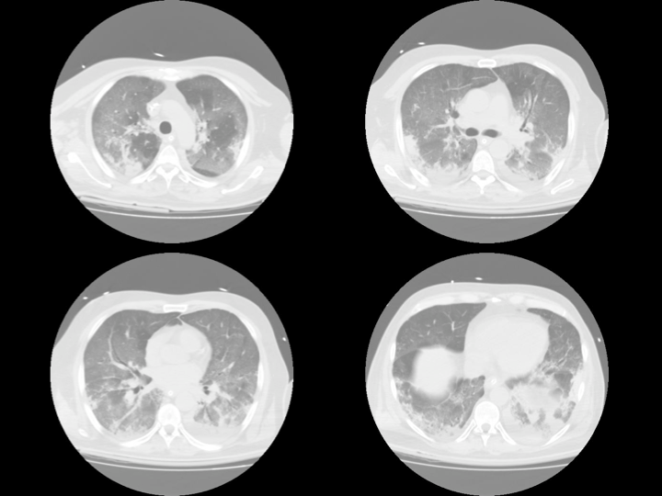

Slide 47


Slide 48

Chi ha paura del lupo cattivo?

Slide 49
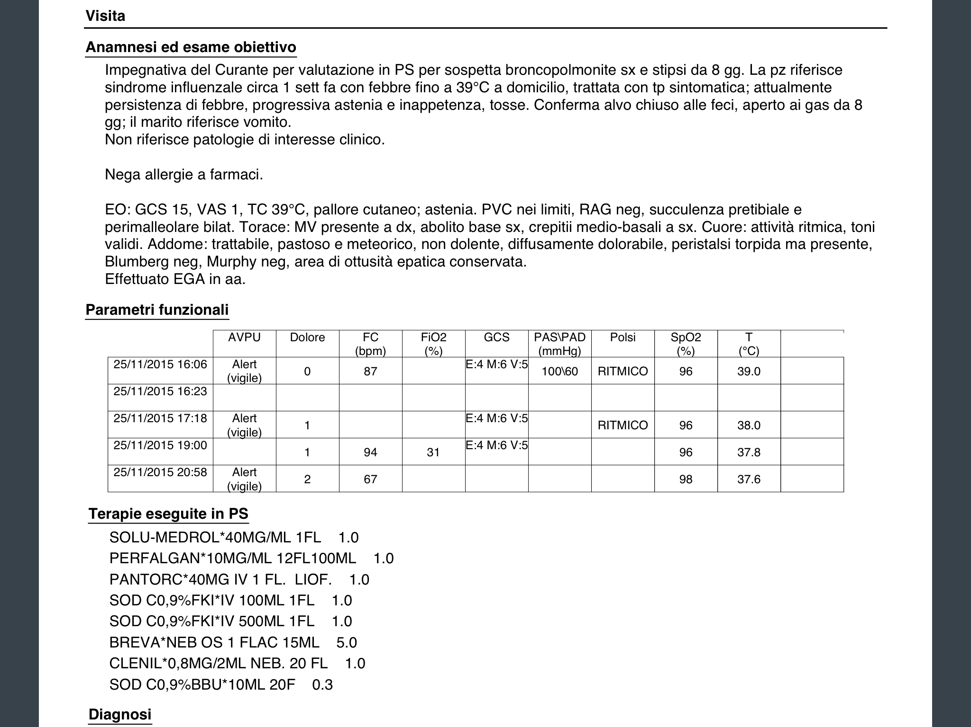

Slide 50
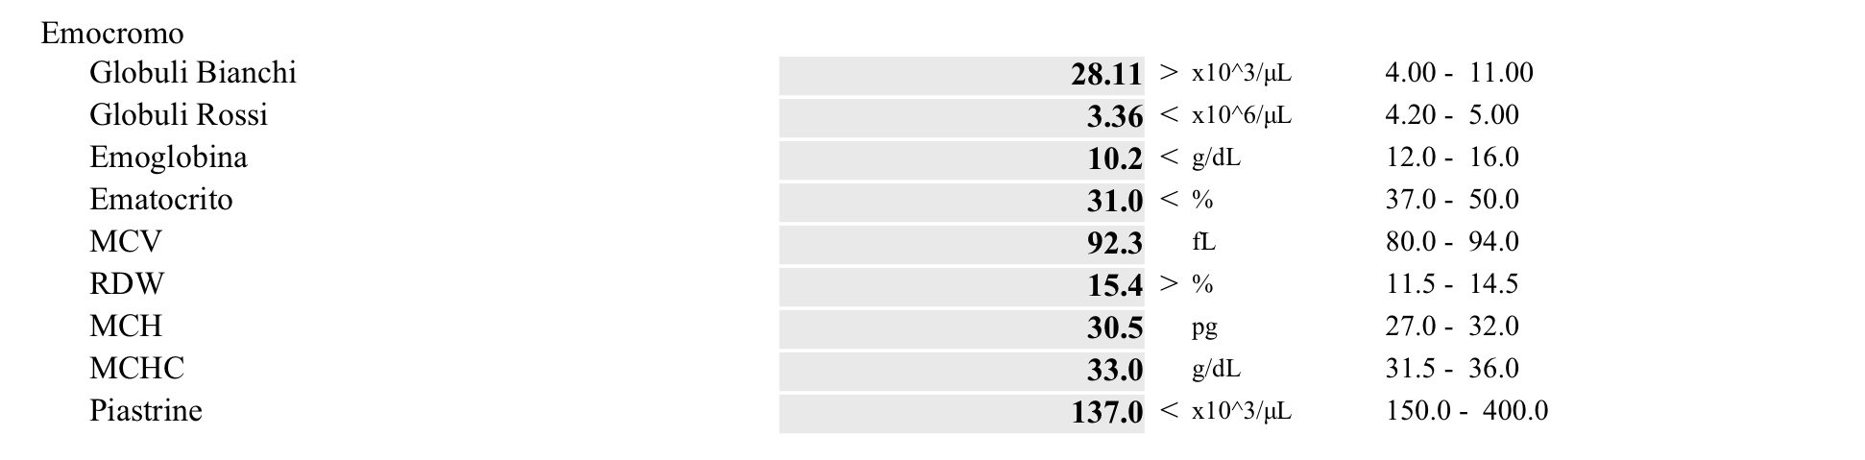
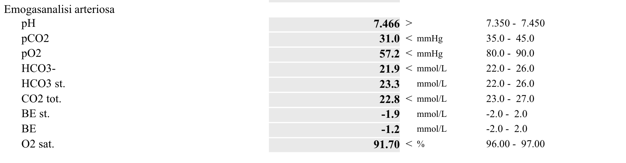
LABS
hypoxiemia

Slide 51
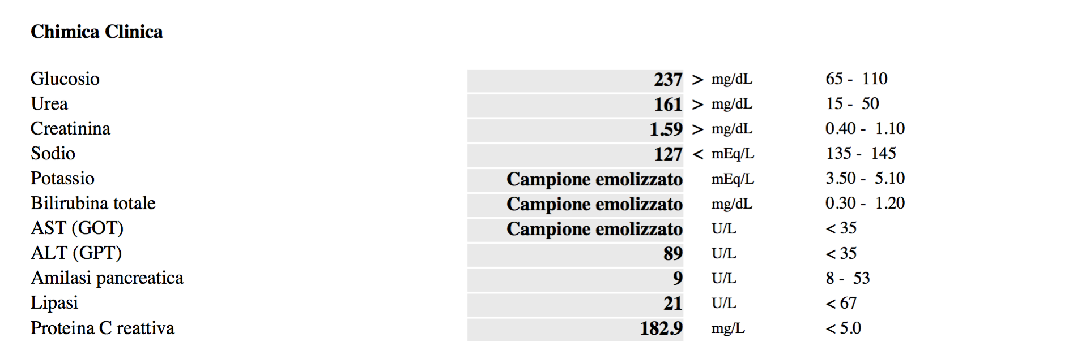

Slide 52

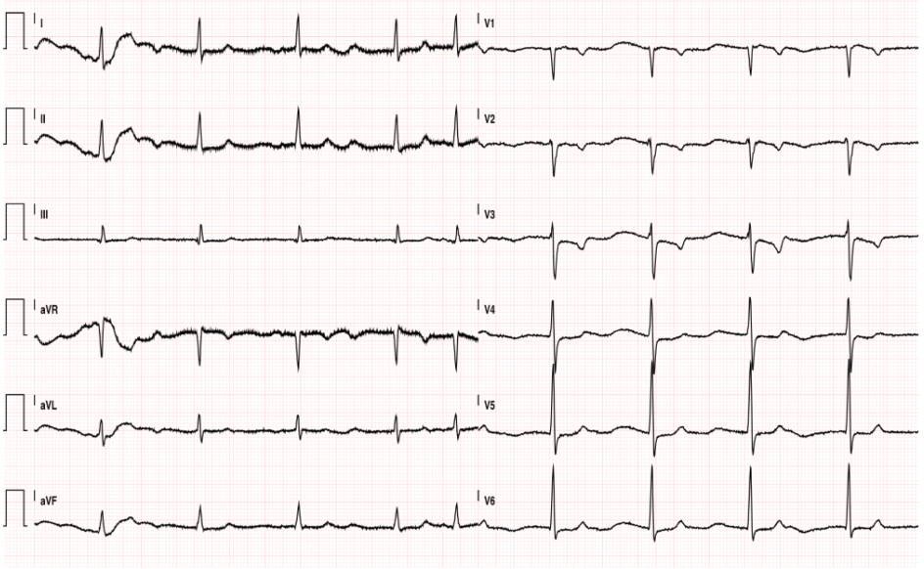

Slide 53
Now we are Little Red Riding Hood
- CVE 200J bifasic wave
- Amiodarone

Slide 54
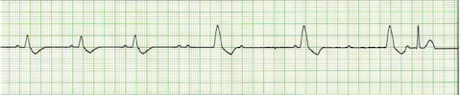
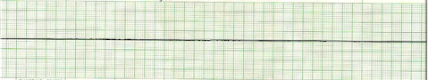
PEA
ASYSTOLE

Slide 55
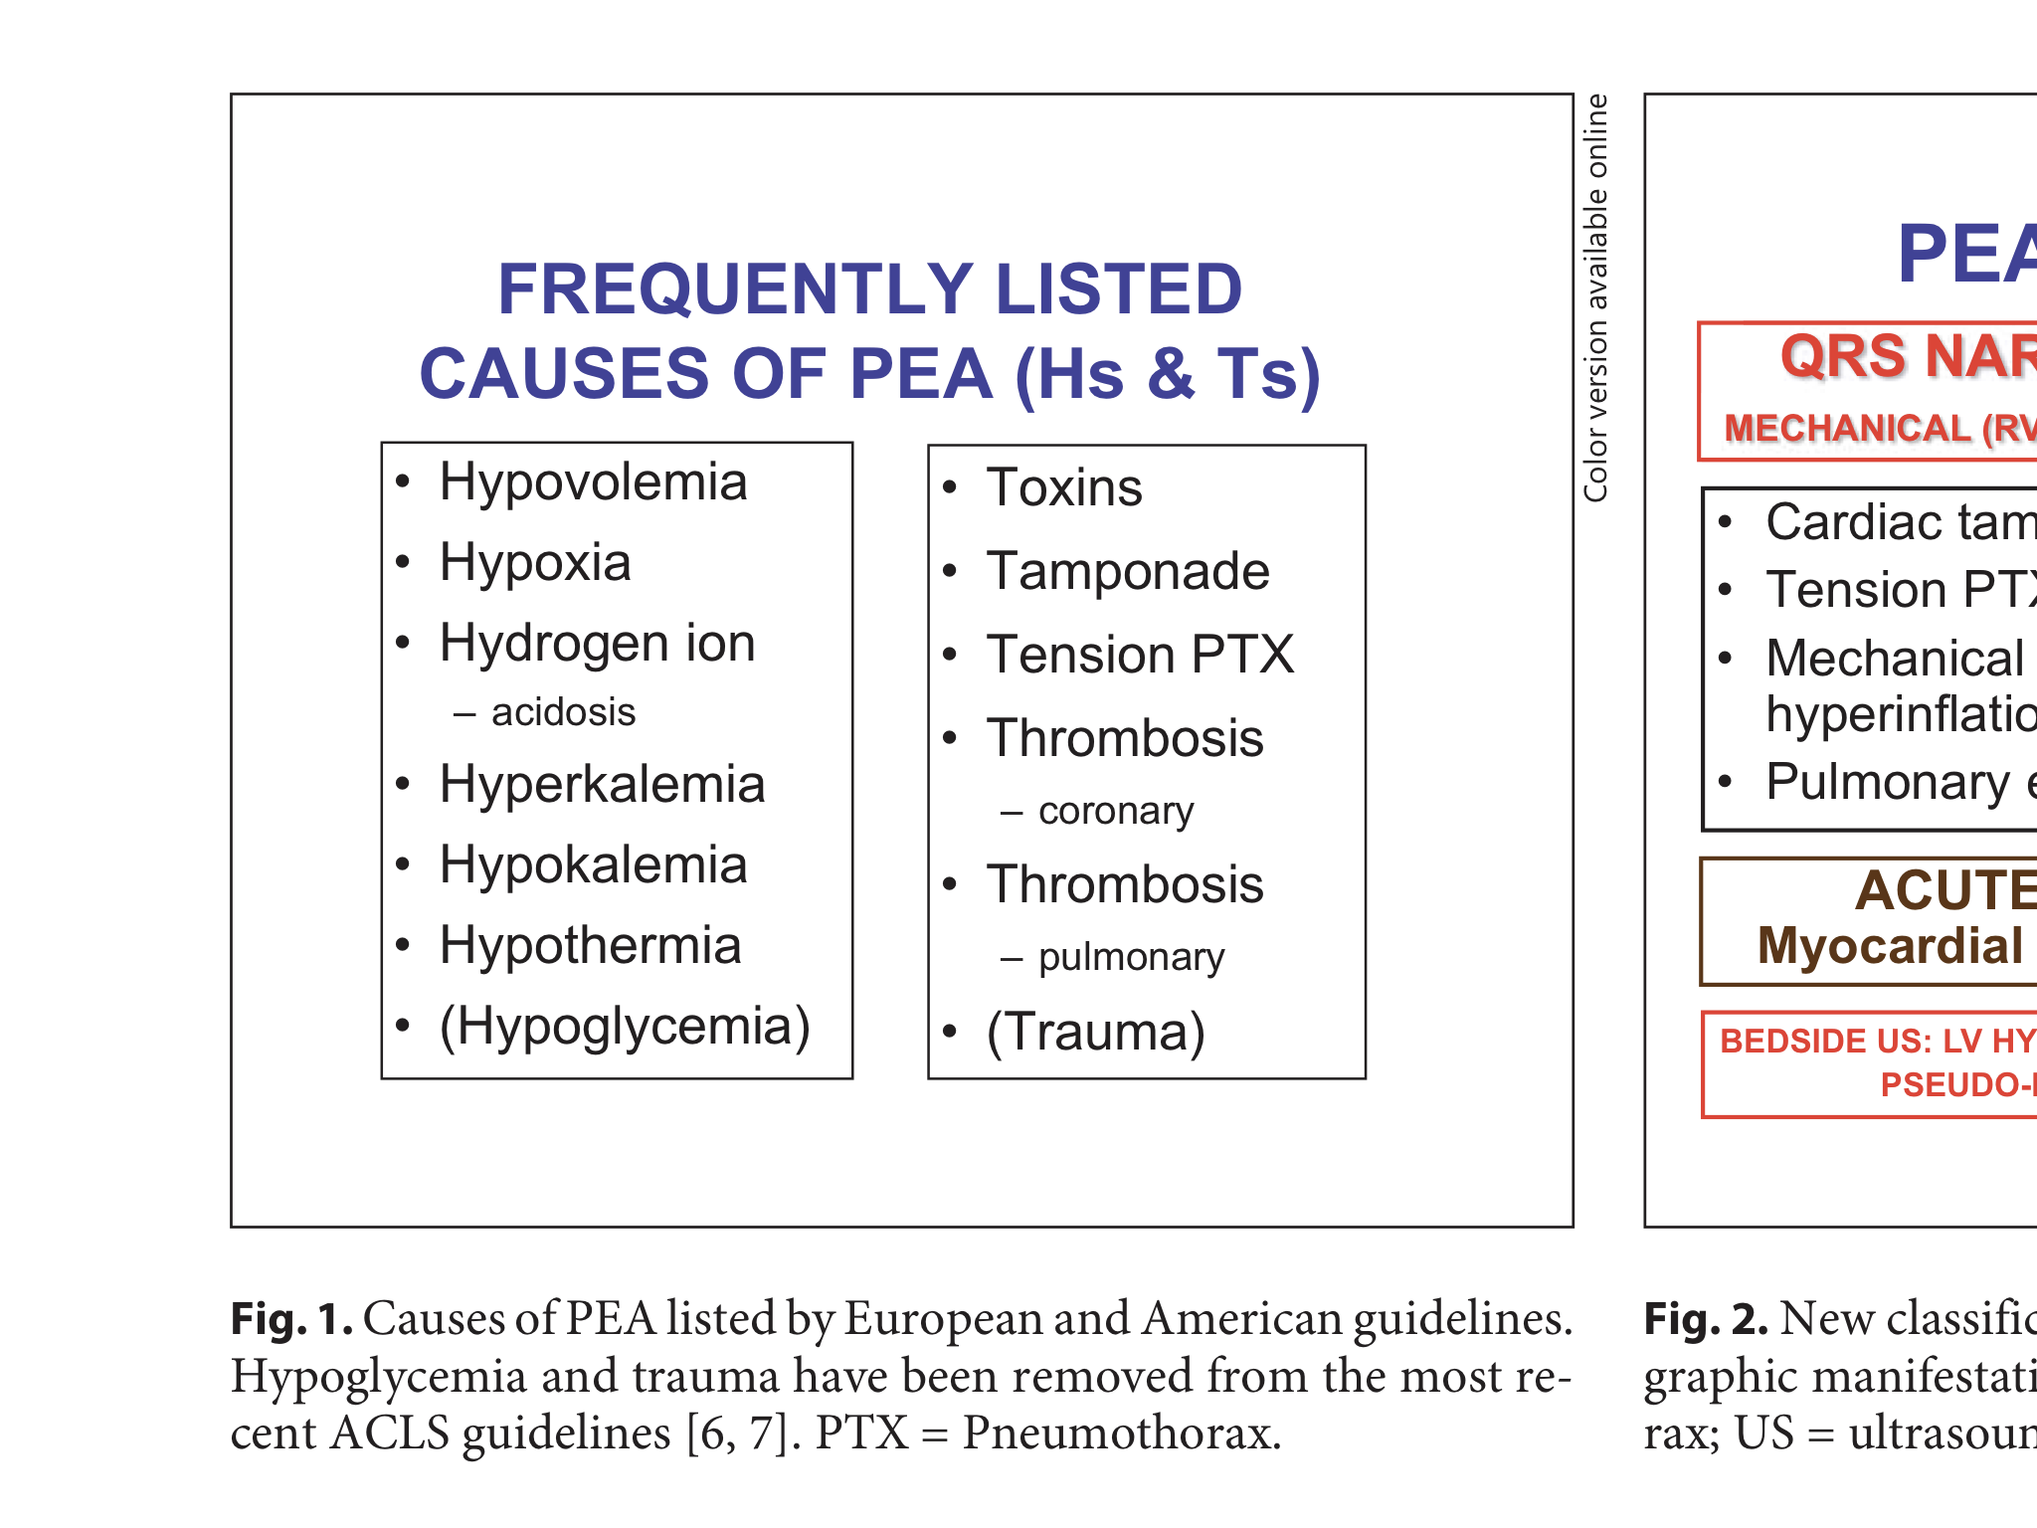
PEA is there a reversible cause?
6H
6T

Slide 56

Who is the wolf?

Slide 57
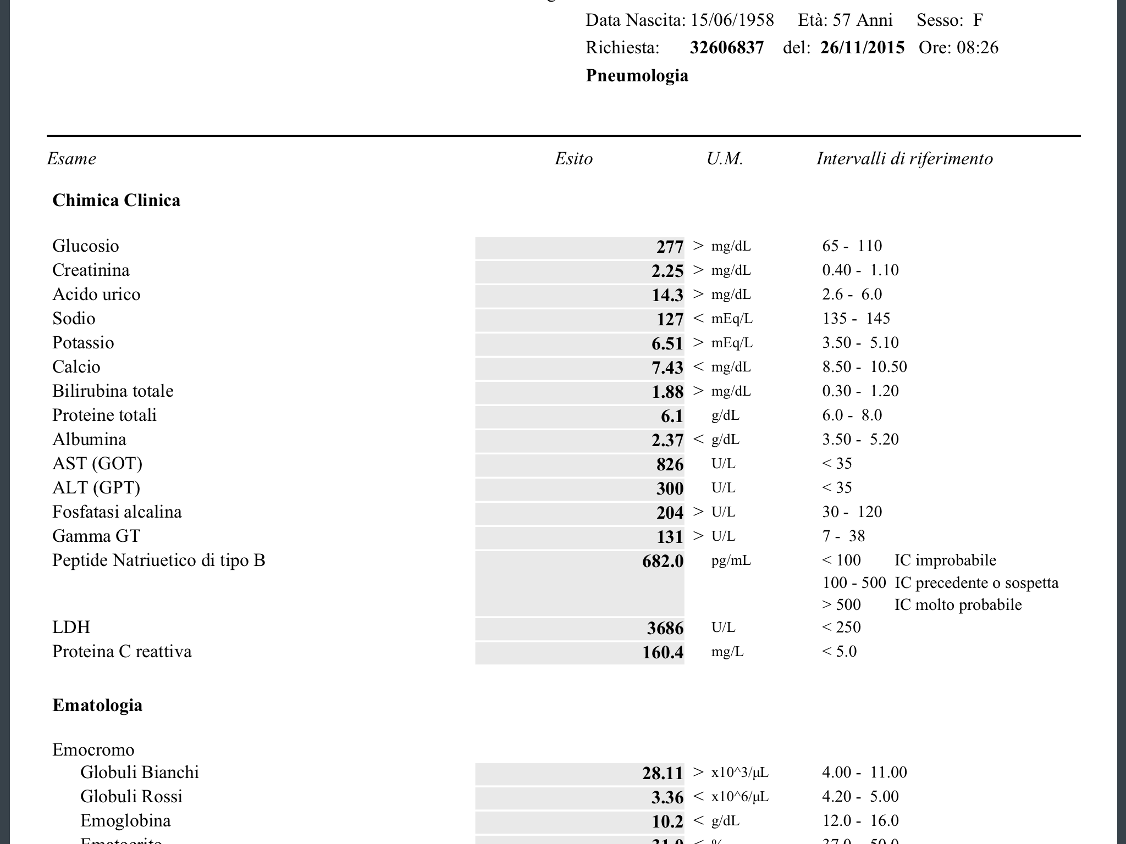
LABS
This is the wolf!

Slide 58
fever
We had to think about it?
hypovolemia
vomit
NSAIDs
PGE2 sintesys depression
GFRate reduction

Slide 59
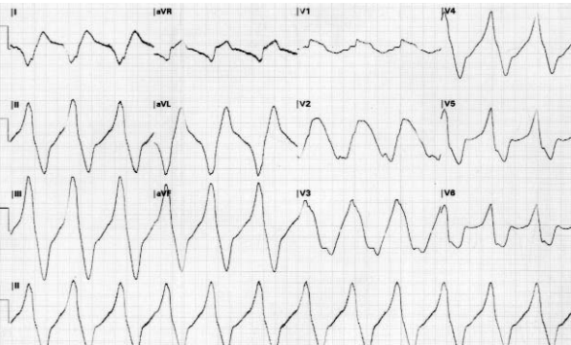
...a typical ECG

Slide 60
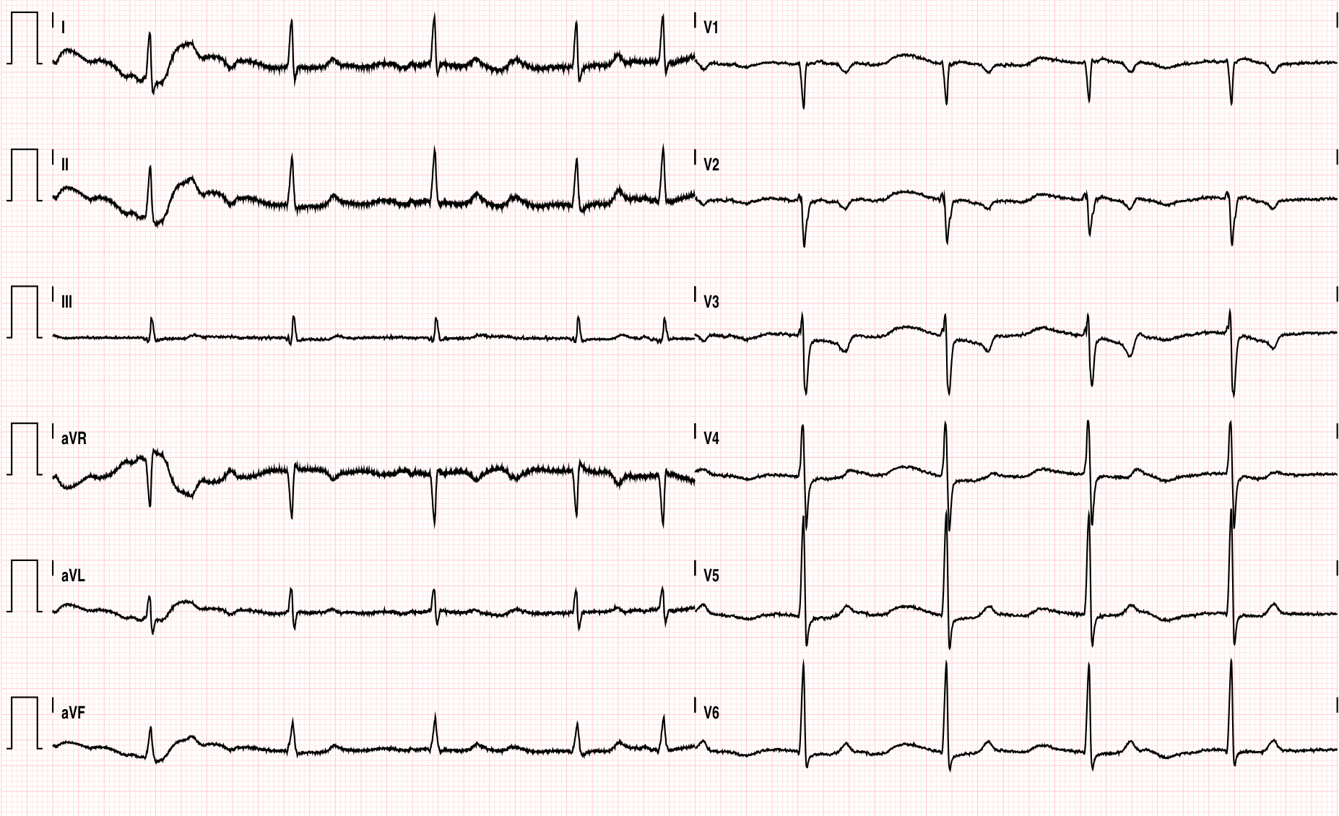
It is not as simple as it seems

Slide 61
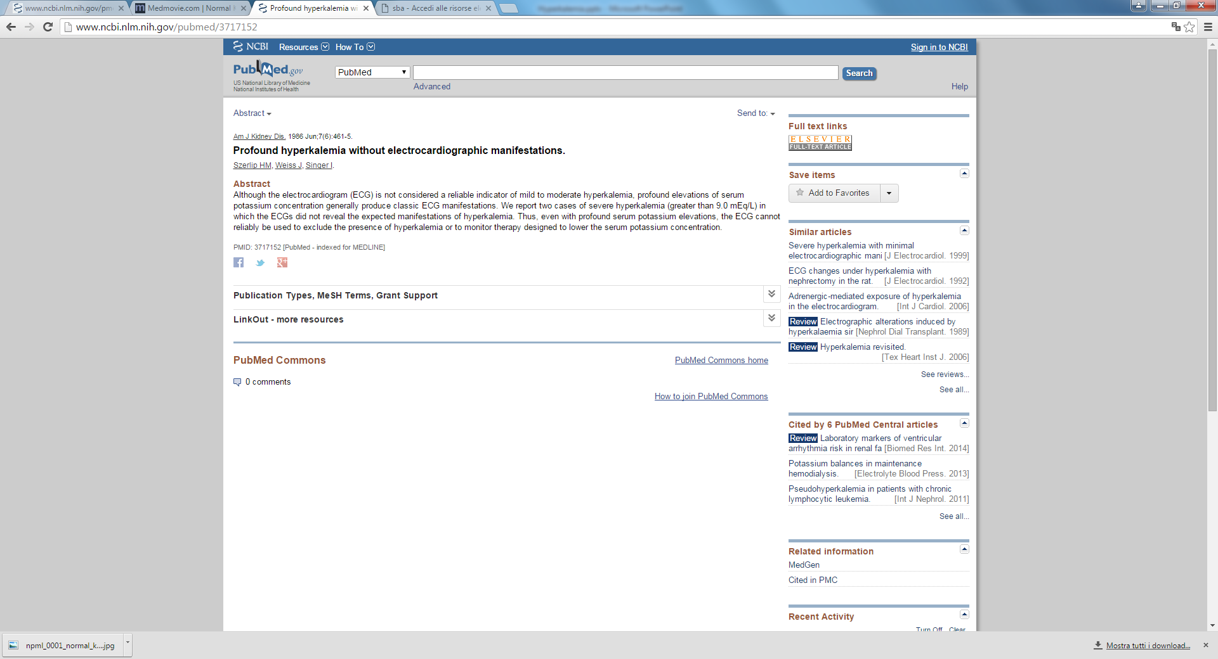
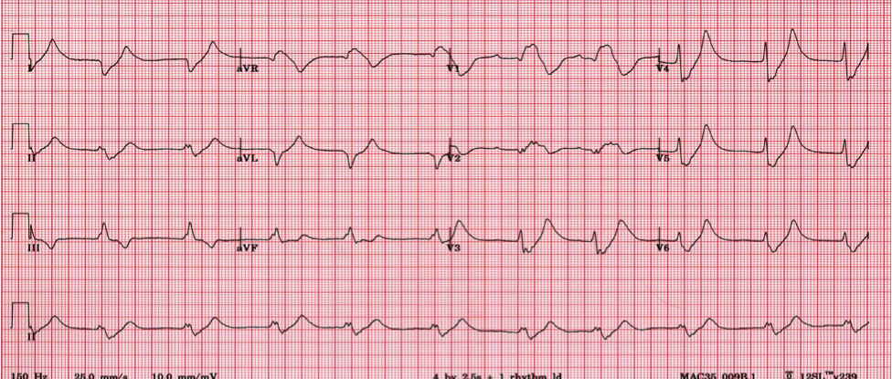
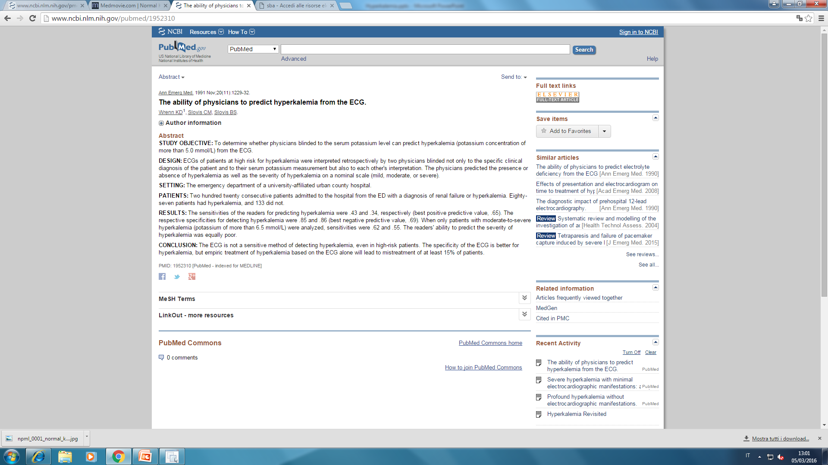

Slide 62
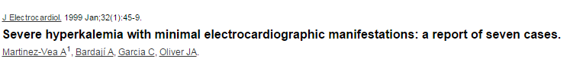
there have been several reports in the lilerature of patients who had potassium levels greater than 7.5 mEq/L with no ECG manifestation of hyperkalemia
Patients who present with hyperkalemia may have a normal electrocardiogram or have changes that are so subtle that physicians frequently have difficulty attributing these changes to increased potassium levels.

Slide 63
Chi ha paura del lupo cattivo?

