Slide 1

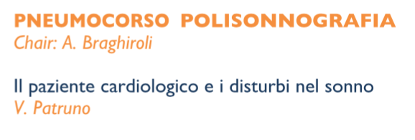

Pneumologia Riabilitativa
Istituto di Medicina Fisica e Riabilitazione “Gervasutta” - Udine
Notes:
venerdì 11. room C 9-10:45. ( quarta di 4 sessioni) 25 minuti circa

Slide 2
DISTURBI DEL RESPIRO NEL SONNO
82%
prevalenza
OSA: 26-53%
CSA: 15-39%
FE < 40%
Yumino et al, J Card Fail 2009; 15: 279-285
Ferrier et al, Chest 2005;128:2116-2122
Oldenburg et al, Eur J Heart Fail 2007;9:251-257

Slide 3
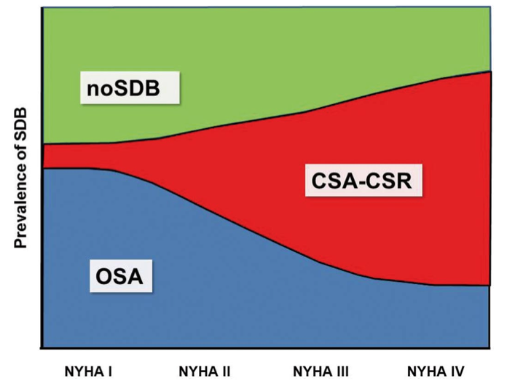
Yumino et al, J Card Fail 2009; 15: 279-285
Ferrier et al, Chest 2005;128:2116-2122
Oldenburg et al, Eur J Heart Fail 2007;9:251-257
Notes:
se vogliamo pensare alla distribuzione in termini di classe NYHA

Slide 4
Notes:
introdurre la fisiopatologia con il concetto che molti CHF esibiscono sia centrali che ostruttutive.

Slide 5
SBD AND CHF : a bidirectional effect
Notes:
l complessi meccanismi di danno cardiovascolare intermedio nell’OSA e

Slide 6
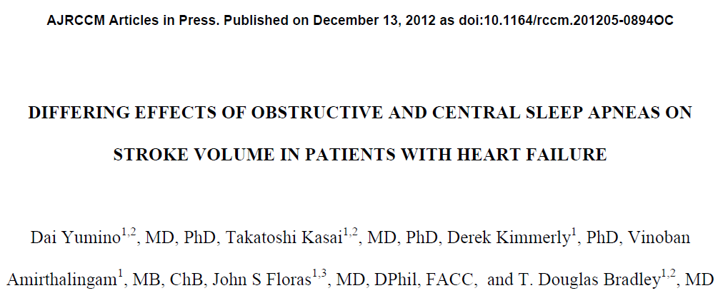
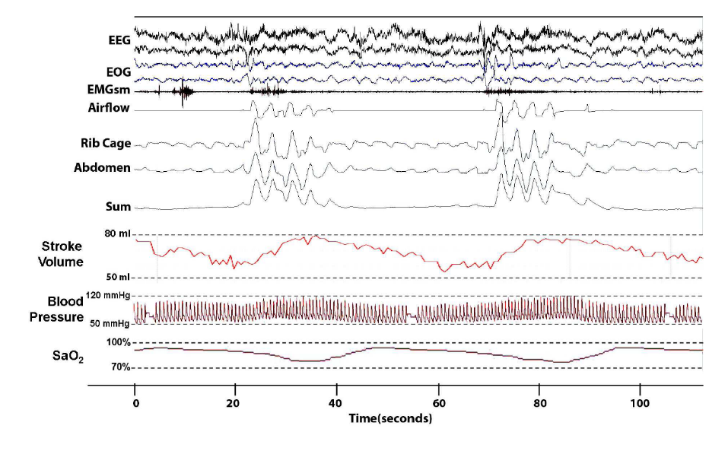
APNEA OSTRUTTIVA
Yumino et al – AJRCCM 2013;187:433-8

Slide 7
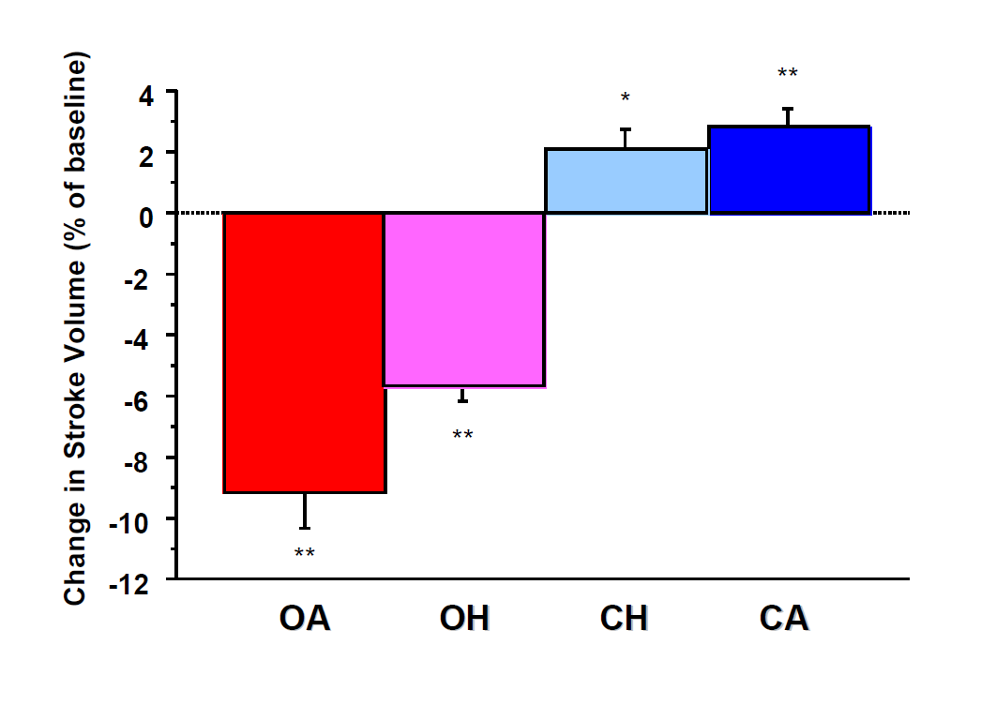
Yumino et al – AJRCCM 2013;187:433-8
Notes:
ma le apnee ostruttive e centrali hanno effetto differente

Slide 8
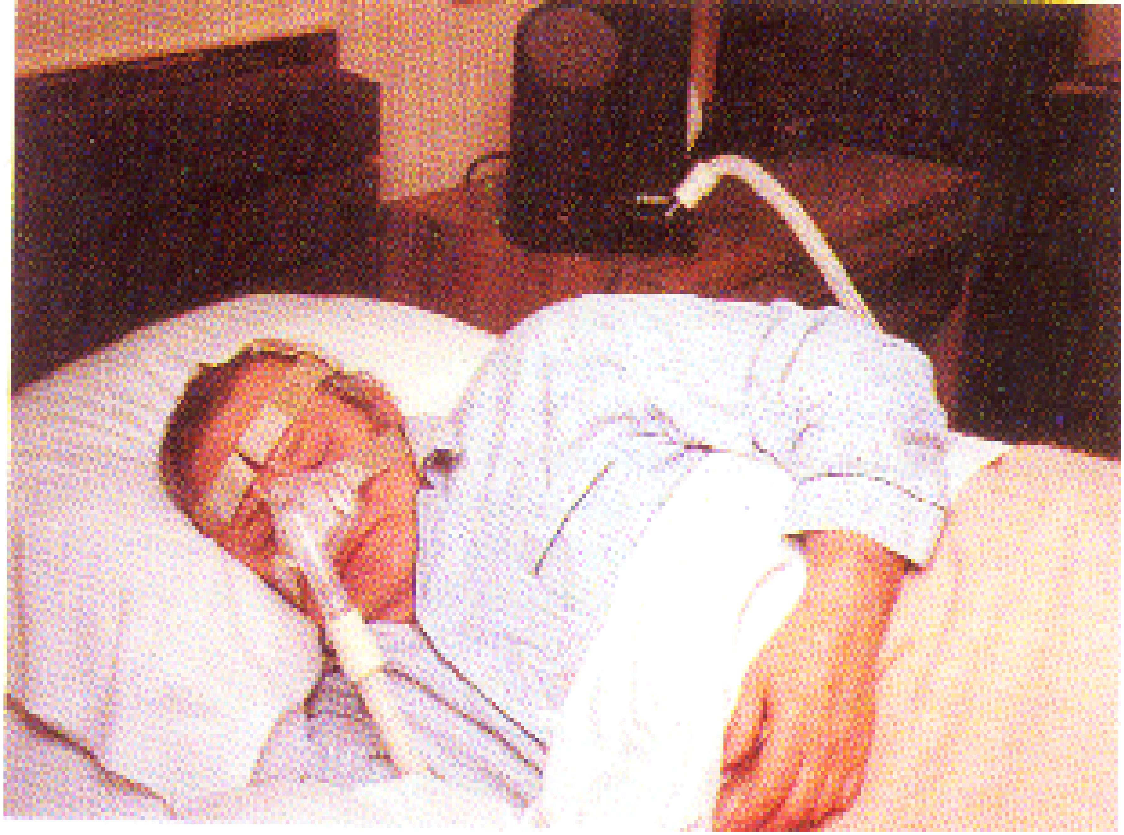
TREATMENT OF obstructive apneas IN CHF
EFFECTS OF CPAP

Slide 9
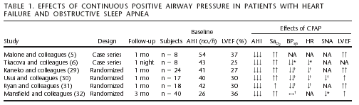
↑ FE 37% → 49% one week of CPAP
Malone et al. Lancet 1991;338:1480-4
Notes:
9

Slide 10

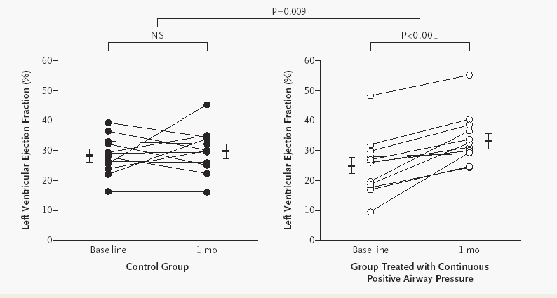
Cardiovascular Effects of Continuous Positive Airway Pressure in Patients with Heart Failure and Obstructive Sleep Apnea
Yasuyuki Kaneko, M.D., N Engl J Med 2003;348:1233-41.
Notes:
10
La relazione di causa-effetto potrebbe essere suggerita dal fatto che la terapia delle apnee ostruttive con CPAP migliora l’ipertrofia ventricolare in soggetti OSAS .

Slide 11

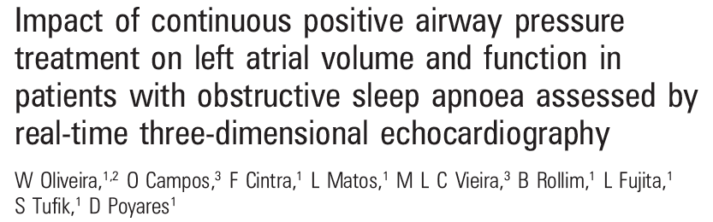
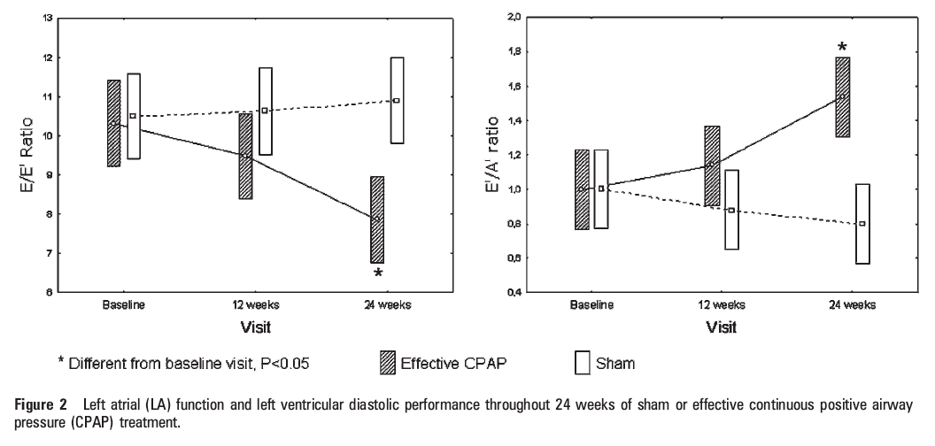
Notes:
11

Slide 12
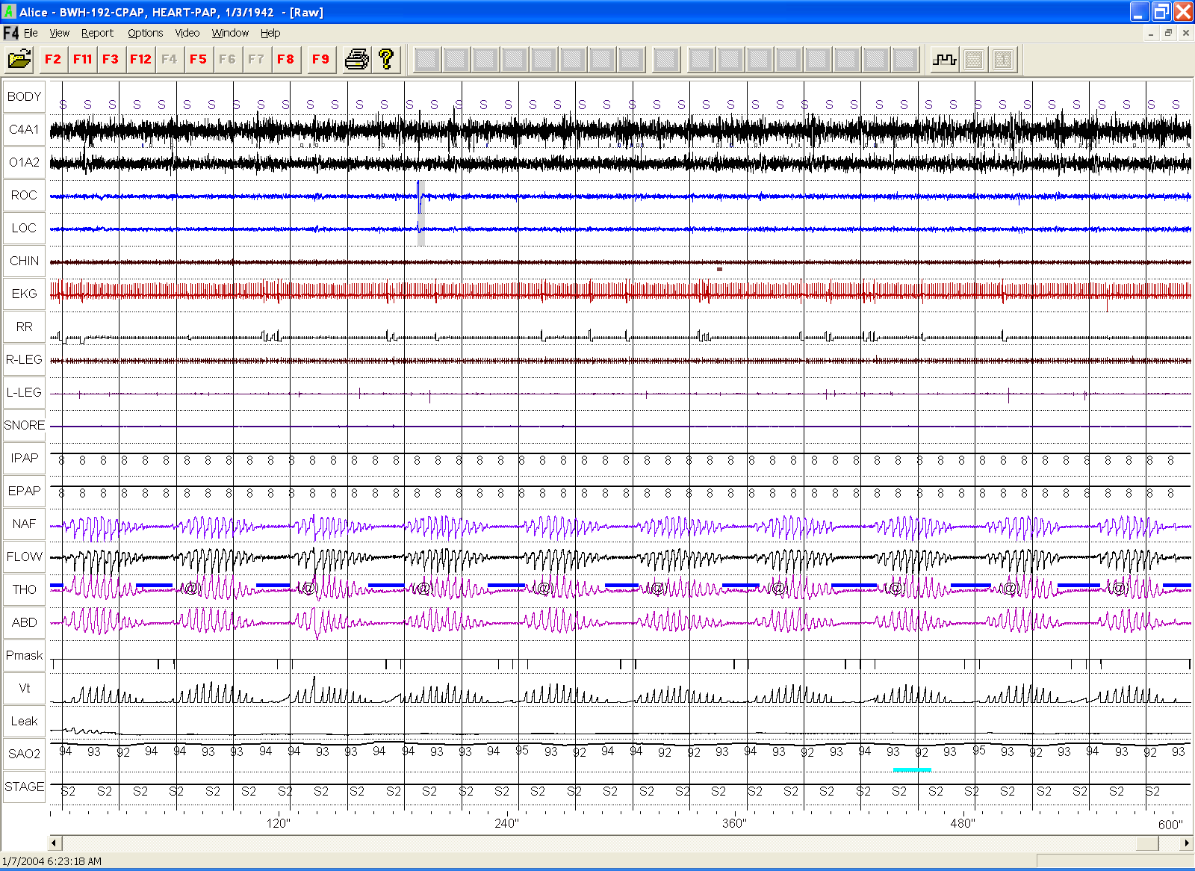
TREATMENT OF CENTRAL APNEA AND CHEYNE STOKE RESPIRATION IN CHF
NEVERENDING STORY

Slide 13
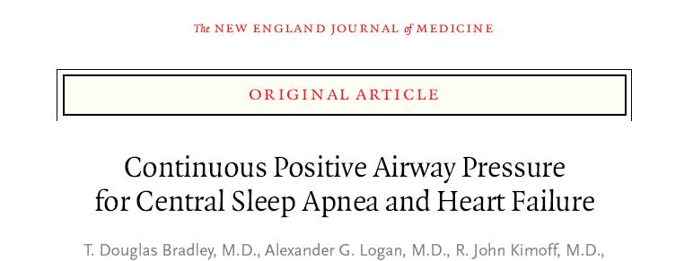
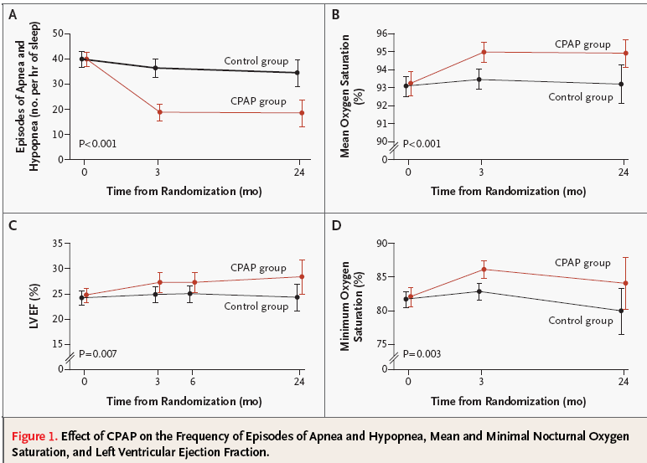
258 CHF + CSA/CRS
(mean Age 63, FE% 24, AHI 40)
CPAP Group 130
Control Group 128
2 years follow-up

Slide 14
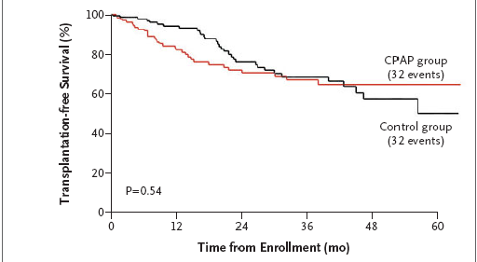

Slide 15
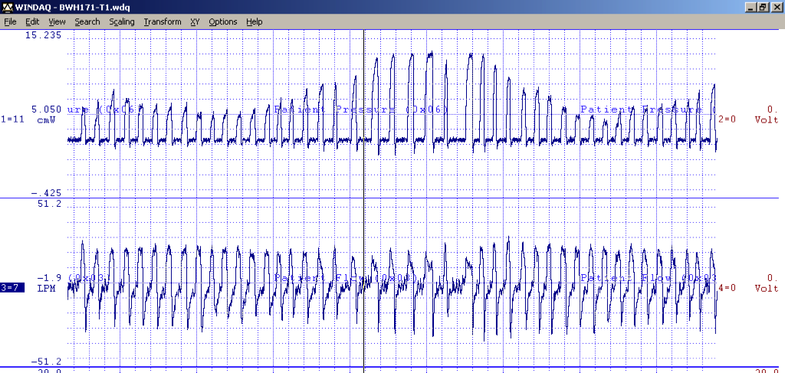
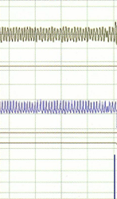
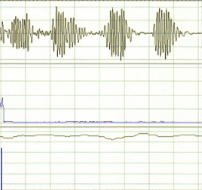
NOT ONLY CPAP......Adaptative Servo-Ventilation

Slide 16
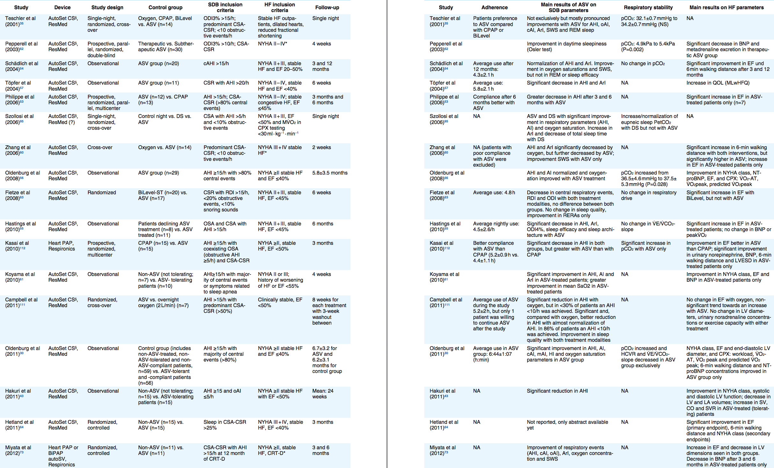
ADAPTATIVE SERVO VENTILATION DATABASE
2001
2015
15 years of positive studies.............. and then?

Slide 17
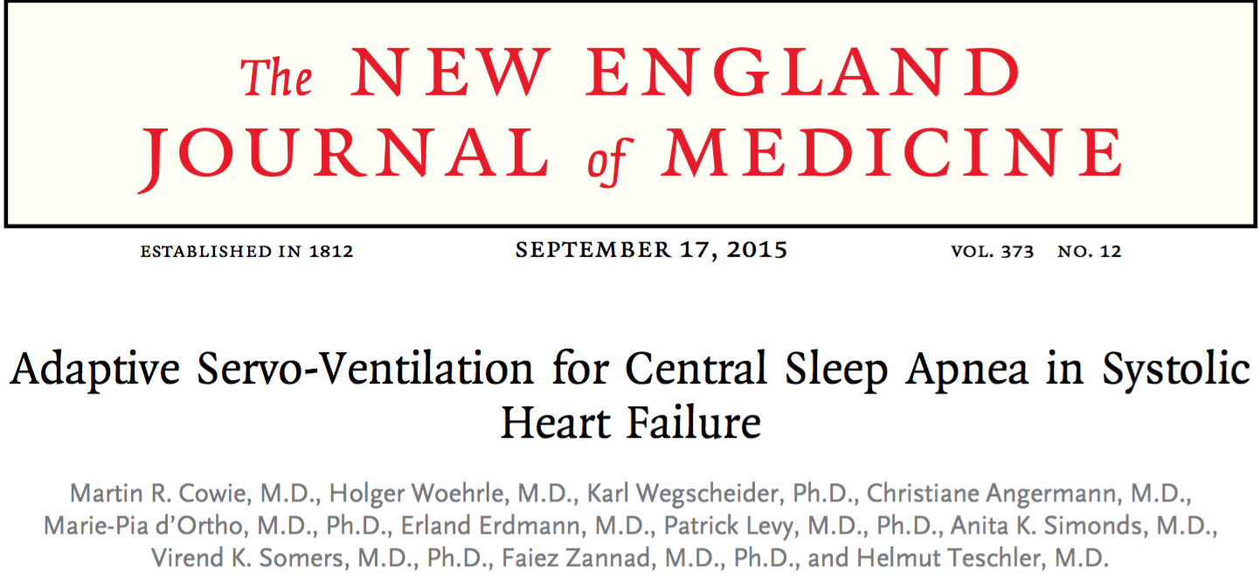
SERVE-HF

Slide 18
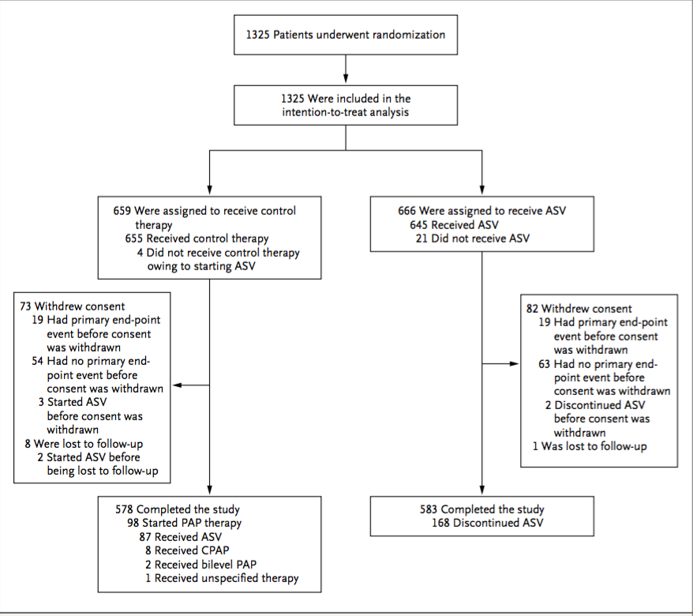
A total of 1325 patients were enrolled from February 2008 through May 2013 at 91 centers and were included in the intention-to-treat analysis; 659 patients were assigned to the control group and 666 to the adaptive servo-ventilation group
n engl j med 373;12 nejm.org September 17, 2015

Slide 19
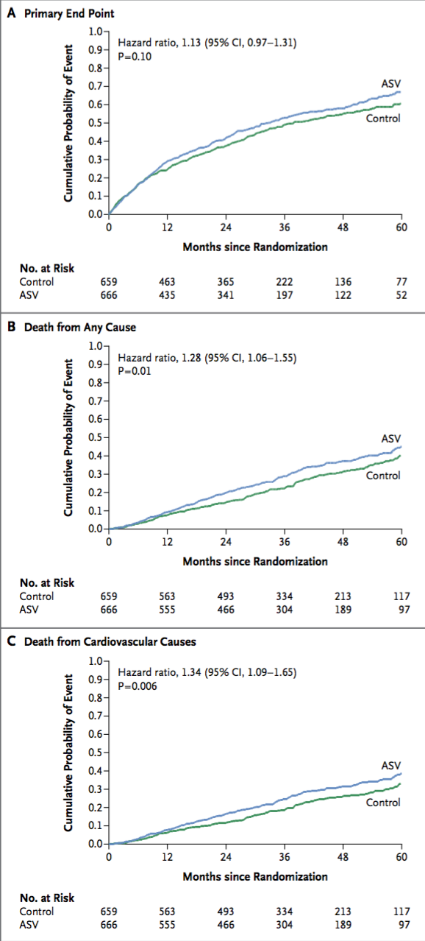
CONCLUSIONS
Adaptive servo-ventilation had no significant effect on the primary end point in patients who had heart failure with reduced ejection fraction and predominantly central sleep apnea, but cardiovascular mortality was increased with this therapy.
n engl j med 373;12 nejm.org September 17, 2015

Slide 20
SERVE HF
“de profundis” of Adaptative Servo Ventilation in CHF?
A Paradigm Shift in the Treatment of Central Sleep Apnea in Heart Failure

Slide 21
SERVE HF WEAKS 1

Slide 22
SERVE HF WEAKS 2 & 3
The primary study end point in the time-to-event analysis was the first event of the composite of death from any cause, a lifesaving cardiovascular intervention, or an unplanned hospitalization for worsening chronic heart failure
Primary end-point
secondary end-point
Cardio-vascular mortality

Slide 23
may be a Paradigm Shift in the Treatment of Central Sleep Apnea in Heart Failure...
...but you consider at least two important things
Notes:
bisogna considerare due aspetti...

Slide 24
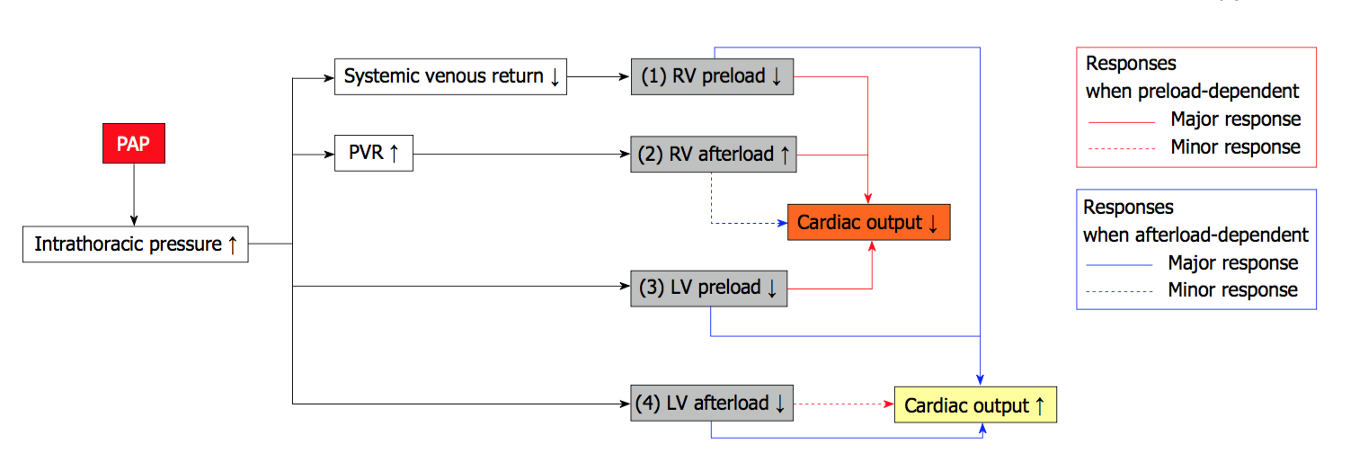
EFFECT OF PAP ON HEMODYNAMICS
(1)
World J Cardiol 2014 November 26; 6(11): 1175-1191
Notes:
L’effetto della PAP sul CO è strettamente dipente dalla dipendenza principale dei soggetti dal post carico destro...soggetti dispendenti dal post carico possono avere un incremento del CO per effetto dell’aumento della pressione intratoracica. Questo perchè vi è un meccanismo ( solo nei CHF con alta pressione di incuneamento) di spostamento del setto verso destra

Slide 25
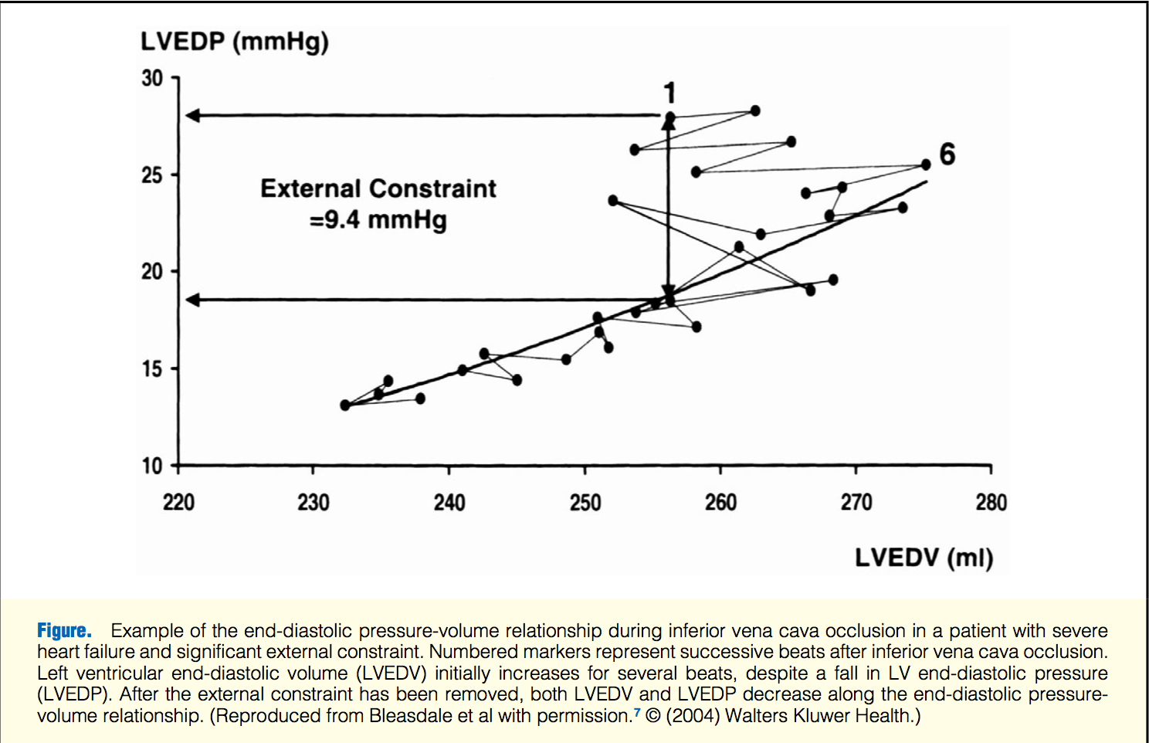

EFFECT OF PAP ON HEMODYNAMICS
An abrupt occlusion of the inferior vena cava immediately reduces the RV volume, coincident with an initial increase in the LV end-diastolic volume, despite a fall in LV end-diastolic pressure, in patients with severe CHF
This phenomenon, termed diastolic ventricular interaction, has been observed in approximately half of the patients with CHF and is related to the clinical observation that the descending limb of the Frank- Starling curve (SW-PCWP relationship) indeed exists in patients with severe CHF.
1. Atherton JJ, Moore TD, Lele SS, Thomson HL, Galbraith AJ, Belenkie I, et al. Diastolic ventricular interaction in chronic heart failure. Lan- cet 1997; 349: 1720 – 1724.

Slide 26
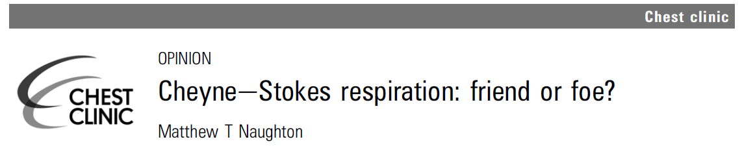

(2)

Slide 27
Foe
SYMPATHETIC OVERFLOW
INTERMITENT HYPOXEMIA
SLEEP FRAGMENTATION

Slide 28
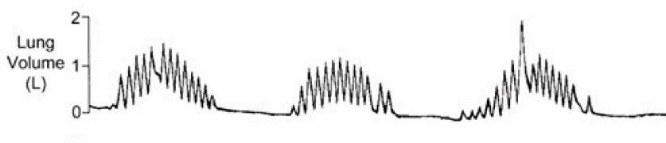
Is CSA-CSR a compensatory mechanism for severe HF ?
End-expiratory lung volume increase by 0.1-0.5 ( mean 400 ml)
Increase ELV would increase oxygen stores offset the restrictive defect and impaired tranfer factor of the lung for CO
This effect in ELV is similar to the effect of 5 cmH2O CPAP (mean 500 ml)
1)

Slide 29
Is CSA-CSR a compensatory mechanism for severe HF ?
2)
Deep breaths of periodic breathing and lung inflation promote vagal and reduce sympathetic activity in normal individuals
  Seals DR, Dempsey JA et al. Circ Res 1993
In CHF during wakefulness large tidal breaths were shown to attenuate MSNA
Naugthon MT et al, Clin Sci 1998

Slide 30
Is CSA-CSR a compensatory mechanism for severe HF ?
3)
Stroke volume has been reported to increase by 25% during hyperventilation period compared with the apnoic period in CHF
  Maze SS et al Chest 1989
MIP/MEP are reduced in CHF. Mathematical modelling indicates that intermittent work followed by rest or recovery is more advantageous than continous work and would offset the risk of developing respiratory muscle fatigue
Hughes PD et al AJRCCM 1999

Slide 31
Is CSA-CSR a compensatory mechanism for severe HF ?
4)
CSR can have some advantages on mean SpO2.
Levin M et al J theor Biol 1995
One study of patient with CHF and anemia reported rise in HB and fall of CSR with 3-months of treatment with EPO and iron.
Ziberman M et al Am Heart J 2007
So, one could speculate that intermittent hypoxia related to CSR would offset anaemia in CHF
        Naugthon MT, Thorax 2012

Slide 32
IN CHF PATIENTS
CPAP FOR HEMODYNAMIC EFFECTs
NOT FOR COSMETIC REMOVAL OF CSR

Slide 33
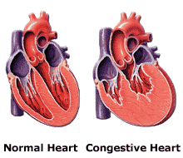
Conclusion
Treating obstructive sleep apnea is mandatory in CHF patients
At this moment ASV treatment of CSA-CSR in CHF patients with EF< 45% is not indicated

Slide 34
grazie per la vostra attenzione...

