Slide 1

La strumentazione del laboratorio di fisiopatologia respiratoria: manutenzione, calibrazione, misurazione
Riccardo Pistelli
Università Cattolica - Roma

Slide 2
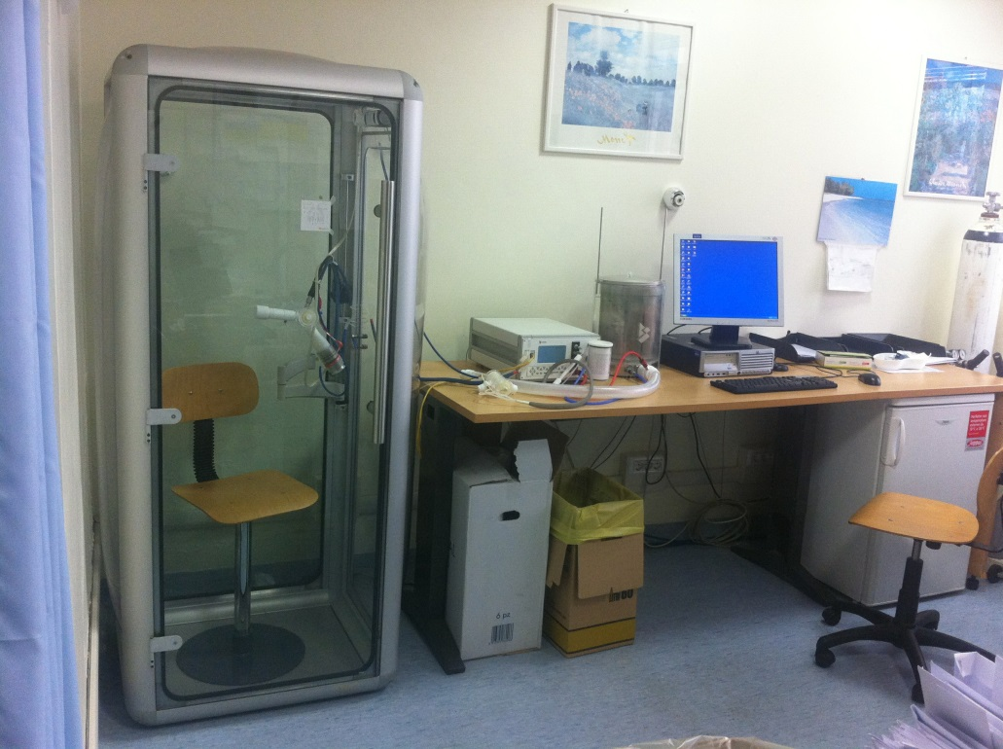
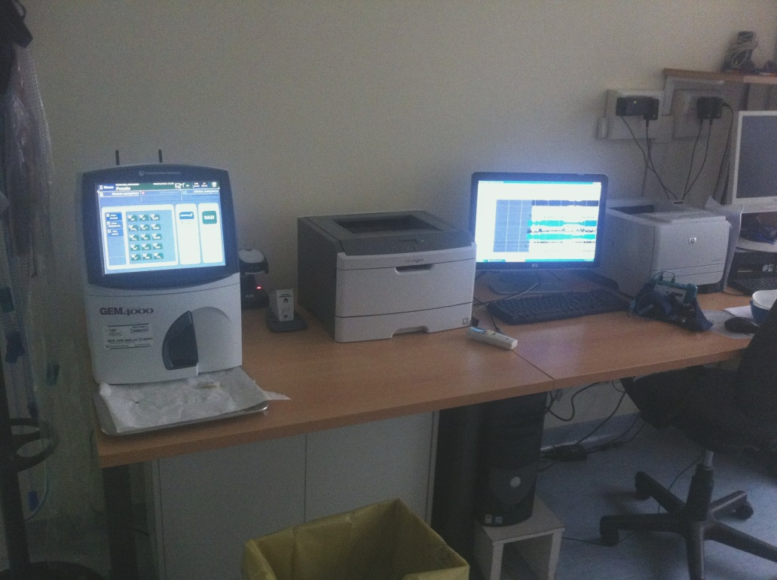
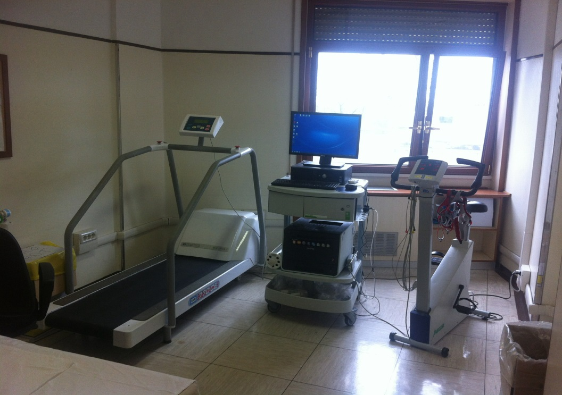

Slide 4
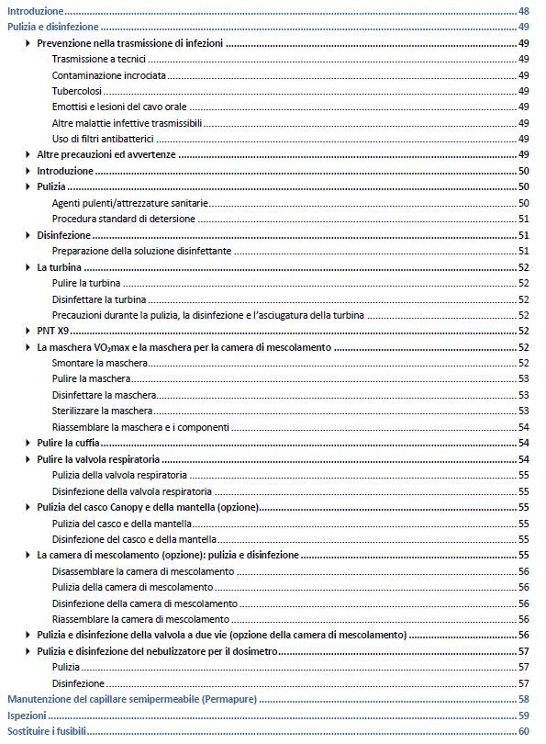

Slide 5
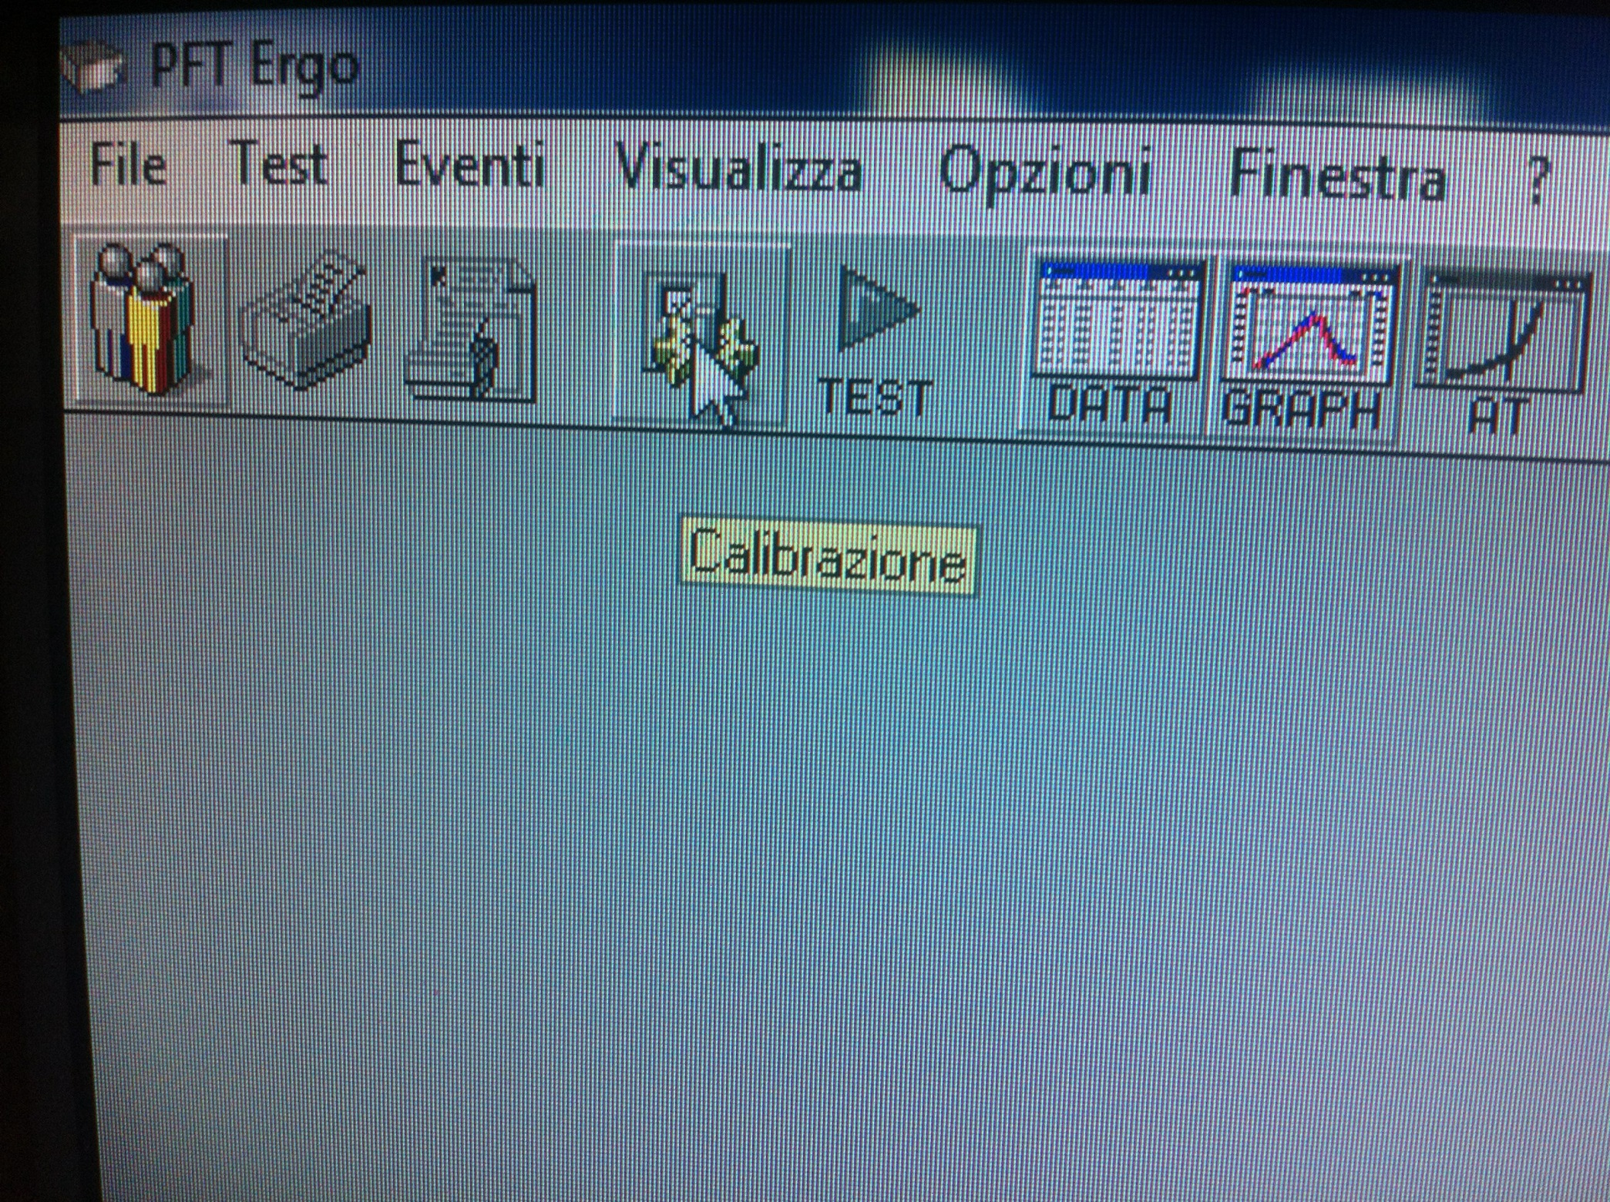

Slide 6
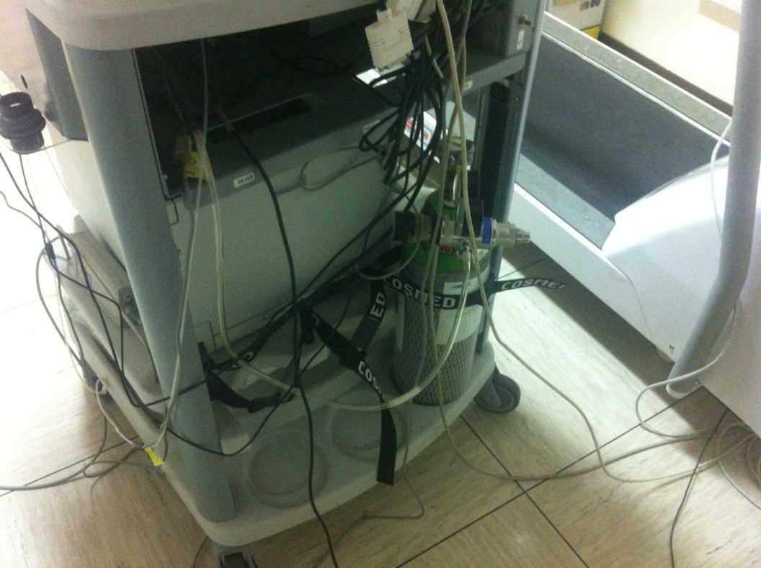
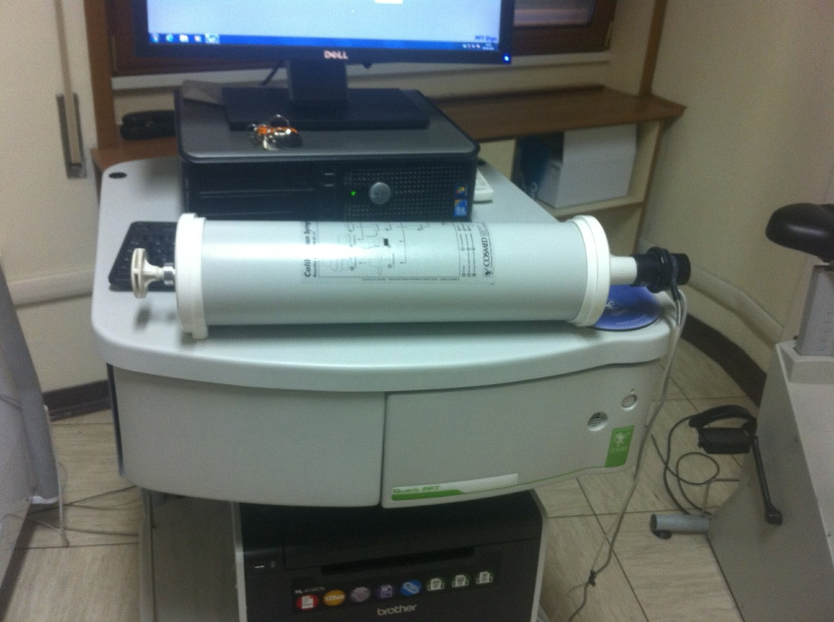

Slide 7
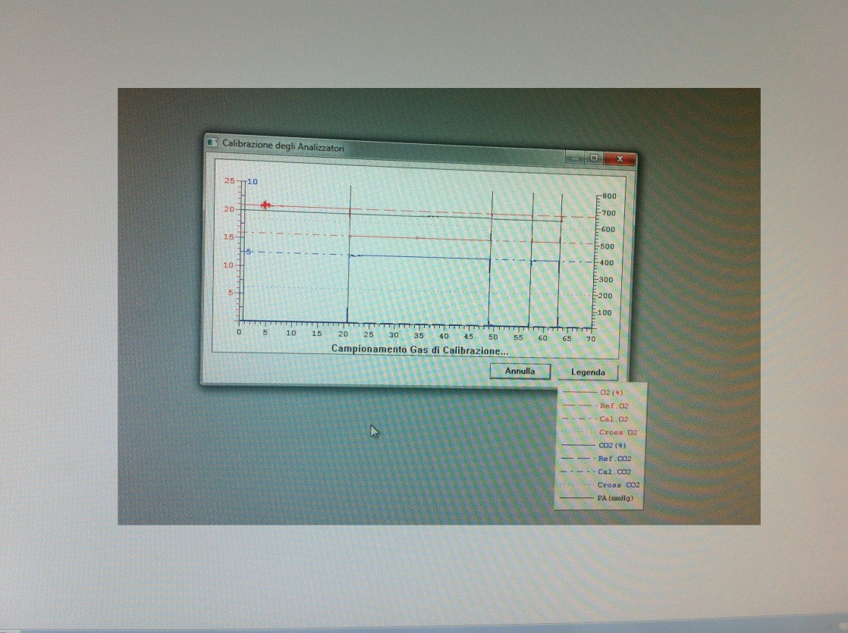
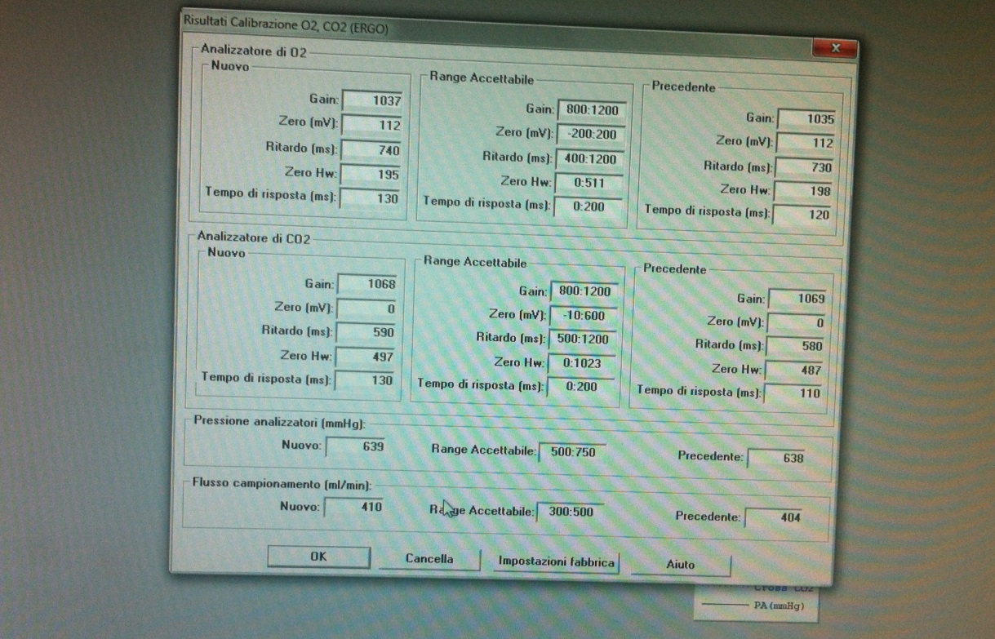

Slide 8
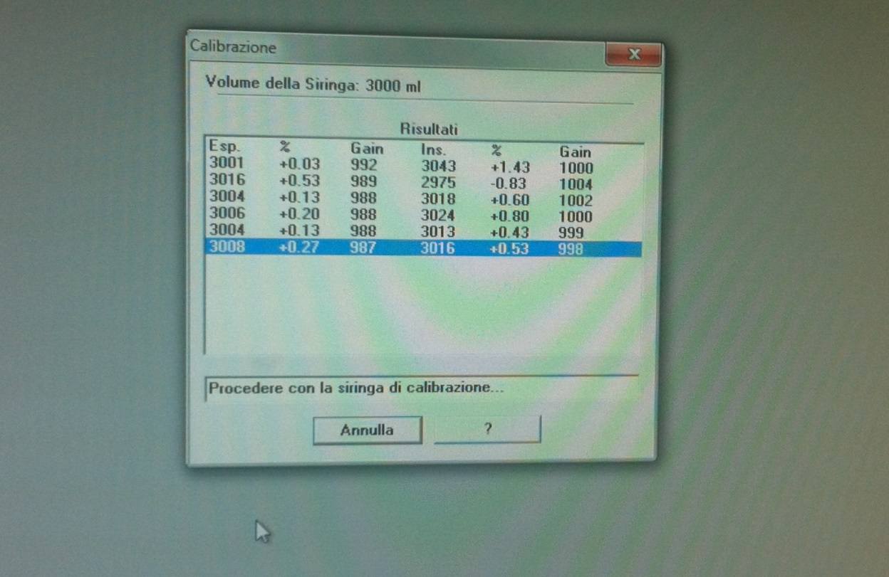
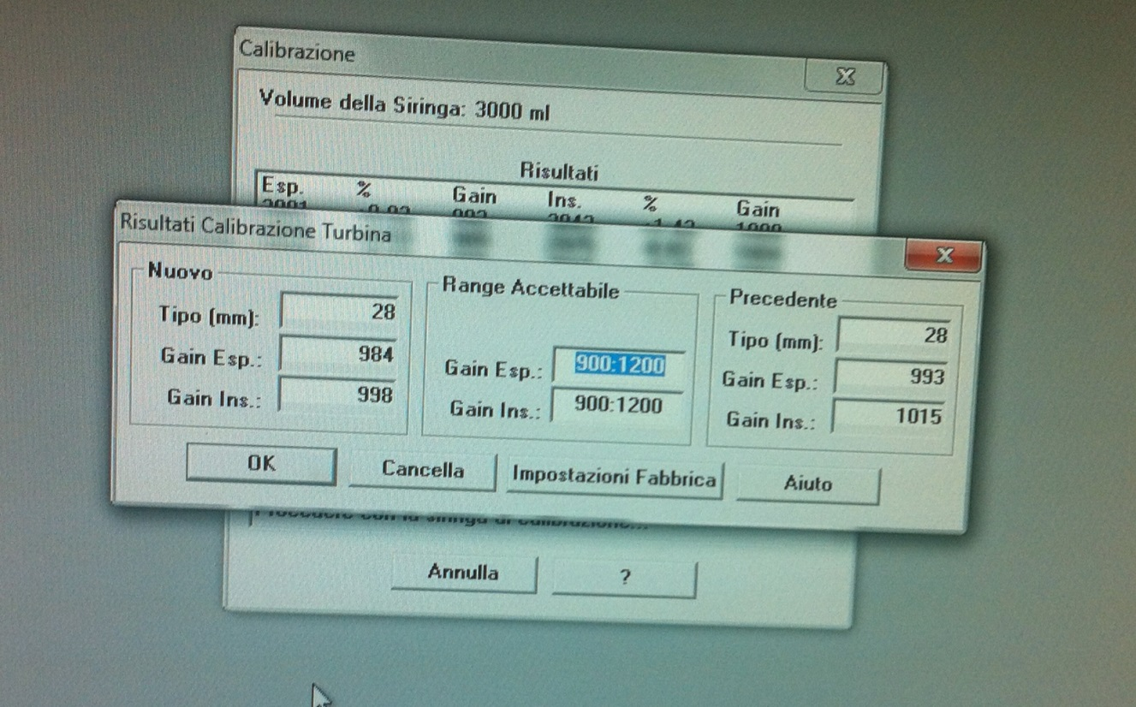

Slide 9
La linea di regressione indica la correlazione fra due dati
La linea di identità indica la concordanza fra due serie di dati

Slide 10
Bland MJ, Altman D (1986) Statistical methods for assessing agreement between two methods of clinical measurement. Lancet 327: 307-310.
.• A change in scale of measurement does not affect the correlation, but it affects the agreement.
• Correlation depends on the range of the true quantity in the sample. If this is wide, the correlation will be greater than if it is narrow.
• The test of significance may show that the two methods are related, but it would be amazing if two methods designed to measure the same quantity were not related.
The test of significance is irrelevant to the question of agreement.
Data which seem to be in poor agreement can produce quite high correlations.

Slide 16
ABSTRACT: The aim of this study was to verify whether the increase of resis- tance to airflow using a filter at the mouth could determine significant systematic errors of measurement or change the diagnostic performance in a respiratory physiology laboratory.

Slide 21
Bland MJ and Altman D Lancet 1986
^{Conclusions}
How far apart measurements can be without causing difficulties will be a question of judgment. Ideally, it should be defined in advance to help in the interpretation of the method comparison and to choose the sample size.

Slide 22
ABSTRACT: The aim of this study was to verify whether the increase of resis- tance to airflow using a filter at the mouth could determine significant systematic errors of measurement or change the diagnostic performance in a respiratory physiology laboratory.
CONCLUSION: The filter Spirobac has a statistically significant effect on the results of some pulmonary function tests. However, this is not considered to be clinically significant, since the changes due to the filter were within the intraindi- vidual variability of repeated measurements for almost all the function indices and no appreciable classification error was found in diagnostic tests.

