Slide 1
Hypersensitivity pneumonitis Should it be viewed as a single entity?
Venerino Poletti versus Athol Wells

Slide 3
Inter-MDT agreement for diagnosis in the setting of diffuse lung disease
70 cases of diffuse lung disease, 22 with histology
Evaluated by expert MD groups in 7 countries
Walsh SL et al, Lancet Resp Med 2016: in press

Slide 4
Inter-MDT agreement for diagnosis in the setting of diffuse lung disease
First step - each component isolation
Clinicians
Clinical data and HRCT at presentation
Up 5 diagnoses with % likelihood
Radiologists
HRCT at presentation (only)
Up 5 diagnoses with % likelihood
Pathologists
Biopsy data (only)
Up 5 diagnoses with % likelihood
Walsh SL et al, Lancet Resp Med 2016: in press

Slide 5
Inter-MDT agreement for diagnosis in the setting of diffuse lung disease
Second step – as “MDT”
MDT
Clinical data, biopsy data and HRCT
Individual diagnoses from step 1
Up to 5 diagnoses with % likelihood
[Predicted disease behaviour]
[Management strategy]
Walsh SL et al, Lancet Resp Med 2016: in press

Slide 6
Inter-MDT agreement in the setting of diffuse lung disease
Hypersensitivity pneumonitis
Kappa = 0.24
<0.4 = poor,
0.4-0.6 = satisfactory,
0.6-0.8 = good,
>0.8 = excellent
Walsh SL et al, Lancet Resp Med 2016: in press

Slide 7
Should CHP be viewed as a single diagnostic entity?
The value of making a diagnosis lies in:
Clinical utility: informing the clinician of the likely natural history and treated course
Pathogenetic insights: understanding disease, developing new treatments
Does the HP diagnostic entity stand up to scrutiny?

Slide 8
CLINICAL BEHAVIOR | TREATMENT GOAL | MONITORING STRATEGY
Reversible & self-limited (e.g. RBILD) | Remove possible cause | Short term (3-6 month) observation to confirm disease regression
Reversible disease with risk of progression (e.g. some NSIP, DIP, COP) | Initial response & then rationalize longer term therapy | Short term observation to confirm Rx response. Long term observation to ensure that gains are preserved
Stable with residual disease (e.g. some NSIP) | Maintain status | Long term observation to assess disease course
Progressive, irreversible disease with potential for stabilization (e.g. some fibrotic NSIP) | To prevent progression | Long term observation to assess disease course
Progressive, irreversible disease despite therapy (e.g. IPF, some fibrotic NSIP) | To slow progression | Long-term observation to assess disease course, need for transplant or effective palliation
Travis W et al, Am J Resp Crit Care Med 2013;188:733

Slide 9
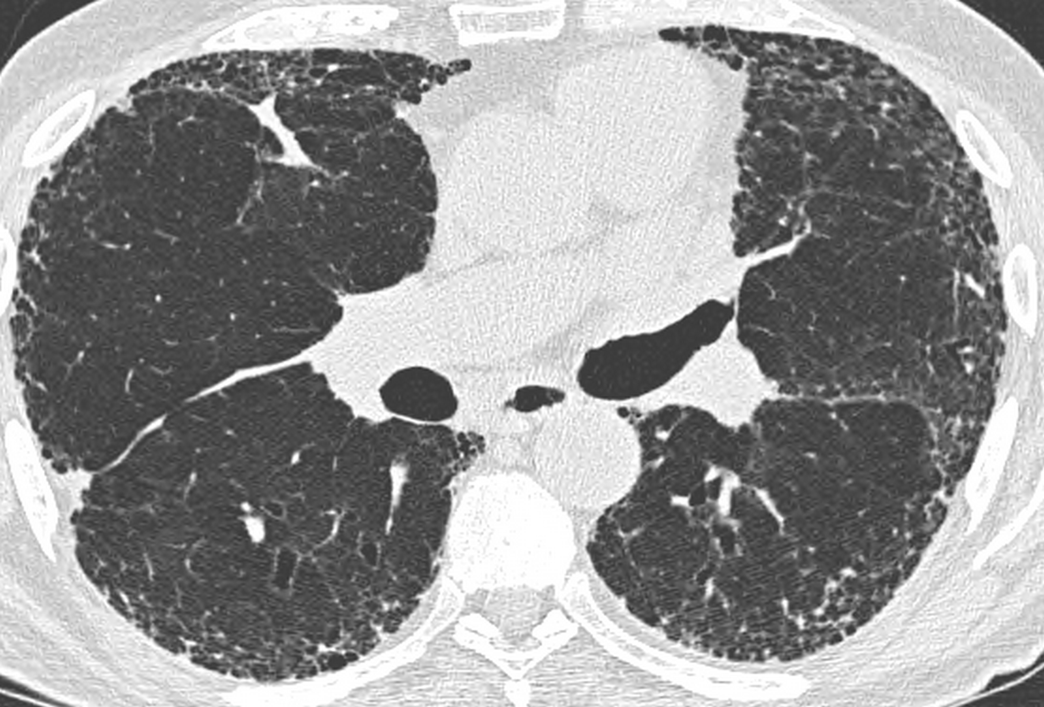

Slide 10
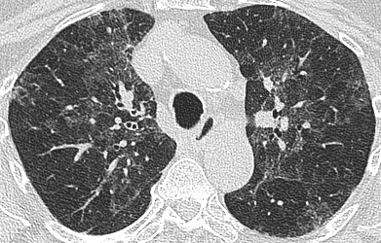

Slide 11
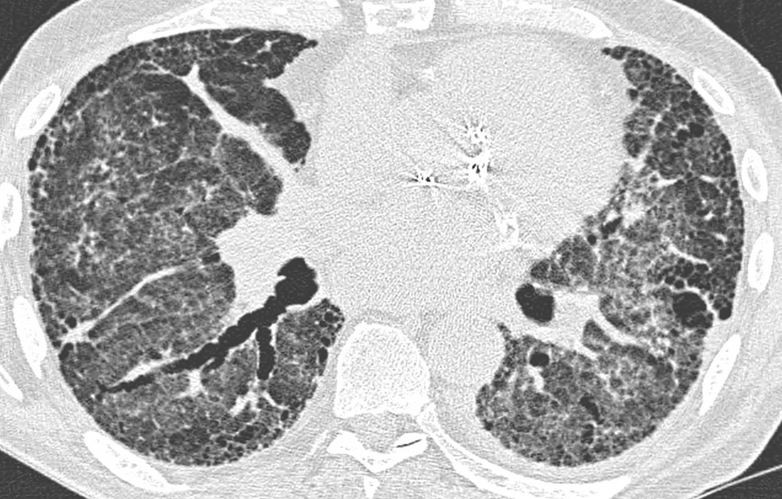

Slide 12
CLINICAL BEHAVIOR | TREATMENT GOAL | MONITORING STRATEGY
Reversible & self-limited (e.g. some HP) | Remove possible cause | Short term (3-6 month) observation to confirm disease regression
Reversible disease with risk of progression (e.g. some HP) | Initial response & then rationalize longer term therapy | Short term observation to confirm Rx response. Long term observation to ensure that gains are preserved
Stable with residual disease (e.g. some HP) | Maintain status | Long term observation to assess disease course
Progressive, irreversible disease with potential for stabilization (e.g. some HP) | To prevent progression | Long term observation to assess disease course
Progressive, irreversible disease despite therapy (e.g. some HP) | To slow progression | Long-term observation to assess disease course, need for transplant or effective palliation

Slide 13
HP: survival against histopathologic pattern
Biopsies (n-110) classified as "typical" (n = 58), NSIP (n = 22), UIP (n = 10), mixed (n = 9), OP (n = 3), airway-centered interstitial fibrosis (ACIF)-pattern (n = 3), non-classified (n = 5)
Patients with UIP had the worst survival (HR: 4.19; 95% CI: 1.66-14.47; p < 0.004)
Patients with NSIP had the best survival (HR: 0.18; 95% CI: 0.04-0.82; p < 0.03)
UIP was associated with significantly lower lymphocyte counts
Gaxiola M et al, Respir Med 2011; 105:608-14

Slide 14
Should HP be viewed as a single diagnostic entity?
The value of making a diagnosis lies in:
Clinical utility: informing the clinician of the likely natural history and treated course
Pathogenetic insights: understanding disease, developing new treatments
Does the HP diagnostic entity stand up to scrutiny?
No!
No!
No!

Slide 15
A prognostic study of HP (n=102) diagnosed by the RBH multi-disciplinary group, tested in Forli
Diagnosis should provide insights into disease behaviour
Goal: to identify patients subsequently exhibiting IPF-like disease behaviour
Prognostic evaluation of factors contributing to multi-disciplinary diagnosis
Confirmatory cohort of Forli HP patients (n=61)
Control cohort of biopsied IPF patients (n=84)
Zappala CJ et al, in preparation

Slide 16
Prognostic significance of key sub-groups
BAL cellularity and HRCT grading both had prognostic value
A sub-group with IPF-like disease behaviour was not identified using HRCT
BAL thresholds evaluated against mortality
The optimal thresholds were a BAL lymphocyte % of <20% (HR=3.93 [1.66, 9.31], p=0.002) and a BAL neutrophil % of >6% (HR=2.62 [1.06, 6.51] p=0.04)
These thresholds remained optimal and statistically significant after adjusting for age, gender, baseline disease severity (using CPI) and treatment status at the time of BAL.

Slide 17
Definition of BAL sub-groups
A BAL lymphocyte percentage of <20% was associated with a BAL neutrophil percentage of >6% in 25 of 102 HP patients (25%).
In this sub-group, with adjustment for age, gender, disease severity and intention to treat status, mortality was strikingly higher than in the remaining HP patients (HR=5.41 [2.11, 13.86], p<0.0001).
BAL profiles were dichotomised as Group 1 (lymphocytes<20%, neutrophils>6%) and Group 2 (the remaining HP patients).
In the Forli HP cohort, patients in Group 1 had a striking increase in mortality (HR = 7.71 [2.12, 28.1], p<0.005).

Slide 18
Comparisons with IPF
The RBH and Forli groups were combined
Mortality in HP Group 1 was only slightly lower than in IPF controls (HR = 1.86 [1.11, 3.14], p=0.02)
On bootstrapping, with adjustment for age, gender and disease severity, mortality no longer differed significantly between HP group 1 and IPF (HR = 1.75 [0.96, 3.20], p=0.07).

Slide 19
Survival in HP sub-groups and in IPF
100
HP group 2, n=123
75
50
HP group 1, n=40
25
IPF, n=84
0
0
20
40
60
Months

Slide 21
Summary
Previous HP classifications do not meet patient needs
Viewing CHP as a single diagnostic entity does not stand up to scrutiny, based on clinical utility, pathogenesis and treatment outcomes
In chronic HP, a large subset has IPF-like disease behaviour and another large subset does not
The thing called “chronic HP” is a pot-pourri of outcomes and pathogenetic pathways spanning the whole fibrotic ILD spectrum

