Slide 1
Chronic Hypersensitivity Pneumonitis: it exists
Venerino Poletti
Dipartimento Malattie Apparato Respiratorio e del Torace, Azienda USL Romagna. Forlì/Ravenna Hospitals (I)
Department of Respiratory Diseases &Allergy
Aarhus University Hospital (DK)

Slide 3
Chronic Hypersensitivity pneumonitis
Britannica does not currently have an article on this topic

Slide 4
K
A
I
R
O
S

Slide 5
Hypersensitivity pneumonitis (HP), also kown as
extrinsic allergic alveolitis (EAA), is a syndrome that
results from repeated inhalation of finely dispersed antigens
Moises Selman. In
“Schwarz King” Interstitial Lung Disease
Fourth Edition

Slide 6
The sieve of Eratosthenes

Slide 7
Lacasse Y, Selman M, Costabel U, et al. Classification of Hypersensitivity Pneumonitis
A Hypothesis. Int Arch Allergy Immunol 2009
CLUSTER 1
41 patients
*more recurrent systemic symptoms (chills and body aches)
*normal chest radiographs
CLUSTER 2
127 patients)
*significantly more clubbing, hypoxemia, restrictive
patterns on pulmonary function tests
*fibrosis on high-resolution computed tomography (HRCT).
Nodular opacities were seen on HRCT as often in cluster 1 as in cluster 2
SUBACUTE HP IS PARTICULARLY DIFFICULT TO DEFINE

Slide 8
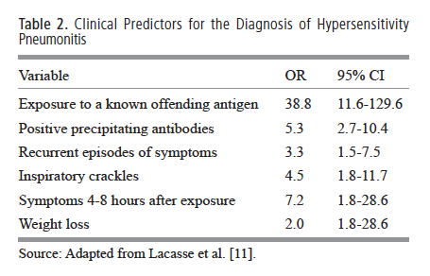

Slide 9
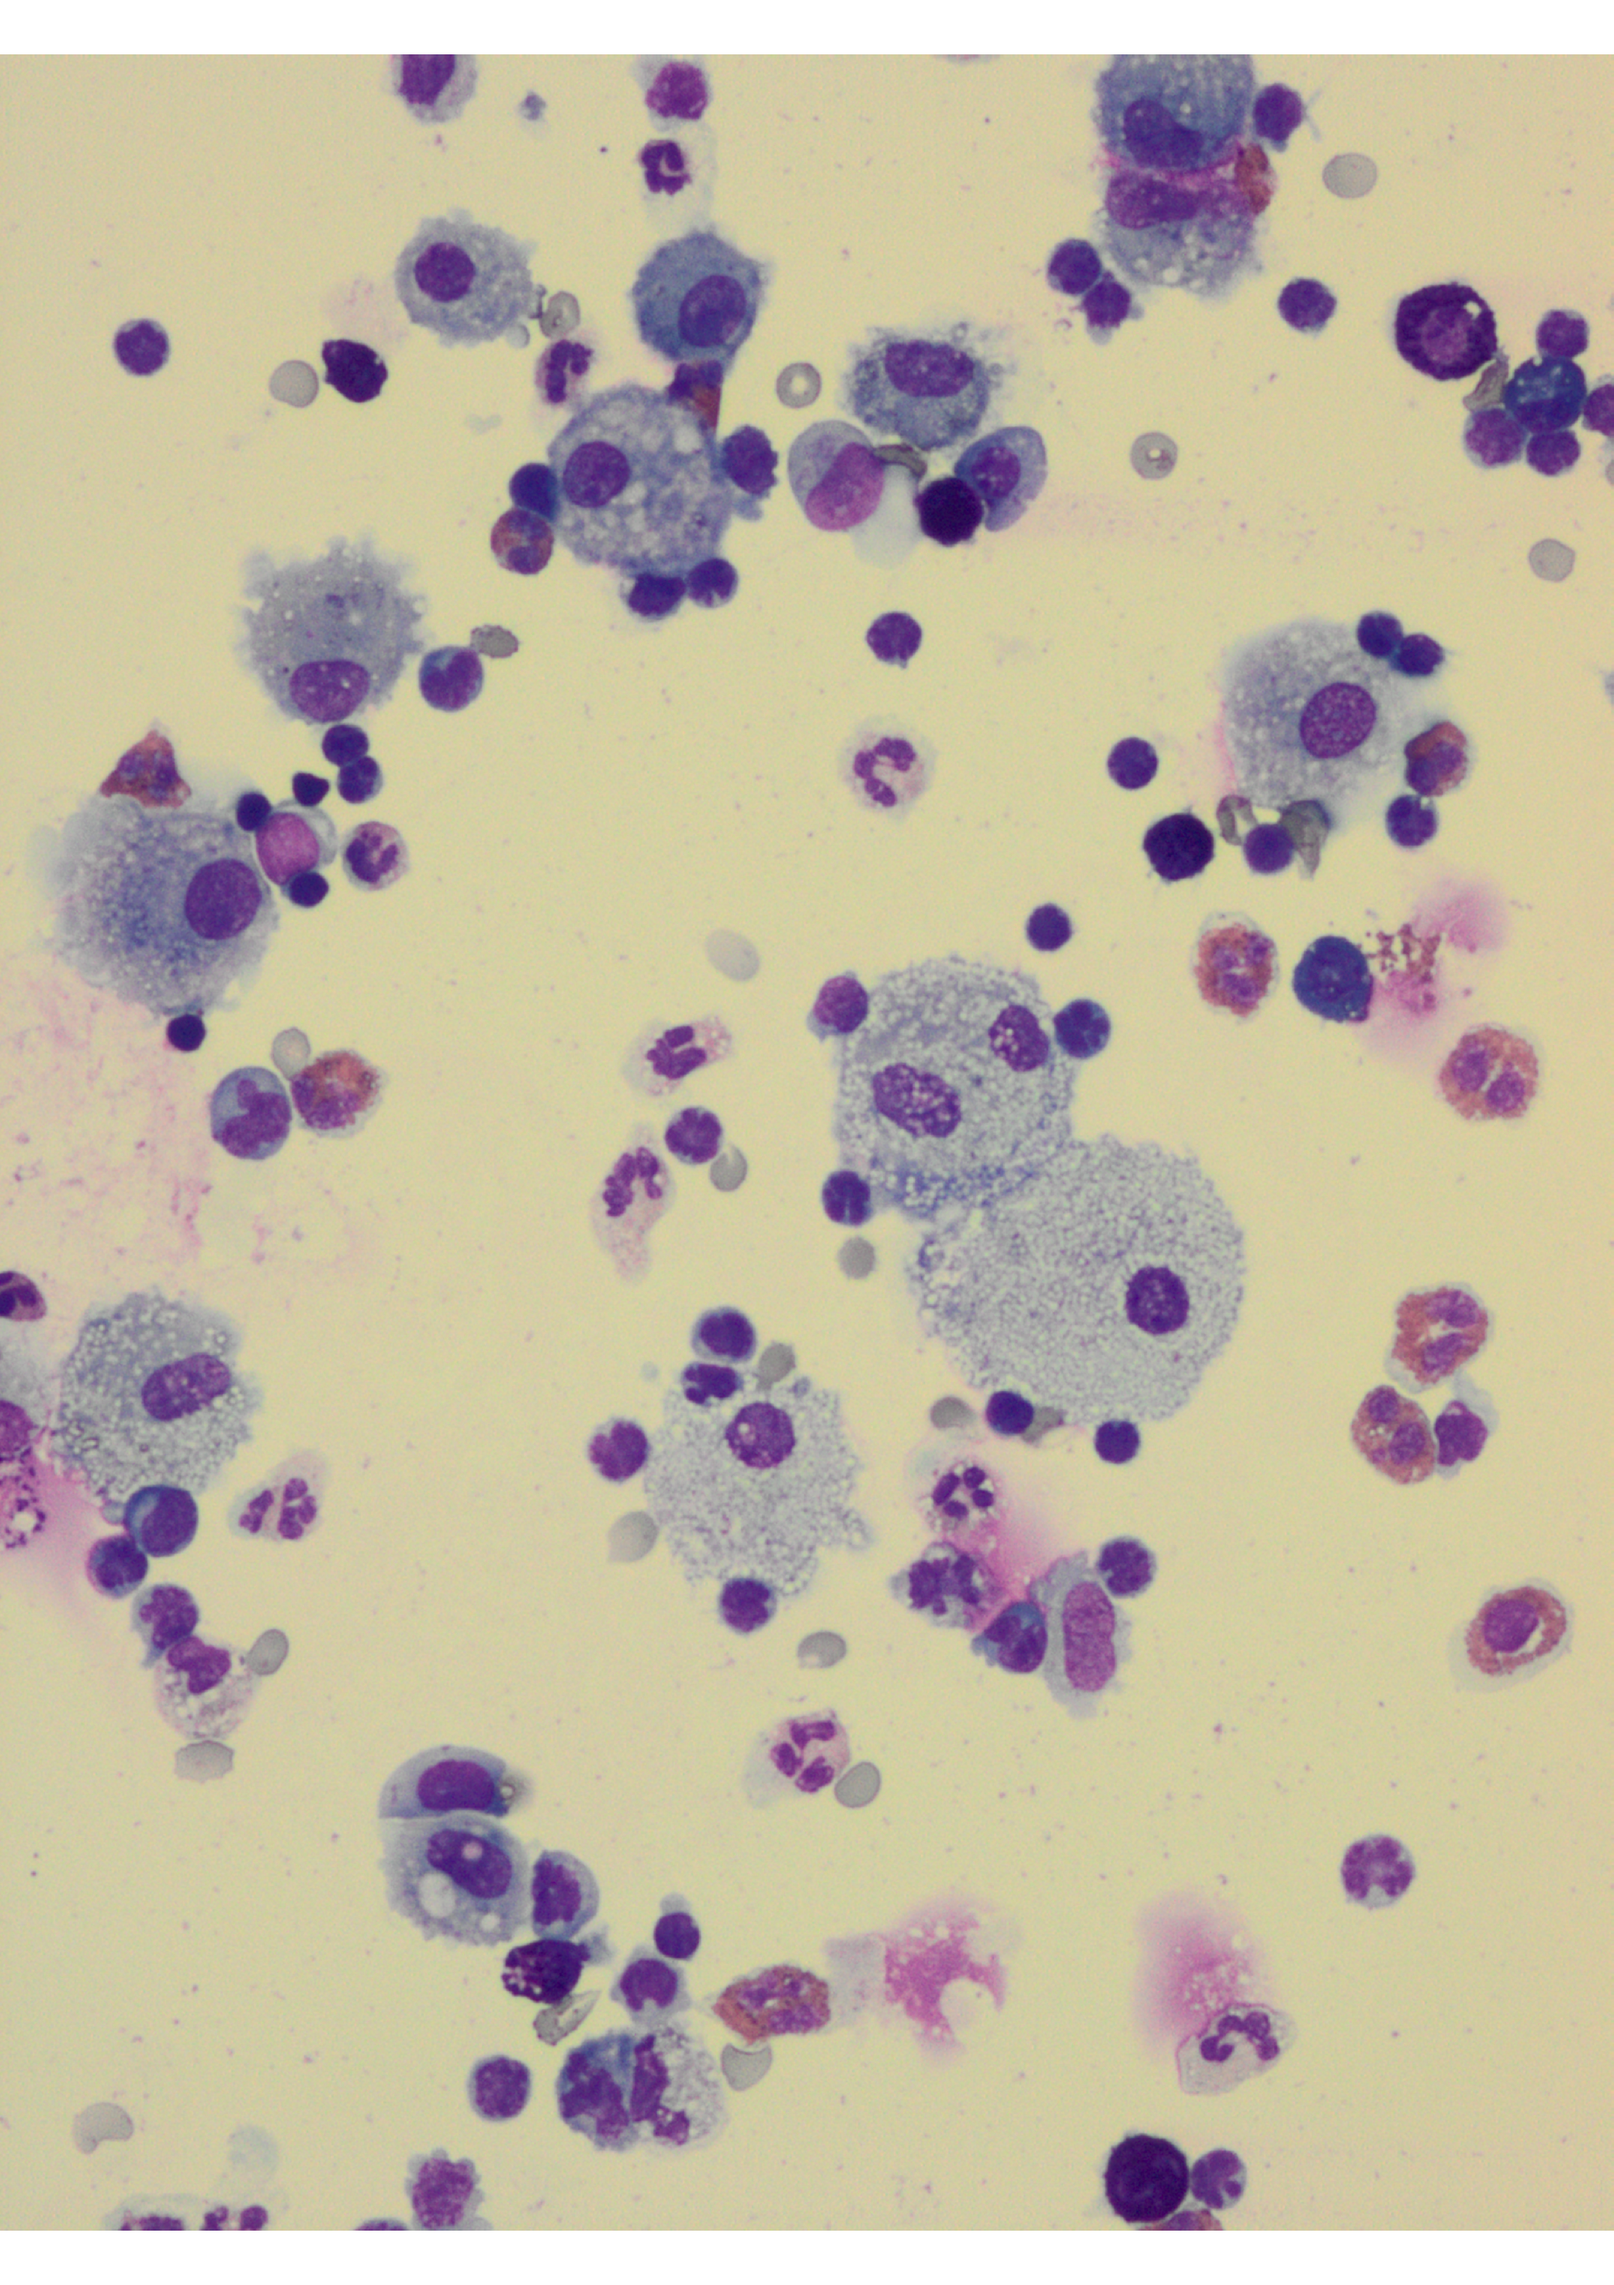
BAL in subacute HP

Slide 10
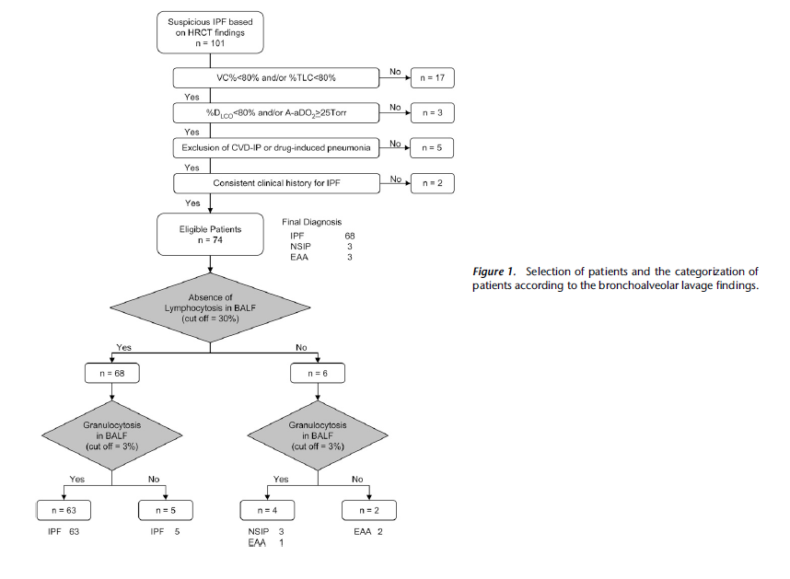
101 pts with a confident HRCT diagnosis of IPF
BAL lymphocytosis changed the diagnostic perception in 30% of patients who would have been misdiagnosed as having
IPF without BAL.
The change in perception of the diagnosis was validated by a surgical biopsy in two cases and by subsequent outcome in four cases
(cHP 2 cases; f-NSIP 4 cases).
Oshimo, Am J Respir Crit Care Med Vol 179. pp 1043, 2009
Notes:
It also has an important place in the personal diagnostic algorithms of many experienced clinicians in the diagnosis of the more prevalent disorders, including sarcoidosis, hypersensitivity pneumonitis and idiopathic pulmonary fibrosis. This use of BAL is not well captured in the medical literature, A Wells Brompton London

Slide 11
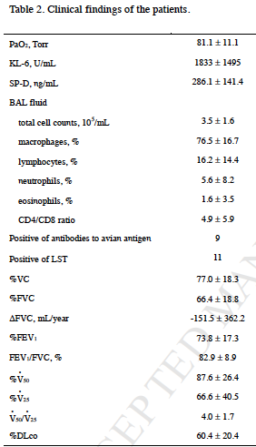
Chest, in press

Slide 12
Histological pattern in chronic pigeon breeder’s disease: correlation with clinical data
 | Typical pattern n = 58 | NSIP pattern n = 22 | UIP-like pattern n = 10 | p
Finger clubbing | 30/56 (53) | 10/21 (47.6) | 8/10 (80) | 0.26
BAL lymphocytes % | 65 ± 21 | 52 ± 23 | 36 ± 23 | 0.0011
BAL macrophages % | 34 ± 20 | 45 ± 23 | 59 ± 18 | 0.0028
BAL eosinophils % | 1 (0–9) | 0 (0–13) | 2 (0–13) | 0.11
BAL neutrophils % | 0 (0–10) | 1 (0–10) | 1 (0–4) | 0.61
HRCT
Inflammation (%) | 30/40 (75) | 11/16 (69) | 1/7 (14) | <0.007
Fibrosis (%) | 10/40 (25) | 5/16 (31) | 6/7 (86) | <0.007
Gaxiola M et al, Respir Med 2011

Slide 14
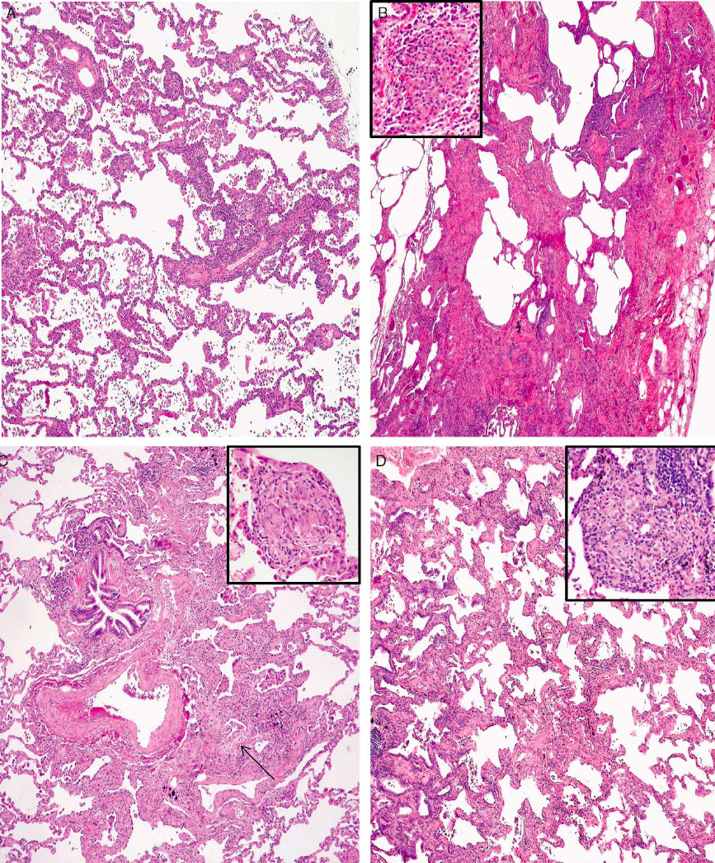
Chronic HP
UIP pattern
NSIP pattern
Centrilobular fibrosis
Bronchiolar metaplasia
Scattered granulomas

Slide 15
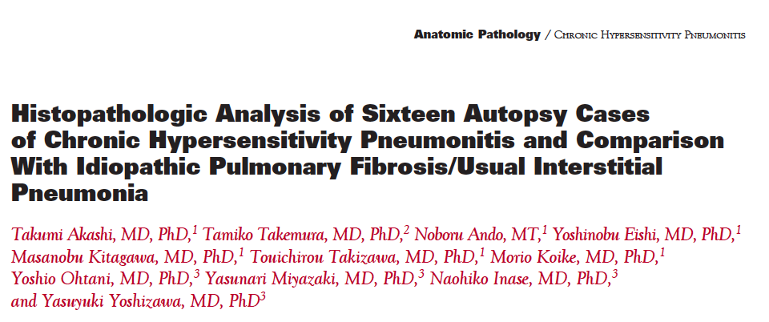

Slide 16
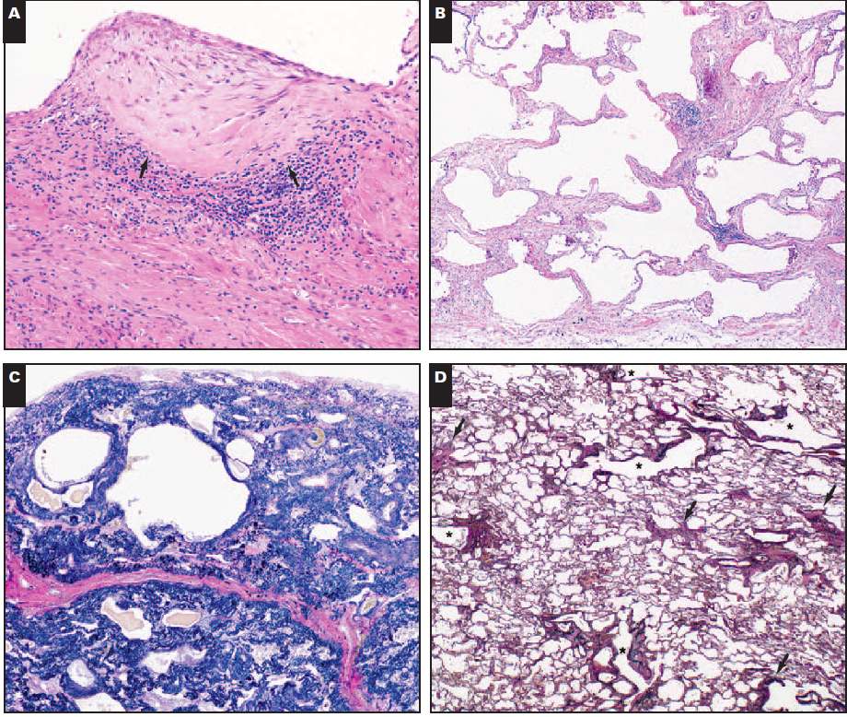

Slide 17
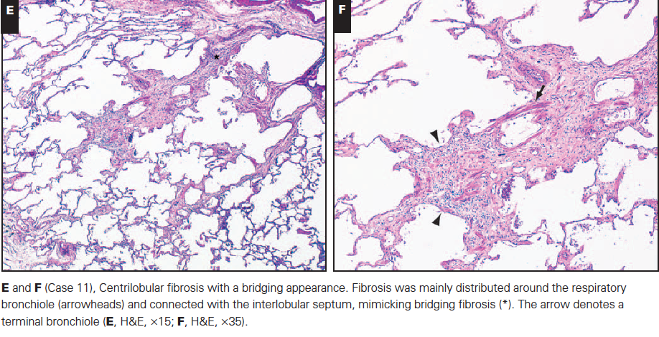

Slide 18
Biopsy proven HP and identification of the offending agents
142 surgical lung biopsy proven HP cases from 1982-2008
at National Jewish in Denver
Antigen identified in 67 patients (47%)
Avian antigens (41%)
Office/home mold exposure (27%)
Farmers, gardeners, etc (16%)
Hot tub users (9%)
Antigen not identified in 75 patients (53%)
Fernandez Perez Er, et al. Chest 2013

Slide 19
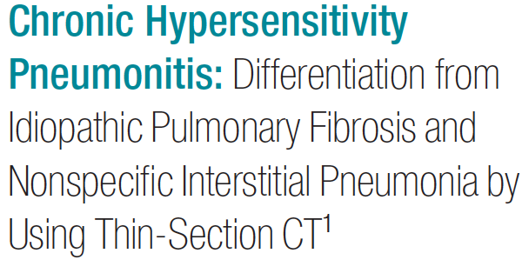
Silva CI, et al. Radiology 2008

Slide 20
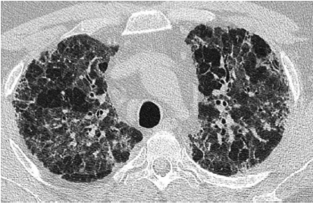
Rate of identification of the offending agent : not clear reports

Slide 21
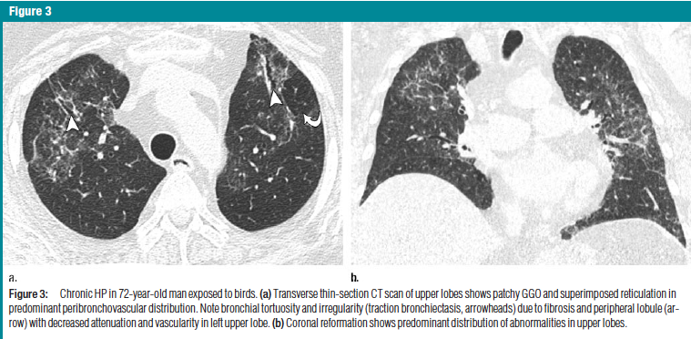
Radiology 2008

Slide 22
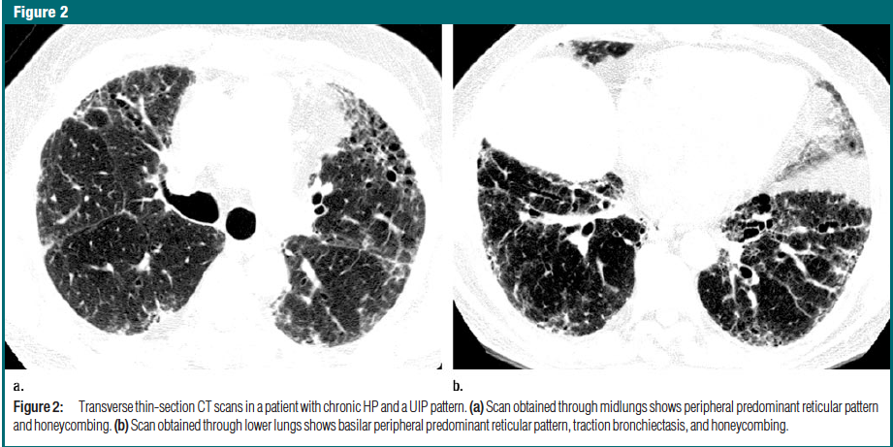
Radiology 2008

Slide 23
Medicine 2008

Slide 24
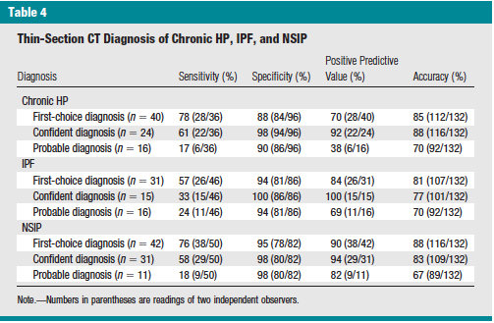
Silva CI, et al. Radiology 2008

Slide 25
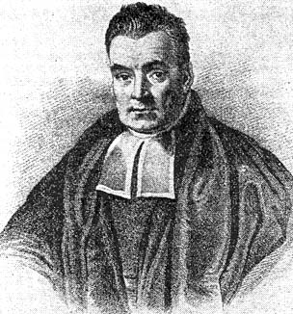
A ROUGH ESTIMATE
Prevalence of HP = 8-10%
Specificity of the tests = 95%
When we identify a subject with
the diagnostic label “chronic HP”
the probability that this
will be the “truth” is about 70%
Thomas Bayes
(LONDRA 1702- TUNBRIDGE WELLS 1761)
25

