Slide 1
TRANSBRONCHIAL CRYOBIOPSY
Venerino Poletti
Dipartimento Malattie Apparato Respiratorio e del Torace
Azienda USL Romagna,
Pneumologie Ospedali di Forlì/Ravenna (I)
Department of Respiratory Diseases & Allergy
Aarhus University Hospital (DK)

Slide 3
TECHNICAL NOTES

Slide 4
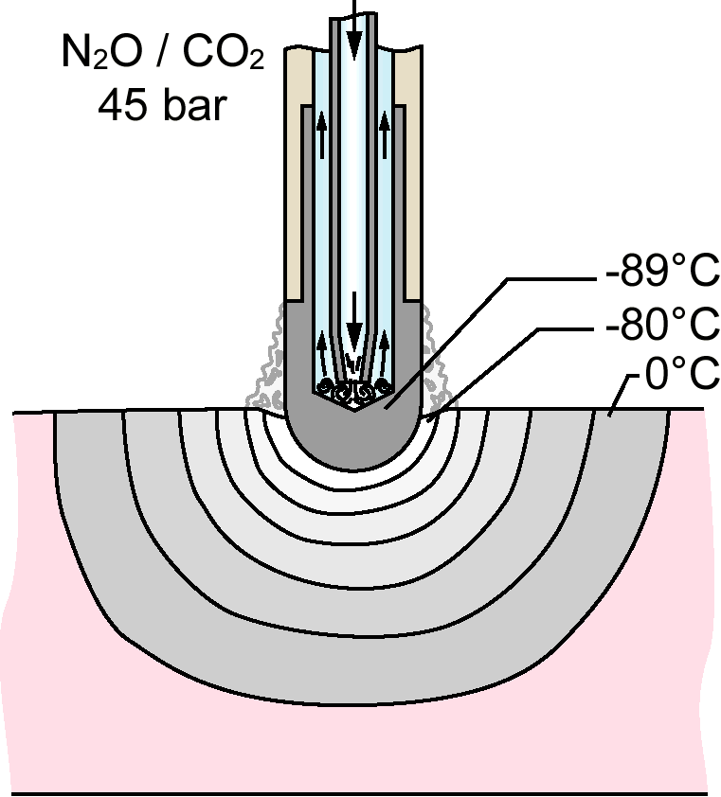
The cooling agent is applied under high pressure (45 bar) through the central canal of the probe
The gas at the tip expands due to the sudden difference in pressure relative to the atmospheric pressure (Joule-Thomson effect), resulting in a drop in temperature at the tip of the probe and subsequent freezing effect
Notes:
What is the mechanism underlying the functioning of cryprobe.
You can see the inner portion of the cryoprobe
The cryosurgical equipment operates by the Joule-Thompson effect
Usually
for the physical effect known as
The development of new, flexible and mechanically more stable cryoprobes with a larger tip area allows
4

Slide 5
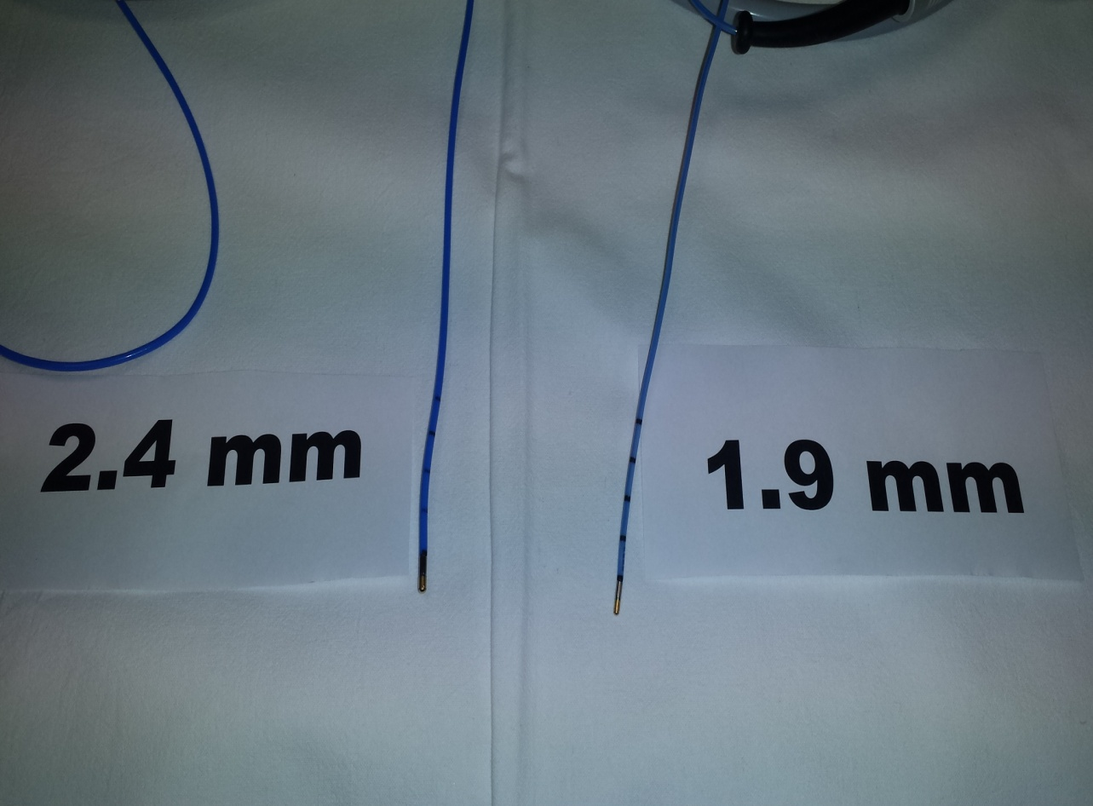
Cryoprobes of different sizes
Notes:
New flexible cryoprobes have different diameters
which is the most used
5

Slide 6
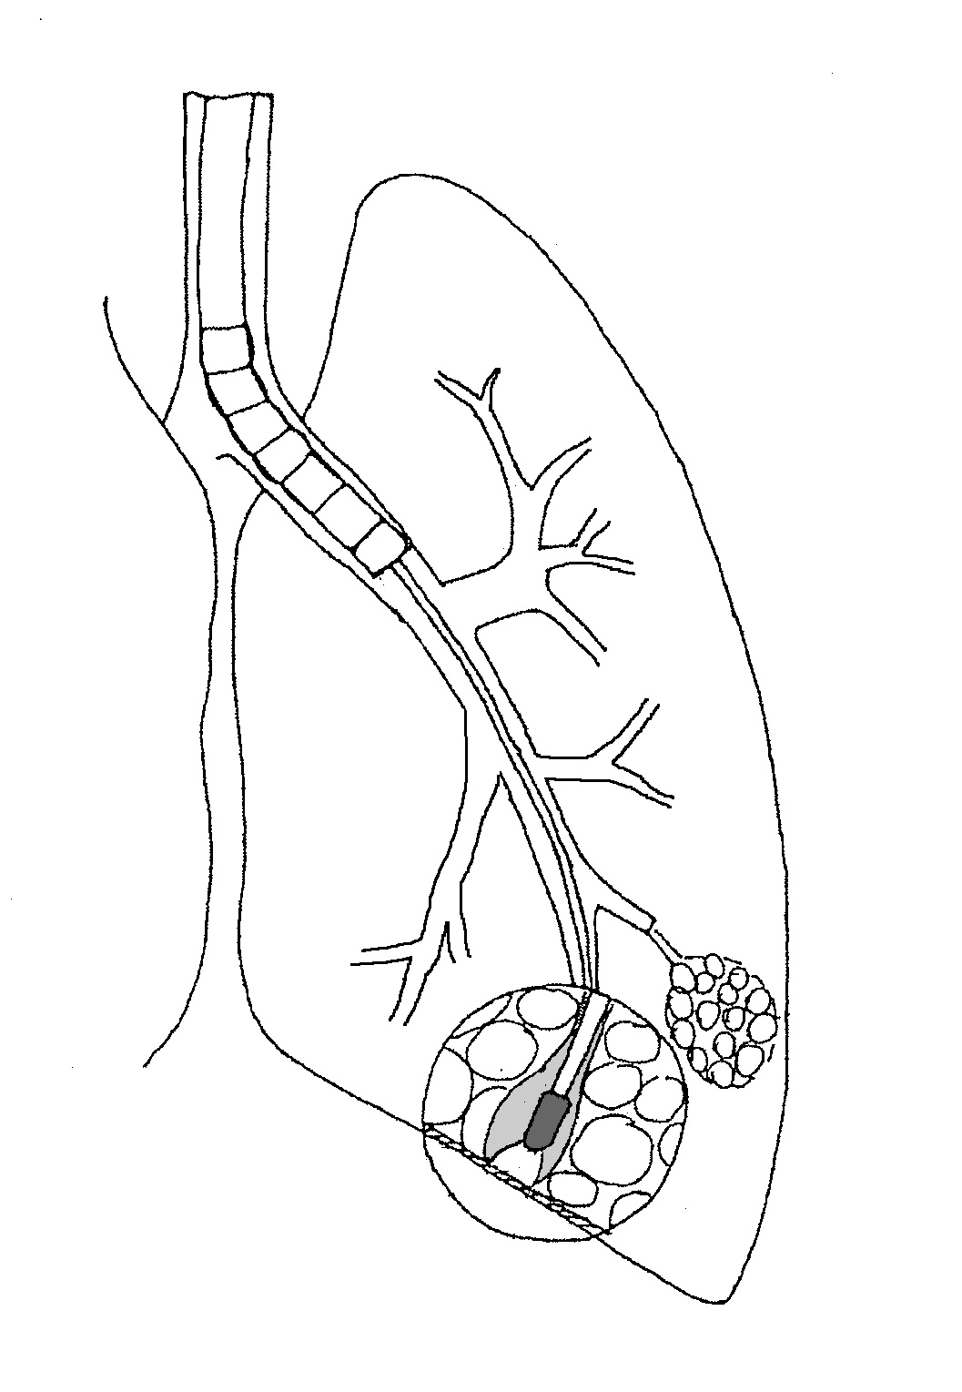
TRANSBRONCHIAL CRYOBIOPSY (MORGAGNI HOSPITAL RECIPE)
General anesthesia (Propofol/Remifentanil)
Spontaneous breathing
Rigid Tracheochoscope (Storz 14 mm-33 cm)+fiberoptic bronchoscope (6.2 mm)
Fogarty balloon
Fluoroscopic control (+/- radial EBUS)
Erbokryo CA, ERBE, Tubingen, Germany (CO2)
Cryoprobe 2.4 mm
A distance of approximately <= 10 mm from the thoracic wall
A perpendicular relation between the thoracic wall and the probe
The probe is cooled for approximately 5-6 s
Poletti V; et al Respirology 2014

Slide 7
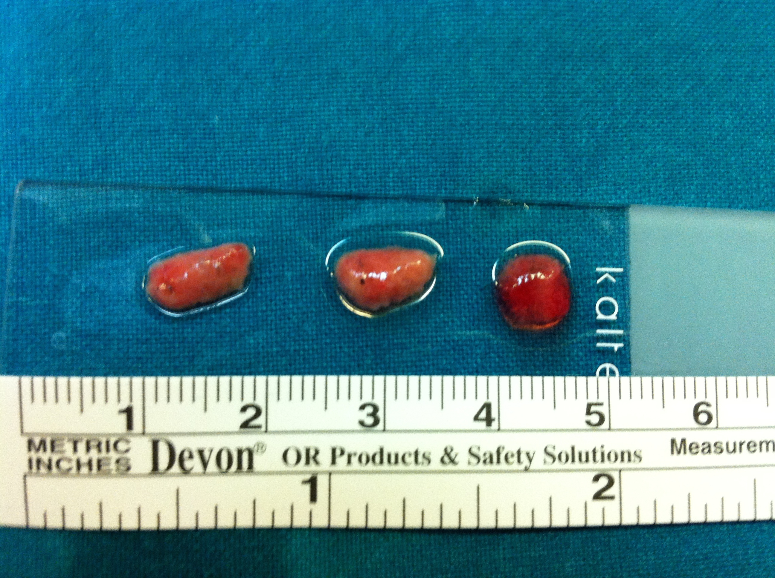

Slide 8
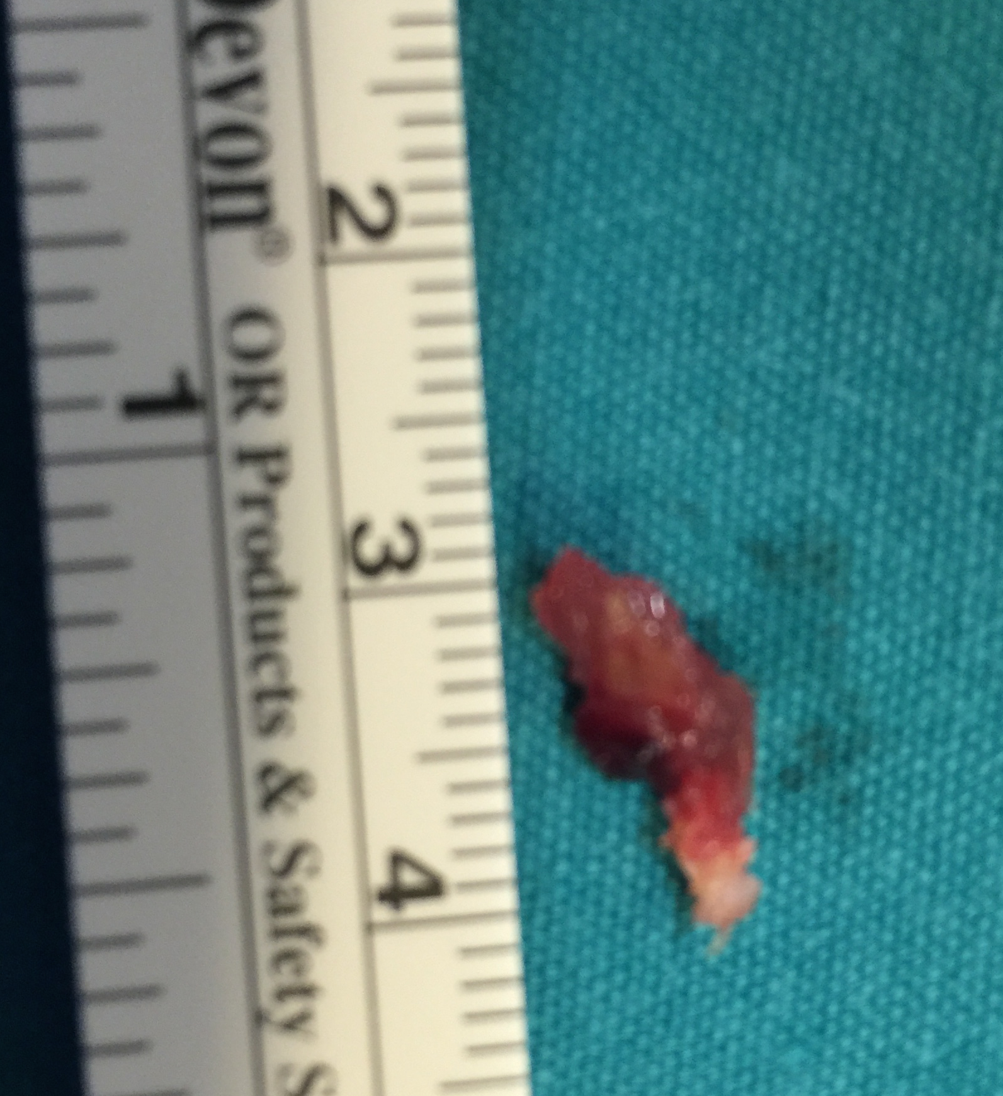

Slide 9
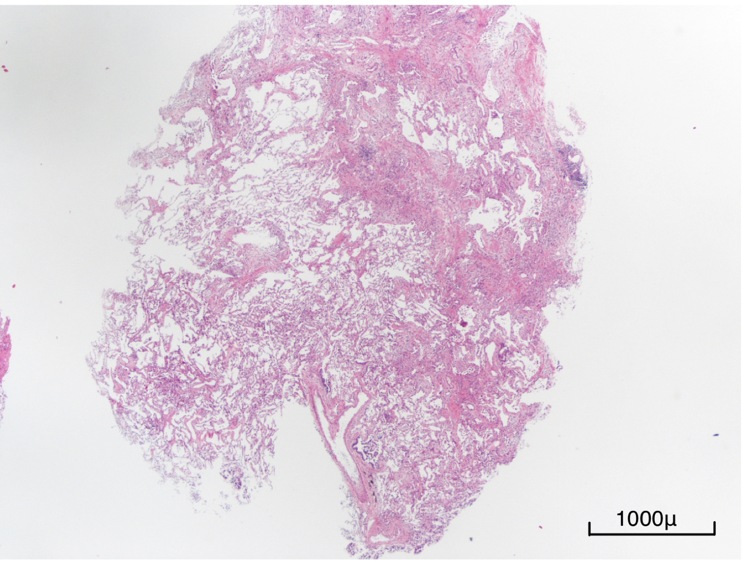

Slide 10
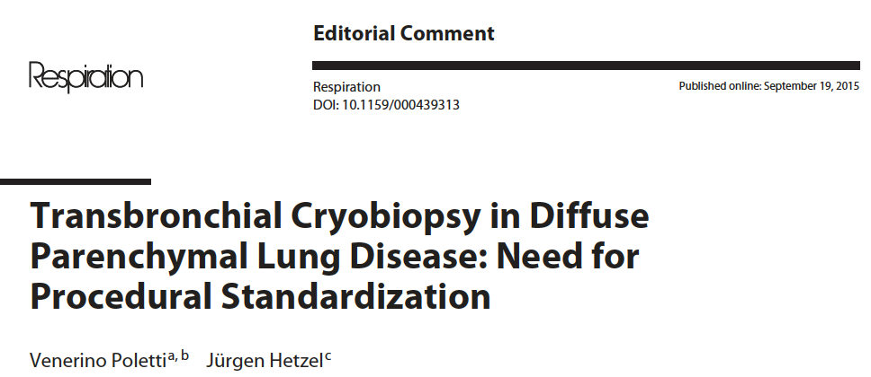

Slide 11
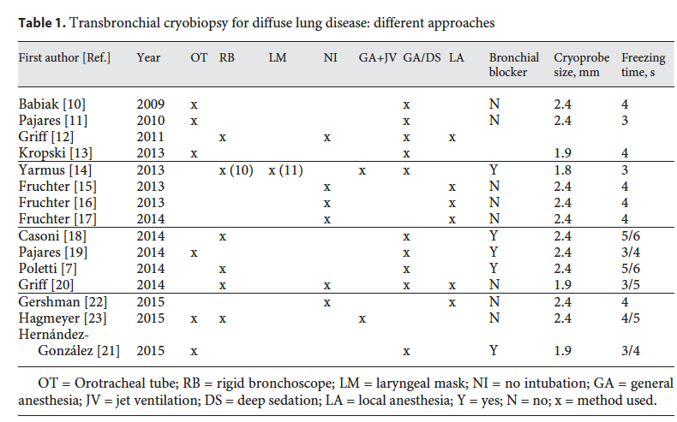

Slide 12
DIAGNOSTIC YIELD

Slide 13
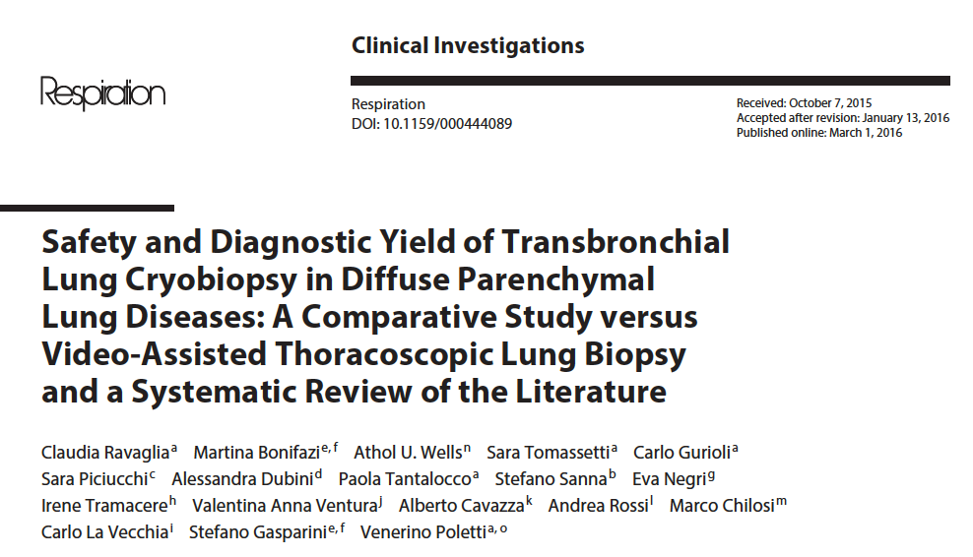

Slide 14
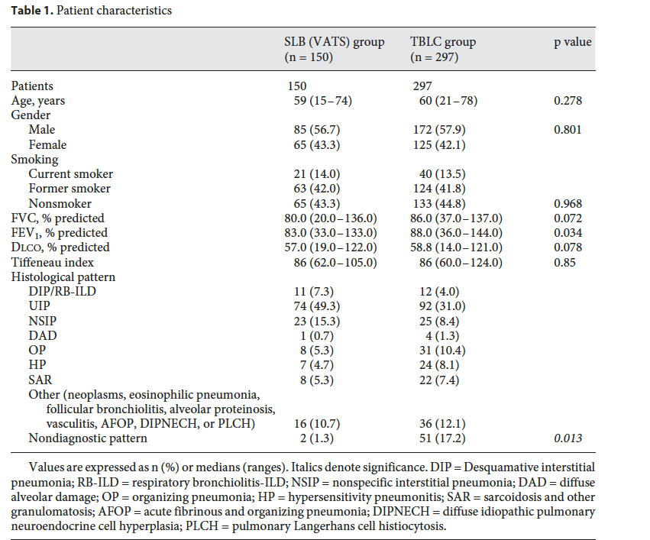

Slide 15
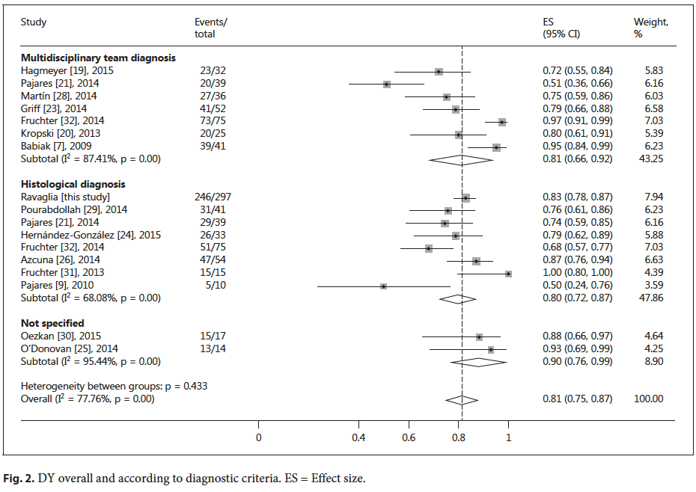

Slide 16
PlosOne- 2014

Slide 17
The area of fragments strongly correlates with the diagnostic yield, mean area was
41,99+/-14.73 mm² for diagnostic cases and 28.43+/-11.66 mm² for non-diagnostic
cases, p = 0.038.

Slide 18
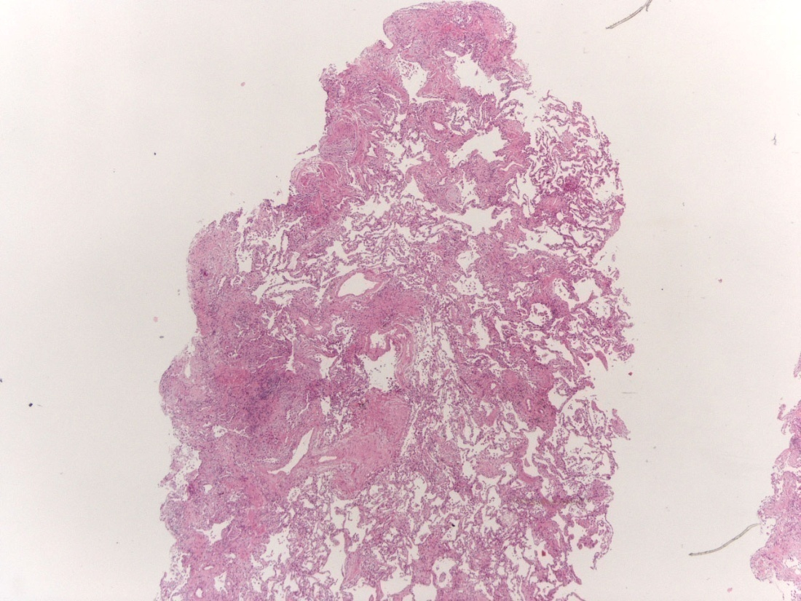
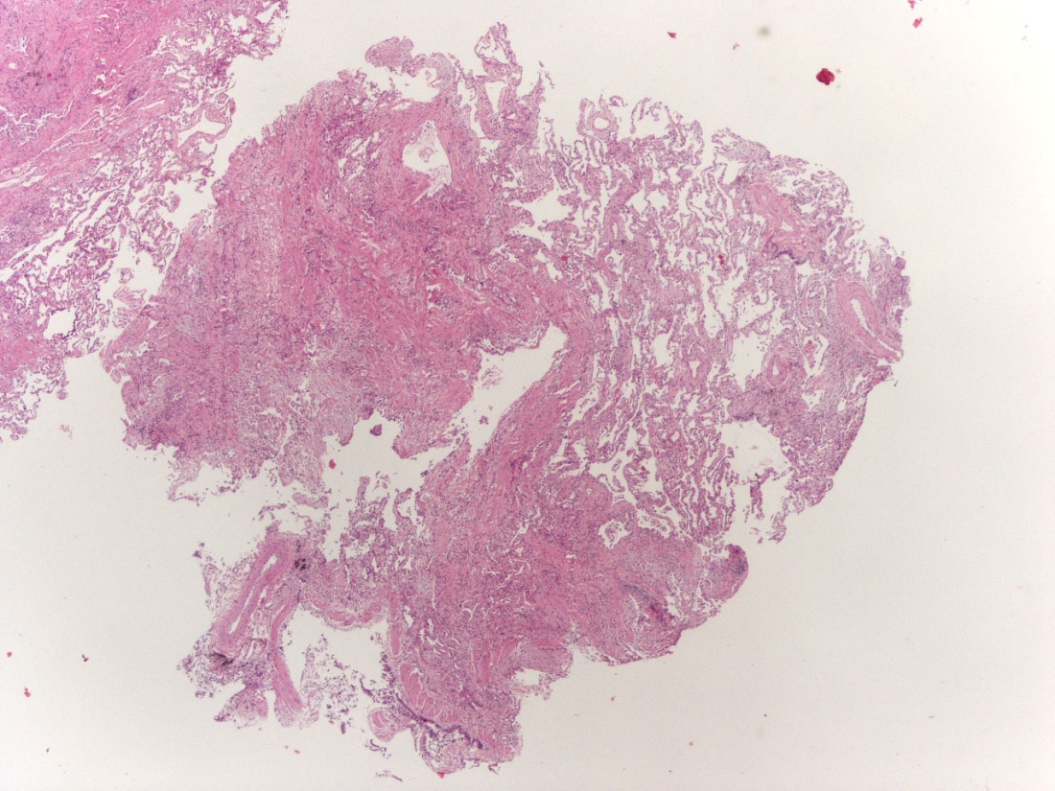
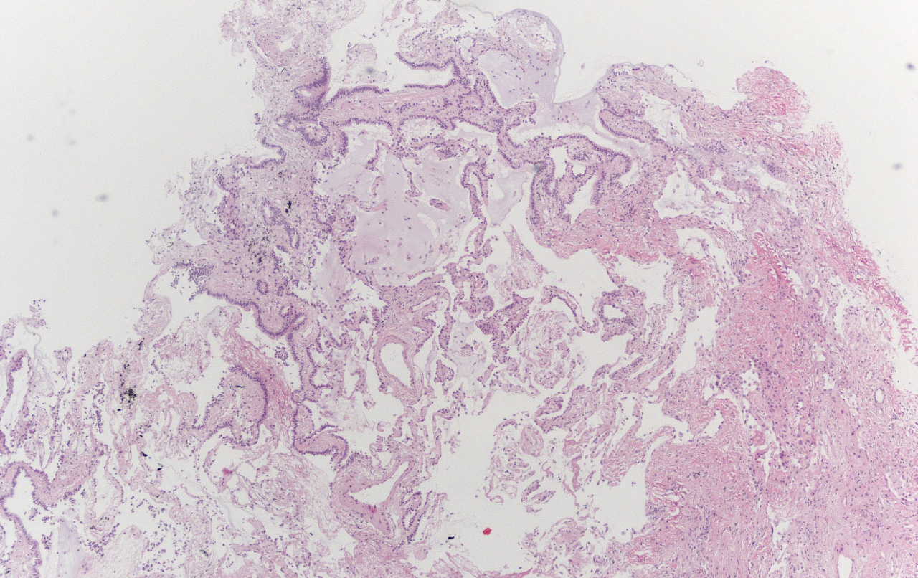
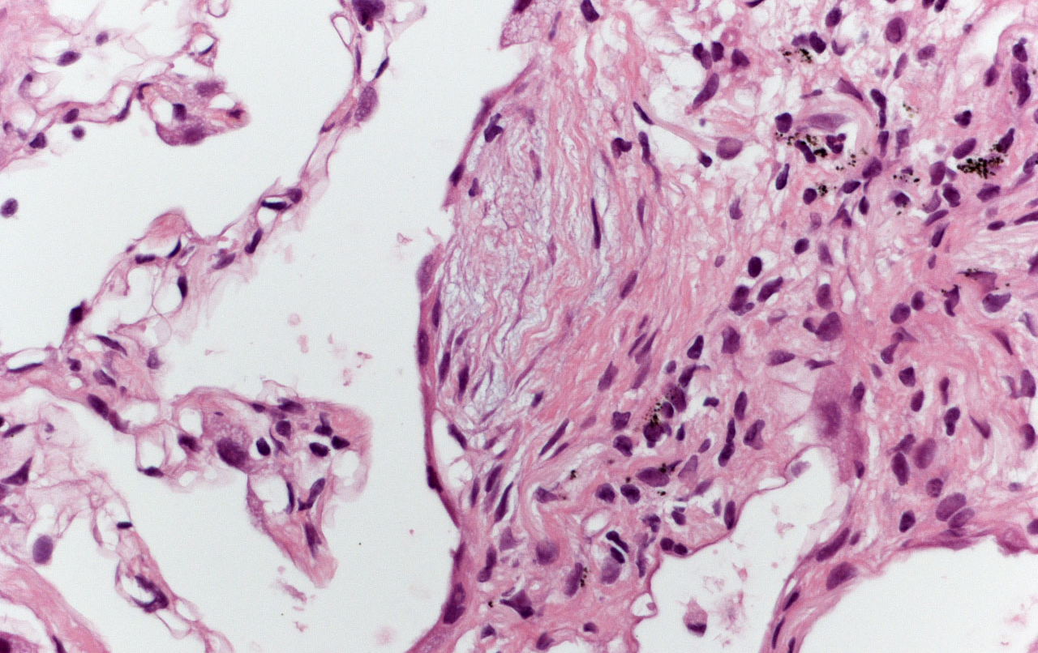
Cryobiopsy: UIP with high confidence

Slide 19
COMPLICATIONS

Slide 20
None of the patients needed intervention to control bleeding, such as intubation with a double-lumen endotracheal tube or surgery
Pneumothorax occurred in 19 patients (27%) after the cryobiopsy procedure; 14 required chest tube drainage..
One patient died (1.4% of the cases) seven days after biopsy of acute exacerbation of UIP
4 screening failures (3 obese patients)
PlosOne, 2014.

Slide 22
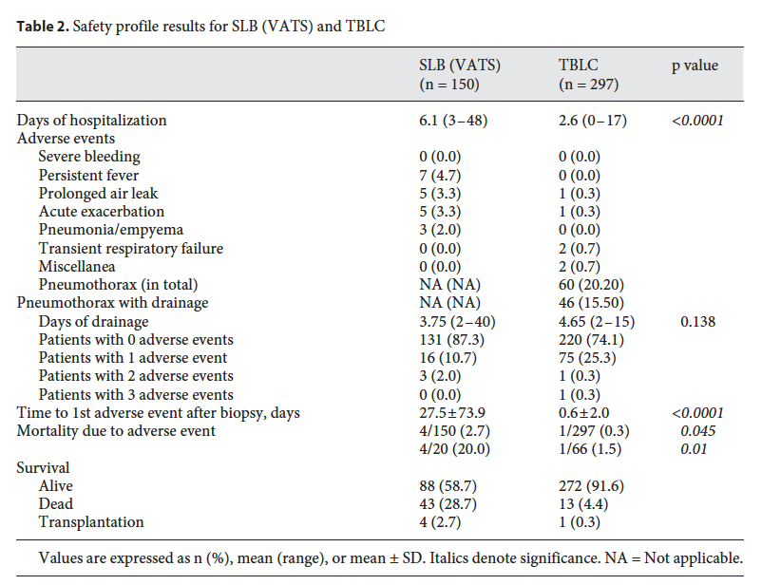

Slide 23
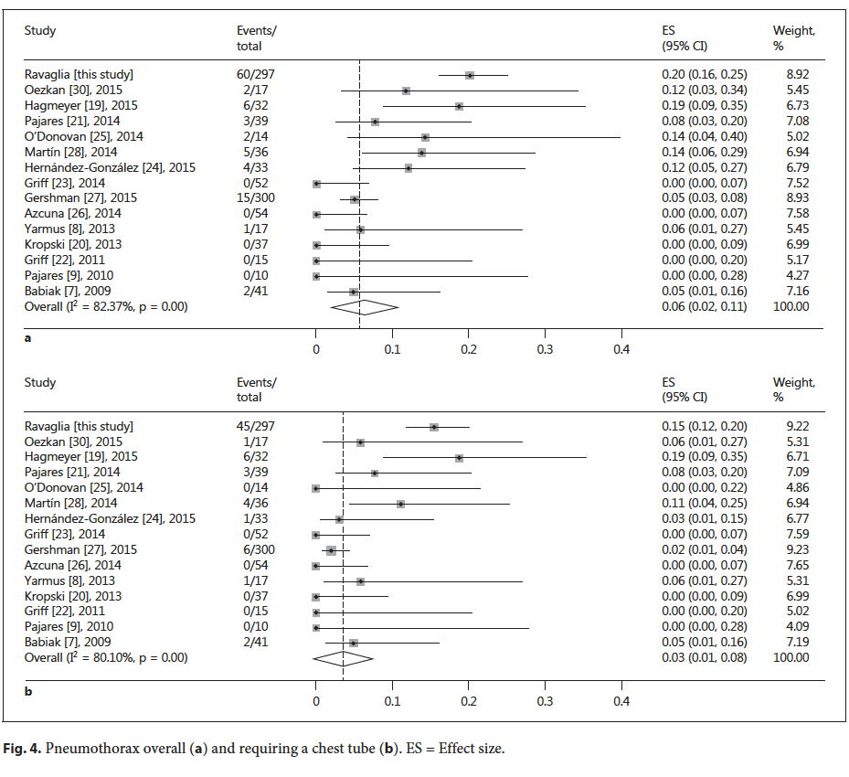

Slide 24
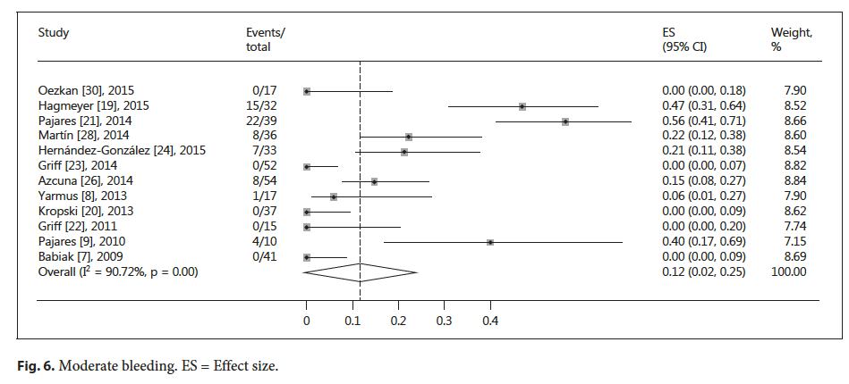

Slide 25
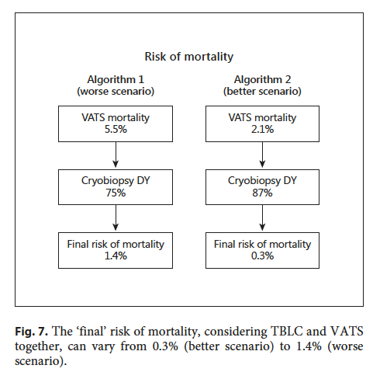

Slide 26
BIOPSY: different strategies

Slide 27
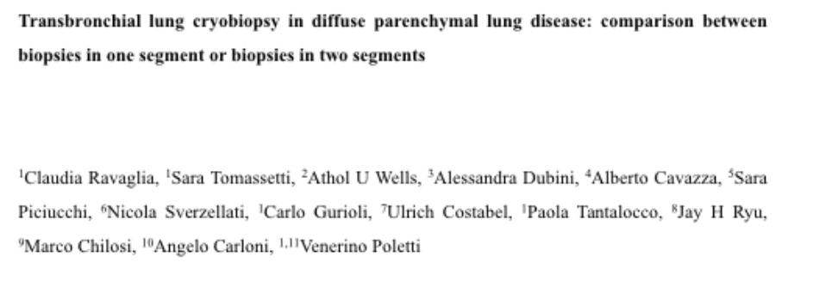

Slide 28
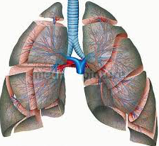
Strategy 1
Strategy 2

Slide 29
Study design
In the first arm (arm 1) four samples from the same segment were obtained ; in the second arm (arm 2) two samples from one segment and two other samples from another segment of the same lobe were taken.
In order to assess the minimum number of samples needed to reach a morphological diagnosis each cryobiopsy sample was processed individually.
Analysis of samples by pathologists was performed in a sequential way (from the first to the last sample) providing the identification of a pattern, or of characteristic morphologic features or, in the worse scenario, just a descriptive report for any single sample analyzed. Adding the next sample on top pathologists were also required to reformulate the report.

Slide 30
Table 1. Clinico-radiologic features of 45 patients
 |  | ARM 1 | ARM 2 | P-value
Cases; N |  | 22 | 23
Male; N (%) |  | 13 (59) | 15 (65) | 0,672
Age, median (range) |  | 65 (29-79) | 59 (22-74) | 0,706
FVC%, median (range) |  | 85,00 (49-137) | 90,00 (55-122) | 0,422
DLCO%, median (range) |  | 69,00 (37-121) | 63,00 (38-100) | 0,361
BMI, median (range) |  | 27,50 (19.8-32,8) | 25,95 (19.00-33,60) | 0,641
HRCT: Possible UIP; N (%) |  | 10 (45) | 11 ( 48) | 0, 873
HRCT: Inconsistent with UIP; N (%) |  | 12 (55) | 12 (52)
BMI= body mass index
HRCT= high-resolution CT scan
Notes:
I test statistici calcolati sono il test del Chi-Quadrato o il test esatto di Fisher per le variabili categoriche e il test di Mann-Whitney per le variabili continue.

Slide 31
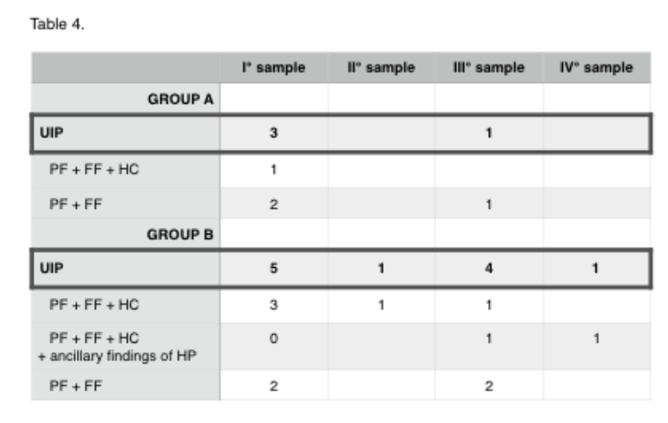

Slide 32
STRATEGY
One sample in one segment and the second one in the adjacent segment
°biopsies in two different lobes:
ongoing multicenter study (Hetzel J, et al)

Slide 33
Clinical role of Cryo-TBB

Slide 34
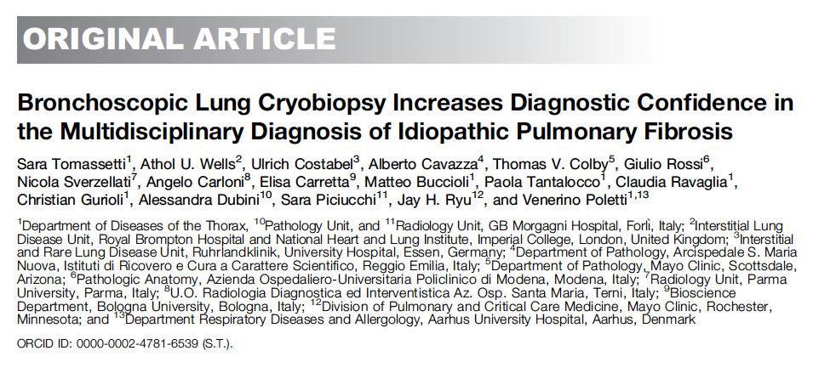

Slide 35
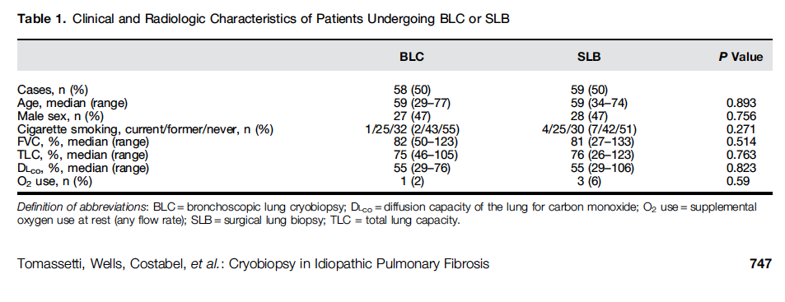

Slide 36
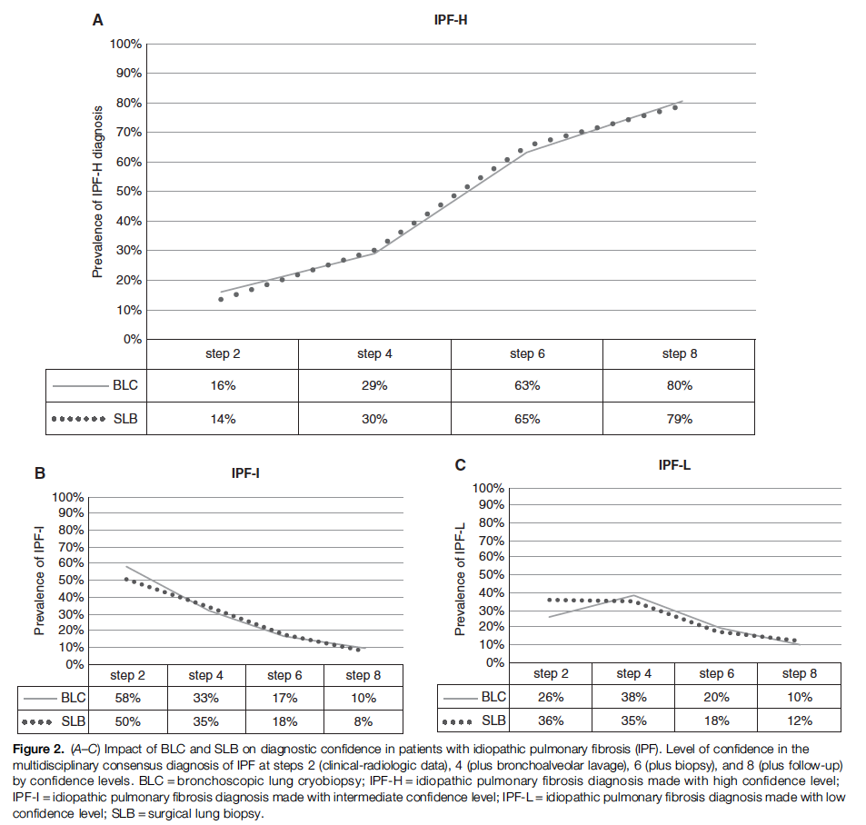

Slide 37
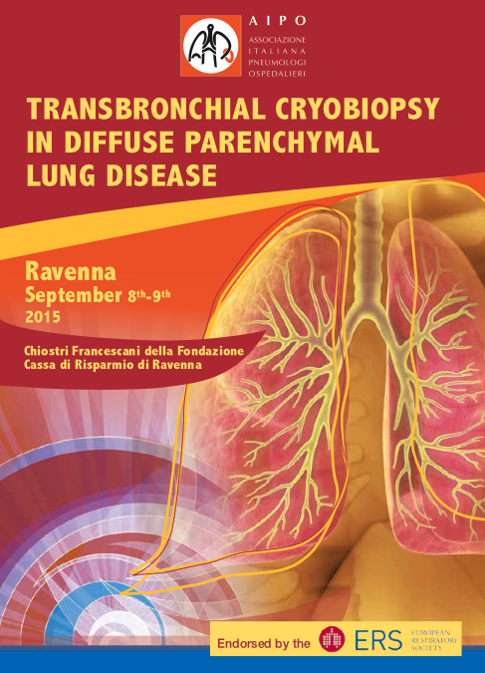
RAVENNA 2016, in preparation

